Slide 1
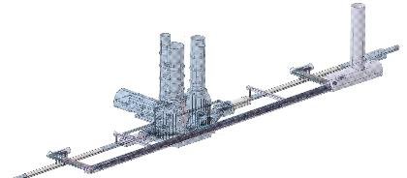
HL-LHC integration
Focussing on underground infrastructure
Baseline frozen on the
18th/09/2015
INTEGRATION: C. Magnier, S. Maridor, B. Vazquez de Prada
R. Calaga, F. Killing, E. Montesinos and the whole WP4
A. Masi, A. Rossi, S. Redaelli and the whole WP5
A. Ballarino, A. Jacquemod and the whole WP6a
J.P. Burnet, C. Coupat and the whole WP6b
F. Rodriguez Mateos, D. Wollmann WP7
S. Claudet WP9
G. Arduini, M. Fitterer: WP2
EN-MME: M. Guinchard Lukasz Jerzy Lacny
WP17: Isabel Bejar Alonso
R. Calaga, F. Killing, E. Montesinos and the whole WP4
J.P. Burnet, C. Coupat and the whole WP6b
S. Claudet WP9
EN-EL: Gerard Cumer, Nuno Dos Santos, Jean-Claude Guillaume
EN-CV: M. Battistin, F. Boralho, P. Pepinster
EN-HE: C. Bertone, B. Feral, R. Rinaldesi, I. Ruehl
GS-ASE: T. Hakulinen, S. De Luca, P. Ninin
GS-SE: J. Osborne, P. Mattelaer
T. Otto
DGS-RP: C. Adorisio
DGS-SEE: J. Gascon
And many others
Prepared by P. Fessia

Slide 2

Summary
The vibration issue
The Double Decker approach in a nutshell
What we need to fit in the Double Decker
Optimising: reasons, consequences, timing and first actions in list (my optimistic approach)
Conclusions

Slide 3
The vibration issue

Slide 4
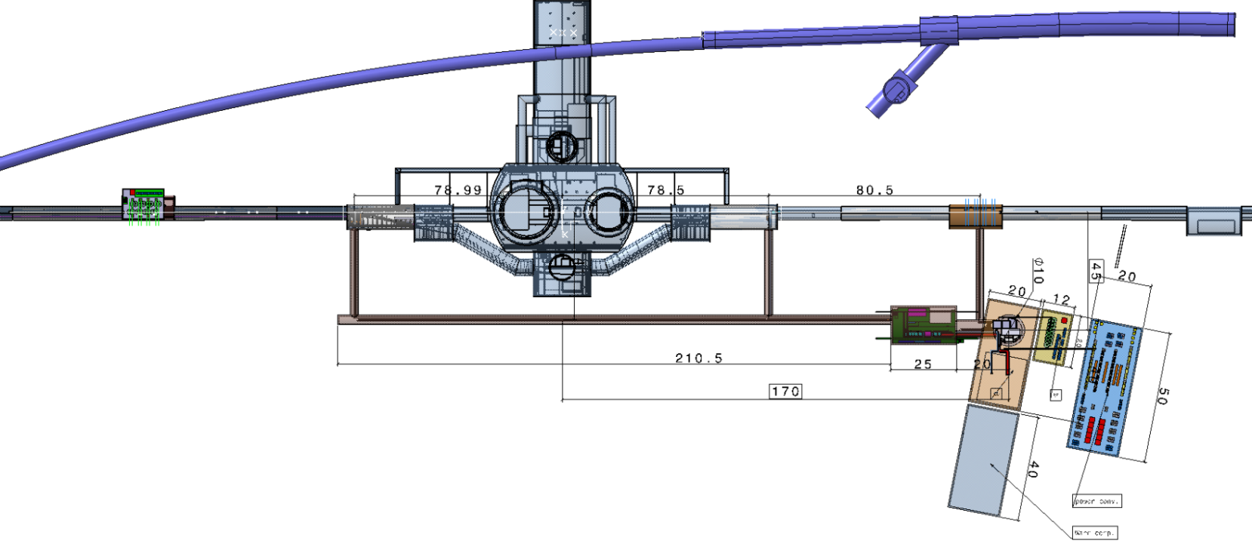
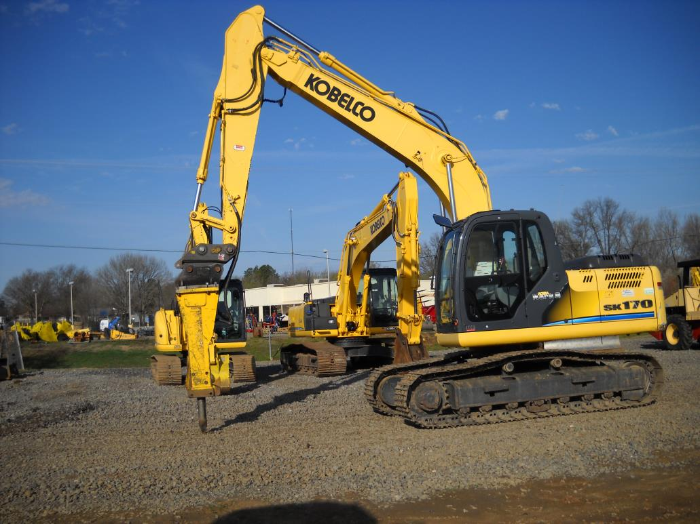
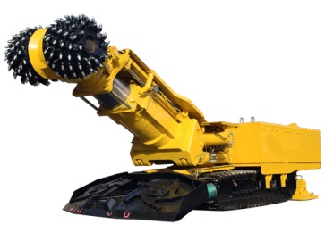
Issue: vibrations induced by Civil Engineering excavation equipment possibly perturbing LHC exploitation

Slide 5
Effect of vibrations on the beam
  Effect of construction works next to IR1/5:
    main effect is a closed orbit distortion due to displacement of quadrupoles
    long term (weeks) drifts could be compensated with orbit correctors or more frequent alignment campaigns
    short term drifts (minutes/hours) could be compensated by current orbit feedback
    low frequency vibrations can not be compensated by current orbit feedback
      largest contribution is expected from the inner triplet during collision due to high β-function and strength
      main effects:
        luminosity loss due to separation of the beams
        increased losses at collimators (Run I: around 40 μm orbit deviation at TCPs caused high losses)
        emittance growth/increased halo diffusion rate -> luminosity loss and higher losses at collimators
      closed orbit distortion depends on wavelength of the vibrations, e.g. ±1 μm displacement of the IT can result in 0-14 μm separation of the beams at the IP and 3-170 μm residual orbit at collimators ⁽¹⁾
    Possible mitigation measures: warm magnets for low frequency
    (0-200 Hz) closed orbit feedback system in IR1/5
    (1) Run III parameters: N_{bunch}=1.25x10¹¹, ε_{N}=2.0 μm, N_{tot}=2740, β*(IP1/5)=0.4 m (option med RunII), E=6.5 TeV, σ_{IP}=10.7 μm
G. Arduini,
M. Fitterer
Notes:
Q=tune, not the fractional tune!

Slide 6
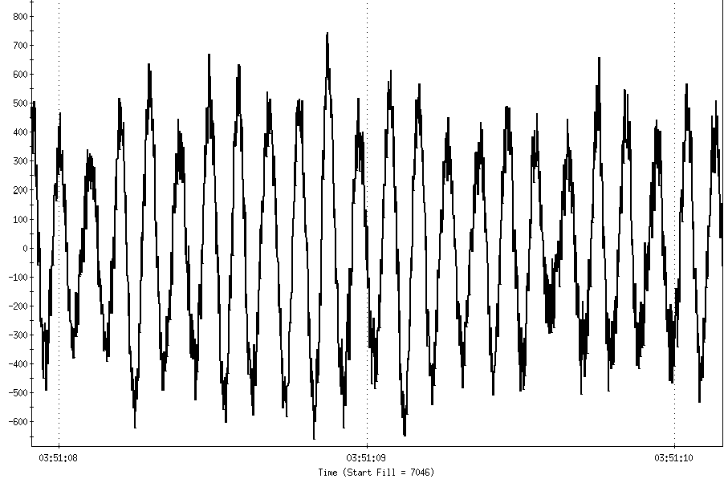
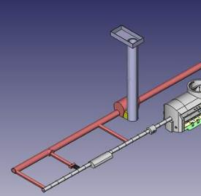
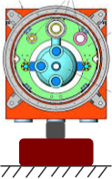
Which are the ingredients of the problem ?
    Build the transfer function from the point where the excavation takes place to the beam axis
H1 (ω)
H0 (ω)
In (ω)
Out (ω)
1μm
Beam stability
H0 (ω)
H1 (ω)

Slide 7
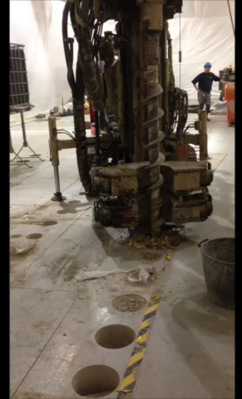
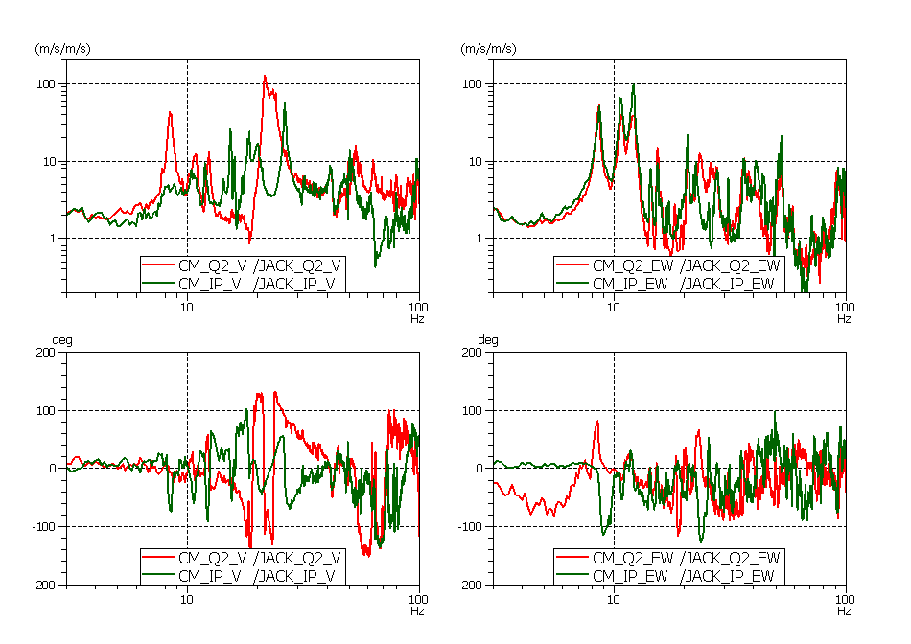
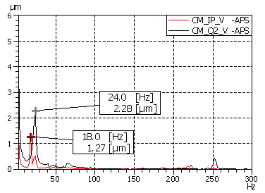
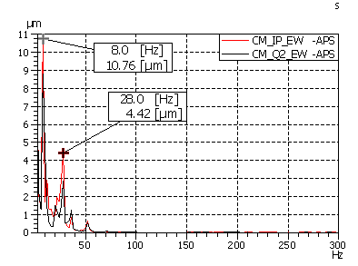
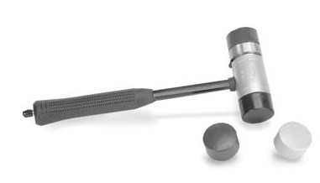
Results about H0 (ω)
H0 (ω)
24 Hz
First bending mode
Vertical
Transversal
8Hz
Rigid movement on feet
Ampl. factor with CE activity
Displacement with hammer impact
Courtesy M. Guinchard,
Lukasz Jerzy Lacny

Slide 8
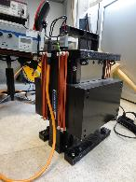
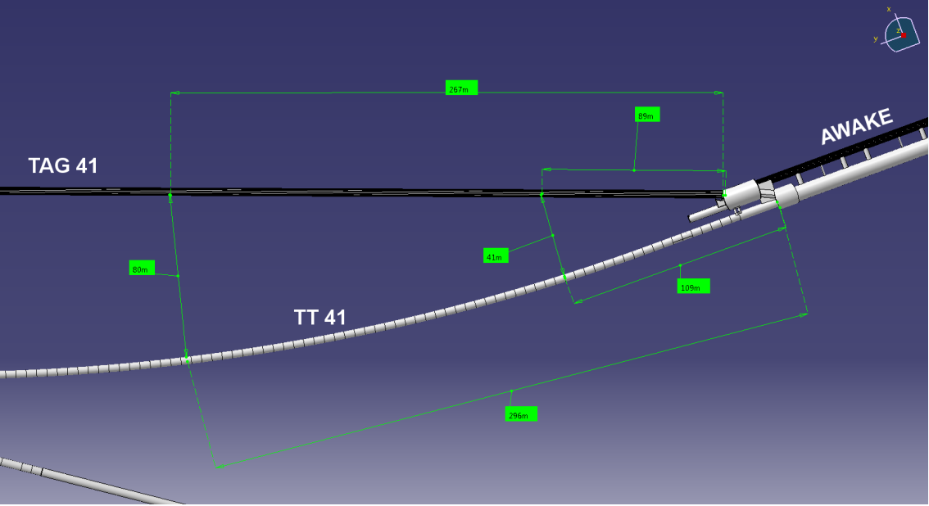
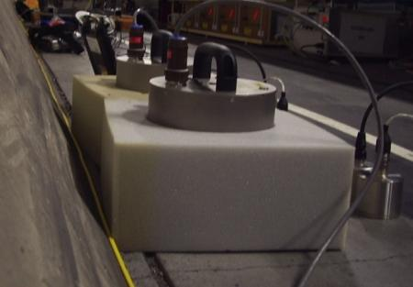
Tunnel transfer function H1 (ω) estimation
80 m
Positions :
+25 m, +10m, 0 m , - 10 m

Slide 9
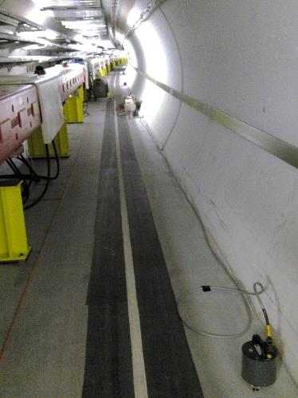
25R
10R
0
10L
Courtesy M. Guinchard,
Lukasz Jerzy Lacny

Slide 10
Putting the pieces together
H1 (ω)
H0 (ω)
In (ω)
Out (ω)

Slide 11
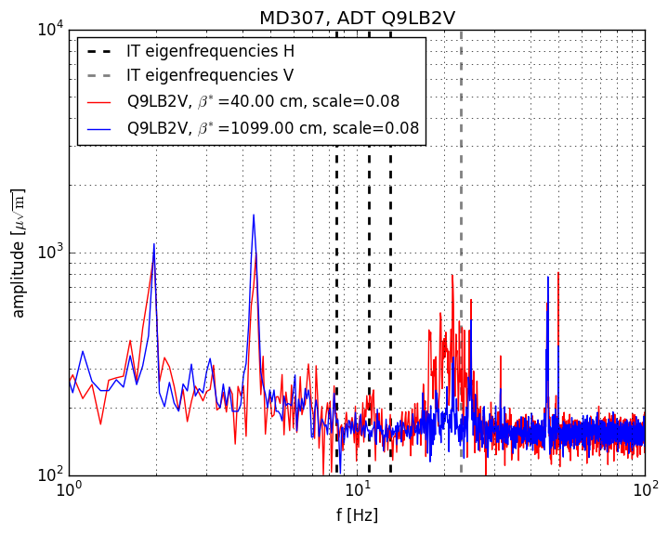
Measurements
  Are the IT eigen-frequencies visible in the LHC beam spectrum?
  Principle: β-function during squeeze changes mainly in the IT in IR1/5 -> IT eigen-frequencies are visible in the beam spectrum if an increase of the amplitude for the IT eigen-frequencies is observed during the squeeze
  Result: 20 Hz first vertical eigen-frequency visible, 10 Hz peak visible, but no increase of amplitude during squeeze
  MD to study effect of a low frequency noise on emittance evolution and tail population
  beam and machine setup:
    weak-strong scenario (single bunch) at injection (colliding)
    mimic long-range encounters with octupoles
    apply sinusoidal (10 Hz horizontal, 20 Hz vertical) excitation on both beams
  record time evolution of emittance + tail population with wire scanners and BSRT and diffusion rates with collimator scans
G. Arduini,
M. Fitterer

Slide 12
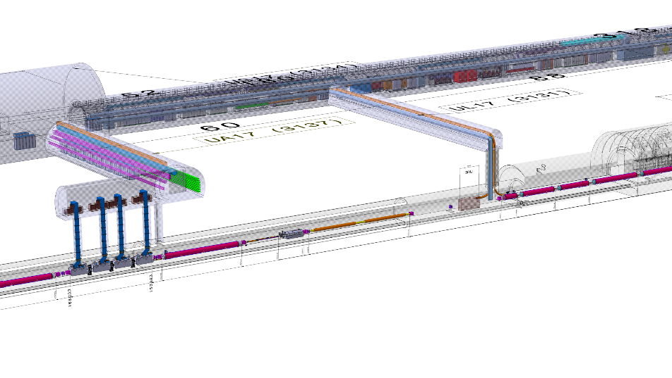
Conclusions and consequences
No margin to perform CE engineering work during LHC beam operation (we need factor 10 and it could be that we see already signature today of the cultural noise)
Today the only viable way is to perform work out of beam time that means anticipating to LS2
SH
AFT
F
I
N
I
S
H
I
N
G
C
O
N
N
E
C
T
I
O
N
Caverns and tunnel

Slide 13
The Double Decker in a nutshell

Slide 14
Double decker key facts
Allows having the underground infrastructure on the same side of the LHC tunnel both for Point 1 and Point 5 (avoiding interference with the transport area)
Reduce the depth of the pit (≈ -11 m)
Provide solution to bring much nearer RF equipment to the RF crab cavities and to access the DFX and DFM from a convenient angle with the SC link. It eases the installation of the SC links and its integration (SC links get also shorter about 60 m).
Reduces the disruption in LS3 of the LHC tunnels with benefit from the planning point of view, avoiding to transport the gravels out from the experimental pits and reducing the risk of inducing structural problem to the LHC machine tunnel
Increase the distance between the LHC machine and the UR/US providing good radiation shielding, limiting naturally ODH risk from the LHC main tunnel, allowing access during operation and increasing further vibration reduction during excavation ( Shaft moved far from the IT area)
Provide the solution for the connection to the BBLRs , if they will be integrated in the baseline (space already accounted for)
It is considered that the following equipment can be installed in the LHC tunnel
  Q.H. power units: possible location present installation area for the IT power converters
  Extra collimation racks near the present collimation racks
Key requirement:
access to all the active equipment installed in the underground structure in all the machine conditions included in beam

Slide 15
Double Decker safety
All required ventilation and safety ducts have been added as such for this integration. The real related loads should be re-analysed in the next optimisation phase
Emergency rooms have been installed along the tunnel length
A safety exit from the UA opposite to the main access shaft to the LHC tunnel is under study (not pictured here). The implementation requires in depth analysis of the impact of linking the LHC tunnel and the Double Decker structure (importing risks, operational impact,…). Its addition it is transparent from the integration point of view with the exception of ventilation and accesses.

Slide 16
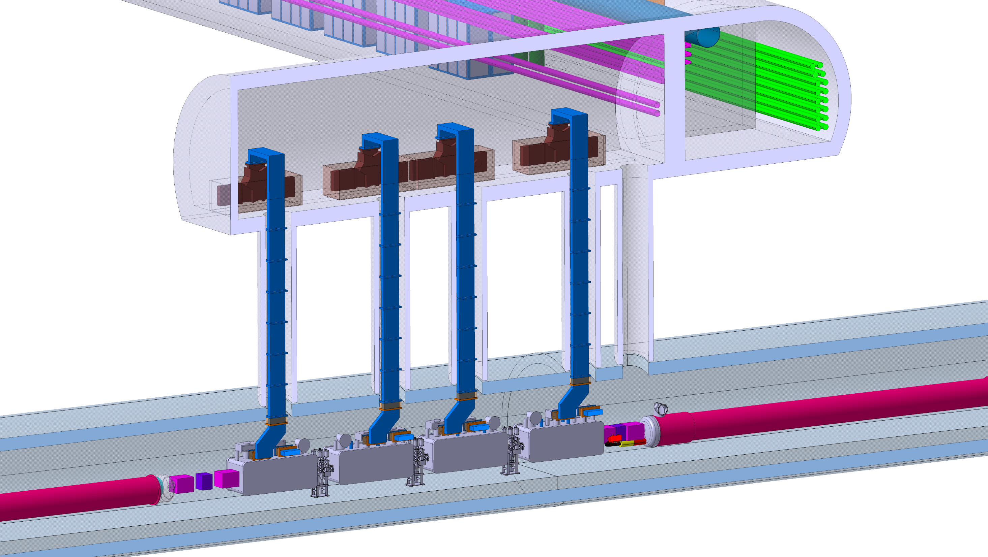
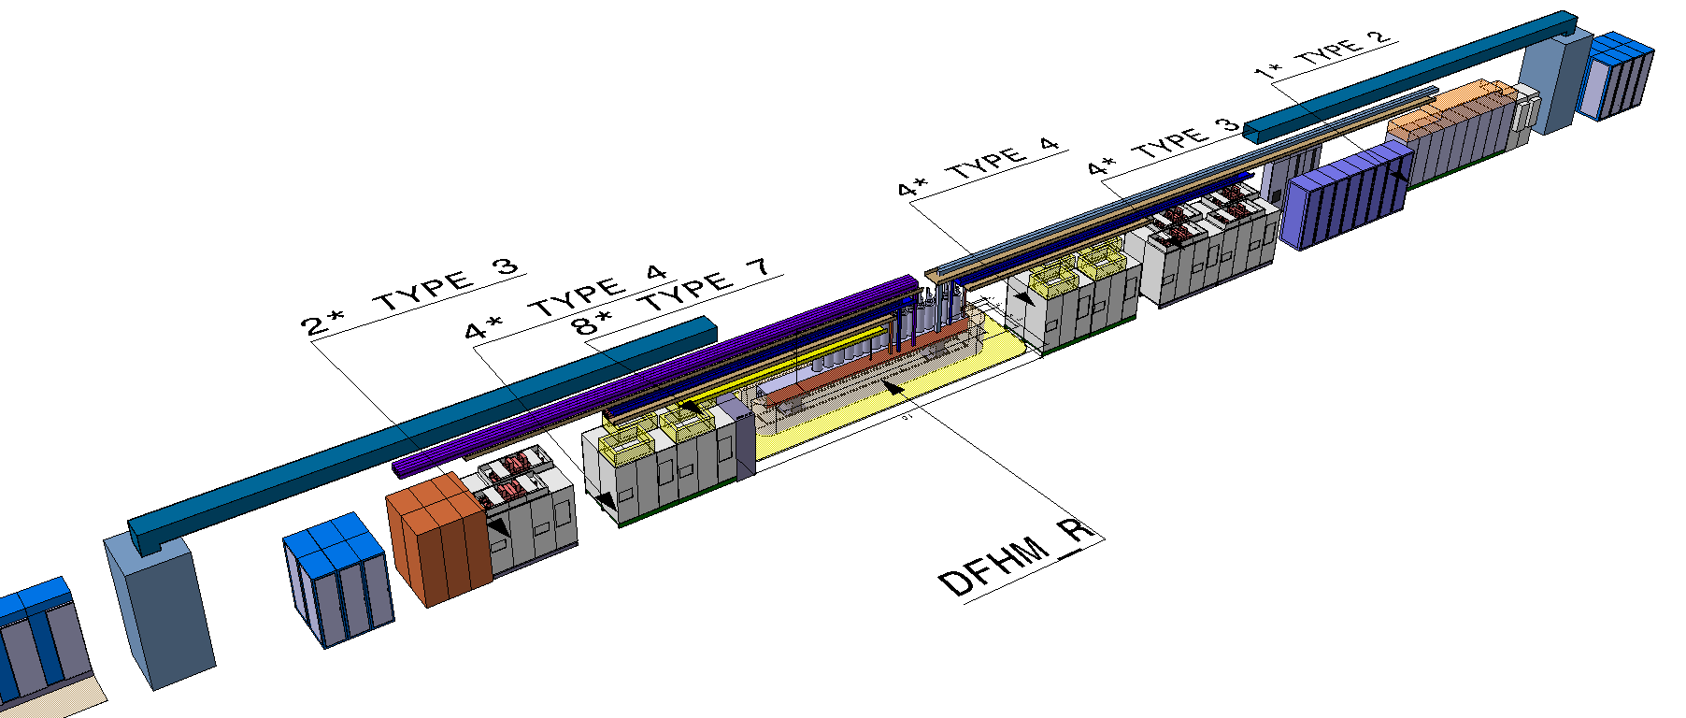
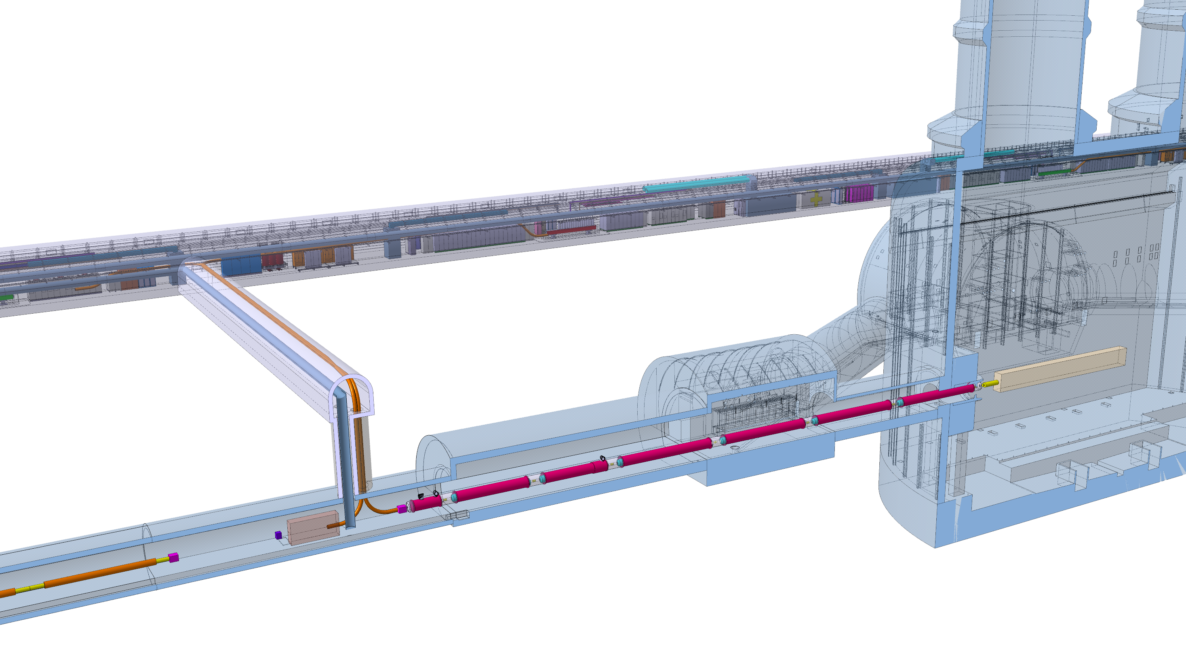
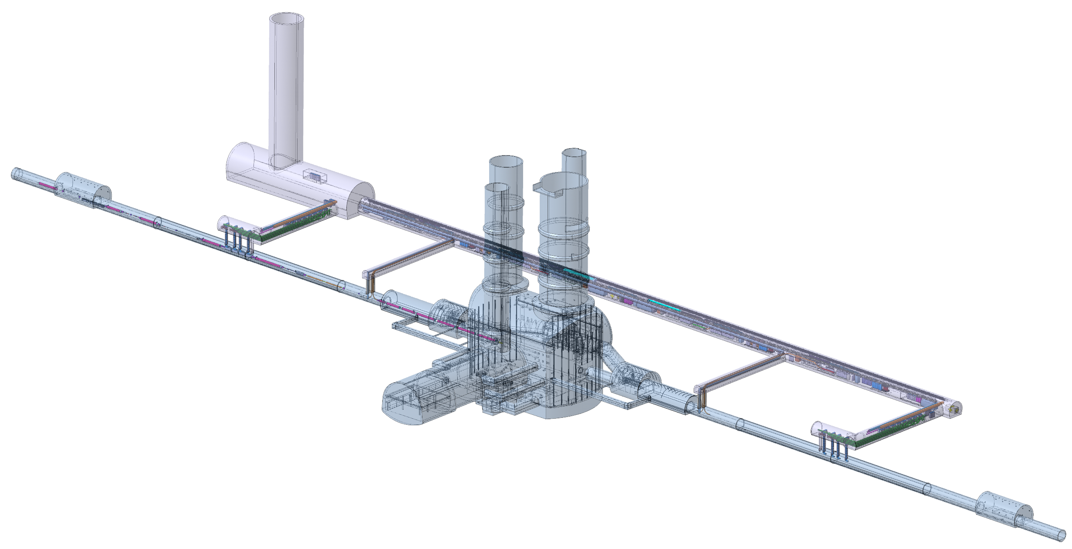
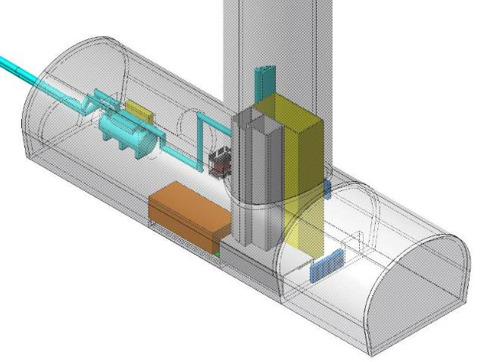
C
R
A
B
The Double Decker approach
Triggering
The 1.9 K Cold Box output shall not be 18 meters higher than the distribution line ->
use this constraint as an opportunity to:
Increase the distance between the service tunnel and the machine
(vibrations and radiation attenuation)
Avoid to invade the transport area
Provide smarter access for the connection between cryo and powering to the machine
Reduce the impact on the LS3 decoupling the planning as much as possible
Provide opportunity for system optimisation for efficiency and costs
Target technical infrastructure installation during Run III
QXLs
SC LINKs
Q1 to D1
Powering
and
protection
1.9 K cold box and cryogenic distribution lines start

Slide 17
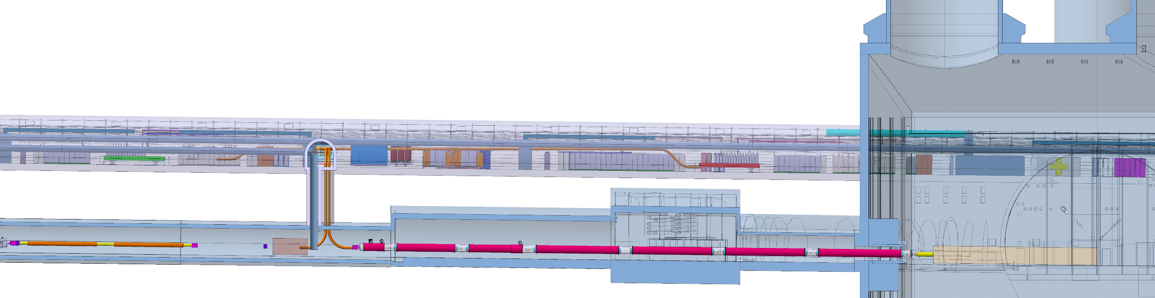
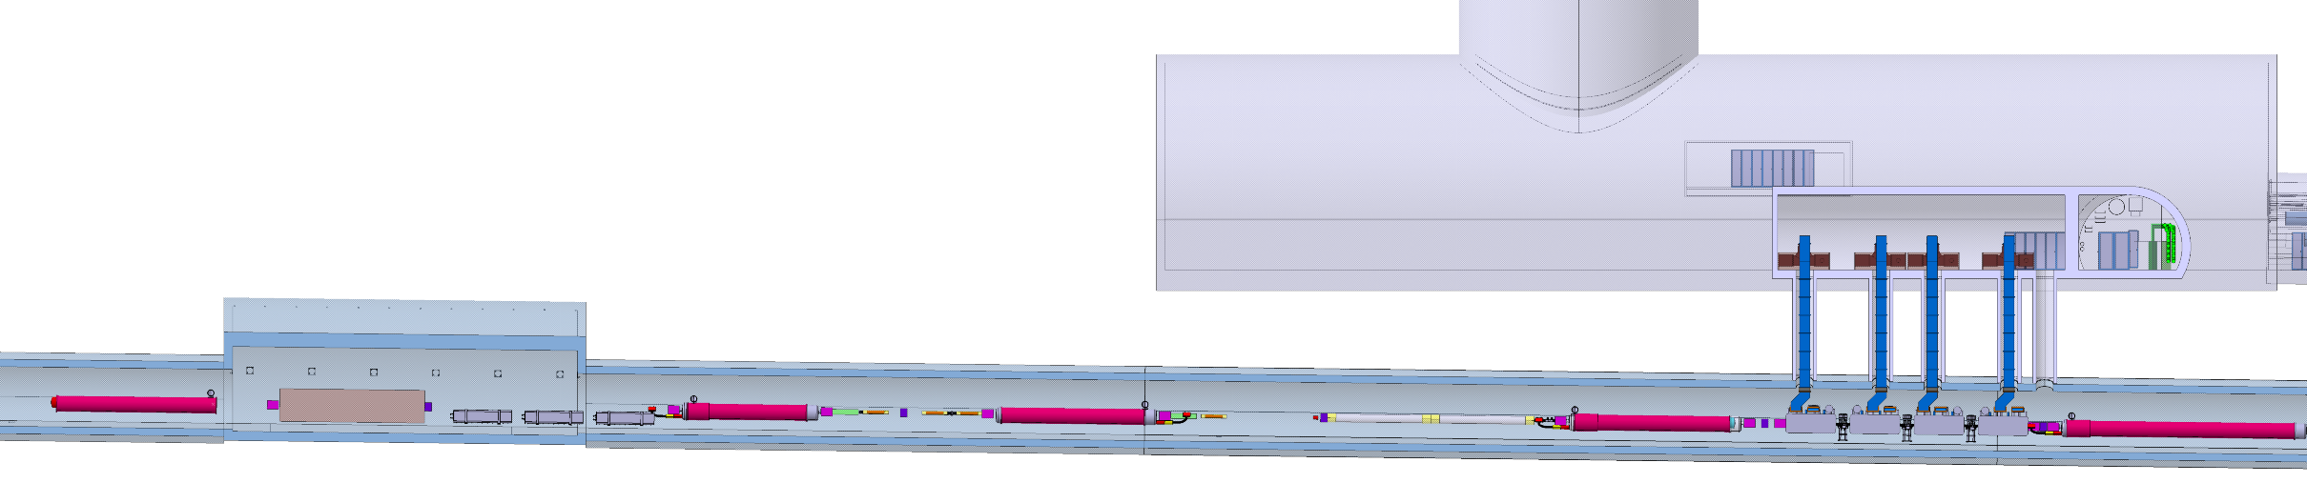
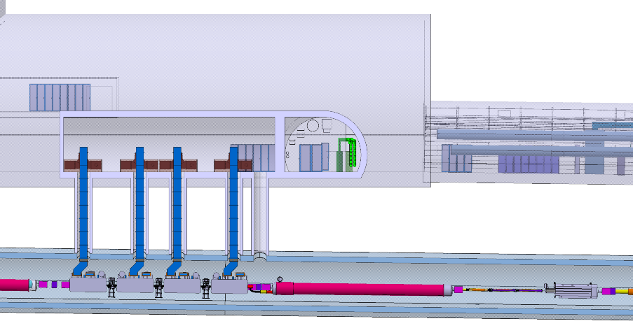

Slide 18
What we need to fit in the Double Decker?

Slide 19
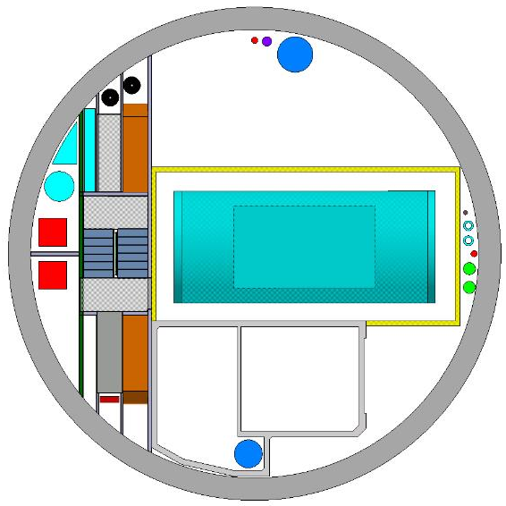
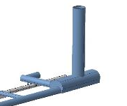
The Shaft (PM): how to fill 12 meter of diameter
[CV] Extraction for batteries
Ø250mm
[SU] access to
reference point
Ø100mm
[CV] Injection fresh air
Ø950mm
[IT/CS]
2 cables for GSM
[CE] PM-Ø12m
[CV] Pumping drain water
DN 100mm
[CRG] cryogenic connection
Surface underground
1m²
[EL]
2x8 cable trays
Vertical transport
area
4mx8m
[CV] Smoke extraction
UR+UA+UL
750x750mm
[CV] Cold water I/O
DN 150mm
[CRG] QURCG
[SU] access to
reference point
DN 100mm
[CV] Smoke extraction
US
750x750mm
[CV] water I/O
DN 300mm
[HE] LIft 3t
[CE] Concrete module
[CE] Metallic module
Services and stairs
Safety stairs
PM
[EL] Safety cables
[CV] Pressurisation sas
Ø750mm

Slide 20
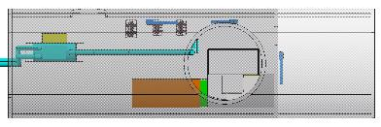
US part I:
PM lowering volume, concrete pressurized volume and lift, safe room, 1.9 K Cold Box with cryogenic distribution lines, transformers and low voltage departures
RF for crab right side
CRG
CV

Slide 21
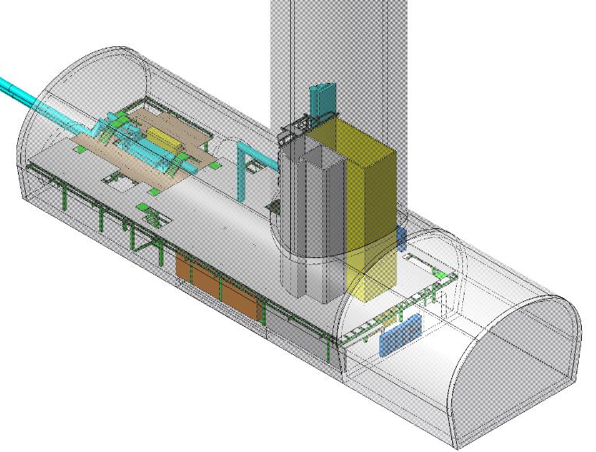
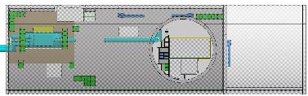
US Part II:
Metallic support structures for equipment, personnel and services
PM metallic support structure for services and stairs
Floor in the CRG area : + 3.8m
False floor for cabling everywhere else (except UW) : +4.3m
Metallic structure to support floor 1
Loading access to 1st floor

Slide 22
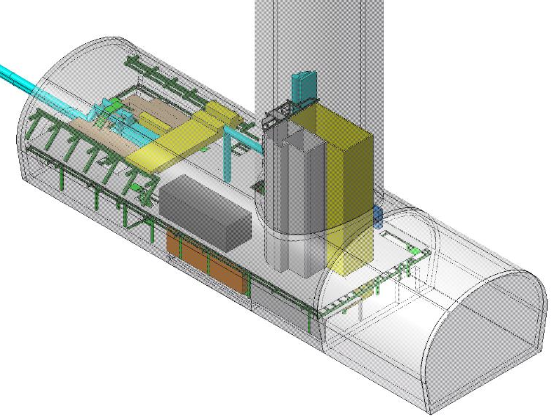
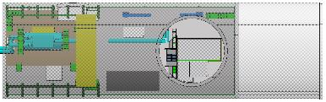
US part III:
Faraday Cage for the RF and for the BBLR
RF (and BBLR) Faraday cage
Right side

Slide 23
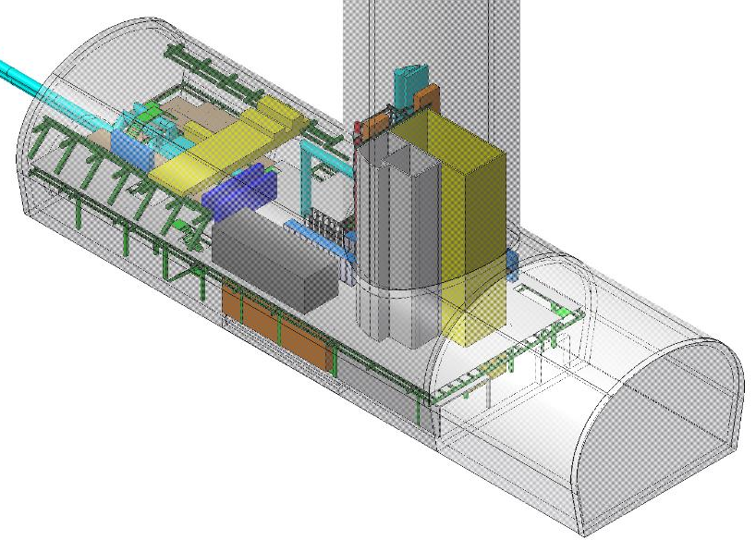
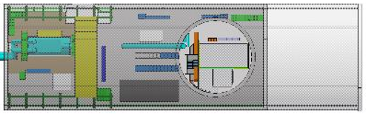
US Part IV:
Racks, control and cable trays ….
Cable trays
Other Racks :
Access system : x5 (it could go to surface)
Survey : x 1
RF
SSA : x 6
PLC : x 4
Not assigned spare racks : x 7
Cryogenic electrical supply and controls
2 x (6000 mm x 600 mm x 2200 mm)
1 x (4000 mm x 600 mm x 2200 mm)
1 standard rack

Slide 24
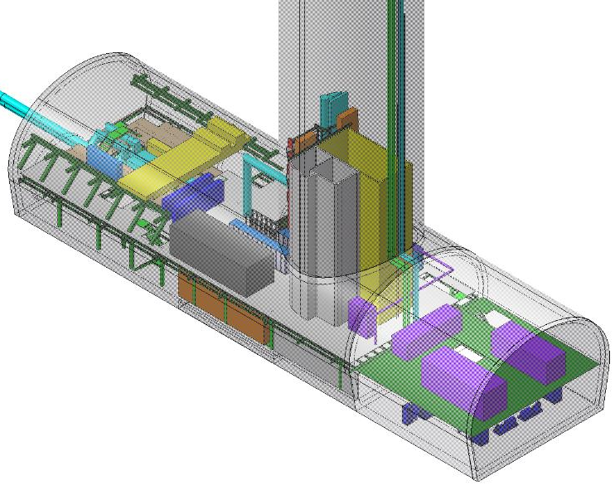
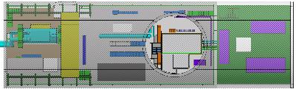
US Part V:
UW with the CV units
Air treatment units

Slide 25
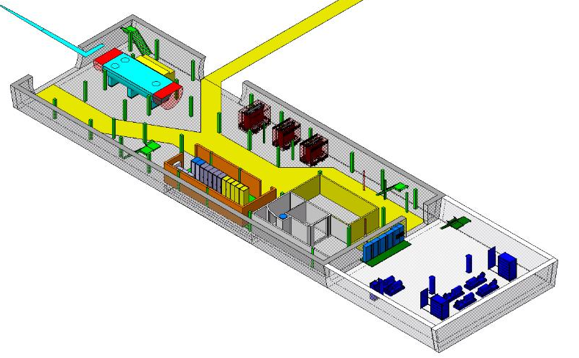
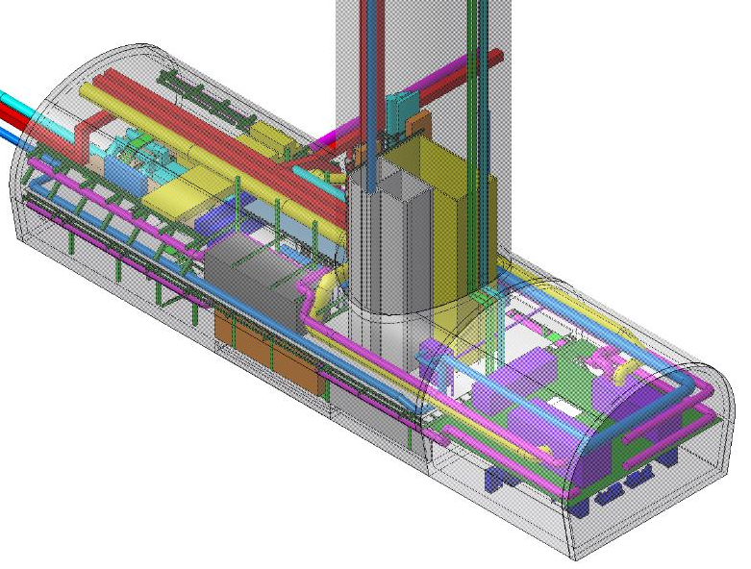
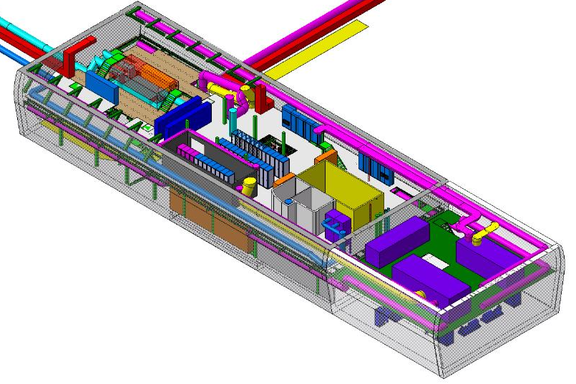
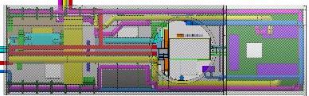
General view with all the cooling and ventilation distribution

Slide 26
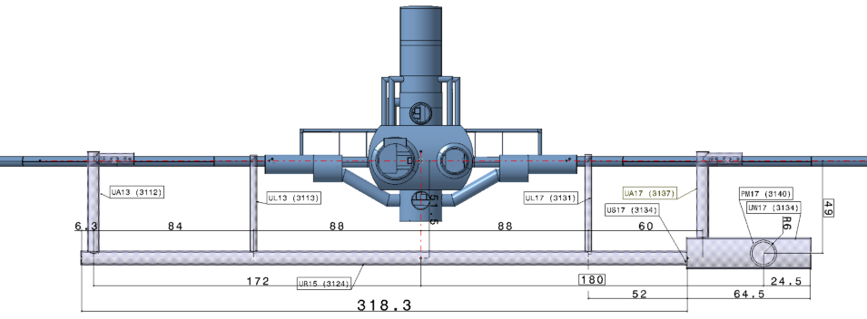
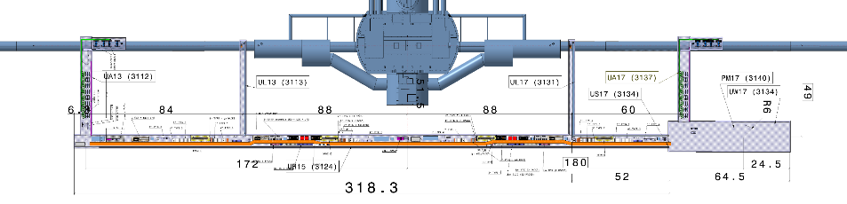
Overall view: US, UW, URs, UAs and ULs
Point 1

Slide 27
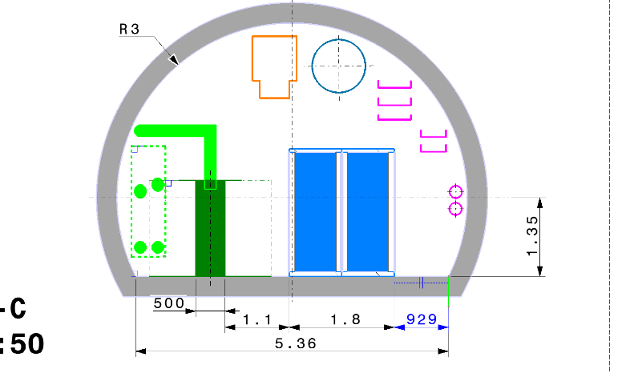
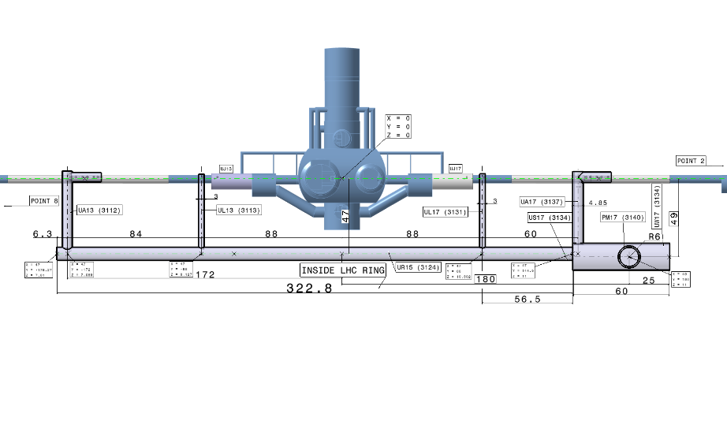
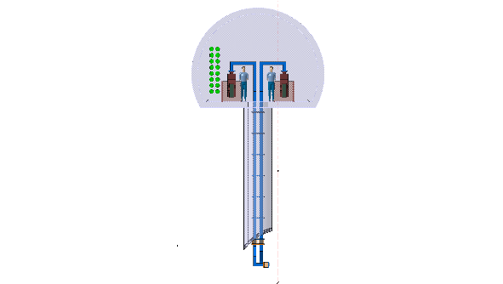
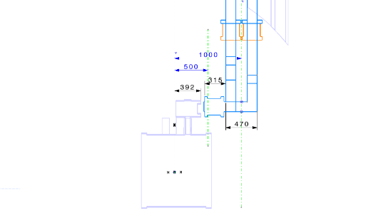
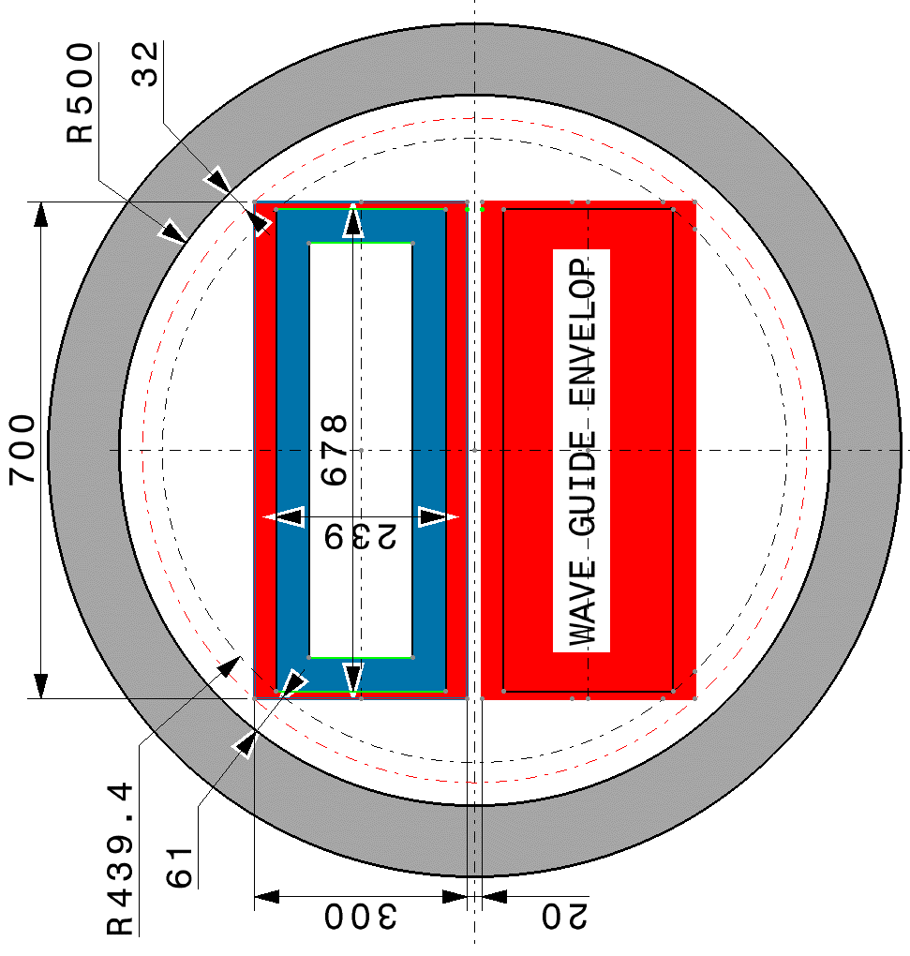
The UA dedicated to RF installation
RF ZONE
Crab cavity

Slide 28
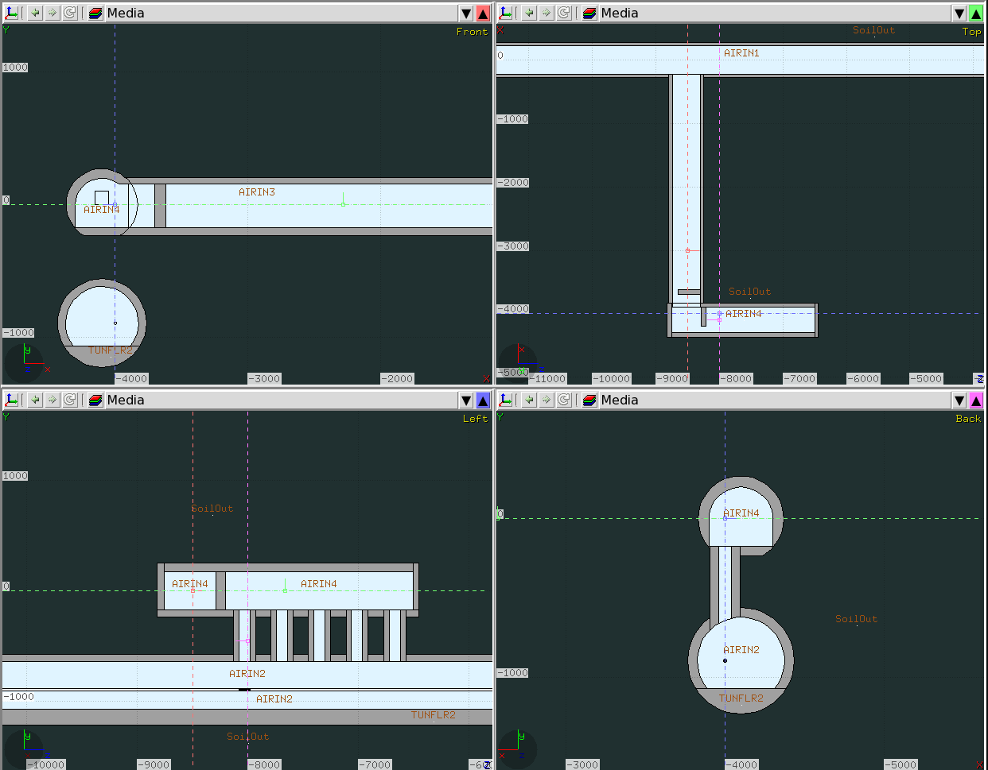
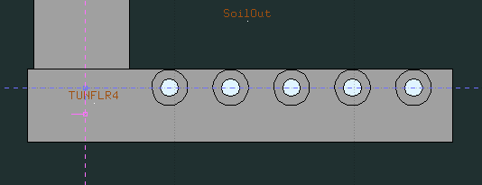
UA: the Radio Protection studies: implemented geometry
Power converter gallery - UR
RF service gallery - UA
RF service gallery - UA
LHC tunnel
~162 from IP
Geometry 4.4
RF service gallery - UA
RF service gallery - UA
LHC tunnel
~162 from IP
Connection cores
LHC tunnel
~162 from IP
Courtesy C. Adorisio

Slide 29


Effective Dose Profile (accidental scenario)
UA tunnel start
6 mSv
Accidental max allowed exposure
Effective Dose (mSv)
Accessible
Area set at 1 mSv
13 m
X (cm)
This position matches the 0.2 µSv/h in operation.
Limit for Non-Designated area < 0.5 µSv/h
Courtesy C. Adorisio

Slide 30




Integration with Tetrode Option.
Remark: IOT option requires less volume underground, but a building on surface. The Integration account for the envelope of the two
EQUIPEMENT RF
circulator
OPTION : TETRODE
tetrodes
Coax cables

Slide 31




RF and BBLR
BBLR :
Powering 2* 8 RACKS (UR)
Control 2*4 RACKS (UR/US) Faraday cage
CAGE DE FARADAY

Slide 32



SC Magnet Powering I: D2 to Q6

Slide 33





SC Magnet Powering II: Q1 to D1

Slide 34



Electrical supplies
Transformer and distribution RF LEFT SIDE
Transformers for PC for magnets

Slide 35

Ventilation
Unit for the powering warm cables
Units for local air treatment
Unit for UA
2.5 m x *2.5 m x 7 m
2 x (2.3 m x 2.3 m X 8 m)
6 x (1.5 m x 1.5 m x 3.5 m)

Slide 36

The most busy section with all longitudinal services
COOLING FOR WARM CABLES
SMOKE EXTRACTION (750*750)
PULSION FRESH AIR (Ø800)
RF HV cables
Opt. Fibres + IT
Signal (Transit RF, Access, …)
Signal (local)
AC distribution
High Voltage
General services
QXL_L
SAFETY
He return line
2*DN 300 (PC)
QXL_R
2*DN 150 (AHU)
2*DN 200 (RF_UA13)
RIA

Slide 37
Optimising reasons, consequences, timing and first actions in list
(my optimistic approach)

Slide 38



One of the reasons to optimise: volume to excavate
CS review
≈ 20 000 m³
1 – OLD BASELINE :
≈ 28 000 m³
2 - OPTION :
CE optimisation and
D. Decker approval
≈ 33 000 m³
Volume integration completed
≈ 41 000 m³

Slide 39
Optimisation for cost efficiency targeting possible reduction of infrastructure needs
In beam machine equipment requirements
Machine equipment services
Electrical supply
Cooling and ventilation supply
Civil engineering
design

Slide 40

Shaft
TARGET:
Reduction of diameter of the shaft from 12 m
MEANS/ISSUES TO DEAL WITH
Need to transport the QURC in inclined or vertical position
Provide sufficiently and correctly positioned routing for ventilation and cable trays
BENEFITS:
Reduction of CE cost
Reduction of excavation time->planning risk mitigation
Reduction of the water infiltration risks and volumes at Point 5
From 12 to 10 m:
Model under screening and study

Slide 41
UR
TARGET:
Reduce the ohmic heating of the SC magnet powering installation without increasing the cold part length
MEANS/ISSUES/OPTIONS/OPPORTUNITIES TO DEAL WITH
Adoption of 2 quadrant PCs for the Q1->Q3 circuit
Adoption of 2 quadrant PCs for the D1 and D2
Allowing to place PCs as near as possible to the DFHs in electrical dissipation reduction approach
Dropping of the Dump and Switches for Q1->Q3 circuit
Lumping of Q1->Q3 in one circuit
BENEFITS:
Reduction of the warm and water cool cable footprint
Reduction of the ohmic dissipation
Reduction of the electrical installation footprint
Reduction of the cooling ventilation system
Reduction of the UR diameter (to be seen)
Reduction of capital and operative cost

Slide 42

Optimisation working hypothesis

Slide 43
-40%
-40%
-40%

Slide 44
UA
TARGET:
Reduce the ventilation installation and if possible reduce the UA diameter
MEANS/ISSUES/OPTIONS TO DEAL WITH
Installation of the HVPS for the tetrodes on the surface
BENEFITS:
Adopt similar strategies for the RF crab powering baseline (tetrodes) and IOT powering with the HVPS in surface on both cases
Reduce the powering delivered to the air in the UA

Slide 45

Timeline
Phase I: COMPLETED
Definition of the full needs and full integration in tunnel and first analysiss on surface: USED FOR THE INVITATION TO TENDER FOR THE CIVIL ENGINEERING DESIGN
Phase II: ONGOING
Optimisations of volumes and of the technical Infrastructure Specification (WP17). It will provide refine drawings for the SIGNATURE OF THE CIVIL ENGINEERING DESIGN. February 2016
Phase III: continuous improvement and refinement keeping in line the milestones for civil engineering activities
Double decker it is taking up speed, we can steer, but better do not break or it will be painful for passengers

Slide 46
Conclusions
The approach for the installation of the supplies and services for the HL-LHC has been reviewed following the vibration studies
The Double Decker approach has been developed and, on the base of this approach, all the services identified by WP17 integrated
The volumes for the surface (not shown here) and underground infrastructures have been frozen as first complete Baseline on the 18th/09/2015

Slide 47
Extra slides

Slide 48







Type 1: 16.5kA
Type 2: 13 kA
Type 3: 6 kA
Type 4: 2kA
2 * Type 5(0.3kA) = 1 racks
“switch”
≈12 m2
2 * Type 6(0.2kA) = 1 racks
dump
4 * Type 7(0.12kA)= 1 racks
Location | Quench Detection Systems (QDS) | PIC | WIC/ FMCM | BIS | CLIQ
 | # of Racks | # of Racks | # of Racks | # of Racks | # of Racks
L1 | 8 | 2 | 1 | 1 | 22

Slide 49


Survey
2* 4 RACKS (UR)
2*1 RACKS (UA13/17)

Slide 50


General View
PM57
US57
UW57

Slide 51


Civil engineering structure related to personnel safety
PM57
Leak tight pressurised concrete module
US57
Pressurised safety area
UW57

Slide 52


Transport volume in the shaft
PM57
Vertical lowering volume 4 m x 8 m.
50 cm margin on sides for largest element
US57
UW57

Slide 53


US handling equipment ( more foreseen in the UW)
Overhead crane
5t for cold box maintenance

Slide 54


Cryogenic installation without control and electrical supply part
QXLR & QXLL
QURCG
QPLG

Slide 55


Safe room
Safe room

Slide 56


UW ground floor
Cooling water treatment
and circulation

Slide 57

Ground floor with transport areas
UR
UA
Transport area ground floor
UA
UR

Slide 58
General view with all the cooling and ventilation distribution
Ventilation Distribution

Slide 59

First floor with transport areas
First floor

Slide 60

General view
PM57
UA57
UW57
US57
UR57

Slide 61

Integration with Tetrode Option.
HVPS : 4 RACKS/TETRODE

Slide 62

The longitudinal services in the section
Cooling for the warm cables
SMOKE EXTRACTION(750*750)
PULSION fresh air (Ø800)
RF HV cables
Opt. Fibres + IT
Signal (Transit RF, Access, …)
Signal (local)
AC distribution
High Voltage
General services
QXL_L
Safety
He Return lines
2*DN 300 (PC)
QXL_R
2*DN 150 (AHU)
2*DN 200 (RF_UA13)
RIA

Slide 63


SC Magnet Powering 3D

Slide 64





Slide 65





Slide 66






Slide 67

VOLUME DE RESERVATION POUR DFH (DFHM ET DFHX)
30 M2
4 RACKS

Slide 68
POWER CONVERTOR LIST (PC)
(EXTRACT FROM Power_converter_list_V16.xlsx)
PC type |  | DFHM_L | DFHX_L | IP_L | IP | IP_R | DFHX_R | DFHM_R | Number of rack 19'' BY TYPE |  | RACK BY IP SIDE | TOTAL BY IP
New | Type 1 | 0 | 2 | 2 | 4 | 2 | 2 | 0 | 10 |  | 20 | 40
Existing | Type 2 | 1 | 1 | 2 | 4 | 2 | 1 | 1 | 9 |  | 18 | 36
Existing | Type 3 | 6 | 0 | 6 | 12 | 6 | 0 | 6 | 4 |  | 24 | 48
New | Type 4 | 8 | 7 | 15 | 30 | 15 | 7 | 8 | 3 |  | 45 | 90
Existing | Type 5 | 0 | 1 | 1 | 2 | 1 | 1 | 0 | 0.5 |  | 1 | 2
New | Type 6 | 0 | 7 | 7 | 14 | 7 | 7 | 0 | 0.5 |  | 4 | 8
Existing | Type 7 | 8 | 2 | 10 | 20 | 10 | 2 | 8 | 0.25 |  | 3 | 6
 |  |  |  |  |  |  |  |  |  |  | 115 | 230
3d
SMARTEAM | TYPE | QTY | COMMENTAIRE |  |  | total
ST0686322_01 | TYPE 1 | 4 | ENSEMBLE equivalent de | 10 | RACKS | 40 | RACKS
ST0686345_01 | TYPE 2 | 4 | ENSEMBLE equivalent de | 9 | RACKS | 36 | RACKS
ST0049908_01 | TYPE 3 | 8 | ENSEMBLE equivalent de | 6 | RACKS | 48 | RACKS
ST0686309_01 | TYPE 4 | 30 | ENSEMBLE equivalent de | 3 | RACKS | 90 | RACKS
ST0186528_01 | TYPE 5 | 2 | RACKS |  |  | 2 | RACKS
ST0619391_01 | TYPE 6 | 8 | RACKS |  |  | 8 | RACKS
ST0186602_01 | TYPE 7 | 6 | RACKS |  |  | 6 | RACKS
 |  |  |  |  | total | 230 | RACKS

Slide 69
Type 1: 16.5kA
Type 2: 13 kA
Type 3: 6 kA
Type 4: 2kA
2 * Type 5(0.3kA) =
1 racks
2 * Type 6(0.2kA) =
1 racks
4 * Type 7(0.12kA)=
1 racks

Slide 70
Type 1: 16.5kA
Type 2: 13 kA
Type 3: 6 kA
Type 4: 2kA
2 * Type 5(0.3kA) = 1 racks
“switch”
≈12 m2
2 * Type 6(0.2kA) = 1 racks
dump
4 * Type 7(0.12kA)= 1 racks
Location | Quench Detection Systems (QDS) | PIC | WIC/ FMCM | BIS | CLIQ
 | # of Racks | # of Racks | # of Racks | # of Racks | # of Racks
L1 | 8 | 2 | 1 | 1 | 22

Slide 71





ENERGY EXTRACTION
Corrector circuit
1 rack = 600 x 900
“switch”
≈12 m2
dump

Slide 72
Interlock Systems
Location | Quench Detection Systems (QDS) | PIC | WIC/ FMCM | BIS | CLIQ
 | # of Racks | # of Racks | # of Racks | # of Racks | # of Racks
L1 | 8 | 2 | 1 | 1 | 22
R1 | 8 | 2 | 1 | 1 | 22
L5 | 8 | 2 | 1 | 1 | 22
R5 | 8 | 2 | 1 | 1 | 22
1 rack = 600 x 900

Slide 73
Interlock Systems
Location | Quench Detection Systems (QDS) | PIC | WIC/ FMCM | BIS | CLIQ
 | # of Racks | # of Racks | # of Racks | # of Racks | # of Racks
L1 | 8 | 2 | 1 | 1 | 22

