Slide 1
From US-LARP to US-HiLumi
G. Apollinari
LARP Director
5th Joint HiLumi-LHC/LARP Annual Meeting
October 27th, 2015

Slide 2
Content
Status and Progress of LARP
  2015 Achievements
  2016 Goals
  New Toohig Fellows
  “LARP2” Program
Transition to US-HiLumi
  Definition of Deliverables
  Functional and Technical Specs
  Preliminary Funding Profile
  Conceptual US-HiLumi Schedule

Slide 3
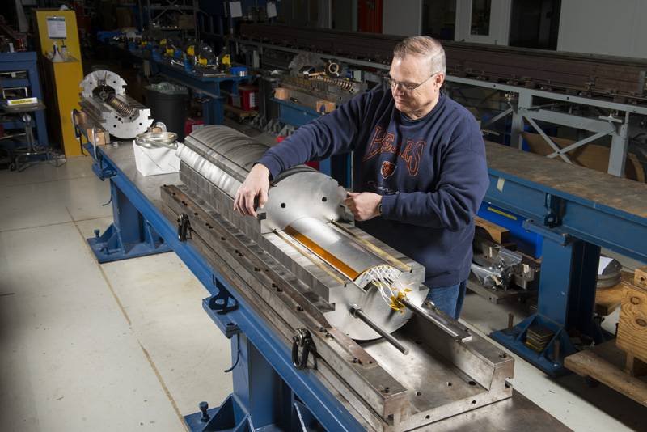
Successful Test of First MQXF Coil
First model coil for HL-LHC magnets assembled and tested in mirror configuration at FNAL. The Mirror Magnet was tested in the IB1 Vertical Magnet Test Facility using for the first time an upgraded 30kA setup.
  Higher current needed for higher-performing Nb₃Sn magnets
Coil achieved HL-LHC “operating current” (16.5kA) in 3 quenches during the first day of testing !
Acceptance
Operations
16.5 kA

Slide 4
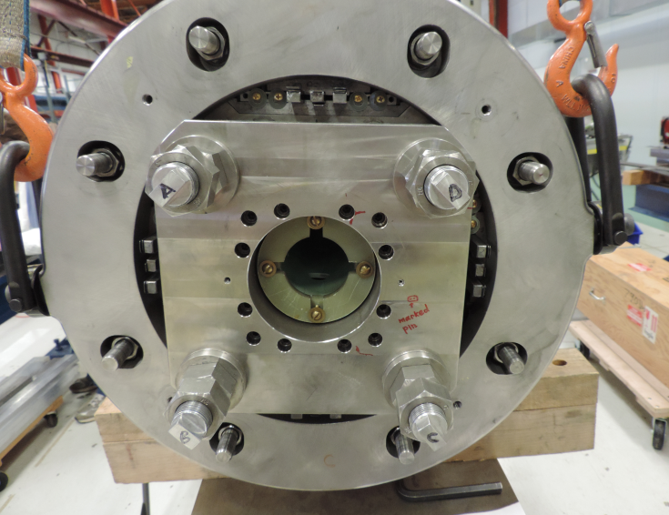
Successful Test of HQ03a
120 mm Aperture
  Excellent Memory
  Achieved 90% SSL at 1.9K, 98% at 4.5K.
  The shims achieved expected change the b3 and b5 harmonics with little effect on other harmonics.
Shims
Keys
Excellent Memory
90% SSL at 1.9K

Slide 5
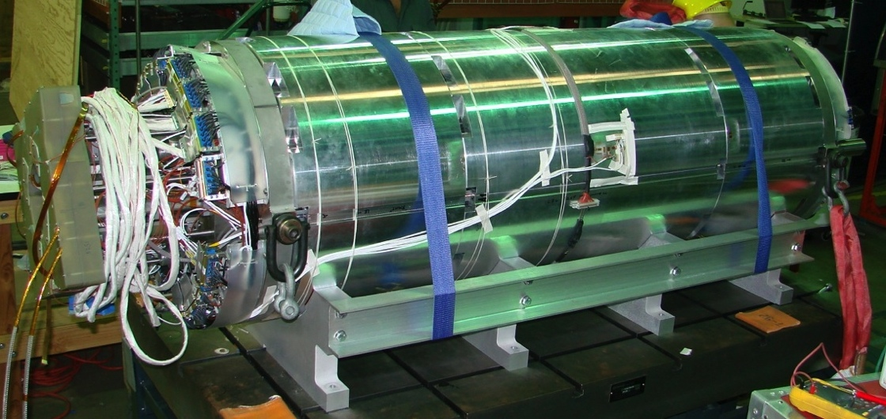
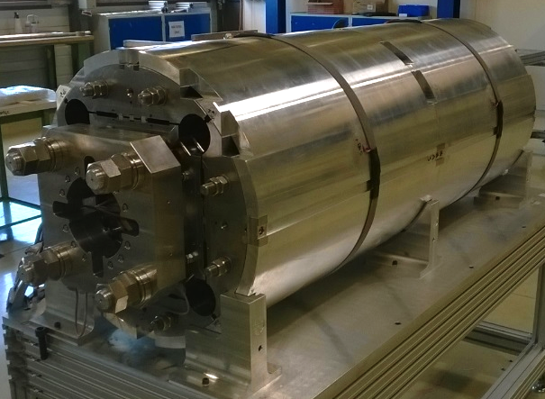
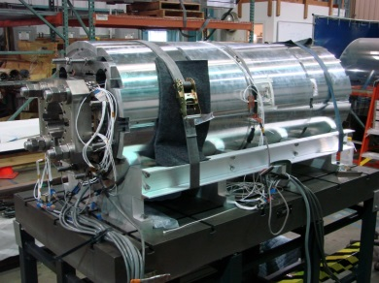
Successful Assembly of First MQXFS.
Test Coming
Two identical structure assembled and pre-loaded with aluminium coils at LBNL and CERN, and then with real coils at LBNL
Component instrumented with strain gauges
  Very good agreement with calcuations

Slide 6
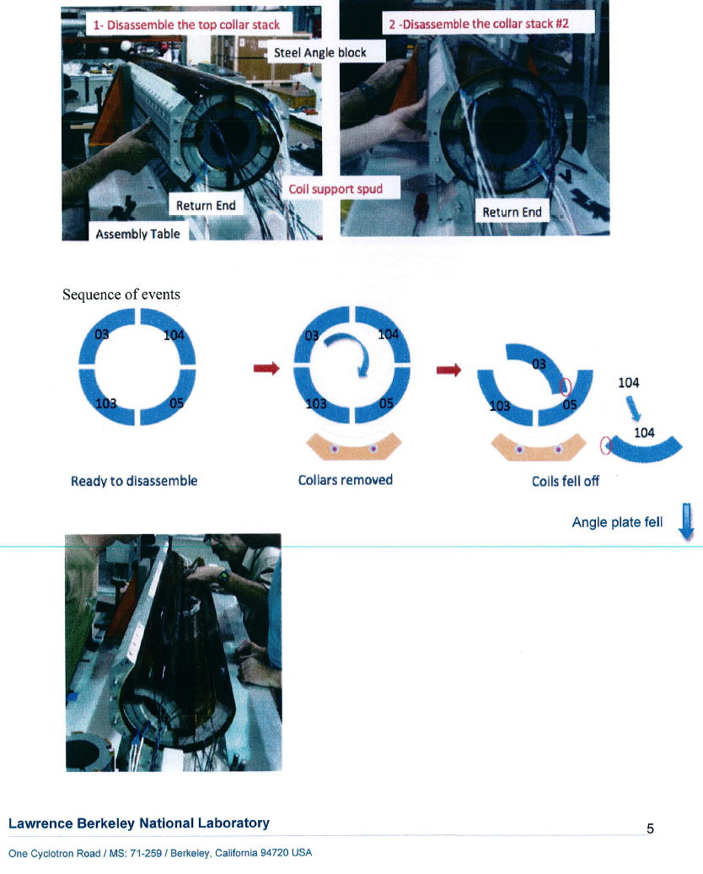
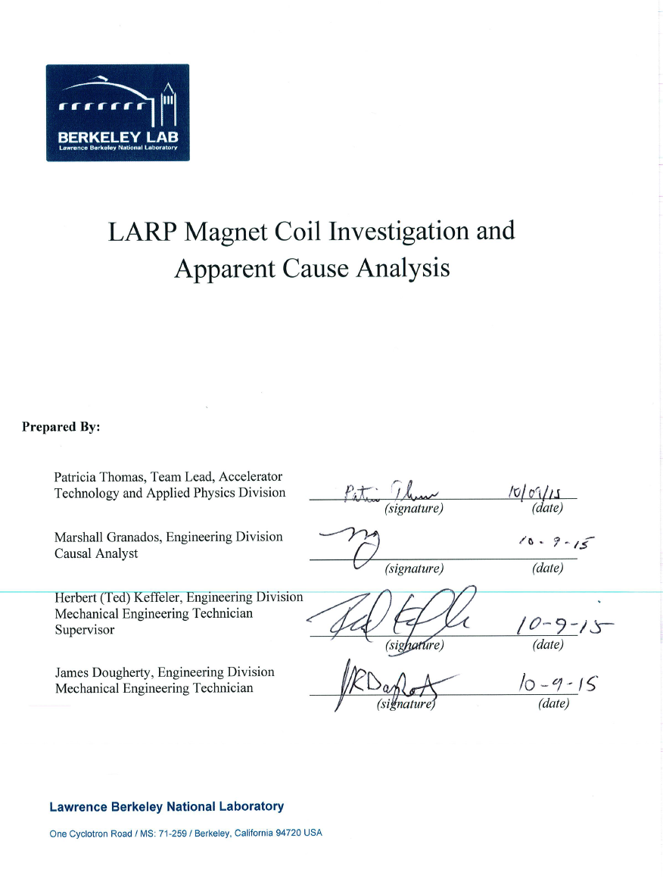
Assembly Mishap during MQXFS

Slide 7
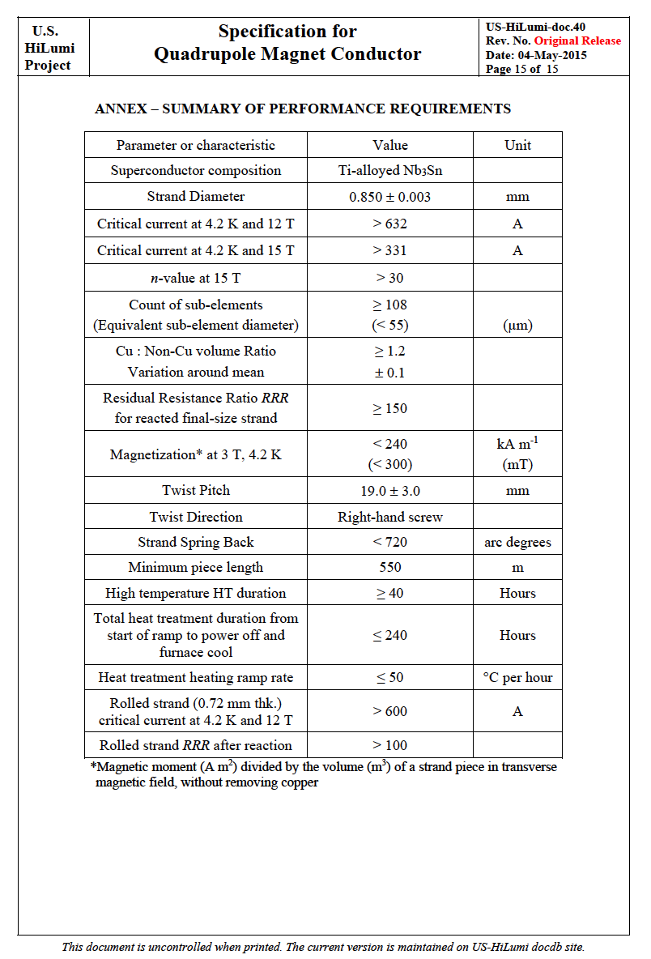
Conductor Procurement
Convergence on 108/127 based on performance and cost analysis.
Order placed by FNAL for ~200 km in Sep ‘15.
First interactions on material certifications with manufacturing company happening as we speak.

Slide 8
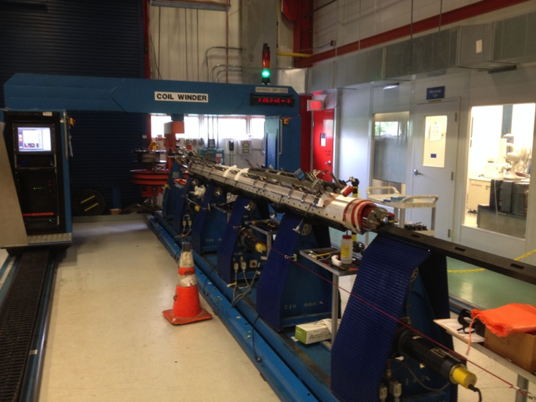
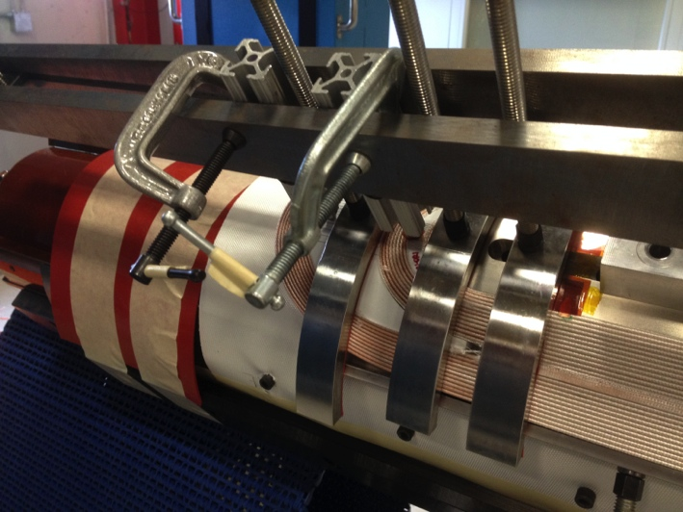
FY16 Goals: Test of Long MQXF Coil & First Long (4 m) MQXF Quad
First US-LARP long (4 m) coil
  Wound and cured at FNAL
  Reacted and under impregnation at BNL
Plan for mirror configuration test in April ’16
  BNL Vertical Stand
Coil #1 on Selva
Coil #1 End Parts

Slide 9
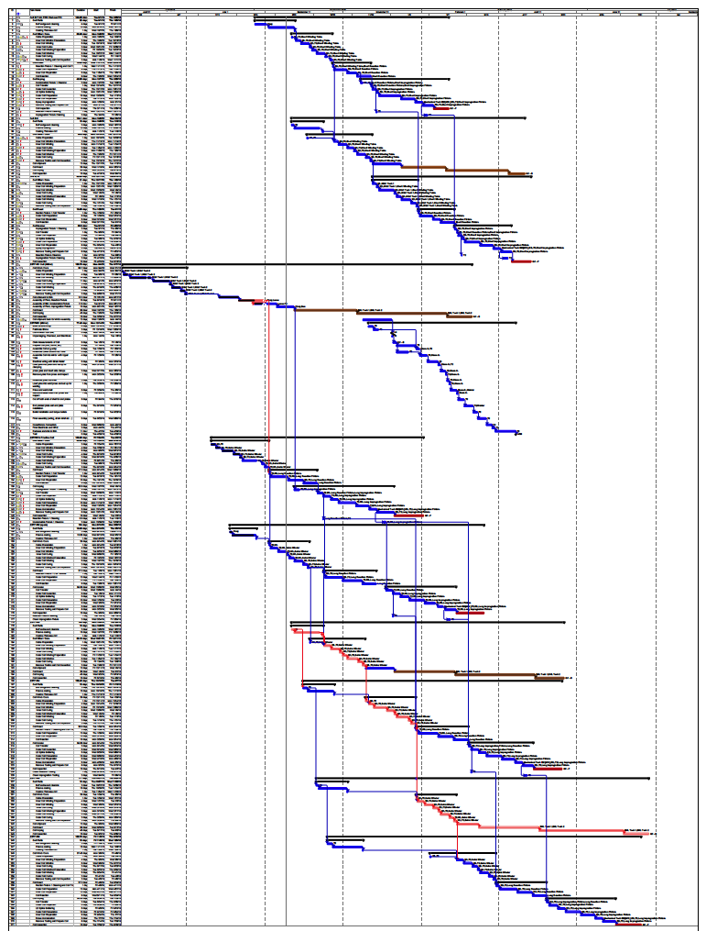
FY16 Goals: Complete First Long (4 m) MQXF Quad
Complete first long (4m) quadrupole in US
  Coil winding at FNAL
  Reaction/impregrantion shared with BNL
  Structure Procurement and Assembly at LBL
    Summer 2015 Internal LARP Review with full participation from CERN
  Test by early FY17
Magnet assembly treated as Project with “poor-man” EVMS to confirm effort estimates for US-HiLumi Project

Slide 10
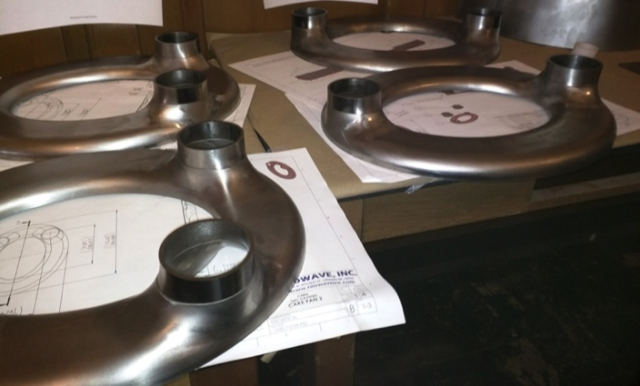
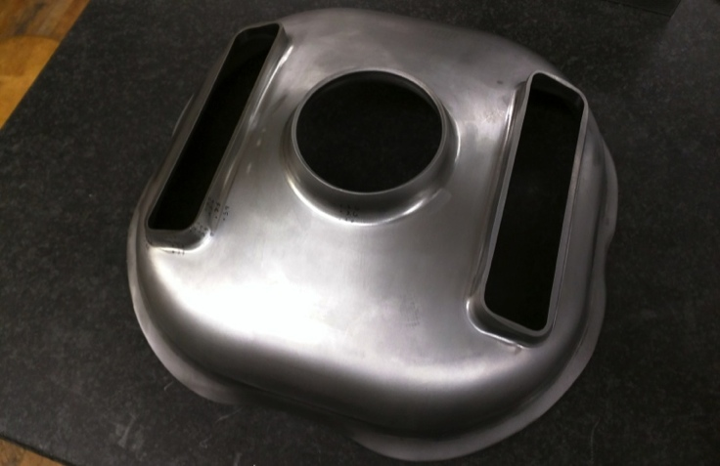
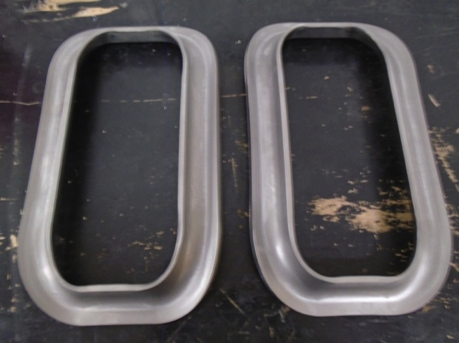
Crab Cavities Situation
What worked:
  Parts stamped OK at Niowave
  EBW limits to imperfections being renegotiated with CERN
What didn’t:
  Plan to weld cavities at JLAB not accepted by NW
  NW continued, and plans to complete, the welding of 2 RFD and 2 DQW
What’s next:
  Decision on acceptance of NW cavities
  If accepted, plans for chemical processing and assembly of the He Vessel at JLAB
  Alternatives need to be investigated

Slide 11
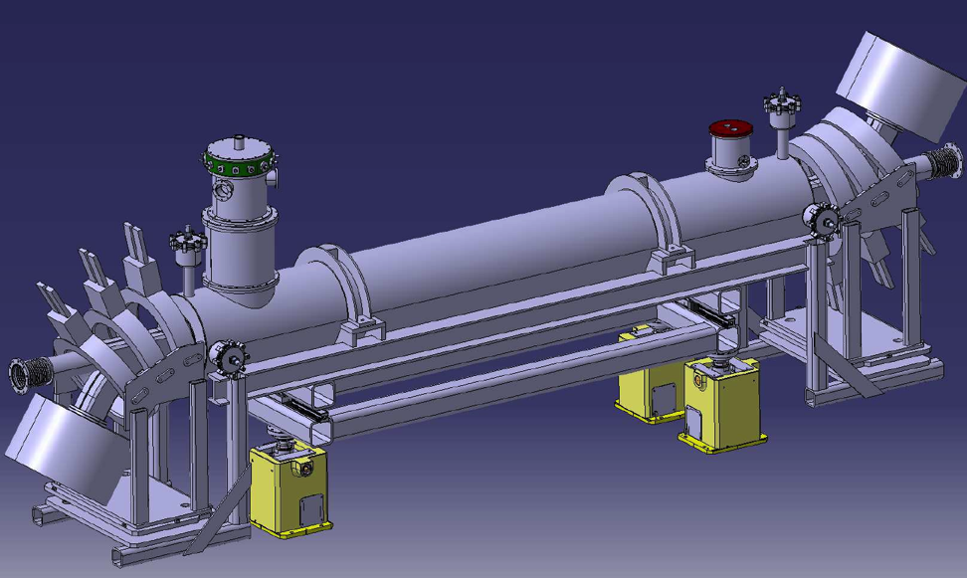
R&D Activities: e-lens
Collimation with hollow electron beams
  Beam studies on halo population and active control in LHC
  Tests and characterization of CERN hollow gun at Fermilab
  Numerical tracking and calculation of loss maps
Long-range beam-beam compensation with electron wire
  Definition of conceptual design
  Beam dynamics simulations of compensation scenarios
Common to collimation and beam-beam compensation
  Study magnetized electron beams with self fields
  Maintain and improve Fermilab electron-lens test stand

Slide 12
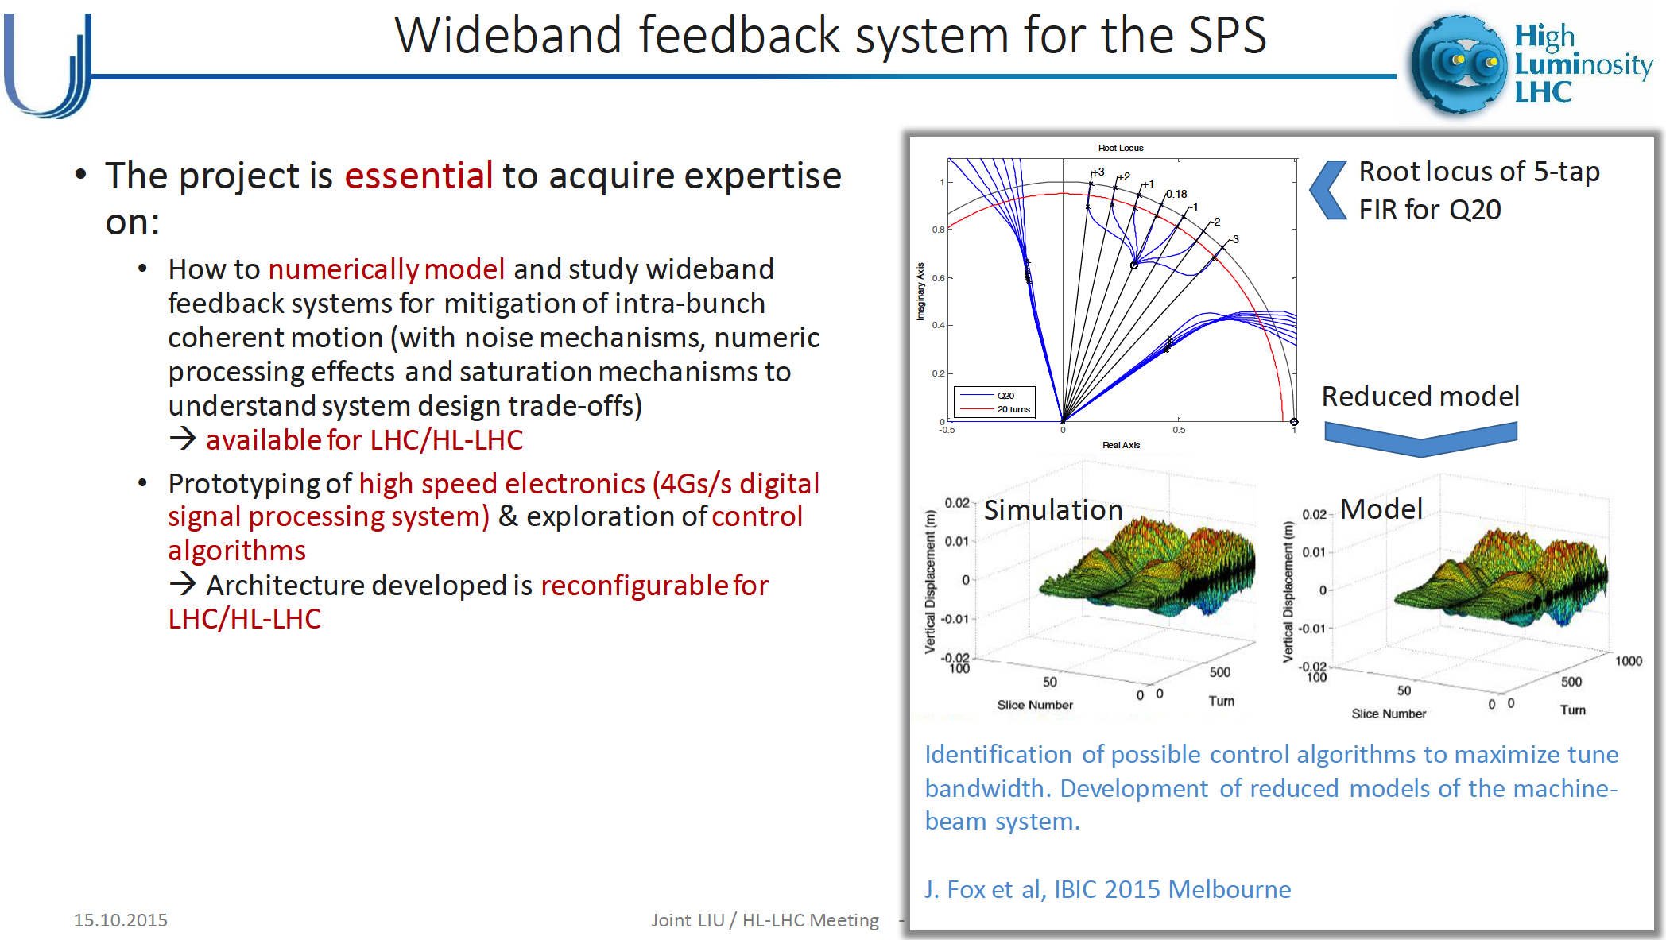
R&D Activities: Wide Band Feedback System
Talk from K. Li at LIU/HL-LHC
Oct 15th, 2015

Slide 13
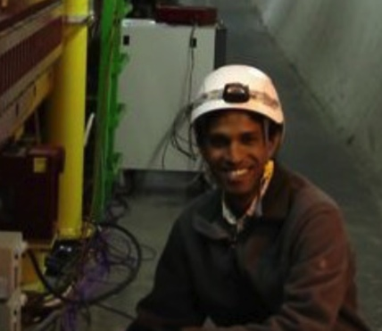
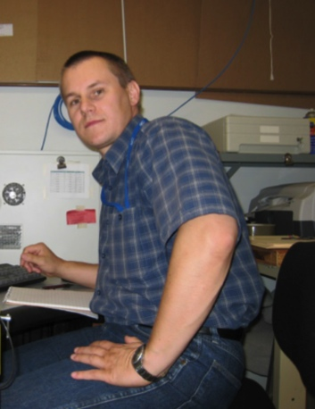

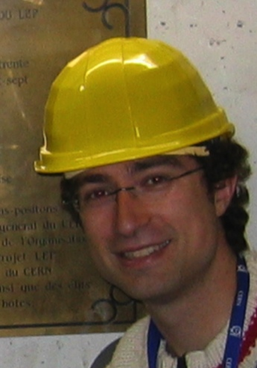
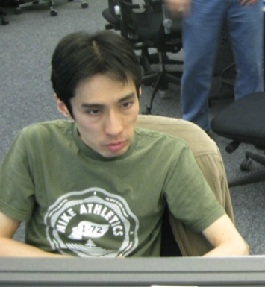
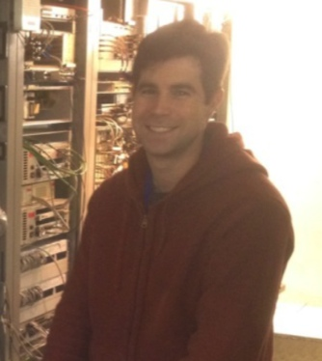
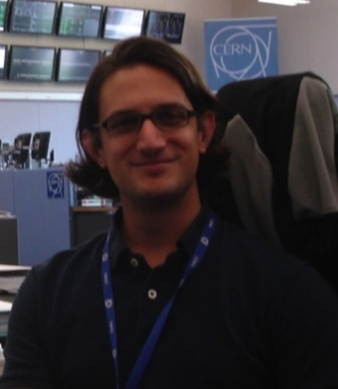

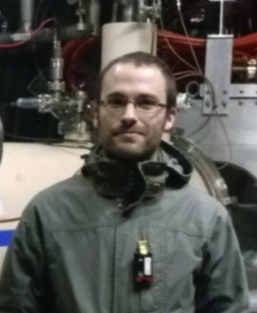

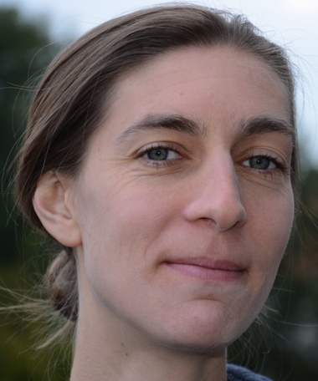
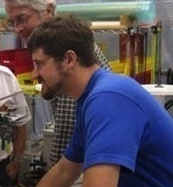
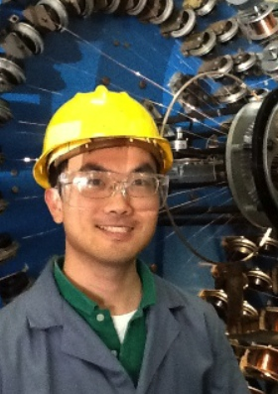
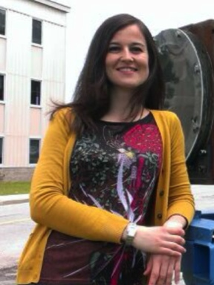
Toohig Fellowship
Following May’15 HiLumi/LARP Meeting, 2 candidates were offered a Toohig Fellow position at US National Labs:
  M Fitterer – FNAL
  E. Ravaioli - LBNL
R. Calaga – CERN
D. Bocian
Prof. HNINP
H. Felice – CEA
V. Previtali
Teacher, Geneve
J.Cesaratto
Phillips
R. Miyamoto – ESS
T. Mastoridis
Prof. CPU
S. White – ESRF
R. DeMaria –CERN
S. Verdu
BNL
T. Holik
FNAL
E. Ravaioli
LBL
I.Pong
LBNL
M. Fitterer FNAL
13

Slide 14

Some Definitions !
LARP (FY15-FY17/18):
  Continue LHC R&D with emphasis on minimizing risk of US in-kind deliverables for HL-LHC Project.
    Deliver 5 QXF Models/Prototypes & 4 dressed CC (SPS Test)
    Support Toohig Fellowship and - if possible - Acc. Phys. activities
US-HiLumi (FY18-FY24):
  US in-kind deliverable to HL-LHC, controlled as a 413.3b Project
    Follows
      DOE-CERN agreement on ICA (done)
      DOE-CERN Protocol (~end CY15)
      Coll. Agreement with in-kind deliverables
      (early CY16?)
“LARP2” (FY19-FY30):
  Program to support US intellectual involvement in HL-LHC while US-HiLumi is being executed or HL-LHC operates

Slide 15
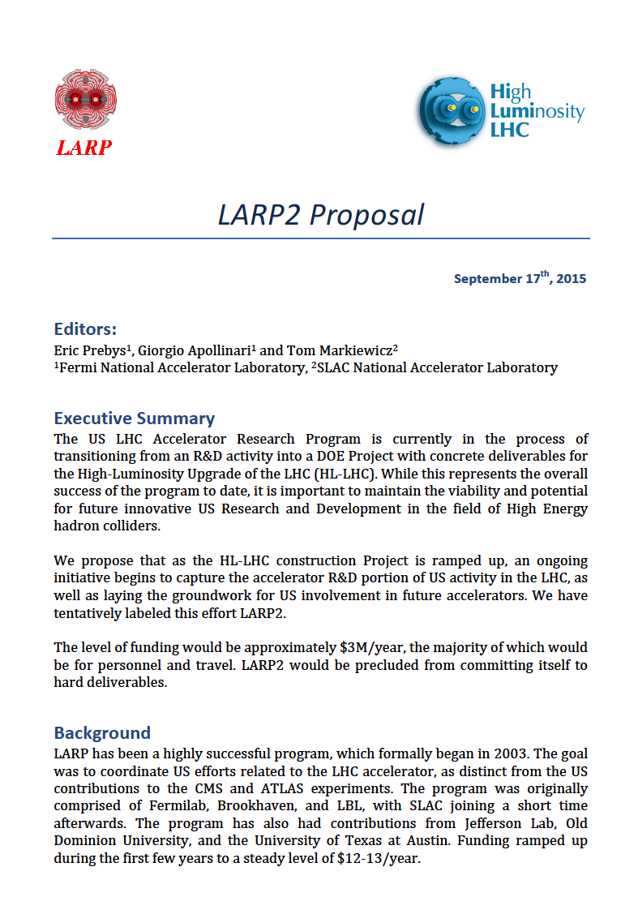
LARP2 (2019 and beyond)
Basic Idea
  Initiative to capture US Acc. R&D at the LHC during HL-LHC Construction
  Focus on intellectual contributions and beam test
    No deliverable to HL-LHC
    Vision for future like LARP 10y ago
    Directed-Program Nature
  Support of Fellows Research fraction, LTV, studies at HL-LHC informing development of Future Colliders
Plan
  Organize a satellite ½-1 day workshop around next HiLumi/LARP meeting in US to converge on proposal to DOE.
  Program driven by US interests, but will solicit feedback and support from CERN

Slide 16
…onward to US-HiLumi

Slide 17
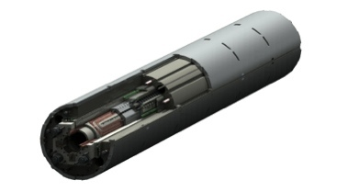

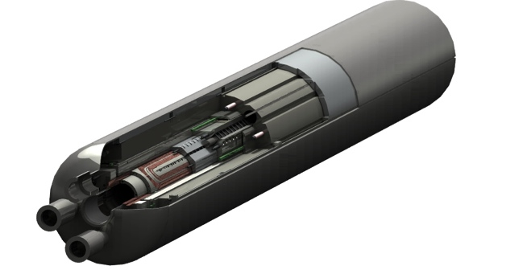
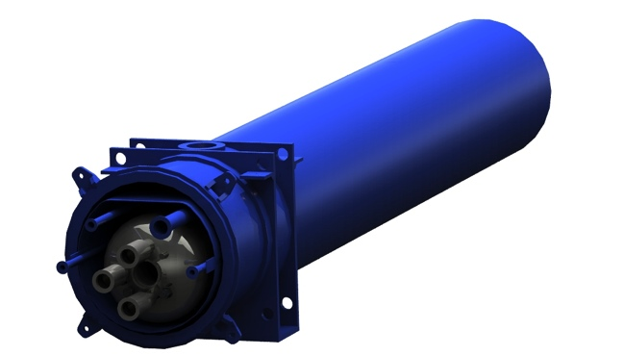
US-HiLumi Deliverables: Magnets
US-HiLumi Focusing Magnets
  Deliver 10 Cold Masses to CERN by end CY24. Each CM contains two 4.2m long, 150 mm aperture magnets
+
US-HiLumi
Scope “Contingency”
US-HiLumi
Baseline Scope
CERN Scope

Slide 18
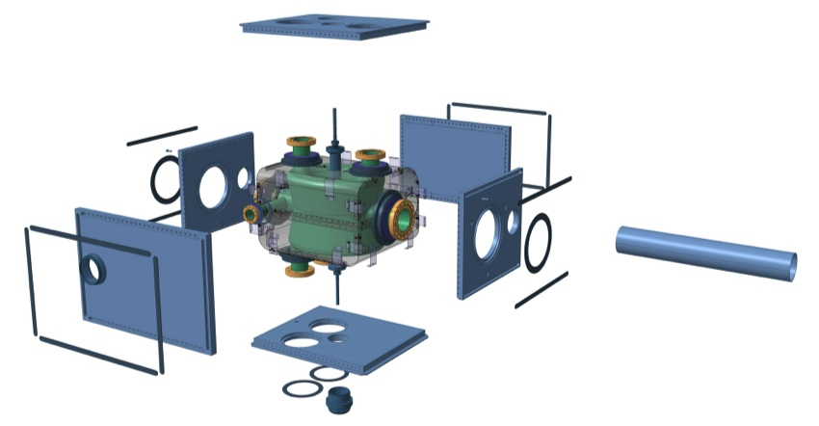
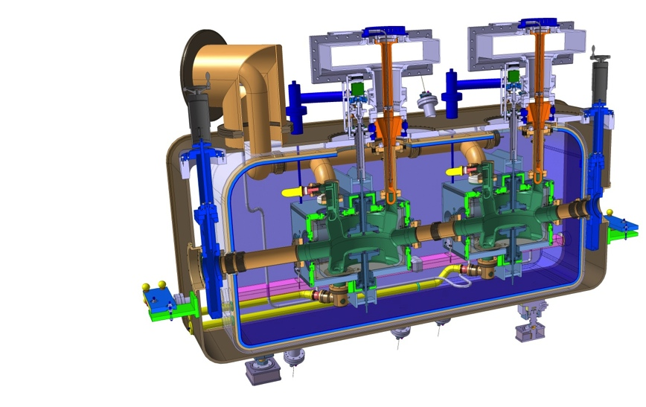
US-HiLumi Deliverables: Crab Cavities
US-HiLumi Crab Cavities
  Deliver 40 Individual He-Vessel Dressed Crab Cavities with HOM and tuners to CERN by end CY24.
US-HiLumi
Baseline Scope
US-HiLumi
Scope Contingency
CERN Scope

Slide 19
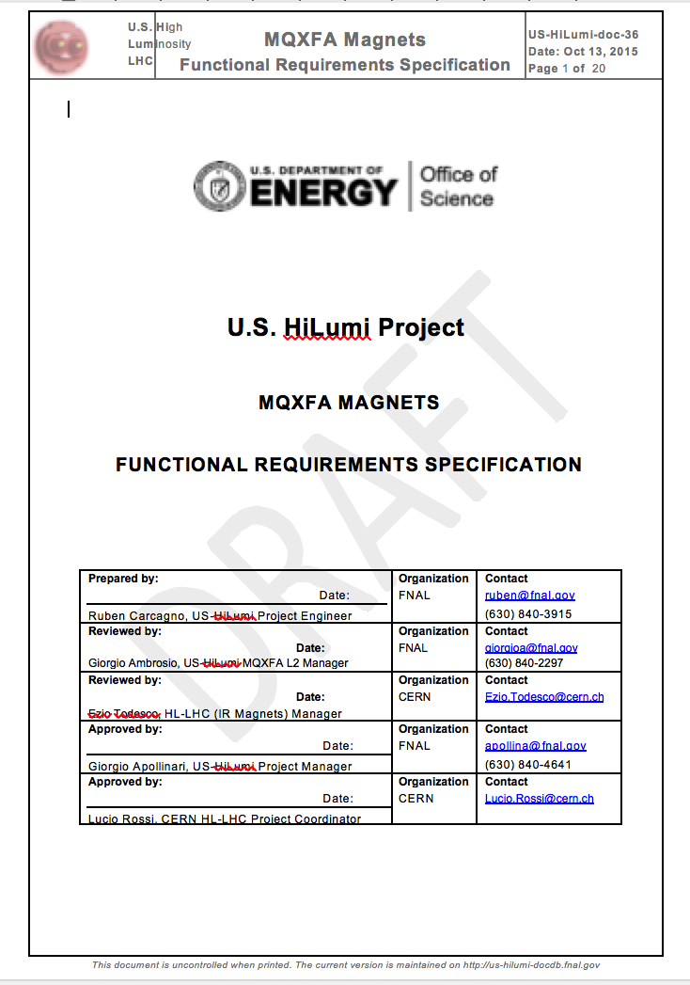
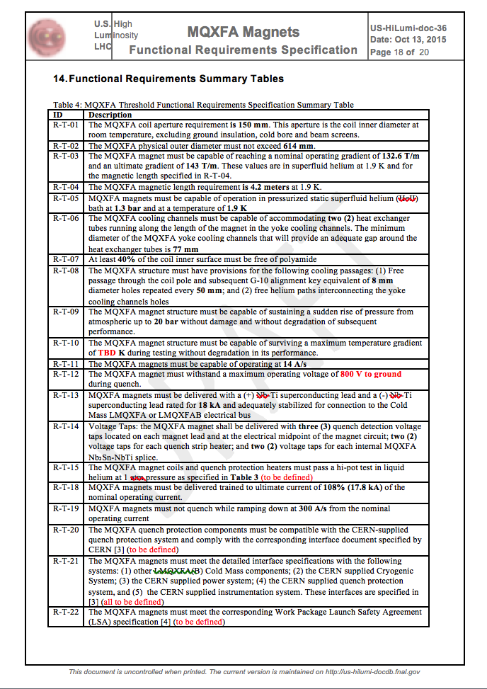
Functional Requirements for MQXF Magnets
MQXF Functional Requirements already exchanged with WP2. V1 with ~6 drafts/inputs preceding it.
Handled in terms of ~22 “Threshold Requirements”, i.e. minimum goals for magnet performance before shipment to CERN:
  Ex: MQXF trained to 108% (17.8 kA) of operating current, withstand 800V to ground during quenching, etc..
Few of these requirements will become “Target KPPs (Key Performance Parameters)” used by US Congress to monitor US-HiLumi Project during its execution.
  Plan to investigate with DOE whether Achievement of Threshold KPP and Acceptance by CERN can be used as synonymous.

Slide 20

Functional Requirements for Cold Mass
Exchanged with WP2 by ~mid October.
Mostly dealing with integration requirements for 2 magnets in one He Vessel.
(Where applicable) Threshold Requirements based on what is considered feasible to achieve “form and function” and/or what has been achieved for present Q2 LHC Triplets.
A convergence on the Functional Requirements for the Magnets and Cold Mass are necessary elements for a proper justification of Project estimates in the US (Project Cost, Contingency Levels, Schedule, etc.)

Slide 21
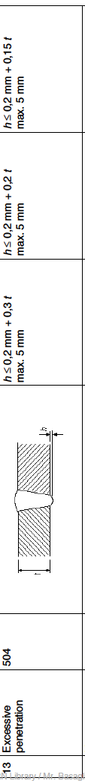
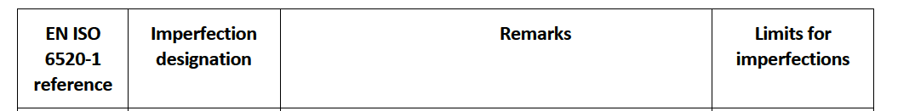
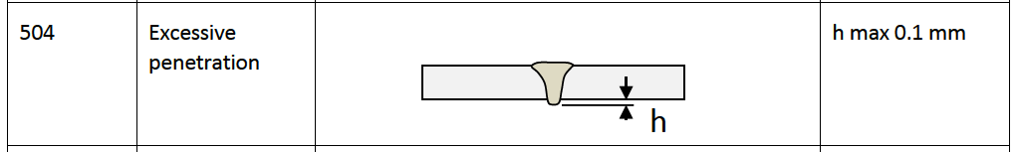
Importance of “Technical Feasibility”
Success story of technical communication across the Atlantic !
During the development of Technical Specification for CC, very stringent requirements on allowed imperfections of Electron Beam Welds found their way into the specification.
After interactions with experts at JLAB and other Labs in the US, a spec based on Stringent Requirement of EN-ISO 13919-2 (Al. EBW) is being considered:
Converging on “technically feasible” specs prevents non-conformities, “explosion” of contingency in US Project estimate, schedule delays, …
EDMS 1389669
h < 0.2 mm + 0.14 x 4 mm = 0.8 mm

Slide 22
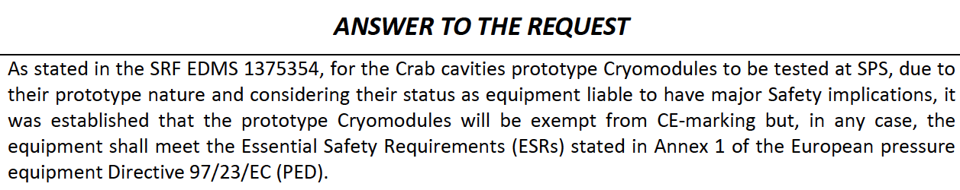
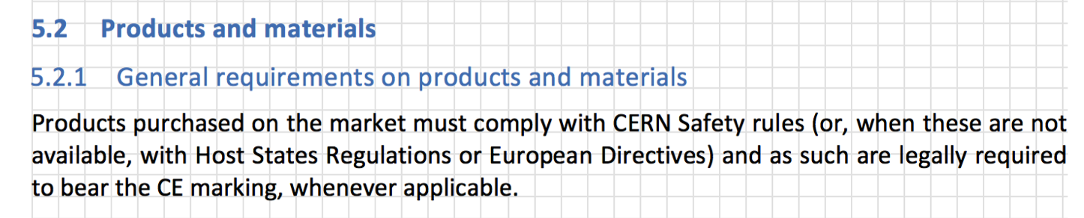
Launch Safety Agreement for MQXF
US-HiLumi PO started inquiring on the stipulation of the LSA that US-HiLumi will need to abide to in order for the US deliverables to be accepted at CERN
Directed to WP3-HSE interactions for Crab Cavities and LSA for 11 T.
  CE-marking
  (Possible) US-HiLumi Project external dependence
  11T LSA
EDMS 1541969
EDMS 1375354
EDMS 1472317

Slide 23
US-HiLumi Project
A DOE construction project is governed by DOE Order 413.3B
  https://www.directives.doe.gov/directives-documents/0413.3-BOrder-b
  Applies to capital assets projects having a Total Project Cost greater than or equal to $50M
DOE projects typically progress through five Critical Decision (CD) gateways, which serve as major milestones
  Each CD marks an authorization to increase the commitment of resources by DOE and requires successful completion of the preceding phase or CD

Slide 24
Critical Decisions
Critical Decision (CD) Gateways
  CD-0: Approve Mission Need
  CD-1: Approve Alternative Selection and Cost Range
  CD-2: Approve Performance Baseline (when KPP are frozen !)
  CD-3: Approve Start of Construction/Execution (Production Start !)
  CD-4: Approve Start of Operations or Project Completion
A project shall be completed at CD-4 within the original approved performance baseline (CD-2)
CD-0 approval is now expected by early FY16
  Mission Need based on DOE/CERN agreements
  US-LARP acting as if we already received CD-0 for US-HiLumi and preparing actively for CD-1
CD-1 approval by ~Jan 17?
  Requires preparation in 2016 for CD-1 Director’s review and CD-1 DOE review
Consolidated CD-2/3 approval
  Approval by Q3 FY18, based on 2 successful long magnet prototypes

Slide 25
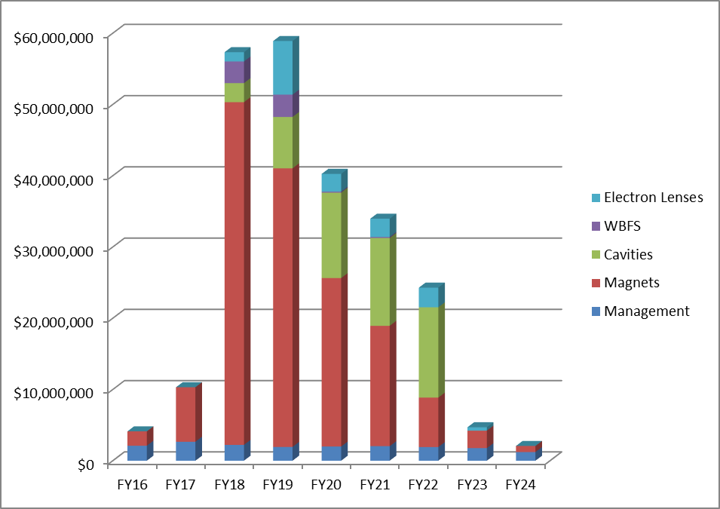
Funding Profile History
Feb ’15 presentation to DOE-Germantown:
DOE Feedback in May ‘15 at HiLumi/LARP Collaboration meeting:
  Plan for funding profile
    starting in FY18 at ~20 M$
    integrating to ~181 M$ by FY24
Pre-FY18
($14.4M)
Project
($222M)
Feb 2015 FY18-22 Estimate
Management | $13M
Magnets | $138M
Cavities | $47M
E-lenses | $17M
WBFS | $7M
TOTAL | $222M
25

Slide 26
Other Relevant “High Level” Inputs
CERN C&S Review – Feb 2015
  Recommendation to consider installation of ~50% of the Crab Cavity System in LS3, with the remaining 50% installed in LS4
CERN Council – Jun 2015
  Plan for a contribution from US to HL-LHC at the level of ~200M$ (previously 181 M$) in the FY18-FY24 timeframe
  Consider possible contribution from US to HL-LHC at the level of ~50 M$ in the FY24-FY29 timeframe
    Homework to CERN to define possible scope for additional contribution
      Very preliminary un-official feedback on “50M$” scope definition (July 2015)
        1a) Hollow e-lens (LS3)
        1b) Complete CC - HOM, Main PC (50% in LS3, 50% in LS4)
        3) e-beam Compensator (LS4)
        4) SPS/HL-LHC WBFS (LS3)
        5) Contribution to 11 T (LS4)

Slide 27
Possibilities
 | Up to LS3 (~ 200 M$) |  |  |  | Up to LS4 ( ~50 M$)
 | Manag. + Magnets | Crab Cavities |  |  | Hollow e-lens | Compensator
Scenario #1 | ~ 160 M$ | ~ 40 M$ |  |  | ~20 M$ | ~30 M$
To be presented today
 | Up to LS3 (~ 200 M$) |  |  |  | Up to LS4 ( ~50 M$)
 | Manag. + Magnets | 50% Crab Cavities | Hollow e-lens |  | 50% Crab Cavities | Compensator
Scenario #2 | ~ 160 M$ | ~ 20 M$ | ~20 M$ |  | ~20 M$ | ~30 M$
What would need to happen for “Scenario #2”:
  Inclusion of e-lens in Baseline by CERN (~this year ?)
  Analysis of possible US contribution (by cost and effort) with discussion and Agreement on scope of US Contribution
    Timing Corollary: a possible US contribution to Hollow e-lens in US-HiLumi (FY18-FY24) cannot rely on much R&D effort. It must be an almost “ready-to-go” contribution based on existing and proven designs (TeV, RHIC,..)

Slide 28
Approach to fit DOE funding profile
Reduce TPC estimate $222M -> ($181M + $19M = $200M):
  Reduce scope (-$24M)
    Removed Electron Lens (-$17M)
    Removed Wideband Feedback System (-7M)
Reduce cost in early FYs:
  CERN LS3 delayed by one year
    Tunnel installation in 2025 instead of 2024
  Enables starting production slowly in FY18/FY19
    Use LARP tooling and LARP technician crew
  As more funding becomes available in FY19/20, ramp-up production rate by adding tooling and technicians
  “Just-in-time” procurements
    Use phased procurements
      Increases schedule risk and escalation cost

Slide 29
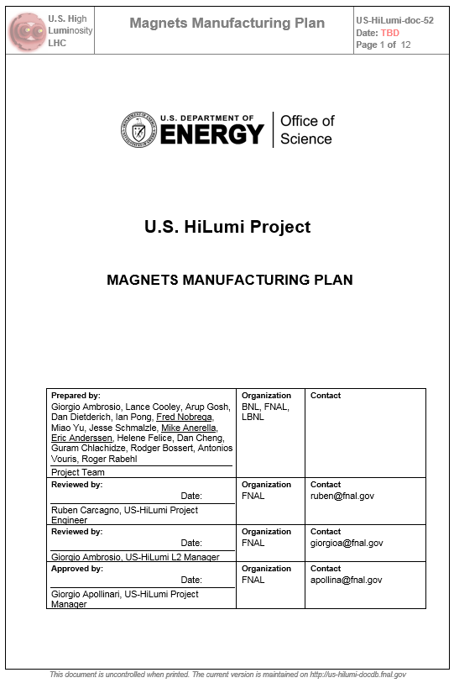
Magnets Manufacturing Plan
Launched a magnets manufacturing plan effort in April 2015
Initial focus on production rates as a function of tooling and crew size

Slide 30
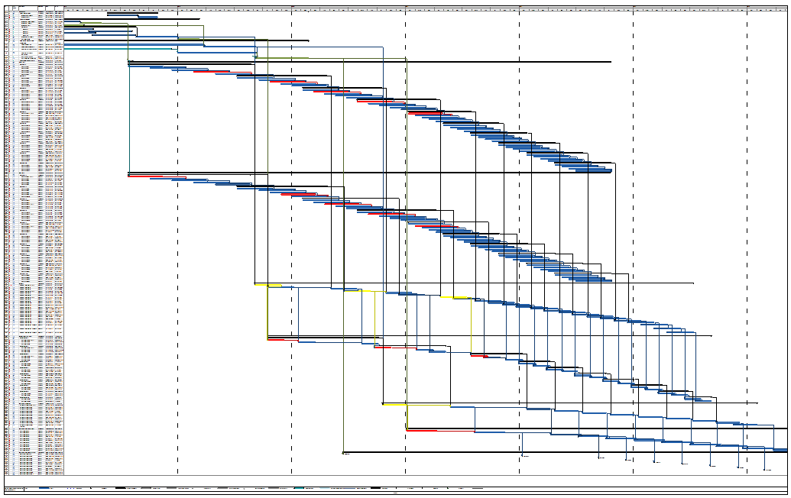
Preliminary Integrated Schedule
MS Project with logic dependencies
FY18
FY19
FY20
FY21
FY22
FY23
FY24
LARP
FNAL Coils
BNL Coils
LBNL Structure Assembly
BNL Vertical Test
FNAL Cold Mass Assembly
FNAL Cold Mass Test
Delivery to CERN

Slide 31
Preliminary LQXF CERN Delivery Dates
Cold Mass | Delivery Date
LMQXFA-1 | 10/11/21
LMQXFA-2 | 6/13/22
LMQXFA-3 | 9/9/22
LMQXFA-4 | 12/8/22
LMQXFA-5 | 3/8/23
LMQXFA-6 | 6/6/23
LMQXFA-7 | 9/4/23
LMQXFA-8 | 11/27/23
LMQXFA-9 | 2/19/24
LMQXFA-10 | 5/27/24
US-HiLumi
Coil Fabrication Starts 4/27/18
Base project duration 76.2 months (6.3 years)
New expected LHC tunnel installation in 2025 during LS3
Last cold mass for tunnel installation (LMQXFA-8) delivered before the end of 2023
Two spares (LMQXFA-9 and 10) delivered in 2024

Slide 32
Comments on Crab Cavities
Design for Crab Cavities is at more preliminary stage than Magnets:
  POP LARP Crab Cav. (‘11-’14) TQ LARP Magnets (’07-’11)
  SPS LARP Cav. (Now) HQ LARP Magnets (’11-’14)
  Pre-Series Cavities (‘19-’20) QXF LARP Prototypes (Now)
  Series Cavities (‘21-’24) QXF Series Magnets(’18-’24)
Present plan: work on Pre-Series Cavities (4) under US-HiLumi in FY19-20, with Series Cavities (36) produced by US-HiLumi in FY21-FY24
  Potential benefits from HL-LHC C&S Review (Feb ‘15) recommendation to split CC installation between LS3 and LS4
FY18 | FY19 | FY20 | FY21 | FY22 | FY23 | FY24
SPS Test | Pre-series (4) |  | Final Design | Series Cavities (36)
LARP | US-HiLumi

Slide 33
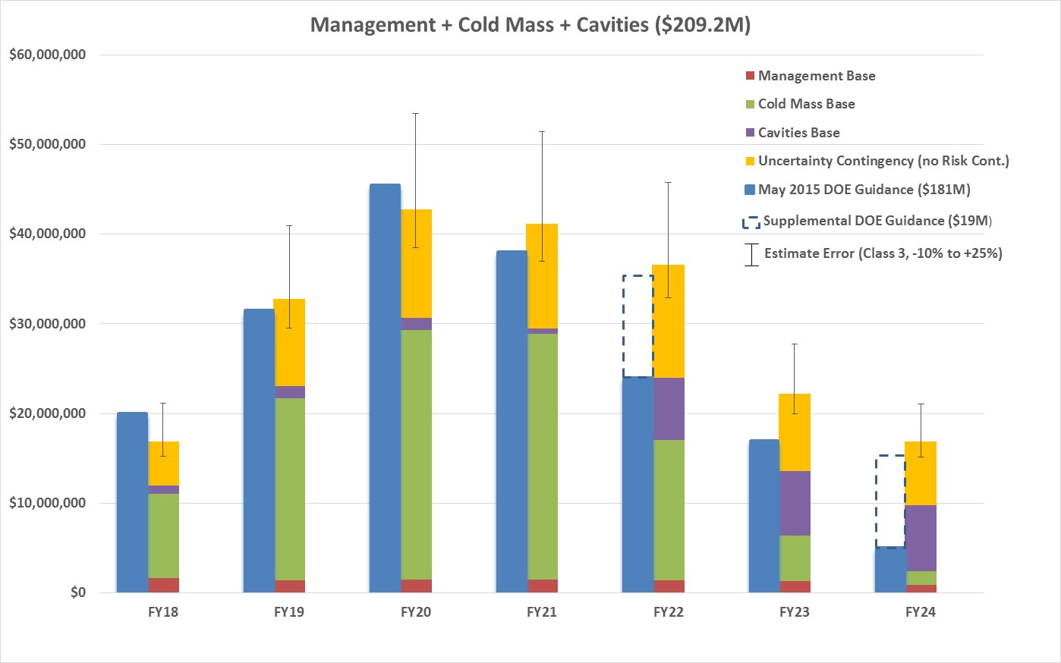
US-HiLumi Cost Model Output

Slide 34
Possible LARP-to-HiLumi-to-LARP2
LARP as we know it today
Asymptotic LARP2
 | FY16 | FY17 | FY18-pre- CD3 | FY18 post-CD3 | FY19 | FY20 | FY21
Total LARP | 15.5 M$ | 18.5 M$ | 13.7 M$ |  | 5.5 M$ | 3.0M$ | 3.0 M$
US-HiLumi |  |  |  | 20M$ | 31.5 M$ | 45.5 M$ | 38 M$
US-HiLumi Project
A major investment from US-HEP in LHC infrastructure !

Slide 35
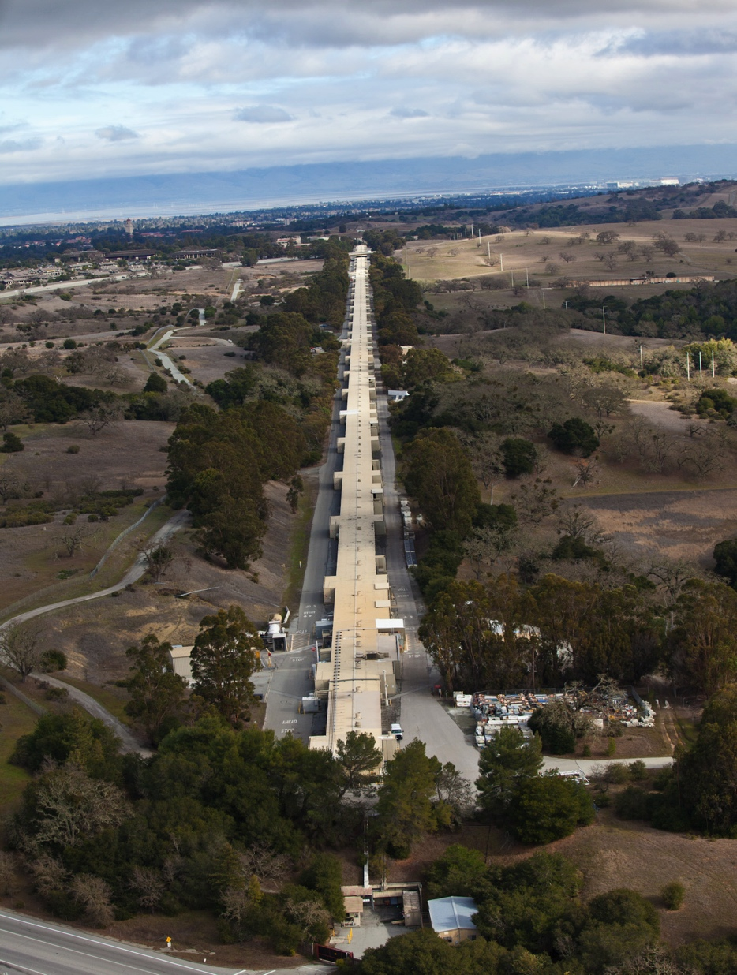

Joint Spring LARP/HiLumi CM
Also LARP-CM26
Where
  SLAC, CA – USA
When (tentatively):
  Week of May 2nd – 6th, 2016
    EuCard2: April 26-28, Malta
    IPAC16: May 9-13, Korea
What
  2 ½ - 3 days format to avoid excessive compression
  LARP2 satellite meeting. Others as needed.

Slide 36
Conclusion
Steady progress under LARP on magnets, crab cavities and other R&D activities
Transition from LARP to US-HiLumi getting to the nitty-gritty details of deliverables, functional specifications, etc.
Preliminary funding profile for US-HiLumi appears to allow deliveries according to CERN schedule needs, albeit at a slightly increased schedule and execution risk (JIT Production)
Preparation of a plan for an Accelerator Physics LARP2 phase is encouraged.

