Slide 1
HL-LHC-UK
G. Burt, Lancaster University

Slide 2
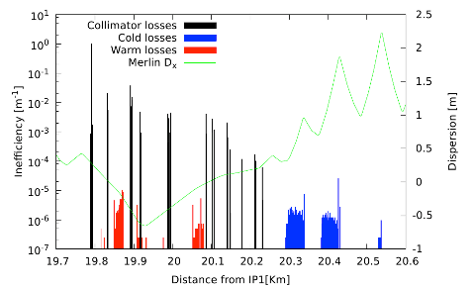
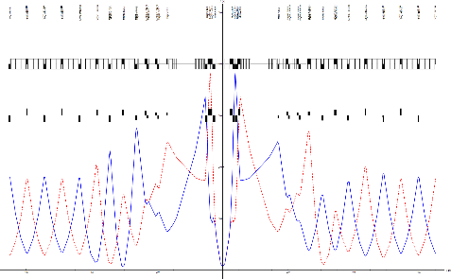
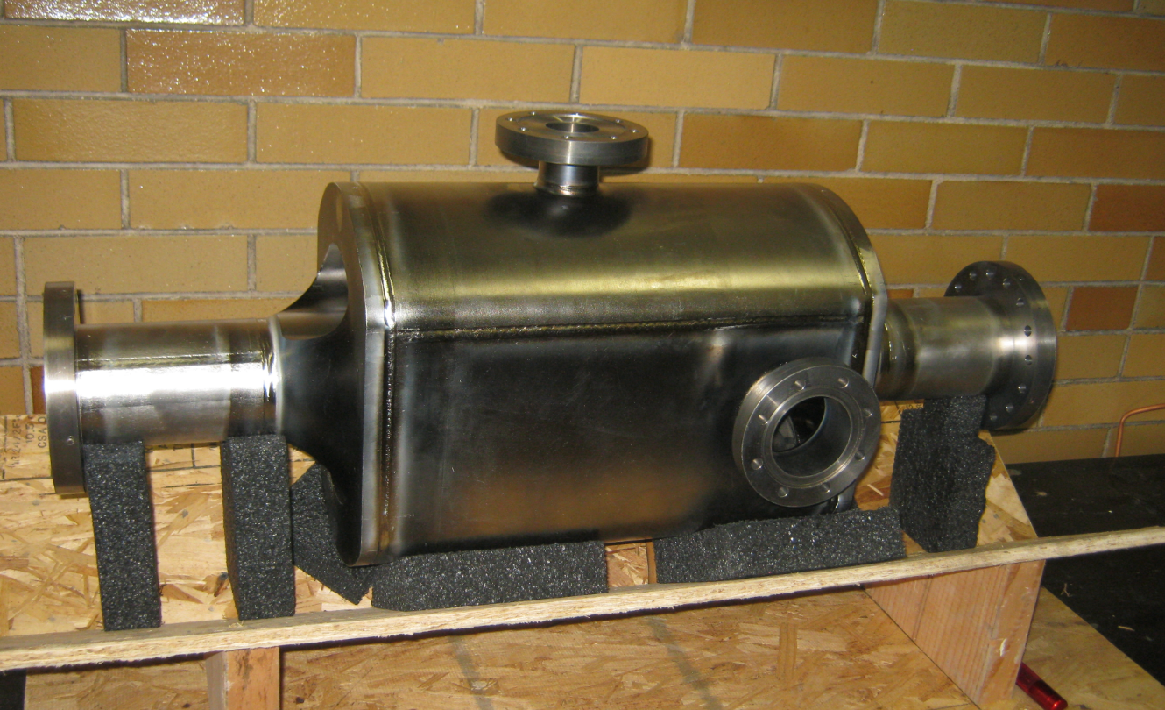
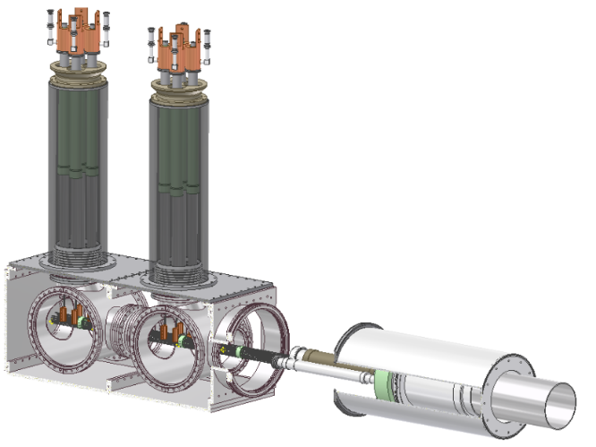
HiLumi-LHC : Science and leadership
Manchester
Lancaster
ASTeC
Manchester
RHUL
Manchester
Liverpool
ASTeC
Crab Cavities
Collimation
Beam dynamics
Manchester
Liverpool
ASTeC
HiLumi-LHC
UK
Southampton
Manchester
Superconductivity and Cryogenics
Liverpool
RHUL
Machine-detector interface
Diagnostics

Slide 3
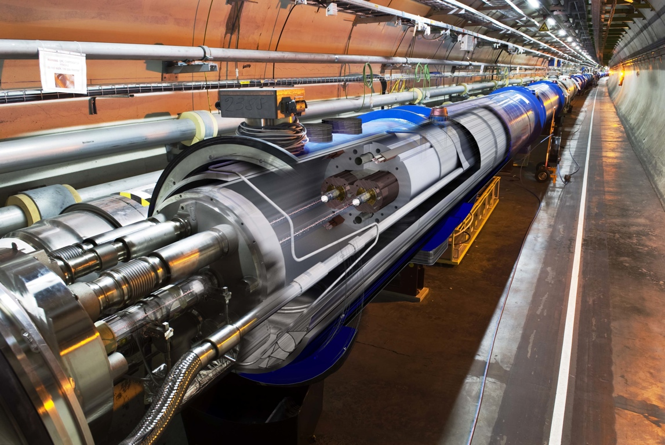
Challenge 1 : Collimation
Beam collimation has been considered one of the most critical aspects for the LHC
Cleaning challenge vs quench (fundamental for this target luminosity)
Small gaps challenge, impedance
> 500 MJ of stored energy per beam
Superconducting coil:
T = 1.9 K, quench limit
~15 mJ cm⁻³
requires collimation during all operation stages!
requires careful design/study and exploitation of the run 2 beam
requires novel collimation solutions
HL-LHC luminosity implies higher leakage from IP & requires additional collimators and collimator diagnostics
Factor 9.7 x 10⁹
Proton beam: 145 MJ
LHC design: 362 MJ
HL-LHC: 500 MJ!

Slide 4
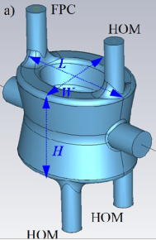
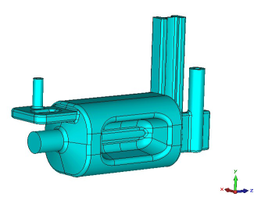
Challenge 2 : Crab Cavities
Crab cavities are proposed to provide bunch rotation to give a geometric overlap with the required crossing angle at HL-LHC
Without crab cavities the beam would lose 50% of the luminosity and would have a greater pile-up density.
they have not been tested on hadron beams.
The SRF crab cavities need 3MV per cavity and 32 cavities are required.
A proof of principle test is envisioned on the SPS beam at CERN before LS2. To understand cavity behaviour, beam dynamics, LLRF and machine protection issues.
A pre-series prototype is then planned to the LHC specification.
effective cross section
HL-LHC

Slide 5
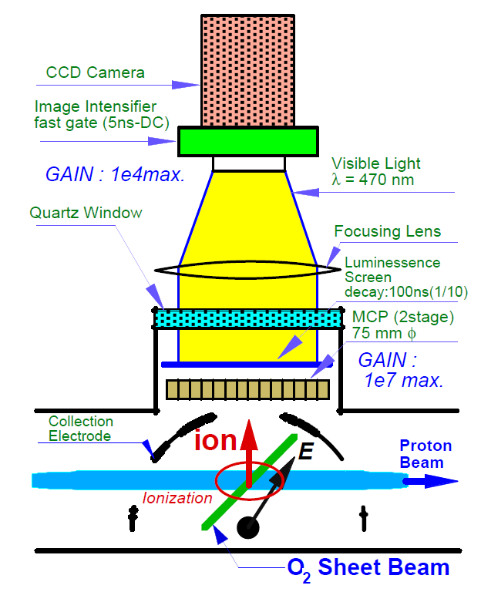
Challenge 3 : Diagnostics
Precise measurement of beam parameters is essential. The LHC is equipped with an extensive array of beam diagnostics that has played a major role in commissioning, rapid intensity ramp-up and safe and reliable operation of the accelerator. The HL-LHC presents new challenges:
Challenge 1:
Crab-cavities will rotate the bunches
A method to accurately measure the bunch rotation is required.
Conventional BPMs have insufficient bandwidth for single pass, intra-bunch measurements.
A new technology is needed:
`
Electro-optic crystals as the BPM pickup
The electric field of the passing bunch induces a polarization change in the crystal that is readout with <50ps time resolution to derive the transverse position along the bunch.
Challenge 2:
The unprecedented stored beam energy would damage conventional diagnostics and/or disrupt the particle beam.
Non-invasive diagnostics are required to measure the beam profile and beam halo.
Gas-jet based beam profile monitor
p-beam
A supersonic jet of neutral gas is shaped into a thin sheet and injected with a 45º tilt across the particle beam.
Ions produced accelerate toward a phosphor screen, to monitor profile
Notes:
- The picture under task 1 is the side view of the BPM showing the proton bunch passing between two crystals on opposite sides of the beam pipe. The light passes through the P=polarizer and A= analyzer, so that a polarization change in the crystal can be analyzed. The intensity is readout by the electronics (fast MSM photo-detectors) on the right.
- the gas-jet picture shows the proton beam interacting with a neutral gas sheet and the produced ions accelerated towards a luminescent screen

Slide 6
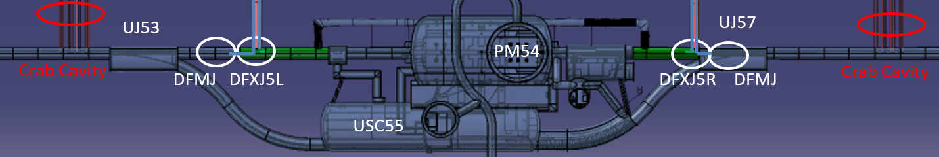
Challenge 4 : Cold Powering
Transport of unprecedented high-currents (|I_{tot}| ~ 200 kA) via superconducting electrical transmission lines (SC-Links) consisting of HTS/MgB₂ cables
Developing a novel Cold Powering Systems relying on cooling with He gas
Required for powering the HL-LHC Triplets and the Matching Sections at P1/P5
  Four high power SC-Link (200kA-5 kV, total individual cables up to 20kA)
  Allows power converters to be located at surface or in the new underground cavern for Hi-Luminosity equipment
Long term and sustainable solution of R2E problems by remote powering
  Increasingly relevant to higher luminosity at higher energy
  Towards a full ALARA approach for radiation protection
Notes:
WP4 will focus on the cryogenic/electrical interfaces, quench protection, and the testing of the SC-Links. It will delivering the full mechanical design of distribution feedbox cryomodules and manufacture the pre-series prototype hardware.
Task 1 : SC-Link interface to HTS current leads (Yang), Soton
Task 2 : SC-Link interface to Magnets (Yang), Soton
Task 1 will enable SC-Link system demonstration in SM18 prior to LS2. It will produce transfer the novel feedbox design concept for manufacturing at CERN, supervise the integration to SC-Link system and participate the full cryogenic/electric tests.
Task 2 will i) study the cryogenic stability of and develop novel quench protection for SC-Links and ii) design and produce a pre-series cryomodule for the SC-Links interface to P1/P5 HL_LHC Triplets and arc magnets

Slide 7
WP 2 : Crab Cavities
Science, tasks, dependencies
WP2 will focus on simulation, production and testing related to the crab cavities for HL-LHC. The leader is Graeme Burt (Lancaster)
  Task 1: Testing crab cavities in SM18 & SPS (Burt), Lancs
  Task 2: Pre-series cryomodule (Pattalwar), STFC, Lancs
  Task 3: Beam dynamics and RF noise (Newton), Liv, Man, Lancs
Task 1 will perform testing and validation of the crab cavity prototypes, including components, cavities, cryomodules and beam tests.
Task 1 has 6 PhD student/PDRA-years of effort + academic time
Task 2 will design, manufacture, and assemble one of the two pre-series crab cryomodules required for HL-LHC
Task 2 has 11.5 Technician/STFC Staff/PDRA-years of effort + academic time
Task 3 will simulate beam dynamics and LLRF issues related to crab cavities and analyse relevant data from the SPS test. This will be used to develop the LLRF system for the crab cavities for LHC.
Task 8 has 11.5 PDRA-years of effort + academic time

Slide 8
Task 1: Testing crab cavities at SM18/SPS
Will help plan testing of FPC, HOM couplers, cavities and cryomodules in SM18/SPS.
Covers SPS and Pre-series systems
Lancaster will base a student at CERN and send a PDRA on long term attachment to take part in testing.
Will then analyse data (in collaboration with Task 3)
Milestones and Deliverables (note some are CERN milestones which UK will support rather than lead)
M2.1 Impedance testing plan and construction of required infrastructure (M6) - Dr G Burt
M2.2 Design of a LLRF system for SPS tests (M12) - Dr A Dexter
M2.3 SPS Cryomodule RF and cryogenic testing in SM18 (M24) - Dr G Burt
M2.5 SPS Cavity and Cryomodule beam testing (M36) - Dr G Burt
D2.1 Report on HOM coupler testing (M12 - Report) - Dr G Burt
D2.3 Report on SPS test results (M 40 - Report) - Dr G Burt

Slide 9
Task 1 Posts
PDRA 1, Kaveh Delfanizari will spend 50% of his time at CERN participating in the various testing at CERN. He will lead testing on the UK cryomodule at SM18 and will be heavily involved in SPS tests. He is split between tasks 1 and 2.
PhD student, Adam Tute (already in post) is based at CERN and will focus on SM18 testing, FPC and HOM couplers. He will also be involved in the SPS tests. A. Macpherson will be his CERN supervisor.

Slide 10
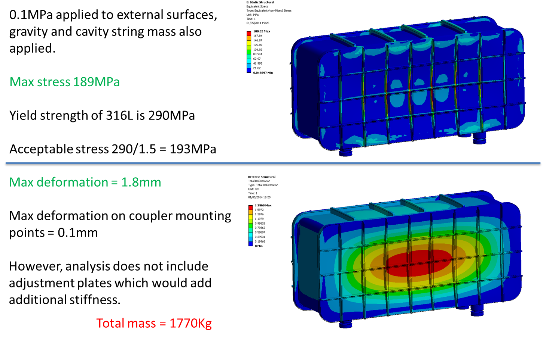
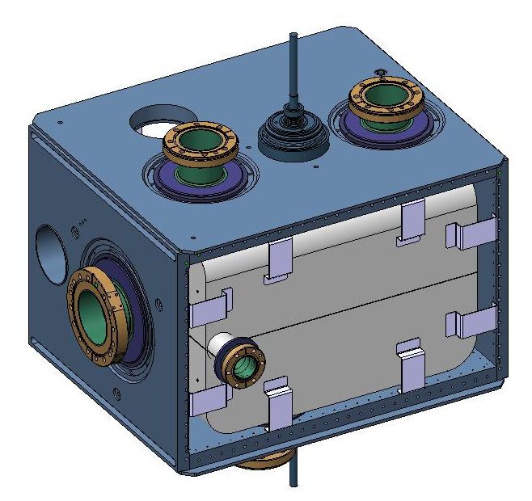
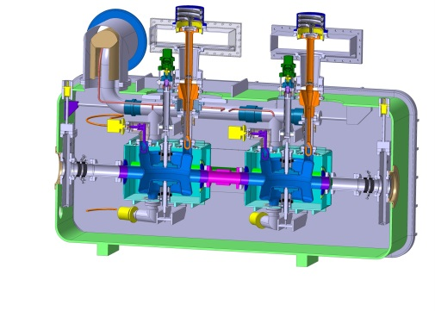
WP 2.2 : Cryomodule
The key goal of this WP is to deliver a UK-led pre-series cryomodule to CERN for testing.
Also covers the mechanical design of components for the SPS cryomodule.

Slide 11
Task 2: Design and assembly of the pre-series prototype
Design of Pre-series cryomodules with CERN
Create drawings for one type of cryomodule
Purchase 50% of the cryomodule parts (equivalent to one cryomodule)
Assemble cryomodule and integrate cavities at Daresbury
Milestones and Deliverables
M2.4 Pre-series cryomodule design review (M24) - Mr S Pattalwar
D2.2 Design of a pre-series cryomodule for HL-LHC crab cavity (M30 - Drawings) - Mr S Pattalwar
D2.4 Production of a pre-series cryomodule for HL-LHC crab cavity (M48 - Hardware) - Mr S Pattalwar

Slide 12
Task 2 Posts
PDRA 1, Kavh Delfanizari, Lancaster will focus on combined EM/mechanical design tasks and thermal analysis. As he will spend 50% of his time at CERN he will be a line of communication with CERN.
S. Pattalwar will project manage the cryomodule assembly and will lead cryogenic instrumentation, and cold cycling tests.
Post 4 (N. Templeton) will focus on mechanical design and creating drawings
Post 5 (T. Jones) will oversee and assist post 4.
3 Technicians are required to complete assembly.

Slide 13
Task 3: Beam dynamics and RF noise studies
The studies will aim at understanding the impact of crab cavities on beam dynamics in HL-LHC, including:
instabilities driven by higher (and lower) order modes;
impact on dynamic aperture and beam lifetime ;
tolerances on amplitude, and phase set by beam quality specifications.
Analysis of Crab Cavity RF fault scenarios for LHC and SPS.
Number | Description | Responsibility | Deadline
D1 | Report detailing results of benchmarking of crab cavity beam dynamics models against beam tests in SPS. | PDRA | Month 30
D2 | Report details SPS crab cavity measurement simulations | PDRA | Month 30
D3 | Report detailing estimates of instability thresholds and growth rates in HL-LHC from crab cavity impedance. | PDRA | Month 33
D4 | Report describing impact of crab cavities on dynamic aperture in HL-LHC. | PDRA | Month 36
D5 | Specification of tolerances on amplitude and phase stability in different operational scenarios. | PDRA | Month 36

Slide 14
Milestones
Number | Description | Relevant Deliverables | Deadline*
M1 | Report summarising calculation of transfer functions from electromagnetic models of the crab cavities. | D1, D3, D4 | Month 6
M3 | Report summarising calculation of crab cavity wake fields/impedance. | D1, D2 | Month 9
M2 | Report describing representation of transfer functions in a form suitable for implementation in a tracking code (for dynamic aperture studies, or strong-strong beam-beam simulations), including effects of amplitude jitter and phase noise. | D1, D3, D4 | Month 12
M4 | Report describing implementation of crab cavity wake fields/impedance in models of SPS and HL-LHC. | D1, D2 | Month 18
M5 | Report summarising beam dynamics results of crab cavity beam tests in SPS. | D1 | Month 24

Slide 15
Task 3 Posts
Post 2 will investigate combined RF/beam dynamics effects and will provide RF support to the other posts
Post 3 will be a LLRF engineer and will look at LLRF implications of this task.
Post 6 will look at the effect of beam dynamic models on SPS and HL-LHC
Post 7 will develop beam dynamics models to be used by post 6.

Slide 16
Resources
Name | Institute | Type | FY 15/16 Effort | FY 16/17 Effort | FY 17/18 Effort | FY 18/19 Effort | FY 19/10 Effort
G. Burt | Lancaster | Ac | 0.1 | 0.2 | 0.2 | 0.2 | 0.1
A. Dexter | Lancaster | Ac | 0 | 0.03 | 0.03 | 0 | 0
K. Delfanazi | Lancaster | PDRA | 0.5 | 1 | 1 | 0.5 | 0
R. Apsimon | Lancaster | PDRA | 0.1 | 0.2 | 0.2 | 0.1 | 0
Post 3 | Lancaster | PDRA | 0 | 0.5 | 0.5 | 0 | 0
S. Pattalwar | STFC | Staff | 0 | 0.5 | 0.5 | 0.5 | 0.5
N. Templeton | STFC | Staff | 0 | 0.9 | 0.9 | 0.4 | 0.7
T. Jones | STFC | Staff | 0 | 0.1 | 0.1 | 0.1 | 0.1
Technician 1 | STFC | Staff | 0 | 0 | 1 | 1 | 0.35
Technician 2 | STFC | Staff | 0 | 0 | 1 | 1 | 0.35
Technician 3 | STFC | Staff | 0 | 0 | 0.45 | 0.45 | 0
R.B. Appleby | Manchester | Ac | 0 | 0.05 | 0.05 | 0.05 | 0.0
Post 6 | Manchester | PDRA | 0 | 1 | 1 | 1 | 0
A. Wolski | Liverpool | Ac | 0 | 0.05 | 0.05 | 0.05 | 0
Post 7 | Liverpool | PDRA | 0 | 1 | 1 | 1 | 0
Also doing a part-time PhD giving an extra 10-15% of his time on HL-LHC
Staff = 17 staff-years + 5.6 technician years
Staff = Task 1 (1.5 years + PhD student), Task 2 (7.9 years + 5.6 technician), Task 3 (7.6 years)
Capital £900,000 for the pre-series cryomodule (Task 2)
Travel = £60k travel + £25k LTA to CERN (pro rata with staff)
PhD students = (2.5 years based at CERN) – (Task 1)

Slide 17
Funding
Proposal has been recommended for full funding by both the peer review panel and the accelerator board in the UK and by the STFC programmes office
At this point the proposal is 95% guaranteed funding barring a major reduction of science funding in the UK
Final decision will be Nov/Dec but is very positive

Slide 18
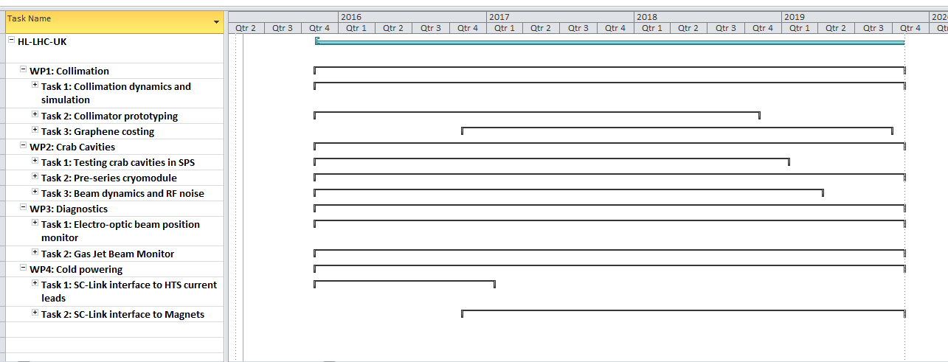
Gantt Chart
and critical path Overall
The programme is expected to commence on the 1st April 2016 and last 4 years (note this is a 6 month delay from below).
May need to extend a bit at the end due to pre-series delay
LS2

Slide 19
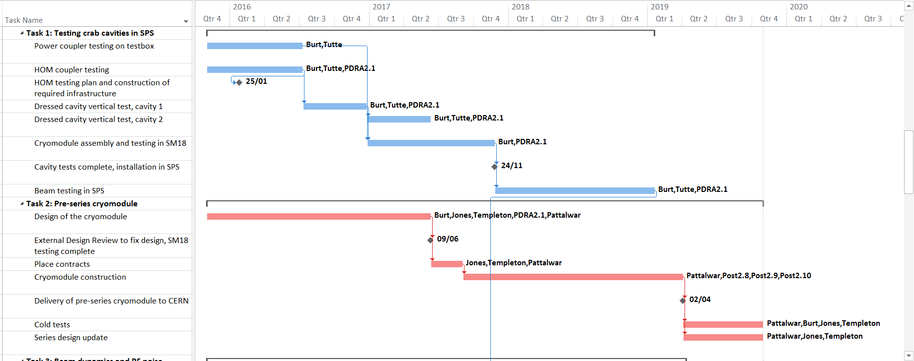
Gantt Chart to WBS2
and critical path WP2
The gantt chart has been updated to level 2 including participant names.
SPS run
LS2

Slide 20
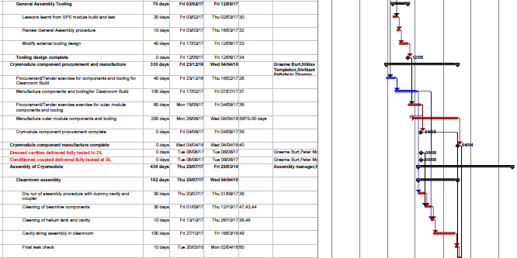
Detailed WP2 Assembly Plan

Slide 21
Conclusion
HL-LHC-UK is a £8M programme covering crabs, collimators, cold powering and diagnostics
Funding is very likely to be approved but with a 6 month delay (april16 start)
For crabs we focus on testing (@CERN), construction of one pre-series cryomodule
Beam dynamics and LLRF for SPS and for HL-LHC crabs.

