Slide 1
MQXF Coil Fabrication: Observations and Summary
E.F. Holik
Acknowledgements: G. Ambrosio, M. Anerella, R. Bossert, N. Bourcey,
E. Cavanna, D. Cheng, D. R. Dietderich, P. Ferracin, A. K. Ghosh,
S. Izquierdo Bermudez, S. Krave, A. Nobrega, J. C. Perez, I. Pong,
E. Rochepault, G. L. Sabbi, C. Santini, J. Schmalzle, and M. Yu

Slide 2
Outline
Coil Fabrication Summary & Overview
Coil size and asymmetry
Cable Expansion / Gap Closure
Cross Section Analysis
Conclusion

Slide 3
MQXF Coil Overview
6 short coils with 108/127 RRP
  Coil 01 – R&I @ BNL, leaky valve impregnation, was cut
  Coil 02 – R&I @FNAL, Mirror, 91% SSL @4.2K, Ta ternary
  Coil 03 – R&I @ BNL, coil in MQXFS01-AS
  Coil 04 – R @ LBNL, Reversed end parts, Not impregnated…
  Coil 05 – R&I @ BNL, coil in MQXFS01-AS
  Coil 06 – R&I @ FNAL, Spare, Slight epoxy voids near LE
LARP is beginning MQXF 2nd gen
  Coil 07 – Winding beginning this week, (108/127 RRP)
  Coils 09 & 10 in queue – 144/169 RRP
3 long coils in fabrication
  Long Coil 01 – Reacted @ BNL, prep for Impreg, For long mirror.
  Long Coil 01p – R&I @ FNAL, Test for 2nd gen radial insulation.
  Long Coil 02 – L1 cured, Spare for mirror and first long magnet.

Slide 4
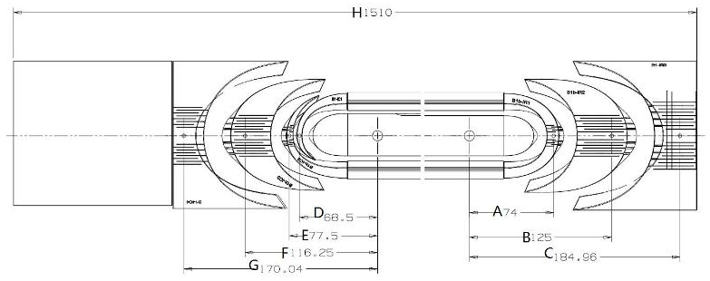
Coil DRs
Bubbles in Practice Coil 1
Reversed End Parts in Coil #4
Epoxy line valve leaked under vacuum.
Image from Keyence Laser Confocal Microscope
Parts mislabeled by Plasma coating company. Coil Electrically sound.

Slide 5
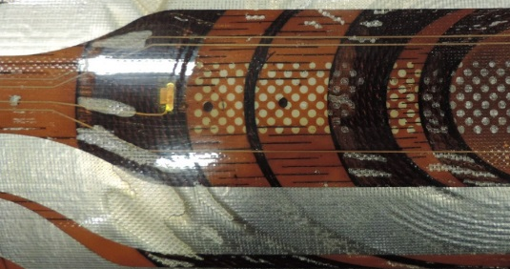
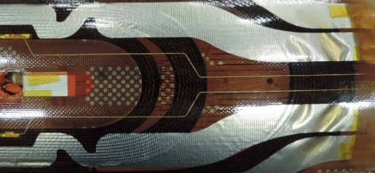
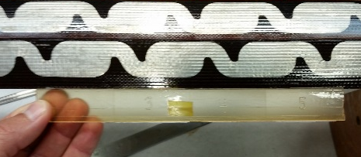
Coil DRs
Weak Impregnation in Coils #2 and #6 near LE
Channel will be filled in subsequent coils.
No adverse effects from Mirror Test
Epoxy Overflow
‘Racetracking’… Epoxy goes through side channel and fills overflow before filling coil, trapping some air in the process
Epoxy inlet

Slide 6
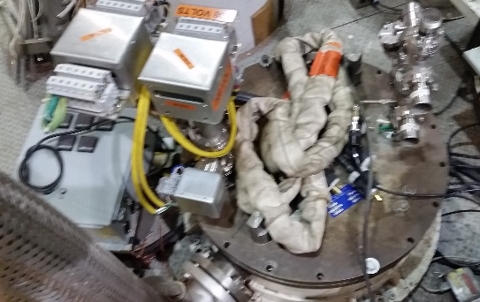
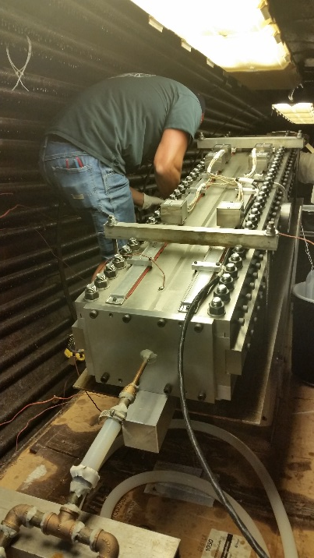
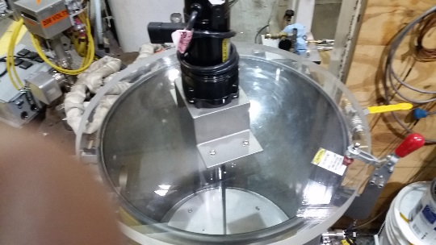
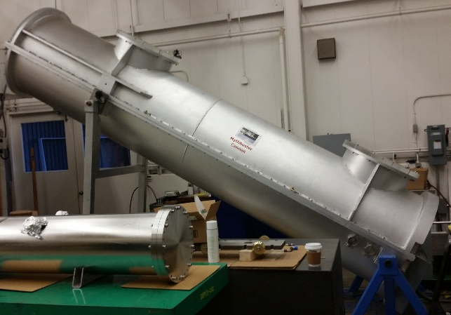
Impregnation
 | LBNL | FNAL | BNL
CTD-101k density = 1.03 g/cc | CTD-101k | CTD-101k | CTD-101k
SETUP
Backout temperature | 110°C | 55°C (80°C possible) (110°C with strip heaters) | 110°C
Bakeout pressure | 10 - 100 mT | 25 mT | 200 - 500 mT
Bakeout time | 6 hrs | 45 hrs | 8 hrs
Dryout Gas flow | none | none | none
Cool down temperature | 60°C | 55°C | 55°C
Coil Orientation | ~30° wrt horiz. | ~13° wrt horiz. | Vertical
Lead Orientation | Leads up | Leads up | Leads up
EPOXY DEGAS
Epoxy Volume mixed (1.7 l needed) |  | 22 liters (6 gal.)
Epoxy degas temperature | 50°C - 60°C | ? | 55°C
Epoxy degas time | ? | 45 min (2h tot mix/heat) | 2 h
Epoxy agitation while degassing | Y | Y | Y
Epoxy Vacuum while agitating | 300 mTorr | 800 mT | 500 mT
Epoxy container depth | ? | 18" | 3.25"
IMPREGNATION
Initial magnet temperature | 60°C | 55°C | 55°C
VPI coil vessel pressure | 1000 mT | 2000 mT | 500 mT
VPI epoxy vessel pressure | 760 Torr | 760 Torr | 760 Torr
Feed method | pressure diff. | pressure diff. | Peristaltic pump/ΔP
Flow measure method | none | visual (1 cm/s) | pump output
Epoxy flow rate | n/a | 7 cc/min | 25 cc/min
Fill time (short coil) | 1.5 h | 1.5 h - 3 h | 2 h
Gel / Soak
Additional Epoxy Through Flow | 30 min (line reservoir) | 30 min (line resevoir) | none
Backfill (re-absorption) | 1"-2" of large tube (~1/10 l [QXF equivalent]) | 2'-4' of tube (~1/3 liter) | n/a
Epoxy Inlet Valve | Closed | Closed | Open
Epoxy Outlet Valve | Open | Open | Closed
Press/Vac cycles (milking) | 2 | 0 | 0
VPI Vessel Pressure | 760 Torr | 760 Torr | 500 mTorr
Coil Back pressure | 760 Torr | 760 Torr | 760 Torr
Soak/Gel time @ 50°C - 60°C | 15 h | 18 h | 16 h
CURE
VPI Vessel Pressure | 760 Torr | 760 Torr | 500 mTorr
Coil Back pressure | 760 Torr | 760 Torr | 760 Torr
Ramp | 60°C - 110°C (4 h) | 60°C - 110°C (1.5 h) | 55°C - 110°C (6 h)
Soak | 110°C (4 h) | 110°C (5 h) | 110°C (5 h)
Ramp | 110°C - 125°C (4 h) | 110°C - 125°C (1 h) | 110°C - 125°C (1.5 h)
Soak | 125°C (17 h) | 125°C (16 h) | 125°C (16 h)
How does the CERN process differ from the LARP labs?

Slide 7
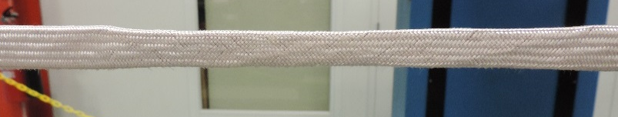
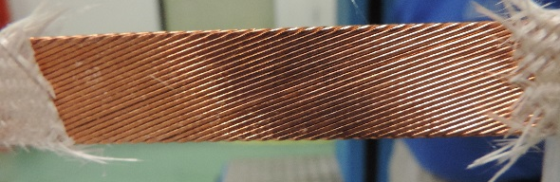
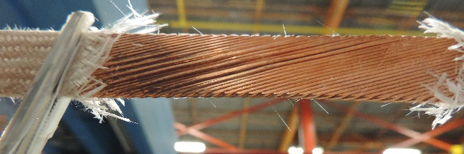
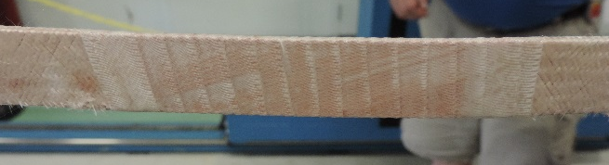
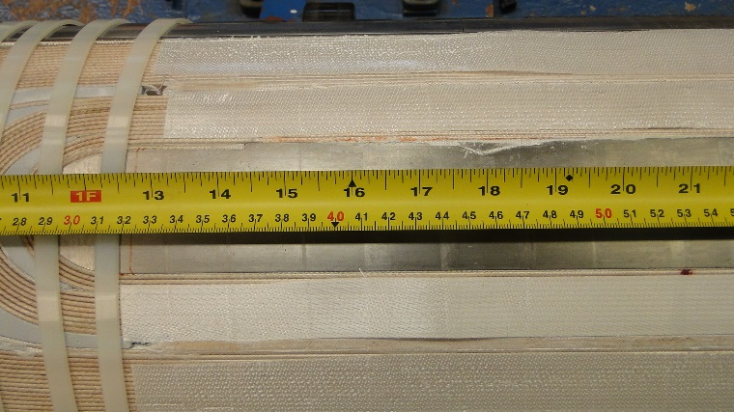
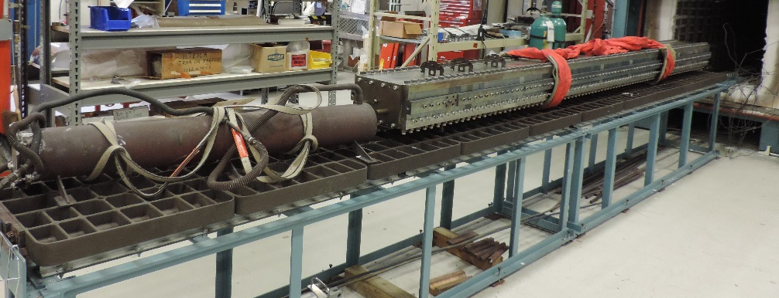
1st Gen Long Coil Fab
Roped Cable in MQXFP 01 (mirror coil).
Additional Insulation in MQXFP 01b practice coil
Insulation was removed and the cable was placed back in registration.
Insulation repaired with 75 µm E-glass half wrap
RXN complete
Additional Radial Insulation to mimic 2nd Gen QXF

Slide 8
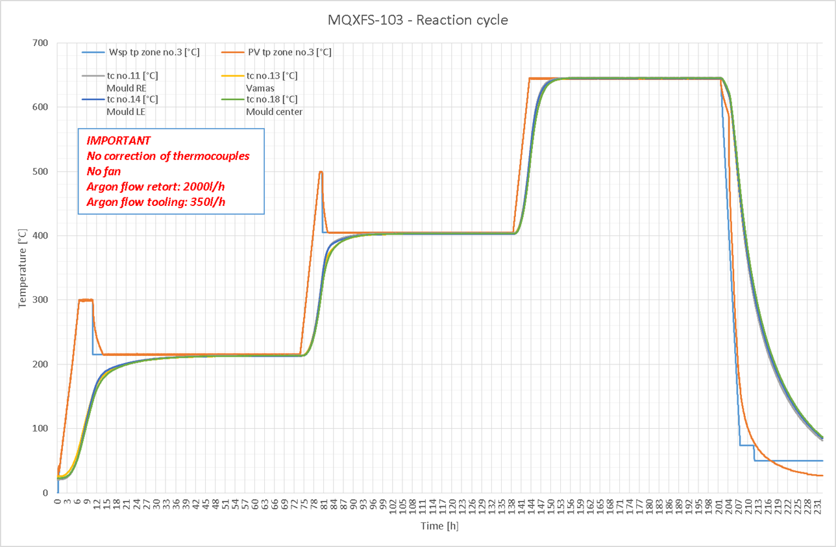
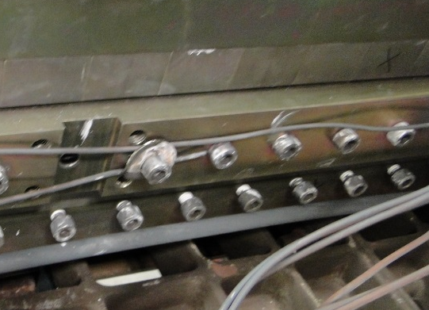
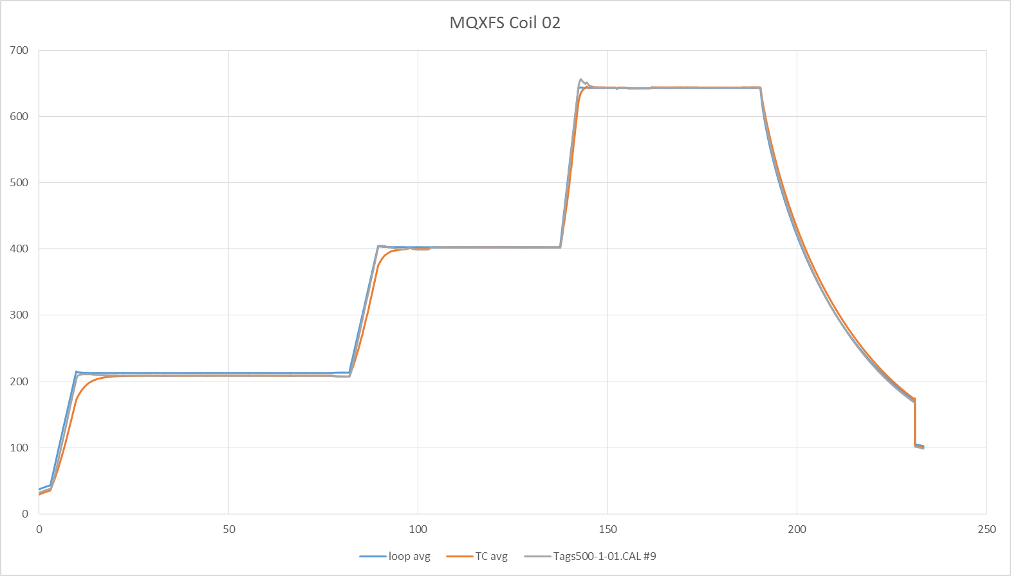
Coil Heat Treatment
50 hr target
Position of the thermocouple in block 5, 16 and 28.
51.6 hr
48 hr target
47 hr
CERN TC LARP TC
Equivalent duration takes into account the estimated lag time.
Multiple TCs locations were tested recently by N. Bourcey for precise measurement of lag time.
48 hr target
47.8 hr
41.6 hr Equivalent
72 hr target
66.3 hr
50.4 hr Equivalent

Slide 9
Outline
Coil Fabrication Summary & Overview
Coil size and asymmetry
Cable Expansion / Gap Closure
Cross Section Analysis
Conclusion

Slide 10
Coil Asymmetry and Size
Coils Best fit on the OD and coil Keyway.
Coil Size = L + R = -237 µm
Coil Asymmetry = L – R = +71 µm
Left Side
Right Side
-83 µm
-154 µm
MQXFS Coil 2
816 mm from LE
10/30/2015 – E. Holik – FNAL

Slide 11
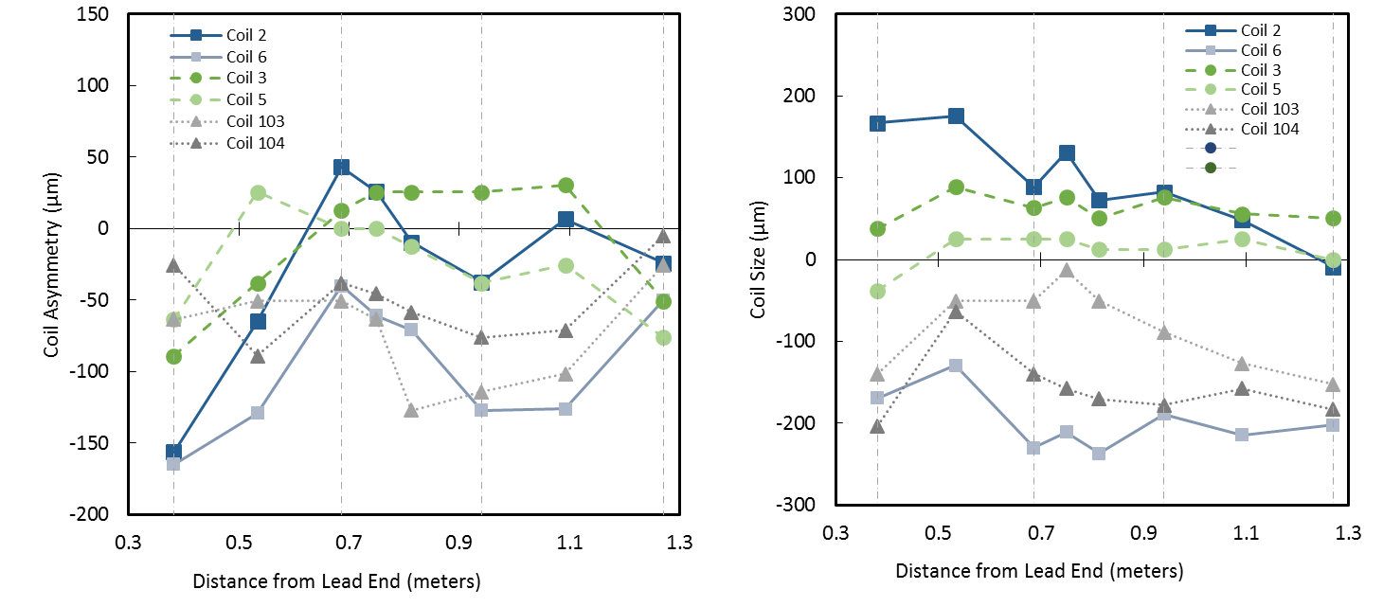
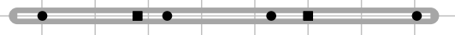
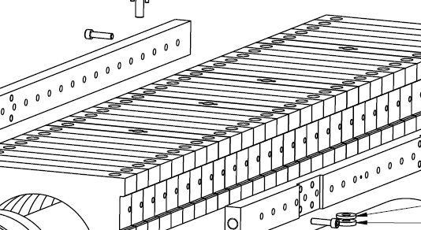
Coil Asymmetry and Size
L – R
L + R
LARP
CERN
L – R < 100 µm for < 1 unit a4, a3
L + R < 50 µm for < 1 unit a3, a6
How might coil size and asymmetry create undesired preload??? To be explored…

Slide 12
Improving Coil Asymmetry
Size and Asymmetry is Tooling Dominated.
Add shim between form and mandrel blocks to account for tolerance buildup and create intimate contact between tooling components
Fabricate additional modified form blocks and select blocks that are ~15 µm within center.

Slide 13
Outline
Coil Fabrication Summary & Overview
Coil size and asymmetry
Cable Expansion / Gap Closure
Cross Section Analysis
Conclusion

Slide 14
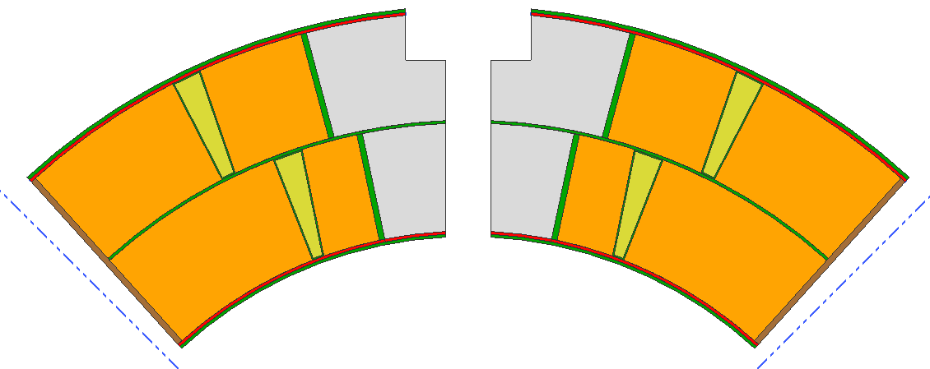
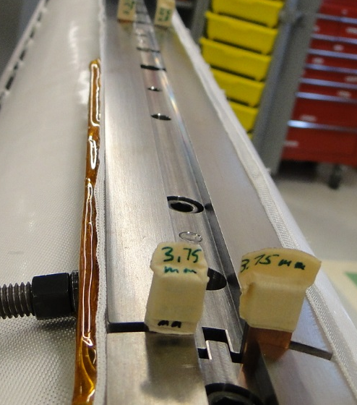
Accommodating Expansion
Nb₃Sn Cable expands laterally when heat treated.
Nb₃Sn Cable contracts axially when heat treated.
Room is left in coil cavity for cable to
expand during heat treatment.
Gaps are left in the pole to allow
cable/coil to contract
Azimuthal:
4.5% expansion allowed
Measured: 3.0 ± 0.3%
Radial:
2% → 1.2% allowed expansion
Free Cable 1.4%
LARP Cable 0.3%
CERN Cable 0.1%
L-01
L-02
L-01b
0.13%
0.06%
0.17%
0.03%
Figure courtesy of E. Rochepault
10/30/2015 – E. Holik – FNAL

Slide 15
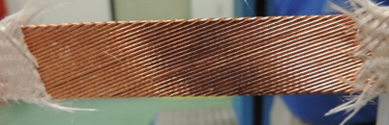
Releasing the Tension
LARP Coils Contract Less than CERN when 25 kg of tension is released
For mechanical stability LARP braided insulation is tighter and initially constricts growth more
L-01
L-02
L-01b
0.13%
0.07%
0.17%
Width Expansion:
Unconfined Cable 1.4%
LARP Cable 0.3%
CERN Cable 0.1%
0.03%
Figure courtesy of E. Rochepault

Slide 16
Altering Expansion
Both conductors expand similarly when unconfined.
CERN insulation preferably constricts width growth
Width Expansion:
Unconfined Cable 1.4%
LARP Cable 0.3%
CERN Cable 0.1%
L-01
L-02
L-01b
0.13%
0.07%
0.17%
Friction between coil and tooling also effects pole gap closure (# layers of mica, pressure between components…, E. Cavanna)
0.03%
Figure courtesy of E. Rochepault

Slide 17
Outline
Coil Fabrication Summary & Overview
Coil size and asymmetry
Cable Expansion / Gap Closure
Cross Section Analysis
Conclusion

Slide 18
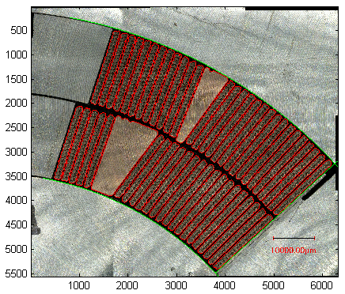
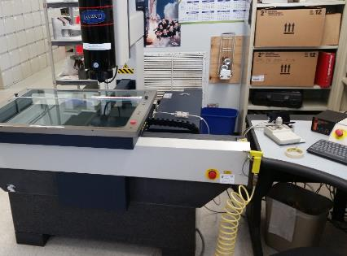
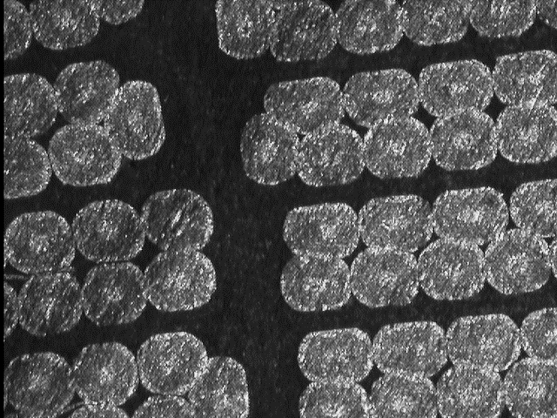
Coil Cross Section Analysis
270°
CERN coil 101, Turn location from Image analysis and edge detection
LARP coil 1, Turn location from Optical Coordinate Measurement Machine

Slide 19
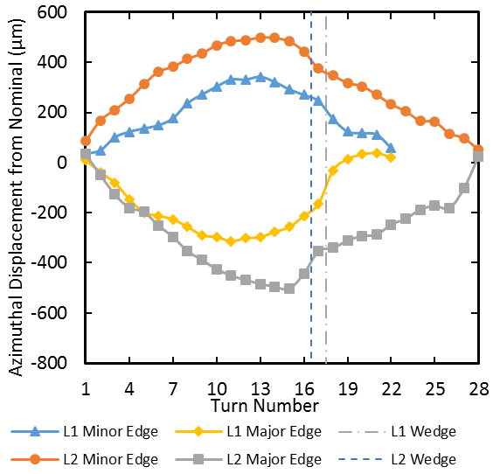
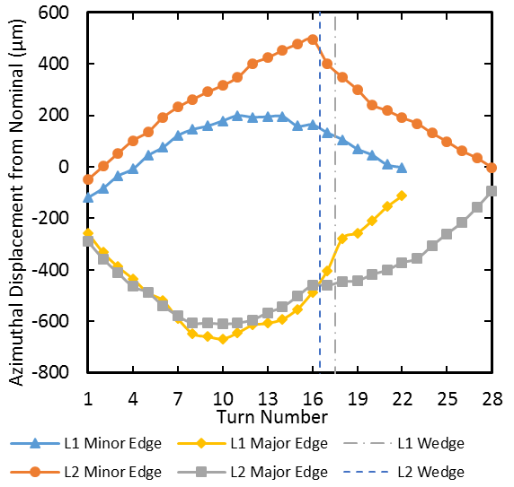
Reduced Expansion →
Turn Displacements
Azimuthal Free Space
  Layer 1: 690 µm → 470 µm in 2nd Gen QXF
  Layer 2: 880 µm → 600 µm in 2nd Gen QXF
Strong similarities between CERN and LARP
Minor edge tends to shift toward midplane
Major edge tends to shift toward pole
Peak Layer 1 difference is at middle turn for both coils
Peak Layer 2 difference is at middle turn and is 995 µm for both coils
_
645 µm
+
845 µm
LARP Coil 1
CERN Coil 101

Slide 20
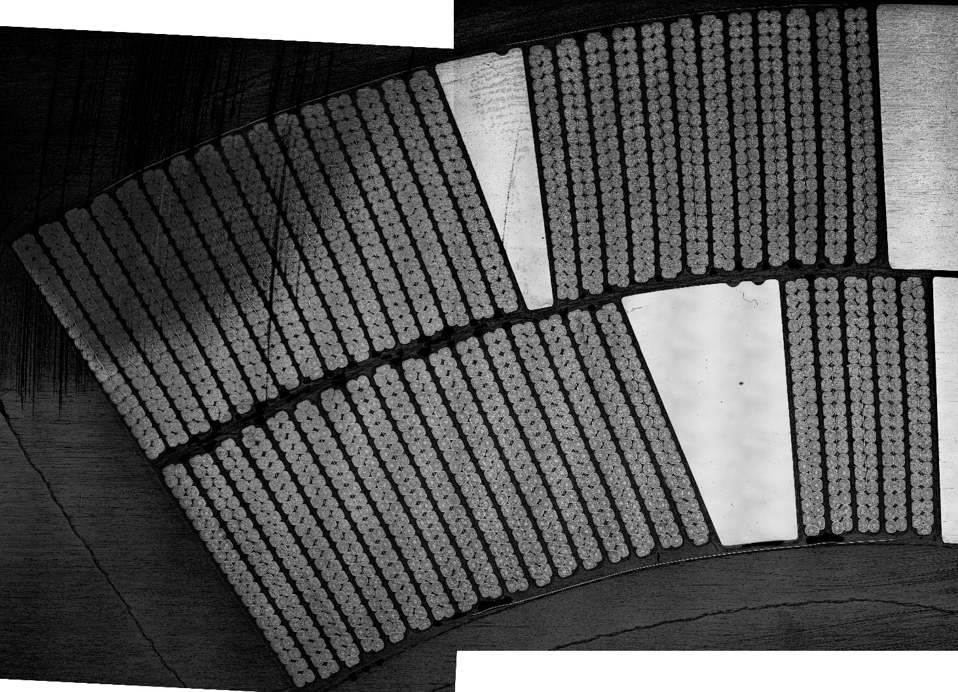
Free space mostly @ ID
Radial Free Space
  CERN 680 µm → 360 µm in 2nd Gen QXF
  LARP 600 µm → 280 µm in 2nd Gen QXF
ID heater is nominally 200 µm from Cable
Average distance is ~ 300 µm @ high field and ~700 µm in low field
New Input parameters for Quench Models
800 µm

Slide 21
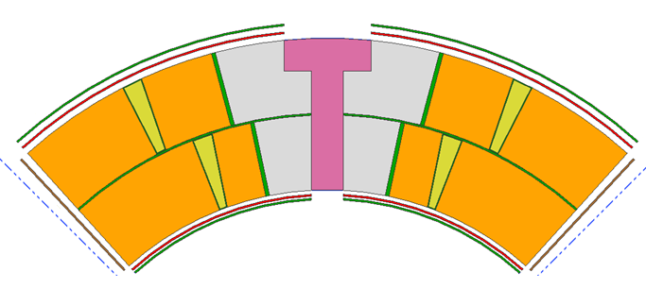
2nd Gen MQXF S2-Glass
10-stack measurements of all insulation → Tighter Material Control
1st gen was undersized by 90 µm total
1st gen was undersized by 75 µm
1st gen was undersized by 5 µm
Impreg Design: 310 µm
2 layers JPS 26781 933 HTS finish (314 um)
Pole Design: 125 µm
Measures: 119 µm, 161 µm with binder
Reaction Design: 410 µm
2 layers BGF 6576 497A finish
(394 µm, 428 µm reacted)
100 µm (4 mil )
Polyimide trace
Cable Insulation
143 ± 3 µm (LARP)
146 ± 3 µm (CERN)
2nd Gen design
150 → 145 µm
250 µm G-10
Thk: 240 – 265 um by micrometer
100 µm (4 mil )
Polyimide trace
Impreg Design: 150 µm
1 layers JPS 26781, 933 HTS finish
(measured 150 um single layer)
1st gen was undersized by 5 µm
Wedge Sock Design: 125 µm
104 µm, 199 µm with binder
Interlayer Design: 660 µm
2 layers Binder BGF 6576 497A finish
(655 um, 642 µm reacted)
1st gen was Oversized by 15 µm
10/30/2015 – E. Holik & E. Cavanna

Slide 22
Conclusion
LARP/CERN has fabricated 13 coils short MQXF coils with arguably the highest success rate of any new high-field Nb₃Sn design.
LARP/CERN is preparing for the first full assembly test at FNAL.
Coil Size and Asymmetry should improve with slight tooling and fabrication adjustments.
Cable insulation Reduces Transverse Growth causing large turn displacement and free space.
The Inner layer heater is ~300 µm (~700 µm) in the High (low) field region rather than the designed 200 µm.
Increased thickness and tighter measurement in 2nd Gen MQXF insulation should improve turn displacement and may improve inner PH delay times.

Slide 23
Spare Slides

Slide 24
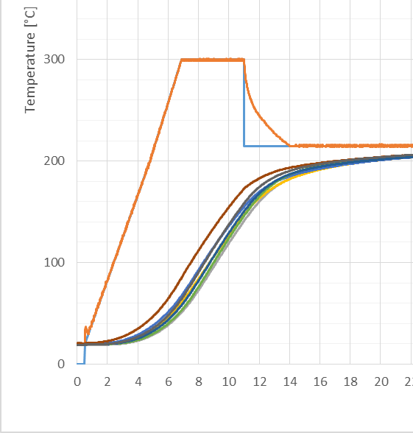
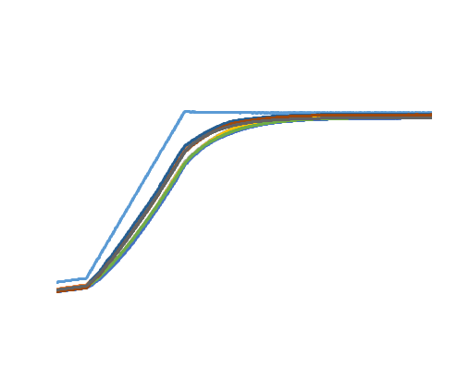
Coil Heat Treatment

Slide 25
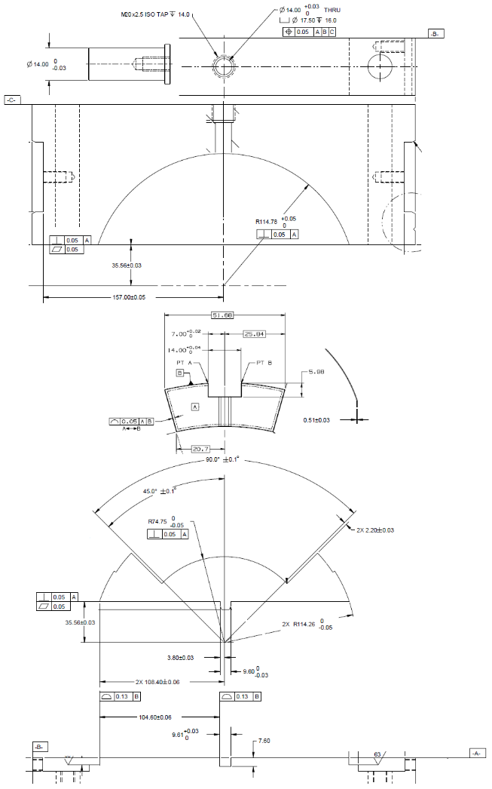
Max Tolerance
Pin
0.015 mm from hole size
Pin hole
0.050 mm from hole location
Form block
0.015 mm from pin size
0.050 mm from form block radius
0.019 mm from form and mandrel block radius centers
(0.110 mm if rigid assembly -> Assembly wouldn’t close.)
0.020 mm from pole keyway size
(0.050 mm) from pole edges (only effects turn asymmetry)
Pole
0.030 mm from SS outer shim
0.030 mm from mandrel block coil midplane
0.050 mm from mandrel block radius
Mandrel block
0.010 mm from intrinsic design
0.289 mm total
-> Maximum L/R asymmetry is 578 um or nearly 23 mils!!!
Base plate

Slide 26
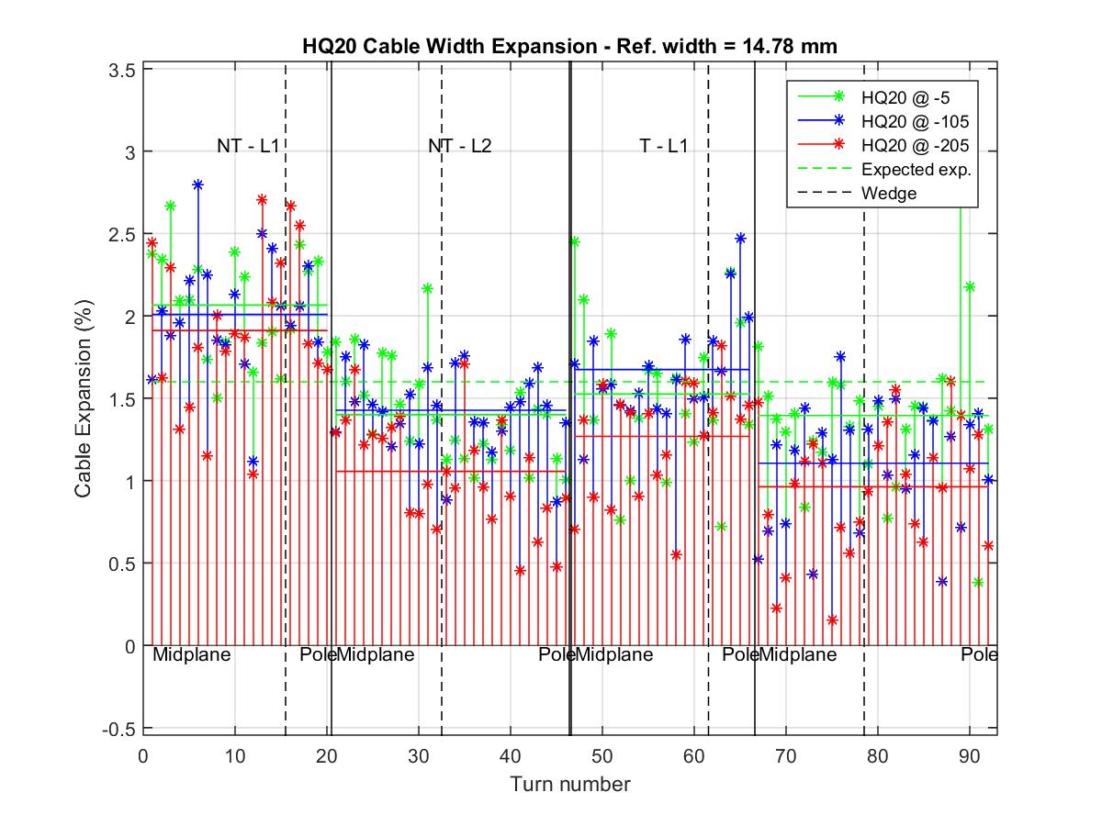
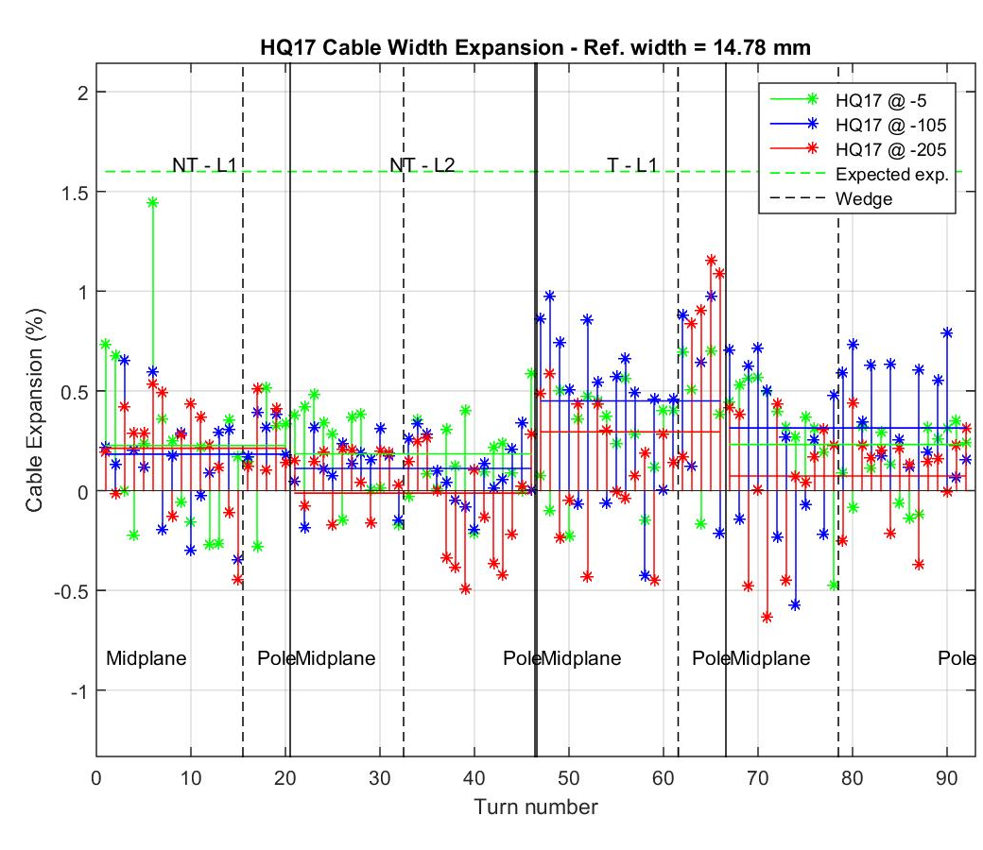
HQ02 Coil 17 and 20
Pole Gap Closure = 0.15%
Pole Gap Closure = 0.01%
10/30/2015 – Andrea Carbonara – FNAL

Slide 27
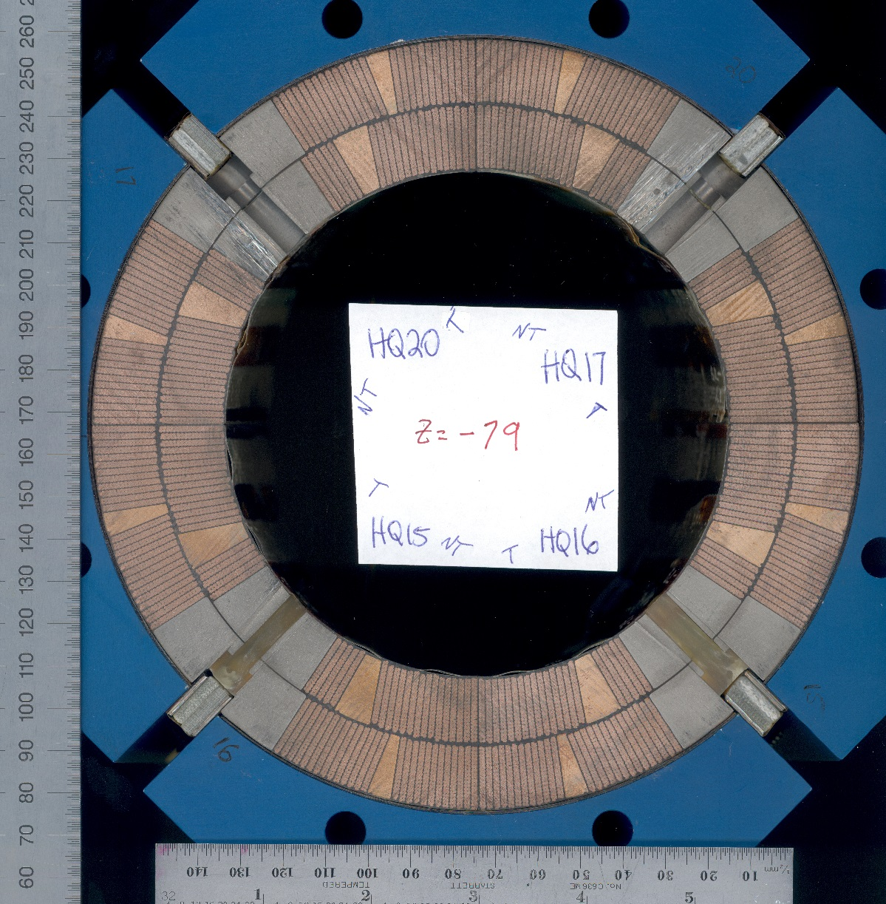
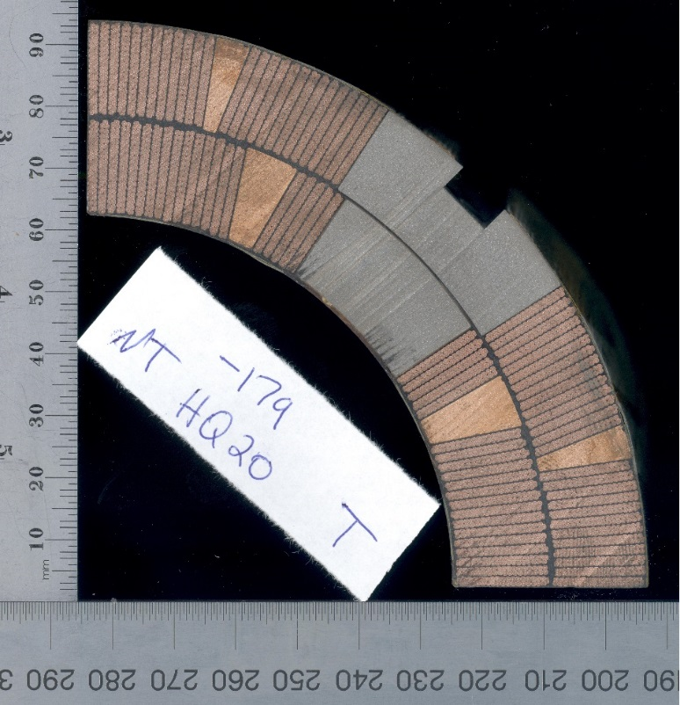
Scans of HQ02

Slide 28
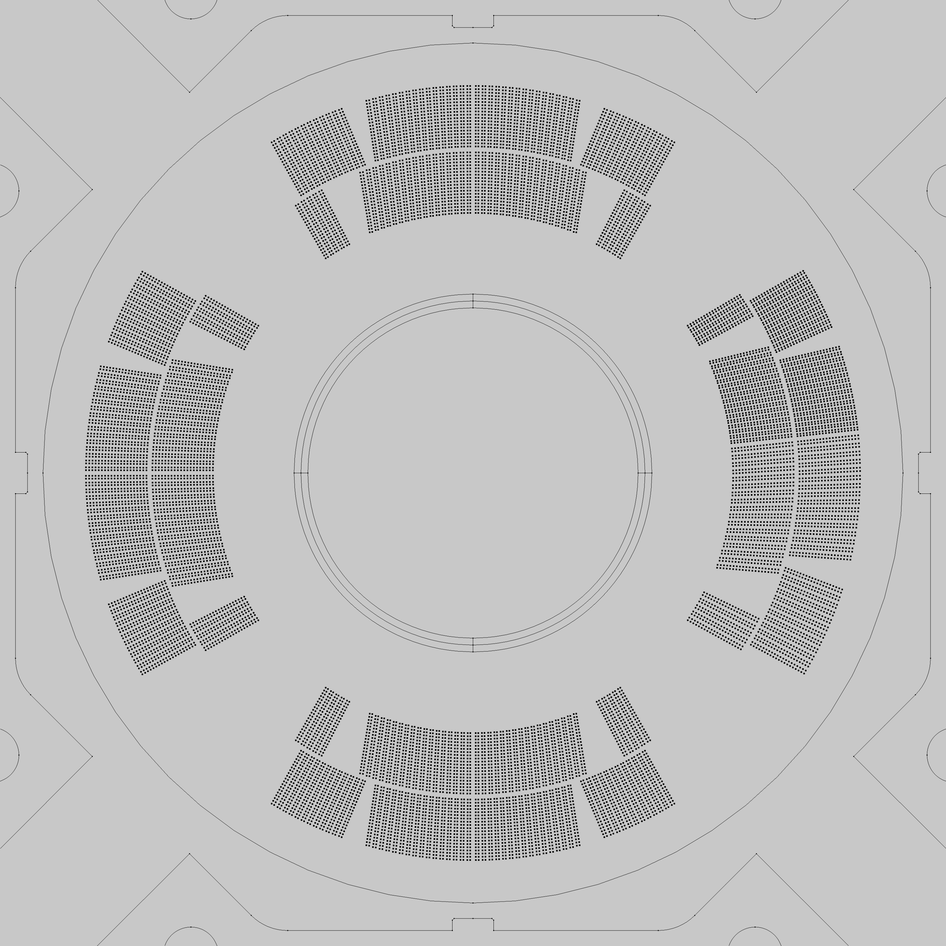
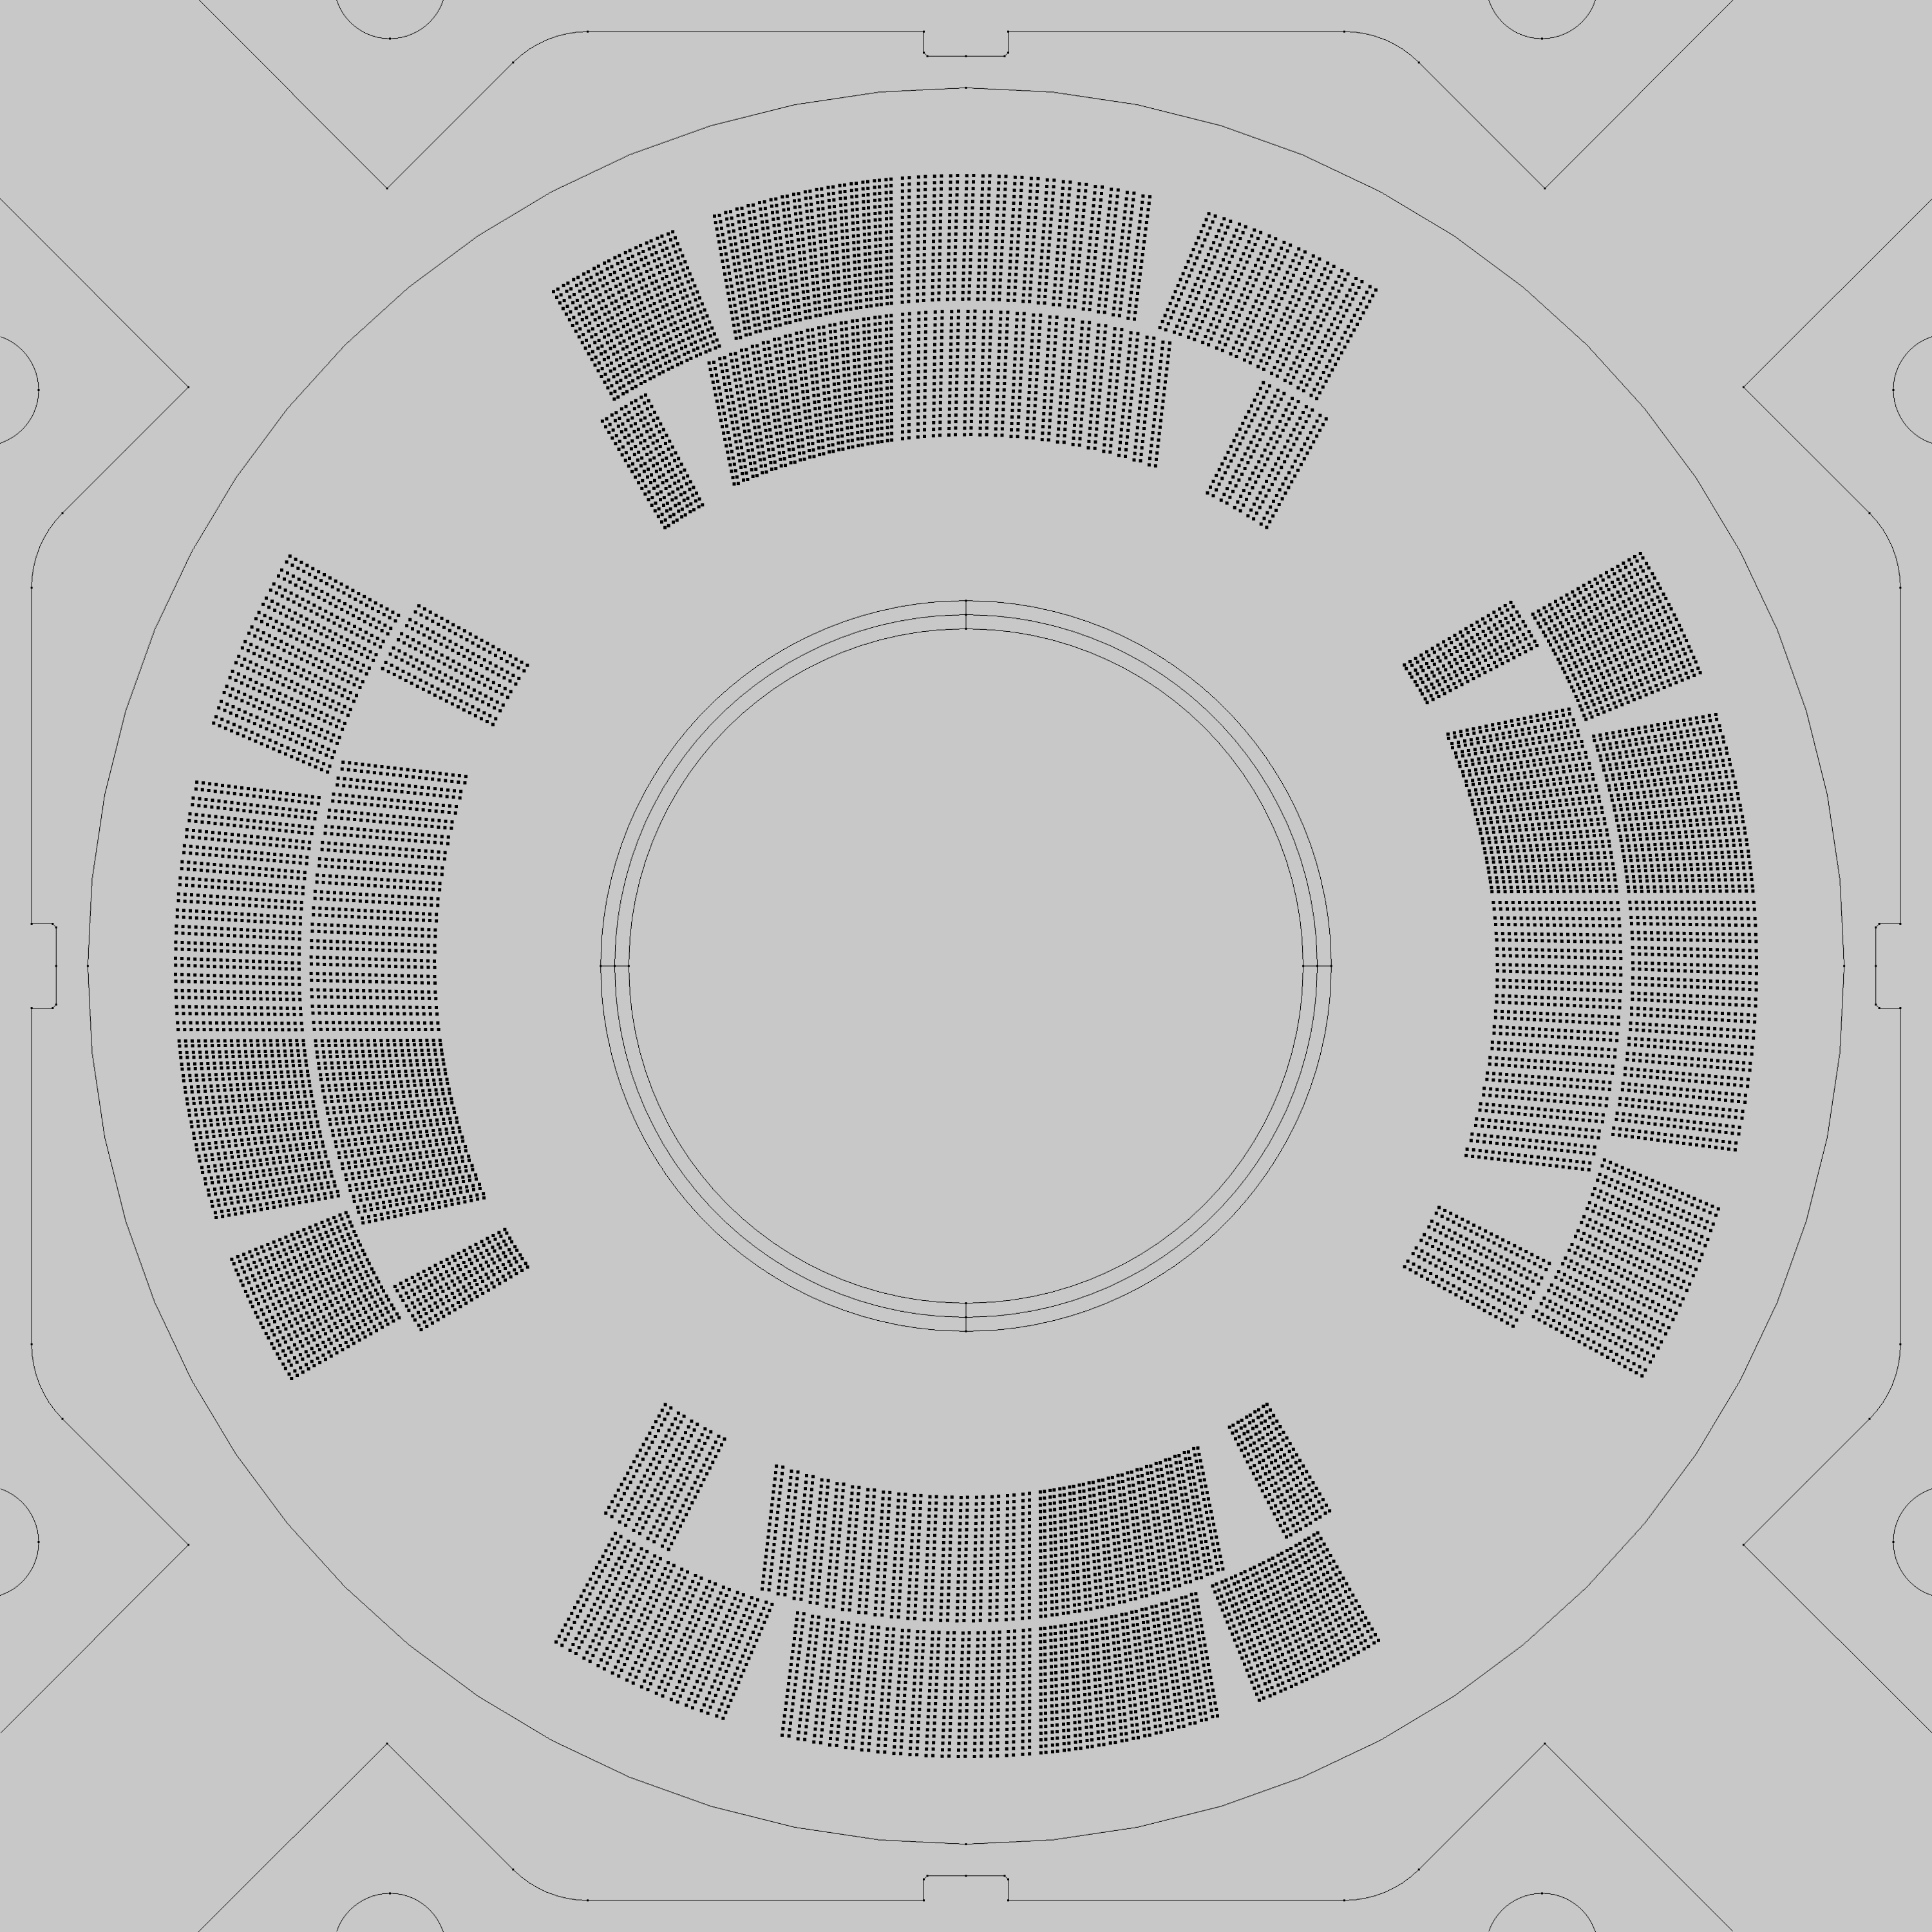
Effect of L – R on Field?
Nominal
Compressed by 50 µm
Nominal
Rotate by 50 µm
Originally oversize by 100 µm
Compressed by 50 µm
L-R
Nominal
0 100 200 300 400
L-R
0 100 200 300 400
Oversize by 50 µm
Undersize by -50 µm
L-R
L-R
0 100 200 300 400
0 100 200 300 400
These estimates suggest that we need at least ~100 µm of L-R accuracy to be within ±1 unit
Effect of several perturbations to QXF Field quality: https://indico.fnal.gov/getFile.py/access?contribId=2&resId=0&materialId=slides&confId=10554
10/30/2015 – E. Holik – FNAL

Slide 29
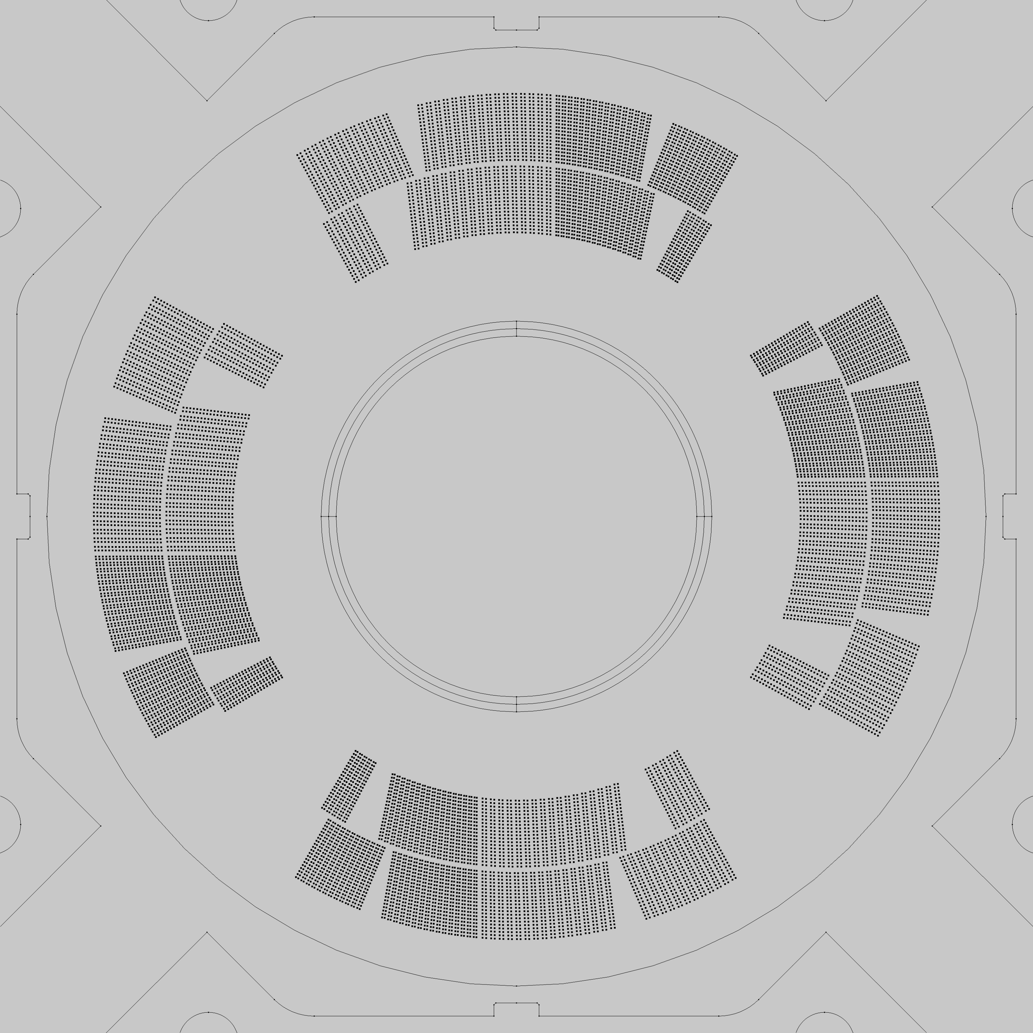
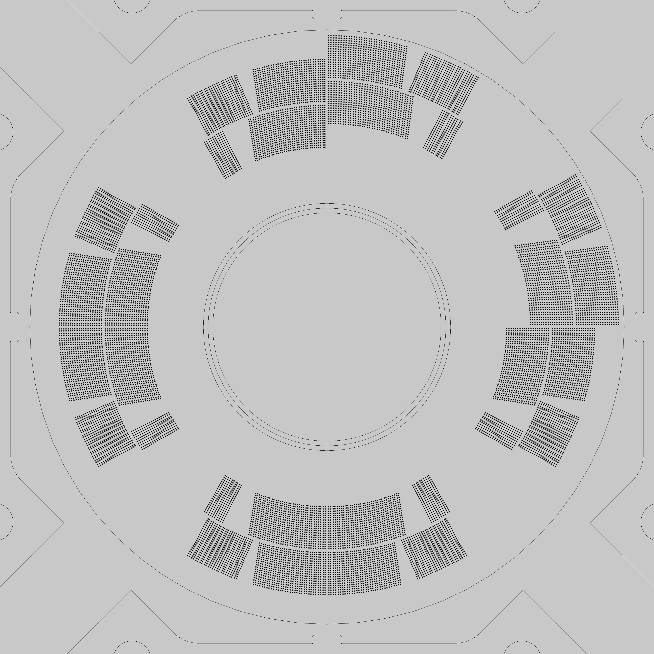
Effect of L + R on Field?
Oversize by 50 µm
Undersizeby -50 µm
Oversize by 50 µm
Undersize by -50 µm
L+R
L+R
0 100 200 300 400
0 100 200 300 400
Oversize by 40 µm
Radial shift by 50 µm
Oversize by 40 µm
L+R
L+R
0 80 160 240 320
0 80 160 240 320
These estimates suggest that we need at least ~50 µm of L+R accuracy to be within ±1 unit
10/30/2015 – E. Holik – FNAL

Slide 30
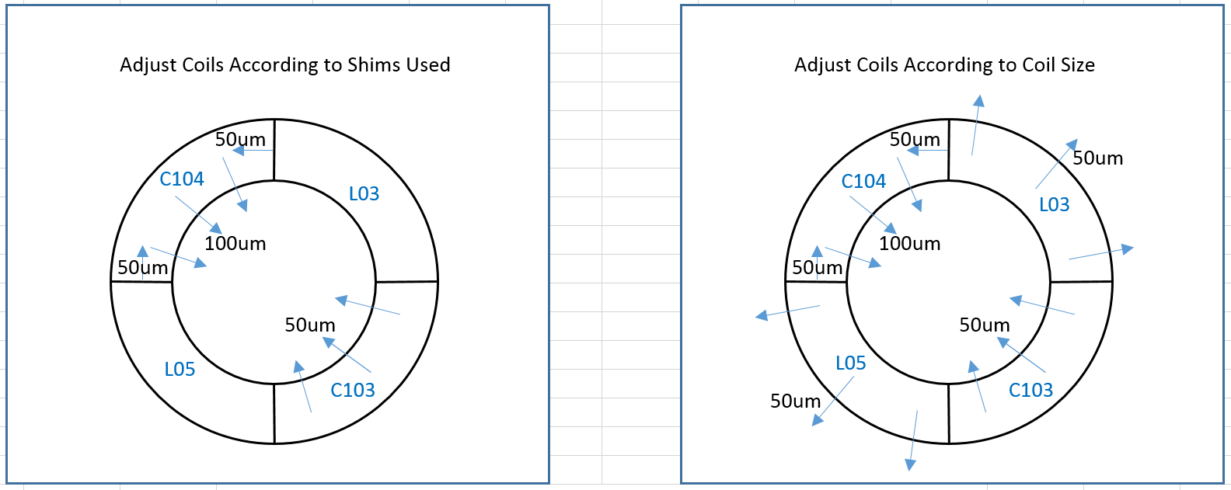
MQXFS-AS, Estimated FQ

Slide 31
Goals of Next 2 Weeks…
HT, TC placement with N. Bourcey
Cross Section analysis with E. Rochepault
CMM / FARO with J. Ferradas Troitino
Coil fab (impreg, materials) with E. Cavanna
Splice equipment
Curing setup
Long coil fab
11 tesla
(ROXIE with S. Izquierdo Bermudez)

