Slide 2

How precisely can we control our magnets? Experience and impact on the expected control of machine parameters (tune and chromaticity)
M.Solfaroli
BE department
OP group
Thanks to: M.Lamont, M. Schaumann, E.Todesco, J.Wenninger

Slide 3
Outline
The FiDeL model and its implementation
Tune: injection and snapback
Q’: injection, snapback, ramp and squeeze
b3 to Q’ “conversion”
5th Joint HiLumi LHC-LARP Annual Meeting – M.Solfaroli

Slide 4
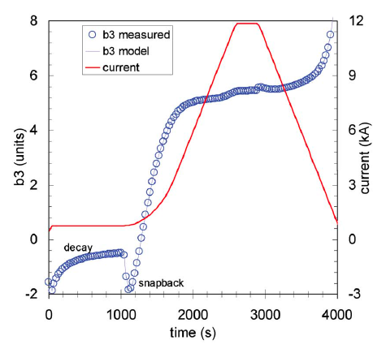
The FiDeL model
FiDeL dynamic component has been studied and modeled based on a massive set of magnetic measurements
Decay
“The decay of harmonics at constant current is driven by current redistribution on superconducting cables, which results in a net decrease of the average dc magnetization of the cables and of its contribution to the total field”
Snap back
rapid reestablishment of magnetization after decay. The field bounces back to its pre-decay level once the current in the magnet starts to ramp up
N. J Sammut et al., Phys. Rev. ST Accel. Beams 9
5th Joint HiLumi LHC-LARP Annual Meeting – M.Solfaroli

Slide 5
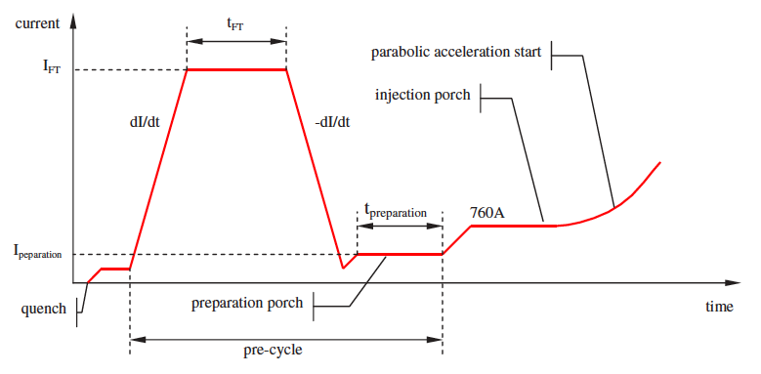
The powering history dependency
The magnitude of the decay depends on the powering history, both on the waveform of the powering cycle as well as waiting times, and has memory of previous powering cycles, thus making this effect non-reproducible from cycle to cycle.
5th Joint HiLumi LHC-LARP Annual Meeting – M.Solfaroli

Slide 6
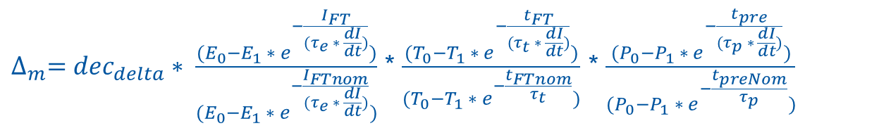
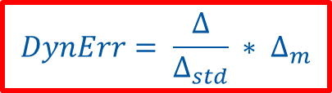
The FIDEL model implementation
decay
$$DynErr= \frac{∆}{∆_{std}} ∗ ∆_{m}$$
PH dependency (reduced for Q)
decay normalization (b3 only)
$$∆ =dec_{d}∗(1 − e^{\frac{−t}{dec_{τ}}})+\left(1 − dec_{d}\right)∗ (1 − e^{\frac{−t}{(9 ∗dec_{τ})}})$$
$$∆_{std}=dec_{d}∗(1 − e^{−\frac{T_{inj}}{dec_{τ}}})+\left(1 −dec_{d}\right)∗(1 − e^{−\frac{T_{inj}}{\left(9 ∗dec_{τ}\right)}})$$
$∆_{m}=dec_{delta}∗ \frac{(E_{0}−E_{1} ∗ e^{−\frac{I_{FT}}{{(τ}_{e} ∗ \frac{dI}{dt})}})}{(E_{0}−E_{1} ∗ e^{−\frac{I_{FTnom}}{{(τ}_{e} ∗ \frac{dI}{dt})}})}$ * $\frac{(T_{0}−T_{1} ∗ e^{−\frac{t_{FT}}{(τ_{t} ∗ \frac{dI}{dt})}})}{(T_{0}−T_{1} ∗ e^{−\frac{t_{FTnom}}{τ_{t}}})}$ * $\frac{(P_{0}−P_{1} ∗ e^{−\frac{t_{pre}}{{(τ}_{p} ∗ \frac{dI}{dt})}})}{(P_{0}−P_{1} ∗ e^{−\frac{t_{preNom}}{τ_{p}}})}$
dec_{tau,} dec_{d,} dec_{delta}
fitting parameters
I_{FT,} t_{FT,} t_{PRE}
Powering History (PH)
I_{FTnom,} t_{FTnom,} t_{PREnom ,} T_{inj}
PH normalization factors
5th Joint HiLumi LHC-LARP Annual Meeting – M.Solfaroli

Slide 7
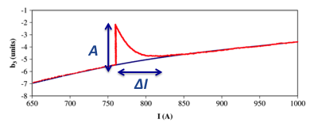

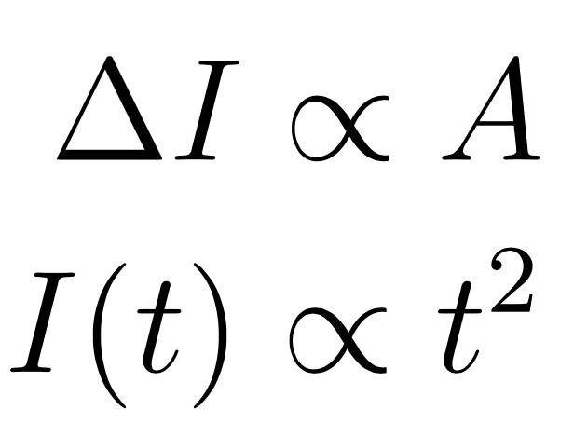
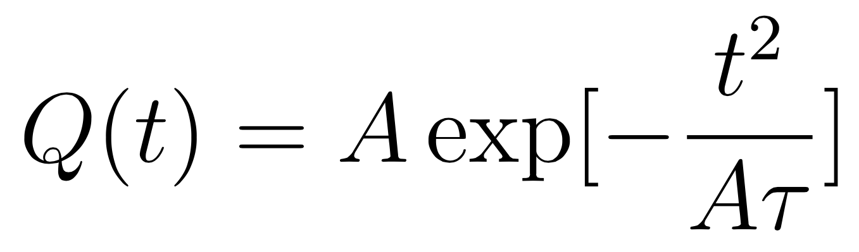

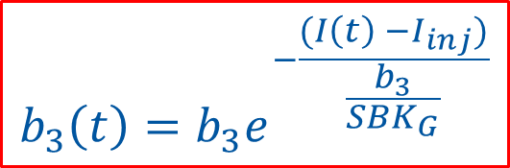
The snapback
Measurements show that the snap-back to the hysteresis curve in the first part of the ramp follows an exponential law in current. As the current at the start of ramp is parabolic, the snapback is Gaussian in time
The amplitude A depends on length of injection plateau & powering history
$$b_{3}\left(t\right)=b_{3}e^{−\frac{(I\left(t\right) −I_{inj})}{\frac{b_{3}}{SBK_{G}}}}$$
N. J. Sammut et al., Mathematical formulation to predict the harmonics of the superconducting Large Hadron Collider Magnets. II. Dynamic field changes and scaling laws. PRSTAB 10, 082802 (2007)
5th Joint HiLumi LHC-LARP Annual Meeting – M.Solfaroli

Slide 8
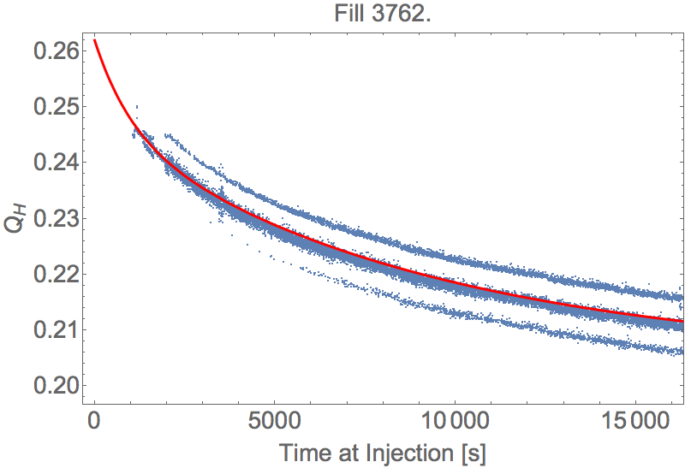
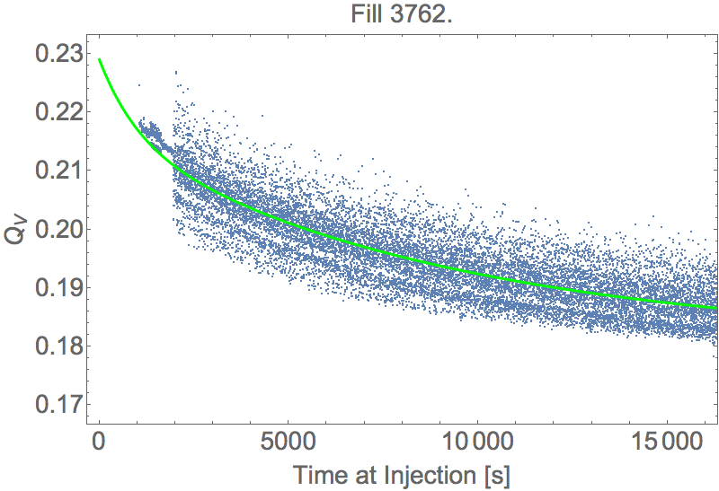
Tune injection decay
Example of bare tune decay at injection with corresponding exponential fit
Synchrotron Sidebands (?)
(Those lines decay with the tune already in the raw data. 50Hz lines have slightly smaller spacing but stay at constant frequency)
5th Joint HiLumi LHC-LARP Annual Meeting – M.Solfaroli

Slide 9
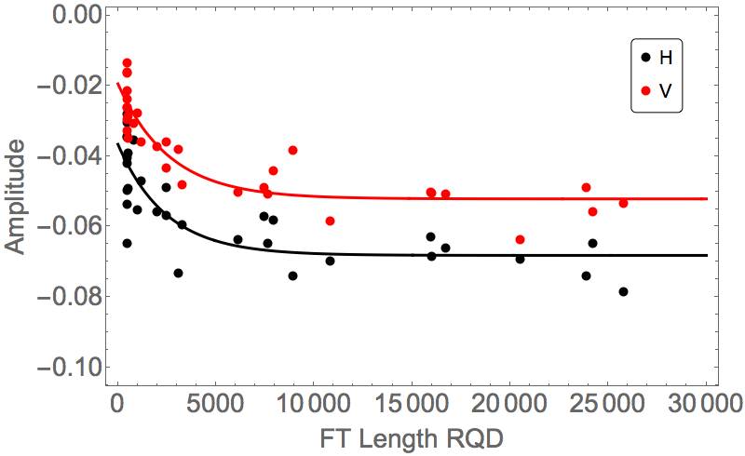
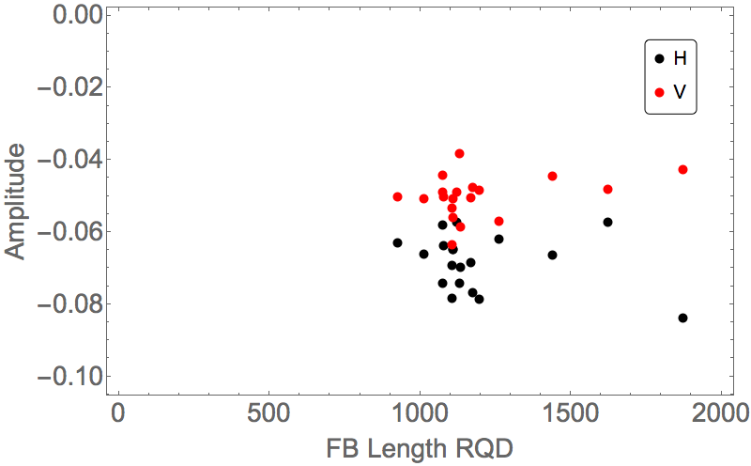
Tune injection decay – PH dependency
To exclude dependence on preparation time, select only cycles with t_{pre}<800s
Control is important, though not extremely critical as tune is always visible and can be corrected
Flat-Top
Flat-Bottom
Although there is no much reproducibility in the data (especially for pre-cycles), thus the fit isn’t good, a dependency of the decay amplitude with Flat-top time (t_{FT}) is visible
No pattern of dependency of decay amplitude on preparation time (t_{pre})
A dependency of decay amplitude on t_{FT} has been implemented in the online correction system in 2015
5th Joint HiLumi LHC-LARP Annual Meeting – M.Solfaroli

Slide 10
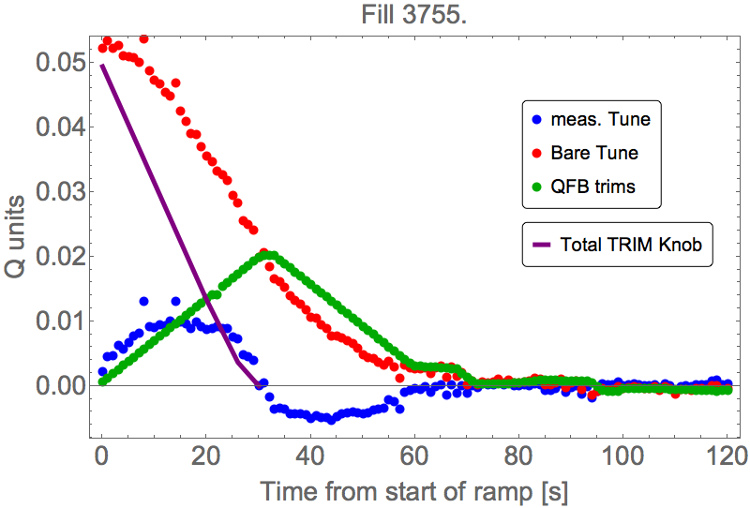
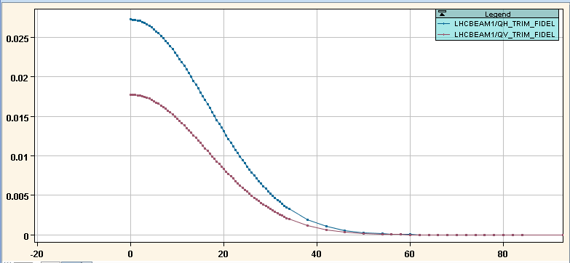
Tune snapback
If the correction incorporation is not good enough, it can be difficult for the QFB to keep the tunes constant and large tune excursions can occur at the beginning of the ramp with the risk of control loss
Example of snapback-like incorporation for Q implemented in Run2 to limit the load on the QFB
5th Joint HiLumi LHC-LARP Annual Meeting – M.Solfaroli

Slide 11
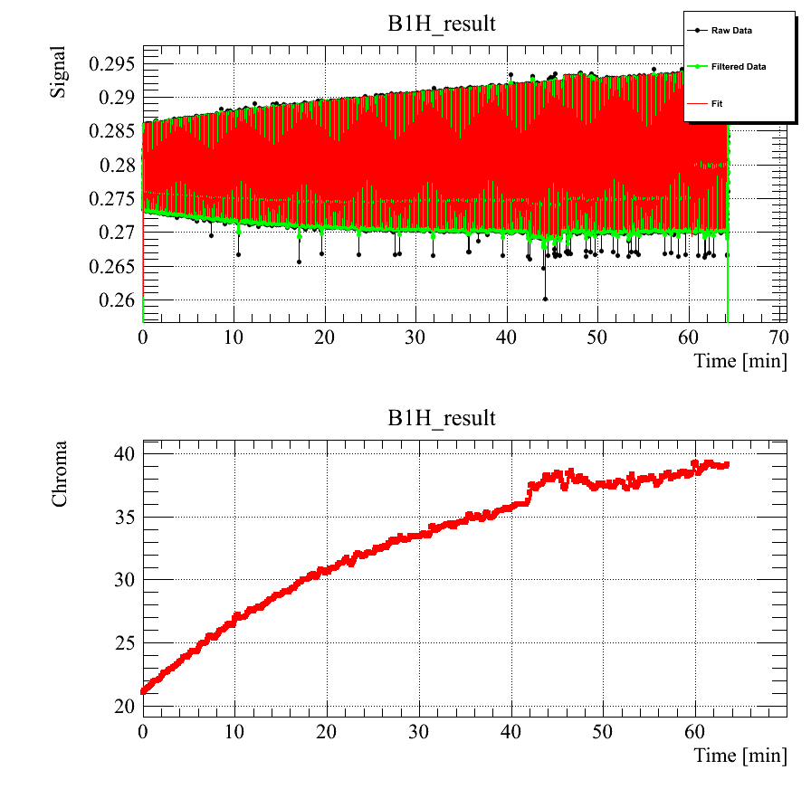
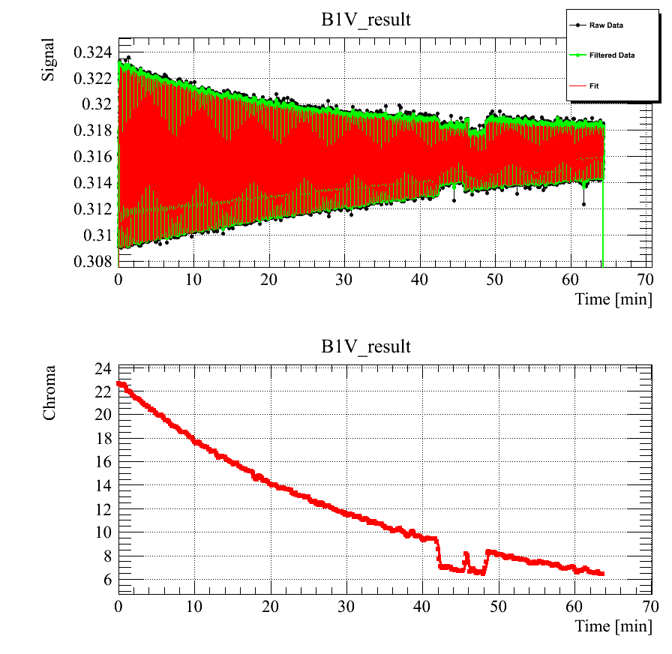
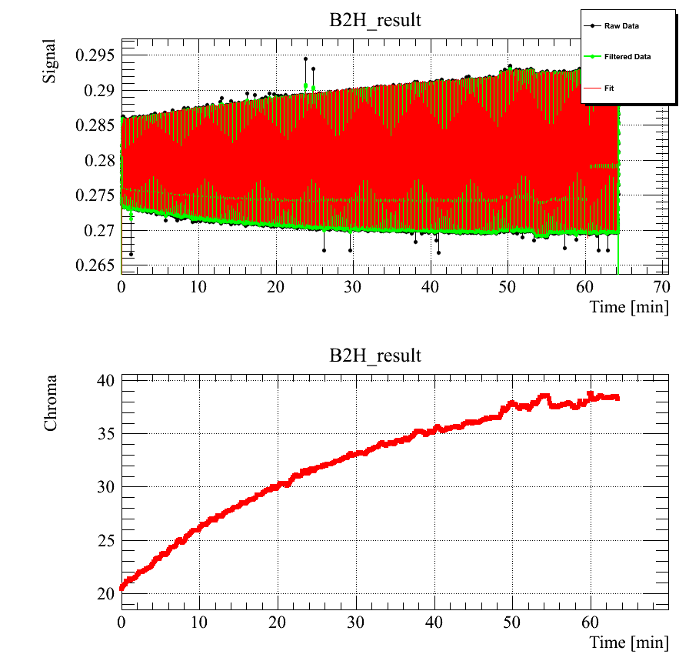
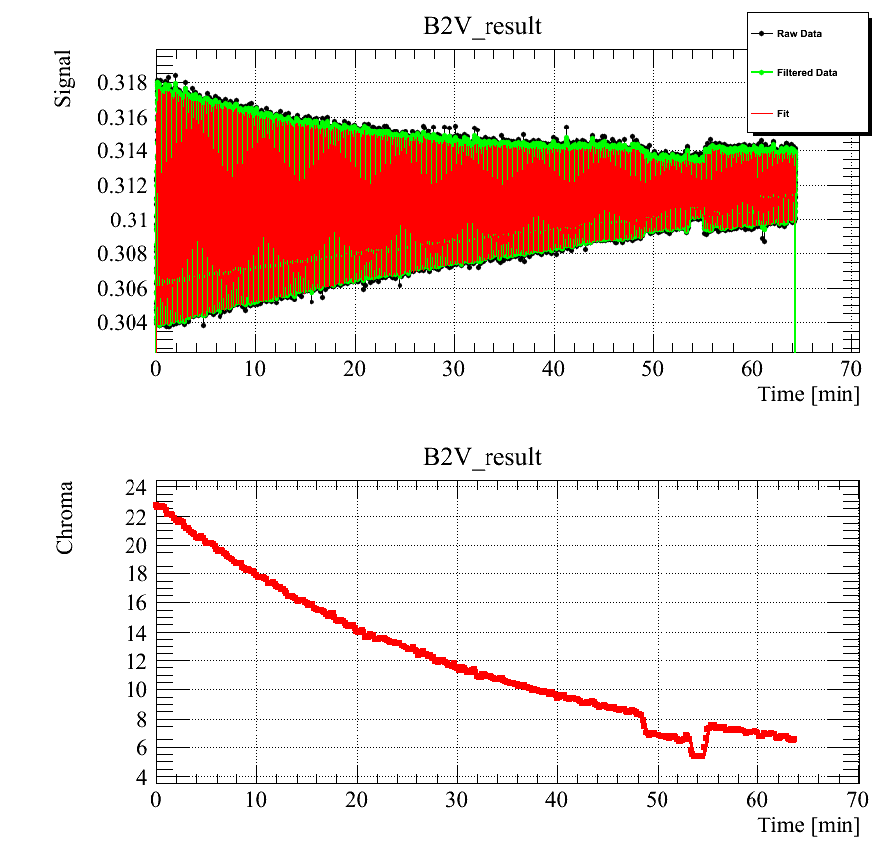
b3 injection decay
B1H
B1V
About 0.46 b3 units (~20 Q’ units) decay in 1 hour
Operationally difficult to inject in the very first part of the injection plateau
Good fit, but few units will always “leak” into lattice sextupole correction
B2H
B2V
As expected, decay amplitude is about 40% larger than at 4 TeV
5th Joint HiLumi LHC-LARP Annual Meeting – M.Solfaroli

Slide 12
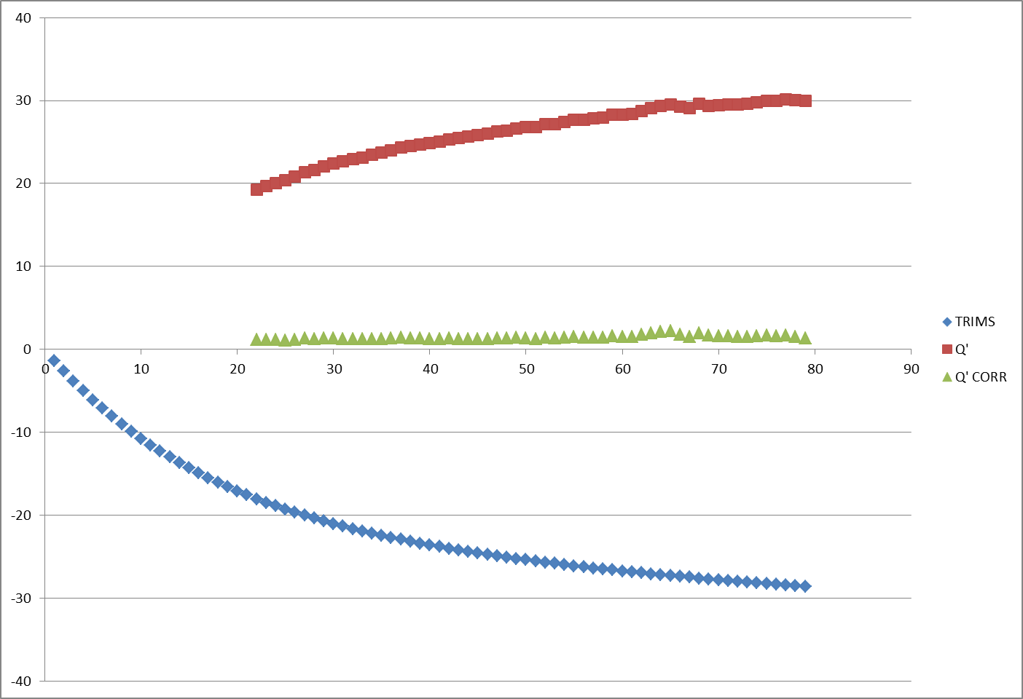
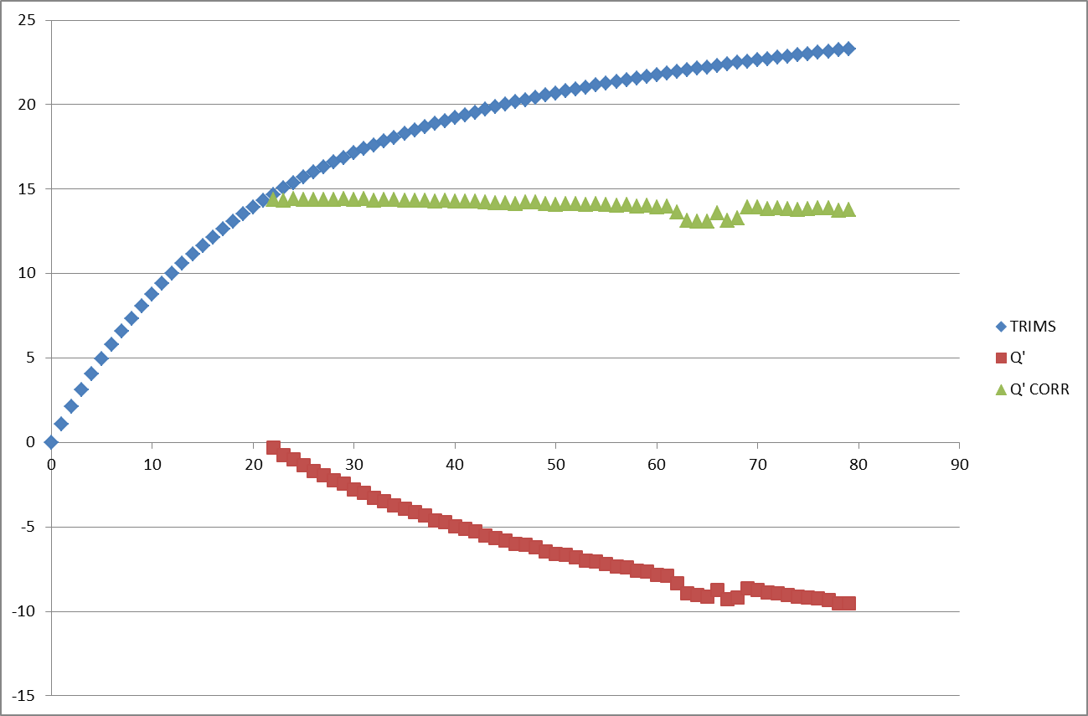
b3 injection decay compensation
Horizontal
Measured Q’
Decay compensation
Corrected Q’
Vertical
The present compensation of b3 injection decay makes Q’ flat
(in within ±0.5 units)
The precision of the correction over several fill depends on the quality of the powering history dependency model
5th Joint HiLumi LHC-LARP Annual Meeting – M.Solfaroli

Slide 13
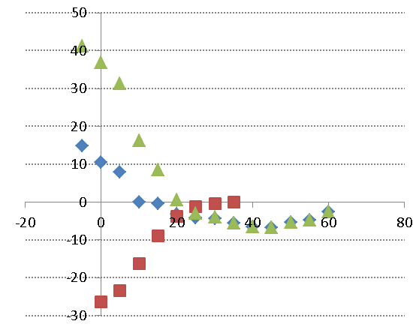
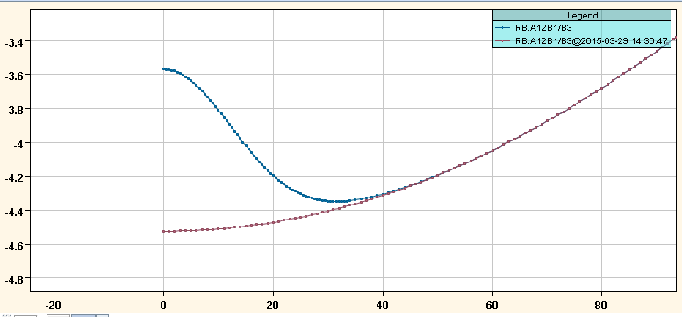
Snapback - Horizontal
Q’H
Q’ corrections
Measured Q’
Natural Q’
b3
sec
sec
b3 correction is fully incorporated in ~30 sec
(depending on the intensity)…consistent with measurements!
5th Joint HiLumi LHC-LARP Annual Meeting – M.Solfaroli

Slide 14
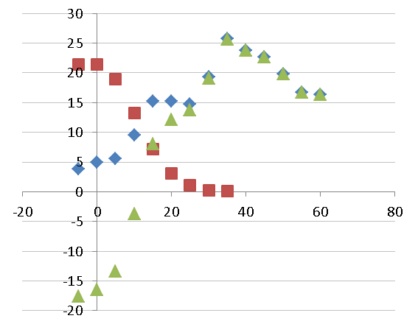
Snapback - Vertical
Q’V
Q’ corrections
Measured Q’
Natural Q’
b3
sec
sec
b3 correction is fully incorporated in ~30 sec
(depending on the intensity)…consistent with measurements!
5th Joint HiLumi LHC-LARP Annual Meeting – M.Solfaroli

Slide 15
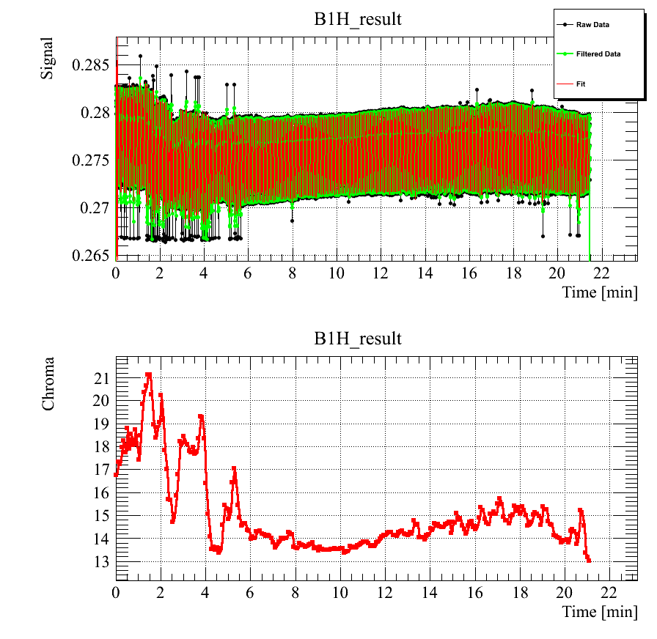
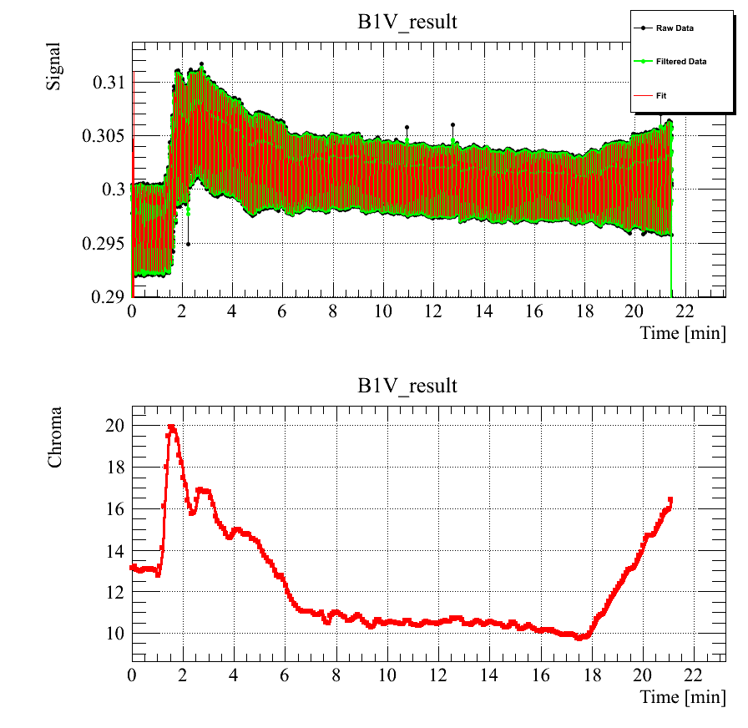
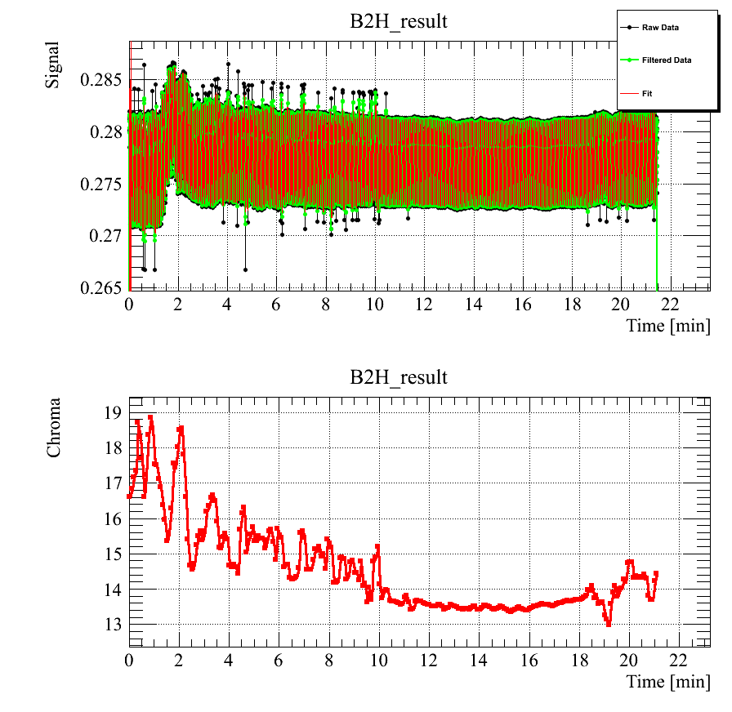
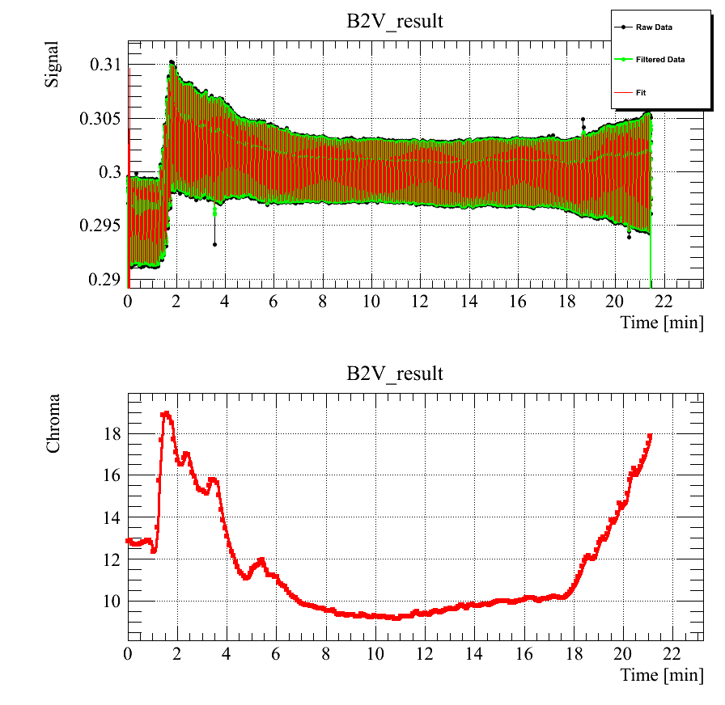
Ramp
B1H
B1V
Q’ along the ramp is well controlled (±2 units)
Small imperfection in the persistent currents model <3 kA, but still very good control considering the 8 units swing (300 Q’ units) of b3
No visible effect from the missing RCS (compensation split on the other 7 circuits)
B2H
B2V
5th Joint HiLumi LHC-LARP Annual Meeting – M.Solfaroli

Slide 16
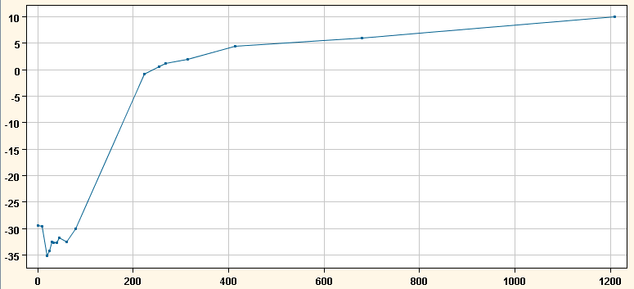
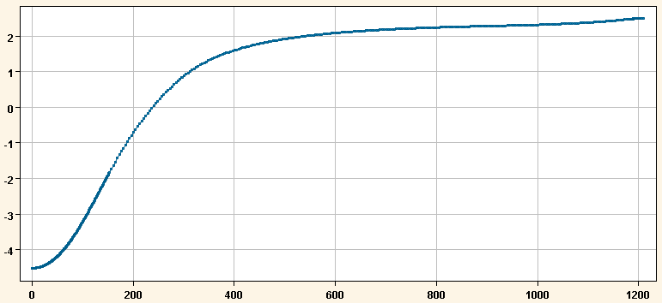
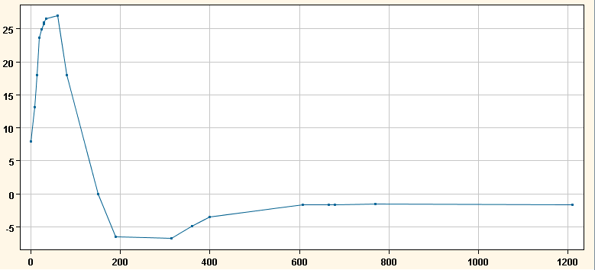
Ramp
Typical sextupole correction
Vertical
b3 evolution during ramp (~8 units -> 300 Q’ units)
Horizontal
Bare Q’ along the ramp
(lattice sext corrections removed):
Precision of the model above 3 kA is ±5 Q’ units
~1 unit of uncorrected b3 below 3 kA
In addition, about 15 Q’ units error (positive in both planes)…on ~300 Q’ swing
5th Joint HiLumi LHC-LARP Annual Meeting – M.Solfaroli

Slide 17
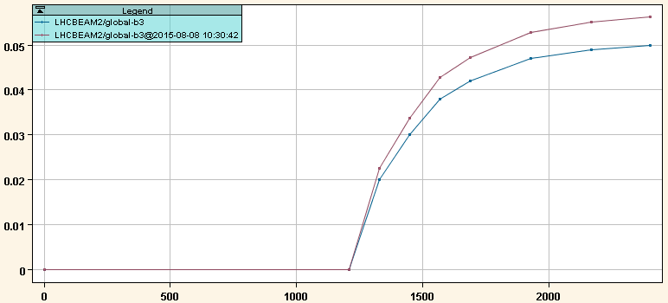
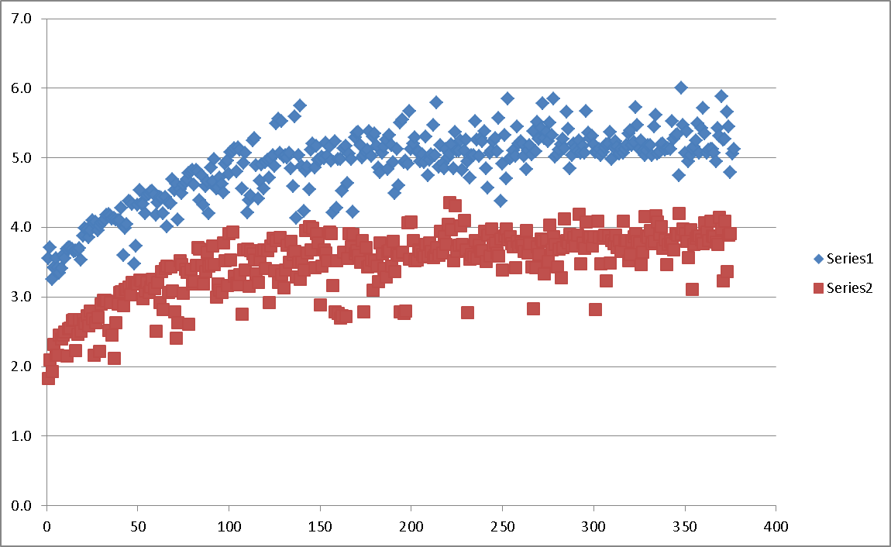
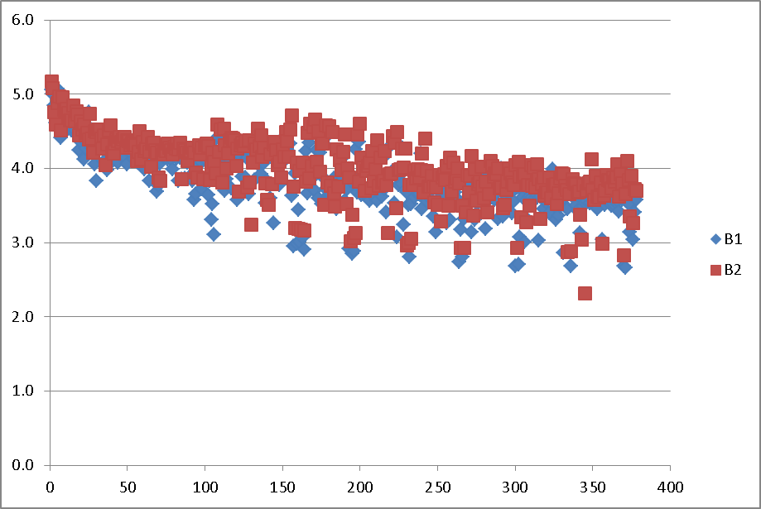
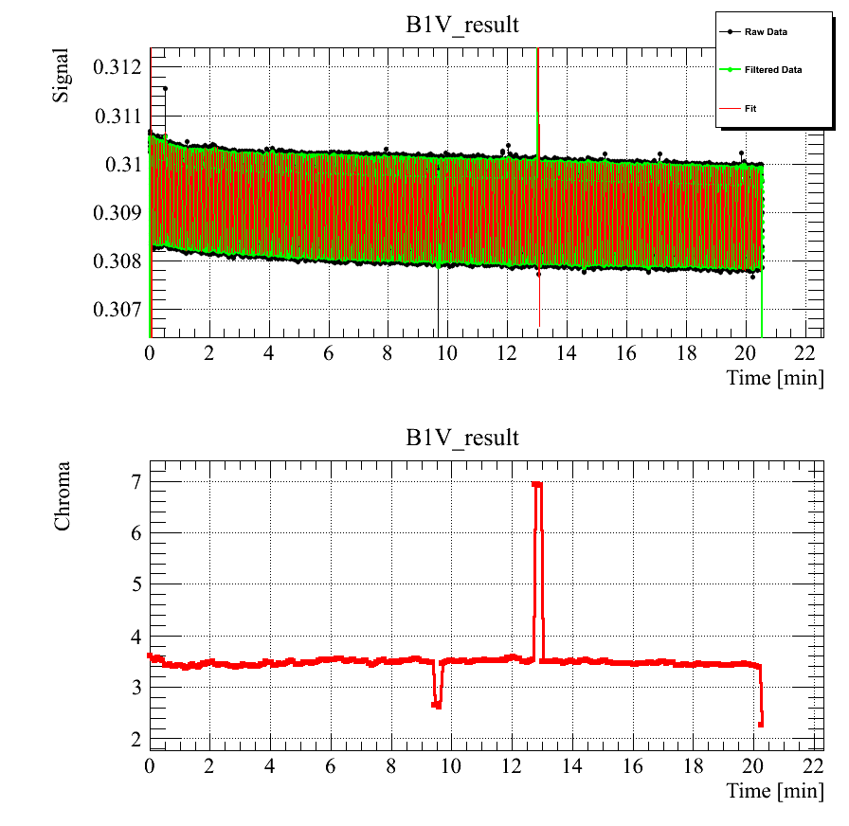
Decay @flat-top
b3 compensation knob
Horizontal
Q’
Vertical
Q’
sec
Q’ decay
~2 units in H
~1.5 units in V
~0.05 b3 units
sec
Example of Q’ measurements at flattop after compensation
Expected to be negligible is indeed very small!
5th Joint HiLumi LHC-LARP Annual Meeting – M.Solfaroli

Slide 18
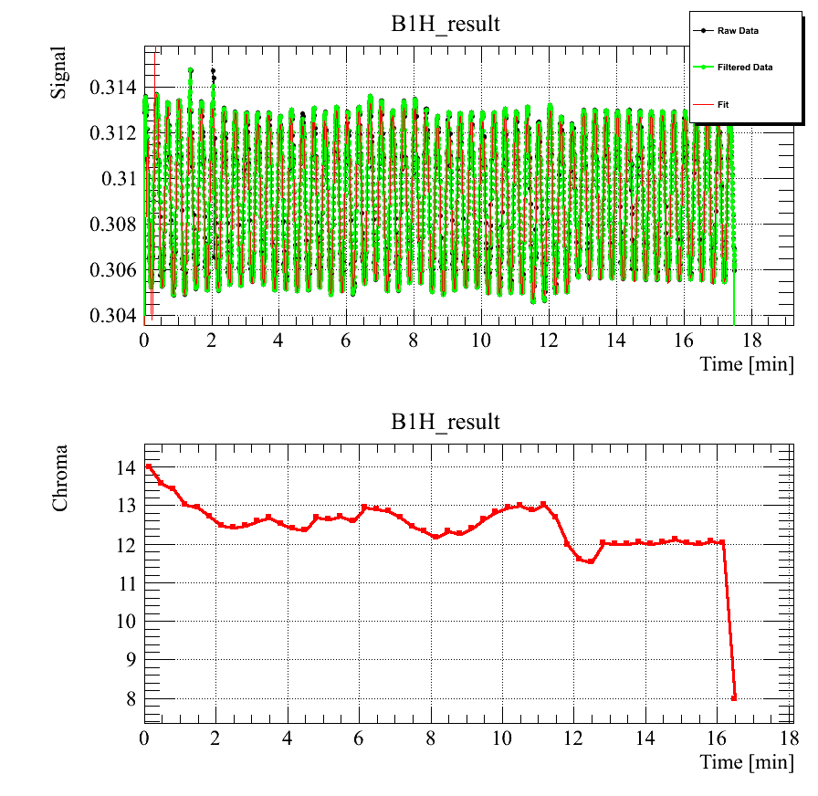
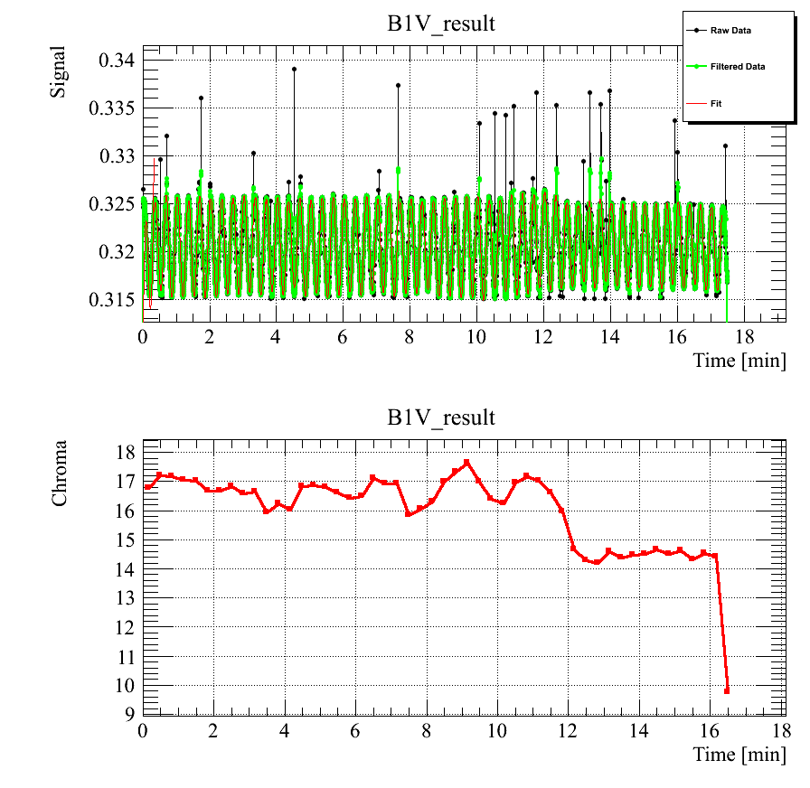
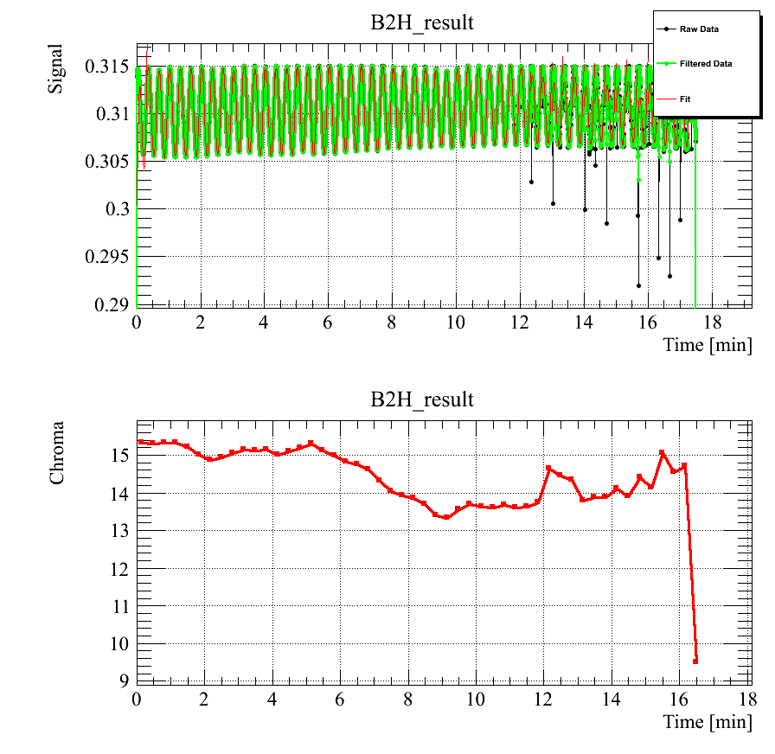
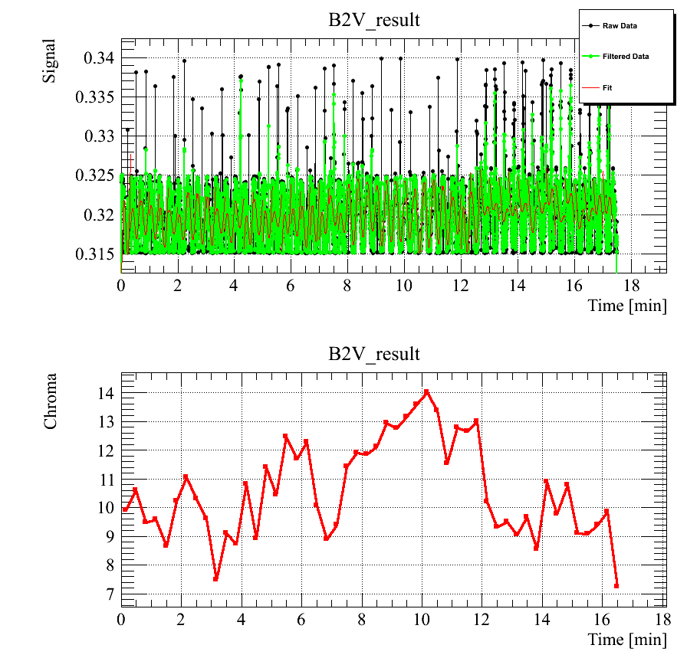
Squeeze
B1H
B1V
Q’ stable in within ±2 units
Noisy signal (V especially) => measurements not fully reliable
Some feed-forward could be done (fine tuning)
B2H
B2V
5th Joint HiLumi LHC-LARP Annual Meeting – M.Solfaroli

Slide 19
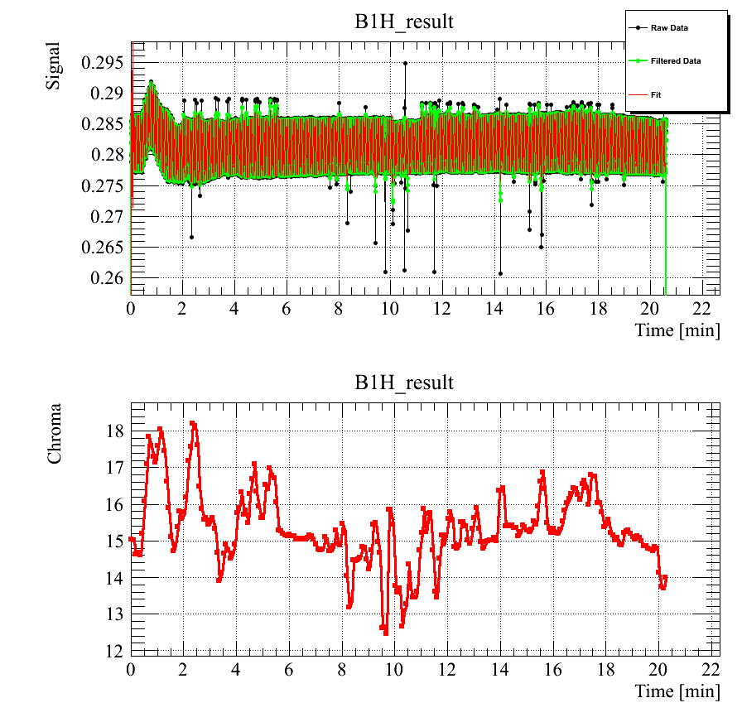
Reproducibility – B1 Horizontal
In Fill 4534 we enter the ramp with ~2 Q’ units more
Fill 4307 on Sept 5th
Fill 4534 on Oct 25th
5th Joint HiLumi LHC-LARP Annual Meeting – M.Solfaroli

Slide 20
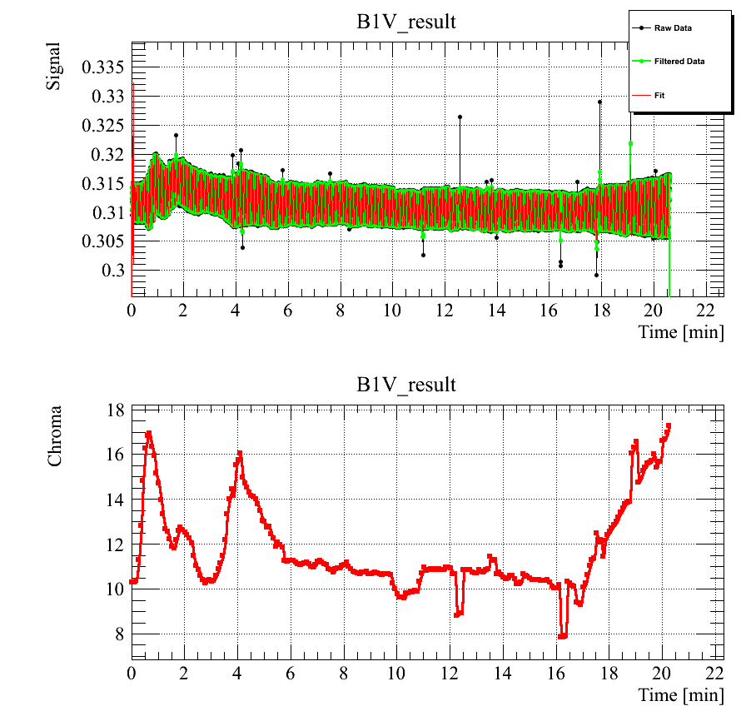
Reproducibility – B1 Vertical
In Fill 4534 we enter the ramp with ~2 Q’ units more
Fill 4307 on Sept 5th
Fill 4534 on Oct 25th
Fed-forwarded peak
5th Joint HiLumi LHC-LARP Annual Meeting – M.Solfaroli

Slide 21
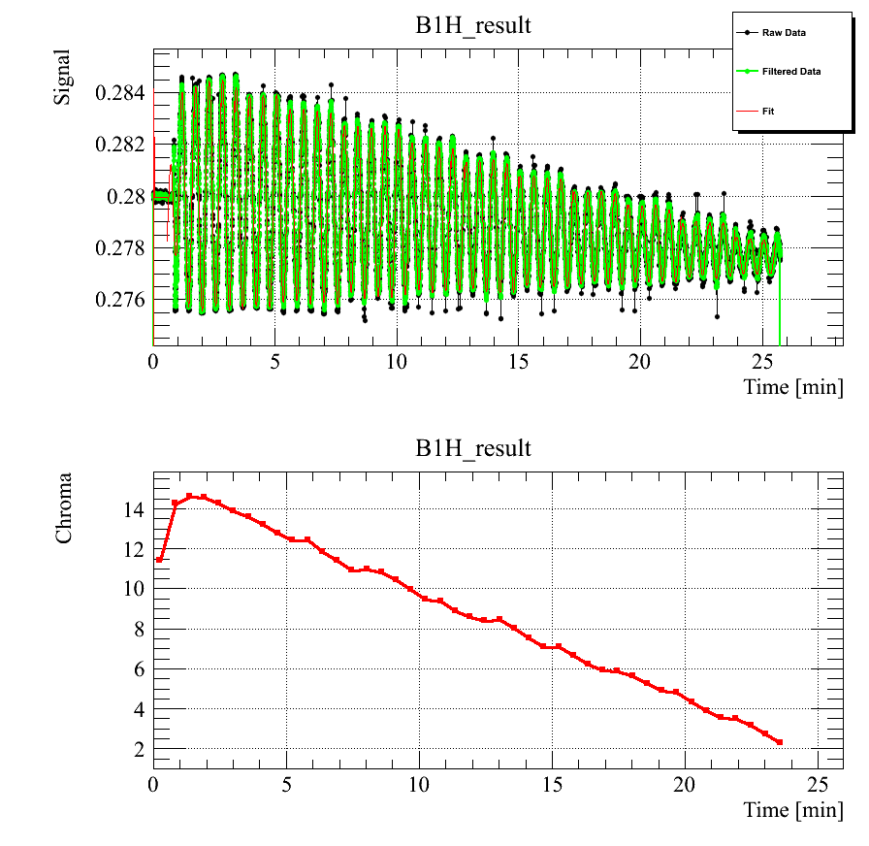
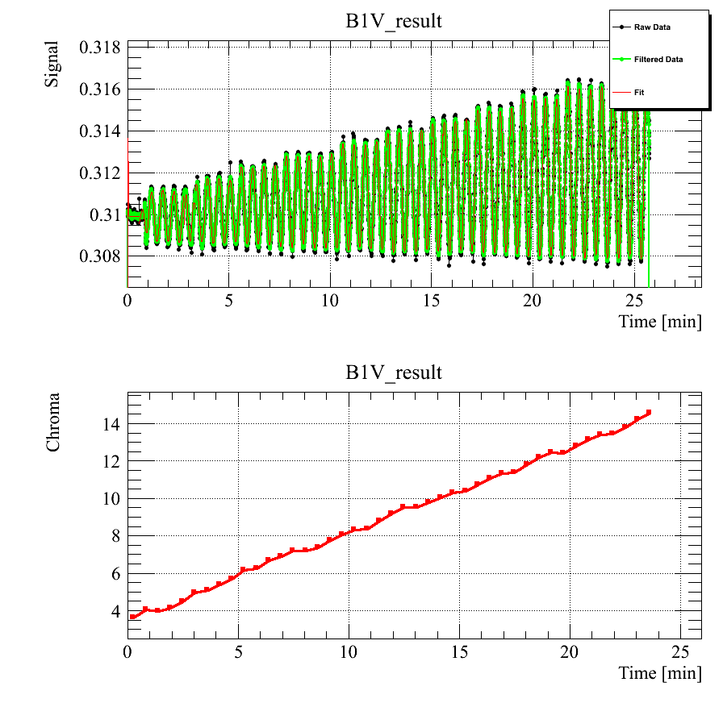
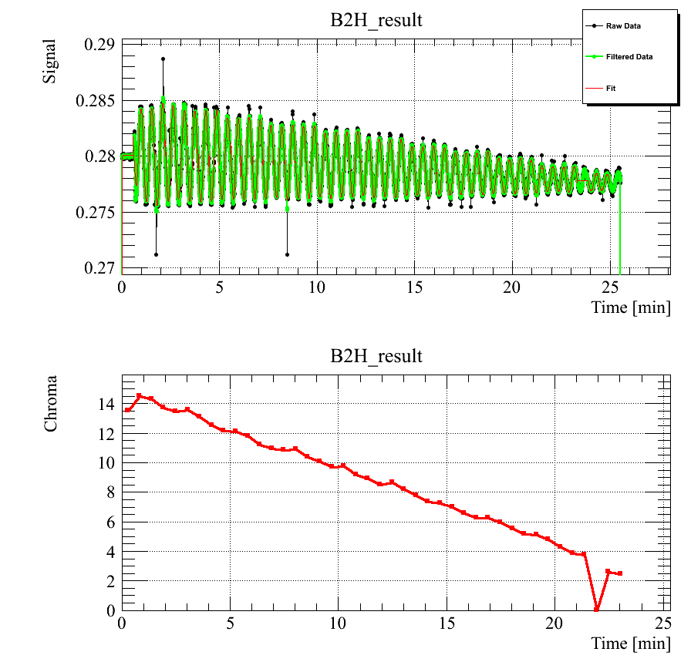
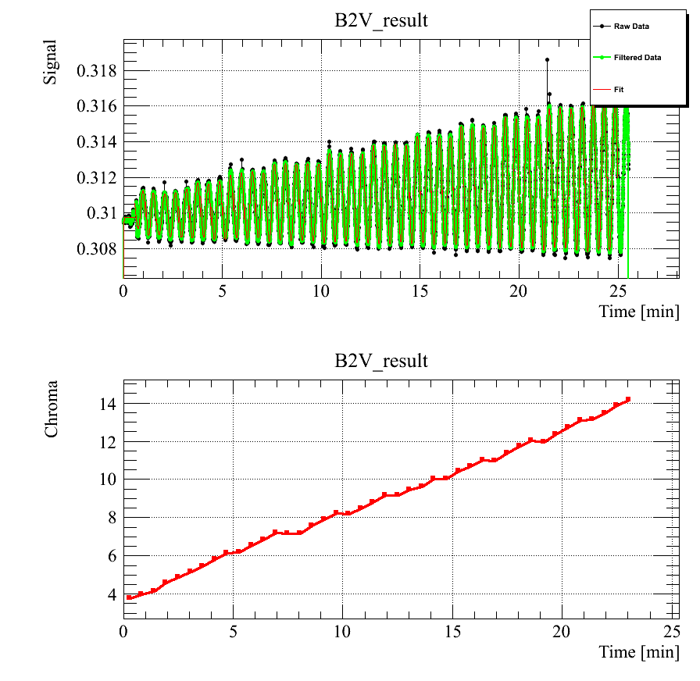
b3 to Q’ measurement
B1H
B1V
Run1 assumption:
1 b3 unit =
43 Q’ units in H
-35 Q’ units in V
Very good agreement
New measurements
1 b3 unit =
B1
H ~ 42.6 Q’ unit
V ~ -35.3 Q’ unit
B2
H ~ 42 Q’ unit
V ~ -35 Q’ unit
0.03 b3 units swing in 10 steps
B2H
B2V
5th Joint HiLumi LHC-LARP Annual Meeting – M.Solfaroli

Slide 22
Conclusions
Tune
  Tunes at injection are under control, although decay isn’t fully reproducible
  Once the ramp starts the tunes are controlled by the QFB
Chromaticity (measured with pilot)
  b3 injection decay is correctly compensated for operational purpose (it would be a plus to verify the powering history dependency)
  Good control and reproducibility during squeeze, ramp and snapback (±2 units)
  Small imperfection in the persistent current model below 3kA
5th Joint HiLumi LHC-LARP Annual Meeting – M.Solfaroli

Slide 23
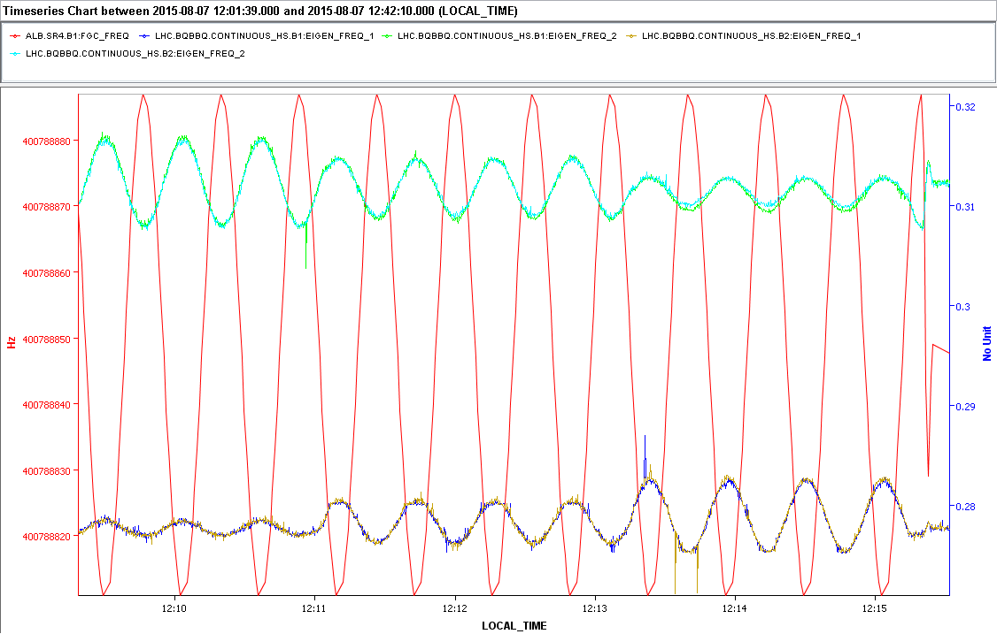
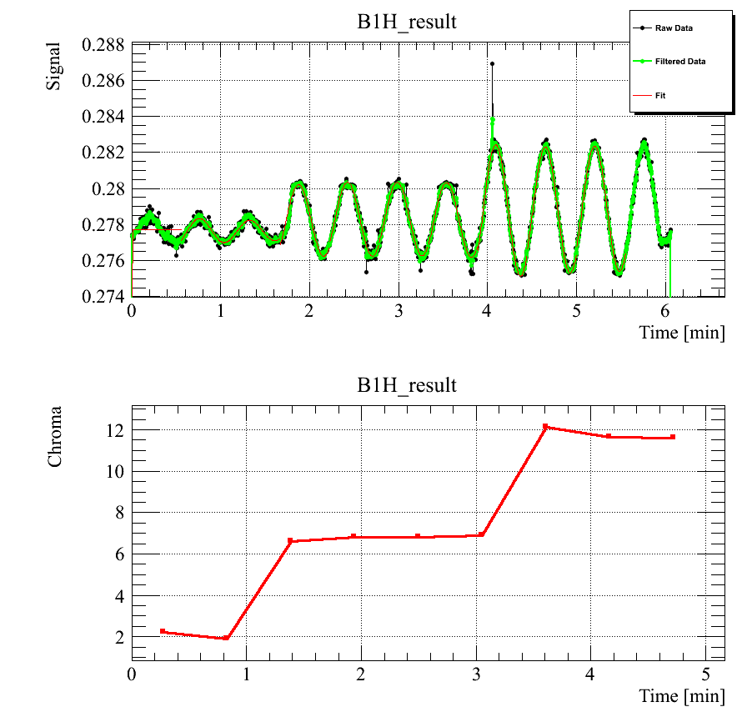
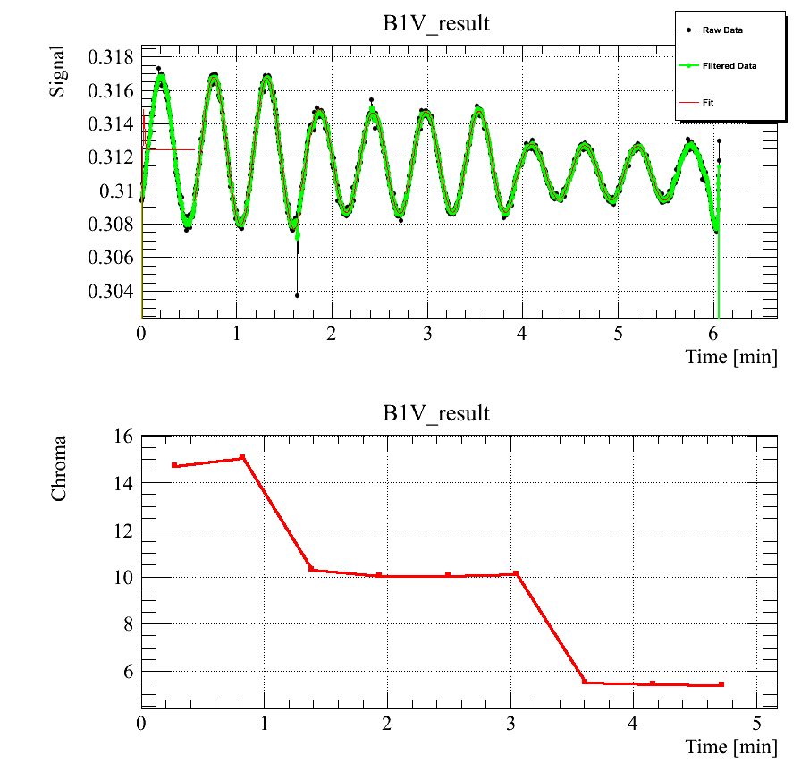
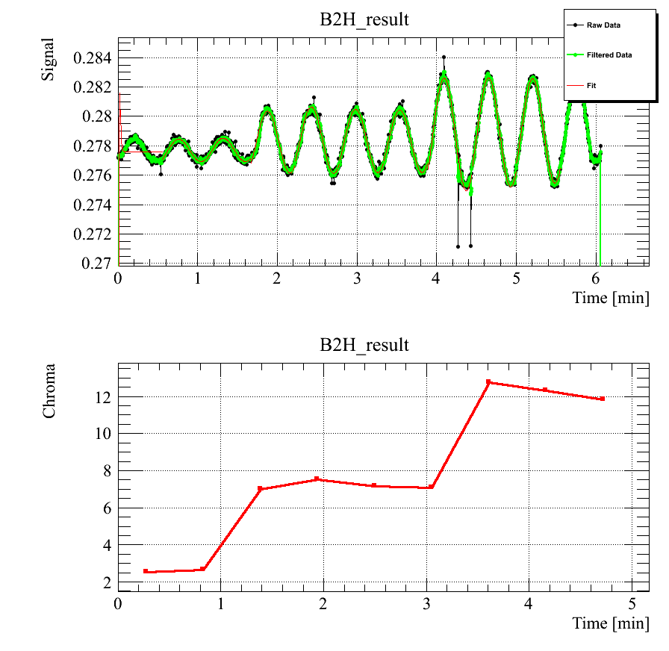
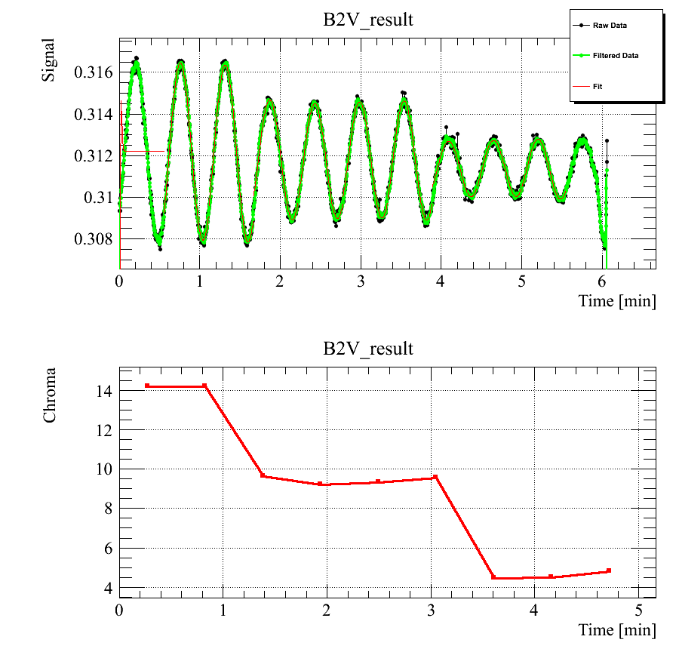
Q’ knob check
Knob measurements
2 steps of 5 units
B1
H -> 2 to 12
V -> 15 to 5
B2
H -> 2.2 to 12.2
V -> 14 to 4
5th Joint HiLumi LHC-LARP Annual Meeting – M.Solfaroli

Slide 24
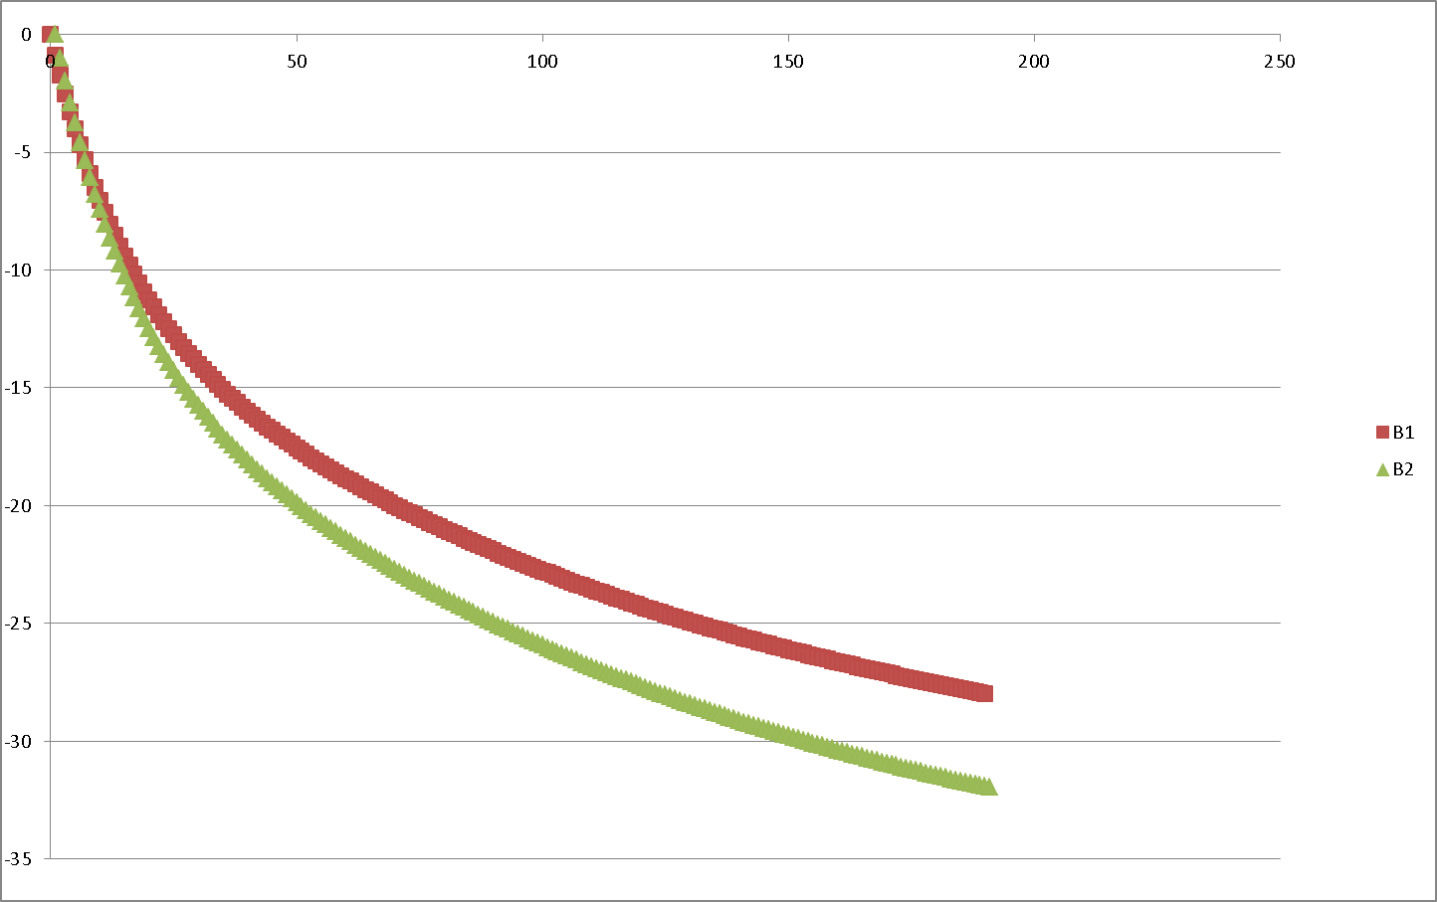








OP without RCS.A78B2
Q’
B2 compensation is calculated as for B1 then multiplied to a 8/7=1.14 factor
Example of H corr
INJECTION
b3 decay
min
RAMP
Snapback
b3 variation (momentum change)
The RCS.A78B2/B3 function has been equally distributed on the other circuits
RCS.A78B2/B3
b3
~7/8 b3 units
sec
The B2 global_b3 knob has been multiplied by a 8/7=1.14 factor
(effect of about 0.2 Q’ units)
b3
FLATTOP
b3 decay
sec
5th Joint HiLumi LHC-LARP Annual Meeting – M.Solfaroli

Slide 25



Ramping w/o RCS.A78B2
First ramp:
At about 800 sec the B2Q’V starts growing and B2Q’H goes down then passes negative…B2 is dumped around 1080 sec after the ramp start
Second ramp:
Both beams survive the ramp, but are dumped about 30 sec after flattop is reached (electrical glitch caught by FMCM RD1.LR5)
Third ramp:
Both beams survive!
Q’ (re-)measured along the ramp (small corrections implemented) and at flattop
5th Joint HiLumi LHC-LARP Annual Meeting – M.Solfaroli

Slide 26

Online Q’
Worked very reliably for several fills
Next improvement steps:
  Q’ trace (e.g. to observe evolution during ramp)
  Feed Forward
  Error Estimation
K.Fuchsberger
5th Joint HiLumi LHC-LARP Annual Meeting – M.Solfaroli

