Slide 1

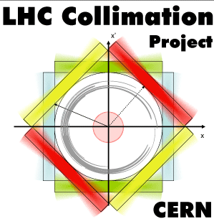

Tracking simulations – where we are and what needs to be done
R. Bruce
on behalf of task 5.2
Notes:
1
1
1540 -> 1609

Slide 2
Outline
Selected highlight results from the last year
  Cleaning
  Asynchronous beam dump
  Other studies
Open points and future plans

Slide 3
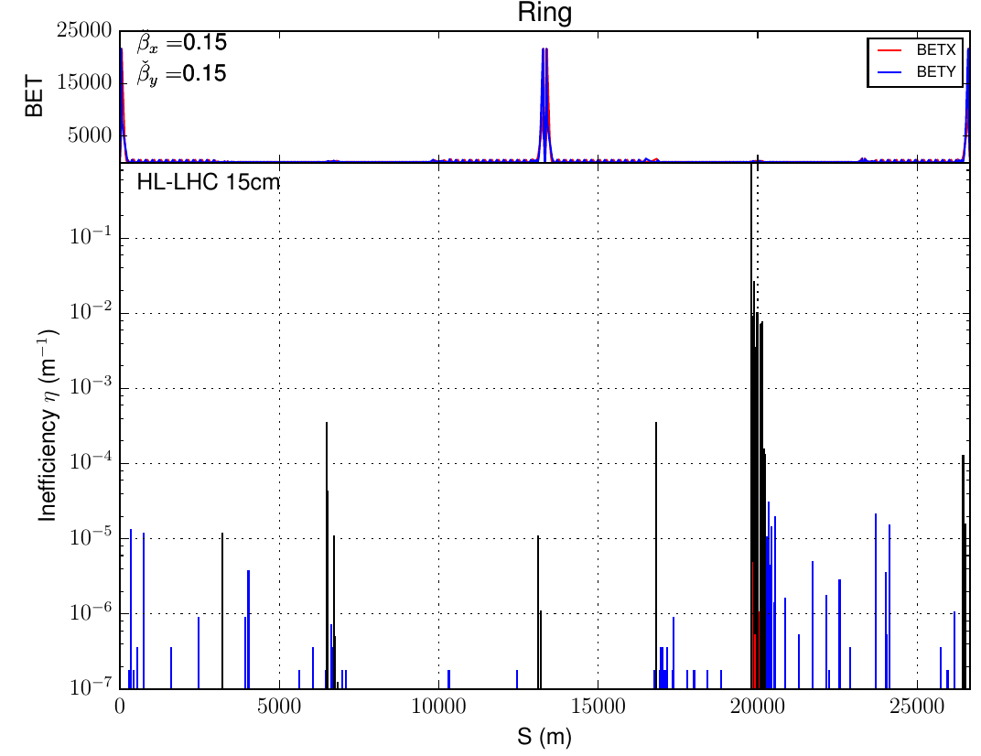
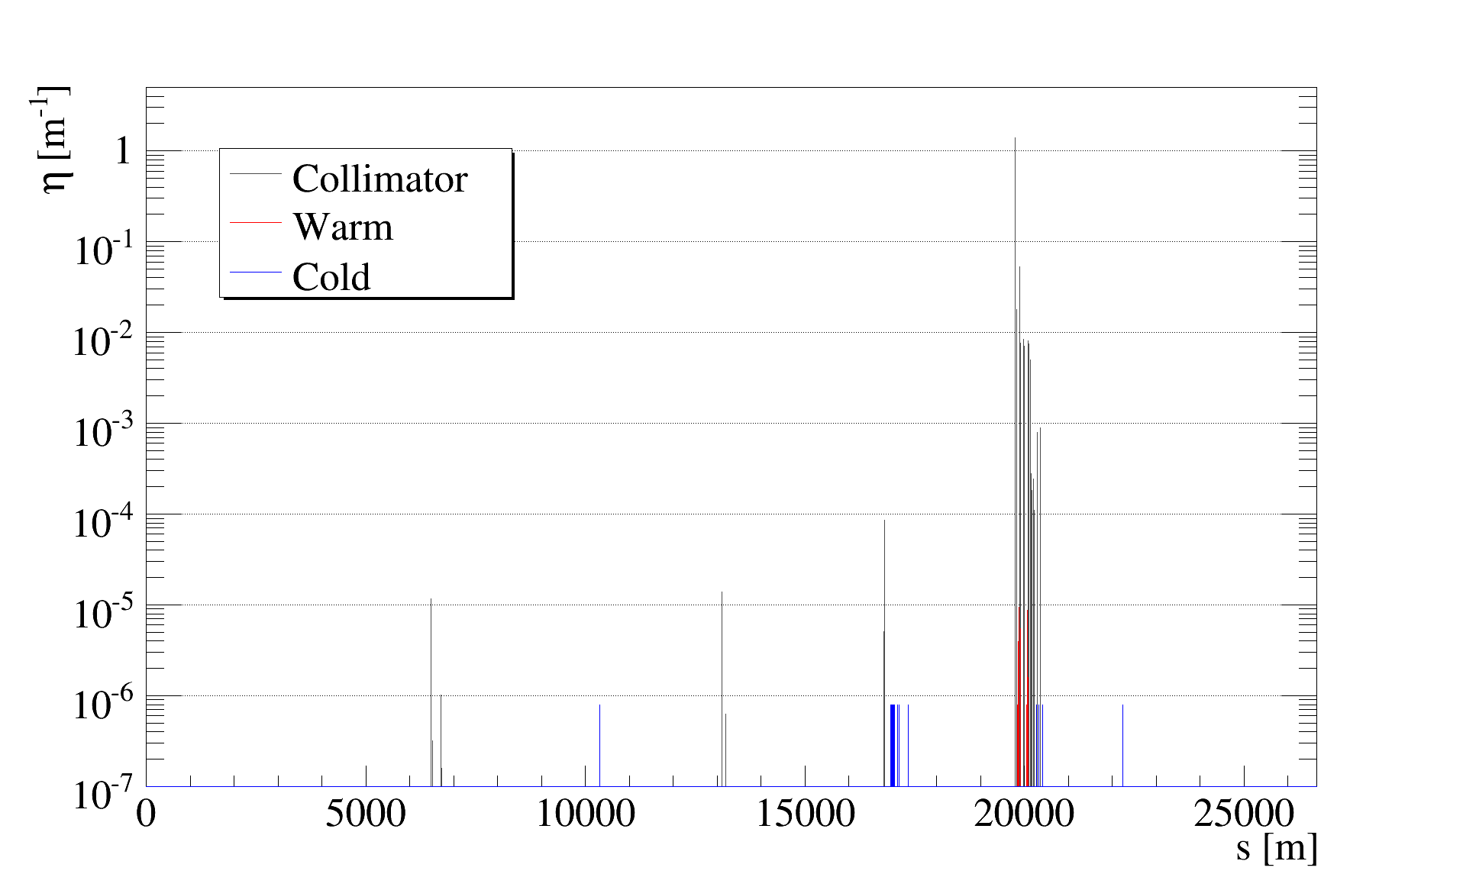
Highlights – cleaning simulations
Cleaning simulations for HL-LHC v1.2 with Merlin and SixTrack (D. Mirarchi, A. Mereghetti, H. Rafique, S. Tygier, A. Valloni)
S. Tygier, Merlin, no TCLDs
D. Mirarchi, SixTrack, TCLDs

Slide 4
Highlights – cleaning simulations
Studies of round/flat beams, comparisons TCT4/5
(Talk R. Kwee)
  Input to FLUKA studies for experimental background
Systematic investigation of IR losses with different TCT settings and aperture (H. Garcia, IPAC15)
HL pre-squeeze, intermediate points (talk S. Tygier)
Cleaning with new low-impedance materials in TCSGs (E. Quaranta et al., IPAC15)

Slide 5
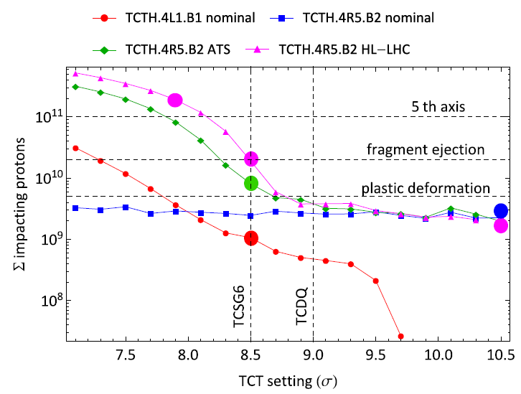
Highlights – asynchronous beam dump
E. Quaranta
TCT damage limit calculations, with FLUKA and MME (E. Quaranta et al., IPAC15)
Updated TCT damage limits for HL: P. Gradassi, CWG 8/6/2015
Threshold | MPP 2013 | Nominal B2 | Nominal B1 | HL-LHC B2 | ATS 2015 B2
Plastic damage | 5.0E09 p | 1.2E11 p | 4.6E09 p | 6.9E09 p | 4.0E09 p
Appearance of ejecta | 2.0E10 p | 7.0E11 p | 1.8E10 p | 2.6E10 p | 3.1E10 p
5th axis compensation limit | 1.0E11 p | 1.1E12 p | 1.4E11 p | 1.7E11 p | 2.1E11 p
P. Gradassi

Slide 6
Highlights – asynchronous beam dump
Tracking for inputs to TCT damage limit calculations, to FLUKA and MME (E. Quaranta et al., IPAC15)
  Updated damage limits for HL: P. Gradassi, CWG 8/6/2015
Input to FLUKA studies of leakage from TCT to triplet
  First results for LHC: P. Ortega, CWG 8/6/2015
HL-LHC v1.2 asynch. dump, with updated simulation setup (E. Quaranta, R. Bruce)
  Based on new measured waveforms (M. Fraser) and DYNK module (K. Sjobak)
Studies of allowed aperture at injection and 7 TeV. Results shown this afternoon

Slide 7
Highlights – other studies
New tracking studies on orbit bumps for BFPP mitigation
(J. Jowett, T. Mertens, M. Schaumann)
Implementation of hollow e-lens in MERLIN (H. Rafique et al., IPAC15)
Crystal collimation studies for LHC (R. Rossi, D. Mirarchi)

Slide 8
Open points
Present collection of results gives convincing evidence that our proposed collimation setup for HL will work for most aspects. However, still some open points
Transverse integration of TCT4 and TCLX IR1/5 (A. Rossi)
  Investigate alternative scenarios. Move TCT4 upstream? Validate any new scenario with tracking
TCTs could get close to damage limit during asynchronous beam dump
    Less than factor 2 safety margin if latest refined simulation models are used. More details in afternoon talk.
    Pursue investigations of lighter materials in TCTs for HL-LHC: cleaning and asynch. dump, experimental background
    WP2: studies of changed phase advance MKD-TCT (S. Fartoukh). Tracking studies to be done if solution found

Slide 9
Future plans
Active halo control
  Hollow e-lens (J. Wagner, H. Rafique)
  Alternative methods with present hardware: ADT method, tune ripple (J. Wagner, H. Garcia)
Improved halo modeling (H. Garcia)
  More general halo will allow to simulate more loss scenarios, such as off-momentum cleaning
Physics debris tracking (D. Mirarchi with input F. Cerutti)
  Study final multi-turn loss distribution around the ring from elastic and inelastic collisions
Experimental backgrounds (R. Kwee)
  Study backgrounds from other sources, such as off-momentum cleaning and cross-talk between experiments

