Slide 1





Effects of losses and LHC/HL-LHC comparison in ATLAS and CMS
M.Guthoff¹, A.Sbrizzi²
¹CERN, ²INFN Bologna
Joint HL-LHC and Experiments session
HL-LHC-LARP workshop 2015
29th Oct 2015

Slide 2
Overview
Damage to Silicon detectors
  Tests performed with current detector modules.
  Concerns and damage levels
Failure scenarios from the point of view of the experiments
Beam loss studies in ATLAS and CMS
  Changes from LHC to HL-LHC
  Influence of the TAS diameter
  Influence of the the beam pipe
Limitations of currently available information and planned studies

Slide 3
Damage to Silicon pixel detectors
Module damage expected to occur at very high instantaneous flux.
  Dose low compared to integrated dose tolerance, but deposition of high amount of energy at one moment.
Huge charge carrier density is created inside sensor
  Energy stored in the HV decoupling capacitor will discharge through the sensor and is dumped into the analog preamplifier, potentially destroying the FETs.
  Such damage mechanisms were observed by CMS on their pixel modules using a high intensity IR laser to deposit massive amounts of charge in the sensor.
    Differences in damage threshold observed as a function of the presence and size of the HV decoupling capacitor.

Slide 4
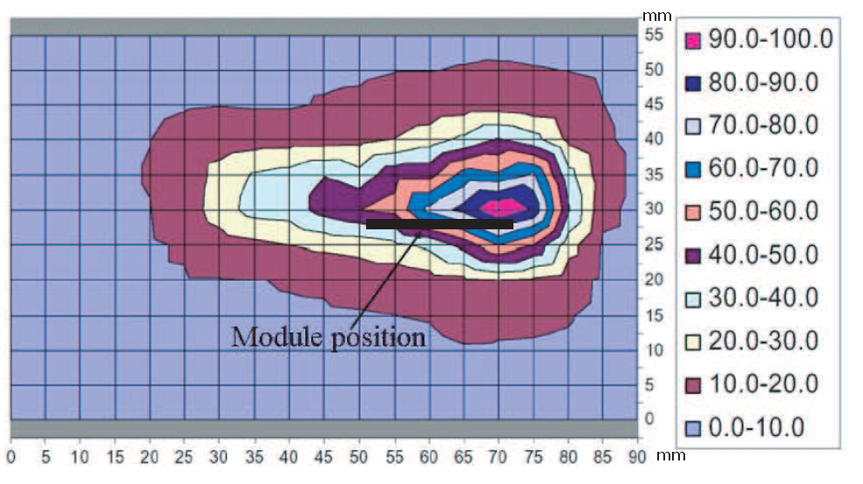
Pixel module tests
ATLAS study phase 0 detector:
Special test beam configuration with a single PS bunch of 10¹¹ p with 42 ns width.
Module (size 1.6 x 6.0 cm) placed edge-on in beam, beam parallel to sensor in long direction
At the center of the extracted beam 3x10¹⁰ p/cm² (average of 1.6x10¹⁰ p/cm² across module).
Production module operating with nominal LV/HV bias, using realistic powering scheme, services, and power supplies.
No damage was observed
  slight increase in leakage current due to total of ~600 Gray exposure.
A. Andreazza et al.
NIM A 565 (2006) 50-54
Fluence map for beam at module location, normalized to % of maximum (3x10¹⁰ p/cm²)
Similar study by CMS showed no damage to CMS pixel sensor at 5 x 10⁹ particles/cm²
M.Dinardo et al. CMS-DN-2013/11

Slide 5
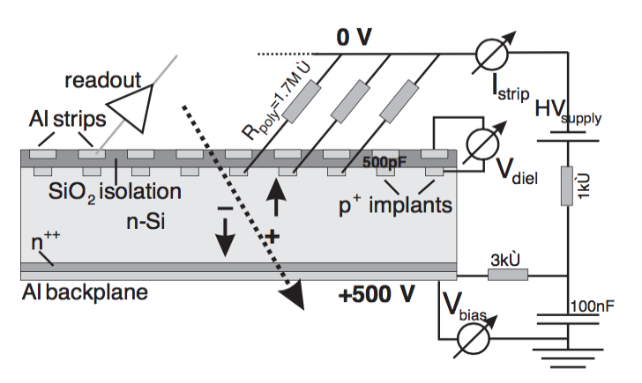
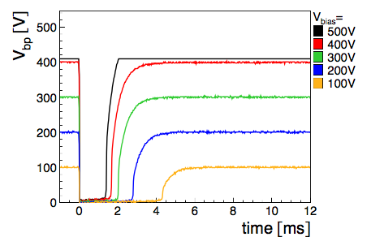
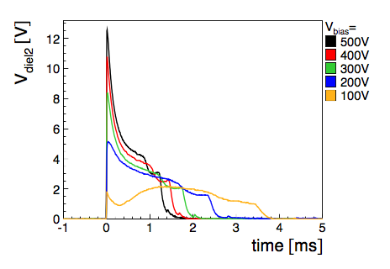
Test beam study, phase 0 strip sensors
Voltage drop over oxide can create “pin holes”, breaking the dielectric layer.
CMS test beam studies have not revealed damage to strip sensors at 1e9 MIPs/cm²
Irradiation of CMS strip modules with PS test beam
Complete breakdown of bias Voltage
Voltage over dielectric, far below critical limit for pinholes (120V)
M.Fahrer, Ph.D. thesis, Univ. Karlsruhe, IEKP-KA/2006-9, M. Fahrer et al. NIMA 518 (2004) 328

Slide 6
Beam loss events
Potentially catastrophic beam loss event can be classified in two groups
Ultra-fast failures
Event could be anywhere in LHC, beam loss mostly in collimation system.
Certain percentage of beam loss at tertiary collimators.
Events between cleaning and experiment most dangerous.
Examples:
  Crab cavity failure
  asynchronous beam bump
Local events
Inelastic beam loss close to experiment
Examples:
  UFOs
  Non-conformities, potentially dangerous in combined failure scenarios.
  Bad vacuum usually too slow.
Related talks at workshop:
  Roderik BRUCE: Collimation hierarchy and tracking for extraction failures. Plenary session, Thursday 9:15
  Andrea SANTAMARIA: Crab cavity failure modes and IR protection. WP5-WP7-WP8-WP14 joint session, Wednesday 16:30
  Kyrre SJOBAEK: Sources of failures and their tracking. Plenary session, Thursday 9:30

Slide 7
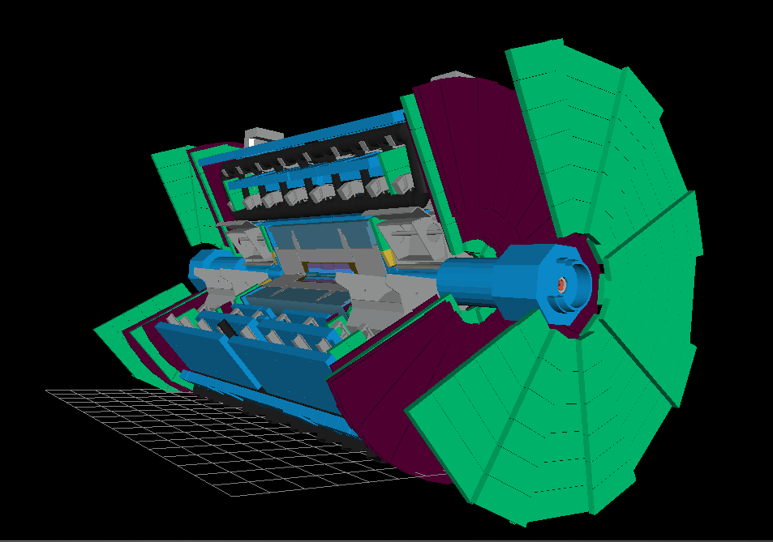
The ATLAS simulation and the TAS
The TAS is a copper cylinder placed inside the ATLAS shielding system.
ATLAS
Pixel detector
TAS
Shielding

Slide 8
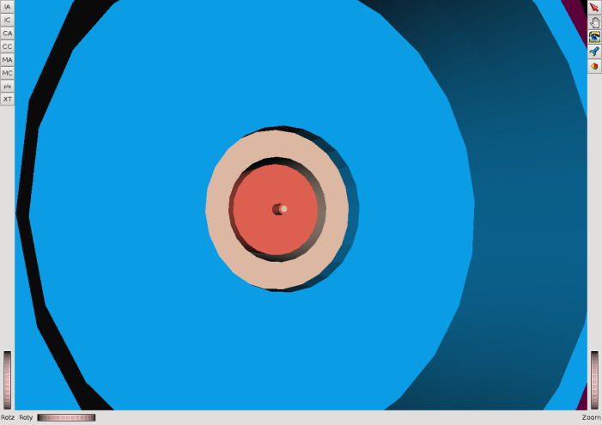
Dimensions of the TAS
TAS radius = 17-250 mm, TAS length = 1.8 m
In the ATLAS simulation the TAS appears split in two cylinders
  17 mm < R < 30 mm, 30 mm < R < 250 mm
Pixel detector
TAS
TAS
Shielding
Shielding

Slide 9
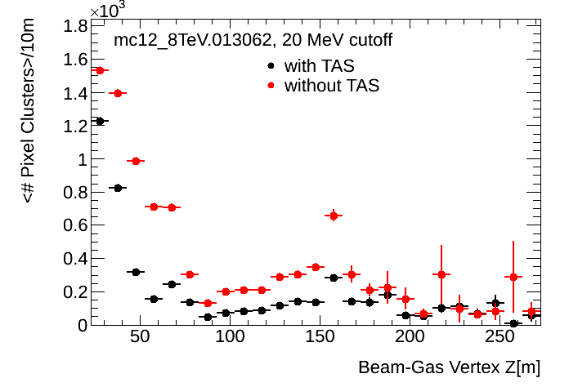
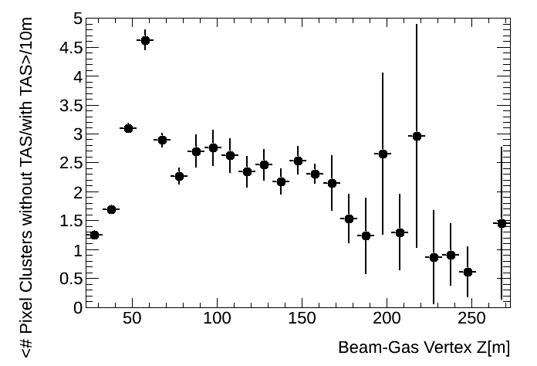
Effect of removing the TAS at ATLAS in LHC
Beam gas interaction simulated in the long straight section using FLUKA. [cern.ch/bbgen]
Particles entering the cavern are recorded to file, pixel cluster hits in ATLAS pixel simulated using Geant4.
LHC 8 TeV
LHC 8 TeV
In case the TAS is completely removed, the average number of pixel clusters is larger by at most a factor 5 (at about 60 m from the IP)
  The TAS protects ATLAS.
  The protection is mostly due to the inner TAS (R < 30 mm)

Slide 10
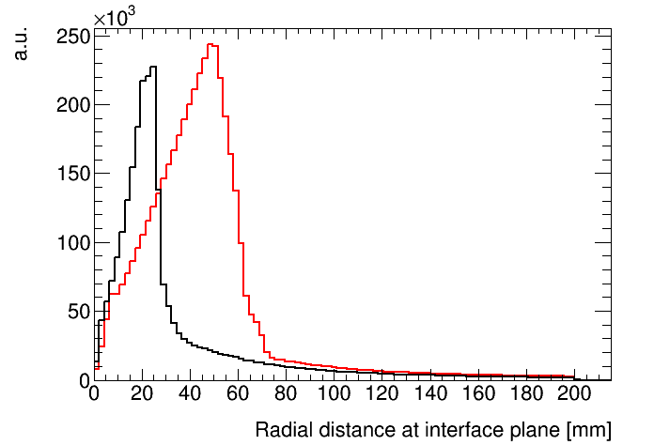

ATLAS:
From LHC to HL-LHC
By increasing the ATLAS TAS aperture from 34 to 60 mm, the average number of pixel clusters doubles.
A saturation is reached at about 50 mm, as suggested by the radial distribution of particles at the interface plane, for the Run2 case.
Given the different radial distribution of particles at the interface plane for HL-LHC, reducing the TAS aperture from 60 to 54 mm will have a larger effect.

Slide 11
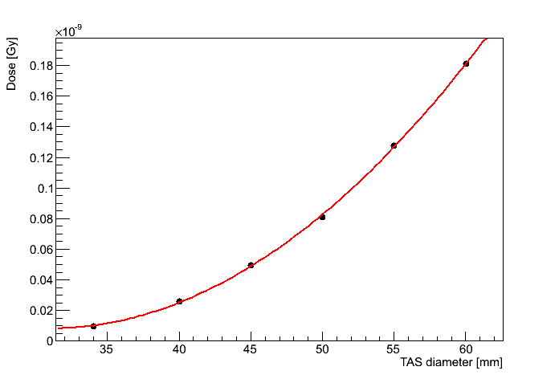
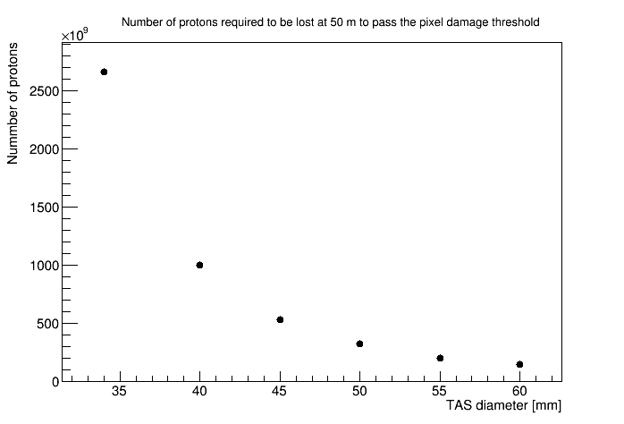
ATLAS:
TAS opening in HL-LHC: damage threshold
Assuming a damage threshold in the pixel detector of 10¹⁰ MIPs/cm² [NIM A, 565 (2006) 50-54] and an energy deposition per MIP of 3.9 MeV/cm, the damage threshold corresponds to:
  dE/dV = 3.9 MeV/cm * 10¹⁰/cm² = 3.9 10⁷ GeV/cm³
The energy density in a silicon sensor (ρ = 2.33 g/cm3) per proton lost is estimated from the simulated Dose:
  dE/dV = Gy*ρ = 6.24 10⁻⁴ GeV/g * 2.33 g/cm³ = 1.45 10⁻³ GeV/cm³
The number of protons to be lost to reach the damage threshold is calculated from the ratio of damage threshold and energy deposition per proton.
Dose per proton lost
LHC
HL-LHC
2nd order polynomial fit

Slide 12
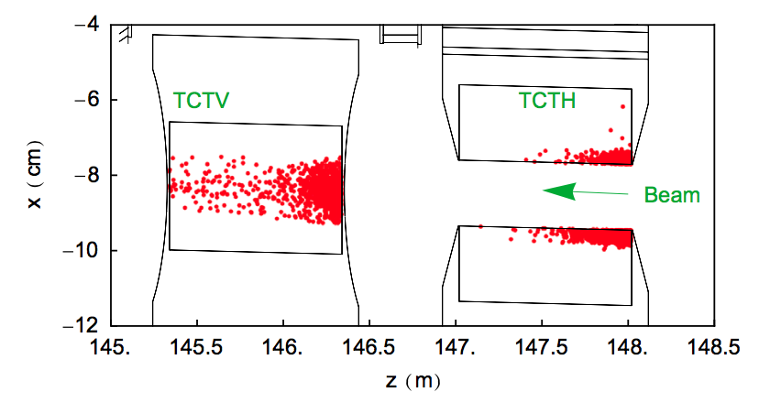
Ultra-fast failures
SIXTRACK simulation of beam loss
  Impact locations and parameters recorded
  Hits close to experiments in tertiary collimators
  Impact distribution different for different loss scenarios
  Related talk: Regina KWEE-HINZMANN: Collimation backgrounds at HL-LHC. WP5 session, Wednesday 11:45.
FLUKA simulation of particle shower in straight section.
  Parameters of shower particles recorded to file at entrance of cavern
Particle shower inside experiment simulated with FLUKA
For current study, files of failure scenario not yet available.
  Approximation by using distributions of operational beam halo hits, provided by Collimation and FLUKA team.
Example of hit distribution on TCTs from beam halo
[R. Bruce et al., NIM A 729 (2013) 825]

Slide 13
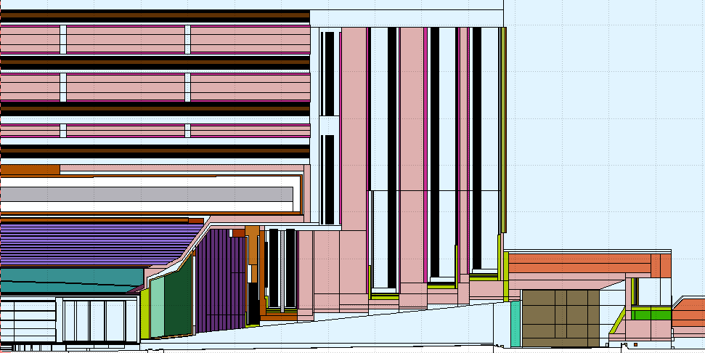
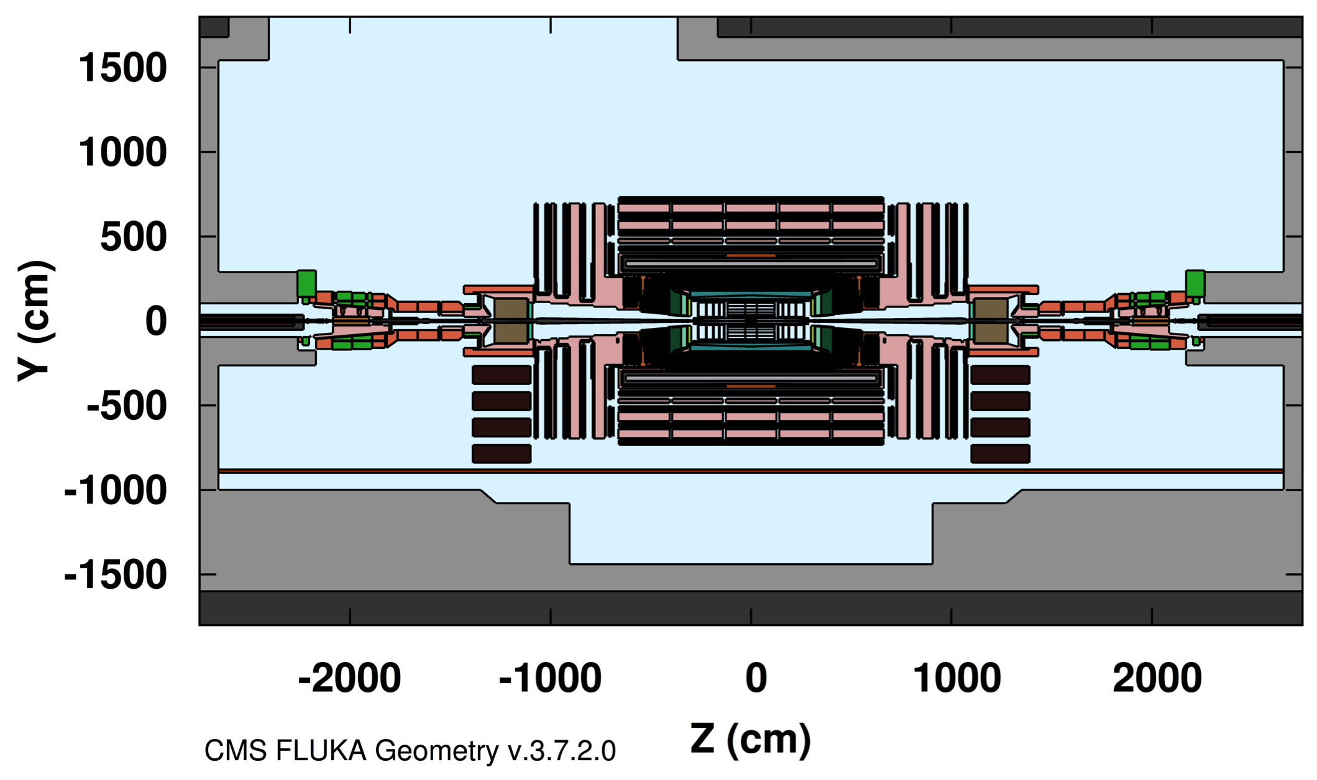
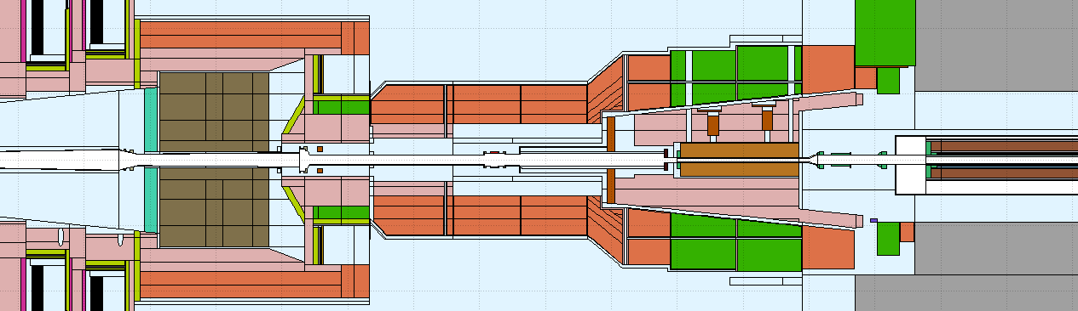
CMS
Phase 2 tracker
IP
TAS ø57mm
TP beam pipe:
Like Run 2, but Al & 150% thick
Increased aperture
HL-LHC quadrupole

Slide 14
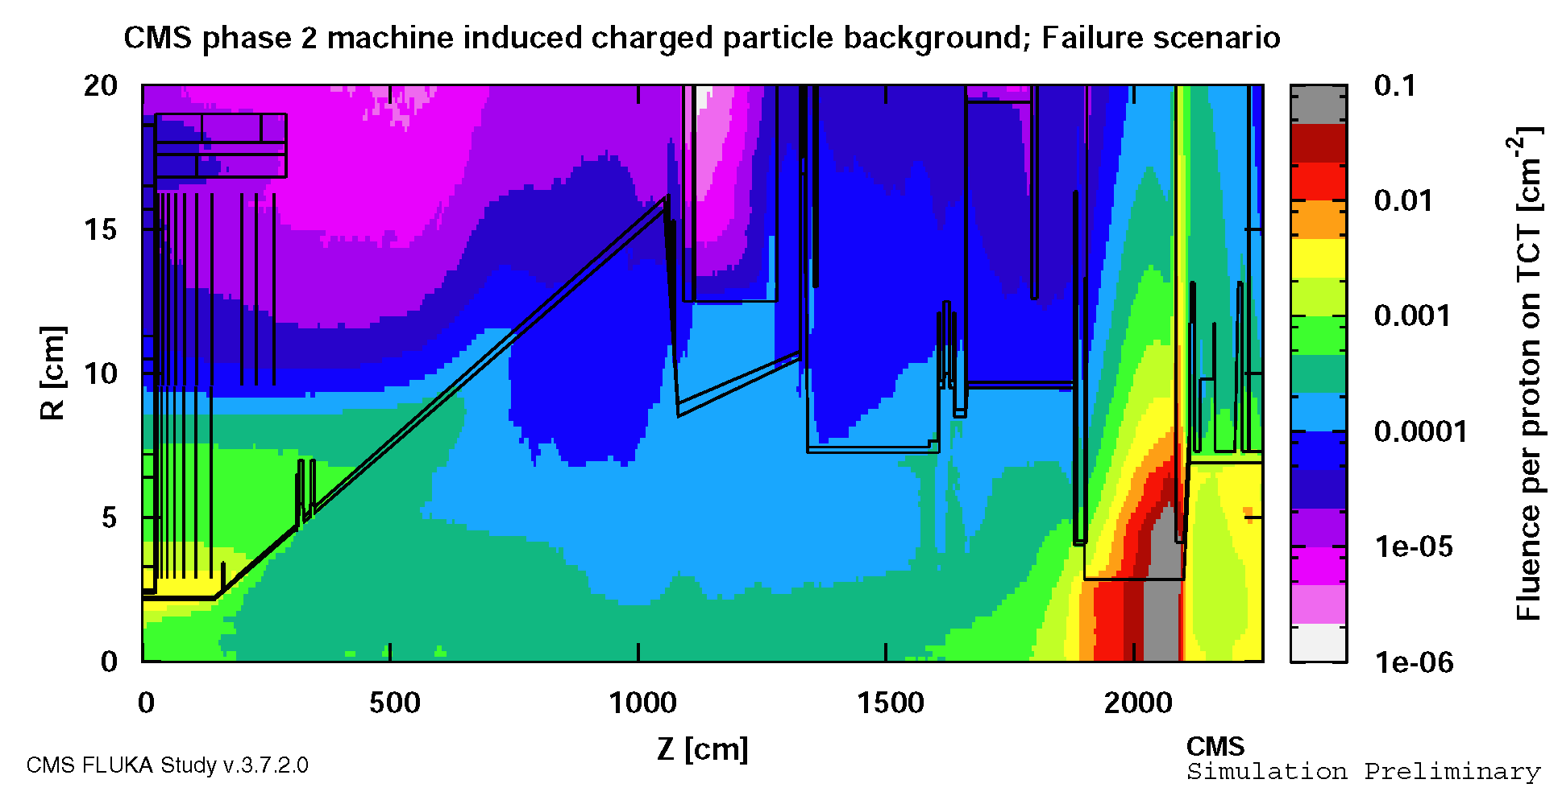
Fluence around CMS beam pipe
HF
TAS
Pixel
IP
BEAM
Average charged particle fluence per proton hit in TCT
TAS reduces charged particle fluence
Particle shower hitting the Pixel created mostly in the beam pipe
  Picture very squeezed, long beam pipe cone is significant material in the path of MIB particles

Slide 15
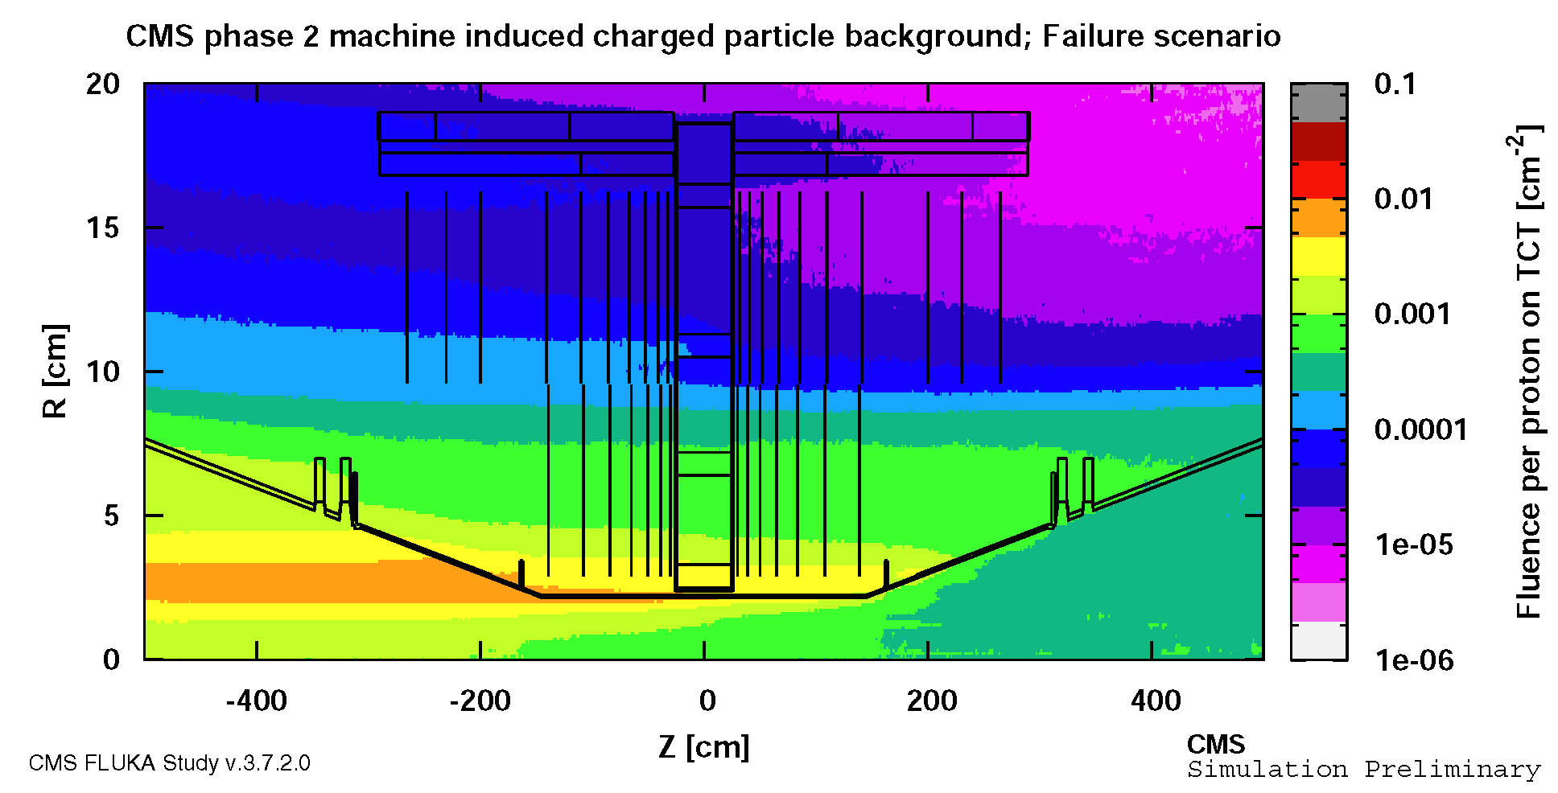
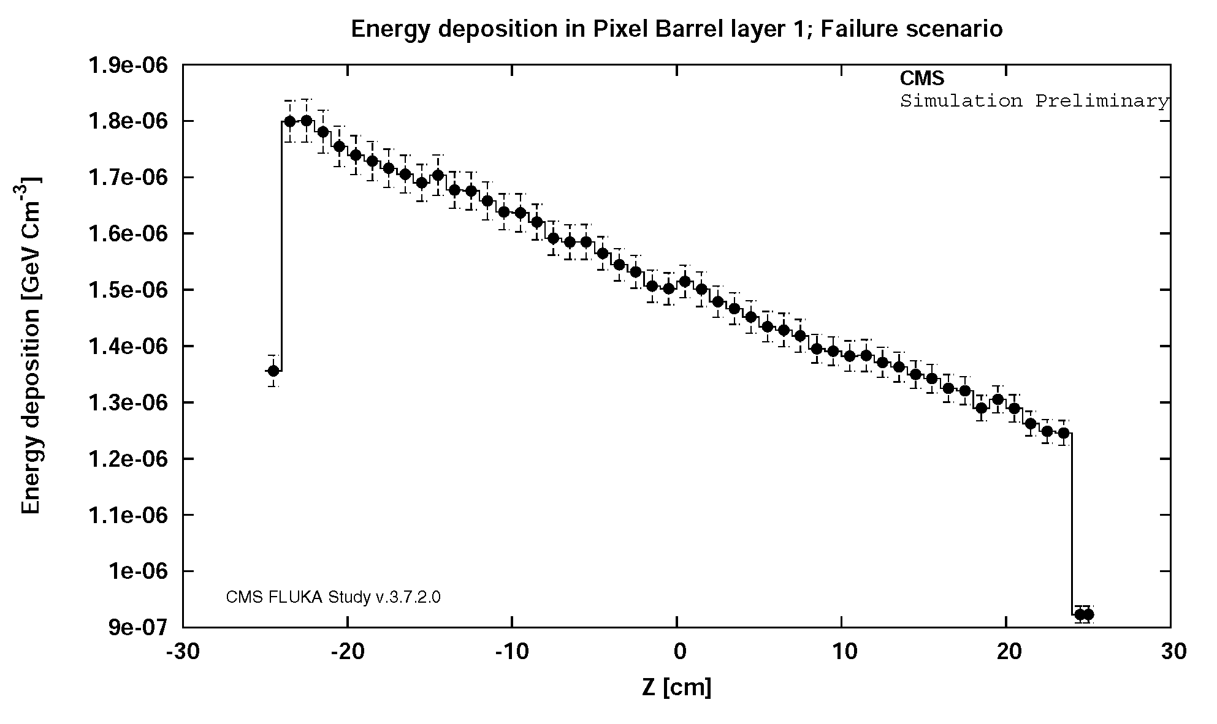
Effects on Tracker
Highest fluence in inner layer of pixel barrel and at low radius edge of endcap discs.
Peak energy density in downstream end of barrel layer.
  1.8 x 10⁻⁶ GeV/cm³ peak deposition in “average material”
  Effective deposition in Silicon: 1.5 x 10⁻⁵ GeV/cm³
Damage threshold defined by CMS tracker community: 1e9 MIPs/cm²
  With 3.876 x 10⁶ GeV cm⁻³ as critical energy density, 2.58 x 10¹¹ beam particles on TCT needed to damage the tracker.

Slide 16
Variation of TAS radius
Same study performed for different radii of TAS opening.
  With more open TAS, fewer particles on TCT are needed to reach the damage threshold
Result can be used to judge severity of beam loss events.
HL-LHC
LHC

Slide 17
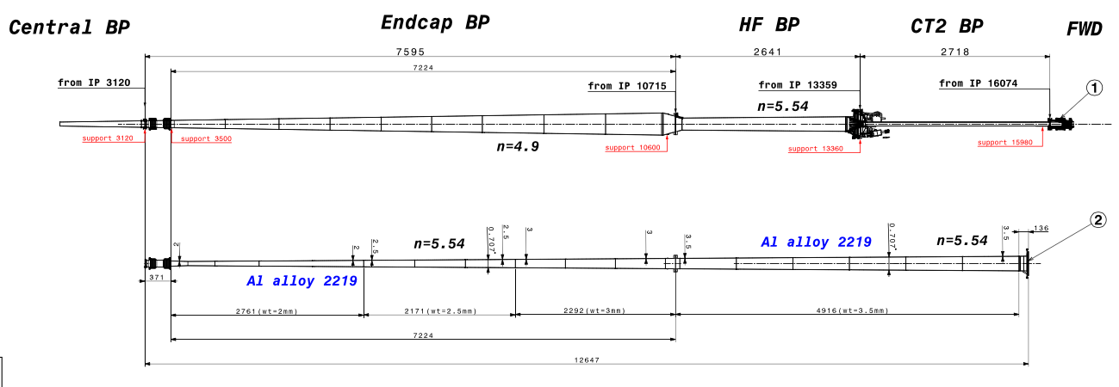
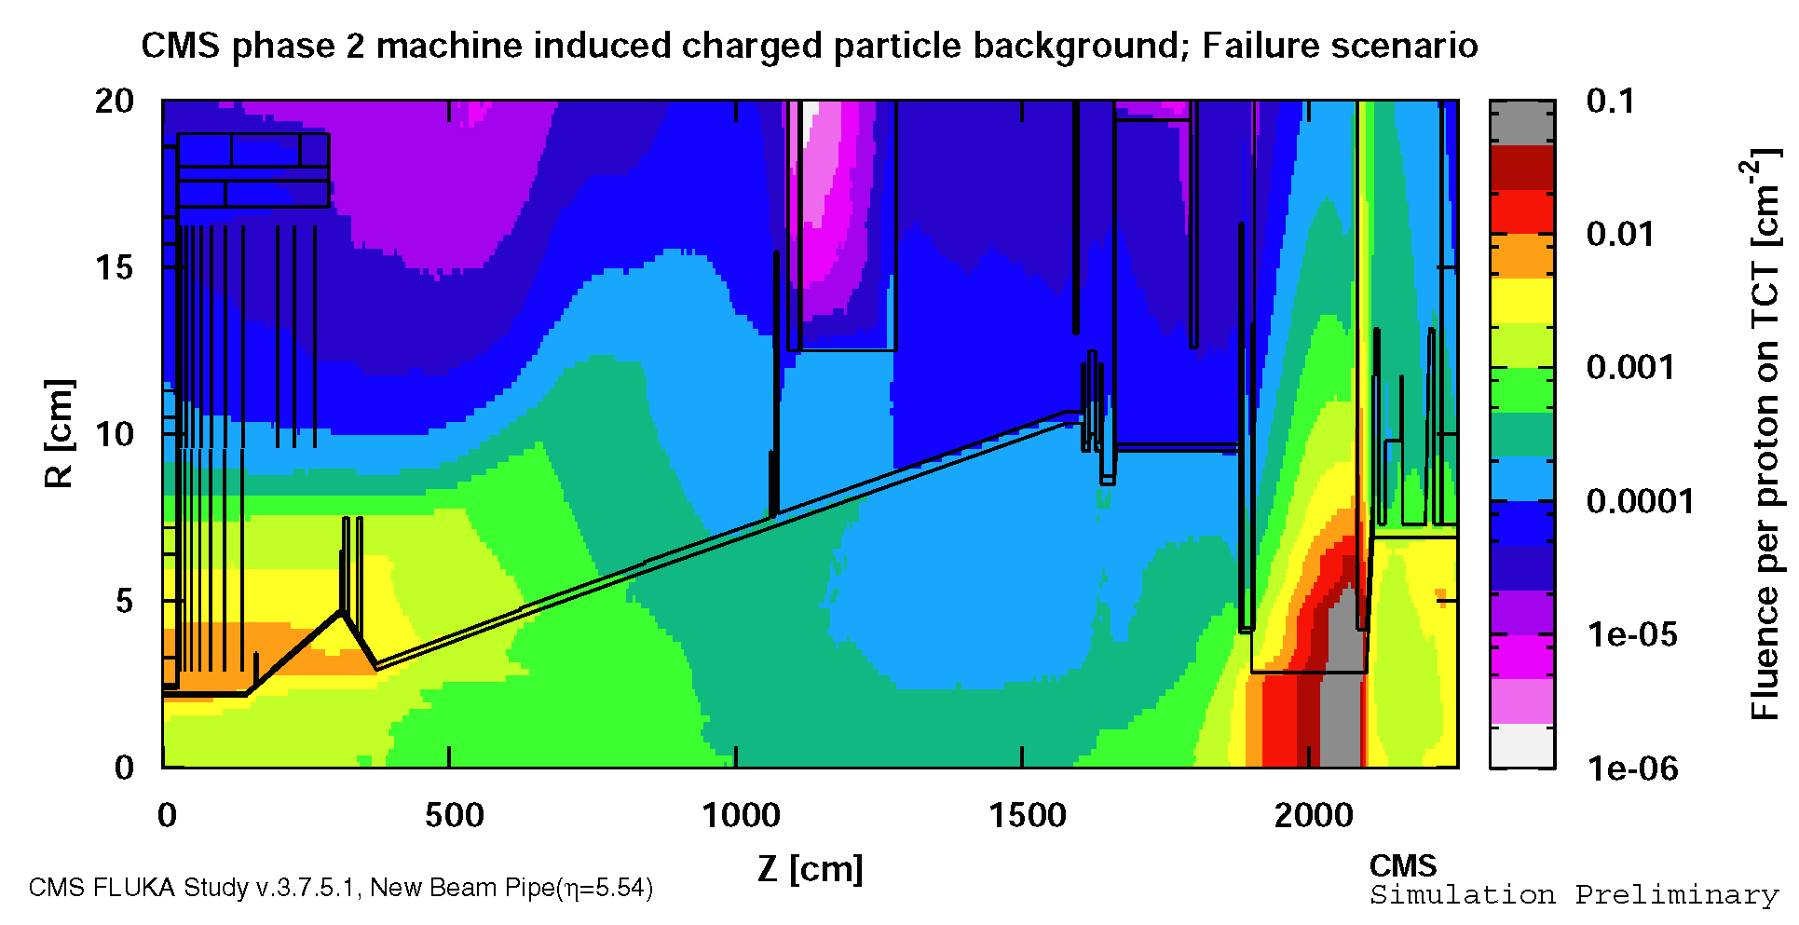
New beam pipe design.
Run2 beam pipe
Proposal of a HL-LHC beam pipe design
(currently under study)
Particle showers from MIB increased.
  High eta cone acts as thick material in path of background.
  Taper between eta cones sticks into high energetic fluence at low R.
  Transition currently being optimized.
Increased energy depositions by 60-70% in inner pixel barrel
Beam pipe has a strong influence on MIB
HL-LHC
Beam pipe

Slide 18
Considerations & Limitations
Generic background data used as first estimation
  Simulations specific to beam loss events to be studied.
  Most interested in crab failure and asynchronous dump
Shown results are for potentially damaging events, significant safety factors should be considered.
Damage thresholds for phase 2 modules to be defined.
  Risk factors may be different due to 65nm instead of 250nm FE electronics process and designs.
  Would expect a substantial difference between planar sensors (operating up to 1500V) and 3D sensors which will likely have less than 100V bias.
  Detector development will include measurements on phase-2 pixel and strip modules under intense beam loss conditions
    Would benefit from a more extensive test period, with larger control over the incident beam

Slide 19
Summary
Passive protection from beam loss events important for experiments.
  Note: For lifetime reasons, innermost Pixel layers in ATLAS and CMS are replaceable, but a major beam accident could be expensive in time and material !
Influence of TAS diameter
  The smaller the better for experiments, especially in HL-LHC
  between 54 and 60 mm are focus of the studies.
  No significant difference in this range for considered beam loss events.
Very interested in ongoing “catastrophic beam loss” simulations, to understand magnitude of effect (p/cm² possible for worst-case accidents).

Slide 20
THANK YOU
Acknowledgements
On behalf of CMS
  Thanks to CMS BRIL Radiation Simulation team, CMS Upgrade coordination, CMS technical coordination, CMS Tracker project.
On behalf of ATLAS
  ATLAS simulation team, ATLAS technical coordination, ATLAS radiation background simulation team, ATLAS Upgrade team.
Thanks to LHC Background Study Group, LHC collimation team
Thanks to FLUKA team (EN-STI)

Slide 21
backup

Slide 22
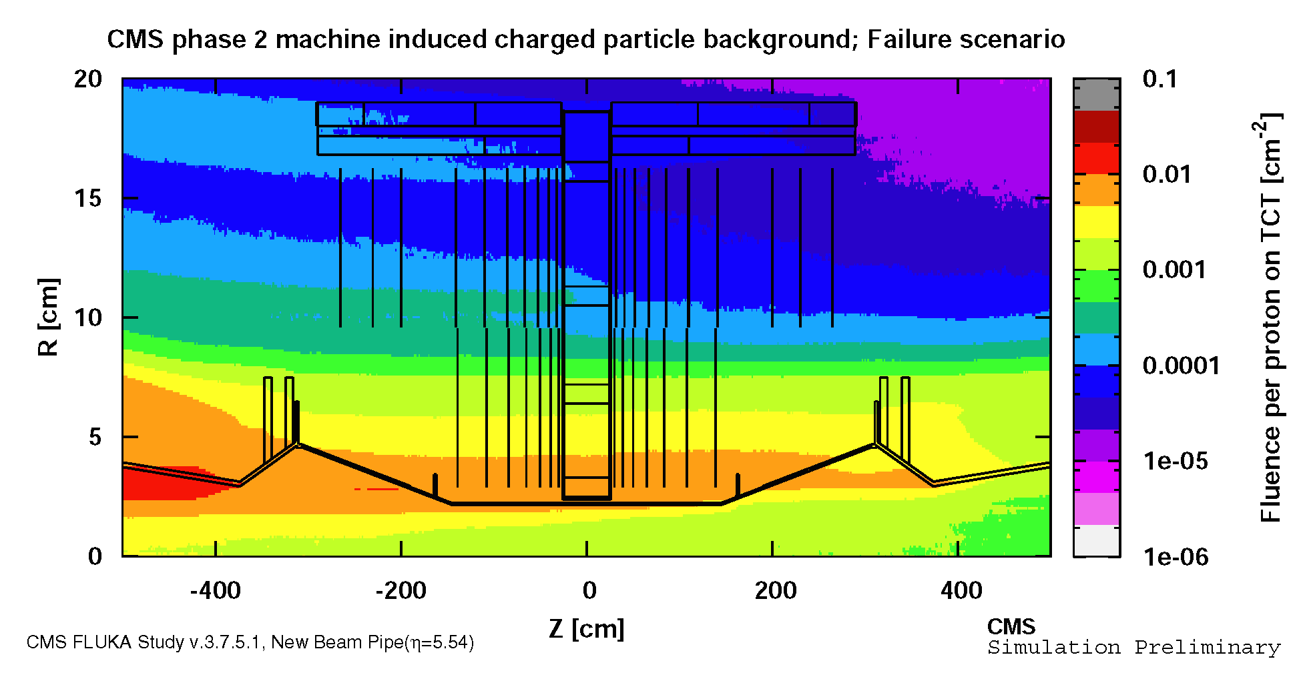

Slide 23
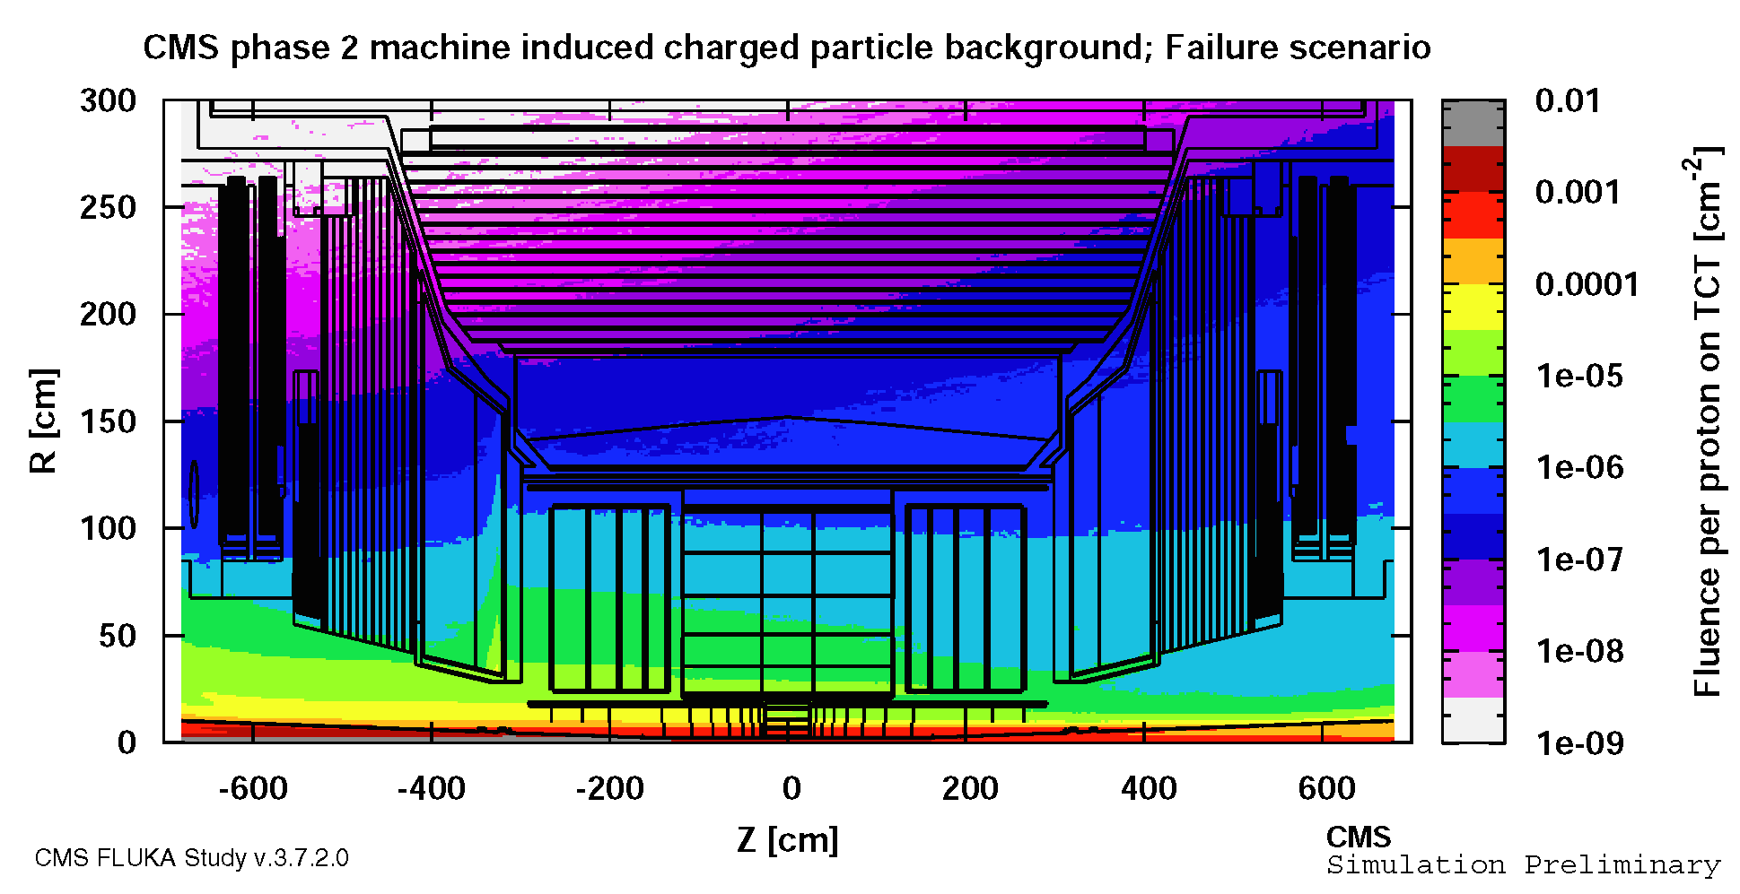
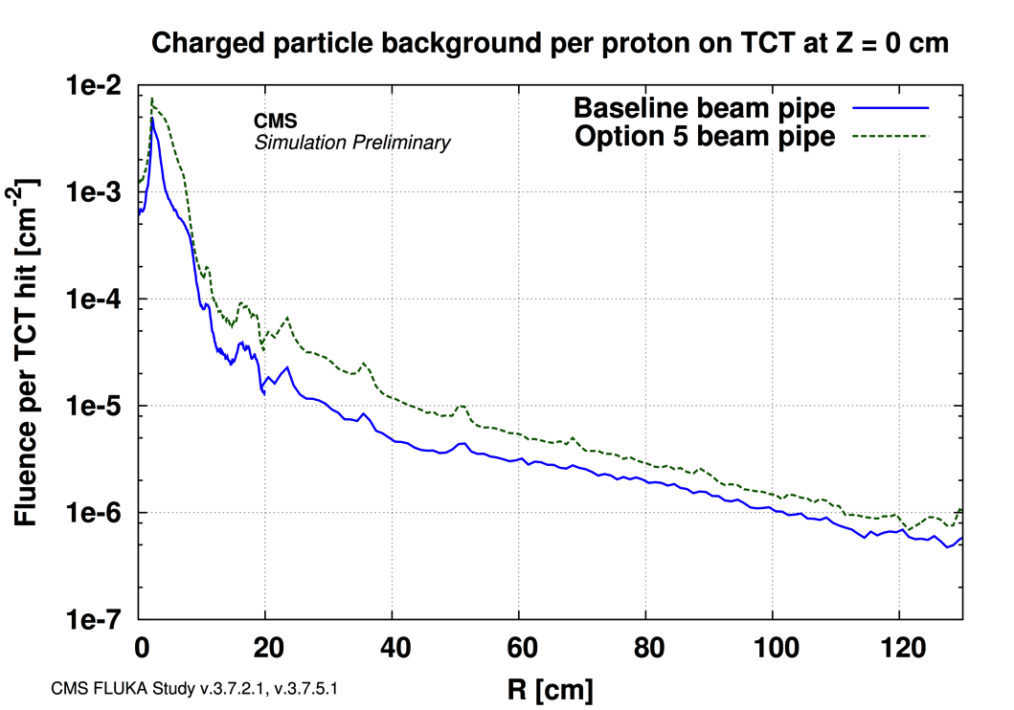
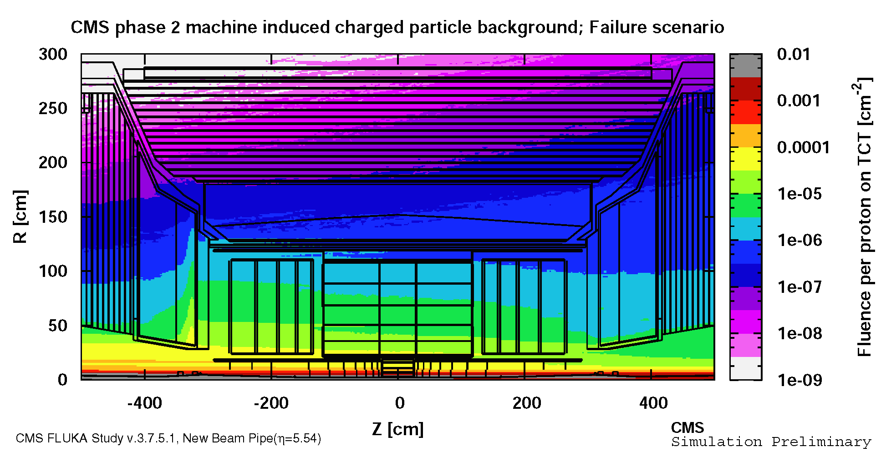
Fluence in CMS Strip Tracker

Slide 24
Considerations & Limitations extended
Protection from “slow events” by active protection. i.e. slower than 3 turns not an issue.
Generic background data used. Simulations specific to beam loss events to be studied. (crab failure, asynchronous dump)
Simulation geometries based on current assumptions, certain elements likely to change
  Final layout of pixel detectors (i.e. radius of inner most layer)
  Beam pipe geometry
  FLUKA model of straight section
Shown results are for potentially damaging events, significant safety factors should be considered.
Actual damage thresholds to be defined for phase 2 sensors & electronics. Part of the development should be measurements on phase-2 pixel and strip modules under intense beam loss conditions:
  Risk factors may be different due to 65nm instead of 250nm FE electronics process and designs.
  Would expect a substantial difference between planar sensors (which might operate with up to 1500V bias after high radiation doses) and 3D sensors which will likely have less than 100V bias.
  Would benefit from a more extensive test period, with larger control over the incident beam (ability to localize charge deposition into a smaller region perhaps ?)

