Slide 1
Crab Cavities: Vacuum Considerations for SPS and HL-LHC
V. Baglin (TE-VSC)
on behalf of WP12
5th Joint HiLumi LHC-LARP Annual Meeting
CERN – 26-30 October 2015

Slide 2
1. Crab Cavities in SPS

Slide 3
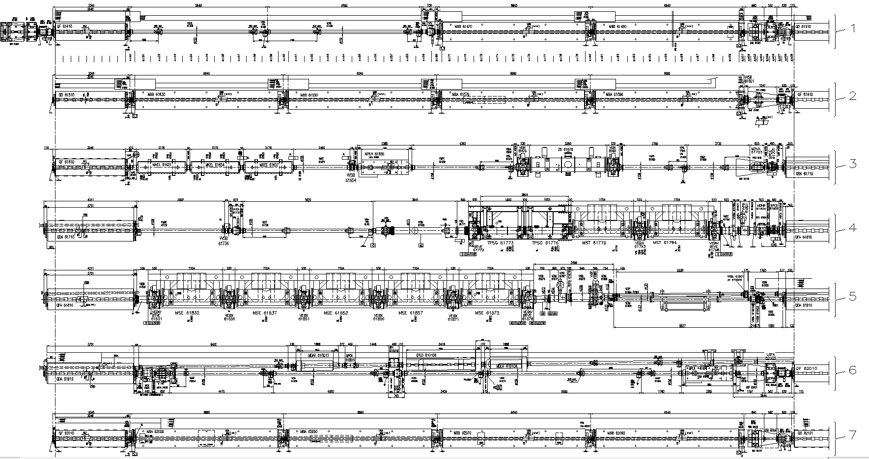

SPS Long Straight Section 6
$$∼9.5 m$$

Slide 4
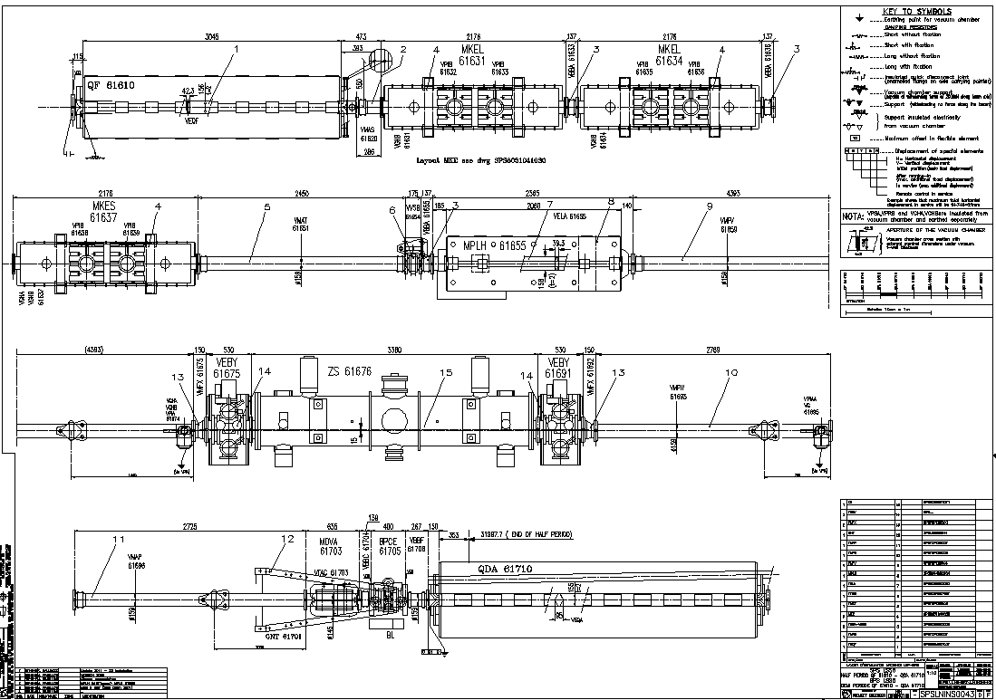
SPS LSS6 – Half period QF 61610 – QDA 61710
VVSB
ZS

Slide 5
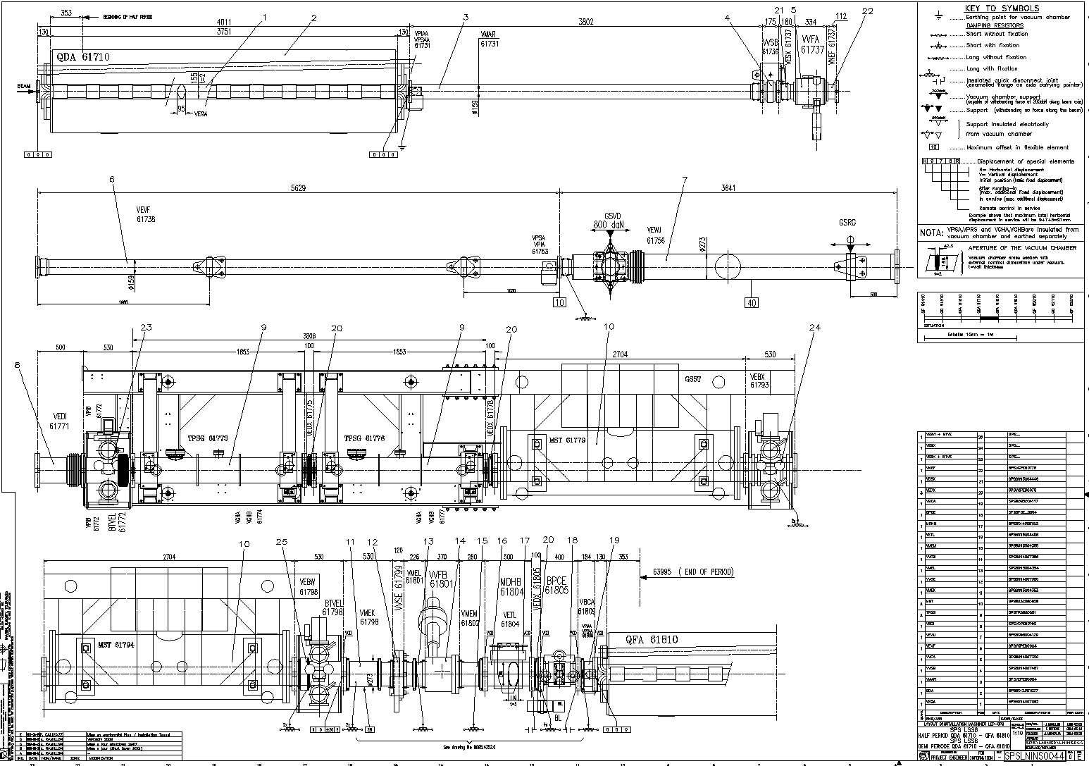
SPS LSS6 – Half period QDA 61710 – QFA 61810
VVSB
VVFA
TPSG
MST

Slide 6
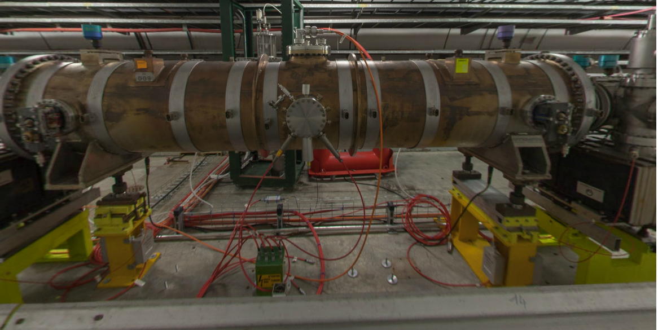
SPS LSS6 –ZS

Slide 7
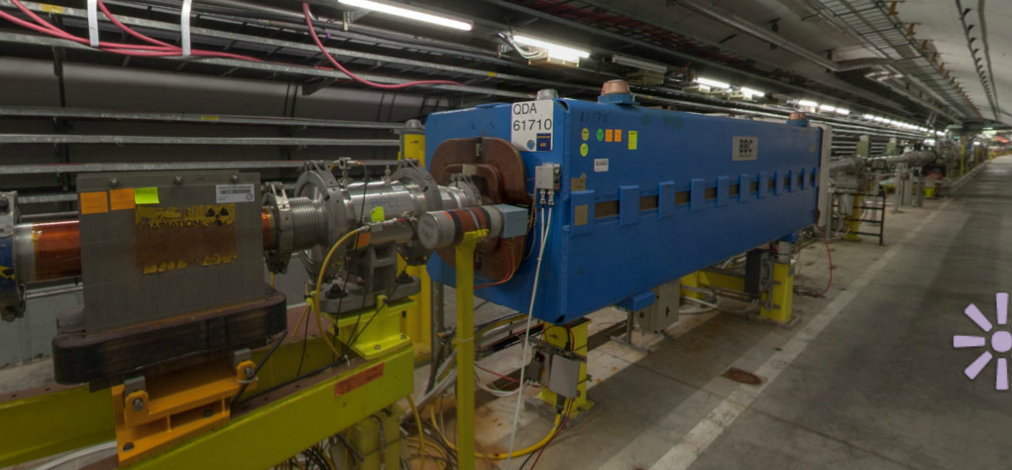
SPS LSS6 –QDA 61710

Slide 8
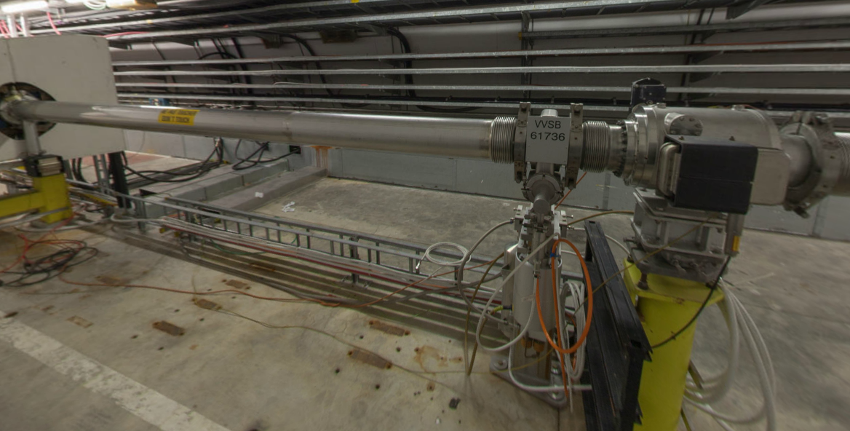
SPS LSS6 – RF testbed area

Slide 9
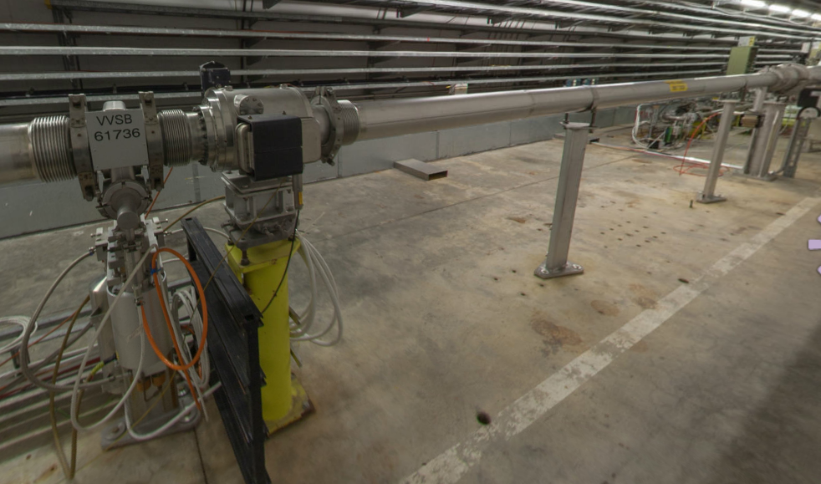
SPS LSS6 – Sector and Fast Valves located in RF test bed area

Slide 10
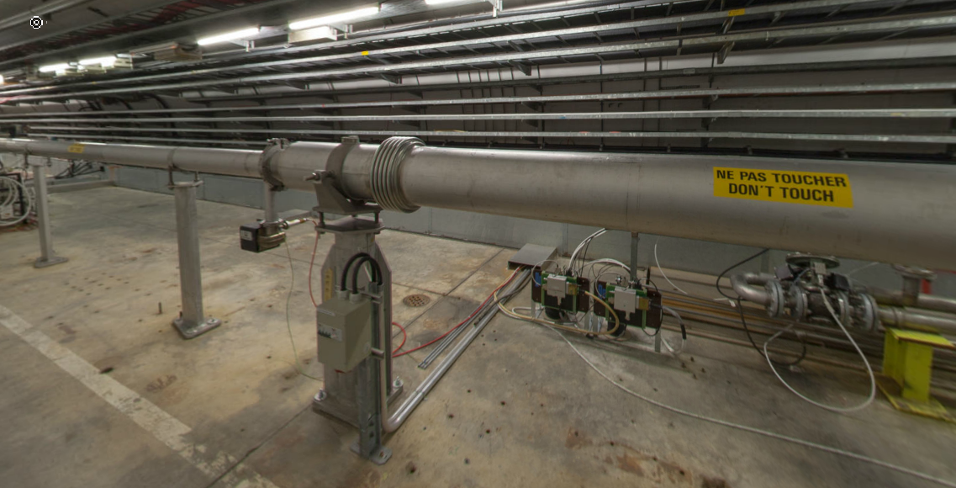
SPS LSS6 – New Position of Sector and Fast Valves

Slide 11
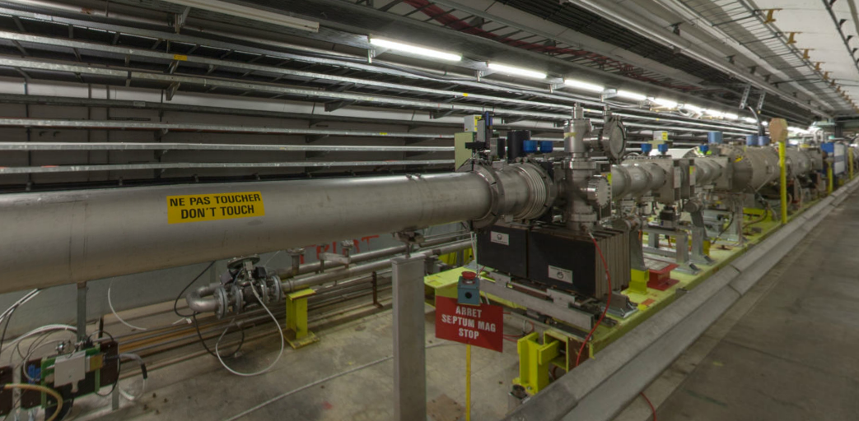
SPS LSS6 – TPSG and MST

Slide 12
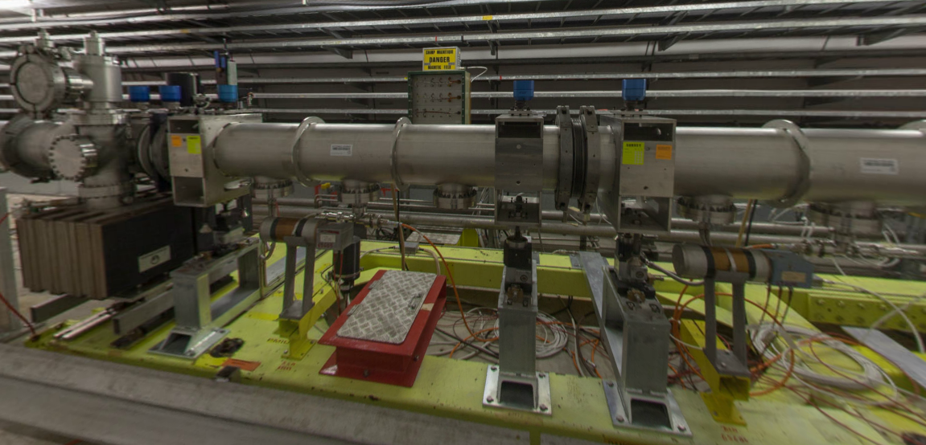
SPS LSS6 – TPSG

Slide 13
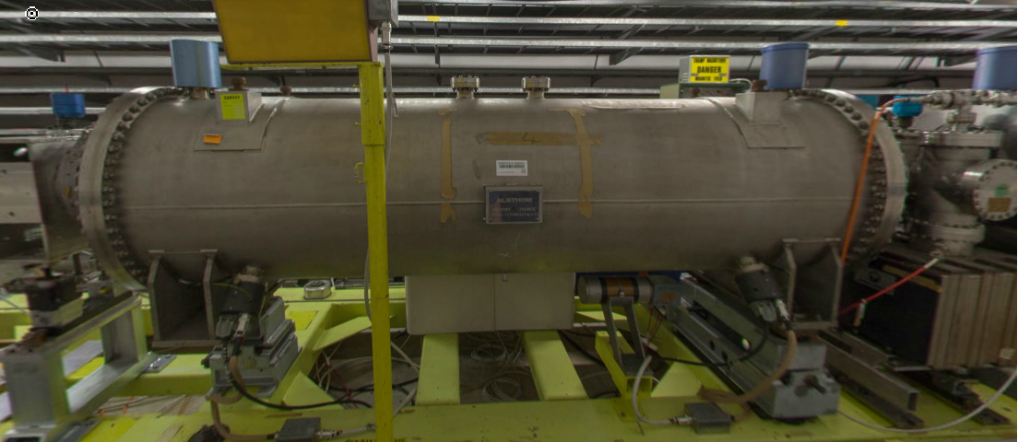
SPS LSS6 – MST

Slide 14
Description
QDA 61710
  A defocussing quadrupole, length 4011 mm
  Vacuum chamber VEQA, elliptical
VVSB
  Aperture 150 mm
  A sector valve
  It must be displaced and moved on the right side by at least xx meters
VVFA
  Aperture 150 mm
  A fast valve which protects the ??
  It must be displaced and placed to at least xx meters upstream to the protect equipment
TPSG
  A graphite mask which protects the downstream septum
  Must be vented, isolated with a new sector valve, and pump down for at least 3-4 weeks before beam
Pumping system
  On the right side of QDA 61710: a 20 l/s ion pump, VPIAA
  At 61753, another a 20 l/s ion pump, VPIAA
  At the level of the TPSG, 61772, 2 ions pumps of 400 l/s each, VPIB

Slide 15
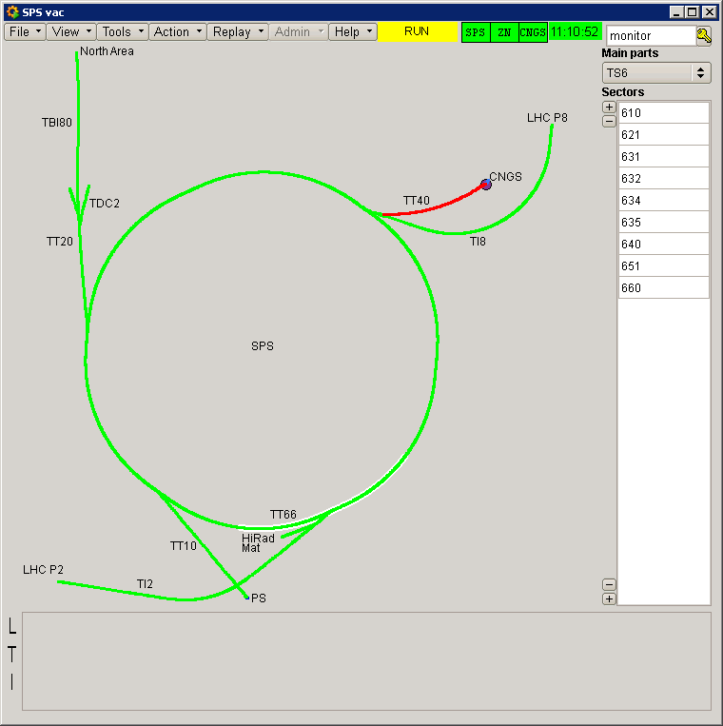
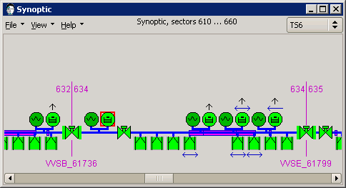
Pressure profile
VGHB_61693: ZS tank left of QDA 61710
VPIA_61731: right of QDA 61710
VGHB_61736: on VVSB_6173 sector valve
VVFA_61737: fast valve
VPIA_61737:
VPIA_61753
VPIB_61771: on left side of TPSG 61773
VPIB_61772: on left side of TPSG 61773
VGHB_61775: TPSG 61773
VGHB_61778: TPSG 61776
VPIB_61792: on right side of MST 61779
VPIB_61793: on right side of MST 61779
VGHB_61793: on right side of MST 61779
VGHB_61693
VGHB_61736
VGHB_61778
VGHB_61793
VGHB_61775
VPIB_61771&72
VPIA_61695
VPIA_61731

Slide 16
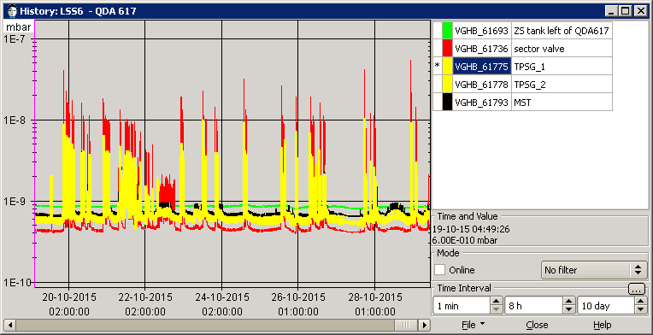
Pressure profile
Actual pressure in the sector ~ 2 10⁻⁸ mbar: dominated by pressure at sector valve

Slide 17
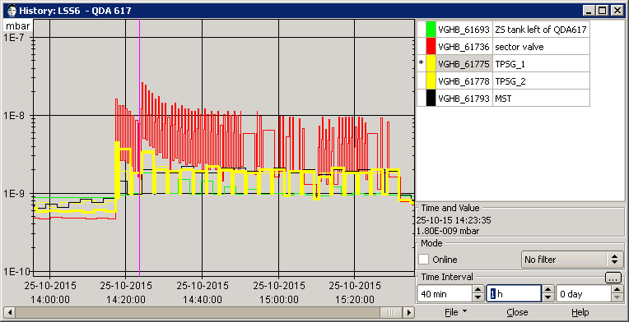
Pressure profile
Actual pressure in the sector ~ 2 10⁻⁸ mbar: dominated by pressure at sector valve
ZS = 2 10⁻⁹ mbar
TPSG = 3 10⁻⁹ mbar
MST = 2 10⁻⁹ mbar
➔ One order of magnitude must be gained to reach the specs : 10⁻¹⁰ mbar in CC

Slide 18
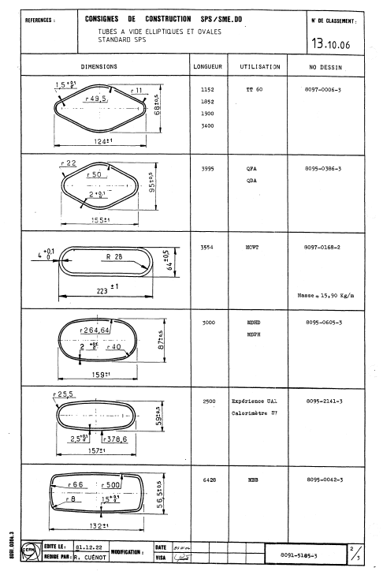
SPS vacuum chambers: QDA
Computing electron cloud levels in QDA type chambers would be beneficial to evaluate the pumping scheme

Slide 19
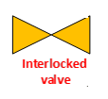
A Possible Instrumentation Layout
CC
4 vacuum sectors:
  Upstream CC, NEG coated
  CC
  Downstream CC, NEG coated
  Bypass, NEG coated
Each vacuum sector has:
  Penning / Pirani gauges
  Roughing valve
NEG coated sectors have:
  Ion pumps
Detailed study is needed to optimise the pumping scheme
More instruments could be added

Slide 20
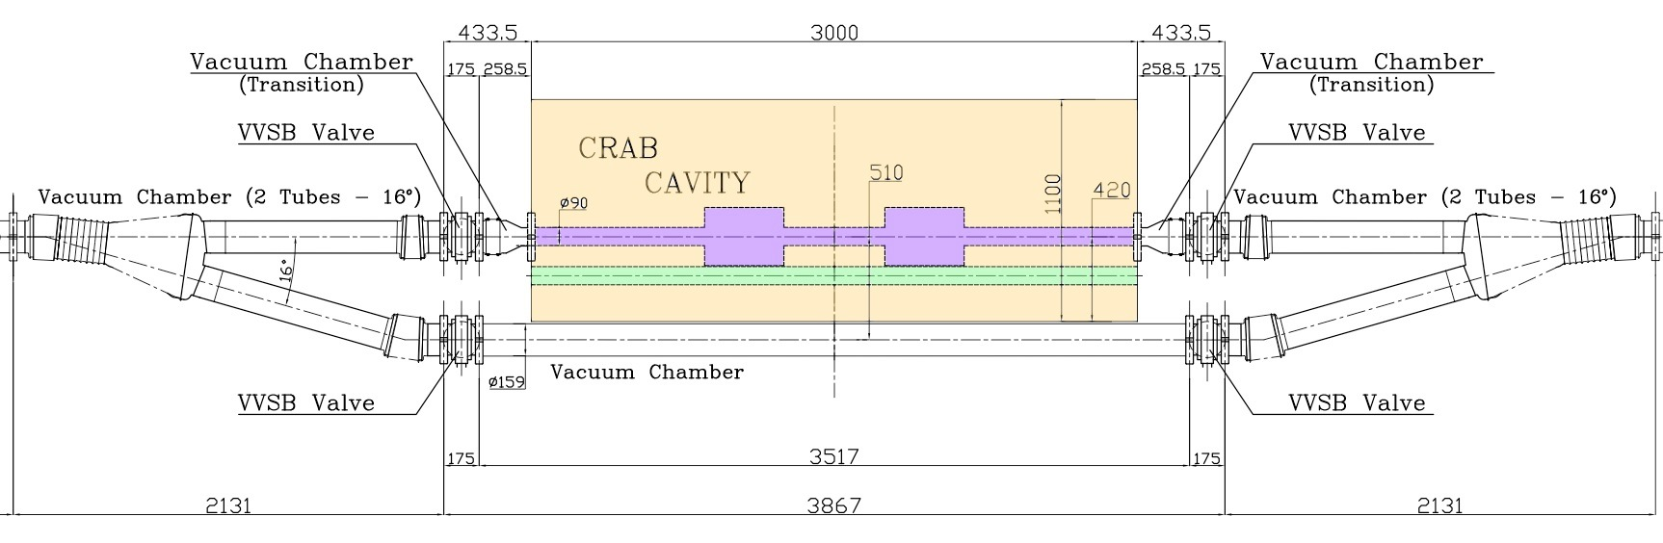
Conceptual Hardware Layout around CC
V1
V3
16º
Preliminary concept
V2
V4
R. Calaga, 27/10/2015
Y chamber
  Impedance free
  NEG coated
  Number of cycles for the bellows ?
Crab cavity volume
  L = 3000 mm
  W = 1100 mm
  Interface flange: CF ? DN100 ?
Bypass chamber
  Distance between mechanical axis of bypass and CC ?
Sector valves, V1,2,3,4
  Fixed to the movable table
Is available longitudinal space of ~ 9.5 m enough ?

Slide 21
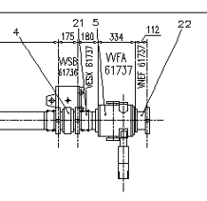
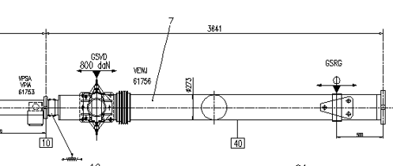
New Sectorisation
The assembly sector valve plus fast valve must be moved towards the right side by ~ 5.5 – 6 m
  ECR needed
  Fast valve might be completely removed from the layout if needed
  The chamber VEWJ can be reduced in length (pending aperture checks) if needed

Slide 22
Installation
Planned for EYETS 2016-17
  Definition needed by Dec 2015 for :
  Vacuum sectorisation & instrumentation layout
  Y chambers ➔ need frozen specification for design
  Procurement of main components : sector valves (6+1), pumps, gauges etc..
Intervention planning to be detailed:
  Venting the 2 adjacent sectors with N2
  Immediate installation of the external sector valves to allow pump down of the adjacent vacuum sectors (ZS tank , Graphite TPSG, Septum …)
  Installation of the movable sectors
  Installation and closure of the CC bypass system with a replacement chamber

Slide 23
2. Crab Cavities in HL-LHC

Slide 24
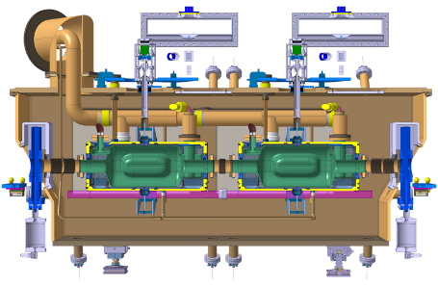
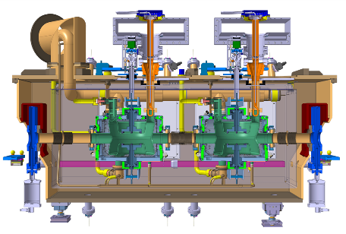
Crab Cavities
Operating pressure ~ 10⁻¹⁰ mbar with beams
2 designs with bulk Nb operating at 2 K
Vacuum instrumentation on the modules is under definition
RF Dipole,
Horizontal Deflection (CMS)
Double Quarter Wave, Vertical Deflection (ATLAS)
R. Calaga, O. Capatina, 27/10/2015

Slide 25
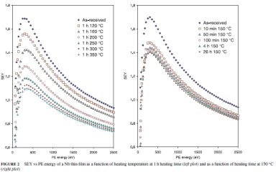
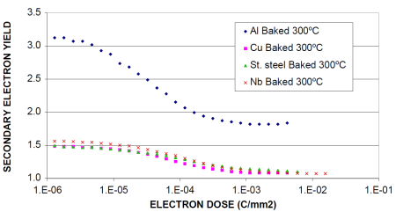
Crab Cavities
Impact of the electron cloud in the CC modules must be evaluated:
    Nb cavity itself
    Inter-cavity tube
    Module cold warm transition
Samples needed for qualification
1.1 < Nb film SEY < 1.7
Electron conditioning
N. Hilleret et al., Appl. Phys. A 79, 1085-1091 (2003)
N. Hilleret et al. EPAC 2000, Vienna, Austria

Slide 26
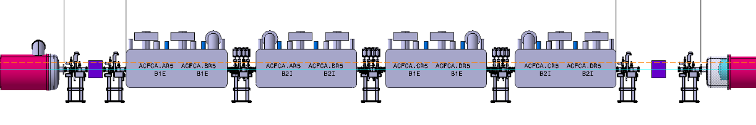
Layout –D2-Q4
D2
LHCLSXH_0010 V0.3 under approval
Q4
Courtesy B. Vasquez de Prada
5 x 4 sector valves between D2 and Q4 !
9 x 2 vacuum sectors !
Room temperature sectors (except CC modules): bakeable and NEG coated
4 sectorised CC modules: unbaked, operating at cryogenic temperature
3 types of sector valves assemblies (VAB)

Slide 27
D2 -1st Module Interconnection
A new vacuum sector is needed following the shift of the module due to DSL link
Detailed integration study is needed (sector valves side by side ?)
D2
CC

Slide 28
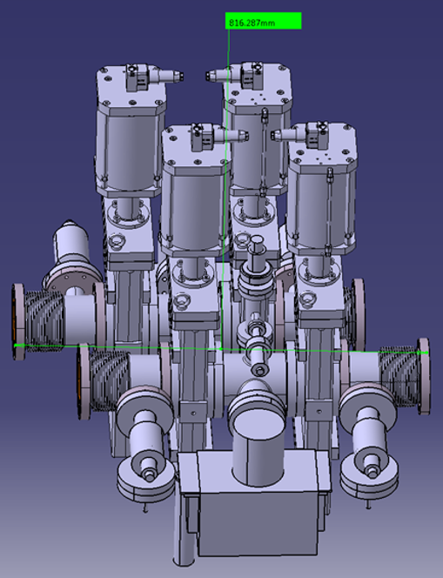
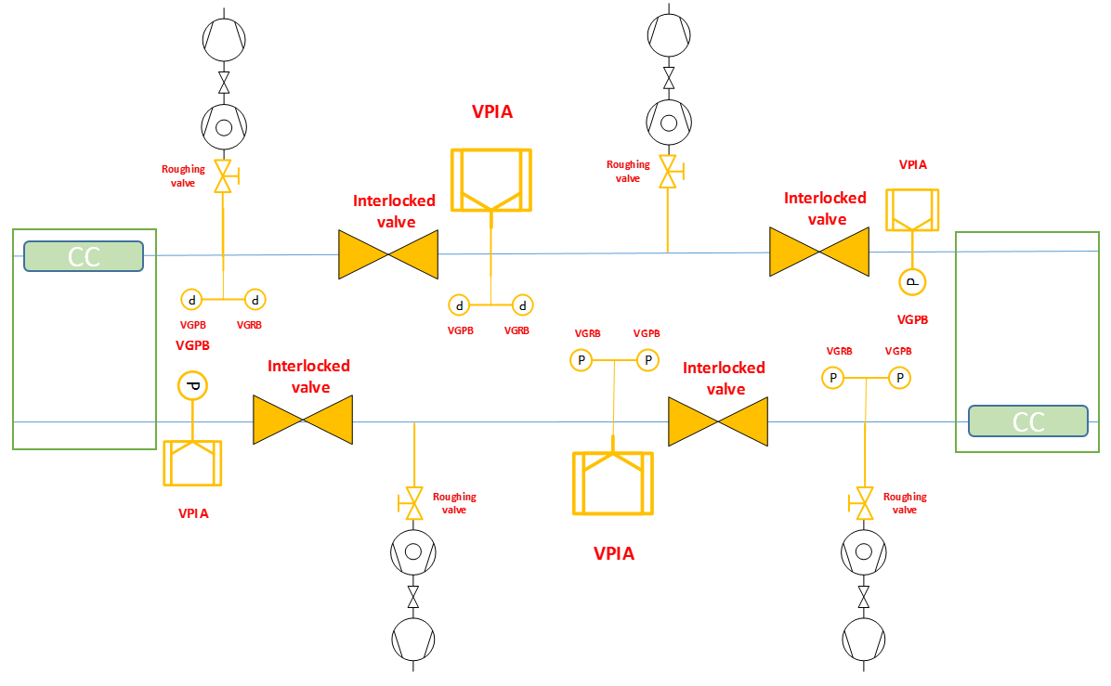
Crab Cavities Modules Interconnection
Progress in the definition of the inter-module: allocated length increased to 820 mm
Courtesy R. F. Gomez

Slide 29
4th Module – NEG sector Interconnection
Detailed integration study is needed (sector valves side by side ?)
NEG pipes
CC

Slide 30
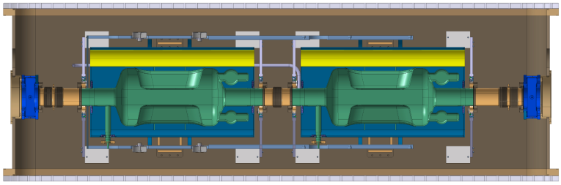
Layout –D2-Q4: 2nd beam pipe
The 2nd beam pipe is held at 2 K and has cold warm transitions (CWT) !
Current material is Ti, diameter limited by space
In LHC, maximum length without beam screen is < 1 m (to be revised for HL-LHC)
Detailed studies are needed to comply with vacuum stability and pressure level (electron cloud !)
CWT
CWT
A beam screen between
2 cryogenic pipes ?
A beam pipe with
Antechamber ?

Slide 31
3. Summary

Slide 32
Summary
SPS layout with crab cavities:
  The bypass layout has to be frozen by end 2015 to start Y chamber design and procurement of main components
  Detailed computation of pressure profile is needed to optimise the pumping scheme
  An installation planning has to be drafted
HL-LHC:
  Crab cavities area vacuum layout is under definition
  Dedicated studies are needed to:
    understand the impact of electron cloud
    design the 2nd (non-crabbed) beam pipe integrating a distributing pumping scheme

Slide 33
Thank you for your attention

Slide 35
Backup Slides

Slide 36
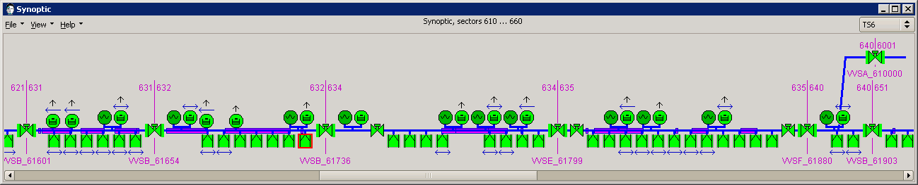
Pressure profile
VGHB_61693:1.6 m left of QDA 61710
VPIA_61731: right of QDA 61710
VVSB_61736: sector valve
VGHB_61736
VVFA_61737: fast valve
VPIA_61737:
VPIA_61753
VPIB_61771: on left side of TPSG 61773
VPIB_61772: on left side of TPSG 61773
VGHB_61775: TPSG 61773
VGHB_61778: TPSG 61776
VPIB_61792: on right side of MST 61779
VPIB_61793: on right side of MST 61779
VGHB_61793: on right side of MST 61779
VGHB_61693
VGHB_61736
VGHB_61778
VGHB_61793
VGHB_61775
VPIA_61695
VPIB_61771&72
VPIA_61731

Slide 37
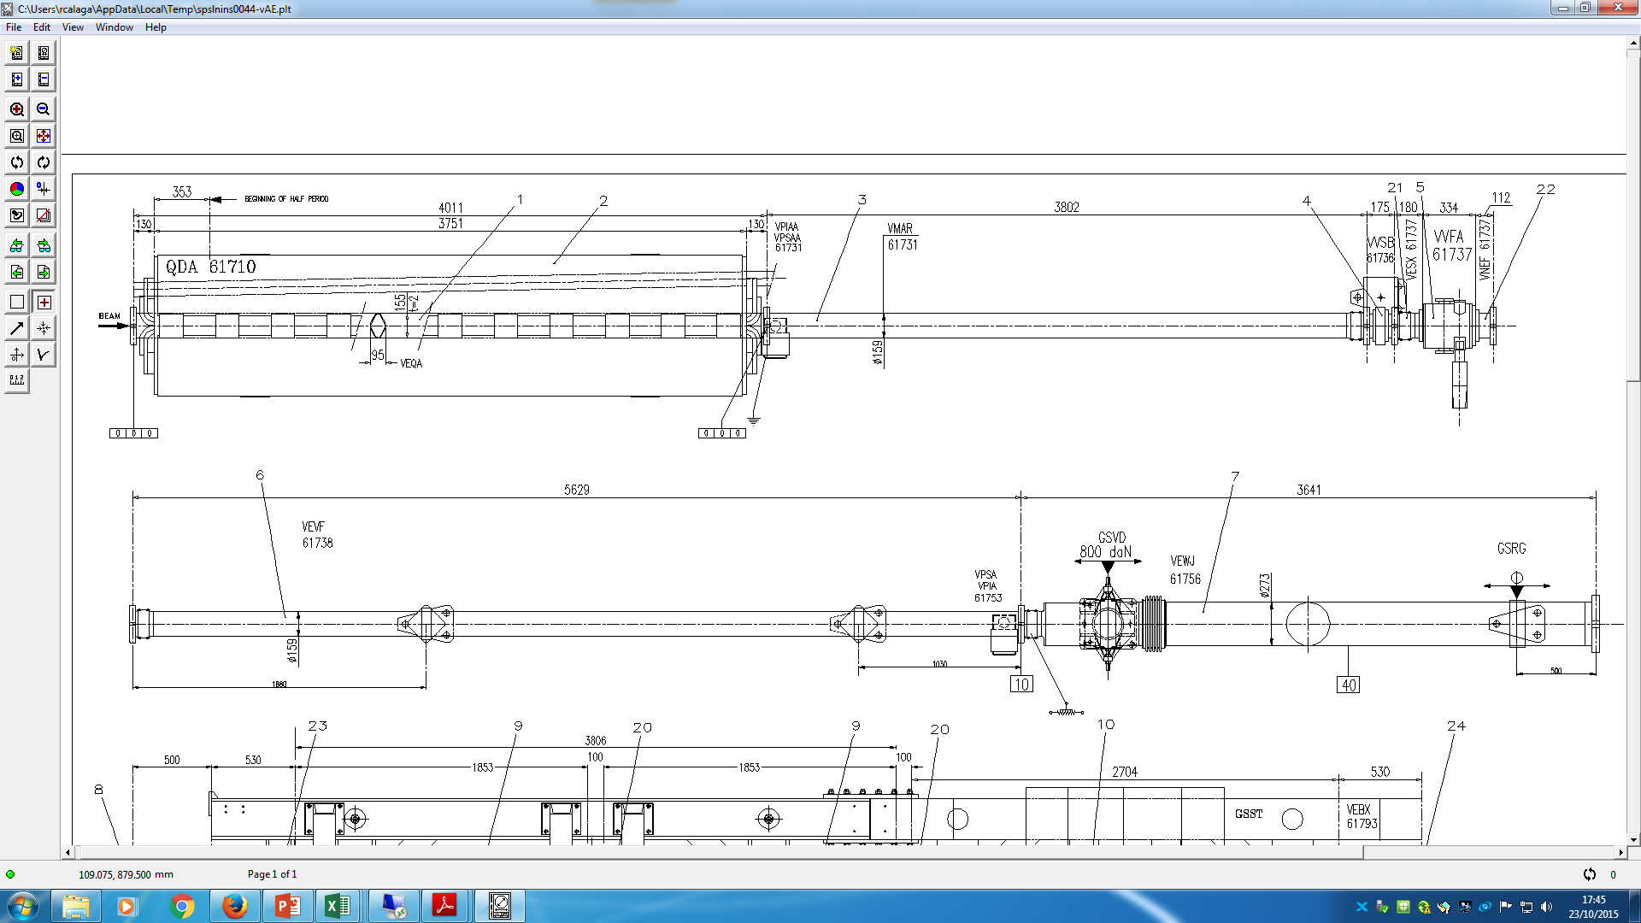
SPS QDA617 – QFA618
Standard SPS Cross Section
Present LSS6, Crab Zone
580 mm
844 mm
1200 mm

