Slide 1
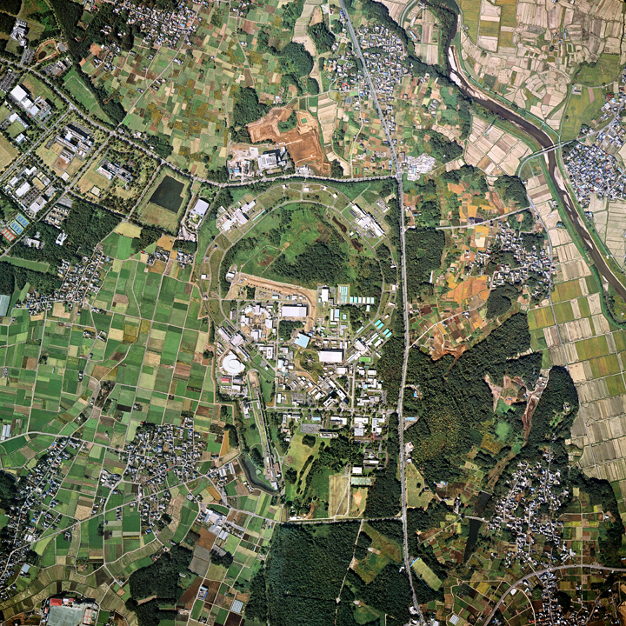

KEK and HiLumi LHC
Katsuo Tokushuku
Institute of Particle Nuclear Studies (IPNS)
High Energy Accelerator Research Organization (KEK)

Slide 2
Contents
KEK organization
Roadmap and diverse physics project
HL-LHC and KEK/Japan
Various R&D activities for HL-LHC

Slide 3
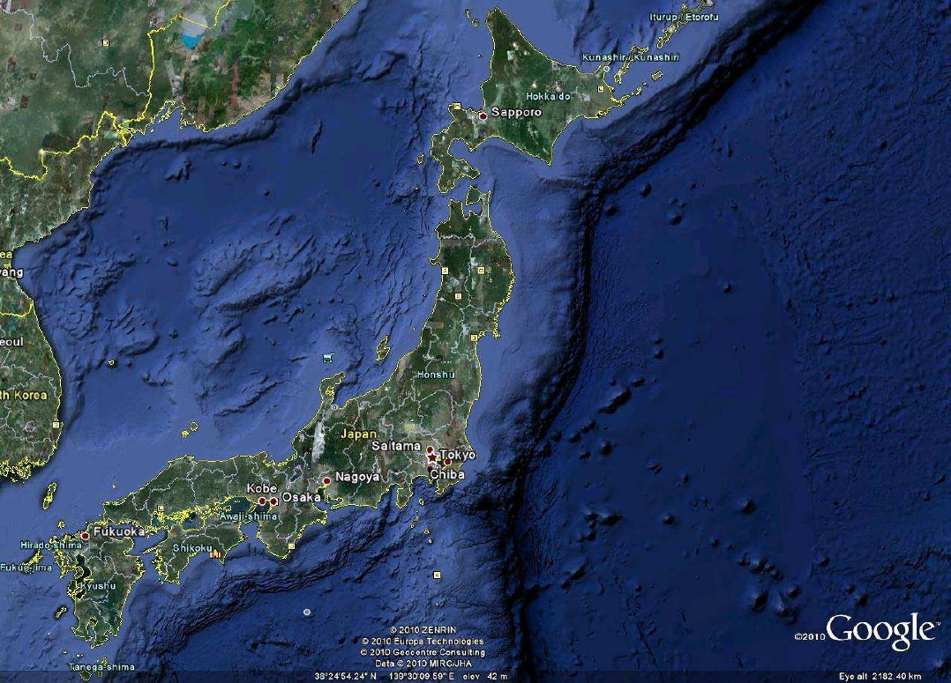
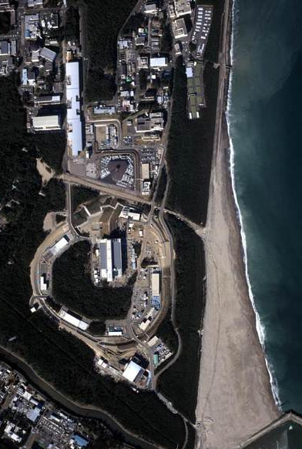
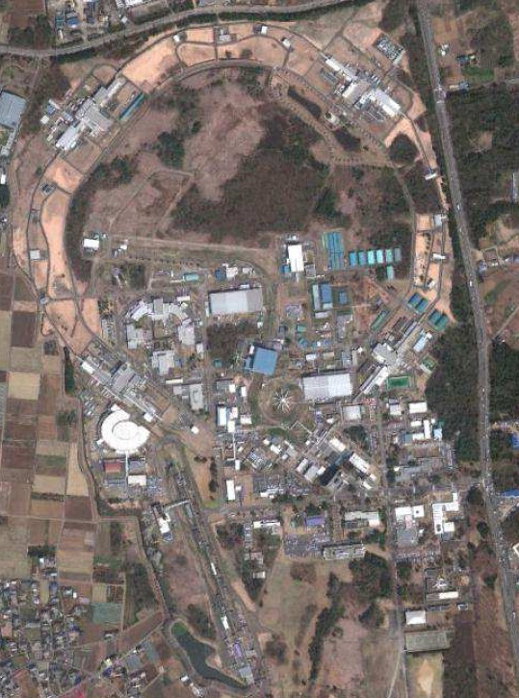
Electron machines in Tsukuba
and proton machines in Tokai
J-PARC
Tokai
KEKB
Tsukuba
ATF
PF, PF-AR

Slide 4
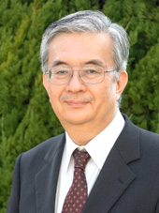
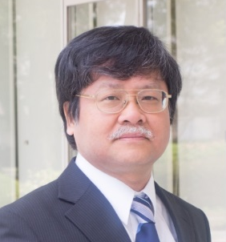
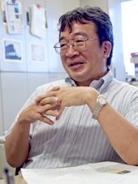
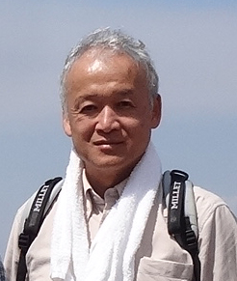
KEK new organization since April
KEK Director General
  Masanori Yamauchi
4 Executive Directors
  Yasuhiro Okada (Research, International Relations..)
IPNS Director
  Katsuo Tokushuku
Accelerator Laboratory Director
  Seiya Yamaguchi

Slide 5
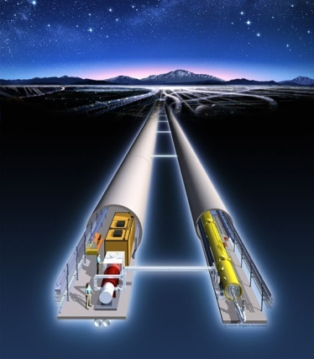
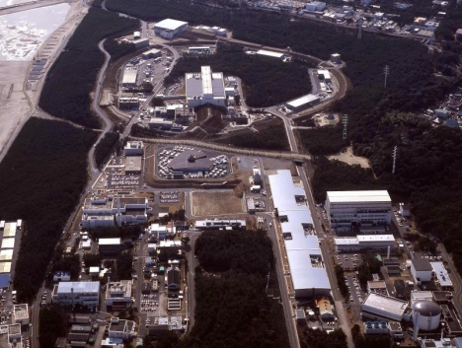
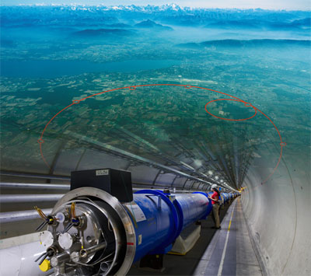
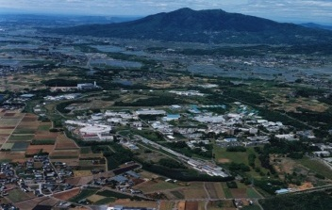
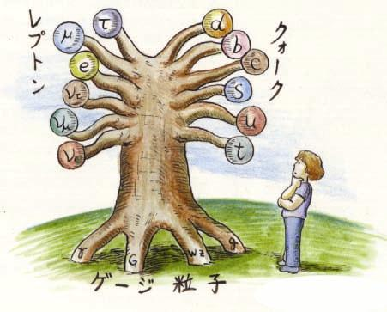
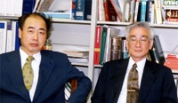
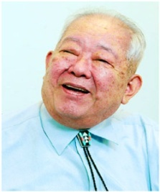
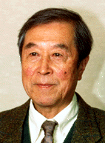
Quest for
Birth-Evolution
of Universe
Quest for Unifying
Matter and Force
International Linear Collider（ILC）
Scientific Activities
Technology Innovations
Talented Human Resources
Lepton CP Asymmetry
Beyond Standard Physics
Power-Upgrade
SuperKEKB
J-PARC
KEK-B
Quark CP Asymmetry
LHC
Lepton
Quark
ν_{τ}
[Origin of Matter]
ν_{μ}
Quest for Neutrinos
ν_{e}
Quest for 6 Quarks
[Origin of Force]
Higgs Particle [Origin of Mass]

Slide 6
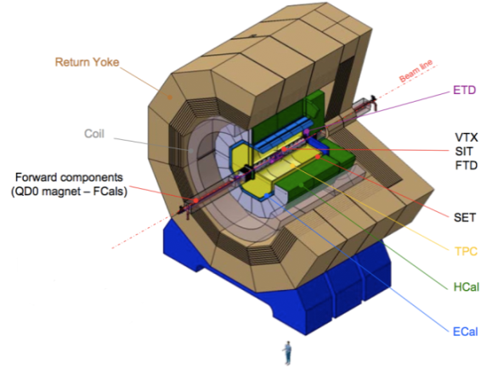
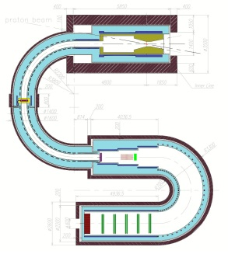
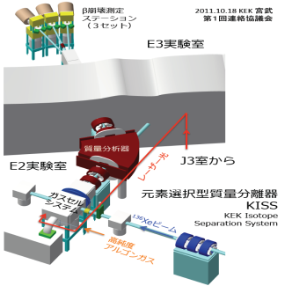
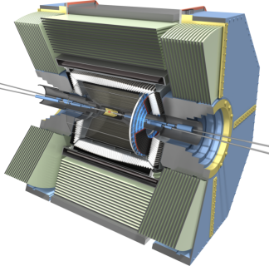
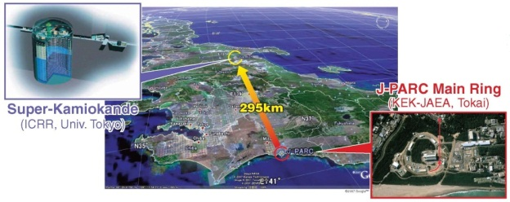
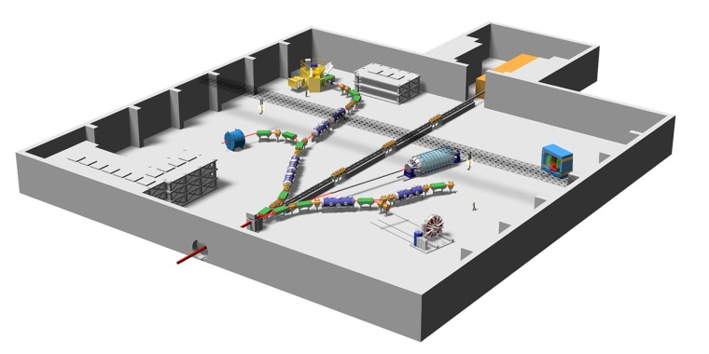
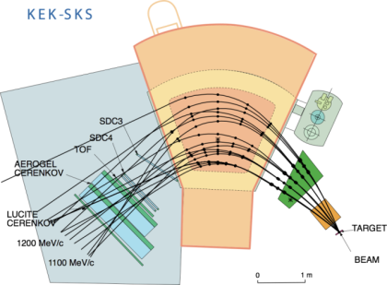
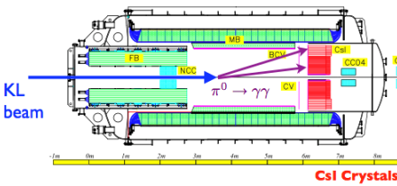
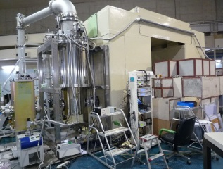
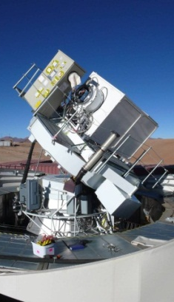
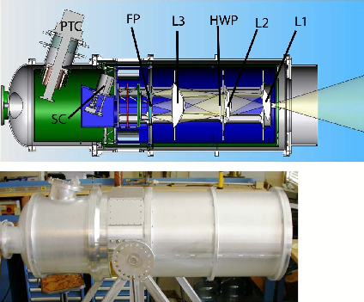
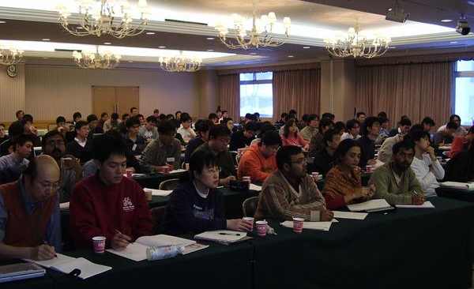
ATLAS
(CERN)
ILC
Energy Frontier
COMET
(J-PARC)
KISS
(RIKEN)
Belle-II
(KEKB)
Flavor Physics
Hadron and NuclearPhysics
T2K
(J-PARC)
Physics
at IPNS/KEK
Hadron hall
(J-PARC)
KOTO
(J-PARC)
Astro- particle Physics
Theory
SKS
(J-PARC)
Theory
String theory
Particle physics
Hadron physics
Cosmo-physics
Lattice simulation
UCN
(RCNP)
QUIET
(Atacama)
PolarBear2
(Atacama)

Slide 7
HEP programs at KEK
Flavor physics program
  SuperKEKB and Belle II
  Super high lum. B factory at 8x10³⁵/cm²/s
  ~5x10¹⁰ B, D, τ sample expected in ~2024
  KOTO K_{L}→π⁰νν at J-PARC
  COMET μ→e conversion search at J-PARC
  g_{μ}-2/μEDM measurement at J-PARC MLF
  Neutron EDM measurement at TRIUMF
Neutrino program
  T2K long baseline neutrino experiment
  J-PARC -----> 295km ----> SuperKamiokande
  Future roadmap: 750kW upgrade and HyperKamiokande
Energy frontier program
  ATLAS at LHC
  ILC

Slide 8
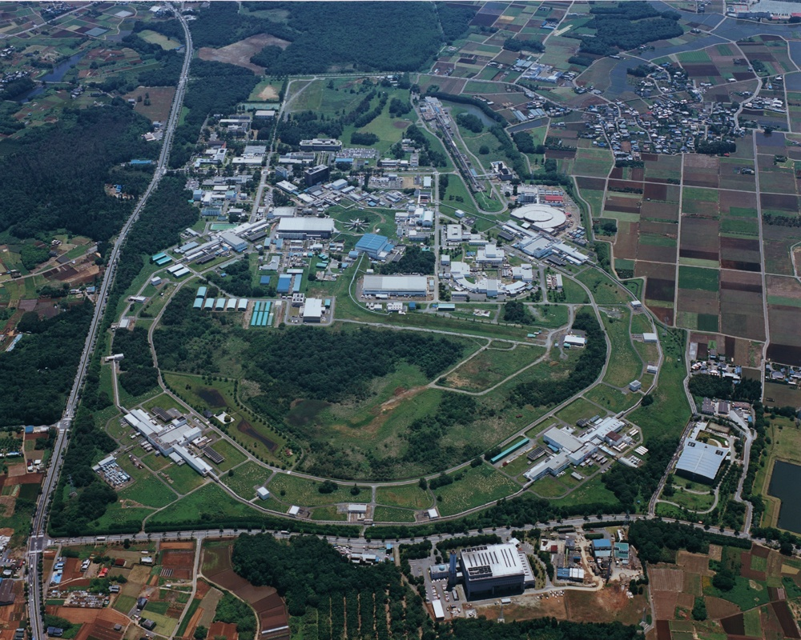
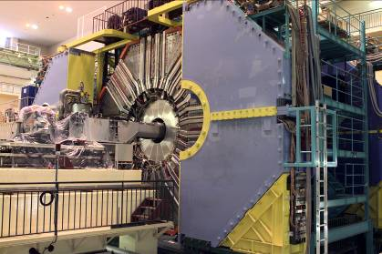
KEKB and Belle
SuperKEKB and Belle II

Slide 9

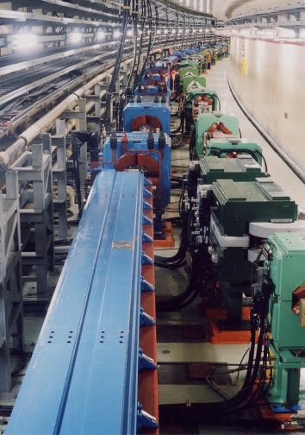
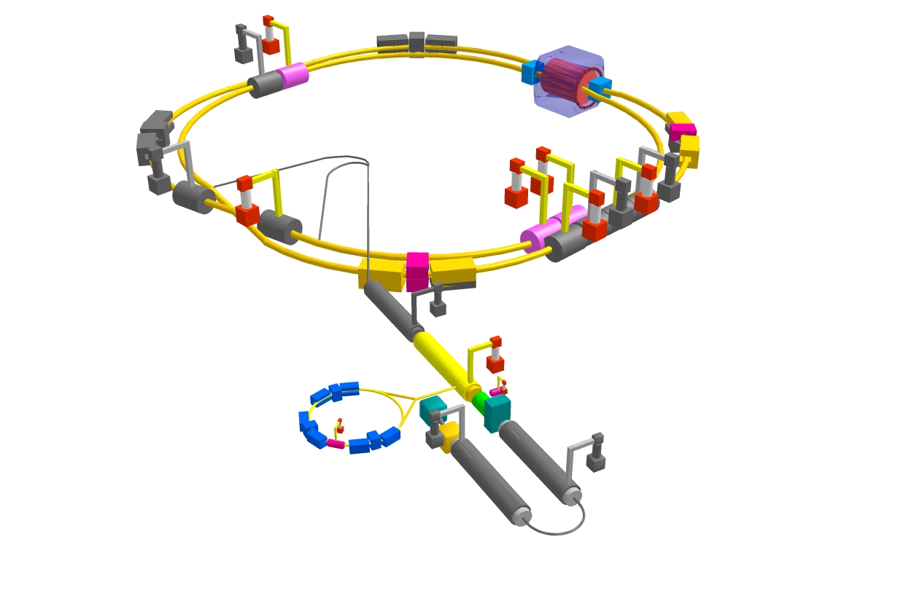
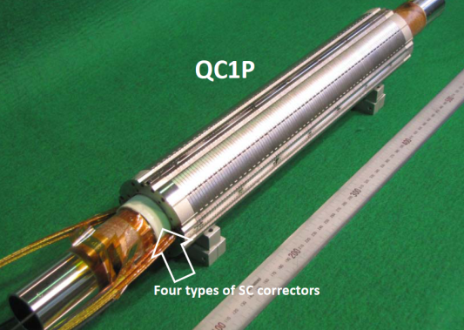
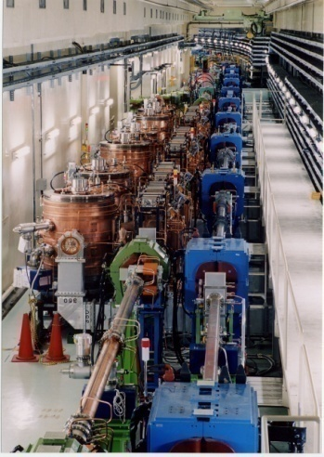
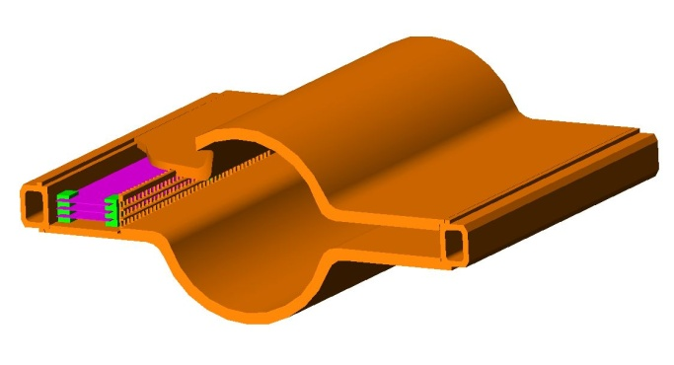
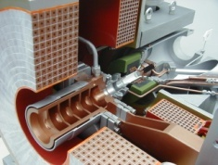
Accelerator upgrade
Low emittance lattice
IR with β_{y}*=0.3mm
SC final focus system
e⁻(2.6A)
SuperKEKB
Add RF systems for higher beam current
e⁺(3.6A)
Damping ring for low emittance positron
injection
Positron
capture section
NEG pumps
Beam
SR
LER beampipe to suppress
photoelectron instability

Slide 10

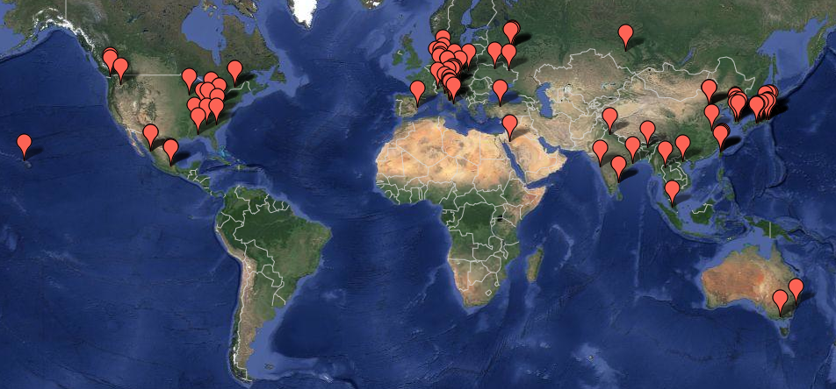
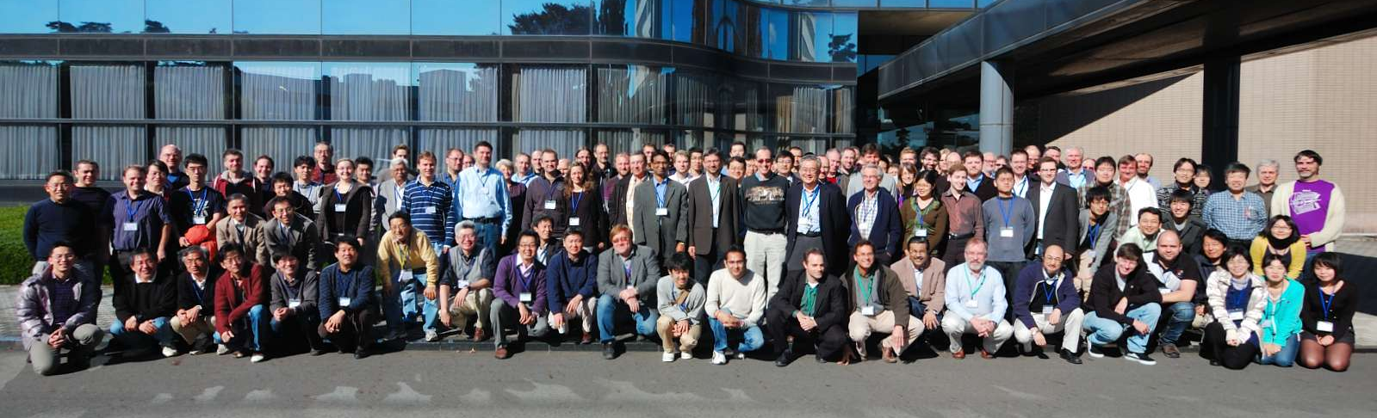
Belle-II Collaboration
600 collaborators from 100 institutions in 23 countries
Spokesperson:
Tom Browder (Hawaii)
Series of open collaboration
meetings in 2008.03 ~2015.2

Slide 11

Belle II Detector Upgrade
CsI(Tl) EM calorimeter:
waveform sampling
electronics, pure CsI
for end-caps
7.4 m
RPC μ & K_{L} counter:
scintillator + Si-PM
for end-caps
4 layers DS Si Vertex
Detector →
2 layers PXD (DEPFET),
4 layers DSSD
7.7 m
PID system
Time-of-Propagation counter
(barrel),
prox. focusing Aerogel RICH
(forward)
Central Drift Chamber:
smaller cell size,
long lever arm

Slide 12
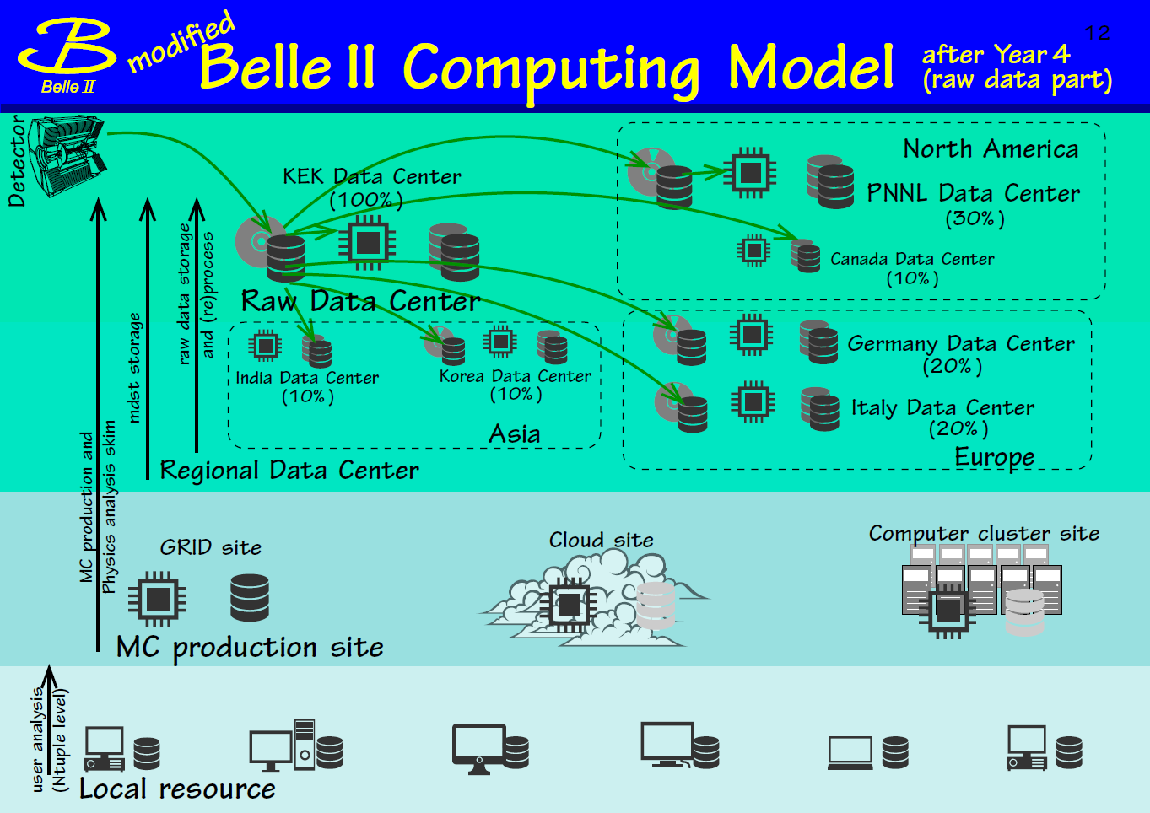
Here again, Interaction with CERN (LCG) is very helpful

Slide 13
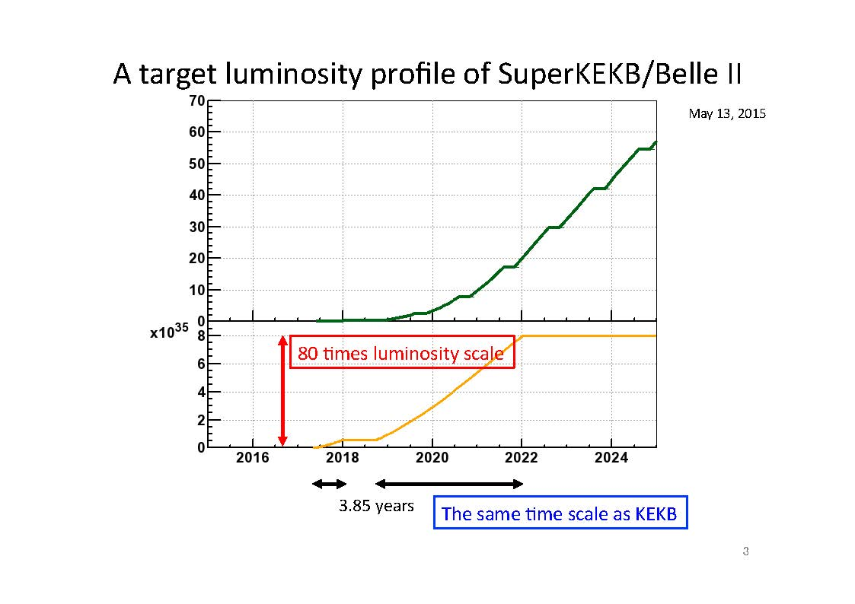
SuperKEKB luminosity projection
Phase-1:
First circulating beam
This is the target we are aiming for.
As SuperKEKB is a challenging machine we need enough resources to handle many expected/unexpected issues.

Slide 14
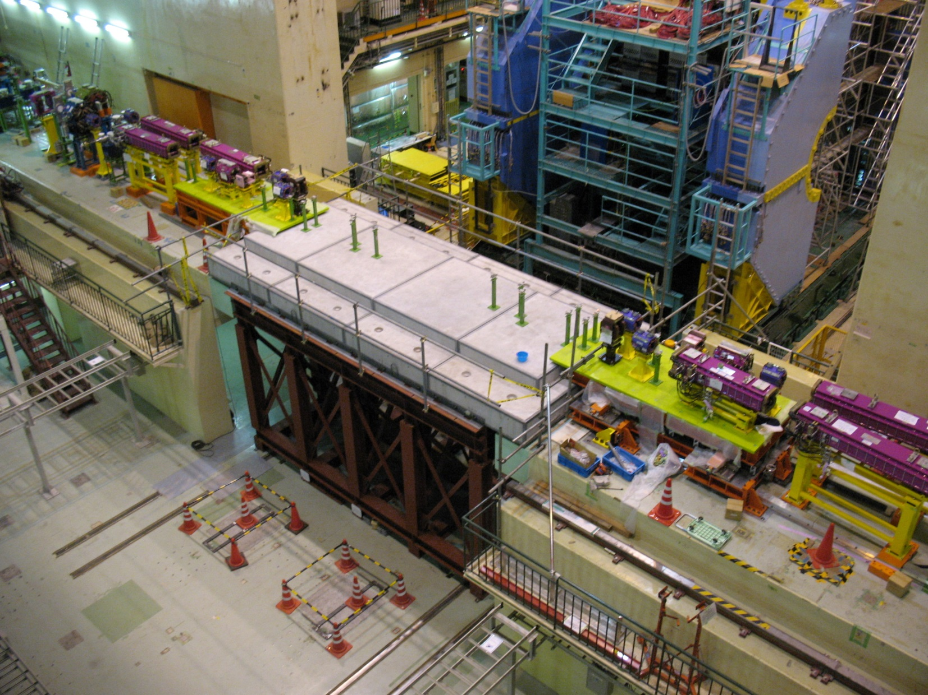
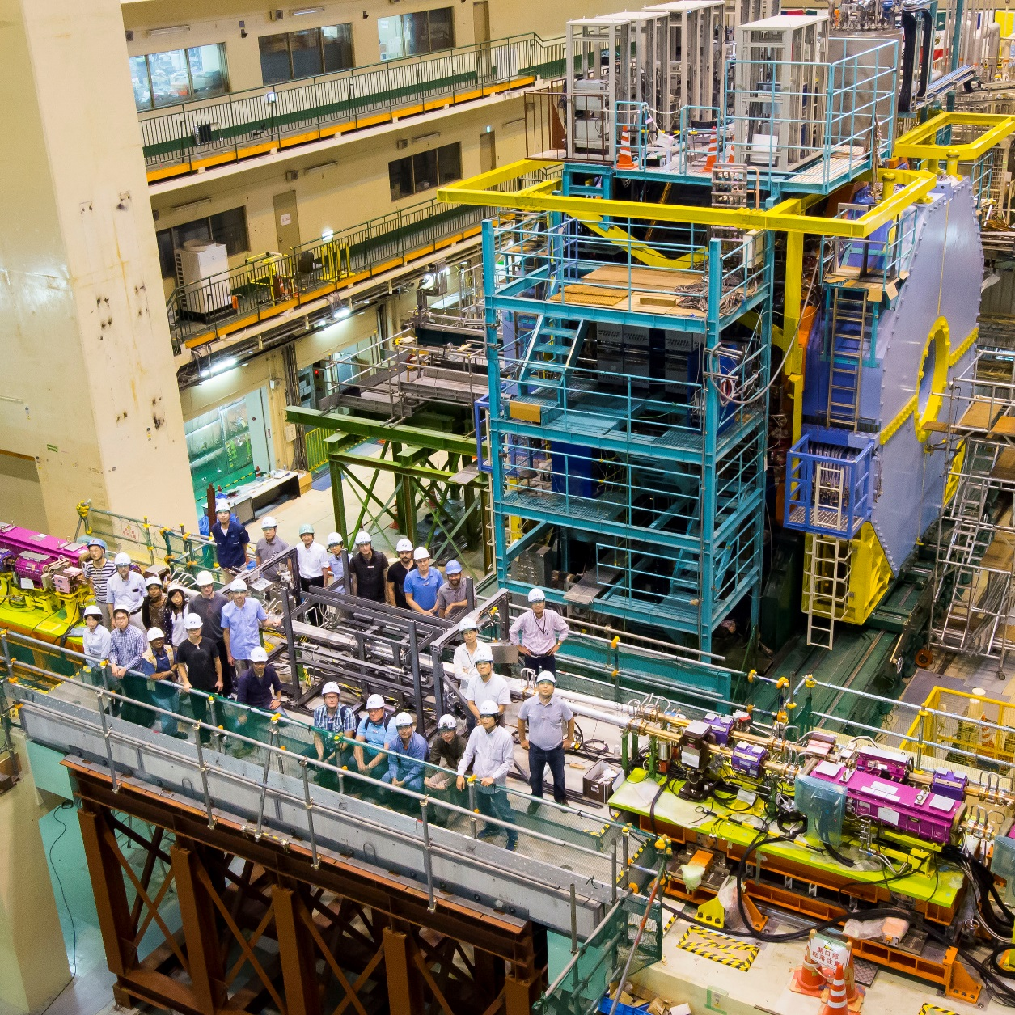
Interaction Region

Slide 15
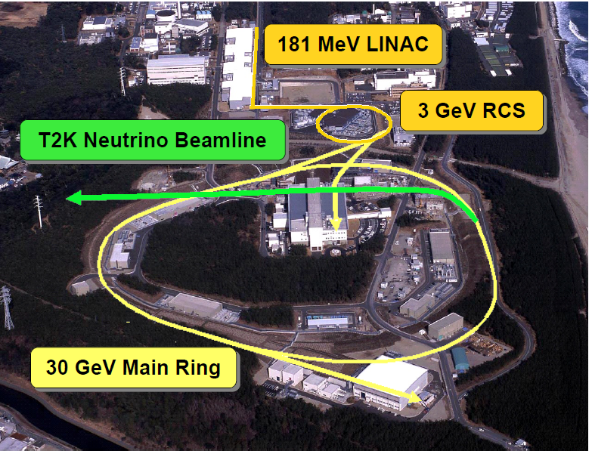
J-PARC
Located in Tokai-village, 60km N.E. of KEK
Completed in 2009
Design goal
  RCS: 1MW
  MR: 750kW
JAEA
Design: 750kW
60km
Joint project of KEK & Japan Atomic Energy Agency (JAEA)

Slide 16
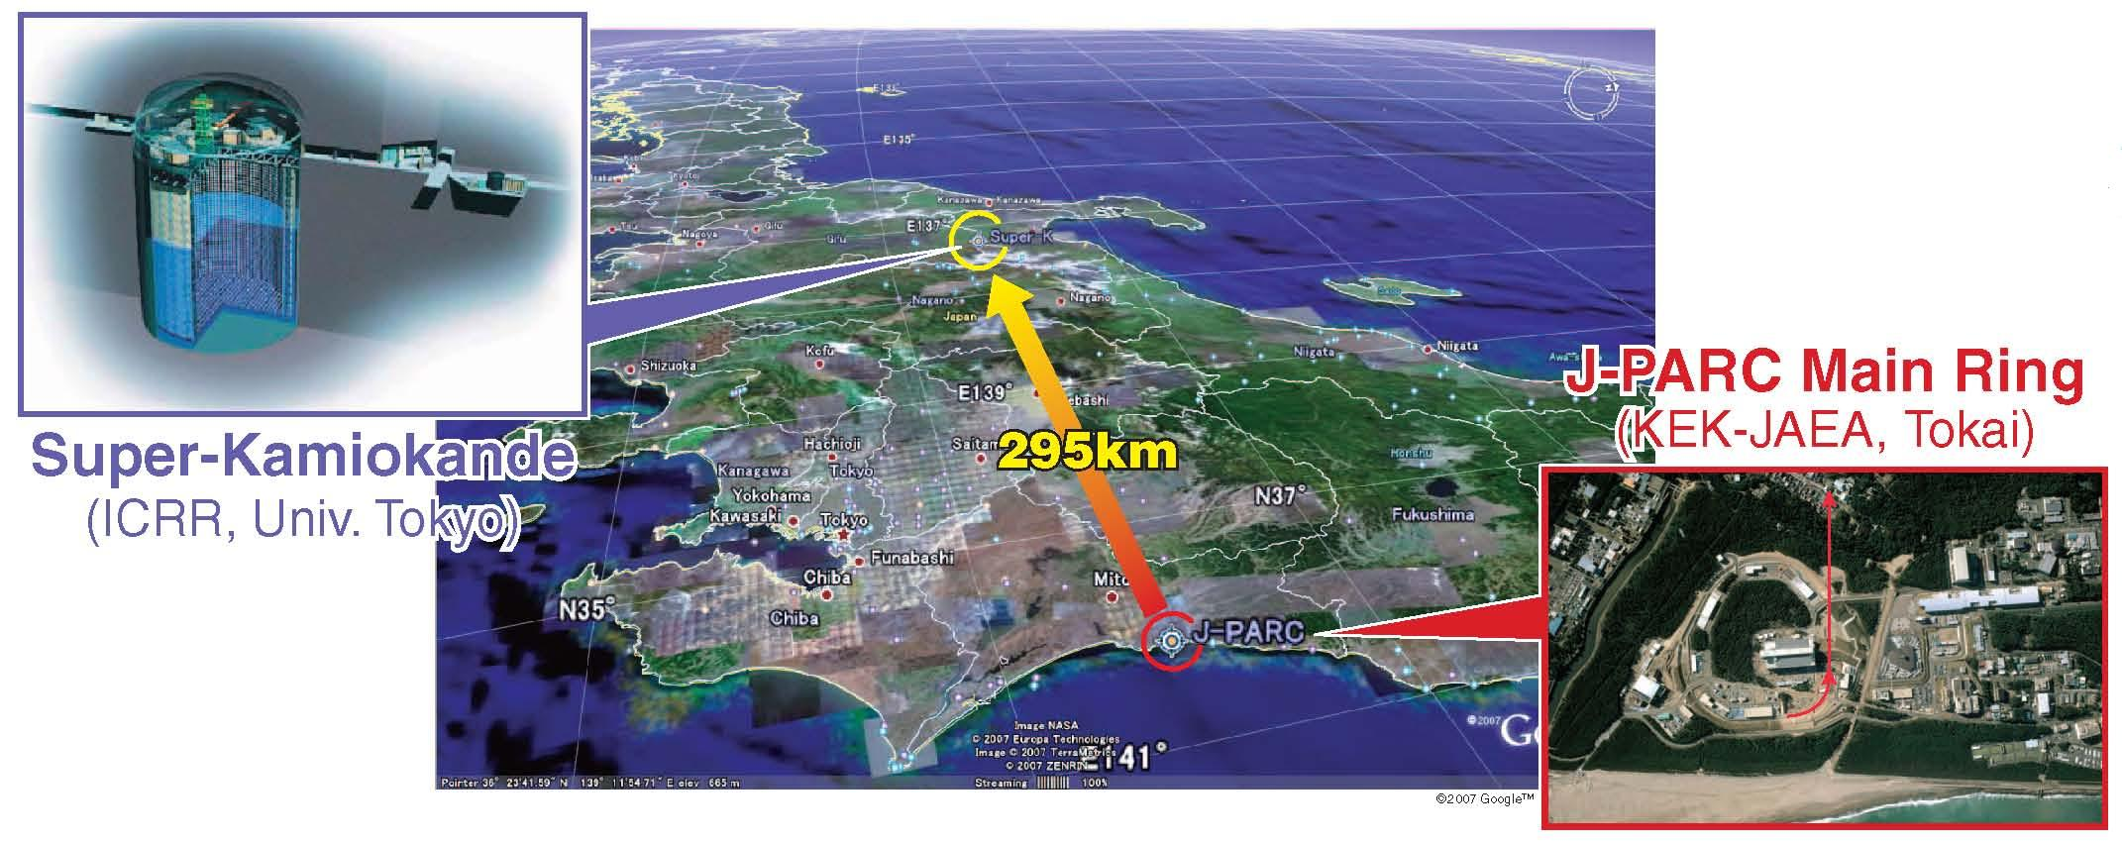
T2K (Tokai to Kamioka) experiment
2010~ (Running)
High intensity ν_{μ} beam from J-PARC MR to Super-Kamiokande
Evidence → Observation of ν_{μ} → ν_{e} (2011-2013)
Updated goals
  Precise measurement of ν_{e} appearance
  Precise meas. of ν_{μ} disappearance
  ➔ Measure CPV phase, contribution to mass hier. determ.

Slide 17
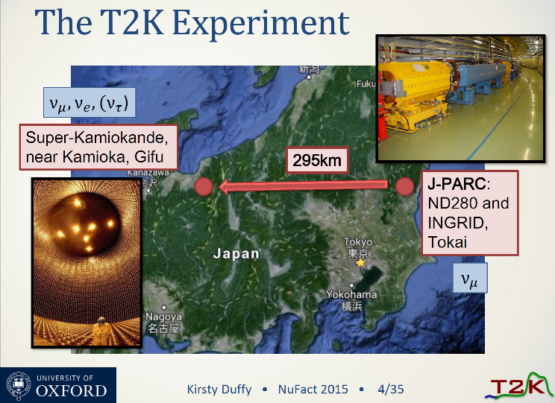
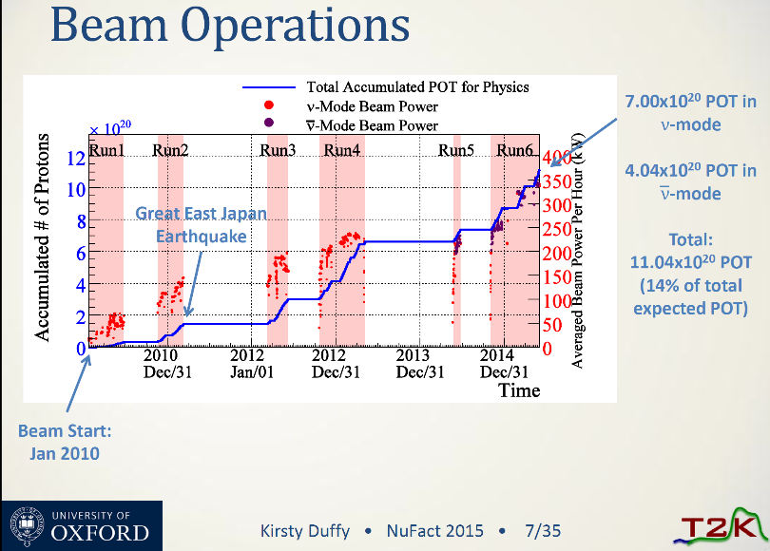
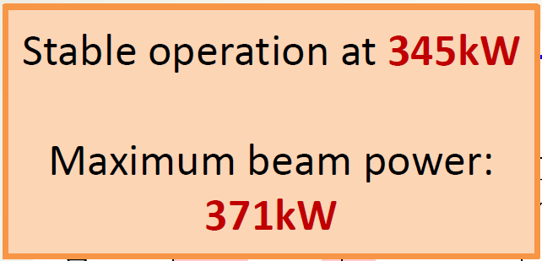
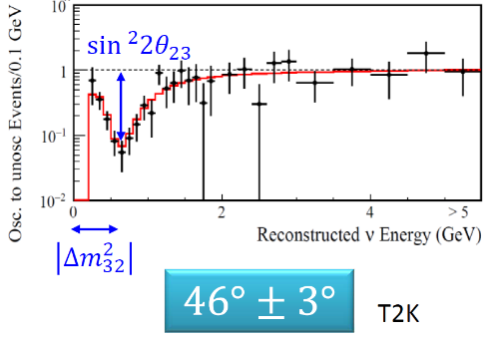
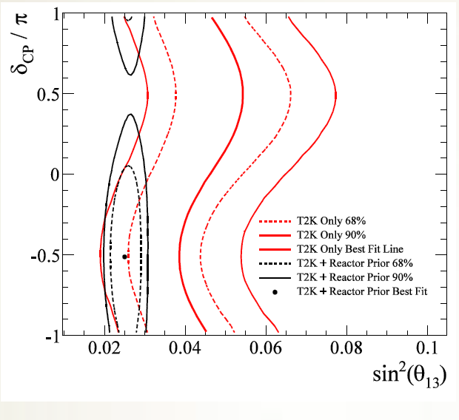
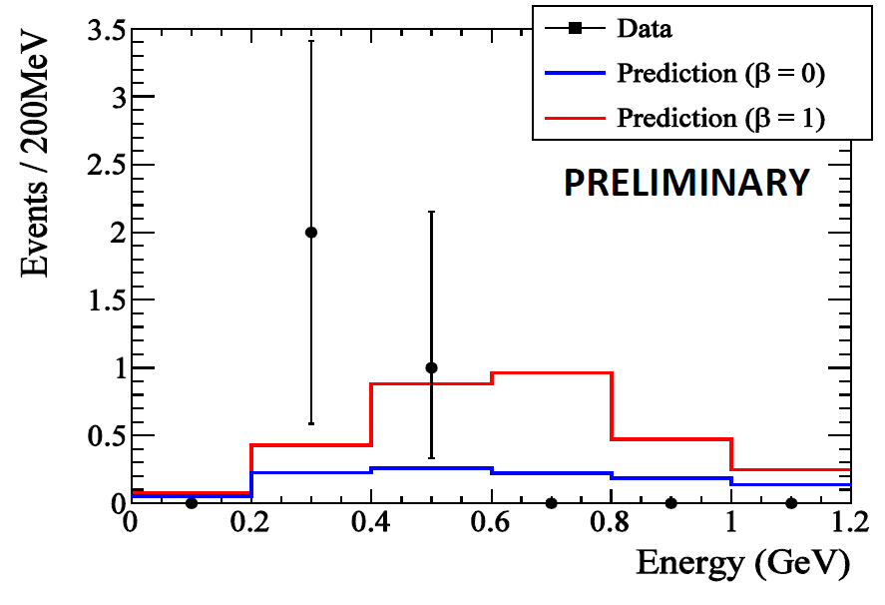





T2K latest achievements
Kirsty Duffy (Oxford)
Aug.11 @ Nufact
First ${\overline{v}}_{e}$app search
${\overline{ν}}_{μ}$ disapp. meas.
3 cand.
Start measuring CPV phase
Start world leading meas.

Slide 18



Next generation LBL experiment
J-PARC → Hyper-Kamiokande
LoI: The Hyper-Kamiokande Experiment arXiv:1109.3262v1
with realization of
J-PARC MR at beam power of ~1MW (>=750kW)
New 1Mt Water Ch det: Hyper-Kamiokande

Slide 19











Nuclear & Particle Physics with J-PARC Hadron Beam
Since 24/April/2015 the normal operation has re-started!
d
Hypernuclei
u
s
u
T-viola-
tion
Strangeness
d
_{ΛΛ}He
Pentaquark Θ⁺
⁶
E19
ΛΛ, Ξ Hypernuclei
Z
K⁰ → π⁰ νν
-2
Λ, Σ Hypernuclei
_{L}
-1
Λ,Ξ
N
0
SKS
K1.8
E14
K1.8BR
KL
K1.1
High p
(not yet)
K meson
Implantation of
Kaon and the
nuclear shrinkage
K1.1BR
Quark
Ｋ⁻
φ
Proton Beam
Free quarks
Bound
quarks
Ｘray
E17
Why are bound quarks haevier？
Kaonic atom
Kaonic nucleus
Mass without Mass Puzzle
Notes:
On the other hand, the hadron experimental hall looks like this.
● Proton beam comes here and various kaon beam lines are prepared, where K=1.8 means kaons with momentum of 1.8 GeV/c.
● At SKS, hypernuclear spectroscopy will be performed for a variety of nuclei. ● In particular, searches for double hypernucleus and pentaquark are the highlights in here.
● In this beamline, kaon implantation is planned. When kaon is implanted inside the nucleus, there is a possibility that high density matter is created. ● Kaonic atom and kaonic nucleus will be studied.
● This beam line is the neutral kaon line to study CP violation, and ● this line is for T-violation experiment.
● Finally, this line, which is not yet completed, is dedicated to the study of chiral symmetry, namely, the mass generation mechanism of bound quarks.
19

Slide 20






J-PARC KOTO experiment
65 participants from Japan, US, Korea, Taiwan, Russia
- CP symmetry breaking
- rare decay: in the SM
CsI calorimeter to measure
background rejection:
hermetic extra-particle detection ( “veto”)
Trigger/DAQ (37k channels):
waveform digitization (14bits, 125MHz ADC), pipeline readout

Slide 21



COMET Phase I & II
Phase I
  Detailed understanding of the beam background and achieving the sensitivity of < 10⁻¹⁴ (100 better than the current limit)
  8GeV, 3.2kW beam, ~90-days DAQ (Graphite as a primary target)
Phase II
  8GeV, 56kW beam, 1-year DAQ (Tungsten as a primary target)
  COMET final goal Sensitivity < 10⁻¹⁶
Proton beam extinction (w/o extraction) of 10⁻¹² has been already achieved (Req. < 10^{-9~10} )
Phase I
Phase II
Phase I background
Detector solenoid
Beam collimator
Transport solenoid
0.03 BG expected
In 7.8x10⁶ sec running time
Capture solenoid ~5T
Proton beam
104MeV/c
muons
Radiation shield
COMET Phase-I Detector
Pion production target

Slide 22
International Linear Collider
KEK proposed to host ILC in Japan, which is under careful consideration in the Japanese Government.
KEK’s role to push the ILC project forward
  Continue accelerator R&D program at ATF, STF and CFF facilities collaborating with the international team.
  Provide the ILC committees with appropriate information to help their timely conclusion.
  Develop a KEK’s evolution plan to prepare for green light given by MEXT.

Slide 23



ILC R&D at KEK

Slide 24
KEK activities: Summary
KEK has diverse program in particle physics.
  Long baseline neutrino program with upgrade plan to HyperKamiokande.
  Flavor physics program at SuperKEKB and J-PARC.
  Energy frontier program: ATLAS/LHC and ILC

Slide 25
FY2015: Special year!
This is the very important fiscal year for KEK
  The first circulating beam in SuperKEKB is planned in early 2016.
  J-PARC SX beam experiments re-started.
  T2K with anti-neutrino beam
On the other hand, The KEK budget for this fiscal year is very tight. It is our first priority to run the current projects (J-PARC/SuperKEKB) on schedule. Now we are negotiating with our FA’s for the better funding for the next FY.
KEK is now working for a “Project Implementation Plan”, for conducing the on-going projects and various future programs/upgrades for the next ~5 years (including LHC upgrade).

Slide 26
HiLumi LHC and KEK/Japan
Discussions in KEK and HEP community
  Japanese HEP sub-committee (2012)
  KEK roadmap: (2013)
  International Review (held by IPNS/KEK) (2014)
    The first priority for Japanese HEP community is the ILC and neutrino programs, HL-LHC has been endorsed as the on-going project.
Discussion in Science Council of Japan
  HL-LHC is listed as one of the big science project we pursue but not (yet) in the high-priority list.
  We are preparing for the next (minor) update foreseen in 2016.

Slide 27
Recommendation of JAHEP sub-comm.
Feb 2012
The committee makes the following recommendations concerning large-scale projects, which comprise the core of future high energy physics research in Japan.
  • Should a new particle such as a Higgs boson with a mass below approximately 1 TeV
  be confirmed at LHC, Japan should take the leadership role in an early realization of
  an e+e- linear collider. In particular, if the particle is light, experiments at low collision
  energy should be started at the earliest possible time. In parallel, continuous studies on new
  physics should be pursued for both LHC and the upgraded LHC version. Should the energy
  scale of new particles/physics be higher, accelerator R&D should be strengthened in order
  to realize the necessary collision energy.
  • Should the neutrino mixing angle θ₁₃ be confirmed as large, Japan should aim to
  realize a large-scale neutrino detector through international cooperation, accompanied
  by the necessary reinforcement of accelerator intensity, so allowing studies on CP
  symmetry through neutrino oscillations. This new large-scale neutrino detector should
  have sufficient sensitivity to allow the search for proton decays, which would be direct
  evidence of Grand Unified Theories.
It is expected that the Committee on Future Projects, which includes the High Energy Physics Committee members as its core, should be able to swiftly and flexibly update the strategies for these key, large-scale projects according to newly obtained knowledge from LHC and other sources.

Slide 28
KEK roadmap / Review
2013
KEK roadmap : Large Hadron Collider (LHC)/ATLAS
  The main agenda at LHC/ATLAS is to continually participate in the experiment and to take a proactive initiative in upgrade programs within the international collaboration at both the accelerator and detector facilities.
International review on the Japanese contribution on LHC and ATLAS. (Nov 2013)
  Chair: Eckhard Elsen (DESY)
  J Dorfan, E Elsen, F Gianotti, M Lamont, J Nash, M Nojiri, L Rossi, A Schopper and B Strauss
  The Report is in public:
  https://kds.kek.jp/indico/event/13329/session/7/material/1/0.pdf

Slide 29
Steps toward requesting new resource
Year 2013: the update of ‘Master Plan of big science projects’ called by the Science Council of Japan.
  207 proposals are accepted in total from various area of science.
  27 projects were chosen as ‘the high priority’ projects in March 2014
  Unfortunately, HL-LHC was not chosen among the 27.
    (High priority projects in HEP/NP are, Hyper-Kamiokande and J-PARC extension. ILC is handled separately.)
  Outcome: It is not so easy to request HL-LHC budget in the straight way before the next update of the Master plan, which is planned in 2016.
  But, the importance of the LHC upgrade is known to the KEK-DG and (a part) of the MEXT section.
  Prepare and update the budget plan to be ready for any chance.

Slide 30
R&D projects for HL-LHC
Various R&D programs related to the HL-LHC are successfully going on
  D1 magnet prototype
  Electro polishing for crab cavity
  Beam halo Monitoring/ Beam dynamics
  RF cavities for PS-Booster (LIU)
  …
  => Big contributions to HiLUMI LHC

Slide 31










Layout of IR Magnets
IT Quads.& D1
HL-LHC
IT Quads. w/ Nb₃Sn
Q1
Corrector
Package
Q2b
Q2a
Q3
SC D1
Nominal LHC
NC D1
Courtesy of P. Fessia
Long Straight Section
HL-LHC
Crab Cavity
Q4
D2
Nominal LHC
Aperture increase in IT Quads:70mm→150mm Large bore also for the new D1
Replacement of current NC D1 by SC D1: Shortening magnet length by 15m
Making room for new crab cavities

Slide 32





D1 Magnet
Coil ID: 150 mm
Integrated field:35 T m (26 Tm at present LHC)
  5.59 T at 12 kA. L_{coil}=6.6 m
T_{op}: 1.9 K by HeII cooling
Op. point (2D coil): 75 %
Coil layout: 1 layer of 15.1 mm cable
  Better cooling. Saving space for iron yoke.
Conductor: Nb-Ti LHC MB outer cable
Structure: Collared yoke structure by keying
Field quality: < 10⁻⁴ at R_{ref} = 50 mm
Cold mass OD: 550 +10 x 2 = 570 mm
Cryostat OD: 914 mm, same as MB cryostat (*TBD)
Radiation, energy deposition:
135 W in total, 2 mW/cm³ at local peak, Radiation dose >25 MGy
4
8
2m model coil is under construction!
13
44 turns
19
2015/10/26
32
32

Slide 33



CERN-KEK Collaboration on Crab Cavity
Objectives:
Based on research and development on crab cavities for the LHC luminosity upgrade progressed, as a cooperative work between KEK and CERN, this agreement, Appendix 16, aims to develop state of the art surface treatment techniques for high field superconducting crab cavities that deflect beam bunches in order to realize the crab crossing for the LHC accelerator luminosity upgrade.
KEK responsibilities for:
Development of a vertical electro-polishing (VEP) system,
Application of VEP to crab cavities,
Fundamental studies on vertical electro-polishing conditions,
Crab Cavity
・ Type : DQW (400 MHz)
・ Used at ATLAS and CMS points
We are fabricating the vertical EP apparatus. The rotation jig and the ozonized water rinsing jig are already fabricated and assembled. After the fitting check of apparatus, we applied the vertical EP to the LHC crab cavity fabricated at BNL.
Dummy chamber held in the rotation jig

Slide 34




Ozonized water rinsing jig and our clean room for rinsing and re-assembling after VEP
Ozonized water rinsing attachment for KEKB cavity
Ozonized water rinsing jig
Dummy cavity
Ozonized water rinsing jig
Rotation jig
Ozonized water rinsing jig
Ready to accept the cavity in December
Our clean room

Slide 35

Beam monitoring
Coronagraph for beam halo measurement
Opaque disk for eclipse
Relay lens
Source
Field lens
Lyot stop
Objective lens
Setup of the coronagraph at B1
Conclusion
From diffraction analysis and Mie-scattering background simulations, We can conclude “we can observe beam halo image with order of 10⁻⁴ contrast to the peak intensity of beam core”.
Objective lens
Obstacle blocking the
Beam core
Square slits
defining the aperture
Field lens
Relay lens
Magnifier
lens
Lyot stop

Slide 36




Very fruitful collaboration with CERN
LHC magnets
J-PARC neutrino beamline
PSB: cavities
J-PARC RF cavities

Slide 37




LIU: RF for PS booster
J-PARC FT3L cavities
10 cell cavities in Ring4
Finemet-FT3L technology will be used for PSB RF upgrade.
Now beam is accelerted by new cavities!
Impedance
Reduction by
Fast feedback
PSB cavity in J-PARC MR
Low Level RF
(Feed Forward)
Beam test at J-PARC during LS１demonstrated that PSB RF system can handle 1.4E13 protons.
F. Tamura, J-PARC@ Finemet review

Slide 38
Conclusions
KEK has diverse physics programs with future upgrades. LHC upgrade is one of the important programs. Priority among the various projects are under discussion.
It is not yet easy to get the funding for the LHC/ATLAS upgrade but we keep pushing.
There are several successful R&D projects related to HL-LHC/LIU. The support from CERN has been very effective.

Slide 39
Backup slides
Backup slides

Slide 40
Layout of IR Magnets
IT Quads.& D1
HL-LHC
IT Quads. w/ Nb₃Sn
Q1
Corrector
Package
Q2b
Q2a
Q3
SC D1
Nominal LHC
NC D1
Courtesy of P. Fessia
Long Straight Section
HL-LHC
Crab Cavity
Q4
D2
Nominal LHC
Aperture increase in IT Quads:70mm→150mm Large bore also for the new D1
Replacement of current NC D1 by SC D1: Shortening magnet length by 15m
Making room for new crab cavities

Slide 41
Latest Design Parameters of MBXF for D1
Coil ID: 150 mm
Integrated field:35 T m (26 Tm at present LHC)
  5.59 T at 12 kA. L_{coil}=6.6 m
T_{op}: 1.9 K by HeII cooling
Op. point (2D coil): 75 %
Coil layout: 1 layer of 15.1 mm cable
  Better cooling. Saving space for iron yoke.
Conductor: Nb-Ti LHC MB outer cable
Structure: Collared yoke structure by keying
Field quality: < 10⁻⁴ at R_{ref} = 50 mm
Cold mass OD: 550 +10 x 2 = 570 mm
Cryostat OD: 914 mm, same as MB cryostat (*TBD)
Radiation, energy deposition:
135 W in total, 2 mW/cm³ at local peak, Radiation dose >25 MGy
4
8
13
44 turns
19
41

Slide 42

2m-long Model Magnet - Overview
Single-layer coil, 4-split spacer collars, collared yoke by keying
Notches and φ 34 mm holes for iron saturation effects
φ60 mm HX hole
HeII cooling channel
Shell: SUS304L
4 split stainless steel spacer collars: NSSC130S
Brass shoes
QPH+Insulations
Collaring keys
NbTi SC cable (LHC MB outer) + Apical insulation
Horizontal split iron yoke:
low-carbon steel (EFE by JFE steel)
Radiation resistant GFRP (S2 glass + BT resin) wedges

Slide 43



200 mm Long Mechanical Short Model
Demonstration of the magnet fabrication processes and the mechanical design.
  Test coil winding.
  Collaring with the positioning mandrel
  Yoking with alignment feature
Improved alignment feature of the collared coil and the yoke was verified.
Coil pre-stress after the assembly was around 60MPa as predicted.

Slide 44


Development of the 1st 2-m Model at KEK
Single layer coil with LHC NbTi/Cu cable
Radiation resistant GFRP for spacers and wedges + Cyanate Ester resin
A set of top and bottom coils are successfully completed in October.
Magnet assembly will be completed in Jan. 2016, followed by the cold test in March.

Slide 45
CERN-KEK collaboration on the crab cavity development
Objectives:
Based on research and development on crab cavities for the LHC luminosity upgrade progressed, as a cooperative work between KEK and CERN, this agreement, Appendix 16, aims to develop state of the art surface treatment techniques for high field superconducting crab cavities that deflect beam bunches in order to realize the crab crossing for the LHC accelerator luminosity upgrade.
Crab Cavity
・ Type : DQW (400 MHz)
・ Used at ATLAS and CMS points
KEK responsibilities for:
Development of a vertical electro-polishing (VEP) system,
Application of VEP to crab cavities,
Fundamental studies on vertical electro-polishing conditions,
CERN responsibilities for:
Necessary technical information and requirements for LHC crab cavities,
Support for the research activities in 3.1, such as experimental evaluation for electro-polishing and cavity performances,

Slide 46



Vertical electro-polishing at KEK
LHC Crab Cavity
Compact and complicated cavity structure to meet space requirements
High fields are required to sufficiently deflect beam bunches
  3.4 MV per cavity at 400 MHz with Q=10¹⁰,T=2K
  14 MV per interaction point using 4 crabs
  (KEKB crab: 1.4 MV at 509MHz with Q=10⁹,T=4.4K)
Surface treatment is one of important issues
  CP(Chemical polishing) is used so far
Alternative treatment: EP (Electro-polishing)
Developed for TRISTAN SC cavities
Horizontally rotating technique
Smoother surface than CP
Standard treatment method for high field cavities
VEP (Vertical EP)
We proposed VEP for LHC crab cavities
Difficult to apply the horizontally rotating technique to the LHC crab cavities
Vertical positioning EP at our EP facility
We started vertical EP R&D in collaboration with CERN
BNL DQW cavity
Horizontally rotating EP system developed for TRISTN SC cavities
Our EP apparatus for 500 MHz cavity

Slide 47



Vertical EP apparatus
N₂ inlet
N₂ outlet
Upper Teflon box
Electrolyte outlet
Al electrode
Teflon cathode bag
Electrolyte inlet
Lower Teflon box
Drain port

Slide 48
Timetable for Vertical EP at KEK
Item | Sep. 2015 | Oct. | Nov. | Dec. | Jan. 2016 | Feb. | Mar.
Electrode
Teflon box
Rotation jig
Ozonized water rinsing jig
Dummy cavity
Fitting check
Vertical EP at KEK
Sending the cavity back to CERN and cold test
Fabrication
Fabrication
Almost done, a stand has to be fabricated
(the stand for KEKB cavity can be used temporarily)
Almost done, a Teflon attachment has to be fabricated
(the Teflon attachment for KEKB cavity can be used temporarily)
Done
We are fabricating the vertical EP apparatus. The rotation jig and the ozonized water rinsing jig are already fabricated and assembled. After the fitting check of apparatus, we applied the vertical EP to the LHC crab cavity fabricated at BNL.

Slide 49



Rotation jig and dummy cavity to support the cavity during VEP
Those were fabricated and assembled
Dummy cavity and its support
rotation jig
Existing stand for KEKB cavity
Dummy chamber held in the rotation jig

Slide 50
Ozonized water rinsing jig and our clean room for rinsing and re-assembling after VEP
Ozonized water rinsing attachment for KEKB cavity
Ozonized water rinsing jig
Dummy cavity
Ozonized water rinsing jig
Rotation jig
Ozonized water rinsing jig
Our clean room

Slide 51
Design of Coronagraph for the observation of beam halo at LHC
Toshiyuki Mitsuhashi (KEK),
Enrico Bravin,
Rhodri Jones,
Federico Loncarolo
Hermann Schmickler,
Georges Trad (CERN)

Slide 52
The coronagraph is planned to apply for an observation of beam halo image in the LHC. This project will perform by two phases.
Phase1: Test observation,
aiming a halo observation with 10³ to 10⁴ contrast to the beam core, and it will set in B2 SR monitor line.
Install the coronagraph in B2 SR monitor line in December 2015.
Phase2: Design and construct an optimum coronagraph for the LHC,
aiming 10⁵ to 10⁶ contrast.
Coming 2 Years.

Slide 53
Coronagraph for beam halo measurement
Opaque disk for eclipse
Relay lens
Source
Field lens
Lyot stop
Objective lens
Setup of the coronagraph at B1
Objective lens
Obstacle blocking the
Beam core
Square slits
defining the aperture
Field lens
Relay lens
Magnifier
lens
Lyot stop

Slide 54
3 stages-optical system in the Lyot’s coronagraph
From diffraction analysis, the background in phase1 coronagraph from leakage of diffraction fringe is estimated to 3.7x10⁻⁴.
Other of 2 fringes in the centre, most of diffraction fringes have intensities of
10⁻⁵ to 10⁻⁶ range.
1ststage:Objective lens system
2ed stage:
re-diffraction system
3ed stage :
Relay lens
3.7x10⁻⁴
Diffraction analysis for Phase 1 Coronagraph

Slide 55

Simulation result of background produced by Mie-scattering from dig on objective surface
The digs having a diameter smaller than 100mm are the majority. An order of 10⁻⁴ to 10⁻⁵ background can be appeared phase 1 using the B2 SR monitor line.
Dig diameter
Conclusion
From diffraction analysis and Mie-scattering background simulations, We can conclude “we can observe beam halo image with order of 10⁻⁴ contrast to the peak intensity of beam core”.
Zoom up
400μm
200μm
100μm
50μm

Slide 56
Very fruitful collaboration with CERN
LHC magnets
J-PARC neutrino beamline
PSB: cavities
J-PARC RF cavities

Slide 57
LIU-RF Collaboration Status
Successful Collaboration for both sides
    CERN obtains Finemet cavity technology
    KEK obtains technology for Solid State Amplifier
    Common interest for high intensity beam, instabilities, RF.
    RF collaboration continues for over 10 years (since LEIR cavities)!
Green light for PSB RF upgrade by wideband system
Remarkable progress on PS longitudinal damper which is mandatory with the future beam characteristics for HL-LHC.
Other applications of wideband system as by-products
  Anti-Proton decelerations at ELENA, AD
  Medical applications: MedAustron, KHIMA

Slide 58
Contributions for PSB RF Upgrade
J-PARC FT3L cavities
10 cell cavities in Ring4
Finemet-FT3L technology will be used for PSB RF upgrade.
Now beam is accelerted by new cavities!
Impedance
Reduction by
Fast feedback
PSB cavity in J-PARC MR
Low Level RF
(Feed Forward)
Beam test at J-PARC during LS１demonstrated that PSB RF system can handle 1.4E13 protons.
F. Tamura, J-PARC@ Finemet review

Slide 59
Recent Progress of PSB RF upgrade
After LS1,
  10 cell Finemet FT3L cavities are used as:
    C02 RF for acceleration
    C04 RF for 2nd Harmonic RF
    C02 + C04, dual harmonic RF
    The cavity is used for the PSB normal operation.
  Radiation level to install the RF system was measured
    Long lifetime of MOSFETs in Solid State Amplifiers in tunnel
  Applications of Finemet FT3L cavities for C16 (Blow-up RF) becomes possible.
    All PSB RF systems (C02, C04 and C16) can be replaced by Finemet FT3L system
This cavity is tested up to highest intensity !

Slide 60







Future contribution for PSB RF
KEK supports the productions of Finemet FT3L cores using established recipe for J-PARC
Removal of burrs from amorphous ribbon for SiO₂ coating
Core winding with monitoring insulation between ribbons
High-quality Magnetic annealing by KEK-made oven
Impedance measurement & checking SiO₂ coating
Shipping to CERN
Small burrs on ribbon.
96 cores
<- High impedance !
96 cores
96 cores
24 spare cores
Install to 3 sections
M. Paoluzzi
M. Paoluzzi
48 cavity cell /straight
Assembling & installation
J-PARC core PSB cores

Slide 61




Contributions for PS Damper
Damper system for Coupled Bunch Instability at PS will be necessary after LS2
Choice of design
  LEIR-type (tube driven)
  PSB-type (solid state amp, wider bandwidth)
Calculation and Measurements
Good to damp many modes
Magnetic Flux power loss
Cavity measurements
Wideband Finemet Damper
Temp. measurement was consistent.
Four out of the six cells are now equipped with amplifiers.
  => Two Amplifiers will be produced by the budget of Japanese ATLAS group and will be shipped in next March.

Slide 62




Recent Progress for Damper
H. Damerau@Finemet Review
H. Damerau@Finemet Review
Damper works remarkably!

Slide 63


Other Applications as by-products
This technology will be used
Anti-proton decelerations
  ELENA deceleration cavity
  AD
Unstable Nuclei
  TSR
Medical Accelerators
  MedAustron (in use)
  KHIMA
  (Korean Heavy Ion Medical Accelerator)
W. Bartmann@IPAC14
Cavity Test at CERN

