Slide 1
Status and Plans to determine damage limits of superconducting magnets in the injection and dump region
V. Raginel, D. Kleiven, D. Wollmann
Acknowledgments: N. Bourcey, S. Luzieux, L. Garcia Fajardo,
M. Guinchard, O. Sacristan De Frutos, D. Grenier, A. Lechner,
T. Griesemer, MSC Group, MPE/PE section

Slide 2
Outline
Motivations from HL-LHC failure cases
Damage limits: upper and lower boundaries
Critical parts and failure modes of Nb-Ti magnets
On-going and planned damage tests without and with beam
Summary

Slide 3
Motivations from HL-LHC ultra-fast failure
Ultra-fast failure < 270 us (3 LHC turns)
Injection failures: main switch erratic, injection kicker (MKI) breakdown, no firing, …
Extraction failures: asynchronous dump, dump with beam in abort gap
Crab cavity failures with 700 MJ HL-LHC beam
Notes:
ULTRA FAST FAILURE = TO FAST TO HAVE ACTIVE PROTECTION, ONLY RELY ON PASSIVE PROTECTION SUCH AS ASORBER
INJECTION FAILURES
=> Main switch erratic: circulating beam kicked
=> Injection kicker breakdown: injected beam kicked by 70% or 125% nominal kick (either lower or upper jaw of TDI)
=> No firing: Injected beam straight on TDI
EXTRACTION FAILURES:
Asynchronous dump
Dump with beam abort gap

Slide 4
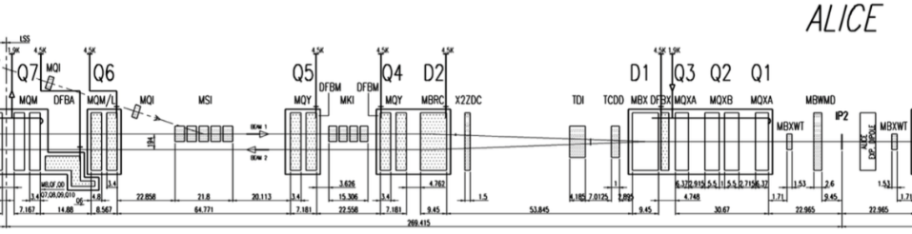
Injection failures
HL-LHC bunch intensities (2.2x10¹¹ p)
Worst cases : Injection Kicker (MKI) main switch erratic (circulating beam kicked) and magnet breakdown (injected beam deflected by either 90 or 110 % nominal)
→ maximum energy density ~100 J/cm³ (> 100 K – include design margins) in D1 coils due to showers from TDI
→ Safe?
What is the damage limit of sc. magnets in case of ultra-fast beam losses?
B1 (inj)
B1 (circ)
A. Lechner et all, Protection of superconducting magnets in case of accidental beam losses during HL-LHC injection, In Proceedings of IPAC15

Slide 5
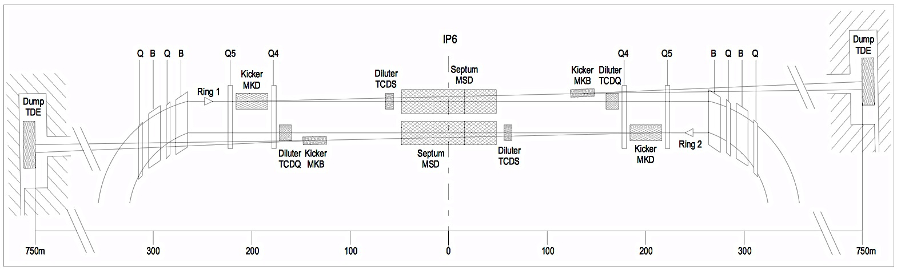
Dump failure: asynchronous beam dumps
HL-LHC bunch intensities (2.2 x 10¹¹ p)
Maximum energy density in Q4 / Q5 due to showers from dump absorber (TCDQ)
→ ~100 J/cm³ with safety margin in Q5 coils
B1
B2
B. Auchmann et all, Quench and Damage Levels for Q4 and Q5 Magnets near Point 6, CERN EDMS 1355063, 2014

Slide 6
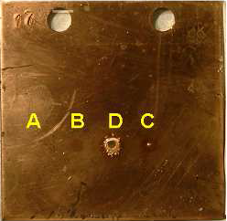
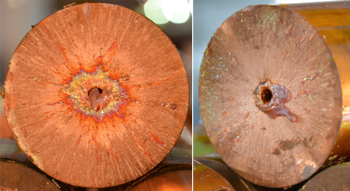
Damage limit: Upper boundaries
Melting of Copper at ~6 kJ/cm³
  TT40 experiment to identify the safe beam limit
  (5e11p @ 450GeV, 9.4e9p @7TeV)
  Benchmarking experiment to verify Hydrodynamic tunneling (HiRadMat CERN)
Disintegration of Polyimide insulation foils (‘Kapton’)
for T > ~400°C
Courtesy V. Kain.
V. Kain, Machine Protection and Bema Quality during the LHC Injection Process, CERN-THESIS-2005-47, 2005.
F. Burkart et al., Experimental and simulation studies of hydrodynamic tunneling of ultra-relativistic protons, In Proceedings of IPAC15
Notes:
TT40 experiment to identify the safe beam limit : no damage to accelerator equipment is expected in case of such intensities
- Hydrodynamic tunneling :
First bunches heated the material until phase transition and a radial shock wave move the material outside of the beam axis
As consequence, the protons delivered in the subsequent bunches penetrate much in deeper into the target
For example, shower of 7 TeV protons in solid carbon extend to about 3 m, which extend to about 25 m for a full LHC beam with 2808 bunches

Slide 7
Damage limit: Lower boundaries
For instantaneous beam losses, minimum energy density to induce quench is ~ mJ
Accidental beam losses during LHC injection in run1
  On the 28.07.2011, Injection kicker (MKI) erratic in IR2:
  ~ 176 bunches (2.5 x 10¹³ p) lost in the machine.
Courtesy A. Lechner
  Peak energy density in
  D1 coils ~ 6 J/cm³
  D1 and triplet quadrupoles quenched, but not damaged.
  However 3 non-powered correctors circuits in front of Q3 with a short to ground
Beam
D1
Q3
Q2
Q1
B. Auchmann et al., Testing beam-induced quench levels of LHC superconducting magnets in Run 1, PR-STAB, submitted 02.2015
A. Lechner et al., Energy deposition studies for fast losses during LHC injection failures, In Proceedings of IPAC13
Notes:
Q3 is MQXA.3L2 here. Peak Energy Deposition is around 1 J/cm3

Slide 8
Is there any damage to sc. magnets between 6 J/cm³ and 6 kJ/cm³?
Which are the critical elements of the sc. Nb-Ti magnets and their failure modes?
      Insulation of the magnets
      Sc. Nb-Ti cables
      Epoxy for potted magnets

Slide 9
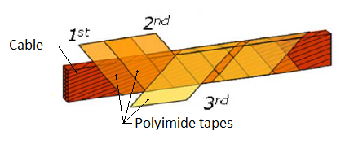
Failure of insulation in the magnet
  Insulation of magnet cable made out of 3 layers of polyimide (total thickness ~ 160 µm) with a dielectric strength of ~20 kV *
Damage due to high temperature (> ~400 C) can lead to
  inter-turn short (fatal for magnet in case of quench)
  short to ground (prevent operation and require most probably a replacement of the damage magnet)
* P. Fessia et al., Electrical And Mechanical Performance Of An Enhanced Cable Insulation Scheme For Superconducting Magnets, sLHC Project Report 46

Slide 10
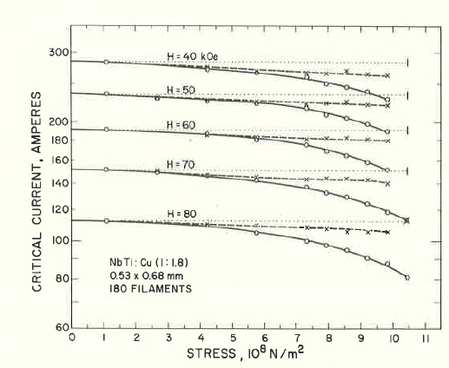
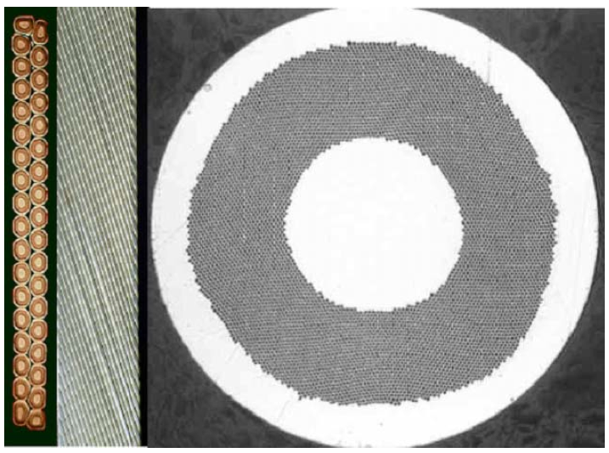
Critical current reduction in sc. cable
  Beam losses → Fast heating → Mechanical stress
  Plastic deformation of Copper Matrix inducing permanent stress on the Nb-Ti filaments. Critical current (I_{c}) of Nb-Ti has a low dependency to stress.
  Nb-Ti filaments breaking leading to a reduction of the I_{c} of the sc. cable
Sc. strands
Sc. cable
Sc. Filaments
* J.W. Ekin, F.R. Fickett, A. F. Clark, Effect of Stress on the Critical Current of NbTi Multifilamentary composite wire, Proc. Int. Cryogenic Materials Conf., 1975; (1977), Adv. Cryog. Eng., 22:449
Notes:
When do we break NbTi filaments due to energy depositions?

Slide 11
Loss of performance for potted coils
Damage of epoxy in potted coils (cracking due to thermal strain or exceeding of glass transition temperature @ 113°C for CTD-101A)
→ loss of performance due to detraining.
Magnet Corrector Sextupole (MCS):

Slide 12
Damage tests without beam

Slide 13
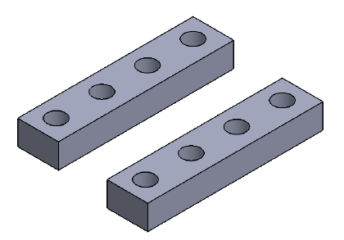
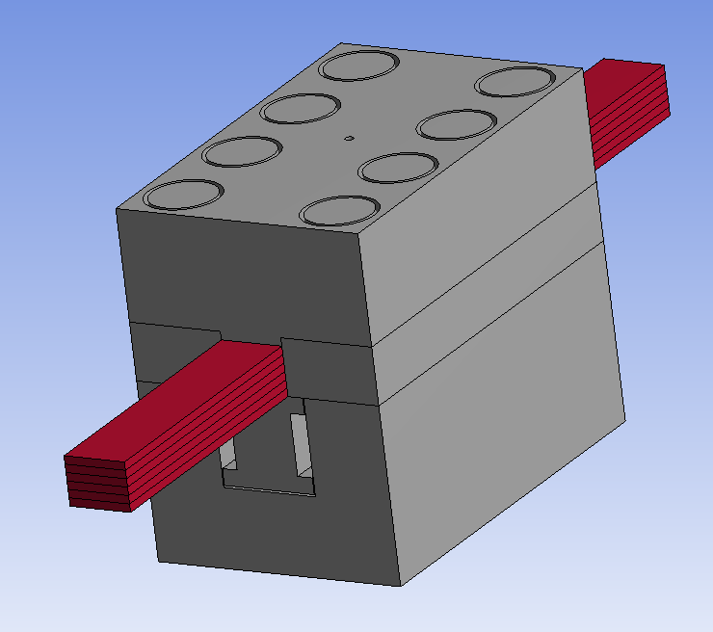
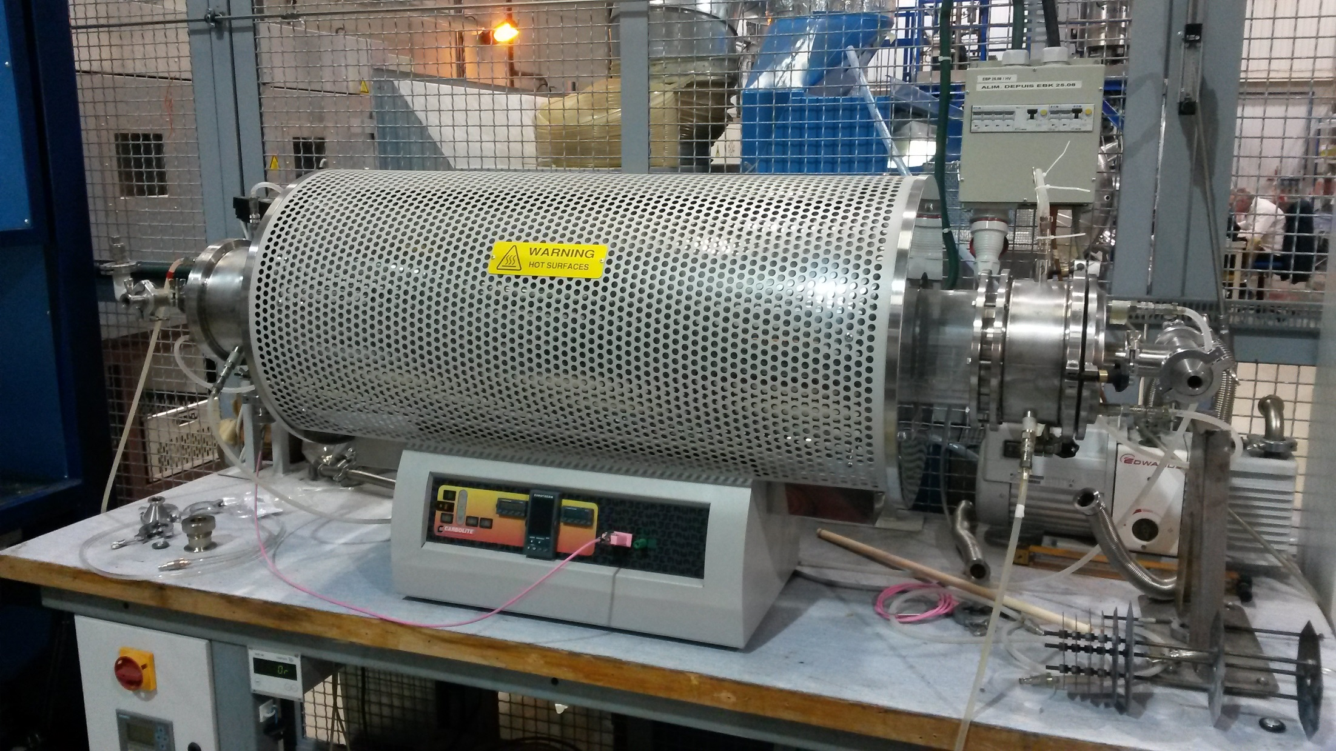
Damage limit of Polyimide film insulation
Measure degradation of insulation due to high temperature under stress within inert atmosphere – conditions comparable to sc. LHC dipole
  Stack of 6 sc. Cables under stress (~ 100 MPa) into a mould
  Heat samples step-wise to temperature between 200°C to 600°C in Argon atmosphere
  Measure the dielectric strength of each samples (outside of the oven)
Mould – Top Part
Mould – Side Parts
Mould - Bottom Part
Strain Gauge Bar

Slide 14
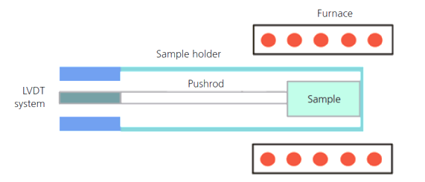
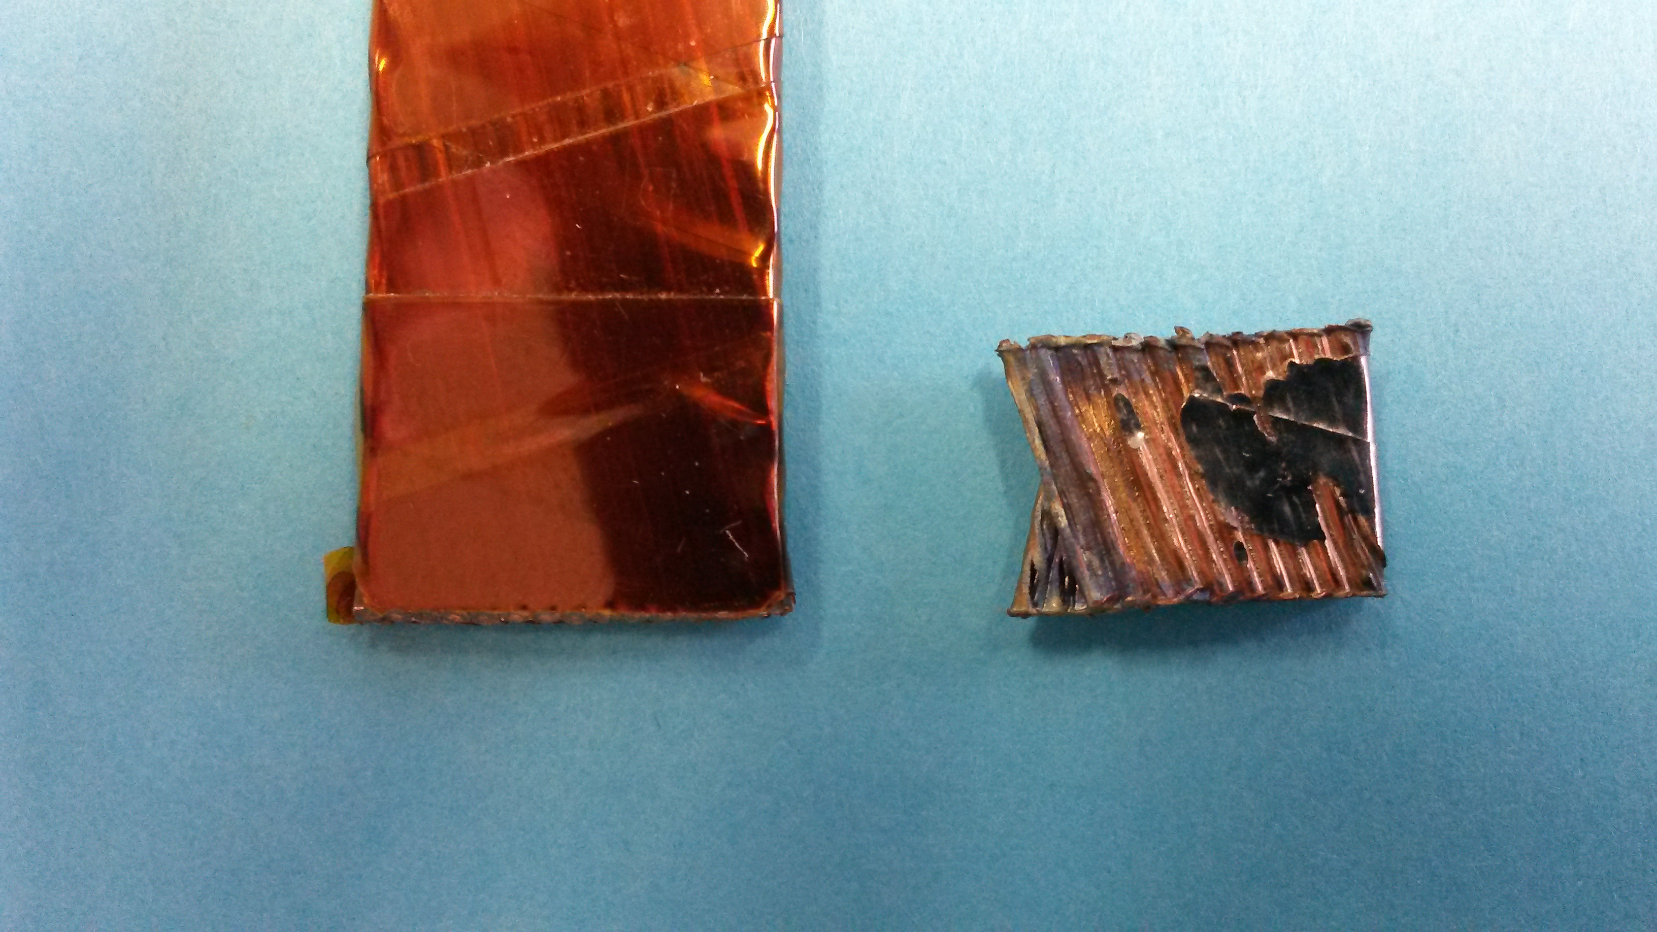
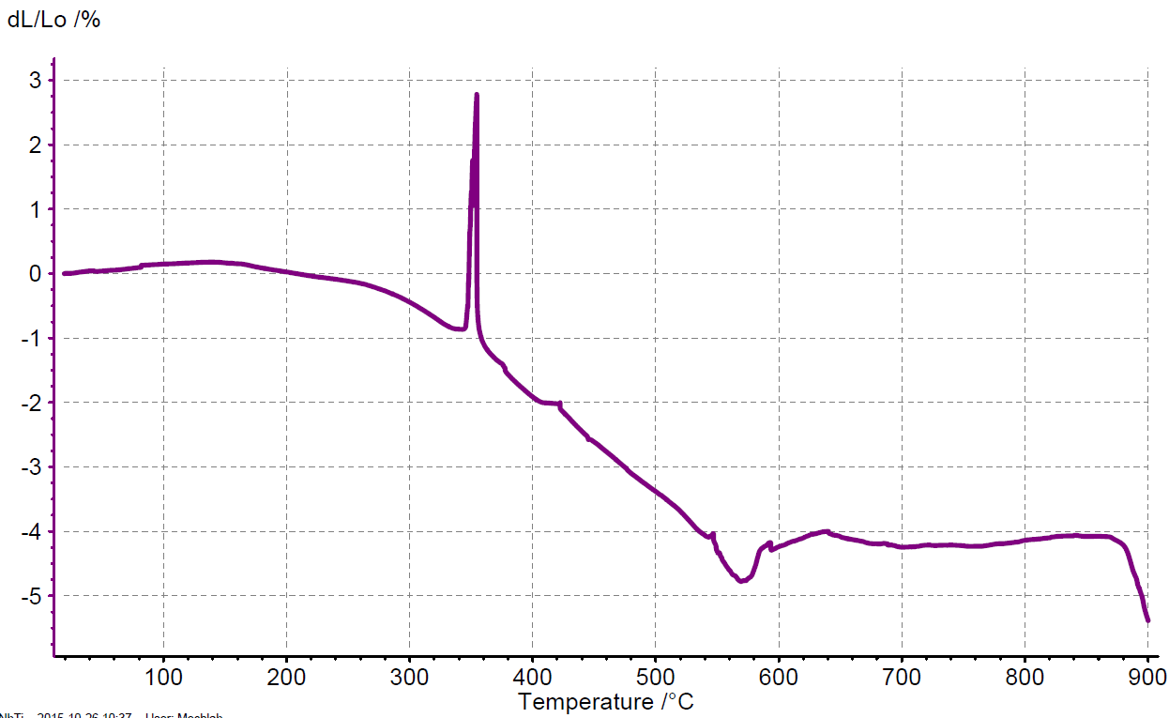
Damage limit of Polyimide film insulation
Pre-experiment to measure variation of thickness of an insulated cable from 20°C up to 900 °C in Helium atmosphere.
Courtesy O. Sacristan De Frutos
3 degrees/min
Unknown
~ 150 µm
Disintegration of insulation
Softening Copper
~ 2h
1h
2h
3h
4h
5h

Slide 15

Damage tests of Nb-Ti strands
Fast current discharge (<10 ms) using quench heater power supply into pre-stressed Nb-Ti strands with increasing peak temperatures.
Measure critical current after the discharge.
Derive degradation of critical current as function of peak temperature and thermal stress.

Slide 16
Damage tests with beam

Slide 17
Damage tests with beam
Test at the CERN HiRadMat test facility
Shoot a 440 GeV proton beam on sc. magnets and cables.
Cryogenic conditions (@4.2 K)
Samples:
    Test coils: Sample coils or LHC Sextupole correctors
    Cable stacks
Measure critical current and electrical integrity of the samples to derive damage limits
Notes:
Measure in situ that´s why we want to have coils!

Slide 18
Damage tests with beam in cryogenic environment
Instrumentation:
Voltage tabs, temperature probes, hall probes
Up to three test coils monitored on-line:
  Beam intensity increasing in steps - hot spot temperature from 50K to 700K
  After each shot: measure electrical integrity (HV test) and critical current (up to 1 kA)
Several Nb-Ti cable stacks into a mould under stress:
  One shot per stack
  Measure electrical integrity and critical current after removal from experiment.
Liquid He
Cable stacks
p⁺
Test Coils
Heater
Insulation vacuum
Support Table

Slide 19
Beam experiment - design on going
Simple cryostat: no windows needed.
→ Peak energy density in cryostat is 3 times lower than in the samples
→ Highest temperature reach in the cryostat wall is < ~300°C
Helium recuperation line available in surface building
→ Feasibility study to extend the recuperation line until tunnel area on-going
Critical current measurement of the test coils: Six DC power cables going from surface to tunnel – possibility to install power supply on surface.

Slide 20
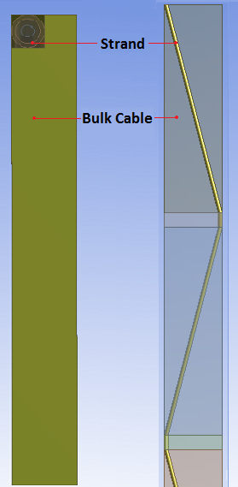

Numerical simulations
FLUKA: derive energy deposition map due to beam impact.
ANSYS Transient module: simulate dynamic stresses.
Study stress in Nb-Ti strands due to different thermal expansion coefficients of Cu-matrix and Nb-Ti (see next slide)
Study stress in Rutherford-cable strands due to thermal gradients over cable width.

Slide 21
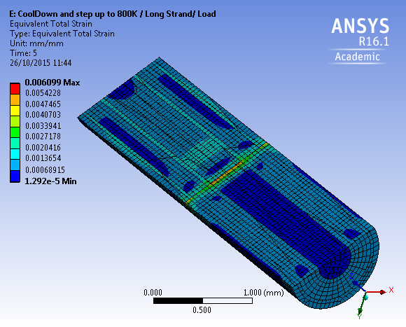
Thermal Stress in NbTi Strands
Steady state simulation with sharp temperature difference
  Cool down from 300 K to 4 K– Stress due to different thermal expansion of Copper and Nb-Ti
  Heating up lower part of the strand up to 800 K – From 300 K, the peak stress located at the interface cold/warm

Slide 22
Summary
Damage limits of sc. magnets due to ultra-fast beam losses are not known
HL-LHC beam parameters bring us into range of possible damage
Experiments:
    Without beam, insulation and Nb-Ti cable damage tests scheduled
    With beam, damage experiment with sc. coils and cable stacks @4.2K using 440 GeV protons of HiRadMad is in preparation for next year
Numerical studies on energy deposition and thermal stress in Nb-Ti strands and cables are on-going
HiRadMat Scientific Board
HiRadMat Technical Board
HiRadMat Beam Time
Opening of HiRadMat Experiment
End 2015
Early 2016
End summer 2016
Early 2017
Oct 2015
2016
2017
Insulation Damage tests
Nb-Ti strand damage tests
Design and Manufacture of HiRadMat Experiment
Test on irradiated sc. cables
Numerical Studies

Slide 23
Thanks for your attention
Questions ?

Slide 24
Spare Slides

Slide 25
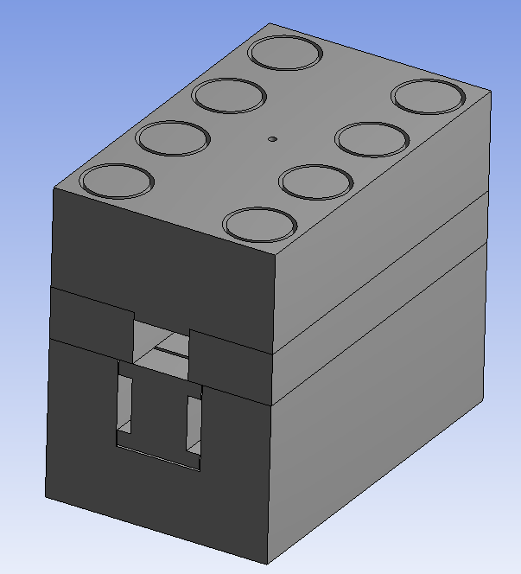
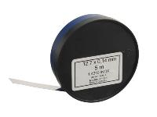
Hole for Thermal Sensor
Mould – Top Part
M10 screw
Mould – Side Parts
105
84
100
62
Mould - Bottom Part
Strain Gauge Bar
Mould dimension 84 x 62 x 100
Material Stainless Steel 304L
Cavity for Six Cable Stack (~ 12 mm)
Fine setting of stress on the cable stack with stainless strip (40 um up to 500 um) insert between the side and top part of the mold

Slide 26
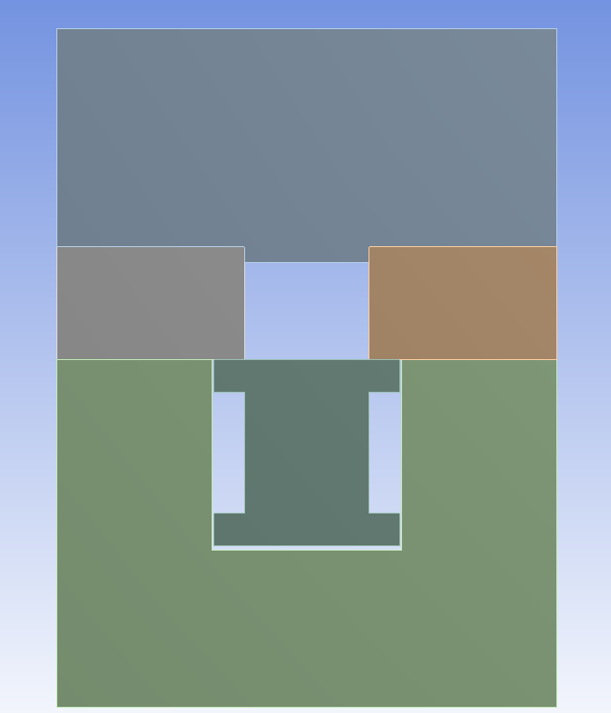
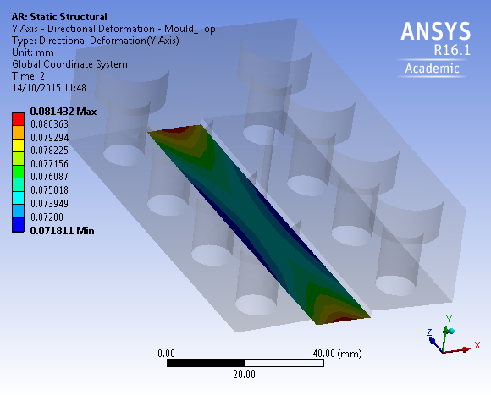
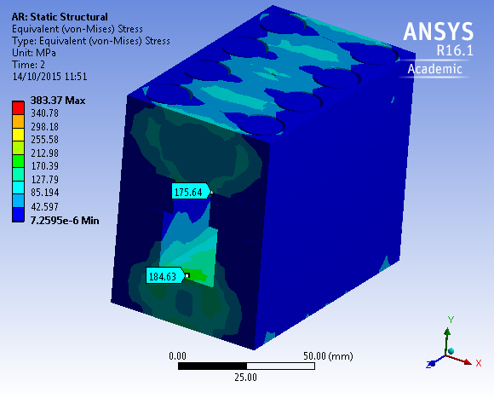
Bending of the top cover
100 MPa
Eq. Stress in Mould
Bending of the face in contact with the cable stack : 10 um between highest and lowest point
4 MPa difference of stress on the cable
Maximum Eq. Stress ~ 380 MPa on the screw
Screw Class 10.9 have 830 MPa Proof strength
Maximum Eq. Stress on mould ~ 200 MPa.
Ok to use Stainless steel 304 L (elastic limit - 240 MPa).

Slide 27
Each finger is instrumented with 4 strain gauges (bridge setup to take into account Poisson ratio and to cancel thermal strain)
6 cables per finger to compensate cable length.

