Slide 1
Conclusions on the Energy Deposition and Material Studies for the Cold Powering System
_{F.Broggi (INFN)}
5th Joint HiLumi LHC-LARP Annual Meeting
_{CERN 26-30 October 2015}

Slide 2
Outline
Recall of the working program from the first HiLumi LHC Collaboration Meeting (CERN 16-18th November 2011)
Irradiation test simulations, material comparison and possible SCL routing
Progress in defining the cable structure, bulk, mixture, real one
Almost definitive SCL routing
Neutrons and MgB₂
P7
Conclusions

Slide 3
WP6 – Cold Powering
Task 6.4. Energy deposition and material studies
• To calculate maps of energy deposition from collision debris and beam losses
• To calculate the induced radiation on the cold powering components
• To study the potential effect of radiation on advanced superconducting materials

Slide 4
(Possible) Solution(III) How to proceed
- Collect and update all the data available in literature
- Perform an irradiation test on the material under study (maybe useful to reproduce a test reported in literature)
Benchmark between the simulation code and the test
Correlate the evaluated DPA with the material characteristics (resistivity, thermal conductivity, …)
- Once the reliability of the code has been stated (in most cases it is not necessary, because the most used codes ondergo to continuous comparisons and benchmarking)
- Simulate the irradiation effects with the actual fluencies and parameters to the components

Slide 5
Work Progress
• Simulation of irradiation with different type of beams on MgB₂, BSCCO, YBCCO (While waiting for the routing of the SCL in the cavern and the cable layout to create the FLUKA geometry
• Evaluation of the different energy neutron beam effects on MgB₂ with ¹⁰B, ¹¹B and ^{nat}B composition (can the n flux damage the B in SCL?)

Slide 6
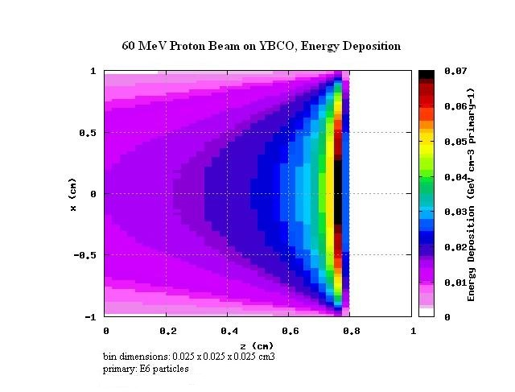
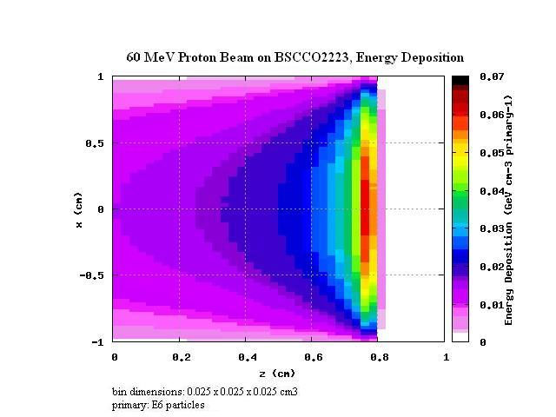
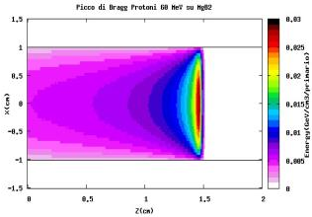
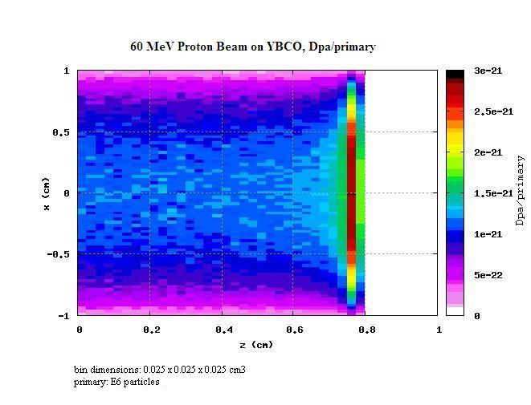
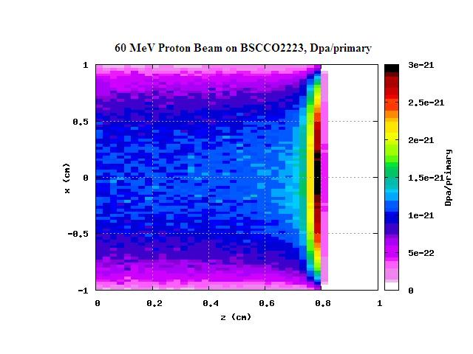
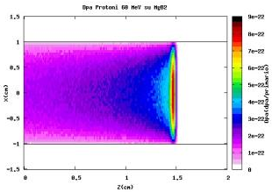
Irradiation Test Simulations
60 MeV p on YBCO and BSCCO beam spot : 2 cm ; Fluence2x10⁹ n/s x 1 d ; target (2x2x1 cm³)
Energy Deposition
YBCO
BSCCO2223
MgB₂
DPA

Slide 7
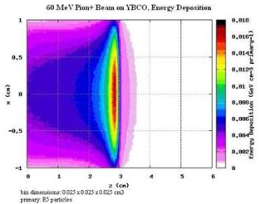
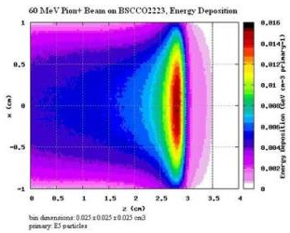
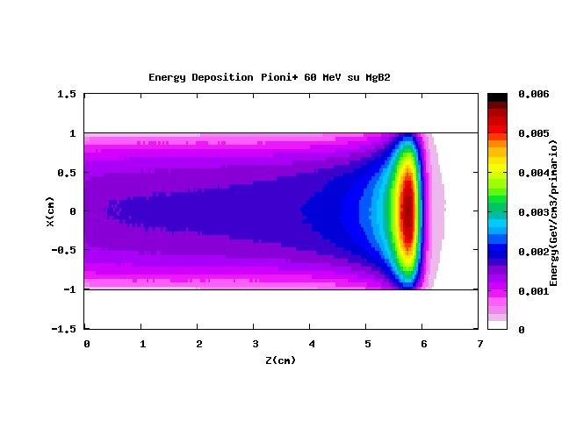
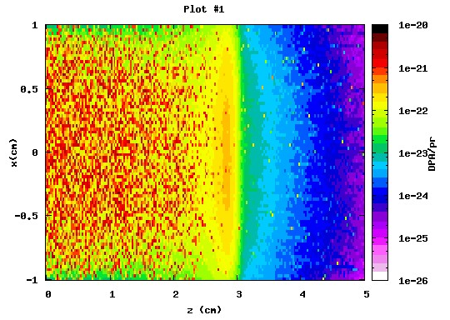
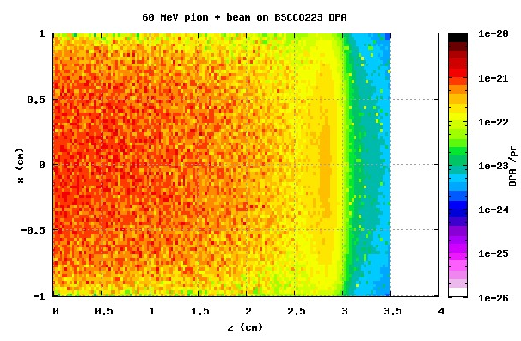
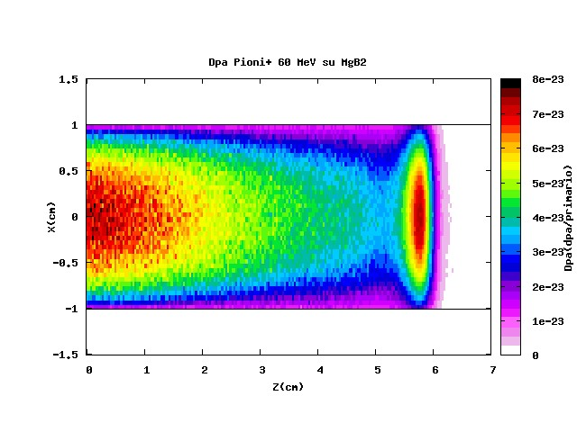
Irradiation Test Simulations
60 MeV π⁺ on YBCO and BSCCO beam spot : 2 cm ; Fluence2x10⁹ n/s x 1 d ; target (2x2x1 cm³)
Energy Deposition
YBCO
BSCCO2223
MgB₂
DPA

Slide 8
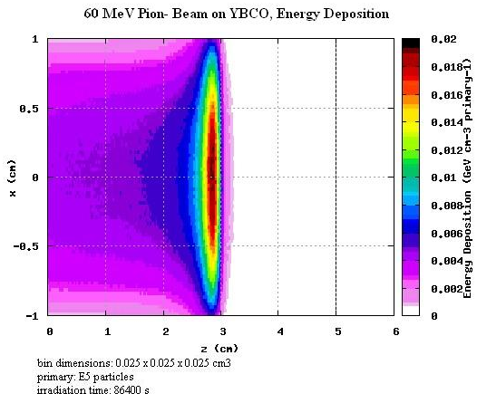
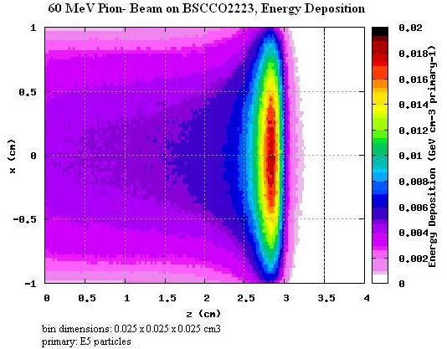
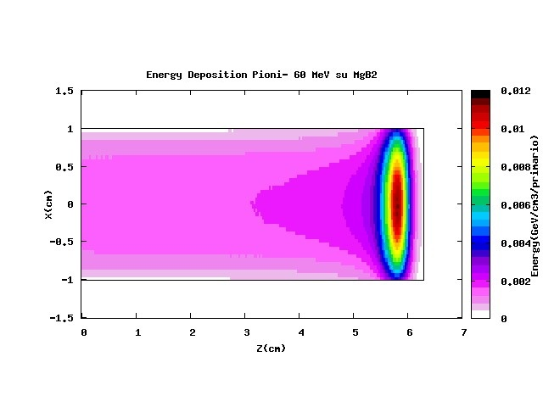
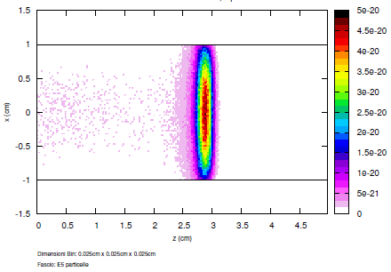
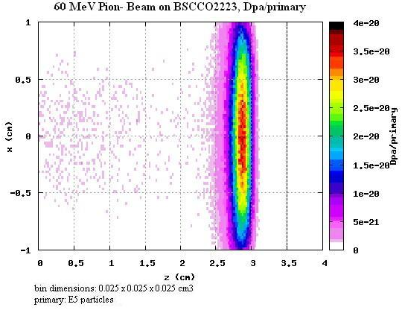
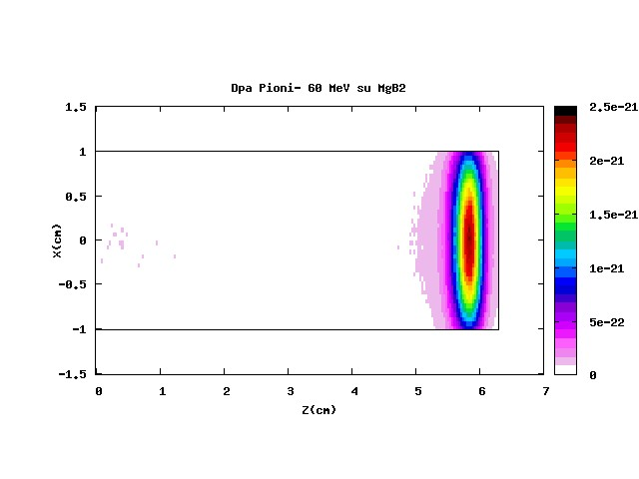
Irradiation Test Simulations
60 MeV π⁻ on YBCO and BSCCO beam spot : 2 cm ; Fluence2x10⁹ n/s x 1 d ; target (2x2x1 cm³)
Energy Deposition
YBCO
BSCCO2223
MgB₂
DPA

Slide 9
Irradiation Test Simulations
Many other data are available (Activation, activated elements, decay time etc.)
Other cases have been studied.
142 MeV protons (Brookhaven energy)
1.5 GeV γ (LHC peak energy photons on low-beta quad coils)
GeV π± ( “ )

Slide 10
Material Comparison in an Almost Real Case
SCL (Homogeneous bulk BSCCO, YBCO, MgB₂)
Inside the Q1 iron yoke
500 7+7 TeV p-p events
2230671 particles
1.83E2 TeV Kinetic Energy
3.46E3 TeV Total Energy
83% of the particles are photons
15% are neutrons
29% of the kinetic energy is from photons
21% from neutrons
31% from pions
1.5% of the total energy is from photons
94% from neutrons
500 7+7 TeV p-p events
2230671 particles
1.83E2 TeV Kinetic Energy
3.46E3 TeV Total Energy

Slide 11
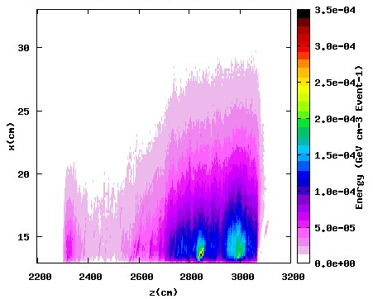

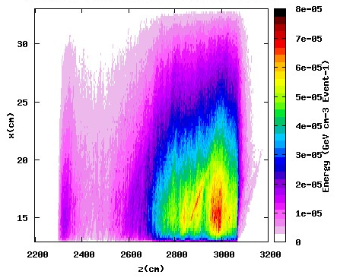
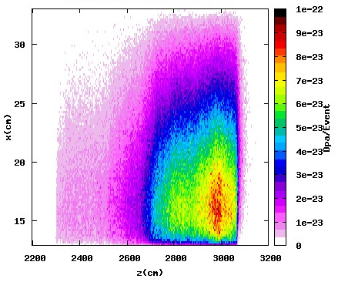
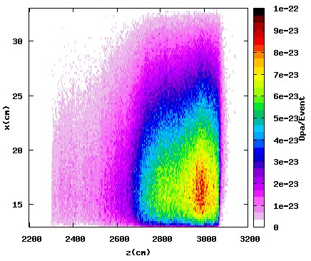
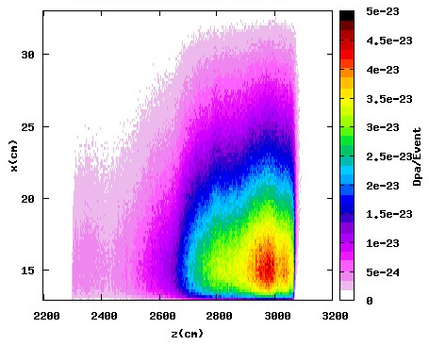
Energy Deposition (top) and DPA (bottom)
YBCO
BSCCO
MgB₂
(the scoring bin dimensions are 0.2x0.2x3.3 cm³).
The abscissa is the distance from the IP.

Slide 12
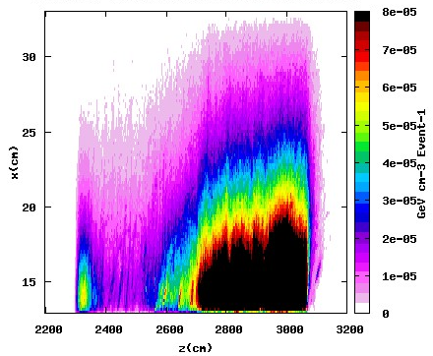
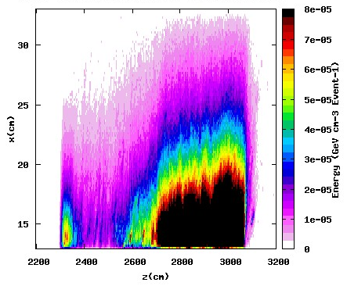
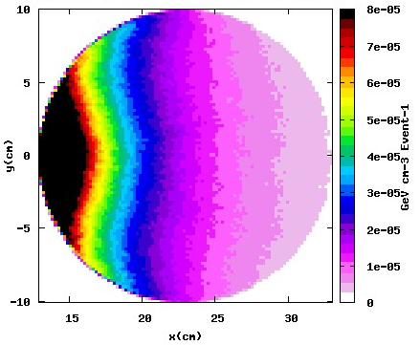
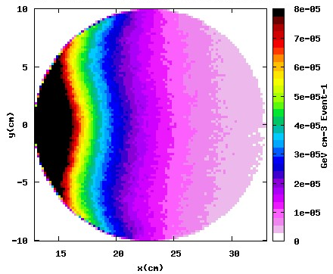
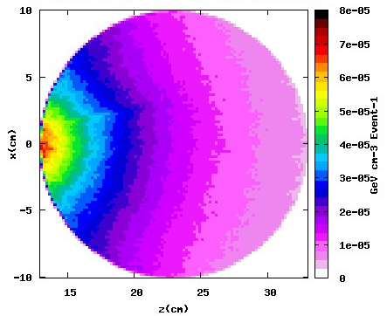
Energy Deposition (same scale)
YBCO
BSCCO
MgB₂

Slide 13
Material Comparison
BSCCO and YBCO are similar
MgB₂ shows a lower energy deposition and DPA

Slide 14
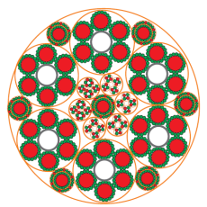

Simulation progress
• BSCCO and YBCO are similar (for the energy deposition and DPA aspects); MgB₂ has a slightly lower energy deposition
• Definitive definition of
the cable geometry and
material composition
• Simulation of this cable aside Q1 (P1 geometry),
to compare the bulk MgB₂
cable with the composite one
Cu
MgB₂ , Φ = 0.85 mm
18 MgB₂ wires
Φ = 6.5 mm
Cable layout
6x20kA , 7x3kA, 4x0.4kA, 8x.12kA
Φext ∼ 65 mm
Courtesy A. Ballarino

Slide 15
Cable Material Composition

Slide 16
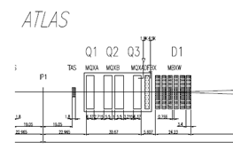
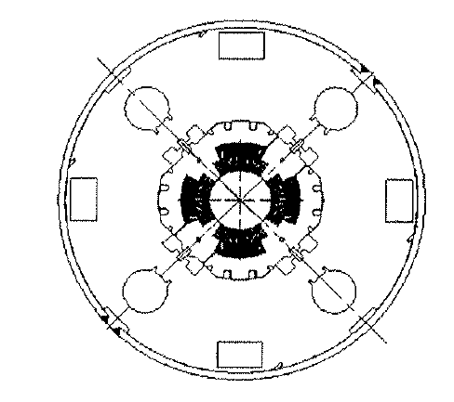
Material (Cable) Comparison
6.5 cm
Particle debris
x
1
z
MgB₂
y
x
68% of the kinetic energy is from neutrons
17% from pions
6% from protons
5% from photons

Slide 17
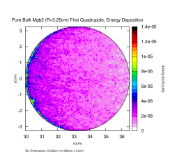
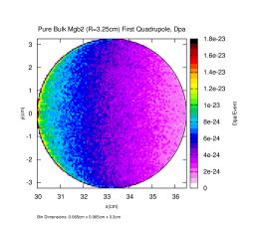
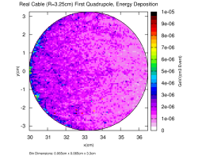
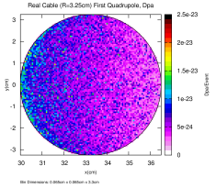
Cable Comparison
Energy Deposition
DPA
Pure Bulk MgB₂
“Mixture” Cable
Scaling factor to 3000fb⁻¹ = 3x10¹⁷
17

Slide 18
Towards the Final Configuration
The definitive layout was not defined (2013) so we simulated the energy deposition in cables running parallel to Q1 (as done so far) located at different positions.
in contact with Q1 (Near case)
at 0°, 90°, 180° and 270°
at 1 m distance from the magnet
(Far case), at the same angular
position.

Slide 19
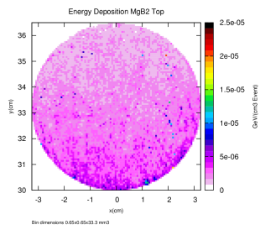
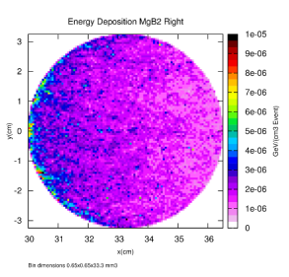
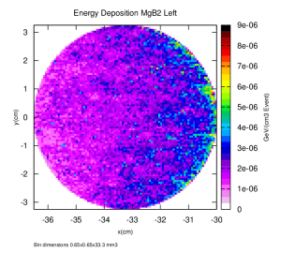
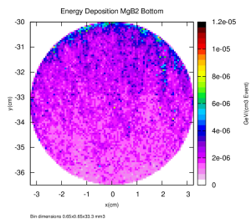
MgB₂ cable aside Q1 (Near case)

Slide 20
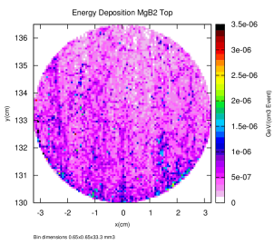
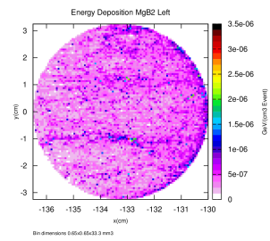
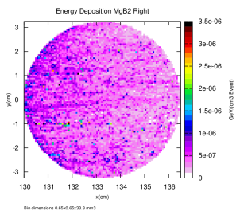
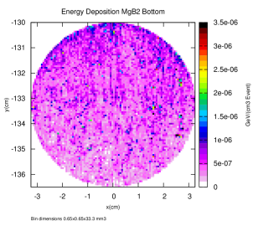
MgB₂ cable at 1 m from Q1 (Far case)
20

Slide 21
Dose and DPA
As we can see the values of dose and DPA should not endanger the cables.
Let’s remind that this configuration is a conservative one, being aside the first quad.

Slide 22

SC Link in FLUKA
•Refinement and definitive definition of the cable geometry
- MgB₂ bulk
- MgB2+SS+Cu+He
homogeneous mixture
- Detailed description
Courtesy A. Ballarino
Cu
MgB₂ , Φ = 0.85 mm
18 MgB₂ wires
Φ = 6.5 mm
Φext ∼ 65 mm
FLUKA geometry

Slide 23
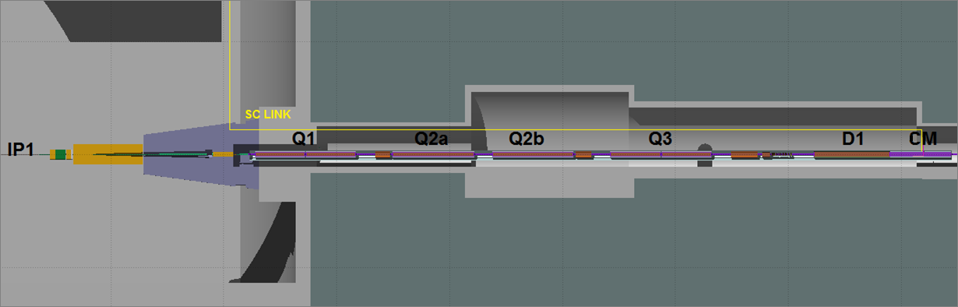
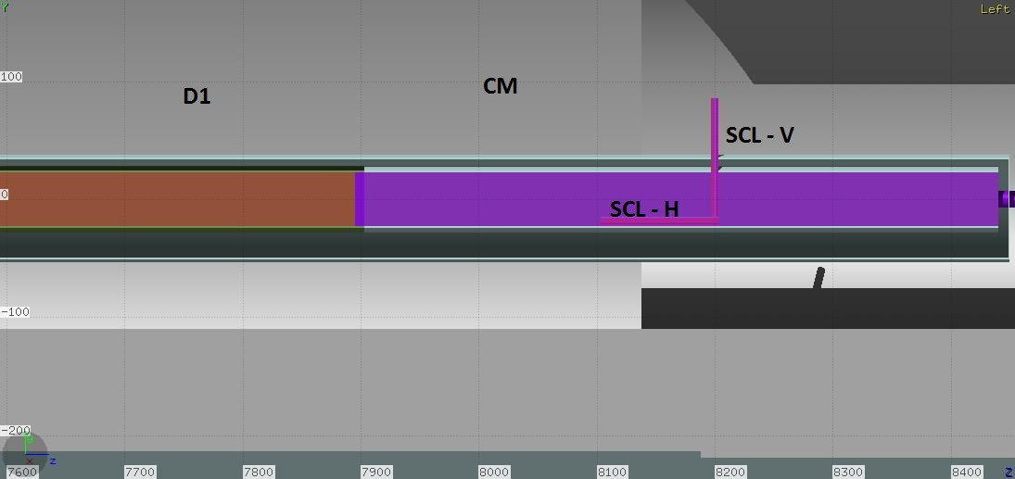
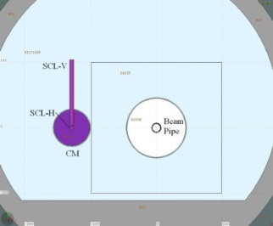
SCL Routing into the tunnel
Two possible routings of the SCL have been investigated:
1) Arrive from surface closer to IP1. The SCL runs aside the triplet and then connect to the Connection Module (CM), aside the beam pipe
2) Arrive from surface
after D1

Slide 24
Particle Fluencies (option 1)
(From Q1 to the SCL 1 m above Q1)
Escaping from Q1
28% photons (1250 ph/event) 9% of the kinetic energy is from photons (3.2 GeV/event)
71% neutrons (3143 n/event) 65% from neutrons (22.8 GeV/event)
Entering the SCL
33% photons (12.5 ph/event) 14% of the kinetic energy is from photons (33.8 MeV/event
67% are neutrons (25.4 n/event) 68% from neutrons (170 MeV/event)
24
24

Slide 25
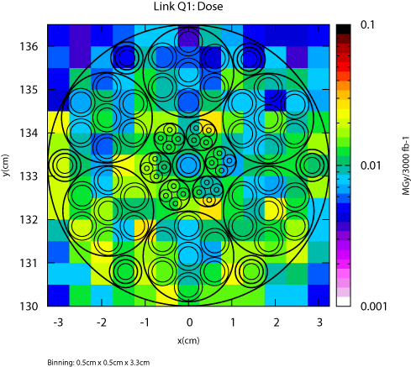
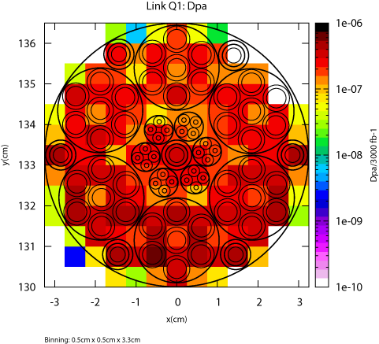
Option 1
(From Q1 to the SCL 1 m above Q1)
The maximum dose is of the order of some 0.01 MGy (at 3000fb⁻¹).
The maximum DPA is about 10⁻⁶.
According to literature* a value of 1.1x10⁻² dpa causes a decrease of the
critical temperature from 38.3 to 36 K and enhancement of the upper critical field, these values should be not endanger the SCL for all the machine operation.
*
M. Eisterer, M. Zehetmayer, S. Tonies, H. W. Weber, M. Kambara, N. Hari Babu, D. A. Cardwell, L. R. Greenwood, “Neutron Irradiation of MgB2 Bulk Superconductors”, Supercond. Sci. Technol. 15 (2002) L9–L12

Slide 26
Particle Fluencies (option 2)
(To the SCL in the CM after D1)
Entering the SCL in the Connection Module
95% photons (126 ph/event) 35.8% of the kinetic energy is from photons (295 MeV/event)
2.4% neutrons (3.2 n/event) 6.3% from neutrons (51.6 MeV/event)
26
26

Slide 27
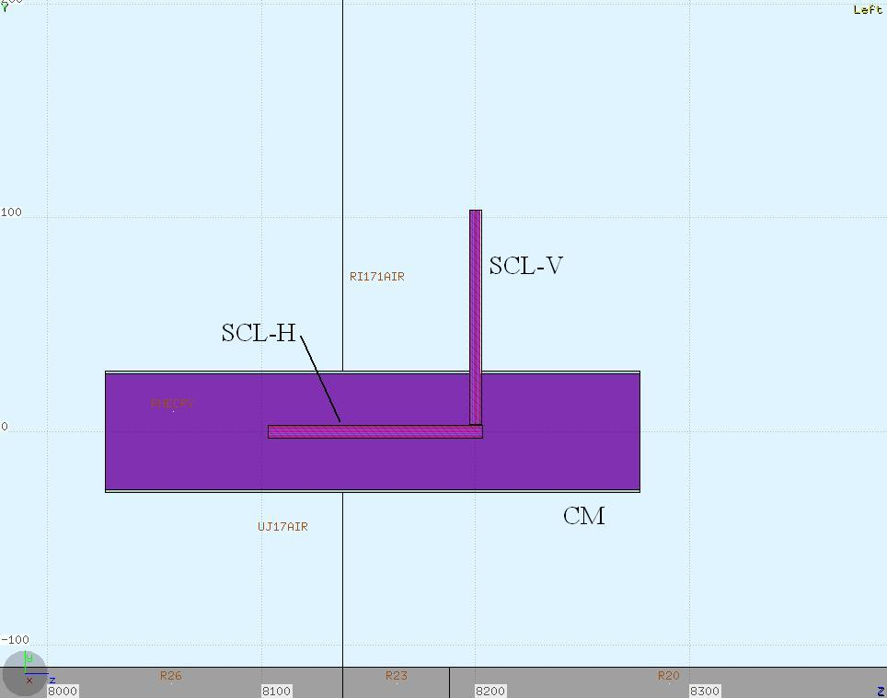
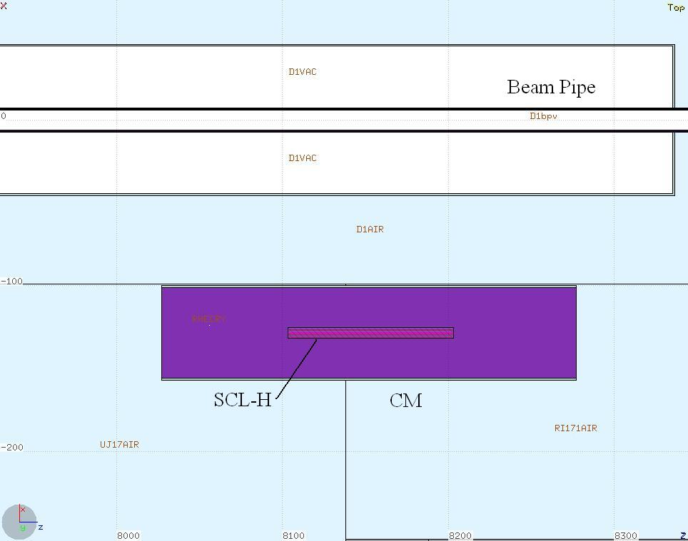
Option 2 Fluka Model

Slide 28




Option 2 Results (definitive)
The internal cable structure is not visible for visualization problems but it is actually implemented
The maximum dose in the SCL is about 0.1 MGy and the maximum DPA is about 10⁻⁶

Slide 29
Conclusions on Energy Deposition and DPA
The SCL configuration used for the simulations so far performed are about definitive. They are in a conservative hypothesis because the external insulation and cryogenic shielding are not take into account.
The dose and DPA induced into the SCL are well below a critical value that can be assumed as 35 MGy (values at which the kapton start to lose its insulating properties and 10⁻² DPA as from irradiation tests. Values from literature indicate that the induced DPA increases the pinning effect at the advantage of an increased performance.
In the future (if necessary), with a detailed layout of the MgB₂ SCL, definitive simulations with the new optics (longer insertion quadrupoles) could be done.
No big variations are expected so we can conclude that the energy/dose deposition and the DPA in the MgB₂ cables, with the conservative hypothesis adopted, are not a concern over the whole lifetime of the SC links (3000 fb⁻¹).
P5 has not been simulated so far, but we do not expect big differences with P1.

Slide 30



Concerns of Neutrons on MgB₂
B natural isotopic composition is : 80% ¹¹B - 20% ¹⁰B
Mg natural isotopic composition is : 78.99% ²⁴Mg – 10% ²⁵Mg - 11.01% ²⁶Mg
¹⁰B has a very high thermal neutron
capture cross section for ¹⁰B(n,α)⁷Li
1 MeV
Thermal
Data from National Nuclear Data Center http://www.nndc.bnl.gov/

Slide 31
Reactions occurring
σ_{term} (b) | σ_{1MeV} (b)
5.7E-2 | 3.3E-4
2.2E-1 | 3E-4
4.3E-2 | 3.7E-4
4.2E3 | 2.2E-1
6.4E-4 | 9.6E-4
5.8E-1 | //
6.1E-3 | 2.2E-6
²⁷Mg → ²⁷Al + β⁻ + ν
²⁷Mg t_{1/2}= 9.5 min
¹⁰Be → ¹⁰B + β⁻ + ν
²⁷Be t_{1/2}= 1.39 x10⁶ y
¹²B → ¹²C + β⁻ + ν
¹²B t_{1/2}= 20.2 ms
Data from National Nuclear Data Center http://www.nndc.bnl.gov/

Slide 32
Neutrons on MgB₂
In order to evaluate the DPA and radiation damage of this reaction
Cases studied
External Beam and External isotropic n source
Thermal Epithermal and Fast
0.025 eV 10 eV 0.1 MeV
TARGET (2x2x2 cm³)
MgB₂ with only ¹⁰B
MgB₂ with only ¹¹B
MgB₂ with natural composition of B (80% ¹¹B – 20% ¹⁰B)

Slide 33

Neutron Beam on Natural B MgB₂
Thermal
Epithermal
Fast
Energy Deposition
DPA

Slide 34

Neutron Beam on ¹¹B Enriched MgB₂
Thermal
Epithermal
Fast
Energy Deposition
DPA

Slide 35
From the previous slides it is evident the effect of th ¹⁰B capture reaction for thermal neutrons
If it is necessary to penetrate the neutrons in the material (for irradiation studies or other needs) it is necessary to use high energy neutrons or ¹⁰B depleted target

Slide 36




Residual Nuclei (at t=0 s)
Neutron beam spot : 2 cm Fluence2x10⁹ n/s x 1 d
Thermal n
1 MeV
t=0
²⁶Mg(n,γ)²⁷Mg
σ_{th}=4.1E-2 b σ_{1MeV}=3.7E-4 b
σ_{th}=5.8E-3 b σ_{1MeV}=1.5E-6 b
¹¹B(n,γ)¹²B
B_{nat}
¹⁰B(n,p)¹⁰Be
σ_{th}=5.8E-4 b σ_{1MeV}=1.0E-3 b
¹⁰B(n,α)⁷Li
σ_{th}=3.8E+3 b σ_{1MeV}=2.1E-1 b
t=1 d
Protons from

Slide 37


External Isotropic Neutron Source
MgB₂ with natural composition of B (80% ¹¹B – 20% ¹⁰B)
Thermal Neutrons (isotropic source)
TARGET (2x2x2 cm³)
n
x
Target
z
The transport cut-off : hadrons 10⁻⁶ GeV neutrons 10⁻¹⁴ GeV
Central section:
neutrons react at the surface
damage energy threshold = 25 eV
5th Joint HiLumi LHC-LARP Annual Meeting CERN 26-30 October 2015

Slide 38


Energy Deposition and DPA
Energy Deposition
1.11E-03(±0.03%) GeV/pr
DPA
3.66E-23 (±0.03%)
DPA is related to Energy Deposition
5th Joint HiLumi LHC-LARP Annual Meeting CERN 26-30 October 2015

Slide 39

n Boron capture reaction
What is the contribution of alpha particles and of Li ion to the DPA?

Slide 40



α Fluence
Reactions occurring at the surface cause a high fluence of alfa particle outside
5th Joint HiLumi LHC-LARP Annual Meeting CERN 26-30 October 2015
Tsukuba November 20th 2014
40
40

Slide 41


Single contribution (of α and Li)
Simulation with single internal isotropic source
α
n
Li
Target
α
n
Li
For the other different cases studied (alpha and Li) there are similar plots
These plots have not any absolute meaning, they just show that all the energy is deposed inside the sample (and the corresponding DPA is all provided inside them) and so the results can be compared.
5th Joint HiLumi LHC-LARP Annual Meeting CERN 26-30 October 2015

Slide 42

Considerations
The most significant parameter for the DPA is its the peak value. As a matter of fact the mean value of the DPA, as it is defined, indicates that every atom undergoes to the given amount of displacement.
It is evident that it does not happen because from previous figures the energy deposition and DPA occur in a limited part of the target, so it is meaningless to attribute a DPA to the whole region.
Conversely the peak value gives an indication of the localized radiation damage and this can give effects on the material characteristics.
42

Slide 43
Single contribution (of α and Li)
Maximum and average DPA in the MgB₂ target induced by the reaction products of the boron capture.
Reaction occurrence |  | Max DPA [DPA/primary]±Err% | Mean DPA [DPA/primary]±Err%
94% | Alpha (1.47 MeV) | 15.911∙10⁻²² ± 7.9 | 6.1633∙10⁻²²± 0.001
 | Lithium (0.84 MeV) | 32.968∙10⁻²² ± 6.9 | 11.952∙10⁻²²± 0.001
 | Photon (0.482 MeV) | == | ==
6% | Alpha (1.777 MeV) | 16.422∙10⁻²² ± 6.3 | 6.3141∙10⁻²²± 0.002
 | Lithium (1.015 MeV) | 31.447∙10⁻²² ± 6.6 | 12.240∙10⁻²²± 0.001
43

Slide 44
DPA Evaluation (of α, Li and n)
Combining the data with the corresponding weight we have
 | Max DPA [DPA/primary]±Err% | Mean DPA [DPA/primary]±Err%
Alpha | 15.942∙10⁻²² ± 7.8 | 6.1724∙10⁻²²± 0.001
Lithium | 32.876∙10⁻²² ± 6.8 | 11.969∙10⁻²²± 0.001
Neutron | 46.295∙10⁻²² ± 5.0 | 18.345∙10⁻²²± 0.001
Summing the contribution of the alpha particle with the Lithium one:
15.942∙10⁻²² + 32.876∙10⁻²² = 48.818∙10⁻²² ± 0.257 max DPA
6.1724∙10⁻²² + 11.969∙10⁻²² = 18.141∙10⁻²² ± 0.001 mean DPA
Internal neutrons
46.295∙10⁻²² ± 2.334∙10⁻²² max DPA
18.345∙10⁻²² ± 0.001∙10⁻²² mean DPA
The Lithium contribution to DPA is 66-67% of the total (the sum of the alpha and Lithium)
The contribution of the alpha is about 33-34%
44

Slide 45
Considerations
PEAK VALUES
The peak value calculated by the sum of the alpha and Li contribution is about 6% higher that the values given by the neutrons.
This because we assume that every neutron reacts with ¹⁰B realizing one Li and one alpha particle.
MEAN VALUES
For the mean DPA calculated by the sum of the alpha and Li contribution is about 1% lower that the DPA induced by the neutrons.
This is probably due to the statistics, and anyway this value (the mean DPA) in our analysis is less important, as explained before.
45

Slide 46
Is the Boron consumpion a worry ?
1 MeV
σ_{term} =4.2 x 10³ b
σ_{1MeV} =2.2 x 10⁻¹ b
1.5×10⁴ b at 20 K (E_{n}=0.0017 eV)
Thermal
As from the data before the n entering the SCL inside the CM (Option 2) are about 3.2 n/event.
At an integrated luminosity of 3000 fb⁻¹ LHC will collect about 3·10¹⁷ p-p events, so the
total amount of n in the SCL will be about 1·10¹⁸ .

Slide 47

Number of ¹⁰B Target in the SC Link
Material composition of the cable
Cu
MgB₂ , Φ = 0.85 mm
18 MgB₂ wires
Φ = 6.5 mm
Considering 1 m Link length
S=33.2 cm²
Being M=45.93 g/mol the MgB₂ molar mass and
ρ=2.57 g cm⁻³the density
Φext ∼ 65 mm
$$\frac{ρ}{M}A=\frac{2.57}{45.93}6.022∙{10}^{23}=3.37∙{10}^{22}$$
Pure MgB₂ atoms cm⁻³
$$3.37∙{10}^{22} ×33.2×100×2×0.245×0.2=1.1×{10}^{25}$$
¹⁰B atoms m⁻¹
Much higher than 1. x 10¹⁸ and even supposing 1 capture reaction per neutron, the ¹⁰B consumption is negligible

Slide 48

P7
(Data presented last year in Tsukuba, no more work on it)
Dose normalized to a number of proton losses in the collimators (10¹⁶) in Run 1 Data allows to tentatively correlate to 30-40 fb⁻¹
The maximum proton loss is after the primary collimators of the Beam 2
In this region we located the model of the cable
In the maximum point we put 3 meters long SC Link model (the same of IP1).
For the simulation we used 30000 protons lost in the collimators (SixTrack output) and then we normalized the data for 30 fb⁻¹

Slide 49


Dose
The maximum dose is about 40 kGy integrated over a period of 30 fb⁻¹
If also we extrapolate proportionaly to 3000 fb⁻¹ we will obtain only 4 MGy over the whole period of exercise

Slide 50

Dpa
The dpa is about 10⁻⁷ over all the cable. This value give us no concern, because it is almost 1 order of magnitude smaller than the one in IP1

Slide 51
Conclusions
The energy/dose deposition and the DPA in the MgB₂ cables, with the conservative hypothesis adopted, are not a concern over the whole lifetime of the SC links (3000 fb⁻¹).
The ¹⁰B consumption is negligible
From this work we get more deep knoweledge of the effects of radiations on HTC materials
In the boron capture reaction the alpha particle and the Lithium nucleus contribute for the 33-34% and 66-67% to the total DPA respectively.
Maximum dose on MgB₂ SC links is not a concern in P7. It won’t be even if we would consider proportional the relation between integrated luminosity and proton losses

Slide 52
Acknowledgments
Thank You for Your attention
A. Bignami (POLIMI and INFN)
C.Santini (POLIMI and INFN)
References:
- A. Bignami, “Studio delle Connessioni Superconduttive in MgB2 per il Progetto HiLumi-LHC”, grad. thesys.
https://www.politesi.polimi.it/handle/10589/81012
- C. Santini, “Studio degli Effetti del Campo di Radiazione sulle Connessioni Supercondutive per il Progetto HiLumi-LHC”, grad. thesys,
https://www.politesi.polimi.it/handle/10589/102125
- Deliverables and Milestone reports

Slide 54


Spare Different interctions of π⁺ and π⁻
For π⁻ the dpa peak is higher than for π⁺
The different behaviour is due to the absorption of the π⁻ by the nucleus (π⁻ + p --> n + γ)
while the π⁺ are not absorbed and decay (π⁺ --> μ⁺ + ν_{μ})

Slide 55
−
²⁷Mg t_{1/2}=9.5 min
²⁷Mg → ²⁷Al + β⁻ + ν

