Slide 2
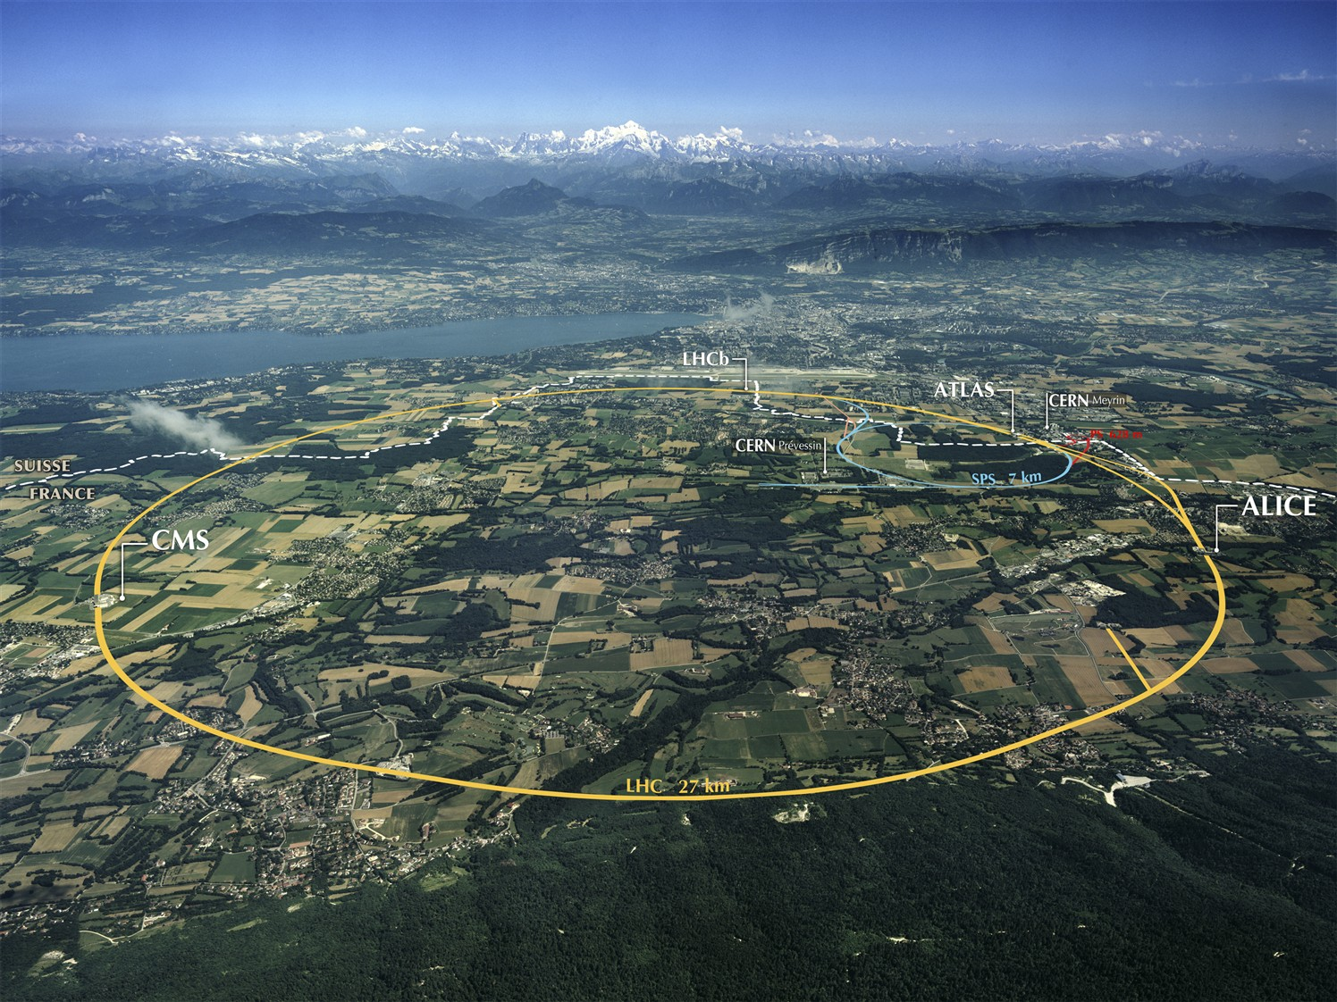

IT-4041/TE/HL-LHC
Bidders’ conference – Jun. 10, 2015
Introduction to CERN
Accelerating Science and Innovation

Slide 3
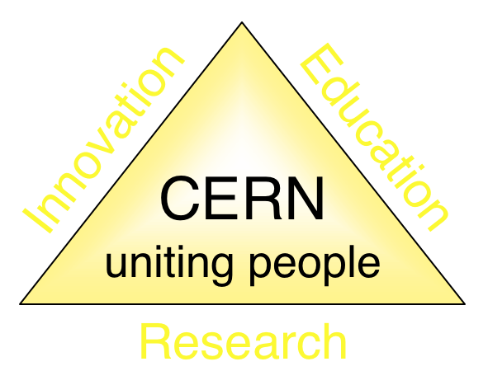
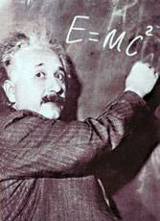



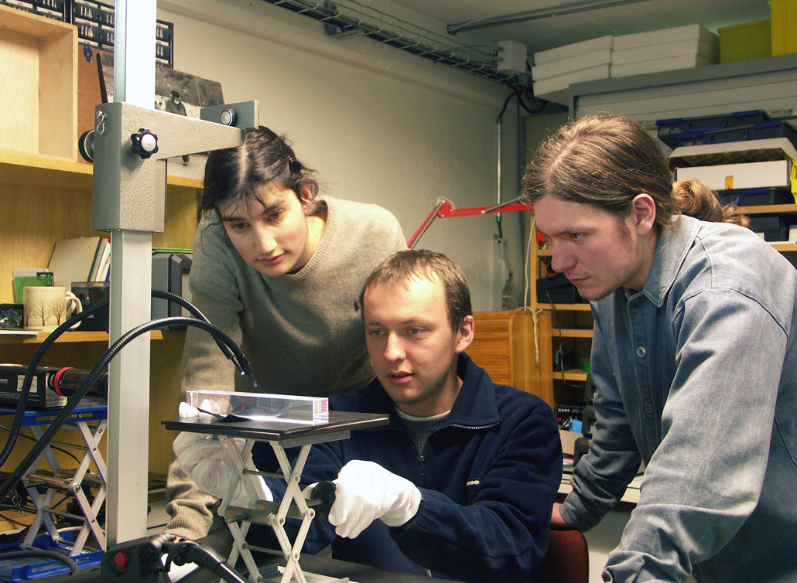
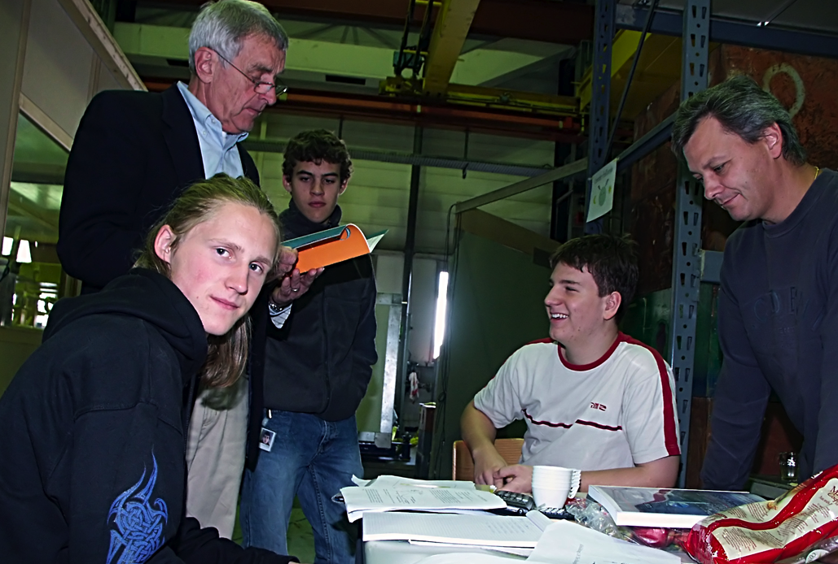
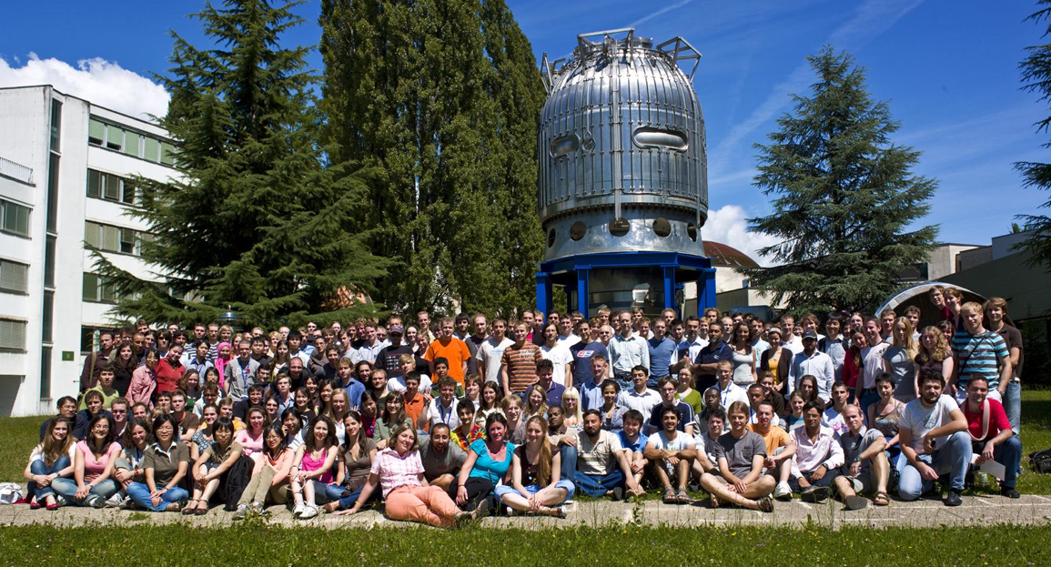
The Mission of CERN
Push forward the frontiers of knowledge
E.g. the secrets of the Big Bang …what was the matter like within the first moments of the Universe’s existence?
Develop new technologies for accelerators and detectors
Information technology - the Web and the GRID
Medicine - diagnosis and therapy
Train scientists and engineers of tomorrow
Unite people from different countries and cultures
Notes:
3

Slide 4


CERN was founded 1954: 12 European States
“Science for Peace”
Today: 21 Member States
~ 2300 staff
~ 1000 other paid personnel
> 11000 users
Budget (2013) ~1000 MCHF
Member States: Austria, Belgium, Bulgaria, the Czech Republic, Denmark, Finland, France, Germany, Greece, Hungary, Israel, Italy, the Netherlands, Norway, Poland, Portugal, Slovakia, Spain, Sweden, Switzerland and
the United Kingdom
Candidate for Accession: Romania
Associate Members in Pre-Stage to Membership: Serbia
Applicant States for Membership or Associate Membership:
Brazil, Cyprus (awaiting ratification), Russia, Slovenia, Turkey, Ukraine
Observers to Council: India, Japan, Russia, Turkey, United States of America; European Commission and UNESCO
4
Notes:
4
----- Meeting Notes (09/01/2013 14:16) -----
nnn

Slide 5
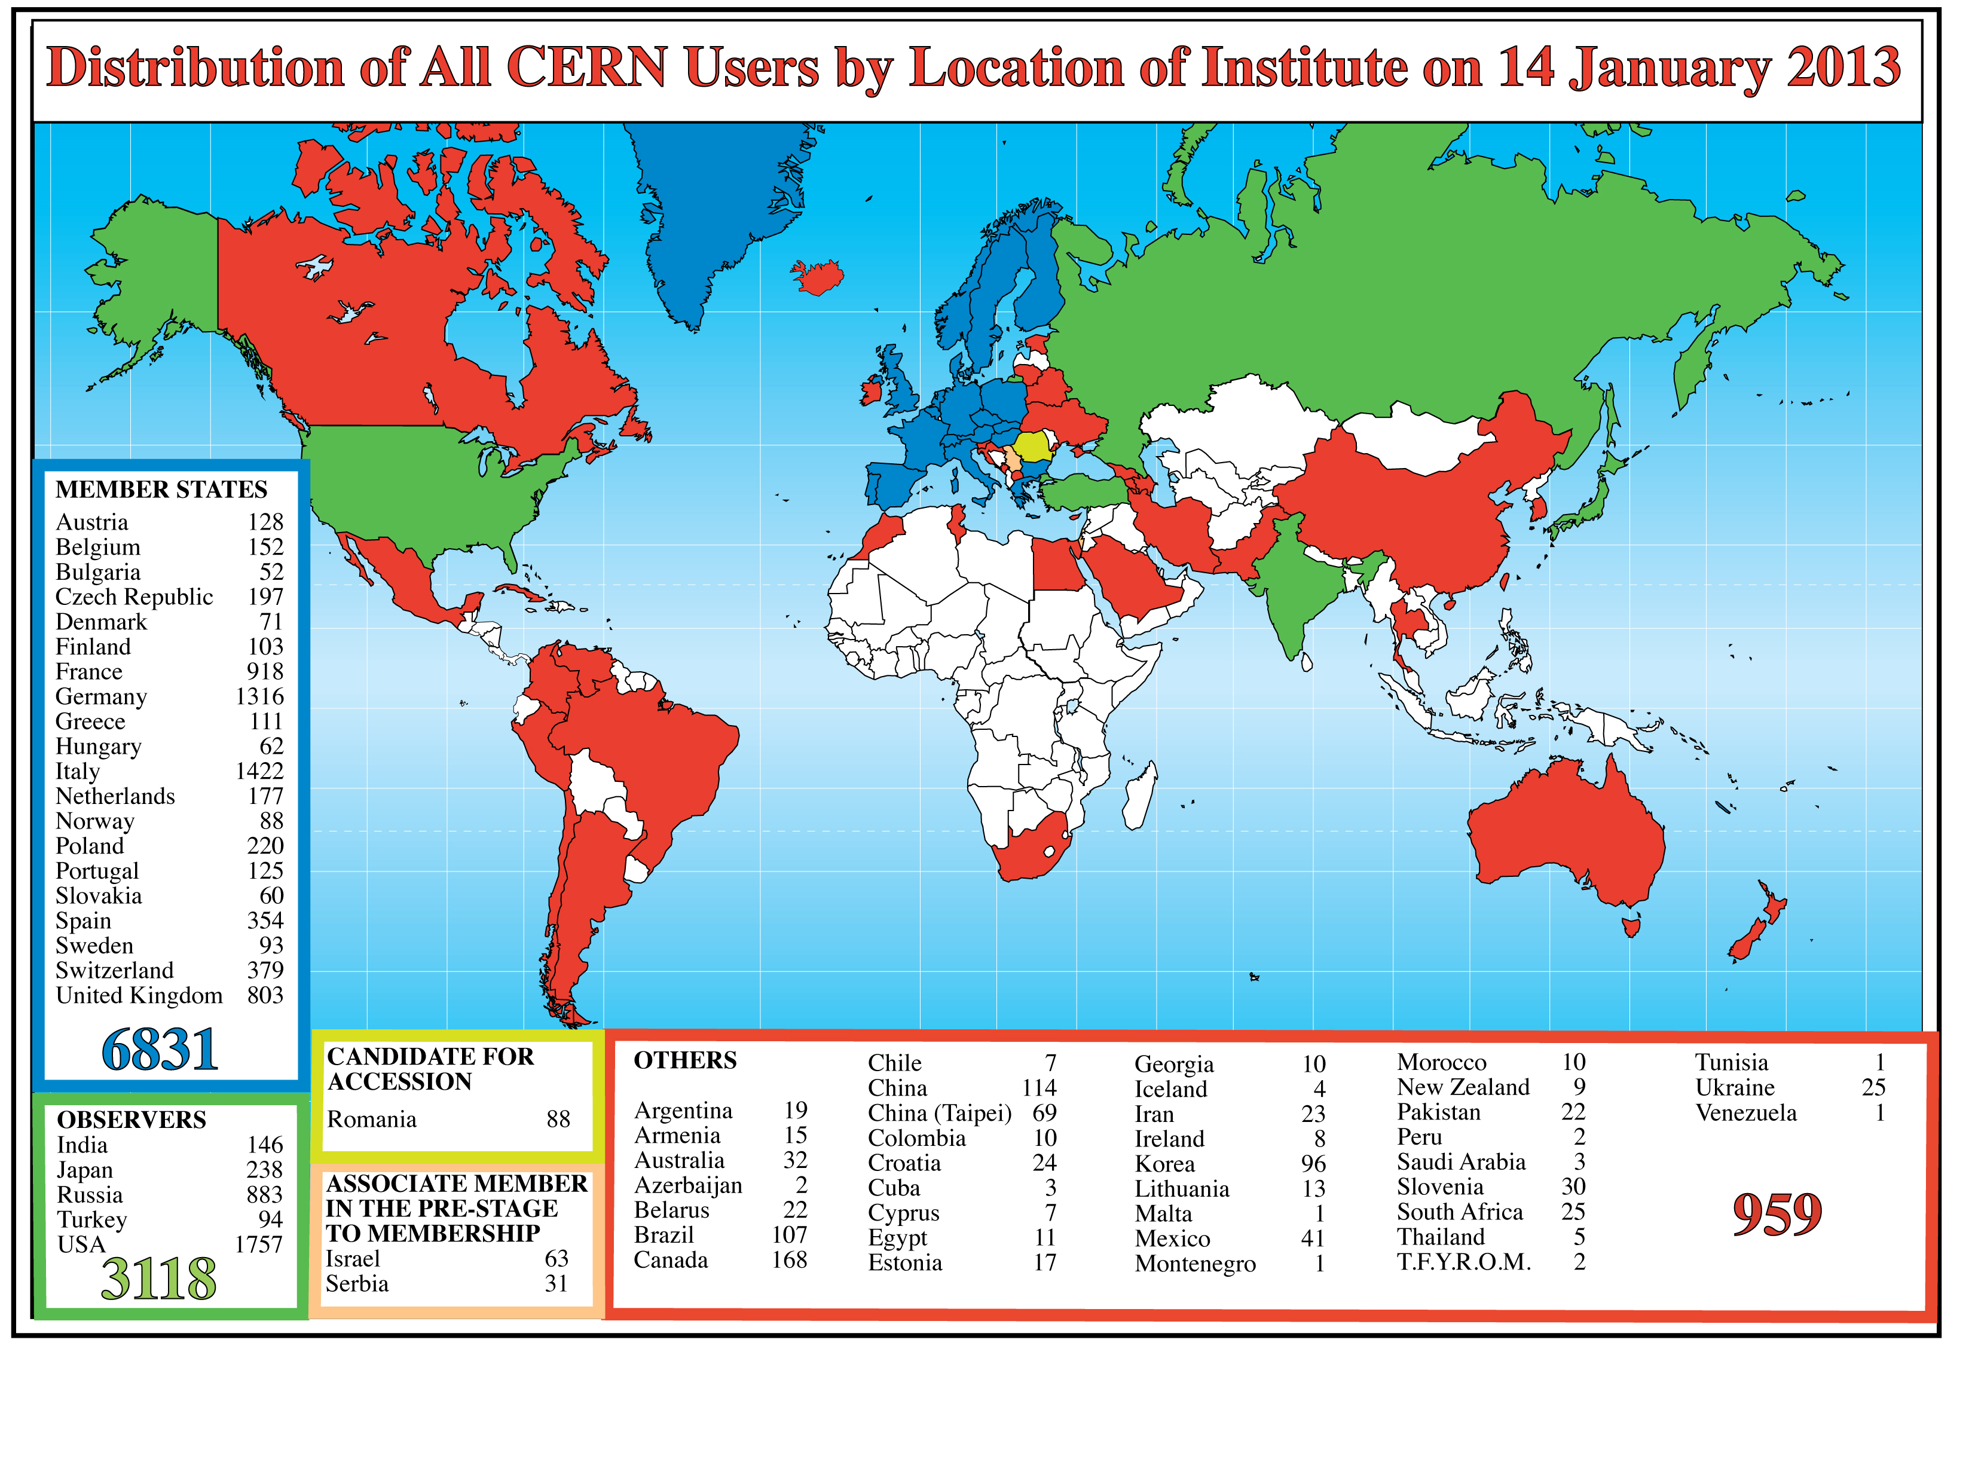
Science is getting more and more global
CERN: x staff, x fellows
Notes:
5
5

Slide 6
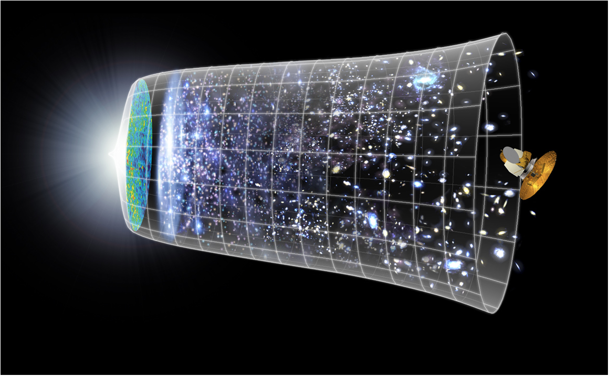
Next Scientific Challenge:
to understand the very first moments of our Universe after the Big Bang
Big Bang
WMAP
13.7 Billion Years
Today
10²⁸ cm

Slide 7
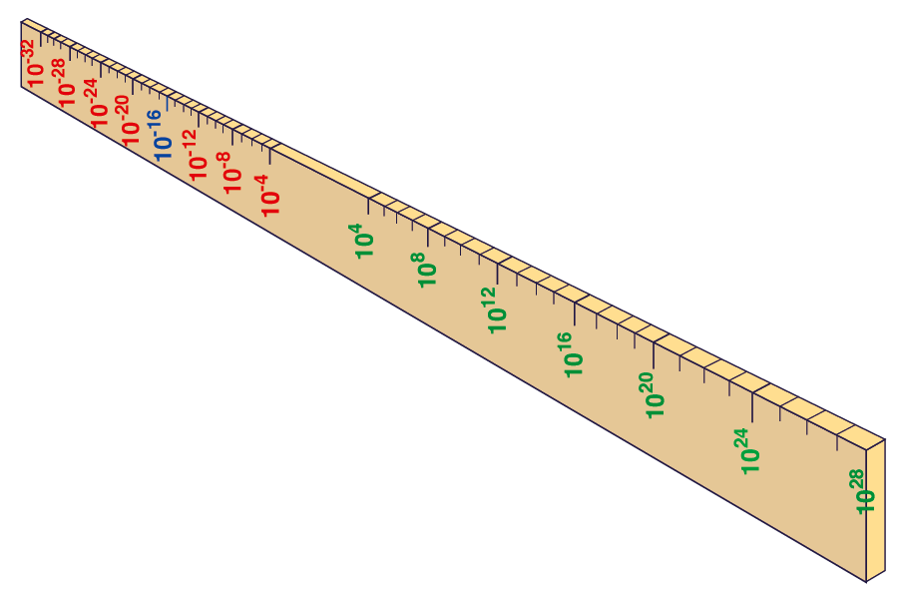
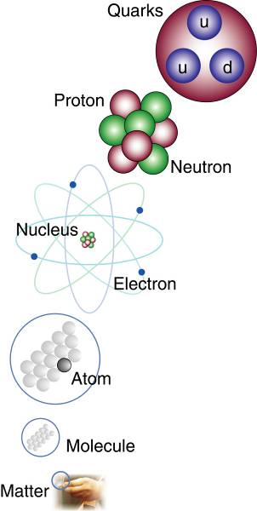
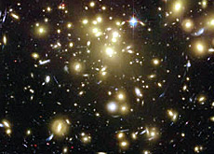
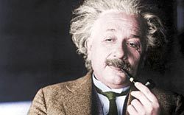
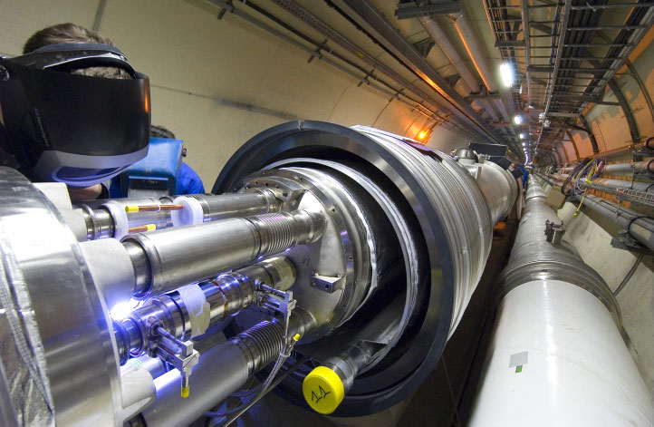
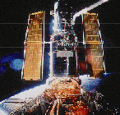
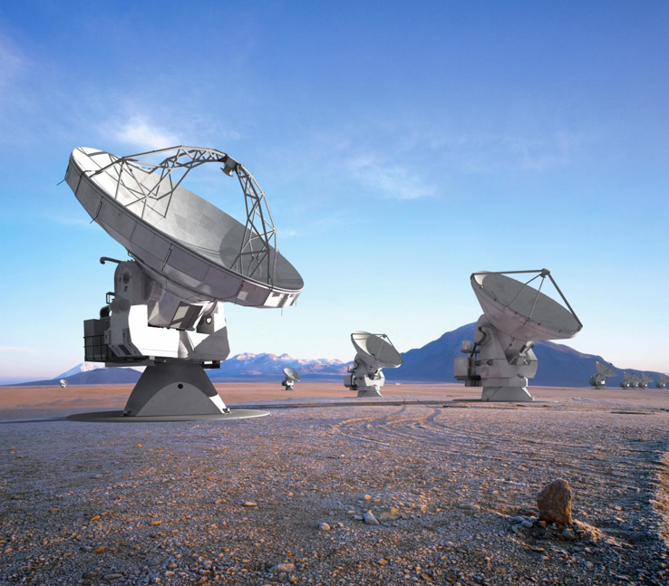
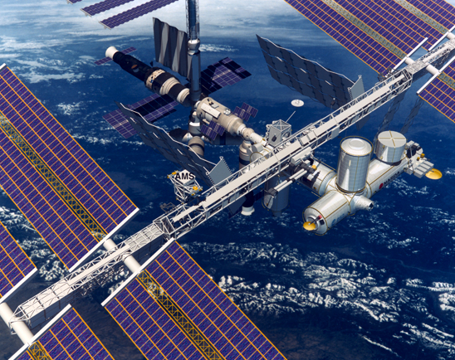
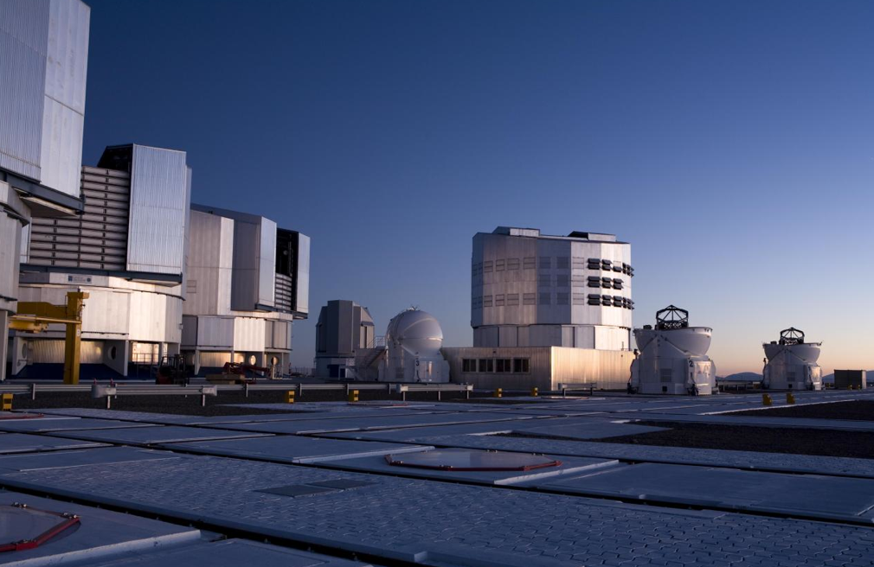
Big Bang
Proton
Atom
Radius of Earth
Earth to Sun
Radius of Galaxies
Universe
LHC
Super-Microscope
Hubble
ALMA
cm
Study physics laws of first moments after Big Bang
increasing Symbiosis between Particle Physics,
Astrophysics and Cosmology
AMS
VLT
Notes:
7
60 Grössenordnungen

Slide 8
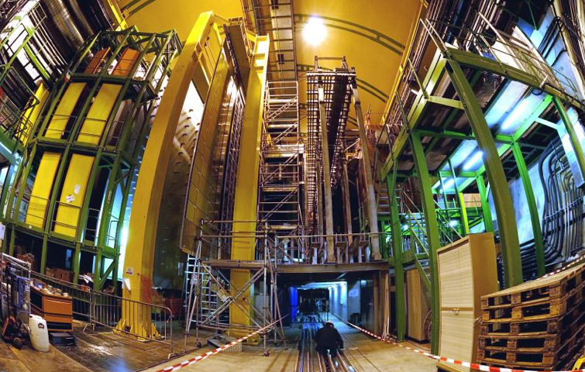
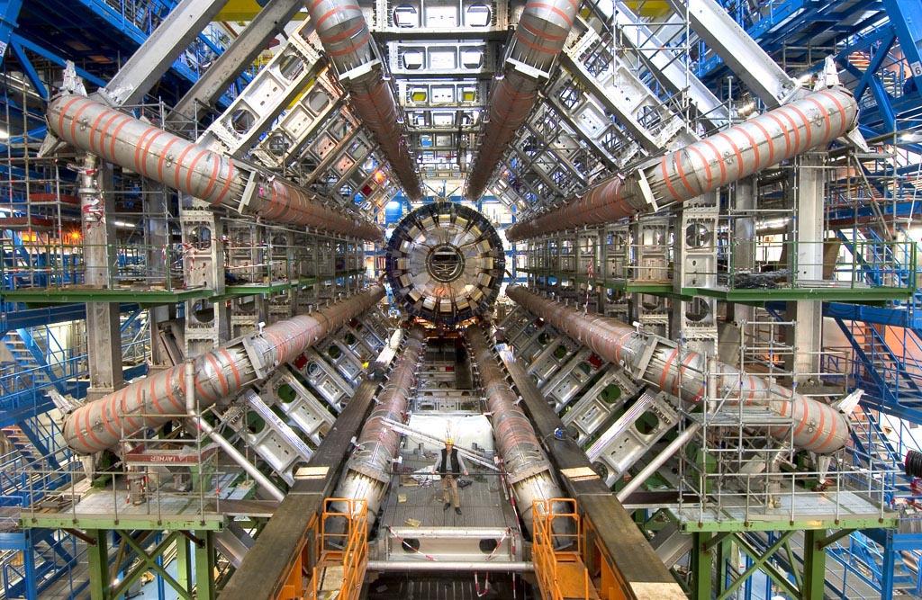
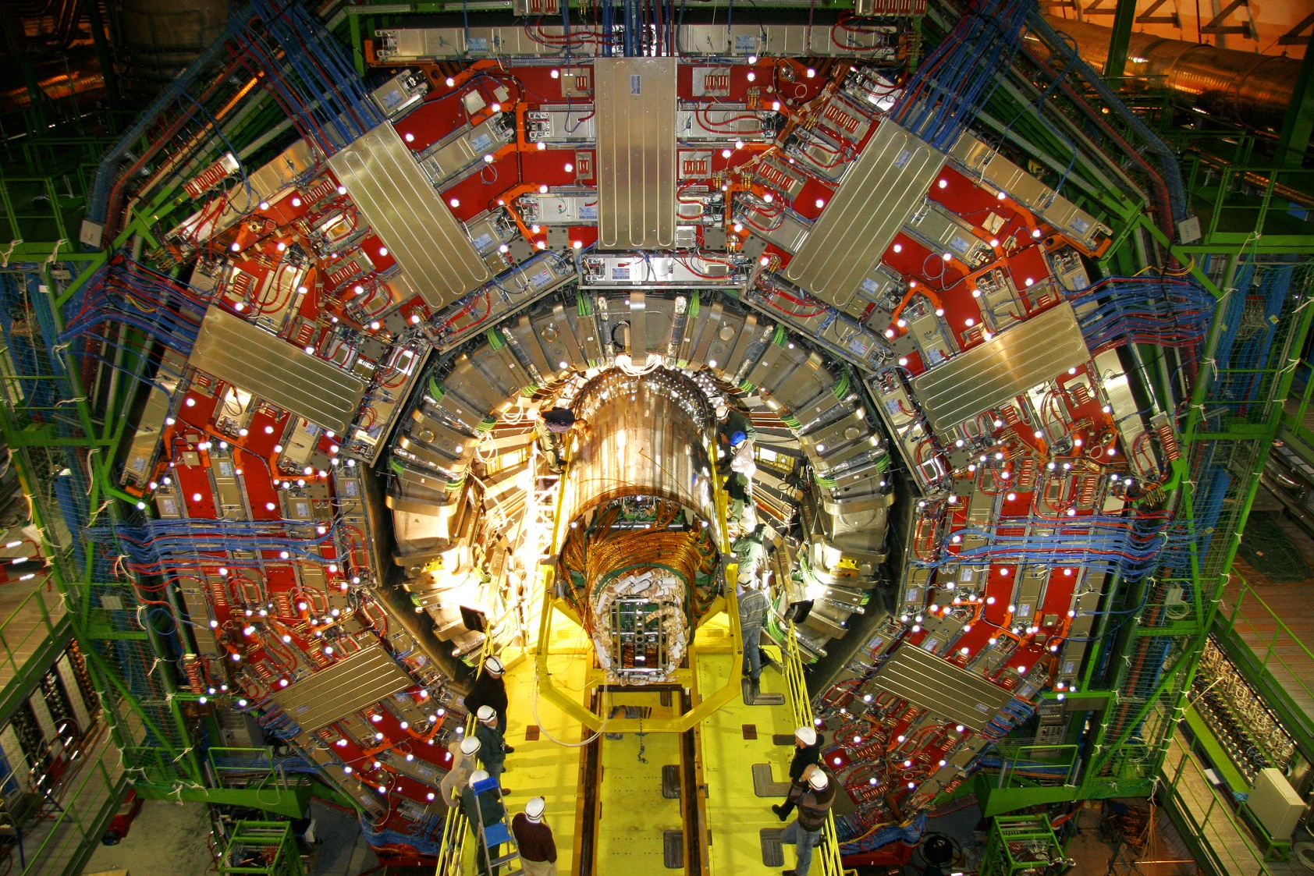
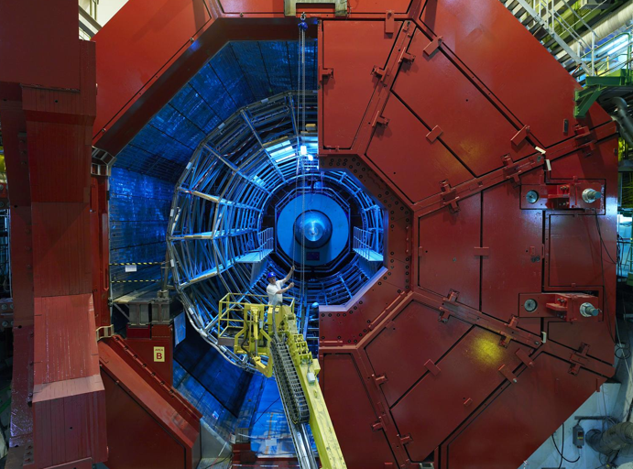
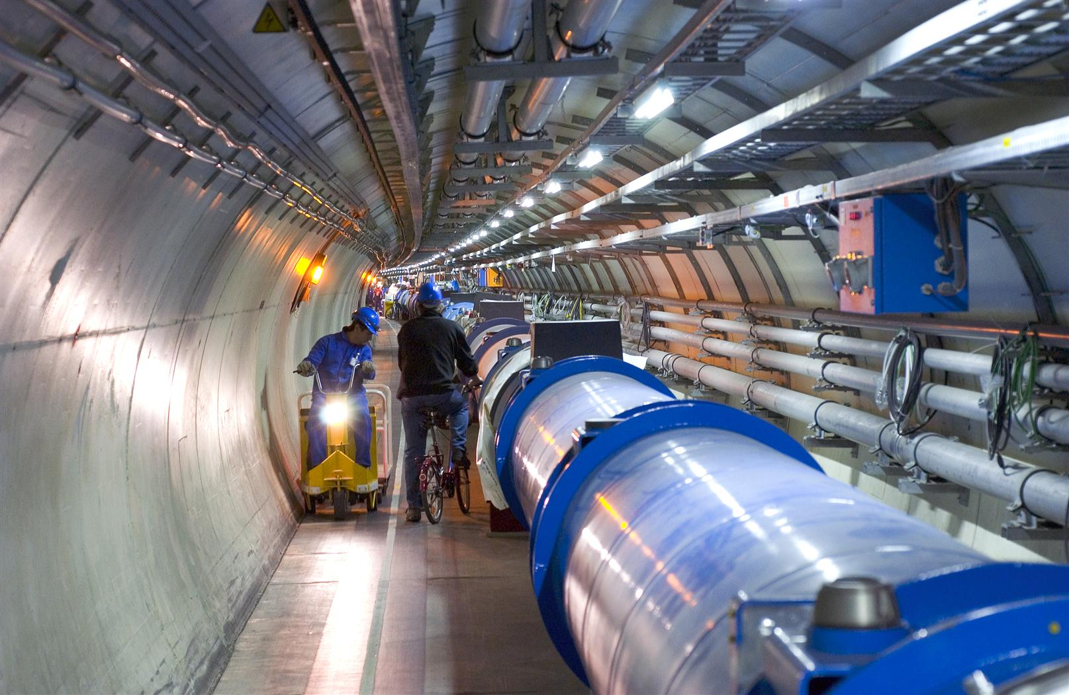
Enter a New Era in Fundamental Science
LHCb
CMS
ATLAS
Exploration of a new energy frontier
in p-p and Pb-Pb collisions
ALICE
LHC machine:
27 km circumference
Notes:
8

Slide 9
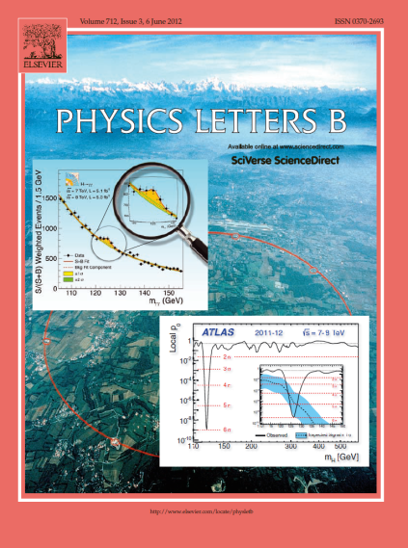

The highlight of a remarkable year 2012

Slide 10
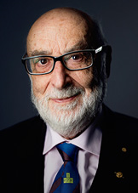
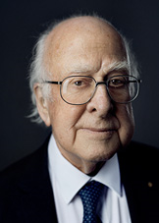

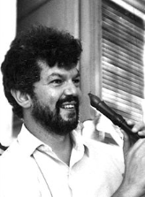

Englert – Higgs – Brout mechanism 2013 Nobel Prize
for the theoretical discovery of a mechanism that contributes to our understanding of the origin of mass of subatomic particles, and which recently was confirmed through the discovery of the predicted fundamental particle, by the ATLAS and CMS experiments at CERN's Large Hadron Collider
10

Slide 11
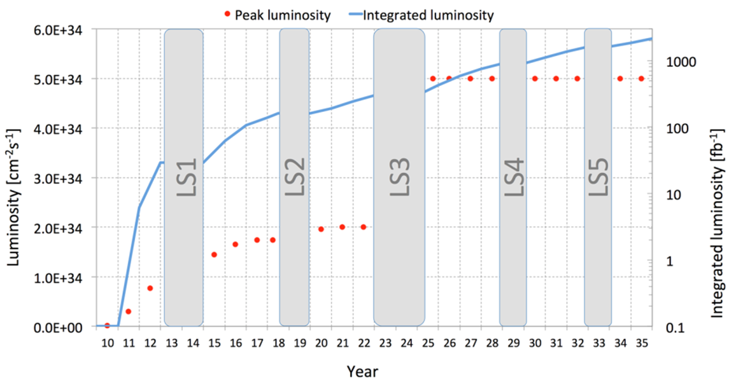
HL-LHC Project Plan
IP2, 2 cryo-assemblies, with 4 x 11T dipoles
IP1, 5, and 7, up to 8 cryo-assemblies, with 16 x 11T dipoles
TODAY
Courtesy L. Rossi
Notes:
The 11T dipole project is staged

Slide 12
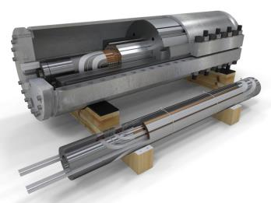
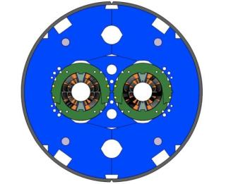
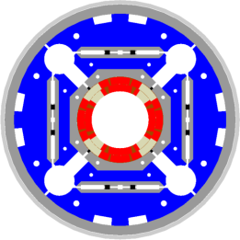
HL-LHC magnets – Nb₃Sn
We are at a crossroad, and in the next 2 (+/- 1) years we will decide whether Nb₃Sn is suitable for a HEP accelerator. Goal: prove Nb₃Sn in the LHC by LS2
DS 11 T dipole (for LS2/LS3) and MQXF (for LS3) in close collaboration with US-LARP

Slide 13
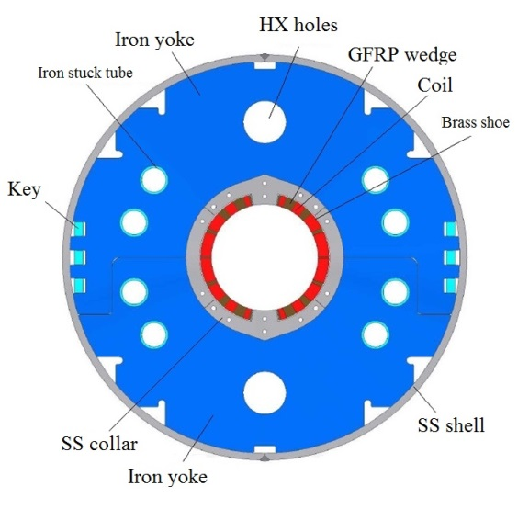
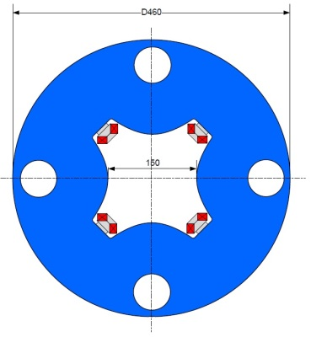
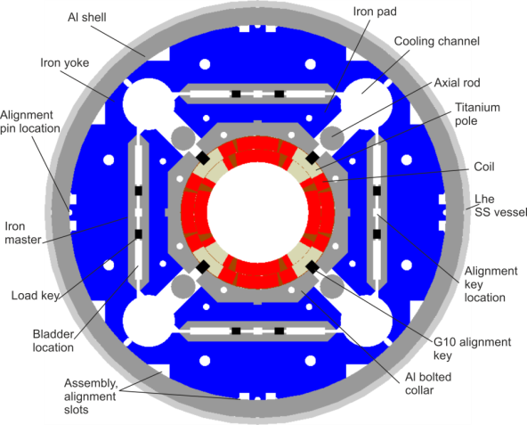
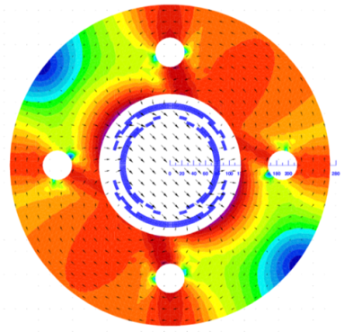
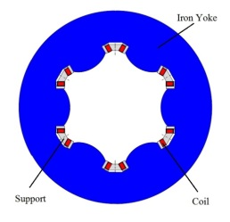
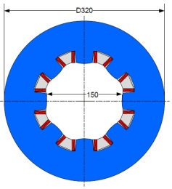
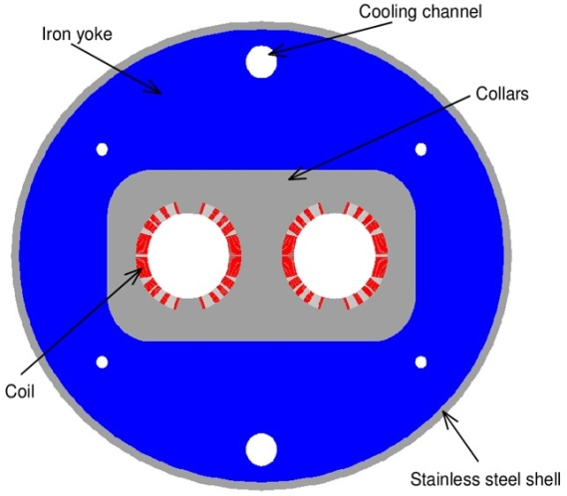
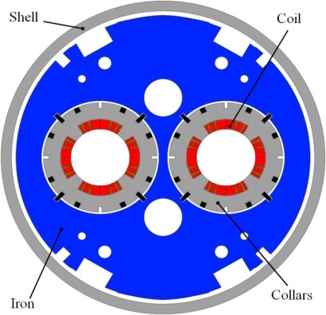
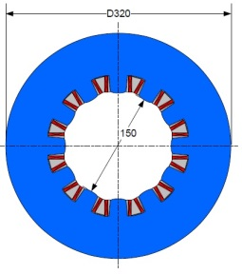
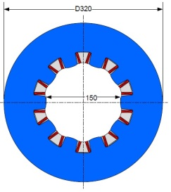
HL-LHC magnet zoo
Skew corrector
(INFN)
Orbit corrector
(CIEMAT)
Triplet QXF (LARP and CERN)
Separation dipole D1 (KEK)
Corrector sextupole
(INFN)
Corrector octupole
(INFN)
Recombination dipole D2 (INFN design)
Q4 (CEA)
Corrector dodecapole
(INFN)
Corrector decapole
(INFN)

Slide 14
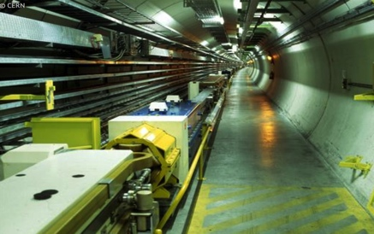
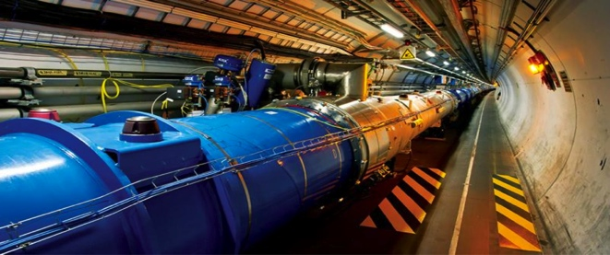


A timeline for HL-LHC and beyond
construction
LEP
physics
upgrade
Design R &D
prototyping
LHC
construction
physics
Design R&D
prototyping
HL-LHC
construction
physics
Design R&D
CDR
prototyping
FCC
construction
physics
1980
1990
2000
2010
2020
2030
2040

Slide 15

The FCC playground
Geneva
PS
SPS
LHC
LHC
27 km, 8.33 T
14 TeV (c.o.m.)
1300 tons NbTi
HE-LHC
27 km, 20 T
33 TeV (c.o.m.)
3000 tons LTS
700 tons HTS
FCC-hh
80 km, 20 T
100 TeV (c.o.m.)
9000 tons LTS
2000 tons HTS
FCC-hh
100 km, 16 T
100 TeV (c.o.m.)
6000 tons Nb₃Sn
3000 tons Nb-Ti

Slide 16
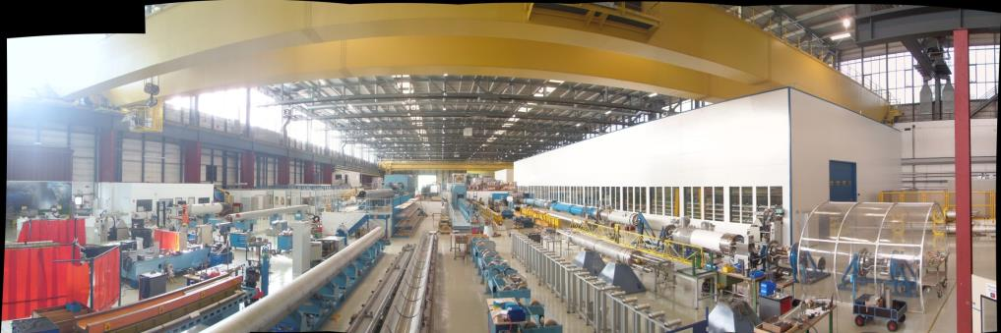
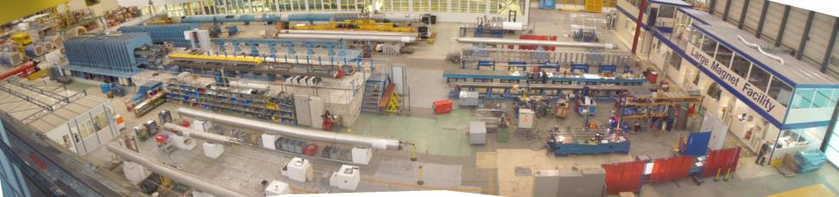
CERN Large Magnet Facility

Slide 17
The CERN approach
Physics Community
Formulate specifications, from which functional requirements are derived
Functional requirements ➔ Conceptual Design
Research & Development
Functional & operation requirements ➔ Prototyping
For series/mass production
Final Design
Engineering design of an accelerator magnet (full-length, with all necessary features for “accelerator”: bus bars, protection, geometry and alignment, vacuum, cooling, cold mass envelope, …)
Short model fabrication and testing in view of validating the concept
Analysis, tooling, integration-interfaces, constraints
“Manufacturability” & industrialization
Electro-magnetic & mechanical analyses
Material selection and testing
Tooling development
Full-length prototype fabrication and testing in real operation conditions, in view of validating the design
Interactions with physicists, and partner technologies (vacuum, cryogenics, cryostating, power supply, protection, …), and industry
Cable development
Feasibility study

Slide 18
Thank you for your attention

