Slide 1

ACC Virtualization flash News
Openstack
Luigi Gallerani
BE-CO-IN
TC 28 May 2015
+ 1 slide about a photographic project for the people in 774…

Slide 2
Slide from Nov 2014 TC
HyperV available for BE-CO until new satisfactory solution is found (max Dec 2015)
Possible solutions
Openstack tuning and evaluation (April 2015)
Prototype GPN Desktop (April 2015)
Prototype Linux server (April 2015)
July 2015: Decision
Working solutions in production Dec 2015

Slide 3
Slide from Nov 2014 TC
HyperV available for BE-CO until new satisfactory solution is found (max Dec 2015)
Possible solutions
Openstack tuning and evaluation (April 2015) DONE
Prototype GPN Desktop (April 2015) DONE
Prototype Linux server (April 2015) DONE
July 2015: Decision -> TAKEN, WE go for OpenStack
Working solutions in production Dec 2015 OpenStack
Confirmed
16 VPC MACHINES ALREADY Running, 4 In use (Fesa dev, 2 BE-CO, 2 BE-BI) HyperV Decomissioning

Slide 4
New ACC VPC Openstack OVPC
cwe-513-vol### cwe-513-vow###
Type: 4 CPU 8 GB RAM (up to 8 CPU 16GB RAM)
OS: BE-CO SLC6 and BE-CO CC7 (when ready dec15)
BE-CO Win7, (only for twido, step7, labview…)
Net: Default: GPN only with internet
TN trust when necessary
NEW OVPC
CREATION

Slide 5
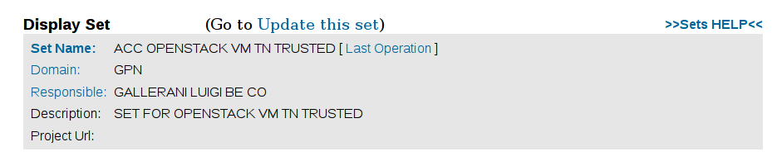
Old VPC can migrate to Openstack
We can migrate old VPCs to openstack*
4 hours downtime / net reregistration
Migration organized by vpc-support + IT-OIS
Net RE-REGISTRATION: Change IP
GPN with internet by default
TN trust with x-host granularity via LanDB Set
VPC
MIGRATION

Slide 6
Actual situation and first steps
ACC VPC HyperV Infrastructure, 30 Servers:
525 VPC : 264 SLC6 4 SLC5 257 Win7
ACC VPC Openstack Infrastructure, 2 Servers
16 VPC: 2 CC7 12 SLC6 2 SLC5 0 Win7
First we have to prepare hardware and convert
some servers to expand openstack infr
Conversion of fastest servers
SERVER
PREPARATION

Slide 7
New Timeline
June 2015 Prepare the production
Openstack Infrastructure
July 2015 : Migration VPCs to Openstack
& NEW OVPC creation
Dec 2015 : Openstack in production
and HyperV-decomisssioned
SERVER
PREPARATION
VPC
MIGRATION
NEW OVPC
CREATION

Slide 8
Conclusion: Concrete events
Between July and December BE-CO-IN will go for Openstack based solution for ACC dev machines
(same solution taken for BE-CO Terminal Servers)
- Newcomers machines only created in Openstack
For those having VPC we will ask you :
  To change to a new Openstack OVPC (recommended)
  If not convenient, migrate your existing VPC to Openstack
  Remember: GPN only by default… TN Trust possible.

Slide 9
ACC Virtualization flash News
Openstack
Luigi Gallerani
BE-CO-IN
TC 28 May 2015
+ 1 slide about a photographic project for the people in 774…

Slide 12
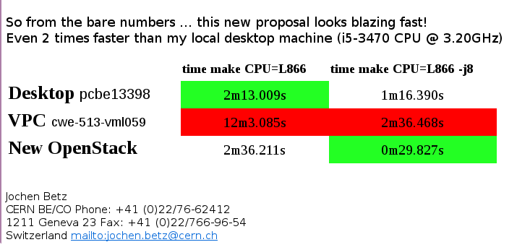
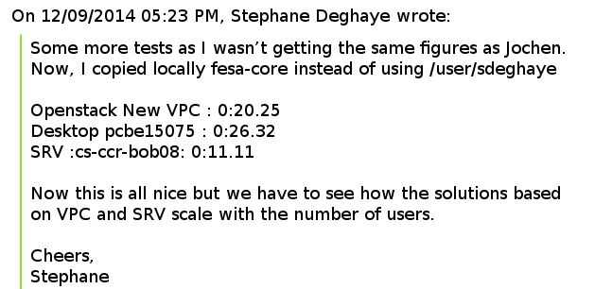

Slide 13
A simple benchmark
27 May 2015
BE-CO SLC6 x64
make –j of
fesa test class
(by Jochen)

Slide 14
Hardware type
Hi Luigi, In general in the cloud model you should not care about the underlying hardware and probably in the future we will not provide this information because it will be extremely difficult to do when we will have many different types.
HP Model : ProLiant DL180 G6
There are two types of CPUs:
Processor : Intel(R) Xeon(R) CPU E5645 @ 2.40GHz
Processor : Intel(R) Xeon(R) CPU E5-2680 0 @ 2.70GHz
We have only few boxes of the second type but good news - all of them will be aggregated to your project. / Sebastien

Slide 16

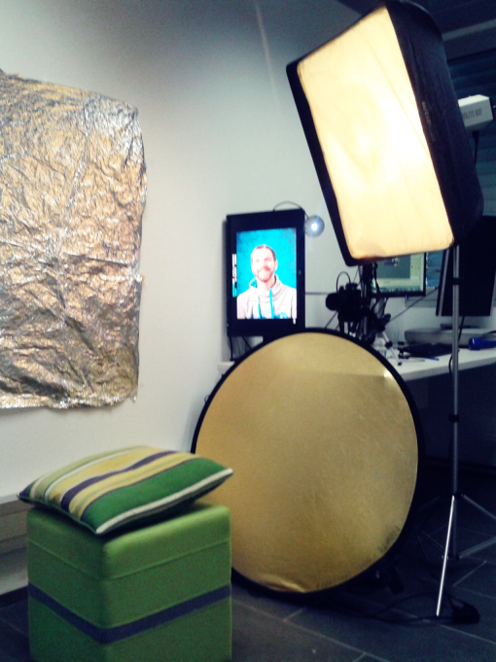
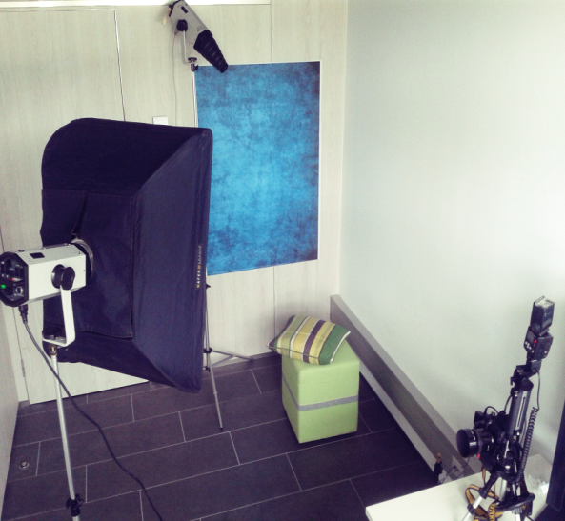

774 Portraits for the
office doors
Small studio for SELF SERVICE photos in preparation @ 774-2-055
good timing will be Friday afternoon…
You just press a button and you’ll see the photo on the large screen
Delete all picture you do not like directly on camera
Once we have bunches of photos ready, they will be printed and attached to the office doors (10x15cm)
…Otherwise your CERN ID pic will be used☺
Studio setup and TEST pictures

