Slide 1
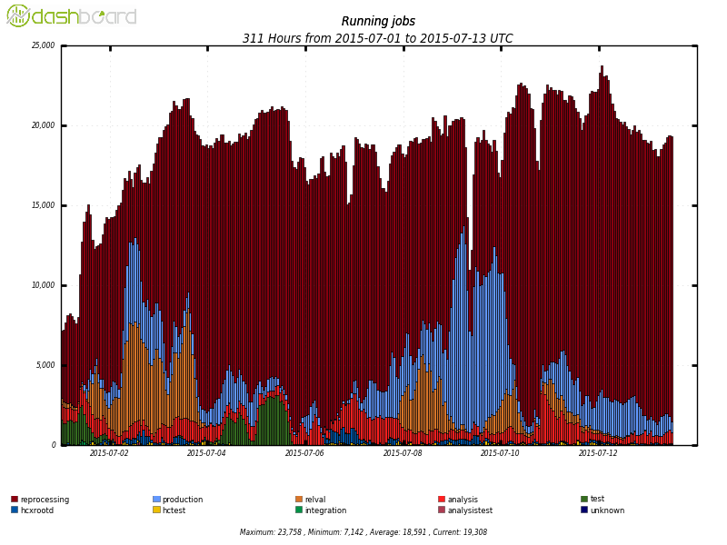
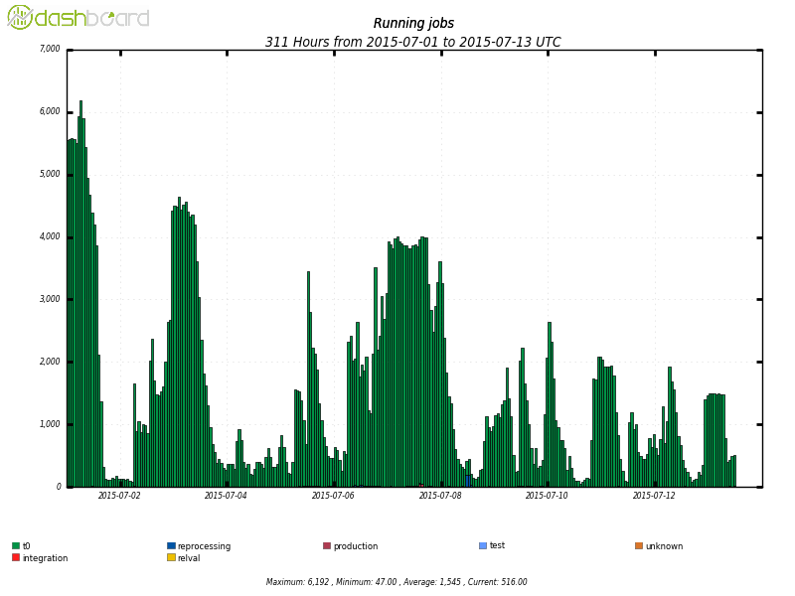
CMS Computing Status
Generally the start up has gone well for computing and offline
  At Tier-1 we have 7-10% less than requested as pledges (Other Tiers match request)
  Full utilization of T1s for simulation
  Changes implemented in LS1 are working
    Disk/Tape Separation, AAA, Flexible workflows, Multi-Core
  Tier-0 has kept up with processing needs
    Prompt Reconstruction is currently averaging 5-7s per event for a pile-up of 14, which tracks our performance expectations
  CRAB3 now serves the majority of users for distributed analysis
20k
4k
Data delivered by AAA to remote applications
Is 1GB/s
Similar to PhEDEx total traffic

