Slide 1
Multicore Accounting
John Gordon, STFC-RAL
WLCG MB, July 2015

Slide 2
Outline
History
Recent Progress
Current Status
Plan

Slide 3
History
I first raised the issue of sites publishing details of the cores used per job at the OMB last December with an update in January.
There was some initial improvement but then progress flattened off.
WLCG are now running many more multicore jobs and wish to see this reflected in accounting.
  Knowing the number of cores used is important in calculating the effective wallclock time and thus the overall occupancy of a cluster.

Slide 4
Recent Progress
At the June meeting of the WLCG Grid Deployment Board I reported that 87% of LHC CPU use was now reported as coming from Sites/CEs which reported the number of cores per job.
Since there were some obvious omissions from important sites and countries I was asked to address this.
I raised tickets against all NGIs and gave them a link to the publishing of cores for June by their sites which run LHC work.
This has mainly been successful. By the end of June we had 95% publishing
  This excluded sites which didn't run any LHC work in June
In July I extended the campaign to include EGI sites not running any LHC work.

Slide 5
Current Status
There are still about 60 sites who have published jobs without cores in the last few days but there is a long tail of failed jobs and rogue CEs that don’t amount to significant CPU use.
There is a smaller number of sites with some or all CEs not reporting cores.
There are few with problems not under their control
Many have never responded to tickets.

Slide 6
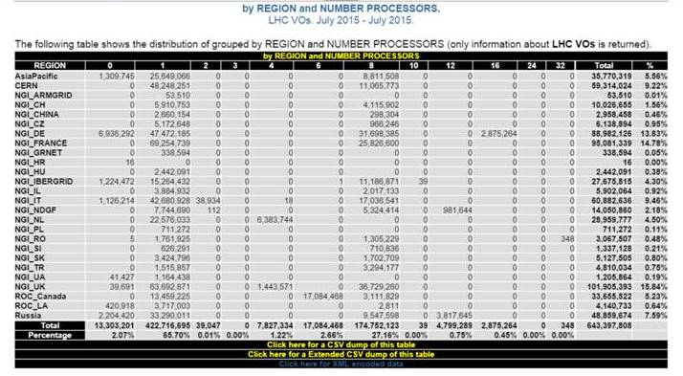
In July 98% of LHC CPU reports cores. (Underestimate)

Slide 7
Sites Publishing zero core jobs since 13/7/15
Site | Country | LHC? | Jobs | HS06Hours
Hephy-Vienna | Austria (NGI-IT) | CMS | 49882 | 3,927,676
RWTH-Aachen | Germany | CMS | 102303 | 3,113,916
MPPMU | Germany | ATLAS | 84533 | 2,079,792
DESY-HH | Germany | CMS | 37408 | 2,035,869
RRC-KI | Russia | Alice | 62779 | 1,788,016
IN-DAE-VECC-02 | India | Alice | 23356 | 1,309,750
IFIC-LCG2 | Spain | ATLAS | 88972 | 1,176,147
ICN-UNAM | Mexico | Alice | 2356 | 396,787
Ru-Troitsk-INR-LCG2 | Russia | Alice, CMS, LHCb | 12637 | 222,022
CBPF | Brazil | No | 2114 | 52,991
Kharkov-KIPT-LCG2 | Ukraine | CMS | 7773 | 41,430
ru-Moscow-SINP-LCG2 | Russia | CMS | 11270 | 27,733
HEPHY-UIBK | Austria (NGI-IT) | ATLAS | 6600 | 25,471
#jobs and CPU for July

Slide 8
Issues
DESY-HH publish from CREAM but not ARC-CE.
  Outstanding ticket with ARC team
  Suspect MPPMU have the same issue although no response from them.
RWTH-Aachen – no response
Austrian sites are part of Italian NGI but were not alerted.
  Acknowledged but no action in a week.
Spanish site publishing from multicore queues but admitted they hadn’t changed single core queue.
  No further response in over two weeks.
Russia (4), India, Mexico, Ukraine – no response

Slide 9
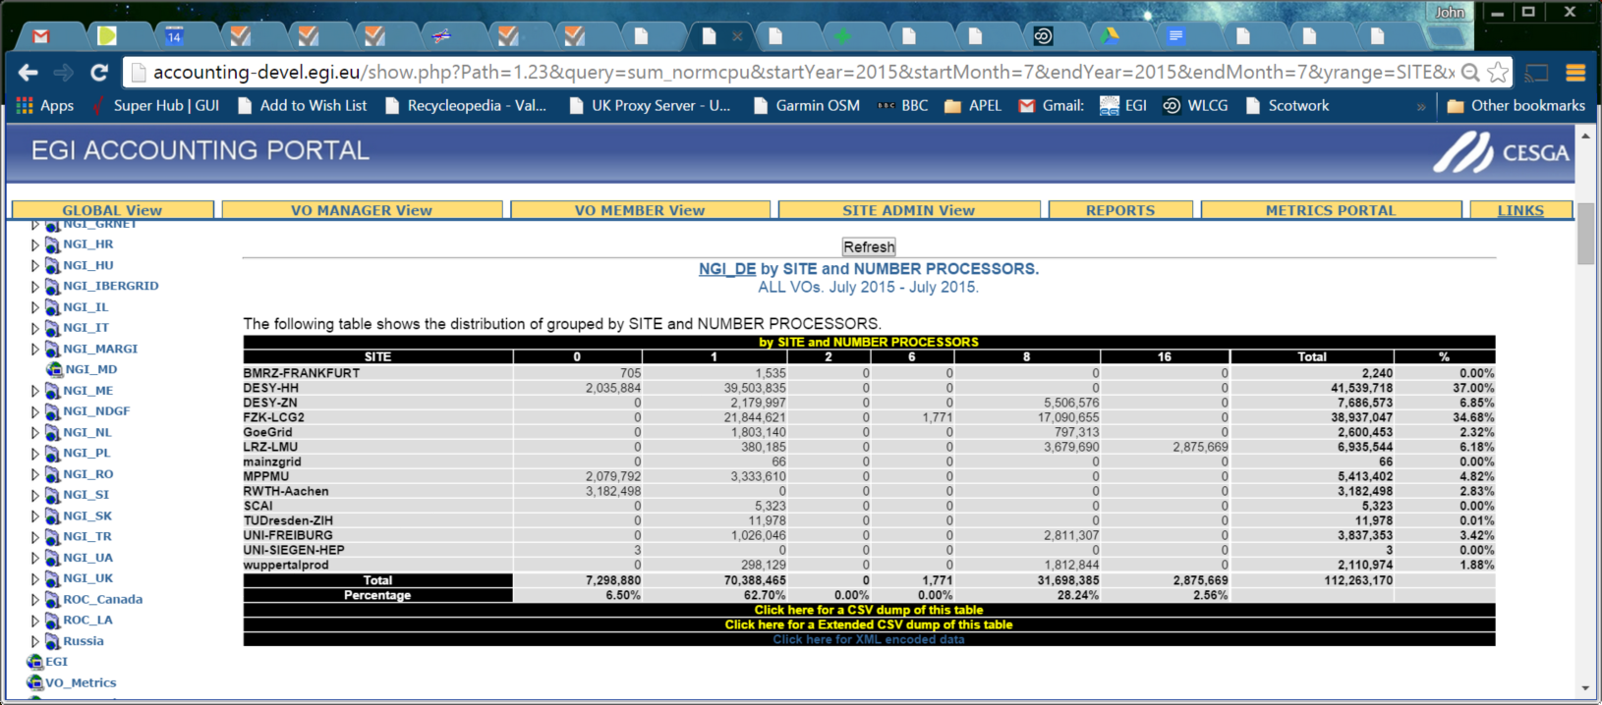
Country View
WLCG View

Slide 10
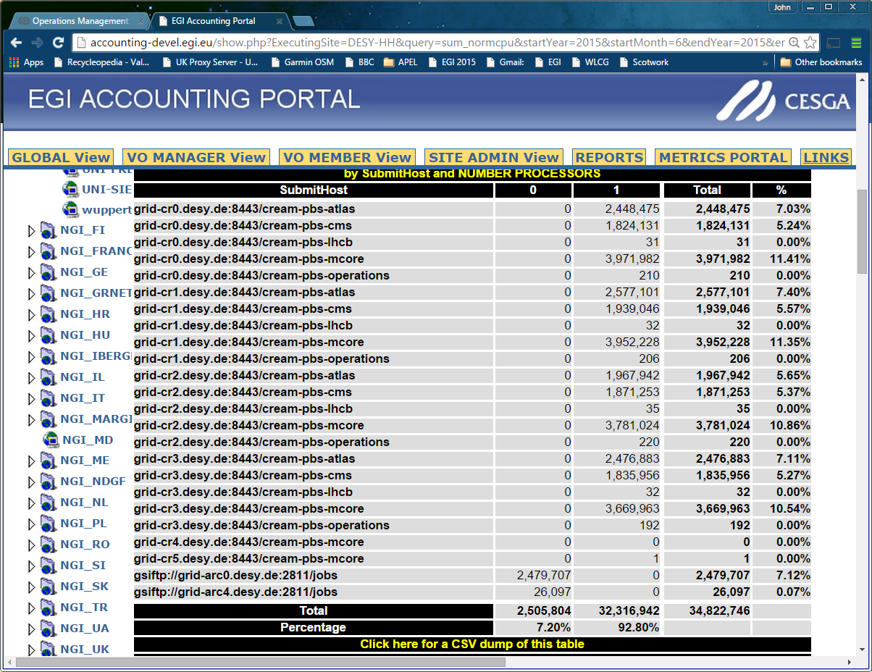
Within a Site
Notes:
Not naming and shaming DESY. They have a problem with ARC CE and their batch system.

Slide 11
Summary
Solution for APEL is simple
  Set parallel=true in parser.cfg for parsers parsing batch logs
For other accounting systems, ask advice.
Just start publishing from now, don’t backdate.
I need help with recalcitrant sites.

