Slide 1
WLCG critical services: reminder
Maarten Litmaath
Andrea Sciabà
WLCG MB
July 14, 2015

Slide 2
Basic concepts
WLCG maintains a list of “critical services” which contains information about their “importance” for the LHC experiments
  The list includes mostly services provided by CERN
  The rating is based on urgency and impact
  The list and the ratings are regularly reviewed with WLCG, experiment and Tier-0 representatives
    Last time was in December
https://twiki.cern.ch/twiki/bin/view/LCG/WLCGCritSvc

Slide 3
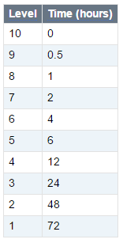
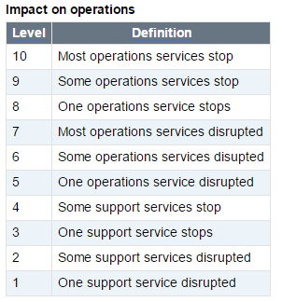
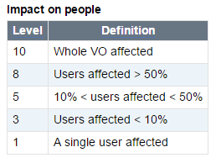
Definitions
Urgency is the delay after which the unavailability of a service reaches its full impact
  Measures how quickly the problem should be resolved
Impact is the amount of “damage” to operations or to people done by the unavailability of the service
  Measures how serious the problem is
Notes
  The numbers refer to a service interruption: real world incidents may have different urgency/impact
Urgency

Slide 4
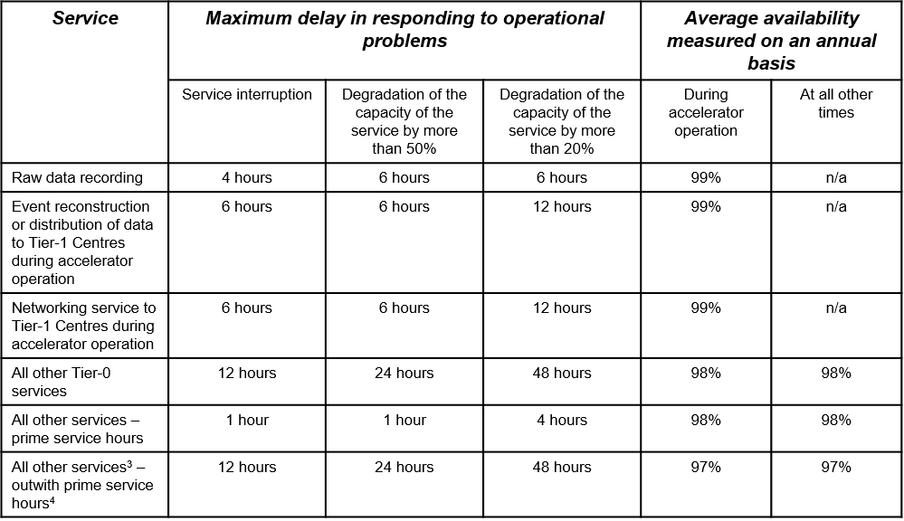
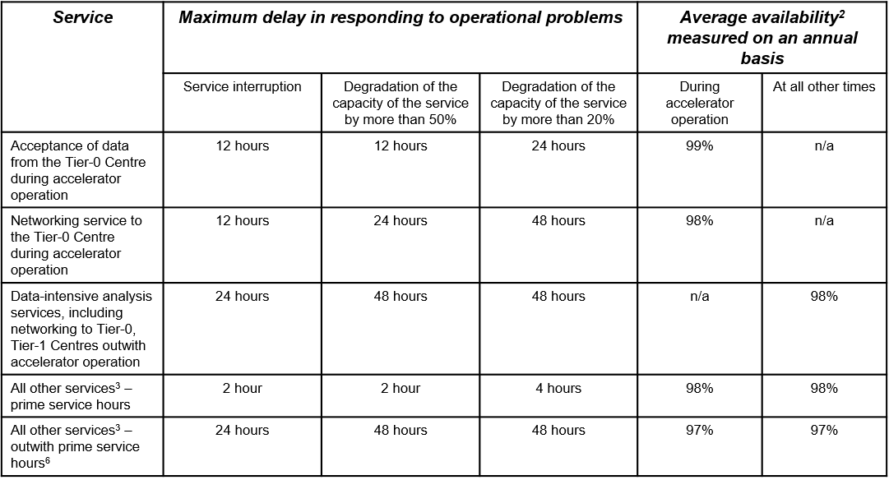
Response time and alarms
Response times are formally still governed by the LCG MoU Annex 3
Alarm tickets are used to report serious problems at any time
  Sites should react within the expected response time
Tier-0
Tier-1

Slide 5
Summary
The WLCG critical services table is used by the experiments to communicate the importance of services to the site and WLCG
  Only done for the Tier-0, extension to Tier-1/2 never requested
The response times (to Alarm tickets) are defined in the MoU

