Slide 1


General Exam
Pedro Sales de Bruin
Notes:
1

Slide 2

Outline
Introduction and thesis outline
Background
  LHC and ATLAS
  Standard Model
  Beyond Standard Model
  Tau leptons and TauID
Thesis Topic: MSSM $A/H/h→ττ$
  Outline
  Run 1 Analysis and Results
  Run 2 Analysis
Conclusion
Previous work (time permitting)
  $A→Zh→llττ$
Pedro Sales de Bruin
Notes:
2

Slide 3
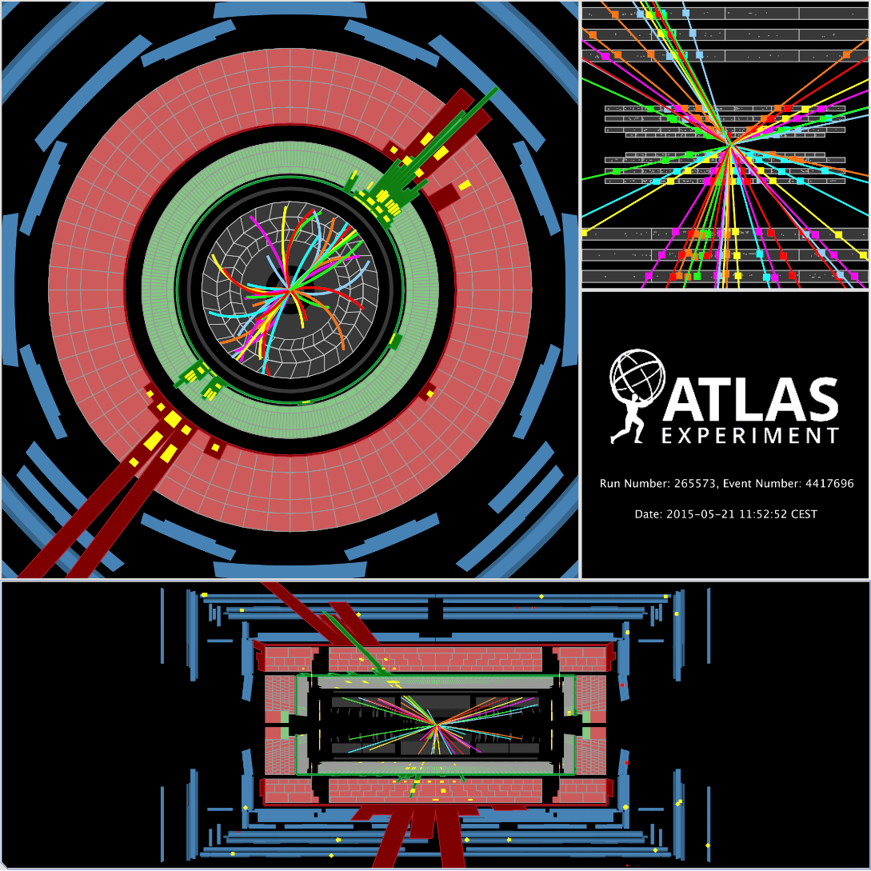
Introduction
I’ve joined Anna’s research group in Spring 2012 and have been based at CERN since Summer 2013.
Our group’s main focus is beyond standard model (BSM) Higgs searches, with a focus on tau final states. Currently composed of myself, Anna and Nikolaos Rompotis (post-doc).
Aim to complete my PhD around Summer 2016, ~1 year after we’ve started collecting data
Pedro Sales de Bruin
Notes:
3

Slide 4
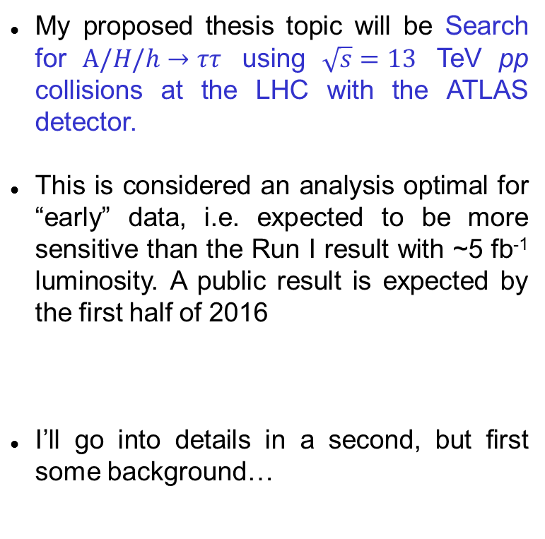
Thesis Proposal
My proposed thesis topic will be Search for $A/H/h→ττ$ using $\sqrt{s}=13$ TeV pp collisions at the LHC with the ATLAS detector.
This is considered an analysis optimal for “early” data, i.e. expected to be more sensitive than the Run I result with ~5 fb⁻¹ luminosity. A public result is expected by the first half of 2016
I’ll go into details in a second, but first some background…
Notes:
4

Slide 5
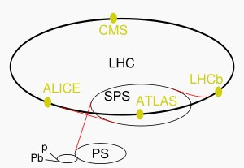

LHC and ATLAS
Currently probing the energy frontier of particle physics, the Large Hadron Collider (LHC) is a 27 km in circumference machine located near Geneva, Switzerland.
ATLAS (A Toroidal LHC ApparatuS) is one of the flagship experiments at CERN.
A very simple breakdown of the detector architecture is:
  Inner Detector (ID): composed of IBL, Pixel, SCT and TRT. Nearest to interaction point (IP).
  Calorimeters: Liquid Argon (LAr) and Tile. Measure energy deposits from particle showers
  Muon Spectrometer: farthest from IP, is a high-efficiency muon detector
Pedro Sales de Bruin
Notes:
5

Slide 6
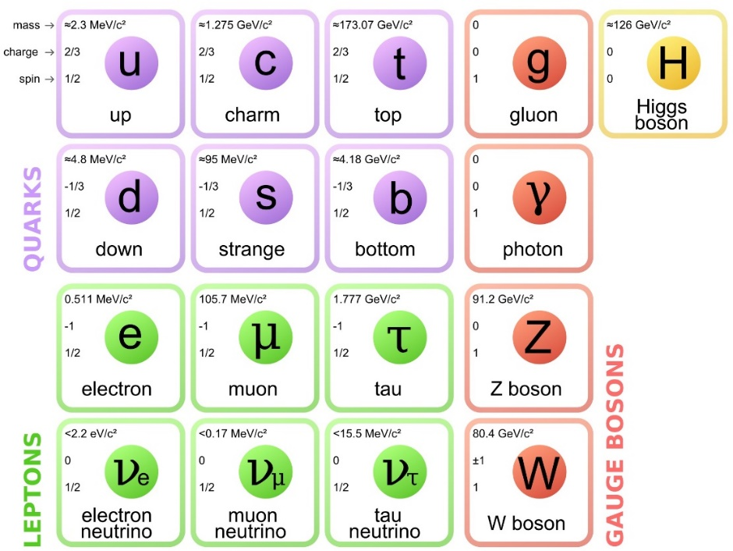
Standard Model
Currently most successful physics model for high energy / small scales, is basically a combination of EWT and QCD
All known forces apart from gravity are accounted for (strong, weak, EM).
Matter is composed of fermions (quarks and leptons). Forces are mediated by bosons
Boasts a strong mathematical framework with high predictive power
Pedro Sales de Bruin
Notes:
6

Slide 7
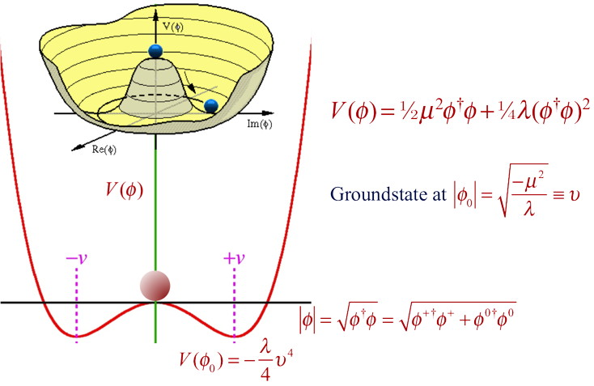
Higgs Mechanism
Proposed in 1964 by 3 independent groups, the Higgs mechanism describes process of electroweak symmetry breaking (EWSB)
In SM, the Higgs field is a doublet of complex scalar fields
Through EWSB the weak isospin and hypercharge massless gauge bosons become the massive W, Z bosons
Went without experimental confirmation for 48 years until…
Pedro Sales de Bruin
Notes:
7

Slide 8
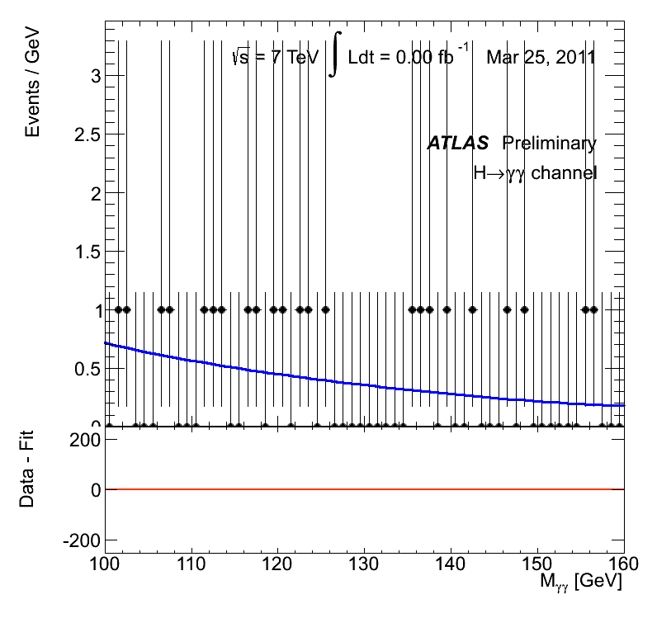
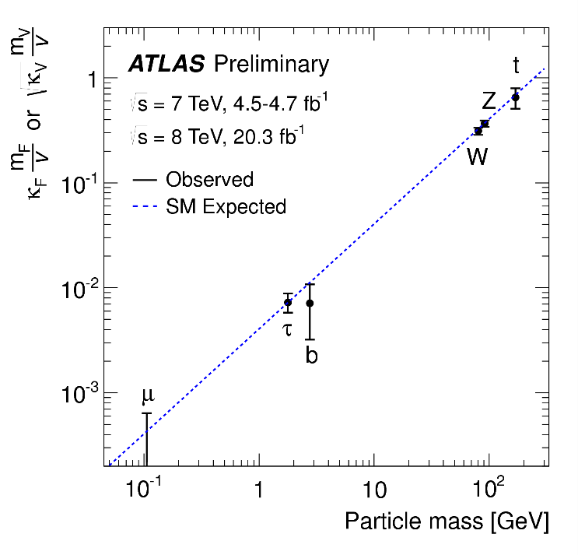

Discovery
Discovery of 125 GeV Higgs announced simultaneously by ATLAS and CMS on July 4th 2012
Observation (or evidence) now been seen in many decay channels:
  - $h→γγ$
  - $h→ZZ→4l$
  - $h→WW$
  - $h→ττ$
New particle is consistent with SM Higgs
Pedro Sales de Bruin
Notes:
8

Slide 9
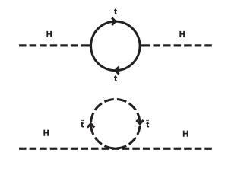
BSM Higgs – Why?
The SM has unanswered questions…
… and BSM models can solve them
Dark Matter
Hierarchy Problem
CP-violation
SUSY
2HDM, SUSY
SUSY, “Higgs Portal”
Pedro Sales de Bruin
Notes:
9

Slide 10
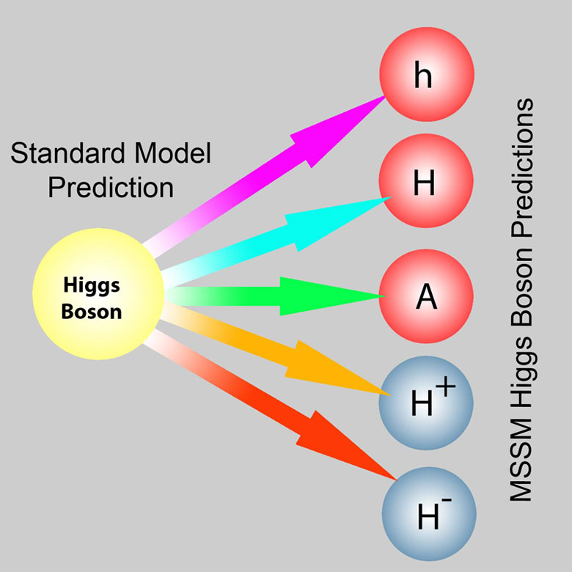
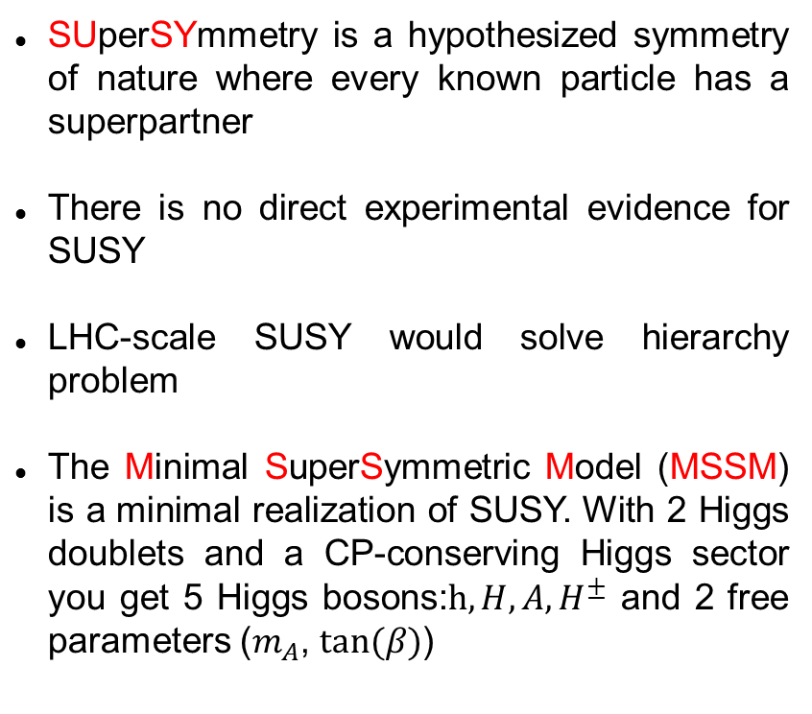
SUSY and MSSM
SUperSYmmetry is a hypothesized symmetry of nature where every known particle has a superpartner
There is no direct experimental evidence for SUSY
LHC-scale SUSY would solve hierarchy problem
The Minimal SuperSymmetric Model (MSSM) is a minimal realization of SUSY. With 2 Higgs doublets and a CP-conserving Higgs sector you get 5 Higgs bosons:$h,H, A, H^{±}$ and 2 free parameters ($m_{A}$, $tan⁡(β)$)
Pedro Sales de Bruin
Notes:
10

Slide 11
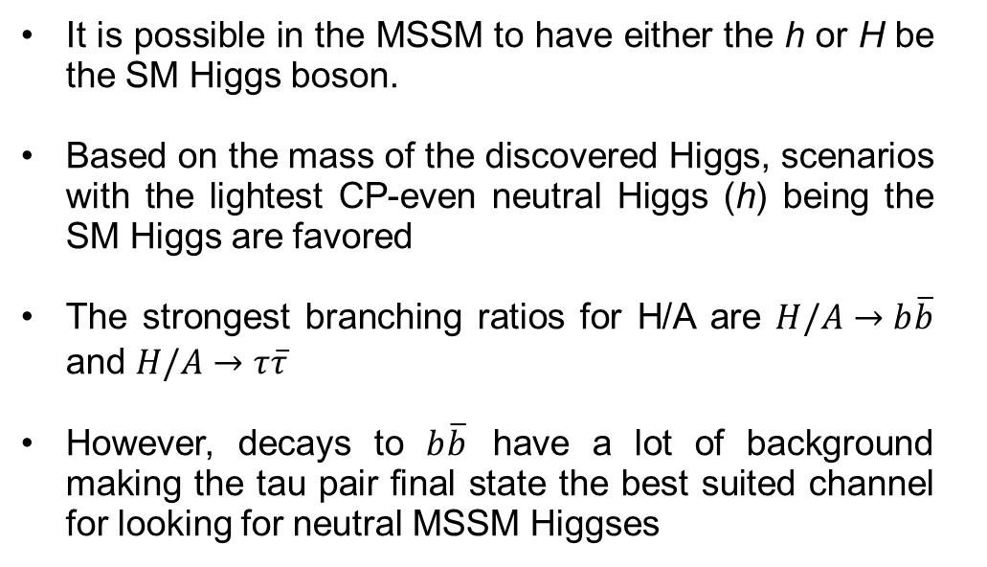
Why taus?
It is possible in the MSSM to have either the h or H be the SM Higgs boson.
Based on the mass of the discovered Higgs, scenarios with the lightest CP-even neutral Higgs (h) being the SM Higgs are favored
The strongest branching ratios for H/A are $H/A→b\overline{b}$ and $H/A→τ\overline{τ}$
However, decays to $b\overline{b}$ have a lot of background making the tau pair final state the best suited channel for looking for neutral MSSM Higgses
Pedro Sales de Bruin
Notes:
11

Slide 12
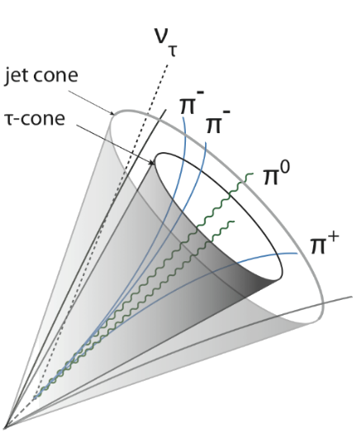
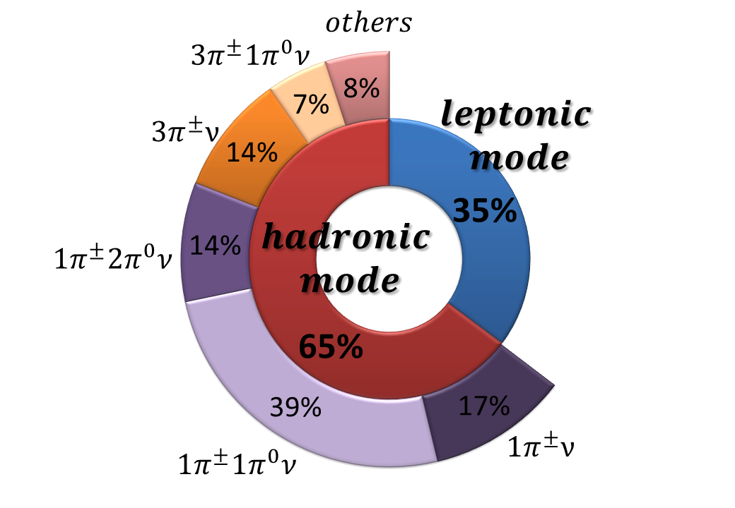
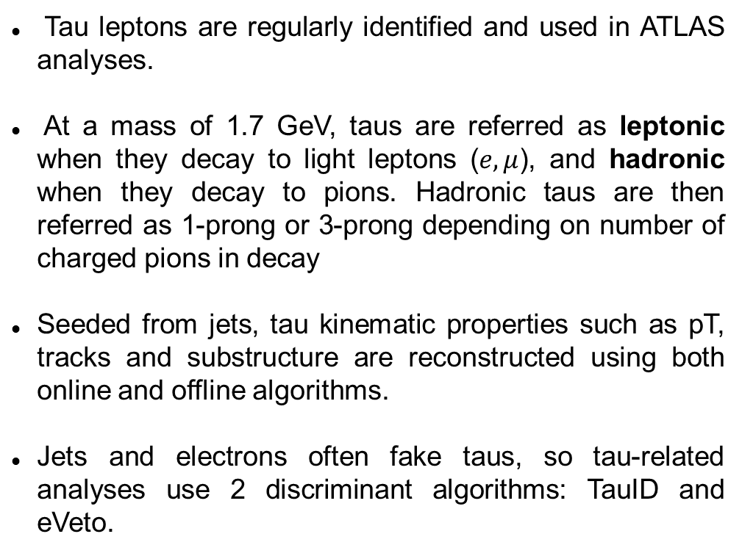
About Taus
Tau leptons are regularly identified and used in ATLAS analyses.
At a mass of 1.7 GeV, taus are referred as leptonic when they decay to light leptons ($e,μ$), and hadronic when they decay to pions. Hadronic taus are then referred as 1-prong or 3-prong depending on number of charged pions in decay
Seeded from jets, tau kinematic properties such as pT, tracks and substructure are reconstructed using both online and offline algorithms.
Jets and electrons often fake taus, so tau-related analyses use 2 discriminant algorithms: TauID and eVeto.
Pedro Sales de Bruin
Notes:
12

Slide 13
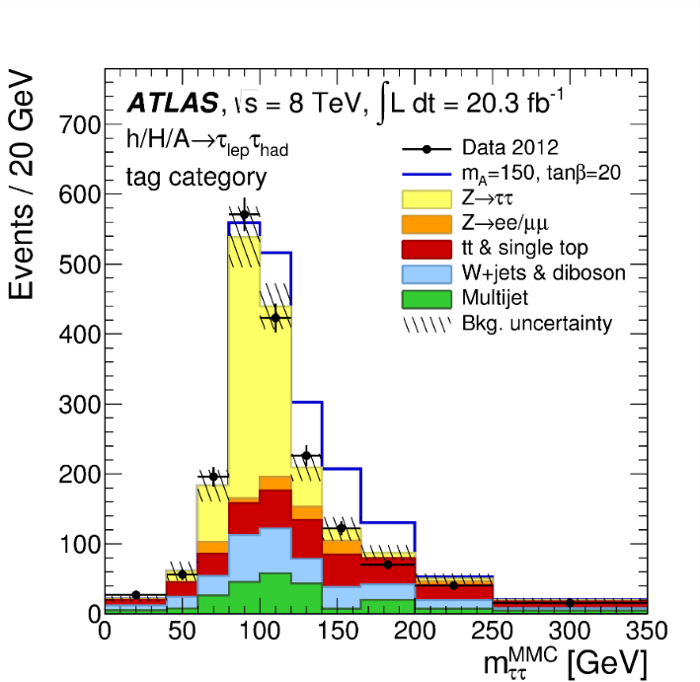
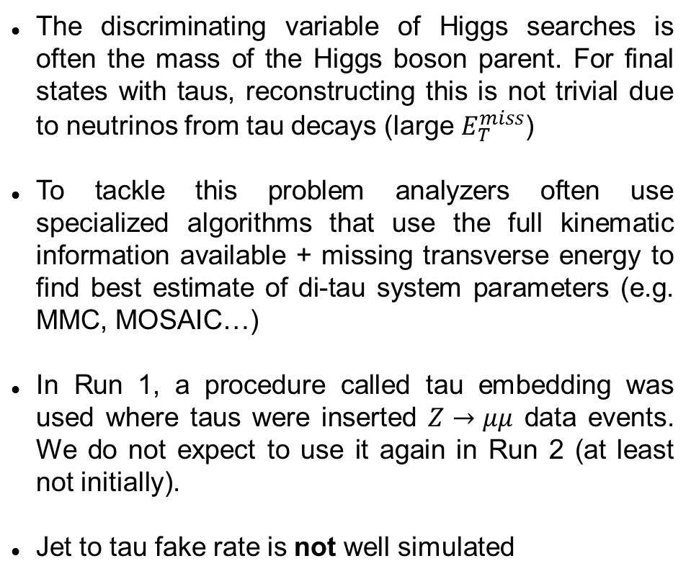
Tau-specific Challenges
The discriminating variable of Higgs searches is often the mass of the Higgs boson parent. For final states with taus, reconstructing this is not trivial due to neutrinos from tau decays (large $E_{T}^{miss}$)
To tackle this problem analyzers often use specialized algorithms that use the full kinematic information available + missing transverse energy to find best estimate of di-tau system parameters (e.g. MMC, MOSAIC…)
In Run 1, a procedure called tau embedding was used where taus were inserted $Z→μμ$ data events. We do not expect to use it again in Run 2 (at least not initially).
Jet to tau fake rate is not well simulated
Pedro Sales de Bruin
Notes:
13

Slide 14
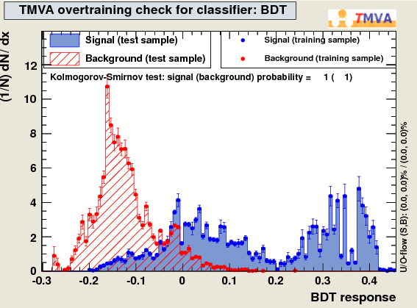
Aside: TauID – Description
For my ATLAS qualification task, I was asked to train the tau/jet discriminant algorithm that was to be used for most of Run 1 tau-related analysis.
The TauID algorithm is a BDT discriminant that uses separately trained trees for 1-prong and 3-prong taus. 8-9 kinematic variables are used as input that capture tau/jet differences such as shower width, track multiplicity, energy distribution and so on…
Pedro Sales de Bruin
Notes:
14

Slide 15
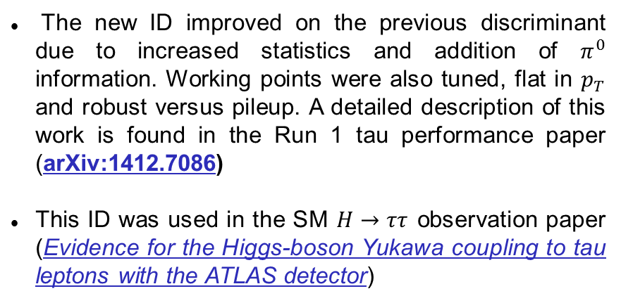
TauID – End Result
The new ID improved on the previous discriminant due to increased statistics and addition of $π^{0}$ information. Working points were also tuned, flat in $p_{T}$ and robust versus pileup. A detailed description of this work is found in the Run 1 tau performance paper (arXiv:1412.7086)
This ID was used in the SM $H→ττ$ observation paper (Evidence for the Higgs-boson Yukawa coupling to tau leptons with the ATLAS detector)
Pedro Sales de Bruin
Notes:
15

Slide 16

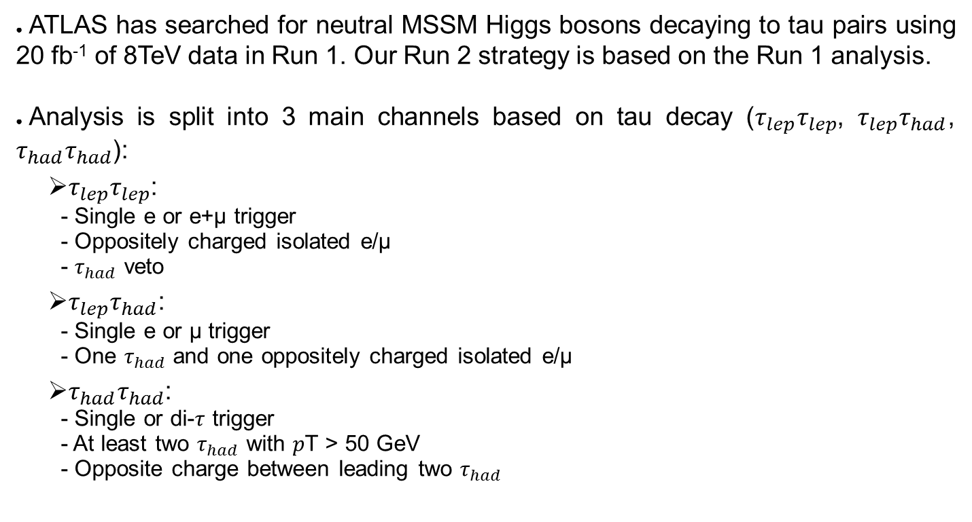
in Run 1: Outline
Pedro Sales de Bruin
Notes:
16

Slide 17

in Run 1: Backgrounds
Pedro Sales de Bruin
Notes:
17

Slide 18
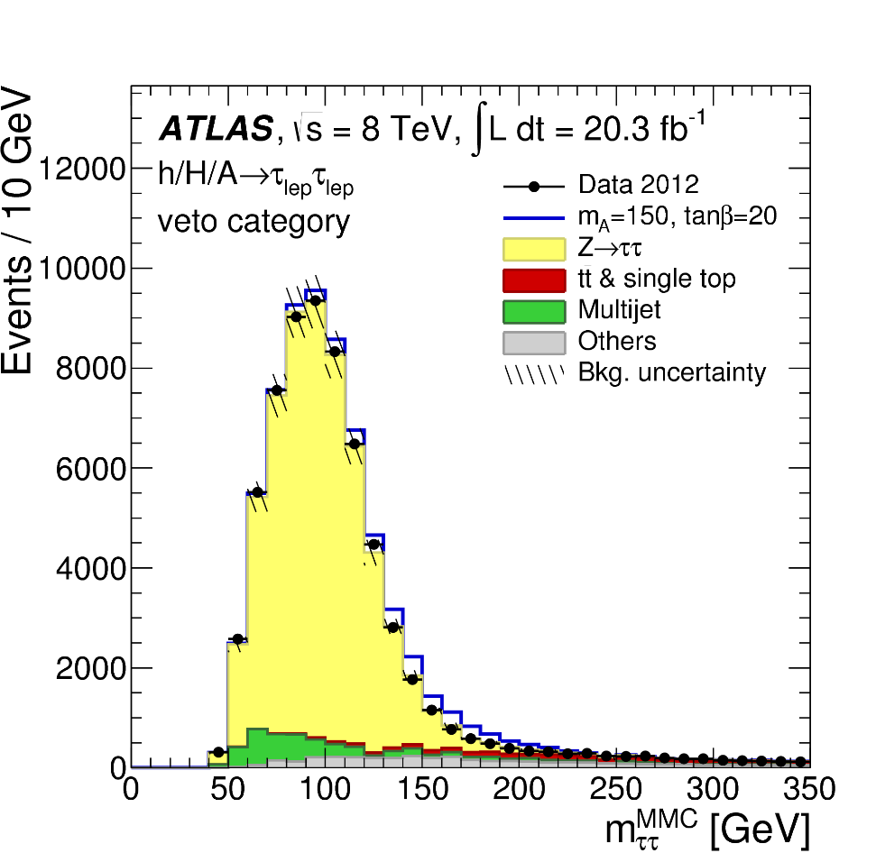
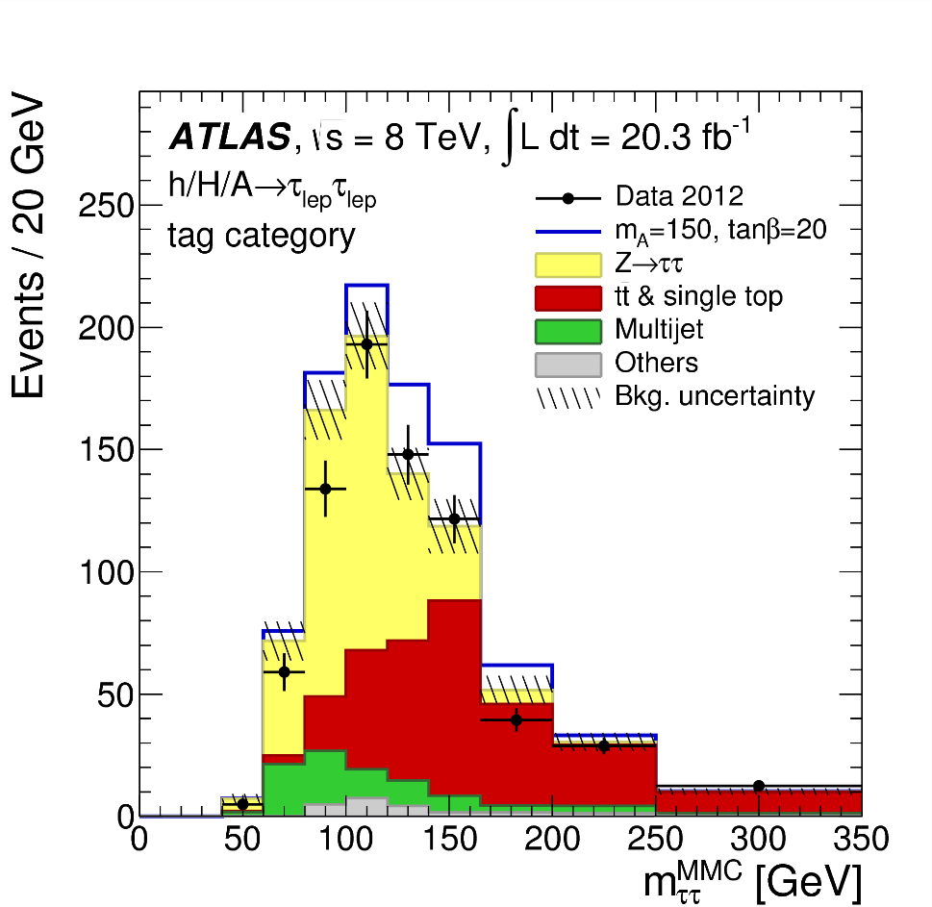
in Run 1:
Pedro Sales de Bruin
Notes:
18

Slide 19
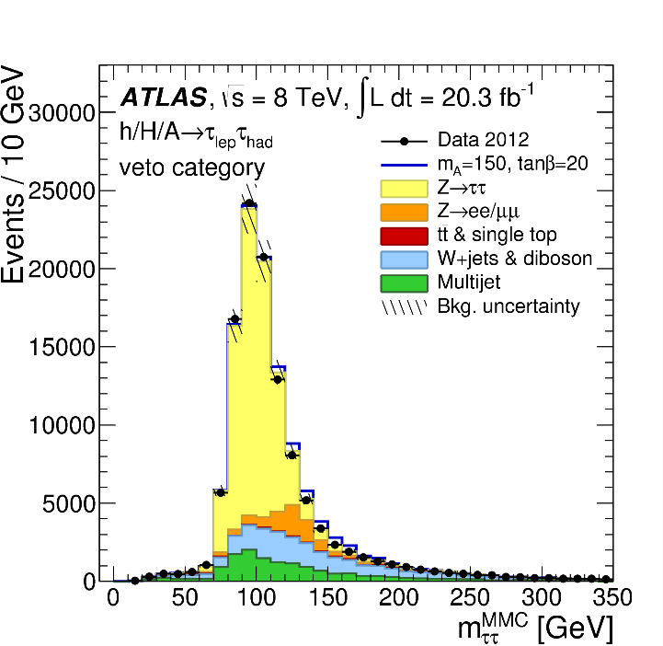
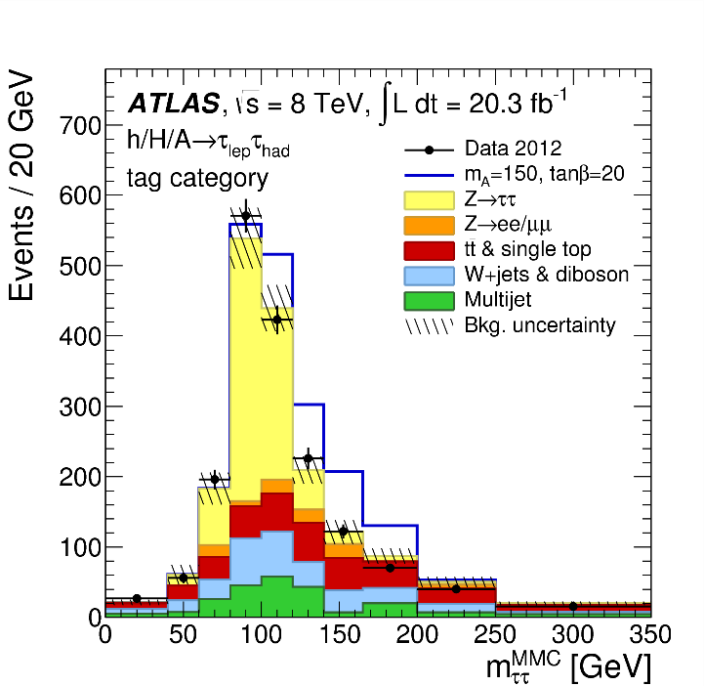
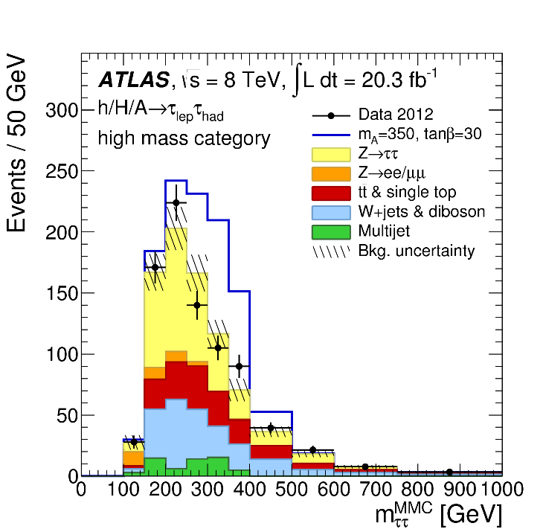
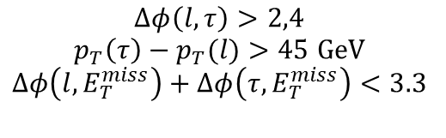
in Run 1:
Low mass
High mass
Pedro Sales de Bruin
Notes:
19

Slide 20
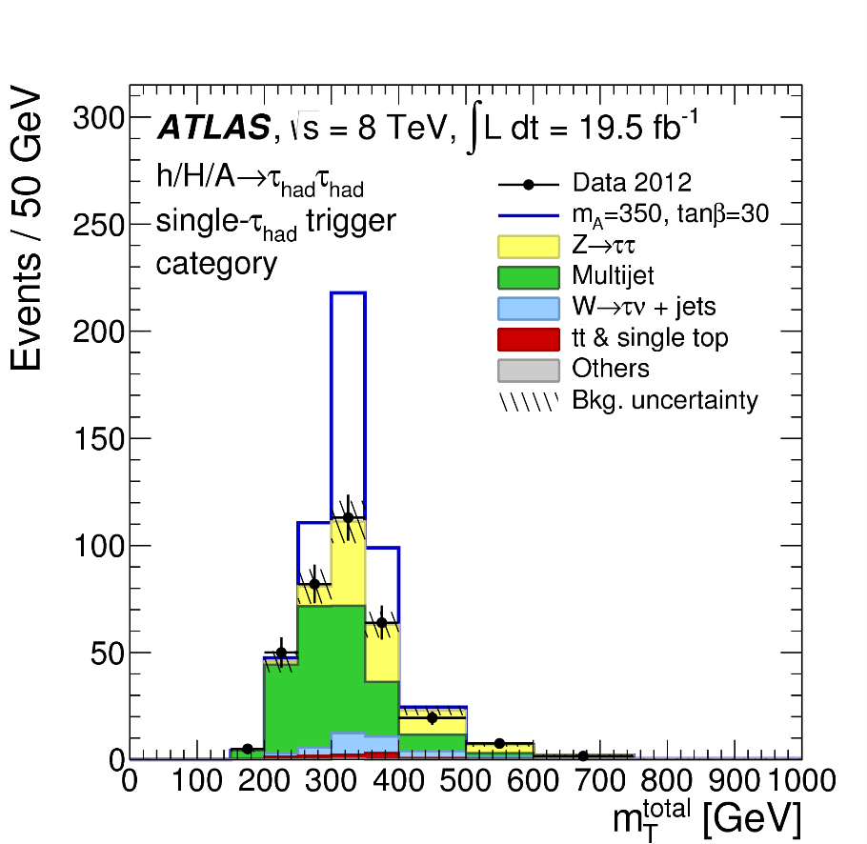
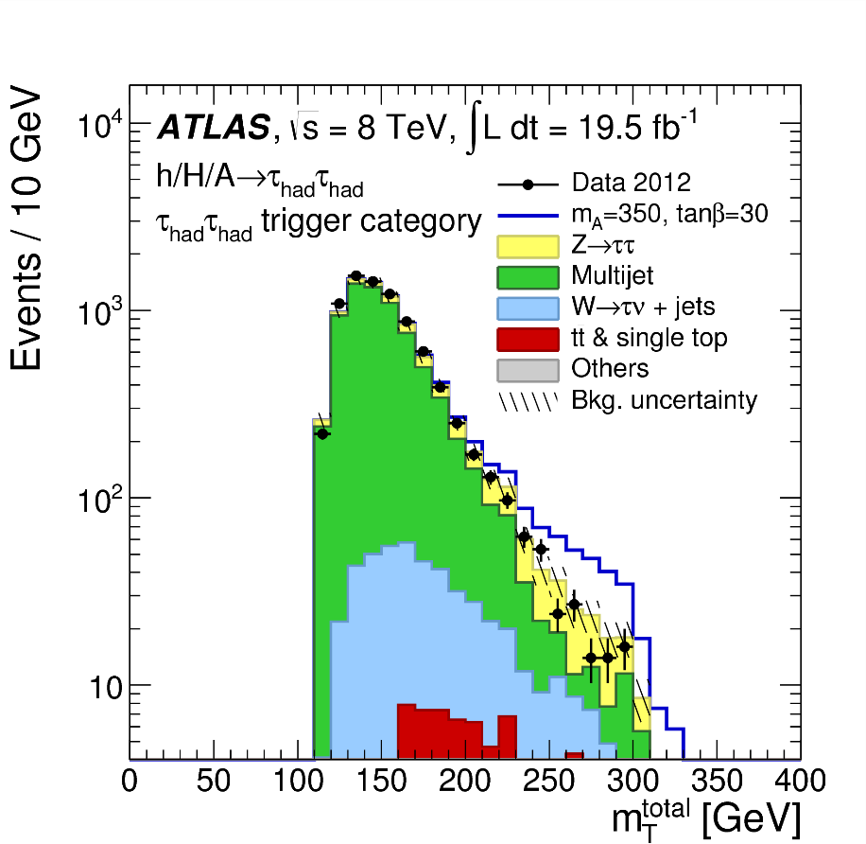
in Run 1:
Hadhad uses transverse mass because it provides better separation against multi-jet
Pedro Sales de Bruin
Notes:
20

Slide 21
$A/H/h→ττ$ in Run 1: Results
No excess was observed, limits were set on production cross section
mA-tan(β) exclusion plots for a variety of MSSM scenarios were also shown
Pedro Sales de Bruin
Notes:
21

Slide 22
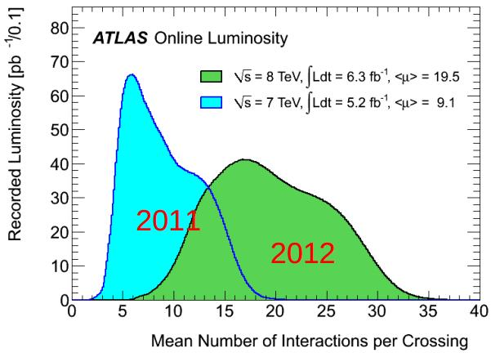
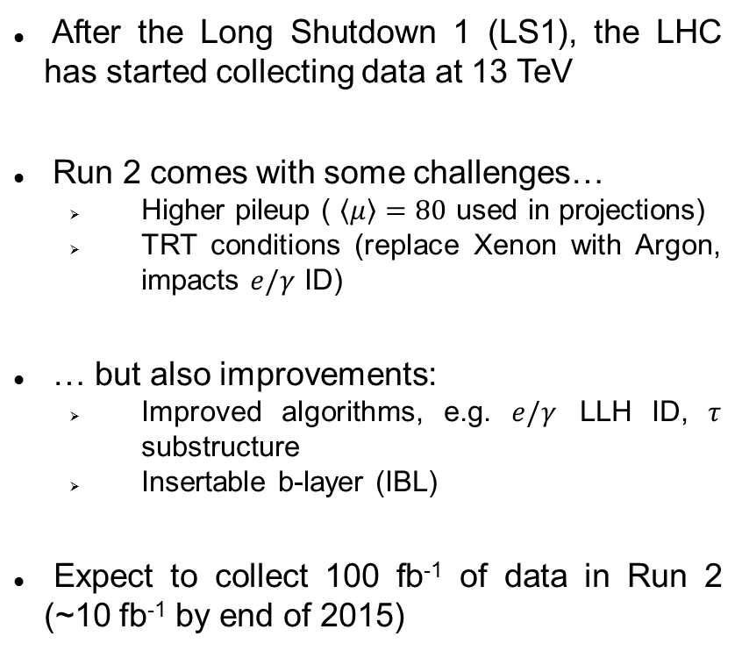
Run 2 at the LHC
2015?
After the Long Shutdown 1 (LS1), the LHC has started collecting data at 13 TeV
Run 2 comes with some challenges…
  Higher pileup ( $\left\langle μ\right\rangle =80$ used in projections)
  TRT conditions (replace Xenon with Argon, impacts $e/γ$ ID)
… but also improvements:
  Improved algorithms, e.g. $e/γ$ LLH ID, $τ$ substructure
  Insertable b-layer (IBL)
Expect to collect 100 fb⁻¹ of data in Run 2 (~10 fb⁻¹ by end of 2015)
2015?
Pedro Sales de Bruin
Notes:
22

Slide 23
$A/H/h→ττ$ in Run 2: outline
The analysis strategy in Run II is based on the Run I experience with a few changes:
  Leplep channel not yet considered, no low mass region
  No b-tag/veto selections in place, but being studied
  No tau embedding
My work within this analysis:
  Contribute to our nTuple framework (xTauFramework): CP recommendations, new variables and functions, debugging…
  Lead ntuplemaker and developer of BSM tautau channel: implement lephad object pre-selection and event selection, keep our channel up to date with xTauFW developments, produce ntuples
  Do background estimation, selection optimization, implement systematics and contribute to limits for lephad channel
  Compute W+Jets fake factors
Pedro Sales de Bruin
Notes:
23

Slide 24
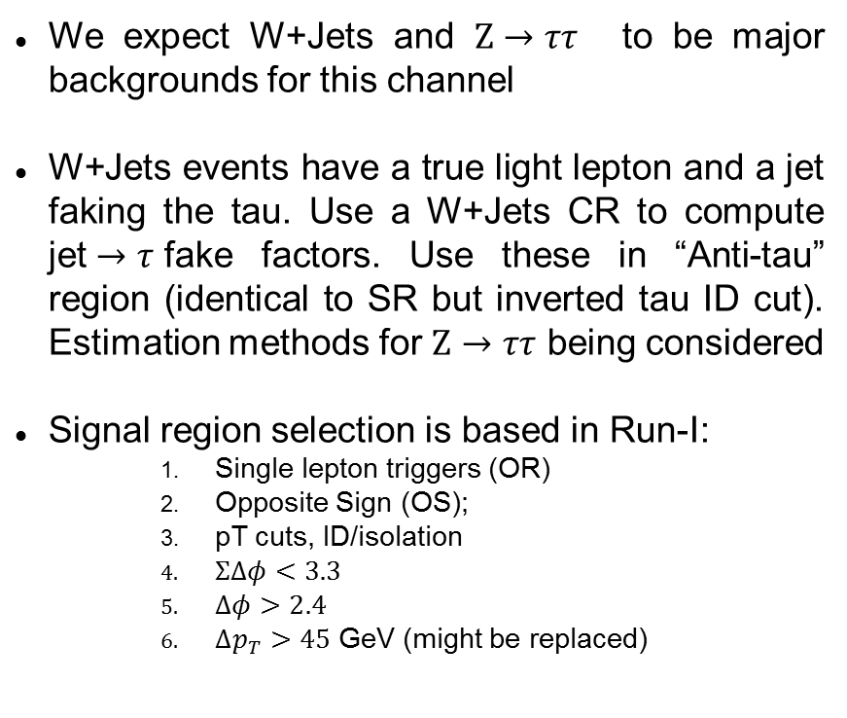
$A/H/h→ττ$ in Run 2: $τ_{lep}τ_{had}$
We expect W+Jets and $Z→ττ$ to be major backgrounds for this channel
W+Jets events have a true light lepton and a jet faking the tau. Use a W+Jets CR to compute jet$→τ$fake factors. Use these in “Anti-tau” region (identical to SR but inverted tau ID cut). Estimation methods for $Z→ττ$ being considered
Signal region selection is based in Run-I:
    Single lepton triggers (OR)
    Opposite Sign (OS);
    pT cuts, ID/isolation
    $ΣΔφ<3.3$
    $Δφ>2.4$
    $Δp_{T}>45$ GeV (might be replaced)
Pedro Sales de Bruin
Notes:
24

Slide 25
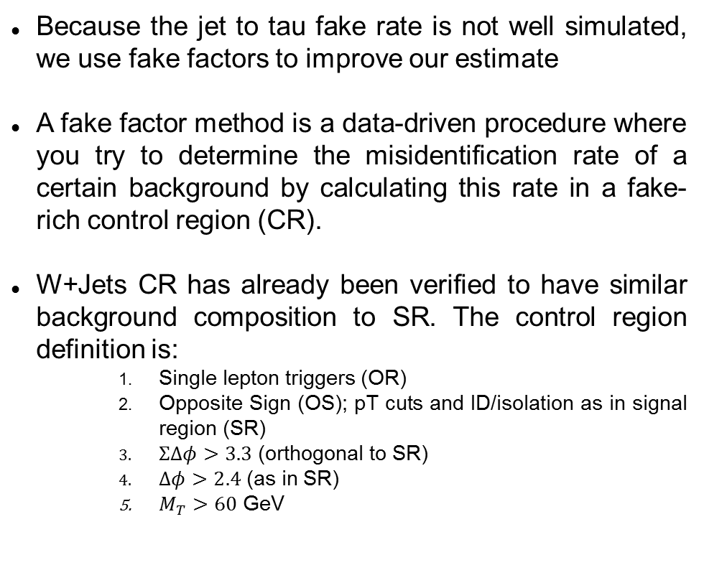
Run 2 analysis – fake factors
Because the jet to tau fake rate is not well simulated, we use fake factors to improve our estimate
A fake factor method is a data-driven procedure where you try to determine the misidentification rate of a certain background by calculating this rate in a fake-rich control region (CR).
W+Jets CR has already been verified to have similar background composition to SR. The control region definition is:
    Single lepton triggers (OR)
    Opposite Sign (OS); pT cuts and ID/isolation as in signal region (SR)
    $ΣΔφ>3.3$ (orthogonal to SR)
    $Δφ>2.4$ (as in SR)
    $M_{T}>60$ GeV
sOverA = signal / AntiTau region
Pedro Sales de Bruin
Notes:
25

Slide 26


Run 2 analysis – Cutflows
$eτ_{had}$ channel
$μτ_{had}$ channel
Luminosity scaled to 2 fb⁻¹ . Signal xs set to 1 pb⁻¹
Pedro Sales de Bruin
Notes:
26

Slide 27
Run 2 analysis – Fake composition
Important to understand your sources of background. Also, we can use truth information from simulated samples to check that our background flavor compositions in control regions are similar to those found in the signal region
Pedro Sales de Bruin
Notes:
27

Slide 28
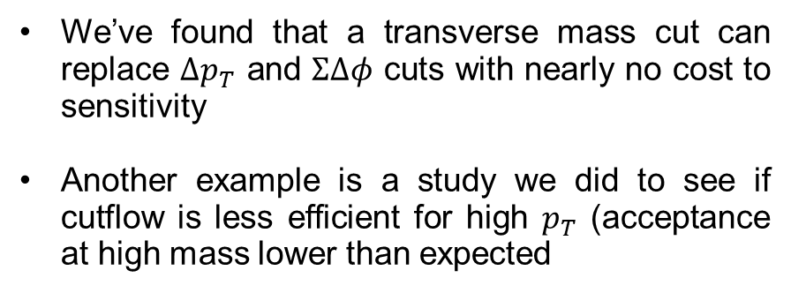
Run 2 analysis – Selection study
We’re constantly trying to optimize our selection aiming at improved sensitivity, better MC/data modelling, higher statistics, etc..
We’ve found that a transverse mass cut can replace $Δp_{T}$ and $ΣΔφ$ cuts with nearly no cost to sensitivity
Another example is a study we did to see if cutflow is less efficient for high $p_{T}$ (acceptance at high mass lower than expected
Lower acceptance at high mass is due to reconstruction efficiency only
No pT bias
Pedro Sales de Bruin
Notes:
28

Slide 29
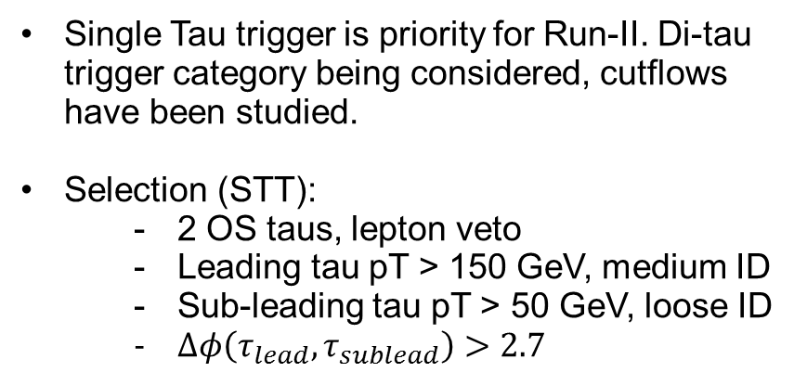
$A/H/h→ττ$ in Run 2: $τ_{had}τ_{had}$
Most sensitive channel in high mass.
Analyzers have run a successful acceptance challenge, estimated and studied backgrounds, defined BSM-specific hadhad derivation and more, but…
…the very important multi-jet background is difficult to estimate due to not enough MC statistics.
Single Tau trigger is priority for Run-II. Di-tau trigger category being considered, cutflows have been studied.
Selection (STT):
  2 OS taus, lepton veto
  Leading tau pT > 150 GeV, medium ID
  Sub-leading tau pT > 50 GeV, loose ID
  $Δφ\left(τ_{lead},τ_{sublead}\right)>2.7$
Pedro Sales de Bruin
Notes:
29

Slide 30
Run 2 analysis – Next steps
Move to MC15: new Monte Carlo samples that have the full Run 2 software upgrades developed by all the different CP groups
Look at data! Analysis will not be blind for first 1fb⁻¹. Expect 50ns data to not be used in final result
Produce and study MC15 signal ntuples
Look at systematics
Fake factors study with data
Supporting note
Pedro Sales de Bruin
Notes:
30

Slide 31
Conclusion
We propose my research topic be the search for neutral supersymmetric Higgses using Run 2 LHC data with ATLAS
Our analysis is reasonably advanced (considering we just started getting the first nb⁻¹ of data): framework in place from ntuple-making to limit setting, acceptance challenge across several independent groups, background estimates for main backgrounds (apart from QCD), signal samples ready or in production and so on…
We expect no show-stoppers for having a public result by next year
If time permits (and if you’re interested) the next slides go over previous work
Pedro Sales de Bruin
Notes:
31

Slide 32
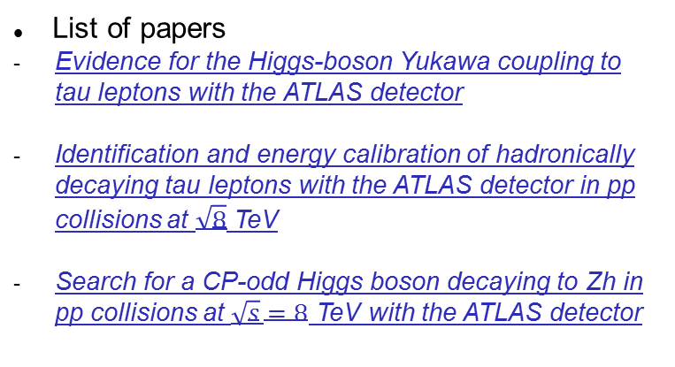
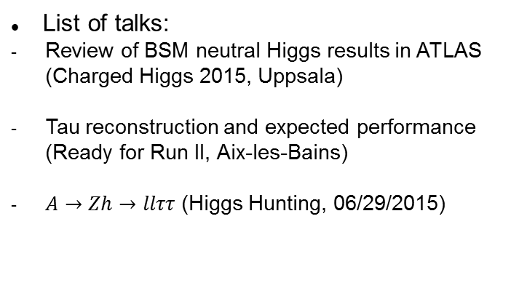
Other work - Summary
List of papers
Evidence for the Higgs-boson Yukawa coupling to tau leptons with the ATLAS detector
Identification and energy calibration of hadronically decaying tau leptons with the ATLAS detector in pp collisions at $\sqrt{8}$ TeV
Search for a CP-odd Higgs boson decaying to Zh in pp collisions at $\sqrt{s}=8$ TeV with the ATLAS detector
List of talks:
Review of BSM neutral Higgs results in ATLAS (Charged Higgs 2015, Uppsala)
Tau reconstruction and expected performance (Ready for Run II, Aix-les-Bains)
$A→Zh→llττ$ (Higgs Hunting, 06/29/2015)
I have also done some TauCP work that is not described in any notes. These include training, tuning of TauID for Run II and recalculating pileup corrections of TauID variables, investigating alternative pileup correction methods for tau kinematic variables, first-look studies on TauID performance with Run II geometry and framework development for tau CP studies
Pedro Sales de Bruin
Notes:
32

Slide 33
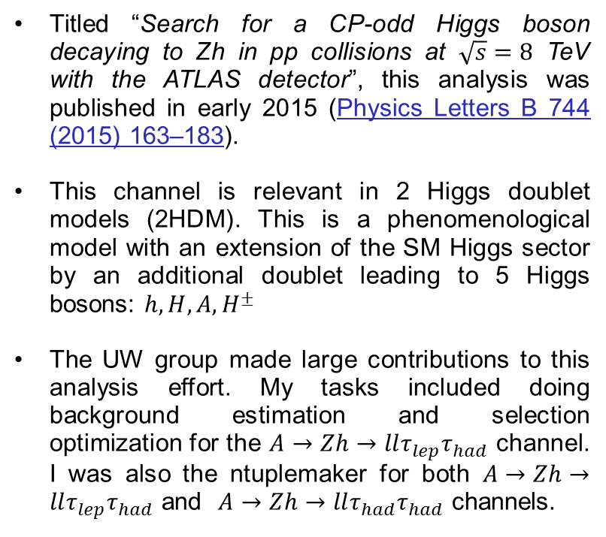
$A→Zh$- Introduction
Titled “Search for a CP-odd Higgs boson decaying to Zh in pp collisions at $\sqrt{s}=8$ TeV with the ATLAS detector”, this analysis was published in early 2015 (Physics Letters B 744 (2015) 163–183).
This channel is relevant in 2 Higgs doublet models (2HDM). This is a phenomenological model with an extension of the SM Higgs sector by an additional doublet leading to 5 Higgs bosons: $h,H,A,H^{±}$
The UW group made large contributions to this analysis effort. My tasks included doing background estimation and selection optimization for the $A→Zh→llτ_{lep}τ_{had}$ channel. I was also the ntuplemaker for both $A→Zh→llτ_{lep}τ_{had}$ and $A→Zh→llτ_{had}τ_{had}$ channels.
Pedro Sales de Bruin
Notes:
33

Slide 34







$A→Zh$- Selection
Pedro Sales de Bruin
Notes:
34

Slide 35
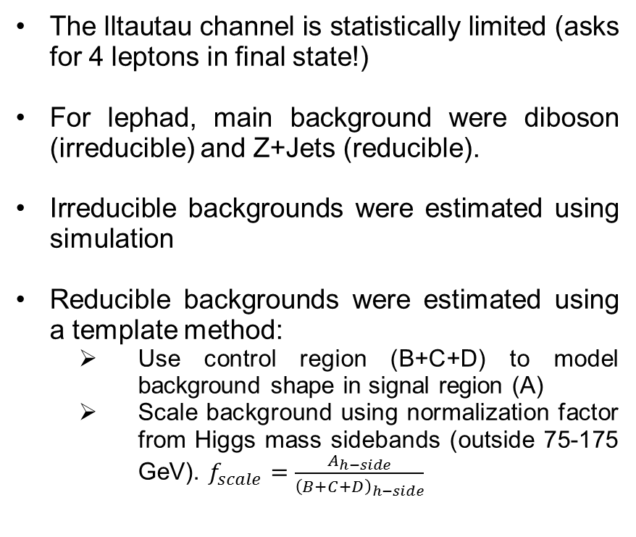
$A→Zh$- Backgrounds
The lltautau channel is statistically limited (asks for 4 leptons in final state!)
For lephad, main background were diboson (irreducible) and Z+Jets (reducible).
Irreducible backgrounds were estimated using simulation
Reducible backgrounds were estimated using a template method:
  Use control region (B+C+D) to model background shape in signal region (A)
  Scale background using normalization factor from Higgs mass sidebands (outside 75-175 GeV). $f_{scale}=\frac{A_{h−side}}{{\left(B+C+D\right)}_{h−side}}$
Pedro Sales de Bruin
Notes:
35

Slide 36
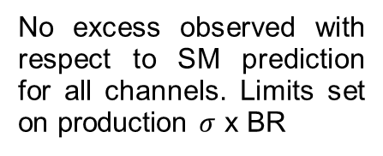
$A→Zh$ - Results
No excess observed with respect to SM prediction for all channels. Limits set on production $σ$ x BR
Pedro Sales de Bruin
Notes:
36

Slide 37
Thanks to Nikolaos Rompotis, Anna Goussiou and all members of the supervisory committee for your time and feedback.
Pedro Sales de Bruin
Notes:
37

Slide 38
BACKUP
Pedro Sales de Bruin
Notes:
38

Slide 39
TauID Performance Gain
Improvement of TauID with substructure with respect to previous ID.
Pedro Sales de Bruin
Notes:
39

Slide 40
Extra details about run I analysis
Definition of transverse mass between two objects:
Pedro Sales de Bruin
Notes:
40

Slide 41
MMC details
Pick best solution by maximizing the likelihood defined in kinematically allowed phase space region
Pedro Sales de Bruin
Notes:
41

Slide 42
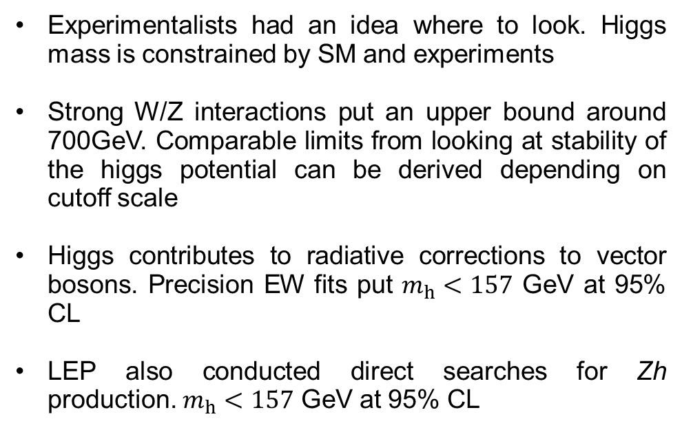
Early limits on $m_{h}$
Experimentalists had an idea where to look. Higgs mass is constrained by SM and experiments
Strong W/Z interactions put an upper bound around 700GeV. Comparable limits from looking at stability of the higgs potential can be derived depending on cutoff scale
Higgs contributes to radiative corrections to vector bosons. Precision EW fits put $m_{h}<157$ GeV at 95% CL
LEP also conducted direct searches for Zh production. $m_{h}<157$ GeV at 95% CL
Pedro Sales de Bruin
Notes:
42

Slide 43
More about BSM
2 Higgs doublets are needed to cancel chiral anomalies from new sparticles (particularly the higgsino). One doublet for up-type fermions, other for d-type
At tree level:
Pedro Sales de Bruin
Notes:
43

Slide 44
More about MSSM
Pedro Sales de Bruin
Notes:
44

Slide 45
Heavy Higgs Masses
Pedro Sales de Bruin
Notes:
45

Slide 46
$A→Zh$ - 2HDM exclusion
2HDM exclusion plots for 4 2HDM scenarios: type I, type II, lepton-specific and flipped
Pedro Sales de Bruin
Notes:
46

Slide 47
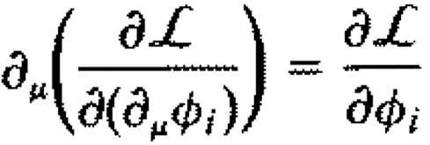
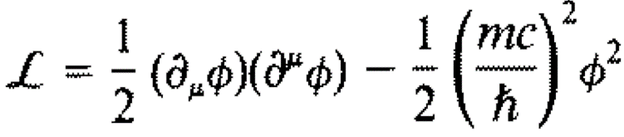
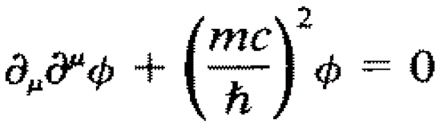
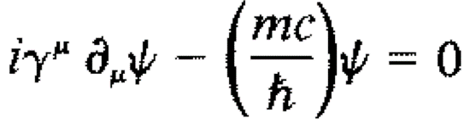
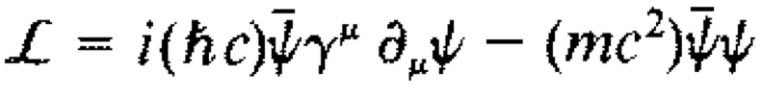
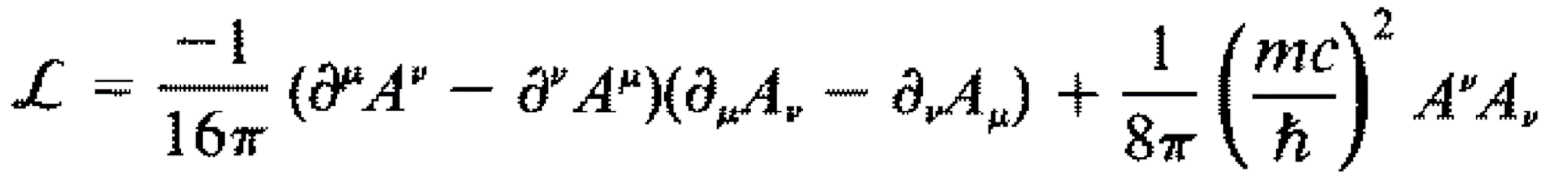
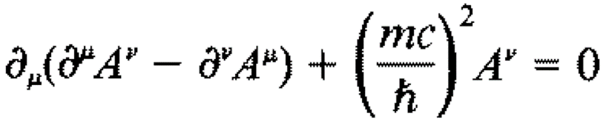
Basic QFT Lagrangians
Generalized Euler-Lagrange equation:
Spin 0 scalar
(K-G)
Spin ½ spinor
(Dirac)
Spin 1 vector field
(Proca)
Pedro Sales de Bruin
Notes:
47

Slide 48

ElectroWeak Interactions
Found some old slides where I try to go through the EWSB process ☺
Chiral Basis
(singlet)
Weak Isospin
For leptons
Weak Hypercharge

Slide 49
ElectroWeak Interactions
Start with group symmetry:
Lagrangian will have usual terms:
, where
,
Full Lagrangian:

Slide 50
ElectroWeak Interactions
EW revisited
There are two new terms, the Higgs field and a Yukawa coupling for each fermion in the theory:
(for electron)
The new higgs field is a complex scalar doublet
, where

Slide 51
Perturbation about the vev
Go to U-gauge to look at particle content

Slide 52

Yukawa coupling
Mass term
Coupling to Higgs ~ m_{F}

Slide 53
W boson
Using
Second term

Slide 54
Z and photon
, where I used
Then
Finally, last linear combination of fields that is orthogonal to Z and W⁺, W⁻ :

