Slide 1
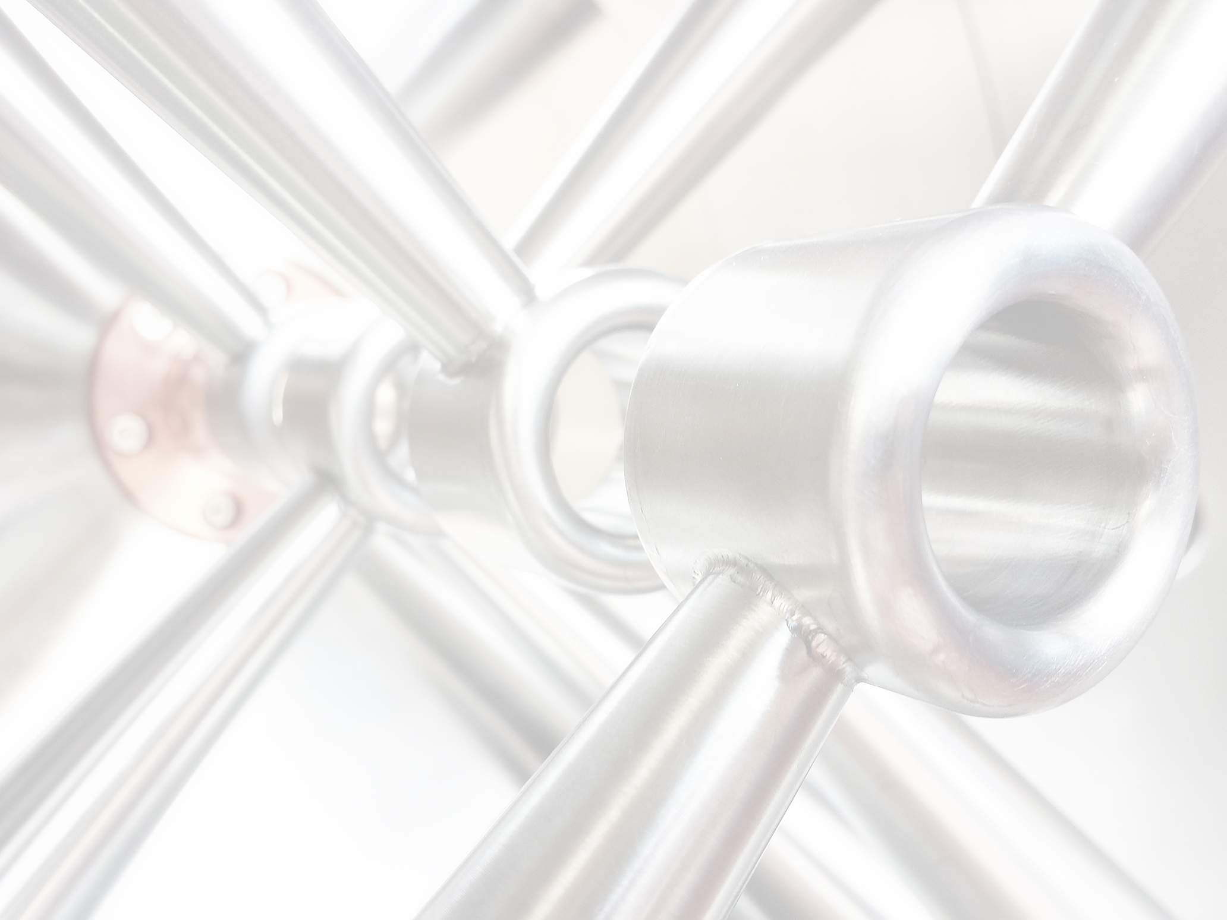
From Ion Sources to High Power Linacs
Research Areas of LINAC and NNP Groups
at the Institute for Applied Physics Frankfurt
LINAC Group
H. Podlech, F. Schneider, M. Busch, F. Dziuba, M. Schwarz, M. Basten et al
NNP Group
K. Schulte, M. Droba, O. Meusel et al
in close coordination and collaboration with
G. Franchetti
CERN, Geneva
June 18th, 2015

Slide 2
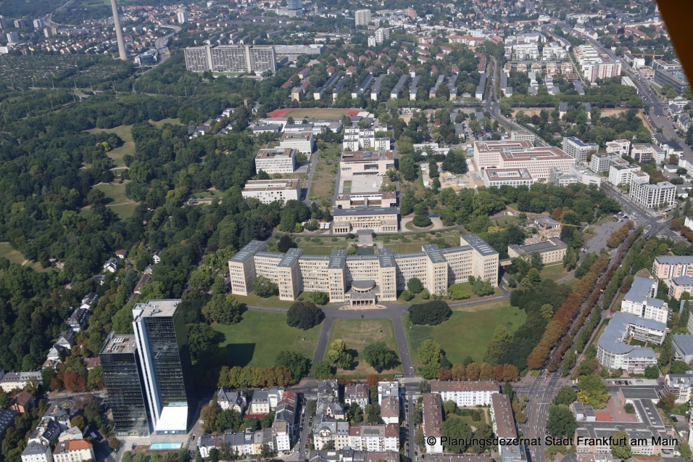
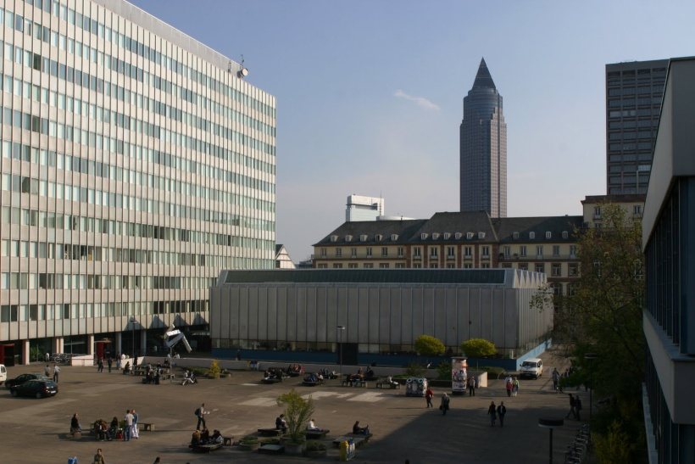
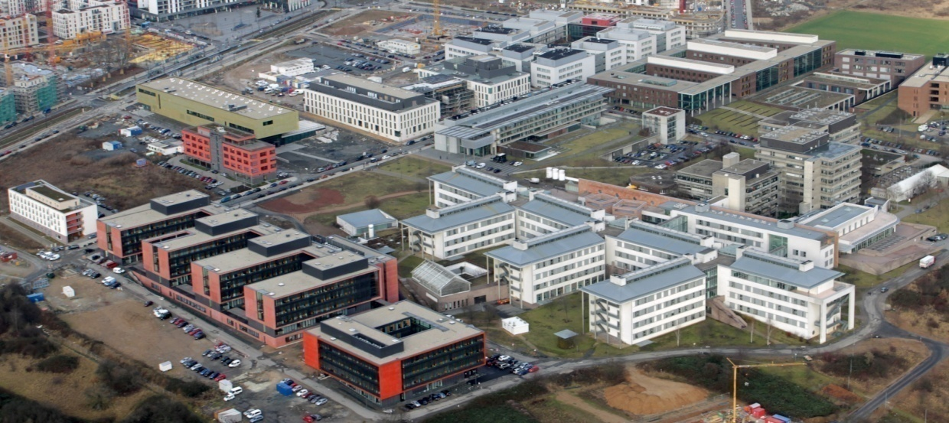
Goethe University Frankfurt
Founded in 1914
16 Departments
3 Campus areas
45000 Students (# 3 in Germany)

Slide 3
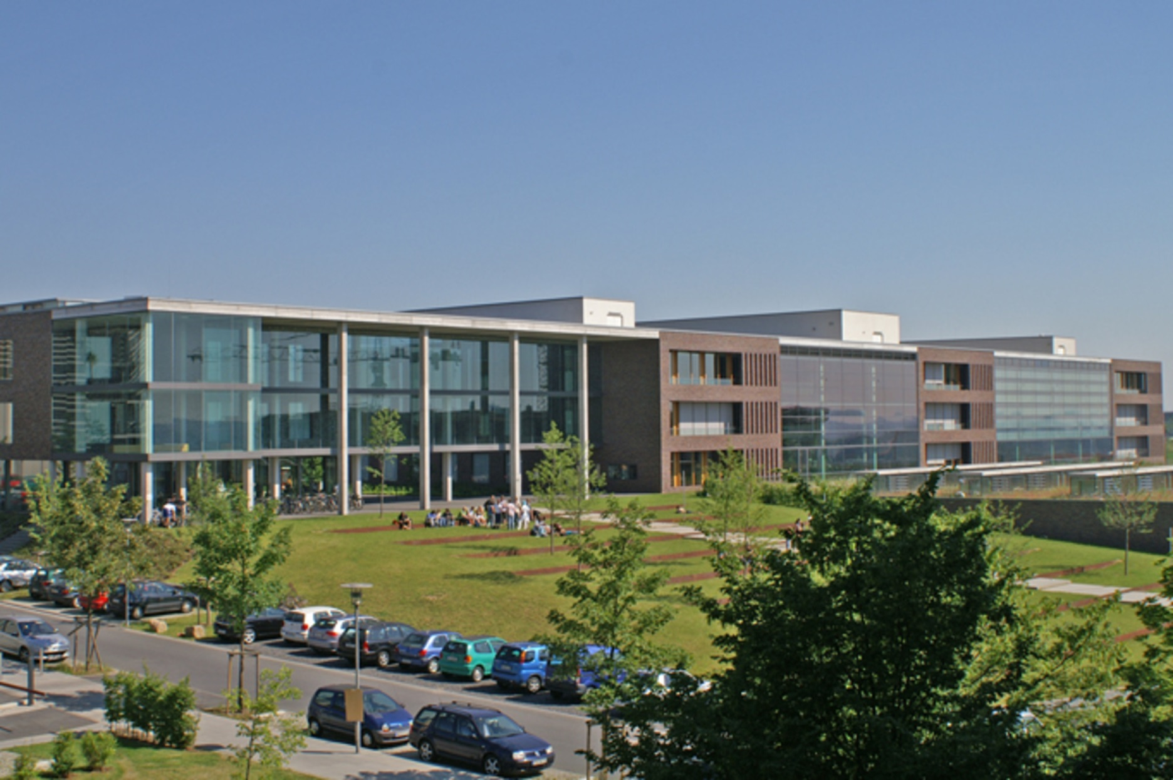
Department of Physics at Goethe University (FB13)

Slide 4
Institute for Applied Physics (IAP)
Nuclear Astro-Physics
Prof. Dr. R. Reifarth
Plasma-Physics
Prof. Dr. J. Jacoby
Accelerator Physics
Prof. Dr. O. Kester
Prof. Dr. H. Podlech
Prof. Dr. U. Ratzinger

Slide 5
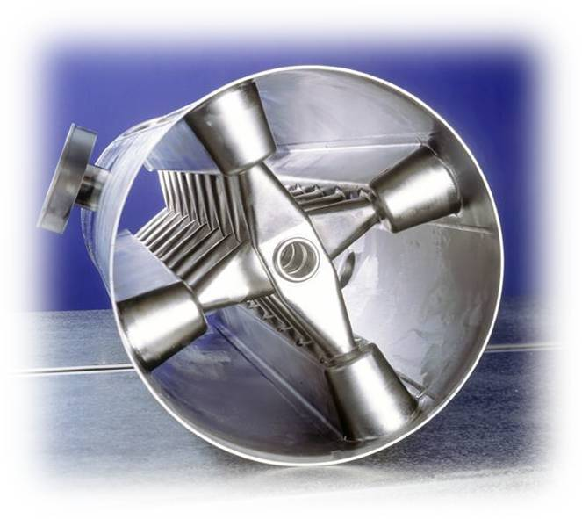
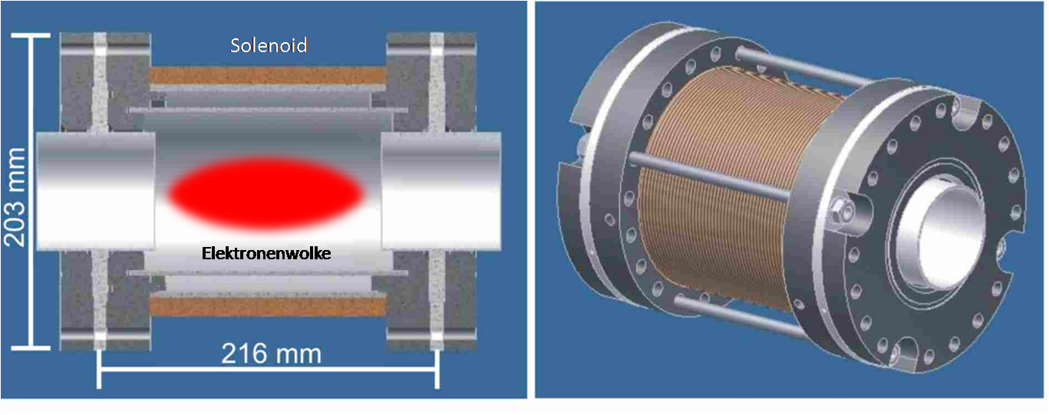
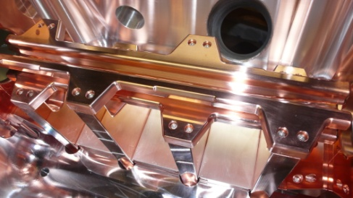
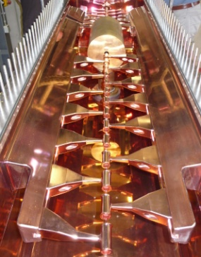
Accelerator Physics at IAP
Superconducting RF cavities
Space Charge Lenses
RFQ accelerators
Beam Dynamics and Code development
Ion sources
Beam diagnostics
Laser-Plasma acceleration
Plasma stripper
Magnet design (rt)
LEBT Sections
Magnetic storage ring
Room temperature RF cavities

Slide 6
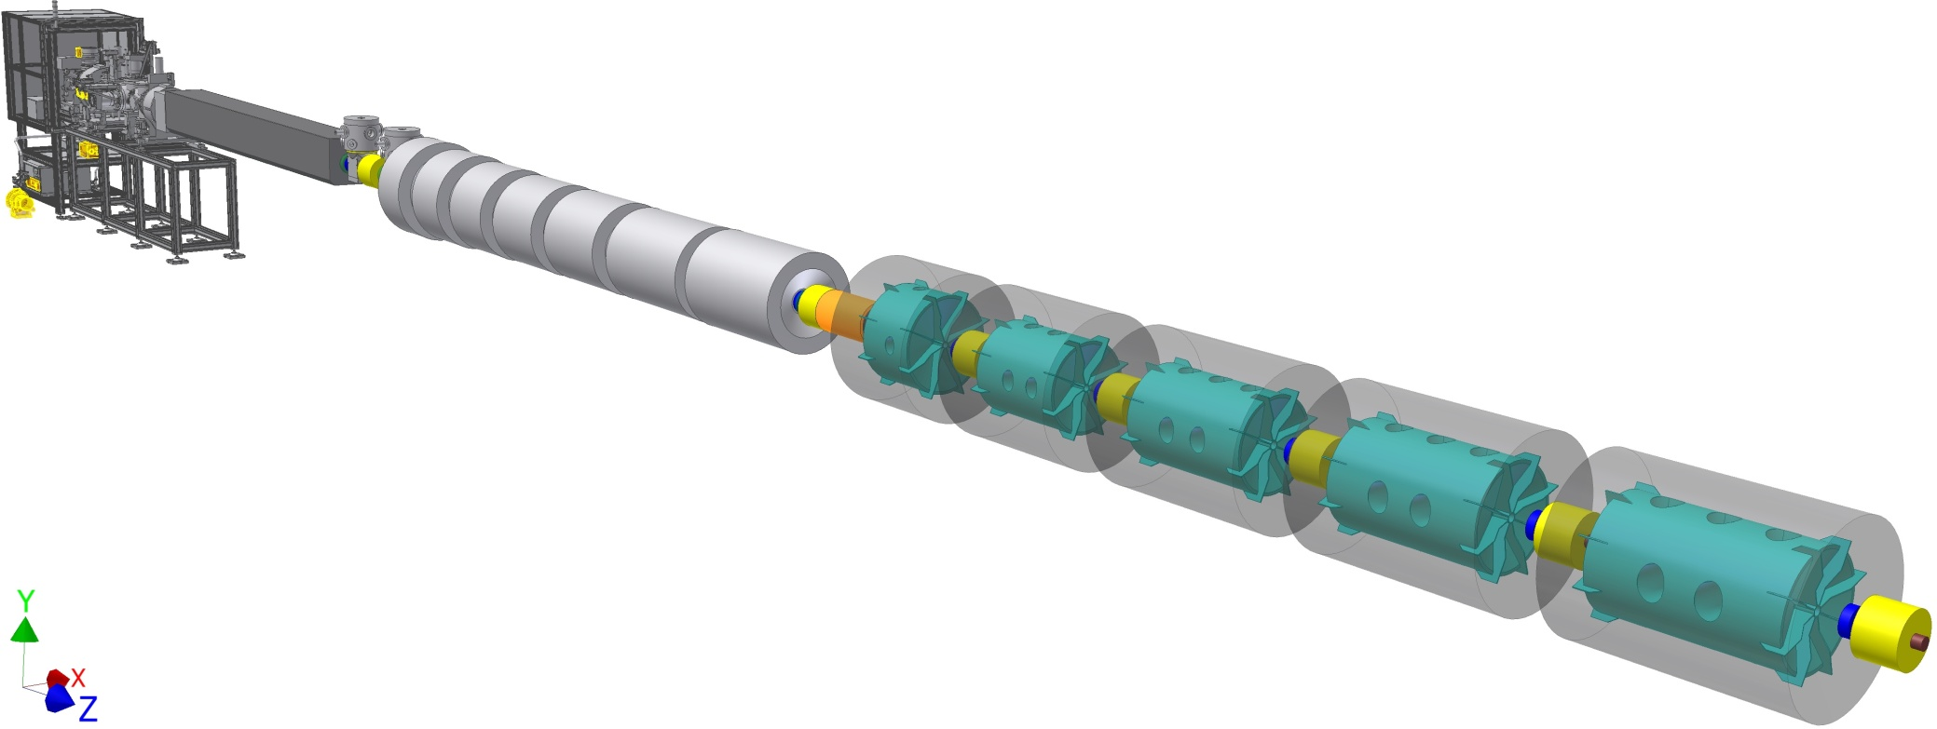
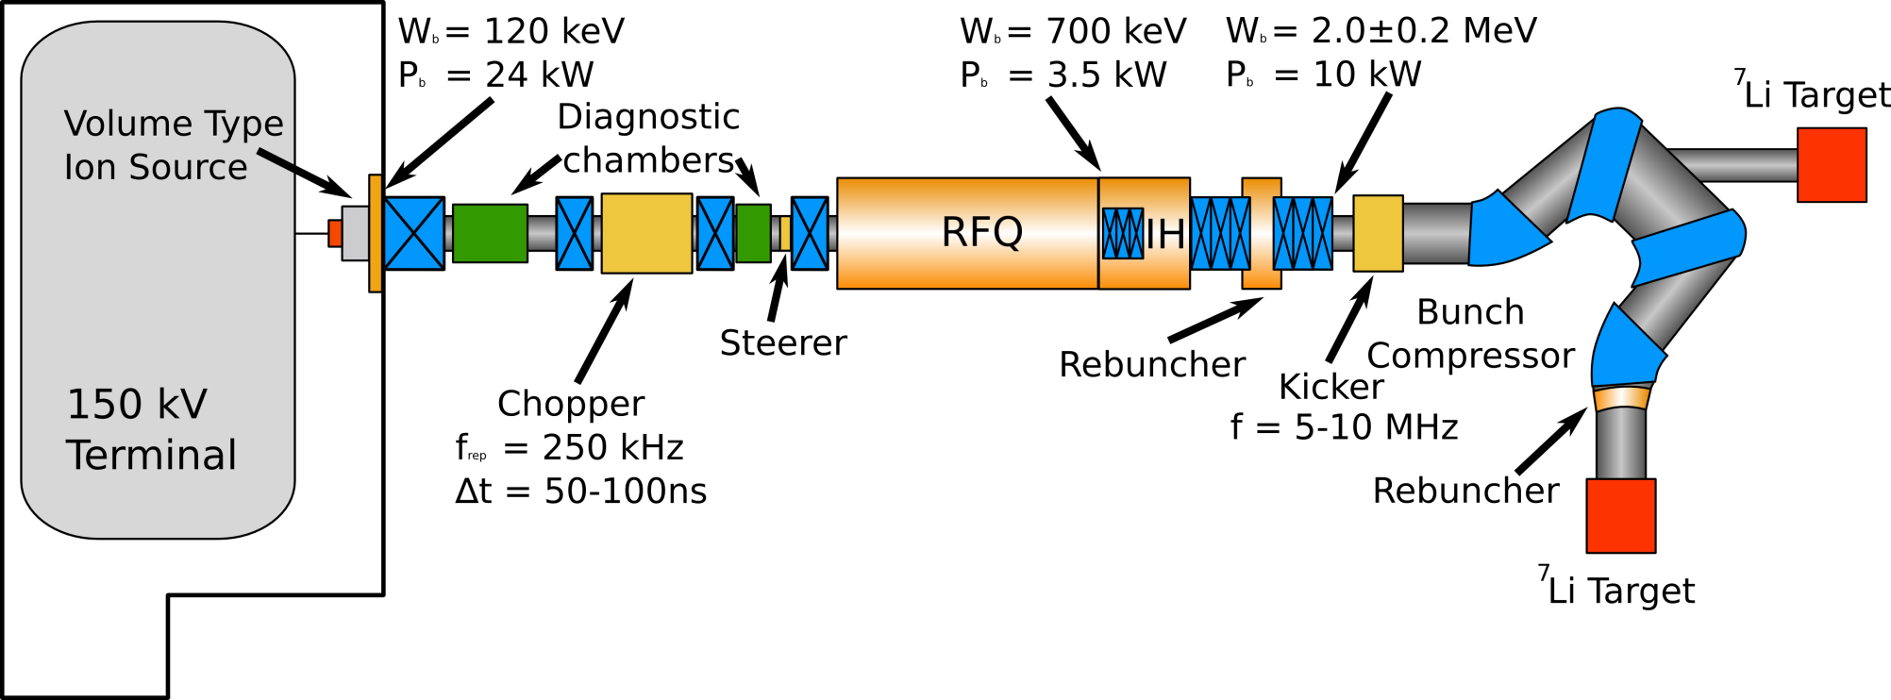
Projects
100% RF duty factor
RFQ-structures
rt DTL-structures
sc DTL structures
17 MeV p-Injector for MYRRHA
FRANZ @ IAP
sc cw linac @ GSI
Hochladungs-Injektor
Buncher
CH0
CH1
CH2
CH3
CH4
CH5
CH6
CH9
CH10
CH7
CH8
HLI
1.4 AMeV
CH-cavity demonstrator
6 AMeV

Slide 7
Frankfurt Neutron Source FRANZ
2 MeV Protons → ⁷Li as Target → Neutrons 0-500 keV
2 mA cw
50-200 mA pulsed, t=50 ns, rep. rate 250 kHz → RF cw
Next stage: Bunch compressor

Slide 8
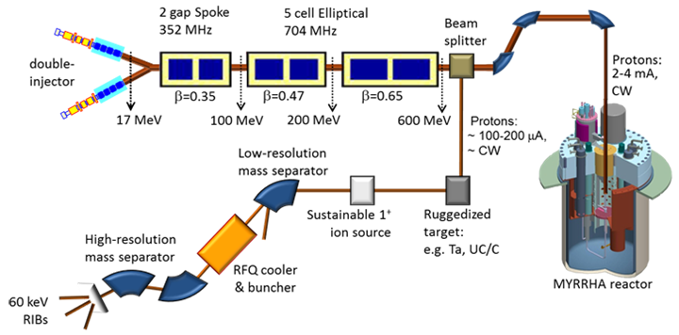
MYRRHA Project
600 MeV Protons, 4 mA, cw
Demonstration of large scale transmutation

Slide 9
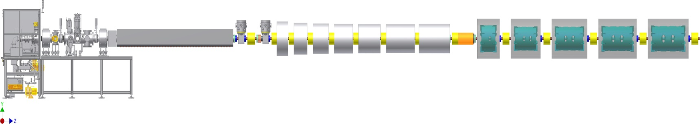
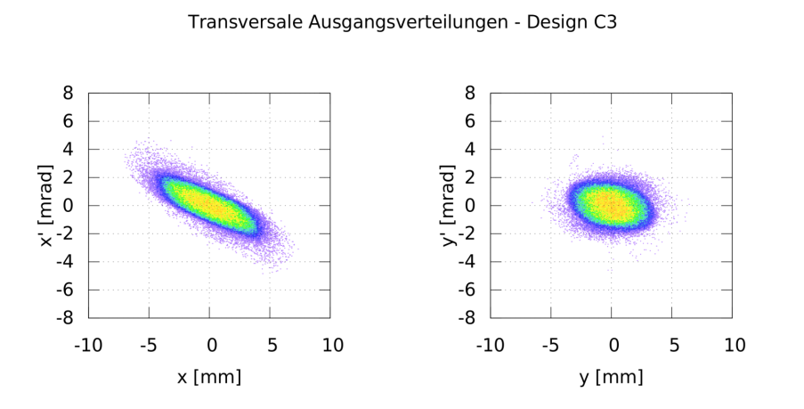
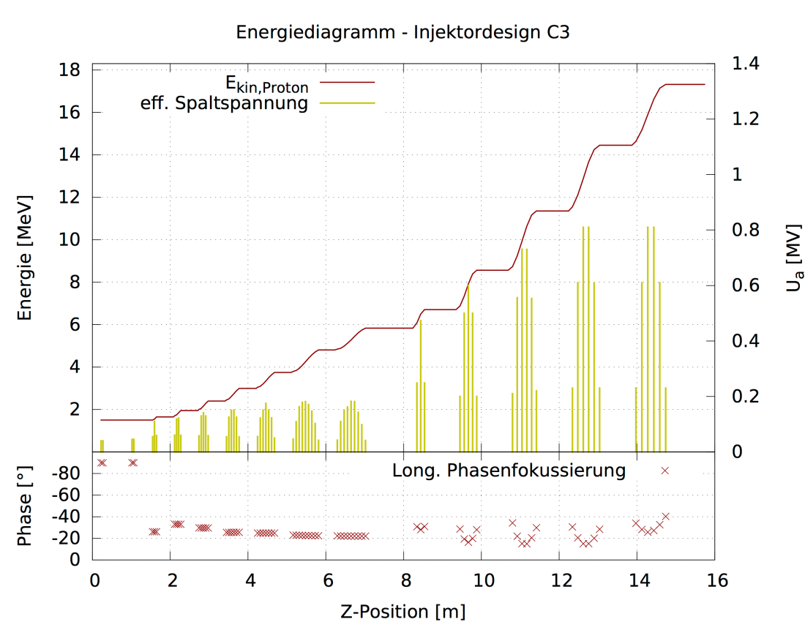
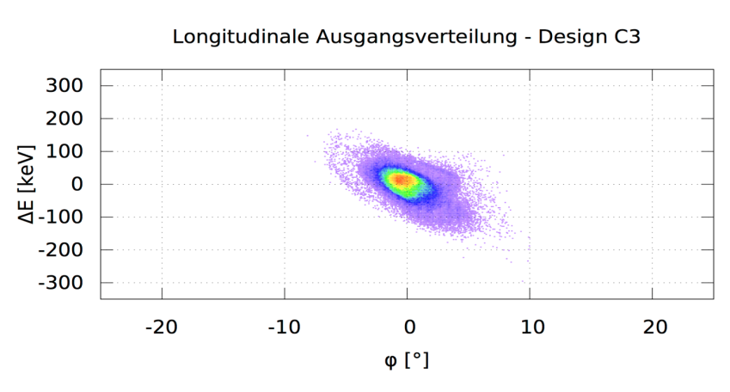
MYRRHA Project 17 MeV Injector
100% duty cycle, high reliability, excellent beam quality
4-rod RFQ
rt CH-cavities
sc CH-cavities
rt CH-cavities

Slide 10
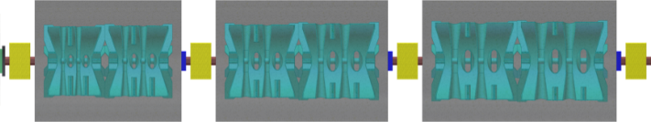
Advanced Demonstrator for GSI-SHE-Linac
Superconducting cw operated heavy ion linac
for the production of superheavy elements
High Charge Injector
Buncher
CH0
CH1
CH2
CH3
CH4
CH5
CH6
CH7
CH8
CH9
CH10
HLI
1.4 AMeV
CH-cavity demonstrator
6 AMeV
2 identical CH-cavities per cryomodule
Constant beta
Warm quadrupoles in inter-tank sections

Slide 11
RFQ Structures
RFQ structures using electric RF quadrupole fields
→ Strong electric focusing

Slide 12
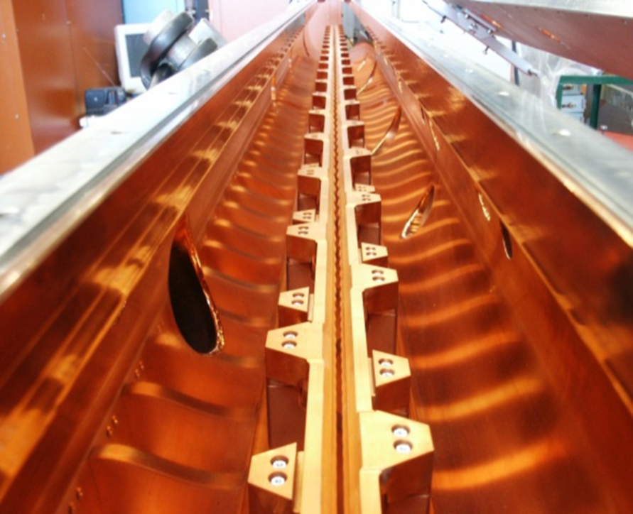
RFQ Development for cw Operation
Parameter | SARAF | FRANZ | MHYRRA | Unit
RF Structure | 4-Rod | 4-Rod | 4.Rod | ---
Frequency | 175 | 175 | 176.1 | MHz
Beam current | 2 | 2-50 | 5 | mA
Duty factor | 100 | 100 | 100 | %
E_{out} | 1.5 | 0.7 | 1.5 | MeV
R_{p} | 67 | 77 | 77 | kΩm
RF Power | 240 | 110 | 108 | kW
Specific power | 60 | 60 | 25 | kW/m
Voltage | 65 | 65 | 44 | kV
Length | 4 | 1.7 | 4 | m
175 MHz 4-Rod SARAF
A. Bechtold, NTG

Slide 13
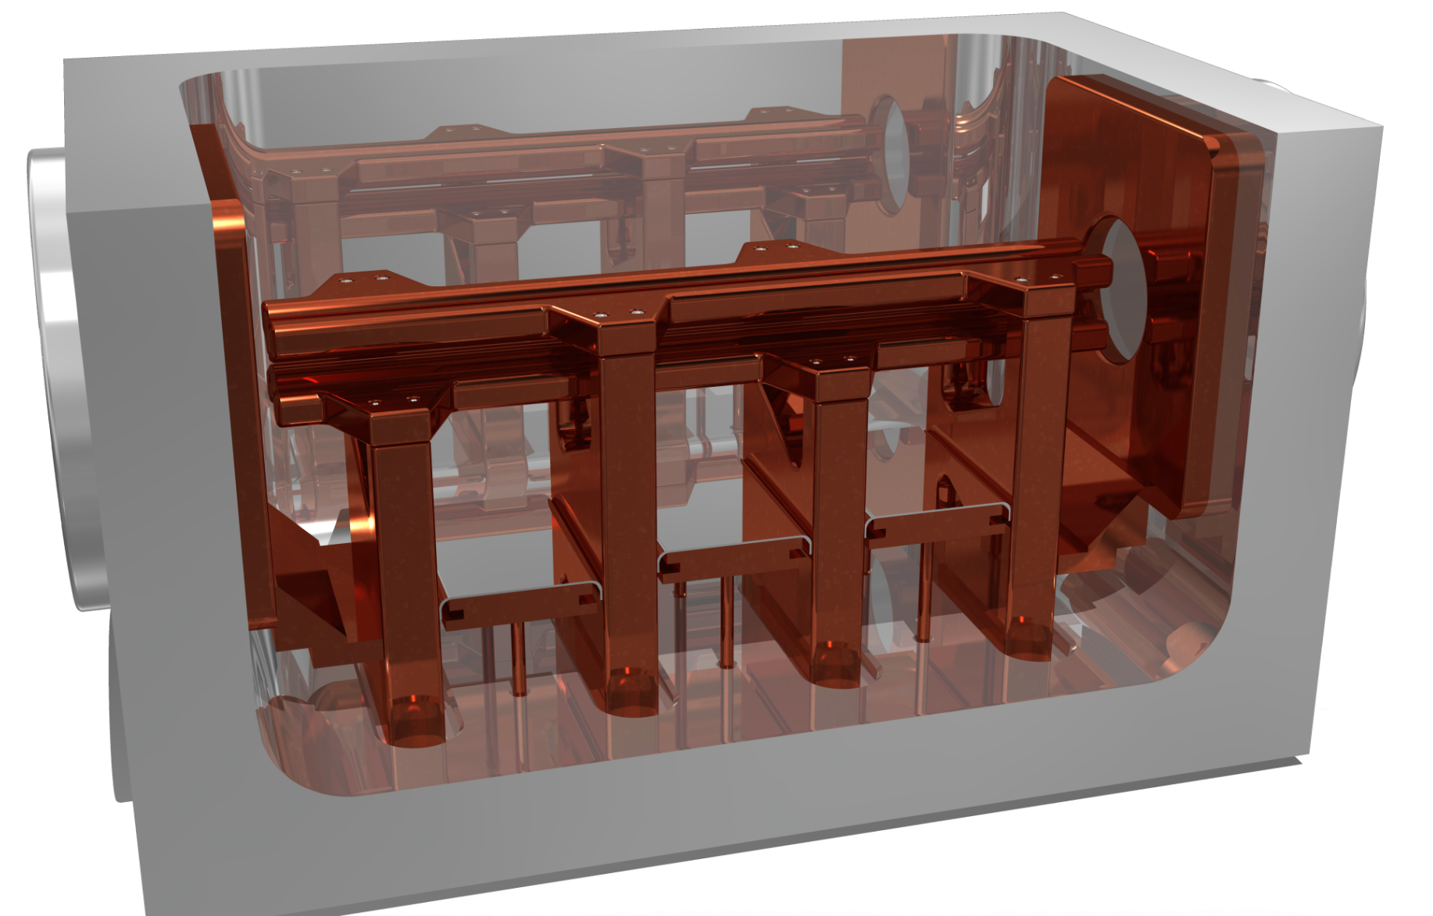
175 MHz cw Prototype RFQ

Slide 14
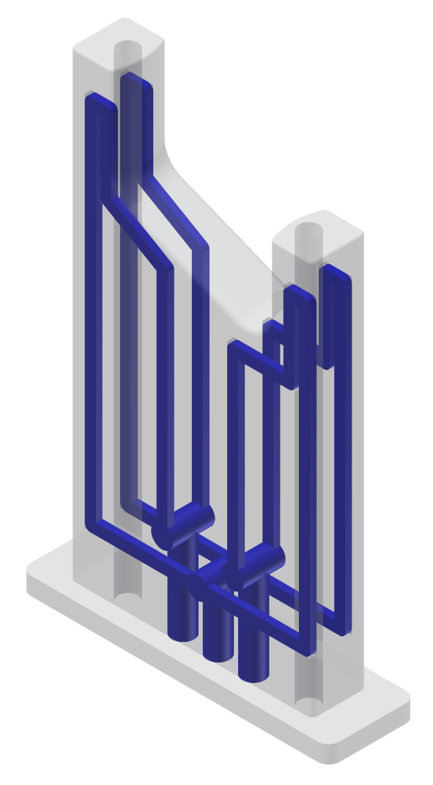
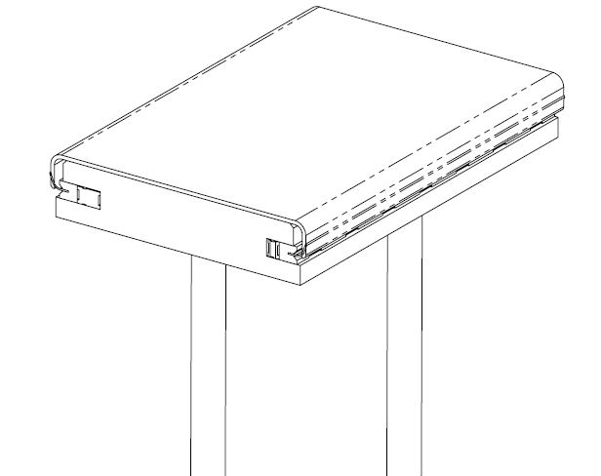
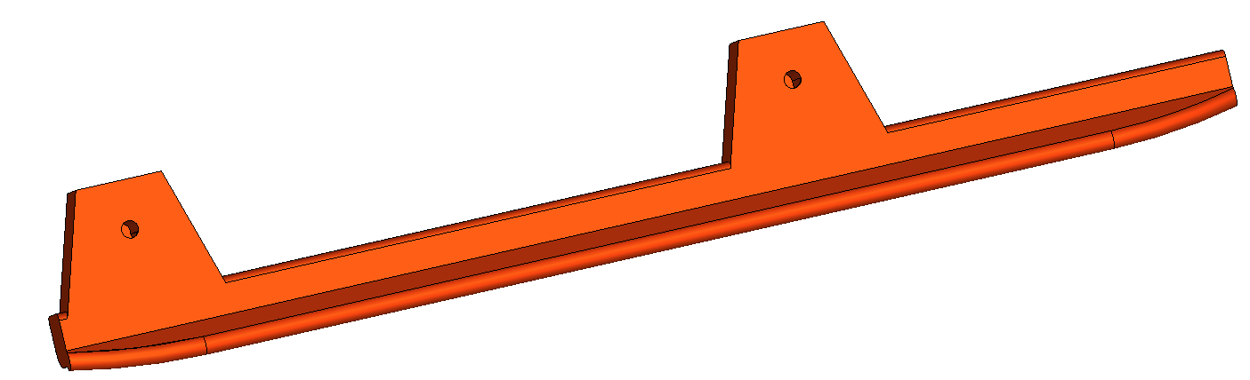
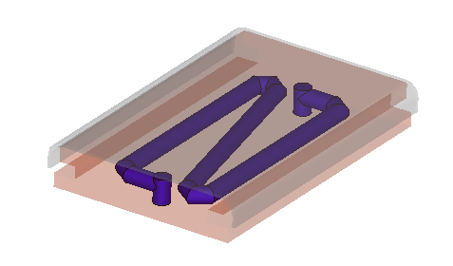
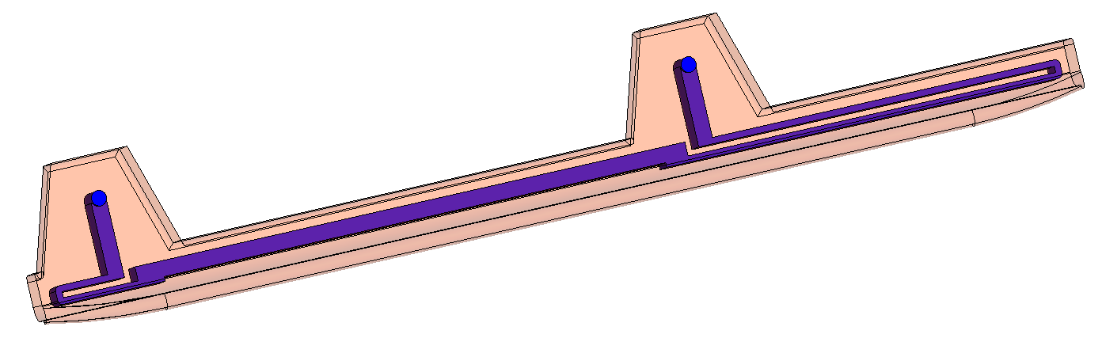
Philosophy of Cooling Concept
As much as possible
Temperature distribution as homogeneous as possible

Slide 15

175 MHz cw Prototype RFQ

Slide 16
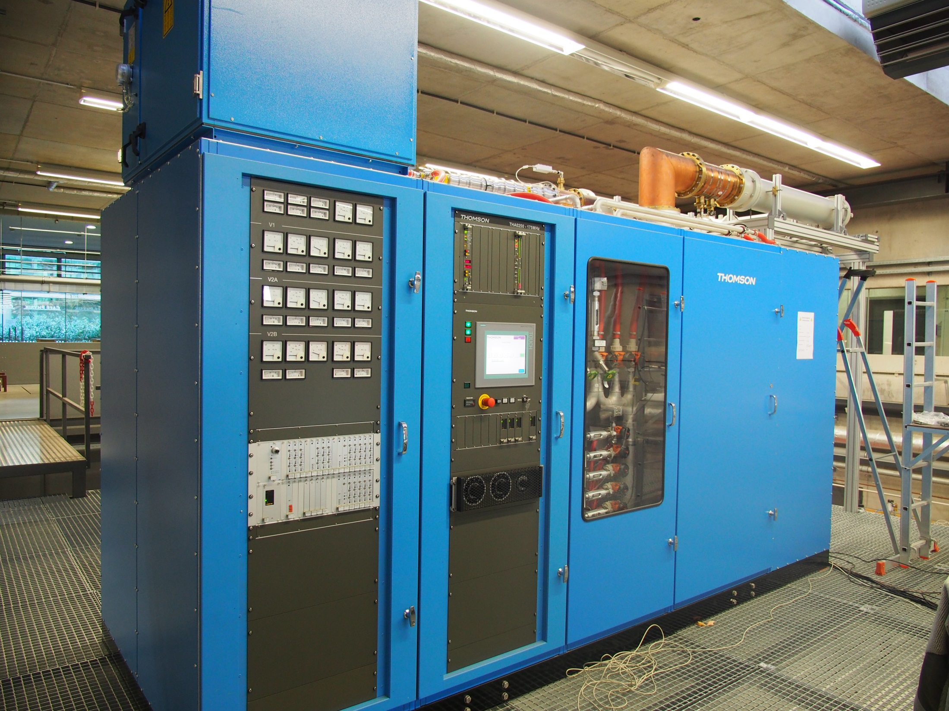
300 kW cw
Amplifier
Philosophy of Cooling Concept

Slide 17
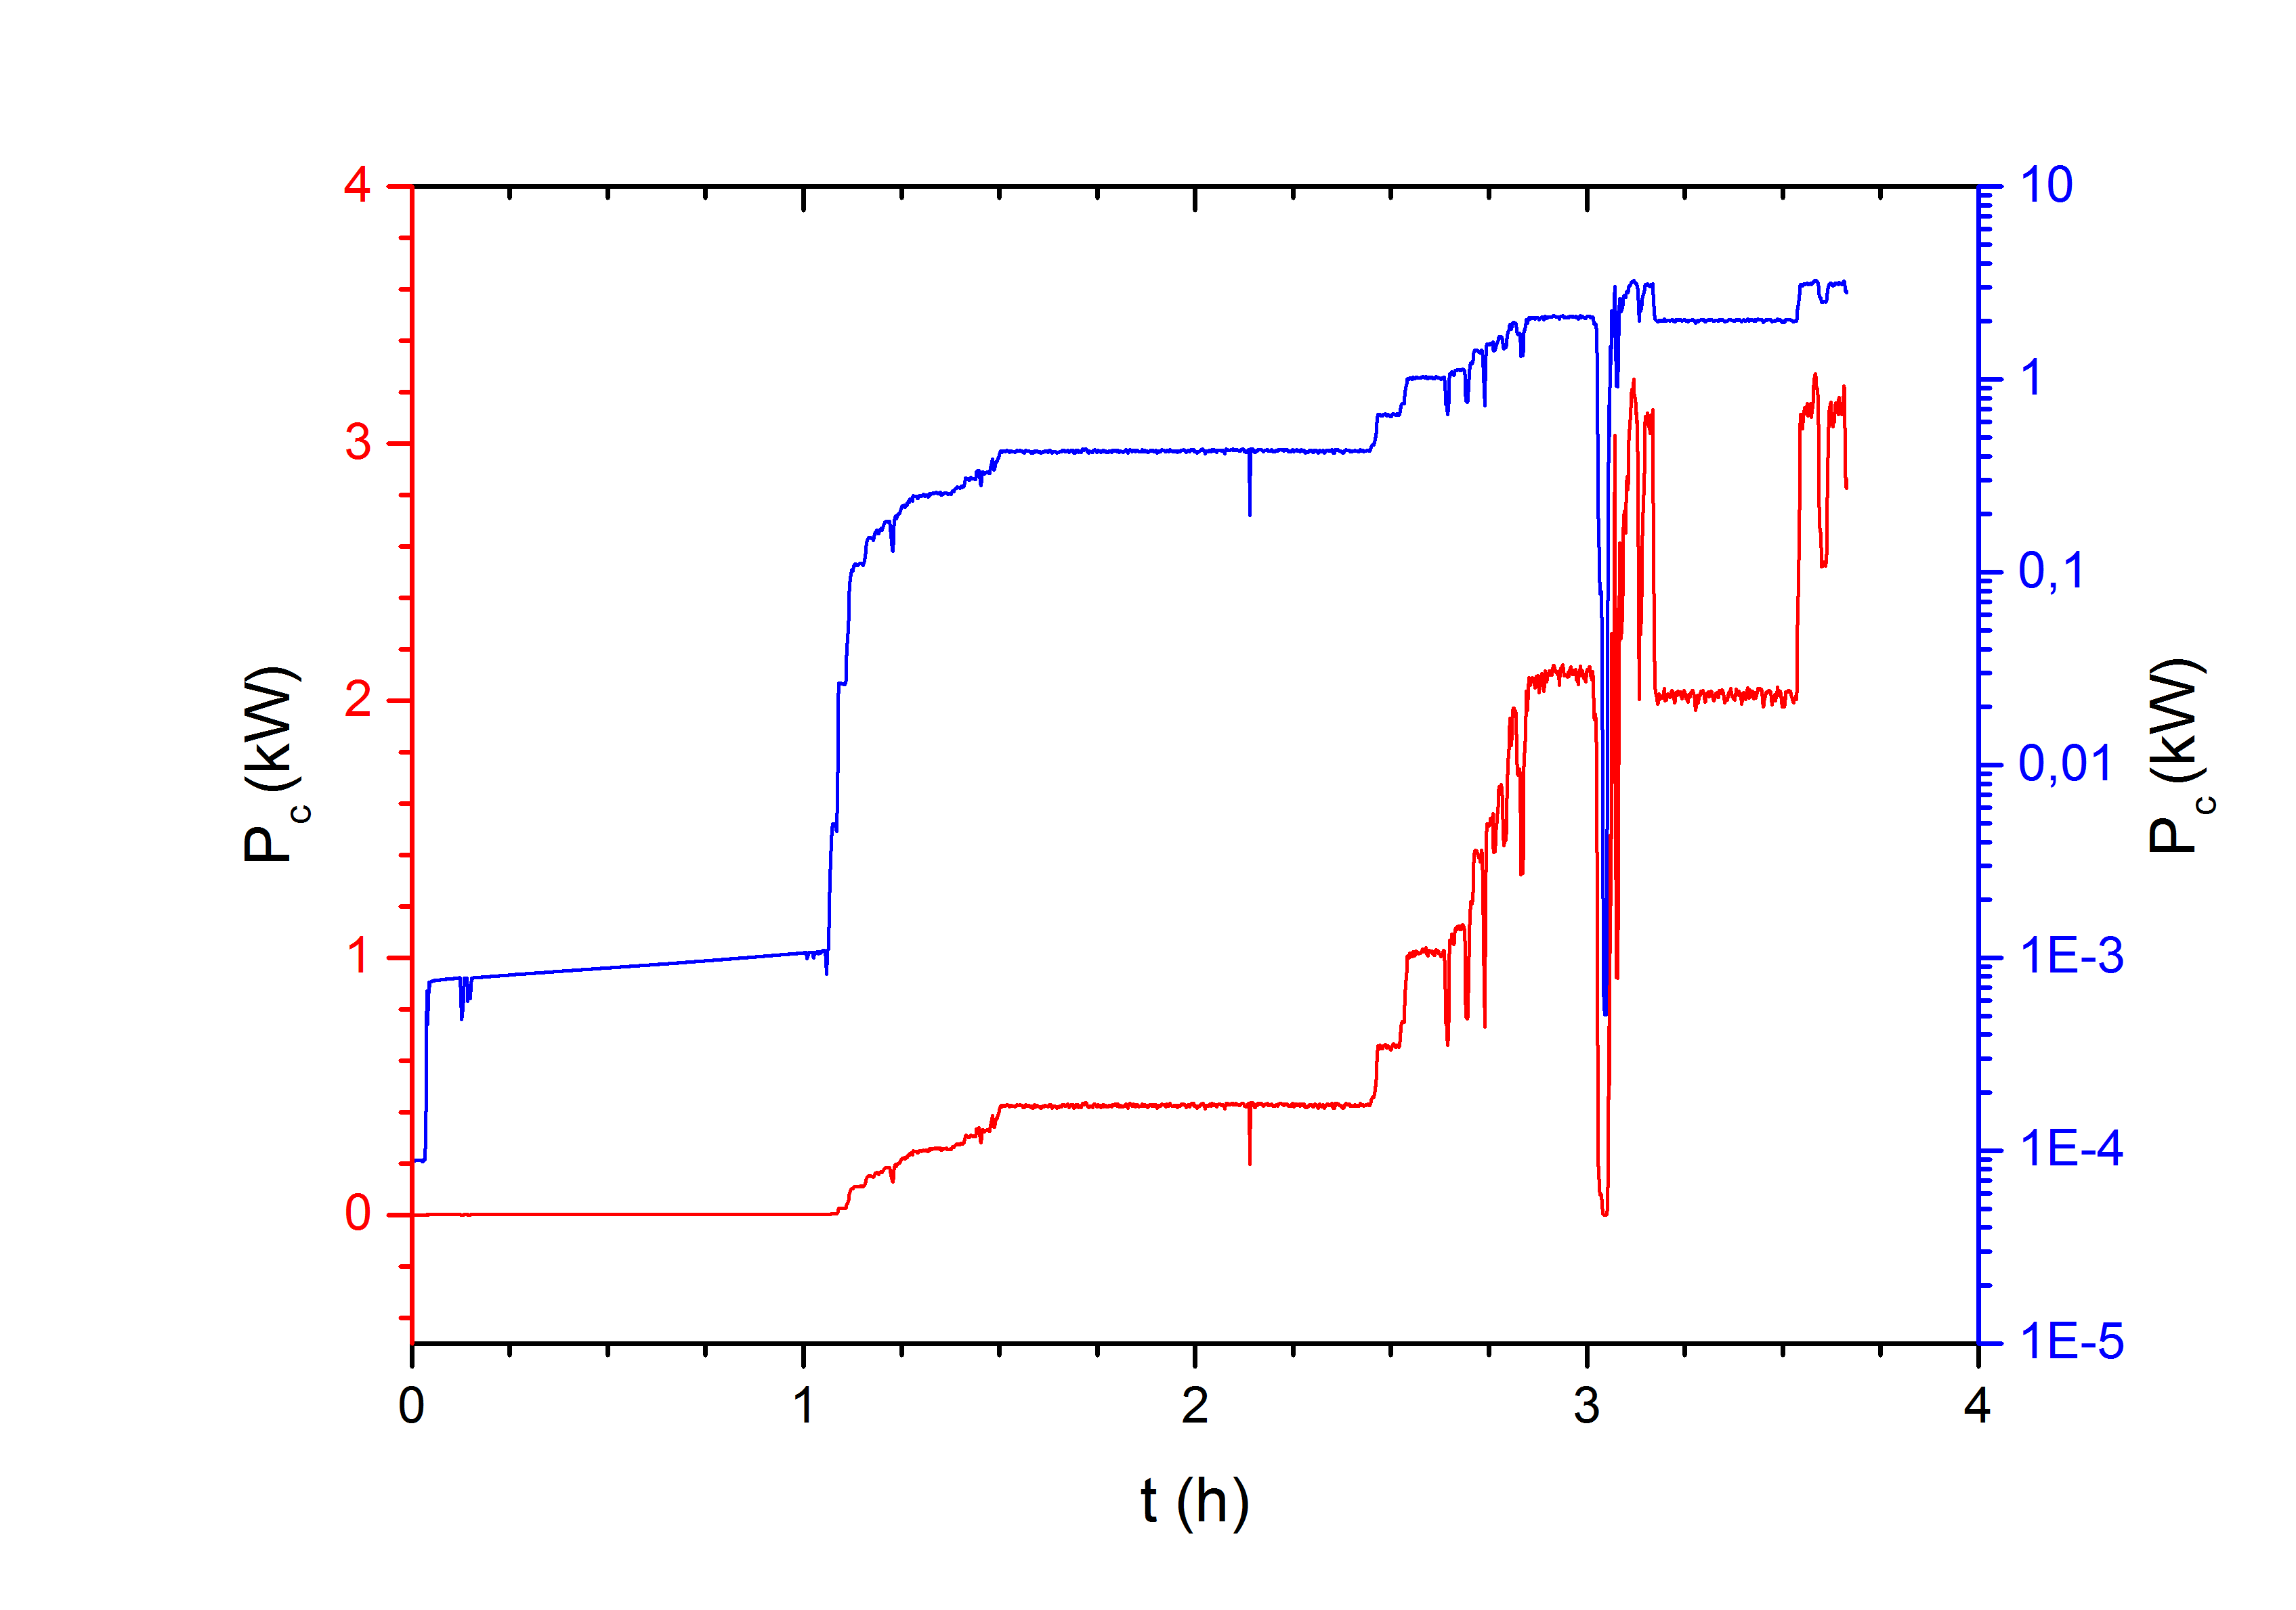
Conditioning

Slide 18
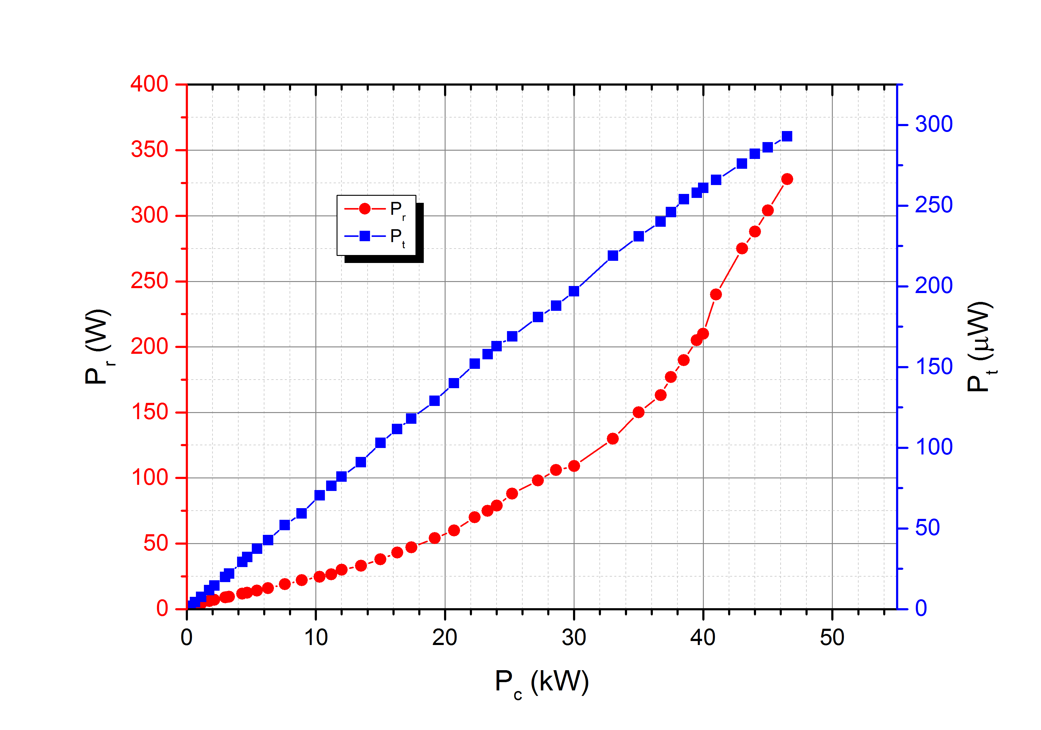
RF Power Test
P_{th}=116 kW/m
U=94.5 kV
E_{p}=29 MV/m

Slide 19
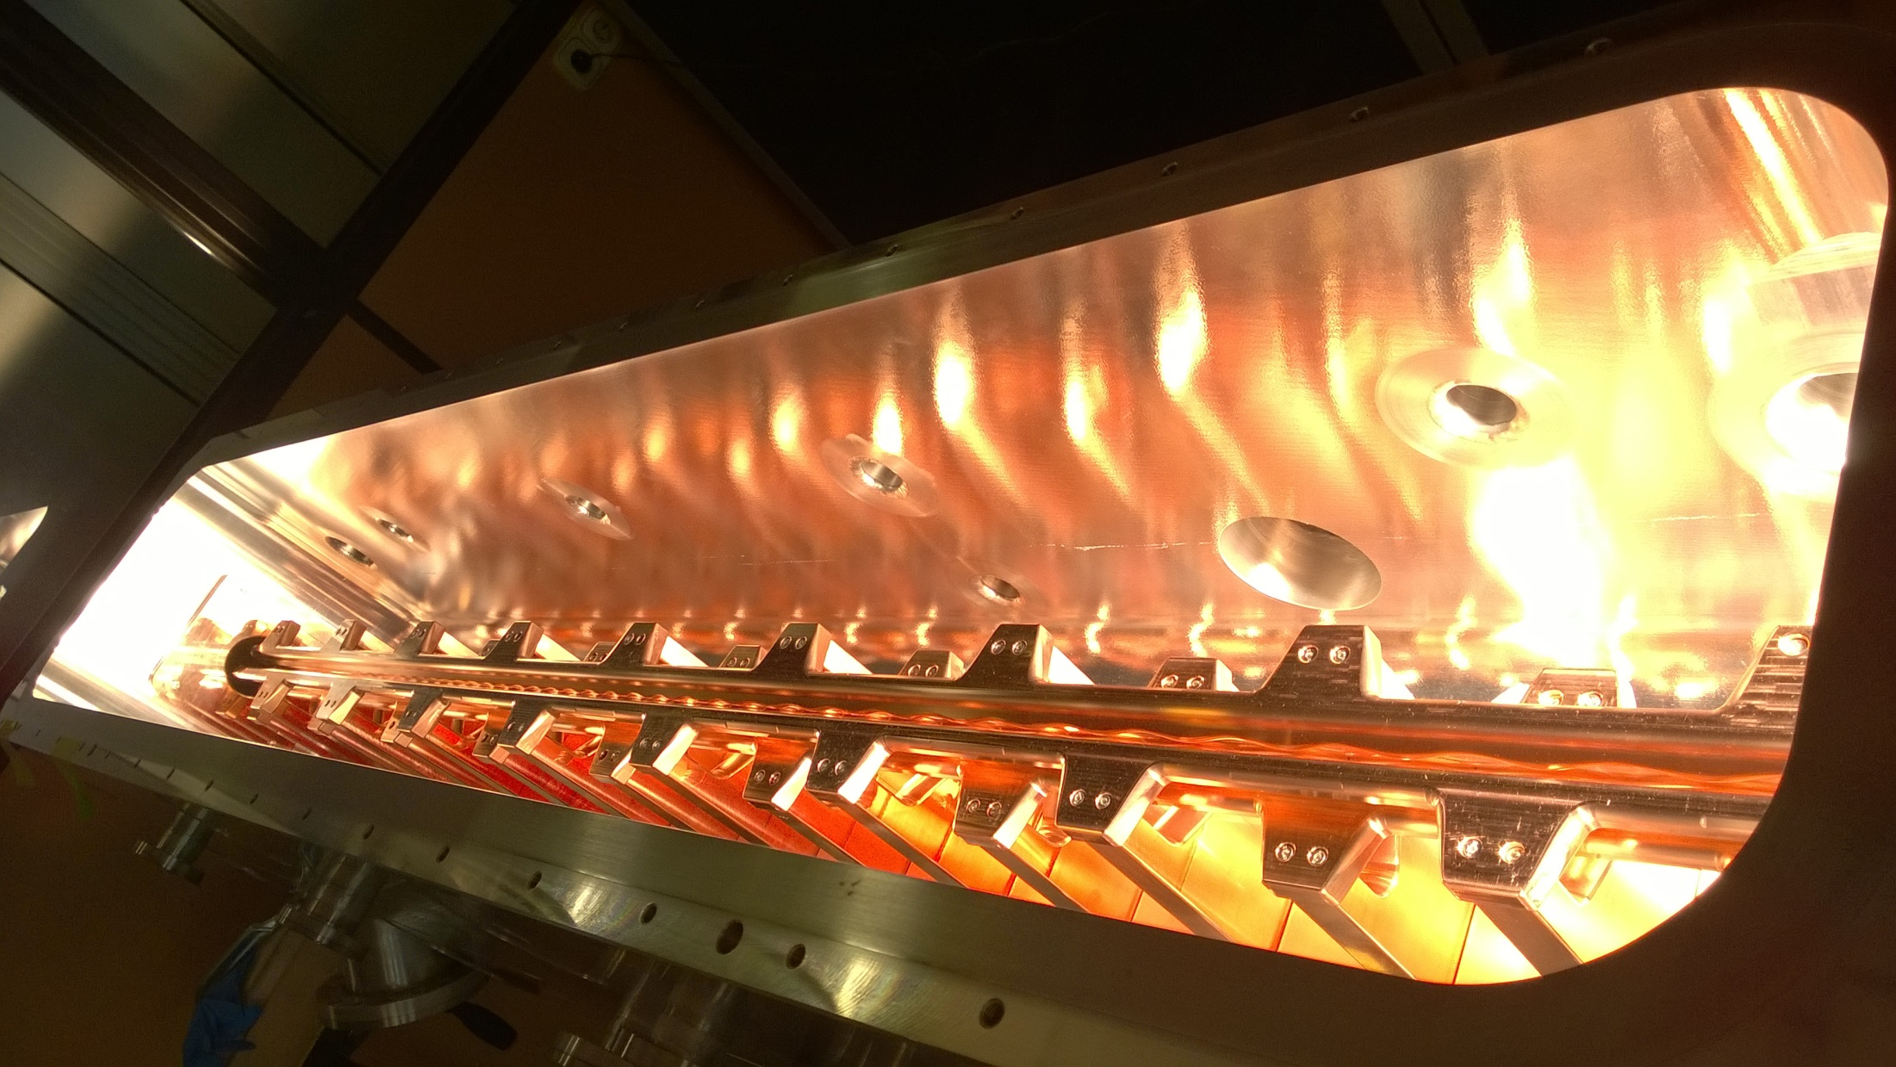
FRANZ RFQ
175 MHz, 700 keV, 1-50 mA, cw, 60 kW/m: Delivered 12.6.2015
Notes:
Spaltkonfiguration
Beschleunigungsgradiente und Vergleich
Design-Kriterium war ein elektrisches Oberflächenpeakfeld von E_p <30 MV/m.
Wichtig: mechanische Steifigkeit
Durchgehende Stützen
Verzicht auf Rippen (auf B_p ~50 mT)
Sternförmig angeordnete Versteifungsklammern, Verschiebung der Enddeckel minimieren.

Slide 20
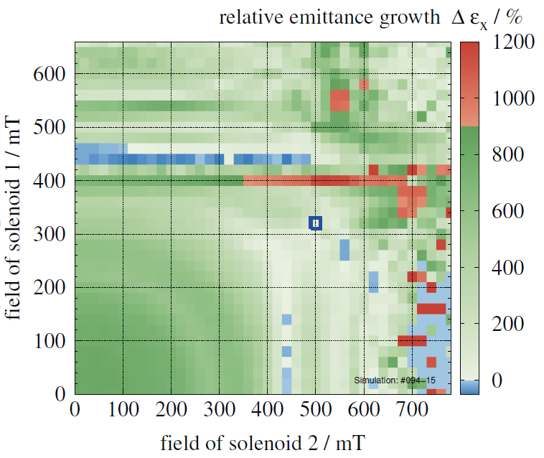
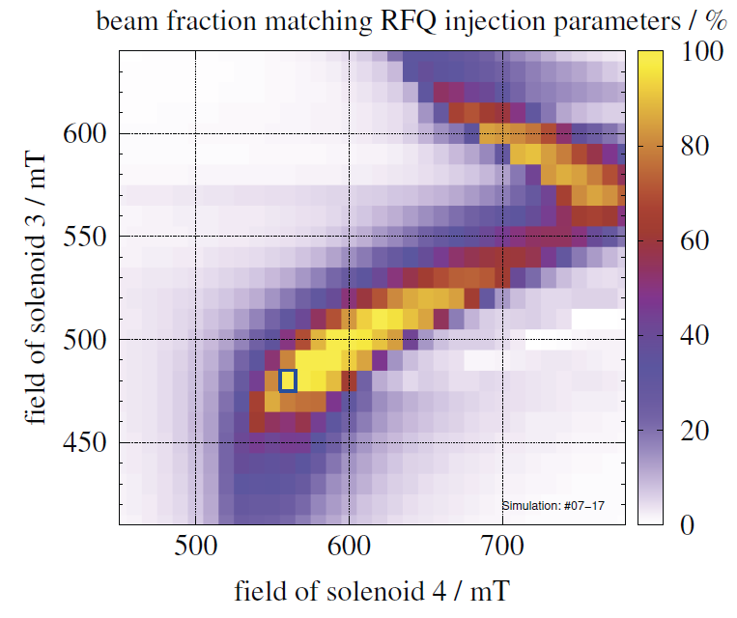
RFQ-Injection
RFQ-accelerators are very sensitive to input beam parameters → often poor transmission
Systematic investigation of RFQ performance for variation of LEBT parmeters
Many effects: Field errors, misalignment, space charge compensation, residual gas pressure, lens parameter
Planned: Investigation (Theor.+Exp) at FRANZ, MYRRHA, HSI

Slide 21
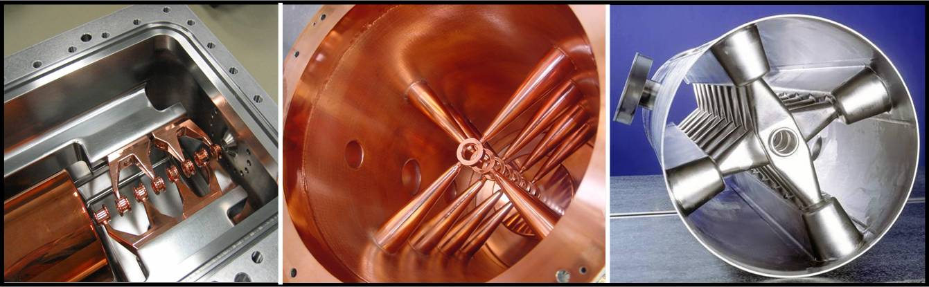
The Family of H-Mode Drift Tube Cavities
H₁₁₍₀₎
H₂₁₍₀₎
H₂₁₍₀₎
Room temperature
IH-DTL
Room temperature
CH-DTL
Superconducting
CH-DTL

Slide 22
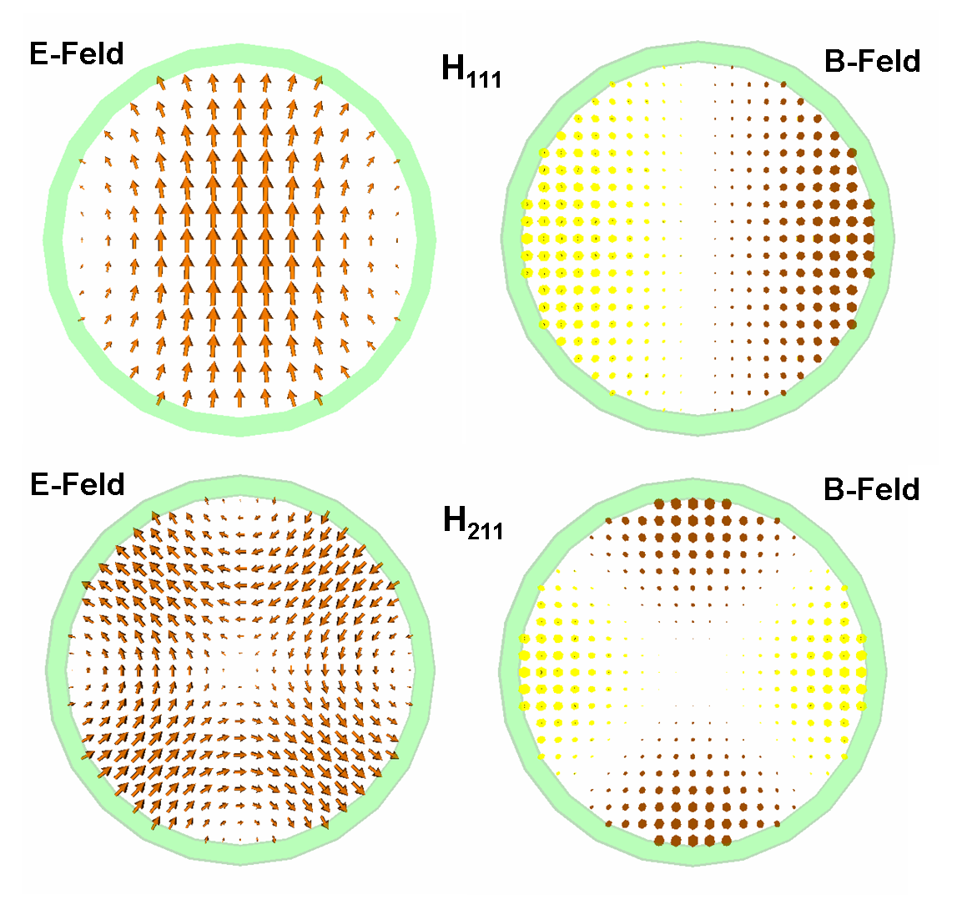
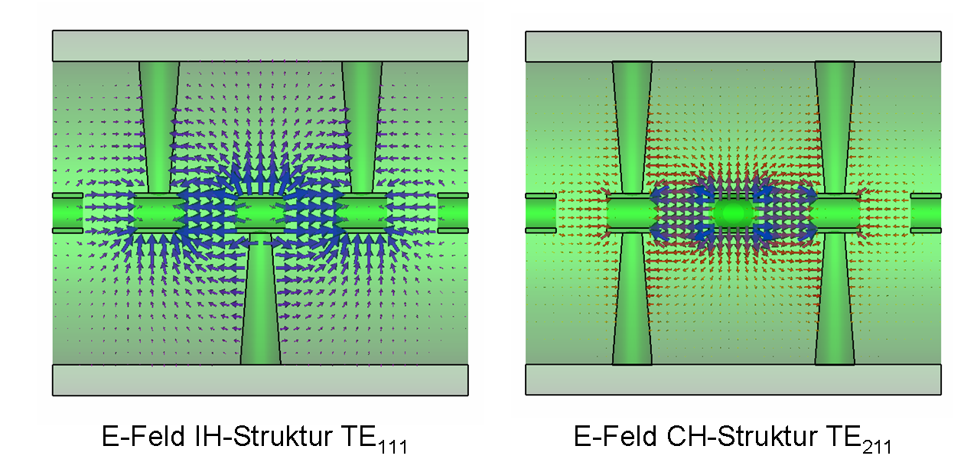
The Family of H-Mode Drift Tube Cavities

Slide 23
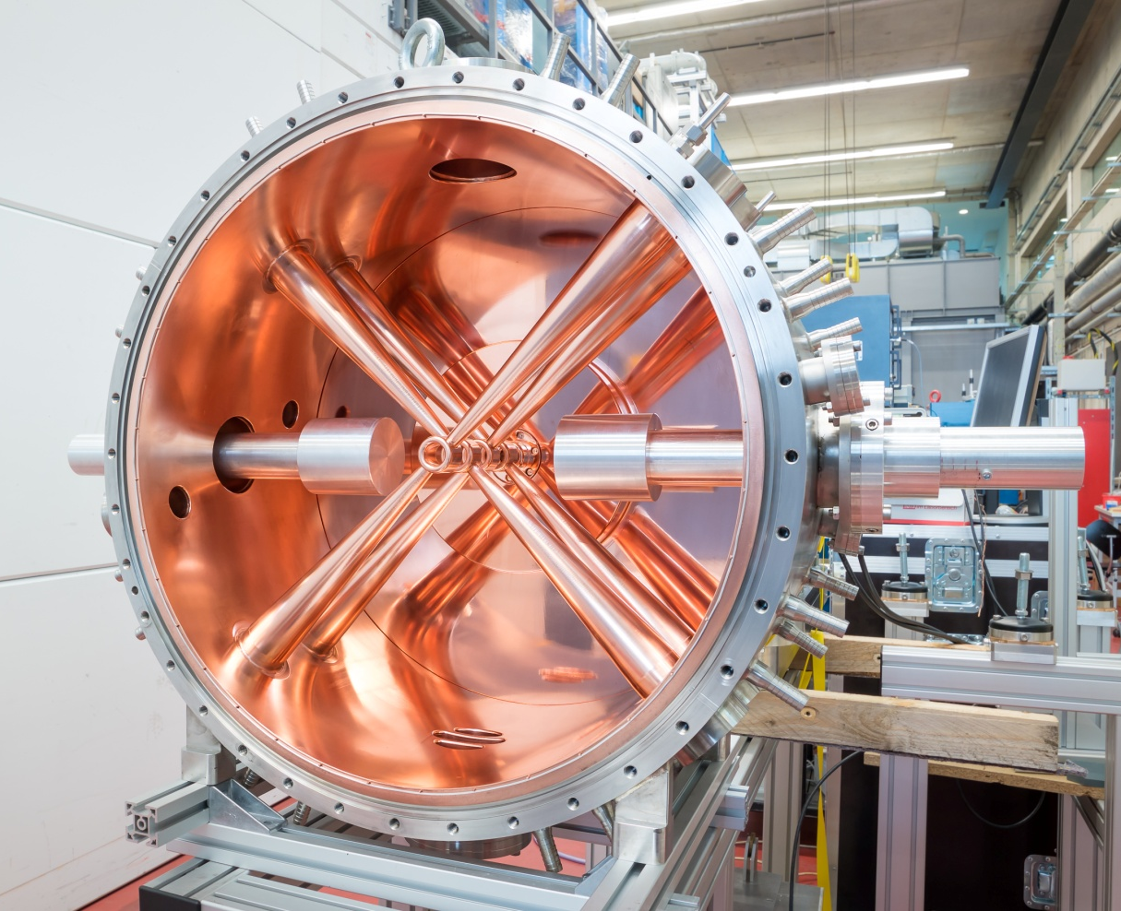
rt CH-Cavity Program
Duty factor 100%
FRANZ, MYRRHA
P/L≈30 kW/m
RF simulations
Thermal/structural mechanical simulations
Tuning

Slide 24
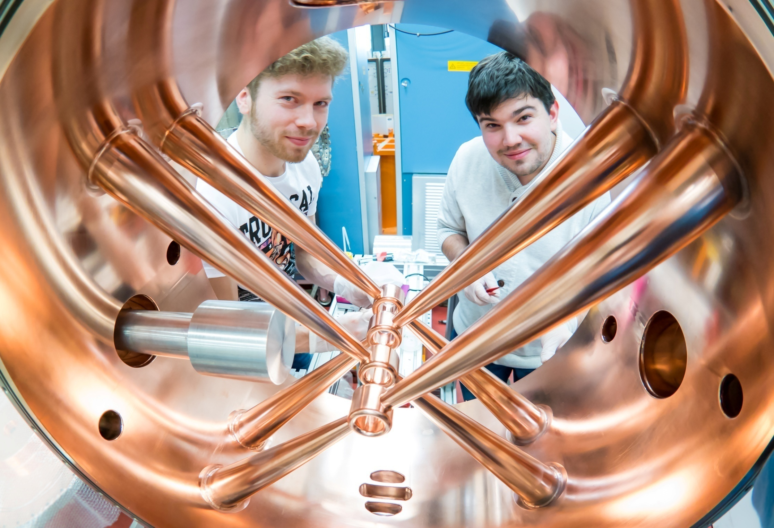
Rt CH-Cavity Programme

Slide 25
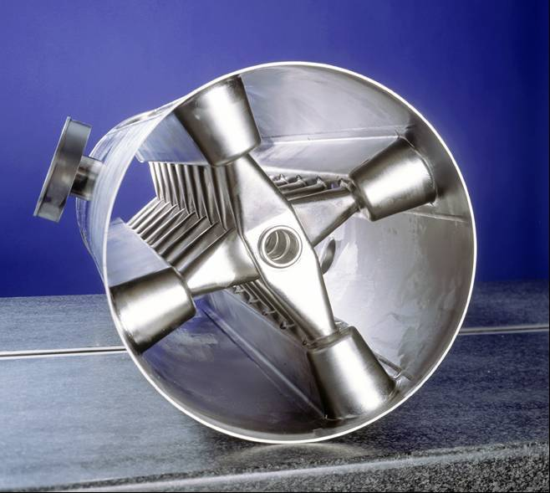
Worldwide the first superconducting multi-cell cavity for the low and medium energy range
Cavity | CH-Mode
Length (mm) | 1048
Diameter (mm) | 280
Cells | 19
β =v/c | 0.1
Frequency (MHz) | 360
Material | Niob
Quality factor | 7·10⁸
H. Podlech et. al, Phys. Rev. ST Accel. Beams, 10, 080101 (2007)

Slide 26
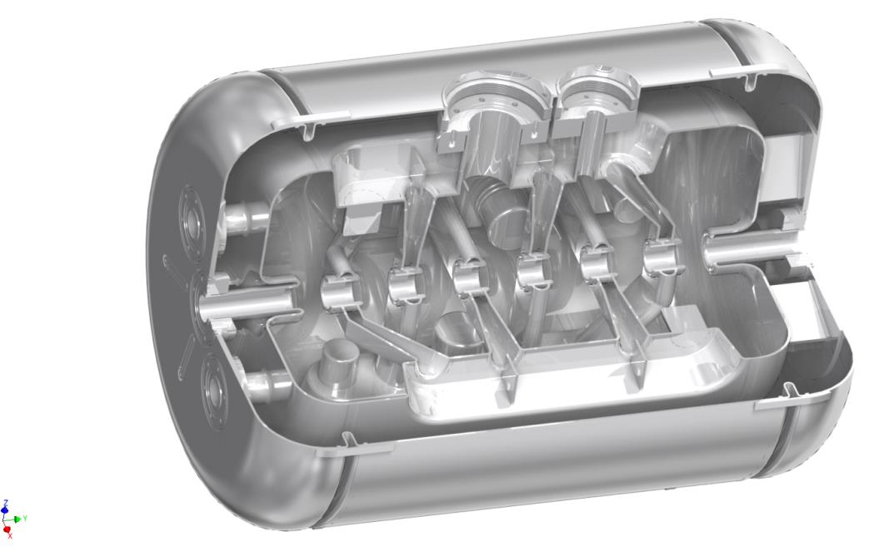
325 MHz CH-Cavity
Bellow Tuners
Static Tuners
β | 0.155
Frequency (MHz) | 325.224
Cells | 7
Length βλ-def (mm) | 505
Diameter (mm) | 350
E_{a} (MV/m) | 5
E_{p}/E_{a} | 5.1
B_{p}/E_{a} [mT/(MV/m)] | 13
G (Ω) | 66
R_{a}/Q₀ (Ω) | 1248
R_{a}R_{s} (Ω²) | 80000
Helium Vessel
Coupler Flanges

Slide 27
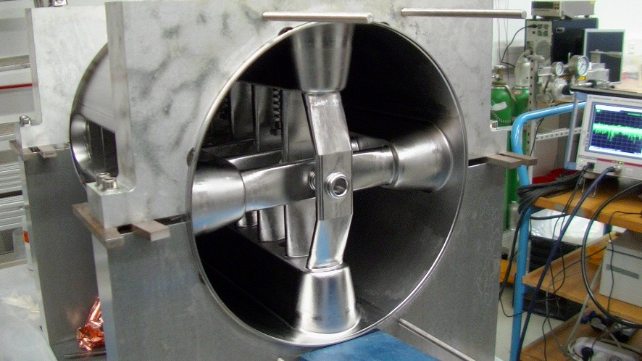
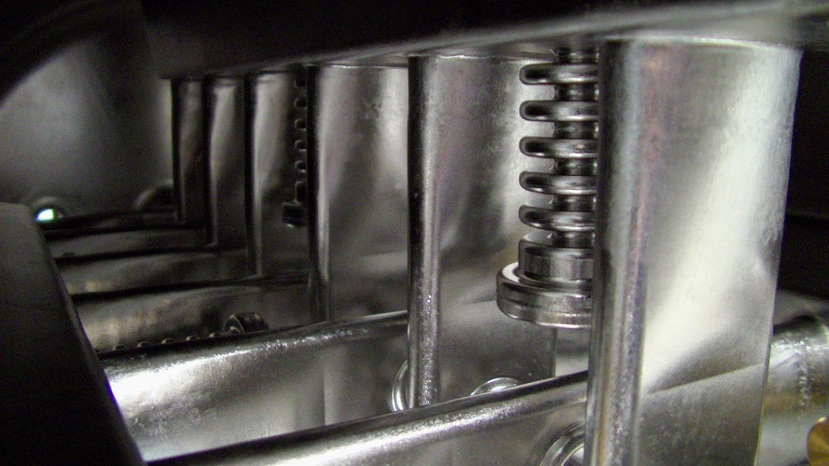
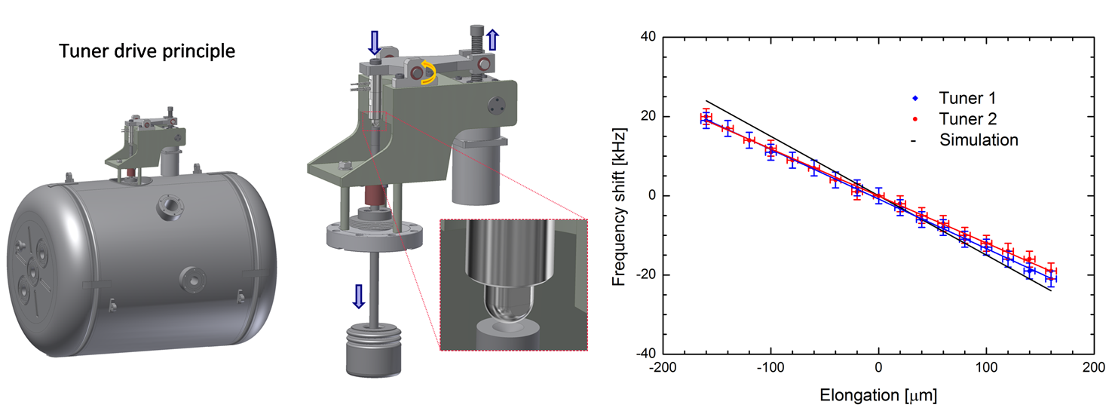
Dynamic Tuning of sc CH-Cavities
Bellow tuner
Niobium, cooled
No longitudinal space needed
±1 mm (slow tuner, stepper motor)
± 5 μm (fast piezo tuner)

Slide 28

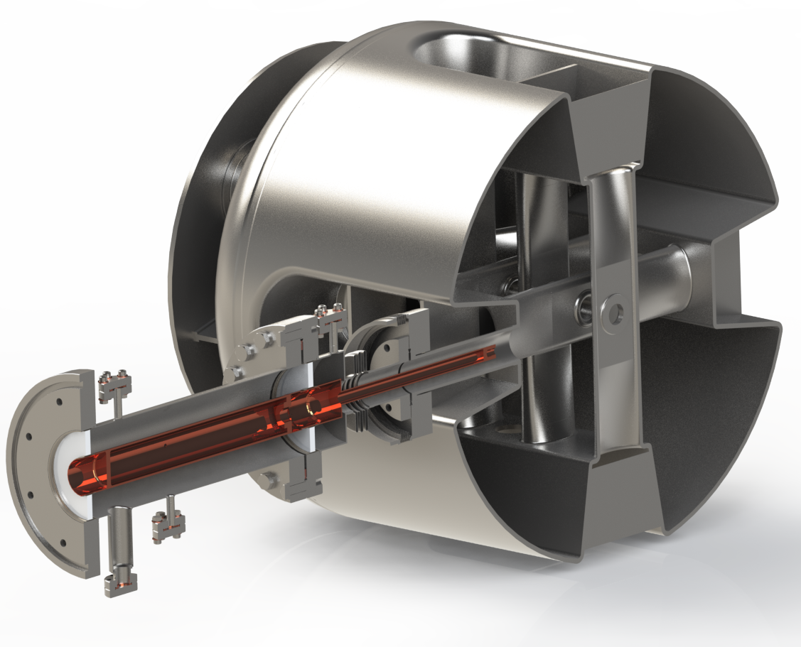
Development of Power Couplers

Slide 29
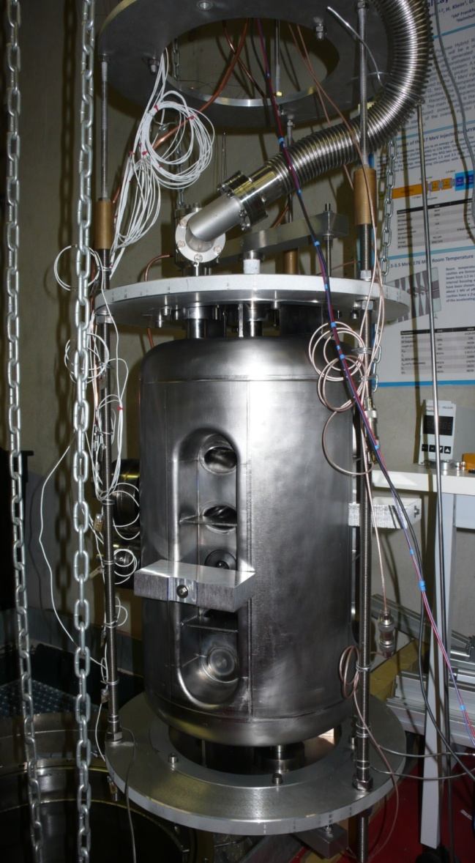
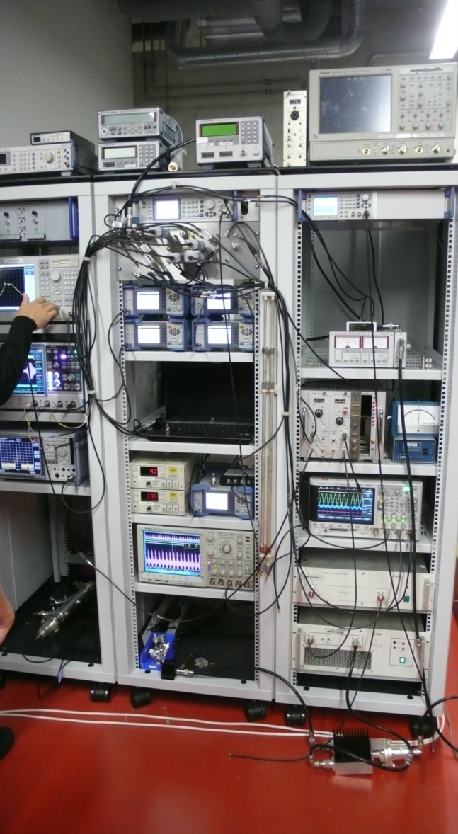
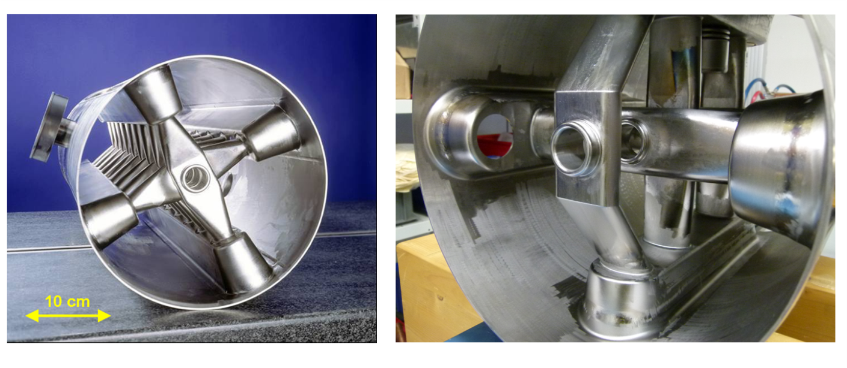
Testing Superconducting CH-Cavities
2 cryogenic RF labs at IAP

Slide 30
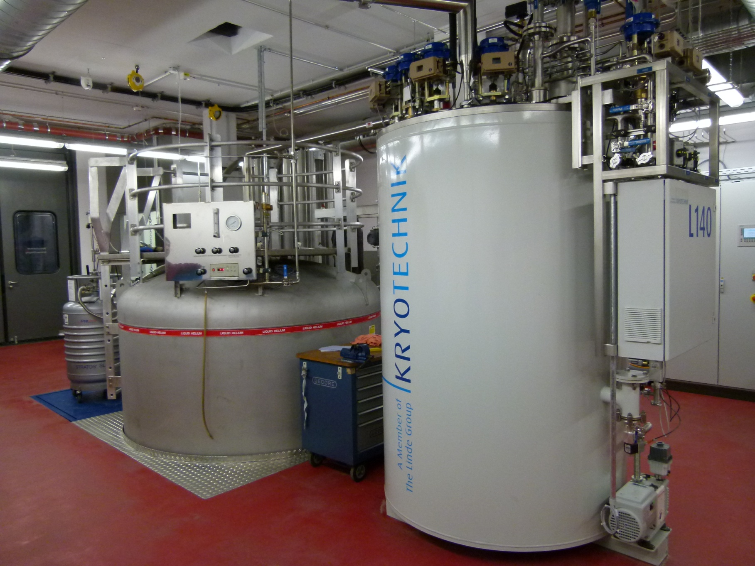
Linde L140 liquifier, 90 l lHe/hr @ 4K

Slide 31
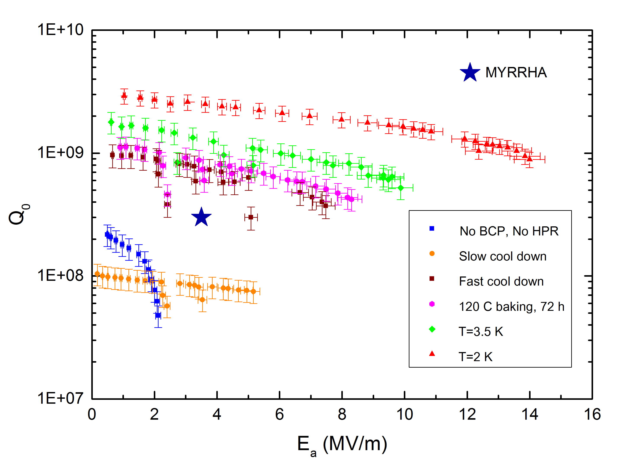
Test Results 325 MHz CH-Cavity
E_{p}=72 MV/m
B_{p}=182 mT

Slide 32
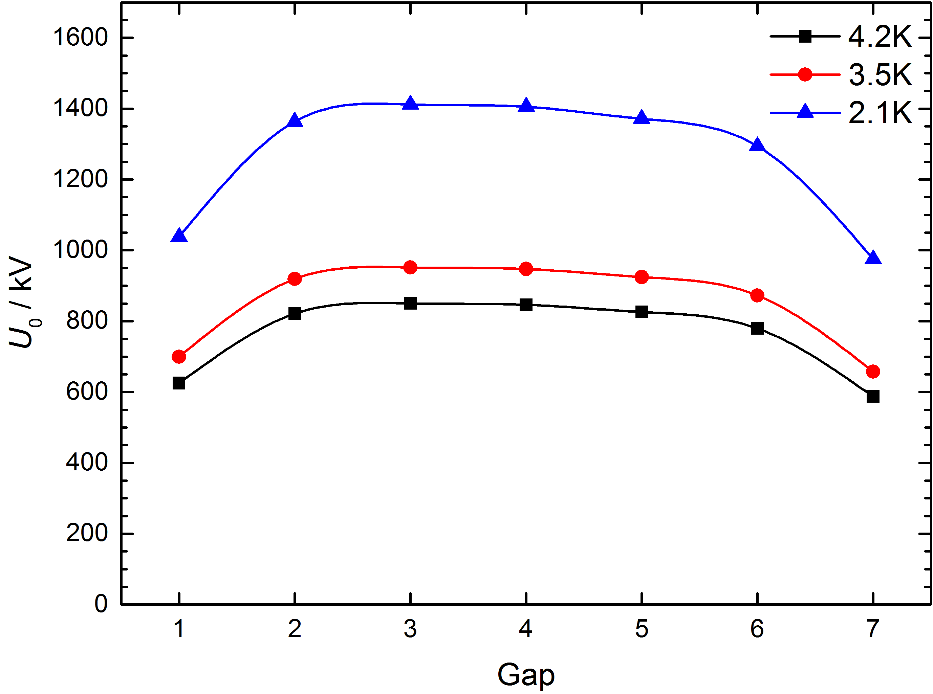
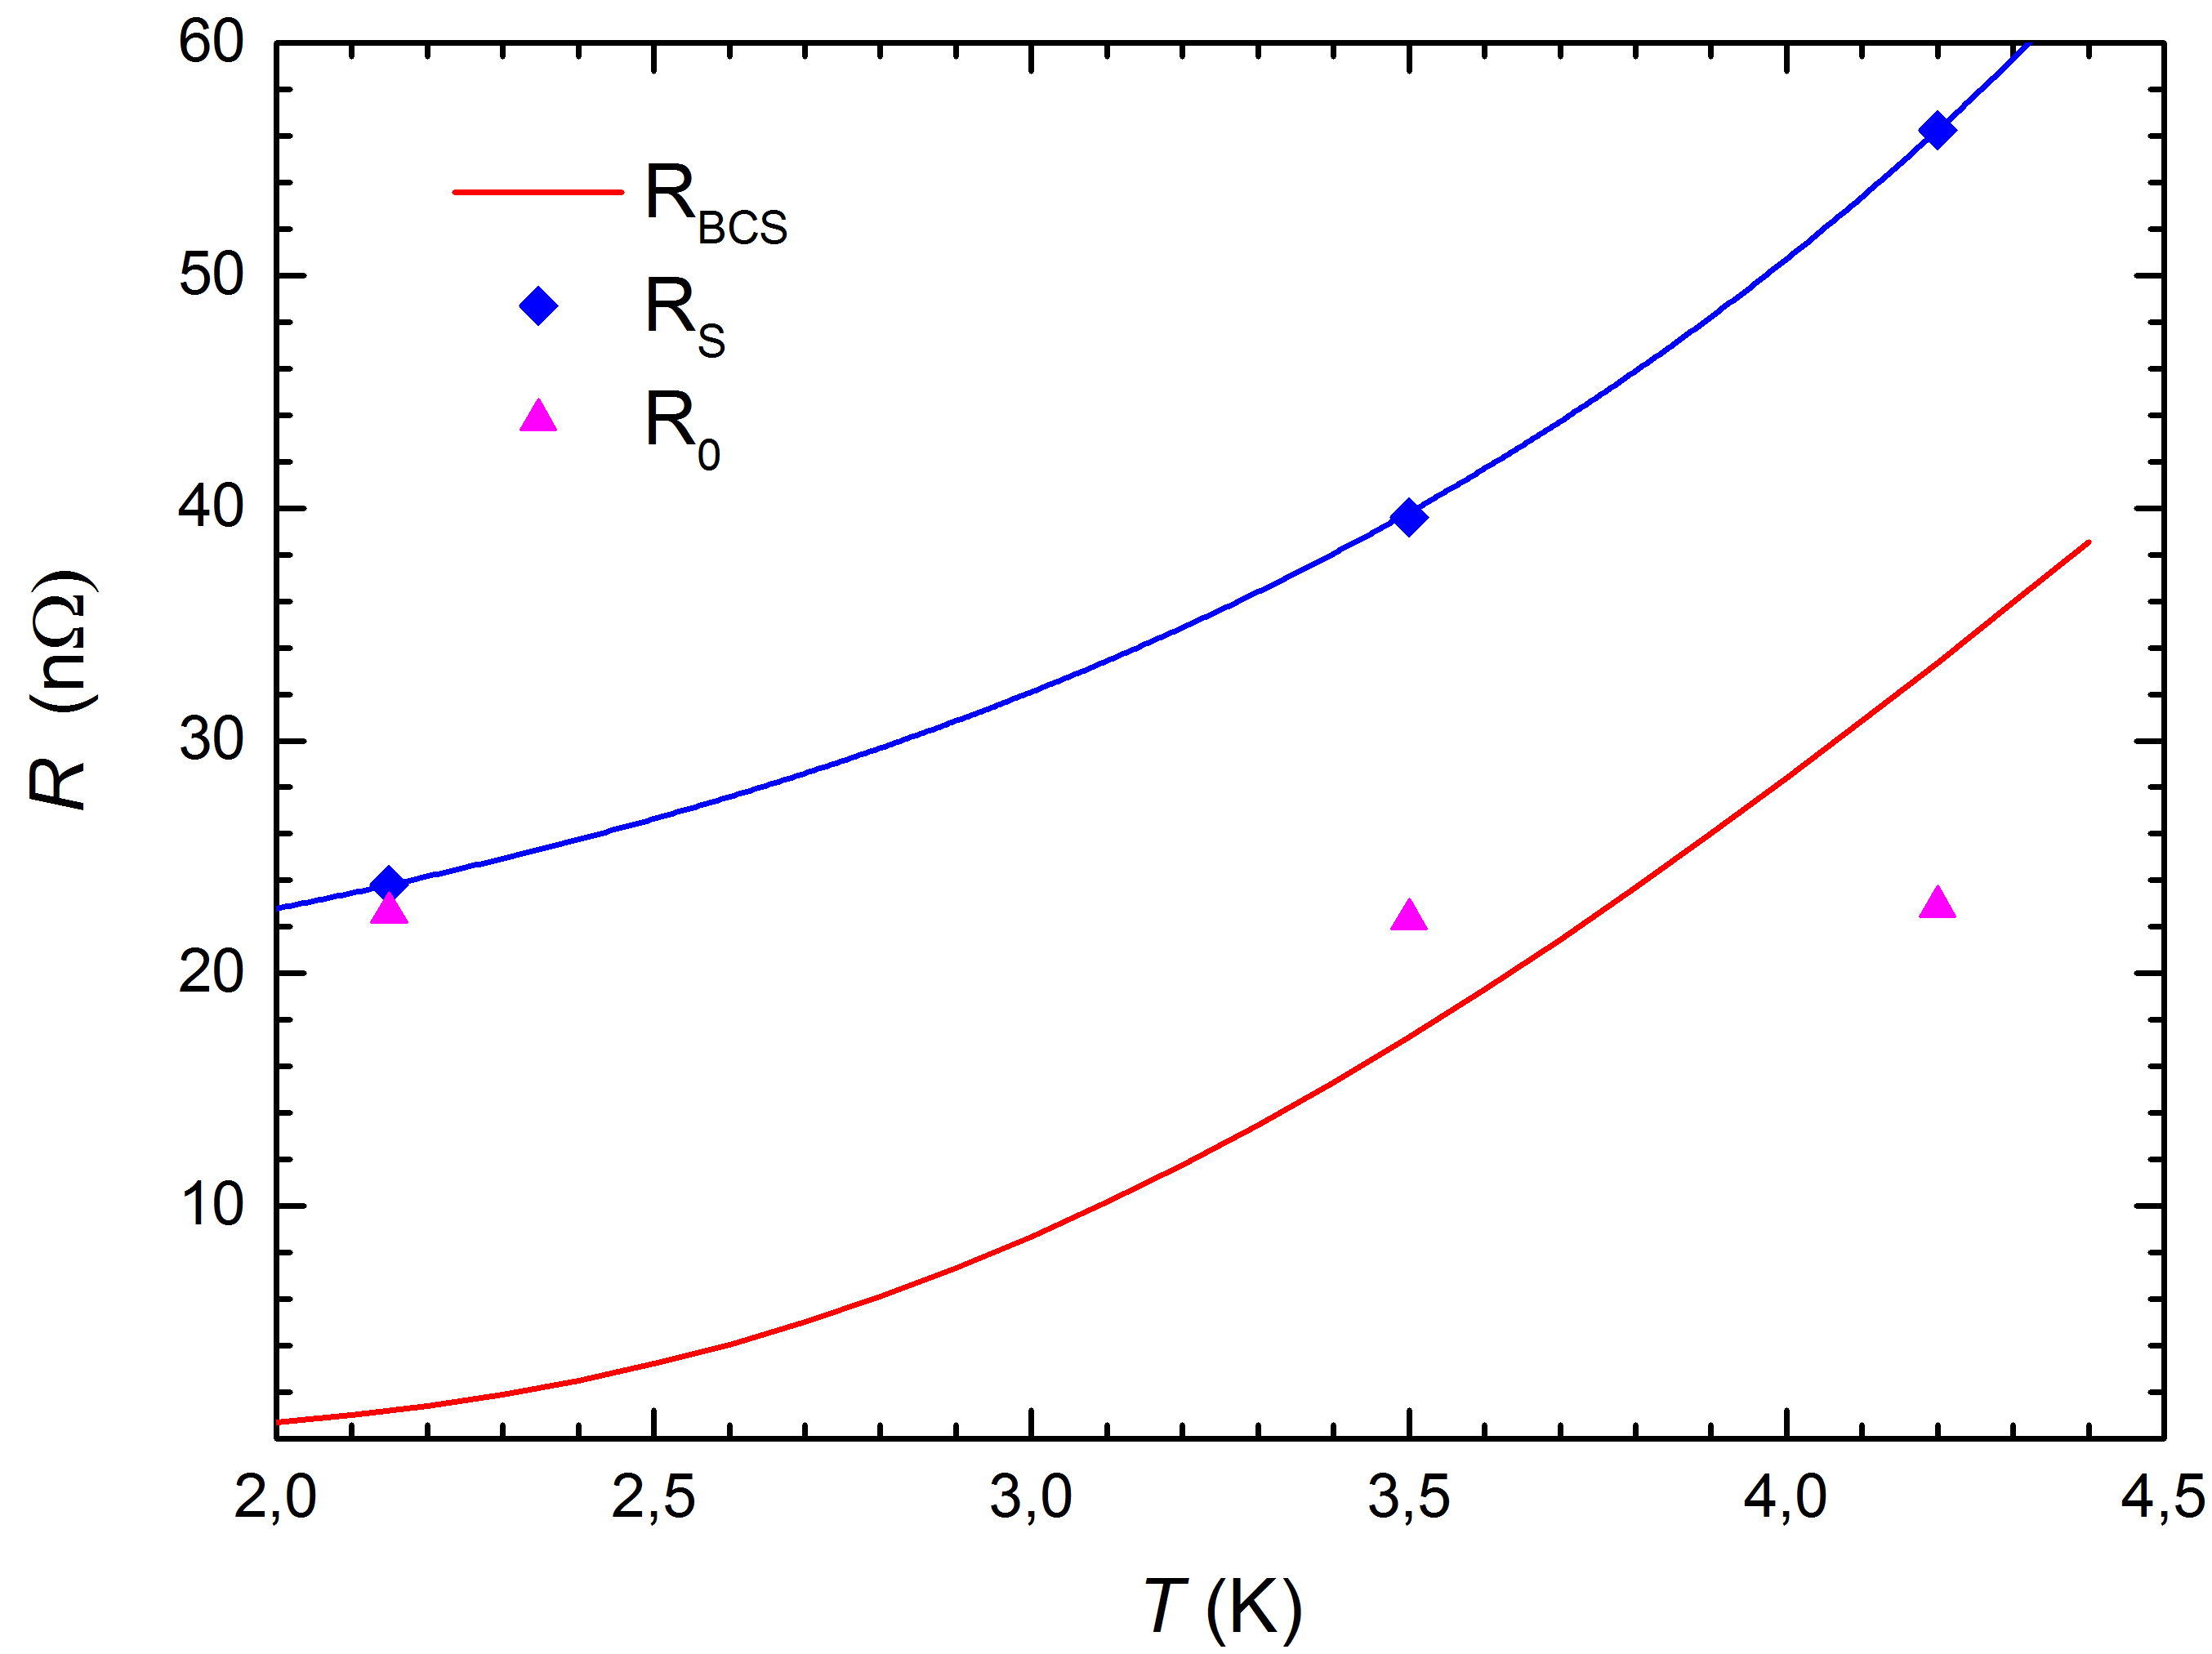
Gap Voltages and Residual Resistance

Slide 33
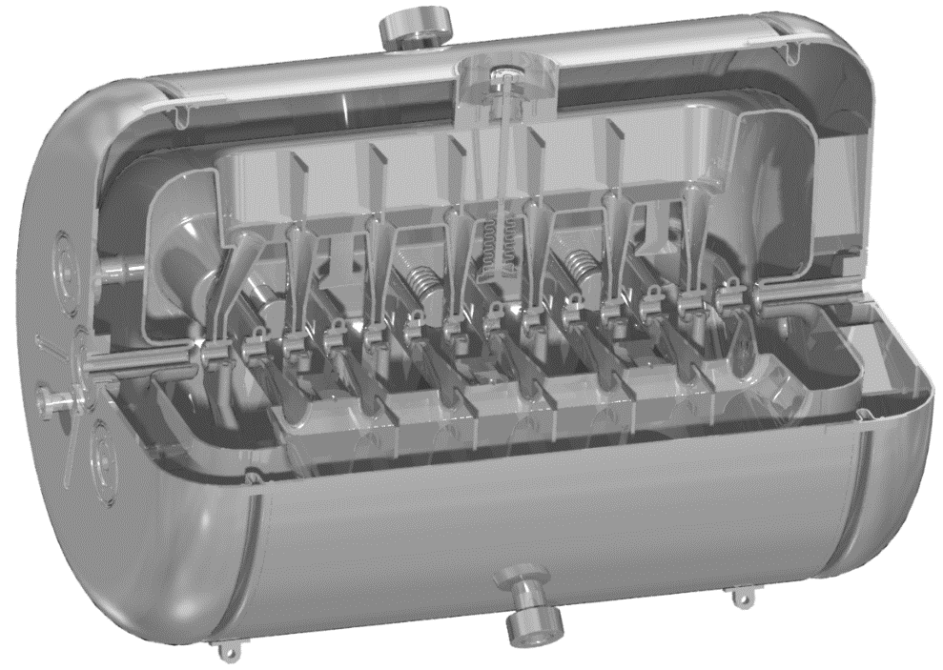
217 MHz SC CH-Prototype
Helium out
PARAMETER | UNIT
Beta |  | 0.059
Frequency | MHz | 216.816
Gap number |  | 15
Total length | mm | 691
Cavity diameter | mm | 409
Cell length | mm | 40.82
Aperture | mm | 20 / 18
U_{a} | MV | 3.369
Energy gain | MeV | 2.97
Accelerating gradient | MV/ m | 5.1
E_{p}/ E_{a} |  | 6.3
B_{p}/ E_{a} | mT/ (MV/m) | 5.7
R/ Q | Ω | 3240
Static tuner |  | 9
Dynamic bellow tuner |  | 3
Tuner flange
Static tuner
Dynamic bellow tuner
Inclined
end stem
Preparation
flange
Helium vessel
Helium in
High Charge Injector
Buncher
CH0
CH1
CH2
CH3
CH4
CH5
CH6
CH7
CH8
CH9
CH10
HLI
1.4 AMeV
CH-cavity demonstrator
6 AMeV

Slide 34
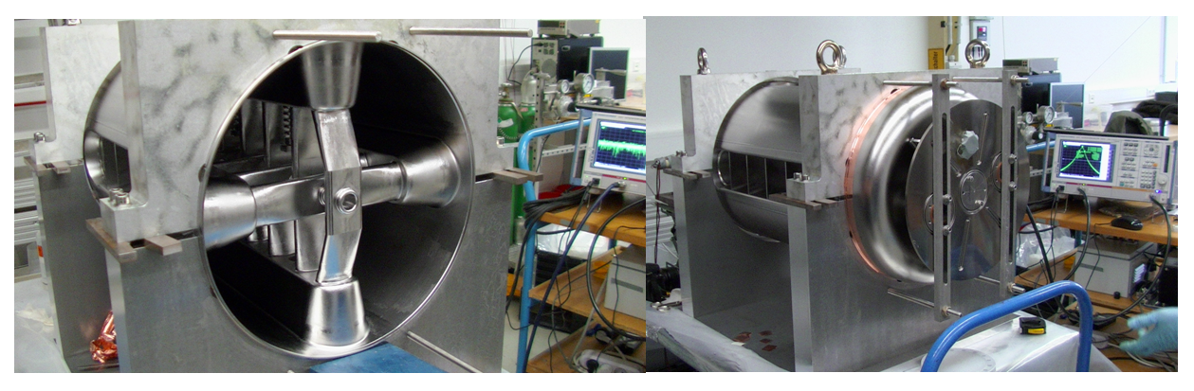
Production of the 217 MHz CH-Prototype

Slide 35


Horizontal Cryo Module for cw Linac

Slide 36



The cw LINAC Demonstrator Project at GSI
A full performance test of the demonstrator in 2016 is one important milestone on the way to a new sc cw LINAC at GSI
The HLI will be used as an injector
for the cw LINAC demonstrator
LN / LHe reservoir
ECR source
RFQ
IH-DTL
Demonstrator
sc 9.5 T solenoid
Control room, RF amplifiers
sc 217 MHz CH cavity
3000 l
LHe reservoir

Slide 37

Advanced Demonstrator for GSI-SHE-Linac
CH-1/2
Call for tender finished
Cryo module design
High Charge Injector
Buncher
CH0
CH1
CH2
CH3
CH4
CH5
CH6
CH7
CH8
CH9
CH10
HLI

Slide 38



Space Charge Lenses for E-Cloud Confinement
„BABY“ - Prototype
„HERO“ – High Field Gabor Lens
160 mT
35 kV
12 mT
6 kV
„HERBERT“ – Gradient Density Gabor Lens

Slide 39
Scheme of Gabor Plasma-Lenses
Longitudinal and transversal confinement of an electron cloud by magnetic and electric fields
Homogeneous electron density leads to linear forces (at least in the ideal world)
Focusing and space charge compensation

Slide 40


RF Probe Diagnostics of E-Cloud Response to Bunch Impact
Investigation of Frequency Spectrum Emitted by the Undisturbed Electron Column
RF-pick up
beam
e-column
antenna

Slide 41



X-Ray Spectroscopy for Investigation of Electron Loss Characteristics
Emitted Bremsstrahlung Spectra
→ Loss mechanism
Dependence on Anode Potential
B=9,7 mT, p=3,4e-7 hPa
B=11,8 mT
p=1,7e-7 hPa
Δt=120 s
Dependence on Magnetic Field
Φ=22 kV
p=5,1e-7 hPa
Δt=300 s
Some electrons have higher energy as expected → Plasma instabilities
Objectives:
study of loss channels
determination of loss rates

Slide 42




Time-Resolved Measurements of E-Cloud Instabilities
Measured Ion Current
Time-Resolved Measurement of an Instabilty
Measured Intensity of
Light Density Distribution
Diacotron-instability
Φ=3400V
B=12 mT
p=7,9-4 hPa (He)
Datei: 18072011
Arising instability seems to be a result of a difference in the local electron density distribution and the electron temperature in transverse and longitudinal direction.

Slide 43






Shaping of Phase Space Distribution by Stably Confined E-Clouds
Ion Beam Transport and Space Charge Compensation Strategies
measurement
measurement
measured beam current
profile
I_{B}=35 mA
Φ_{A}= 9.8 kV
B_{z}= 10.8 mT
ε_{rms,n}= 0.236 π mm mrad
ε_{rms,n}= 0.170 π mm mrad
measured light density
distribution
measured light density
distribution profile
measured beam current
profile
Φ_{A}= 9.8 kV
B_{z}=10.8mT
Notes:
97% Emittanz ist zu sehen im Vergleich zur Simualtion

Slide 44




Superconducting Gabor Lens for XHV Applications
Gabor Lens Filling Scheme under XHV - Conditions
Beam optics for SC LINACs
Reduced risk of quenching due to reduced magnetic field strength
Cold emitter as an e-source
Collaboration with INFN Catania and Bologna
CNT
Ion Beam
Courtesy of F. Odorici
SC – Gabor Lens
SC – Cavity (DTL)

Slide 45

Neutralized Merging of Bunch Trains by Gabor Lens
two beam RFQ
Gabor Lens
deflector
ion sources
& LEBTs
Gabor lens
Ion sources
& LEBT‘s
bunching and acceleration
matching
merging
merging
Shift of beam axis behind electron column at t = 75 ms
Two separted bunch trains at the exit of the RFQ
Crossover under full space charge w/o e-column
y
y
x
x

Slide 46


Numerical Simulation of E-Cloud Dynamics
GaborM
fluid description
steady state
GabLensM2
3D PIC code
kinetic description
dynamic processes
bender
3D PIC code, kinetic description
ionization of residual gas and secondary electrons on surfaces implemented
built-up and decay time of e-clouds
State of the plasma column after 140 μs, U=9.8 kV, B=10.8 mT, 1e-3 Pa Ar+

Slide 47
Summary
Broad research portfolio in accelerator physics
Capabilities at IAP
Test stands for sc cavities
Vertical cryostat Ø 900 and 600 mm
RF amplifiers 4 W-300 kW and
from 50-1000 MHz
Test stands for rt cavities
RFQ design, RFQ tuning, testing
IH/CH design, tuning, testing
Beam diagnostics
RF control systems
He-Liquifier
Proton/Ion sources
Tuner systems
LEBT sections
Beam dynamics codes
Parmteq, LORASR, TraceWin
Bender, GaborM, GabLensM2
RF Simulations
Thermal simulations
Structural mechanics simulations

Slide 48

Bolivia 2014
Pomerape 6250 m

Slide 49

RF Power Test

Slide 50

Water cooling

Slide 51


Slide 52

RFQ Structures
Mechanical modulation on electrodes
→ Longitudinal field components for bunching and acceleration

Slide 53



RFQ Structures
More than 60 4-Rod RFQs have been built at IAP

