Slide 1

TOWARDS UNICOS
PRELIMINARY ANALYSIS
André Manuel Paiva e Rocha

Slide 2
Introduction
Vac-FW workflow VS UNICOS-FW workflow
UNICOS limitations / solutions for vacuum
Blocking points for getting started
Roadmap
Conclusions

Slide 3
Vacuum-FW Workflow
DB EDITOR
EXPORT TOOL
PLC
SCADA
PLC
HW CONF
PLC #1
CODE
PLC #2
CODE
PLC #N
CODE
IMPORT
FILE
CONF
FILES
Download
Download
Download
Download
IMPORT
COPY
SCADA APPLICATION
PLC
PLC
PLC

Slide 4

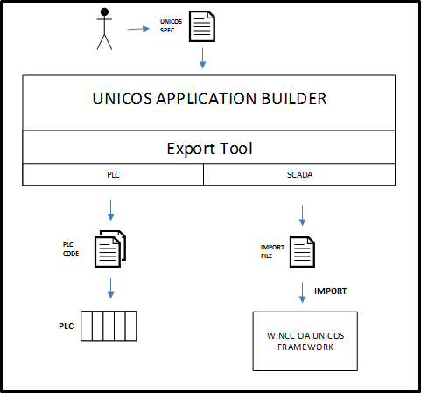
UNICOS-FW WorkFlow (as in ISOLDE)
UNICOS
SPEC
.xls
x
Number of PLCs
PLC
HW CONF
PLC
CODE
IMPORT
FILE
(worst case scenario: update all 140 PLCs of LHC)
 | Vacuum-FW | UNICOS-FW
Data Sources to Update/Maintain | 1 | 140
Generation Jobs | 1 | 140
SCADA imports | 1 | 140
PLC updates | 140 | 140
Download
Download
Import
SCADA APPLICATION
PLC
CONF FILES

Slide 5
UNICOS – Limitations for Vacuum
How to create/maintain a huge number of specs ?
UNICOS
SPEC #1
UNICOS
SPEC #2
UNICOS
SPEC #N
By generating them from a single source of data, i.e. a database (VacDB or Layout DB)

Slide 6
UNICOS – Limitations for Vacuum
How to manage a huge number of UAB builds ?
UNICOS
SPEC #1
UNICOS
SPEC #2
UNICOS
SPEC #N
x 1
PLC #1
CODE
PLC #2
CODE
PLC #N
CODE
UAB must process a batch of specs
PLC
PLC
PLC

Slide 7
UNICOS – Limitations for Vacuum
How to manage a huge number of SCADA imports ?
UNICOS
SPEC #1
UNICOS
SPEC #2
UNICOS
SPEC #N
IMPORT
FILE
x 1
PLC #1
CODE
PLC #2
CODE
PLC #N
CODE
IMPORT
SCADA APPLICATION
By having a single import operation for the SCADA
independently of the number of PLCs
PLC
PLC
PLC

Slide 8
UNICOS – Limitations for Vacuum
Adding Vacuum Specific files
UNICOS
SPEC #1
UNICOS
SPEC #2
UNICOS
SPEC #N
Vacuum Application specific files
PLC #1
CODE
PLC #2
CODE
PLC #N
CODE
IMPORT
FILE
IMPORT
DOWNLOAD
DOWNLOAD
DOWNLOAD
SCADA APPLICATION
COPY
PLC
PLC
PLC

Slide 9
Towards UNICOS – Blocking/important issues
Blocking issues
{
Layout DB ?
Vac DB ?
UNIVAC DB ?
UNICOS
SPEC #1
UNICOS
SPEC #2
UNICOS
SPEC #N
Vacuum Application specific files
{
Can EN/ICE modify UAB ?
PLC #1
CODE
PLC #2
CODE
PLC #N
CODE
IMPORT
FILE
IMPORT
DOWNLOAD
DOWNLOAD
DOWNLOAD
SCADA APPLICATION
COPY
Are the current (S)PLCs
fit for UNICOS ?
{
PLC
PLC
PLC

Slide 10
Roadmap
Specification of new UNICOS objects
Mini-set of UNICOS objects for HIE-ISL (2015)
Pilot Project HIE-ISL
(2015)
Today
LS2
Solve Blocking issues
Develop UNICOS objects full set for L4 (2015)
Develop Data Source
+ Specs Generation
(in UNIVAC)
Develop Migration Tool
Pilot Project
LINAC4
Extension to LHC
+ Injectors
(2018)
Develop Data Source + Specs Generation
(in Layout-DB)
Specification of Functionalities
Implement Vacuum Specific Functionalities in UNICOS

Slide 11
ICM Actions
  Decide if we wait for BE/CO to provide Layout DB + Editor, or develop our own solution, keeping in mind of possible future changes
  Start discussions with EN/ICE on the modifications of UAB to suit vacuum needs:
    Possibility of executing batch UAB jobs
    Single SCADA import
  Develop 1 new vacuum-specific UNICOS object in order to estimate the development efforts required.
  Ideal new UNICOS objects = Gauge, Pump, Valve, Gauge Controller, etc..
  Estimate PLC Hardware requirements for UNICOS. From that, determine which PLCs need to be replaced, and the associated cost.

