Slide 1
GÉANT BoD Service Evolution
Introducing SDN capabilities in backbone
Mian Usman
IP Network Architect
GÉANT
LHCOPN/ONE meeting – Amsterdam
28th – 29th Oct 2015

Slide 2
Agenda
Current Implementation of BoD Service in GÉANT
Role of Technology Proxy
DynPac Framework
  Path Computation Element
SDN based BoD Architecture
Work in progress

Slide 3


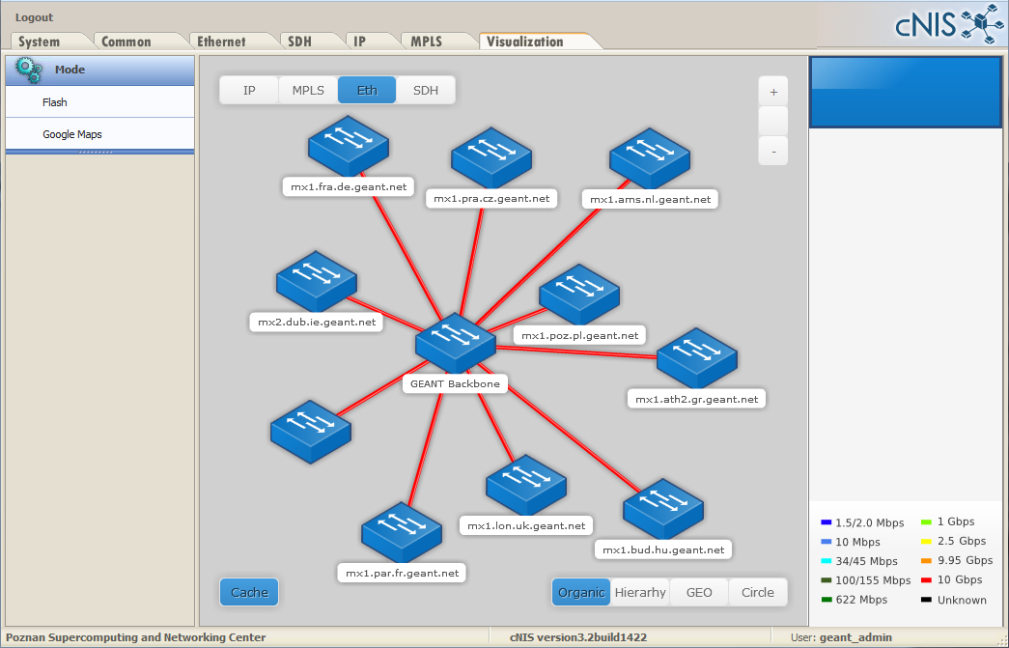
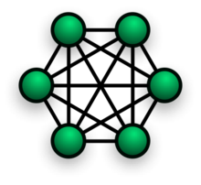

Current implementation of BoD Service
It is repository for data regarding the network topology which is loaded into Autobahn at startup
BoD Portal
Autobahn instance IDM/DM
Technology Proxy
0
cNIS
JunOS Space
ce
GEANT MPLS Core

Slide 4
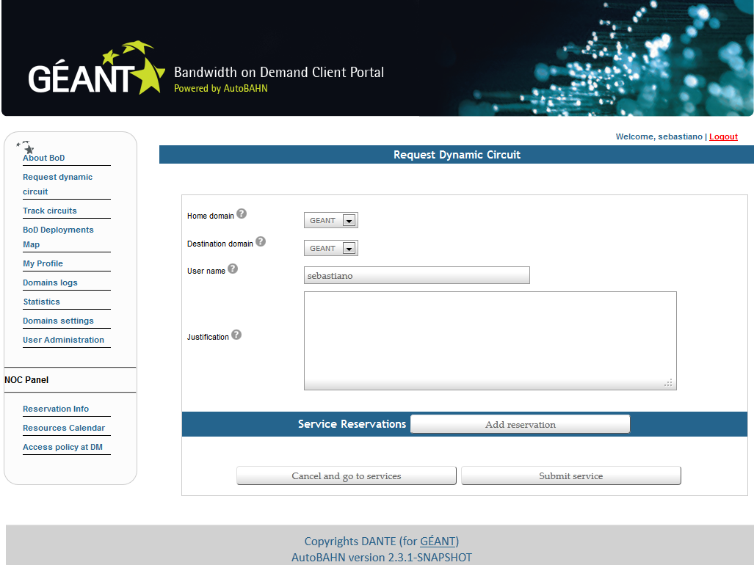
Current implementation of BoD Service
1
A request comes in thru the user’s interface to BoD
BoD Portal
Autobahn instance IDM/DM
Technology Proxy
cNIS
JunOS Space
ce
GEANT MPLS Core

Slide 5
Current implementation of BoD Service
1
2
BoD Portal
Autobahn instance IDM/DM
Technology Proxy
Translate SOAP requests received from the Autobahn DM into REST requests for JunOS Space APIs.
3
4
cNIS
SOAP
REST
JunOS Space
ce
The feasibility of the request is evaluated against the topology information acquired from cNIS.
If accepted the request is then sent to the Technology Proxy.
It is also responsible for
communicating with our
tools.
GEANT MPLS Core

Slide 6
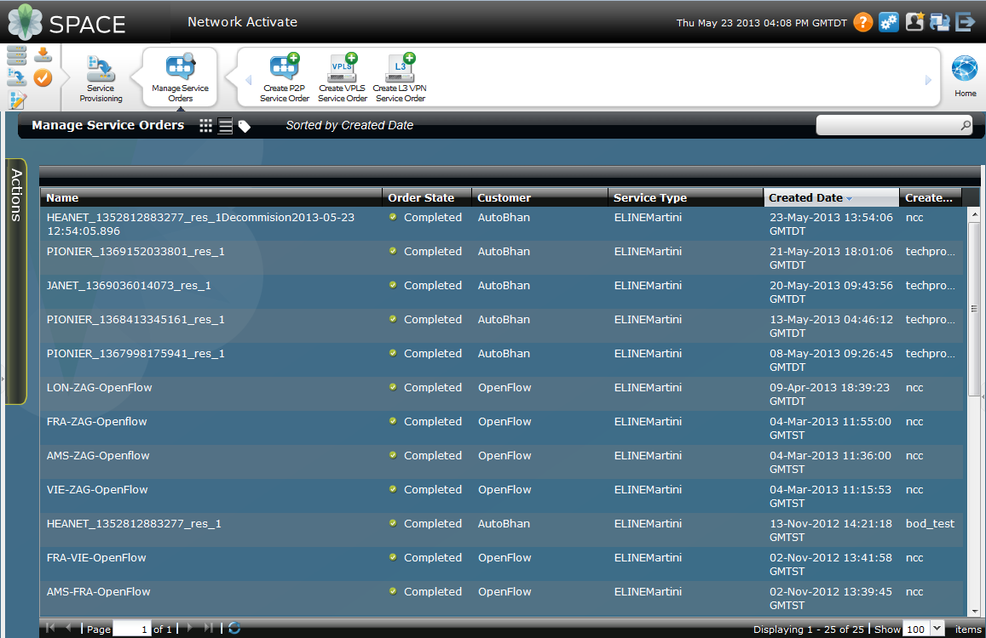
Current implementation of BoD Service
BoD Portal
Autobahn instance IDM/DM
Technology Proxy
Controls and configure the devices in the network.
4
cNIS
JunOS Space
ce
5
GEANT MPLS Core

Slide 7
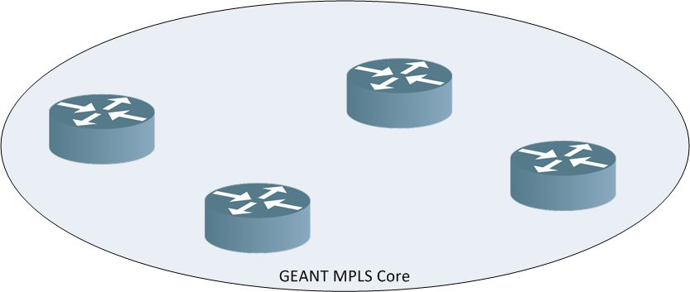
Current implementation of BoD Service
A cluster of 2 JunOS Space J1500 appliances pushes configuration changes to the Network Elements

Slide 8
Current implementation of BoD Service
A cluster of 2 JunOS Space J1500 appliances pushes configuration changes to the Network Elements
An L2circuit is configured in between two VLANs/Interfaces.

Slide 9
The role of the Technology Proxy
The Technology Proxy is responsible for communicating with our Operation Database, Cacti and for informing us via email should an issue be encountered.

Slide 10

DynPaC: Dynamic and Adaptive Traffic Engineering for SDNs
Jasone Astorga, Alaitz Mendiola, Aitor Urtasun, Eduardo Jacob, Mariví Higuero, Victor Fuentes
PhD Assistant Professor in the University of the Basque Country

Slide 11
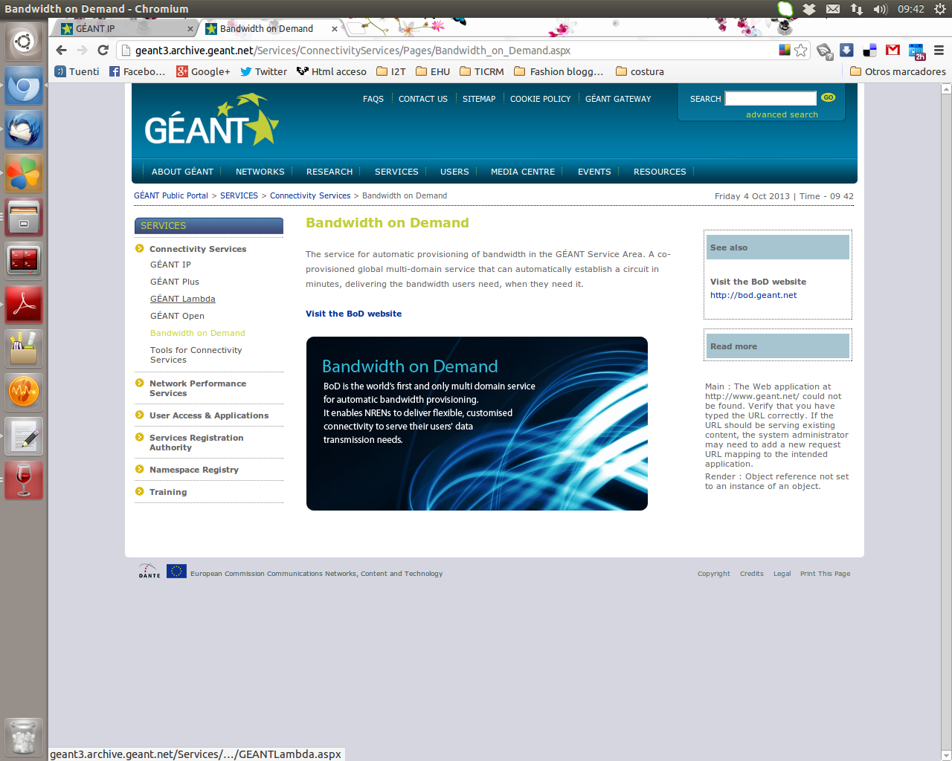
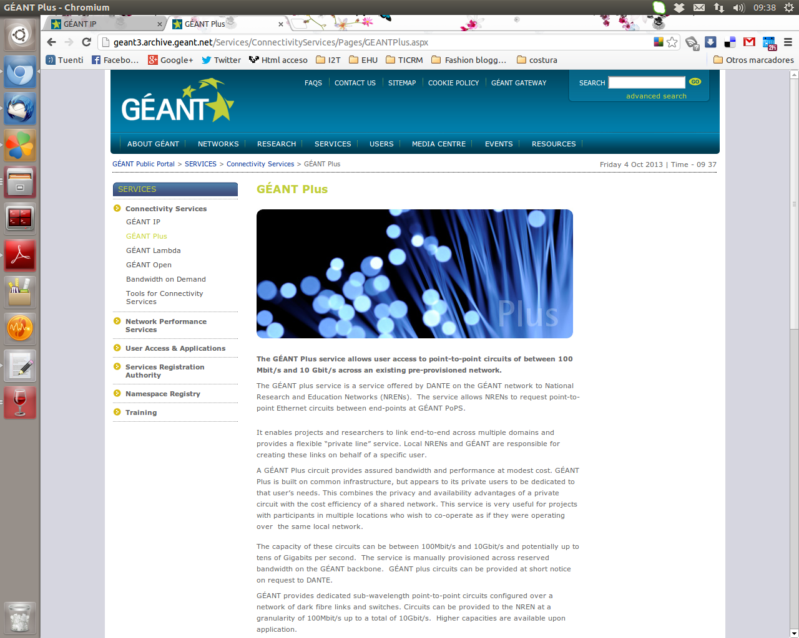
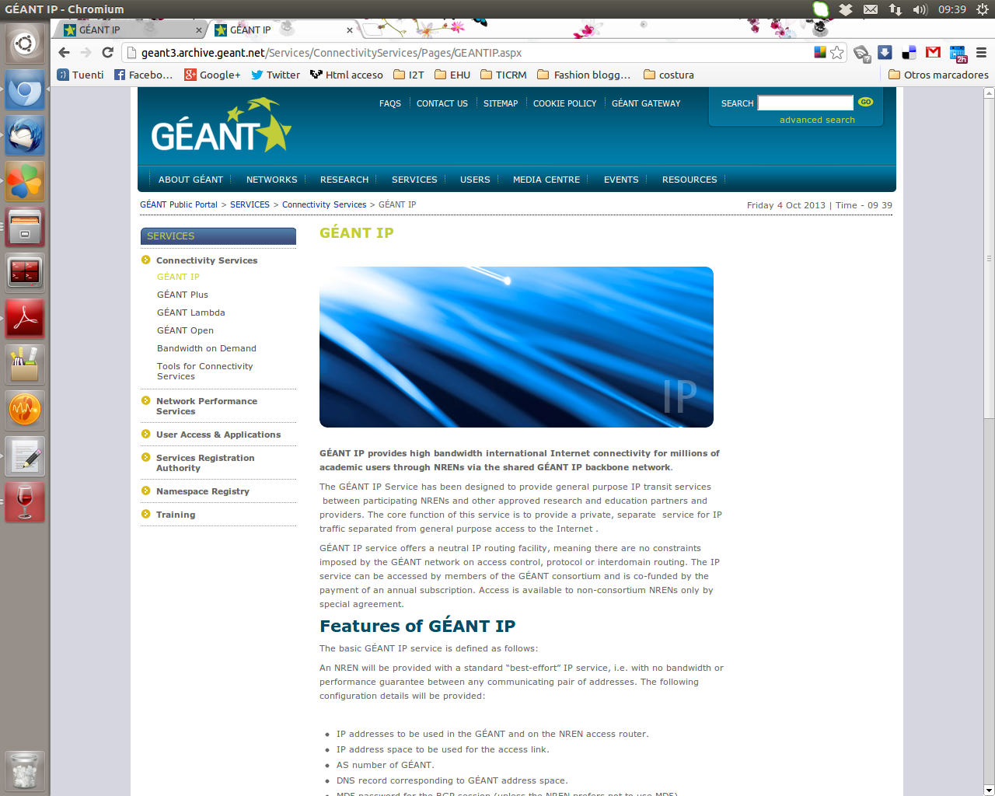
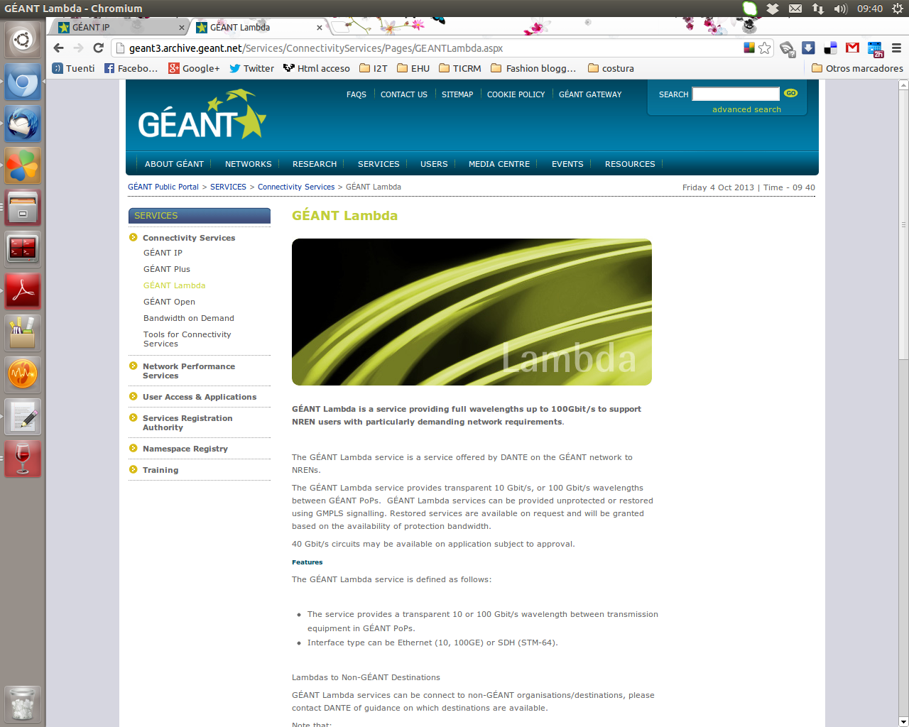
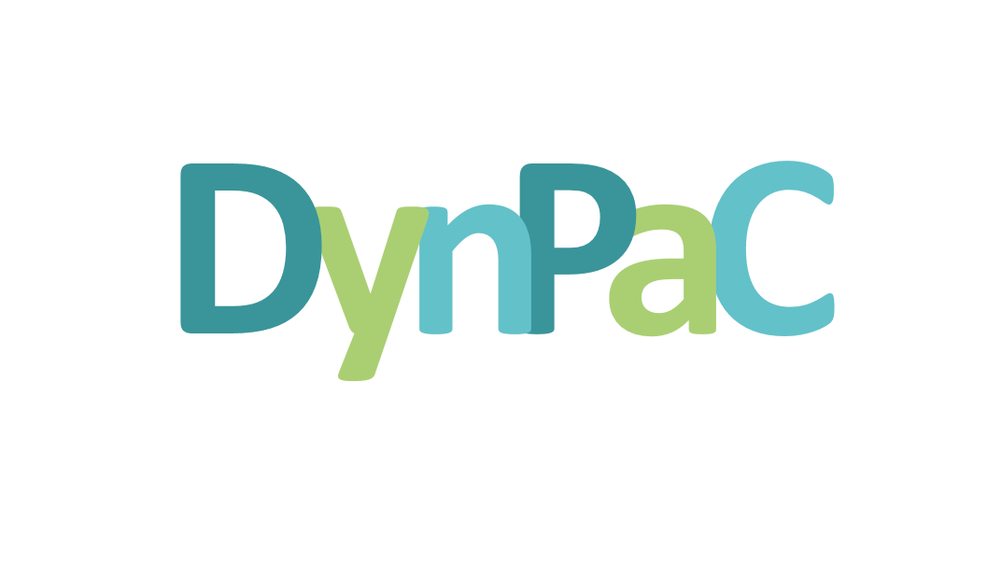
The DynPaC Framework
  GÉANT Connectivity Services
  How can we improve this service?
Notes:
The general objective defined for the DynPaC project is to allow the deployment of a disruptive point-to-point Ethernet connectivity service, like GÉANT Plus, on top of a SDN/OpenFlow-pure infrastructure. In a nutshell, with DynPaC users are able to request bidirectional L2 services with a guaranteed bandwidth from a given source to a given destination.
Therefore, DynPaC proposes and implements a TE algorithm which maximizes network utilization while preserving the performance of the applications being transmitted through the network.
In fact, traffic engineering (TE) is one of the most promising applications for Software Defined Networking (SDN), mainly due to two key reasons: on the one hand, the logically centralized nature of the control plane allows making routing decisions based on an overall view of the network topology and real-time information about the network status. On the other hand, SDN technologies provide the necessary mechanisms to implement at the data plane level the routing decisions taken by the centralized control plane. That is, SDN provides the flexibility and granularity demanded by TE algorithms to manage and route independently specific traffic flows.

Slide 12
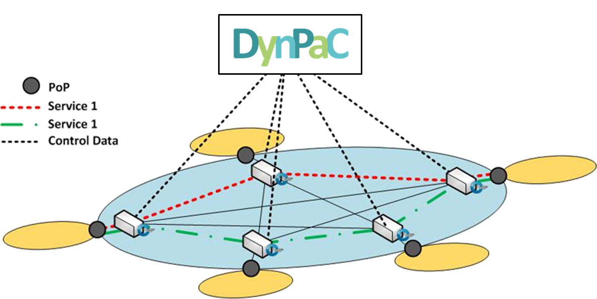
The DynPaC Framework
Objectives:
  Efficient use of the network capacity:
    Flow relocation.
    Flow disaggregation.
  Resiliency in case of a link failure with quick recovery times:
    Pre-computed backup paths.
    Two types of services: regular and gold.
  Reduction of the operational costs of the service management:
  Improvement of the network monitoring by gathering real time information.
Notes:
DynPaC is a very powerful framework that supports the dynamic computation of paths taking into consideration time and bandwidth constraints.
It is also a very powerful tool in terms of network utilization. Thanks to its flow relocation and disaggregation mechanisms it is capable of making room for new service requests either moving already established flows to alternative paths or splitting the traffic into multiple sub-services in order to route them along other paths.
The framework is also able to react against link failures To achieve this functionality, at the
time of computing the optimal path through which a flow is transmitted, a set of backup paths are also computed. Regarding resiliency functionalities, DynPaC distinguishes two types of services: regular and gold. For regular services no bandwidth is reserved for backup paths, while for gold services it is reserved, in order to be able to guarantee that it can be provided at any moment.
On the other hand, thanks to the use of SDN, DynPaC enables the automation of service management, reducing the operational costs of the service management.
Additionally, the centralised control plane allows to be aware of the state of the entire network, which leads to better monitoring strategies.

Slide 13
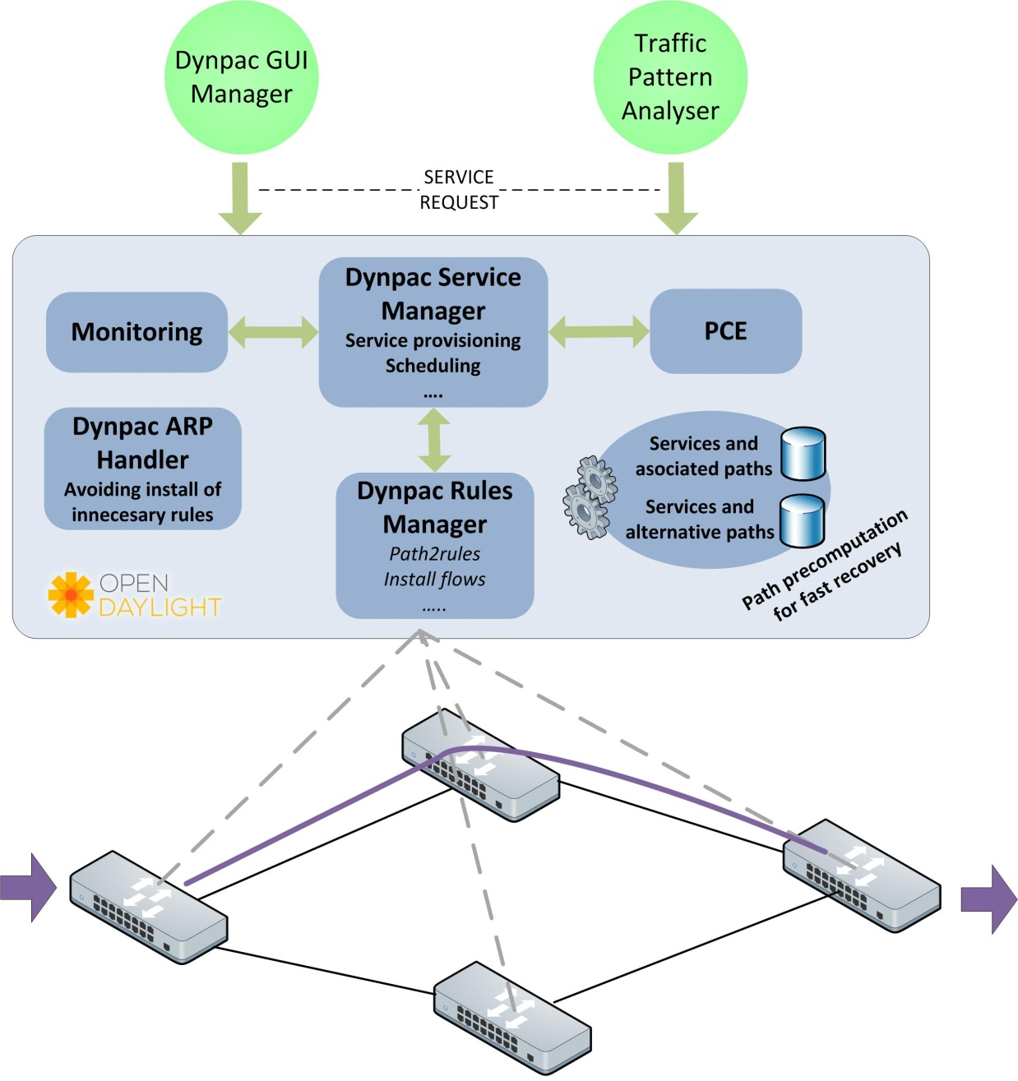
The DynPaC Framework
Notes:
DynPaC has been implemented as a flexible and modular software framework with well-defined interfaces between the modules it consists of.
The architecture aims to be as technology agnostic as possible and consists of six different modules: GUI, DynPaC Service Manager, PCE, Monitoring, DynPaC ARP Handler and DynPaC Rules Manager. Besides, the architecture also includes an interface to a traffic information gathering system.

Slide 14
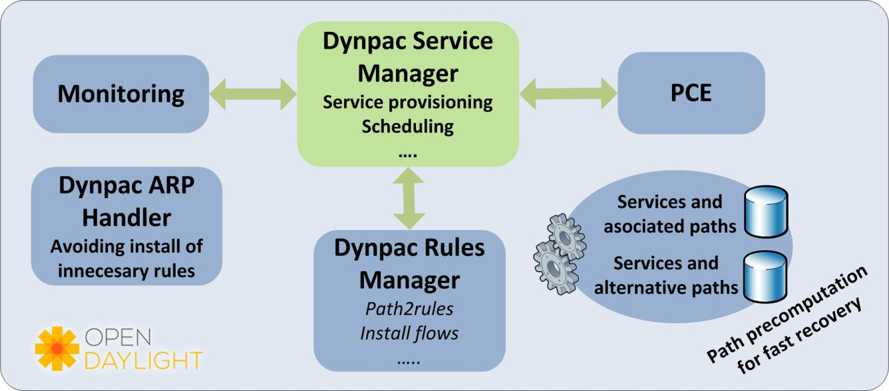

The DynPaC Framework:
DynPaC Service Manager
DynPaC Service Manager:
  The CORE of the DynPaC framework.
  Acts as the coordinator.
      Orchestrates the interaction between the modules of the framework.
      Listens to topological and monitoring events to react upon changing conditions.
  Manages the introduction of new services in the network. If necessary…
    Moving ongoing flows to alternative paths.
    Asking for the disaggregation of ongoing services.
  Provides resiliency and fault recovery:
    Keeping track of the services and the links they are using.
    When a link goes down, it identifies the affected services and commits the backup path.
  Performs the scheduling of the services.
    By defining network snapshots.
Notes:
The DynPaC Service Manager is the core module of the architecture, as it is the entity in charge of coordinating the workflow between the rest of the DynPaC modules.
The coordinator is in charge of notifying the DynPaC Rules Manager module when a service must be installed or removed from the networking devices.
It also provides resiliency, by handling the transition from the primary paths of a given service to the secondary path.
This module is also in charge of handling the reallocation of already installed flows in the network to make room for new services. Regarding flow reallocation and disaggregation, once a service is programmed into the network, it remains
unchanged as long as possible. However, it is possible to reallocate a service into another path in order to free the necessary resources for a new service request. In this case, it is a priority to reallocate the service without disaggregating it. But in the cases in which it is not enough with moving the service to another path, the service can be disaggregated into multiple sub-services using the information provided by the traffic information gathering system.
The DynPaC Service Manager also receives the notifications sent by the monitoring module to inform about services that
violate the SLAs agreed between the user and the service provider. When the DynPaC Service Manager receives a notification of this nature, it informs both the user and the service provider about the situation.
Taking into consideration that the architecture must be able to handle future network states, it stores the information about all the requested services.

Slide 15
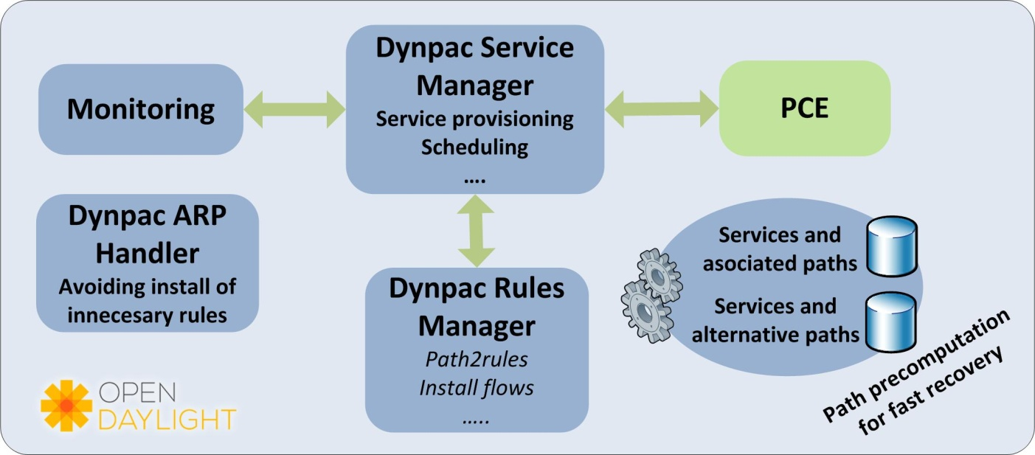
The DynPaC Framework:
Path Computation Element
Path Computation Element:
    Obtains the network physical topology and computes the shortest path between two network points:
        ODL topology and switch manager modules are used for this purpouse.
    It takes into consideration bandwidth constraints and scheduling information.
    Provides a primary path and a pair of auxiliary paths.
DynPaC Service Manager asks the PCE for a path between the source and destination nodes, accordingly with the available bandwidth and topology.
Notes:
The PCE implements two different algorithms.
The first one pre-computes all the possible paths in the network at bootup time between all the possible sources and all the
possible destinations. This way, when a user request a service between a given source and a given destination, the DynPaC Services Manager communicates with the PCE and obtains all the possible paths for that specific pair of nodes. The list of possible paths is ordered, prioritising the shortest paths. Later, the DynPaC services manager uses this path list with all the alternatives of the affected snapshots to check whether the network can allocate the service or not.

Slide 16
The DynPaC Framework:
Path Computation Element
Path Computation Element:
    When a new service request cannot be provided with the current flow distribution:
        RELOCATION of flows: The DynPaC Service Manager implements an algorithm which evaluates all possible flow distributions for all the snapshots affected by the new service request.
        If the relocation algorithm does not provide a positive outcome for all the affected snapshots: Traffic disaggregation.
    Traffic disaggregation:
      Attempt to split flows according to the information provided by the Traffic Pattern Analyser.
      Try to accommodate the resulting more granular sub-flows in the network.
      The algorithm prioritizes solutions that minimize the number of split flows.
Notes:
On the other hand, the second algorithm is in charge of the disaggregation of flows and it is only called when a service cannot be allocated in the network just be moving ongoing services.
To be able to disaggregate the services, the algorithm identifies the services tracked by the traffic information gathering system and obtains their disaggregation information.
The disaggregation algorithm checks one by one the disaggregable services, and analyses in each of the possible paths for the new service the bandwidth that it is necessary to free and if it is possible to do it by moving one of the dissagregable services. If it is possible to free the required bandwidth, the disaggregation algorithm tries to reallocate the sub-services in which the dissagregable service can be divided until it finds a solution.

Slide 17
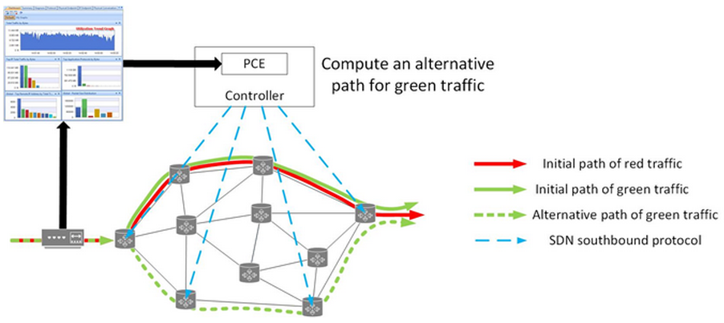
The DynPaC Framework
Notes:
DynPaC has been implemented as a flexible and modular software framework with well-defined interfaces between the modules it consists of.
The architecture aims to be as technology agnostic as possible and consists of six different modules: GUI, DynPaC Service Manager, PCE, Monitoring, DynPaC ARP Handler and DynPaC Rules Manager. Besides, the architecture also includes an interface to a traffic information gathering system.

Slide 18
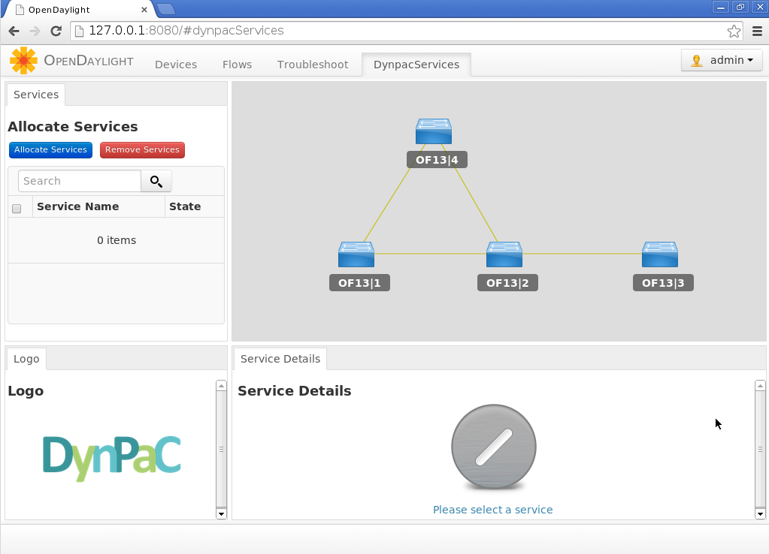
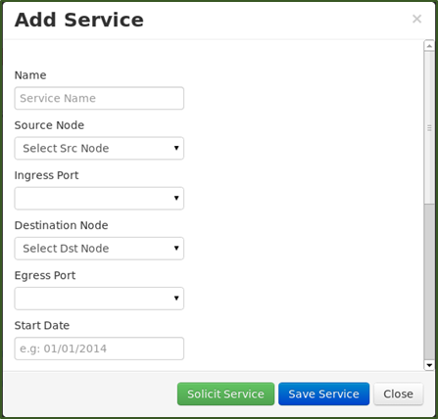
The DynPaC Framework:
GUI
Procedure to request a new service
Notes:
The implementation of the GUI has been done adding an extra tab to the Open Daylight GUI. The GUI supports the addition and deletion of L2 services, defined by the ingress and egress ports of the source and destination nodes respectively, and the source and destination MAC addresses.
As mentioned before, the GUI also provides the means to specify the duration of the service, the bandwidth and the service type.

Slide 19
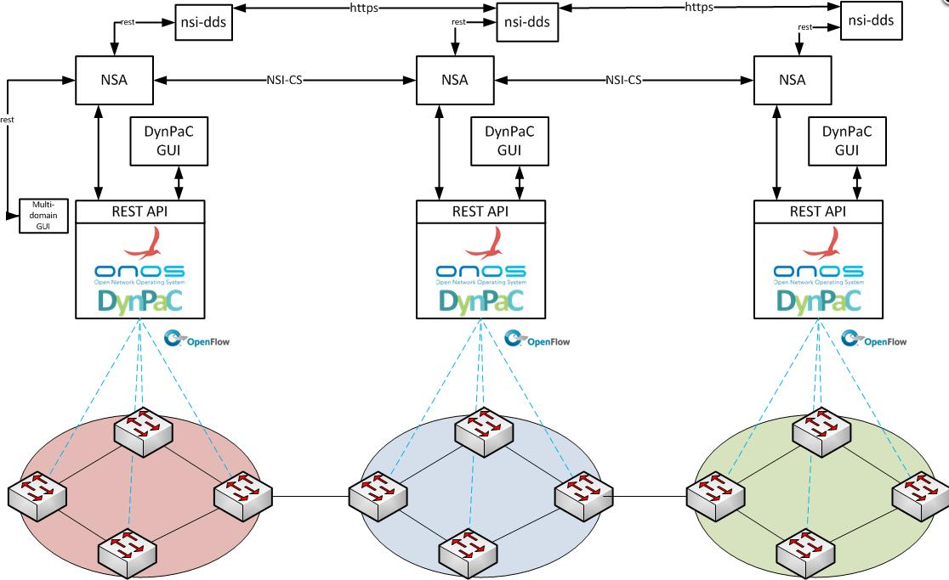
SDN based BoD Architecture

Slide 20
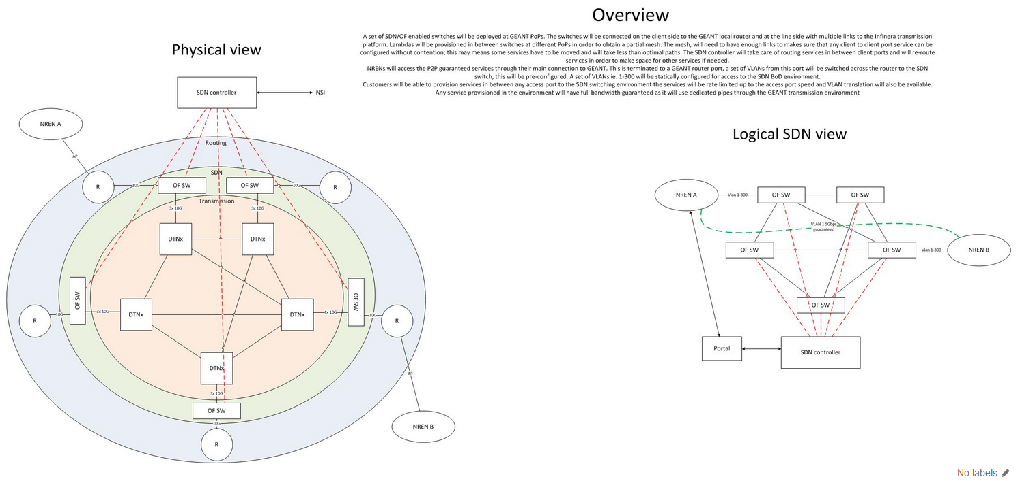
SDN based BoD Architecture

Slide 21
Work in Progress
DynPac GUI and Interface
DynPac Migration to ONOS
Topology Exchange
  Working with On.Lab, CORSA and Infinera to test these frameworks and develop new features
Developing DynPac Framework / APP for ONOS Controller
Developing REST API plugin for Infinera OTSv

Slide 22
Mian.usman@geant.org

