Slide 1
LHCONE L3VPN
Status update
Mian Usman
LHCOPN/ONE meeting – Amsterdam
28th – 29th Oct 2015

Slide 2

World regions
Asia
Europe
North America
Latin America
GÉANT LHCONE NetFlow Data
: IPv6 enabled

Slide 3
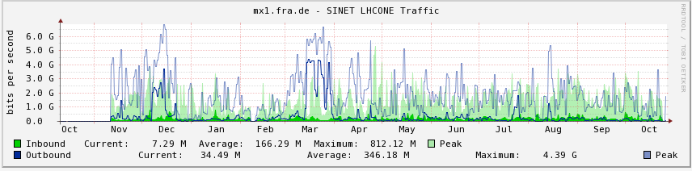
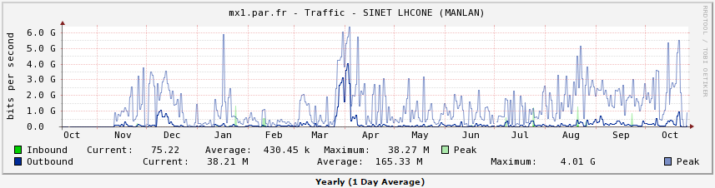
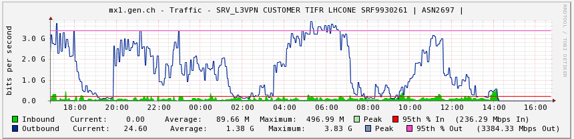
Asia-Pacific
TIFR Peering with GÉANT LHCONE VRF
LHCONE VRF now setup in TEIN and peering with GÉANT LHCONE vrf
No routes being advertised by TEIN
THAIREN likely to be the first NREN to peer with TEIN LHCONE
PERN likely to join LHCONE as well

Slide 4
LHCONE in Europe
LHCONE IP Service in Europe is deployed in:
  ARNES (Slovenia)
  CERN/CERNLight (Switzerland)
  CESnet (Czech Republic)
  DFN (Germany)
  GARR (Italy)
  GÉANT
  NORDUnet
  RENATER (France)
  RoEduNet (Romania)
  SURFnet (Netherlands)
RENs in these countries connect:
  Six Tier 1s in Europe to LHCONE
  30 Tier 2s in Europe to LHCONE
  Indian T2
  Russian T2s (only to NORDUNet/CERN)
LHCONE IP Service in Europe is deployed in:
  ARNES (Slovenia)
  CERN/CERNLight (Switzerland)
  CESnet (Czech Republic)
  DFN (Germany)
  GARR (Italy)
  GÉANT
  JISC (UK)
  NORDUnet
  RENATER (France)
  RoEduNet (Romania)
  SURFnet (Netherlands)

Slide 5
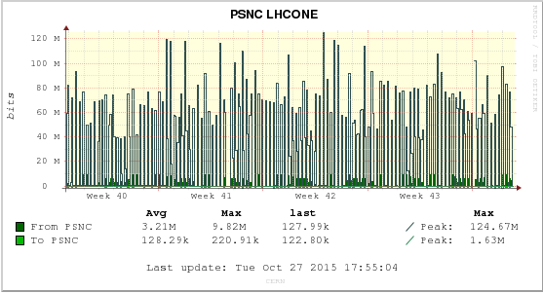
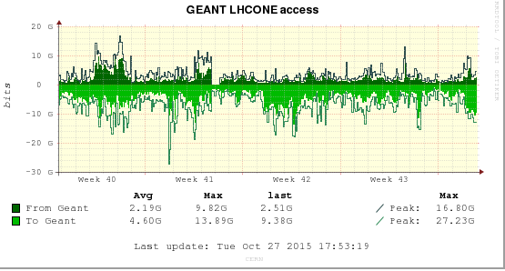
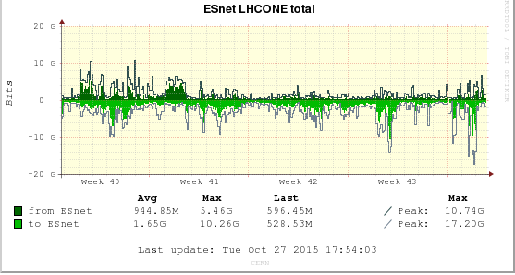
CERN
Tier1 is now directly connected to GÉANT and ESnet with 100G interfaces
  1 x 100G GEANT
  2 x 100G ESnet
The peering with GÉANT is now direct, not through CERNLight
CERNLight now peers with PSNC (Polish NREN)

Slide 6
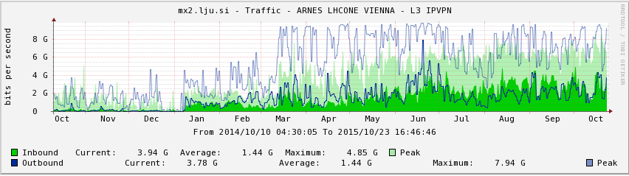

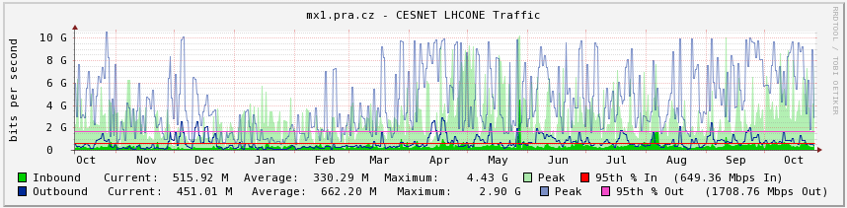

ARNES - CESNET

Slide 7
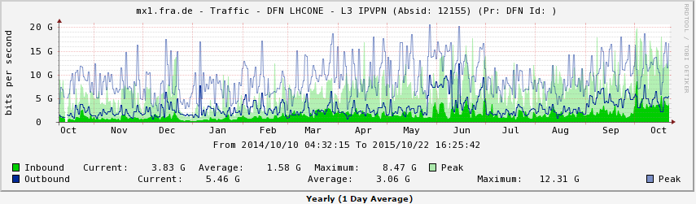

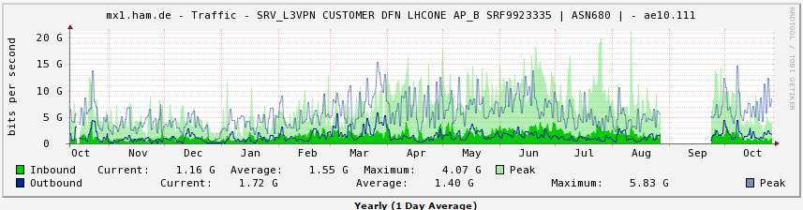
DFN

Slide 8
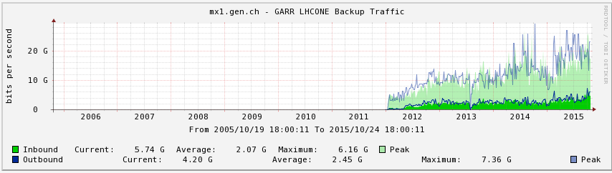

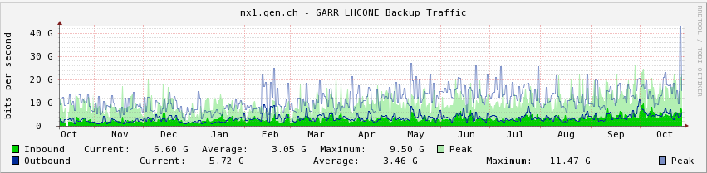
GARR

Slide 9
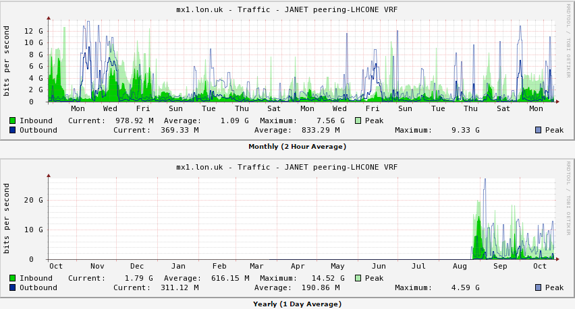

JISC
VRF established on the JANET network
Configuration completed during April/May ‘15
Imperial College is the first site to connect
  Currently in production

Slide 10
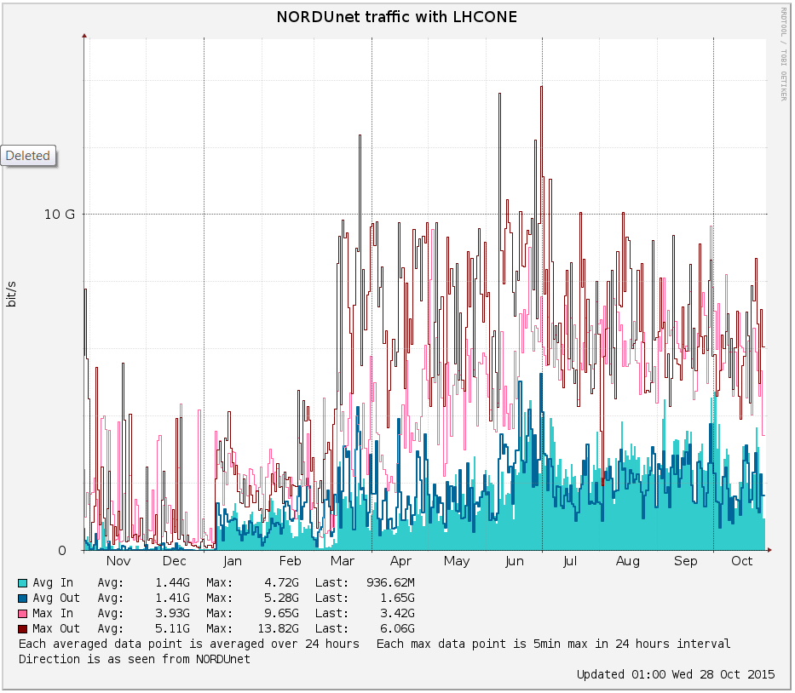

NORDUNet
Moved the LHCONE connection to GÉANT from Copenhagen to London on 100G port
The LHCONE connection to ESNet and Internet2 is at MANLAN via ANA-200G
  The peering is on the NORDUNet router in MANLAN

Slide 11
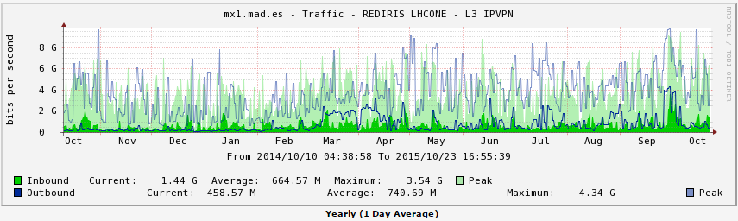

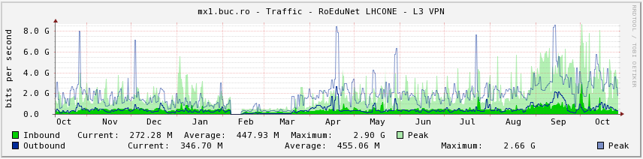

RedIRIS - RoEduNet

Slide 12
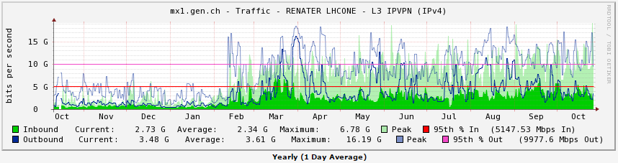

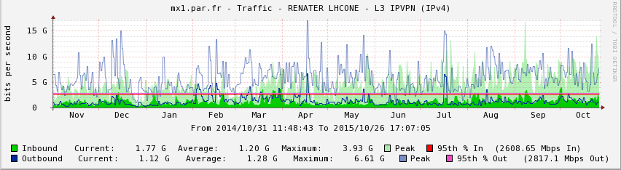
RENATER

Slide 13
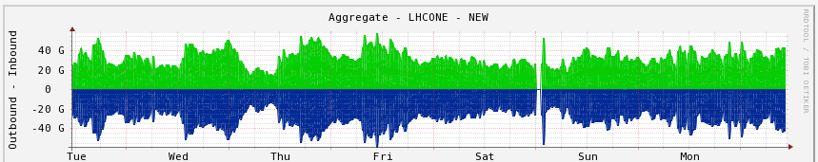
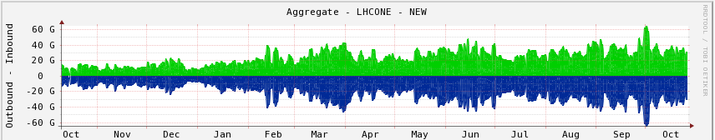
GÉANT overall
Weekly
Yearly

Slide 14
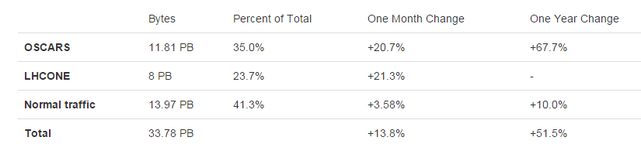
ESnet
DNIC-(798) - Headquarters, USAISC,US
IHEP-SU(2643) AS,RU
ERX-ERNET(2697) Education and Research Network,IN
JINR(2875) JINR/HEPNET,RU
RUNNET(3267) State Institute of Information Technologies and,RU
NERDCNET(6356) - Northeast Regional Data Center,US
OPTIPUTER(26397) - The Regents of the University of California - University of California, San Diego.,US
GRIDPNPI(29493) Federal State Budget Institution Petersburg Institute of Nuclear Physics of B.P. Konstantinov,RU
RWTH(47610) RWTH Aachen University,DE
NKN-CORE-NW(55824) NKN Core Network,IN
Now peering with GÉANT in the new ESnet PoPs in Europe
  LON, AMS, GVA
  3 x 100G
Peering with CERN in GVA
  2 x 100G
Sites connected
  ARLINGTON(18515)
  BNL(43)
  FNAL(3152)
  SLAC(3671)
  UIUC(38)
  UNL(7896)
  OPTIPUTER(26397)
  AGLT2(229)

Slide 15
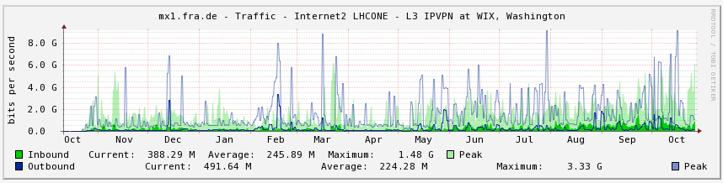
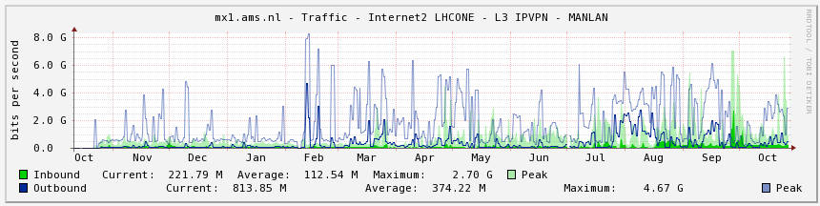
Internet2
Traffic between Internet2 and GÉANT LHCONE VRFs

Slide 16

CANARIE
Upgraded to 100G to PacificWave Seattle
Upgraded to 100G to MANLAN
Sites news:
  T2 at University of Victoria upgraded to 100G
  T2 at University of Alberta decommissioned
    Resources absorbed by Univ. Victoria and SFU
http://weathermap.canarie.ca/lhcone/index.html

Slide 17

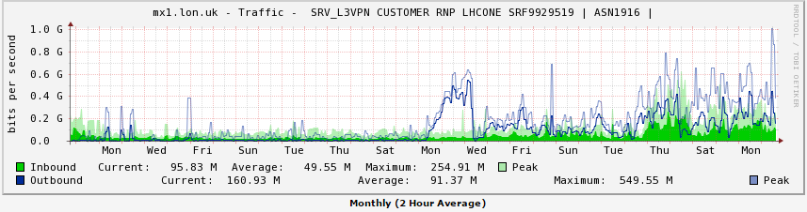


Latin America
Configuration of the peering from GÉANT VRF to RNP VRF completed
  Peering point in London, both IPv4 and IPv6
No VRF in RedCLARA for the time being
  Just delivering the L2 circuit from GÉANT to RNP
  VRF creation will be investigated if more NRENs in L.A. request to connect
Circuit and BGP peering established in May ’15
  CBPF and GRIPER/SAMPA Brazil now connected to RNP’s VRF
GÉANT
LHCONE
VRF
RNP
LHCONE
VRF
VLAN 2015
mx1.lon.uk

Slide 18
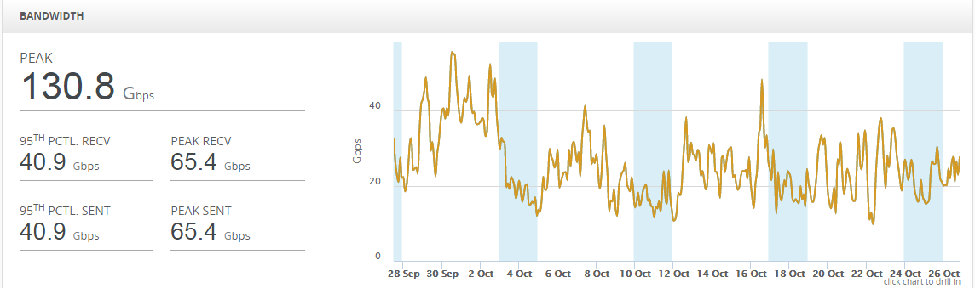
GÉANT LHCONE Overall

Slide 19
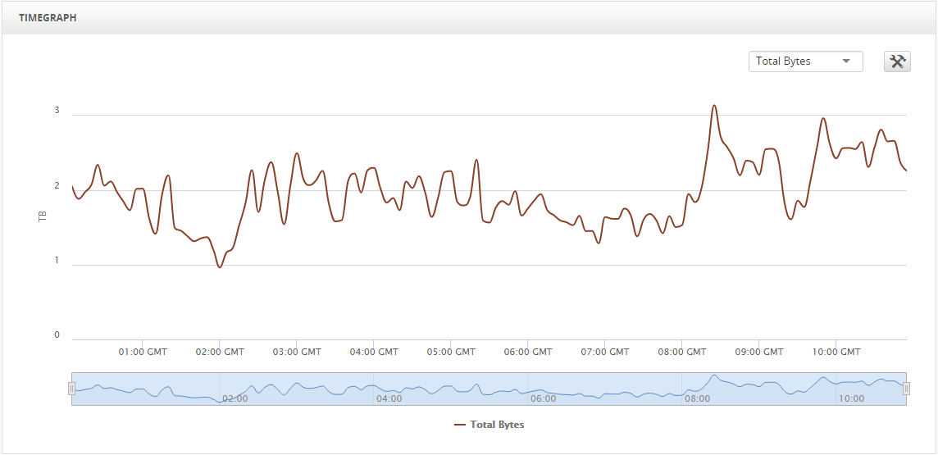
GÉANT Terabytes Transferred

Slide 20
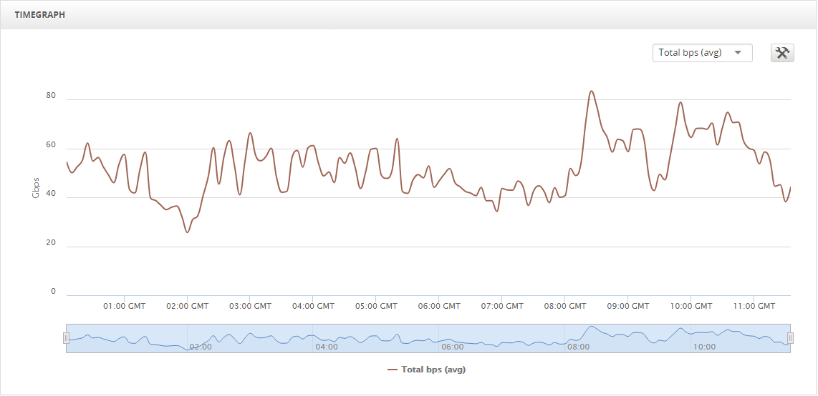
GÉANT Total LHCONE Gbps

Slide 21
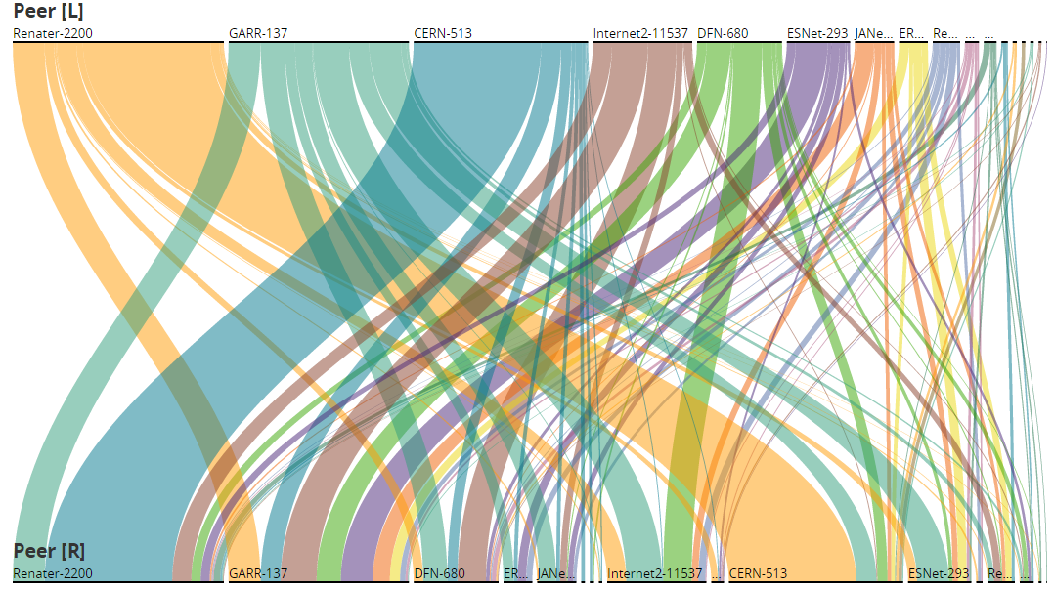
GÉANT LHCONE Traffic Between Peers

Slide 22
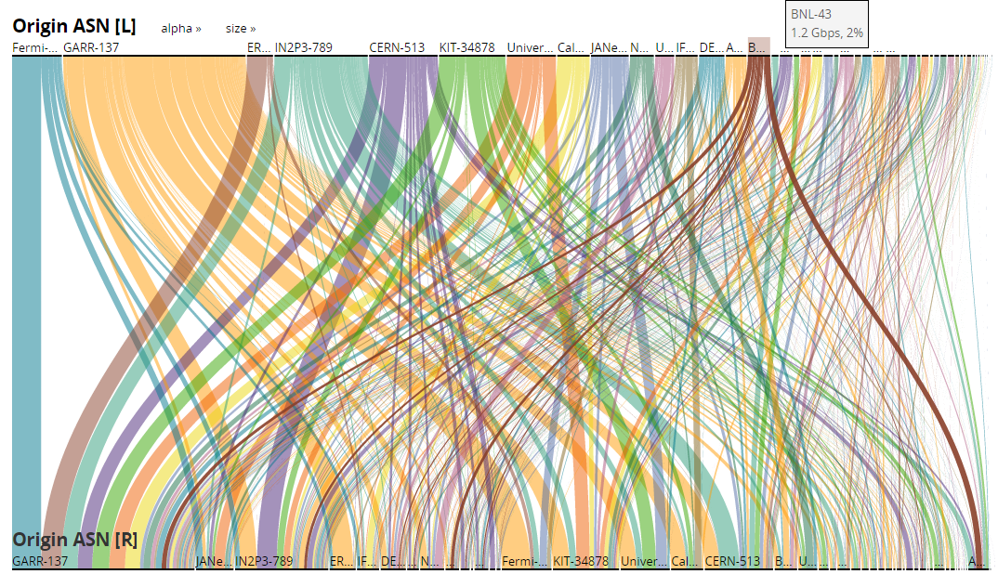
GÉANT All LHCONE Traffic Flows

Slide 23
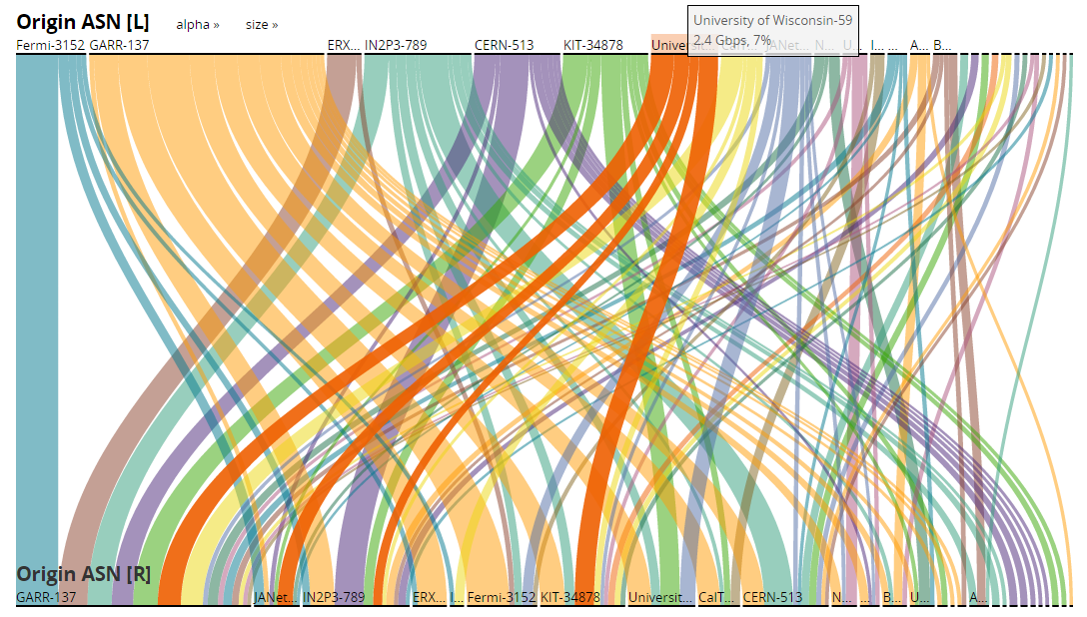
GÉANT LHCONE Traffic Flows (Top 10%)

Slide 24
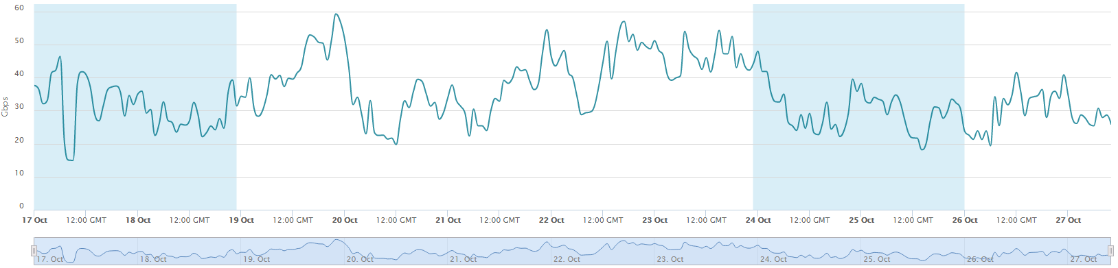
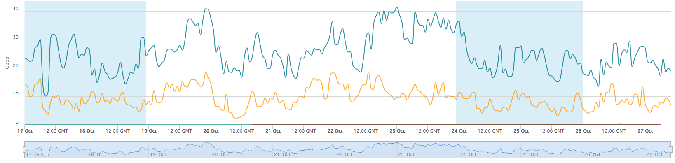
LHC Traffic in General Purpose IP

Slide 25
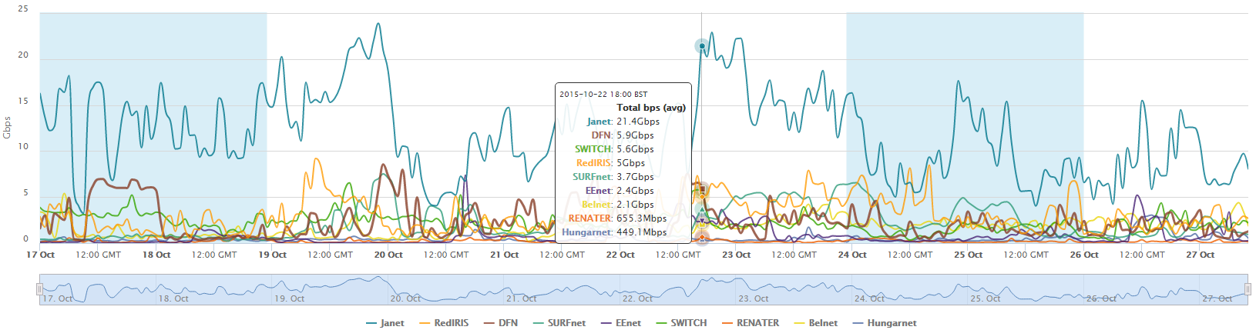
LHC Traffic in General Purpose IP
Traffic to or from LHC prefixes with in GÉANT general purpose IP
Most LHC traffic to/from JISC in general purpose IP

Slide 26
Any questions?
vincenzo.capone@geant.org

