Slide 1


  Automated GOLE update
Gerben van Malenstein
LHCOPN-LHCONE meeting
October 29, 2015 – Amsterdam, the Netherlands

Slide 2
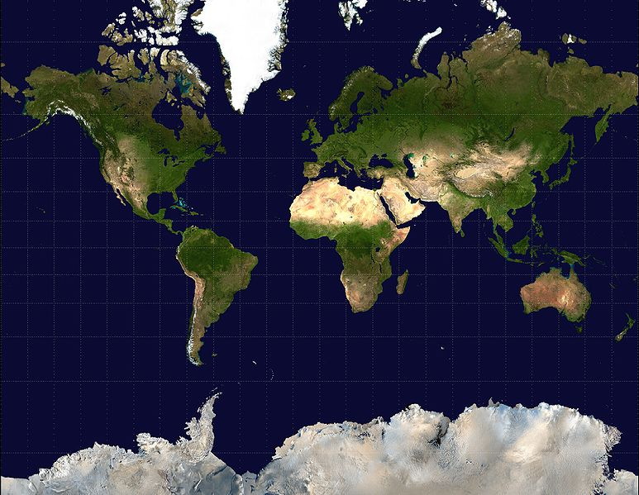

Automated GOLE Fabric
NORDUnet
ANA
Pionier
GLORIAD
KRLight
StarLight
NetherLight
Caltech
MAN LAN
GÉANT
ANA & EEX
CzechLight
KDDI Labs
JGN-X
UvA
CERN
Caltech
ESnet
AIST
AMPATH
SouthernLight

Slide 3
AutoGOLE
AutoGOLE fabric delivers dynamic network services between GOLEs and networks
  Based on NSI Connection Service v2.0 and TLS
  Using DDS service between aggregators
  Used for projects
    FELIX consortium, 2015
    Open Cloud eXchange (OCX) by GÉANT
    SC’13 and SC’14 ‘Portable cloud’ by JGN-X
    NRM with OpenFlow underneath by iCAIR
    UltraGrid by CESNET
    NEXPReS by JIVE

Slide 4
Work items 2015
I. Monitoring system for fault finding and troubleshooting
  AutoGOLE Dashboard
II. Supporting LHC Sites
  Supporting LHC sites that are connecting to the AutoGOLE
III. More redundant control plane
  Forwarding requests to another aggregator if a certain uPA cannot be reached

Slide 5
Status
Clear call for automation from Prague GLIF meeting
First prototype of the AutoGOLE Dashboard
Setup of 100G interconnect to ESnet’s EEX in Amsterdam for dynamic circuits
Facilitated two projects over the past months:
  ‘SURFsara-BNL’ for LHCONE:
    Brookhaven connects to ESnet and then through EEX to NetherLight
    SURFsara connects to NetherLight via SURFnet
  FELIX
    Service between Japan and Poland for connecting OpenFlow testbeds

Slide 6
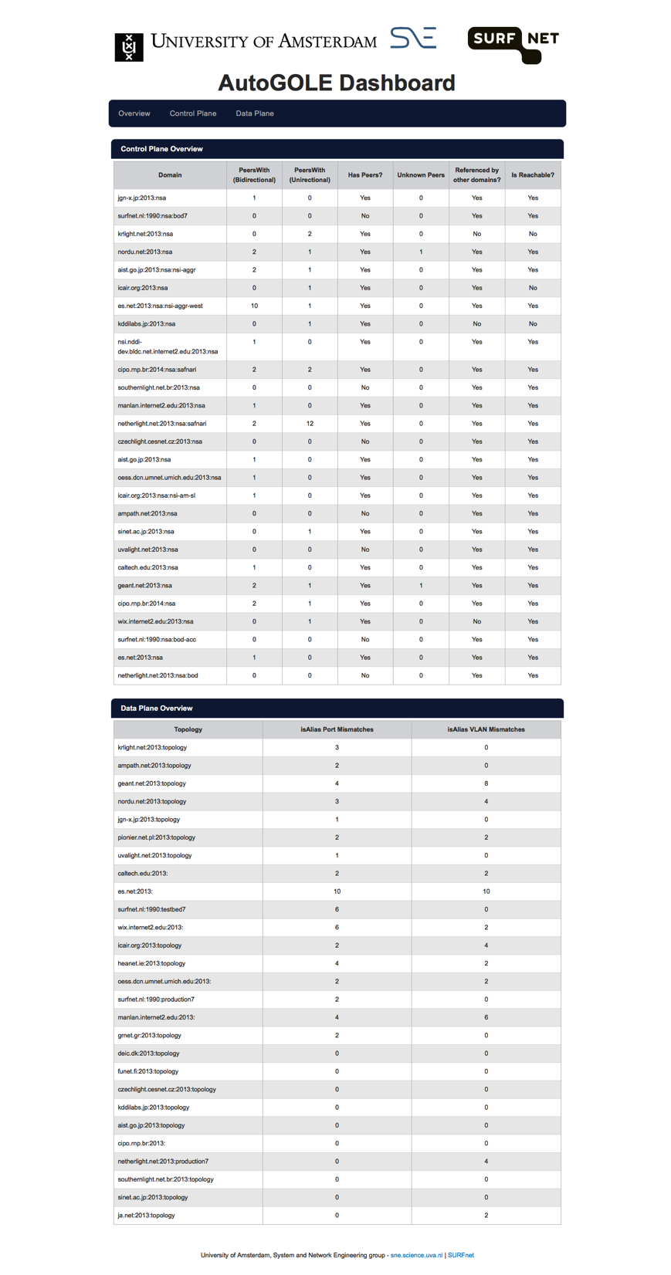
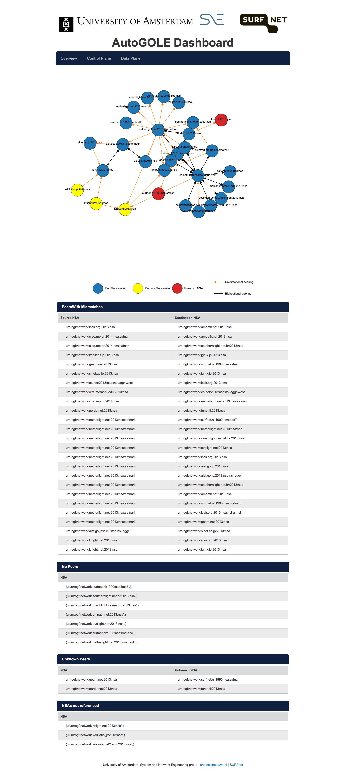
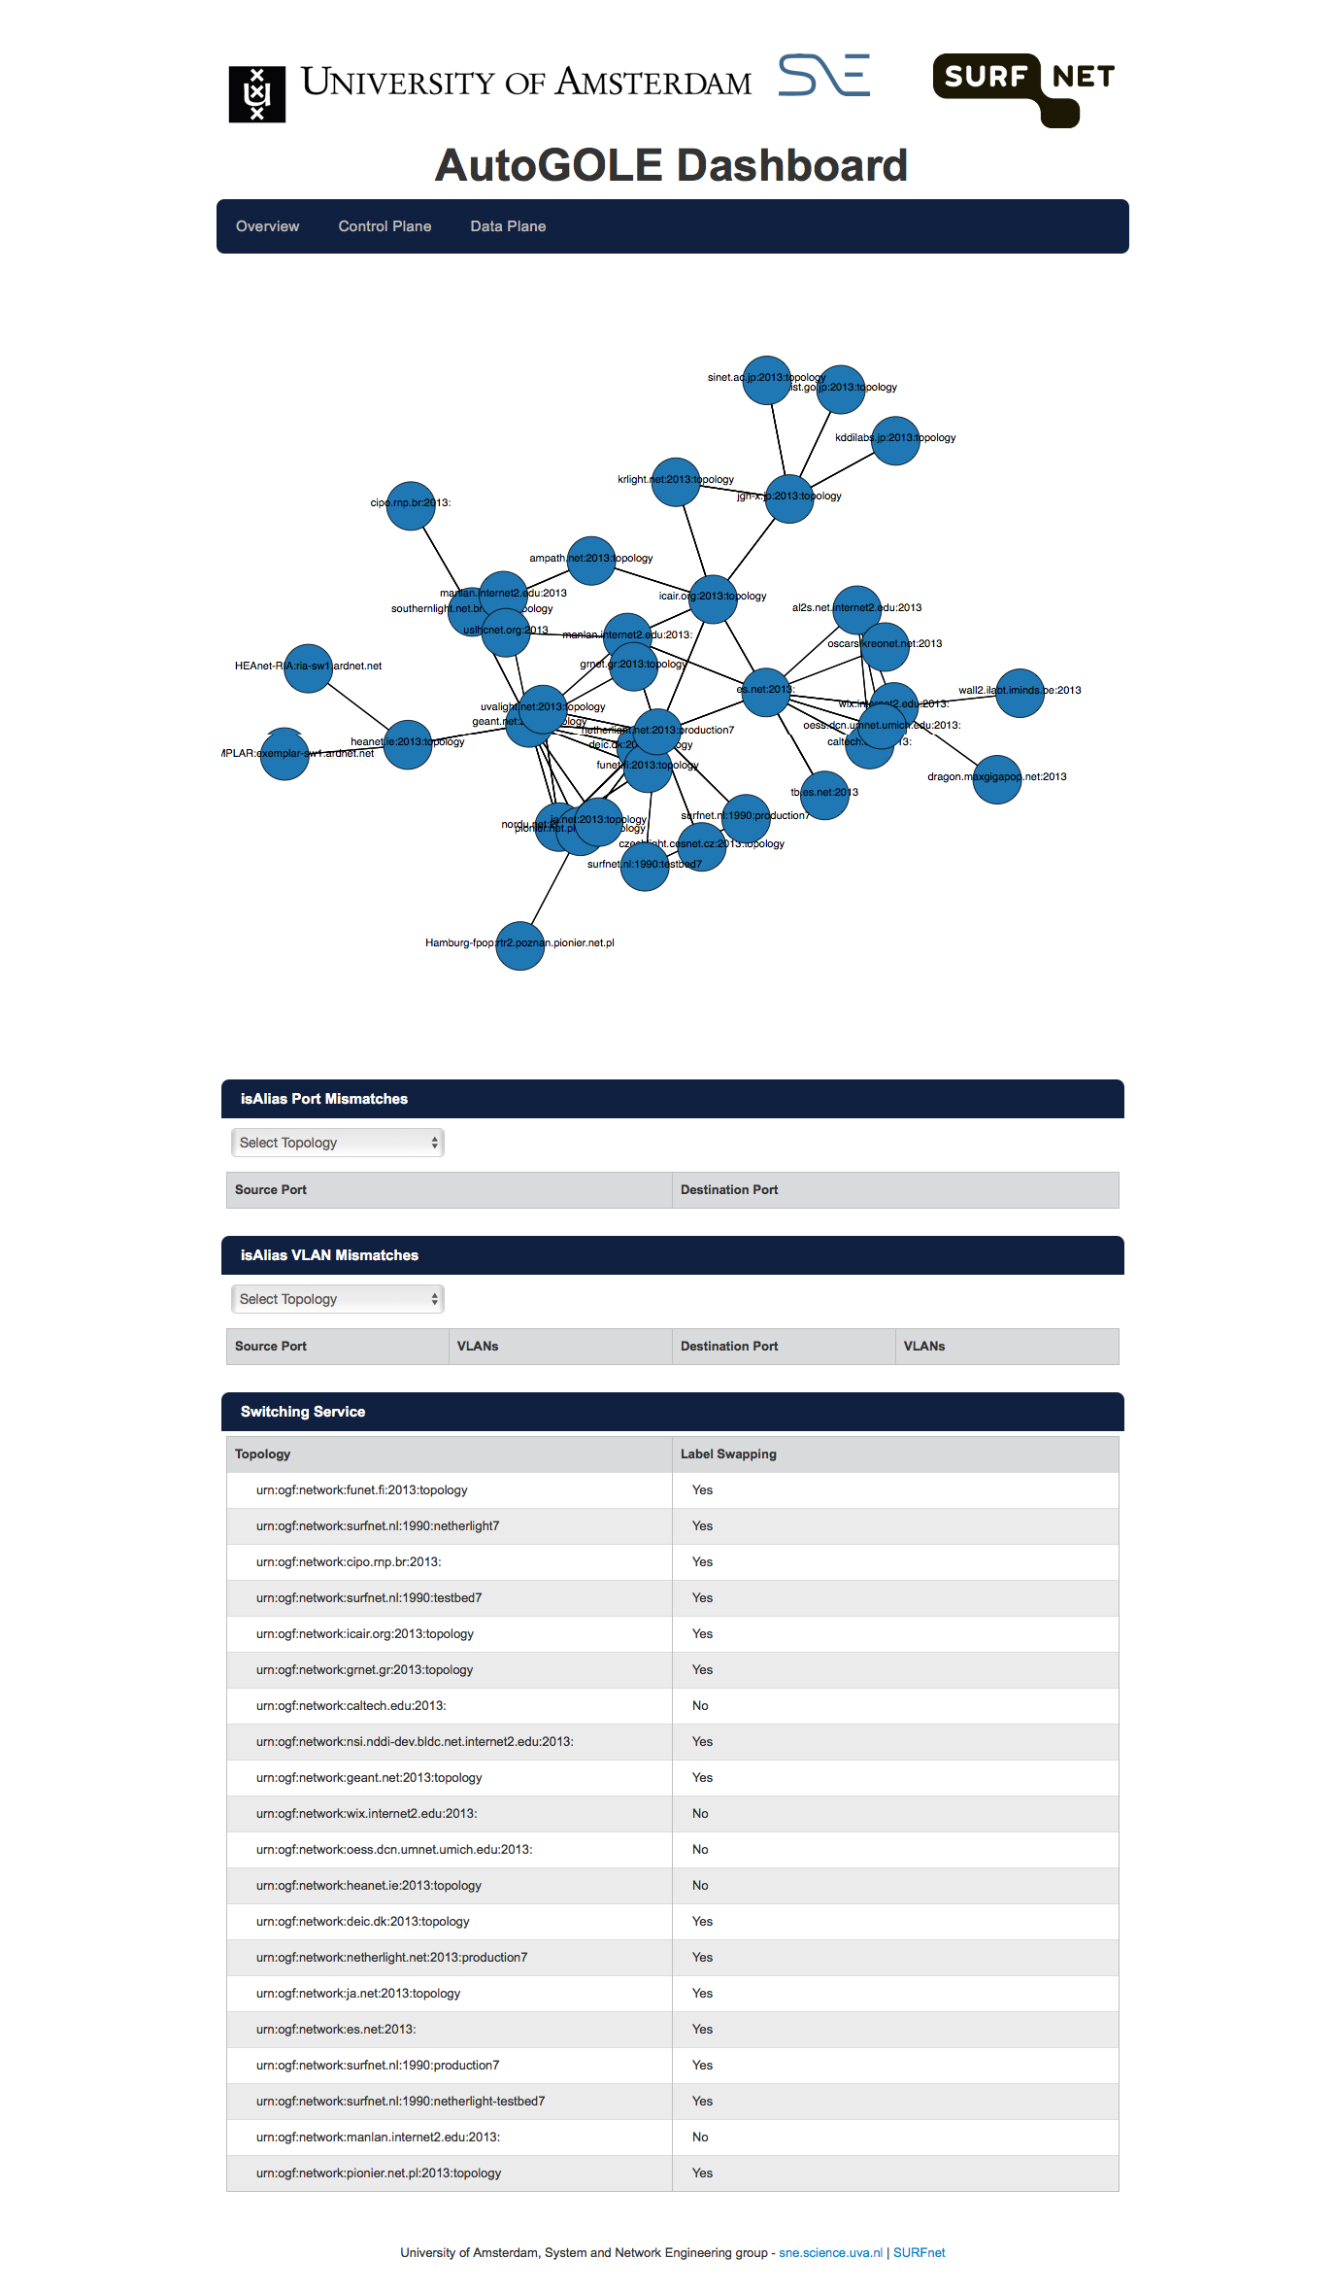
AutoGOLE Dashboard http://dashboard.lab.uvalight.net:8000/dpm

Slide 7
Other topics / Moving forward / Discussion
Getting rid of old common VLAN range
  Support for VLAN retagging needed in all GOLEs and networks
  Ultimately using ENNI ports between networks
  (requires a new service definition)
Further data plane improvements, e.g. full dynamic control over longhaul links
Shifting from manual/NOC operation
to ‘dynamic provisioning by default’

Slide 8




Gerben.vanMalenstein[at]SURFnet.nl
www.surfnet.nl
+31 30 2 305 305
Creative Commons “Attribution” license:
http://creativecommons.org/licenses/by/3.0/
W

