Slide 2
IT String requirements
Marta Bajko
TE-MSC

Slide 3
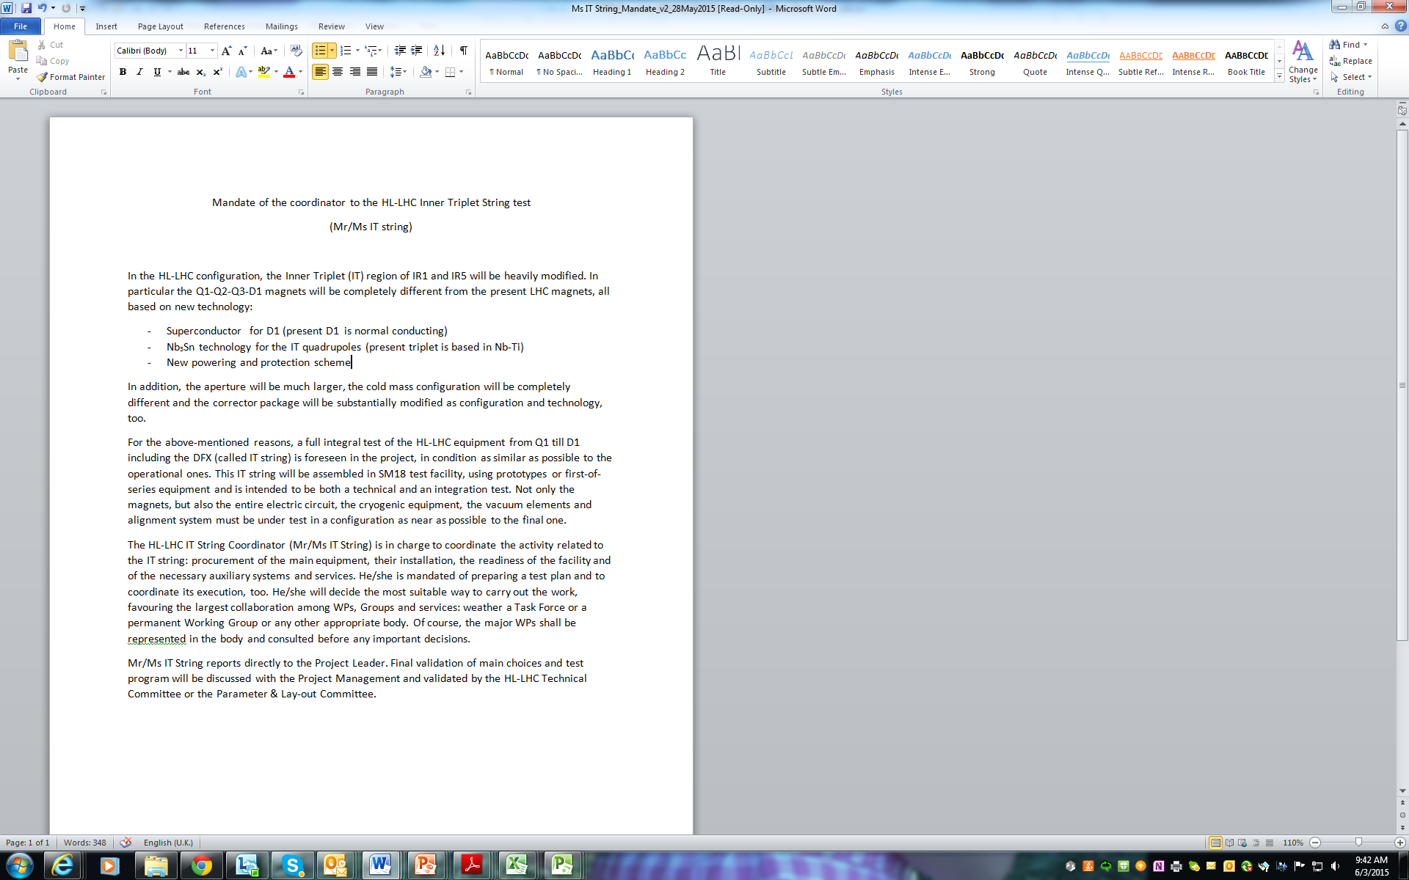
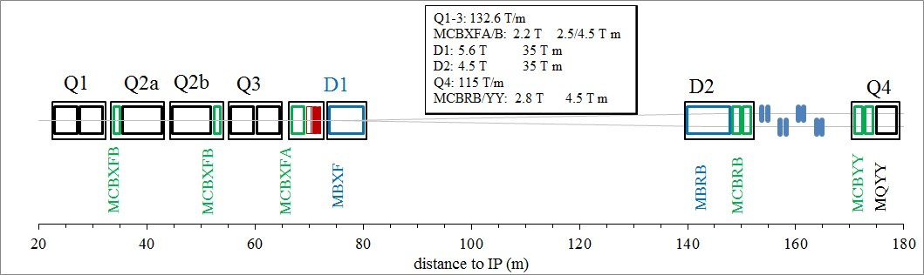
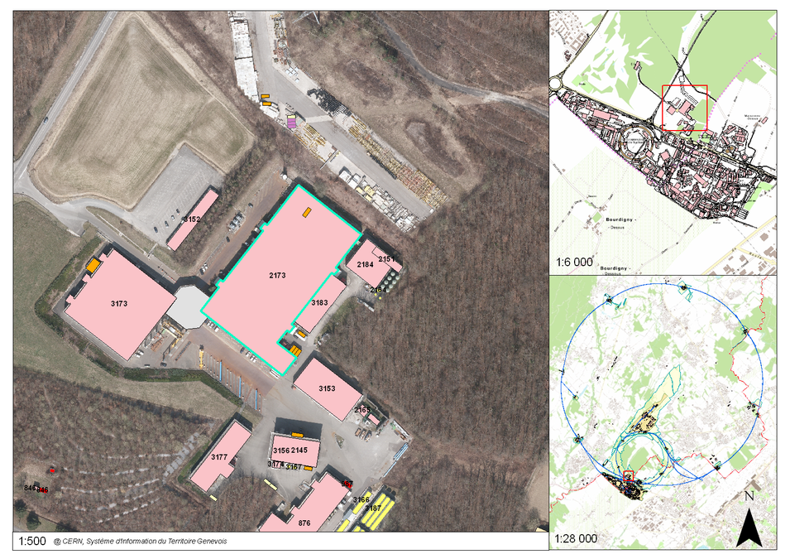
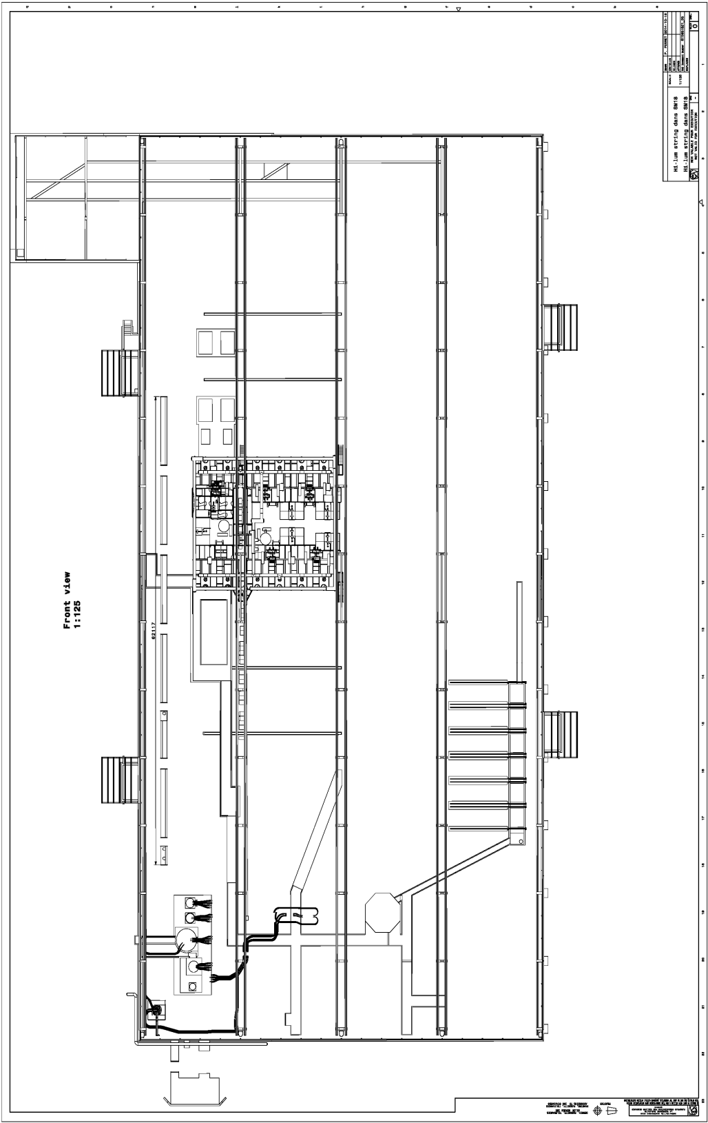

IT STRING SCOPE
IR STRING DSH
DFH + CL IR PC
Cluster D
Cluster A
Cluster E
Cluster B
Cluster F
Cluster C

Slide 4
IT STRING short term ACTIVITIES
Extract from the Mandate
….
Based on scope , the preliminary studies and cost estimates will be prepared in parallel with
Set up a TEAM and the modus operandi with GL and WPLs
ESTABLISH a COMPLET list of INGREDIENTS
Set up a possible TIMELINE and agree on that
WORK out a TEST plan
Work out a BUDGET and RESOURCES
Check specifically those equipment which are only be used in Sm18

Slide 5
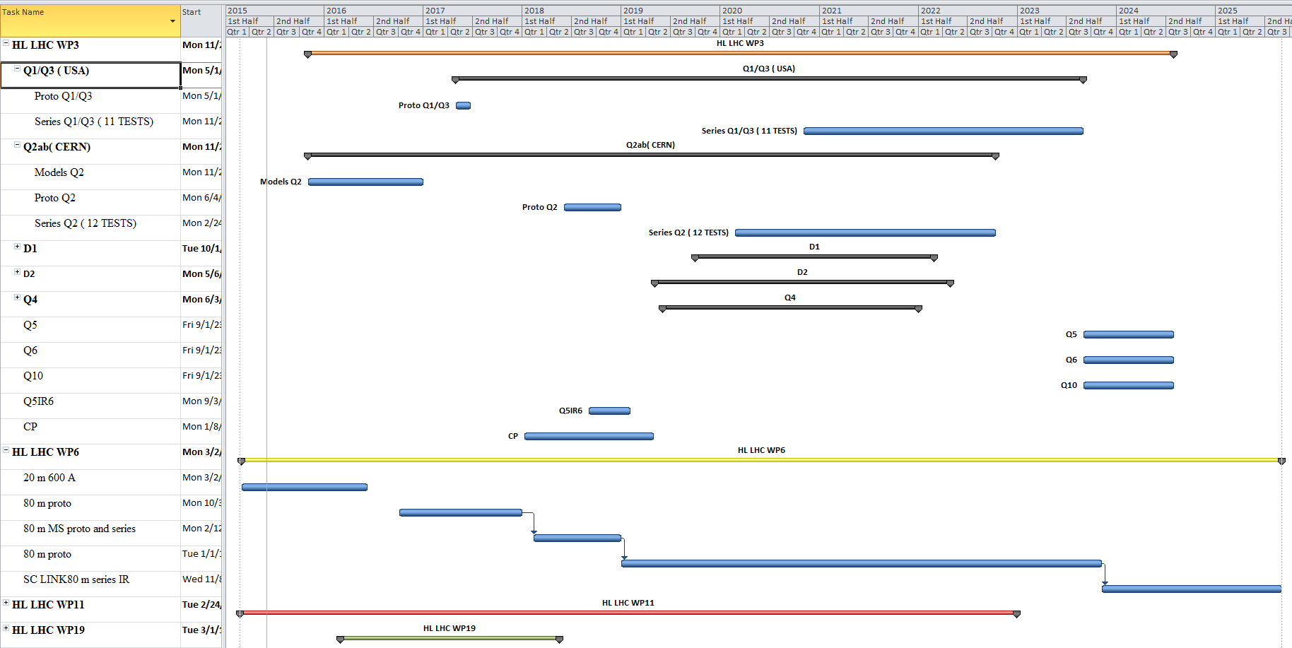
TIMELINE test for HL LHC magnets
From these it was defined the test stand readiness requirements ( see the presentation of Volker)

Slide 6
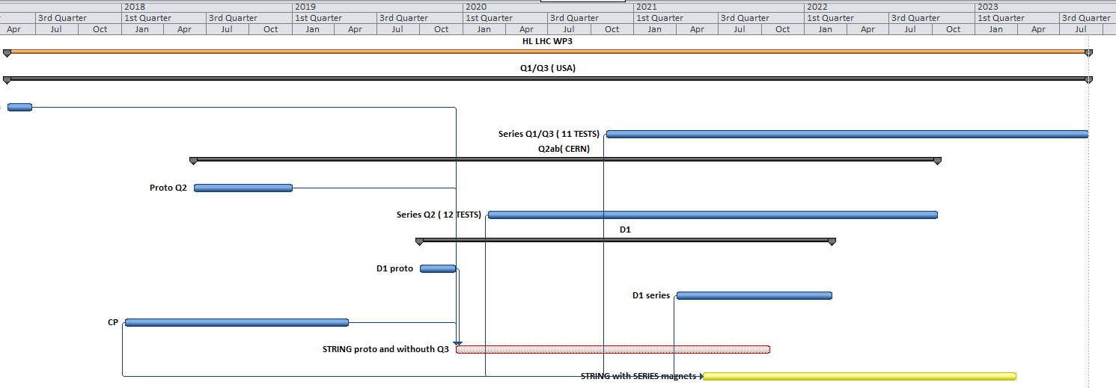
TIMELINE HL LHC IR STRING
2018
2019
2020
2021
2022
2023
STRING Phase1 can start in 2019 end with prototypes but Q3 will missing
STRING Phase2 can not start before mid 2021 due to late arrival of the 1st series of D1

Slide 7
HL LHC STRING preliminary TEST PLAN
Validation of a layout- integration
Validation of installation sequence and procedures
Validation of a system (of components)
Validation of their collective behaviour
Quench: provoked, natural, holding current, propagation, detection, protection, clic, dump, switch
Cryogenics: cooling- warming speed ( Nb₃Sn), heat load, recovery after quench, pressure, temperature, shielding
Integration: layout, interconnections, systems around ( racks, cables trays, control cables et), total weight
Powering: bus bar, connections, current leads, power distribution at warm and at cold, converters, water cooled cables
Electrical integrity: splice resistance, electrical insulation
Interlock
Vacuum: leak detection, beam screen
Instrumentation , DAQ systems, DB , QA, QC: specific or not to string
Alignment
GOALS in parallel:
Develop methods, techniques
Develop tooling
Develop procedures
Installations
Test
Operation
X
definition of
2
support
HWC
OP

Slide 8

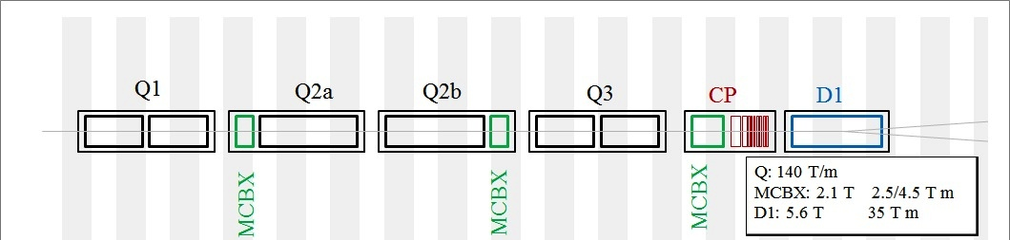
IT STRING INGREDIENTS
Test the COLLECTIVE BEHAVIOUR of ingredients tested individually
HL LHC STRING Ingredients… mainly from the WPs and possibly series equipment
Magnets: Q1, Q2a, Q2b, Q3,CP, D1
Power converters: 3 x 20 kA, 6 x 3 kA, 9 x 120 A
Power distribution: DFH and Current leads + SC link ( DSH)
Protection and EE system: 3 x switches x 20 kA, 3 x Dump
Cryogenic equipment ( cooling and cryo distribution)
Vacuum equippment
DAQ, Interlock, Software for Analysis ect is to be tested in the STRING
He gas recovery
Switch & Dump
Shuffling Module
D1
CP
Q3
Q2b
Q2a
Q1
DFH
LHe 4.2 K
20 kA
20 kA
12kA
Cryogenic feed box
Bus Bars
6 x3 kA
9 x 0.12 kA
Connection Module
SC Link (DSH)
Connection Module
80 m
Converters
SERVICE UPGRADE needed for :
Cryogenic cooling: additional 6 kW power plant and ( see estimates in the presentation of Luigi based on the complete planning of HL LHC magnet test plan + LHC spare magnet test program)
Demineralised water cooling: additional 55 m³/h ( aprox.0.5 MW) ✓
It is now blocked due to the fact that we have the approval together with the primary water
Primary water cooling: additional 2.5 MW for cryogenics
Electricity : tbc
These was defined and is part of the SM18 Test Facility UPG Project. See the presentation of Volker.

