Slide 1
SM18-UPG orientation
– Overview –
22.6.2015
V. Mertens

Slide 2
Introduction
Follow-up to mtg on 5.3.2015 – https://indico.cern.ch/event/374108/ (but shorter).
See also recent presentations in HL-LHC PL Cttee on 4.6.2015 – assume here all known:
https://indico.cern.ch/event/396467/contribution/2/material/slides/1.pdf (overview)
(includes test planning (what will be required by when) and more details on ongoing works)
https://indico.cern.ch/event/396467/contribution/4/material/slides/1.pdf (IT String)
RF needs now better defined (increased).
Cryogenics consumption recalculated (based on estimates and benchmarks).
Baseline workplan for cryogenics upgrade proposed – incl. several options (see L. Serio‘s talk).
Converge on extent and time table for the cryogenics upgrade (main SM18-UPG cost driver).
Right time now to put resources onto this if shall become ready during 2019.
IT String in turn is main driver for this (see M. Bajko‘s talk).
If String only operates in 2021/22 could still postpone decision, but would like to profit earlier.
Cryogenics upgrade ultimately to be formally approved (which format ?).
Mentioning other goals (cluster D, HFM, horizontal benches) „on the fly“ –
probably not last meeting of this kind.
Number of questions in today‘s talks –
ideally answer them on-line (or establish work list for things to clarify further).
Main aim of today:

Slide 3
Budget
L. van den Boogaard
Recall of the budget envelope:
13 MCHF in MTP for „TE infrastructure consolidation“.
HL-LHC project held prospect to contribute with 10 MCHF (but not transferred yet).
Other potential income sources (SC R&D, FCC, ...) unconfirmed – remaining vague.
Probably waiting to know what SM18-UPG will cost ...
For this useful to know what is inside and what not – assuming the following:
HFM budget-wise not integrated in SM18-UPG (but planning-wise looked after nonetheless).
IT String (3.8 MCHF ??) probably staying outside SM18-UPG as well; should be HL-LHC WP.
SM18-UPG provides sufficient cryogenics, water, electricity „from the plug“ + floor space.
Works on primary water system borne by EV-CV consolidation (4.6 MCHF).
Serves to create reserve on the SPS loop for LIU RF upgrade + modernise + upgrade f cryo.
Some of the main cost drivers not defined yet:
Cryogenics (today ?)
Horizontal benches for 20 kA (for series tests)
Safety
T. Otto / F. Viggiano
TO + FV making a full tour through SM18, in the frame of the initiative „Safety files for building“.
Preliminary hazard identification made. Risk evaluation in progress.
Preliminary study made into the risks from the presence of cryogenic fluids –
to be followed up in the framework of the above initiative (C. Fabre - 02/2015).

Slide 4
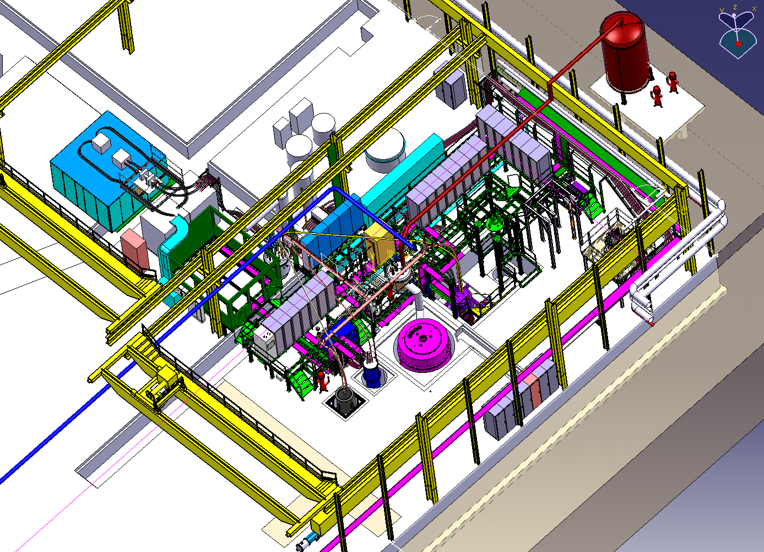
“Cluster G” (vertical test benches incl. former ”Block 4”)
Typically used for models and small size (corrector) magnets.
POWER CONVERTER
I_max 20 kA
FEED BOX
He gas
LONG
D 600 mm
L 3800 mm
HFM
SIEGTAL
D 800 mm
L 1400 mm
DIODE/LEADS
T min 4.2K
Ch. Giloux / Ph. Perret
TE-CRG confirmed HFM cryogenics will be completed by end 04/2016.
Cryostat weld problem being fixed – shall arrive here wk 29/2015.
TE-MSC: how do things proceed for current leads ?
First CERN-built Q2 model to come in 04/2016, FReSCa2 magnet in 07/2016.

Slide 5
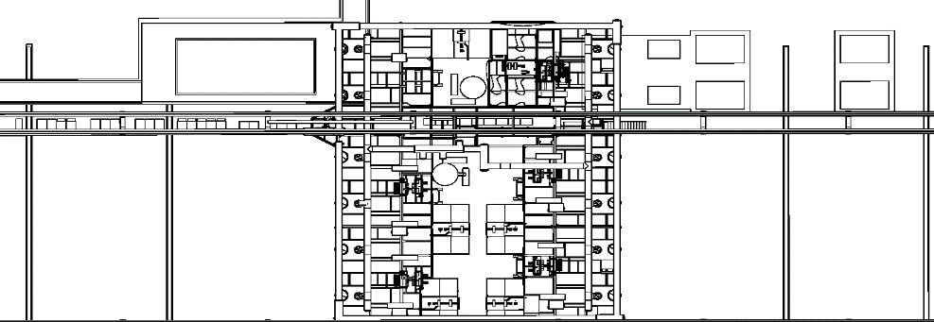
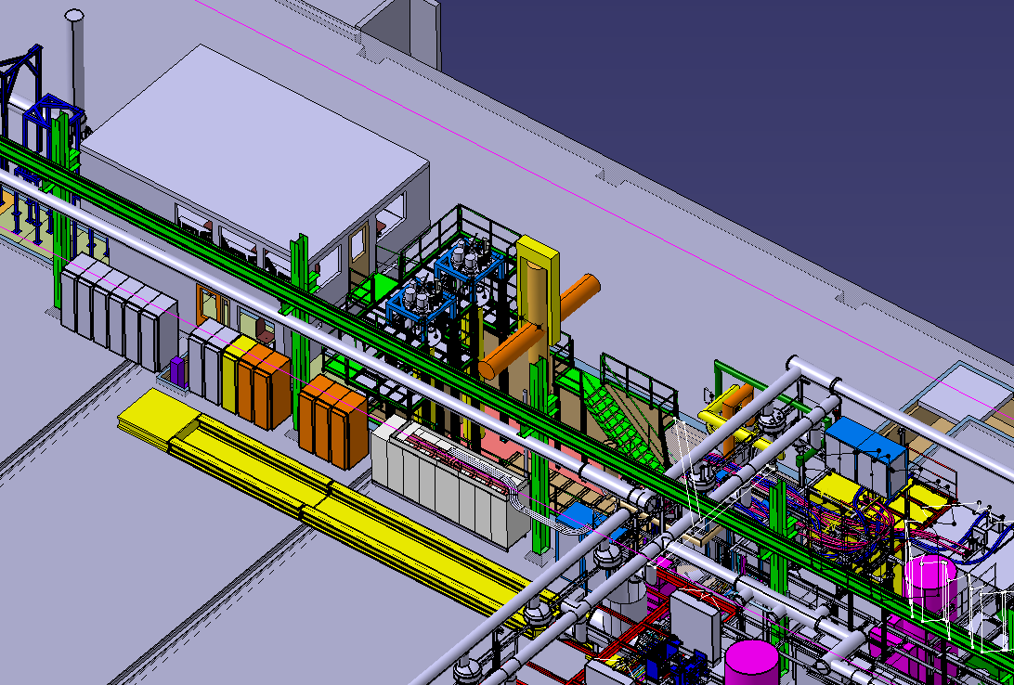
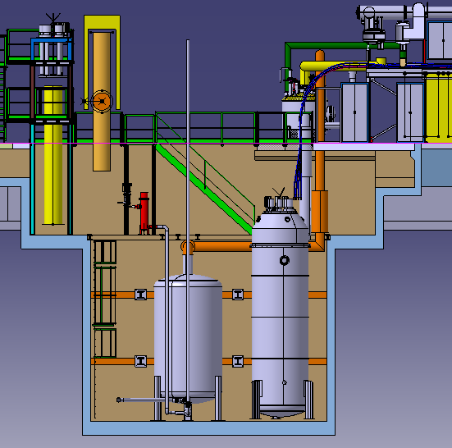
“Cluster D” (new vertical test bench)
Overall cost ca 5.6 MCHF.
Cross section
Cluster D
Cluster A
Cluster E
OSQAR
Cluster B
Cluster F
Cluster C
Cluster D
D 800 mm
L 5000 mm
I 30 kA
TE-CRG confirmed cryoge-nics will be completed by end 06/2016.
Lots of technical details still being worked out (cabling, interlocks, DAQ, ...).
Cryostat expected now for 02/2016.
TE-MSC: how do things proceed for current leads ?
TE-MPE: will 30 kA switch and new QPS card be ready in time (present plan 07/2016) ?
Ch. Giloux / Ph. Perret

Slide 6
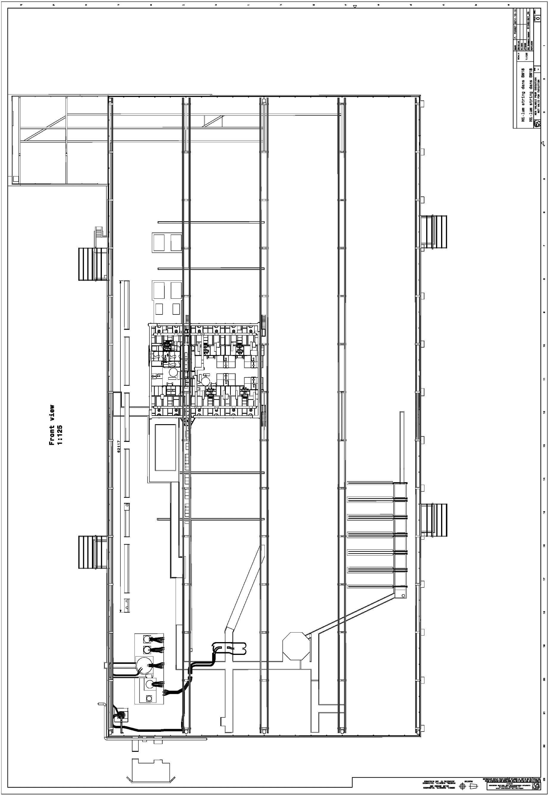

SC link
To test prototype SC link w 3 independent circuits of 2 x 15 kA + 17 kA. Reallocating PCs from cluster A and D; those benches will be blocked.
SC link of 60 m
IR Power Converters
Cluster D
Cluster A
Cluster E
Cluster B
Cluster Y
Cluster F
Cluster C
To be ready towards end 2016.
Uses existing cryogenics feedbox.
Needs appropriate current leads for SC link + 3 sets of water-cooled cables (from cluster D ?).
This (accepted) solution is 2.8 MCHF cheaper than the desired solution (with dedicated PCs).
The system test (2020) will use the existing feedbox or a new one,
and PCs from/for IRs (to develop).

Slide 7

H benches: various options, results pending
To test cryostated magnets (Q2 prototype in 2017 and series of Q1/Q3, Q2, Q4, D1, D2 in 2018) with up to 20 kA + 2 x 2 kA for correctors
(so far 10 benches left with 6 PCs, 1 of 17 kA (cl. A), 4 of 15 (14) kA;
CFUs equipped with 13 kA and 600 A current leads).
Cold connection between B2 and C1 ?
Cluster D
Cluster A
Cluster E
OSQAR
Cluster B
Cluster Y
Cluster F
Cluster C
Testing capabilities of present PCs: 20 kA reached in 05/2015 (cluster A, nominally 17 kA).
Main point: what are the CFUs/current leads capable of ? Which results and for when ?
If sufficient for 20 kA can equip 1st cluster like this for mid-2017
(and a 2nd later, for 2019/2020, to test the bulk of the series magnets).
Latest idea: Replace 14 kA PC by 20 kA, and re-use 2 x 7 kA to upgrade 2 more to 21 kA.
If not need to launch work on much more involved solution –
combining 2 H benches at warm or at cold (implying much higher cost, effort, time).
One such (Y-)bench only good for 6 magnets/yr but should be able to test up to 15 – need 2nd facility (Y-combination eating space) + OSQAR/ALPS (?) also around.
New demand to add EE on other H benches (than cluster A).
2 x 1 MCHF ???
3.3 (2) MCHF + ???

Slide 8
Summary
Acknowledgement to the many groups and persons involved in this ambitious extension programme, and the preparatory work done over past years.
Pushing forward on many fronts to reach the milestones.
Short-term milestones planned + intensively followed up; cluster D schedule (07/15) at risk.
Plea to groups (in particular with critical WPs)
  to put the required resources and respect the schedules.
Concepts worked out for some of the longer term items (primary water, ...).
Degree of cryogenics upgrade to be reviewed and formally adopted (lion´s share of cost).
– time line and resource situation also to be looked at (m-y to be firmly assigned).
Feasibility for some medium term goals still to be proven; technical choices to be made.
Some items in work not mentioned here (safety, control room(s), ...).
Some other items still to be looked at (electricity, ...) – starting.
Budget frame to be better defined (income, expenses).
Manpower to perform all the planned tests also to be foreseen (a different discussion ...).

Slide 9
Extra slides

Slide 10
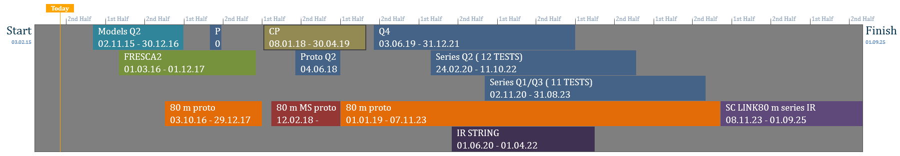
Test planning – which upgrade/modification will be needed when ?
2015
2016
2017
2018
2019
2020
2021
2022
2023
2024
2025
Underlying „normal test programme“ (repaired spares)
Timeline: M. Bajko
Demineralised water station upgrade
Horizontal test bench allowing higher current (up to 20 kA + 2 x 2 kA)
2nd horizontal test bench for higher current
(up to 20 kA + 2 x 2 kA)
Powering from Clusters D + A
New vertical cryostat for larger diameter and higher current
(„Cluster D“)
Modification of horizontal bench for multiple powering circuits
Cryogenics plant upgrade (incl. primary water + possibly electricity upgrade)
25 t crane upgrade
Powering from own range of converters
New vertical cryostat for larger diameter (“HFM”)

Slide 11
B180-SM18 project
SM18-UPG
construction 2014 to ca. 2019
(IT String operation in 2021/22)
readymid-2016
PL
V. Mertens
Project management
Assistance to PL, overall coordination F. Formenti
Planning
E. Page
Technical coordinators
Magnet/SC link test stations
M. Bajko
Cavity test stations
K. Schirm
Cryogenic infrastructure
L. Serio
Work packages
...
EN-CV
...
...

Slide 12


SM18 – The Safety point of view
T. Otto / F. Viggiano
PRELIMINARY Hazard identification:
Substances: Cryogenic fluid (Helium)
Fire and Explosion
Electrical Hazard
  Under Voltage Elements
  Short-circuiting
Physical Hazard
  Noise
Thermal Hazard
Mechanical hazard
  Liquids under pressure
  Mechanical motions
  Manual tools
Material Embrittlement
Drop
Oxygen Deficiency Hazard (ODH)
Extreme Cold Hazard
Fire Hazard
Oxygen Enriched Hazard
Over Pressurization or Explosion due to Rapid Expansion
This is only a preliminary hazard analysis, THE EVALUATION IS IN PROGRESS

