Slide 2
SM18 cryogenics infrastructure upgrade
L. Serio
TE-CRG

Slide 3
Outline
Project definition
  Scope of work, limit of supply and interfaces
  Requirements and assumptions
  Estimation of the cryogenic loads based on
    Users planning and theoretical loads
    Benchmarking with measured data
Baseline conceptual proposal
  Phased implementation
  Budget and resources
Alternative scenarios parametric study
Risks and opportunities

Slide 4
Scope of Work
Consolidation and upgrade of the SM18 cryogenic infrastructure
  for the HL-LHC Project and other large cryogenic capacity needs
  to cover the 2015-2023 period (and beyond ?)
The new infrastructure shall:
· increase testing rate and parallel testing capabilities -> increase LHe production and 1.8 K pumping capacity
· increase availability
-> implement redundancy
· fulfil cooling needs for IT String (3) (triplet Q, SC link and feed box)
-> additional and dedicated equipment

Slide 5
Limit of supply and interfaces
Limits of supply
Magnet test stations
 | Vertical
 | Horizontal
 | SC links / IT String (3)
Cavity test stations
 | Vertical
 | Horizontal
Cryogenic test station
 | GReC
Cryogenics production
 | Helium liquefiers / refrigerators
 | compressor stations
 | purification system and balloons
 | L/G He and LN2 common storage
 | Warm and cold pumping units
 | Common valve boxes and TL
 | CWUs
Utilities
 | Cooling water
 | Electrical power distribution
 | Industrial controls
Interfaces
Magnet test stations proximity cryogenics
 | Vertical
 | Horizontal
 | SC links / IT String (3)
Cavity test stations proximity cryogenics
 | Vertical
 | Horizontal
Cryogenic test station
 | GReC
Utilities
 | Civil engineering
 | Cooling and ventilation
 | Electrical power distribution
 | Transport and handling
 | Integration
 | Platform and structures
 | Industrial controls

Slide 6
Requirements and assumptions
  Baseline testing capability/requirement based on foreseen test plan (incl. other limitations) and theoretical loads (Q1-2014)
    Magnets: 2 Vertical and 2 Horizontal magnet cold / month (2 powering)
    Cavities: 1 cavity test/2 weeks; 1 module test every 6 months
    SC link or IT String (3)
      Integrated systems testing, commissioning and operation
      ‘demanding’ individual systems tests on dedicated facilities
    Apply 50 % contingency for
      Known unknowns
      (e.g. unplanned tests, repeated tests and low performing components)
      Unknown unknowns

Slide 7
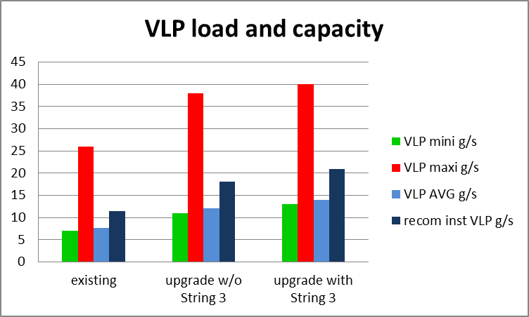
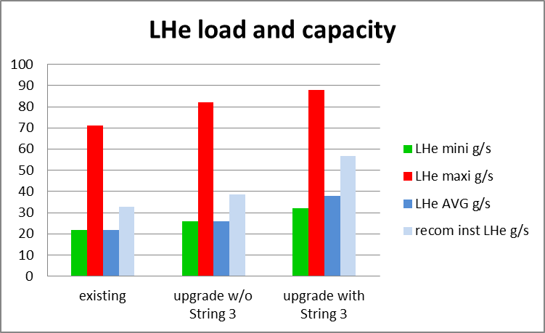
Estimated loads and capacity
Mini: lower consumption tests
Maxi: no HW limitation – all tests
AVG: assumptions and 1 month avg
Recommended installed: AVG + 50 % margin
new
LHe 4.2 K
existing
new
VLP 1.8 K
existing

Slide 8
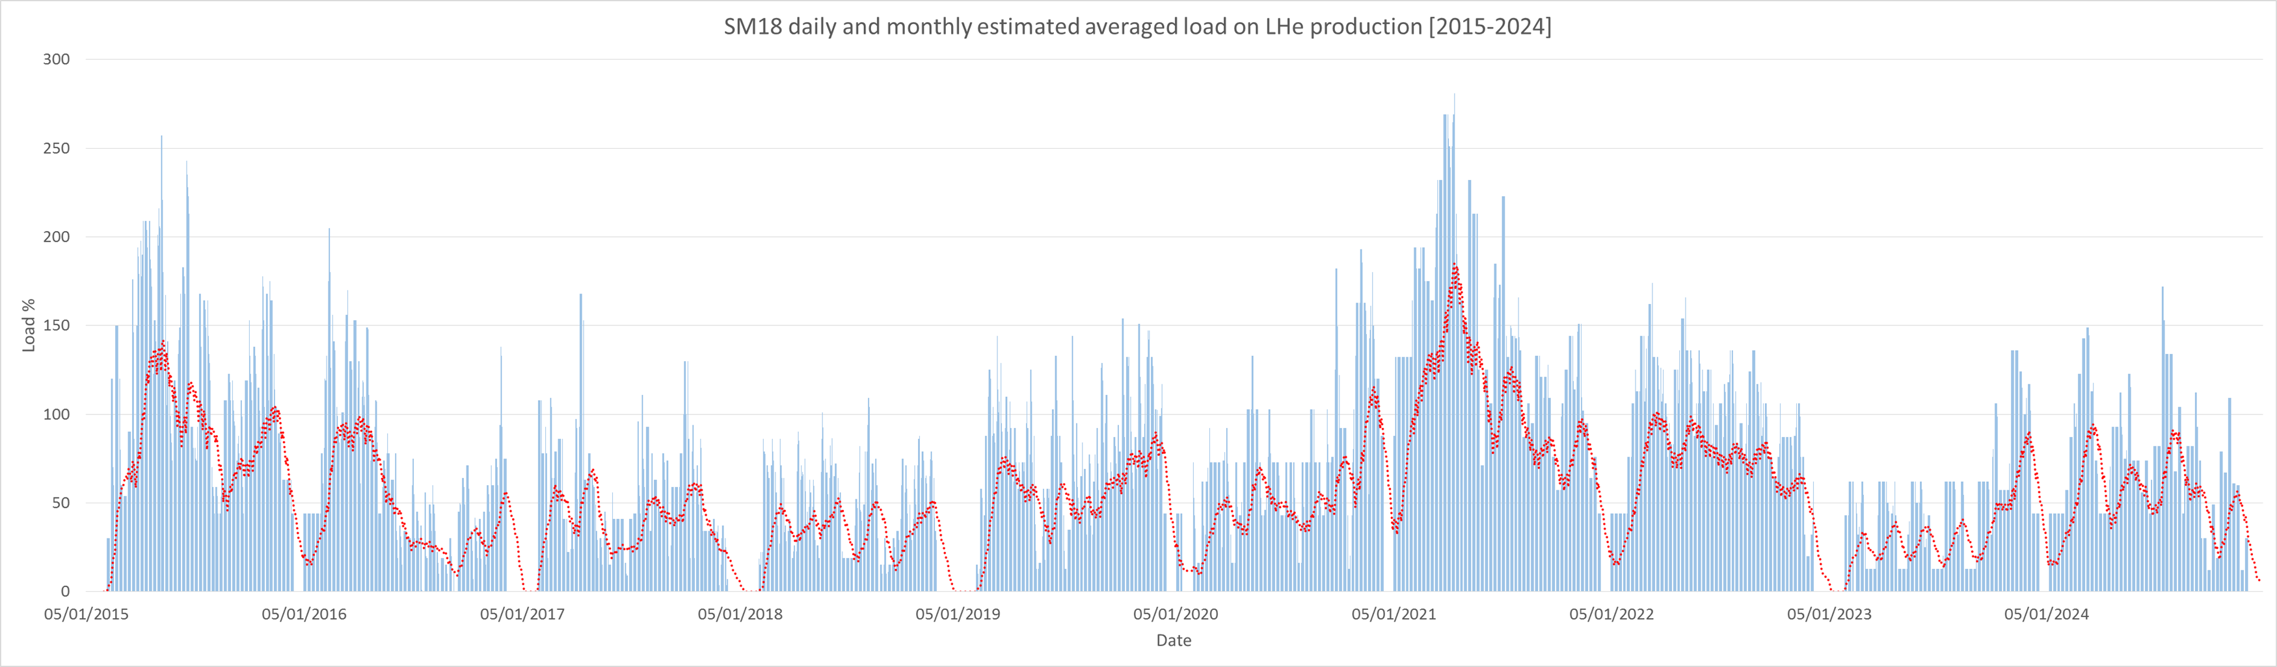
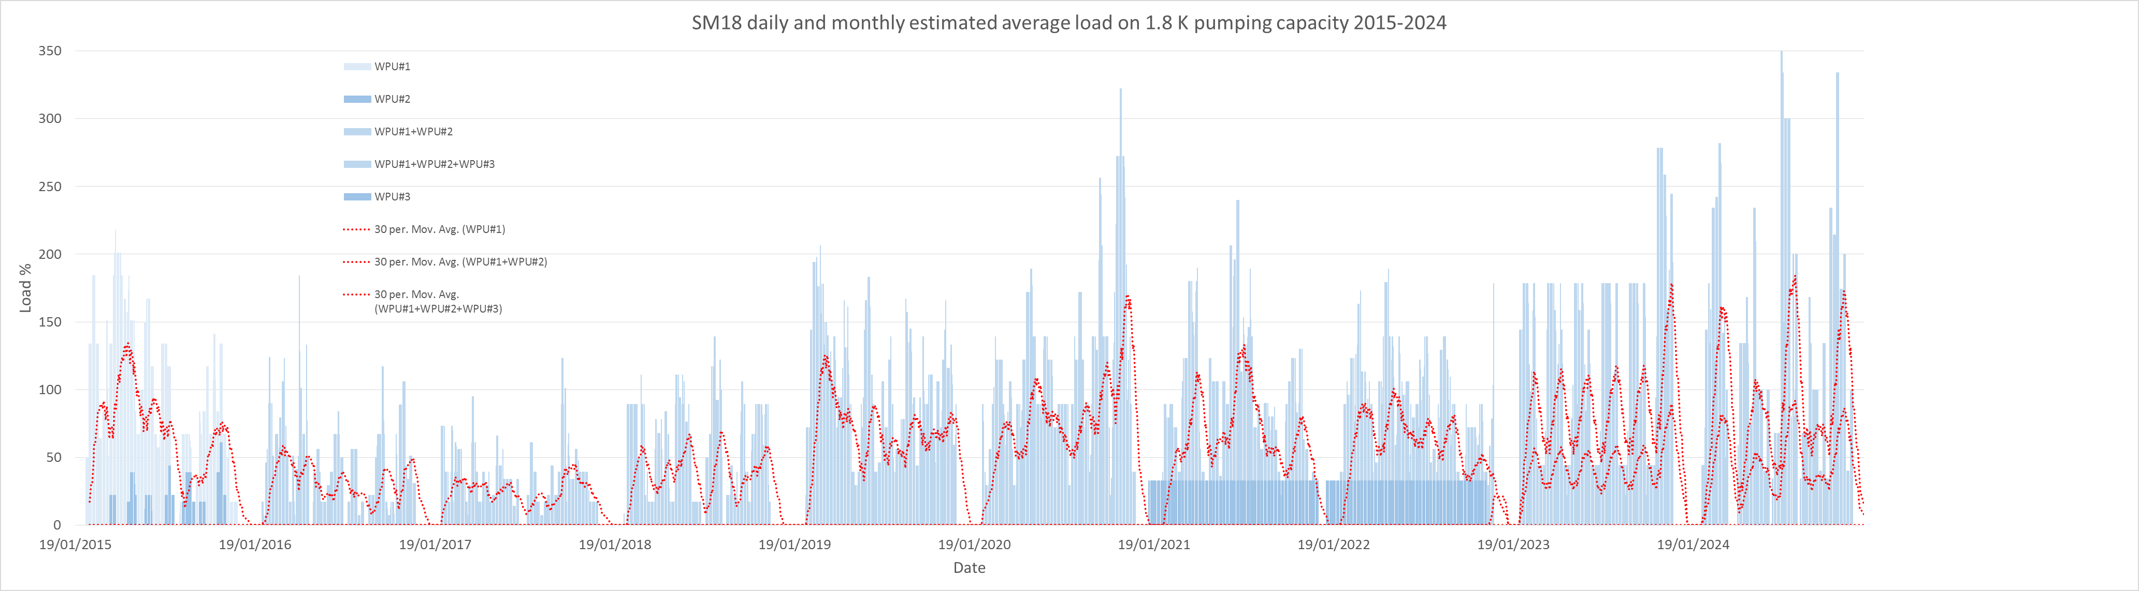
Cryogenics loads based on users planning
[estimated theoretical loads and benchmarking]
Delayed start
New benchmark
point
6 kW Linde + new 35 g/s liquefier
6 kW Linde
6 kW Linde + new 10 g/s liquefier
Longer and delayed SD
WPU1 + WPU2 + WPU3
WPU1 + WPU2 + WPU3
WPU1 + WPU2
WPU1 + WPU2
WPU1 & WPU2

Slide 9
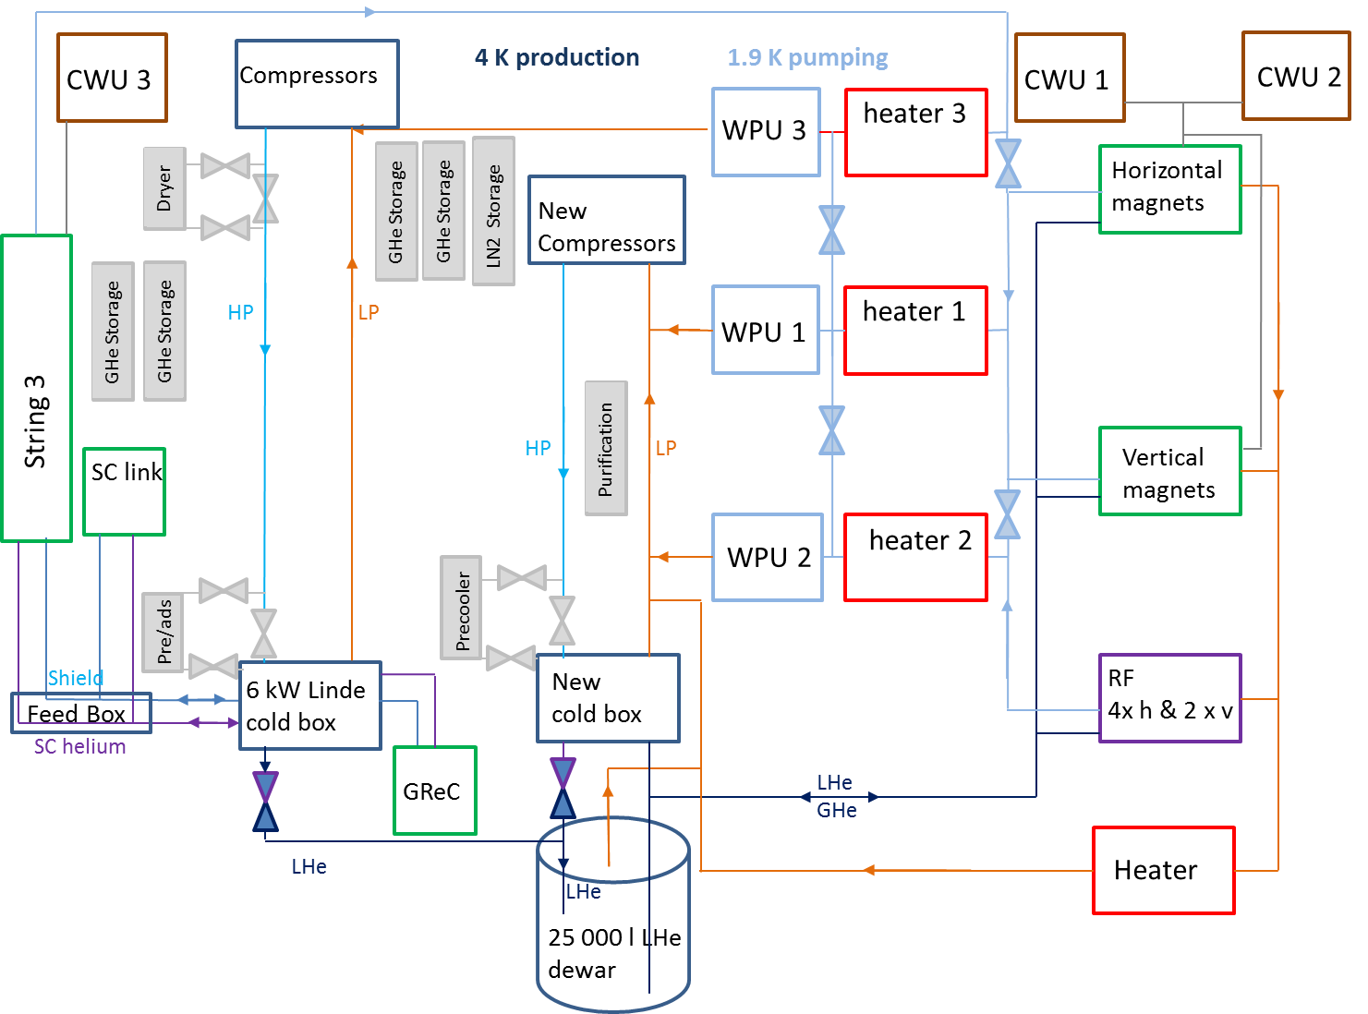
Baseline conceptual proposal

Slide 10
Proposed implementation plan
Phased approach with available resources (minimisation of risk and investment) :
  Review tests requirements, milestones and implementation plan
  Review availability (redundancy) requirements
  Implement instrumentation (HW and virtual) to control/optimise distribution
  Upgrade controls (advanced) to improve performance and optimize
  Upgrade VLP (interconnections) to increase capacity and availability
  New WPU and CWU
  New refrigerator
done
done
implementing
under study
under study
on-hold
on-hold
production capacity:
< 6 g/s @ 1.8 K
< 18 g/s @ 2.0 K
< 27 g/s LHe
< 200 kW CWU
< 12 g/s @ 1.8 K
< 36 g/s @ 2.0 K
< 200 kW CWU
< 18 g/s @ 1.8 K
< 54 g/s @ 2.0 K
< 27 g/s LHe
< 300 kW CWU
< 18 g/s @ 1.8 K
< 54 g/s @ 2.0 K
< 60 g/s LHe
< 300 kW CWU

Slide 11
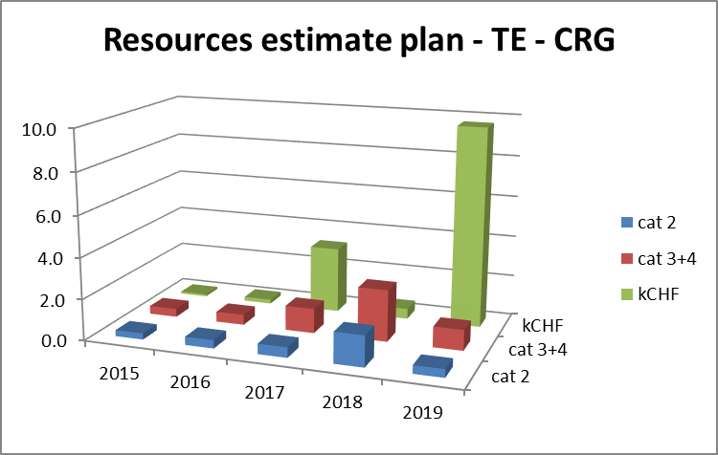
Budget and resources
Estimates for cryogenic production infrastructure
  Utilities and civil engineering tbd after reviewing global SM18 UPG project
  Doesn’t take into account String 3 resources needs and overlap
Budget and resources available for TE/CRG
  Conditional to smooth operation and maintenance of the LHC
  Conditional to successful implementation in 2016 of new CRG O&M contract

Slide 12
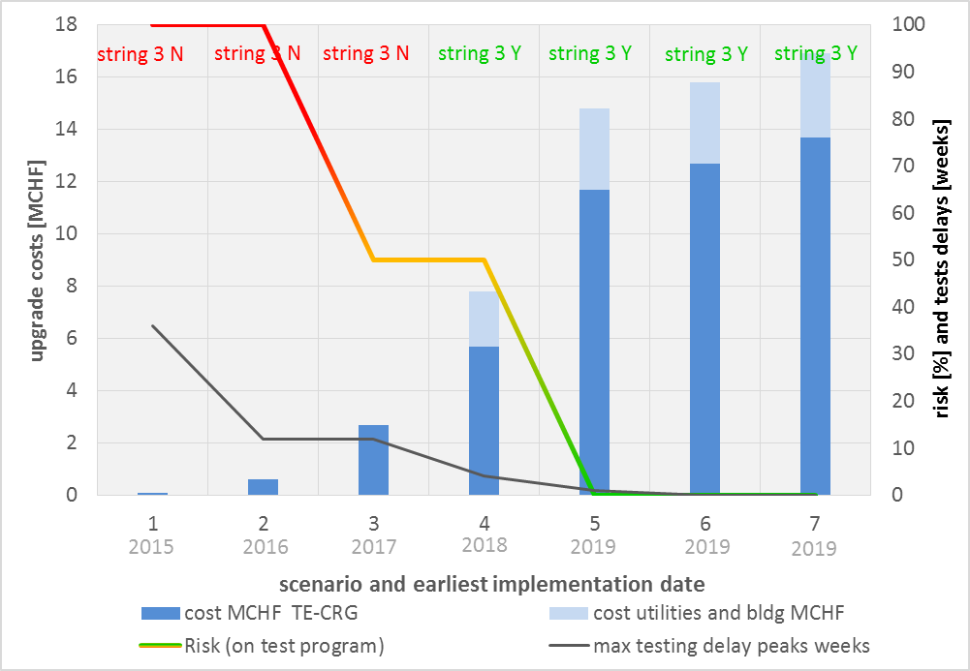
Alternative scenarios parametric study
possible
BASELINE
recommended
Scenarios:
Controls/instr.
Coupling WPUs
WPU3
New liq 10 g/s
New liq 25 g/s
New liq 35 g/s
New ref 6 kW

Slide 13
Risks and opportunities
RISKS
  Not finalised or changing requirements -> cost against performances (?)
    Existing test stands: configuration, test rate, planning and required parallelism
    Contingency for known unknown and unknown unknown
    What beyond 2024 ?
  Resources availability constraints
    Smooth operation and maintenance of the LHC / New M&O contract ?
    Other projects (e.g. HL-LHC, SM18 proximity cryogenics, String 3, HIE-ISOLDE)
    LS2 overlap and conflict
  Budget
    Review of global SM18 UPG requirements and impact on utilities and CE
OPPORTUNITIES
  String 3 delayed to 2021 / 2022
    Proceed with scenario 2 only
    Delay to 2016 the decision based on a comprehensive review of all costs of SM18 project
  Synergies with other projects
    HL LHC, FAIR (?)

Slide 14
References
SM18 upgrade Project Plan
  https://edms.cern.ch/document/1488041/2
Presentation TE-TM
  https://edms.cern.ch/file/1373723/2/TE_TM_L_Serio_20140410.pdf

Slide 16
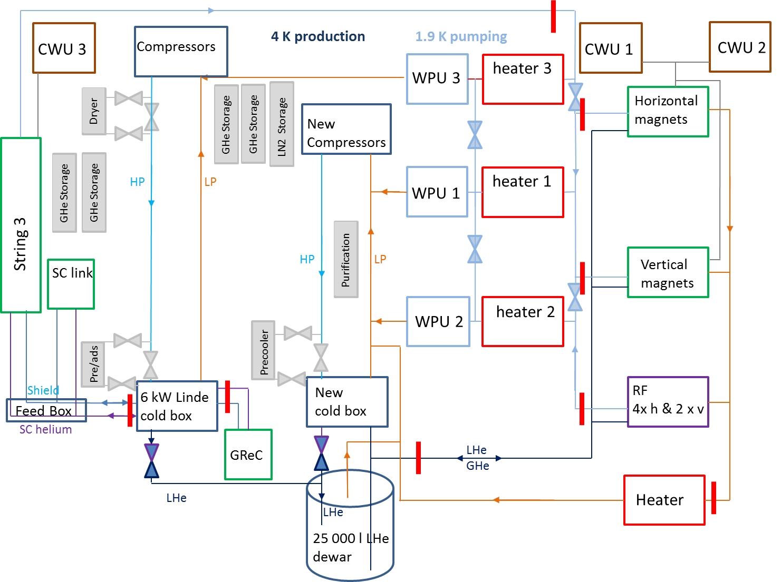
boundaries

Slide 17
SM18 Infrastructure
Compressors
WPU 3
heater 3
Dryer
New Compressors
LN2 Storage
GHe Storage
GHe Storage
HP
LP
heater 1
GHe Storage
WPU 1
HP
LP
Purification
WPU 2
heater 2
Pre/ads
Precooler
6 kW Linde
cold box
New
cold box
By-pass valves
By-pass valves
LHe
GHe
LHe
Heater
LHe
25 000 l LHe
dewar

Slide 18
CWU 3
Proximity Cryogenics
CWU 1
CWU 2
Horizontal magnets
String 3
SC link
Vertical
magnets
Shield
RF
4x h & 2 x v
Feed Box
SC helium
GReC

Slide 19
WBS
1 | PROJECT MANAGEMENT
2 | CRYOGENIC PRODUCTION AND DISTRIBUTION
2.1 |  | 6 kW LINDE LIQUEFIER
2.2 |  | 6 kW LINDE COMPRESSOR STATION
2.3 |  | new REF or LIQU. |  | 6 kW
2.4 |  | new COMPRESSOR STATION
2.5 |  | CWU 1
2.6 |  | CWU 2
2.7 |  | new CWU 3 |  | 100 kW
2.8 |  | main distribution valve box
2.9 |  | main distribution transfer lines
3 | PURIFICATION SYSTEM
3.1 |  | Purification system 1
3.2 |  | Purification system 2
3.3 |  | Recovery compressor 1
3.4 |  | Recovery compressor 2
3.5 |  | Balloon system
3.6 |  | impure storage
4 | STORAGE
4.1 |  | LHe dewar - 25'000 l
4.2 |  | LHe mobile dewar - 10'000 l
4.3 |  | GHe tanks
4.4 |  | LN2 dewars
4.5 |  | new GHe tanks
5 | 1.9 K pumping system
5.1 |  | Warm pumping unit 1 & heater
5.2 |  | Warm pumping Unit 2 & heater
5.3 |  | Refurbished (new) Cold Pumping Unit 1
5.4 |  | New Cold Pumping Unit 2
5.5 |  | New WPU cold distribution box
5.6 |  | New Warm Pumping Unit 3 |  | 6 g/s
5.7 |  | New Cold Pumping Unit 3
6 | CONTROLS AND ELECTRICAL
6.1 |  | Controls upgrade
6.2 |  | New refrigerator
6.3 |  | New pumping Unit
6.4 |  | Infrastructure
7 | UTILITIES
7.1 |  | Civil engineering 250 m2
7.2 |  | Controls and network upgrade
7.3 |  | Cooling and ventilation 2 MW; 100 kW
7.4 |  | Electrical power and distribution 2 MW
7.5 |  | Transport and Handling 20 t crane

Slide 20
Review of client baseline testing program and consumptions
Estimates of the 4.5 and 1.8 K loads based on 2014 last quarter test plan
Comparison with measured loads
Extrapolation to 2015 – 2026 baseline test program

Slide 21
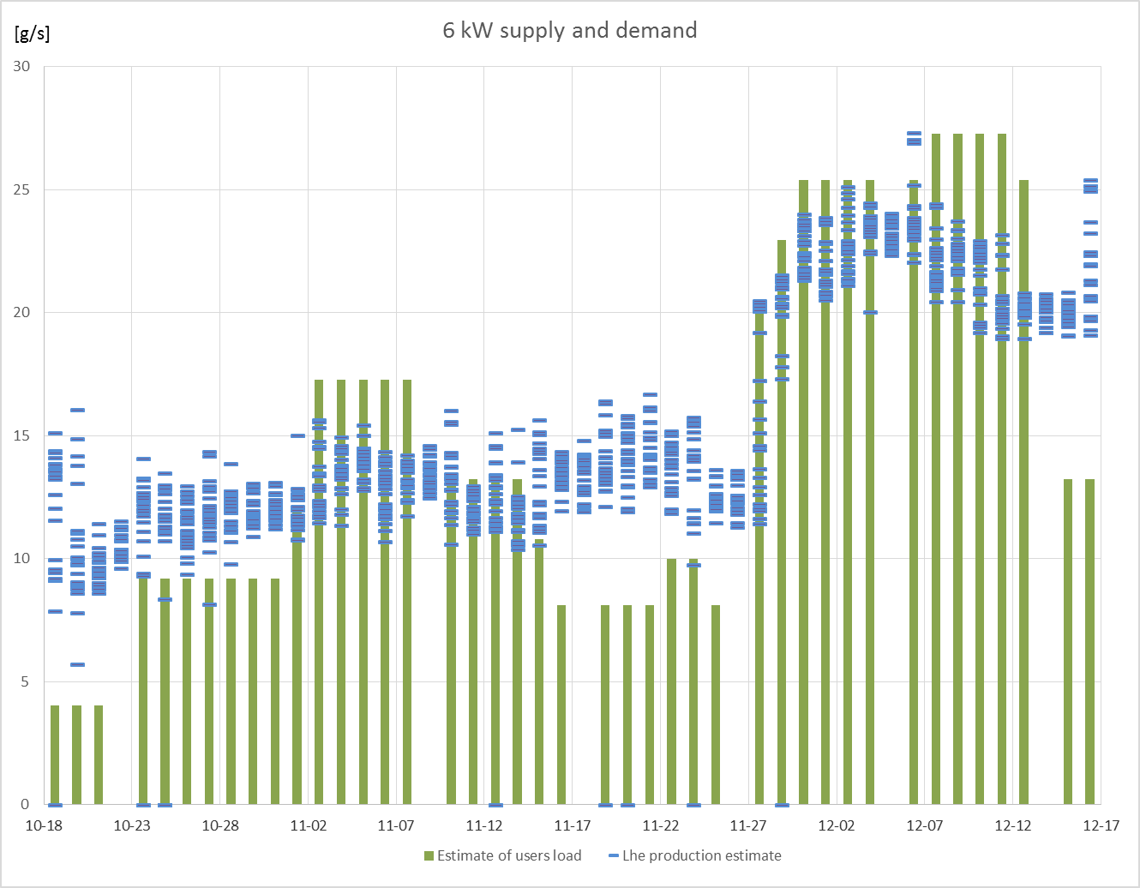
Benchmark on 2014 tests: 4.5 K

Slide 22
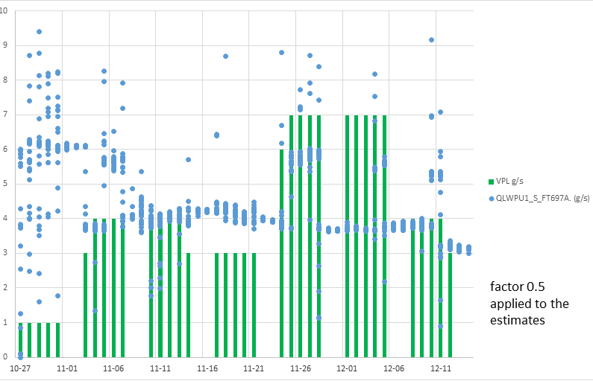
Benchmark on 2014 tests: 1.8 K

Slide 23
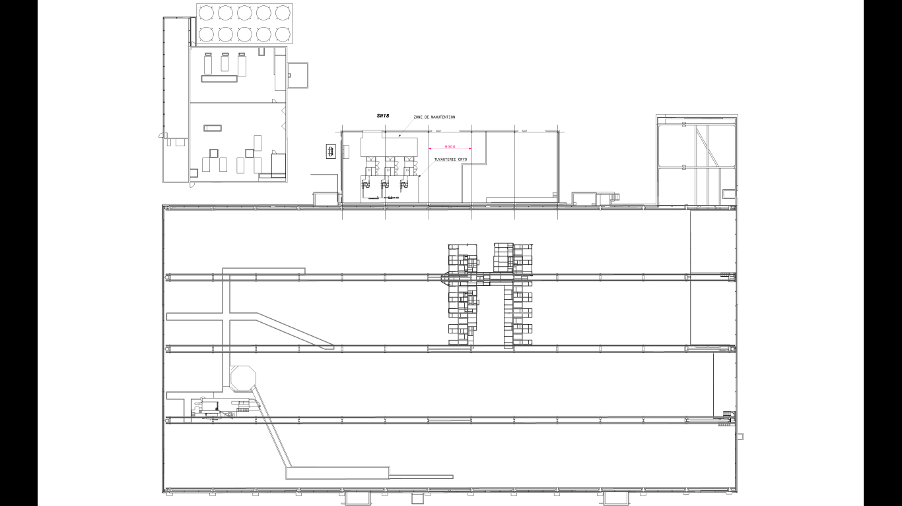
Conceptual study ongoing for positioning of cryogenics infrastructure to supply IT String.
Very likely that a new building will be required.
New refrigerator or liquefier
SM18
New compressor station
New WPU3
SW18
Cooling water
&
Cryogenics
?
SH18
cryogenics
New compressor station

Slide 24
Phase 3a
Cold by-pass for full redundancy between the heaters and WPU’s (check for use of existing interface box valves

Slide 25
Phase 3b (ready for String 3)

Slide 26
Upgrades and loads

