Slide 1
FCC-ee Joint accelerator and physics Video
29 June 2015
1. conference presentations and invitations
-- need a volunteer speaker’s board
2. FCC-ee activities
-- upcoming workshops
3. recent reviews

Slide 2
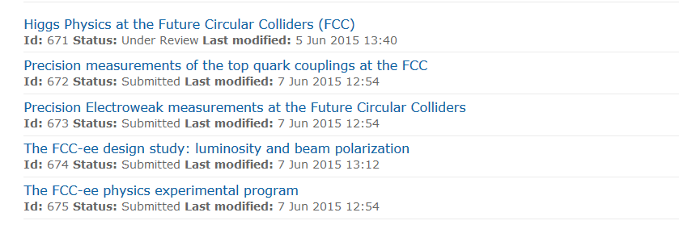
EPS-HEP
Id 747
Flavours at a high luminosity e+e- collider (FCC-ee)
Talk, Monteil
Talk, Klute
Talk, Janot
Talk, Dam
Koratzinos(poster)
Blondel (poster)
or volunteer

Slide 3
Other invitations:
LHCP15 (31-Aug - 5 sept) : Fulvio
"17th Lomonosov Conference" (Moscou, 20-26 aout) David d’Enterria
ECT* Trento (8-11 sept), David d’Enterria
13-18 septembre: Pologne - http://indico.if.us.edu.pl/event/us2015
speaker on FCC-ee Need volunteer.
August 2-10 Summer school, campus of Shandong University at Weihai City (http://en.wh.sdu.edu.cn/enDefault.html)
3 lectures of 1.5 hours. Alain will go
Workshop 10-12 August - CEPC physics workshop in August (http://indico.ihep.ac.cn/event/4937/overview). I will be in the committee but cannot go. need talks
Conference in Crete: 23-30 August indico.cern.ch/event/icnfp2015
invitation for talk on FCC-ee need volunteer
There is a demand --
WE NEED A SPEAKERS’BOARD system and chair. M. Klute will discuss this next time.

Slide 4
FCC-ee activities
-- upcoming workshops
Detector workshop
1st FCC-ee mini-workshop on Detector Requirements
17-18 Jun 2015 - 13:00 - CERN - 40-5-A01 see report later.
First FCC-ee mini-workshop on Precision Observables and Radiative Corrections
13-14 Jul 2015 - 14:00 - CERN - TH Conference Room
Workshop on high-precision alpha_s measurements: from LHC to FCC-ee https://indico.cern.ch/event/392530/ 12 Oct - 13 Oct 2015 (CERN)
    Higgs physics workshop Markus Klute
    https://indico.cern.ch/event/401590/ 24-25 September 2015
Next General FCC-ee physics workshop in november
Asked John Ellis to organize in London.
Oliver Buchmuller, Mario Campanelli, John Ellis, Andreas Korn, Bjorn Penning, as LOC Favorite date : 11-13 November 2015

Slide 5
FCC internal Reviews
presentation of physics requirements 5 June 2015
FCC-hh (Michelangelo Mangano)
FCC-ee (Patrick Janot)
(revised version uploaded on this meeting page)
FCC tunnel footprint and implementation Thursday 11 June
FCC-ee crab-waist scheme Friday 12 June

Slide 6
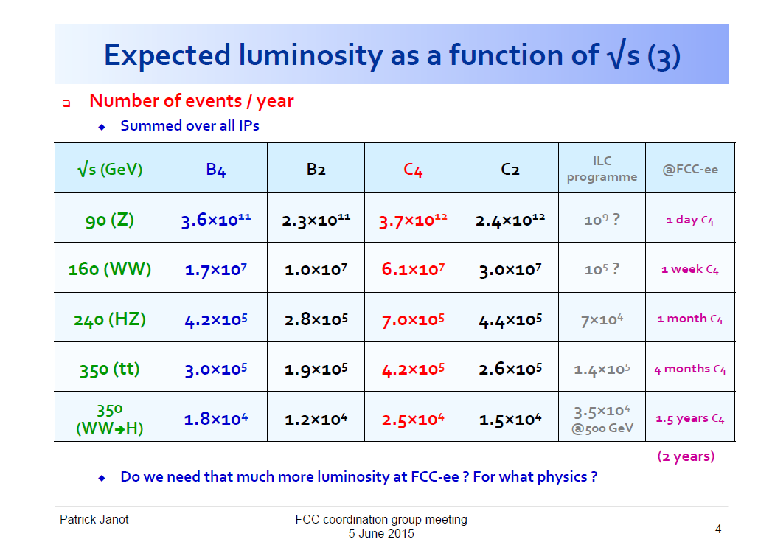

Slide 7
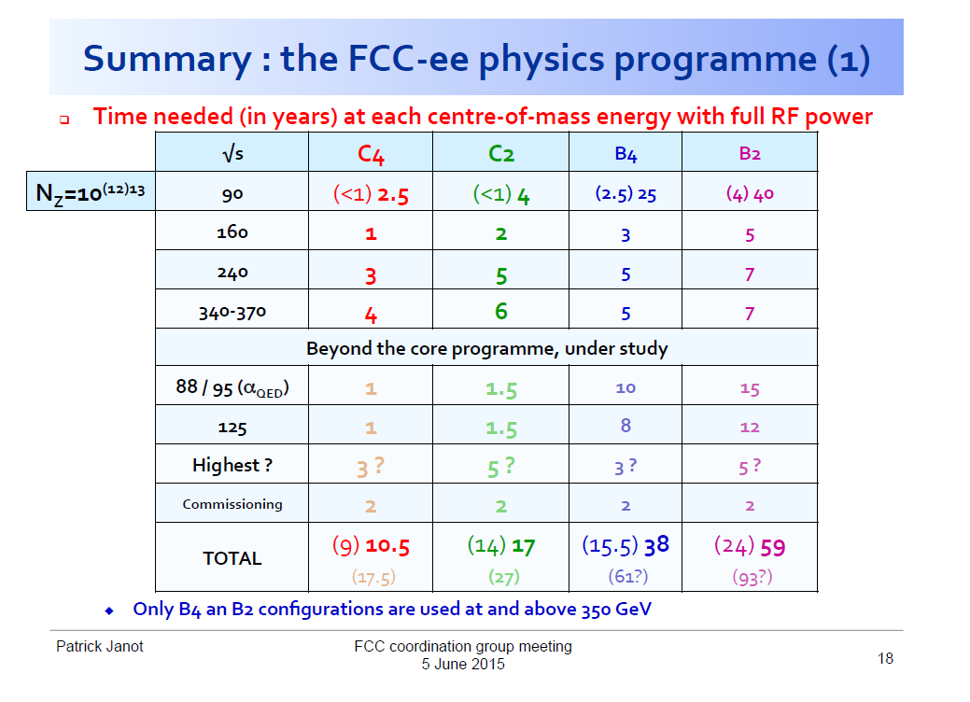

Slide 8
-- crab waist scheme review
should be encouraged as it provides high luminosity.
principle is sound.
difficulty with several points of implementation
-- synchrotron radiation in the experimental section.
.should try to avoid any dipole magnet stronger than those in the arcs
.limits on critical energy and power should be evaluated
for the experiment and for the environment
-- solenoid compensation and interface with experiment
. will require to establish the optics principles of the compensation
. and then a work party between magnet designers
report has been prepared by Oide-san.

Slide 9
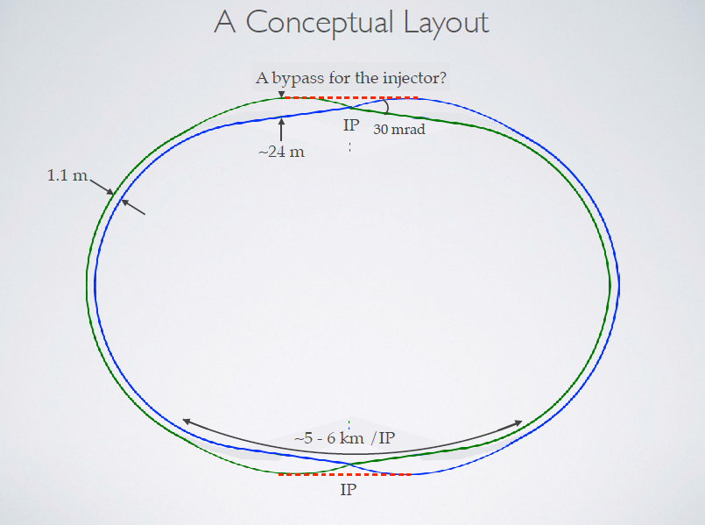
Oide

Slide 10
FCC tunnel footprint and implementation Thursday 11 June
noted that there is not a single solution that works for the electron machine yet.
Need scheme for RF staging, implementation of bypasses etc... to be decided
-- possibility to have a non flat geometry was discussed
.leads to less deep access shafts and caverns
.at this point not sure if this is either needed or sufficient
.leads to loss of top energy in hadron collider
.delicate corrections for spin or vert. dispersion in electron machine
-- but an elegant solution was found using solenoid and twisted quads
to adapt one bending plane and spin orientation to the next.(Kopp)
should work at all energies.
spin matched at zeroth order both at Z and WW. Higher orders?
- more studies needed concerning deep caverns in Molasse terrains
summary by P.Lebrun at FCC coordination group 24 June.

Slide 11
MOUs: we need to get our MOU signed !
If your institute does not have an MOU, please let us know asap
→ We will be chasing you

