Slide 1
HL-LHC V1.2
Update
G. Arduini, R. De Maria, M. Fitterer, M. Giovannozzi
Thanks to, C. Garion, S. Fartoukh, P. Fessia,
C. Magnier, H. Prin, E. Todesco, B. Vasquez De Prada, P. Campana, R. Linder, E. Thomas, G. Wilkinson, J. Uythoven, M. Fraser, F. Cerutti, R. Kersevan, P. Ferracin

Slide 2
HL-LHCv1.2 status
Optics repository ready and validated/used by collimation team
Still undergoing iterations with integration team (many incremental changes in warm elements and crab cavity positions from first 1.2 layout provided in spring). Full checks (IR1/5 Left/Right) not yet completed. Other small changes expected.
IR6 squeeze being update due to new layout from 1.0 and refined optics constraints from ABT.
New triplet aperture are emerging from detailed analysis of coil to cold bore layer thickness. Same level of analysis not done for D2 and Q4.
New length for TAXN, but design do be re-discussed since did not include diverging pipes.
Issues with transverse TCT integration led to discussions on aperture strategies and possible relocations of TCT.
Aperture estimate being analyzed with different/newer algorithms.

Slide 3
Aperture update

Slide 4
Squeezed optics
Optics scenarios considered:
β* | 15 cm | 7.5cm/30cm | 20 cm | 10 cm/40 cm
Crossing angle | ± 295 μrad | ± 245 μrad | ± 255 μrad | ± 210 μrad
 | 12.5 σ | 14.5 σ | 12.5 σ | 14.5 σ
Separation | ± 2.00 mm | ± 0.75 mm | ± 2.00 mm | ± 0.75 mm

Slide 5
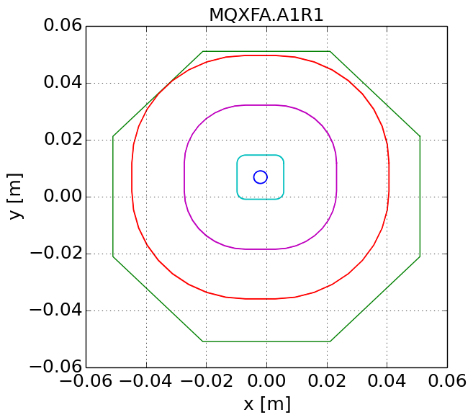
Aperture margins ingredients
Optics defines nominal orbit and beam sizes.
Geometry of the vacuum region (e.g. beam screens inner dimensions with tolerances incuded provided).
Operational tolerances on the beam position.
Alignment and fiducialization tolerances are subtracted from available aperture.
The maximum amplitude that fit in the aperture is calculated and given in beam sigma with operational tolerances on sigma.
The available stay-clear distance of a beam with the target amplitude is computed in mm.
In practice:
an area of possible beam positions with respect to an ideal aperture is found by adding all tolerances from the ideal beam positions.
the distance between the boundary of the this area and the ideal aperture in measured for several angles in mm and scaled with the imperfect sigma for a given angle.

Slide 6
Aperture and knobs effects
 | Coil aperture | Beam¹ aperture | H,V²full gaps | Sep. knob | Crossing Knob | Crab shift knob | Crab slope knob | Offset knob
 | [mm] |  | [mm] | [mm] | [mm] | [mm] | [mm] | [mm]
TAXS |  | Circle | 60, 60 | 0.8 | 6.1 | 0.0 | 0.0 | 2.0
MQXFA.[AB]1 | 150 | Octagon | 99, 99 | 0.8 | 11.2 | 0.0 | 0.0 | 2.4
MQXFB.[AB]2 | 150 | Octagon | 119, 119 | 1.2 | 16.7 | 0.2 | 0.0 | 3.6
MQXFA.[AB]3 | 150 | Octagon | 119, 119 | 0.8 | 16.6 | 0.4 | 0.0 | 2.8
MBXF | 150 | Octagon | 119, 119 | 0.5 | 15.5 | 0.5 | 0.0 | 2.4
TAXN |  | Circle | 85, 85 | 0.2 | 5.5 | 0.9 | 0.0 | 3.0
MBRD | 105 | Octagon | 84, 84 | 0.1 | 3.3 | 1.0 | 0.0 | 3.3
MCBRD | 105 | Octagon | 84, 84 | 0.1 | 1.7 | 1.0 | 0.1 | 3.4
MCBYY | 90 | Octagon | 70.8,70.8 | 0.0 | 0.1 | 1.0 | 0.5 | 4.0
MQYY | 90 | Octagon | 70.8,70.8 | 0.0 | 0.0 | 1.0 | 0.5 | 3.9
TCLMB.5 |  | RectEllipse | 57.8, 48 | 0.0 | 0.0 | 0.4 | 0.2 | 3.7
MCBY[HV].5 | 70 | RectEllipse | 57.8, 48 | 0.0 | 0.0 | 0.0 | 0.0 | 3.6
MQY.5 | 70 | RectEllipse | 57.8, 48 | 0.0 | 0.0 | 0.2 | 0.1 | 3.5
TCLMC.6 |  | RectEllipse | 45.1,35.3 | 0.0 | 0.0 | 0.0 | 0.0 | 2.3
MCBC[HV].6 | 56 | RectEllipse | 45.1,35.3 | 0.0 | 0.0 | 0.0 | 0.0 | 2.1
MQML.6 | 56 | RectEllipse | 45.1,35.3 | 0.0 | 0.0 | 0.0 | 0.0 | 2.1
¹Either Beam screen or beam pipe;
² Mechanical tolerances already removed. Rectellipse types are exchanges the H,V orientation depending on the polarity.

Slide 7
Beam tolerances and collimation apertures
Beam Tolerance | LHC Design | HL-LHC Inj./Coll.
Emittance [µm] (normalization only) | 3.75 | 3.5/3.5
β-beating [%] | 20 | 10/20
Orbit error [mm] | 4 | 4/2
Spurious Disp. [%] | 27.3 | 14/10
Energy error [10⁻³] | 8 | 6/2
Target aperture [σ] | 8.4 | 9⁽¹⁾/12(18⁽²⁾)
Beam tolerances have been re-defined by:
taking into account LHC Run I positive experience
adding safety margins based on possible unknowns.
For collimation:
magnet protected by TCT: ≥12 σ
magnet not protect by TCT: 18 σ⁽²⁾ or possibly less pending dedicated studies (R. Bruce) .
R. Bruce et al.
Minimum aperture not protected by TCT in collision and aperture targets at injection should be confirmed by WP5⁽²⁾ and WP14⁽¹⁾.

Slide 8
Survey tolerances
 | Ground motion |  |  | Fiducializaton
 | r [mm] | h [mm] | v [mm] | r [mm] | h [mm] | v [mm]
TAXS (*) | 2.0 | 0 | 0 | 0 | 0.5 | 0.5
Triplets | 0.6 | 0 | 0 | 0 | 1.0 | 1.0
BPMs | 0 | 0 | 0 | 2.5 | 0 | 0
TAXN (*) | 0.84 | 0.36 | 0 | 0 | 1.0 | 1.0
D1 | 0.6 | 0.36 | 0 | 0 | 1.0 | 1.0
D2/Q4/Q5 | 0.84 | 0.36 | 0 | 0 | 0.9 | 0.6
r
v
h
Value derived from J. Jeanneret, LHC rep 1007 but to be validated by survey, WP3, WP8(*) teams

Slide 9
Aperture update
Adding tolerances one by one in the next tables:
Bare: no mechanical tolerances, perfect beam, perfect alignment
Mech: mechanical tolerances in beam screen, perfect beam, perfect alignment
Beam: mechanical tolerances in beam screen, imperfect beam (including triplet misalignments in orbit budget), perfect crab and perfect IP alignment
Crab: mechanical tolerances in beam screen, imperfect beam (including triplet misalignments in orbit budget), crab misalignment, perfect IP alignment
Offset: mechanical tolerances in beam screen, imperfect beam (including triplet misalignments in orbit budget), crab misalignment, IP misalignment

Slide 10
Aperture Round
β=15cm
Θ_{c}=±295 μrad
d_{sep}=±2 mm
 | bare [σ] | mech[σ] | beam[σ] | crab[σ] | offset[σ]
TAXS |  | 17.3 | 13.9 | 13.9 | 11.9
MQXFA.[AB]1 | 17.4 | 16.7 | 14.2 | 14.2 | 13.2
MQXFB.[AB][23] | 12.8 | 12.4 | 10.5 | 10.4 | 9.4
MBXF | 13.6 | 13.1 | 11.1 | 10.9 | 10.3
TAXN |  | 17.3 | 14.7 | 14.2 | 12.7
MBRD | 19.7 | 18.7 | 15.7 | 14.9 | 12.6
MCBRD | 21.7 | 20.7 | 17.4 | 16.6 | 14.1
MCBYY | 25 | 23.7 | 19.8 | 18.7 | 14.9
MQYY | 26.3 | 25 | 20.9 | 19.7 | 15.7
TCLMB.5 |  | 28.6 | 23.9 | 23.9 | 20.2
MCBY[HV].5 |  | 29.6 | 24.7 | 24.5 | 20.6
MQY.5 |  | 30.6 | 25.6 | 25.4 | 21.4
TCLMC.6 |  | 29.2 | 23.9 | 23.9 | 21.2
MCBC[HV].6 |  | 30.3 | 24.7 | 24.7 | 24.7
MQML.6 |  | 30.2 | 24.6 | 24.6 | 21.8

Slide 11
Aperture Round
β=15cm
Θ_{c}=±295 μrad
d_{sep}=±0.75 mm
 | bare [σ] | mech[σ] | beam[σ] | crab[σ] | offset[σ]
TAXS |  | 17.5 | 14.2 | 14.2 | 12.3
MQXFA.[AB]1 | 17.4 | 16.7 | 14.2 | 14.2 | 13.2
MQXFB.[AB][23] | 12.8 | 12.4 | 10.5 | 10.4 | 9.4
MBXF | 13.6 | 13.1 | 11.1 | 10.9 | 10.3
TAXN |  | 17.3 | 14.7 | 14.2 | 12.7
MBRD | 19.7 | 18.8 | 15.7 | 15.0 | 12.6
MCBRD | 21.7 | 20.7 | 17.4 | 16.6 | 14.1
MCBYY | 25 | 23.7 | 19.8 | 18.7 | 14.9
MQYY | 26.3 | 25 | 20.9 | 19.7 | 15.7
TCLMB.5 |  | 28.6 | 23.9 | 23.9 | 20.2
MCBY[HV].5 |  | 29.6 | 24.7 | 24.5 | 20.6
MQY.5 |  | 30.6 | 25.6 | 25.4 | 21.4
TCLMC.6 |  | 29.2 | 23.9 | 23.9 | 21.2
MCBC[HV].6 |  | 30.3 | 24.7 | 24.7 | 24.7
MQML.6 |  | 30.2 | 24.6 | 24.6 | 21.8

Slide 12
Aperture Round
β=20 cm
Θ_{c}=±255 μrad
d_{sep}=±2.0 mm
 | bare [σ] | mech[σ] | beam[σ] | crab[σ] | offset[σ]
TAXS |  | 19.4 | 15.6 | 15.6 | 13.2
MQXFA.[AB]1 | 21.6 | 20.8 | 17.8 | 17.8 | 16.6
MQXFB.[AB][23] | 16.3 | 15.8 | 13.5 | 13.4 | 12.3
MBXF | 17.1 | 16.5 | 14.1 | 13.9 | 13.2
TAXN |  | 20.6 | 17.5 | 17 | 15.2
MBRD | 22.6 | 21.6 | 18.1 | 17.2 | 14.5
MCBRD | 25.0 | 23.8 | 20.0 | 19.1 | 16.2
MCBYY | 28.9 | 27.4 | 22.9 | 21.6 | 17.2
MQYY | 30.5 | 28.9 | 24.2 | 22.8 | 18.2
TCLMB.5 |  | 33.1 | 27.7 | 27.7 | 23.4
MCBY[HV].5 |  | 34.2 | 28.6 | 28.4 | 23.9
MQY.5 |  | 35.4 | 29.6 | 29.4 | 24.7
TCLMC.6 |  | 33.7 | 27.6 | 27.6 | 24.5
MCBC[HV].6 |  | 34.9 | 28.5 | 28.5 | 28.5
MQML.6 |  | 34.9 | 28.4 | 28.4 | 25.2

Slide 13
Aperture Flat
β=30/7.5cm
Θ_{c}=±245 μrad
d_{sep}=±0.75 mm
 | bare [σ] | mech[σ] | beam[σ] | crab[σ] | offset[σ]
TAXS |  | 15.2 | 12.5 | 12.5 | 11.1
MQXFA.[AB]1 | 15.7 | 15.2 | 13 | 13 | 12.3
MQXFB.[AB][23] | 12.5 | 12.1 | 10.4 | 10.4 | 9.7
MBXF | 13 | 12.7 | 10.9 | 10.8 | 10.3
TAXN |  | 14 | 11.9 | 11.6 | 10.6
MBRD | 15.2 | 14.7 | 12.4 | 12.0 | 10.8
MCBRD | 16.8 | 16.1 | 13.6 | 13.2 | 11.9
MCBYY | 19.7 | 18.9 | 15.9 | 15.4 | 12.9
MQYY | 20.2 | 19.4 | 16.3 | 15.8 | 13.4
TCLMB.5 |  | 20.6 | 17.1 | 17.1 | 14.5
MCBY[HV].5 |  | 21.4 | 17.8 | 17.6 | 15
MQY.5 |  | 21.7 | 18.1 | 18 | 15.3
TCLMC.6 |  | 20.7 | 16.8 | 16.8 | 14.9
MCBC[HV].6 |  | 21.4 | 17.4 | 17.4 | 17.4
MQML.6 |  | 21.7 | 17.7 | 17.7 | 15.7

Slide 14
Aperture Flat
β=40/10 cm
Θ_{c}=±210 μrad
d_{sep}=±0.75 mm
 | bare [σ] | mech[σ] | beam[σ] | crab[σ] | offset[σ]
TAXS |  | 17.9 | 14.8 | 14.8 | 13.3
MQXFA.[AB]1 | 18.1 | 17.5 | 15 | 15 | 14.2
MQXFB.[AB][23] | 14.4 | 14 | 12.1 | 12 | 11.2
MBXF | 15 | 14.6 | 12.6 | 12.4 | 11.9
TAXN |  | 16.2 | 13.8 | 13.5 | 12.3
MBRD | 17.6 | 16.9 | 14.3 | 13.9 | 12.5
MCBRD | 19.3 | 18.6 | 15.7 | 15.3 | 13.7
MCBYY | 22.7 | 21.8 | 18.4 | 17.8 | 15
MQYY | 23.3 | 22.3 | 18.9 | 18.2 | 15.5
TCLMB.5 |  | 23.8 | 19.8 | 19.8 | 16.8
MCBY[HV].5 |  | 24.7 | 20.5 | 20.4 | 17.3
MQY.5 |  | 25.1 | 20.9 | 20.8 | 17.6
TCLMC.6 |  | 23.8 | 19.4 | 19.4 | 17.3
MCBC[HV].6 |  | 24.7 | 20.1 | 20.1 | 20.1
MQML.6 |  | 25.1 | 20.4 | 20.4 | 18.1

Slide 15
Optics and wire beta/crab impedance

Slide 16
Optimization of Q4/Q5 position
Three different scenarios:
minimization of crab cavity voltage
minimization of impedance = minimize
optimization of beta function ratio for wire = ratio at Q4 + 5m is
=> obtain optimal solution by scanning over beta at Q4 for 99.3% of maximum Q7 strength (this means optics are matched for a particular beta_{x} and beta_{y} at Q4)

Slide 17
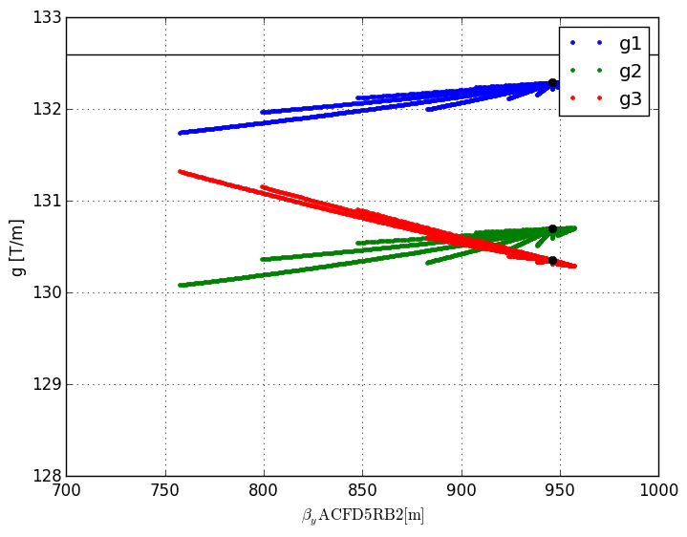
Baseline: Q4@177.6, Q5@207.49
triplet gradient vs beta at Q4
IT gradient stays in all cases below 132.6 T/m

Slide 18
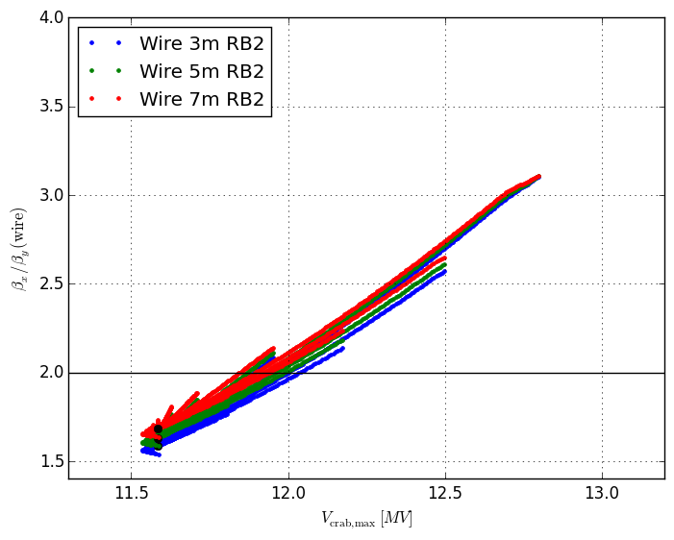
Baseline: Q4@177.6, Q5@207.49
wire vs crab cavity voltage
minimum voltage not reached for beta function ratio of 2 at the wire

Slide 19
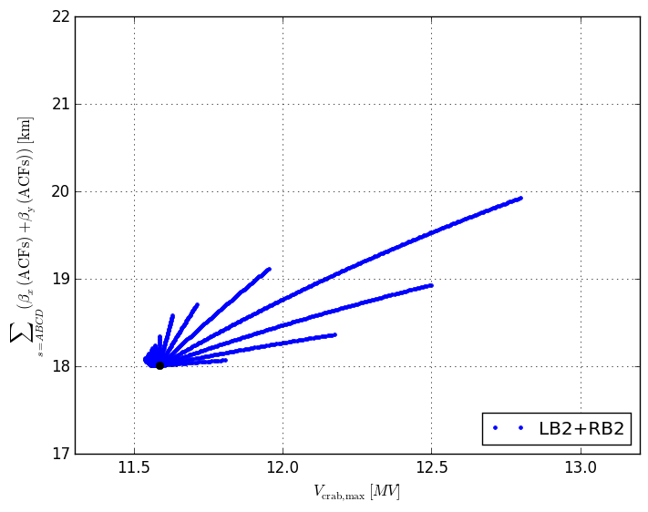
Baseline: Q4@177.6, Q5@207.49
impedance vs crab cavity voltage
impedance fairly independent of cc voltage except for the separate paths

Slide 20
Dependence on Q4 position
moving Q4 towards the IP:
- higher cc voltage for optimal ratio of 2 of beta@wire
- loss in Q4 and Q5 aperture (higher beta)
- no relevant change in impedance
- gain in optics flexibility, more operational margin for optics correction
- better aperture for alignment optics
moving Q4 towards the arc:
- smaller cc voltage for optimal ratio of 2 for beta@wire
- gain in Q4 and Q5 aperture (smaller beta)
- no relevant change in impedance
- less optics flexibility, less operational margin for corrections
- much worse aperture for alignment optics

Slide 21
Dependence on Q5 position
moving Q5 towards the IP:
- no relevant difference for Q4/Q5 aperture
- no change in cc voltage for optimal ratio of 2 of beta@wire
- no relevant change in impedance
- small loss in optics flexibility
moving Q5 towards the arc:
- no relevant difference for Q4/Q5 aperture
- no change in cc voltage for optimal ratio of 2 of beta@wire
- no relevant change in impedance
- small gain in optics flexibility

Slide 22
Comparison of cornercases
case | optics | β_{x}/β_{y} (wire) | β_{min}/β_{max} [m] (wire) | V_{max} [MV] | β_{cc} [km] | β_{min}/β_{max} [m]
 |  |  |  |  |  | MBRD | Q4 | Q5
baseline | wire | 2 | 455/909 | 12.22 | 18.9 | 1523/1929 | 622/1100 | 183/507
 | ccvolt | 1.6 | 487/781 | 11.93 | 18.1 | 1381/1992 | 676/929 | 173/479
 | impedance | 1.63 | 480/780 | 11.97 | 18 | 1380/1984 | 669/928 | 169/478
Q4+2m, Q5+2m | wire | 2 | 408/814 | 12.21 | 18.2 | 1442/1936 | 577/981 | 135/474
 | ccvolt | 1.7 | 449/764 | 11.89 | 18.2 | 1386/1999 | 630/913 | 152/464
 | impedance | 1.65 | 451/742 | 11.86 | 18 | 1361/2006 | 637/883 | 149/454
Q4-2m, Q5-2m | wire | 2 | 474/948 | 12.43 | 18.8 | 1546/1891 | 643/1150 | 202/514
 | ccvolt | 1.53 | 525/801 | 11.98 | 18 | 1379/1983 | 722/950 | 196/495
 | impedance | 1.53 | 525/801 | 11.98 | 18 | 1379/1983 | 722/950 | 196/495
=> moving Q4 and Q5 by 2m is advantageous in some respects and worse for optics flexibility, alignment optics, small loss in D2 aperture (to be checked taking also the orbit into account) and a very small degradation of the impedance.

Slide 23
LHCb upgrade

Slide 24
Implication of running to higher levelled luminosity in LHCb
Levelled luminosity LHCb [10³⁴ cm⁻²s⁻¹] | Opt fill length (IP1/5) [h] | Integrated luminosity ATLAS/CMS [fb⁻¹/y] | Integrated luminosity LHCb [fb⁻¹/y] | β* IP8 [m] | Levelling time IP8 [h]
0.2 (nom.) | 9.3 | 261 | 10.5 | 3 | 9
1 | 9.1 | 258 | 28 | 3 | 0.5
1 | 9 | 257 | 37 | 2 | 3
1 | 8.8 | 256 | 47 | 1 | 6
1 | 8.8 | 255 | 51 | 0.5 | 8
2 | 9.1 | 258 | 28 | 3 | 0
2 | 8.9 | 257 | 40 | 2 | 0
2 | 8.5 | 253 | 69 | 1 | 2
2 | 8.3 | 250 | 87 | 0.5 | 4.5
β* not demonstrated yet
β*=0.5 m
-> Challenging without IP shift
β*= 1.0 m
->Challenging with IP shift
Preliminary, G. Arduini 8/9/2015

Slide 25
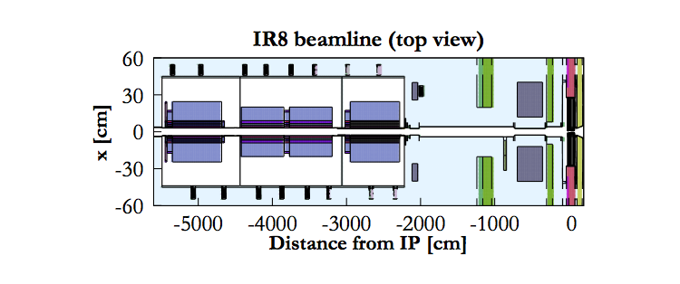
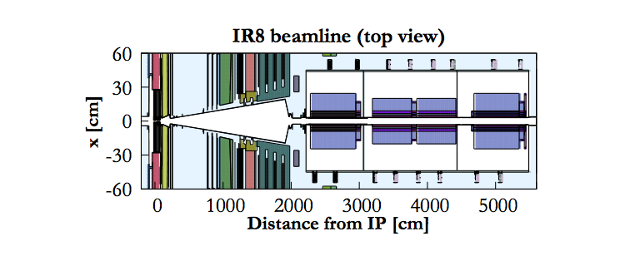
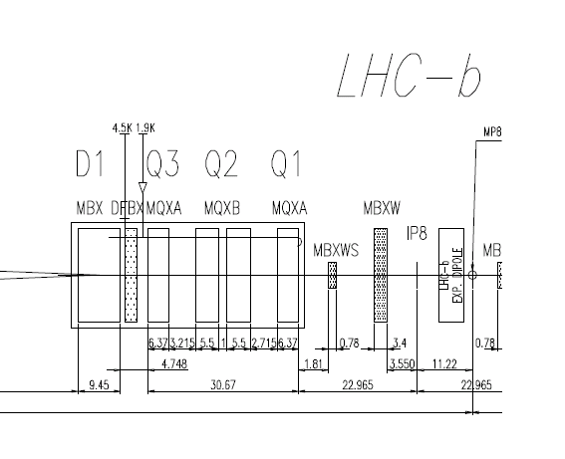
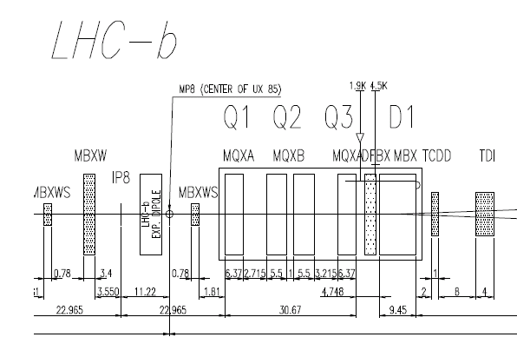
Layout
E. Thomas , R. Lindner
IP8 displaced by 3.74 m to Point 7
D1(new) (0.9 - 1.2 Tm) at 2 m
from IP8 to Point 7
D2(LHCb) (~4.0 Tm) at 2 m
from IP8 to Point 7
3.74
3.74

Slide 26
Layout
Element | Nominal Specification | Nominal Position | Upgrade position
MQXA.1L8 | 205 T/m, 6.37m | -26.15 m | -26.15 m
L* |  | -22.965 m | -22.965 m
BPMSW.1L8 |  | -21.595 m | -21.595 m
MBXWS.1L8 | 0.78 T, 1.1 m | -20.765 m | -20.765 m
MBXWH.1L8 | 1.24 T, 3.4 m | -5.25 m | -5.25-3.74 m
IP8 |  | 0 m | -3.74 m
MBNW (“D1”) | 0.9-1.2 Tm | n/a | 2 m
MBLW.1R8 (“D2”) | 3.636 T, 1.1m | 5.25 m | 5.25 m
MBXWS.1R8 | 0.78 T, 1.1 m | 20.765 m | 20.765 m
BPMSW.1R8 |  | 21.595 m | 21.595 m
MQXA.1R8 | 205 T/m | 26.15 m | 26.15 m

Slide 27
Optics considerations
Collision optics needs to compatible with ATS squeeze in Point 1: need extra flexibility
Required crossing angle and separation (at injection): need to look at the details of the orbit in the experimental region
Triplet powering: with the shift we need large differences in triplet powering, perhaps beyond the limit of the powering scheme.
Quadrupole strengths: max triplet gradient 205 T/m like present IR1/IR5 or more? Margins from energy deposition?
Triplet aperture: to be checked depending on external angle
Experimental pipe apertures: to be checked
Orbit correct strengths: limit total external crossing angle
Collimation efficiency: what is the impact of a new global bottleneck?

Slide 28
Status Preliminary optics
There was a previous attempt B. Schmidt and S. Fartoukh to build a solution with 7.5m shift and no extra dipole. 3m obtained but no ATS, spectrometer bumps closed with MCBX (Private communication with Stephane)
Currently squeeze IP8 to 2 m, 1 m, 70 cm without IP shift and round ATS: easier from many point of views, allow some beam-beam scaling. Flat ATS should be possible as well if needed.
Optics with IP shift under preparation:
2 m reached with round ATS but not yet optimal
Increasing Q1 Trim (now 600A) could be beneficial to reduce Q1 right strength
Spectrometer bumps to be refined (additional strength in corrector may be gain by a magnetic TAS)

Slide 29
Back-up

Slide 30
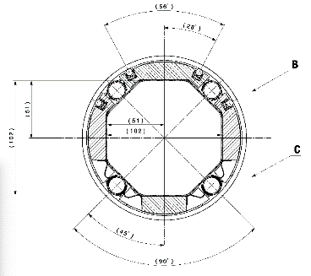
Triplet area aperture
Triplet beam screens, C. Garion
Octagonal beam screens for triplets/D1 with Tungsten shielding have been designed.
Expected straightness 0.5 mm and shape tolerance +- 1 mm (C. Garion 12/06/2015 ), to be confirmed by the prototype.
To be checked the possibility of reducing the W layer thanks to alternating crossing angle sign (F. Cerutti, S. Fartoukh).
cooling
shielding
Nominal apertures | H,V gap [mm] | 45° gap [mm]
Q1 | 102 | 102
Q2-Q3-CP | 122 | 114
D1 | 122 | 114
The tolerance of 1.5 mm is removed radially to the tolerance budget thus reducing the available aperture.

Slide 31
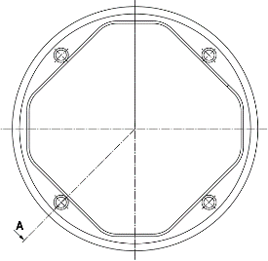
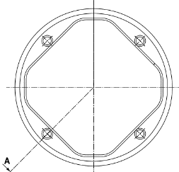
D2-Q4-Q5 Aperture
New D2-Q4 octagonal beam screens have been designed, no tolerances given yet. Same triplet tolerances removed from the shape.
D2
Nominal apertures | H,V gap [mm] | 45° gap [mm]
MBRD | 87 | 78
MQYY | 73.8 | 63.8
C. Garion, no tolerance included
The tolerance of 1.5/2 mm is subtracted from the gaps thus reducing the available aperture.
Q4
Q5 beam screens (MQY, rectellipse of 57.8/48 mm) oriented to optimize apertures in collision optics.

