Slide 1
IR6 squeeze for layout HLLHCV1.2
M. Fitterer, R. De Maria
Acknowledgments: R. Bruce, S. Fartoukh, J. Uythoven, M. Fraser

Slide 2
Outline
IR6 optics – aperture optimization at injection
IR6 constraints from ABT and collimation
IR6 squeeze (round, flat, flathv)

Slide 3
IR6 constraints from ABT + collimation
Constraints derived from V1.0 squeeze analysis and RunII optics
(M.A. Fraser, J. Uythoven, R. Bruce):
maximize β-functions at dump in order to ensure a sufficient distribution of the beam energy
        Beam 1: β_{x} > 5012 m, β_{y} > 3955 m
      Beam 2: β_{x} > 5052 m, β_{y} > 3698 m
    Limits taken not to decrease nominal LHC ones.
    -> Can they be relaxed to minimum over both beams ?
    -> What is the true minimum on the β in one plane, what is the minimum on sqrt(β_{x}*β_{y}) ? -> FLUKA simulations needed (Jan)
MQY.4L6.B1 and MQY.4R6.B2 constant in order to ensure enhancement of the MKD kick (1% gradient error acceptable)
dispersion smaller than 0.5 m in straight section (educated guess)

Slide 4
IR6 constraints from ABT + collimation
Constraints derived from V1.0 squeeze analysis and RunII optics
(M.A. Fraser, J. Uythoven, R. Bruce):
asynchronous dump:
    phase advance of π/2 between MKD and TCDQ to ensure protection by TCDQ in case of asynchronous dumps -> 10% relative error tolerable
    Δμ_{x} (MKD->TCDQ) = 0.5*π ± 0.025*π
    maximize β-functions at TCDQ in order to ensure a sufficient distribution of the beam energy (hor. less critical as already diluted by horizontal kick)
    β_{x/y} (TCDQ) > 160 m (= nominal LHC)
in addition: aperture limit at 7 TeV =β_{IR6} < β_{arc} + 20 m, e.g. flat β_{arc}=1150 m

Slide 5
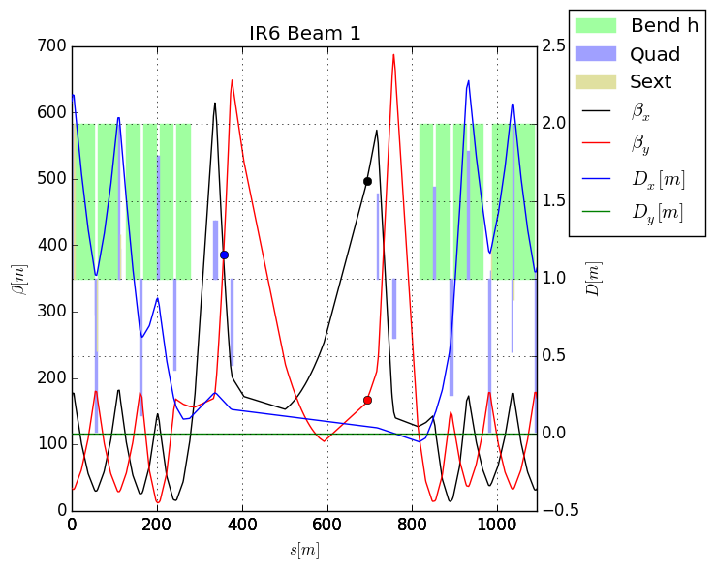
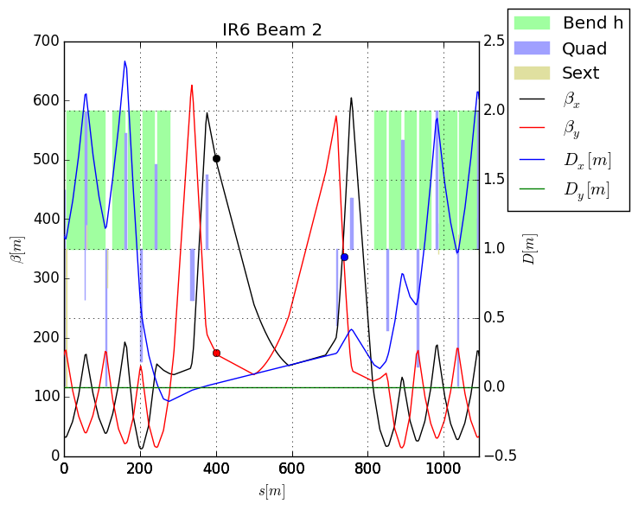
Injection β*=6m - optics
TCDQ (black/red)
MKD

Slide 6
Injection β*=6m - aperture
layout | β_{x/y}* [m] | minimum n1, Beam 1 |  | minimum n1, Beam 1
 |  | element | value | element | value
LHC, RunI | 11 | MQ.11R6.B1 | 9.54 | MQML.10R6.B2 | 9.49
LHC, RunII* | 11 | MQ.11R6.B1 | 9.49 | MQML.10R6.B2 | 9.47
HLLHCV1.0 | 6 | MQ.11R6.B1 | 9.42 | MQML.10R6.B2 | 9.50
HLLHCV1.1 | 6 | MQML.10L6.B1 | 9.28 | MCBV.12R6.B2 | 9.40**
HLLHCV1.2 | 6 | MQ.11R6.B1 | 9.24 | MQML.10R6.B2 | 9.25
*injection with MQT for adjustment of WP (beta-betating), strength unchanged
**aperture for b1 worse in order to fulfill β_{x/y}(TCDQ)>160 m, for beam 2 dump constrained is not fulfilled
β_{x/y}(dump, V1.1)=3538 m < 3955 m
aperture degraded in order to meet ABT+collimation constraints
+ n1>9.4 in straight section
relaxation of β_{x/y} (TCDQ) or β_{x/y} (dump) would improve aperture at injection (see V1.1 optics)

Slide 7
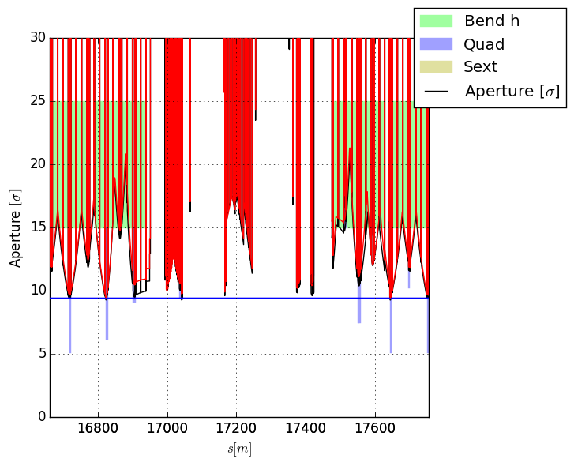
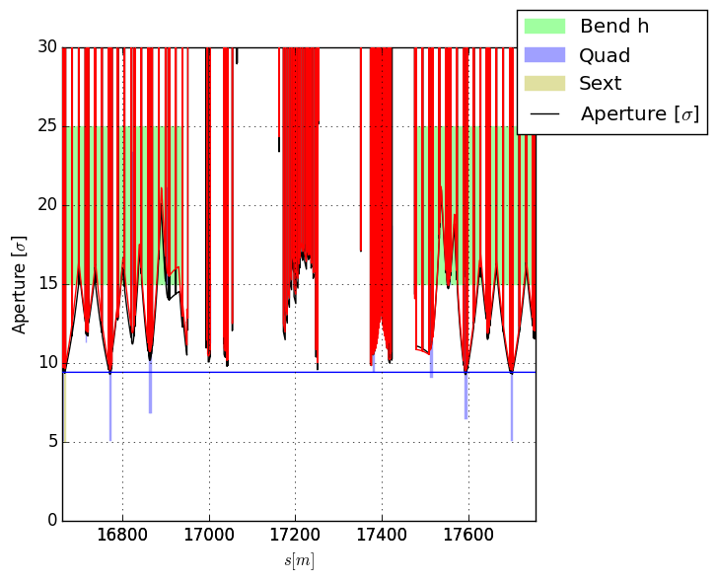
Injection β*=6m - aperture
9.4
(real target to be defined)
HLLHCV1.0
HLLHCV1.2

Slide 8
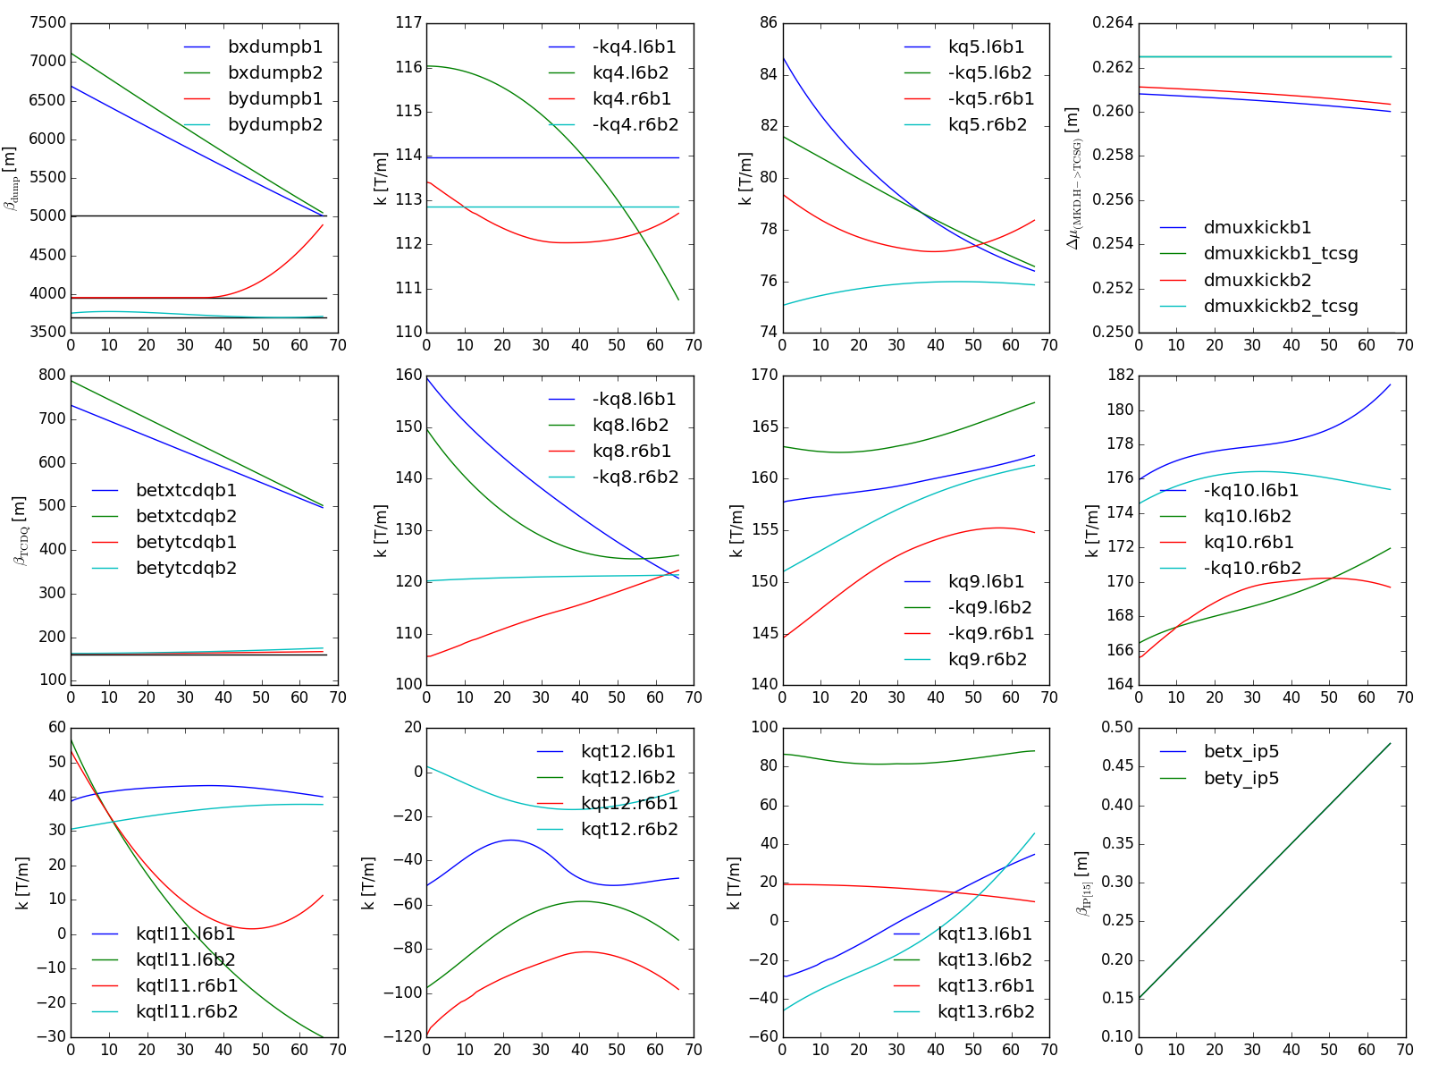
Squeeze round: 0.48 m -> 0.15 m
no change of slope
not possible to remove
(origin kq10.l6b1)

Slide 9
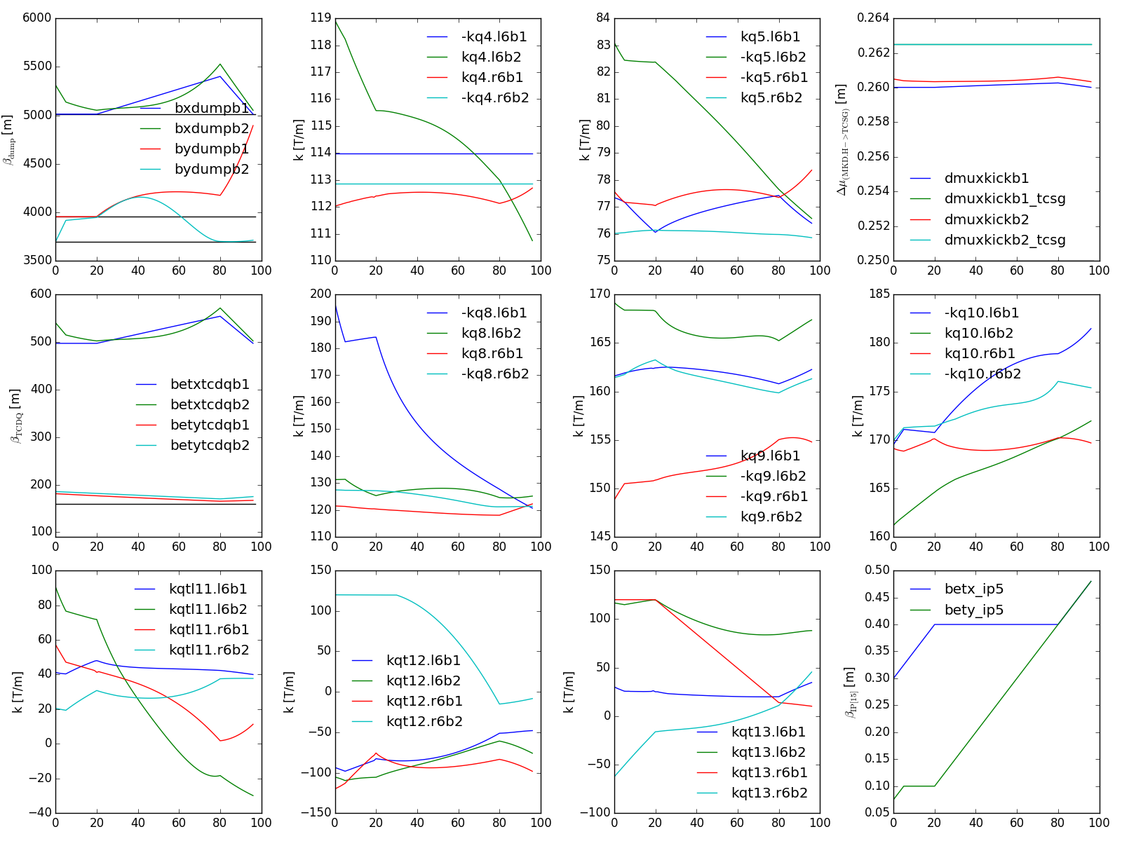
Squeeze flat: 0.48 m -> 0.075/0.30 m
very difficult to remove
-> small change results in large impact on other quadrupoles
no change of slope
results in change of slope in kq4.r6b1
round
flat 0.40/0.10 m

Slide 10
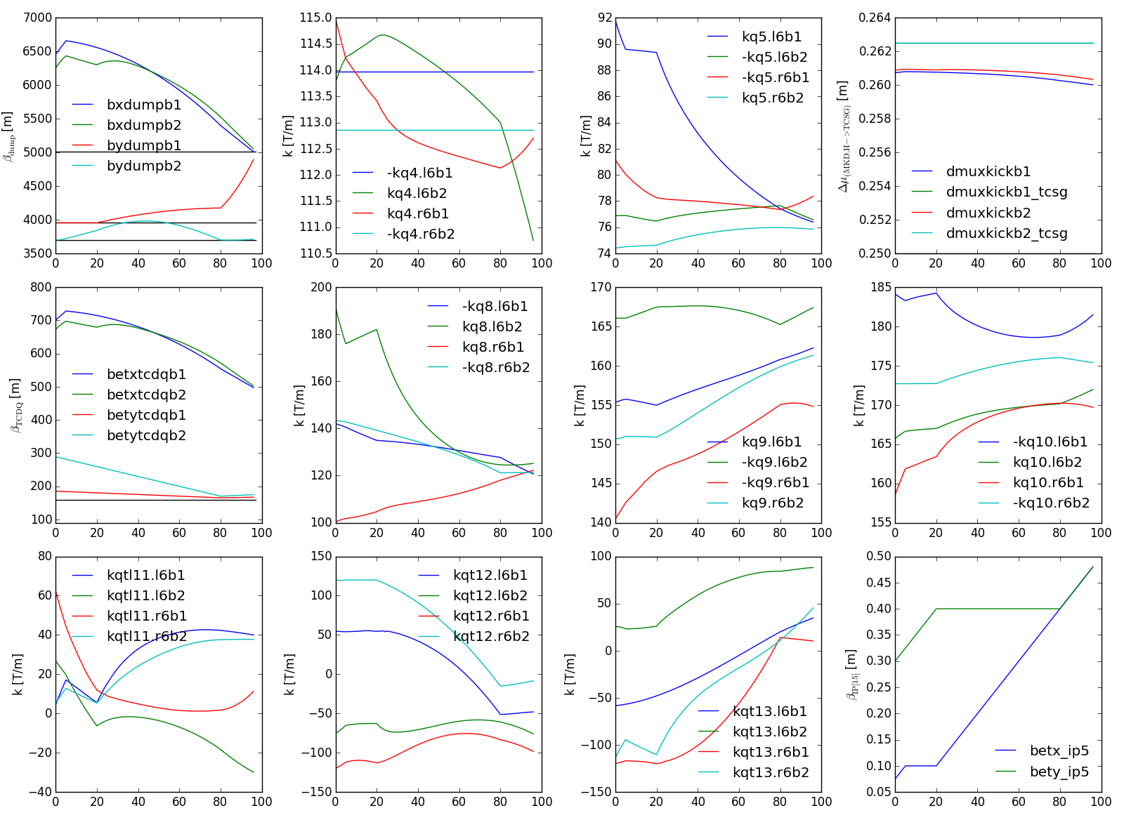
Squeeze flathv: 0.48 m -> 0.30/0.075 m
induces strong changes of slope in kq5.l6b1, kq9.r6b1,kq10.r6b1, kq10.l6b1, …
induces strong change of slope in kq4.l6b2
round
flat 0.10/0.40 m
Notes:
1) compare squeeze 41 and 42

Slide 11
Summary
injection aperture could be improved if β_{x/y} (TCDQ) or β_{x/y} (dump) are relaxed
round, flat and flathv meet ABT/collimation constraints (MQY4 strength for kick enhancement, maximum beta at dump and TCDQ for dump and asynchronous dump protection, dispersion)
smoothness of flat and flathv could be improved by squeezing both planes equally fast. Each change in the squeeze causes “steps”. Ideal squeeze x/y-ratio for β*-leveling to be defined.

Slide 13
beta @ MKD and TCDQ
layout | β_{x/y}* [m] | MKD.H5[LR]6.B[12], β [m] |  |  |  | TCDQA.A4[LR]6.B[12], β [m]
 |  | x, b1 | y, b1 | x, b2 | y, b2 | x, b1 | y, b1 | x, b2 | y, b2
LHC, RunI | 0.6/0.6 | 382 | 356 | 377 | 355 | 495 | 165 | 500 | 165
LHC, RunII* | 0.8/0.8 | 382 | 356 | 377 | 355 | 484 | 161 | 488 | 162
HLLHCV1.0 | 0.15/0.15 | 195 | 460 | 269 | 350 | 966 | 129 | 697 | 168
HLLHCV1.1 | 0.15/0.15 | 232 | 438 | 281 | 273 | 814 | 133 | 667 | 216
HLLHCV1.2 | 0.15/0.15 | 258 | 363 | 239 | 362 | 732 | 161 | 788 | 162
HLLHCV1.2 | 0.075/0.3 | 380 | 327 | 349 | 318 | 497 | 181 | 540 | 185
HLLHCV1.2 | 0.3/0.075 | 270 | 320 | 280 | 204 | 700 | 185 | 673 | 289
*injection with MQT for adjustment of WP (beta-betating), strength unchanged

Slide 14
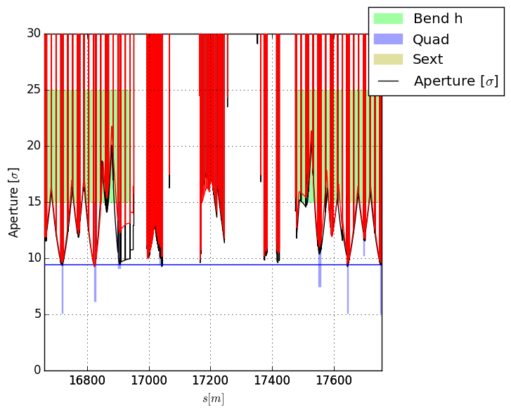

Injection β*=6m - aperture
9.4
(real target to be defined)
HLLHCV1.1
HLLHCV1.2

Slide 15
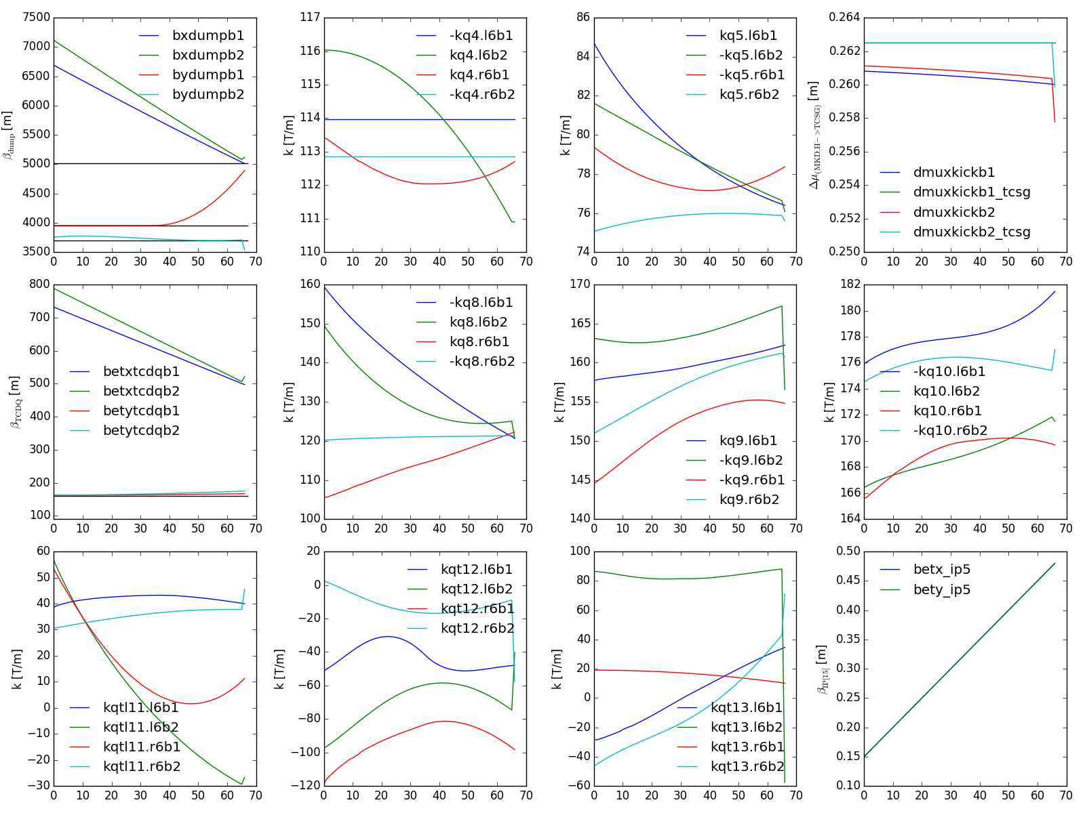
Squeeze round with V1.1 injection endpoint
Notes:
1) compare squeeze 41 and 42

