Slide 1


Update on e-cloud activities
G. Iadarola, A. Axford, K. Li, A. Romano, G. Rumolo
Joint HiLumi LHC - LARP Annual Meeting, 11-13 November 2015, Fermilab, USA

Slide 2
Outline
e-cloud buildup with/without shielding baffle plates
  For details:
    http://indico.cern.ch/event/396577/
    http://indico.cern.ch/event/446452/
Update on PyHEADTAIL simulations
    For details:
    http://indico.cern.ch/event/394530/
      http://indico.cern.ch/event/446452/
Lessons learned from the 25 ns run so far
  For details:
  http://indico.cern.ch/event/446455/

Slide 3
Outline
e-cloud buildup with/without shielding baffle plates
  For details:
    http://indico.cern.ch/event/396577/
    http://indico.cern.ch/event/446452/
Update on PyHEADTAIL simulations
    For details:
    http://indico.cern.ch/event/394530/
      http://indico.cern.ch/event/446452/
Lessons learned from the 25 ns run so far
  For details:
  http://indico.cern.ch/event/446455/

Slide 4
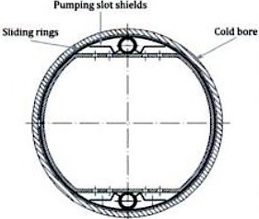
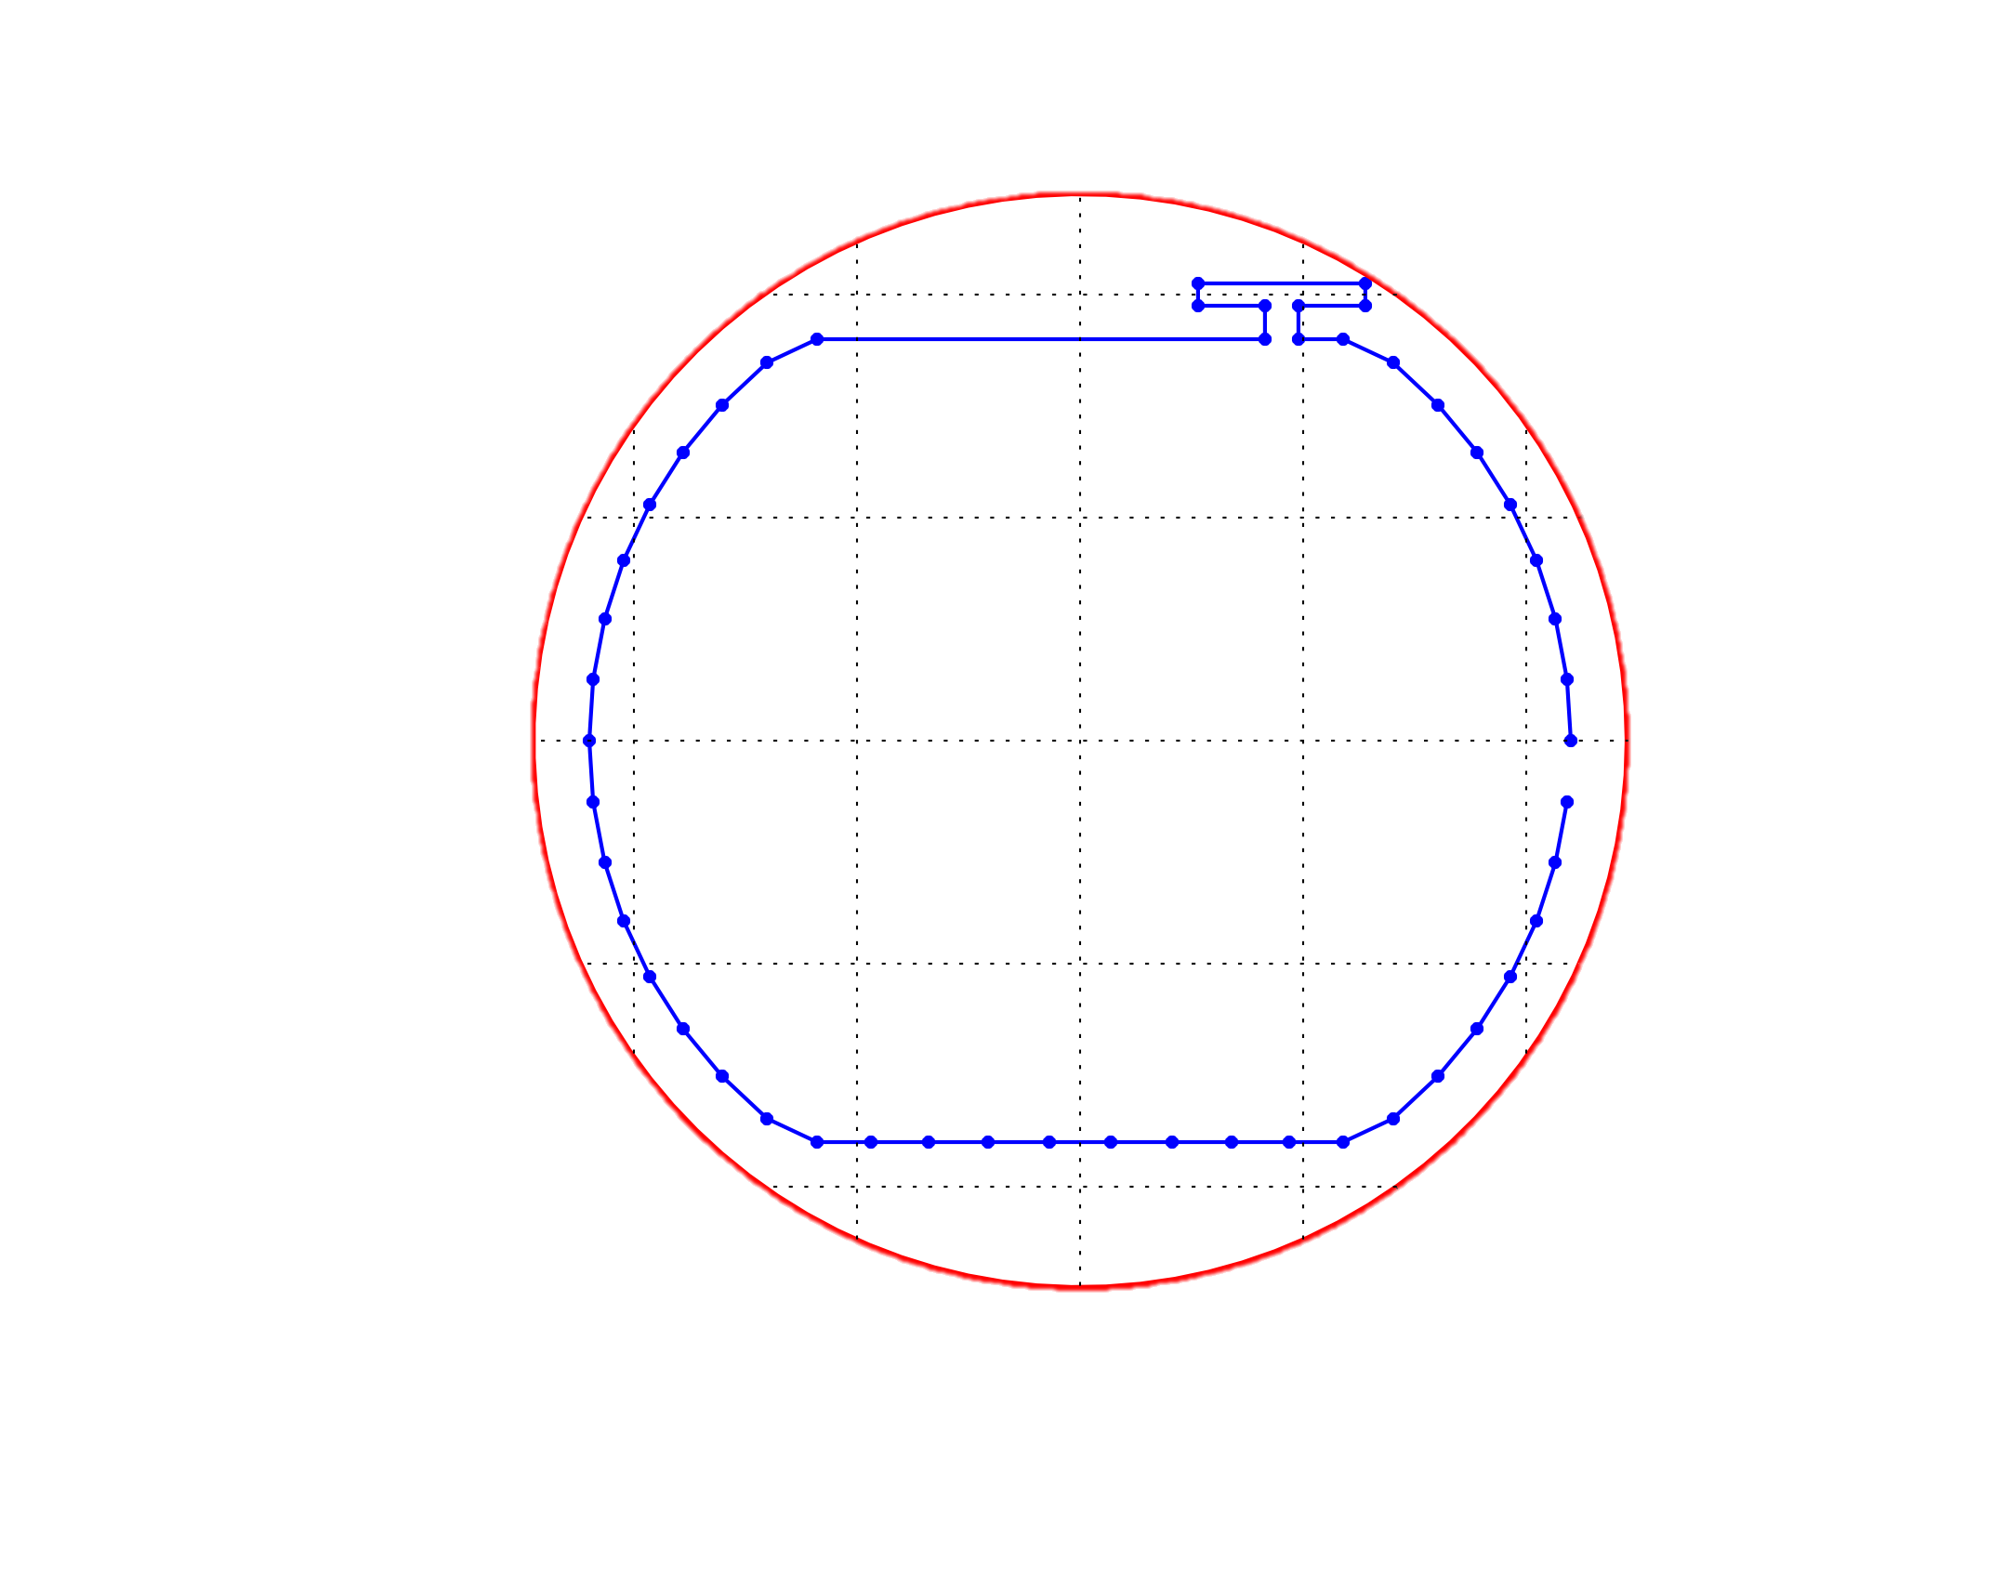
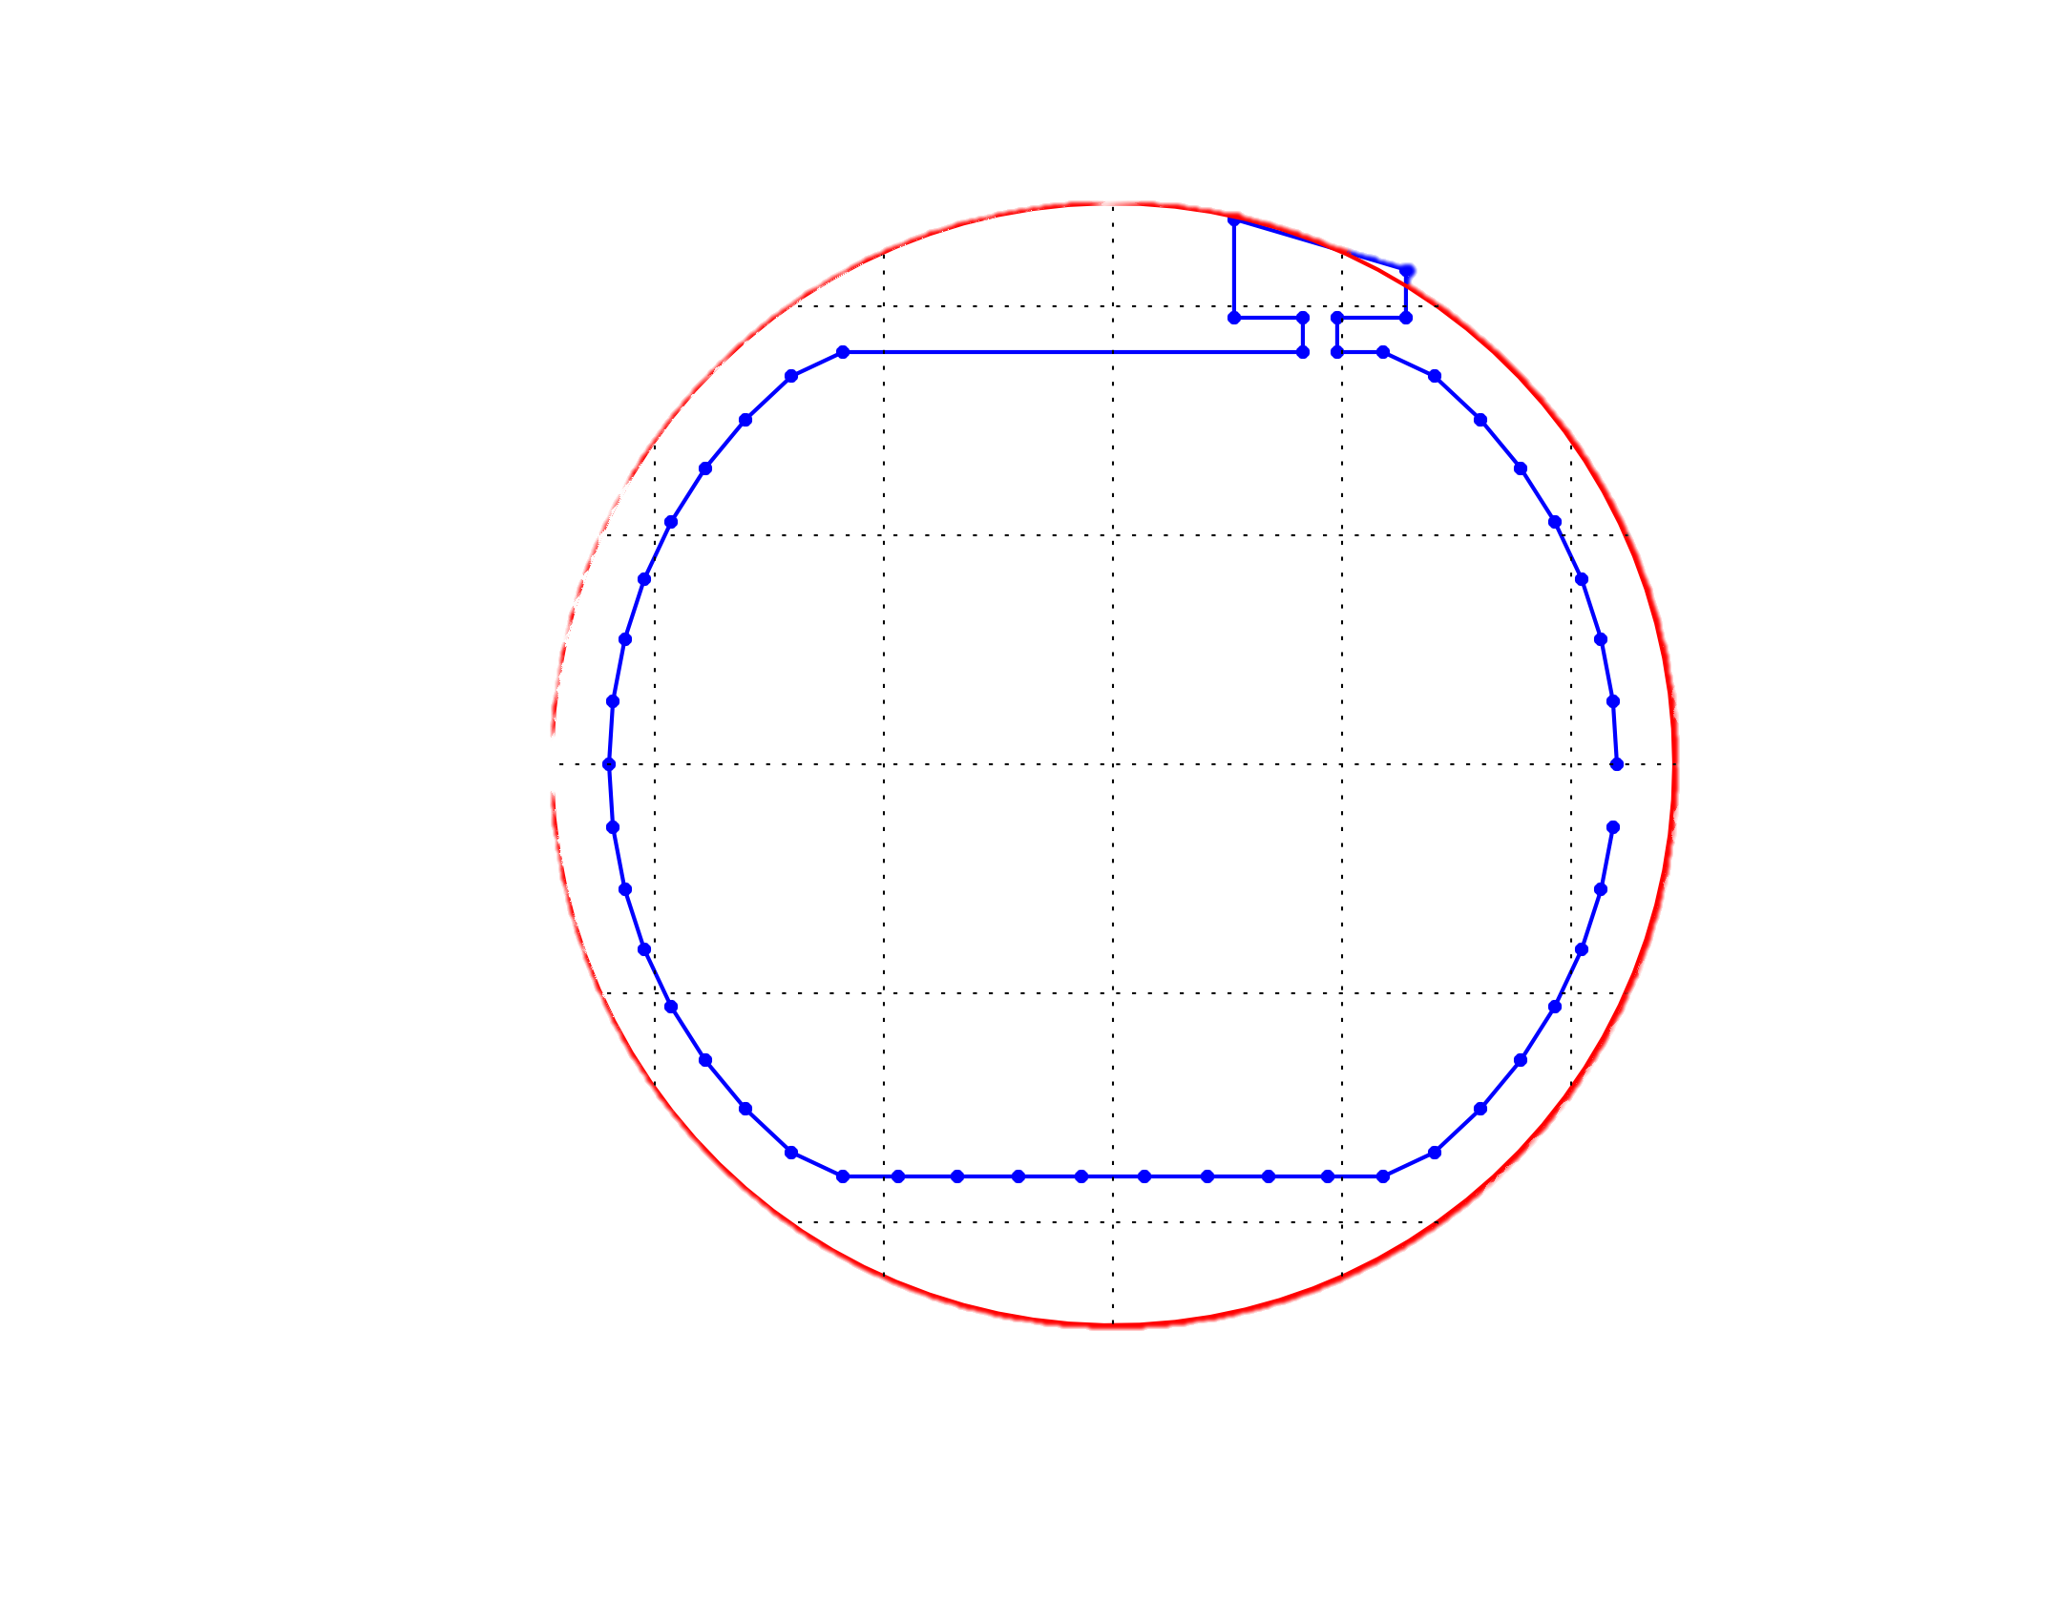
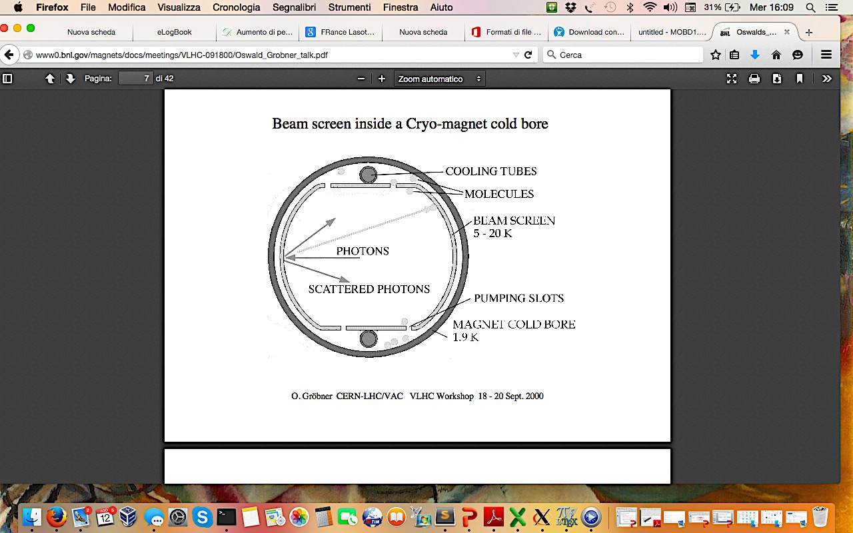
e-cloud buildup with/without shielding baffle plates
LHC beam screen with baffle plate
LHC beam screen without baffle plate
  Goal: check the need to shield the pumping holes to avoid multipacting with the cold bore
    Check whether electric shielding provided by the beam screen is already sufficient to suppress multipacting
  PyECLOUD had to be modified in order to handle non convex boundaries:
    Electron impact detection and handling
    Boundary condition in the PyPIC space charge module (to continue using Shortley-Weller refined boundary)

Slide 5
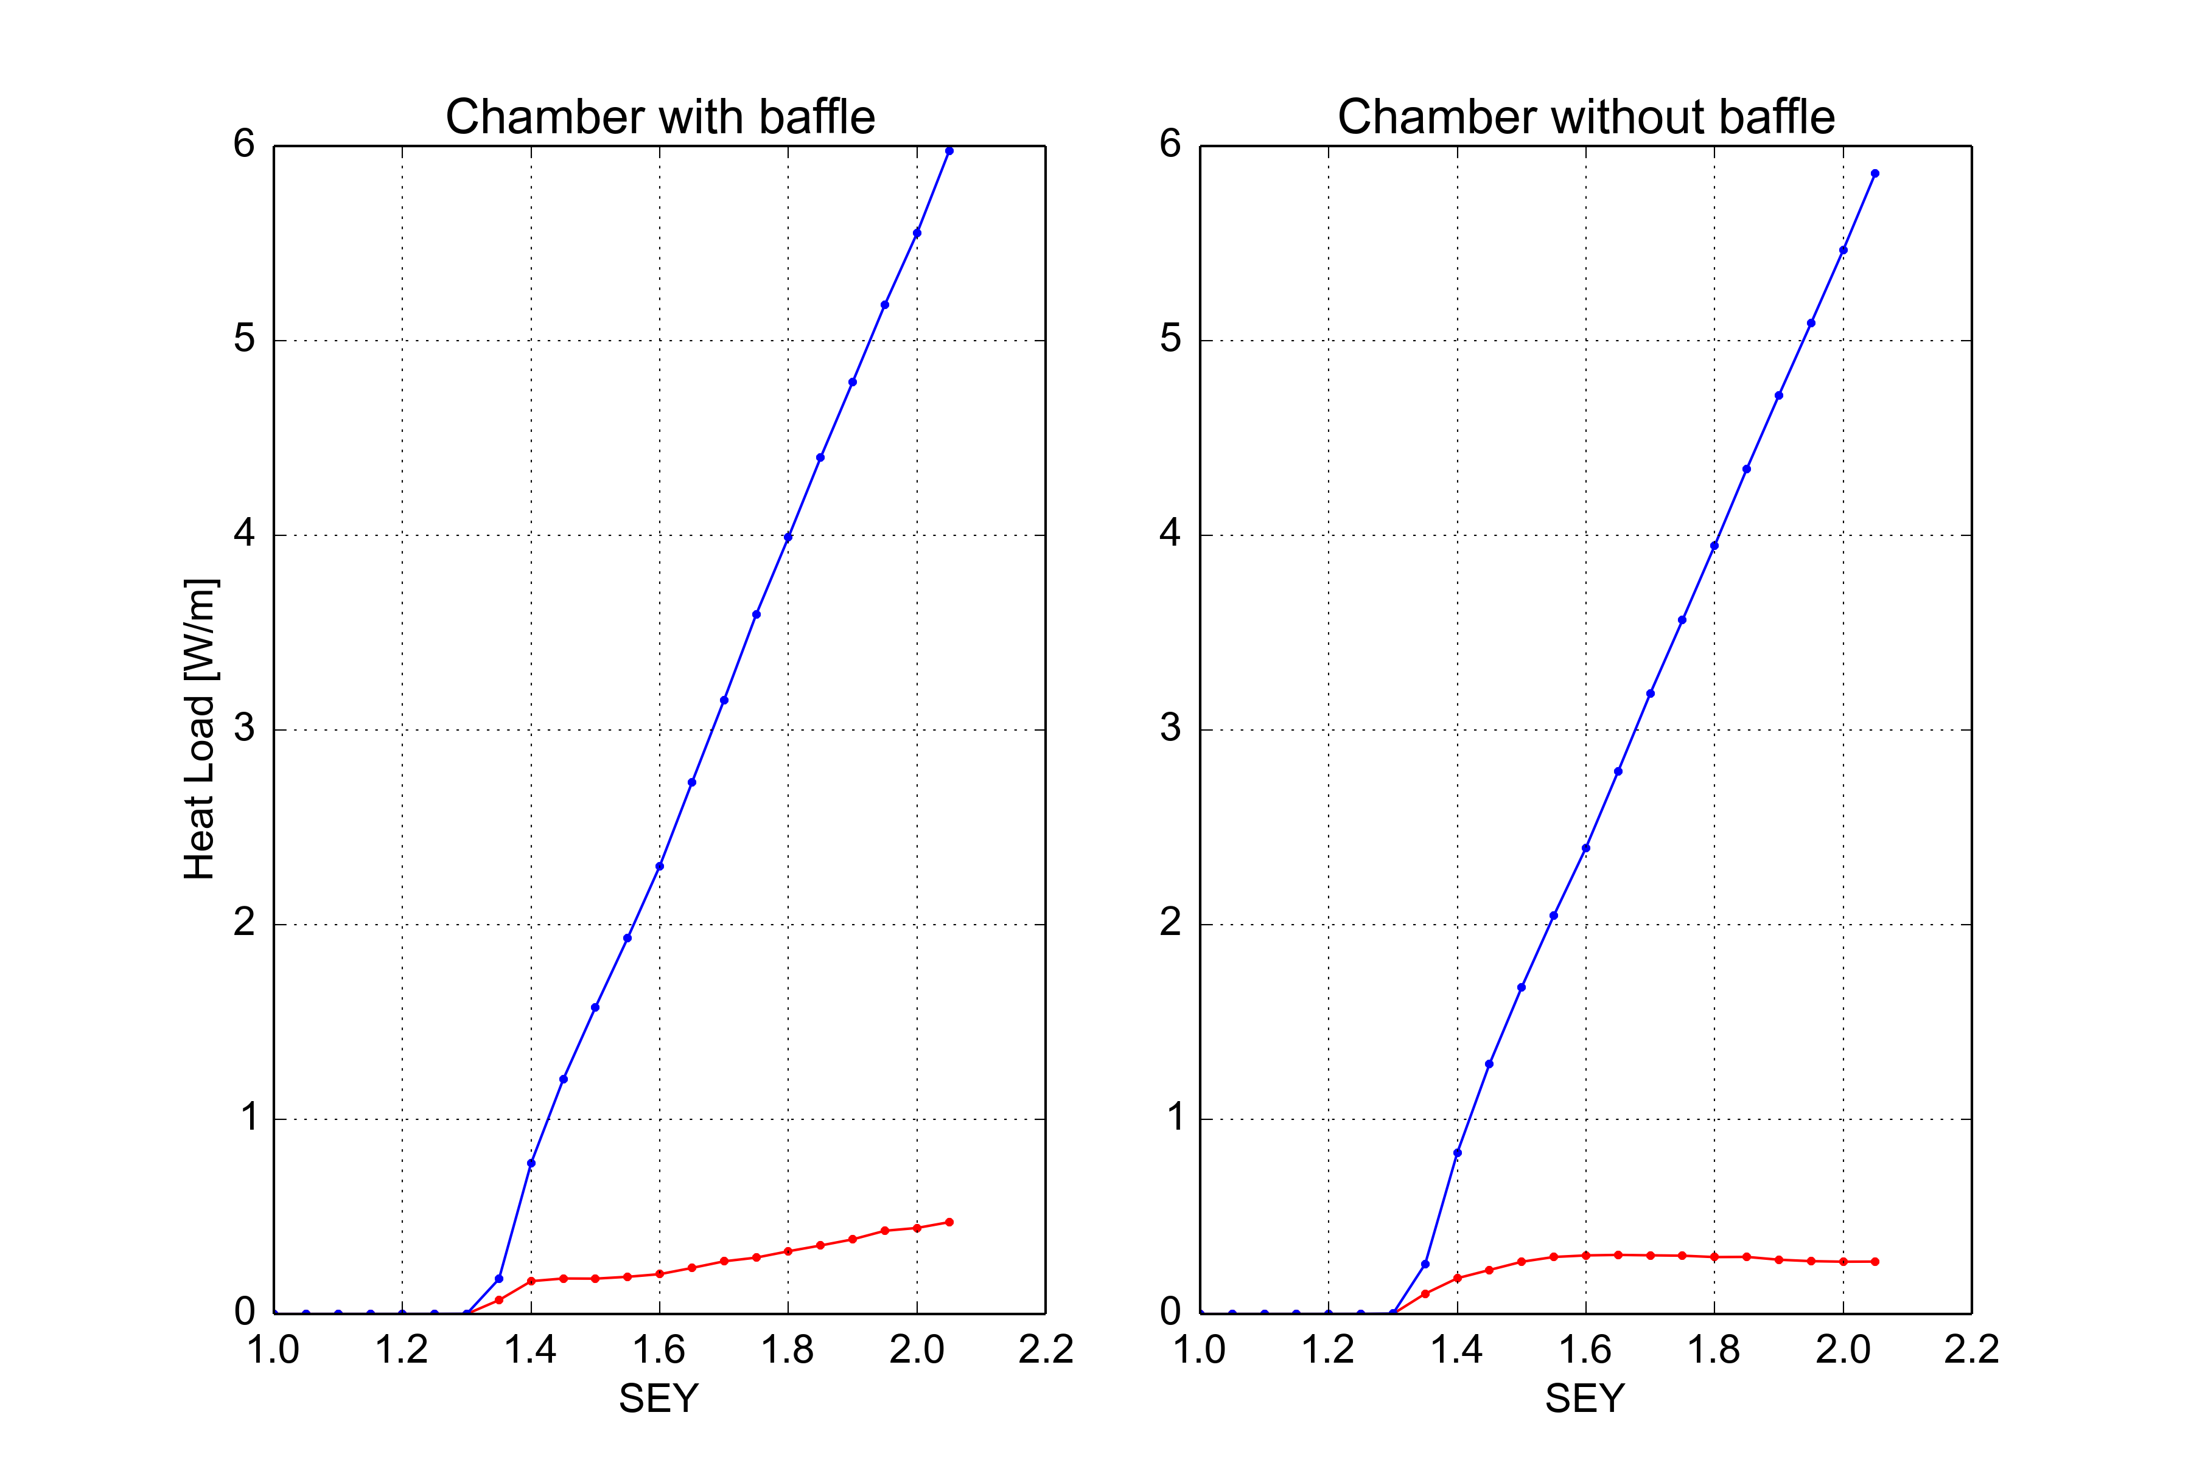
Simulations results
Without baffle
With baffle
Arc dipole
450GeV
Heat load on
the chamber
Heat load on
the chamber
Heat load on
the cold bore
Heat load on
the baffle plate
Assuming the SEY equal to 1.4, the heat load deposited is almost 0.15 W/m for both cases
  → baffles protect the cold bore from a non regligible heat load

Slide 6
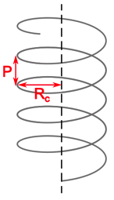
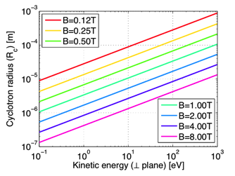
Underlying mechanim
At 450GeV B=0.53 T: cyclotron radius does not exceed few micrometers
  Practically Electrons practically move only in vertical
The kinetic energy of secondary electrons is not larger than 30 eV
  It is enough for them to make few mm per ns
  Electrons can make it to go back into the chamber before the following bunch passage even without being accelerated by the beam
file:///.file/id=6571367.13687216

Slide 7
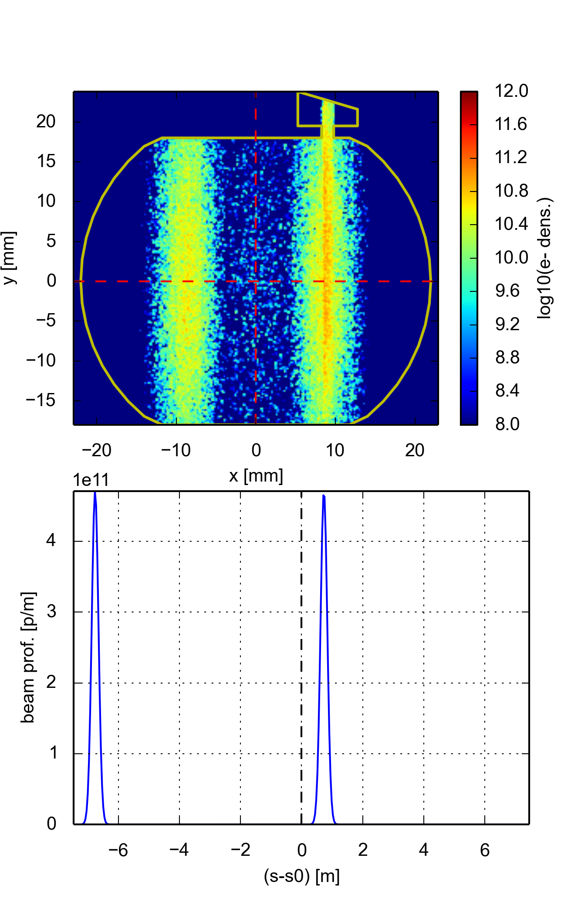
EC build-up
file:///.file/id=6571367.13687216
Electron Cloud meeting 18/09/2015

Slide 8
Outline
e-cloud buildup with/without shielding baffle plates
  For details:
    http://indico.cern.ch/event/396577/
    http://indico.cern.ch/event/446452/
Update on PyHEADTAIL simulations
    For details:
    http://indico.cern.ch/event/394530/
      http://indico.cern.ch/event/446452/
Lessons learned from the 25 ns run so far
  For details:
  http://indico.cern.ch/event/446455/

Slide 9
e-cloud instability simulations for the HL-LHC
We simulated the interaction of a single bunch with the electron cloud in the dipoles and in the quadrupoles separately scanning the bunch intensity and the electron density
Before the bunch passage electrons are uniformly distributed in the chamber and at rest
Parameter | Value @ 450 GeV | Value @ 7 TeV
N (p/b) | 1.3 – 2.3 x 10¹¹ | 1.3 – 2.3 x 10¹¹
ε_{x,y} (μm) | 2.5 | 2.5
σ_{z} (m) | 0.1 | 0. 075
B (T, T/m) | 0.53, 12 | 8.2, 187
V_{400MHz} (MV) | 8 | 16
N_{el} (e⁻/m³) | 0.3 – 20 x 10¹² | 0.3 – 20 x 10¹³
N_{segments} | 79 | 31
N_{MP} (e⁻) | 10⁵ | 10⁵
N_{MP} (p) | 3 x 10⁵ | 3 x 10⁵
N_kicks | 70 | 31
Grid zize (m) | 0.2e-3 | 0.07e-3
Time step (ps) | 10 | 5
Simulations at 7 TeV are numerically more challenging due to the smaller beam size (need for finer grid) and stronger magnetic fields (need fro smaller time steps to resolve electron motion)

Slide 10
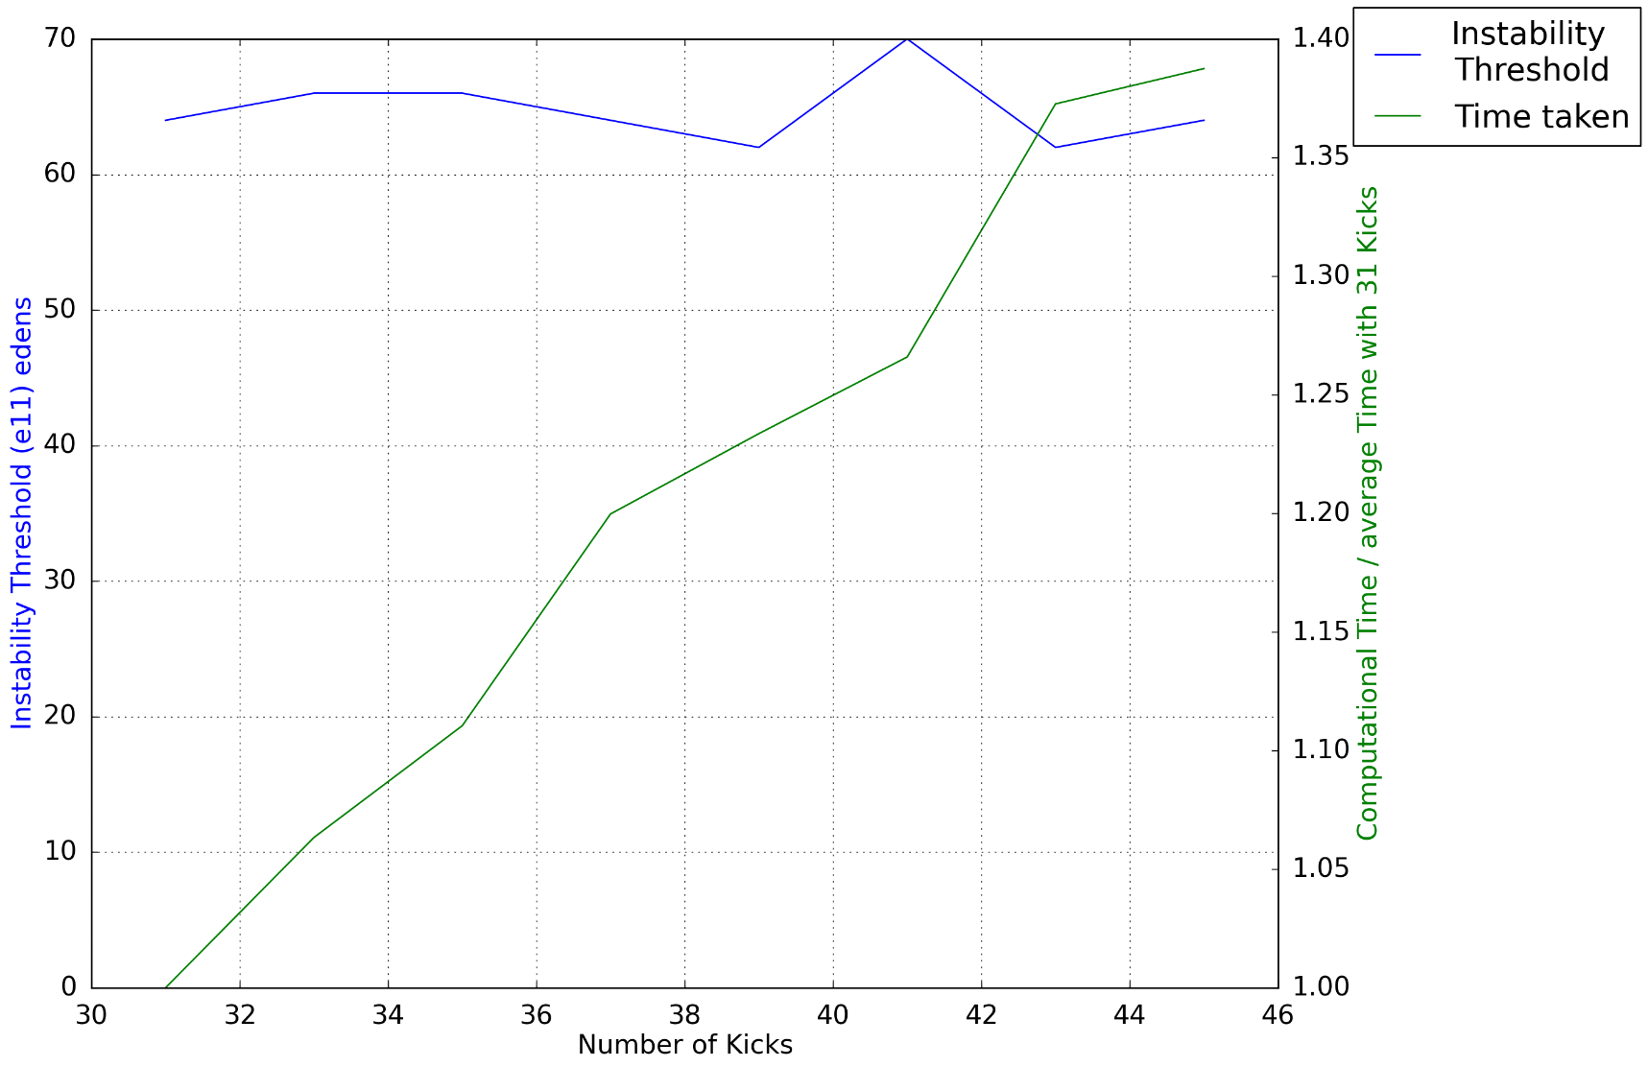
Convergence scans
Continued validation of our new PyECLOUD-PyHEADTAIL simulation setup
Over the last months extensive convergence scans (especially at 7 TeV) with respect to:
  The number of kicks
  The grid size
  The number of slices
Each parameter scanned together with electron density (for dipoles and quadrupoles)
Each simulation repeated 5 times to mitigate dependence on initial conditions (seed)

Slide 11
Instability thresholds
Basically confirmed preliminary results presented at Fermilab:
 | 1.3 x 10¹¹ ppb | 1.8 x 10¹¹ ppb | 2.3 x 10¹¹ ppb
450 GeV | 9 x 10¹² e⁻/m³ | 9 x 10¹² e⁻/m³ | 10 x 10¹² e⁻/m³
7 TeV | 1.2 x 10¹⁴ e⁻/m³ | 1.1 x 10¹⁴ e⁻/m³ | 1.2 x 10¹⁴ e⁻/m³
Arc quadrupoles
(~5% of the machine)
 | 1.3 x 10¹¹ ppb | 1.8 x 10¹¹ ppb | 2.3 x 10¹¹ ppb
450 GeV | 1.2 x 10¹² e⁻/m³ | 1 x 10¹² e⁻/m³ | 1 x 10¹² e⁻/m³
7 TeV | 8 x 10¹² e⁻/m³ | 8 x 10¹² e⁻/m³ | 9 x 10¹² e⁻/m³
Arc dipoles
(~65% of the machine)
Dependence on bunch intensity is quite weak
The threshold e⁻ density for transverse instability increases by one order of magnitude going to 7 TeV → effect of increased beam rigidity

Slide 12
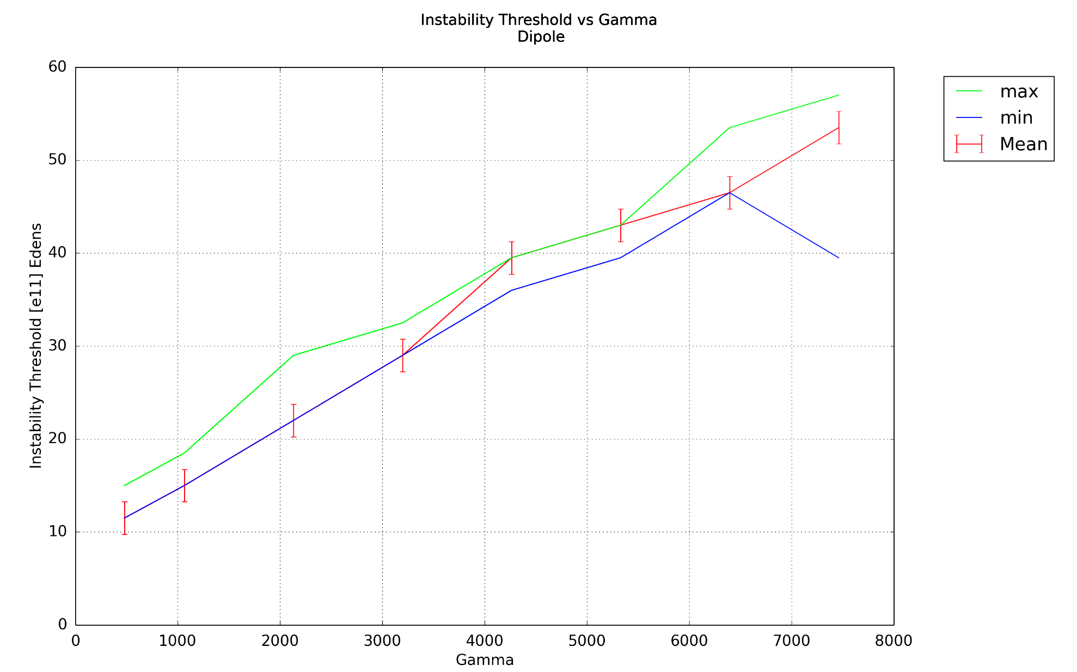
Dependence on beam energy
Started with simplified case (easier to spot “suspect” behaviours of the code):
  Constant bunch length
  Constant RF voltage
  Bunch matched do the backet
  Magnetic fields increasing with energy
Instability threshold scales linearly with gamma

Slide 13
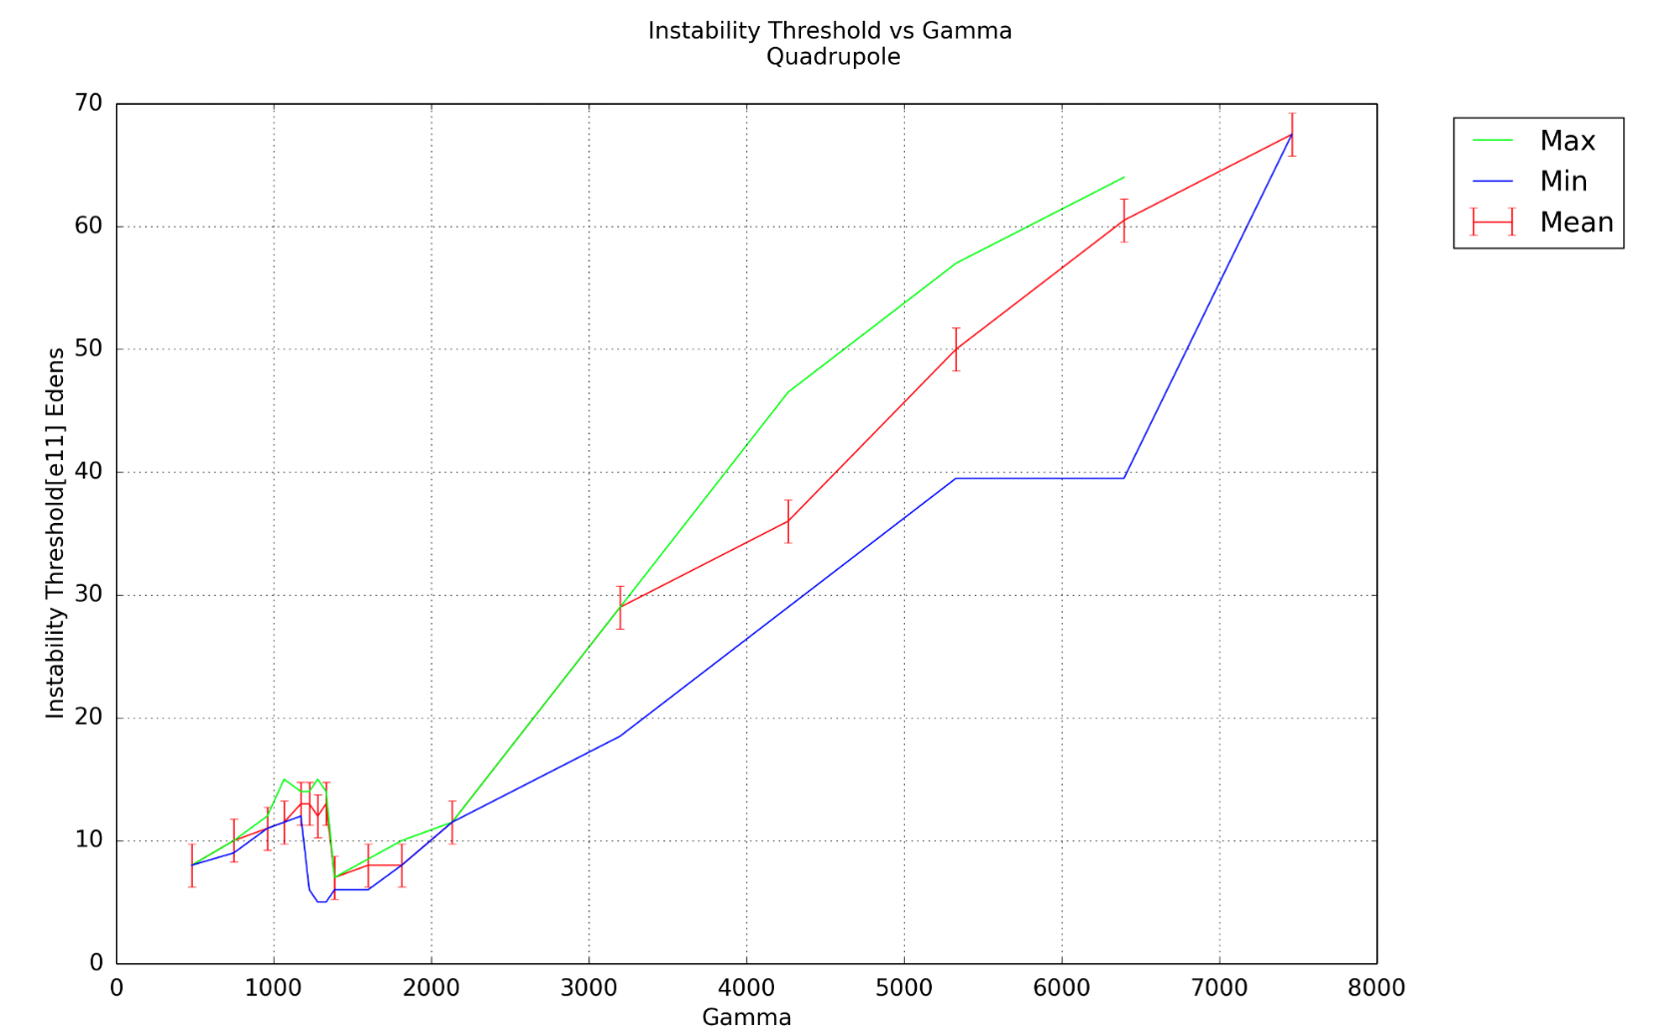
Dependence on beam energy
Started with simplified case (easier to spot “suspect” behaviours of the code):
  Constant bunch length
  Constant RF voltage
  Bunch matched do the backet
  Magnetic fields increasing with energy
Instability threshold scales linearly with gamma
  Related to the change in gradient
    → to be further investigated

Slide 14
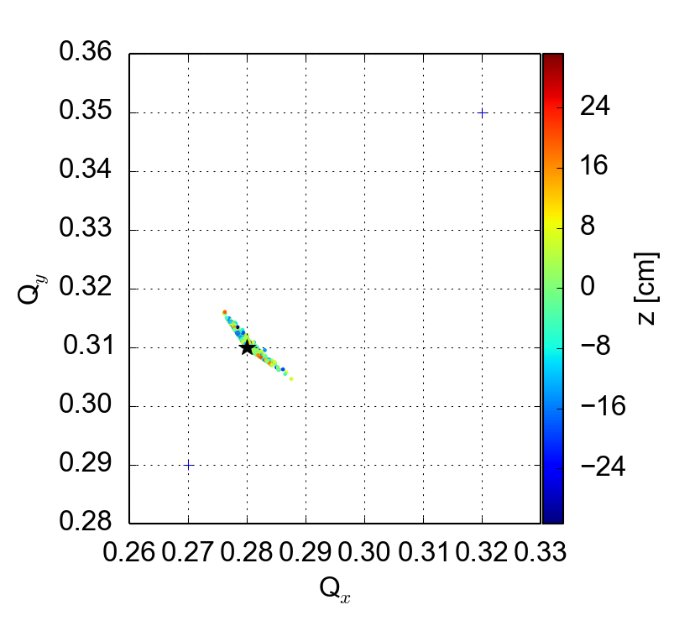
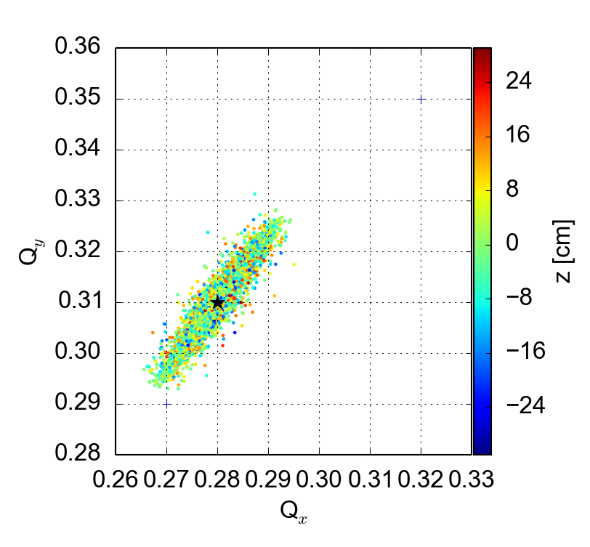
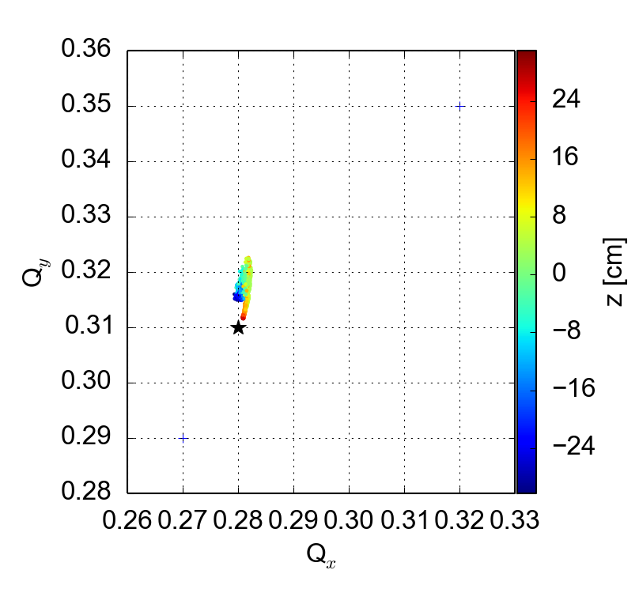
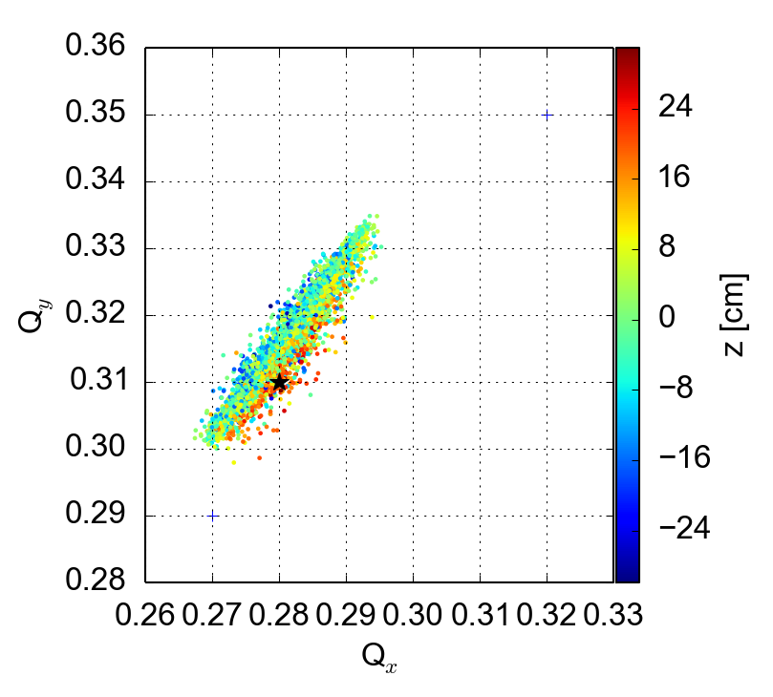
Tune footprints with ecloud, Q’ and octupoles
Octupole knob at -1.5
Q’=0/0, no e-cloud
Octupole knob at -1.5
Q’=15/20, no e-cloud
  Nominal bunch intensity
Octupole knob at 0.
Q’=0/0, 5 x 10¹¹ e/m³
Octupole knob at -1.5
Q’=15/20, 5 x 10¹¹ e/m³

Slide 15
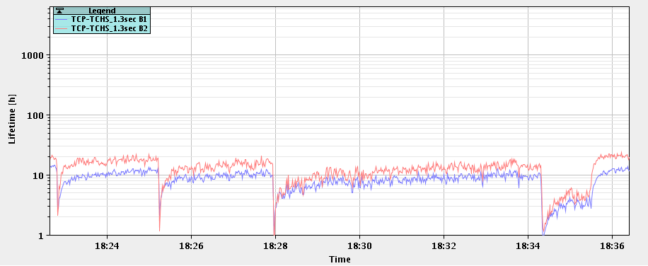
Consistent with recent machine observations:
Q’v=15
Qv=.305
Q’v=15
Qv=.300
Q’v=10
Qv=.305
  Losses are on the trailing bunches of the train (as axpected)

Slide 16
Outline
e-cloud buildup with/without shielding baffle plates
  For details:
    http://indico.cern.ch/event/396577/
    http://indico.cern.ch/event/446452/
Update on PyHEADTAIL simulations
    For details:
    http://indico.cern.ch/event/394530/
      http://indico.cern.ch/event/446452/
Lessons learned from the 25 ns run so far
  For details:
  http://indico.cern.ch/event/446455/

Slide 17
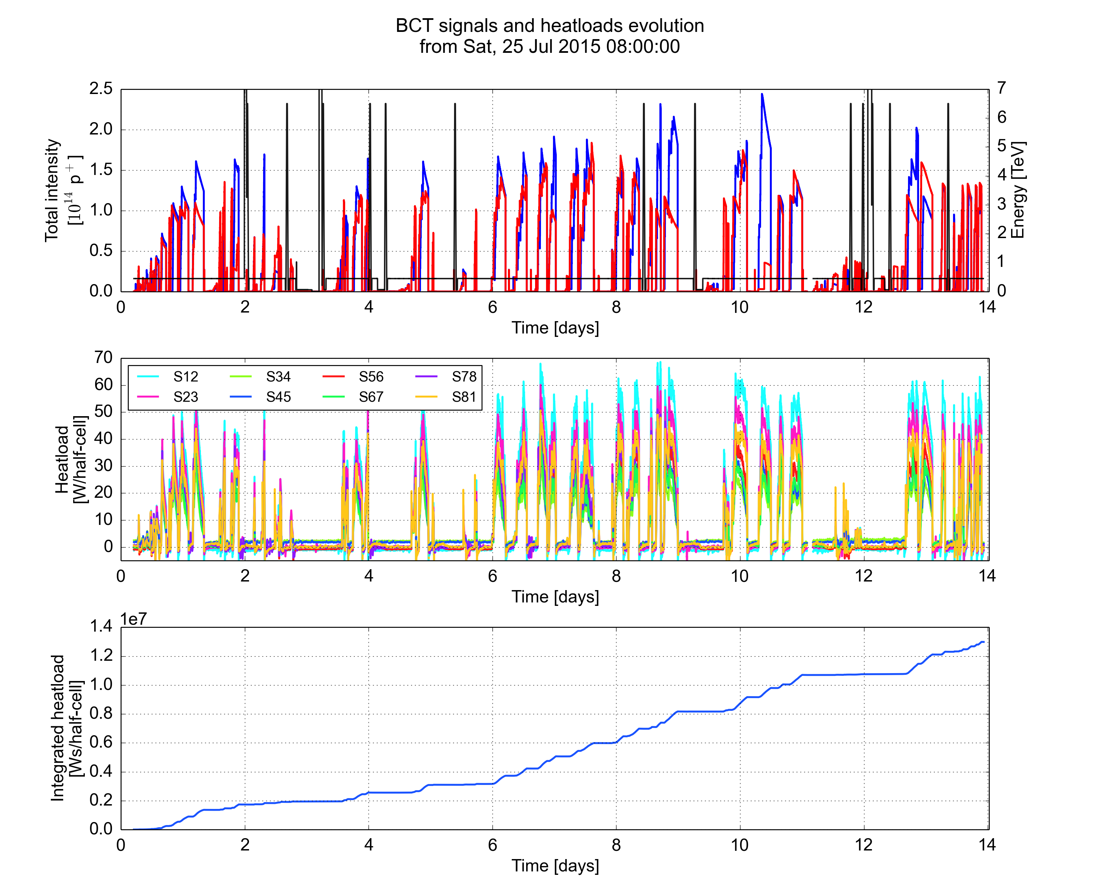
Lessons learnt from experience with 25 ns beam in 2015
Scrubbing Run for 25 ns operation (25 July - 7 August 2015)
Scrubbing accumulated during Run 1 lost completely during the shutdown
  → Deconditioning observed even after the (after running in low e-cloud conditions)

Slide 18
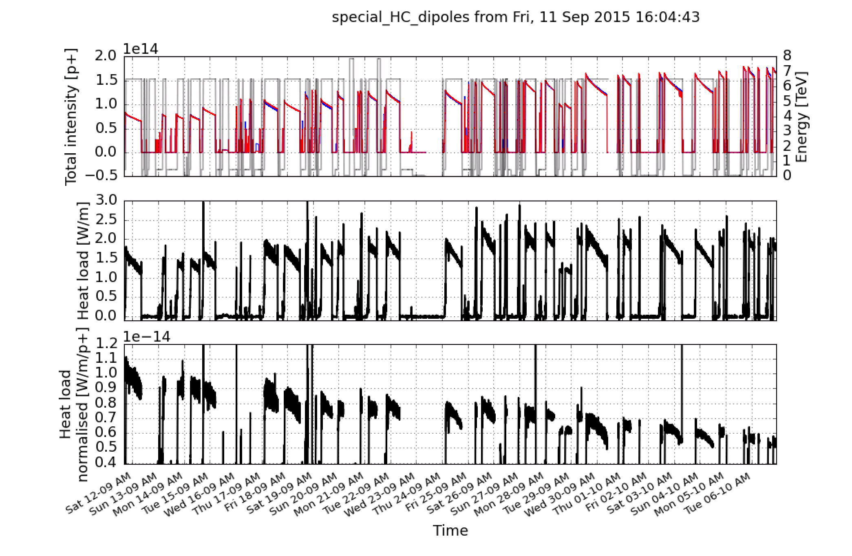
Heat load evolution during the last weeks
After scrubbing e-cloud still observed in the machine
→ but further scrubbing visible during intensity ramp up
745b.
889b.
1033b.
1177b.
1321b.
1465b.
1608b.
Bun. length target
1.35 ns

Slide 19
Lessons learnt from experience with 25 ns beam in 2015
Scrubbing Run for 25 ns operation (25 July - 7 August 2015)
Scrubbing efficiency relies on our capability to keep injecting and preserve good beam quality:
  Injection speed can be limited by transients on heat loads observed when injecting beam. Important improvements from:
    Feedforward algorithm on Cryo regulation
    Optimization of Cryo Maintain limits on beam screen temperature
Improved vacuum in MKI region and more robust TDIs would significantly help
Transverse damper performance is crucial to keep the beam in the LHC (even in presence of intra-bunch instabilities)
Need to run with high Q’ and octupoles → Tune optimization can strongly improve beam lifetime

Slide 20
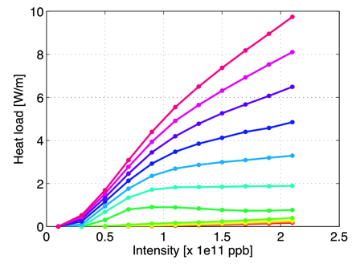
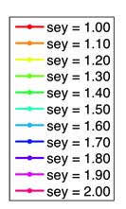
Scrubbing in the HL-LHC era…
Dependence on bunch intensity is quite steep for high values of the SEY and flattens down when approaching the threshold:
→ cooling capacity important to minimize required scrubbing time

Slide 21
Thanks for your attention!

