Slide 1






Energy deposition in the Triplet-D1 region (v1.2)
A. Tsinganis, F. Cerutti
EN/STI/EET
With input from: C. Garion, R. Fernandez-Gomez, T. Lefevre, R. De Maria, S. Fartoukh,
P. Ferracin, M. Sugano, I. Efthymiopoulos
Acknowledgements: G. Arduini, E. Todesco, T. Nakamoto, P. Fessia
The HiLumi LHC Design Study is included in the High Luminosity LHC project and is partly funded by the European Commission within the Framework Programme 7 Capacities Specific Programme, Grant Agreement 284404.

Slide 2

Outline
Simulation setup
  Layout and optics
  Geometry
Results for round optics (V/H)
  Total power
  Peak power/dose
Other optics
Dose minimisation with alternative optics & crossing combinations
Summary
Energy deposition in the Triplet-D1 region (v1.2) | WP2 Meeting – October 16, 2015 | AT

Slide 3
Simulation setup
Energy deposition in the Triplet-D1 region (v1.2) | WP2 Meeting – October 16, 2015 | AT

Slide 4
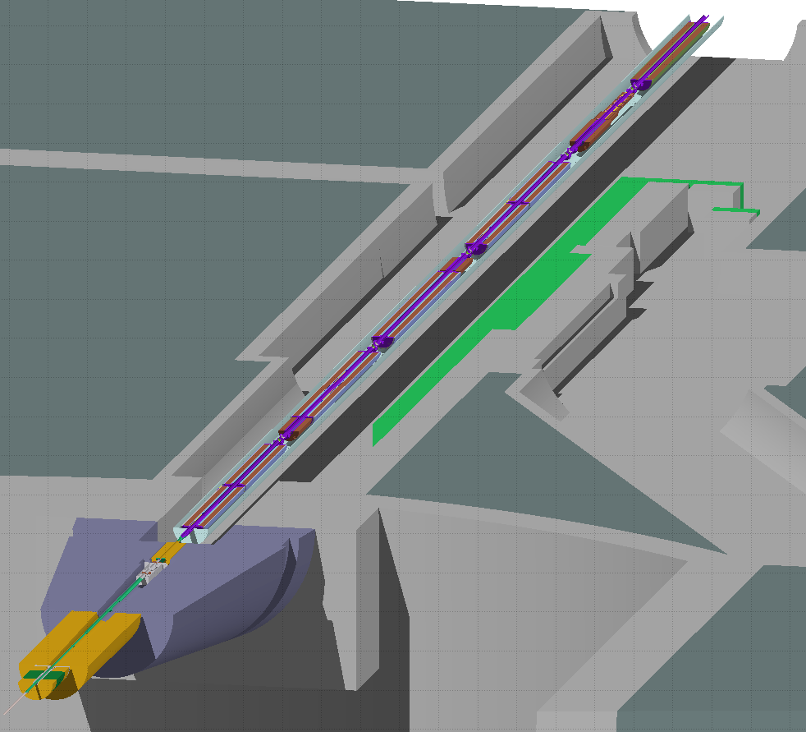
Layout and optics
Element lengths and positions extracted from V1.2 TWISS file
  Exception: TAS kept at V1.1 position
  TAS aperture = 60mm
New magnetic field map for D1
  Special treatment necessary to remove unphysical spikes at certain boundaries
Main scenarios studied:
  Round optics, β*=15cm, crossing 295μrad
    1. Vertical crossing (IP1)
    2. Horizontal crossing (IP5)
Energy deposition in the Triplet-D1 region (v1.2) | WP2 Meeting – October 16, 2015 | AT

Slide 5
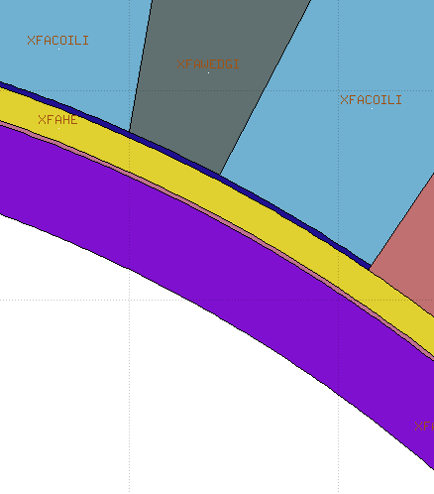
Geometry upgrades & updates
1. Update of various layer thicknesses
Coil aperture (cold): R = 7.435cm
250μm insulation
1.5mm liquid He
200μm insulation
4mm cold bore (R_{in} = 6.84cm)
Energy deposition in the Triplet-D1 region (v1.2) | WP2 Meeting – October 16, 2015 | AT

Slide 6
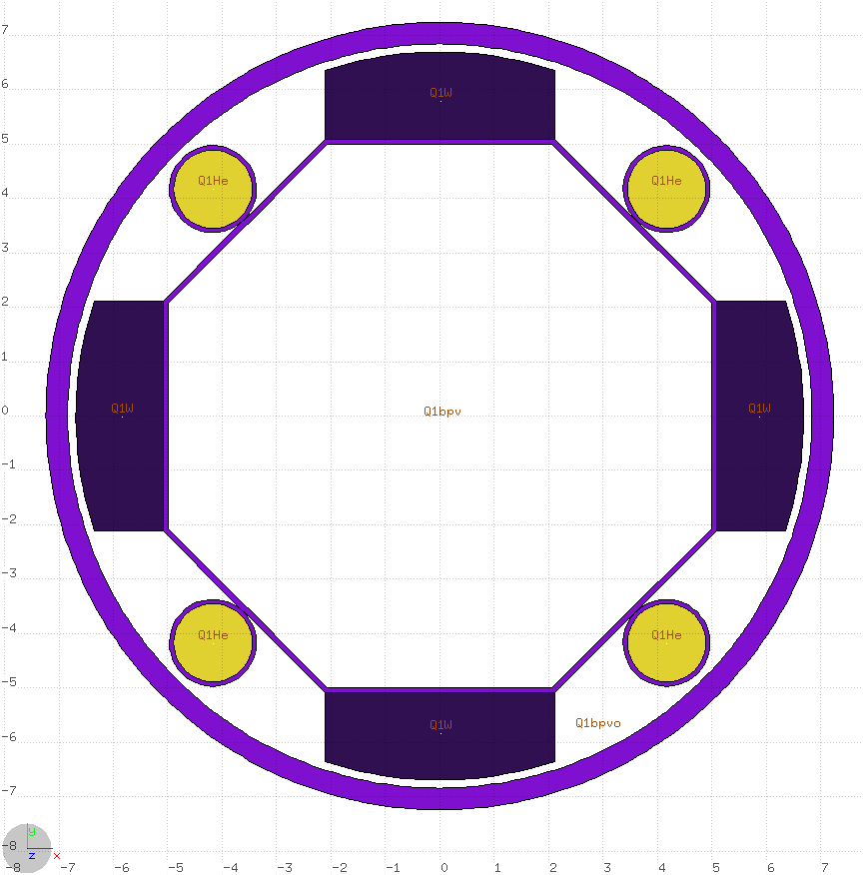
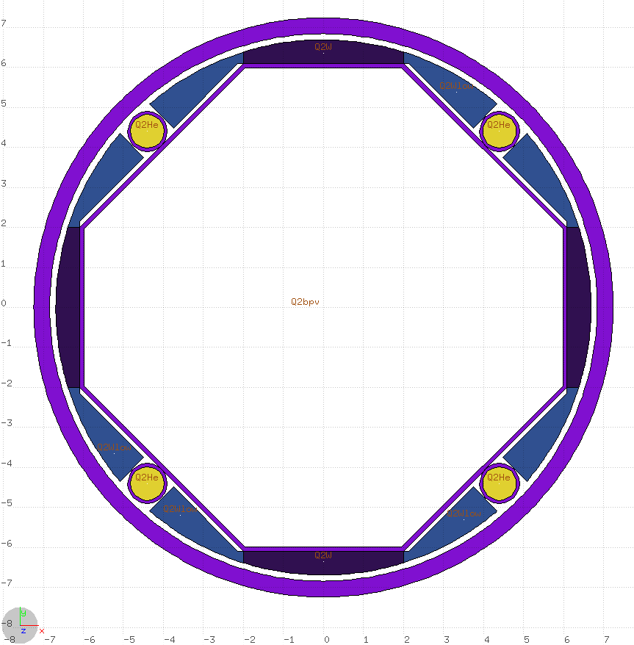
Geometry upgrades & updates
2. Beam screen design
  Inermet shielding extended towards the poles in “thin” BS (50% filling factor)
  Adjustment (1.1mm radial reduction) of dimensions to adapt to change in the defined coil aperture and other layers (insulation etc.)
Q1
Q2 and beyond
d_{max} = 16mm
1.5mm clearance from cold bore
d_{max} = 6mm
99.8mm
119.8mm
112.4mm
50% filling factor
Energy deposition in the Triplet-D1 region (v1.2) | WP2 Meeting – October 16, 2015 | AT

Slide 7
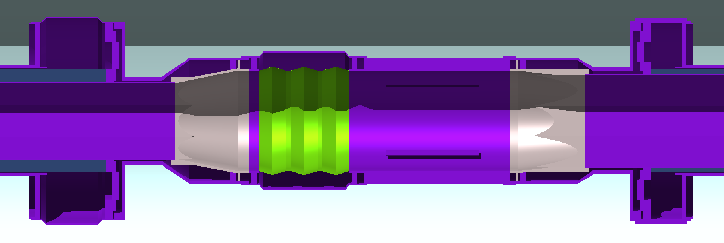
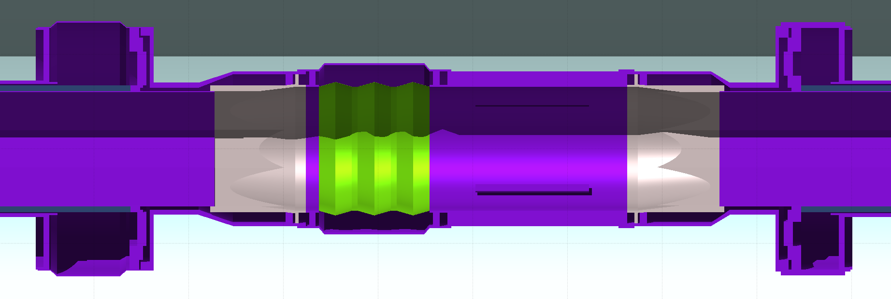
Geometry upgrades & updates
3. New FLUKA models of interconnect with circular BPM
BS shielding gap 70.8cm
Q1→Q2
Q2→Q3
and beyond
Design provided by R. Fernandez-Gomez, T. Lefevre
Energy deposition in the Triplet-D1 region (v1.2) | WP2 Meeting – October 16, 2015 | AT

Slide 8
Results
Energy deposition in the Triplet-D1 region (v1.2) | WP2 Meeting – October 16, 2015 | AT

Slide 9
Total power for L=7.5L₀
 | Round vertical |  | Round horizontal |  | RV V1.1
 | Magnet cold mass | Beam screen | Magnet cold mass | Beam screen | Magnet cold mass | Beam screen
 | Power [W]
Q1A + Q1B | 167 | 251 | 176 | 257 | 140 | 210
Q2A + corr. | 139 | 115 | 128 | 102 | 150 | 90
Q2B + corr. | 170 | 147 | 179 | 153 | 165 | 100
Q3A + Q3B | 186 | 154 | 161 | 125 | 220 | 105
CP | 86 | 106 | 57 | 74 | 105 | 90
D1 | 114 | 108 | 92 | 84 | 135 | 80
TOTAL | 862 | 881 | 793 | 795 | 915 | 675
Extension of BS shielding towards poles re-balances loads between CM and BS
Loads in horizontal crossing ~10% lower with respect to vertical crossing
Energy deposition in the Triplet-D1 region (v1.2) | WP2 Meeting – October 16, 2015 | AT

Slide 10
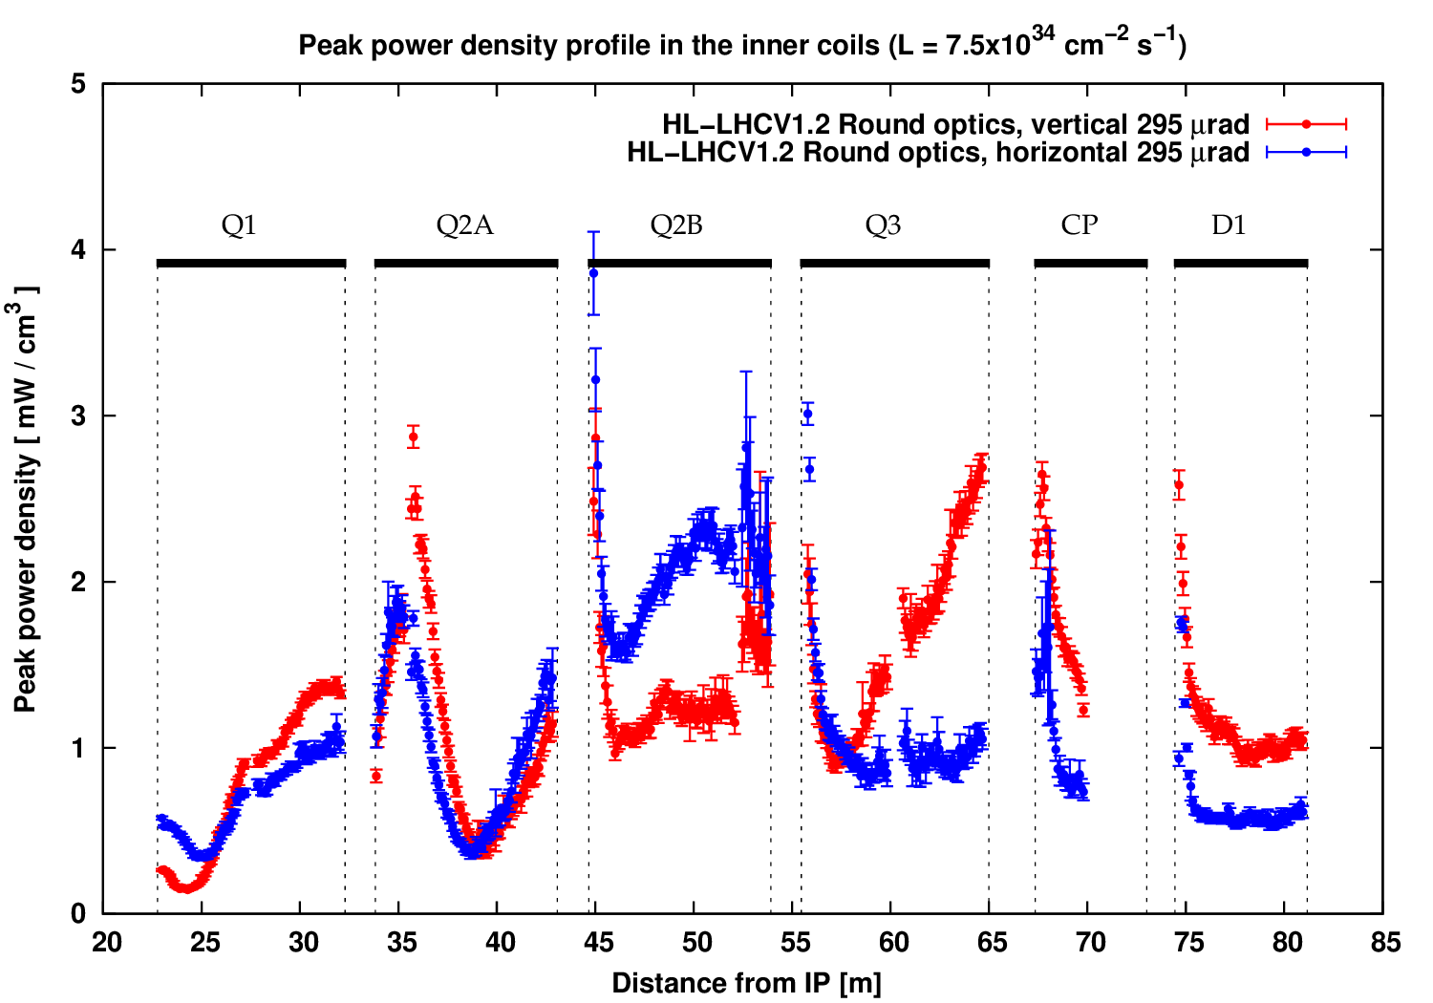
Peak power density (L=7.5L₀)
Values quite low overall
There is an important effect in the IP-faces due to shielding gap in the interconnect, especially in horizontal crossing
Energy deposition in the Triplet-D1 region (v1.2) | WP2 Meeting – October 16, 2015 | AT

Slide 11
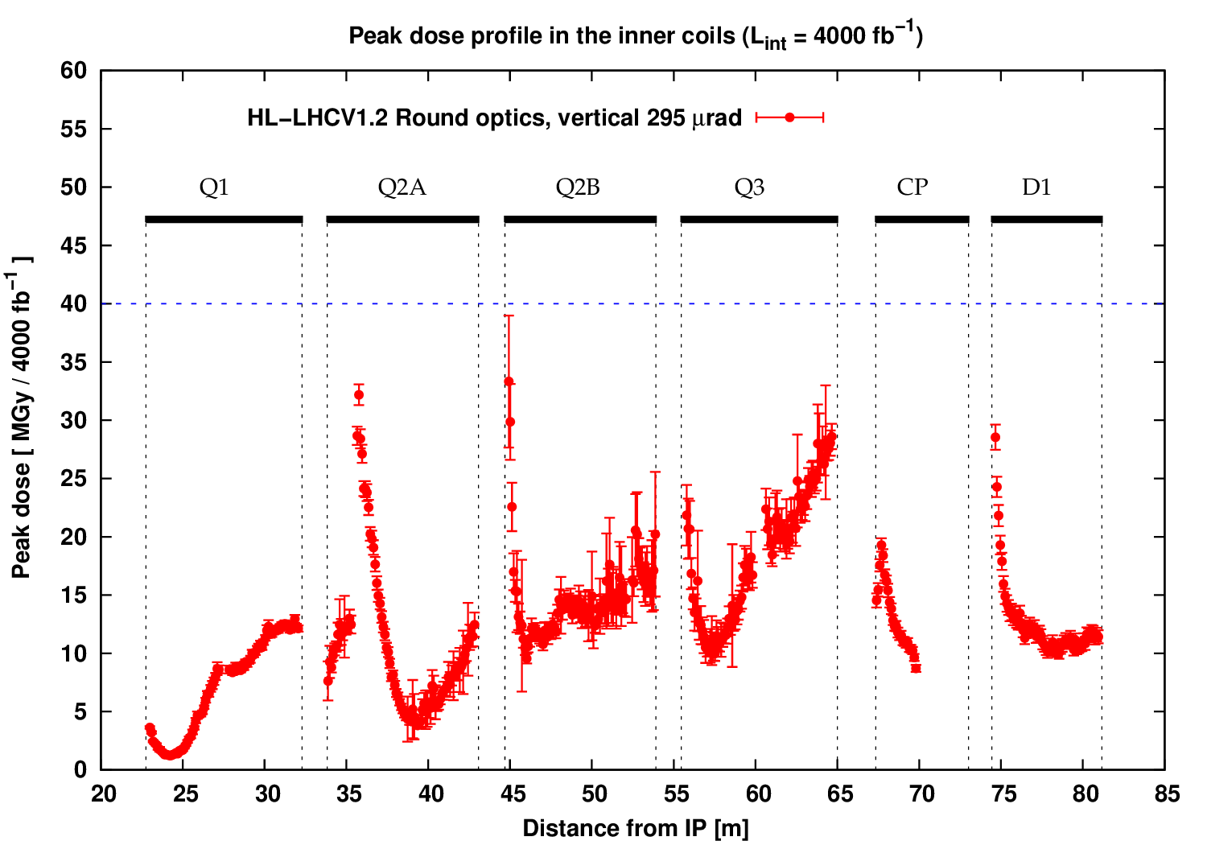
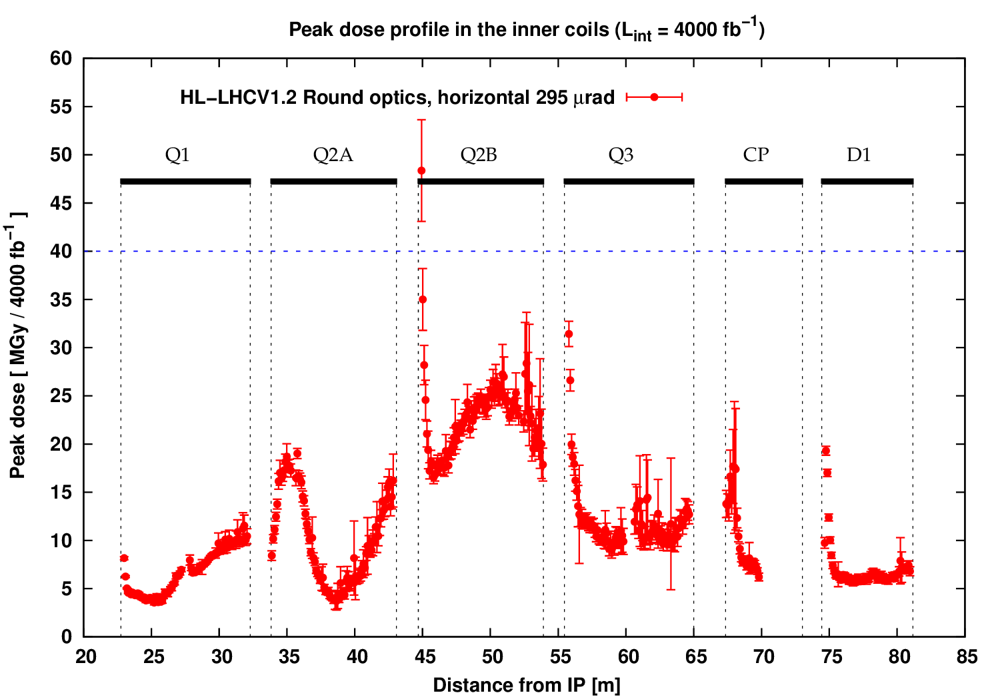
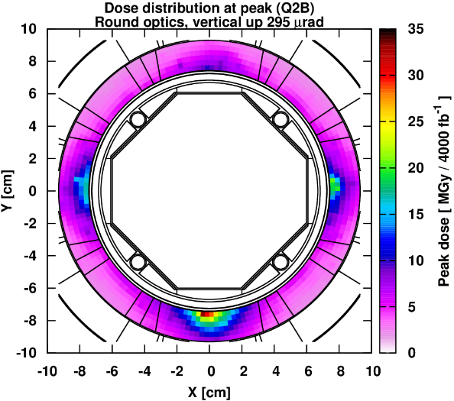
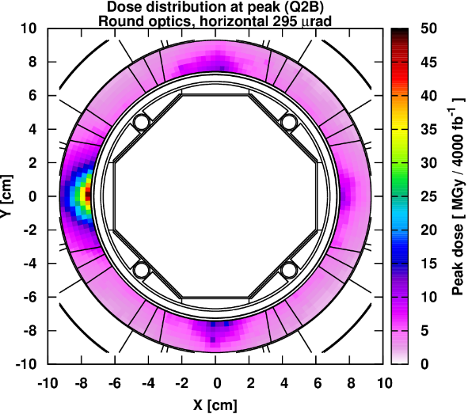
Peak dose (L_{int} = 4000fb⁻¹)
Vertical crossing
Horizontal crossing
Energy deposition in the Triplet-D1 region (v1.2) | WP2 Meeting – October 16, 2015 | AT

Slide 12
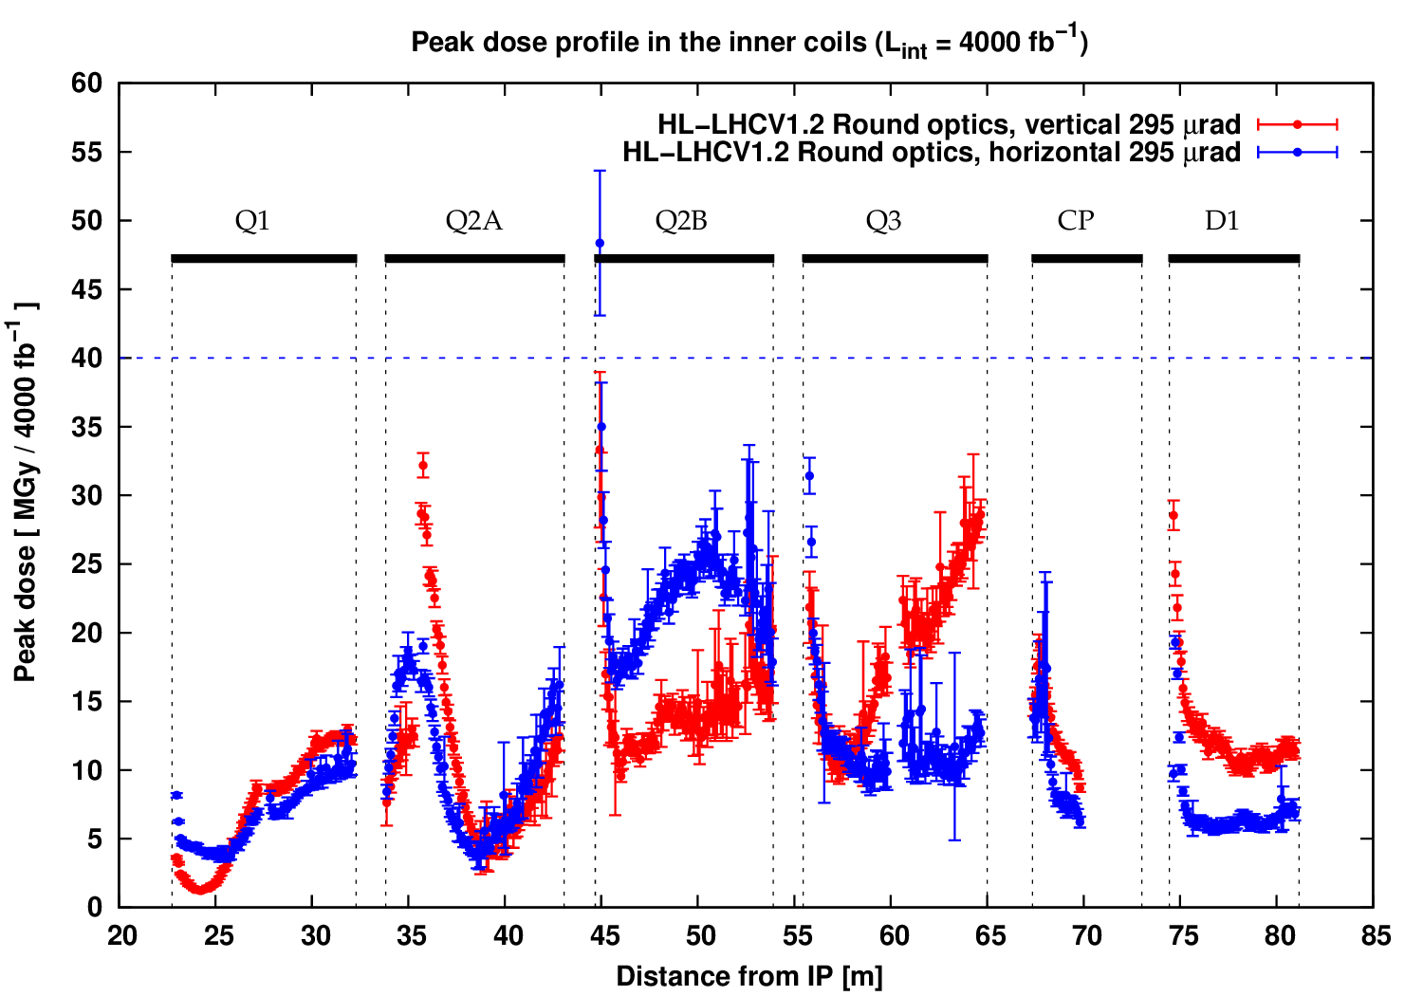
Peak dose (L_{int} = 4000fb⁻¹)
The horizontal case is worse
  Shielding gap in the interconnect creates a localised problem
Energy deposition in the Triplet-D1 region (v1.2) | WP2 Meeting – October 16, 2015 | AT

Slide 13
Is this consistent with previous results?
YES
  An increase in the peak dose in Q2B is expected going from vertical to horizontal crossing
  A longer gap (from 10 to 50cm) in the BS shielding was shown to lead to significantly higher peak dose values in the IP-faces (especially in Q2B)
    REMINDER: Gap is now ~71cm
L_{int} = 3000fb⁻¹
Q1
Q2A
Q2B
Q3
CP
D1
See F. Cerutti, 5th PLC Meeting, July 2, 2013
Energy deposition in the Triplet-D1 region (v1.2) | WP2 Meeting – October 16, 2015 | AT

Slide 14
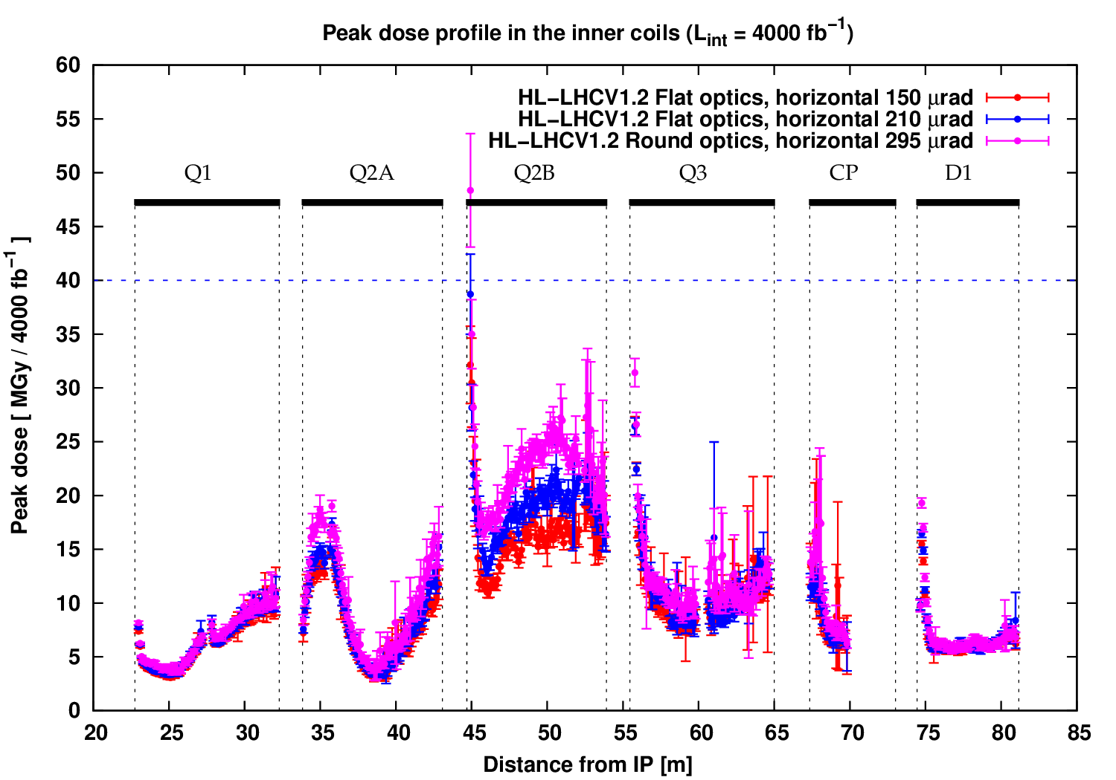
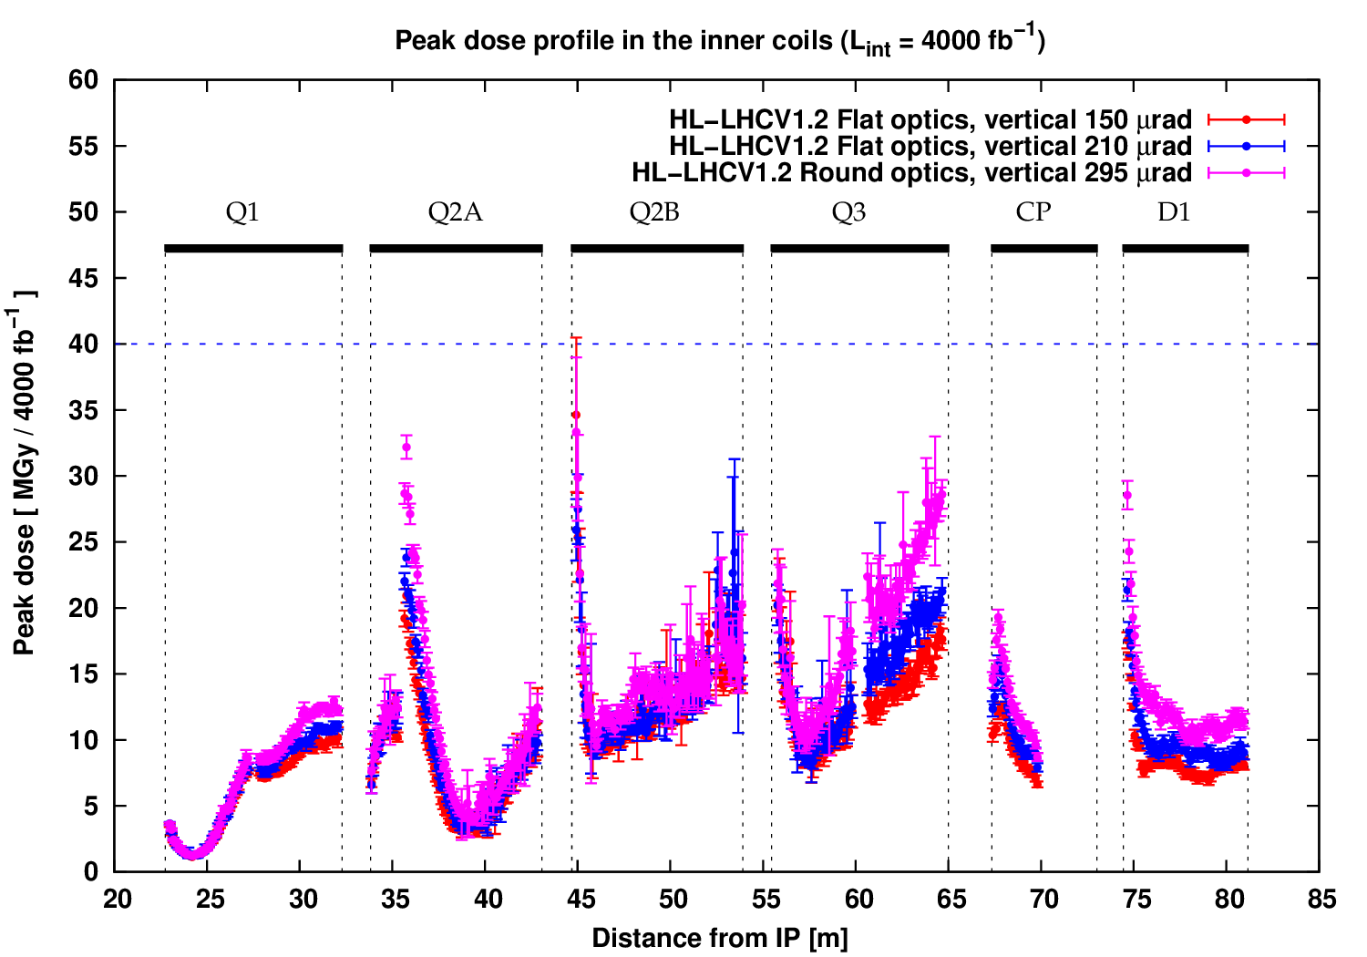
Further studies: flat optics
Two flat optics scenarios were also studied for both vertical and horizontal crossing
  150μrad half-crossing angle, β*_{x} / β*_{y} = 40 / 10 cm
  210μrad half-crossing angle, β*_{x} / β*_{y} = 40 / 10 cm
Sensitivity of results to changes in bunch length and beam divergence is limited
On the contrary, the crossing angle plays an important role
  Lower dose for lower crossing angle
295μrad
210μrad
150μrad
295μrad
210μrad
Energy deposition in the Triplet-D1 region (v1.2) | WP2 Meeting – October 16, 2015 | AT

Slide 15
Peak dose minimisation with alternative optics & crossing combinations
In collaboration with S. Fartoukh (BE/ABP)
Energy deposition in the Triplet-D1 region (v1.2) | WP2 Meeting – October 16, 2015 | AT

Slide 16
Peak dose minimisation scenarios
Different combinations of optics and crossing can reduce peak dose values
The flexibility of such combinations depends on various constraints e.g.:
  Possibility of exchange of crossing planes between IP1 and IP5 (HV→VH)
  Possibility of running with the same crossing plane in IP1 and IP5 (HH or VV)
Four scenarios considered, with decreasing constraints:
  1. Baseline scenario: 50% vertical up (V⁺) / 50% vertical down (V⁻) in IP1, 100% horizontal (H) in IP5 with round optics
  2. Crossing plane exchange between the two IPs: 50% H, 25% V⁺, 25% V⁻ with round optics
  3. Crossing plane exchange between the two IPs: 50% H, 25% V⁺, 25% V⁻ with flat optics (150μrad)
  4. No constraints: 50% V⁺ / 50% V⁻ with flat optics (150μrad) in both IPs, which is better than 100% H
Energy deposition in the Triplet-D1 region (v1.2) | WP2 Meeting – October 16, 2015 | AT

Slide 17
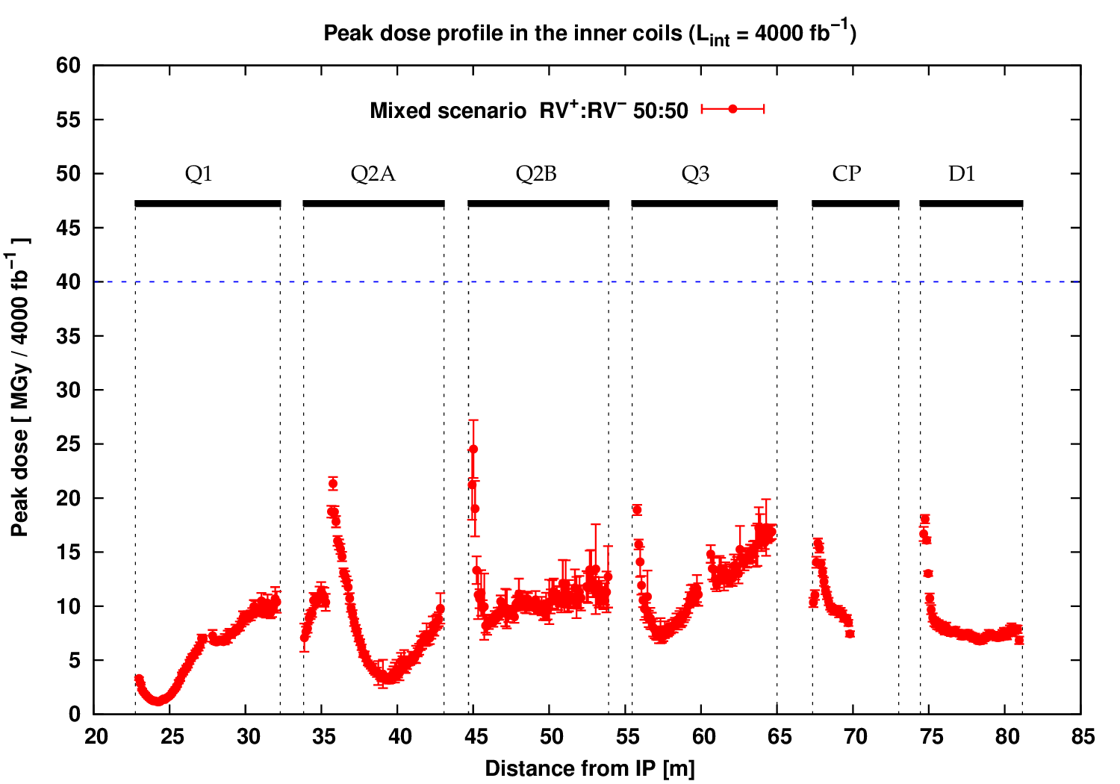
Peak dose minimisation scenarios
1. Baseline scenario:
  50% vertical up (V⁺) / 50% vertical down (V⁻) in IP1
  100% horizontal (H) in IP5 with round optics
Important reduction in IP1 (from 35 to 25MGy)
BUT, we remain exposed to the high peak value in IP5
  If the local problem is cured, peak values would be below 30MGy.
IP1
IP5
Energy deposition in the Triplet-D1 region (v1.2) | WP2 Meeting – October 16, 2015 | AT

Slide 18
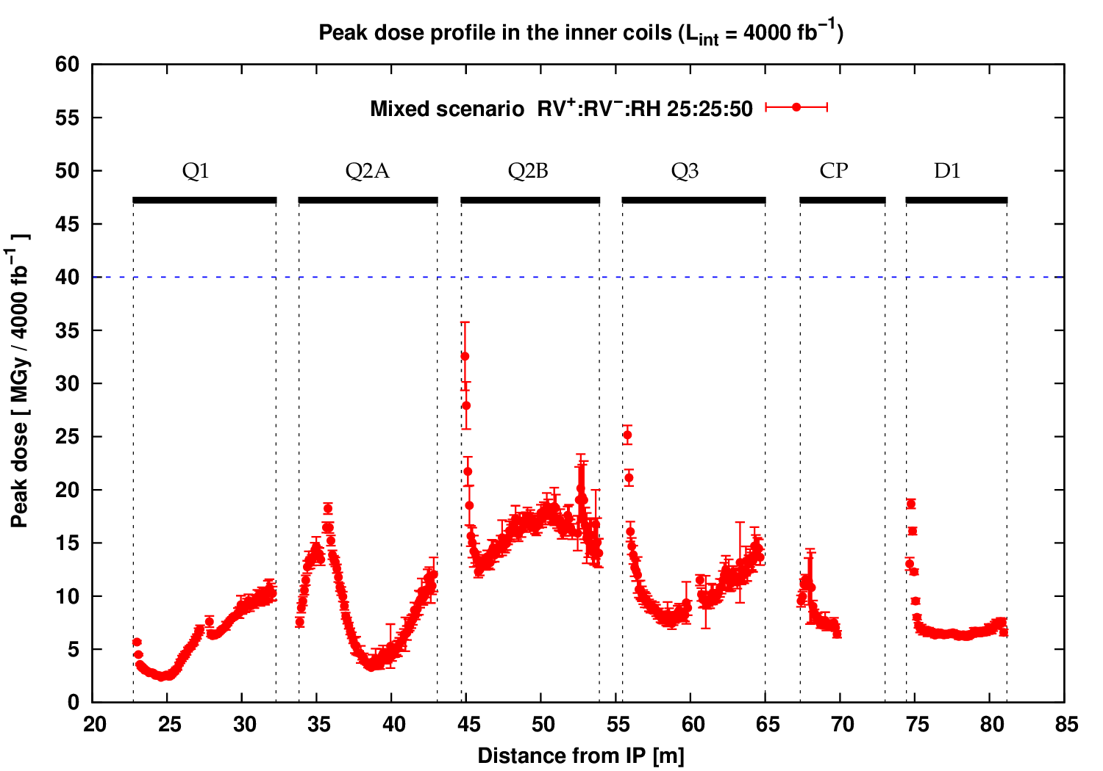
Peak dose minimisation scenarios
2. Crossing plane exchange between the two IPs
  50% H, 25% V⁺, 25% V⁻ with round optics in both IPs
Energy deposition in the Triplet-D1 region (v1.2) | WP2 Meeting – October 16, 2015 | AT

Slide 19
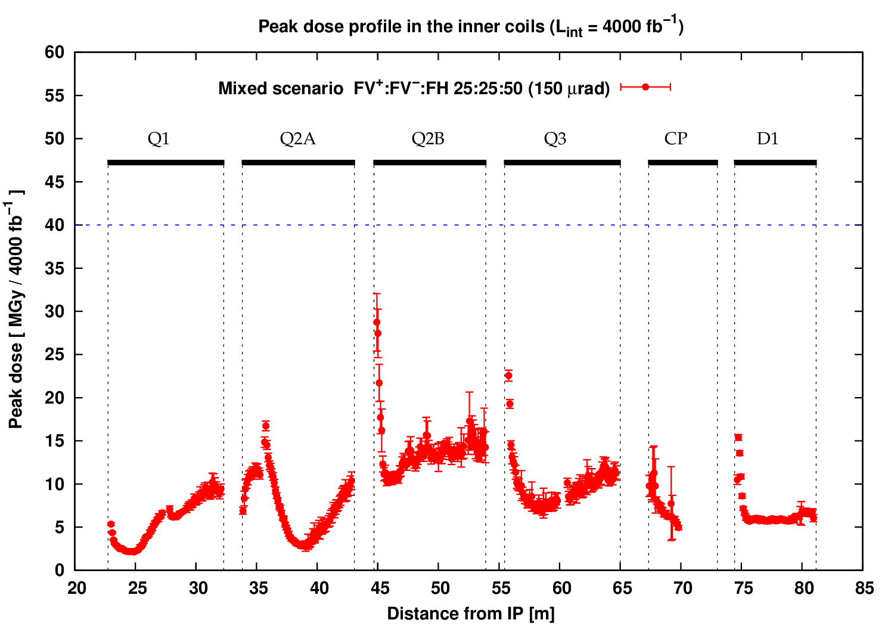
Peak dose minimisation scenarios
3. Crossing plane exchange between the two IPs
  50% H, 25% V⁺, 25% V⁻ with flat optics (150μrad)
Energy deposition in the Triplet-D1 region (v1.2) | WP2 Meeting – October 16, 2015 | AT

Slide 20
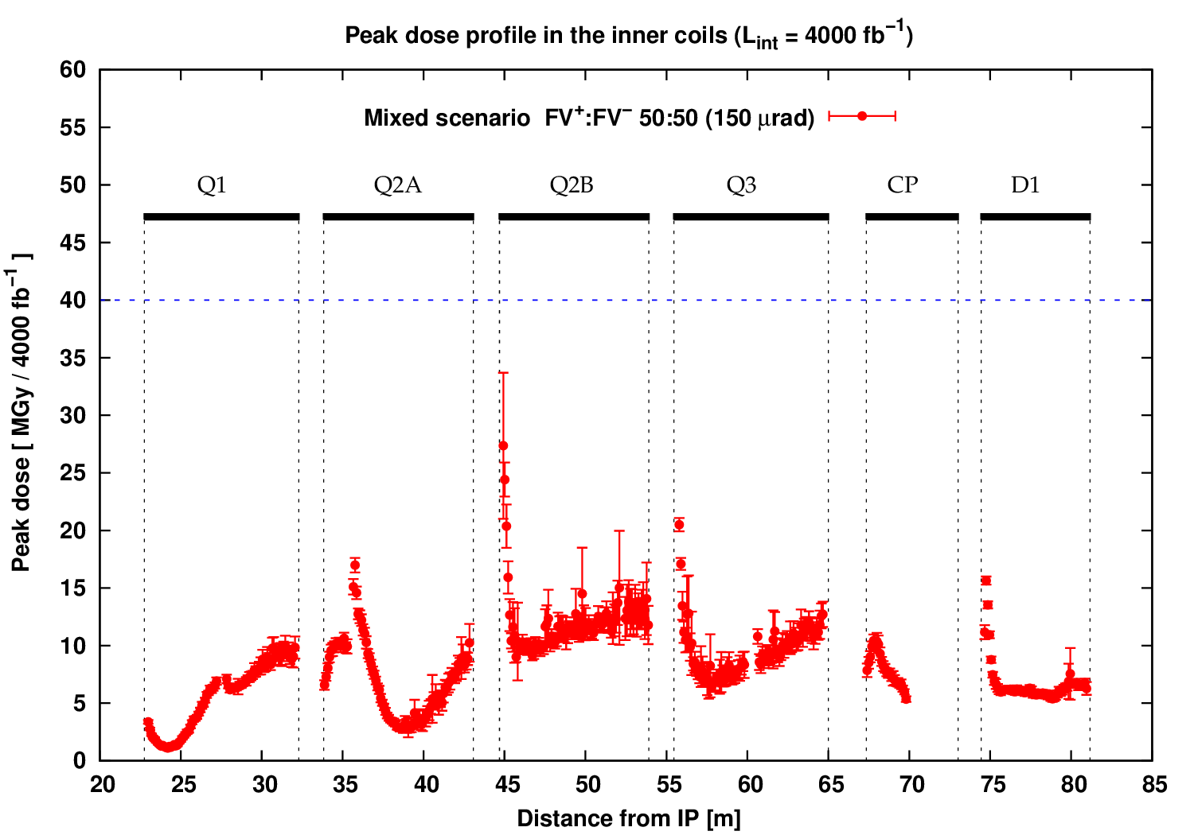
Peak dose minimisation scenarios
4. No constraints
  50% V⁺ / 50% V⁻ with flat optics (150μrad) in both IPs
Energy deposition in the Triplet-D1 region (v1.2) | WP2 Meeting – October 16, 2015 | AT

Slide 21
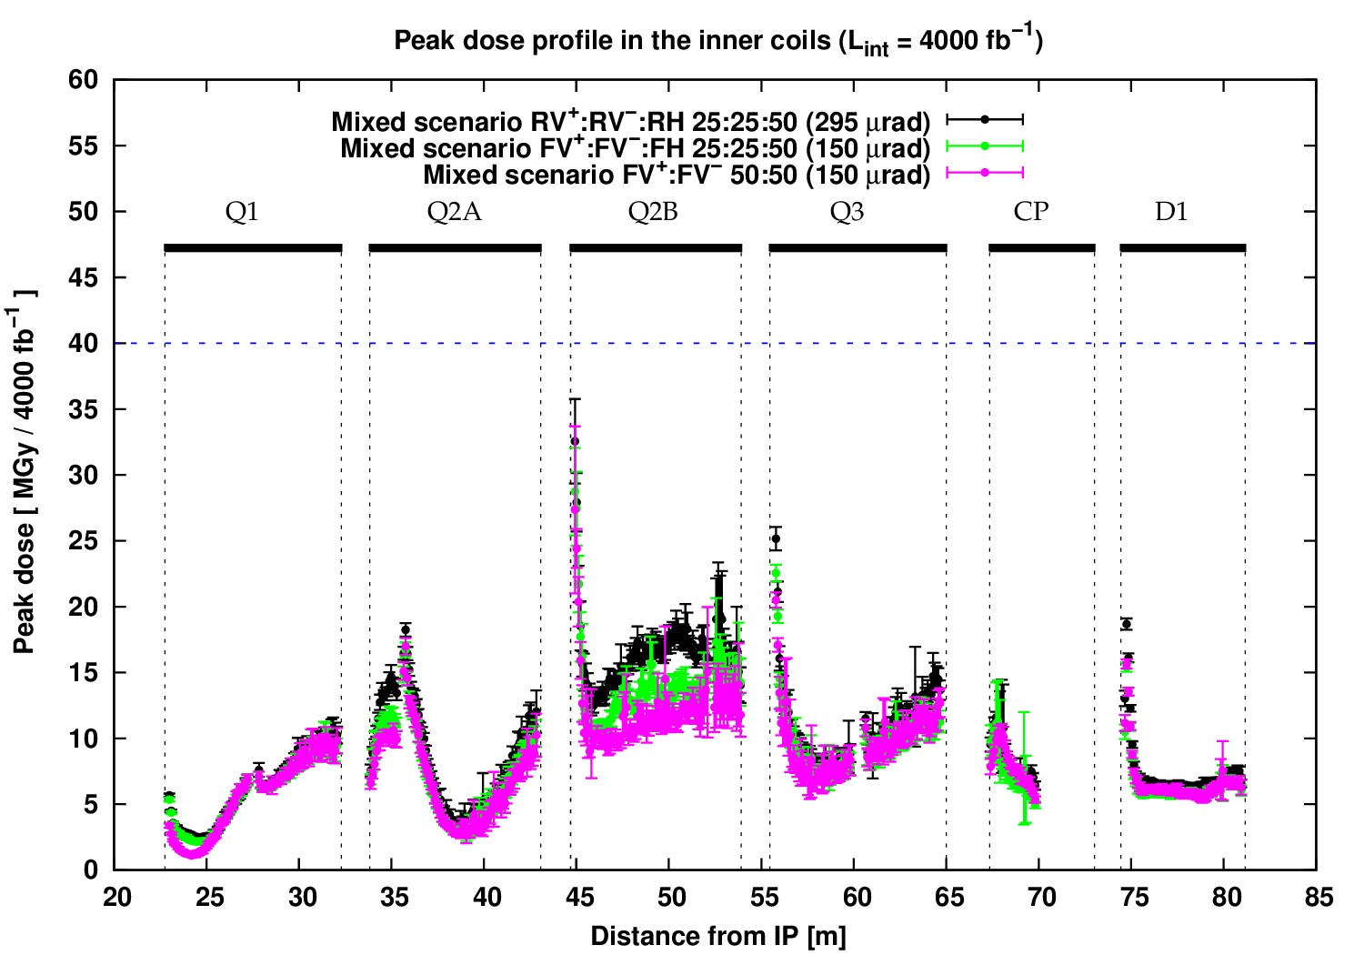
Peak dose minimisation scenarios
Comparison of three mixed scenarios:
Energy deposition in the Triplet-D1 region (v1.2) | WP2 Meeting – October 16, 2015 | AT

Slide 22
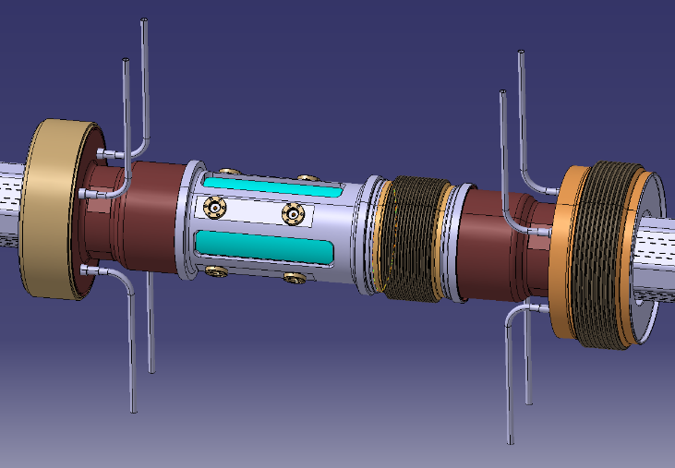
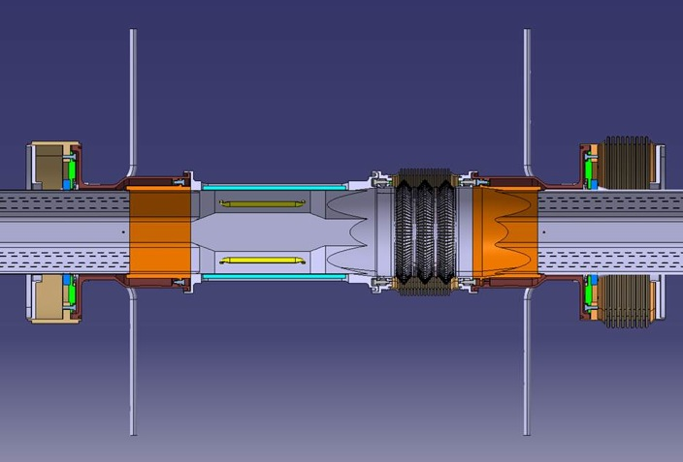
Possible improvement
Octagonal shielded BPM
  Shielding gap reduction to ~57cm (instead of 71cm with circular BPM)
  The shorter gap would surely lead to a reduction of peak dose values
  BUT the gap is still quite long (more than the 50cm studied in the past)
  This solution is not expected to cure the problem
Additional shielding
Courtesy: T. Lefevre
Energy deposition in the Triplet-D1 region (v1.2) | WP2 Meeting – October 16, 2015 | AT

Slide 23
Summary
Simulation parameters updated to V1.2
Various geometry updates (magnet aperture, BS designs)
New models added: interconnects with circular BPM
Peak dose estimates show challenging localised problem in IP-face of Q2B, especially for horizontal crossing
Flat optics scenarios show improvements attributable to the lower crossing angle
Different optics and crossing combinations (depending on hardware options) could significantly reduce peak dose values
Study will be extended to the matching section
Energy deposition in the Triplet-D1 region (v1.2) | WP2 Meeting – October 16, 2015 | AT

Slide 24
Extra slides
Energy deposition in the Triplet-D1 region (v1.2) | WP2 Meeting – October 16, 2015 | AT

Slide 25
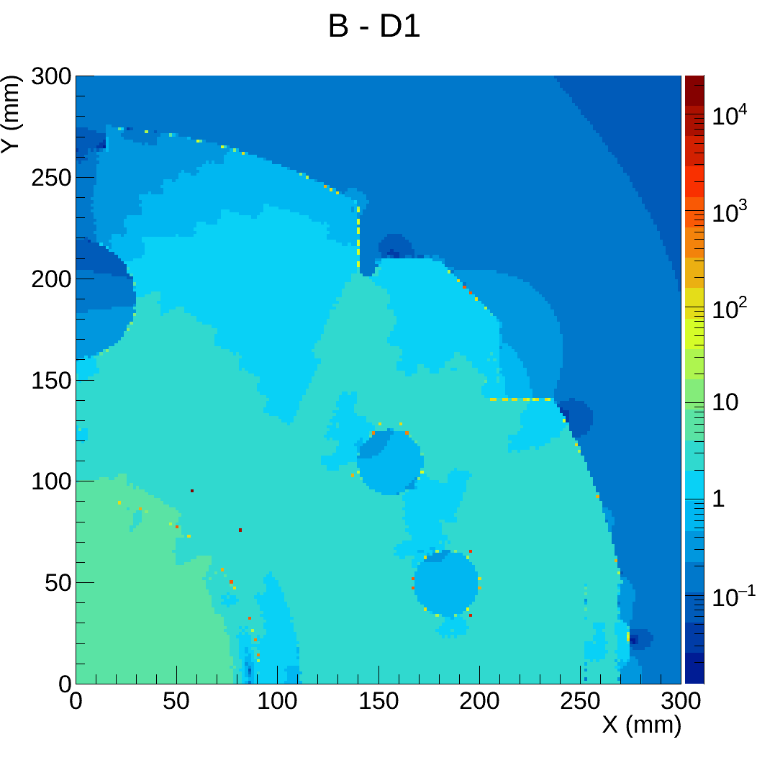
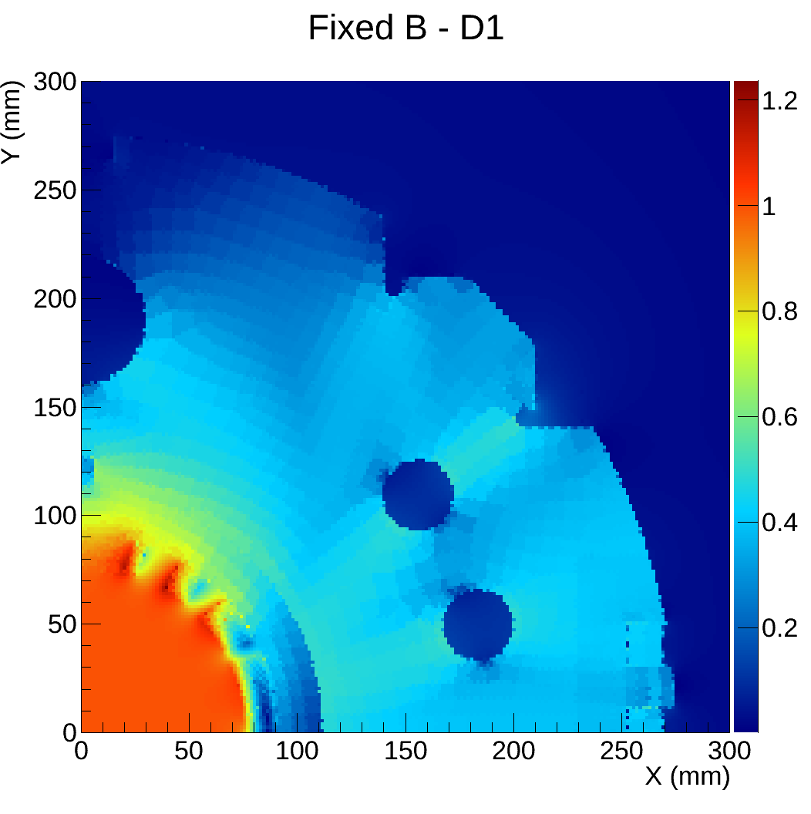
D1 magnetic field map
Unphysical field values at certain boundaries
  Due to numerical issues in Roxie?
A routine was written to detect these spikes and replace them with the average of neighbouring values (excluding neighbouring spikes)
Energy deposition in the Triplet-D1 region (v1.2) | WP2 Meeting – October 16, 2015 | AT

Slide 26
The HiLumi LHC Design Study is included in the High Luminosity LHC project and is partly funded by the European Commission within the Framework Programme 7 Capacities Specific Programme, Grant Agreement 284404.

