Slide 1
LHC IR Stripline BPM
MD Results
Thibaut Lefevre and Drasko Draskovic
on behalf of the BI group
61st HL-LHC WP2 Task Leader Meeting
27.11.2015

Slide 2
Outline
Design of HL-LHC stripline BPMs
- Current status
LHC Stripline BPM MD: DOROS vs WBTN in IR
- Overview
- Main results and conclusion

Slide 3
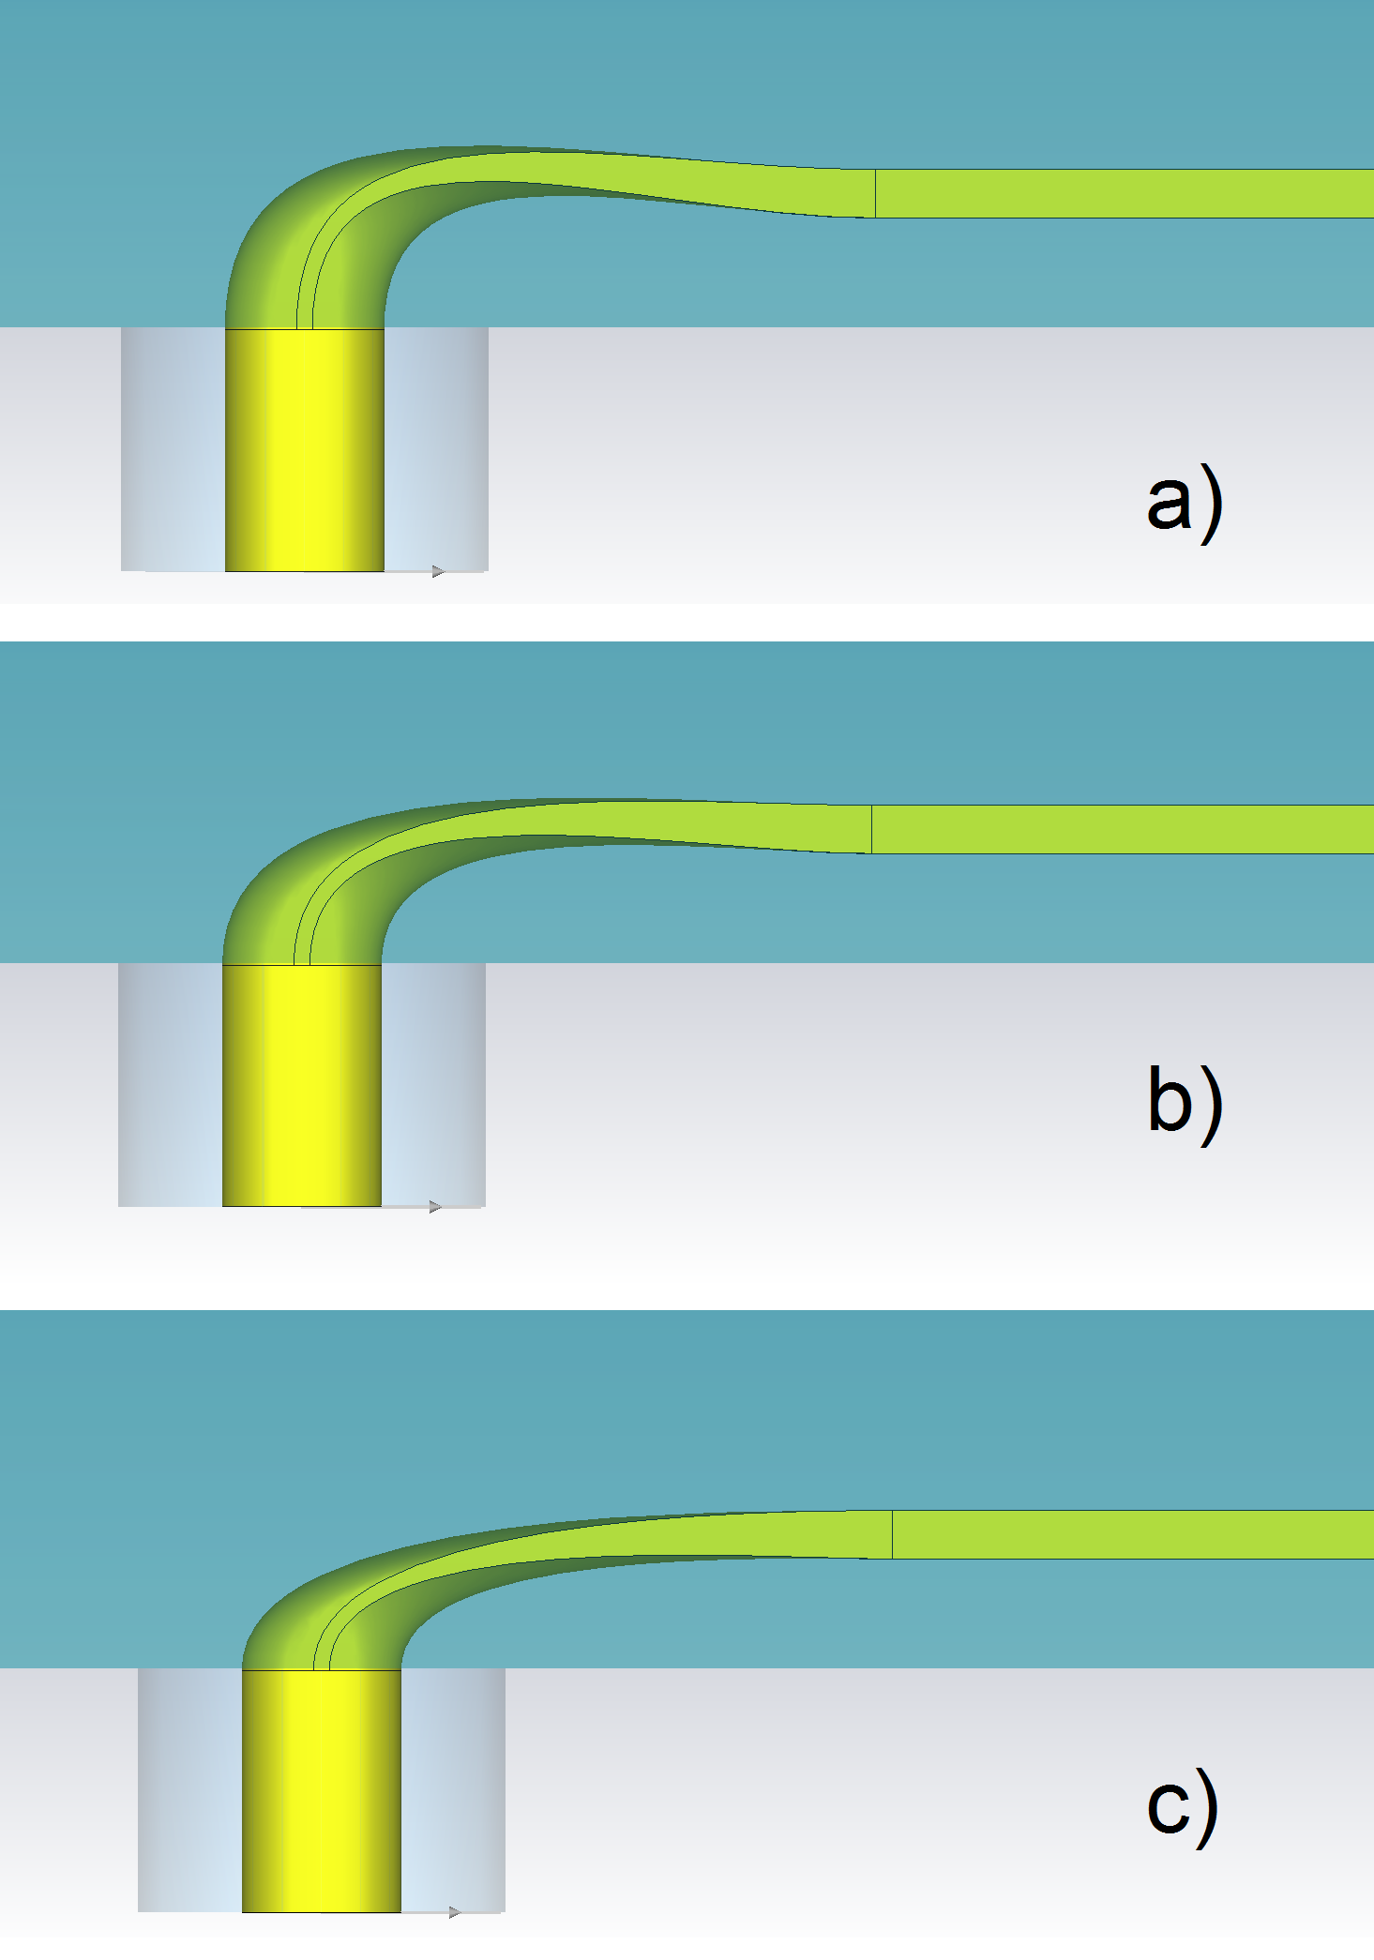
Design of Stripline BPMs for the
High Luminosity LHC
Optimizing the stripline directivity to provide best possible accuracy
RF simulations showed 7 to 10dB improvement compared to current LHC design (IPAC’15 paper MOPTY053)

Slide 4
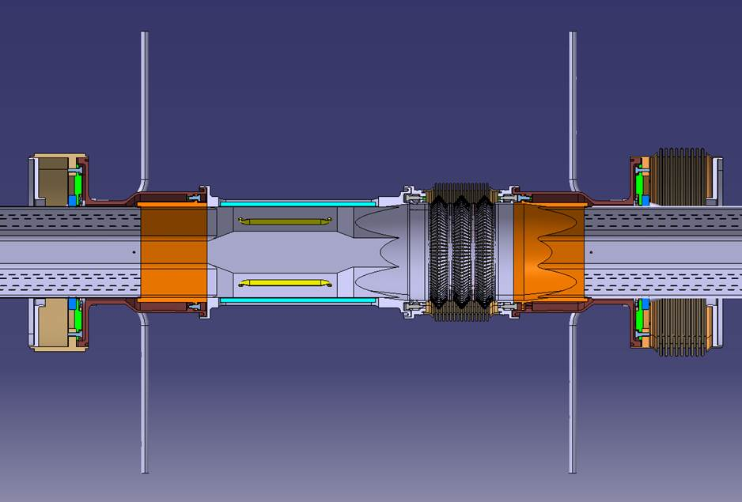
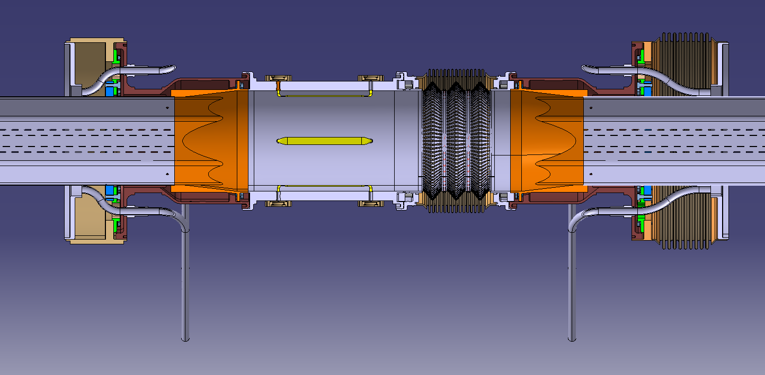
Design of Stripline BPMs for the
High Luminosity LHC
Mechanical design launched
Integration of pick-up in the triplet interconnection: two designs being considered (circular and octogonal shape)
Additional FLUKA simulations are being performed to confirm the need of Inermet absorbers and their dimensions

Slide 5
MD LHC BPM
Goal
Check the sensitivity of the BPM electronics with two acquisition chain electronics systems, WBTN (Wide Band Time Normalizer) and DOROS (Diode ORbit and Oscillation System) to the position of the BPM with respect to beam encounters.

Slide 6
MD LHC BPM
Proceed with cogging in small steps of 0.625ns.
Log and live plot the RF parameter #dTMean - the relative time difference between the two beam revolution frequencies B1 and B2, as well as the horizontal and the vertical beam positions for both beams for WBTN and DOROS
Procedure
Check on the oscilloscope the initial readings of the analog sum signals for stripline BPMs in IP1 and IP5 (Left and Right).
Cogging in large steps (5ns) to find the overlapping position (our reference)

Slide 7
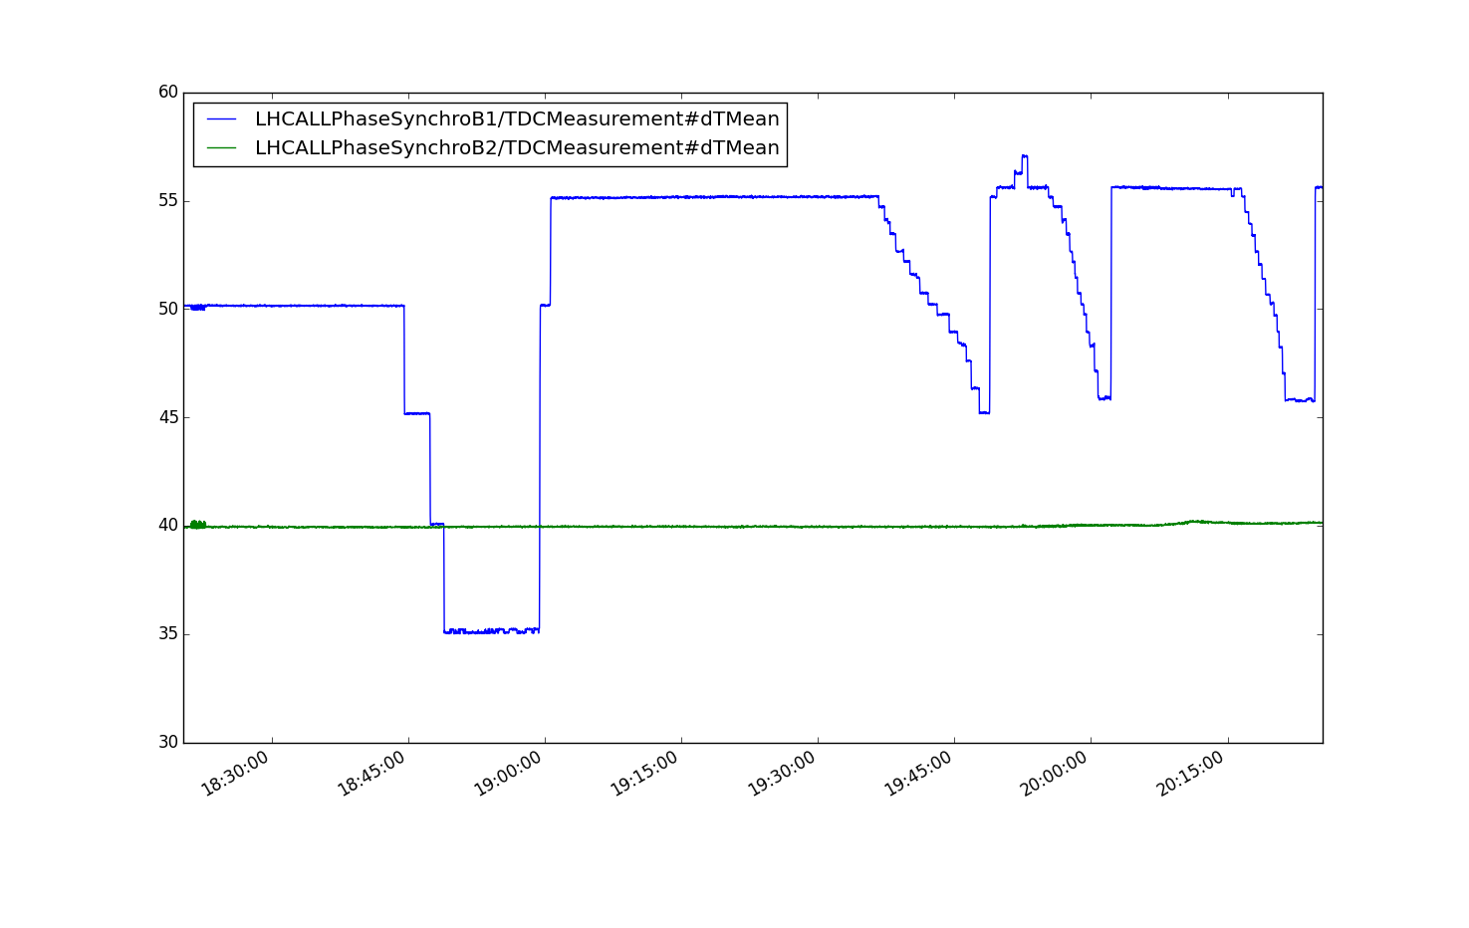
MD Three Scenarios
Both beams, with the same intensity per bunch, centered in the BPMSW, then adjust the RF cogging to adjust the time overlap between the two beams in the pick-up
The same as 1 but with offset in position for both beams (typical separation bumps)
The same as 1 but with offset in position for both beams and with factor 2 difference in bunch intensity between B1 and B2
1: Both beams centered 2: Offset in position for beams 3: Same as 2 with 2x difference in intensity

Slide 8
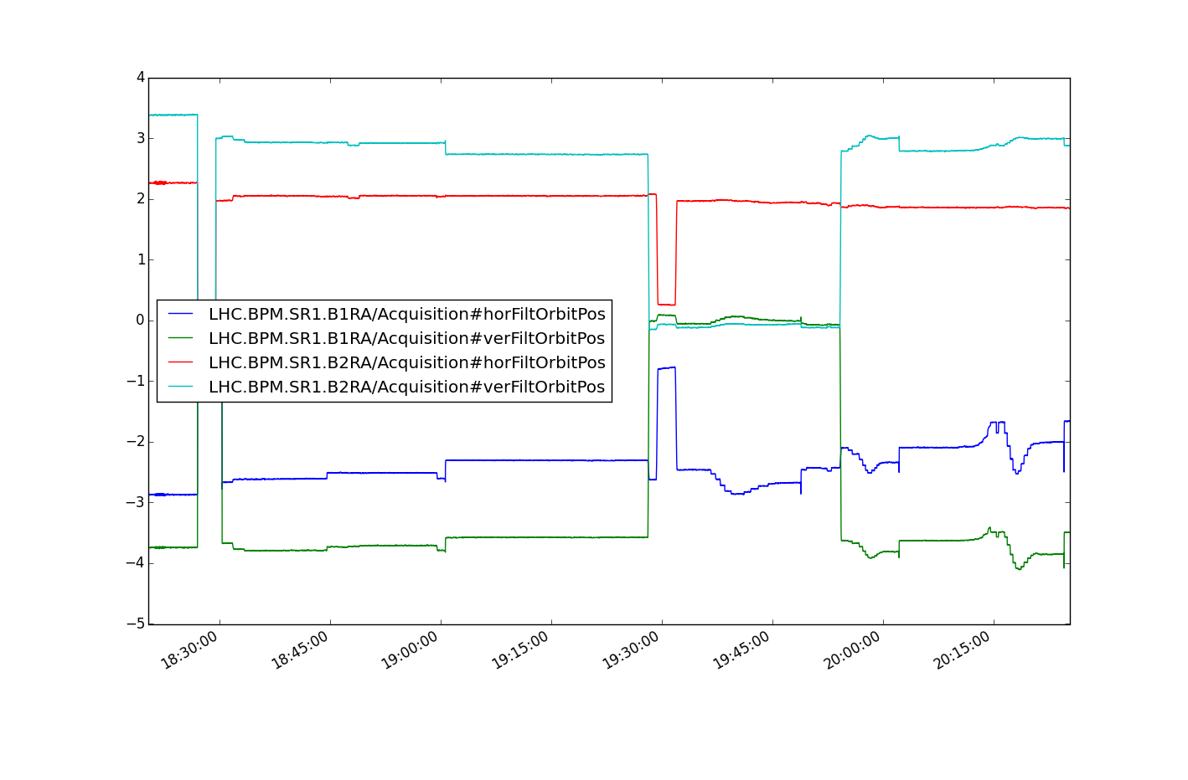
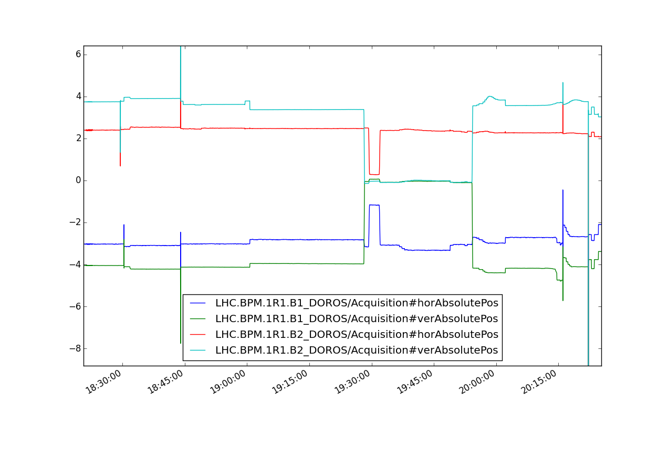
WBTN DOROS
1: Both beams centered 2: Offset in position for beams 3: Same as 2 with 2x difference in intensity

Slide 9
P1 Scenario 1, horizontal plane

Slide 10
P1 Scenario 1, vertical plane

Slide 11
P1 Scenario 1, horizontal position drift

Slide 12
P1 Scenario 1, vertical position drift

Slide 13
P1 Scenario 1, vertical position drift
Unperturbed beam position
Perfect overlap of the two beams in time: >100um offset

Slide 14
Significant difference in response
DOROS
The offset for DOROS is gradually decreasing as the two beam signals do not overlap in time, and after a Δt of 3ns, the DOROS reading does not change anymore. Then, at this stage one can consider that DOROS electronics is processing the beam signals with no crosstalk from the other beam.
WBTN
The WBTN chain has a more complex behavior.
After a Δt of 3 ns, the WBTN offset changes sign and it needs more than 6 ns of time separation to consider that the WBTN electronics processes the signals with no crosstalk

Slide 15
Comparison of the BPM reading absolute change (range) due to cogging (in mm)
P 1
 | Scenario 1 |  | Scenario 2 |  | Scenario 3
 | H | V | H | V | H | V
WBTN B1 | 0.213 | 0.073 | 0.252 | 0.200 | 0.494 | 0.324
DOROS B1 | 0.249 | 0.053 | 0.278 | 0.222 | 0.225 | 0.199
P 5
 | Scenario 1 |  | Scenario 2 |  | Scenario 3
 | H | V | H | V | H | V
WBTN B1 | 0.116 | 0.098 | 0.239 | 0.126 | 0.563 | 0.219
DOROS B1 | 0.128 | 0.103 | 0.387 | 0.139 | 0.532 | 0.218

Slide 16
Comparison of the BPM reading absolute change (range) due to cogging (in mm)
The maximum beam offsets measured by both systems is very similar. It corresponds to the case where the beam signals are perfectly overlapping in time and there is no way for the electronics to separate the signals induced by both beams.
With both beam separated in position, the measured errors become larger (up to 10%).
When two beams have different bunch intensities, i.e. scenario 3, the measured error on the lower bunch intensity becomes proportionally larger, i.e. twice larger for 50% lower bunch intensity.

Slide 17
Δt acceptable time (ns)
 | Scenario 1 | Scenario 2 | Scenario 3
WBTN B1 | 6.82 | 6.68 | 6.47
DOROS B1 | 2.53 | 2.95 | 2.75

Slide 18
Conclusion

Slide 19
Conclusion (1/2)
When the two beams propagate at the same time in the pick-up, DOROS and WBTN show similar beam offsets. These offsets become larger when the beams have opposite positions in the vacuum chamber.
If one beam has a larger intensity than the other, its contribution to the measurement of the other beam is significantly larger. Offsets up to 500um have been measured in such conditions.

Slide 20
Conclusion (2/2)
DOROS
DOROS demonstrates that for temporal offset larger than 3ns, its position reading is not influenced anymore by the presence of the other beam.
WBTN
The WBTN electronics would need more than 7ns of temporal offset in order to avoid any contribution from the counter propagating bunch.

Slide 21
Discussion

