Slide 1
Muon Accelerators: Implementation and Technology
Mark Palmer
Director, US Muon Accelerator Program
June 25, 2015

Slide 2
Muon Accelerators for HEP
μ – an elementary charged lepton:
  200 times heavier than the electron
  2.2 μs lifetime at rest
Physics potential for the HEP community using muon beams
  Tests of Lepton Flavor Violation
  Anomalous magnetic moment a hints of new physics (g-2)
  Equal fractions of electron and muon
  neutrinos at high intensity for studies of
  neutrino oscillations –
  the Neutrino Factory concept
  Large coupling to the “Higgs mechanism”
  As with an e⁺e⁻ collider, a μ⁺μ⁻ collider would offer a precision leptonic probe of fundamental interactions

Slide 3
Muon Accelerator Capabilities for HEP
Long Baseline NF

Slide 4
Why Neutrino Factories?

Slide 5
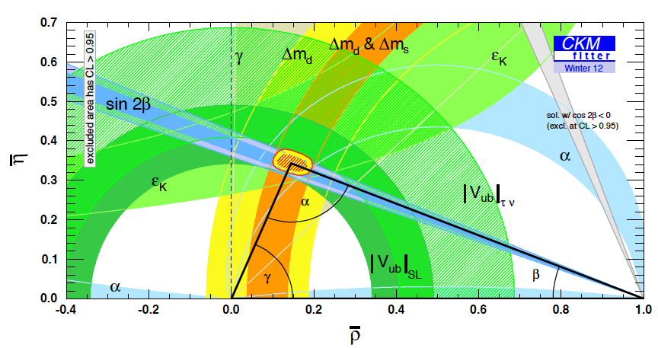
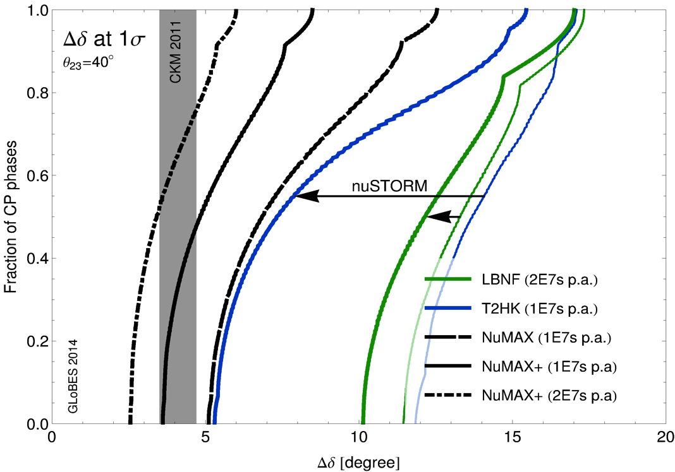
The Critical Issues
What must we understand in the neutrino sector?
  δ_{CP}: Can this be done with the same
  precision as the quark sector???
  The mass hierarchy
  The value of θ₂₃-π/4: +, - or zero?
  Resolve the LSND and other short
  baseline experimental anomalies
  And enable the search for new
  physics
Impact of precision short-baseline NF capabilities
Impact of precision long-baseline NF capabilities
GLoBES Comparison of Potential
Performance of the Various
Advanced Concepts (courtesy P. Huber)

Slide 6
Microscopes for the ν Sector
Superbeam technology will continue to drive observations in the coming years
However, anomalies and new discoveries will drive our need for precision studies to develop a complete physical understanding
Neutrino Factory capabilities (both long- and short-baseline) offer the route to controlled systematics and precision measurements, which are required to fully elucidate the relevant physics processes
a Precision Microscopes for the ν sector

Slide 7
Current Neutrino Factory Thrusts
Short Baseline NF
  nuSTORM
    Definitive measurement of sterile neutrinos
    Precision ν_{e} cross-section measurements (systematics issue for long baseline SuperBeam experiments)
    HEP muon accelerator proving ground…
Long Baseline NF with a Magnetized Detector
  IDS-NF (International Design Study for a Neutrino Factory)
    10 GeV muon storage ring optimized for 1500-2500km baselines
    “Generic” design (ie, not site-specific)
  NuMAX (Neutrinos from a Muon Accelerator CompleX)
    Site-specific: FNAL a SURF (1300km baseline)
    4-6 GeV beam energy optimized for CP studies
      Flexibility to allow for other operating energies
    Can provide an ongoing short baseline measurement option
    Detector options
      Magnetized LAr is the goal
      Magnetized iron provides equivalent CP sensitivities using ~3x the mass

Slide 8
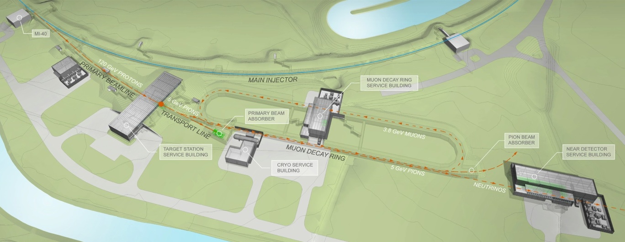
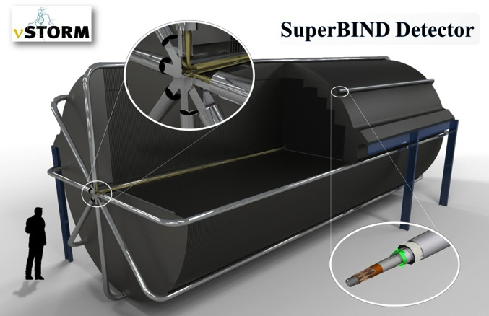
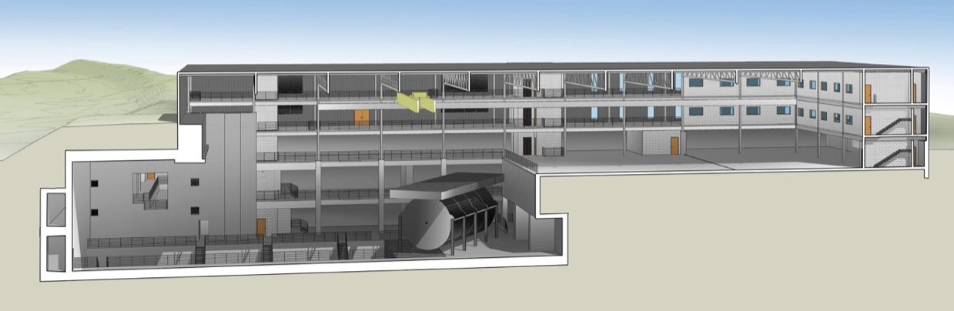
νSTORM – the First NF?
μ decay ring: P = 3.8 GeV/c ± 10%
  No new technologies required!
  Could be deployed now!
To Far
Hall
Fermilab
Configuration
Near Hall
Far Hall @1.9km
Far Detector

Slide 9
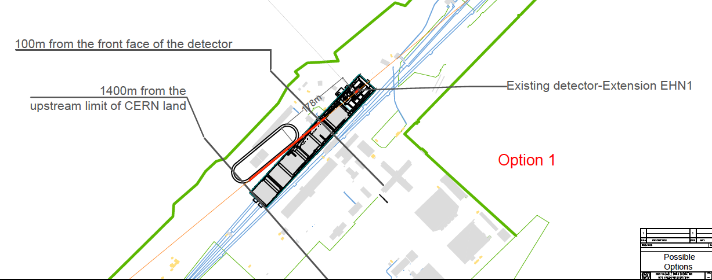
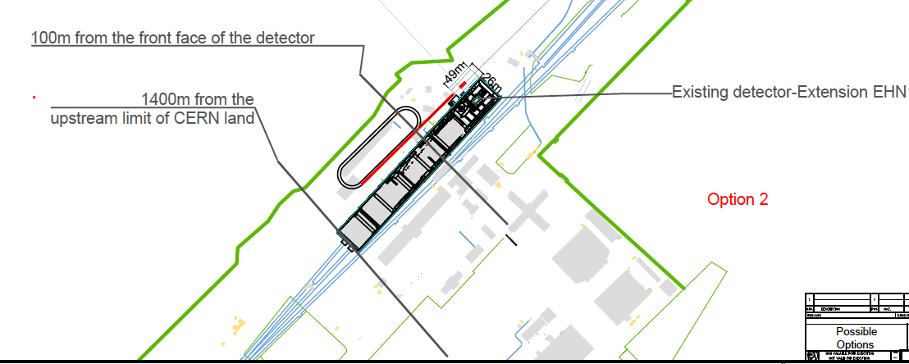
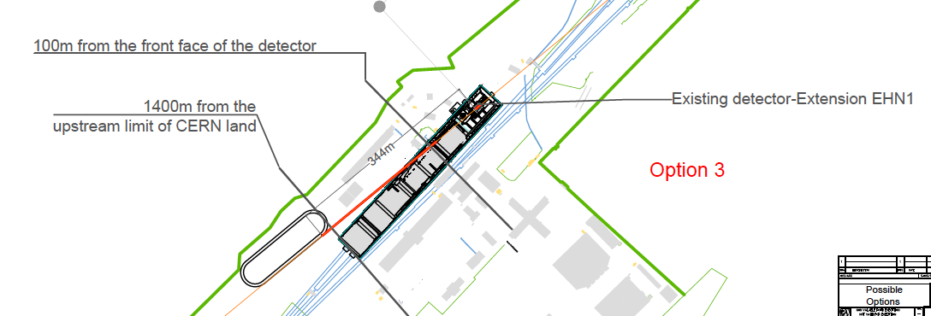
νSTORM Option for the CERN Neutrino Platform under study: M. Nessi, et al.

Slide 10
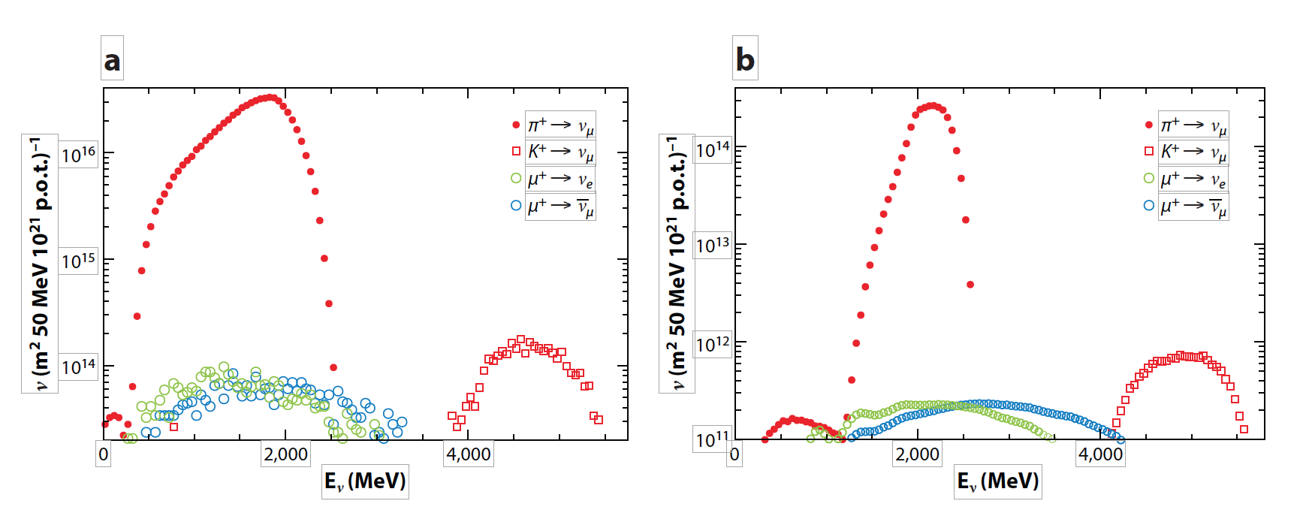
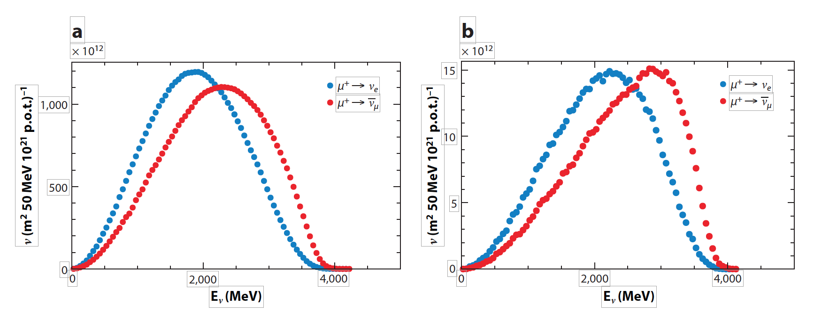
ν Beams at nuSTORM
π⁺ ➔ μ⁺ + ν_{μ}, π decays in injection straight
ν beams from π decay at nuSTORM:
High flavor purity with flux known to <1%
ν beams from μ decay at nuSTORM:
Absolute flavor purity with flux known to <1%
@50m
@2000m
μ⁺ ➔ e⁺ + ν_{e} + ν_{μ}-bar, decays from stored muons
@50m
@2000m

Slide 11
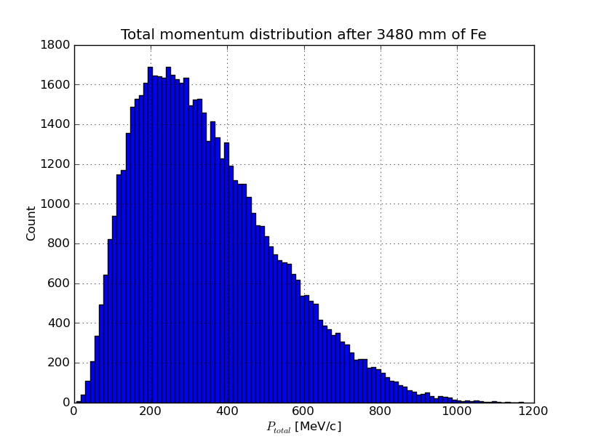
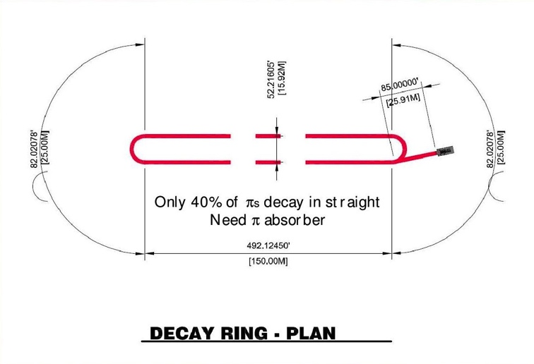
νStorm as an R&D platform
A high-intensity pulsed muon source
100<p_{μ}<300 MeV/c muons
  Using extracted beam from ring
  10¹⁰ muons per 1 μsec pulse
Beam available simultaneously with physics operation
A platform to test instrumentation for characterizing high intensity muon beams

Slide 12
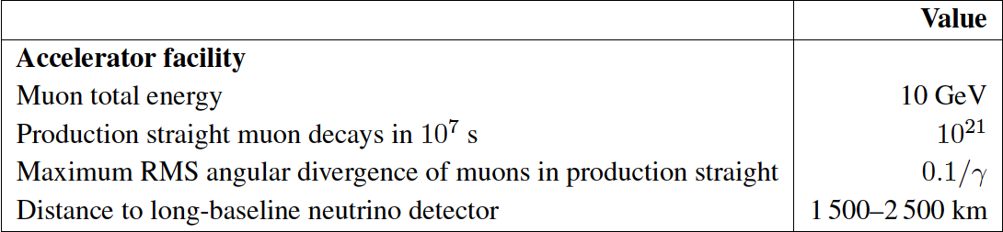
The Long Baseline Neutrino Factory
IDS-NF: the ideal NF
Muon Accelerator Staging
Study:
An incremental approach -NuMAX@5 GeVaSURF

Slide 13
The MAP Muon Accelerator Staging Study a NuMAX
5 GeV Storage Ring optimized for Fermilab-to-SURF baseline
NuMAX Staging:
Commissioning
  1MW Target
  No Muon Cooling
  10kT Detector
NuMAX+
  2.75 MW Target
  6D Muon Cooling
  34kT Detector

Slide 14
MASS NF Parameters

Slide 15
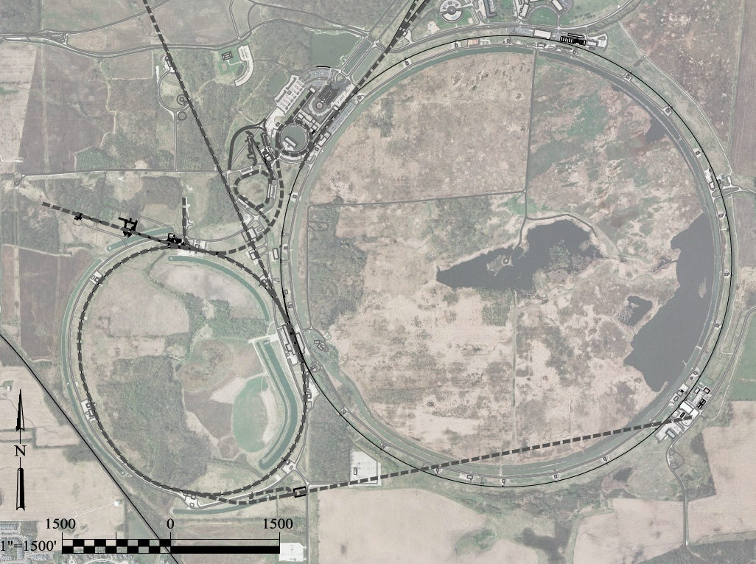
Possibilities for NF Capabilities at Fermilab:
νSTORM ➔ NuMAX
0.8 GeV Proton
Linac (PIP-II)
SURF
Superbeam
Accumulator,
Buncher,
Combiner
Front
End
0.8-3 GeV Proton
Linac (PIP-III)
Remains fully compatible with the PIP-II a III staging option
To
SURF
Target
Final
Cool
NuMAX:
νs to SURF
6D
Cool
Initial
Cool
1 GeV Muon
Linac (325MHz)
3-7 GeV Proton &
1-5 GeV Muon
Dual Species Linac
To Near Detector(s) for
Short Baseline
Studies
Muon Beam
R&D Facility
Possible to deploy subsequent muon collider capabilities
ft
νSTORM
ft

Slide 16
Going Beyond Neutrino Factory Capabilities

Slide 17
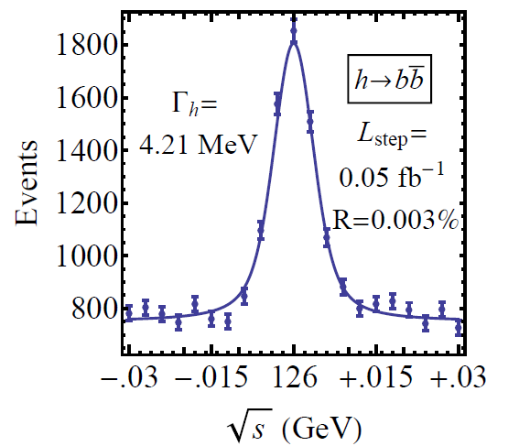
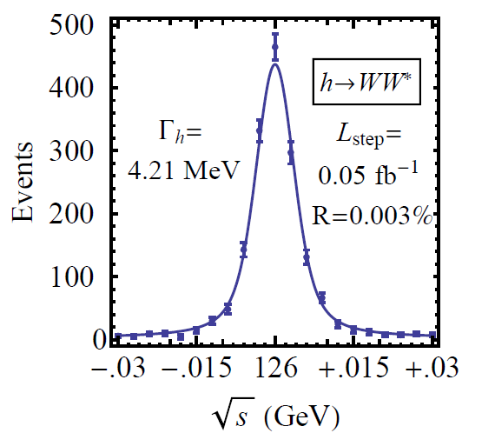

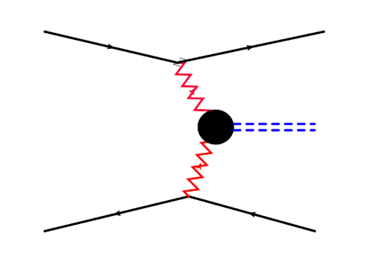



Features of the Muon Collider
Superb Energy Resolution
  SM Thresholds and s-channel Higgs Factory operation
Multi-TeV Capability (≤ 10TeV):
  Compact & energy efficient machine
  Luminosity > 10³⁴ cm⁻² s⁻¹
  Option for 2 detectors in the ring
  For √s > 1 TeV: Fusion processes dominate
  a an Electroweak Boson Collider
  a a discovery machine complementary to a
  very high energy pp collider
  >5TeV: Higgs self-coupling resolution <10%
What is our most efficient accelerator option if
new LHC data shows evidence for a multi-TeV
particle spectrum?

Slide 18
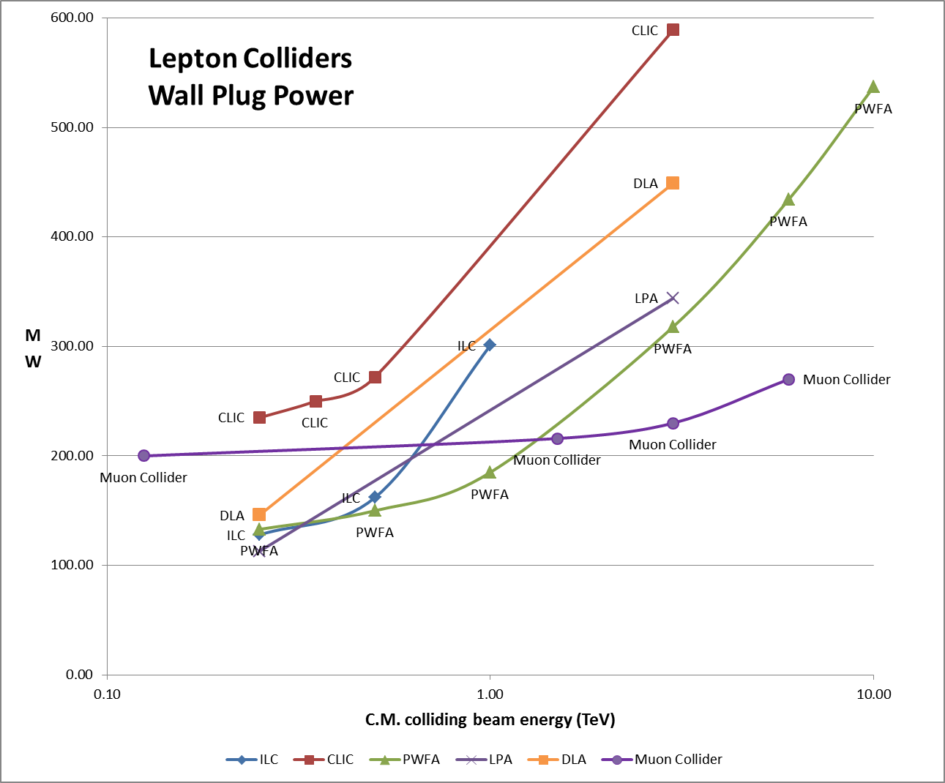
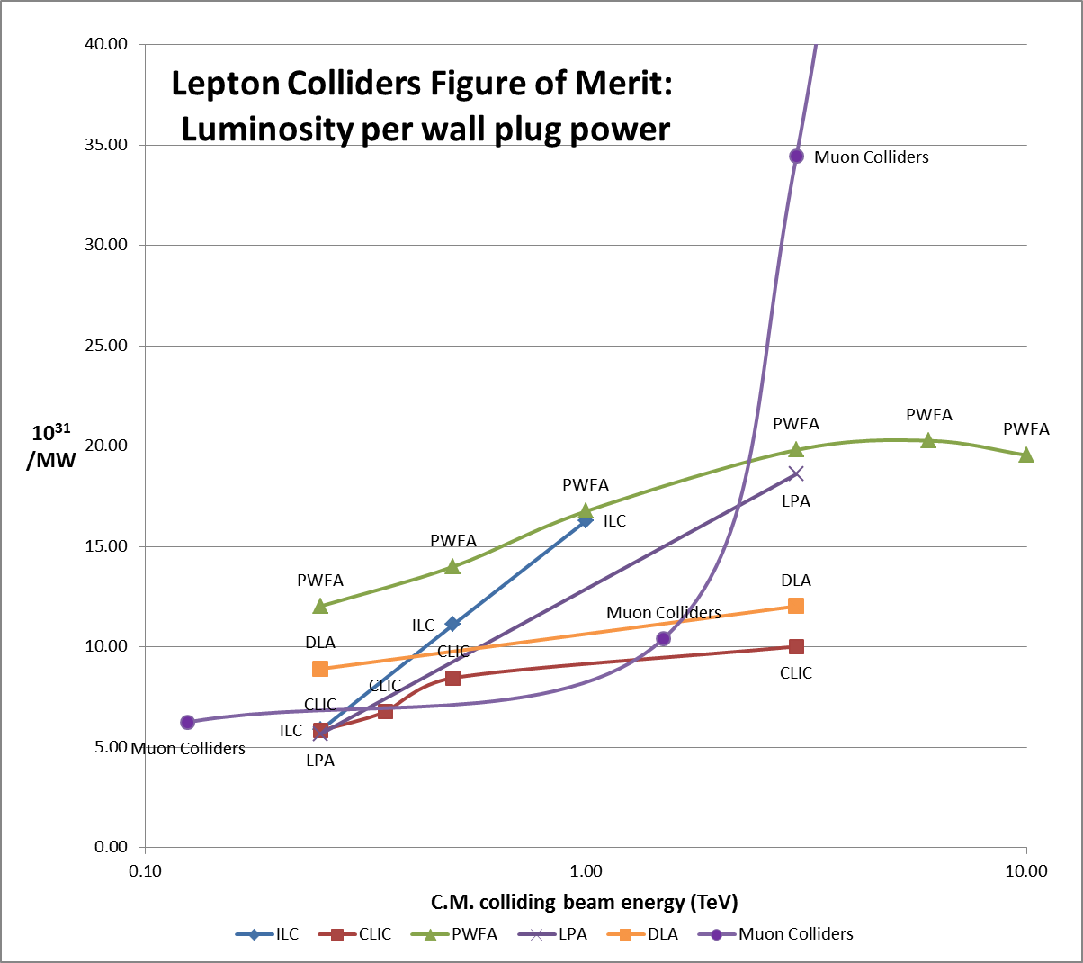
Muon Colliders –
Efficiency at the multi-TeV scale
Efficiency of multi-pass acceleration

Slide 19
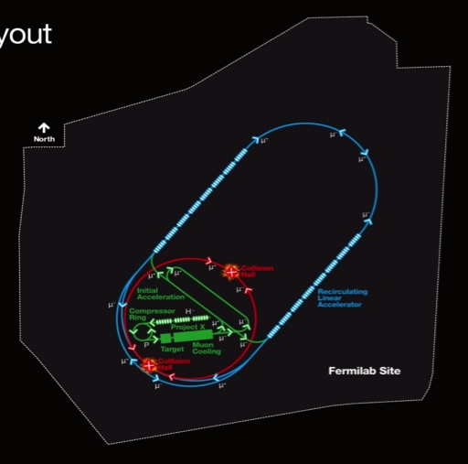
Muon Collider Parameters
Exquisite Energy Resolution
Allows Direct Measurement
of Higgs Width
Success of advanced cooling
concepts a several × 10³²

Slide 20
Muon Accelerator R&D

Slide 21
Accelerator R&D Effort
Design Studies
  Proton Driver
  Front End
  Cooling
  Acceleration and Storage
  Collider
  Machine-Detector Interface
  Work closely with physics and detector efforts
Technology R&D
  RF in magnetic fields
  SCRF for acceleration chain (Nb on Cu technology)
  High field magnets
    Utilizing HTS technologies
  Targets & Absorbers
  MuCool Test Area (MTA)
Major System Demonstrations
  MERIT – demonstrated the potential of a liquid Hg jet target
  The Muon Ionization Cooling Experiment – MICE

Slide 22
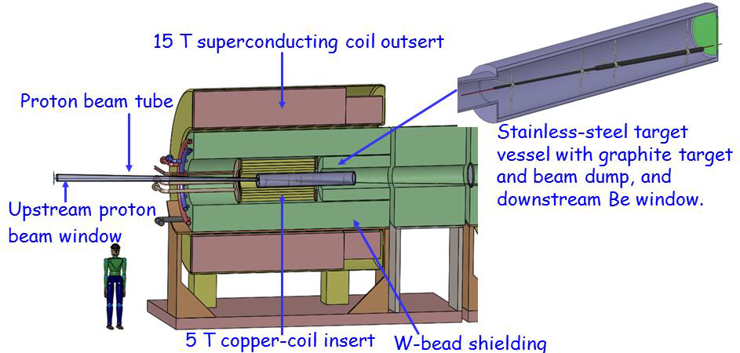
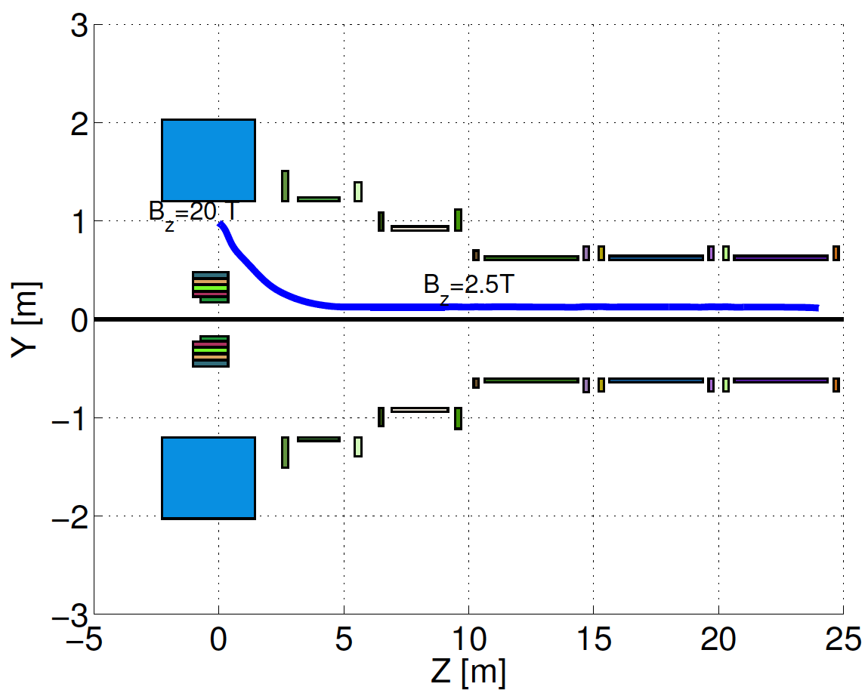
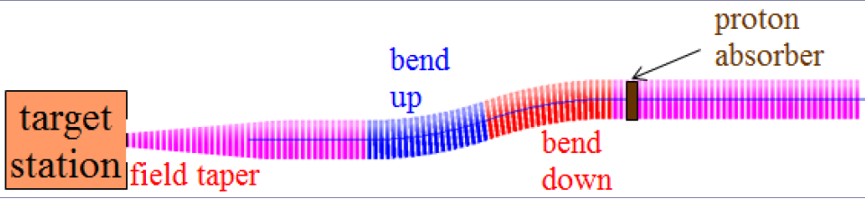
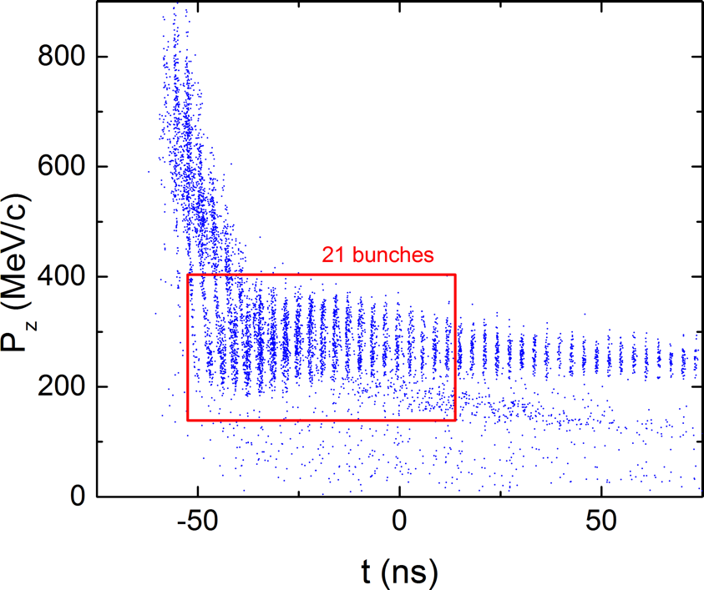
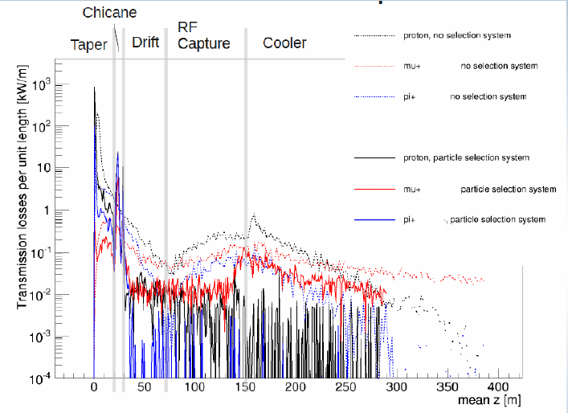
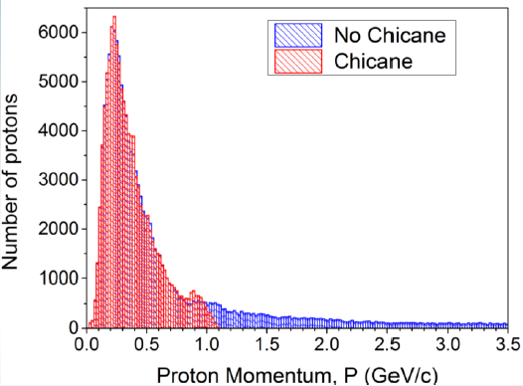
Target & Front End Progress
Compact
Taper Design
C Target
Control of FE Energy Deposition
Buncher and Phase
Rotator Matched to a
325 MHz Initial Cooling
Channel
FE Energy
Deposition

Slide 23
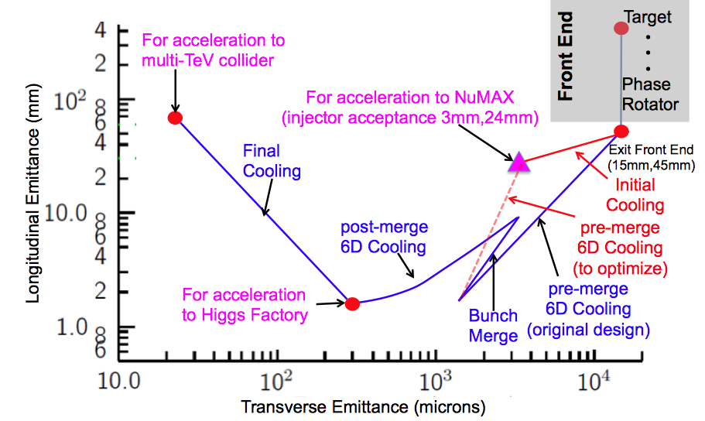
Muon Ionization Cooling
Advanced techniques a
Improved HF Luminosity
Simplified Final Cooling requirements

Slide 24
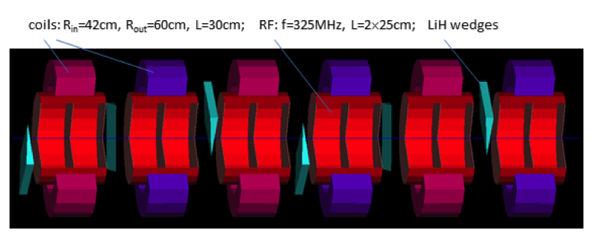
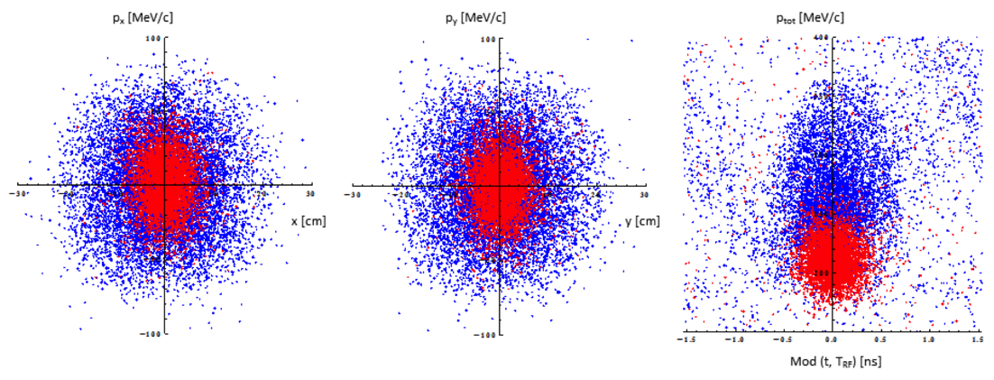
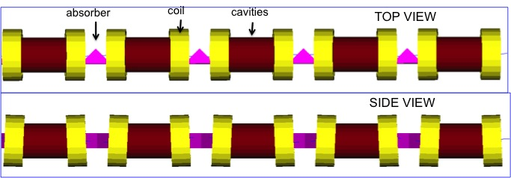
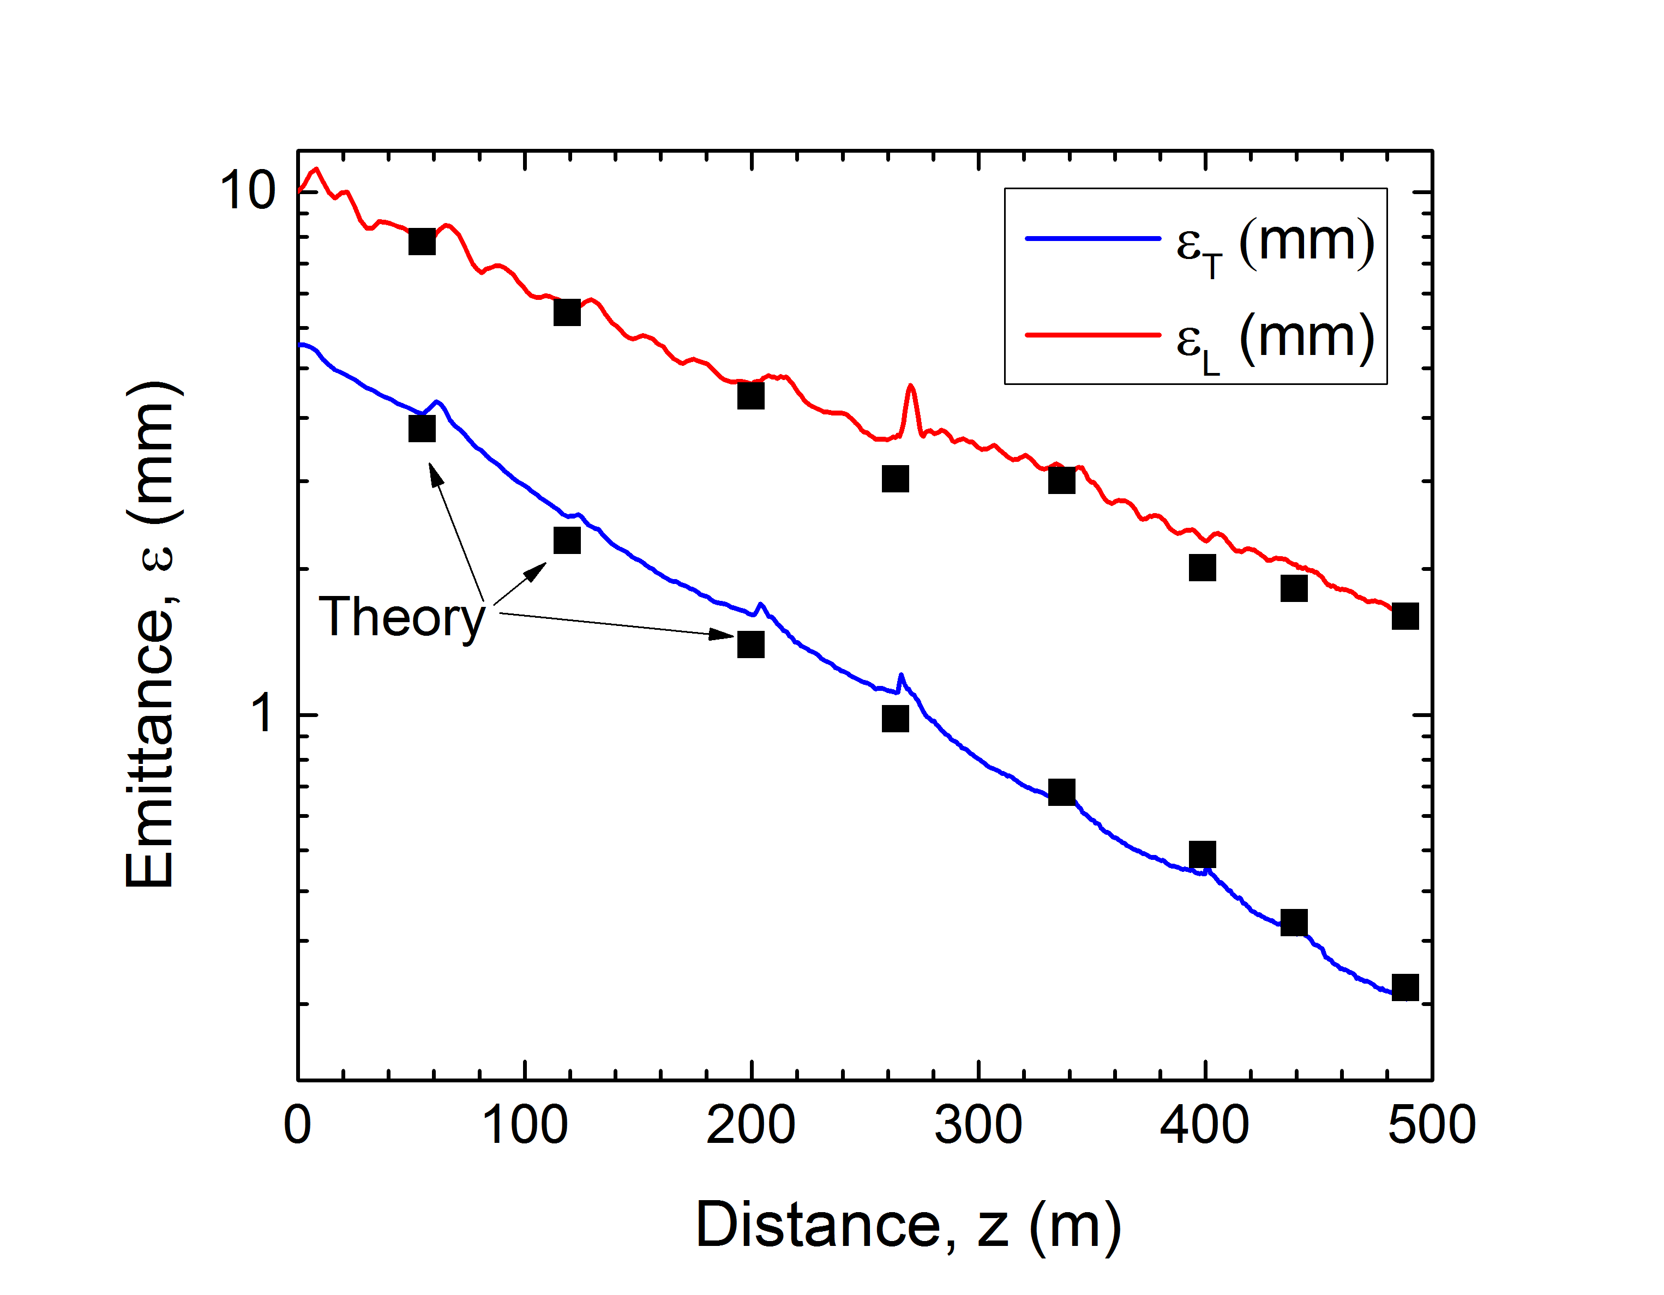
Muon Ionization Cooling (Design)
Initial 6D Cooling: ε_{6D} 60 cm³ a ~50 mm³; Trans = 67%
6D Rectilinear Vacuum Cooling Channel (replaces Guggenheim concept):
ε_{T} = 0.2mm, ε_{L} = 1.8mm, Trans = 55%(40%) without(with) bunch recombination

Slide 25
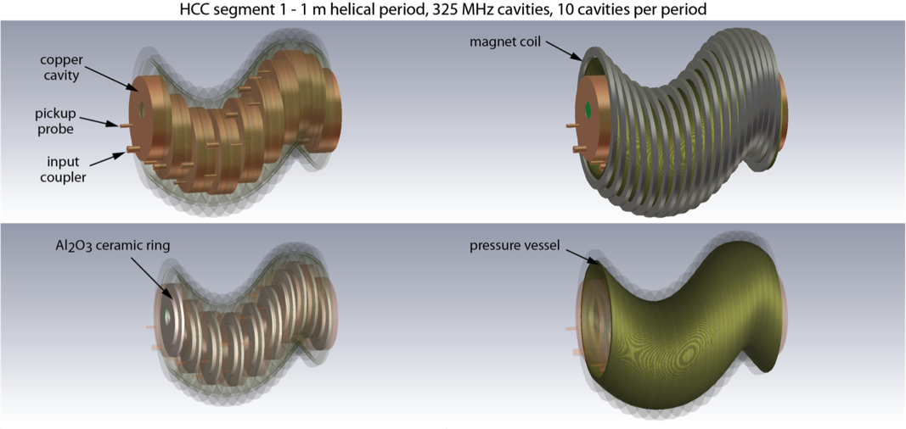
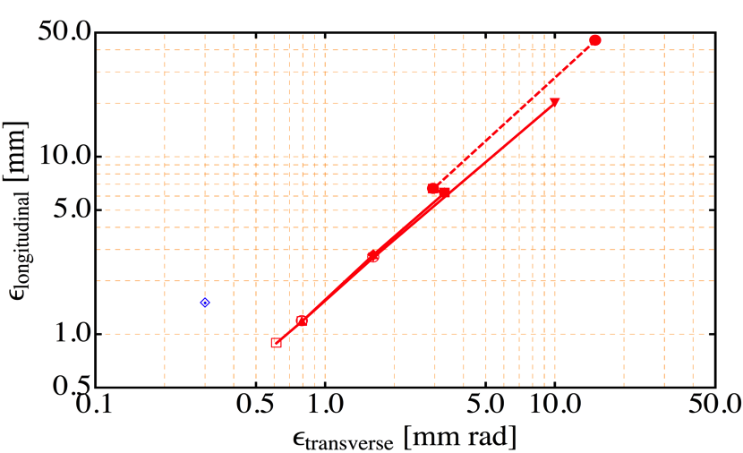
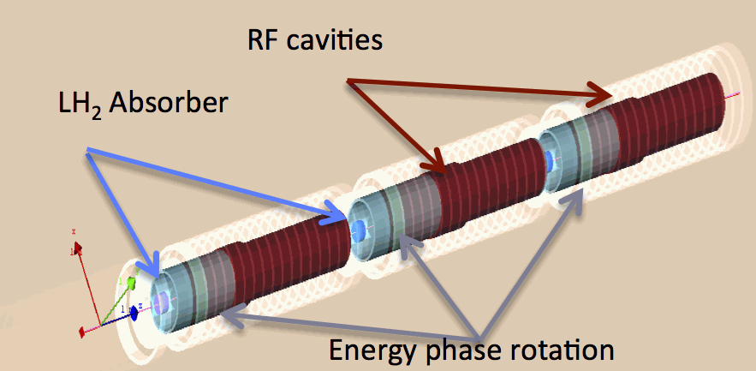
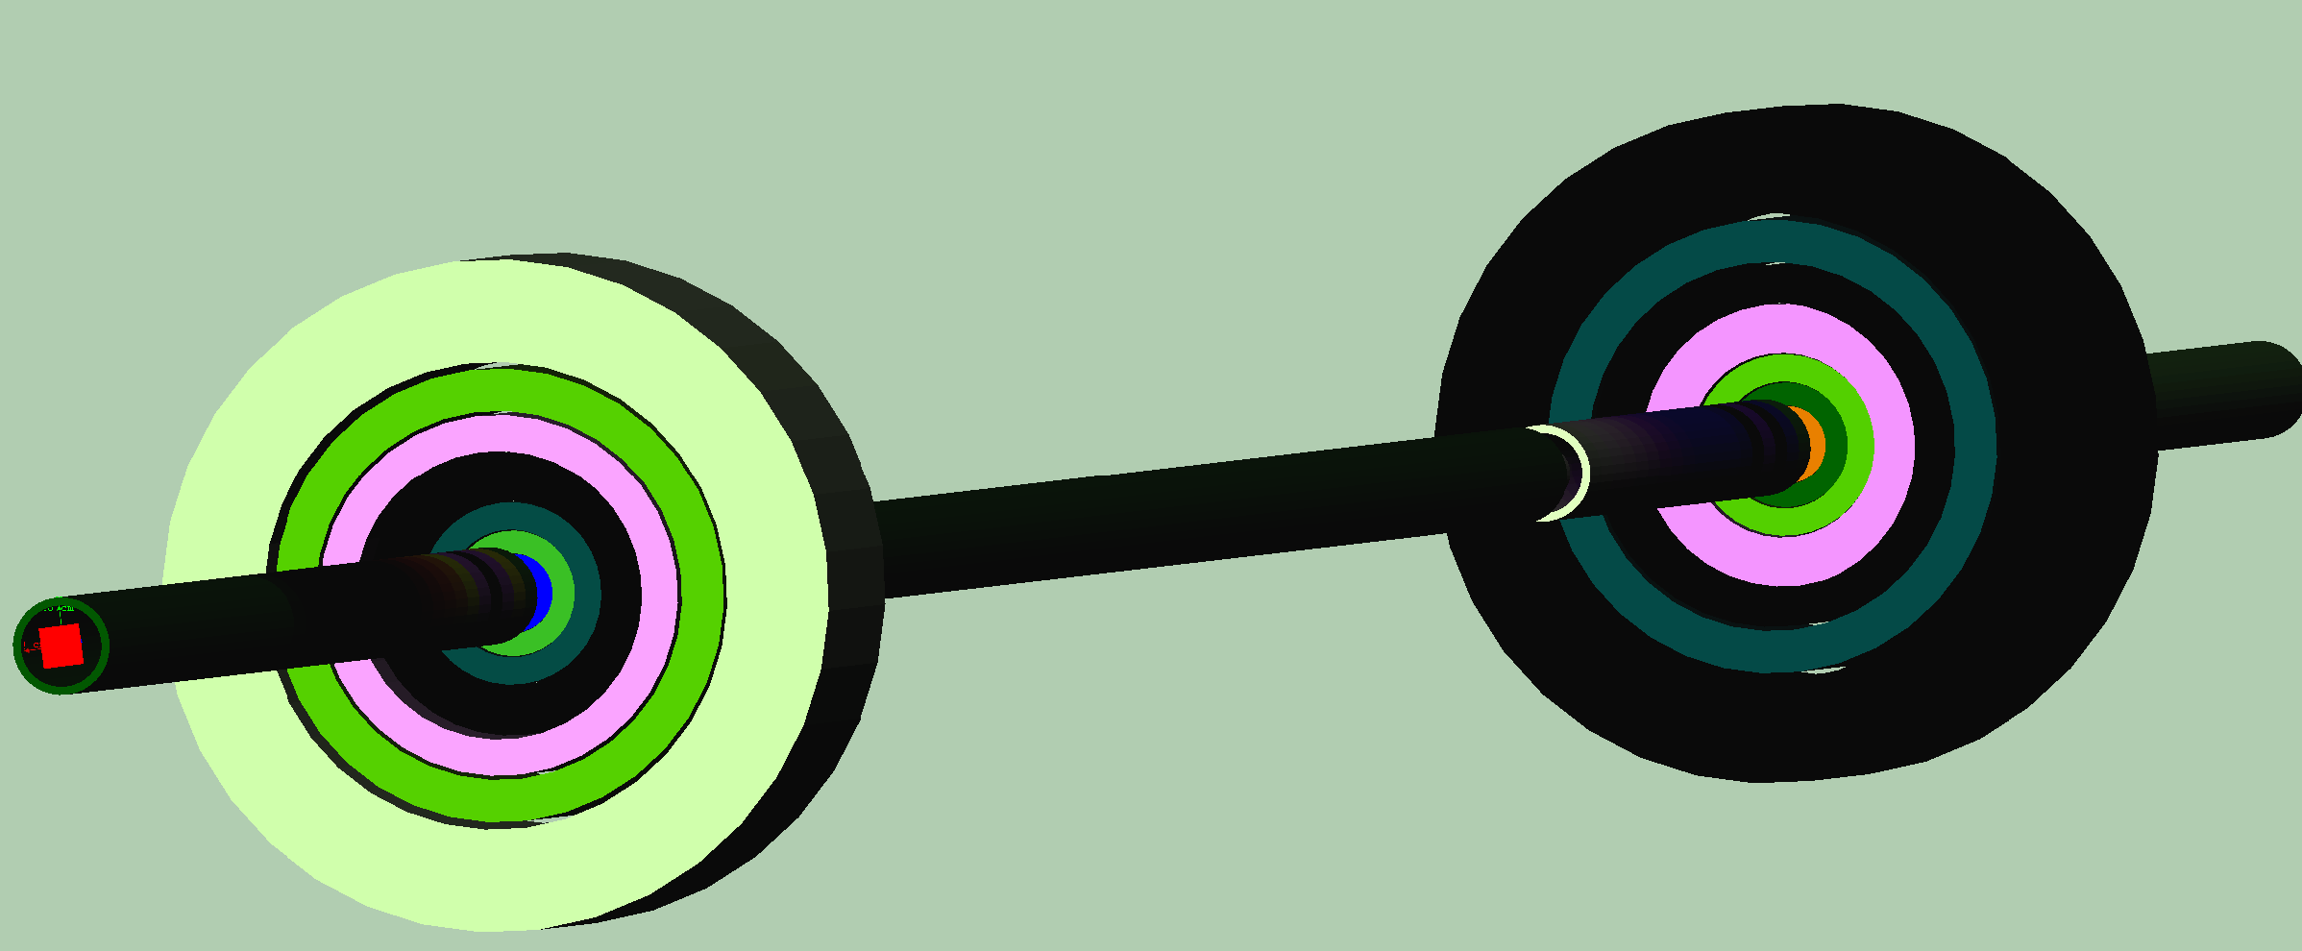
Muon Ionization Cooling (Design)
Initial 6D cooling
Matching
325 MHz cooling
650 MHz
Helical Cooling Channel (Gas-filled RF Cavities): ε_{T} = 0.6mm, ε_{L} = 0.3mm
Late Stage w/ Induction Linac
Final Cooling with 25-30T solenoids (emittance exchange):
ε_{T} = 55μm, ε_{L} = 75mm

Slide 26
Muon Ionization Cooling (Design)
Longitudinal Merge
Bunch Merge
MAP Baseline Designs offer
  Factor >10⁵ in emittance reduction
Alternative and Advanced Concepts
  Hybrid Rectilinear Channel
  (gas-filled structures)
  Parametric Ionization Cooling
  Alternative Final Cooling
  a Early stages of existing scheme
  a Round-to-flat Beam Transform
  a Transverse Bunch Slicing
  a Longitudinal Coalescing
  (at ~10s of GeV)
  a Considerable promise to exceed our original target parameters
Bunch
Merge
Transverse Merge
ε_{T}
Trans
σ_{t}
MASS identified extension of the 6D cooling concepts
and modification of Final Cooling scheme to be one of
most likely areas of performance improvement

Slide 27
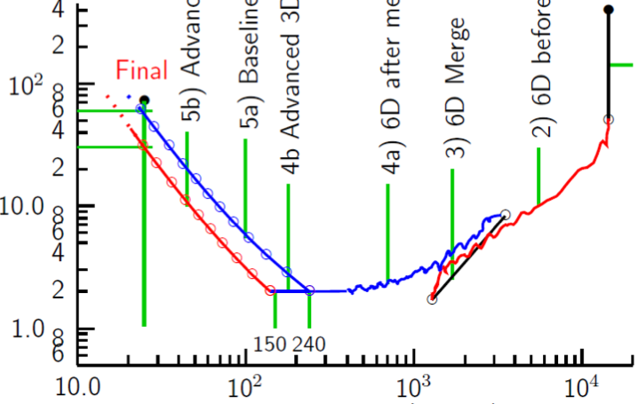
Cooling: The Emittance Path
Target
Y
Specification Achieved (simulations)
•
•
•
For acceleration to
multi-TeV collider
Front End
For acceleration to NuMAX (325MHz injector acceptance 3mm,24mm)
Phase
Rotator
Final
Exit Front End
(15mm,45mm)
Initial Cooling
Longitudinal Emittance (mm)
Initial
(X)
Initial
(Y)
Final
Cooling
Merge
post-merge 6D Cooling
pre-merge
6D Cooling (original design)
For acceleration
to Higgs Factory
HCC
VCC
Bunch
Merge
VCC
Hybrid
Transverse Emittance (microns)

Slide 28
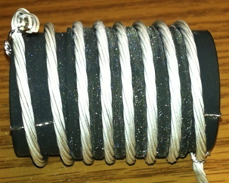
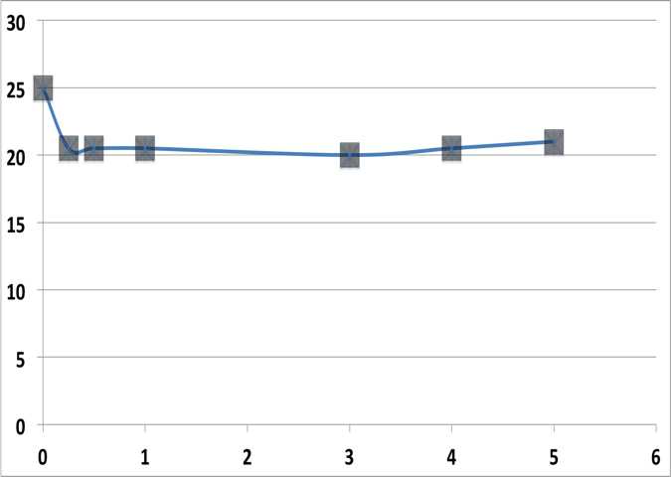
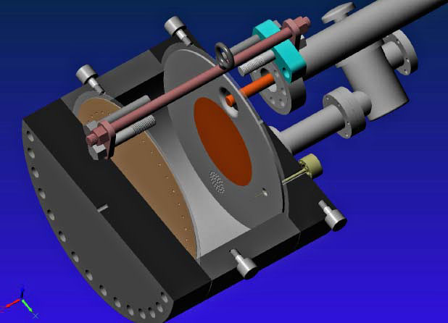
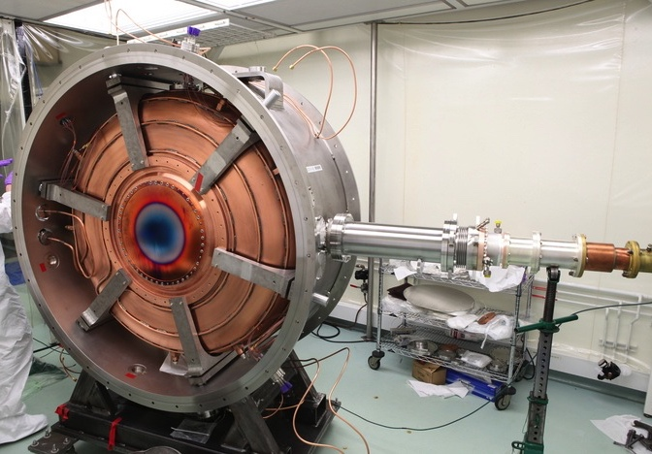
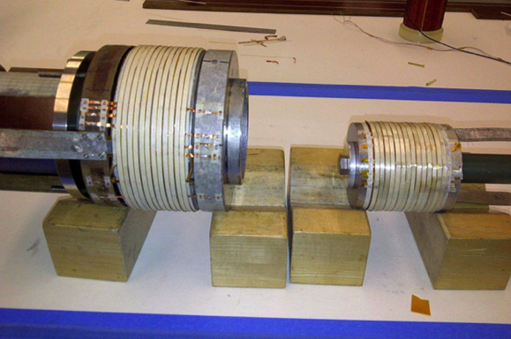
Cooling Technology R&D
>20MV/m operation
in up to 5 T B-field
Successful Operation of 805 MHz “All Seasons” Cavity in 5T Magnetic Field under Vacuum
MuCool Test Area/Muons Inc
Demonstration of High Pressure RF Cavity in 3T Magnetic Field with Beam
Extrapolates to required
μ-Collider Parameters
MuCool Test Area
Breakthrough in HTS Cable Performance with Cables Matching Strand Performance
FNAL-Tech Div
T. Shen-Early Career Award
World Record HTS-only Coil
15T on-axis field (16T on coil)
R. Gupta
PBL/BNL
MICE 201 MHz RF Module –
MTA Acceptance Test in B-field Complete
11MV/m in Fringe of 5T Lab-G Solenoid
<4×10⁻⁷ Spark Rate (0 observed)
1% Dry Air (0.2% O₂) in GH₂
Pure GH₂
1% Dry Air
(0.2 % O₂)
in GH₂ at
B = 3T
~50X reduction in
RF power dissipation
E₀ = 25 MV/m

Slide 29
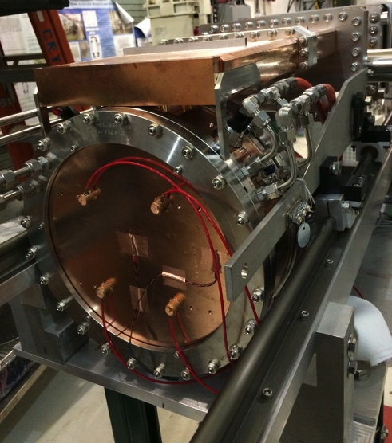

Cooling Technology Status
Magnets
  MAP Initial Baseline Selection (IBS) process
  a 6D cooling baselines that do not require HTS magnets
  HTS Solenoids may be required as part of a higher performance 6D Cooling Channel and for parts of the Final Cooling Channel
RF Cavities
  Successful test in magnetic field of the MICE RF Module shows
    The importance of cavity surface preparation
    The importance of designs incorporating detailed magnetic simulation
  High Pressure Gas-Filled RF Cavities provide a
  demonstrated route to the required
  gradients with high intensity beams
  Vacuum RF: recent B-field tests
  consistent with our physical models
    805 MHz “Modular” Cavity:
    A test vehicle to characterize
    breakdown effects in vacuum cavities

Slide 30
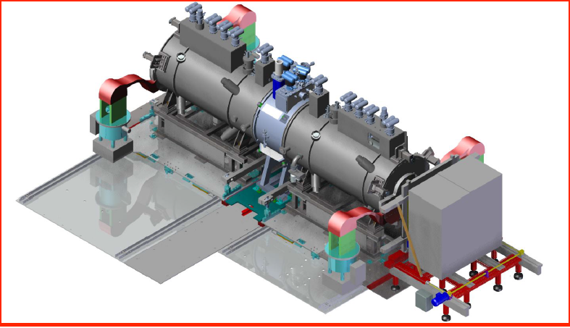
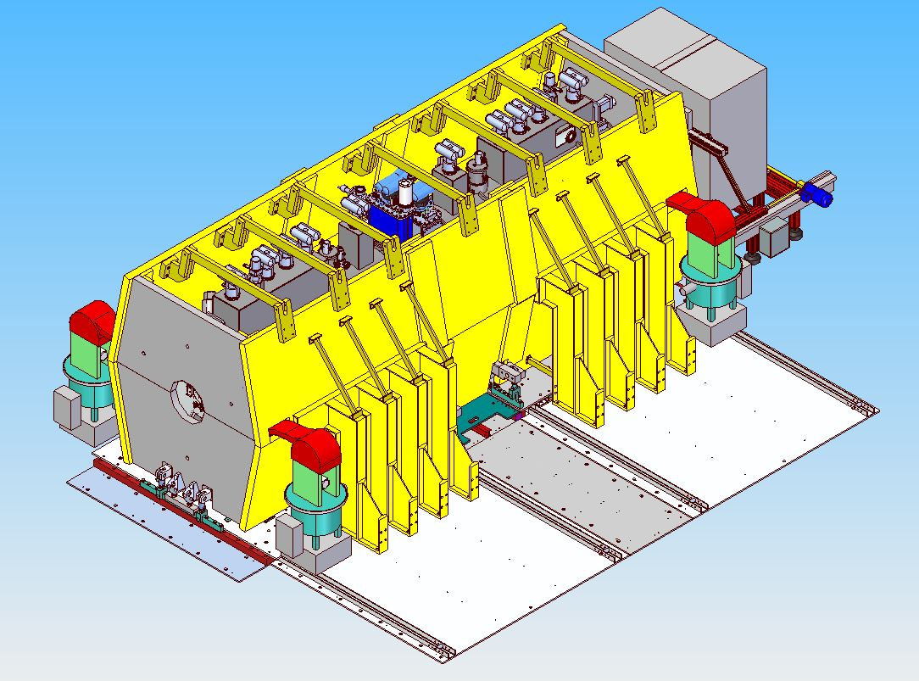
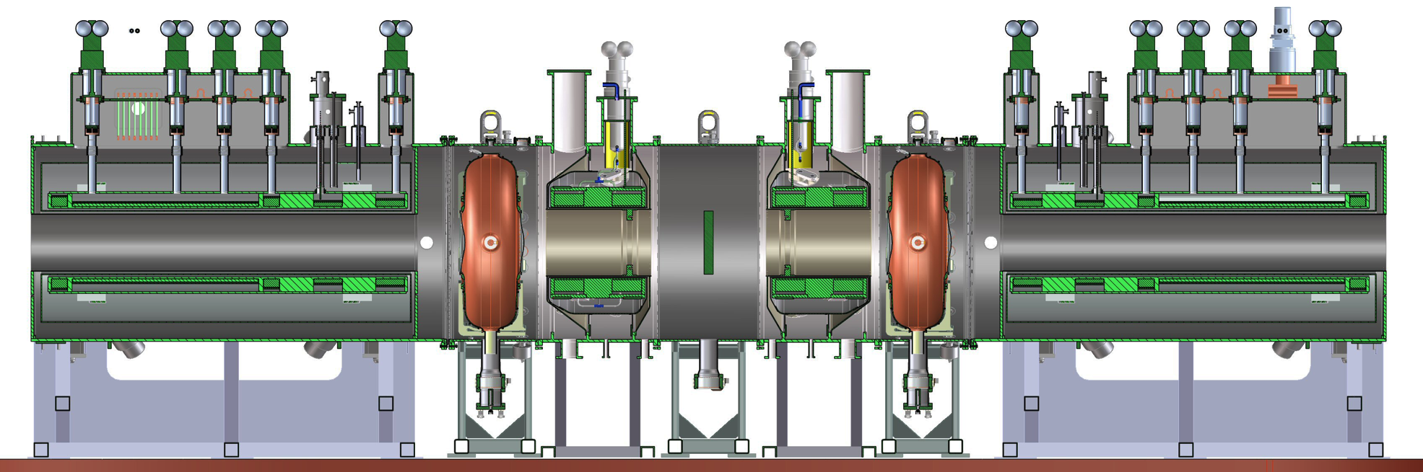
MICE Demonstration @ RAL
2015 Data
MICE Step IV:
Study of Absorber
Materials
2017 Data
Demonstration of Muon Ionization Cooling (Re-baseline)

Slide 31
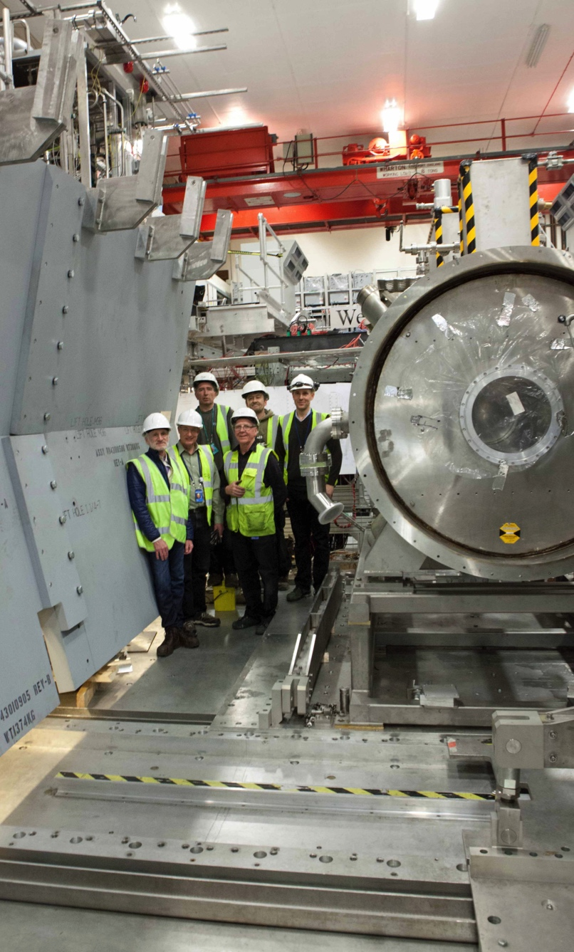
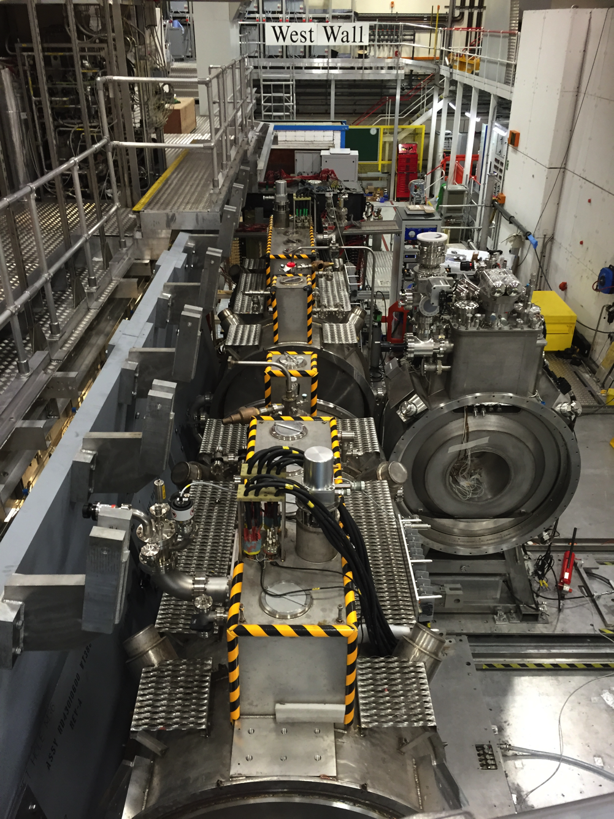
MICE Installation/Commissioning
Systems and Beam Commissioning Underway

Slide 32
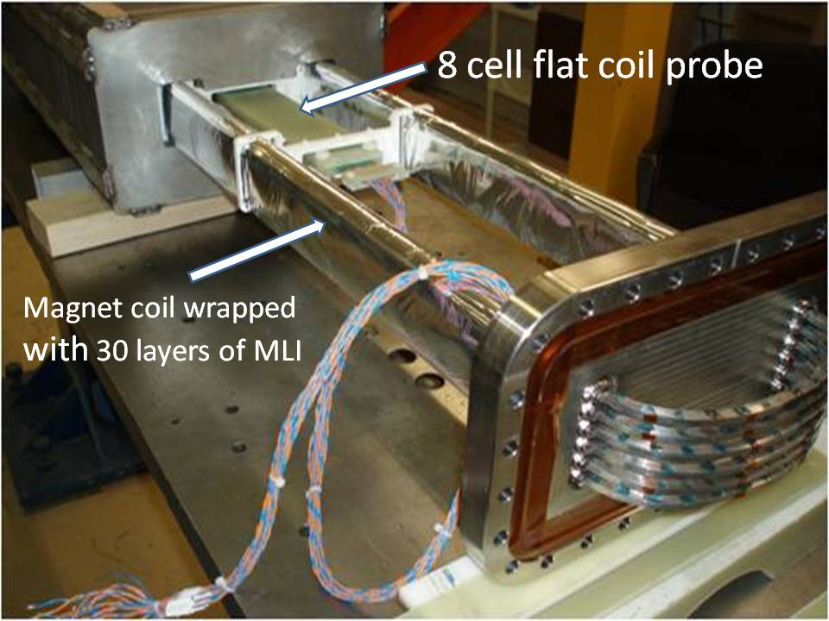
Technology Challenges - Acceleration
Muons require an ultrafast accelerator chain
a Beyond the capability of “standard designs”
Solutions include:
  Superconducting Linacs (NuMAX choice)
  Recirculating Linear Accelerators (RLAs)
  Fixed-Field Alternating-Gradient (FFAG) Rings
  Rapid Cycling Synchrotrons (RCS)
  RCS requires
  2 T p-p magnets
  at f = 400 Hz
  (U Miss & FNAL)
EMMA – FFAG
JEMMRLA Proposal:
JLAB Electron Model of
Muon RLA with Multi-pass
Arcs

Slide 33
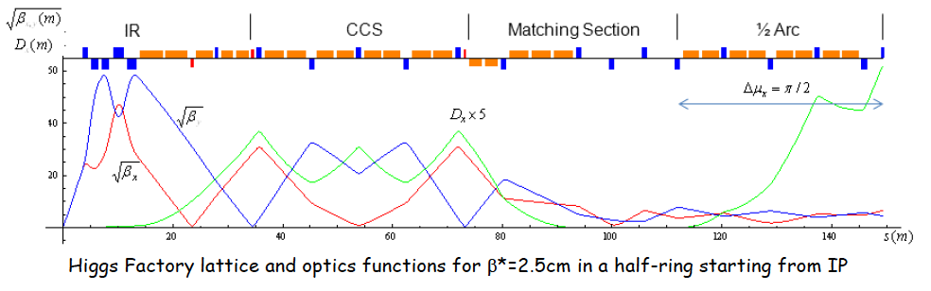
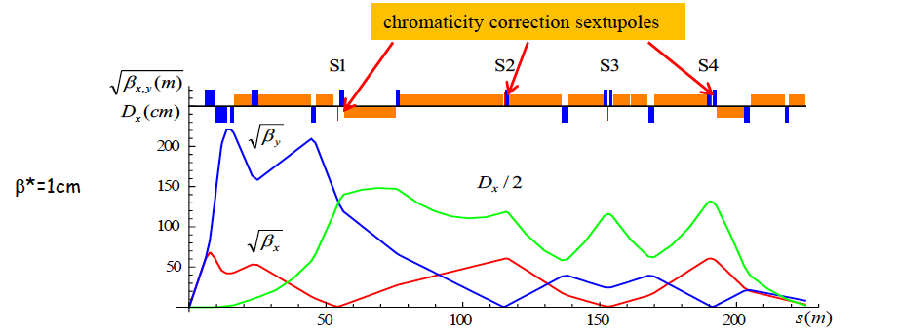



Muon Rings
NF: nuSTORM, IDS-NF and NuMAX designs
Collider: Detailed optics studies for Higgs, 1.5 TeV,
3 TeV and now 6 TeV CoM
  With supporting magnet designs
  and background studies
  Detector occupancy similar to
  that seen in the LHC
  Luminosity Upgrade

Slide 34
Concluding Remarks
Neutrino Factory capabilities offer precision microscopes a likely needed to fully probe the physics of the neutrino sector
A multi-TeV muon collider may be the only cost-effective route to lepton collider capabilities at energies > 5 TeV
The International Muon Ionization Cooling Experiment represents a crucial step towards realizing these unique capabilities
The start of MICE Step IV begins a new era for HEP

