Slide 2
Internal workshop on Machine protection system readiness for MJ beams (post LS1)
Executive Summary

Slide 3
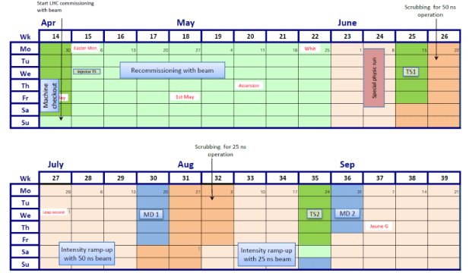
Operation in 2015 Q2/Q3
MP Workshop
Beam commissioning (mostly) finished, Started 2015 operation with special physics run
Up to TS#1: < 4.5MJ
50ns scrubbing: < 12 MJ
50ns ramp-up: < 180MJ
25ns scrubbing: < 26 MJ
25ns ramp-up: ->340MJ
Paul / DG: No athletic jumps or short-cuts, but serious
and systematic approach towards 100MJ range

Slide 4
Objectives of Workshop
1 day workshop @ CERN to review and discuss the readiness of vital MP and related equipment systems for high intensity operation.
  Are the systems operating with nominal parameters?
  Are there any non-conformities?
  Any weakness that has been observed so far?
  New failure modes after LS1 modifications?
  Were all the commissioning steps performed, and what is still missing?
  What is the operational experience from the first two months of operation?
  Diagnostic Data for PM and Logging all available?
  ….

Slide 5
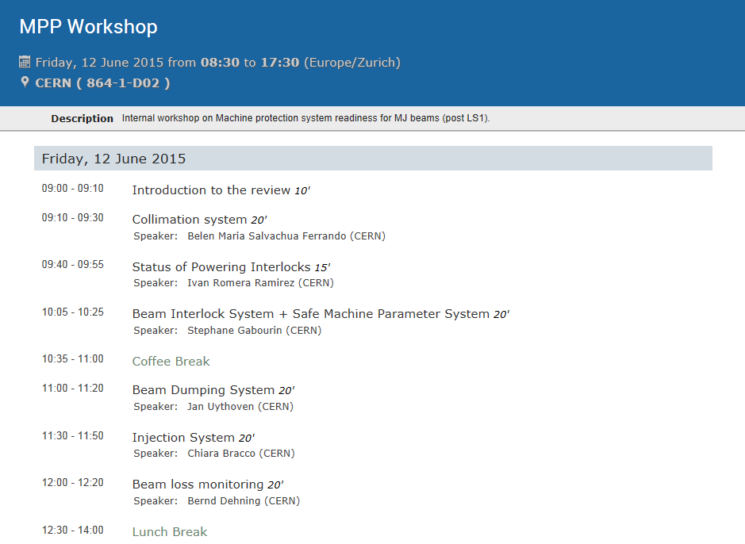
Program 1/2
Collimation and Interlocks
Injection and Dump System + BLMs
https://indico.cern.ch/event/397348/

Slide 6
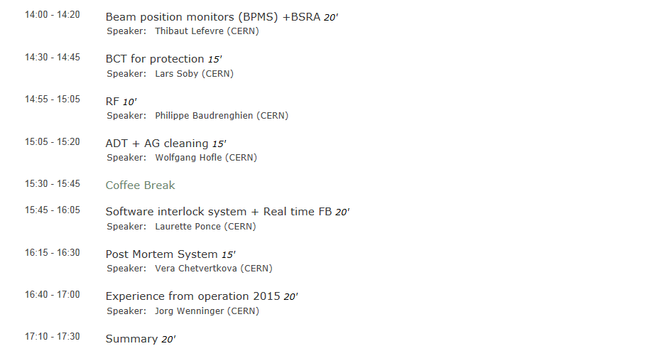
Program 2/2
Beam Instrumentation + RF/ADT
Operational aspects and Post Mortem
https://indico.cern.ch/event/397348/

Slide 7
Collimation system (Belen Maria Salvachua)
No large surprises in cleaning wrt to 2012, loss maps look in general OK, some peaks to be further investigated (possibly related to BLMs?)
All position and temperature interlocks were checked and validated (>1600 sequences)
Aperture generally OK for 80cm beta* (allocated 2 sigma margin to MP as endorsed by LMC)
  min aperture measured 15.7, consistent with assumption of protected aperture in IR1/5 of 15.1 sigma
Large offset found on TCLA.D6R7 -> Has been re-aligned in TS1, requires new alignment and validation
Need more time to validate new off-momentum loss-map technique, considered a good investment as validation will be (much faster)
  Need to agree on a (reduced) set of loss-maps after technical stops
Integrated BPM result very promising, only requiring a few seconds for alignment, but electronics still to be completed
Beta * limits remain to be deployed
Two issues with temperature interlocks (logic modification proposed), respectively spike on LVDT (disabled until TS1)

Slide 8
Powering Interlocks – (Ivan Romera)
No critical updates during LS1, 5000 tests performed, commissioning completed
Redundant opening of 13kA EE switches through SIS – to be commissioned in TS1
Testing of redundant opening of 13kA EE switches (main dipole and quadrupole) through SIS
QPS_OK toggling – needs to be fixed as blocks too many injections
Quench heater monitoring – automatic notifications to be re-established
FMCM commissioning: has been completed, confirming (expected) better resolution due to 6.5TeV operation
FMCM test at 6.5TeV to be done as well for RMSD?!
UPS validation for LBDS/QPS/BLM/BPM/… after mitigation actions (EDMS 1505860)
  Collimators were retracted ? Are they powered by UPS?
Re-test the ACCESS interlock after TS1

Slide 9
Beam Interlocks & SMP – (Stephane Gabourin)
BIS
  All IST tests have been performed (but with some delay)
  BIC timing misalignment between SPS and LHC timing network of few 10us
  Redundant power supply in IR4 (DIAMON to be re-established)
  CIBDS arming sequence was not working -> Reworked Sequencer arming sequence, no major issue since
    Hardware revision ongoing for YETS
  SW tools: monitor redundant power supplies of user boxes.. to be made working
SMP
  New equations for generation of Normal, Restricted and Beam Setup flags
  Flickering of SBF due to noise on BCT-B2 → fixed by filtering (1s → 16s above 500GeV).
  Firmware upgrade of monitoring part of CISA during TS#1
  Remove/adapt beta* window opening of currently allowed 0.1m (due to interleaving low/medium/high beta* operation).
  Logging of data for SMP in decoded way
  Optics ID transmitted for TL lines but not yet commissioned

Slide 10
Beam Dumping System – (Jan Uythoven)
One MKD erratic on 4th June, (3/y and beam expected), all worked correctly, rule is to replace a switch, after one erratic
  reference measurements now taken and have to be compared for any future occurrence
  Need checklist for switch replacement , the procedure seems effective + was followed twice
Reference losses TCDS and TCDQ also to be officially written down so can be done by non-specialists
New and longer TCDQ + BETS
  Problem with arming / interlocking during commissioning
MKD waveform rise time to be revalidated (along with AGK) after TS#1 decrease to 925ns
Outstanding MPS tests:
  Non-conformity during UPS powering failures – TS#1Redundant PSU surveillance by SIS
  Commission direct BLM (small testing procedure is required?) – access needed…
  Procedure for non-working beam dump (EDMS #1166480) -> Replace last step with loss generation by ADT
  XPOC filling pattern still manually edited (Delphine)
  Some XPOC modules can be reset by OP which should not be the case
  AG cleaning at 6.5TeV needs to be commissioned – need BSRA + Automatic cleaning via SIS
  Interlocked BPMS – see Thibaut

Slide 11
Injection System (Chiara Bracco)
Different trajectories for PILOT and INDIV/25ns (different extraction point from the SPS, still below 1mm for run1).
Possible solution to put pilot on SLOW cycle to allow for proper setup of LHC
Solved issue in RBI in TI8 (Changing the DAQ and acquisition card), to solve an issue of the FEI, should put back old reference to avoid loosing in IR7
Sunglasses: LIC vs IC – more statistics when injecting higher intensity -> See BLM
Extraction issues in LSS6: Convolution of several issues, extraction aperture was the same for both cycles, setup of 25ns cycle not complete, uncaptured beam kicked out by longer risetime of MKE6 wrt to MKE4.
Orbit drift at extraction points are still not fully understood. BPCE resolution not enough for fine interlock -> Possible mitigation: Interlock through IQC
Missing: Optics ID for TCDI, all done up to distribution over timing. FESA class not ready to do this (although foreseen)? Would also go into FESA class of LHC collimators. What MP tests would have to be re-done?
TDI limits: No more than 144b in 1 train, Critical flipping between 25ns and 50ns, changing the length of MKI flat-top + total intensity in SPS?! -> Procedure of Anton
MKI rise-time too long (1.2us instead of 0.9us) -> TBD during TS1 -> Do MKI waveform scan (sign of injection oscillations in vertical plane)
Injection gap cleaning

Slide 12
Beam Loss Monitors (Bernd Dehning)
BLM high voltage issue(s): 2 events 30/09/2014 + this year , losses increase
Plot shows 12 second of history, fast transition in a few 100ms, jumped by 3 orders of magnitude
  >1900V measured, cannot come from BLM power converters
  Actions (cause still not found): overvoltage protection on tunnel cables -> What will be done?!
  Exchange of HV cables + additional earthing;
New injection crate firmware ready for deployment TODAY – needs quick revalidation, also of new capture buffer/XPOC PM buffer
Filter checks still tbc (found 1 missing filter, 6 could not be verified due to small losses).
Thresholds and updated:
  TS1: IT, IPQ, IPD
  TS2: collimators, DS-RBs

Slide 13
BSRA and BPMS (Thibaut Lefevre)
BSRA
Calibrated in May, many issues solved
PMT gate protection – operator needs to re-enable PMT
Zeroing of AG population – beam presence flag is not there with unbunched beam
  Can use another flag from the BIS?
HV regulation loop to be adjusted for B2
Threshold need to be set
IR6 BPM
Modified system, improved processing of interlock data
All bunches 154 turns, better dynamic range, high sensitivity for scrubbing run
Issues: integrator mezzanine broken, faulty RF filter => should be fixed before continuing
SW/FW issues: discrepancy and calculated by FE, capture buffer issues
Some communication issues…. new FESA release will cure it
Issue with MCS settings (changing interlock limits). Now solved, release in TS1
Calibration procedure to be reviewed -> Remove tolerated offset, e.g. allow for certain re-calibration within a given window
Doublets: Up to 2mm offset and larger errors/fluctuations (1-2mm) depending on the relative bunch intensity
-> Mix both nominal and doublet bunches to validate injection (trust in nominal) -> Should not wait to long to try

Slide 14
BCTs for protection (Lars Soby)
DCCTs
System B for Beam 2 has more noise: fixed by filtering (increasing integration window >500GeV)
Important to have DECODED SMP data in Logging
SBF reliability: not a high SIL system
Some short term improvement are being done, e.g. scaling factor hard coded
  Long term solutions: different solutions, e.g. FPGA with direct links to be defined! specification needed
BCCM
System A and B (A operational)
New FESA class not yet operational (frequent crashes)
New BCTs promising
Looks good from the operational experience for the first weeks…
All thresholds are still independent of energy….
Proposal to use it already now with relaxed threshold, enable BIS input after scrubbing run.

Slide 15
RF (Philippe Baudrenghien)
Klystron trips, beam passes in empty cavity which is not acceptable since the beam induces (mostly reflected power (up to several 100 kW)
Klystron trips: 560 kW can get into load, in this case dump beams in three turns
Transients are acceptable
Beam excited HOM, dedicated couplers are required, 500, 535, 779, 1184, 1238 MHz, designed for 1 kW -> power and temperature are monitored and interlocked
Power extracted scales with beam current
No problems with 50ns, not fully known for 25ns and for different bunch patterns
Monitoring of HOM is recommended
RF interlocks are existing and should protect the systems

Slide 16
ADT and AG cleaning (Wolfgang Hoefle)
Many changes were done during LS1
Some interlocks on HW (e.g. to protect the amplifier)
Some voltage induced from beam (to be watched for 25ns beam)
Abort gap cleaning: tests were done
Injection gap cleaning- h-plane, to be done before long bunch trains
Abort gap cleaning at 6.5 GeV to be done
For bunch trains 25 ns –set up fine delays
Verify PM (not understood) concurrent use for dump and for head-tail
Other commissioning steps: setting switches, flat frequency response, scrubbing doublet setting-up, then readiness for doublet beams: should be ok
Can have instability of two bunches in doublets, not been seen…
High intensity – damage of HW is not excluded

Slide 17
SIS and Real time FB (Laurette)
New SIS interlock tree, with 3 different Powering branches
1 branch is conditioned by the SBF inside the SIS
All logic branches tested, remains to be enabled:
  PM_mach_pro – ok can be unmasked, BSRA and CODs
  PC interlock needs commissioning, takes over from the SIS-COD interlock
  Orbit is active, COD interlock still masked
  QPS ok too noisy – injection permit – risk to stay at injection
  Redundant 13kA EE switch opening – to be enabled during TS1
  Abort gap cleaning to be activated (cleaning switched on by SIS) – getting info from BSRA
15 dumps by SIS – not related to intensity (14 wrong) – being investigated
FB: Major refactoring towards BFSU/OFC during LS1 (new machines, migration to FESA3, new developers), but similar functionality
Orbit, complex process, change reference during ramp
OFB: missed some timing events, has been hopefully fixed
Feed-forward would avoid tune feedback (preferred solution)
More experience with bunch trains is needed

Slide 18
Post Mortem (Vera Chetverkova)
Most post mortem modules existed before
Have been commissioned during early part of run, a few bugs…
Safe for injection => Flag into SIS, should be ok now
Powering PM server being built up: automated event analysis for quenches,…
  Quench heaters after discharge is being tested…. after TS1 should be operational
Still tbd:
  Diamond detectors still missing
  interlock BPMs in IR6
  time for BCT is not correct, collimator time stamps
  event classification, review dump classification…..
MPE-MS-SW team et al will follow up the non-conformities ….

Slide 19
Experience from OP in 2015 (Jorg Wenninger)
Started operation with experience of run1
60 days from first injection to stable beams (maybe leaving some things aside), less enthusiasm (care for the detail) as people worked on many // things
Often parallel commissioning threads require different ‘task combinations’
Need another 2-3 weeks of regular operation (not scrubbing) as all shift crews should have seen all phases of cycle
No evident stoppers for increasing intensity
Daily and careful work on injection has so far been left ‘aside’: For intensity ramp up steering and monitoring of TL has to become important
Decay of persistent current, first time observed orbit decay (snapback) – not a problem -> Orbit FB
Need to understand orbit drifts up to +-0.2mm (origin around IR8 triplet?!)
Key item for integration are abort gap and injection cleaning
FBs now stable from controls point of view
Octupoles and ADT almost at full strength -> Not a problem for MPS

Slide 20
Conclusion
In general, looks good, e.g. efficient protection against training quenches – beam dump without beam movement
No major show-stopper for intensity ramp up, but many (minor) issues still to be followed up
Very important to have intensity ramp up
Need to clarify remaining injection commissioning and intensity ramp-up ahead of scrubbing run t
Thanks to all speakers, co-organisers and Stefanie

Slide 21
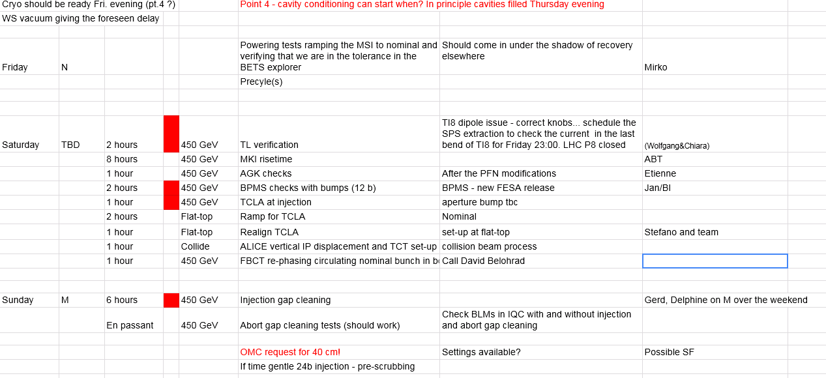
Tentative plan to come back from TS#1
Add validation of BLM inj crates (dump on closed COLL and enable/disable blinding)
+ validation of new XPOC buffer – 2 hours in // to TL setup…?
Loss maps at injection
Cycle with pilot (+ dump at 6.5TeV, beta * limits,…)

Slide 22
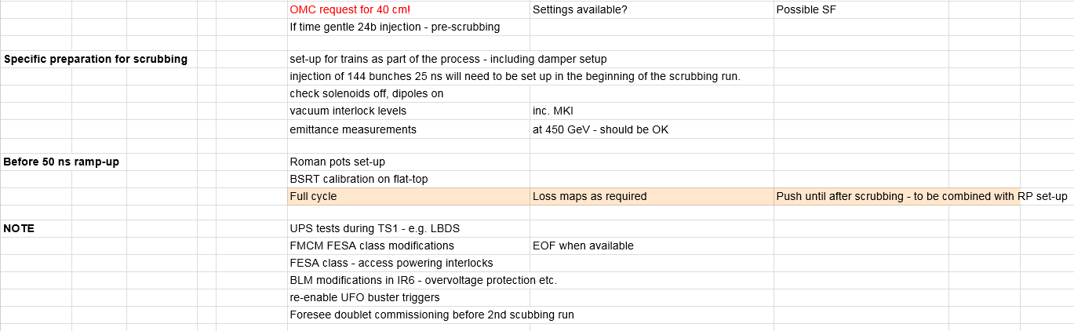
Program after TS#1 continued

