Slide 1
TOTEM Roman Pots
MPP Meeting 19/06/2015

Slide 2
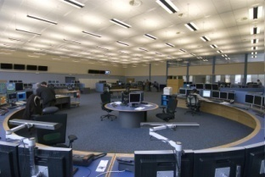
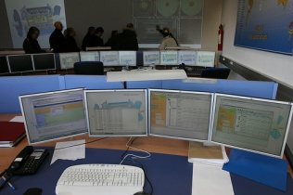
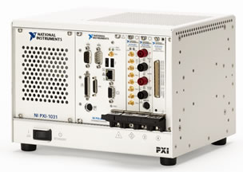
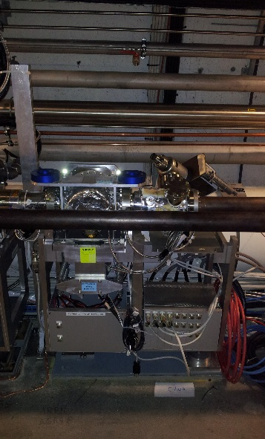
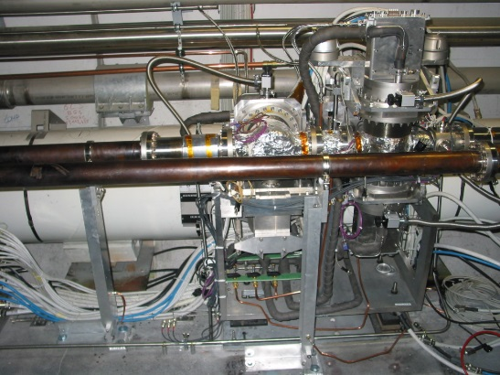
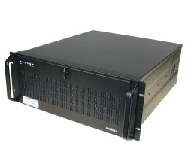
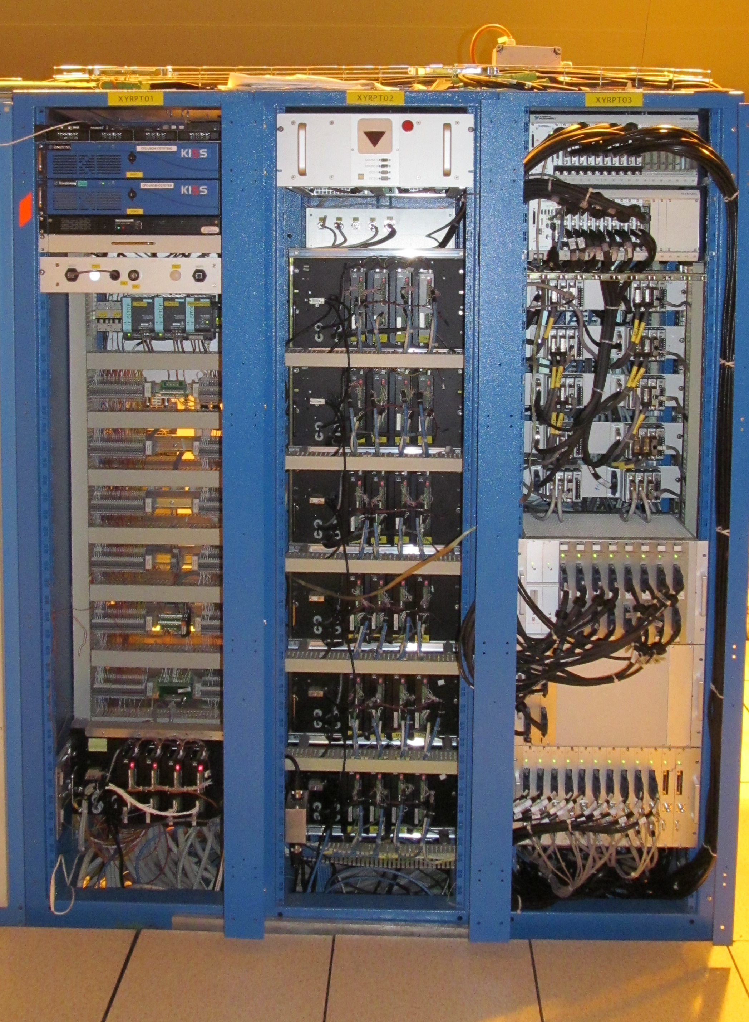

TOTEM Roman Pots Control System Structure
CCC UI / BE-CO
DCS / TOTEM
RPCS / PH-DT
PXI
Roman Pots / TOTEM
DIM
Rack Motor Control
+ Interlock Mngt
FESA Gateway / EN-ICE

Slide 3
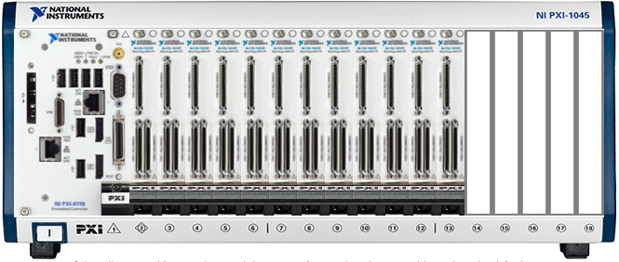
TOTEM PXI Structure
Before LS1 -> 24 pots
After LS1 -> 32 pots + Resolver integration
To FESA Server and DCS through DIM
To FESA Server and DCS through DIM
PXI for Motor Control including:
RS485 communication with encoder
Resolver Measurement
DIM Communication with FESA and DCS
Data exchange between PXIs via NI Shared Variables :
Inner and Custom limits
LVDT Positions
One PXI for :
LVDT Measurement and Interlock generation
RS485 communication with encoder
DIM Communication with FESA and DCS
Resolver not included
PXI for LVDT including :
LVDT Measurement and Interlock generation

Slide 4
Bug and solution
Bug during 08/06/2015 TOTEM RP Alignement
Solution
t
t
Use of NI Shared variables to exchange information between PXI controllers over the network
Misconfiguration of NI Shared Variable:
  A FIFO buffer could be linked to this variable,
  If this buffer is empty, reading the variable returns an empty value
  At the Shared Variable creation, by default, the buffer option is activated
  The Shared variable used to set the limits in the second PXI was configured with a buffer.
The consequence is that sometimes, the array which contained the custom limits handled by this Shared Variables, became empty. Therefore, it was impossible to modify the array and send new limits to the second PXI.
Removed buffer from the configuration of Shared Variable to avoid empty array and always keep the last set value,
Used Shared Variables only to exchange data between PXIs
  LVDT positions
  Custom and Inner Limits
Replaced Shared Variables by local variables to manipulate arrays in each PXIs

Slide 5
Conclusion
The SW fixes done on Thursday 11/6 have stabilized the system
We believe there is no intrinsic technology limitation
The PXI software will be saved and archived in TOTEM svn zone :
  \\svn.cern.ch\reps\totem\trunk\rp_pxi_software

