Slide 1
Beam losses in the triplet due to AC-dipole excitation
V. Chetvertkova

Slide 2
Contents
27 May, 2.11 am: Sequence of events
Concerns
MAD-X simulations
Conclusions

Slide 3
Sequence of events
Optics (beta-function)_measurements
Beam:
  6 bunches at 6.5 TeV
  intensity ~7e9 (SMP: present, safe)
Beam setup/ squeeze
BSTAR: 0.8 / 10 / 0.8 / 3 m
Half-gap of the collimators:
  TCP.D6R7 (vert.): 4.5 mm
  TCP.C6R7 (hor.): 6 mm
  TCTPV.4R5: 15 mm
  TCTPH.4R5: 15 mm
The beam was excited by AC dipole (MKQA.6L4)

Slide 4
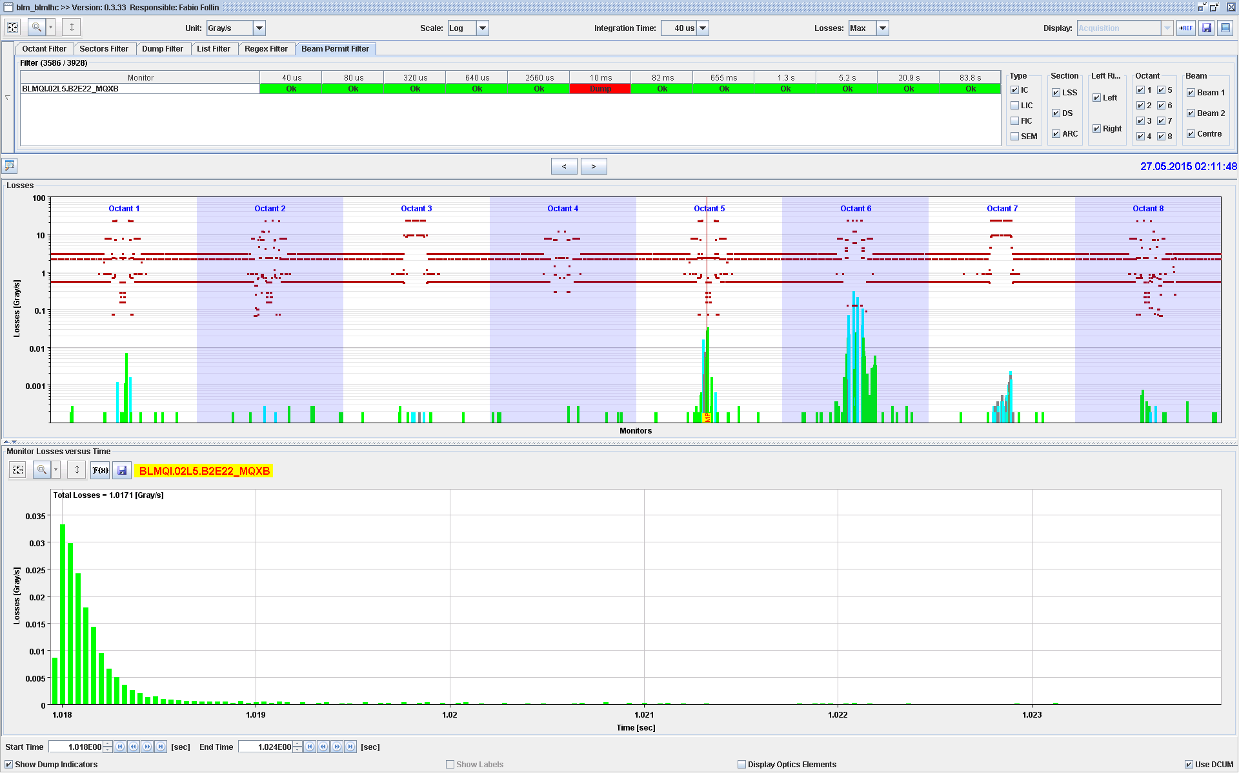
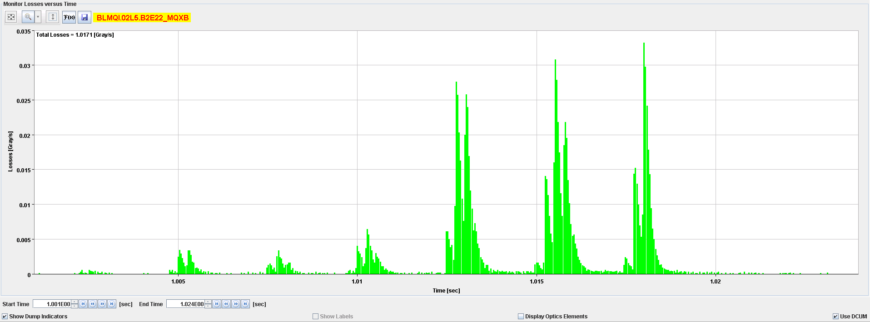
Sequence of events
Beams were dumped due to 10ms RS by a BLM at IP5:

Slide 5
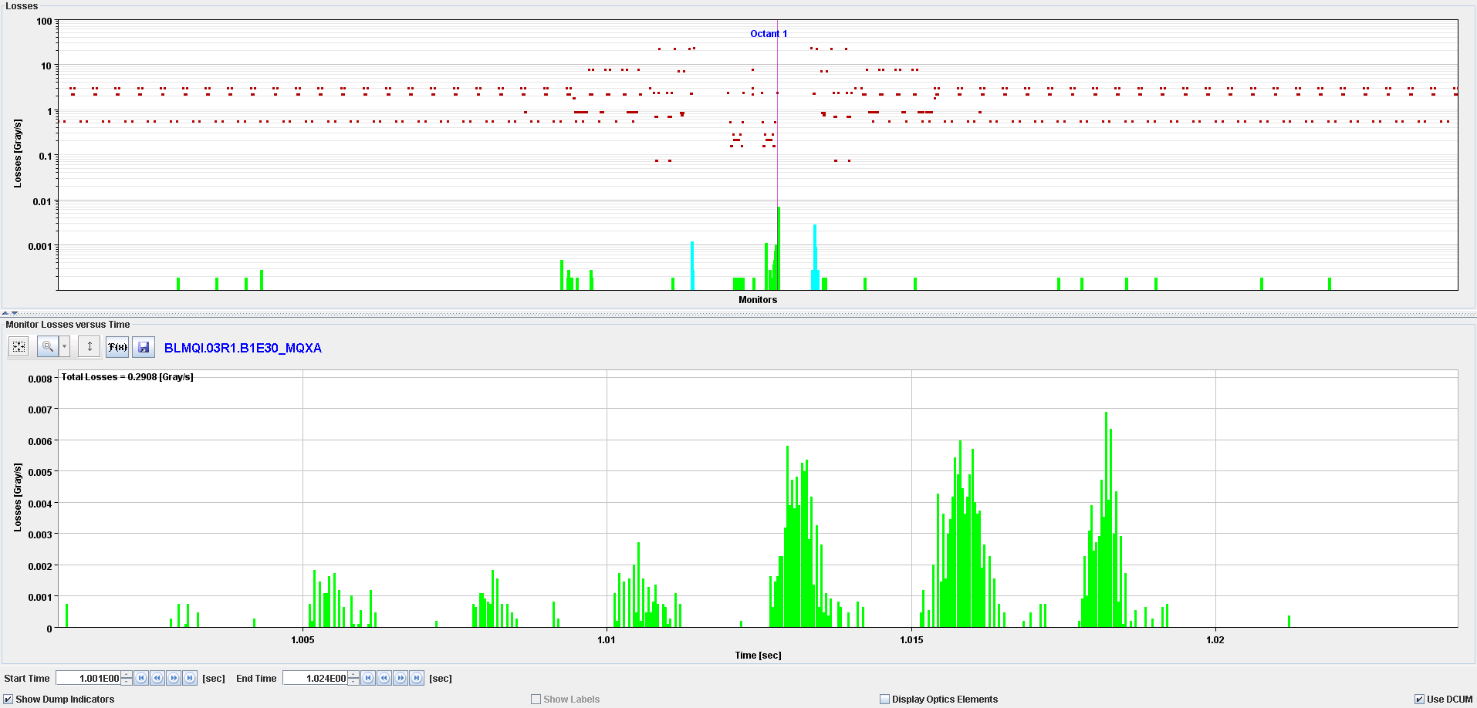
Sequence of events
BLM signal at IP1:

Slide 6
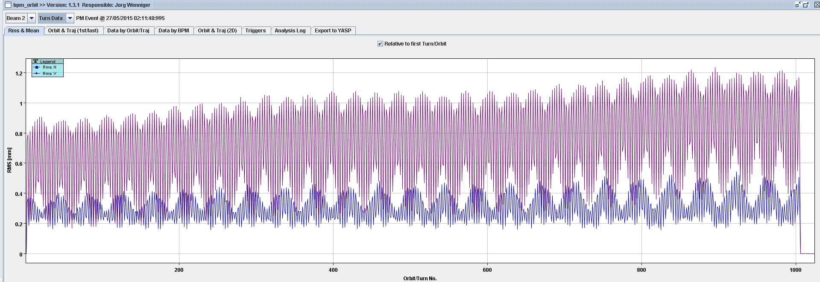
Sequence of events
Beams were dumped due to 10ms RS by a BLM at IP5: BLMQI.02L5.B2E22_MQXB
  Beam losses were observed during ~15ms, with peaks every ~3ms
BPM ORBIT:
Frequency of the AC dipole trimmed too close to the tune value

Slide 7
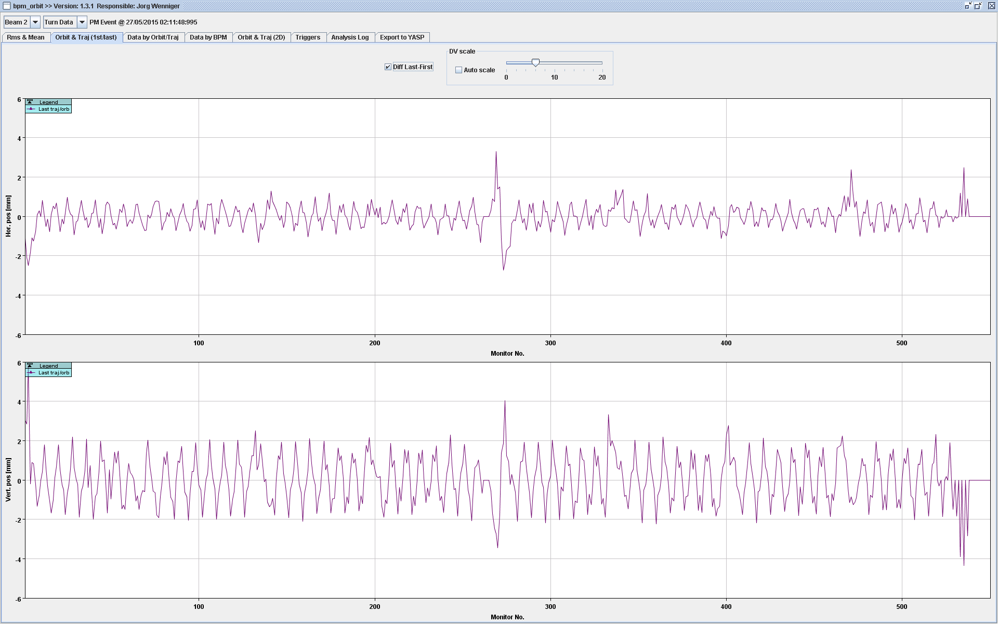
Sequence of events

Slide 8
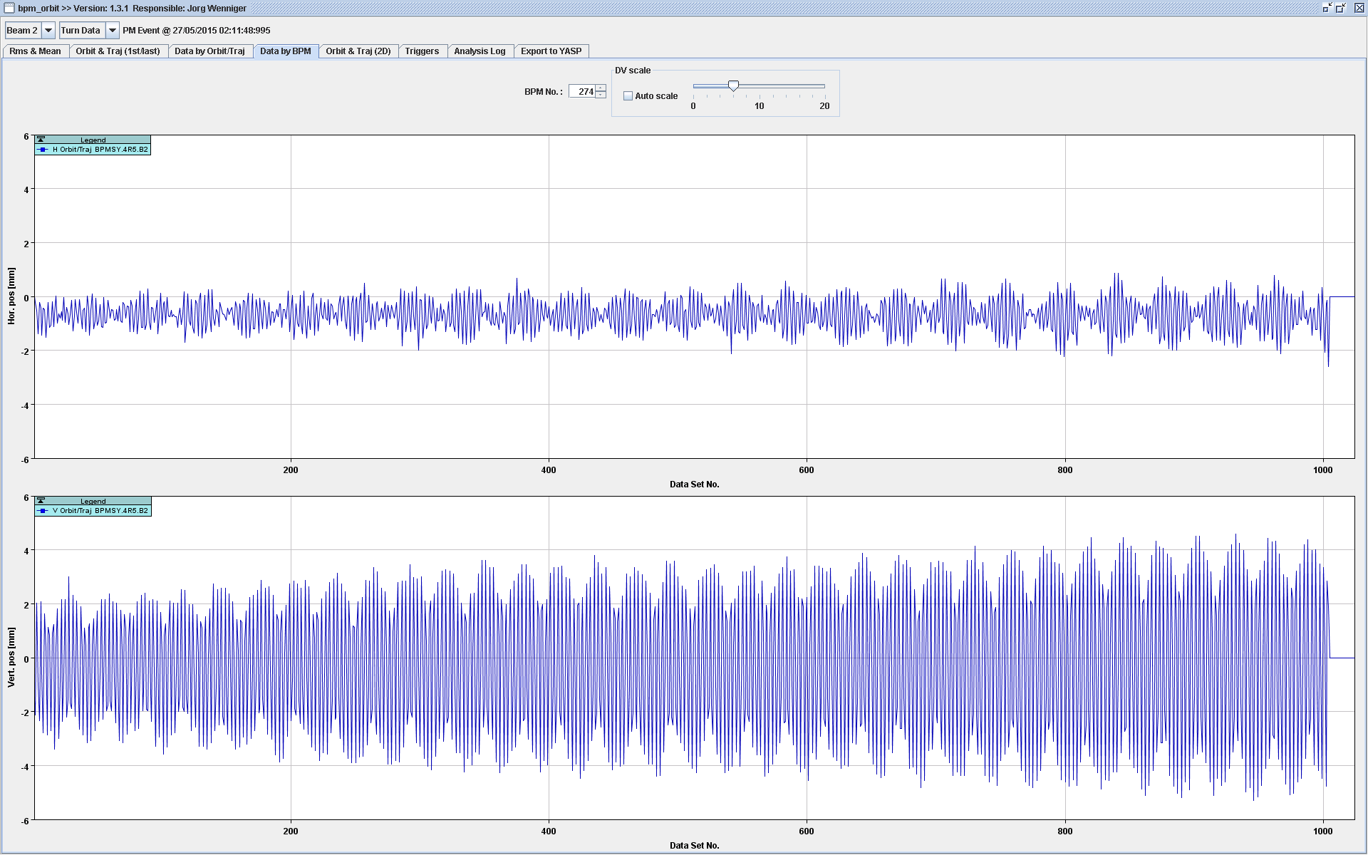
Sequence of events

Slide 9
Concerns
Why was the triplet at IP5 first hit by beam losses? Is this the general aperture limitation?
The TCT in IR5 did not protect the triplet, why?
What should be the position of the TCT to protect the triplet?

Slide 10
MAD-X simulations
Task:
Check where the losses occur when MKQ has
  Tune frequency (Qy = 59.32)
  Nearly tune frequency (Qy-0.001; Qy-0.01)
Check the aperture size at the bottlenecks
V6.503 sequence
0.8 / 3 / 0.8 / 3 m optics
3.5 mm·mrad – normalized emittance
lhc_as-built sequence (run 2 version)
0.8 / 10 / 0.8 / 3 m optics
0.8 / 10 / 0.8 / 3 m optics was not yet available at the time of event
Preliminary

Slide 11
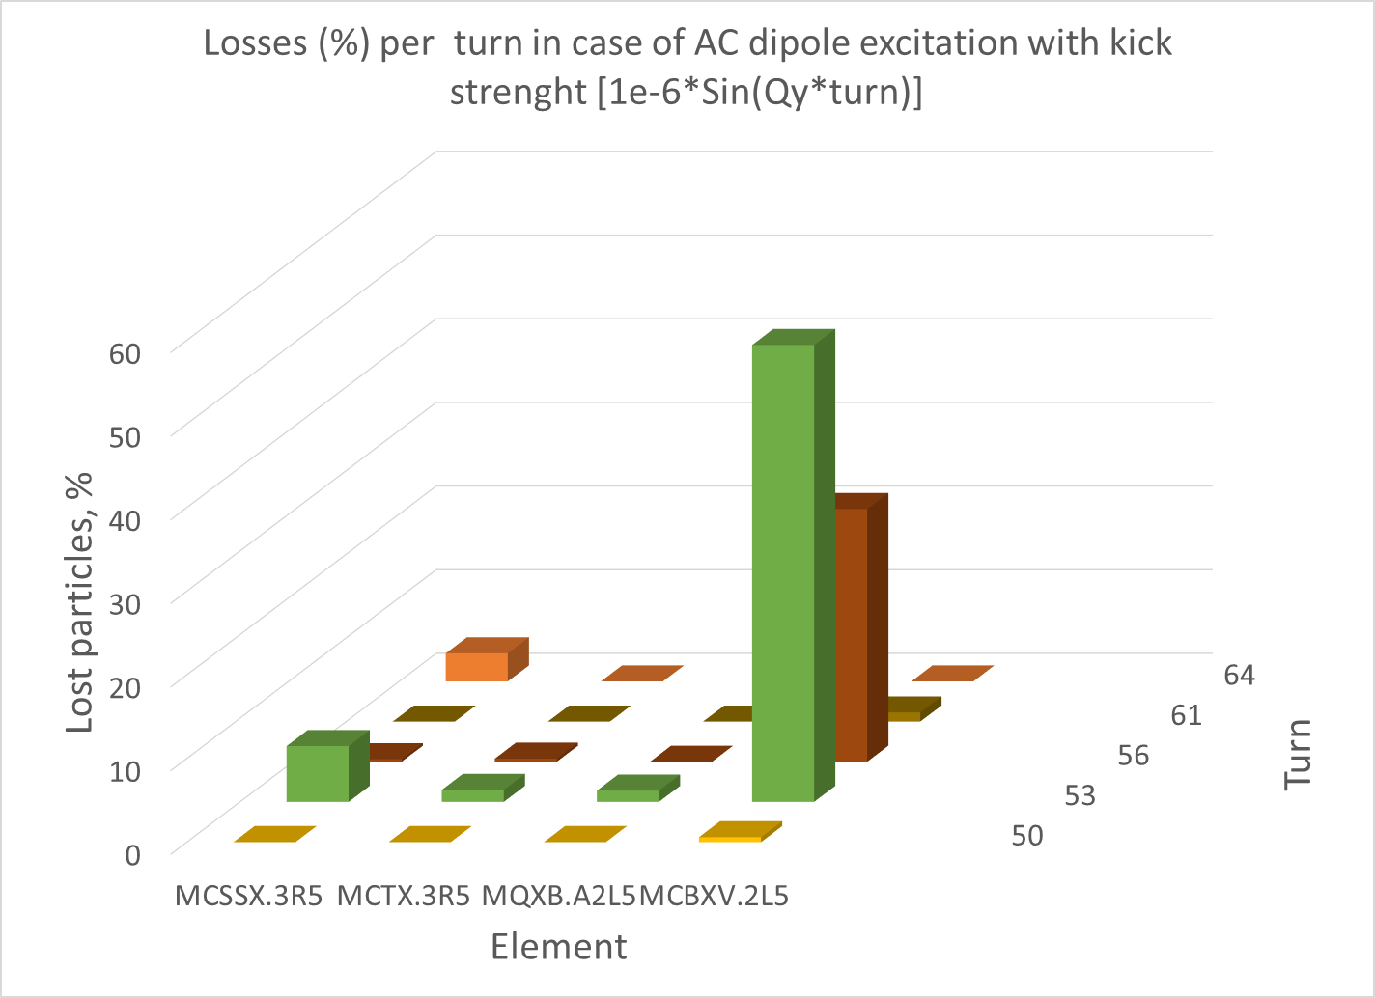
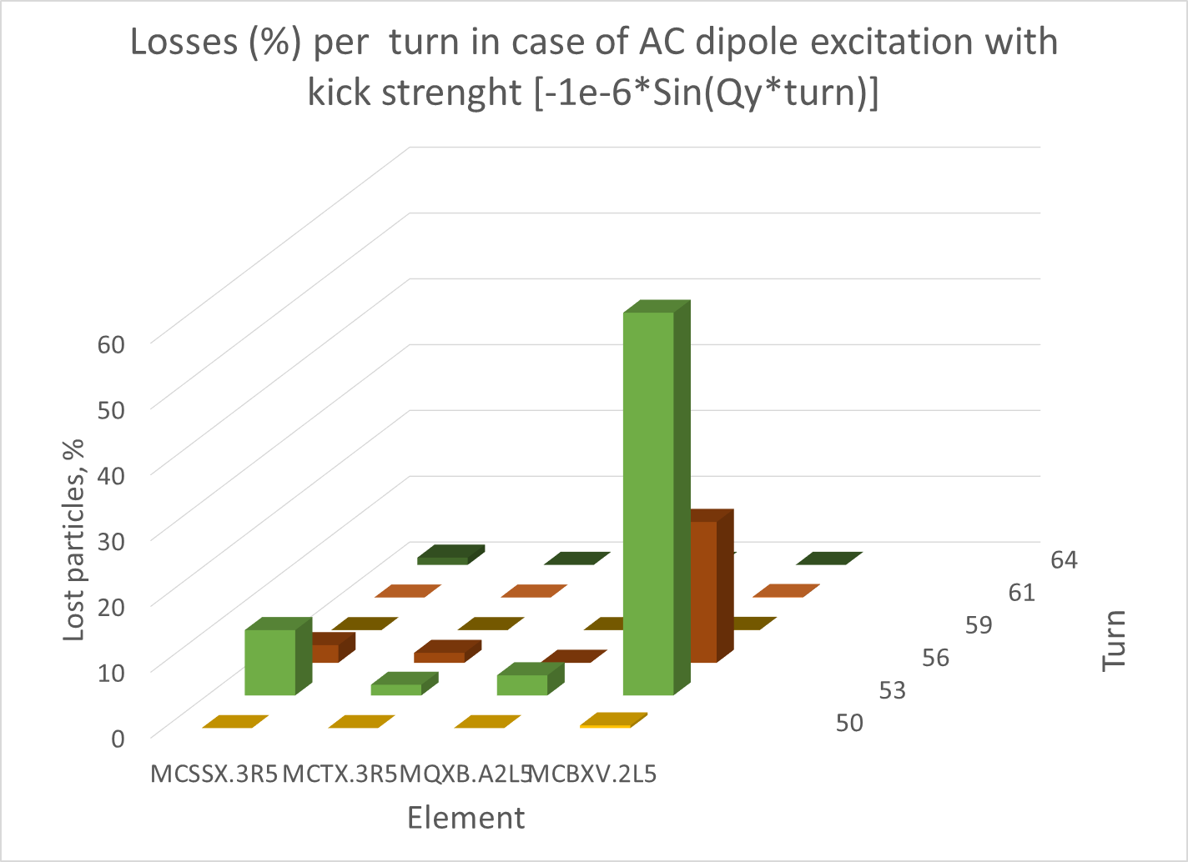
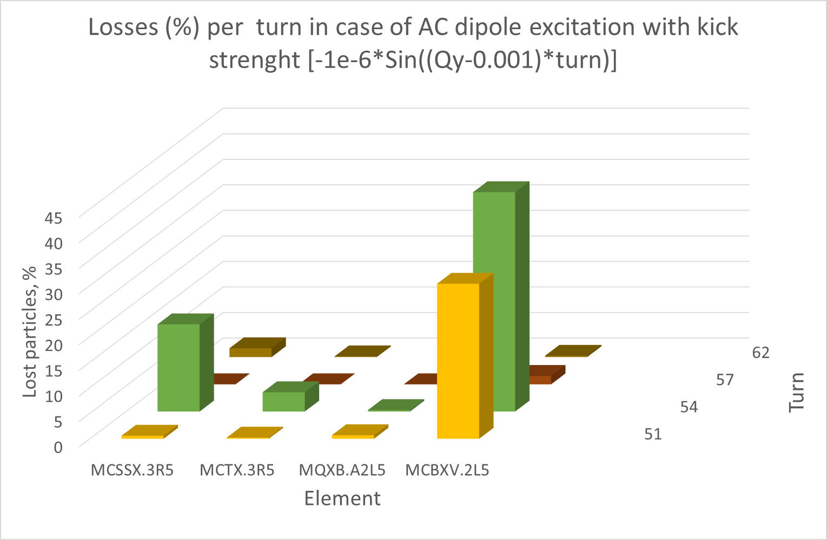
MAD-X: Comparison of the loss patterns in case of various MKQ kicks
If the MKQ frequency is equal to
Qy
Qy-0.001
Losses are mostly observed in MCBXV.2L5
If the difference with tune is 0.01 (Qy-0.01)
– no losses are observed

Slide 12
MAD-X: Aperture bottlenecks
Run 1, 0.8 / 3 / 0.8 / 3 optics
vs.
Run 2, thick 0.8 / 10 / 0.8 / 3 optics
 |  | RUN 1 : 0.8 / 3 / 0.8 / 3 |  |  |  |  |  |  | RUN 2 (thick): 0.8 / 10 / 0.8 / 3
NAME | S, m | Aperture-X, mm | Aperture-Y, mm | SIGMA-X, mm | SIGMA-Y, mm | Aperture-X, sigma | Aperture-Y, sigma |  | SIGMA-X, mm | SIGMA-Y, mm | Aperture-X, sigma | Aperture-Y, sigma
TCTPV.4R5.B2 | 13183.95 | 40 | 15 | 0.74 | 0.47 | 53.93 | 31.86 |  | 0.74 | 0.47 | 54.02 | 31.64
TCP.D6R7.B2 | 6460.043 | 40 | 4.5 | 0.28 | 0.20 | 141.19 | 22.63 |  | 0.28 | 0.20 | 141.75 | 22.54
TCP.C6R7.B2 | 6462.043 | 6 | 40 | 0.28 | 0.20 | 21.76 | 195.61 |  | 0.27 | 0.21 | 21.85 | 194.80
MQXA.3R5 | 13282.32 | 28.9 | 24 | 0.86 | 1.13 | 33.48 | 21.17 |  | 0.98 | 1.01 | 29.58 | 23.77
MQXB.B2R5 | 13290.74 | 28.9 | 24 | 1.22 | 0.73 | 23.77 | 32.99 |  | 1.24 | 0.65 | 23.37 | 36.93
MQXB.A2R5 | 13297.24 | 28.9 | 24 | 1.16 | 0.60 | 24.87 | 40.11 |  | 1.03 | 0.60 | 28.18 | 39.78
MQXA.1R5 | 13306.32 | 28.9 | 24 | 0.69 | 0.63 | 42.12 | 38.15 |  | 0.58 | 0.58 | 50.05 | 41.56
MQXA.1L5 | 13358.62 | 28.9 | 24 | 0.63 | 0.69 | 45.94 | 34.98 |  | 0.63 | 0.85 | 45.95 | 28.16
MQXB.A2L5 | 13366.84 | 28.9 | 24 | 0.60 | 1.16 | 48.30 | 20.65 |  | 0.63 | 1.23 | 45.84 | 19.54
MCBXV.2L5 | 13367.31 | 28.9 | 24 | 0.64 | 1.23 | 45.18 | 19.48 |  | 0.64 | 1.23 | 45.19 | 19.47
MQXB.B2L5 | 13373.34 | 28.9 | 24 | 0.73 | 1.22 | 39.73 | 19.74 |  | 0.85 | 1.12 | 34.00 | 21.40
MQXA.3L5 | 13382.62 | 28.9 | 24 | 1.13 | 0.86 | 25.49 | 27.80 |  | 1.16 | 0.82 | 24.81 | 29.23
MQXB.B2R1 | 26617.58 | 28.9 | 24 | 1.22 | 0.73 | 23.77 | 32.99 |  | 1.24 | 0.65 | 23.37 | 36.93
MQXB.A2R1 | 26624.08 | 28.9 | 24 | 1.16 | 0.60 | 24.87 | 40.11 |  | 1.03 | 0.60 | 28.18 | 39.78
MQXB.A2L1 | 34.8 | 28.9 | 24 | 0.60 | 1.16 | 48.30 | 20.65 |  | 0.63 | 1.23 | 45.84 | 19.54
MQXB.B2L1 | 41.3 | 28.9 | 24 | 0.73 | 1.22 | 39.73 | 19.74 |  | 0.85 | 1.12 | 34.00 | 21.40
MQXA.3L1 | 50.15 | 28.9 | 24 | 1.13 | 0.86 | 25.49 | 27.80 |  | 1.16 | 0.82 | 24.81 | 29.23

Slide 13
MAD-X: Aperture bottlenecks
Run 2, thin 0.8 / 10 / 0.8 / 3 optics is available since 2pm 18 June ☺
NAME | APER_X, m | APER_Y,m | sigma-x, mm | sigma-y, mm | Aper-X, sigma | Aper-Y, sigma
TCP.D6R7.B2 | 0.04 | 0.0044 | 0.28 | 0.20 | 141.75 | 22.03
TCP.C6R7.B2 | 0.006 | 0.04 | 0.28 | 0.20 | 21.67 | 196.43
TCTPH.4R5.B2 | 0.015 | 0.04 | 0.74 | 0.45 | 20.32 | 88.08
TCTPV.4R5.B2 | 0.04 | 0.015 | 0.74 | 0.47 | 54.02 | 31.64
MQXB.A2L5 | 0.0289 | 0.024 | 0.63 | 1.23 | 45.84 | 19.54
MCBXH.2L5 | 0.0289 | 0.024 | 0.64 | 1.23 | 45.19 | 19.47
MQXB.B2L5 | 0.0289 | 0.024 | 0.65 | 1.24 | 44.46 | 19.40
TCTPH.4R1.B2 | 0.04 | 0.04 | 0.74 | 0.46 | 54.12 | 86.66
TCTPV.4R1.B2 | 0.04 | 0.03 | 0.74 | 0.47 | 54.08 | 64.29
MQXB.B2R1 | 0.024 | 0.0289 | 1.24 | 0.65 | 19.40 | 44.46
MCBXH.2R1 | 0.024 | 0.0289 | 1.23 | 0.64 | 19.47 | 45.19
MQXB.A2R1 | 0.024 | 0.0289 | 1.23 | 0.63 | 19.54 | 45.84

Slide 14
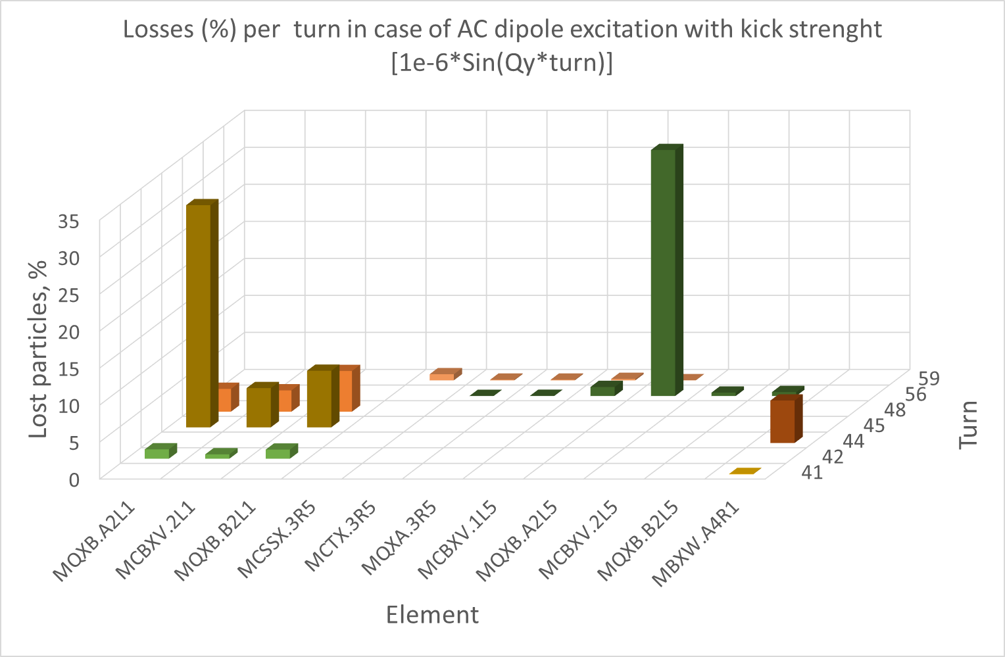
MAD-X: Loss pattern vs turn

Slide 15
Conclusions
In case of AC-dipole vertical excitation of Beam 2 with the frequency close to that of the tune, the aperture bottleneck is located in the triplet at IP5 (in quadrupoles and corrector).
In order to intercept the losses in the triplet-region, the TCT should be moved to <19 sigma.

