Slide 1

Updates in the ATLAS-ALFA interlock logic
110th MPP 19-06-2015
Sune Jakobsen
on behalf of ATLAS-ALFA.
Updates to the system made by:
Sylvain Ravat (PH-DT)

Slide 2

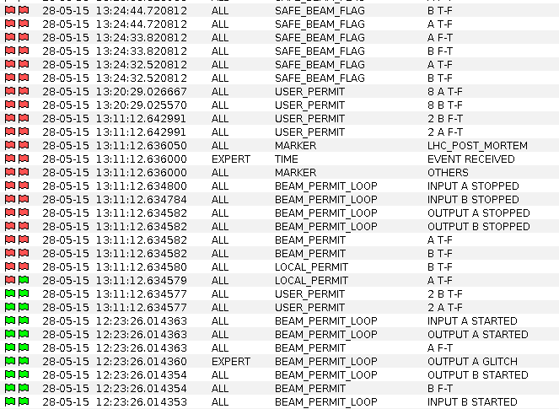
Facts Interpretations Solution and validation Logging
3 beam dumps by ALFA – Facts
The ALFA USER_PERMIT for beam 2 was lost with beam in LHC on the 28-05-2015 at 13:11:12.634577.
This dumped the beam (as it should).
The USER_PERMIT was reestablished ~8 ms later.
None of the ATLAS/ALFA monitoring was fast enough to catch the change.
The USER_PERMIT for beam 1 was not affected.
Both CIBUs for beam 2 was affected.
Nothing like this has been observed before by ALFA.
Unexpected extractions of the Roman Pots occurred during test of the moving in sequence. This was cured by changing the margin to the warning limits from 100 µm to 150 µm.
Another beam dump (beam 2) occurred at a loss-map-fill for Roman Pots.
The USER_PERMIT was reestablished ~8 ms later.
To add margin all Roman Pots by retracted by 350 µm.
The final beam dump (beam 2) happen after ~2 hours of Stable Beam in the first fill for LHCf.
The USER_PERMIT was reestablished ~8 ms later.
The LVDT bypass key was turned (by passing the LVDT comparison and disabling the current to the motors) and the ALFA Roman Pots has not been moved with beam in LHC since.
Updates in the ATLAS-ALFA interlock logic 110th MPP 19-06-2015
Sune Jakobsen
Sune Jakobsen
2/5

Slide 3
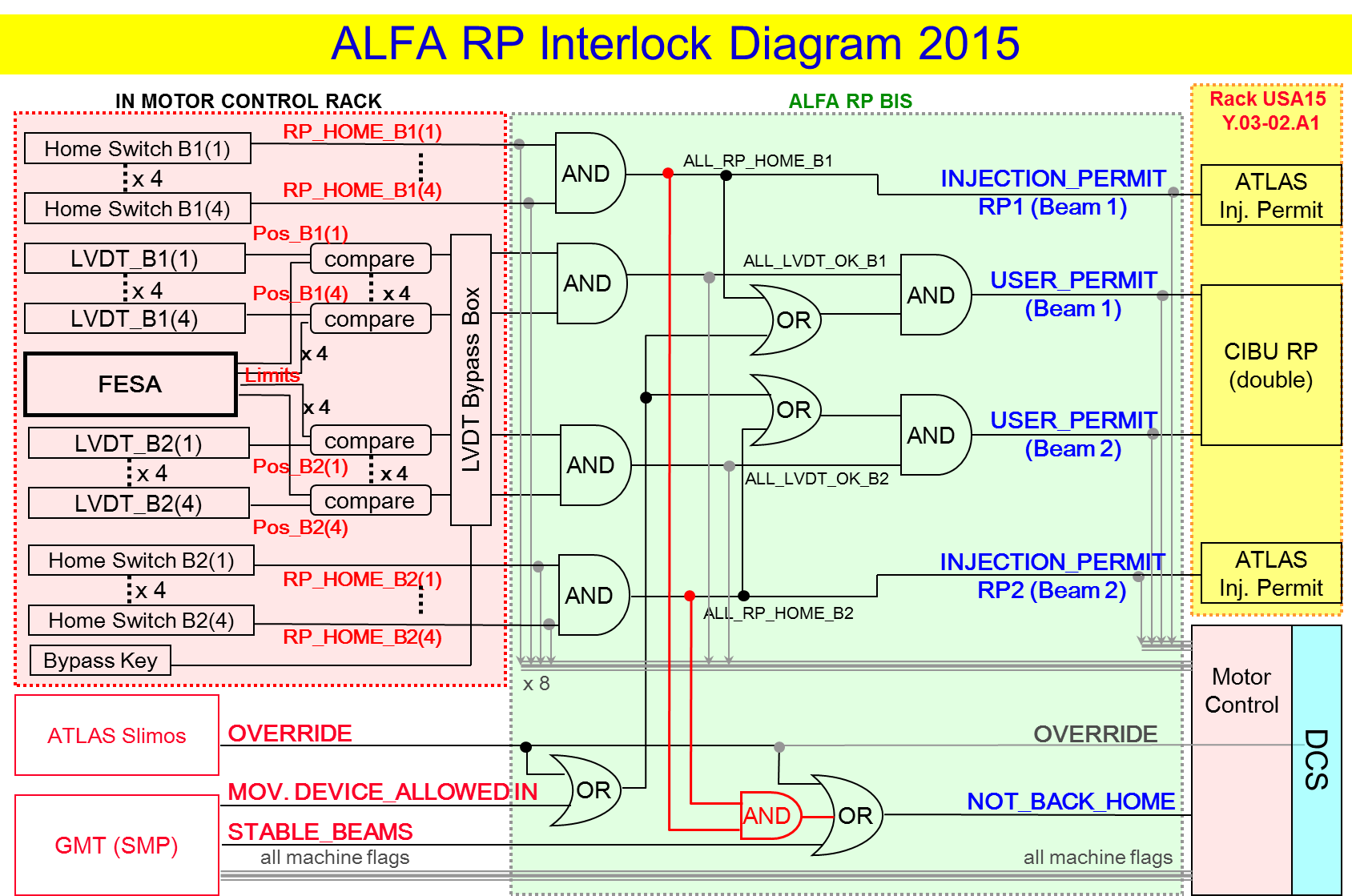
Facts Interpretations Solution and validation Logging
Beam dumps by ALFA – Interpretations
On the ALFA side two things can trigger a loss of the USER_PERMIT:
1) A Roman Pot HOME switch showing a Roman Pot out of garage (without override or stable beam).
The time scale is too short for the mechanical contact of the HOME switches to change and 2 of the dumps was not in garage position.
2) LVDT value out of limits (comparison).
The LVDT comparison is made every 6 ms (10 ms in Run1), so the timescale is comparable to a single reading violating the limits.
Up stream for of ALFA (ATLAS interlock box/CIBU):
Not likely since both signal A and B on ALFA CIBU 2 was lost simultaneously and nothing else in ALFA or ATLAS was affected.
No loss of the USER_PERMIT observed for the very long periods with ALFA in LVDT_BYPASS_MODE.
Conclusion: It is the ALFA LVDT comparison that fails and lower the USER_PERMIT and extract the Roman Pots.
Updates in the ATLAS-ALFA interlock logic 110th MPP 19-06-2015
Sune Jakobsen
Sune Jakobsen
Sune Jakobsen
3/5

Slide 4
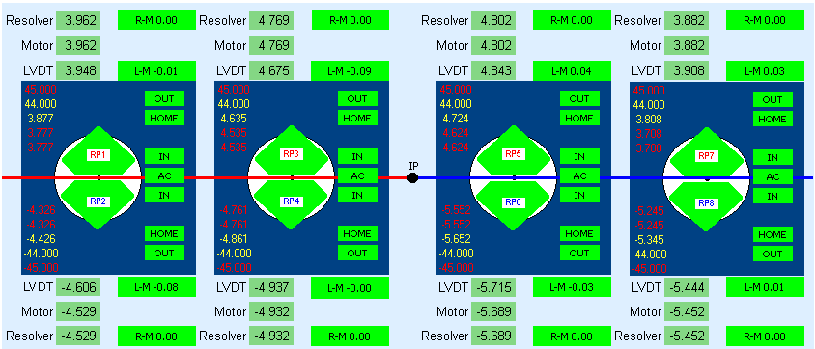
Facts Interpretations Solution and validation Logging
Beam dumps by ALFA – solution and validation
All the beam dumps was coursed by only one LVDT comparison falling.
Proposed change: Only extract the Roman Pots and lower the USER_PERMIT if 3 consecutive LVDT/limit comparison fails.
The extraction/dump time would change from ~6 ms to ~18 ms.
In 18 ms a Roman Pot at full speed moves ~5 µm (one step).
The final solution was implemented Thursday afternoon.
All limits interlock were successfully validated late Thursday afternoon and will be included in the EDMS ALFA interlock validation note: 1515678.
At 19:00 all Roman Pots was positioned at physics positions with 100 µm to the warning limit and 200 µm to the dump limit.
This stability test is still ongoing and so far neither the warning or the dump limit has been violated.
Updates in the ATLAS-ALFA interlock logic 110th MPP 19-06-2015
Sune Jakobsen
Sune Jakobsen
Sune Jakobsen
4/5

Slide 5
Facts Interpretations Solution and validation Logging
Additional logging implemented
A special logging for the LVDT values has been introduced on directly on the PXI.
The raw ratio of the LVDT are logged every 4 ms.
This is only meant to be used for commissioning as it takes a lot of recourses on the PXI.
Analyzing the values none of the LVDTs are outstanding from the others in terms of noise.
Logging on change of HOME switch values has been introduced directly on the PXI.
Logging
Logging
Logging on change of the results of the LVDT/limit comparison has been introduced directly on the PXI.
Logging
Logging
The logging is _BEFORE_ the LVDT bypass box and it is therefore possible in LVDT_BYPASS_MODE to check if the USER_PERMIT potentially would have been lost.
ATLAS CIBU (Siegfried Wenig) output to DCS has been updated to prolong signals to minimum ~3 s and thereby make them visible in the current logging.
Updates in the ATLAS-ALFA interlock logic 110th MPP 19-06-2015
Sune Jakobsen
Sune Jakobsen
Sune Jakobsen
5/5

