Slide 2
Job Opportunities at CERN
João SILVA (GS-AIS)
LITHUANIA @ CERN
8th of July 2015

Slide 3
Agenda
Opportunities for Professionals
Opportunities for Graduates
CERN Spring Campus
Project Associates

Slide 4
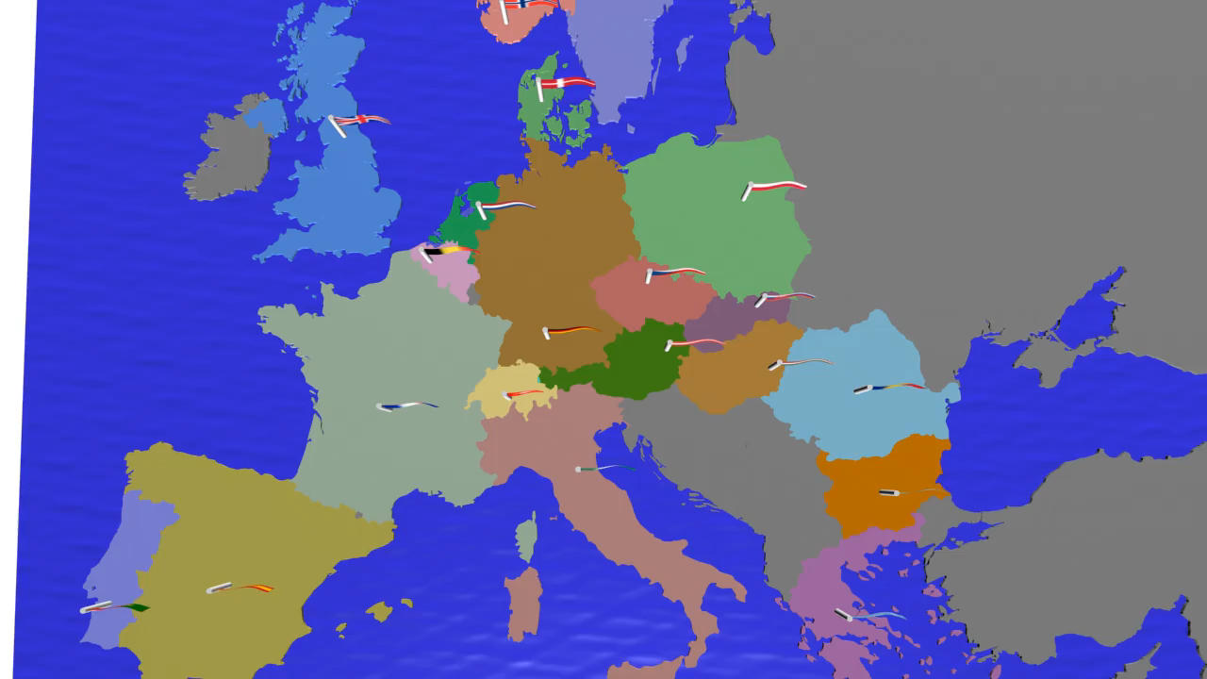






















Twenty-two Member States
Austria (1959)
Belgium (1953)
Bulgaria (1999)
Czech FR (1993)
Denmark (1953)
Finland (1991)
France (1953)
Germany (1953)
Greece (1953)
Hungary (1992)
Israel (2013)
Italy (1953)
Netherlands (1953)
Norway (1953)
Poland (1991)
Portugal (1986)
Romania (2015)
Slovak FR (1993)
Spain
(1961-1968, 1983)
Sweden (1953)
Switzerland (1953)
United Kingdom
(1953)

Slide 5
Agenda
Opportunities for Professionals
Opportunities for Graduates
CERN Spring Campus
Project Associates

Slide 6
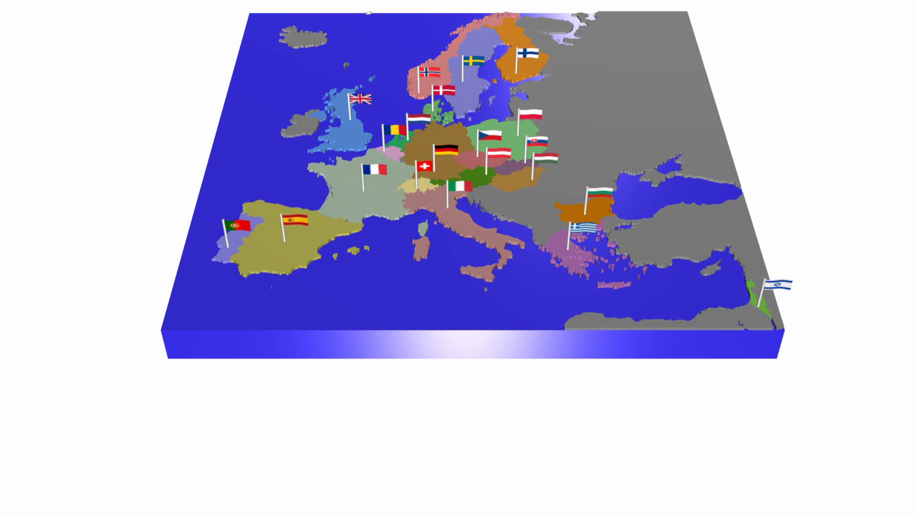
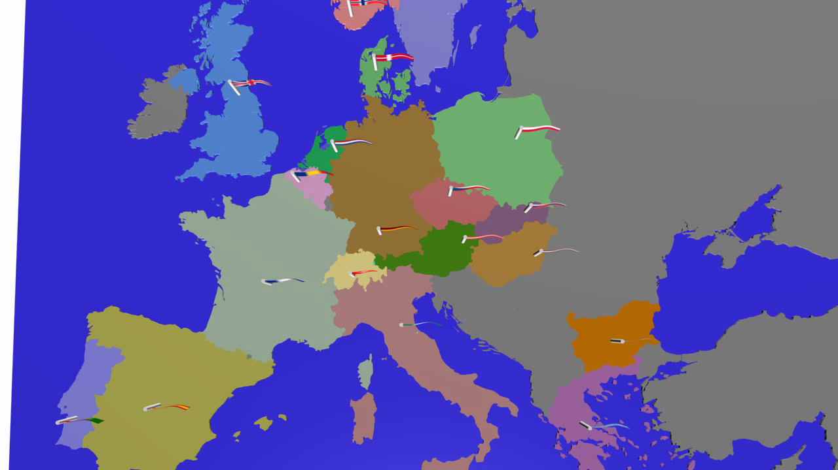
Twenty-one Member States
Austria (1959)
Belgium (1953)
Bulgaria (1999)
Czech FR (1993)
Denmark (1953)
Finland (1991)
France (1953)
Germany (1953)
Greece (1953)
Hungary (1992)
Israel (2013)
Italy (1953)
Netherlands (1953)
Norway (1953)
Poland (1991)
Portugal (1986)
Slovak FR (1993)
Spain
(1961-1968, 1983)
Sweden (1953)
Switzerland (1953)
United Kingdom
(1953)

Slide 7
A few examples of professions at CERN
Information Officer
Administrative Assistant
Electronics Engineer
Technical Engineer (Electronics)
Computing Engineer
Lawyer
Vacuum Technician
Firefighter
Machine Operator
Radioprotection Engineer
Translator
Physicist

Slide 8

JOBS at CERN
Staff positions
~ 200 positions/year
EMPLOYED MEMBERS OF PERSONNEL RECRUITED FROM OUR MEMBER AND ASSOCIATE MEMBER STATES
Eligibility : > from apprenticeship to PhD
Selection : > vacancies published on the WEB
Features : - Maximum 5+3 year contract
- competitive salaries incl. social benefits
- training possibilities (language courses, technical training)

Slide 9
Agenda
Opportunities for Professionals
Opportunities for Graduates
Spring Campus
Project Associates

Slide 10

PROGRAMS
Fellowship program
140-160 positions/year
FIELDS : physics, engineering, computing
ELIGIBILITY : BSc, MSc or PhD
no more than 10 years relevant post-MSc experience
SELECTION: 2 selection committees per year
FEATURES : 2-3 year employment contract
attractive salary incl. social benefits
training possibilities
Fellows are normally nationals of the Member States of CERN. There also exist a limited number of places for Fellows from non-Member States.

Slide 11

PROGRAMS
Doctoral Student program
40-50 positions/year
FIELDS : applied physics, engineering, computing
ELIGIBILITY : enrolled in a doctoral program in
a Member State university
LENGTH : 1-3 years
FEATURES : a technical project, leading to a PhD thesis
co-supervised by the university thesis advisor and a CERN staff member
a living allowance incl. Health insurance

Slide 12
Agenda
Opportunities for Professionals
Opportunities for Graduates
CERN Spring Campus
Project Associates

Slide 13
ASSOCIATES
Project Associates
50-60 positions/year
FIELDS: applied physics, engineering, computing
ELIGIBILITY: BSc, MSc or PhD
From a university with a collaboration agreement
LENGTH: up to 3 years
FEATURES : a technical project, a living allowance, health insurance

Slide 15
What is AIS?
Running CERN’s administrative computing infrastructure for more than 20 years…
  Money:
    Purchasing, Contracts, Teams Codes,
    Payments (Payroll, Claims, Invoices, etc.).
  People:
    Employment Contracts, Health Insurance,
  Processes:
    EDH, Project Management, Planning,
  Infrastructure:
    Visits, Directories, Shipping, Distribution, Mail Office

Slide 16
CERN’s Business Computing

Slide 17
Support
User Support
Reporting
Processes
Human Resources
Finance
Materials
Records
Payments
Stores
Contracts
Services
Accounting
Career
Roles
Suppliers
Treasury
Inventory
ePool
Training
Recruitment
Planning
Contracts
Logistics
Leave
Claims & Payroll
CERN Hotel
Budget
Purchasing
Admin Support
Safety
Equip.
EU Reporting
Team Codes
Projects & Experiment Support
Infrastructure
Safety
Buildings
Access
Project
Management
Medical data
Phonebook
Mail
Safety
Roles
Public Outreach
Intervention Management

Slide 18
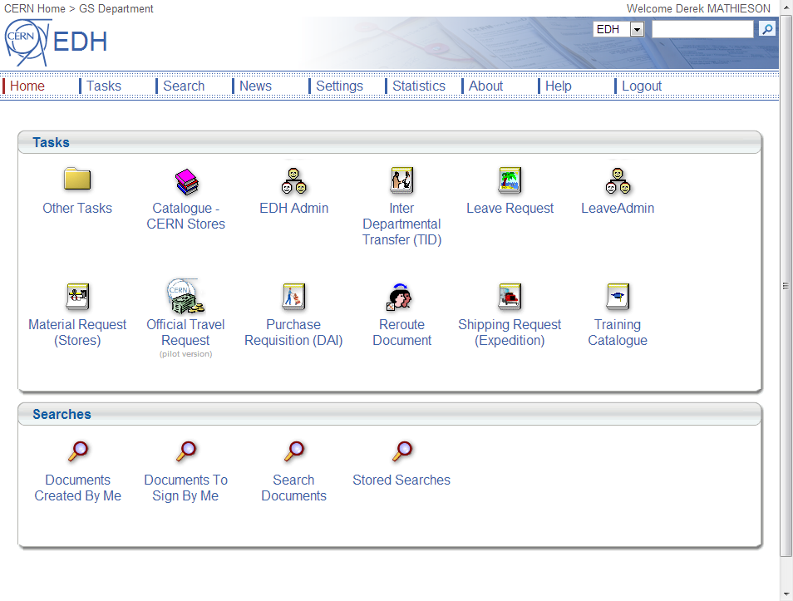
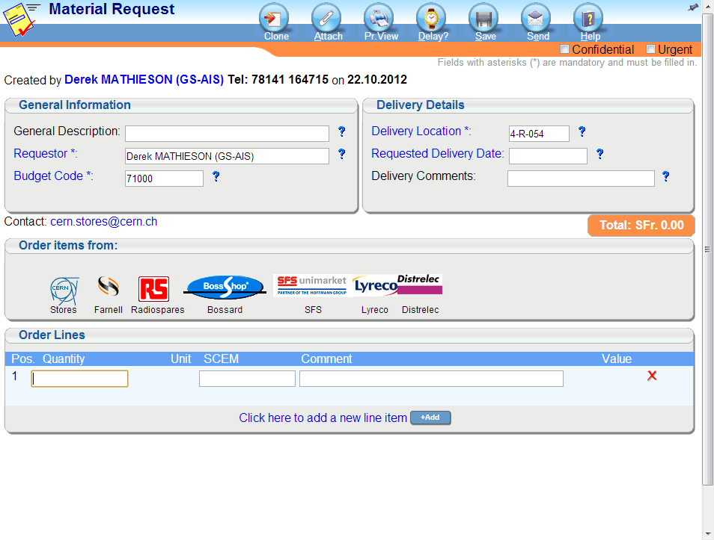

Slide 19
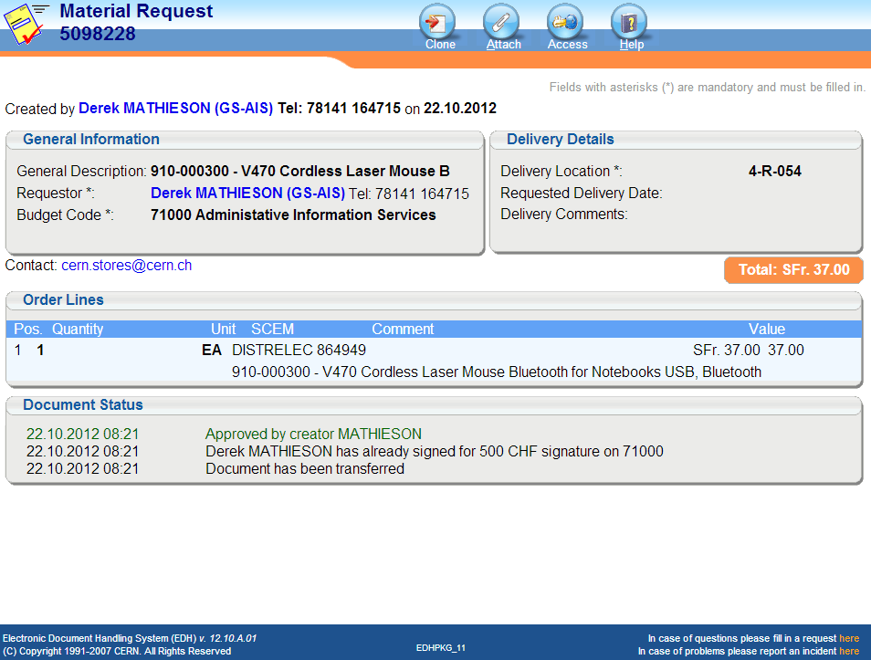
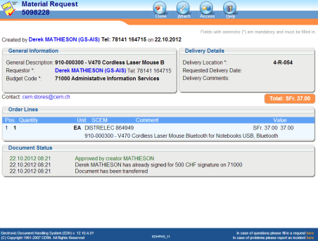

Slide 20




Payment
cXML
EDH

Slide 21
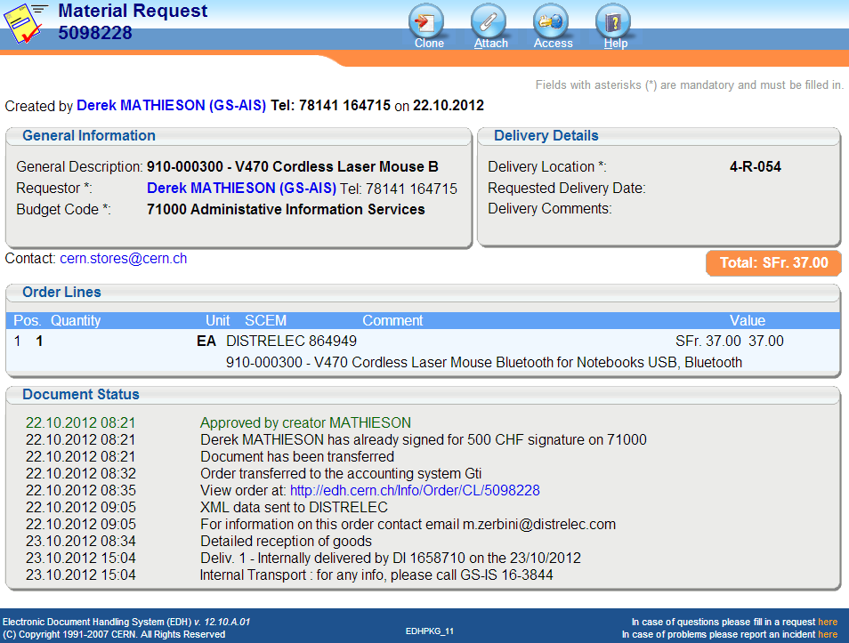
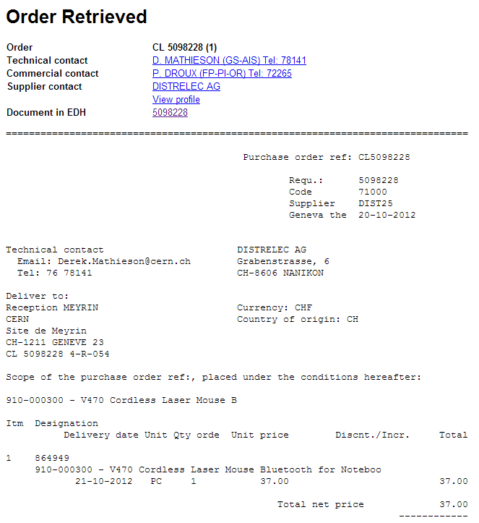
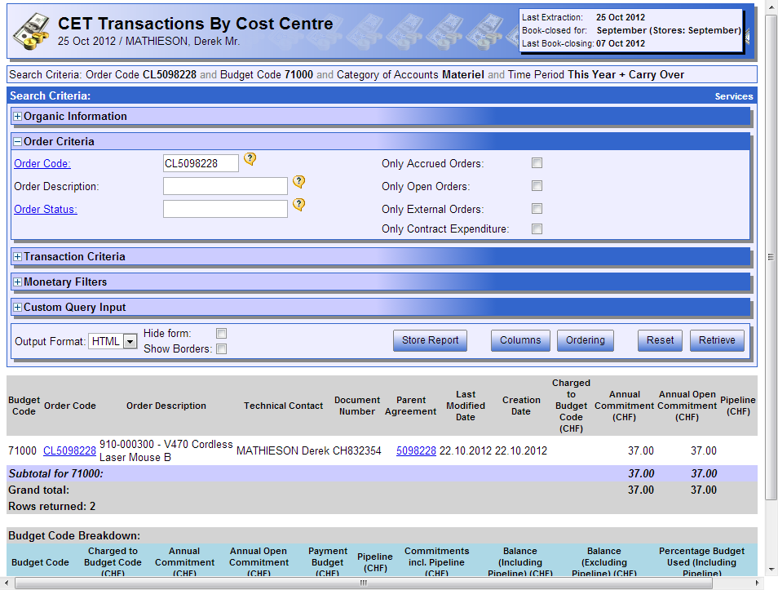
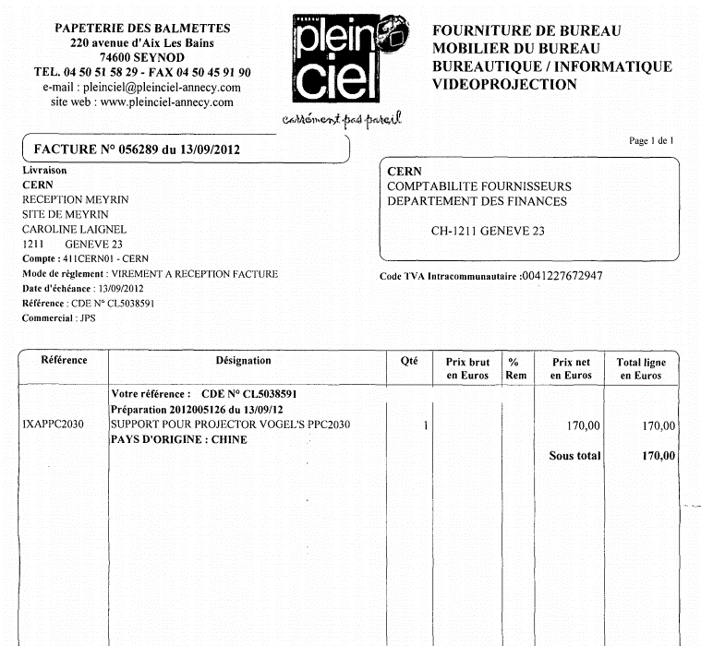

Slide 22
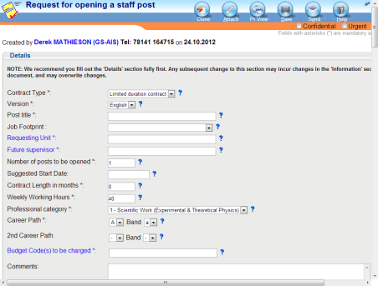
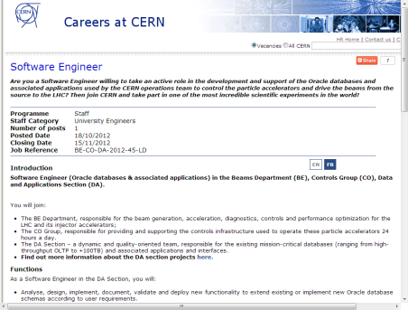
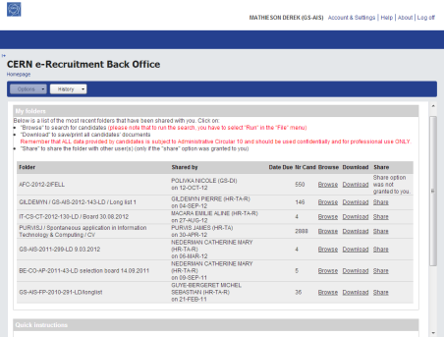
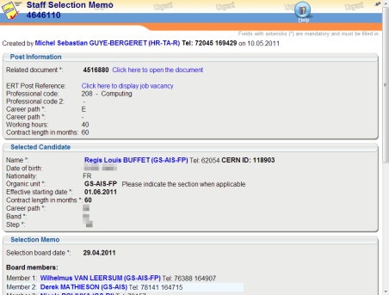
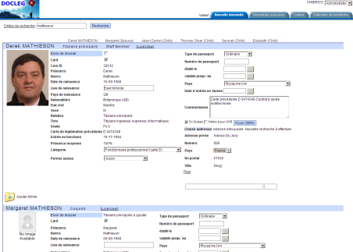
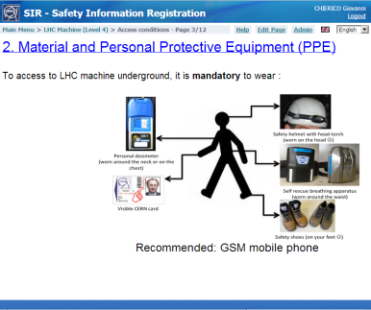
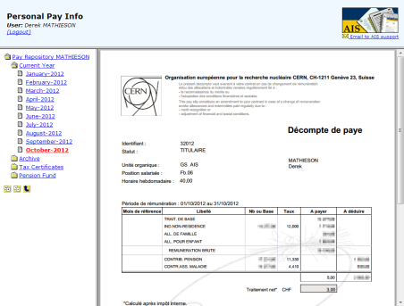
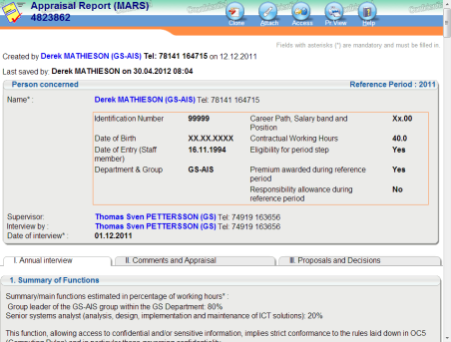
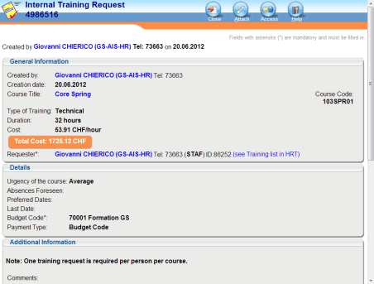
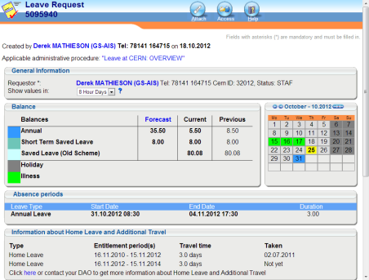
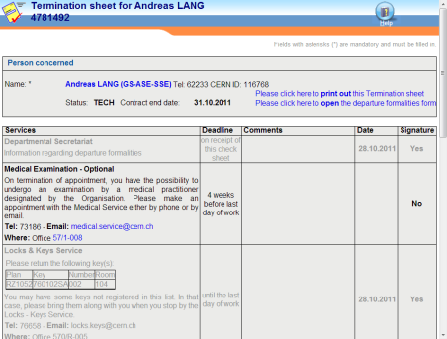
Open Post
Advertise
Recruit
Hire
Register
Safety Training
Pay
Appraise
Develop
Absences
Exit

Slide 23
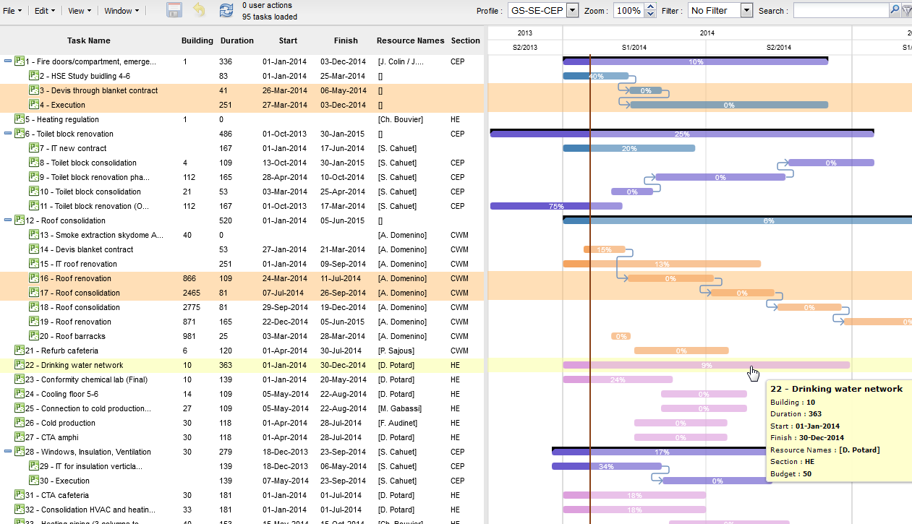
Planning

Slide 24
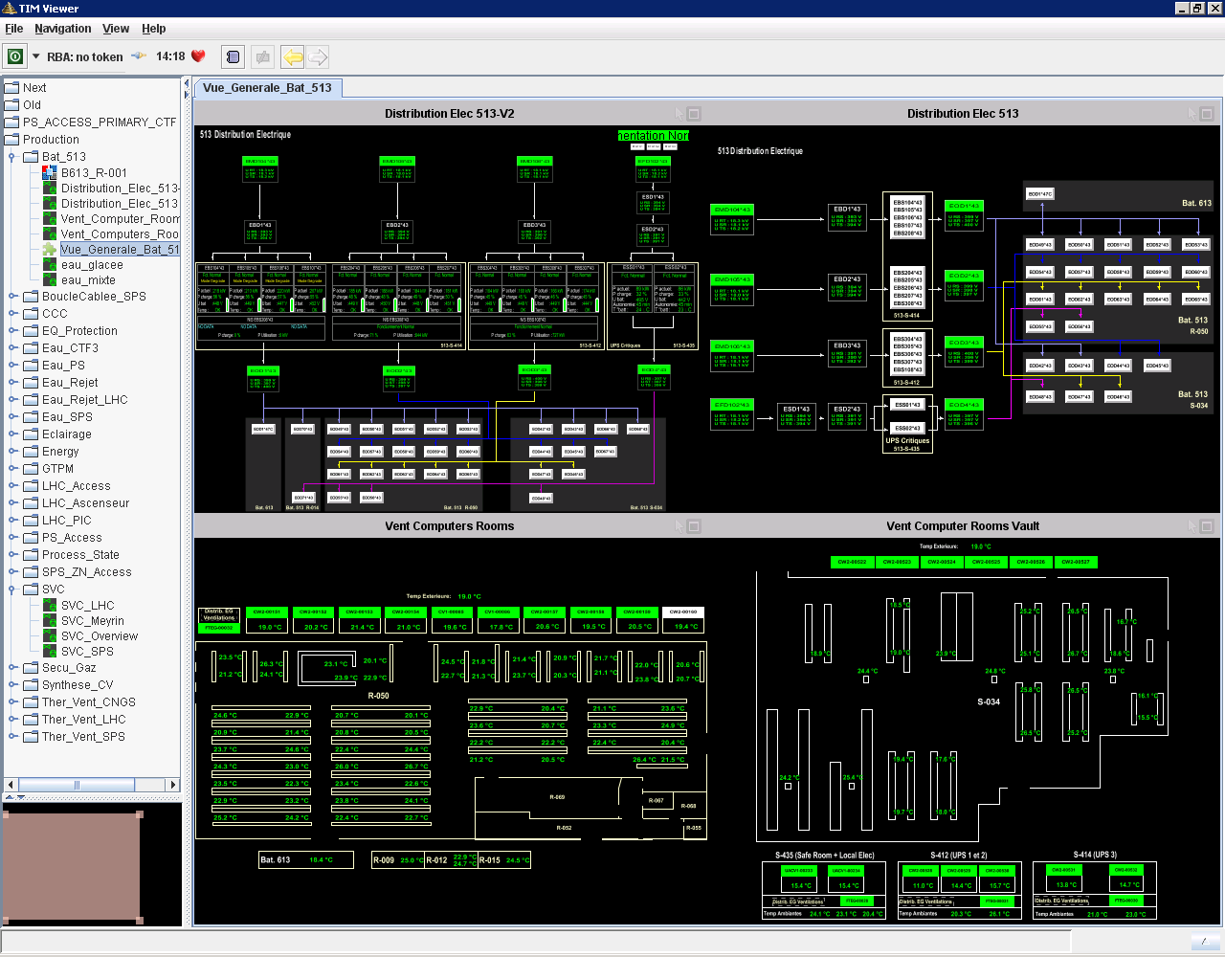
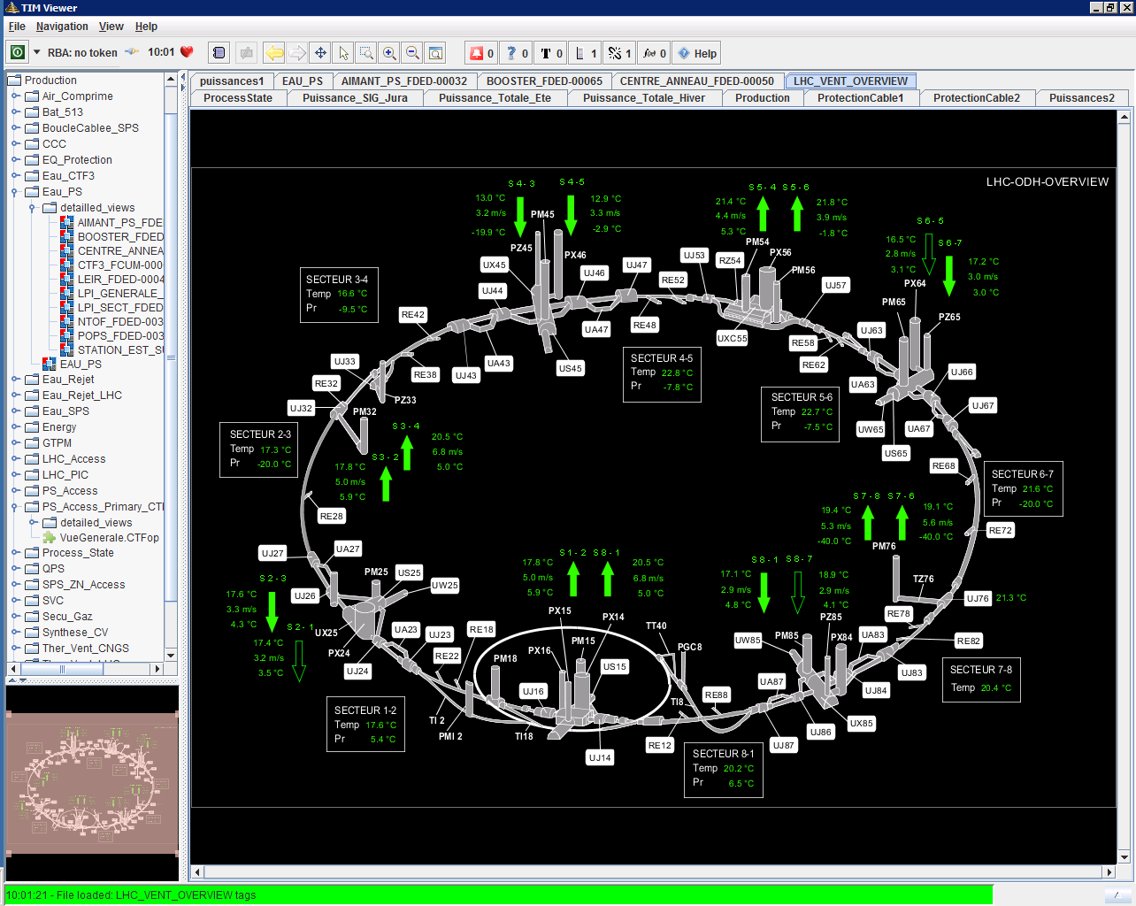
Technical Monitoring

Slide 25
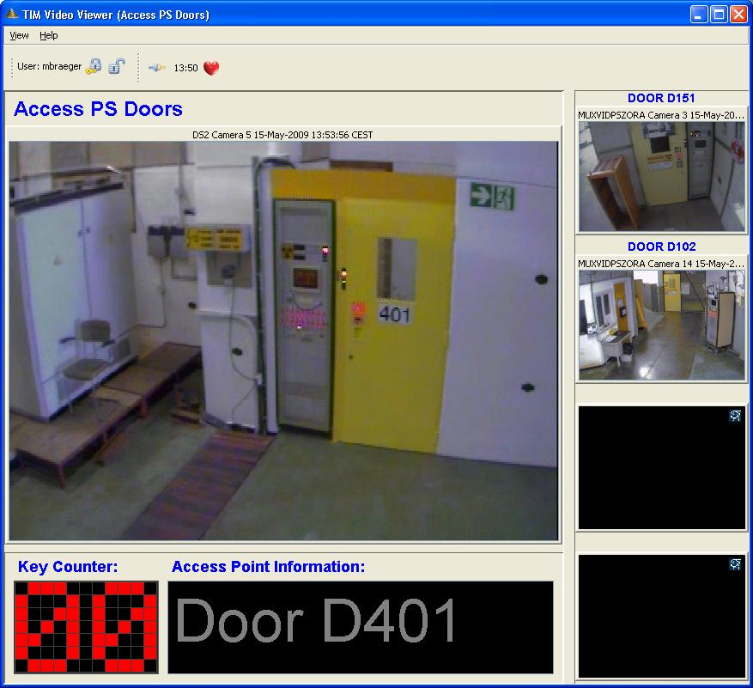
Video Surveillance

Slide 26
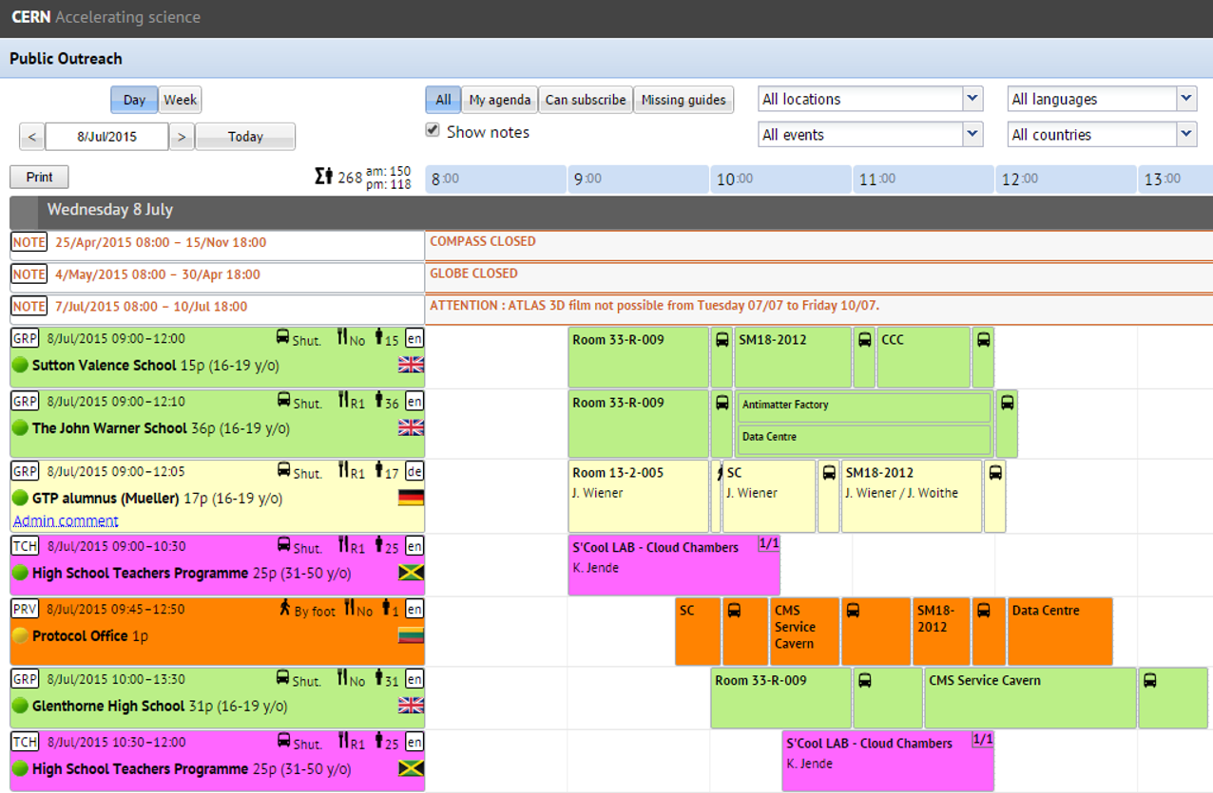
Public Outreach
>100k visitors from >90 countries

Slide 27
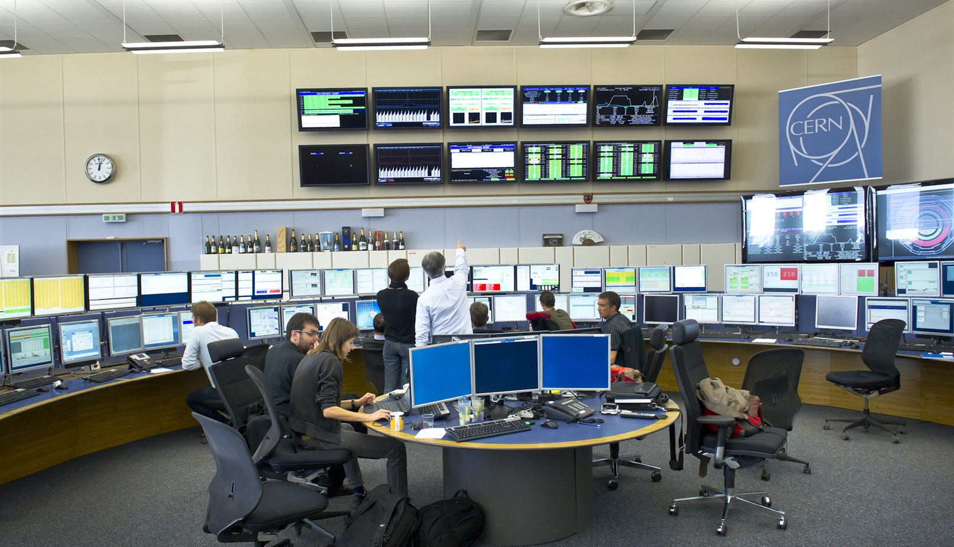
Accelerator Control

Slide 28


CERN Computer Centre
91,000 processing cores
30 PetaBytes of data storage on disk
70 PetaBytes of data storage on tape
    ~25 PetaBytes/year

Slide 29
PJAS Statistics

Slide 30
IT Project Associates

Slide 31
AIS Project Associates

Slide 32
Project Associate Future Careers

Slide 33
Agenda
Opportunities for Professionals
Opportunities for Graduates
CERN Spring Campus
Project Associates

Slide 34
CERN Spring Campus
Series of schools dedicated to Information Technology and Computing
Goals
  Promote scientific and technological dissemination, and cultural exchange
  Prepare young engineers for the job market
25 hours of sessions covering
  Information Technology
  Team work
  Entrepreneurship
  Job Interview Techniques

Slide 35

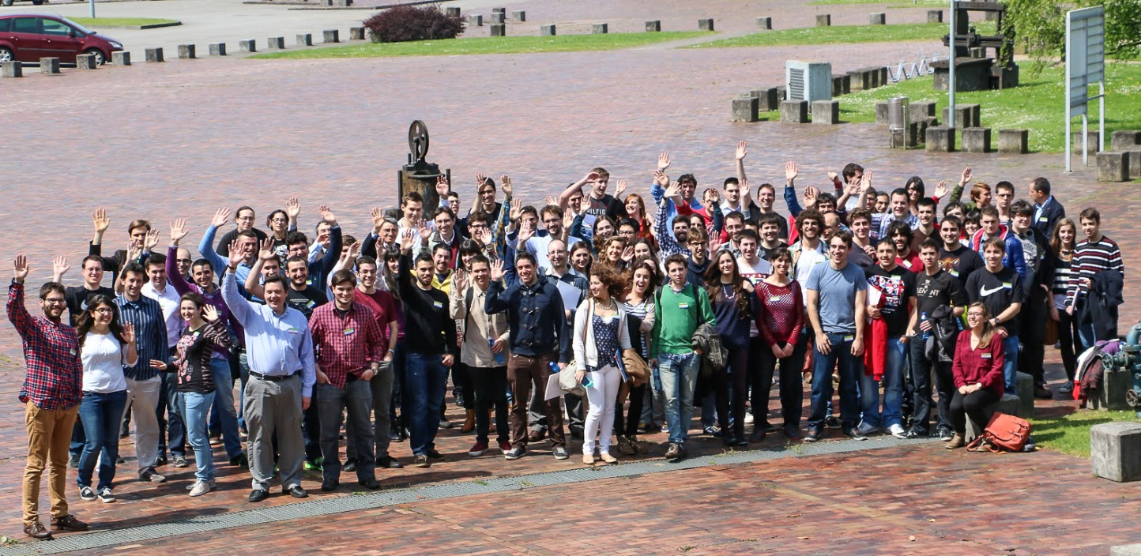
2014, Oviedo, Spain
It has been a reat experience
The concept is very nice, but I would make it longer
I was exposed to many new technologies and methodologies

Slide 36

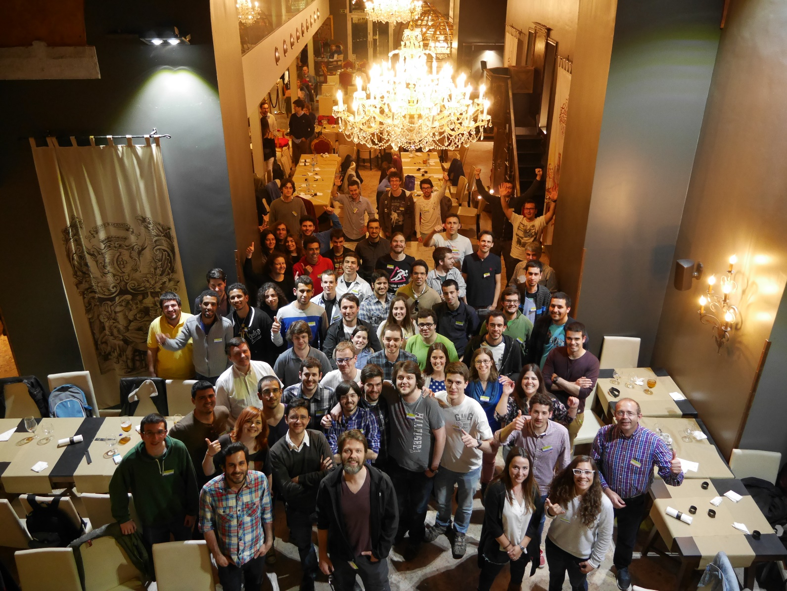
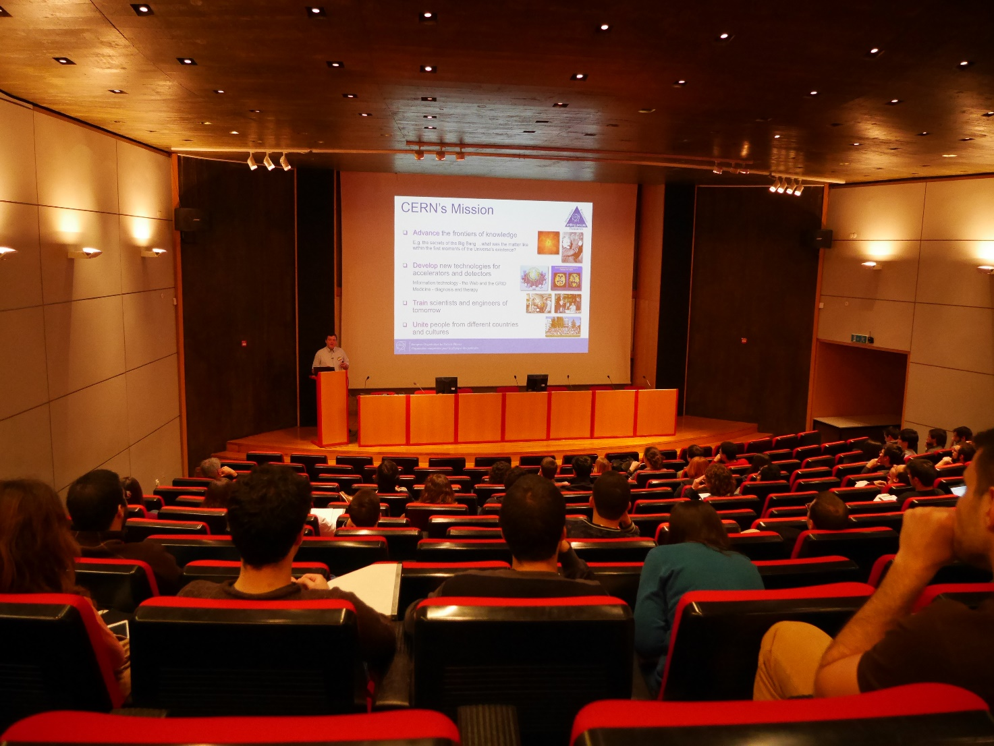
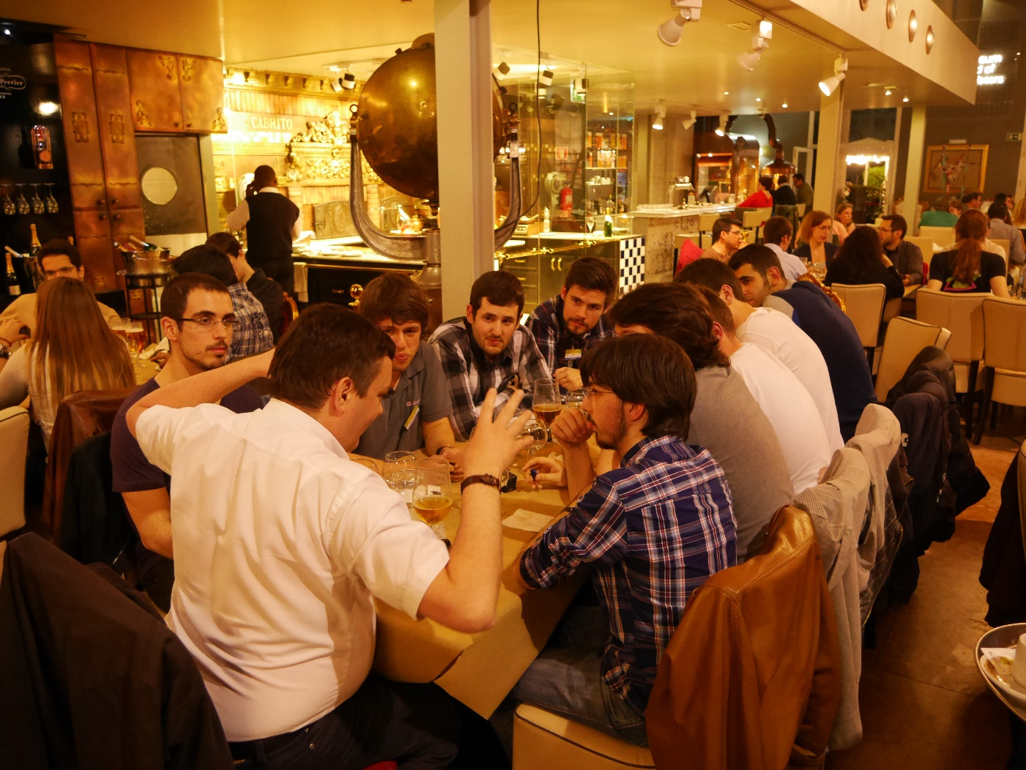
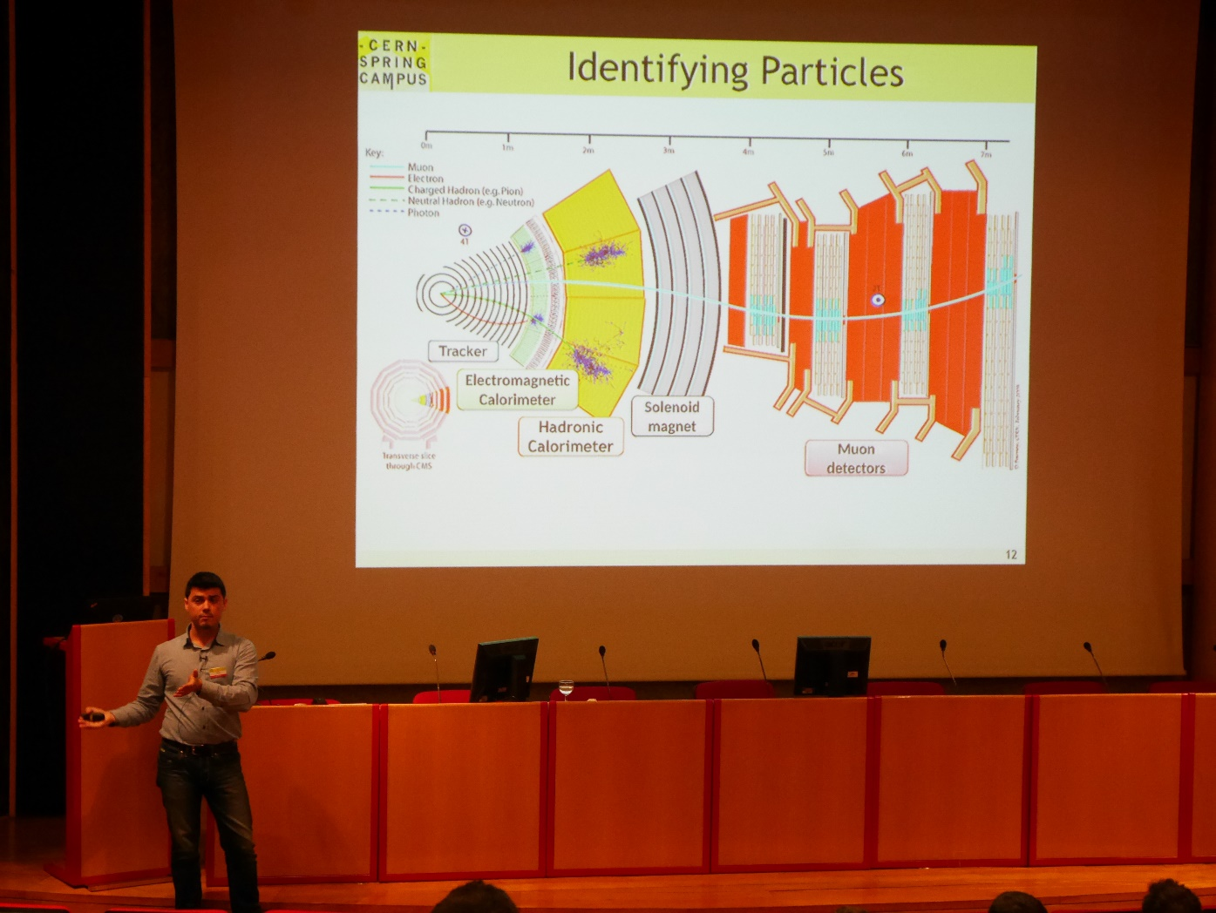
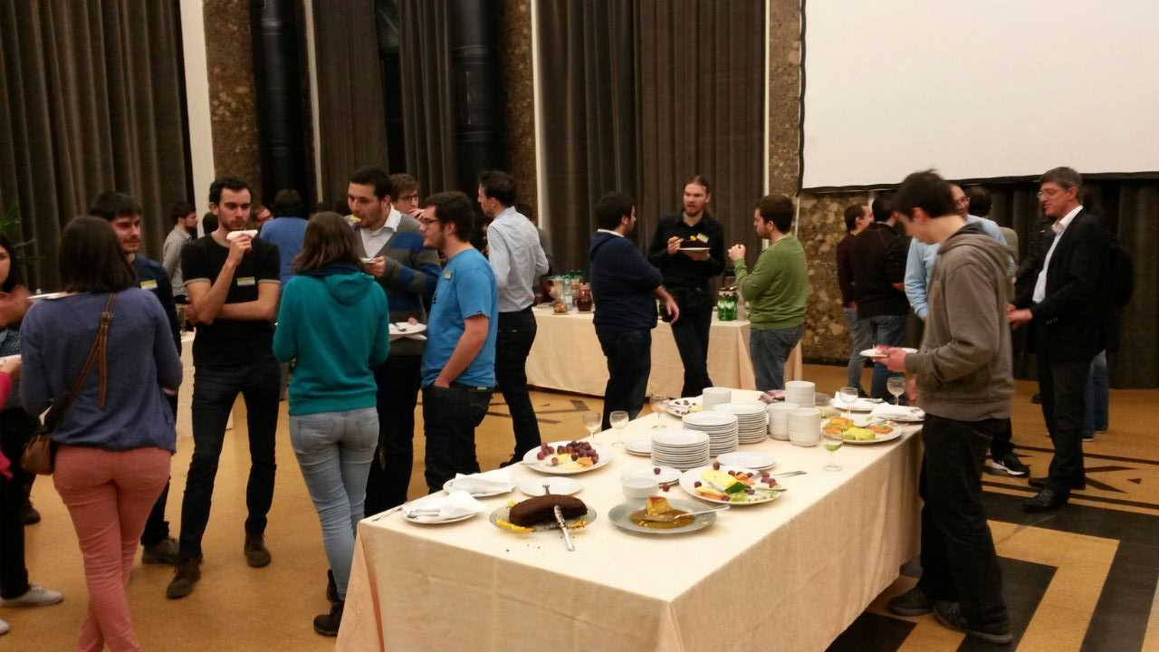
2015, Lisbon, Portugal

Slide 38


2016, Vilnius, Lithuania

Slide 39
Thank you

