Slide 2
CERN
Educational Outreach

Slide 3
CERN and Education
Teachers
Teacher Programmes
Teaching Resources
General Public
Guided Tours
Exhibitions
Virtual Visits
S’Cool LAB
Students
Travelling Exhibitions
Special Events
(Fares, Conferences)

Slide 4
DG-EDU Education Group

Slide 5
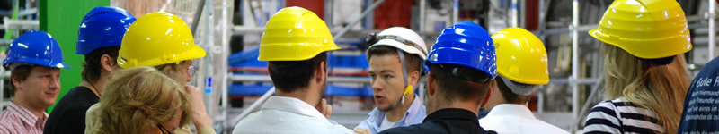
CERN Guided Tours
huge demand
~200k-300k
tours given by volunteer guides
normally ½ day visits
  Introduction
  2 Visits Points

Slide 6
CERN Visits Points
CERN guided tours take place all over the laboratory, at original experiment and facility locations as well as at specifically designed visit point extensions of facilities.

Slide 7
Permanent Exhibitions
CERN runs two permanent exhibitions, “Universe of Particles” in the Globe of Science and Innovation and the Microcosm.
Both are currently in maintenance.

Slide 8
Globe of Science and Innovation
A Platform for Partnership
Ground floor:
“Universe of Particles”
    ~ 65000 visitors/a
First floor:
Multi-purpose area
    ~ 30000 users/a
    ~ 200 events/a
  Special Events with Industry and Society
  Conferences
  Film Festival
  VIP Events
  Receptions
  Lectures
  Workshops

Slide 9
CERN Educational Outreach
Visits of Teacher and Student Groups
Teacher Programmes
Participation in Student Programmes
Permanent and Travelling Exhibitions
Education Research
Education Resources

Slide 10
CERN Teacher Programmes
Goal
  Raise interest of young people in modern science
  modern science - physics - particle physics / astrophysics / fusion / ...
How?
  Introduce modern science through topics the students find interesting
  Once their interest is raised, they will ask questions …
  ... and are (more) willing to learn ‘basic’ concepts
Why teachers?
  Teachers are
    role models,
    multipliers, and
    the crucial link for bringing modern science to young people.

Slide 11
CERN Teacher Programme Types
International Programme
“High School Teachers’ Summer School” – HST
  3 weeks in July every year since 1998
  English language
  up to 54 participants
  subsistence for accommodation/meals: 2000 CHF
  fully funded by CERN for member states (programme, travel, accommodation)
  participants from US, Asia, South America, and Africa funded externally
National Language Teacher Programmes – NTP
  1 week
  national language
  up to 36 participants
  cost for travel, meals, and accommodation: ~700 CHF
  funded in many diverse ways

Slide 12
Teacher Programmes for the World

Slide 13
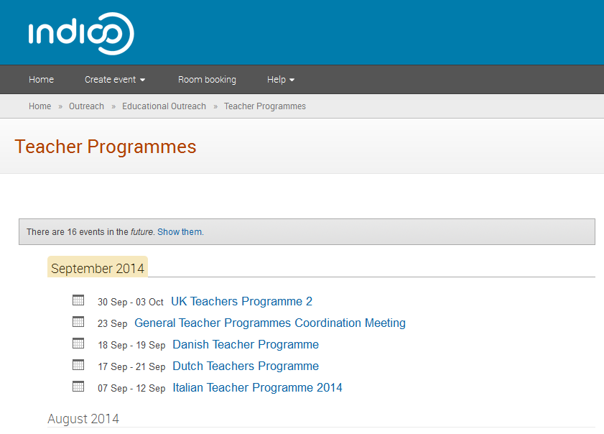
All Programmes and Material in InDiCo

Slide 14
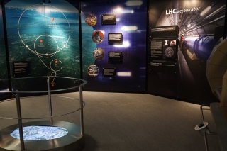
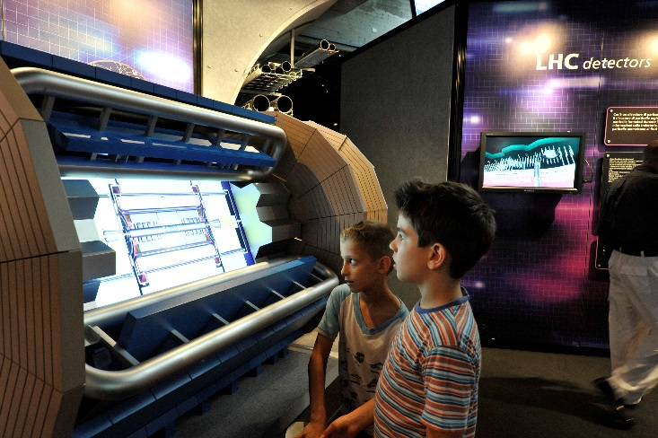
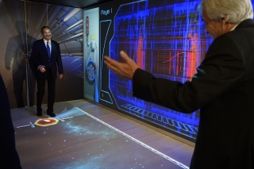
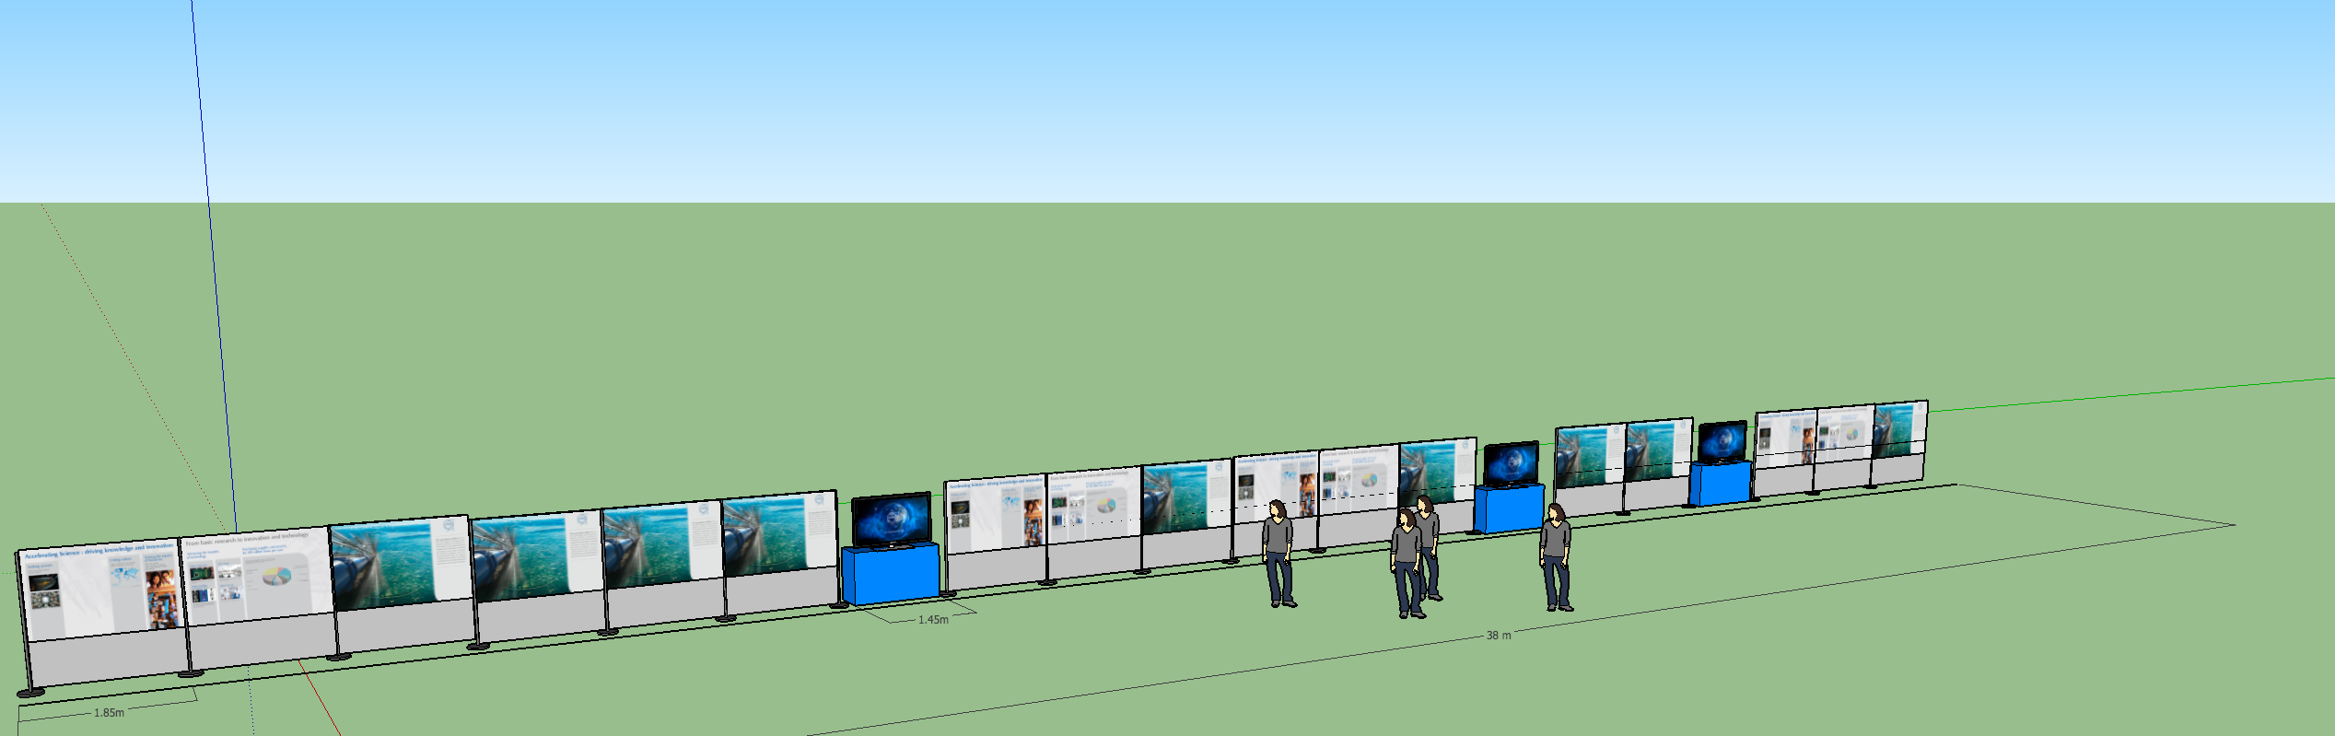
Travelling Exhibitions
CERN currently provides three different formats of travelling exhibitions
  “Accelerating Science” – a large travelling exhibition
  “CERN in Images” – a medium size exhibition
  “Interactive LHC Tunnel” – an outreach tool

Slide 15
Education Research
Small research group working on several projects for modern physics in classrooms:
  adaptation of Masterclasses for high schools
  teaching cosmic ray physics
  teaching cosmology
  teaching particle physics to 12-year-olds
  experiments on modern physics

Slide 16
CERN’s
School-lab

Slide 17
Experiments
Particle Acceleration
Electron Tube
Superconductivity
Basic Principles
Radioactivity
Hall Effect
Particle Detection
Cloud Chamber
Specific Charge of the Electron
Paul Trap
Spinthariscope
Franck-Hertz Experiment
Planck’s Constant
Rutherford Experiment
X-Rays
MediPix
COSmic Muon Observer
« KamioKanne »
γ−γ Coincidence

