Slide 1
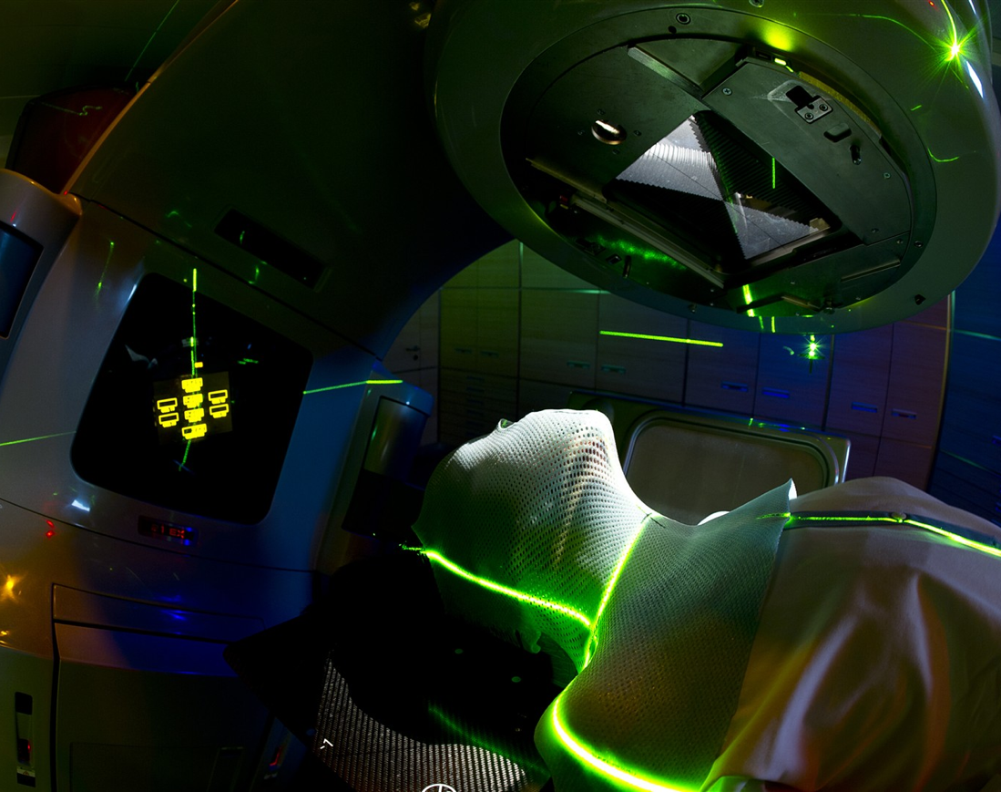
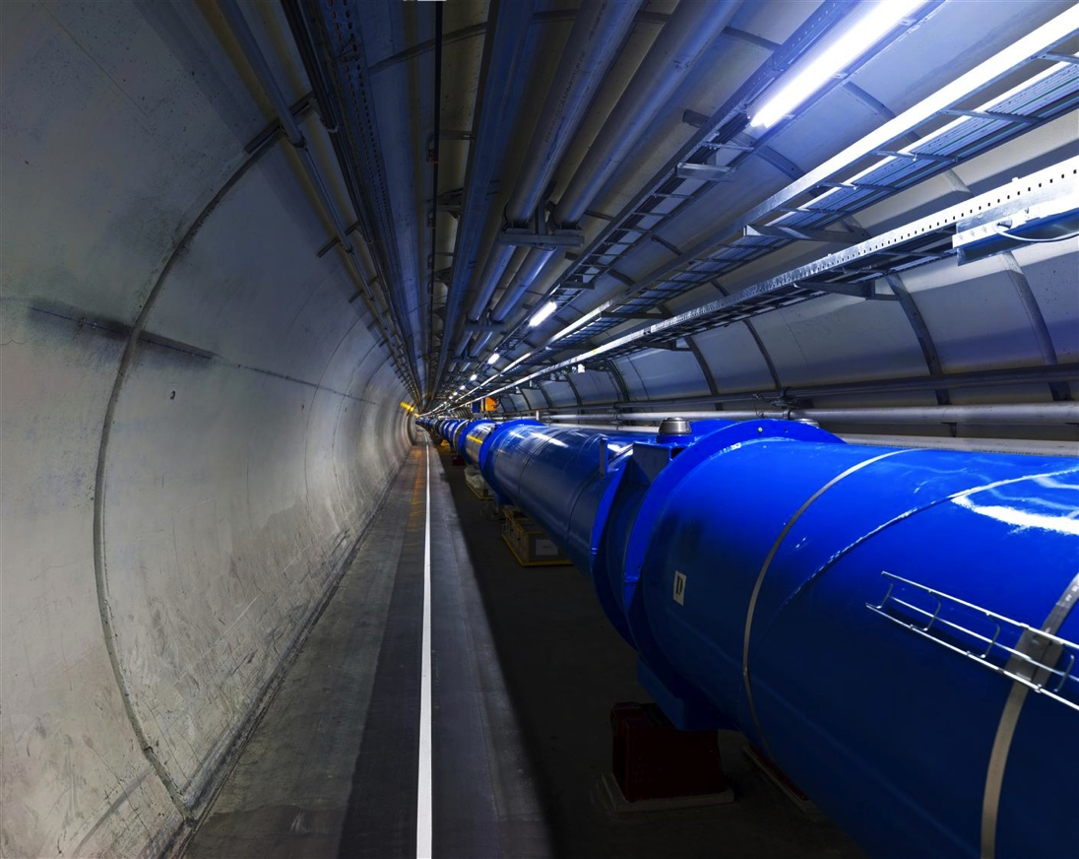
CERN Medical Applications
Michael Campbell

Slide 2
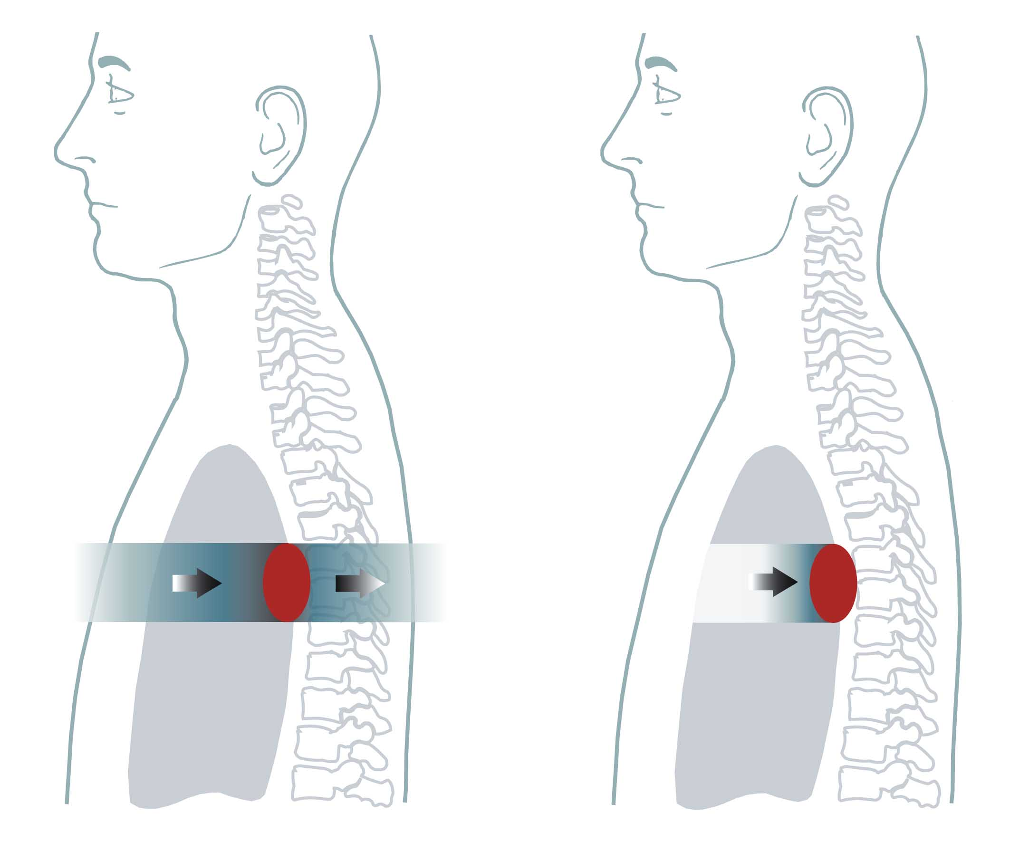
HADRON THERAPY
X rays
Protons
Image courtesy MedAustron

Slide 3
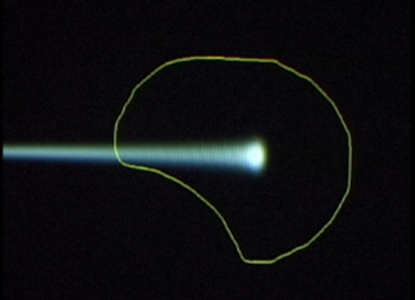
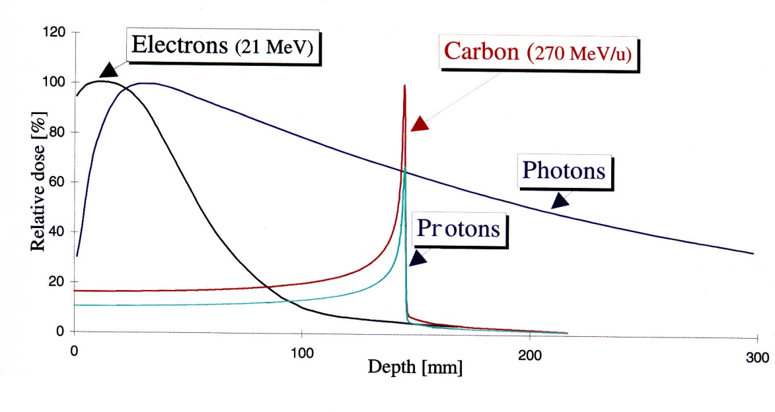
Why Hadron Therapy?
The physics properties of light ions (Bragg) may make them much more efficient in treating some kinds of tumours
Tumours close to critical organs
Tumours in children
Radio-resistant tumours

Slide 4
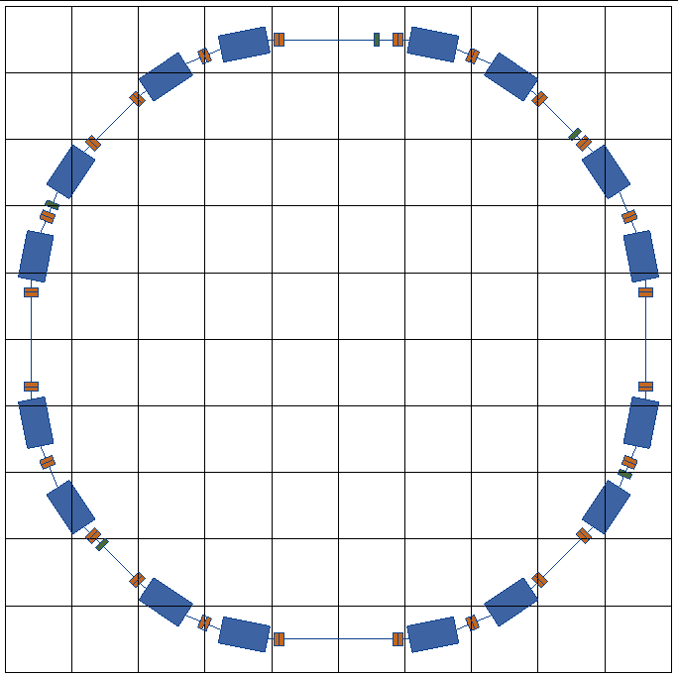



1996-2000
PIMMS study
at CERN

Slide 5
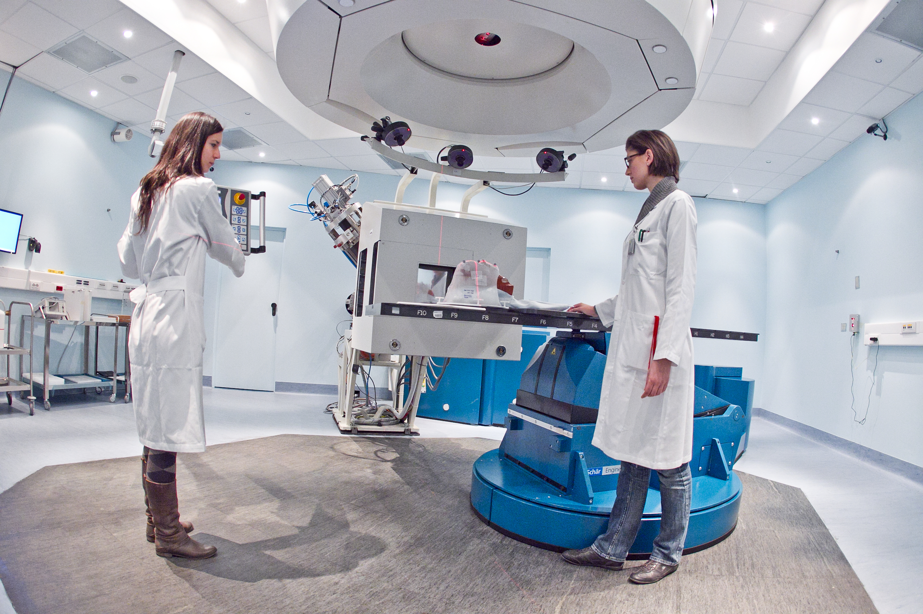
CNAO-PAVIA
1st patient: 2011

Slide 6
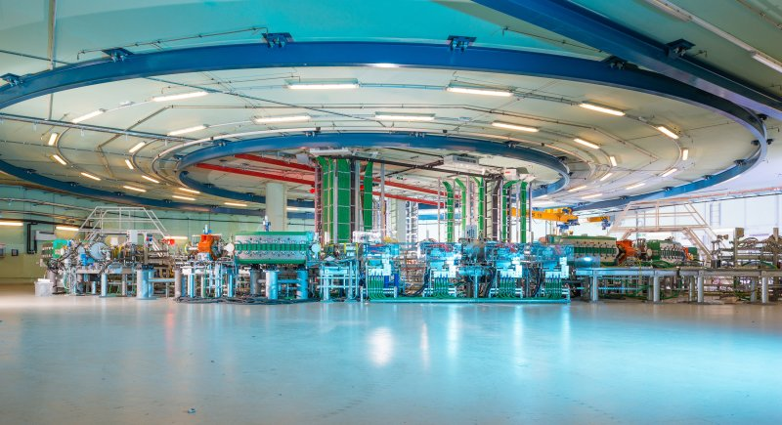
MedAustron – Wiener Neustadt
Start treatments in 2016

Slide 7
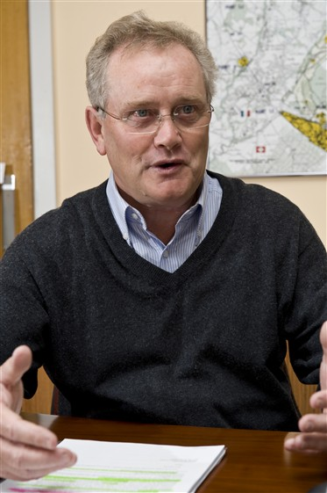
CERN Medical Applications Office
January 2014: establishment of the CMA Office led by Steve Myers
CERN to become established as an important facilitator of medical physics in Europe
Bring all the diverse medical physics activities at CERN together under a single umbrella , ensuring that our efforts are optimised

Slide 8

An aerial view of the CERN accelerator complex

Slide 9
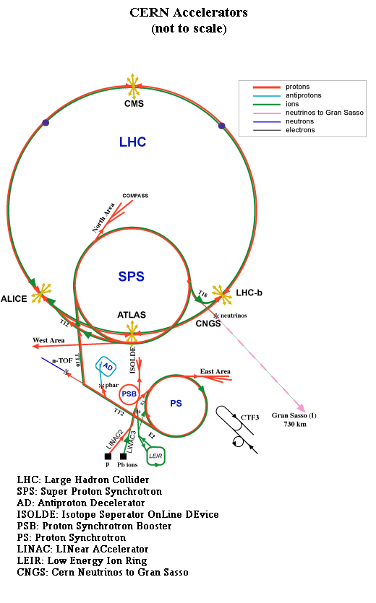
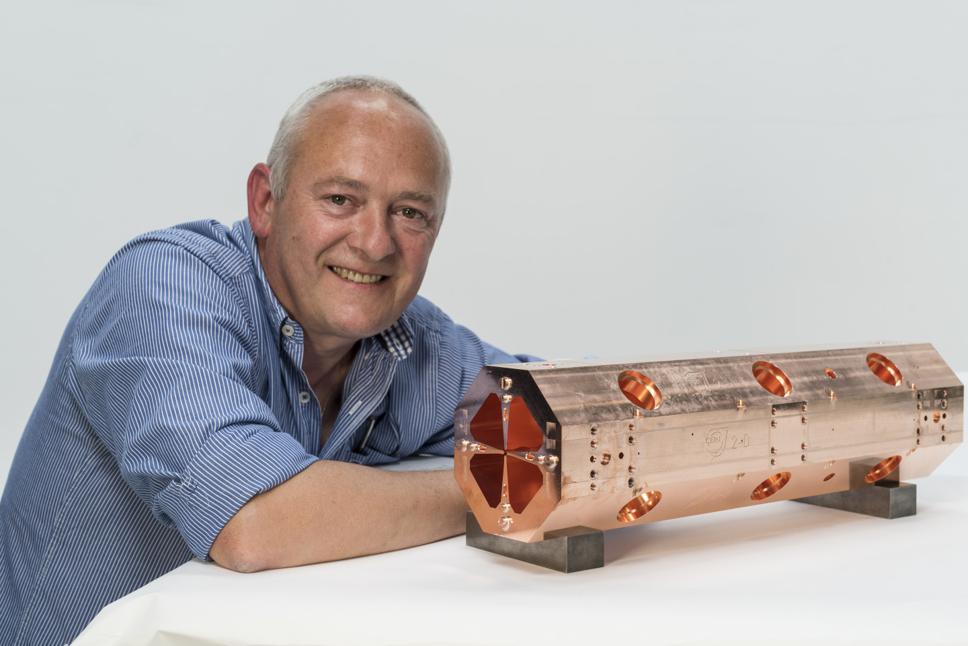
Details of the CERN accelerator complex
  CERN aims to coordinate an international collaboration to design a new compact, cost-effective accelerator facility, using the most advanced technologies
Notes:
Some background info:
• formerly: LEAR - Low Energy Antiproton Ring
• now (for LHC): LEIR - Low Energy Ion Ring
– Desired luminosity for LHC lead experiments 10^{27}cm^{-2}s^{-1} requires ~7\cdot10^{7} ions /bunch at 2.7 TeV/u within normalised emittances smaller 1.5\mu m .[Chanel2002]
– intensity/emittance ratio achievable via PS and Booster falls short of LHC specifications by factor ~30
– LEIR uses accumulation and phase space cooling to transform a series of long (~200\mu s ), low-intensity ion pulses from Linac 3 into short (\sim200 ns ), high-intensity bunches.
• Why LEIR?
– Only used during LHC ion programme (xxx weeks / year ? + commissioning)
– Would not impact on other CERN programs... no other machines required
– Energy reach of LEIR is appropriate for radiobiological experiments

Slide 10
Details of the CERN accelerator complex
LEIR (Low Energy Ion Ring)
  accumulator for LHC ion programme (lead ions)
  only used for several weeks / year
Plan to establish facility (OPENMED) for
  Test-bed for medical instrumentation
  Diagnostics and dosimetry
  radiobiology
  basic physics studies such as fragmentation of ion beams
Notes:
Some background info:
• formerly: LEAR - Low Energy Antiproton Ring
Size of C ion facility (used only 1 month per year at present)
• now (for LHC): LEIR - Low Energy Ion Ring
– Desired luminosity for LHC lead experiments 10^{27}cm^{-2}s^{-1} requires ~7\cdot10^{7} ions /bunch at 2.7 TeV/u within normalised emittances smaller 1.5\mu m .[Chanel2002]
– intensity/emittance ratio achievable via PS and Booster falls short of LHC specifications by factor ~30
– LEIR uses accumulation and phase space cooling to transform a series of long (~200\mu s ), low-intensity ion pulses from Linac 3 into short (\sim200 ns ), high-intensity bunches.
• Why LEIR?
– Only used during LHC ion programme (xxx weeks / year ? + commissioning)
– Would not impact on other CERN programs... no other machines required
– Energy reach of LEIR is appropriate for radiobiological experiments

Slide 11
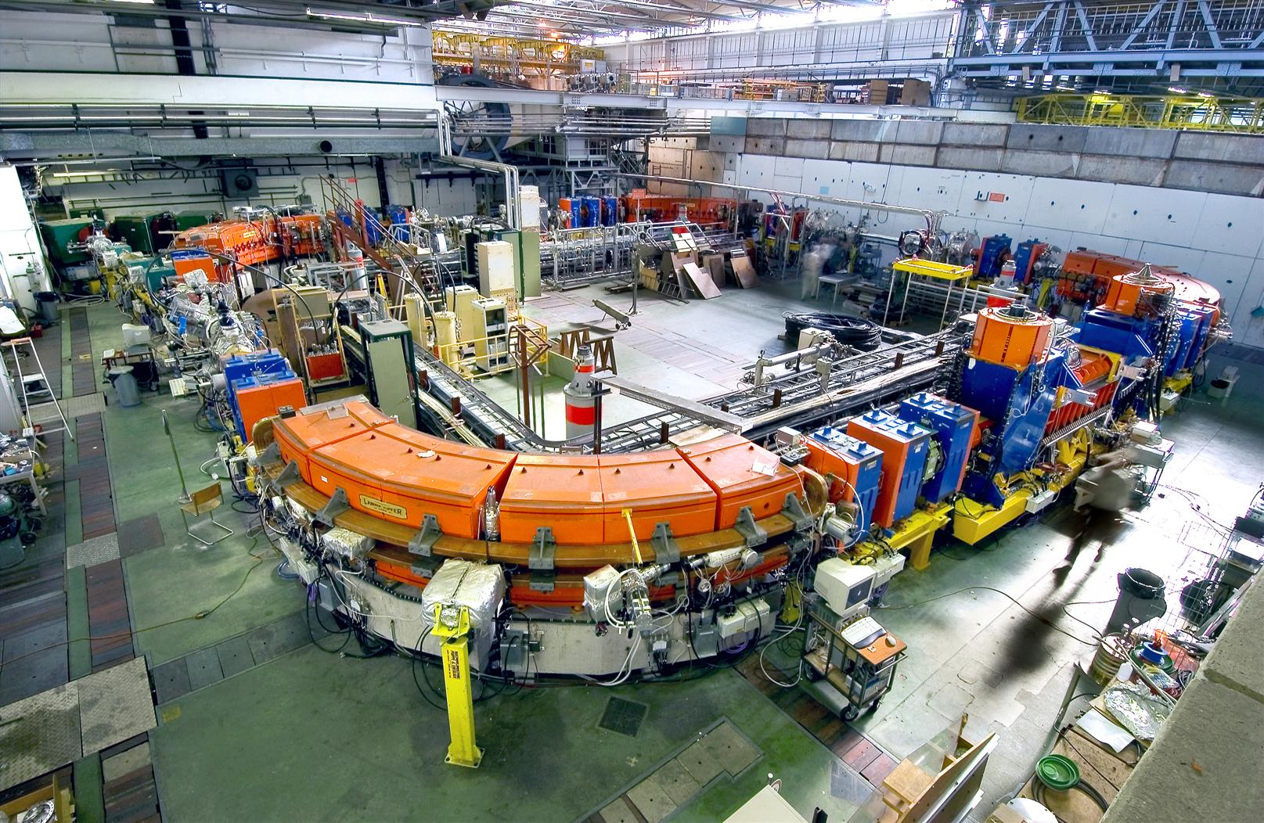
OPENMED - LEIR
Ion beams for biomedical research

Slide 12
Details of the CERN accelerator complex
  ISOLDE has been producing radio isotopes in many flavours for 40 years already
  CERN-MEDICIS will use a dedicated beam line from ISOLDE with the aim of researching novel radio-isotopes for medical diagnostics and treatment
Notes:
Some background info:
• formerly: LEAR - Low Energy Antiproton Ring
• now (for LHC): LEIR - Low Energy Ion Ring
– Desired luminosity for LHC lead experiments 10^{27}cm^{-2}s^{-1} requires ~7\cdot10^{7} ions /bunch at 2.7 TeV/u within normalised emittances smaller 1.5\mu m .[Chanel2002]
– intensity/emittance ratio achievable via PS and Booster falls short of LHC specifications by factor ~30
– LEIR uses accumulation and phase space cooling to transform a series of long (~200\mu s ), low-intensity ion pulses from Linac 3 into short (\sim200 ns ), high-intensity bunches.
• Why LEIR?
– Only used during LHC ion programme (xxx weeks / year ? + commissioning)
– Would not impact on other CERN programs... no other machines required
– Energy reach of LEIR is appropriate for radiobiological experiments

Slide 13
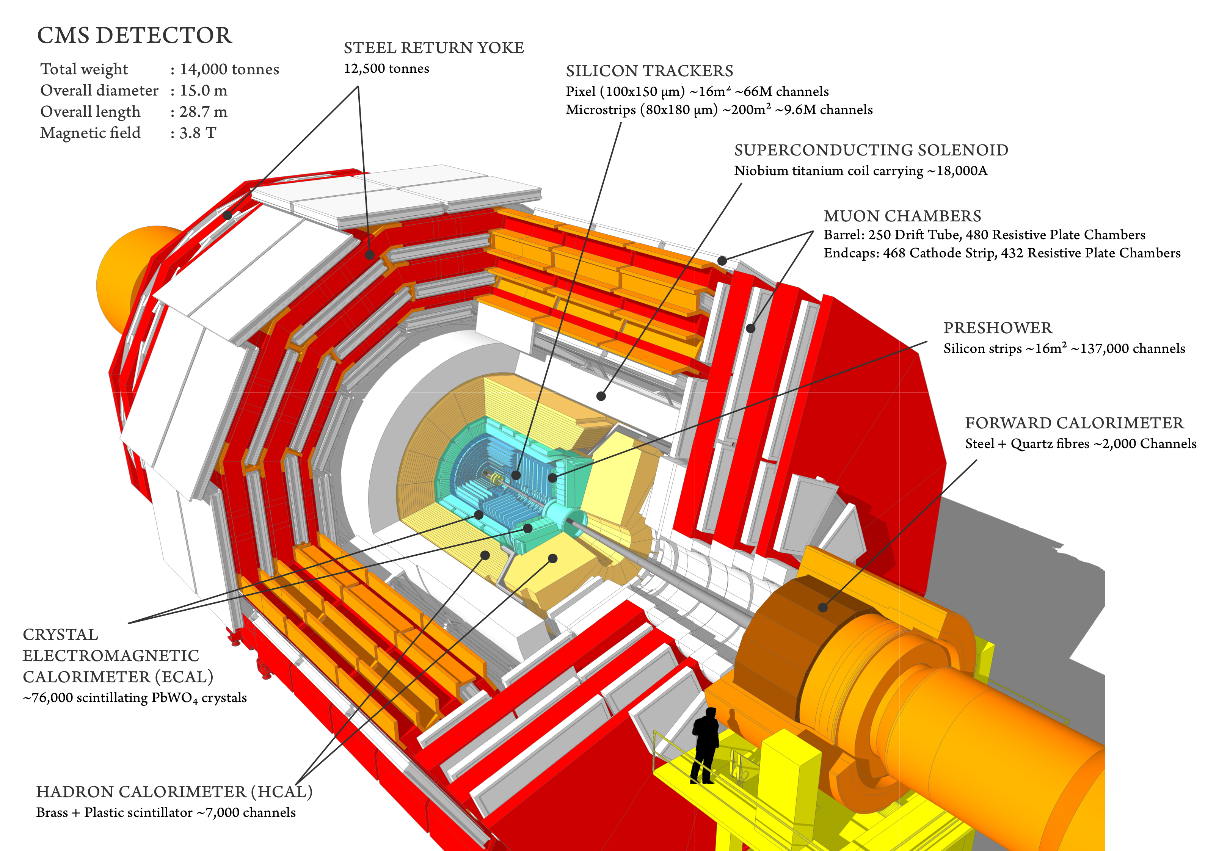
CERN Detector technologies

Slide 14
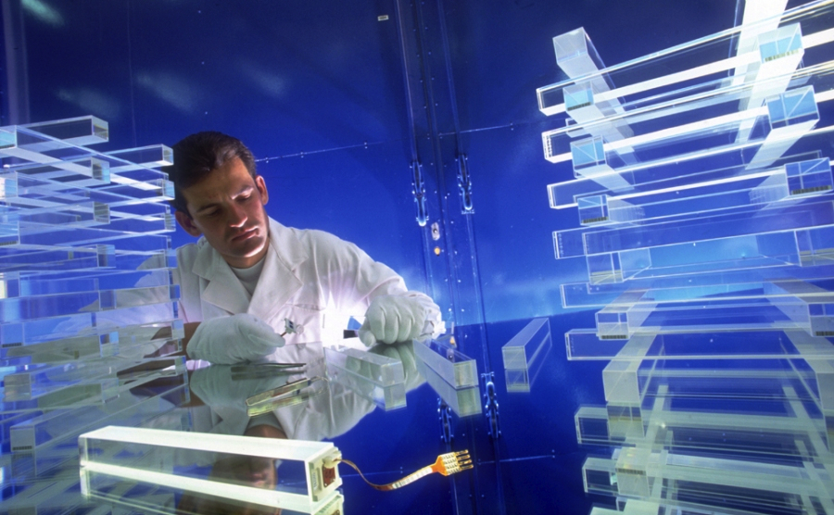
SCINTILLATING CRYSTALS
Photos: CERN

Slide 15
PET systems derived from CMS crysatl work (Crystal Clear Collaboration)
Since 1996: ClearPET: PET for small animal imaging
Since 2001: ClearPEM: PET dedicated to breast imaging
Since 2010: EndTOFPET: Endoscopic PET for pancreatic and prostate cancer

Slide 16
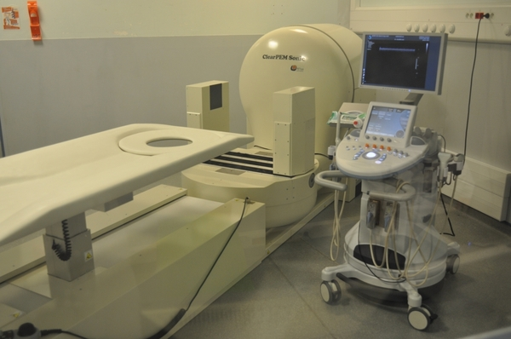
ClearPEM – Positron Emission Tomography for Mammography
Photos: Crystal Clear Cololaboration

Slide 17
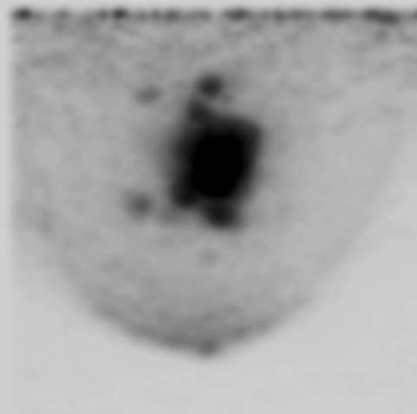

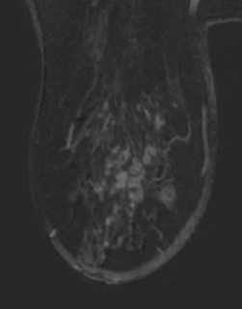
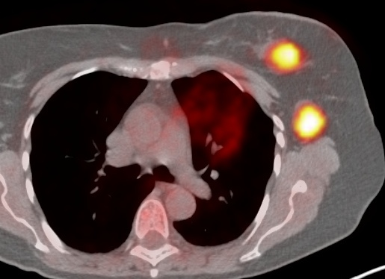
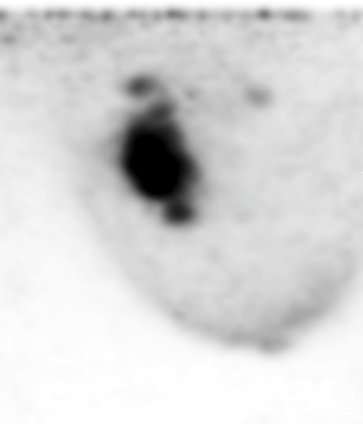
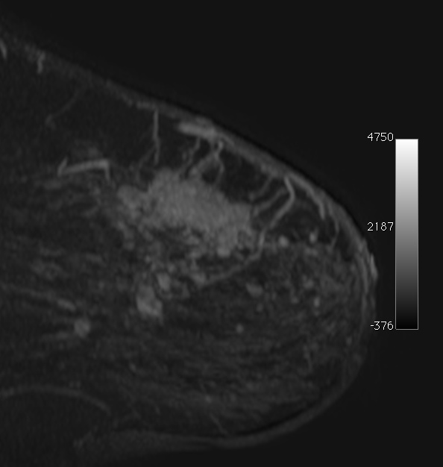
ClearPEM – First images
MRI
CLEARPEM
Axial
view
Sagittal
view
Full body PET
M. Pizzichemi on behalf of ClearPEmsonic collaboration
CHEF2013 conference, Paris April 2013

Slide 18
CERN Detector technologies (contd.)

Slide 19
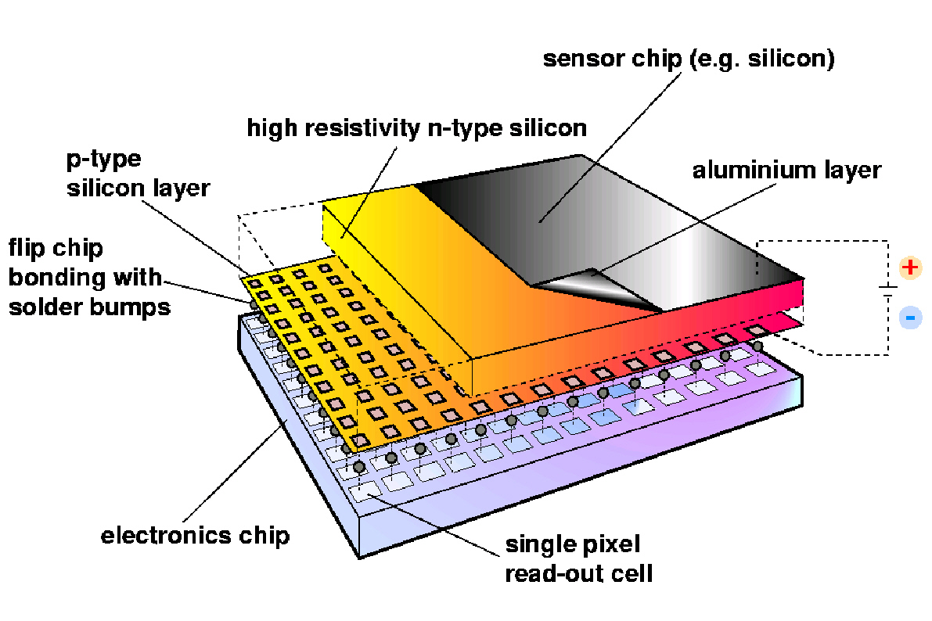
Medipix - Hybrid pixel detectors
Developed initially for LHC:
3 large scale vertex detector systems operating smoothly
One large RICH detector system (based on hybrid pixels in a photodetector tube) contributing to LHCb physics
In the Medipix2 and Medipix3 Collaborations we have taken the technology into many new fields
Medipix2 – single photon counting
Timepix – energy measurements at low rate
Medipix3 – Energy measurements at high rate with good energy resolution
Timepix3 – Data driven readout containing both energy and time stamp information
Notes:
The chips in the Medipix family are Hybrid Pixel Detector Readout chips.
This is a drawing of a hybrid pixel detector. It consists of a segmented semiconductor detector connected to a readout chip implemented in a standard CMOS process.
The fact that sensor and readout electronics are separated means that you can optimize them separately for a given application.
The small input capacitance of the readout electronics allows optimal signal to noise ratio at high rates.
Why to use hybrid pixels?
Any CMOS commercial process can be used
􀂋􀂋 The detector can be optimised for application
􀂄 Si, thin EPI or 3D Si
􀂄 GaAs, CdTe for mammography etc..
􀂋􀂋 Sometimes no sensor is used
􀂄 Gas gain grid for gas detector readout
􀂄 Micro channel plate
􀂋􀂋 Optimal signal to noise at high rates – essential for
clean pattern recognition in complicated high energy
physics events

Slide 20

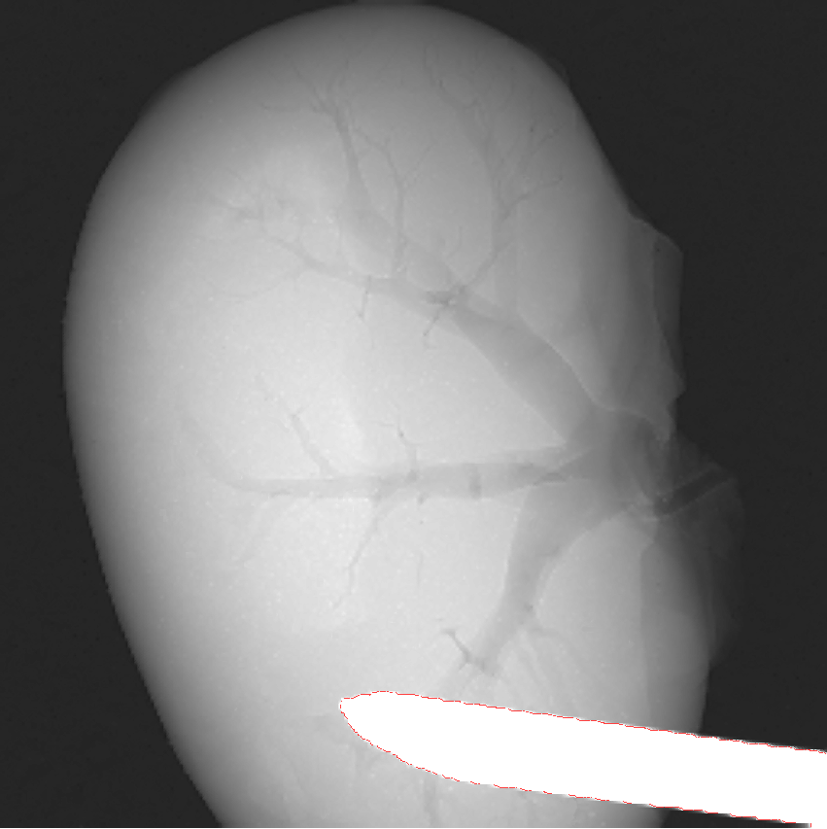
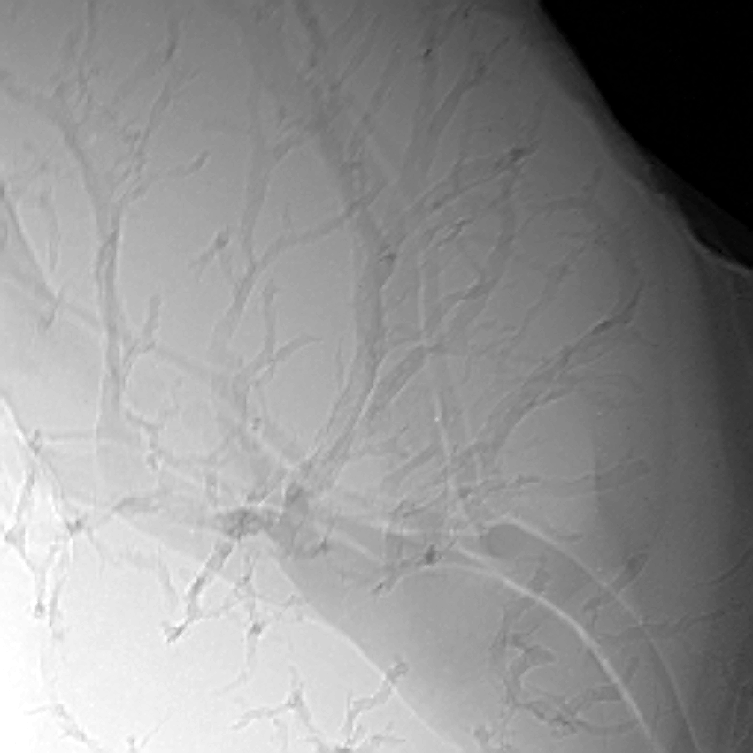
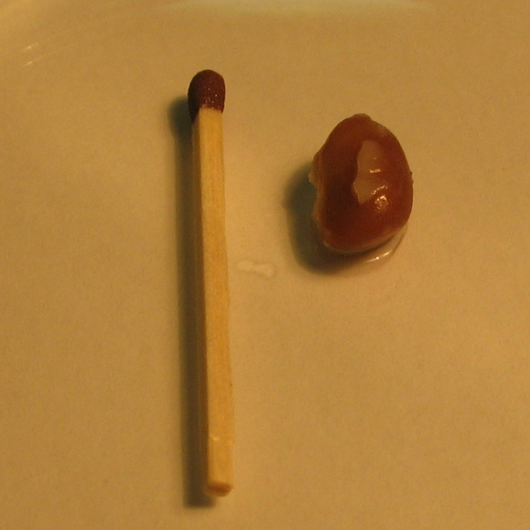
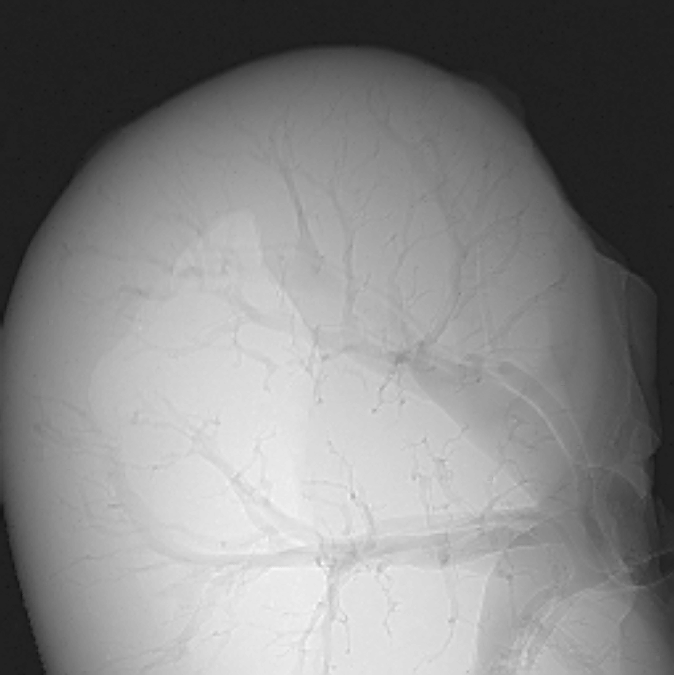
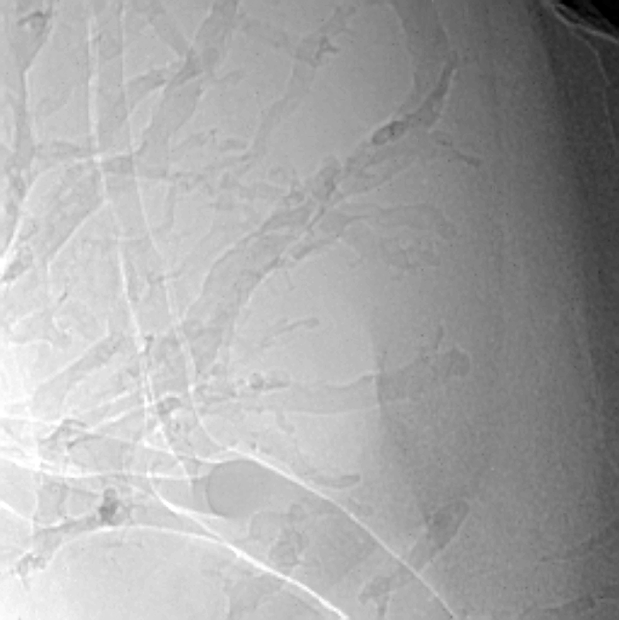
High resolution X-ray imaging using a micro-focus X-ray source(2)
Edges are enhanced
by phase contrast effect
Needle holding the sample
J. Jakubek et al.
Notes:
Next, we used the detector medipix for imaging of animal tissue. In this picture we concentrated (konsentreit) on mouse kidneys. We were looking for presence of tumors in mouse kydney. The first picture presents the kidney without tumor cells. Also you can see different magnification. We clearly observe (ebzerv) the inside structure of kidney.

Slide 21
Medical Applications of Spectroscopic X-ray Detectors
A series of 3 workshops hosted by CERN (2011, 2013, 2015)
Representatives of 4 major equipment suppliers (GE, Philips, Siemens, Toshiba)
Invitation only and focused of applications made possible by spectroscopic X-ray detection
  Better usage of a given dose
  Attenuation of beam hardening artifacts
  Functional imaging using biomarkers in X-ray CT

Slide 22
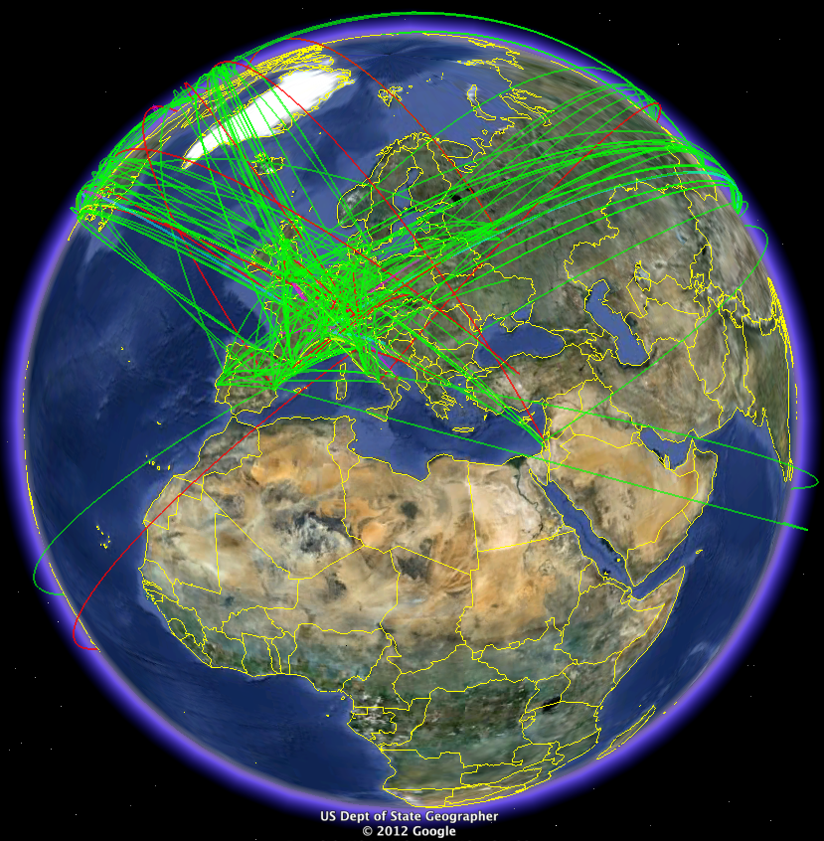
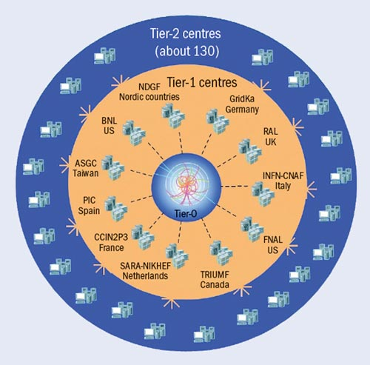
The Worldwide LHC Computing Grid
Tier-0 (CERN): data recording, reconstruction and distribution
nearly 160 sites,
35 countries
~250’000 cores
Tier-1: permanent storage, re-processing,
analysis
173 PB of storage
> 2 million jobs/day
Tier-2: Simulation,
end-user analysis
10 Gb links
WLCG:
An International collaboration to distribute and analyse LHC data
Integrates computer centres worldwide that provide computing and storage resource into a single infrastructure accessible by all LHC physicists

Slide 23
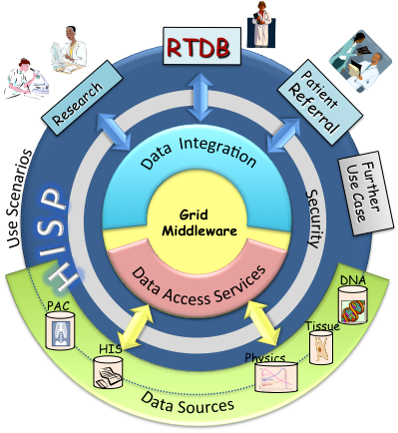
HISP
grid computing for hadron therapy
Notes:
HardonTherapy Information Sharing Platform
Part of PARTNER EU project

Slide 24
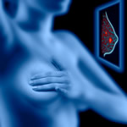
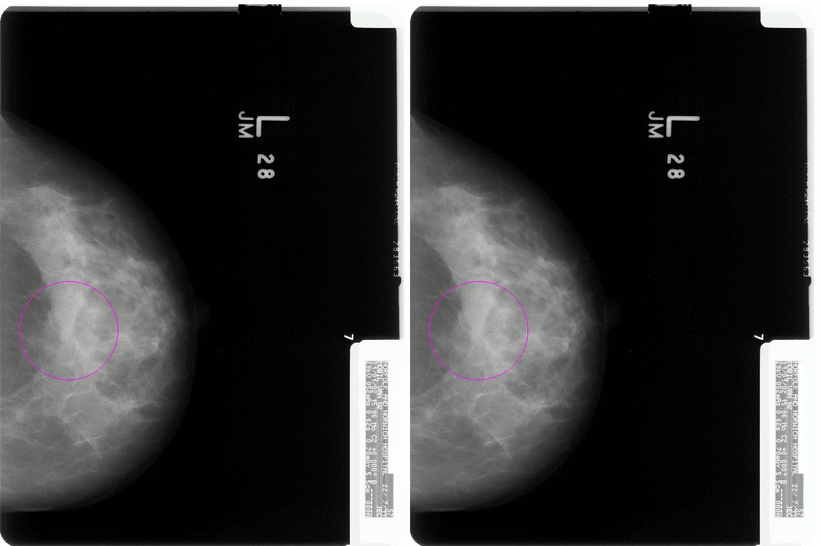
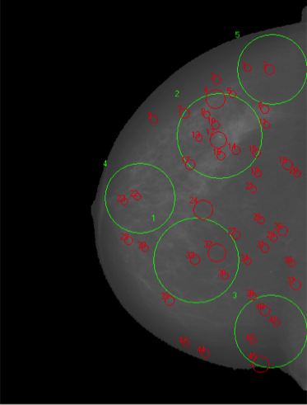
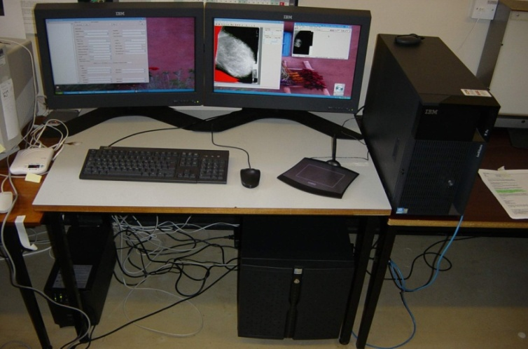
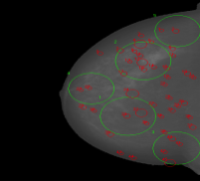
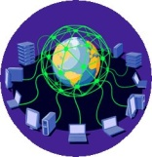
MAMMOGRID
Second Opinion
Cancer Screening
Education and Training
Reference Database / Repository
Oncology
Breast Cancer (micro-calcifications and masses)
From: David MANSET, CEO MAAT France, www.maat-g.com
Notes:
Datbase of mammographies for training doctors etc

Slide 25
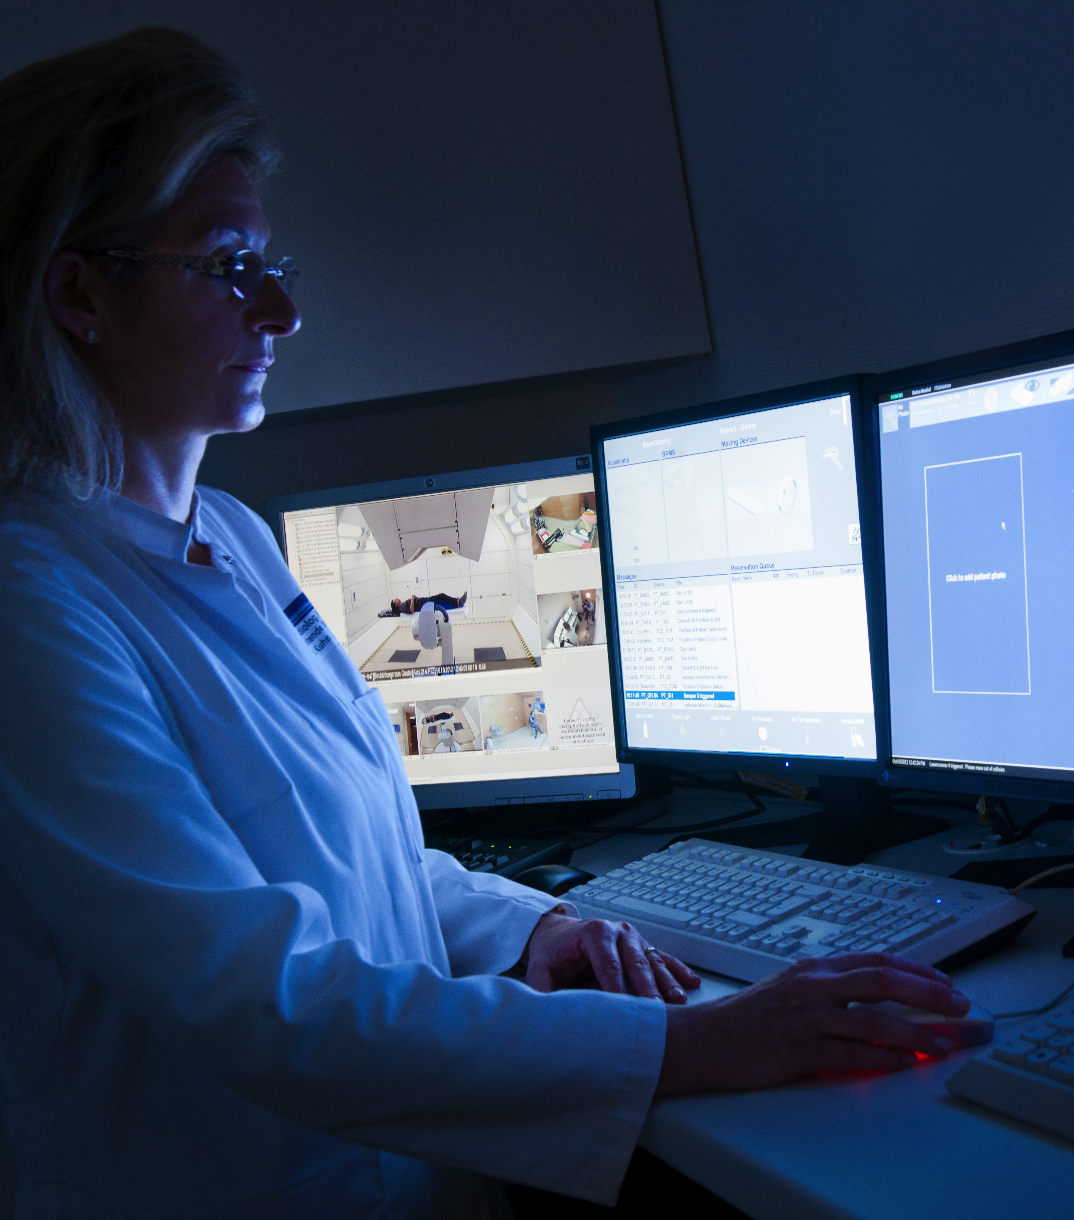
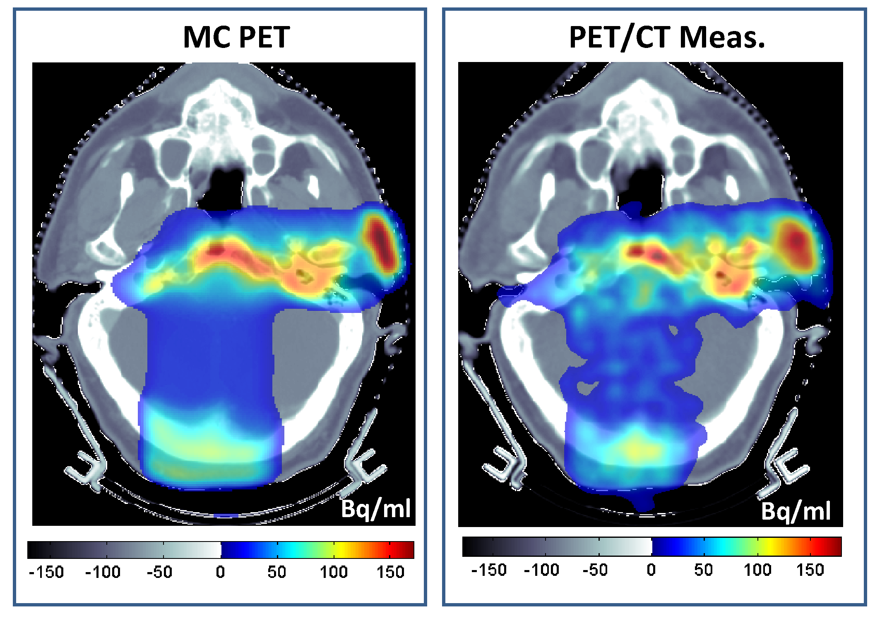
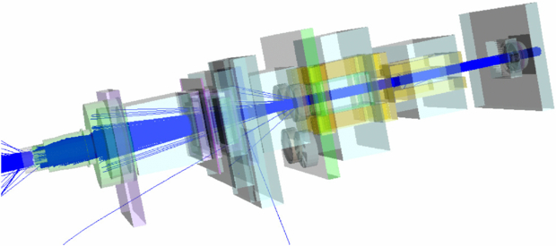
COMPUTER SIMULATIONS

Slide 26
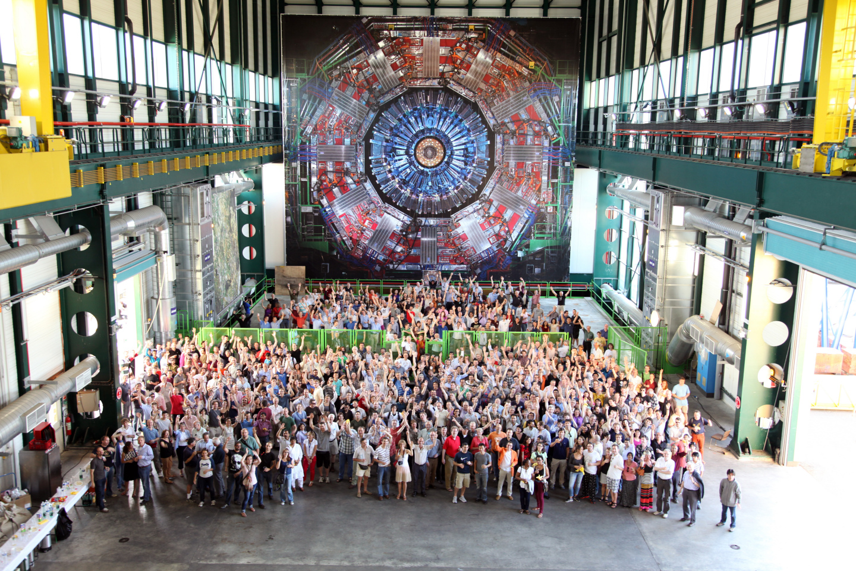
THE 4th PILLAR
Collaboration

Slide 27
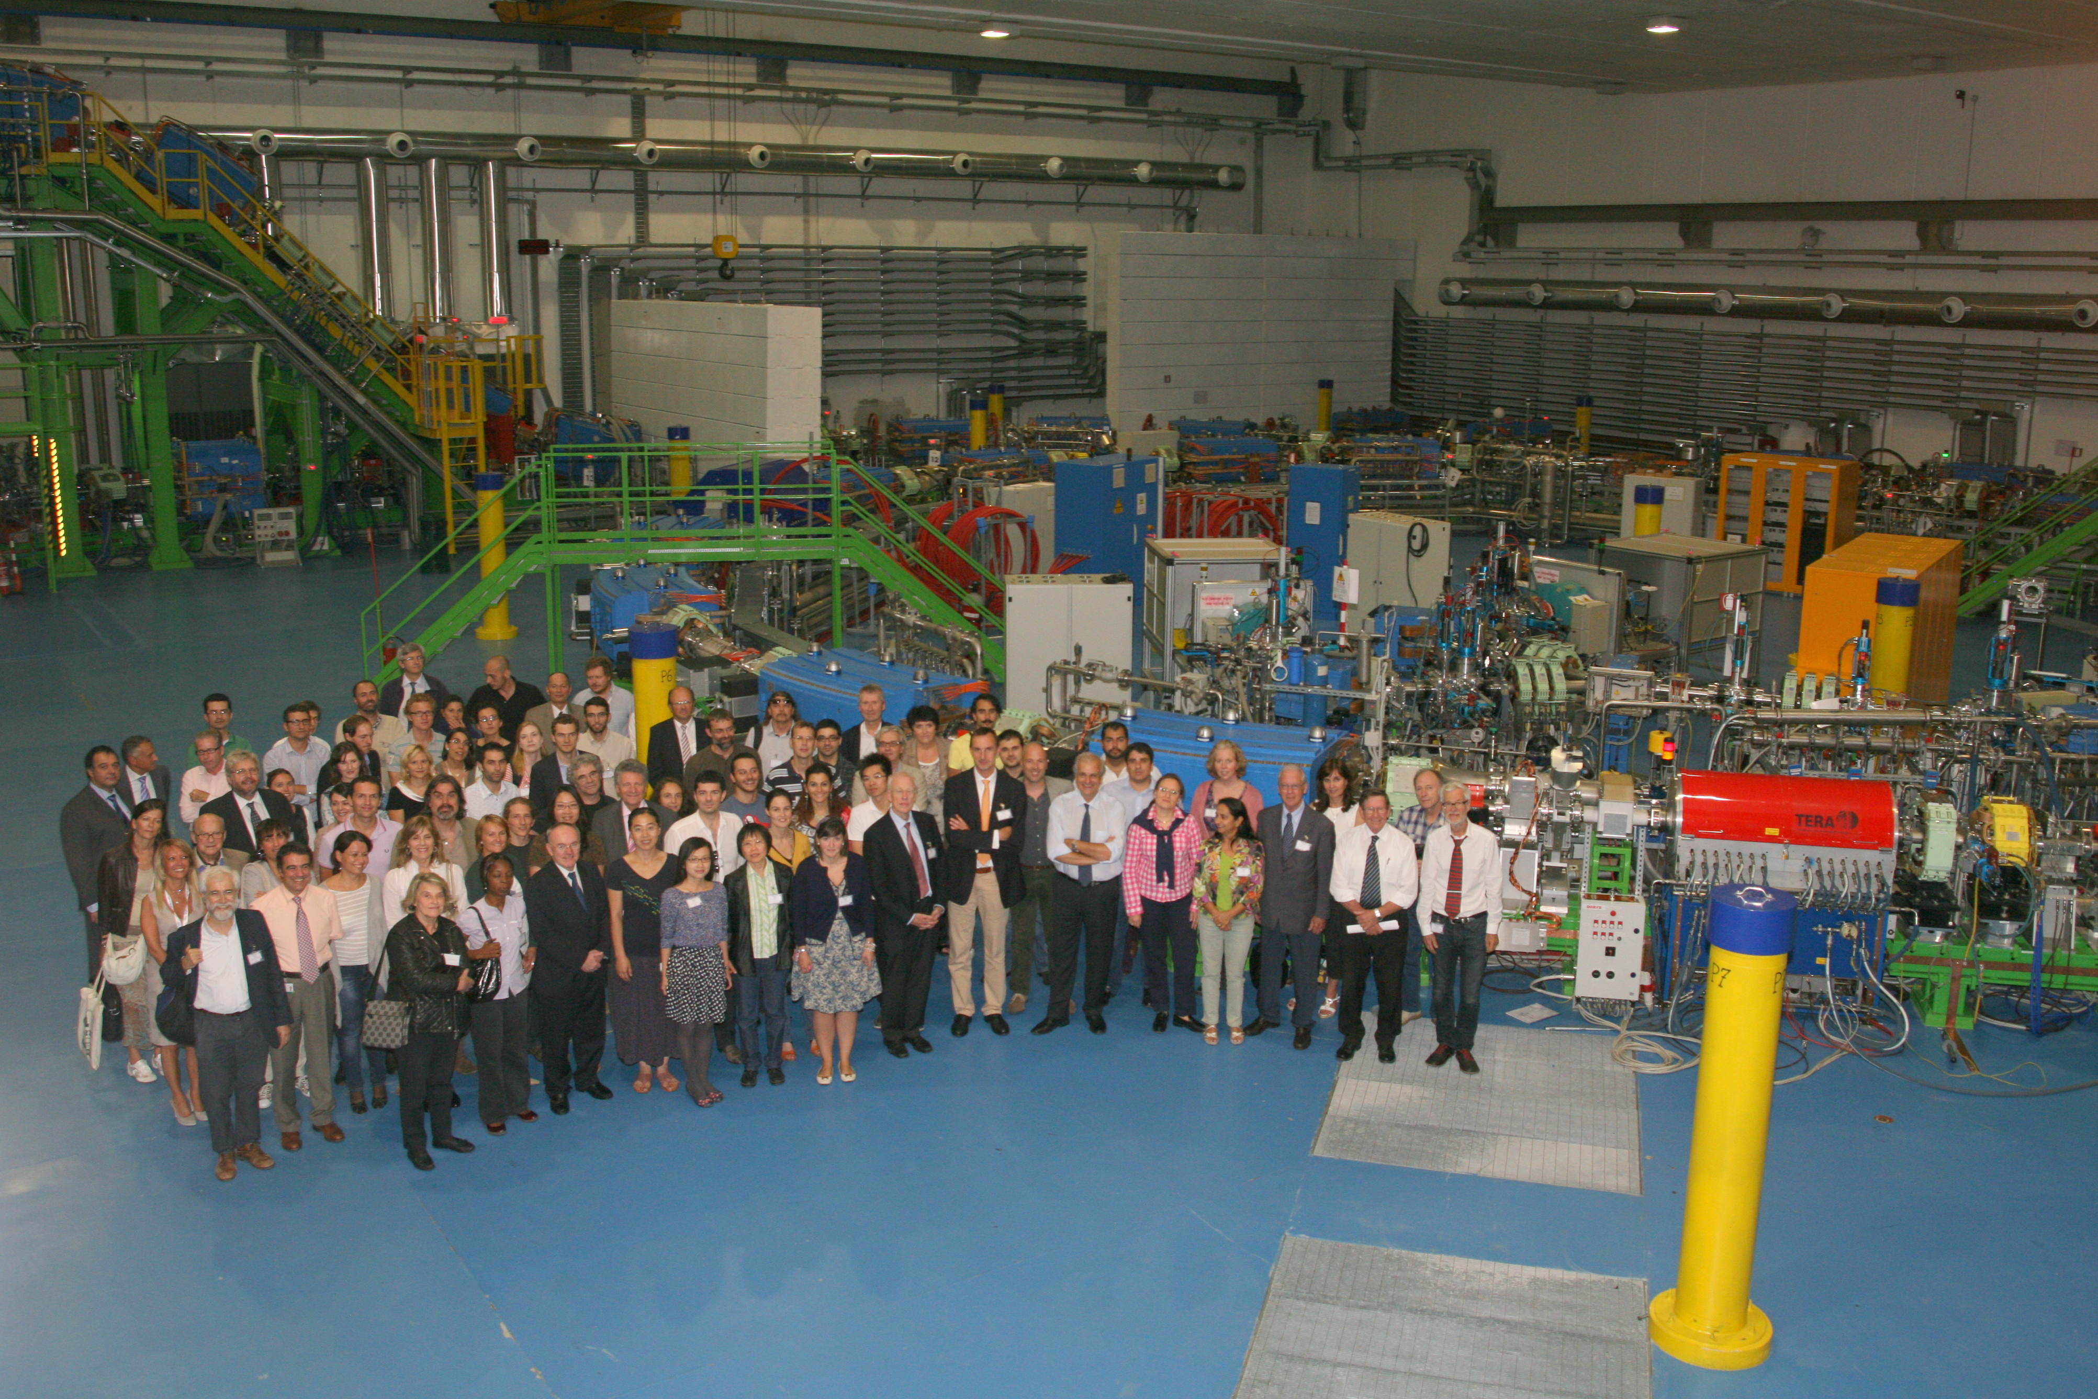
ENLIGHT
A network for hadron therapy

Slide 28

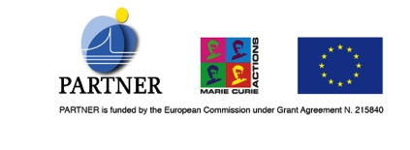
Multidisciplinary training
Image guided hadron therapy and PET prototype
to optimize patient treatment
Radiobiology
to elucidate the underlying biology and improve treatment
Novel accelerator and gantry studies
to design and develop cost effective technologies
PARTNER
trainings, collaborations, exchanging ideas and data
Clinical studies and epidemiology
to investigate the clinical outcome of hadron therapy
Simulations, dosimetry and treatment planning
to measure and simulate physical quantities
Information and communication technologies and networking
towards a prototype GRID

Slide 29
CMA Initiatives: Where are we?
Obtained some “seed” funding from CERN, as well as donations from outside
“CERN Medical Applications Workshop” followed the ICTR-PHE (15-16 February, 2014)
Attracted ~80 top experts from all over the globe
Funding, governance,… “institute or..”
International Strategy Committee (First Meeting Nov 2014, second April 2015)
CERN as a medical data repository (HUG, EPFL, CHUV, NCI)
Radio-isotopes project well under way
A “White” paper well under way
HF-RFQ (750MHz) development

