Slide 2
CERN IT Activities
Ian Bird
IT Department & WLCG Project Leader
Visit of Rector of Vilnius University
8th July 2015

Slide 3
IT Organisation 2015
Director of Research
and
Computing
Sergio Bertolucci
CERN openlab
Alberto Di Meglio
Department Head
Frédéric Hemmer
CERN School of Computing
Alberto Pace
Deputy Head
David Foster
Planning Officer
Christian Isnard
Externally Funded Projects
Bob Jones
WLCG
Ian Bird
Computer Security
Stefan Lüders
Department Heads Office (DHO)
Comms Systems
(CS)
Tony Cass
Platform & Engineering Services
(PES)
Helge Meinhard
Database Services
(DB)
Eric Grancher
Collaboration
& Information
Services
(CIS)
Tim Smith
Departmental Infrastructure
(DI)
Christian Isnard
Computing Facilities
(CF)
Wayne Salter
Data & Storage Services
(DSS)
Alberto Pace
Operating Systems & Infrastructure
Services
(OIS)
Tim Bell
Support for Distributed Computing
(SDC)
Markus Schulz

Slide 4
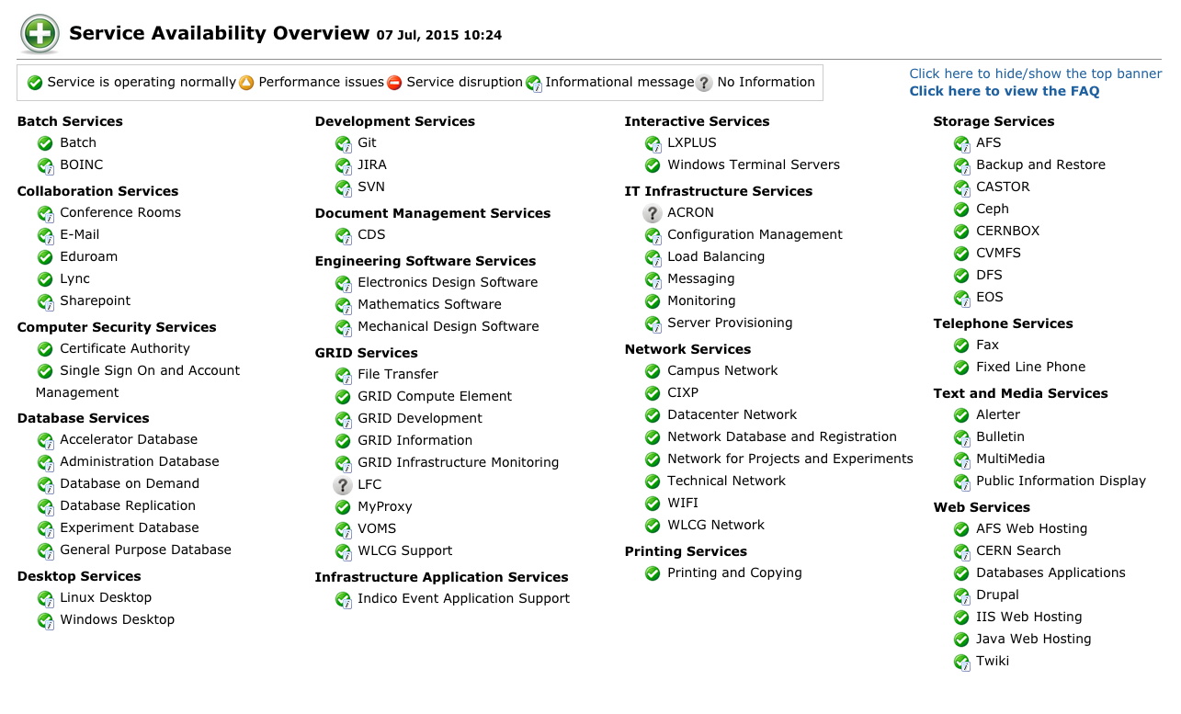

Slide 5
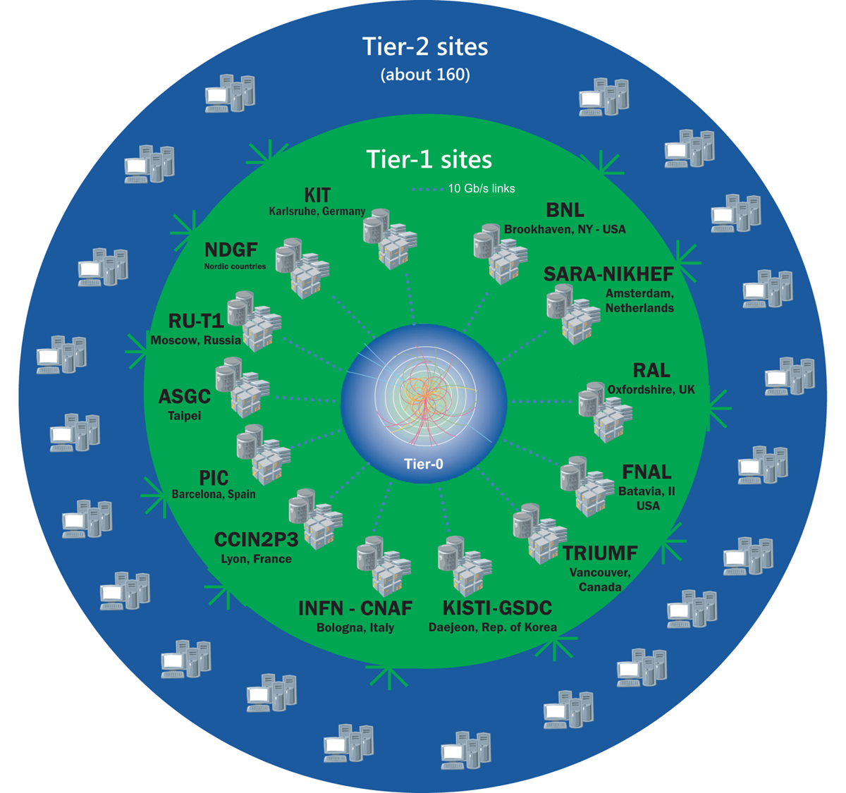
The Worldwide LHC Computing Grid
Tier-0 (CERN): data recording, reconstruction and distribution
nearly 170 sites,
40 countries
~350’000 cores
Tier-1:
permanent storage, re-processing,
analysis
500 PB of storage
> 2 million jobs/day
Tier-2:
Simulation,
end-user analysis
10-100 Gb links
WLCG:
An International collaboration to distribute and analyse LHC data
Integrates computer centres worldwide that provide computing and storage resource into a single infrastructure accessible by all LHC physicists

Slide 6
CERN Data Centres

Slide 7
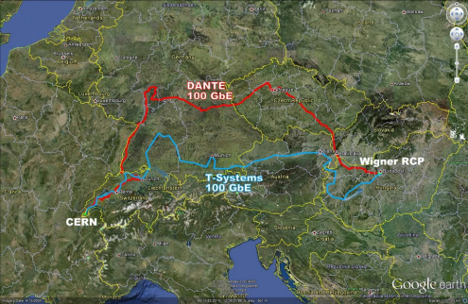
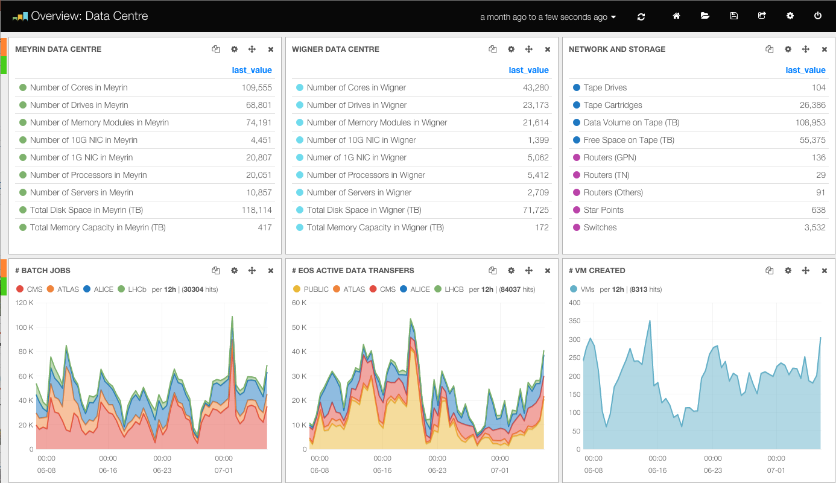
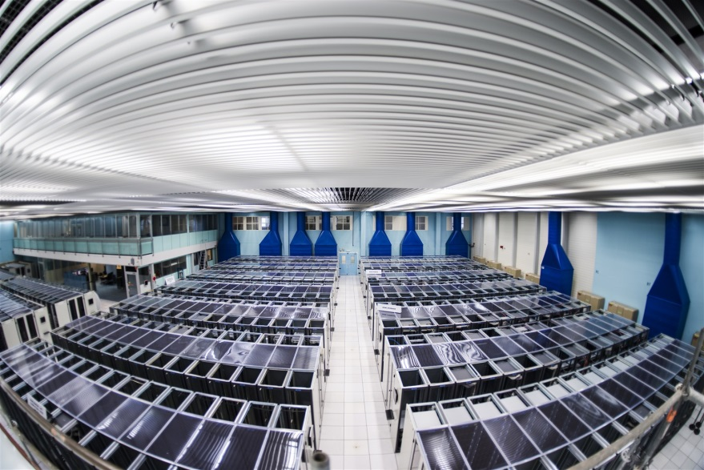
CERN Computer Centre
LHC Computing Grid Tier0
Key numbers
3.5 MW for equipment in Meyrin (CH)
2.7 MW for equipment at Wigner (Hu)
2x100Gb links (21 and 24 ms RTT)

Slide 8
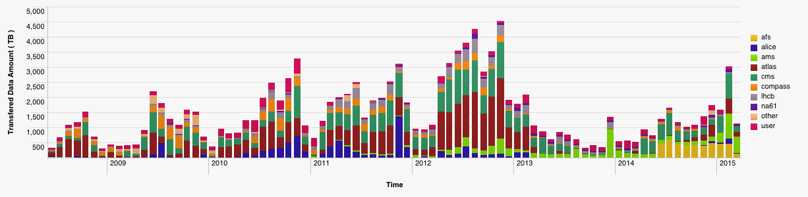
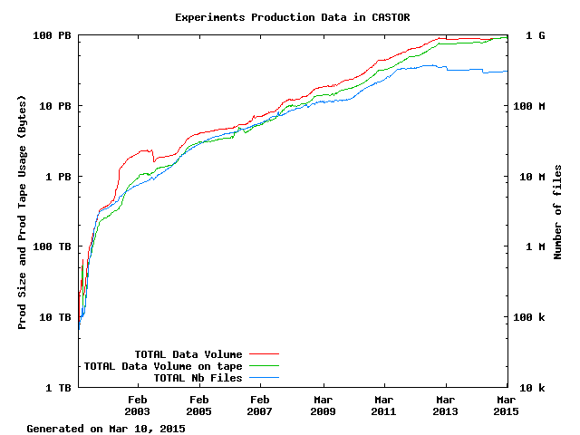
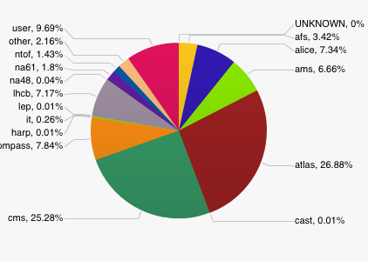
Scale of data today …
CERN New data
27 PB
Data:
~105 PB physics
data (CASTOR)
~7 PB backup (TSM)
Tape libraries:
IBM TS3500 (5)
Oracle SL8500 (4)
Tape drives:
~100 archive
Capacity:
~70 000 slots
~25 000 tapes
15 PB
23 PB
CERN Archive
>100 PB
1 billion files

Slide 9
CERN Data
Scientific data
  Large data sets (~1 PB/week during LHC running)
  Long (infinite) retention period
  High concurrency (1 LHC experiments: few 10³ physicists)
  Completely distributed infrastructure
    Physicists at universities (o(100) institutes)
    LHC Computing Grid (o(100) centres 20% at CERN)
      Enabled by massive data transfers
  Sharing
    Distributed analysis teams of tens of physicists
Computer centre infrastructure
  IT services built on storage infrastructure
    Notably Zenodo
CASTOR
EOS
FTS
CERNBox

Slide 10
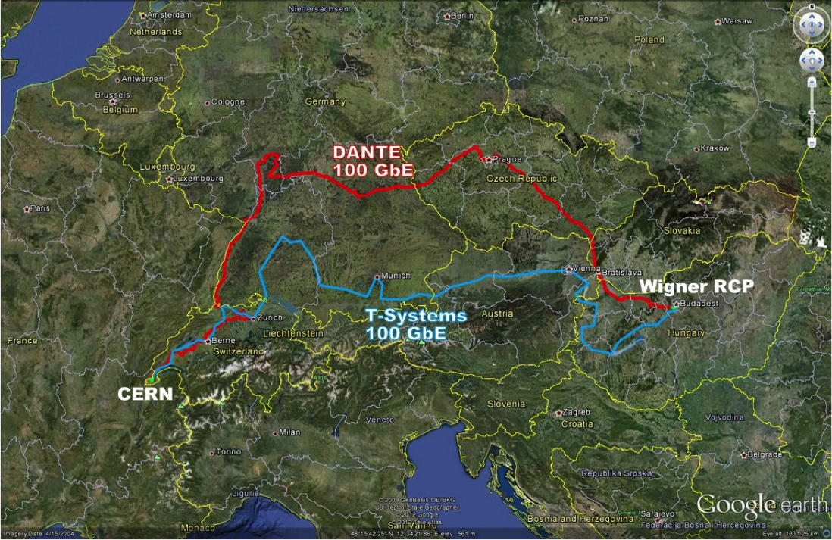
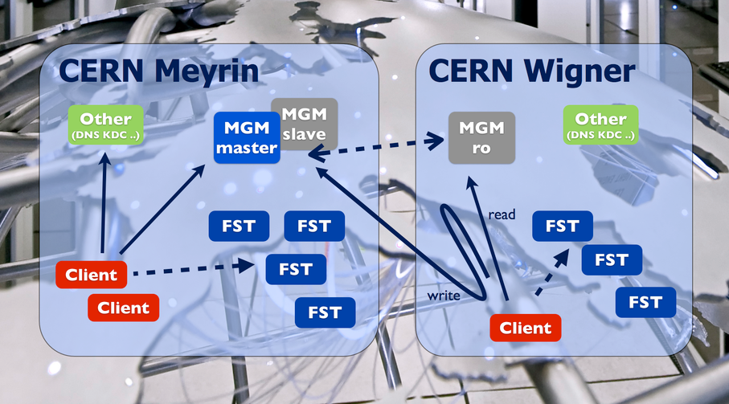
EOS: CERN Storage for LHC
MGM = File Catalogue (NameSpace/Metadata)
FST = Disk servers
140 PB disk space
35000 HD
1000 Nodes (FST)

Slide 11






EOS + CERNBox
Modern cloud storage interfaces
fused with Petabyte storage
fs
webdav
xroot
sync
share
mobile
web
EOS
ACLs
Namespace
Physical Storage

Slide 12
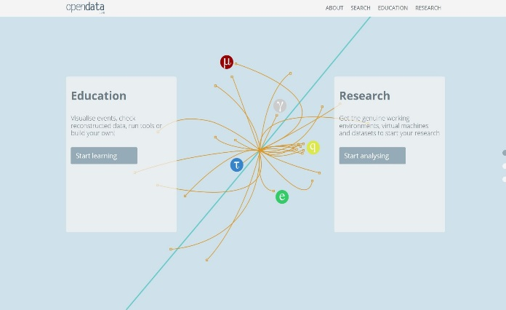
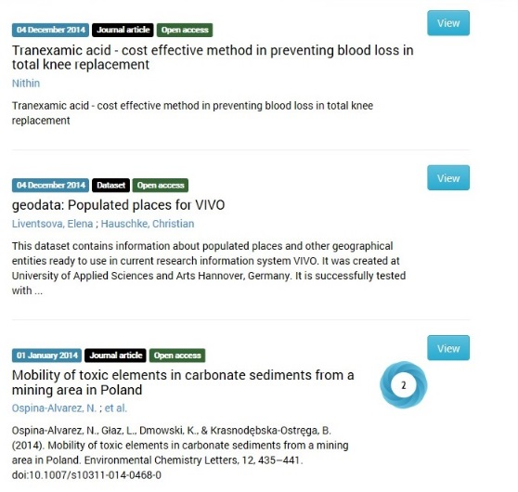
Open Data – Open Knowledge
CERN & the LHC experiments have made the first steps towards Open Data (http://opendata.cern.ch/)
  Key drivers: Educational Outreach & Reproducibility
  Increasingly required by Funding Agencies
  Paving the way for Open Knowledge as envisioned by DPHEP (http://dphep.org)¹
¹ICFA Study Group on Data Preservation and Long Term Analysis in High Energy Physics
CERN has released Zenodo, a platform for Open Data as a Service (http://zenodo.org)¹
  Building on experience of Digital Libraries & Extreme scale data management
  Targeted at the long tail of science
  Citable through DOIs, including the associated software
  Generated significant interest from open data publishers such as Wiley, Ubiquity, F1000, eLife, PLOS
¹Initially cofunded by the EC FP7 OpenAire series of projects

Slide 13



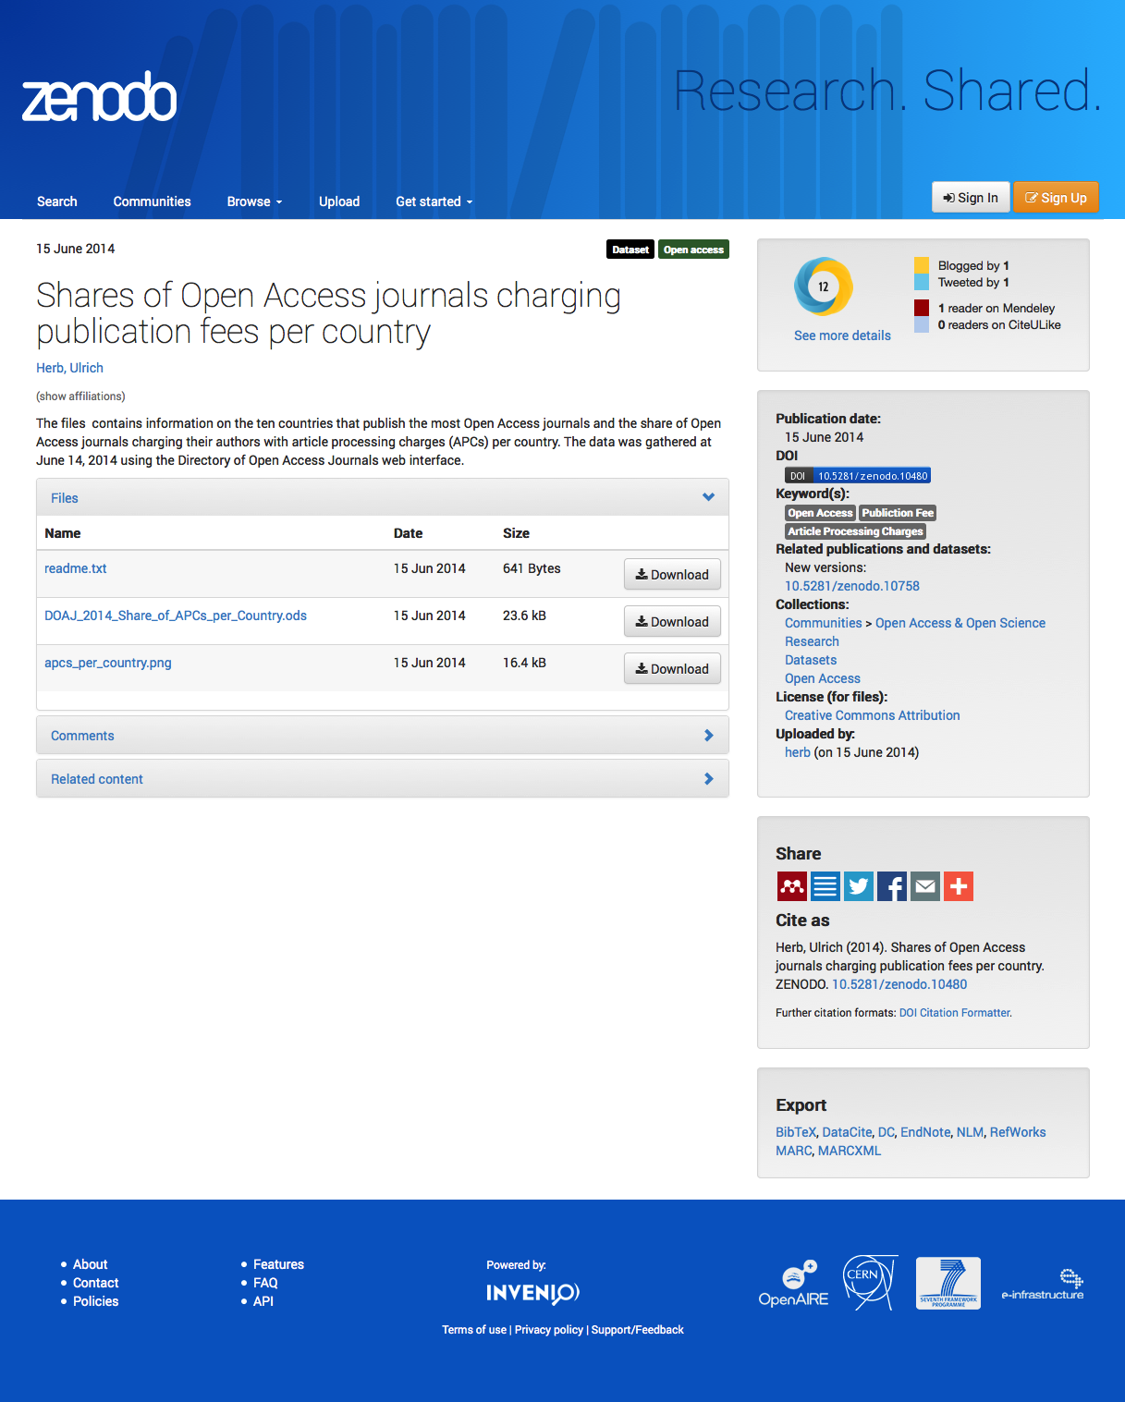





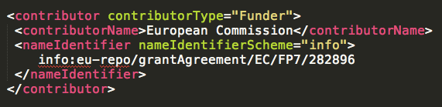


Open Data as a Service

Slide 14
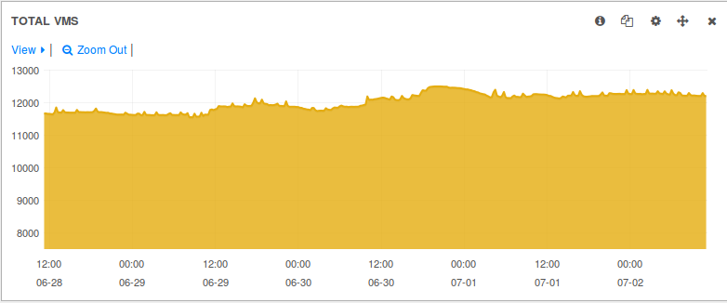
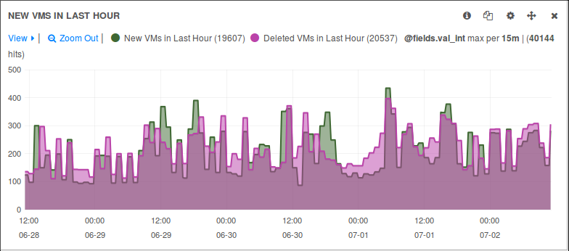
CERN Private Cloud
Based on OpenStack Juno
Spans between 2 datacentres
~5000 hypervisors
  ~120000 cores
12000 VMs
1500 users
1800 projects

Slide 15

Database on Demand (DBoD)
Users can request and manage different database instances
  MySQL, PostgreSQL, Oracle
Users are provided with a self-service portal
  Ease of administration, Integrated backup & recovery, Monitoring,
  One click patching
No access to underlying hardware
No database administration nor application support
  OS administration and service support is provided
https://twiki.cern.ch/twiki/bin/view/DB/DBOnDemand

Slide 16
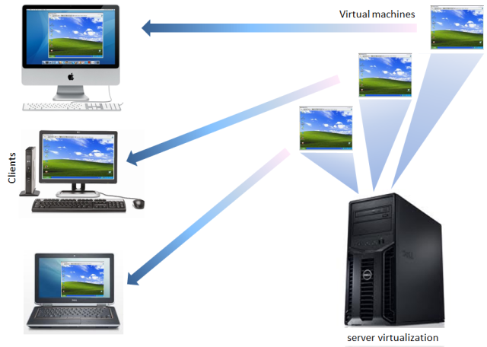

Self-Service Virtual Machines
CERN Private Cloud Service
  “Get your VM (Virtual Machine) in 15 minutes!”
Open to all CERN users
  Quota for 5 VMs, 10 cores, 50 GB volumes
  Shared project upon request
  Currently ~200 VMs owned by EN department users
IT-supported operating systems
  Windows 7, 8, Windows Server 2012 R2, 2008 R2,
  CentOS 7, SLC6, SLC5
  Possibility to upload user-supplied images
Go to http://openstack.cern.ch
  Subscribe to the service
  Link to the user guide
  Log on and enjoy!

Slide 17
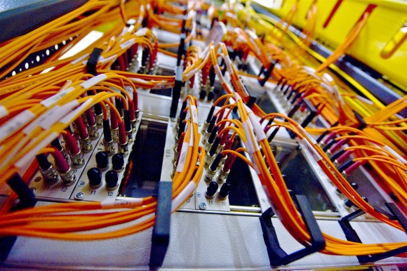
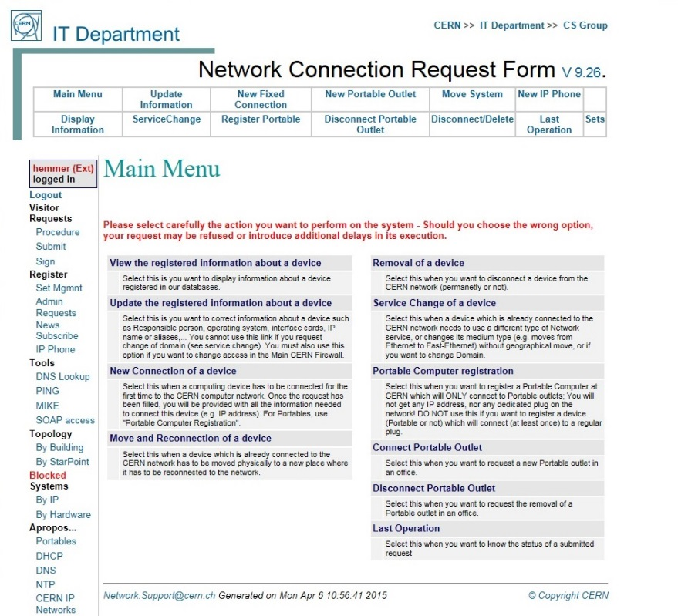
CERN Networks
Campus Network
  ~180,000 registered devices
  Servers, PCs, Macs, phones, tablets, …
  Structured Cabling: Over 65,536 UTP sockets
  Wi-Fi: ~1,600 access points, ~15,000 active devices per day
Technical and Experiment Networks
  Dedicated networks for safety, controls, cooling, electricity
  Filters access to/from the outside world
24x7 First line support through contractors
Significant investment in automation through custom developments
External Networking
  High speed links to Wigner Data Centre in Budapest, WLCG Tier-1 sites, Academic and Research networks, general Internet
  CERN Internet Exchange Point: ~40 companies interconnect at CERN
  (including K-Net)

Slide 18
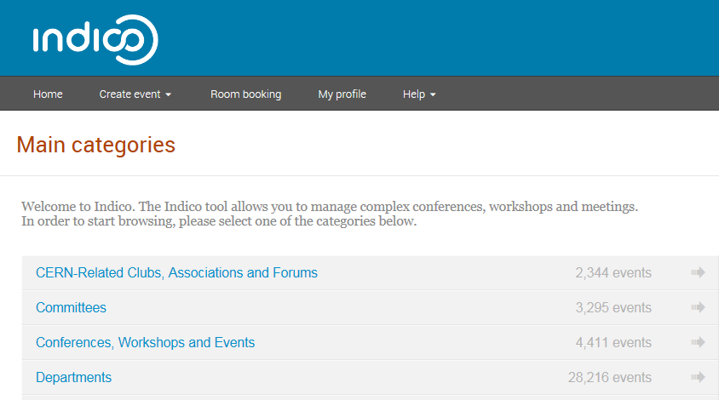
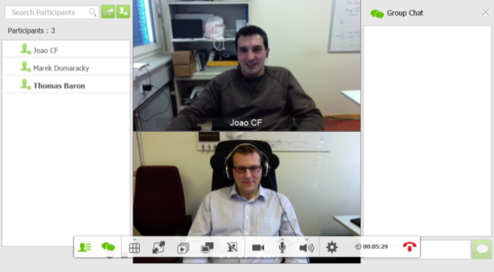
Meeting and Videoconferencing Tools
Indico (http://indico.cern.ch)
  Organise and manage meetings and conferences
  User interface and room booking improvements
  Collaboration services booking
    Vidyo for videoconferencing
    Webcast and recording services are possible for some meeting rooms
  Adopted by 0(100) institutes
  Investigating a global science service
Vidyo (http://cern.ch/vidyo)
  Universal videoconference system: from meeting rooms, desktops (windows, MacOS and linux), mobiles (Android and iOS), phones
  Request and access through Indico
  Replaced audio conferencing since Jan 2015
  Many improvements over the past year
    e.g. new user interface, improved muting capabilities
  Investigating a pan-european science service

Slide 19
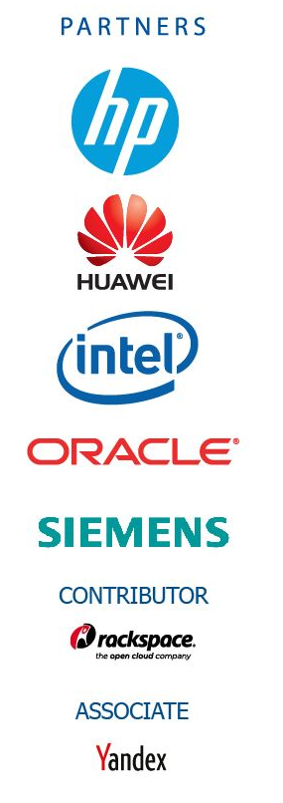
CERN openlab in a nutshell
A science – industry partnership to drive R&D and innovation with over a decade of success
Evaluate state-of-the-art technologies in a challenging environment and improve them
Test in a research environment today what will be used in many business sectors tomorrow
Train next generation of engineers/employees
Disseminate results and outreach to new audiences

Slide 20
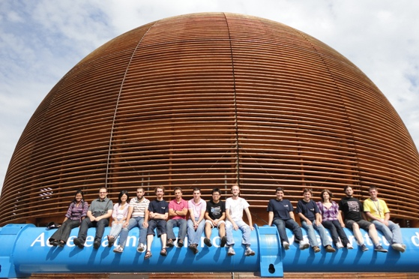
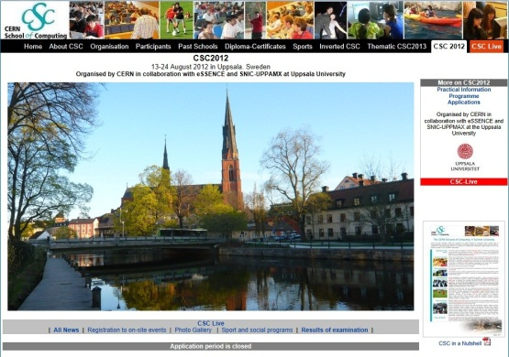
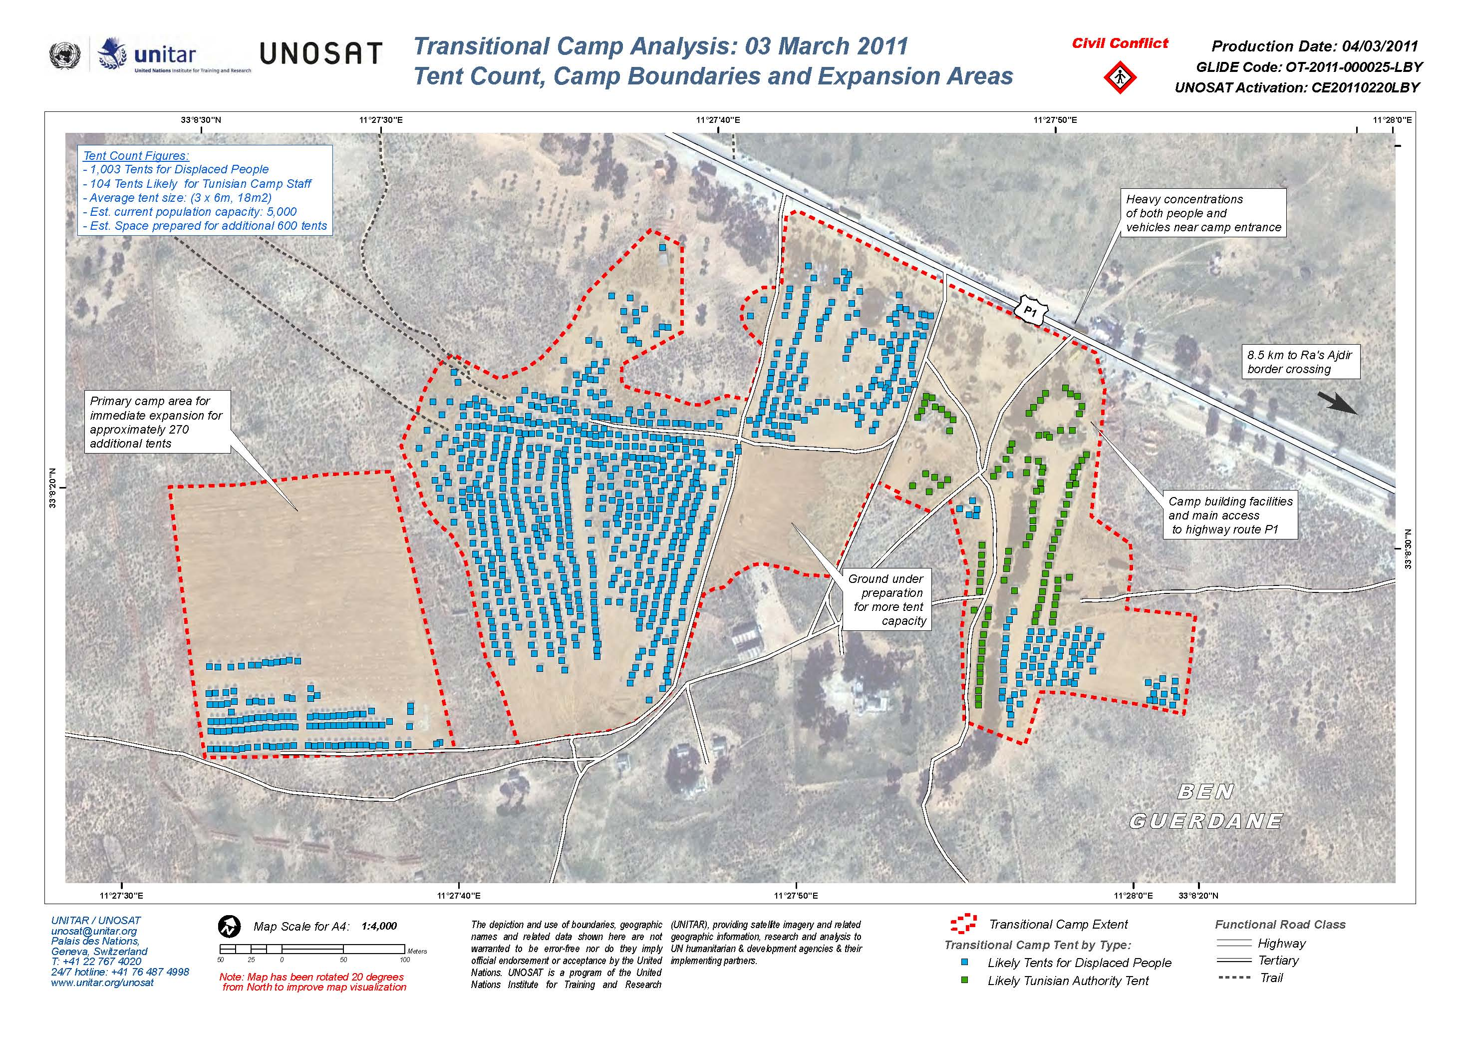

Collaboration - Education
CERN openlab
  Intel, Oracle, Siemens, HP Networking
  http://cern.ch/openlab
CERN School of Computing
  http://cern.ch/csc
UNOSAT
  http://cern.ch/unosat
EC Projects
  (EMI, EGI-Inspire,) HelixNebula, ICE-DIP, EUDat, CRISP, OpenAire
Citizen Cyber Science Collaboration
  Involving the General Public
  LHC@home, ATLAS@home, etc.

Slide 21
Questions?

