Slide 2
SRF thin films @ CERN
Alban Sublet
on behalf of TE/VSC
08.07.2015

Slide 3
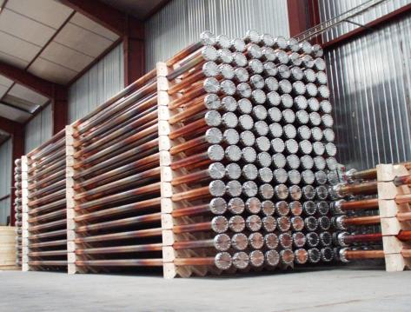
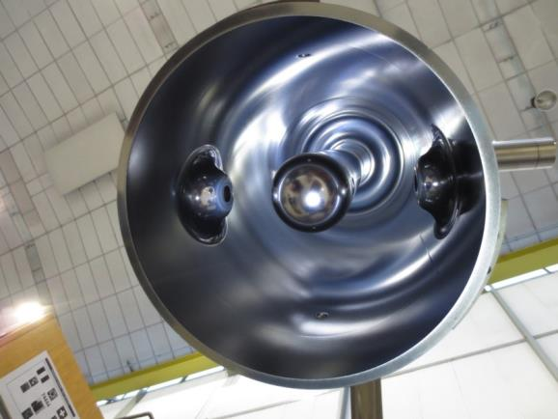
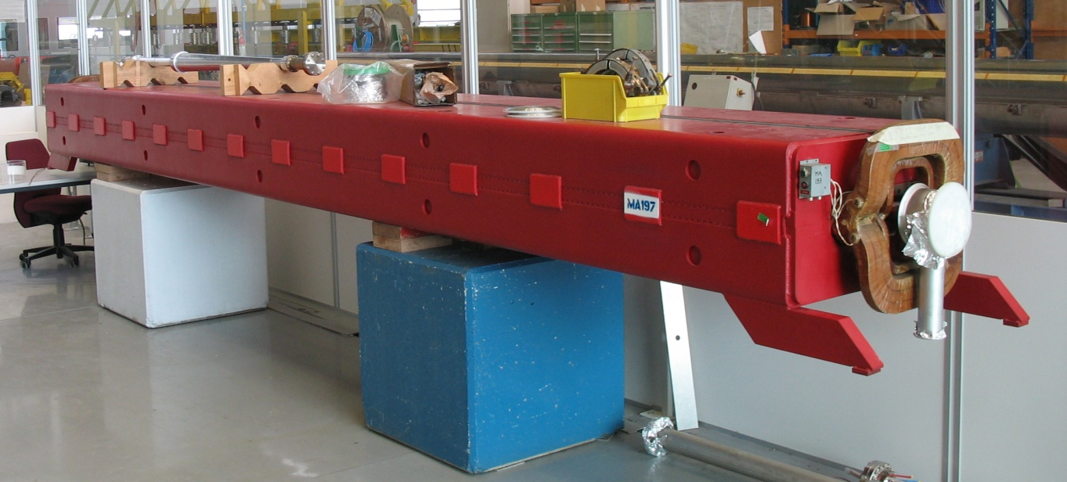
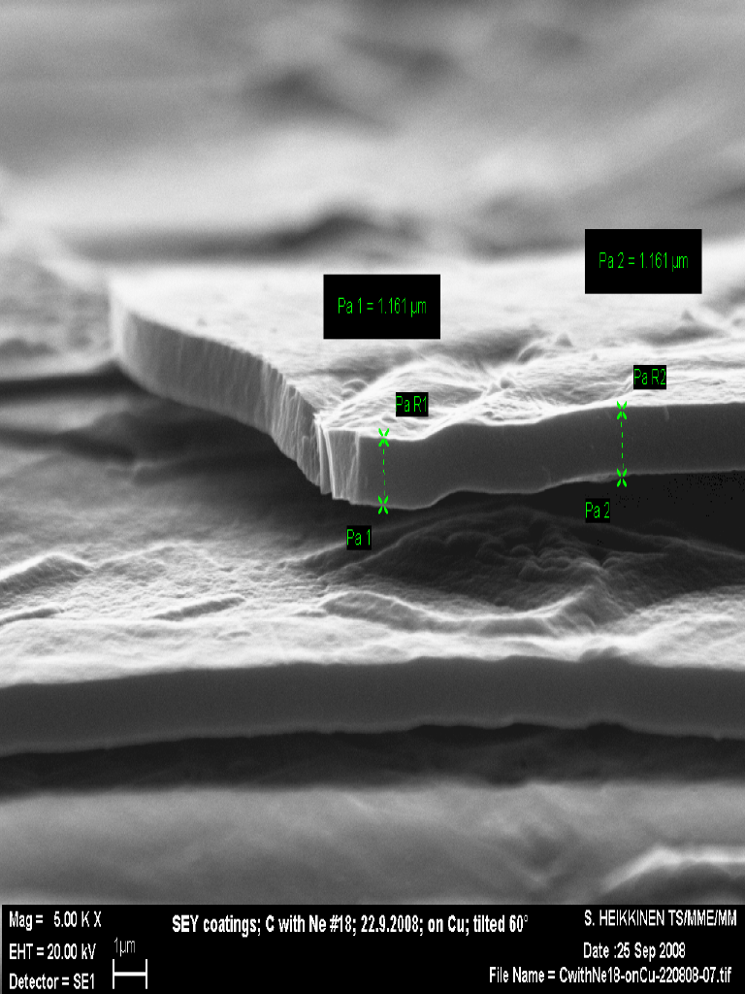
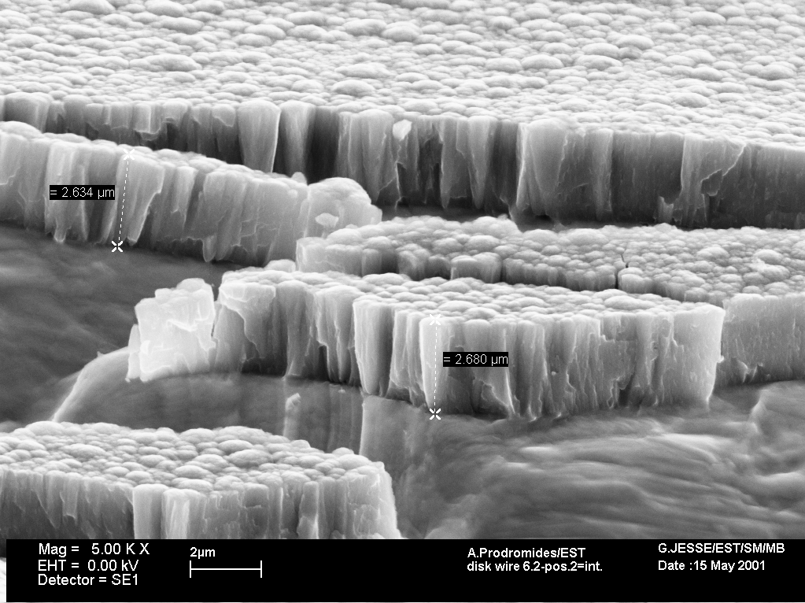
Thin films activities @ CERN
3 main applications:
RF accelerating cavities → superconductive layer
Pumping in vacuum → NEG layer
Against electron cloud → low SEY layer
1. HIE-ISOLDE cavities
2. LHC LSS (~7 km)
3. SPS dipoles (~ 200 m)
6.5 meter
a-C layer
Ti Zr V layer
Nb layer

Slide 4
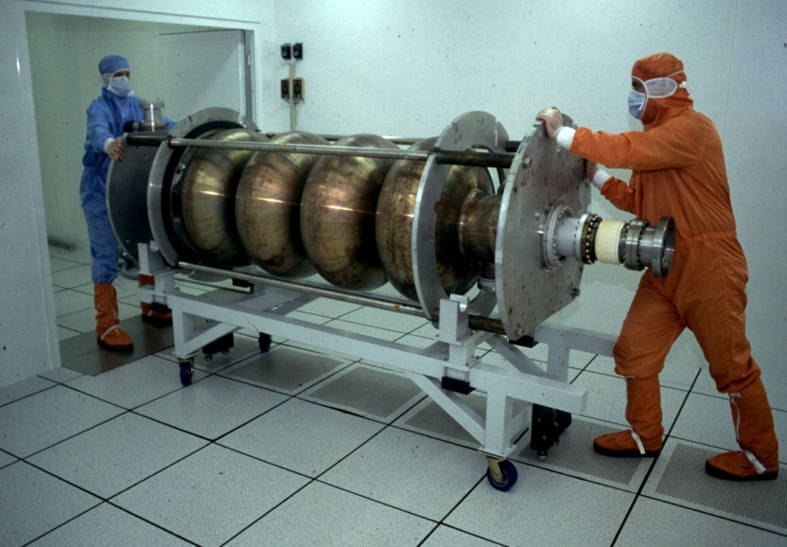
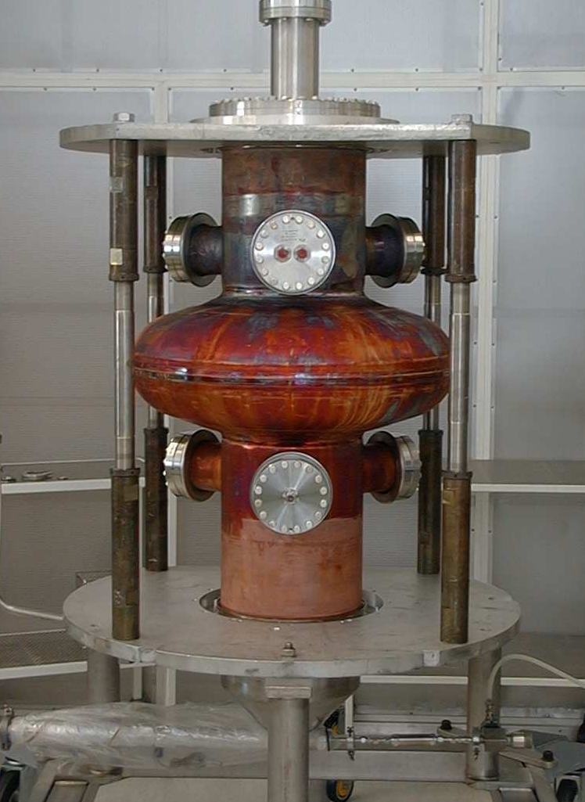
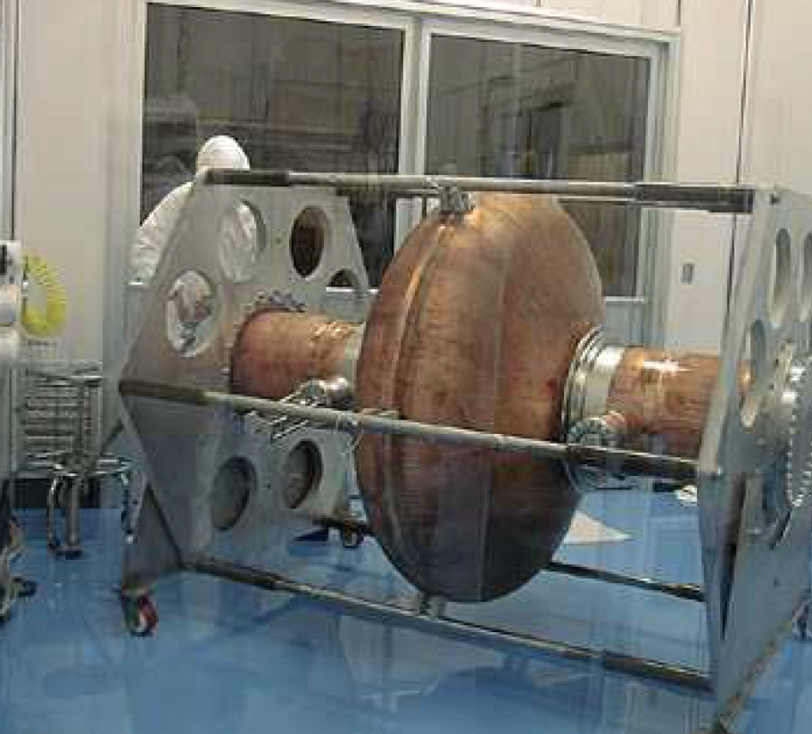
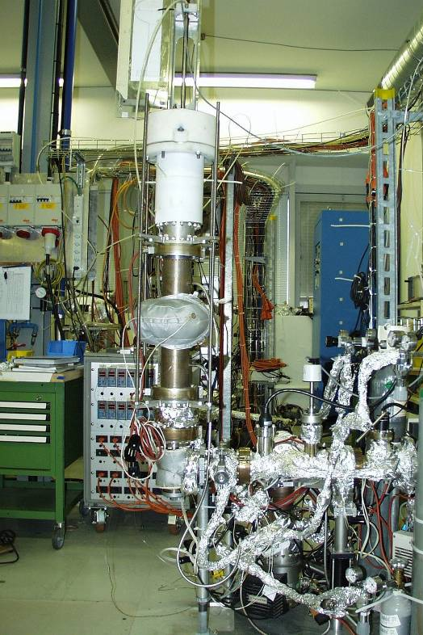
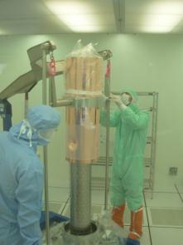
SRF thin films production activities I/III
Past:
288 Nb/Cu cavities installed in LEP
16 Nb/Cu cavities installed in LHC
(+ Soleil prototypes, 3HC, 200 MHz Cornell...)
Current:
20 Nb/Cu for HIE-ISOLDE
Spare LHC cavities

Slide 5
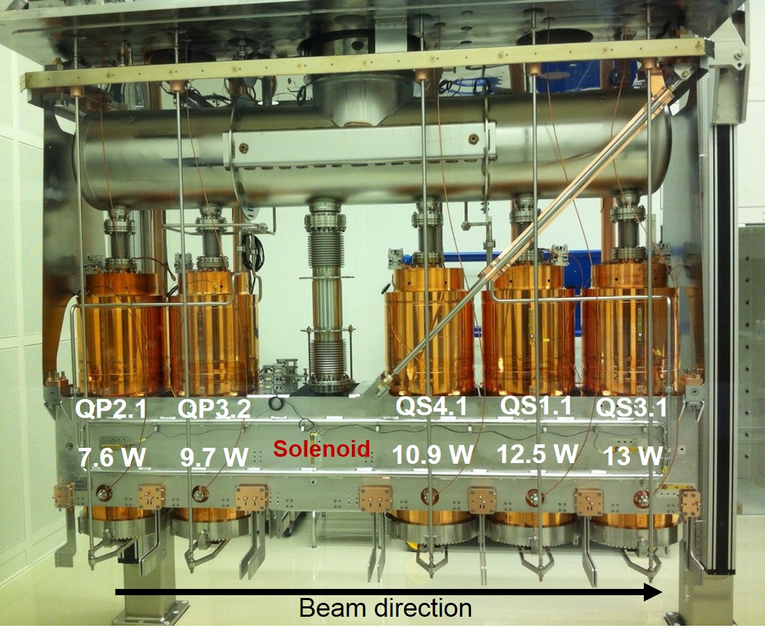
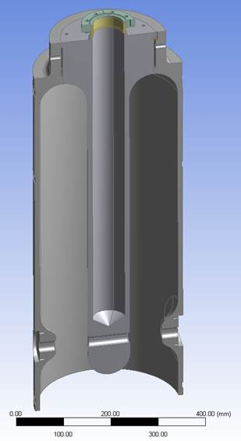
SRF thin films production activities II/III
HIE-ISOLDE QWR 100 MHz
  1 test cavity with sample holder + QPR sample
  20 “high-β” cavities (phase 1 + 2) → on going
  12 “low-β” cavities (phase 3) → to be approved
First cryomodule under commissioning
Coating of cavities for second cryomodule on the way
R&D continuing

Slide 6
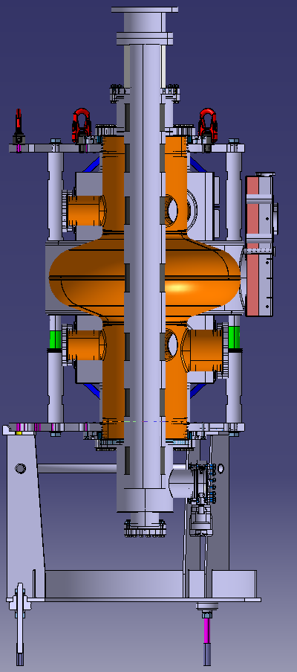
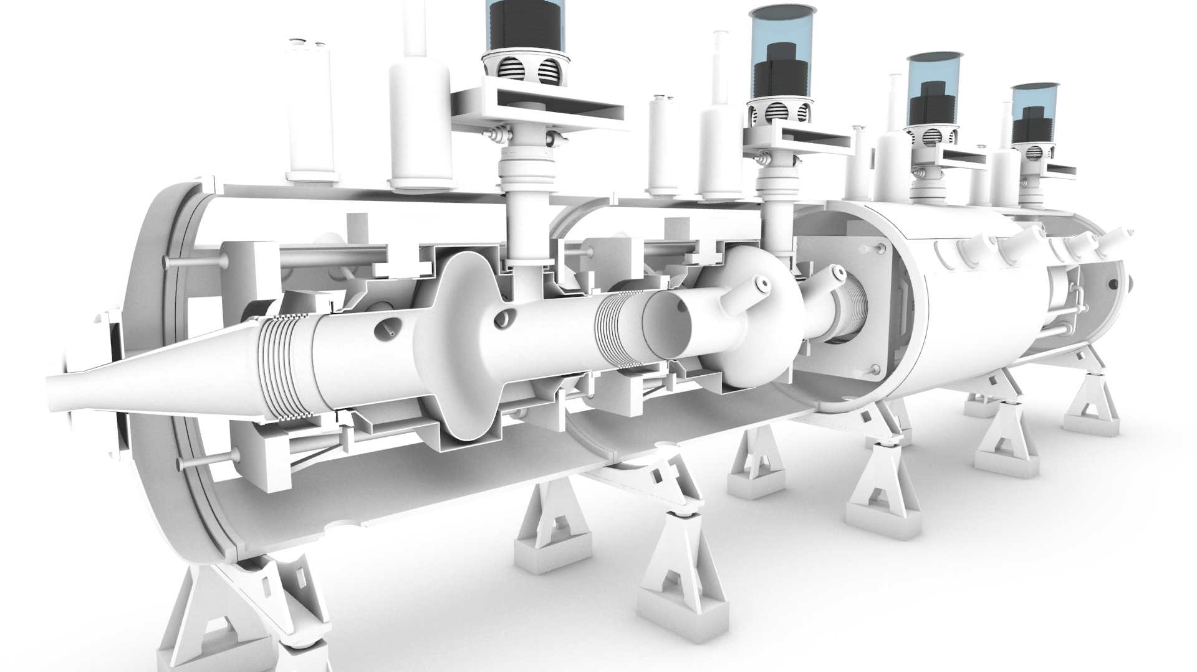
SRF thin films production activities III/III
LHC single cell 400 MHz spare cavities
  Test tube to asses coating setup
  2 prototypes → fabrication on going
  1 full cryomodule + spares

Slide 7
SRF thin films R&D: projects
HIE-ISOLDE high/low-β (100 MHz)
HL-LHC Crab Nb/Cu (400 MHz)
LHC upgrade/ERL/FCC (800 MHz)
FCC (400/800 MHz)

Slide 8
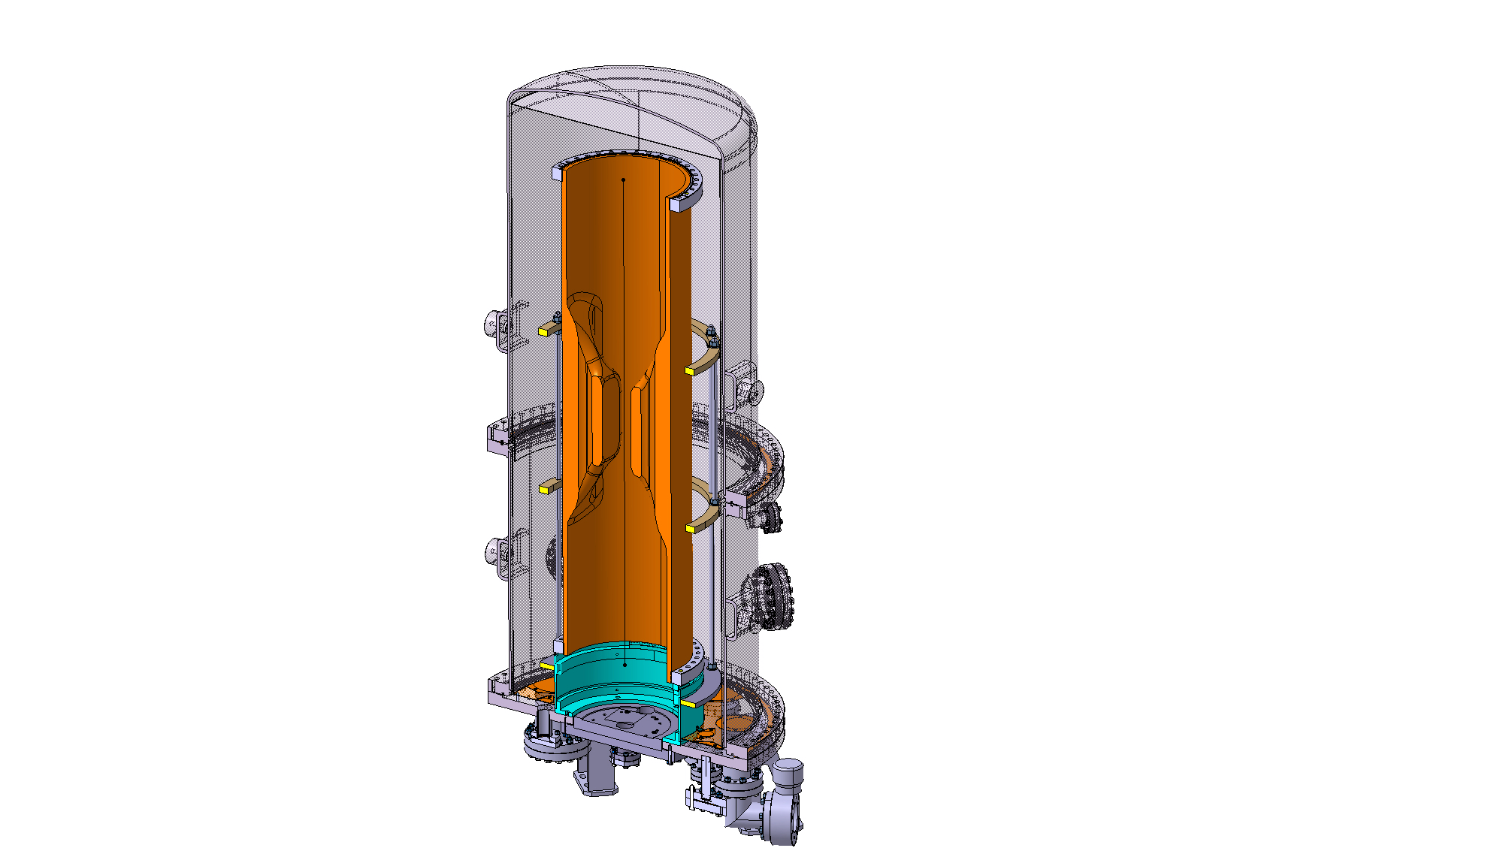
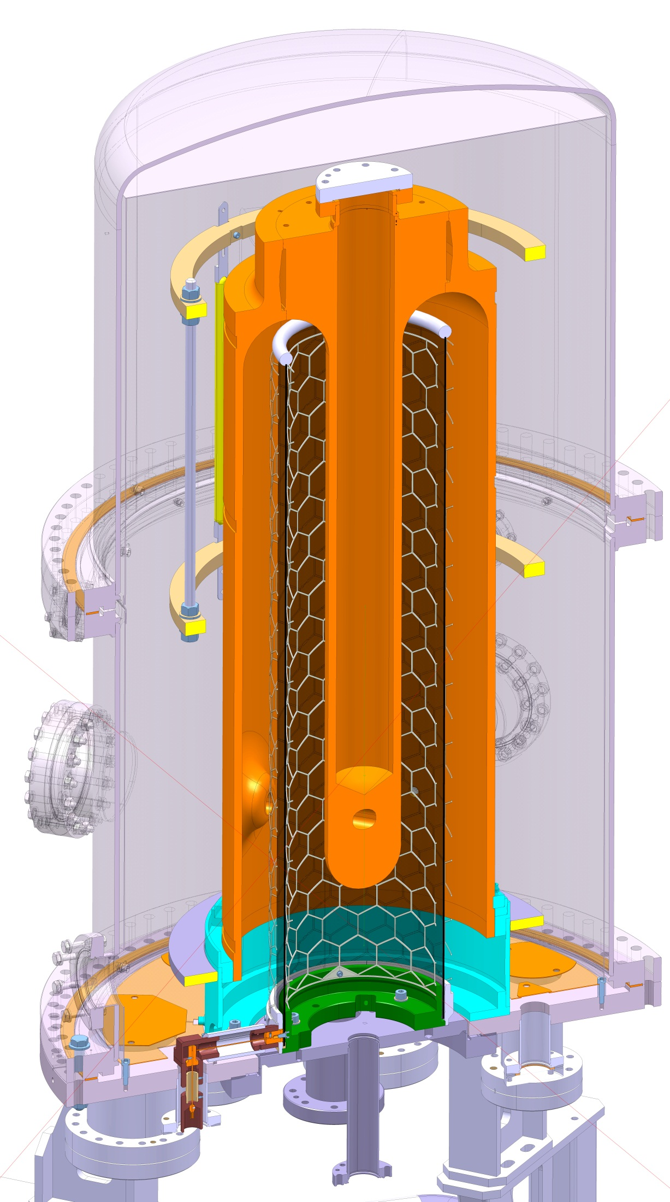
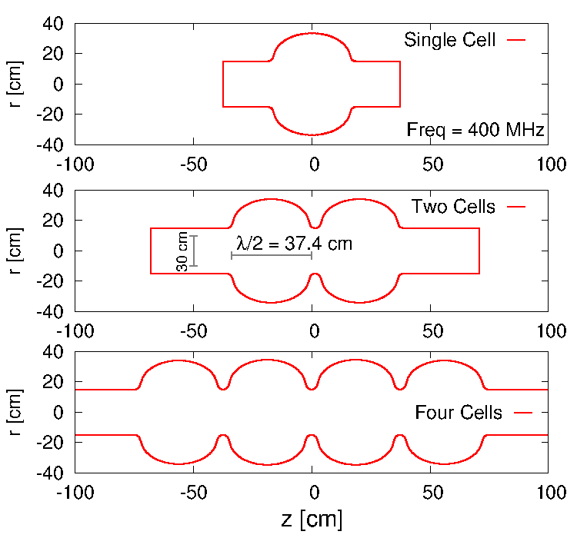
SRF thin films R&D: cavities shapes
0.9 m
1.2 m
R. Calaga
QWR (HIE-ISOLDE)
WOW Crab Nb/Cu (HL-LHC)
elliptical x-cell(s) (FCC)

Slide 9
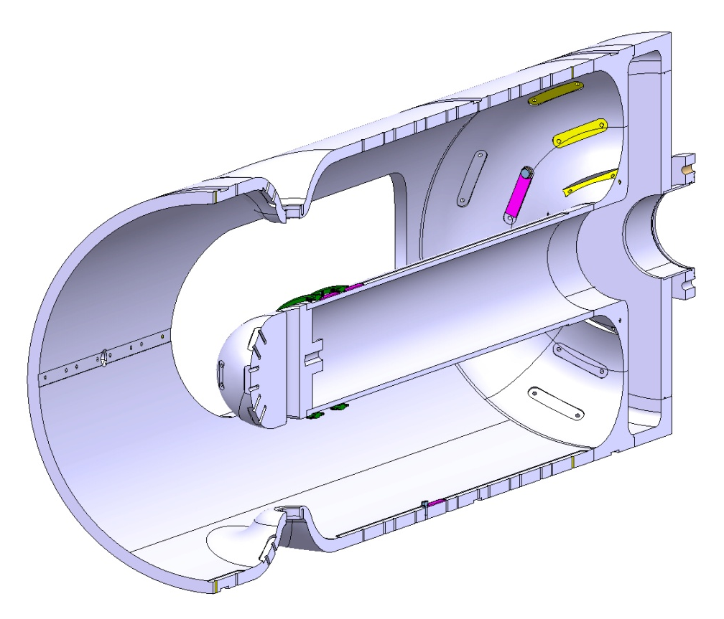
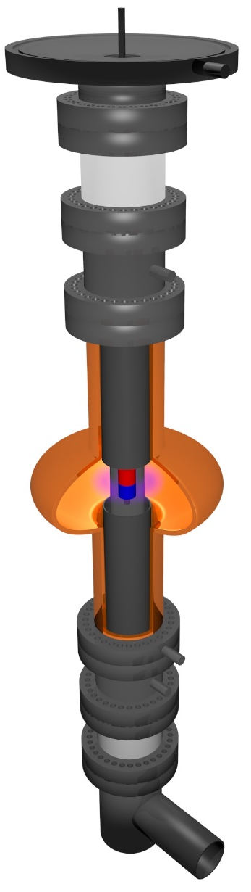
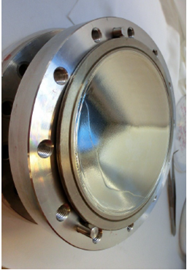
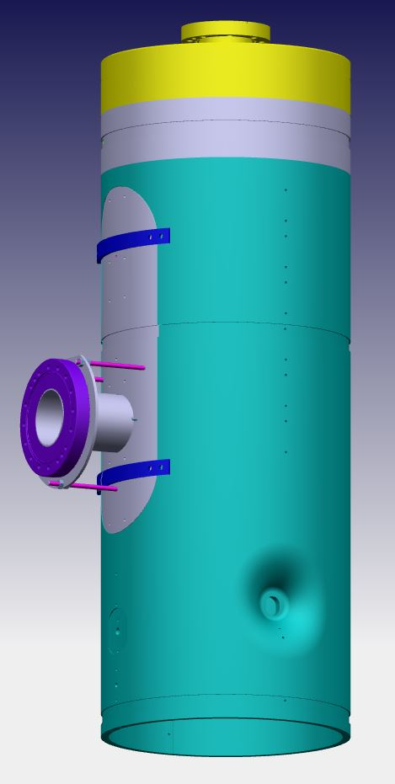
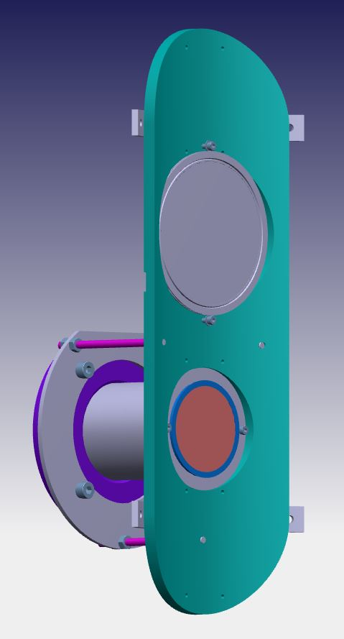
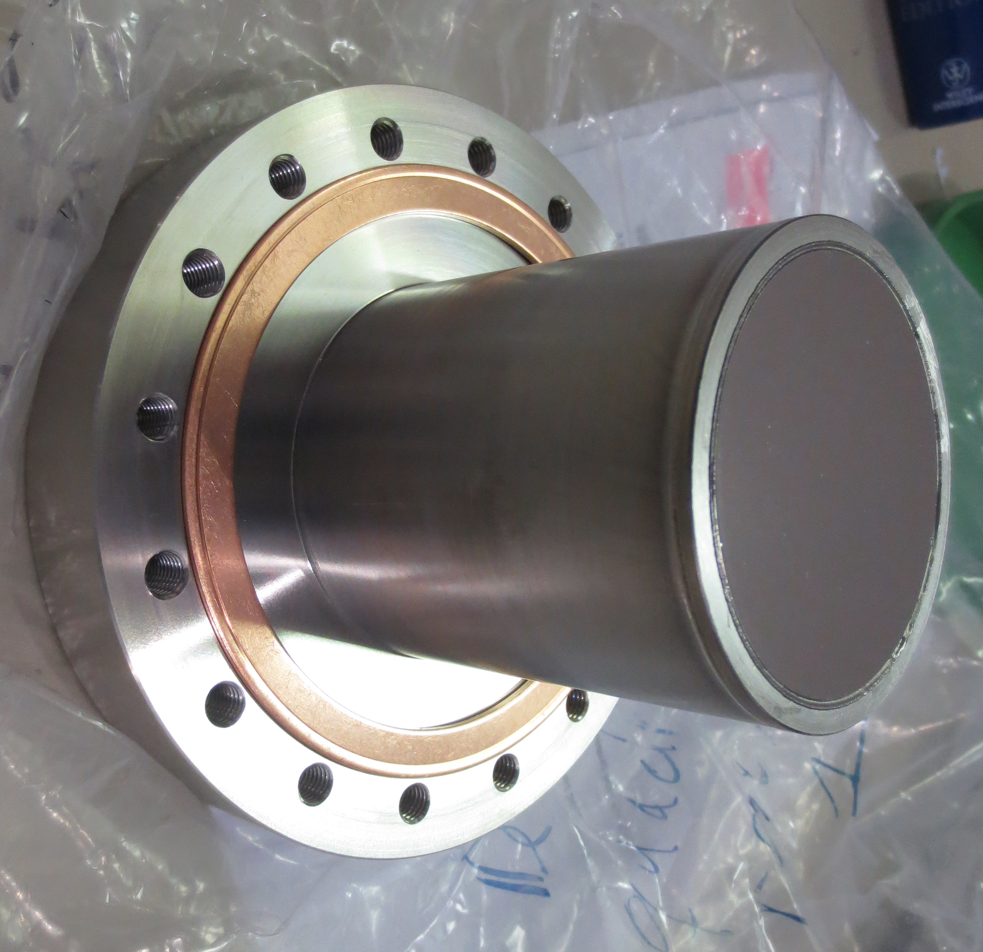
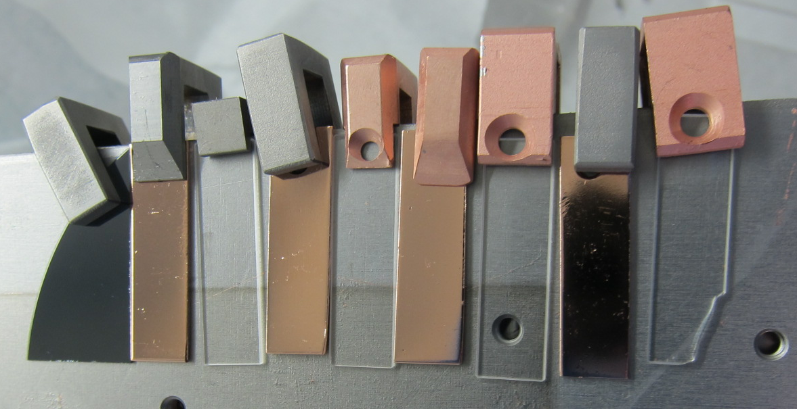
SRF thin films R&D: test substrates
126 mm
Upper anode bias connection
Orsay Cu-disk
Upper anode
400 mm
75 mm
Lower anode
Lower anode bias connection
QPR-sample
35 mm
Q4 sample cavity (HIE-ISOLDE)
elliptical 1.3 GHz cavity
Si-wafer/quartz/Cu coupons

Slide 10
SRF thin films R&D: functionality characterization
Basic studies:
RRR on quartz sample → CERN
Point Contact Tunneling (PCT) → ANL
Muon Spin Rotation (μ-SR) → PSI/TRIUMF
Third harmonic magnetometer → Saclay
RF characterization:
TE011 test cavity for Cu-disk → Orsay
RF Quadrupole Resonator for QPR-sample→ CERN
RF test on 1.3 GHz cavity (cryolab) → CERN
RF test on cavities (SM18) → CERN

Slide 11
SRF thin films R&D: topics
Thin film R&D approach focused on 4 main topics:
Coating technics
SC Material
Material/thin film analysis
Plasma diagnostics and plasma simulation

Slide 12
SRF thin films R&D: coating technics
DC bias diode sputtering, production level
DC magnetron Sputtering, production level
HiPIMS (+bias), development level
Cathode design/shape
Biasing, grid design
Heat treatment
Substrate temperature
Nitrogen treatments

Slide 13
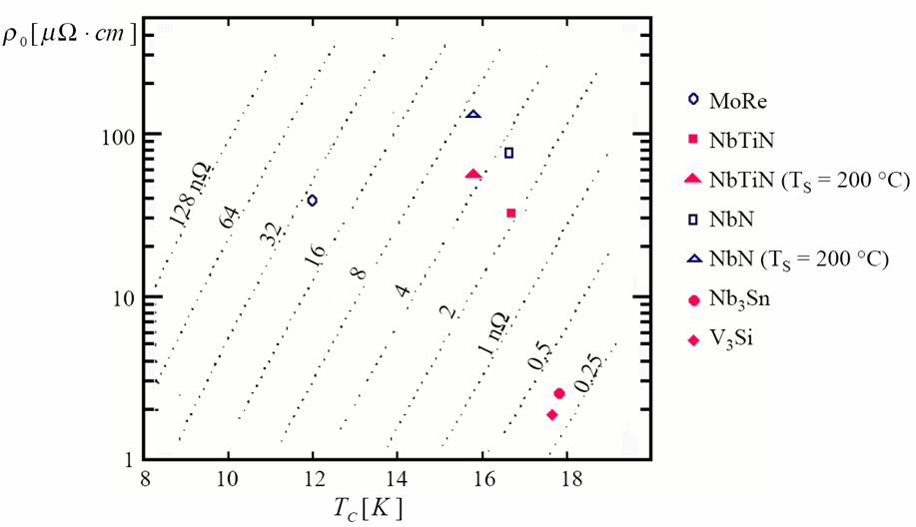
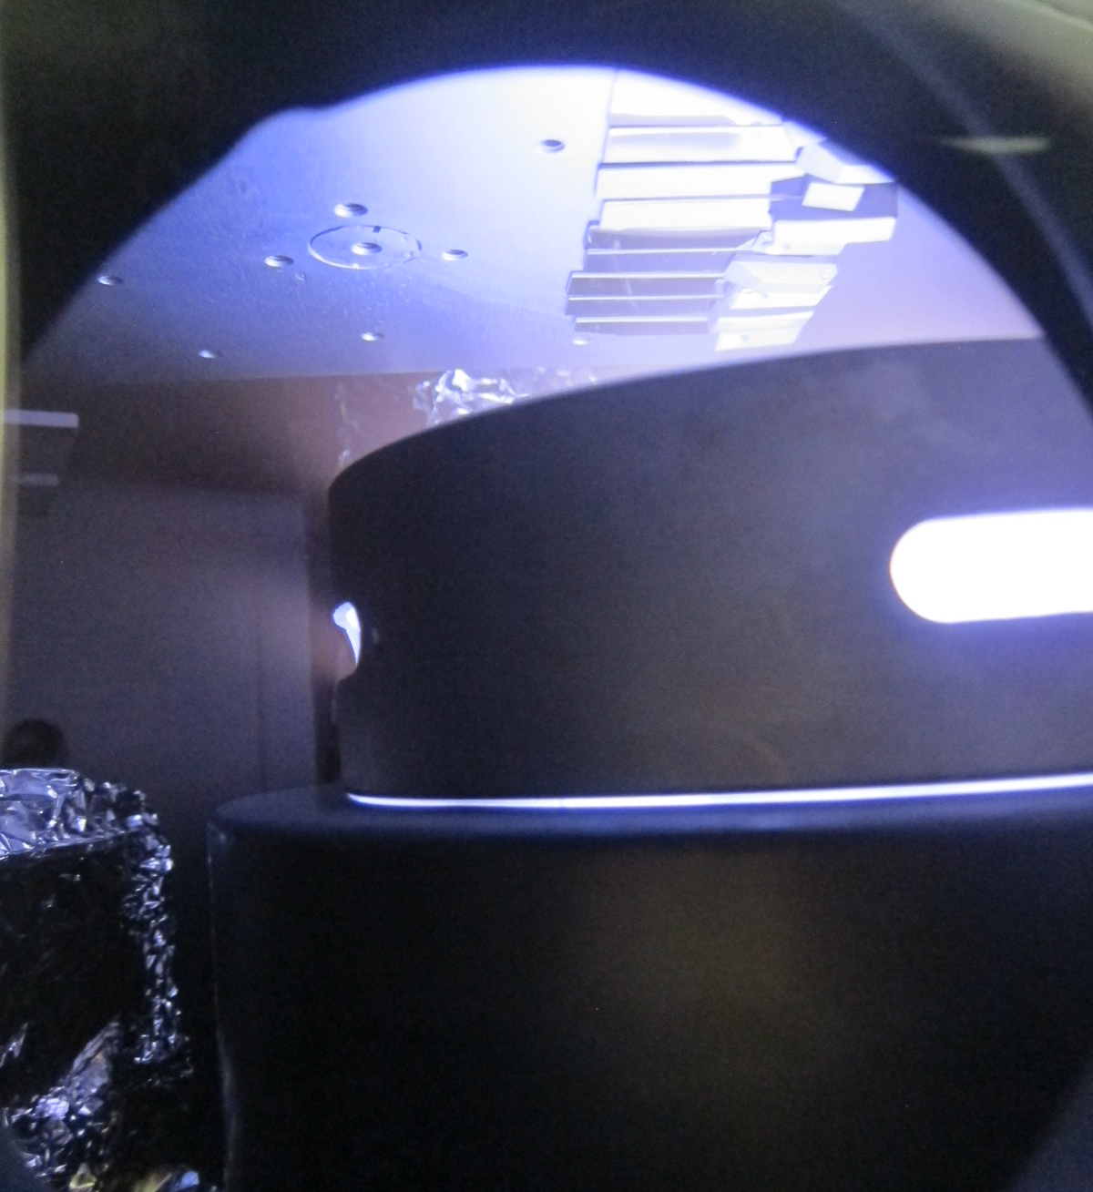
SRF thin films R&D: SC material
Niobium
A15 compounds: Nb3Sn and V3Si
BCS surface resistance at 4.2 K
and 500 MHz for films ( Nb ~ 45 nΩ)
Planar magnetron Nb3Sn target sputtering

Slide 14
SRF thin films R&D: material/thin film analysis
XRF, XPS, XRD (CERN), SIMS, …
SEM/EDS – FIB/SEM, STEM/TEM (CERN/EPFL)
HIE-ISOLDE
Q4 sample from middle antenna
Nb/Cu, 14 runs coating
Courtesy B. Bartova and EPFL-CIME

Slide 15
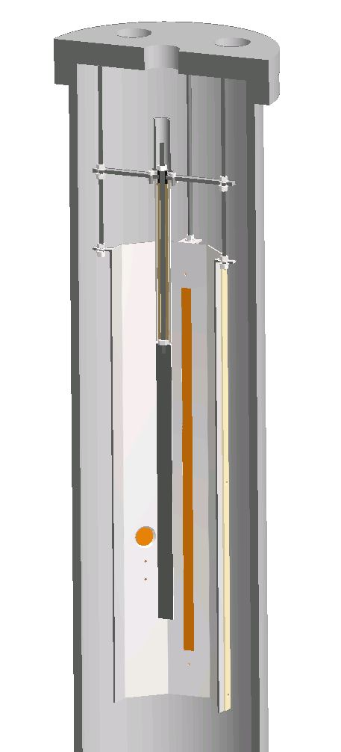
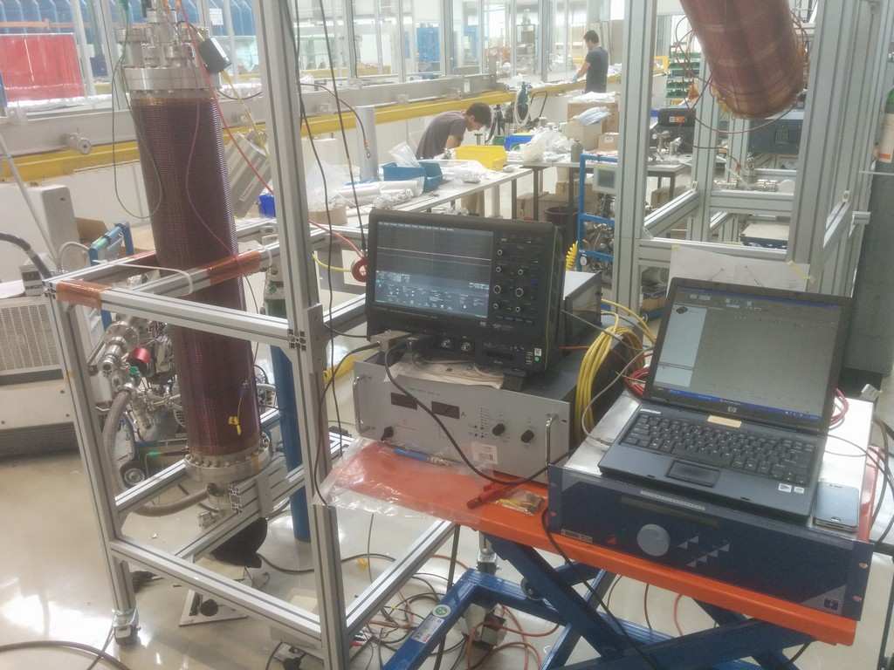
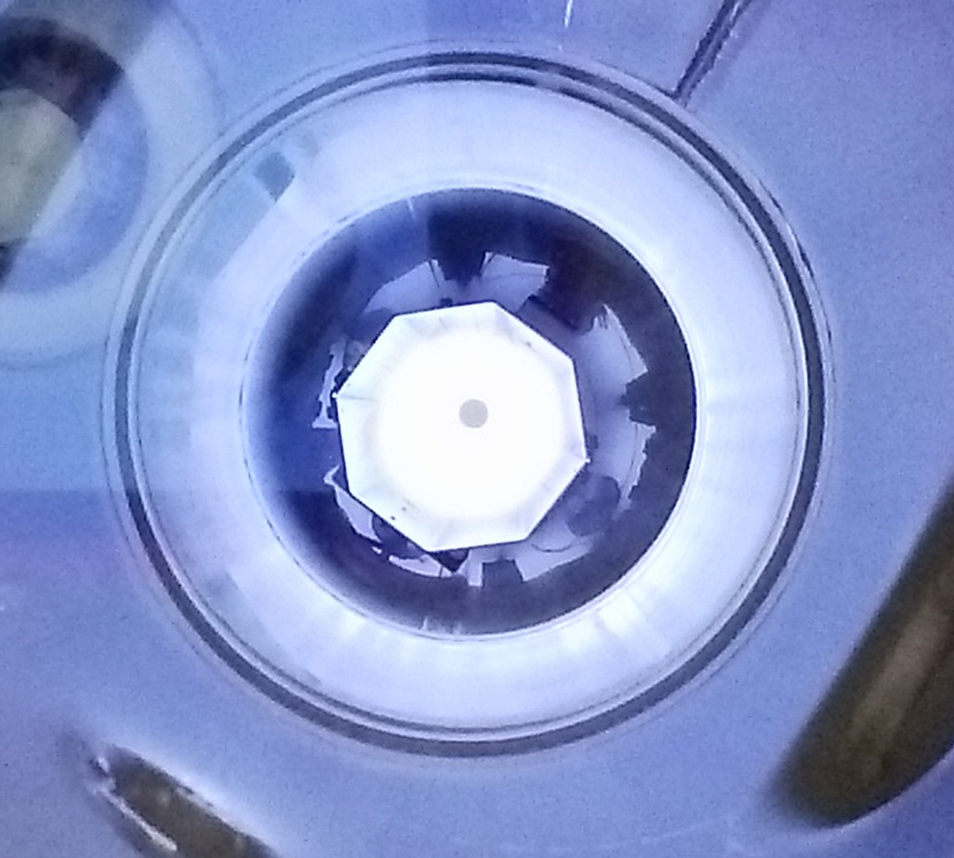
SRF thin films R&D: plasma diagnostics
UHV vacuum chamber
Plasma test bench
anode tube (+bias)
Nb cathode
DC bias diode
DCMS
HIPIMS
diagnostic port:
RFA, Qz-balance
  current/voltage probes
  Retarding Field Energy Analyzer
  Fast intensified camera
  Quartz balance
  OES
  Langmuir probe
Cu strip for thickness profile
400 mm height
Bottom view of plasma

Slide 16
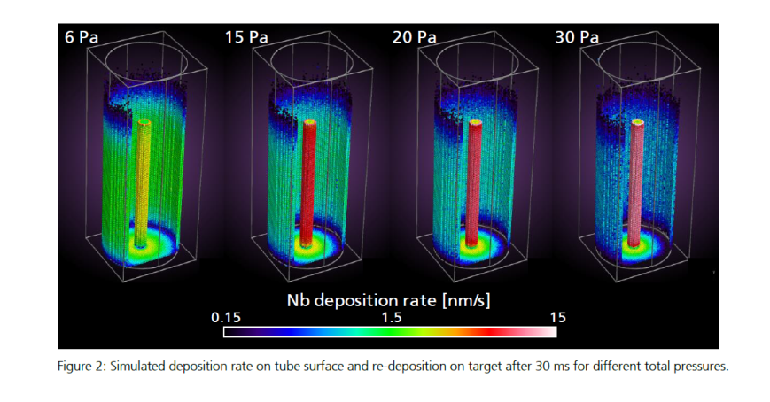
SRF thin films R&D: plasma simulation
DSMC/PIC-MC code
p = 0.32 mbar (diode discharge)
Constant wall temperature (200°C)
Initial charged particles density = 10¹³ m⁻³
Power = 10 W
Maximum voltage = 1000 V
benchmarking with plasma test bench
Courtesy A. Pflug – Fraunhofer IST

Slide 17
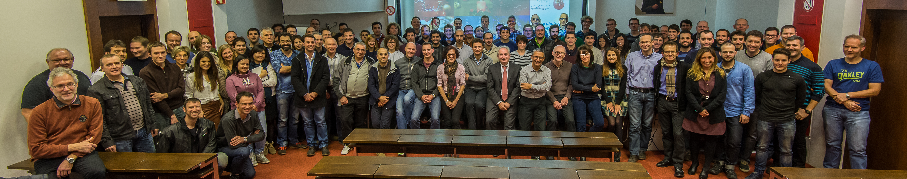
Thank you for your attention
TE-VSC group

Slide 19
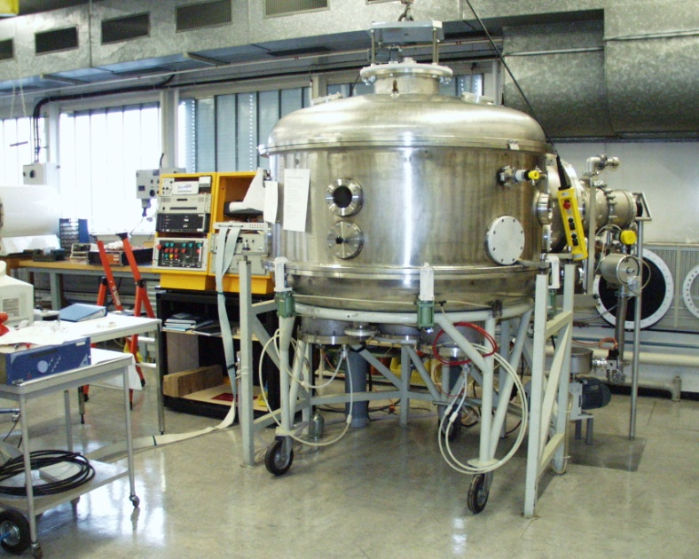
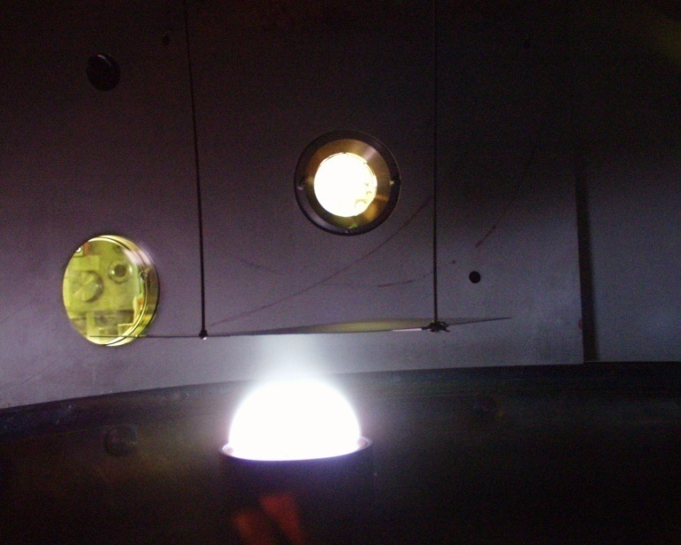
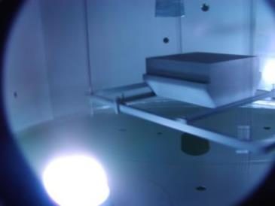
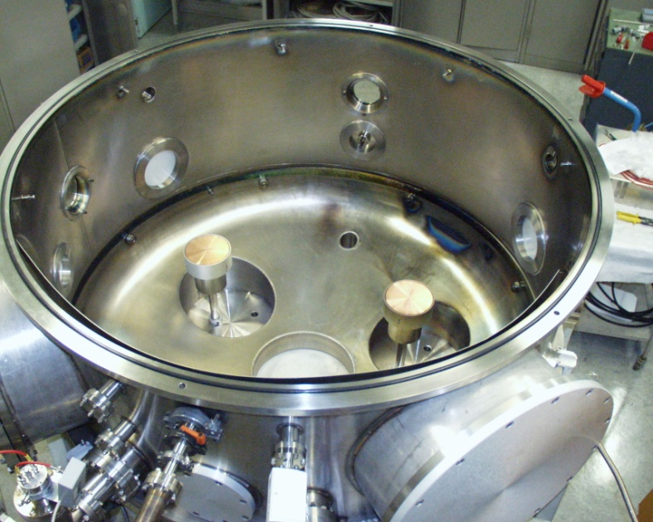
Thin films activities @ CERN
Possibility to coat substrates up to 1.2 m length, substrate rotation for complex shapes
Up to 3 independent targets for alloy deposition with tunable composition
Typical materials:
Cu, Au
Ti
NEG (TiZrV)
Nb, Nb3Sn
B₄C
Foreseen developments:
- insulators, reactive sputtering, RF magnetron…..

Slide 20
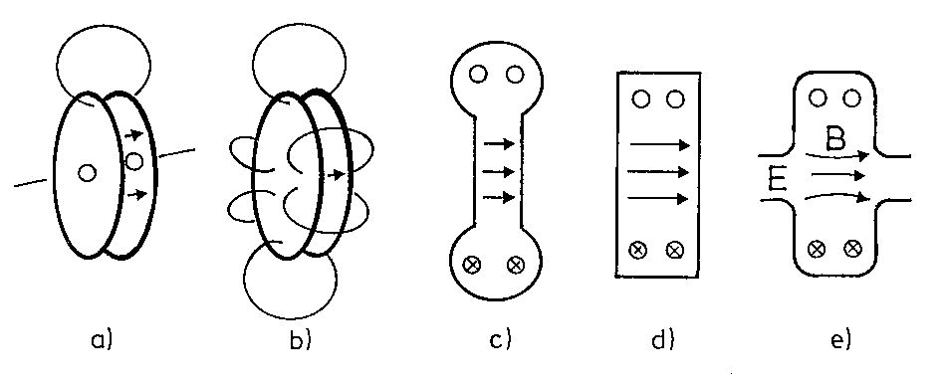
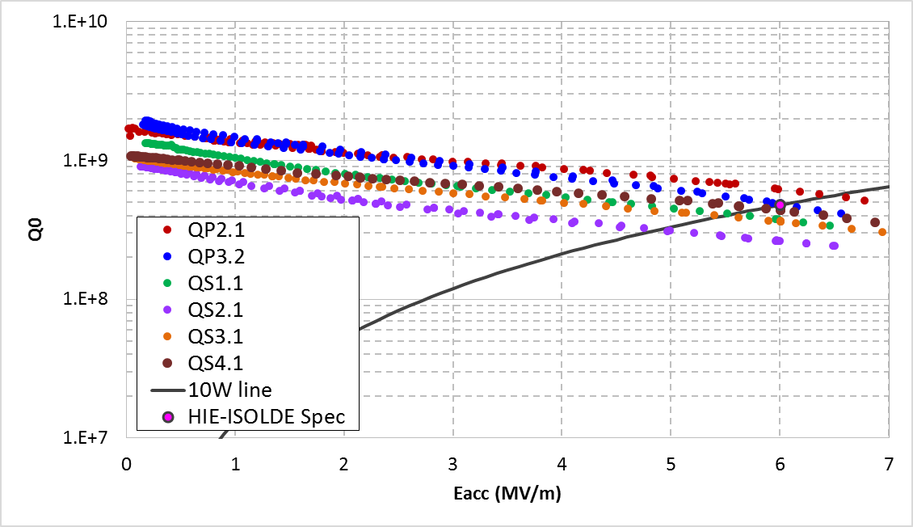
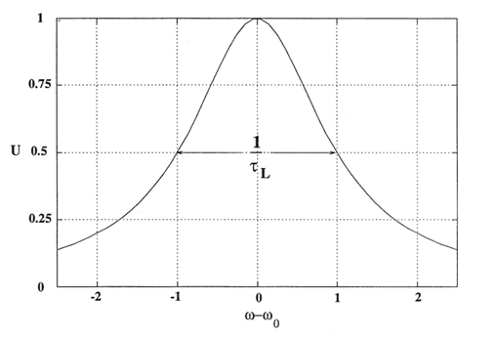
SRF cavity
S = superconducting
  Lower power losses through surface resistance reduction
  Increased quality factor
RF = radiofrequency excitation to provide accelerating gradient in the resonant cavity
Cavity = resonator for an electromagnetic wave
Resonator characterized by f₀, Q₀
U is the energy stored in the cavity volume and P_{c}/ω₀ is the energy lost per RF period by the induced surface currents
→ Cavity characterized by its Q₀ vs accelerating gradient (E_{acc}) curve

Slide 21
SRF cavities bulk Nb vs thin film
Nb bulk
Expensive (900$/Kg)
Low thermal conductivity
High accelerating gradients
Well known technology
Thin film
Q disease (early quench)
Behaviour not fully understood/explained
Cheaper bulk material (Cu)
High thermal conductivity
Well known technique used since LEP generation
Future accelerators needs:
Low power consumption → high efficiency cryogenics
Low cost → limit the use of bulk Nb as much as possible, superconductive thin film prefered
Approach:
Improve Nb coatings properties: substrate treatment / post coating treatment / coating technic
Look for new materials: higher Tc and lower Rs

Slide 22
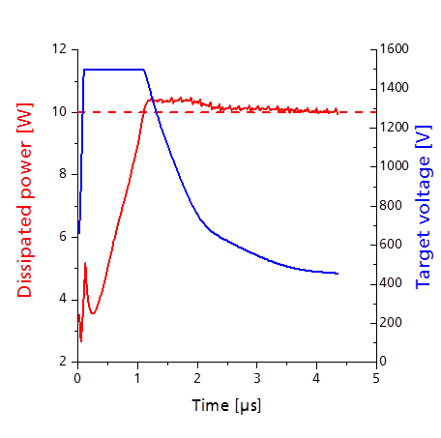
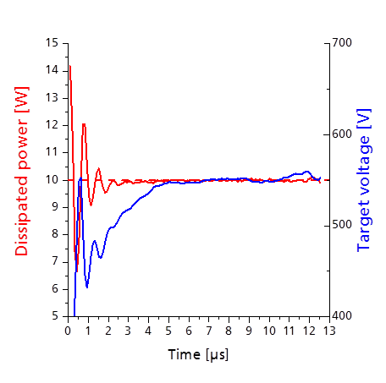
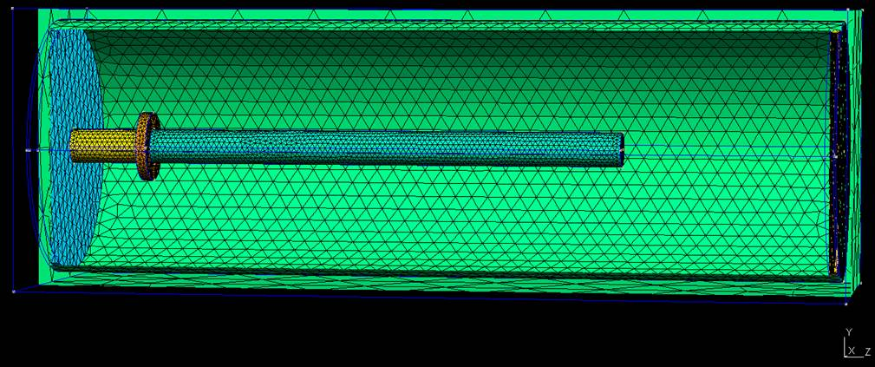
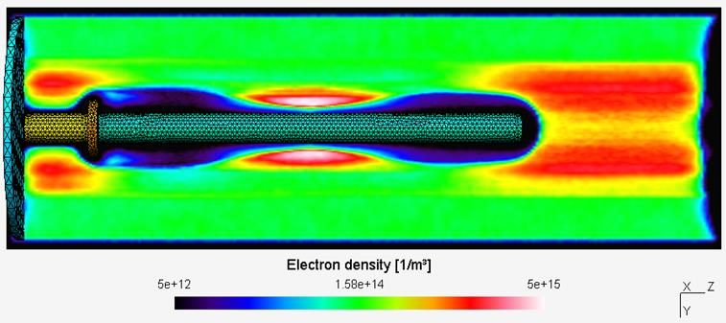
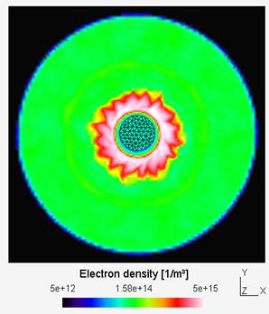
SRF thin films R&D topics
Plasma simulation: DSMC/PIC-MC code
Courtesy A. Pflug – Fraunhofer IST

