Slide 1
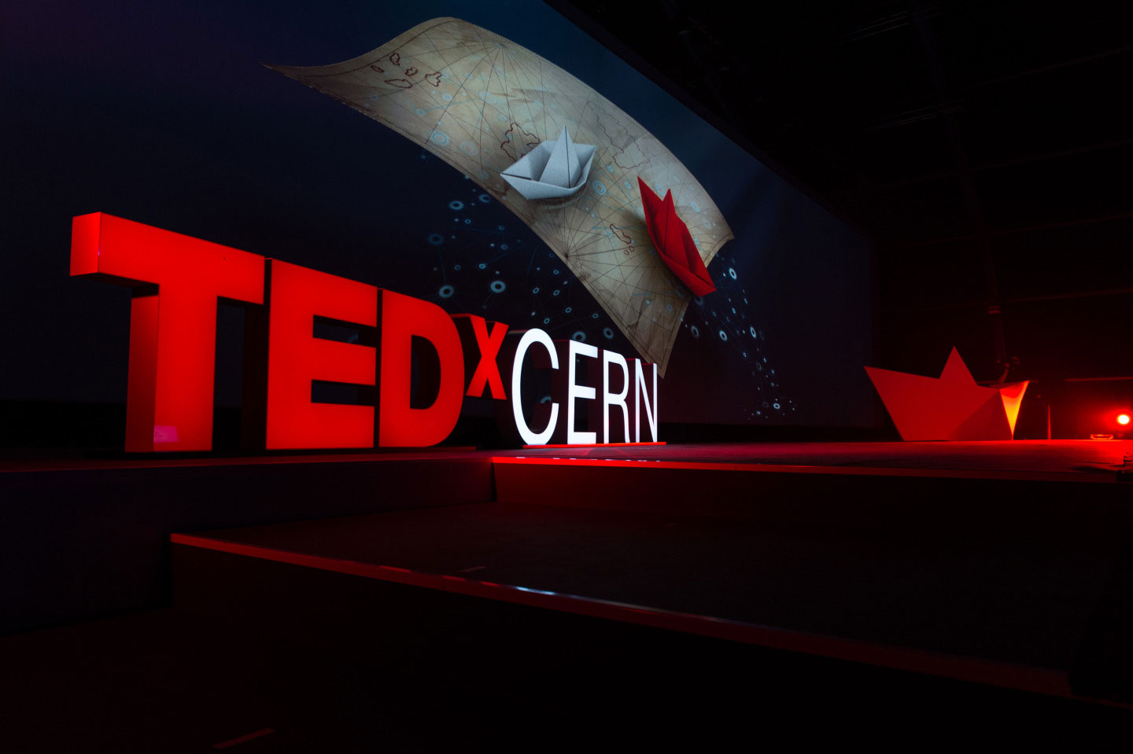
TEDxCERN 2015
Friday, October 9th

Slide 2
What is TED?
TED is a non-profit organization
experts from diverse background
18 minutes talks with an idea worth spreading
Notes:
TED is a non-profit organization, that brings together experts from diverse backgrounds, such as scientists, artists, designers, innovators, story tellers, to give talks up to 18 minutes with an idea worth spreading.
The videos are recorded and made public on TED.com.
Each talk has an average view of one million.
The most viewed TED talk is from sir Ken Robinson on “Do schools kills creativity” with more than 30 million viewers

Slide 4
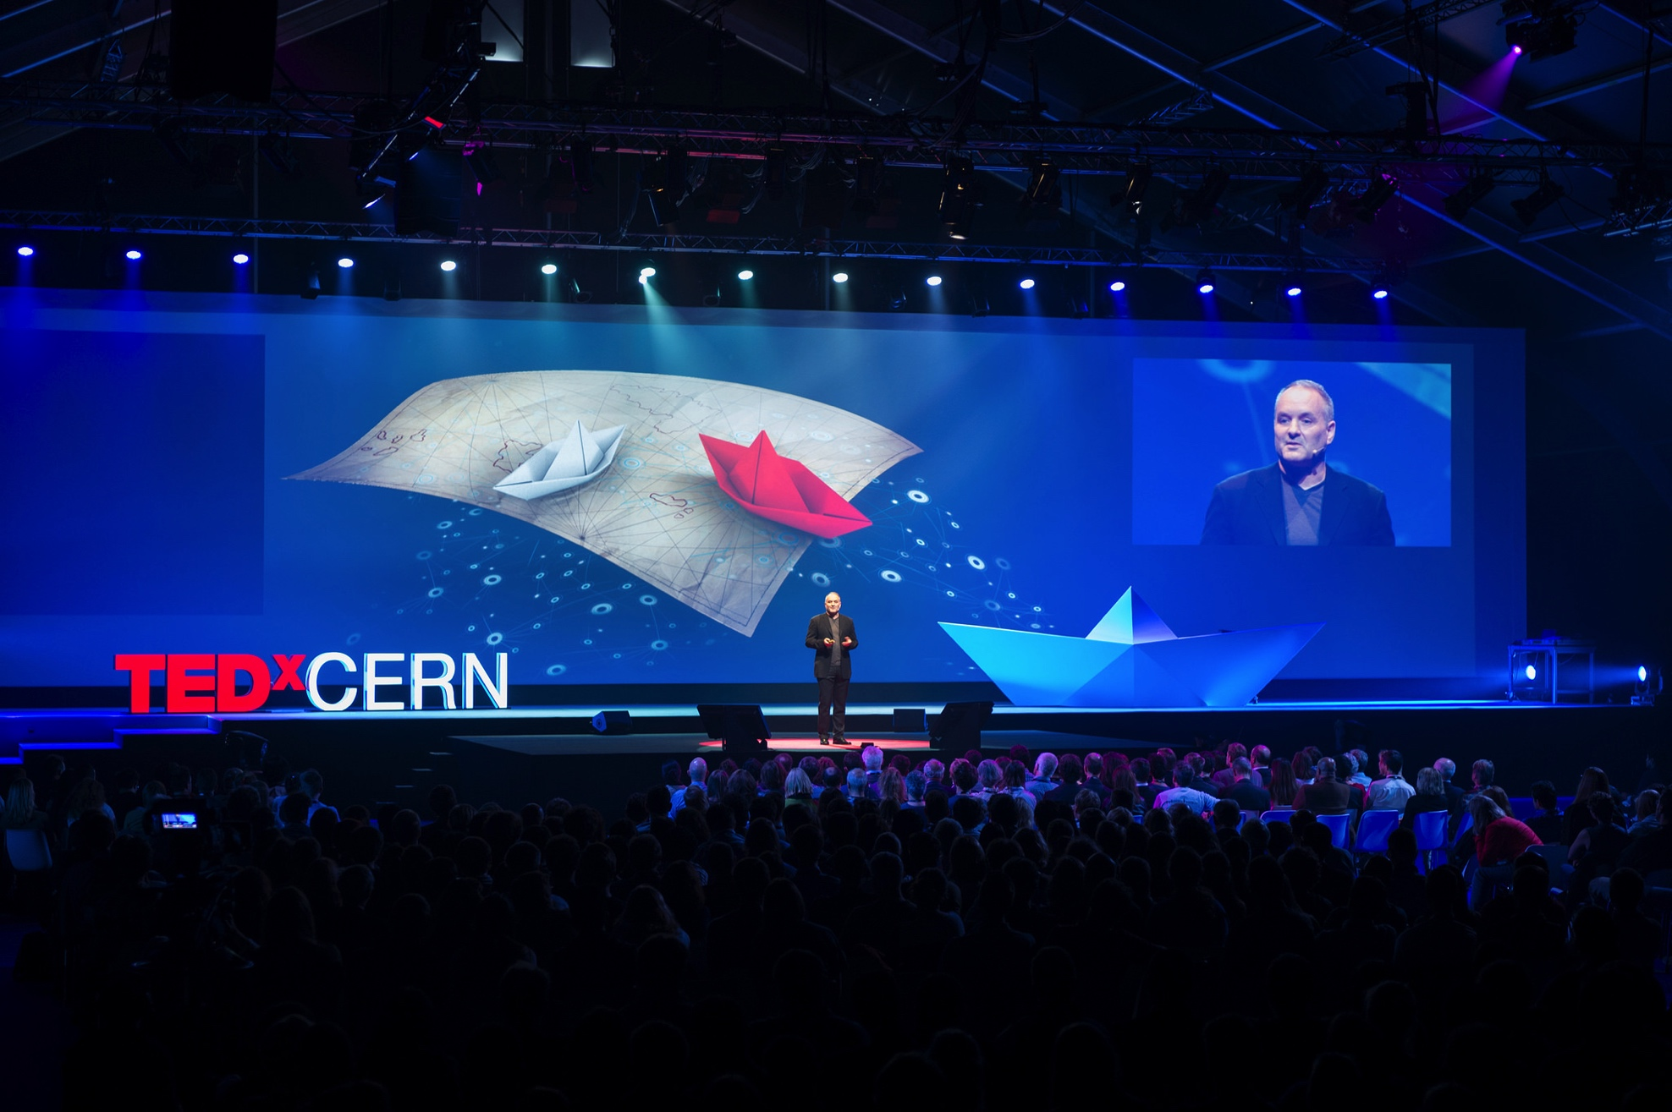
1200 guests
More than 2,000 online
Videos seen by 18000 viewers
17 institutes hosted a webcast viewing event
Notes:
CERN has held 2 TEDx events. Last year we had an audience of 1200 people live plus more than 2000 online. Each talk we produced have an average of xxx on YouTube and those publised on ted.com have over a million viewers.

Slide 5
Institutes participants
Europe
IFIN-HH (Horia Hulubei National Institute of Physics and Nuclear Engineering): Bucharest, Romania
2SLO: Warsaw, Poland
Centre for the Promotion of Science: Belgrade, Serbia
CESGA (Centro de Supercomputación de Galicia): Santiago de Compostela, Spain
CUI (Le Centre Universitaire d'Informatique): Geneva, Switzerland
HIP (Helsinki Institute of Physics): Helsinki, Finland
NCSR Demokritos: Athens, Greece
NTUA (National Technical University of Athens): Athens, Greece
Vrije Universiteit Brussel: Brussels, Belgium
Australia
Centre of Excellence for Particle Physics at the Terascale, University of Melbourne: Melbourne, Australia
CSIRO: Perth, Australia
Monash University: Melbourne, Australia
Asia
DTU (Delhi Technological University): New Delhi, India
KISR (Kuwait Institute for Scientific Research): Kuwait City, Kuwait
USA
Jefferson Lab: Newport News (VA), United States
Saint Vincent College: Latrobe (PA), United States
UALR (University of Arkansas at Little Rock): Little Rock (AR), United States

Slide 6
TEDxCERN 2015 “Breaking the rules”
History is full of examples of innovations that have changed the world. Think of the World Wide Web, for example, or the profound impact of polio vaccine. The time is ripe for some new transformative innovation, and we want TEDxCERN 2015 to be a platform for that.
Notes:
What is TED and TEDx
TEDxCERN numbers from past
TEDxCERN 2015 theme
Talk about three speakers and what they will be talking about
Organizing a viewing party
benefits
what is needed

Slide 7
TEDxCERN 2015 “Breaking the rules”
Day of the event
13:00 - 14:00 | CERN - Transportation to CMS Experiment
14:00 - 14:30 | Performance
14:30 - 16:15 | 1st Session – Rule Breakers
16:15 - 17:15 | Break - Networking & Interactive experience
17:15 - 19:00 | 2nd Session - Visionaries
19:00 - 21:00 | Reception

Slide 8
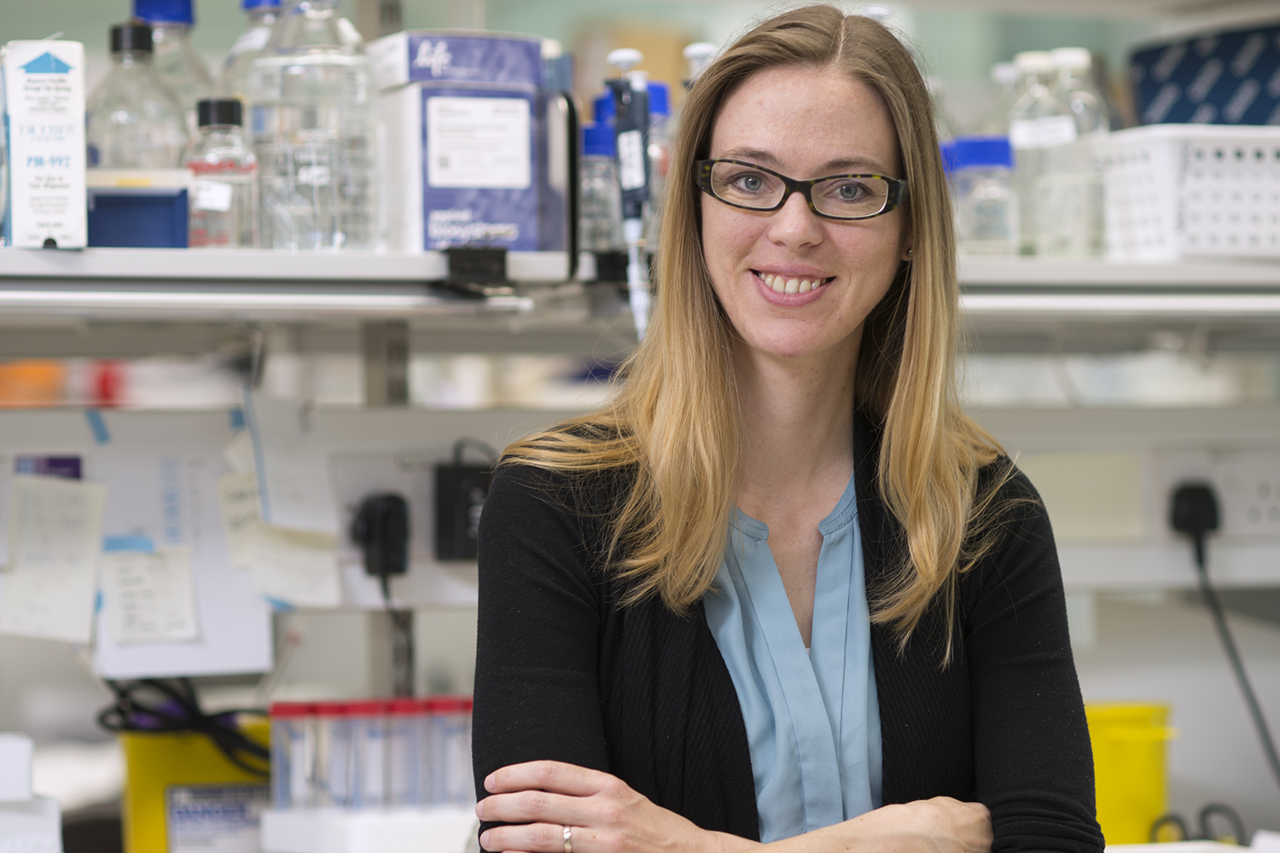
Madeline Lancaster
Neurobiologist, grows mini-brains and has a lab at University of Cambridge’s Medical Research Council Laboratory of Molecular Biology. Her work utilizes a completely new approach called cerebral organoids that uses human stem cells to generate brain tissue clumps in a dish. These mini-brains are the first 3D model of a developing human brain.

Slide 9
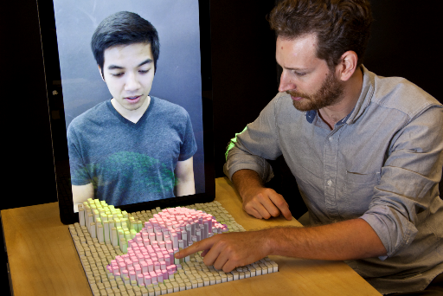
Sean Follmer
Assistant Professor at Stanford University in the Mechanical Engineering Design Group, researching how we can apply shape­-changing and deformable interfaces to interact with each other when using devices.

Slide 10
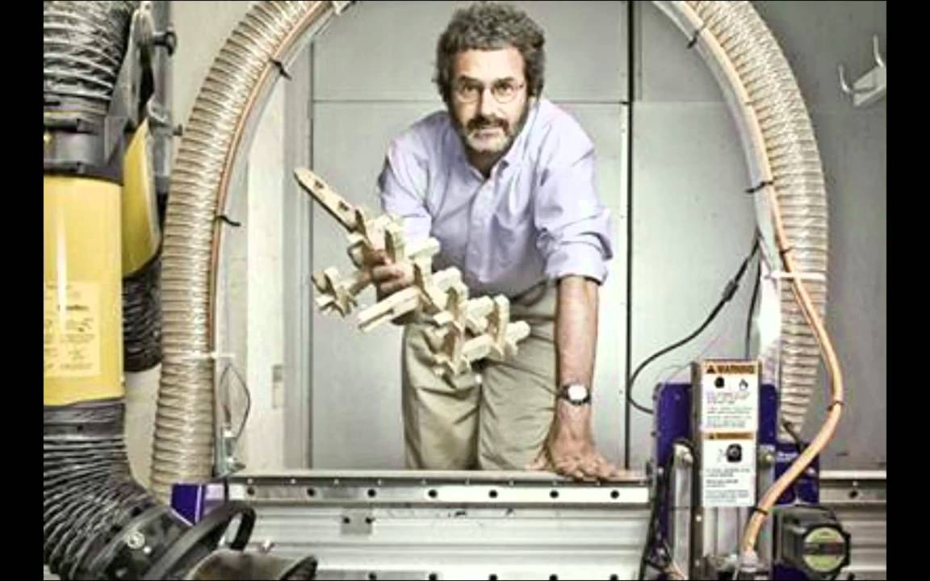
Neil Gershenfeld
Director of MIT’s Center for Bits and Atoms explores the boundaries between the digital and physical worlds. His famous Fab Lab is immensely popular among students at MIT, who crowd Gershenfeld's classes.

Slide 11
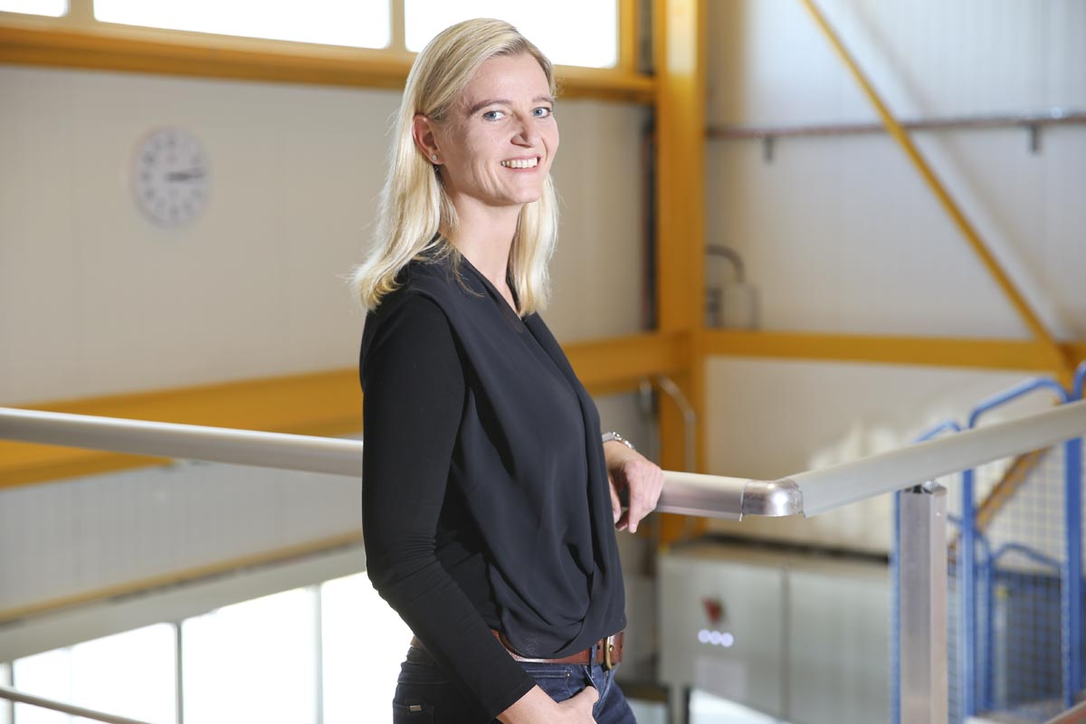
Edda Gschwendtner
CERN researcher and group leader. Her research is focused in Neutrino - wakefield acceleration technology , that once is fully developed, could replace many of the traditional RF accelerators currently found in particle colliders, hospitals and research facilities.

Slide 12
Why to host TEDxCERN webcast event
TEDxCERN is an excellent opportunity for universities to engage with their community about science and STEM subjects
You can build your own event around the live feed from CERN by adding one or two live speakers from your own community
Official webcast participants will be featured in a dedicated section on the official TEDxCERN website.
Notes:
What is TED and TEDx
TEDxCERN numbers from past
TEDxCERN 2015 theme
Talk about three speakers and what they will be talking about
Organizing a viewing party
benefits
what is needed

Slide 13
What you need to do
Book a room where you can hold the webcast
Invite those whom your institution could engage in constructive dialogue
Promote the event in your institute and community
Organize a reception to create networking opportunities
Add one or more speaker from your community

Slide 14
Support provided
A poster template with customization
CERN press release will be made available for distribution in your own community
An HD webcast feed
Technical support

