Slide 1

PROGRESS ON PROTECTION STUDIES
FOR THE INJECTOR CHAIN
ANDREA APOLLONIO
A. Apollonio TE-MPE-PE

Slide 2
INTERLOCK SYSTEM: GENERAL OVERVIEW
INTERLOCK SYSTEM
BEAM INTERLOCK SYSTEM
SOFTWARE INTERLOCK SYSTEM
EXTERNAL
CONDITIONS
BIS: fast reaction times or minimization of machine activation needed
SIS: monitor slow-changing parameters or for complex logic implementation
EC: Optimization (Users requests,…)
CIBU
USER_PERMIT
BIC
BEAM_PERMIT
MASTER
SLAVE
LOCAL
BEAM_PERMIT
A. Apollonio TE-MPE-PE

Slide 3
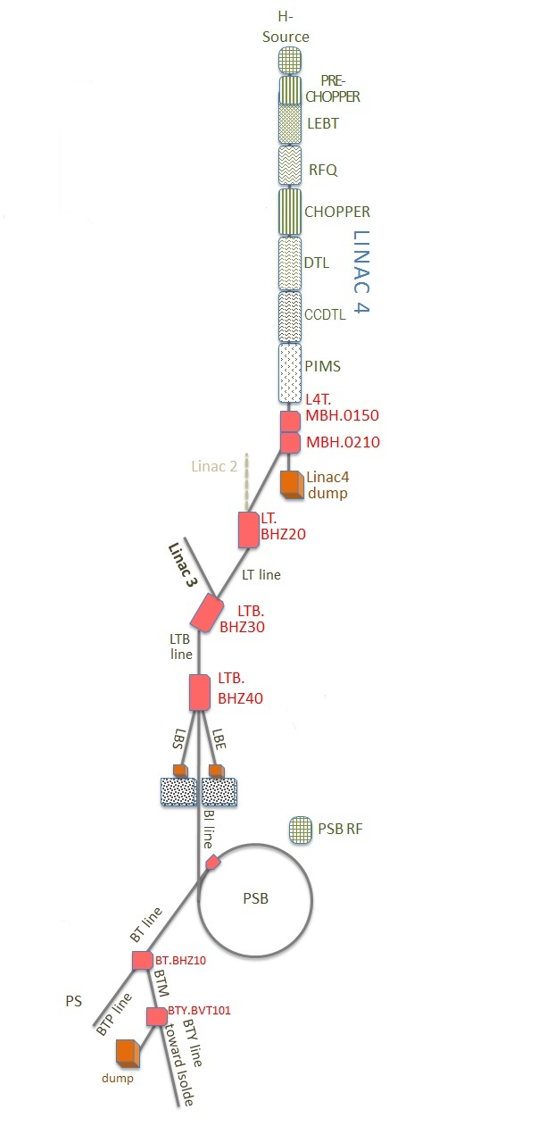
LINAC4 TO PSB BEAM INTERLOCK SYSTEM
LINAC4 TO PSB BEAM INTERLOCK SYSTEM
BIC L4
(2 MASTERS)
BIC PSB
(1 MASTER)
MASTER:
CHOPPERS
MASTER:
SOURCE RF
MASTER:
PSB EJECT
SLAVE L4
SLAVE L4T
SLAVE LBE
SLAVE LBS
SLAVE PSB
SLAVE PSB INJ
A. Apollonio TE-MPE-PE

Slide 4
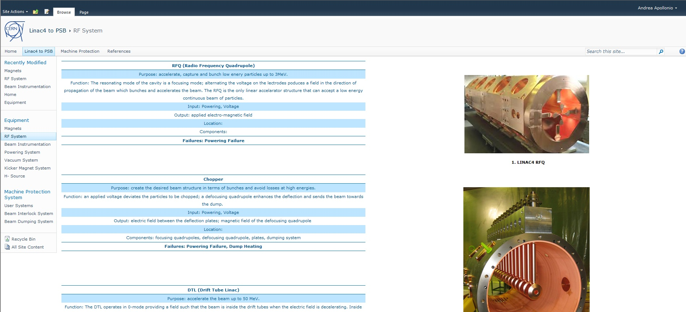
RETRIEVING AND COLLECTING INFORMATIONS: WEBSITE (1/2)
‘SITES’
‘PAGES’
A. Apollonio TE-MPE-PE

Slide 5
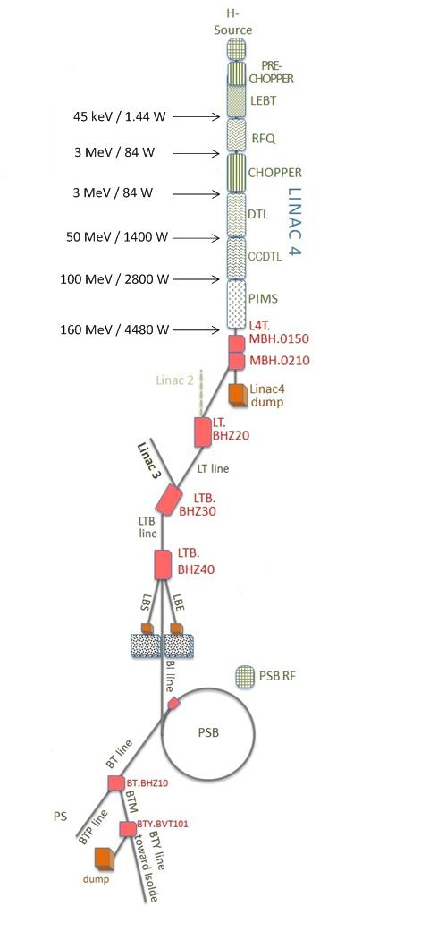
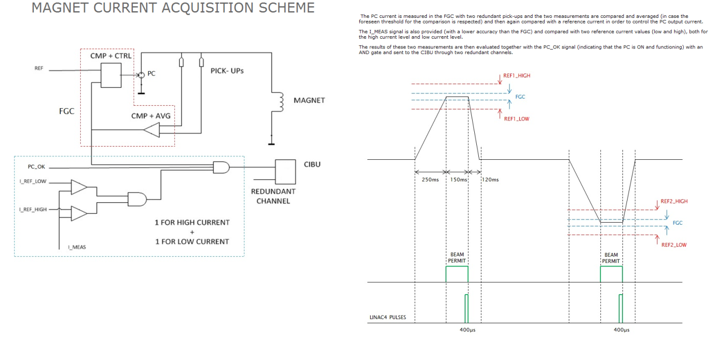
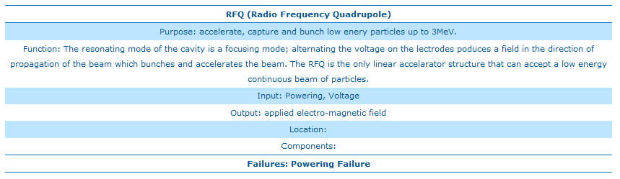
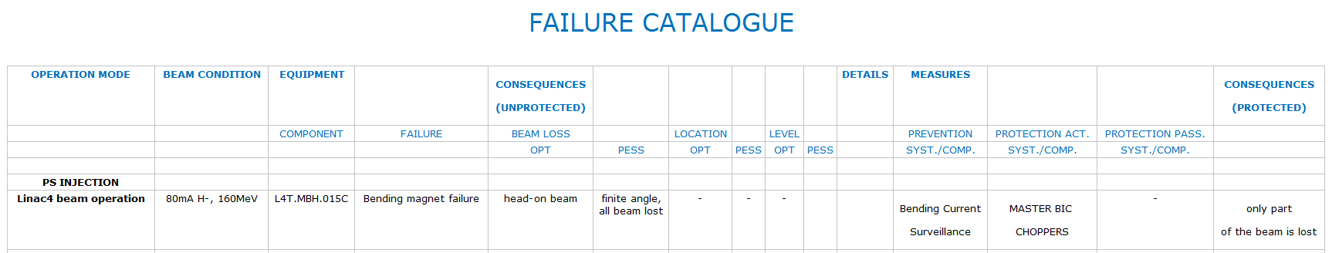
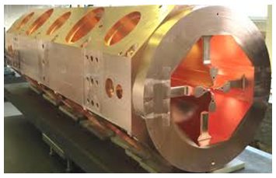
RETRIEVING AND COLLECTING INFORMATIONS: WEBSITE (2/2)
HOME:
Introduction
Acronyms
Glossary
CLICK…
LINAC4 to PSB:
Components description
Images
MACHINE PROTECTION:
Failure catalogue
Components and interlocks
REFERENCES:
Links to the reference documents
A. Apollonio TE-MPE-PE

Slide 6
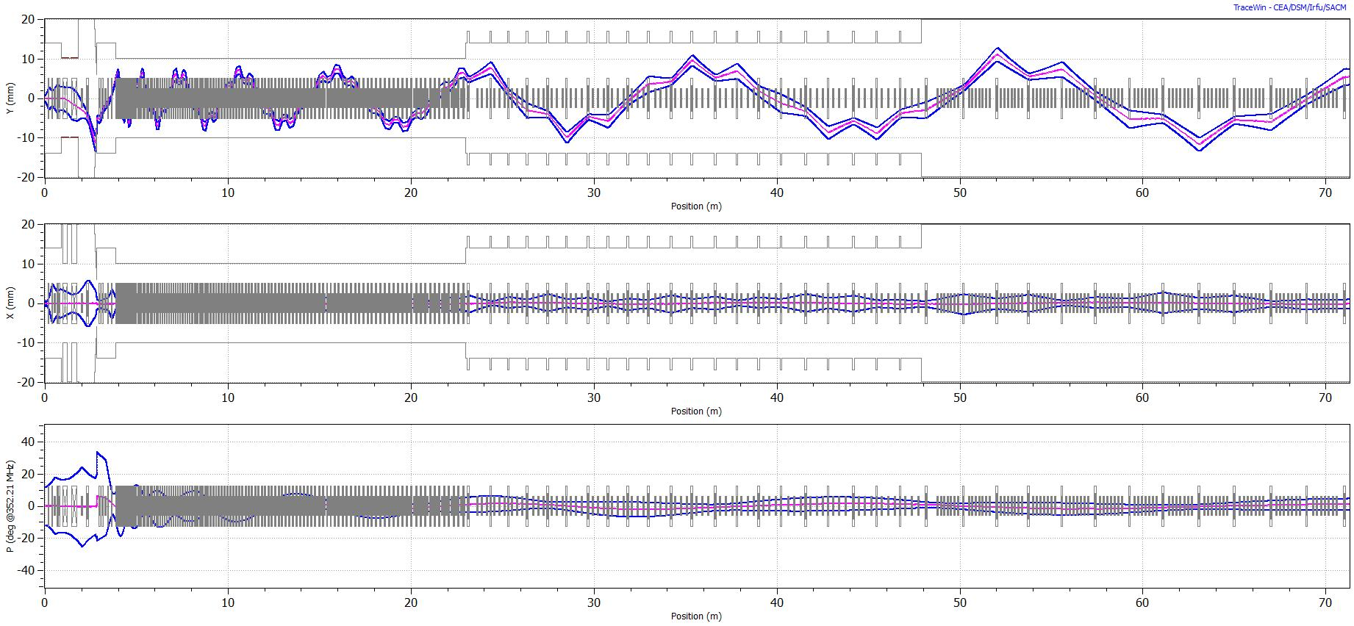
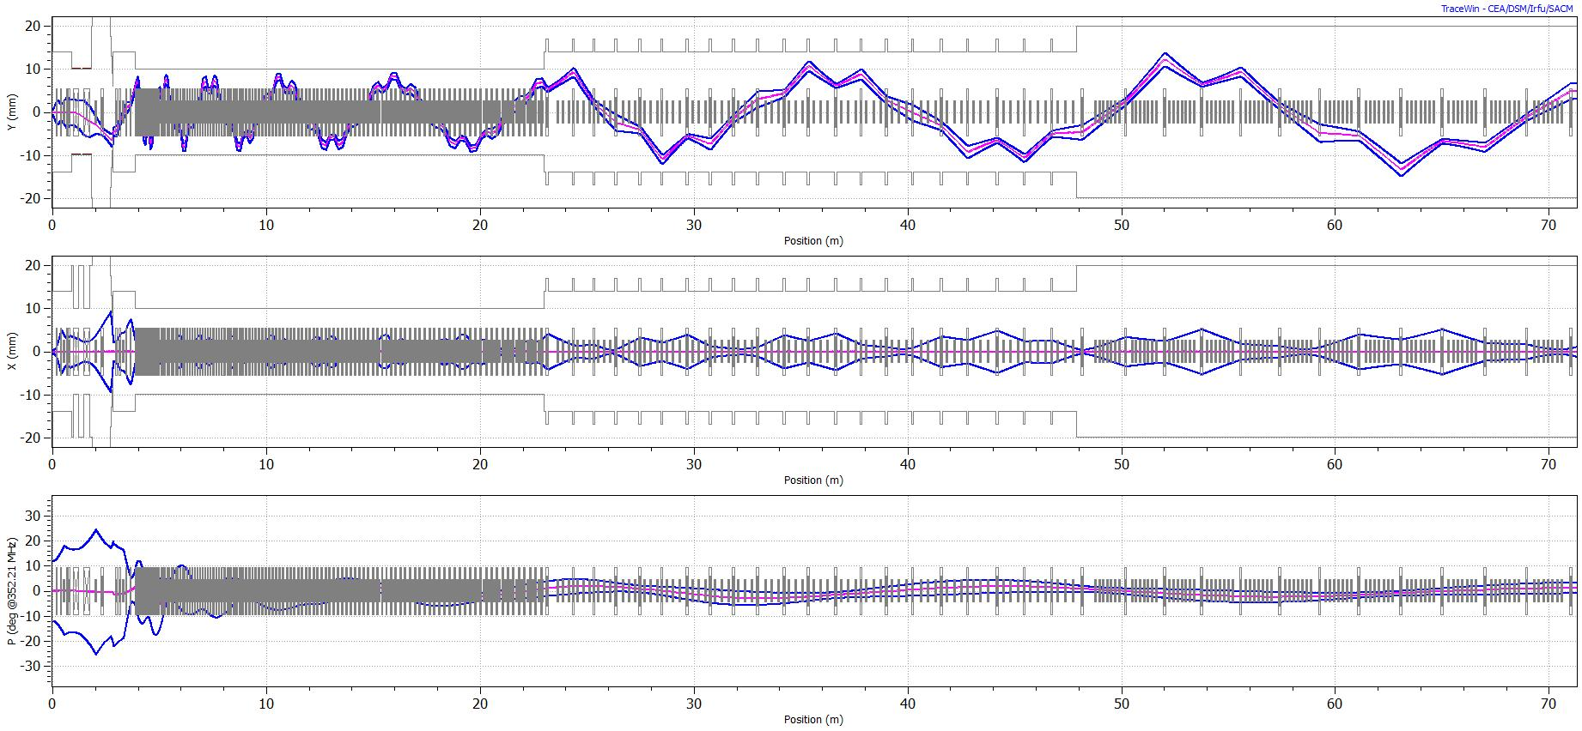
LINAC4: SIMULATIONS OF FAILURES (1/5)
One component failing in each simulation (chopper, EMQs, cavities):
J.B. Lallement
Example: CHOPPER ON + DEFOCUSING QUADRUPOLE (ON/OFF)
NOTE: for cavity failures it is assumed that the only effect on the beam is caused by the absence of the accelerating field.
A. Apollonio TE-MPE-PE

Slide 7
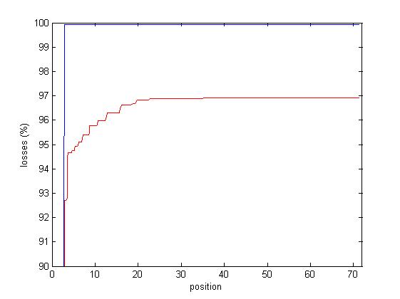
LINAC4: SIMULATIONS OF FAILURES (2/5)
Example: CHOPPER ON + DEFOCUSING QUADRUPOLE (ON/OFF)
INTEGRATED
LOSSES (%)
QD ON
QD OFF
MEBT 0m
DTL 3.9m
CCDTL 25.5m
PIMS 48.8m
END PIMS 70.6m
Losses propagate also in the transfer line if the QD is OFF
A. Apollonio TE-MPE-PE

Slide 8
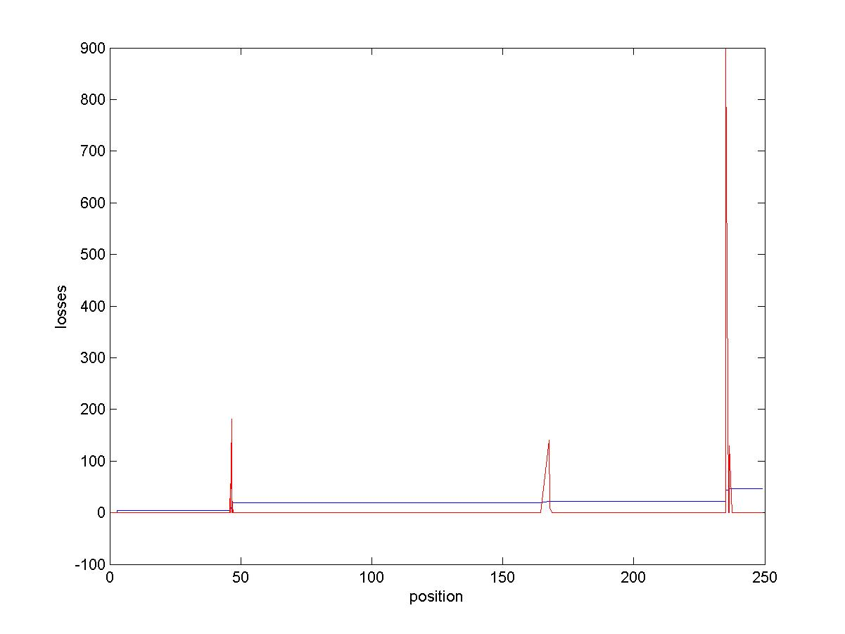
LINAC4: SIMULATIONS OF FAILURES (3/5)
Example: LAST CCDTL EMQ OFF
MEBT 0m
DTL 3.9m
CCDTL 25.5m
PIMS 48.8m
END PIMS 70.6m
1st BENDING M 77.7m
2nd BENDING M 81.8m
3rd BENDING M 85.9m
VERICAL STEP:
1st BENDING M 120.8m
2nd BENDING M 130.8m
BHZ20 141.1m
BHZ30 171.1m
BHZ40 237.5m
(%)
(W)
20% of the beam lost in the PIMS,
5% in BHZ30 and 20% in BHZ40
A. Apollonio TE-MPE-PE

Slide 9
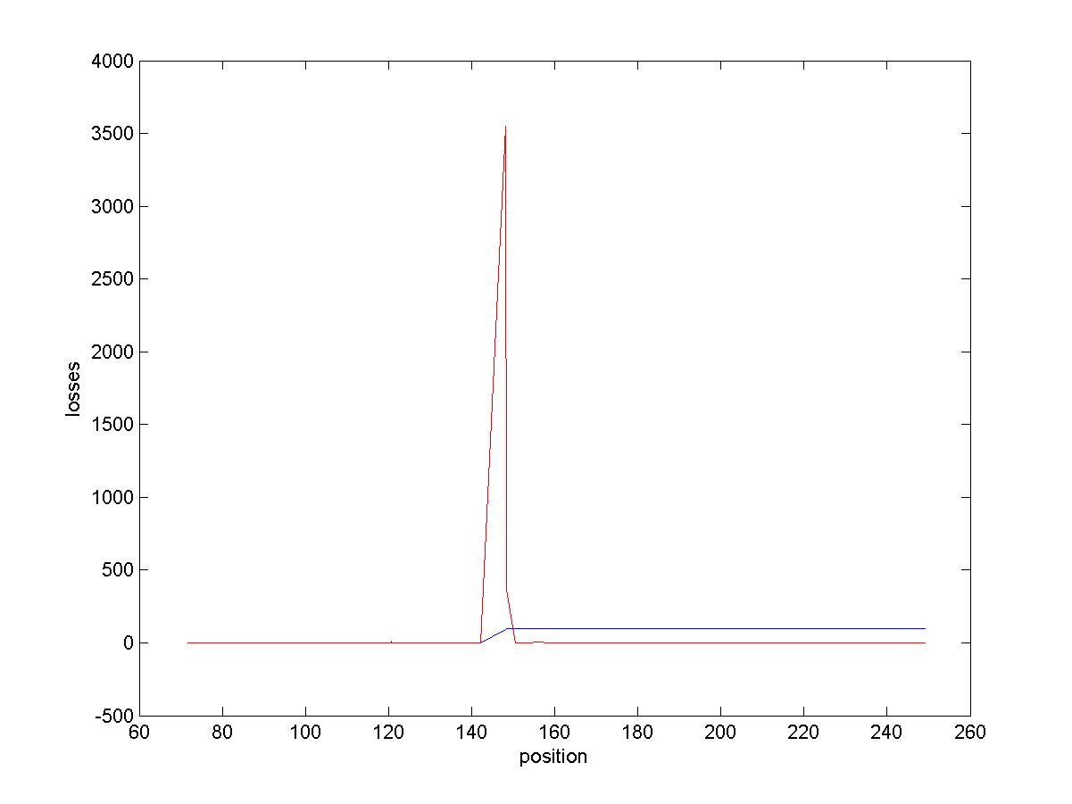
LINAC4: SIMULATIONS OF FAILURES (4/5)
Example: LAST PIMS MODULE OFF
MEBT 0m
DTL 3.9m
CCDTL 25.5m
PIMS 48.8m
END PIMS 70.6m
1st BENDING M 77.7m
2nd BENDING M 81.8m
3rd BENDING M 85.9m
VERICAL STEP:
1st BENDING M 120.8m
2nd BENDING M 130.8m
BHZ20 141.1m
BHZ30 171.1m
BHZ40 237.5m
(%)
(W)
100% Beam lost in BHZ20
A. Apollonio TE-MPE-PE

Slide 10
LINAC4: SIMULATIONS OF FAILURES (5/5)
“Potential Beam Pipe Damages in Linac4”, C. Maglioni, 7/4/2011
1.5mm SS Beam Pipe, 66mrad:
beam size is 1.5 x 1.5 mm (H x V, 1 rms)
Total ads power is 1530 W (55% of beam)
Energy density peak is 4560 J/cm^3/pulse
A. Apollonio TE-MPE-PE

Slide 11
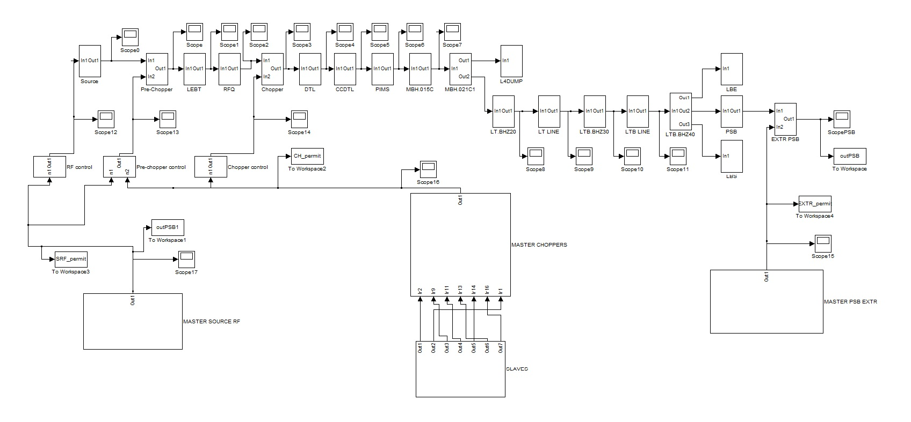
SIMULINK MODEL: MONTECARLO SIMULATIONS (1/2)
A. Apollonio TE-MPE-PE

Slide 12
SIMULINK MODEL: MONTECARLO SIMULATIONS (2/2)
The goal is to observe if the beam reaches the end of the model (output=1)
In case the beam doesn’t, verify if it is due to the BIS triggering or to the failure of a component
Produce statistics for such events, with random failures and input configurations
Considerations:
Still under development
An accurate study only makes sense if realistic failure rates for all the components are found
A. Apollonio TE-MPE-PE

Slide 13
FUTURE DEVELOPMENTS
Complete the website with an exhaustive failure catalogue (failure modes + study of consequences)
Maintain the website
Possibly apply the same approach to CLIC and the LHC (S.Wagner)
Perform Montecarlo simulations with the Simulink model to estimate availability and safety of the system
A. Apollonio TE-MPE-PE

Slide 14
PROGRESS ON PROTECTION STUDIES
FOR THE INJECTOR CHAIN
THANK YOU FOR YOUR ATTENTION
A. Apollonio TE-MPE-PE

