Slide 1
Summary
Machine Protection Workshop with main focusing on linear accelerator complexes
6-8 June 2012
Workshop page:
http://indico.cern.ch/conferenceDisplay.py?confId=185561

Slide 2
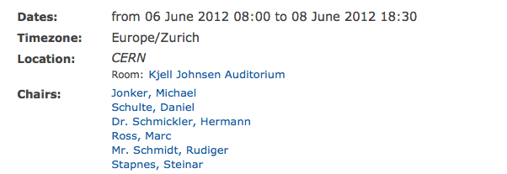
Some WS numbers and info
Registered participants 66
16 participants from outside Cern
Average audience 35
First ever international WS on MP
Idea for the workshop dates back to about 2.5 years ago when CLIC Machine Protection activities (and CDR) were starting.
  Initially foreseen as a MP workshop with members from LHC to profit from experience of LHC
  IWLC2010 in Geneva: Enlarge the scope and look for synergies with other institutions with similar requirements.
    Delayed because of CDR write-up activities.
  Organization planning taking off at IPAC11

Slide 3
Objectives
Workshop Objectives:
Bring together experts working on machine protection systems for accelerator facilities with high brilliance or large stored beam energies, with the main focus on linear accelerators and their injectors.
Establish a coherent view of failure modes and consequences for linear accelerators.
Review the current state of the art in machine protection systems.
The participants will benefit from the experience of colleagues who have designed, commissioned and operated such systems.
The workshop will provide input to the design of machine protection systems at future accelerators, in particular for CLIC and ILC.
It also should promote synergies in the development of protection systems at different accelerators.

Slide 4
Program
http://indico.cern.ch/conferenceOtherViews.py?view=standard&confId=185561
Wednesday (experience and future needs)
Machine protection and operational availability, issues and solutions.
Review of existing solutions and challenges faced by future installations:
Beam loss mechanisms.
Experience of existing and previsions for future accelerator complexes, addressing three types of beam losses and their potential impacts:
  Operational beam losses, Equipment failure induced beam losses, Transient beam losses, or beam losses related to changing environment (temperature drift, ground motion, ufo, others).
Thursday (instrumentation and technology)
Failure onset detection.
This section will address the detection of failures that may lead to uncontrolled beams.
  Beam Quality Assessments (for active systems and Post Pulse Analysis)
  Equipment failure detection
Failure mitigation.
Reviews of various types of failure mitigation:
  Passive protection (masks , materials, collimators, non linear optics), RT protection, Safe by design, Interlock systems (equipment and post pulse assessment)
Friday
Operational aspects (commissioning, intensity ramp, machine availability)
Risk assessment: management and tools
Summing up and conclusions

Slide 5
Workshop program
5 sessions + summing up
Machine protection, issues and solutions.
  Experience from LHC, Flash, light sources
  Challenges for ILC, CLIC, XFEL, ESS
Beam loss mechanisms.
  Operational beam losses: quasi continuous losses (e.g. beam gas induced) that form the loss background that has a major impact on the radiation environment in the accelerator.
  Equipment failure induced beam losses, which – if ill controlled – may lead to major damage of the accelerator structures.
  Transient beam losses, or beam losses related to changing environment (breakdowns, ufo, temperature drift, ground motion, …).
Failure onset detection.
  Beam Quality Assessments (for Active Protection and Post Pulse Analysis)
  Equipment failure detection
Failure mitigation.
  Passive Protection (masks , materials, collimators, non linear optics)
  RT protection
  Safe by design
  Interlock systems (equipment and post pulse assessment)
Operational aspects.
  Operational aspects (commissioning, intensity ramp, machine availability)
  Risk assessment: management and tools
Notes:
Experiences and future needs
Instrumentation and technology
Engenering and operational expereince.

Slide 6
Machine Protection System?
CONTROL SYSTEM
(Configuration management)
BPS
(Beam Permit System)
≈ 1000 signals
Response time: 5-10µs
MID
(MPS Input Devices)
Binary
OK/NOK
Binary
OK/NOK
MOD
(MPS Output Devices)
BIS
(Beam Interlock System)
TIMING SYSTEM
Post Mortem

Slide 7
The MPS consists of:
1) a single bunch damage mitigation system,
2) an average beam loss limiting system,
3) a series of abort kickers and low power dumps,
4) a restart ramp sequence,
5) a beam permit system,
6) a fault analysis recorder system,
7) a strategy for limiting the rate with which magnetic fields (and insert-able device positions) can change,
8) a sequencing system that provides for the appropriate level of protection depending on machine mode or state, and
9) a protection collimator system.
...
An accident recovery strategy (spares, fast exchange procedures)
A system validation protocol

Slide 8
Failure modes
20 ms:
Last delivered pulse
-2 ms
Next Pulse permit
-0.1 ms
Beam in flight
-0.01 ms
Beam at BDS
Slow errors and drifts:
Post pulse analysis
Fault analysis
Recovery policy
Spares policy
Intervention plan
Performance, equipment settings, …
In flight errors:
Masks and RT protection
ramp up policy
Inter pulse equipment errors:
Interlock system
Last moment equipment errors:
Safe by design (equipment inertia)

Slide 9
Machines covered
LHC
Flash
XFEL,
ESS
ILC
CLIC
ASTA
CEBAF
Fermi@Elettra

Slide 10
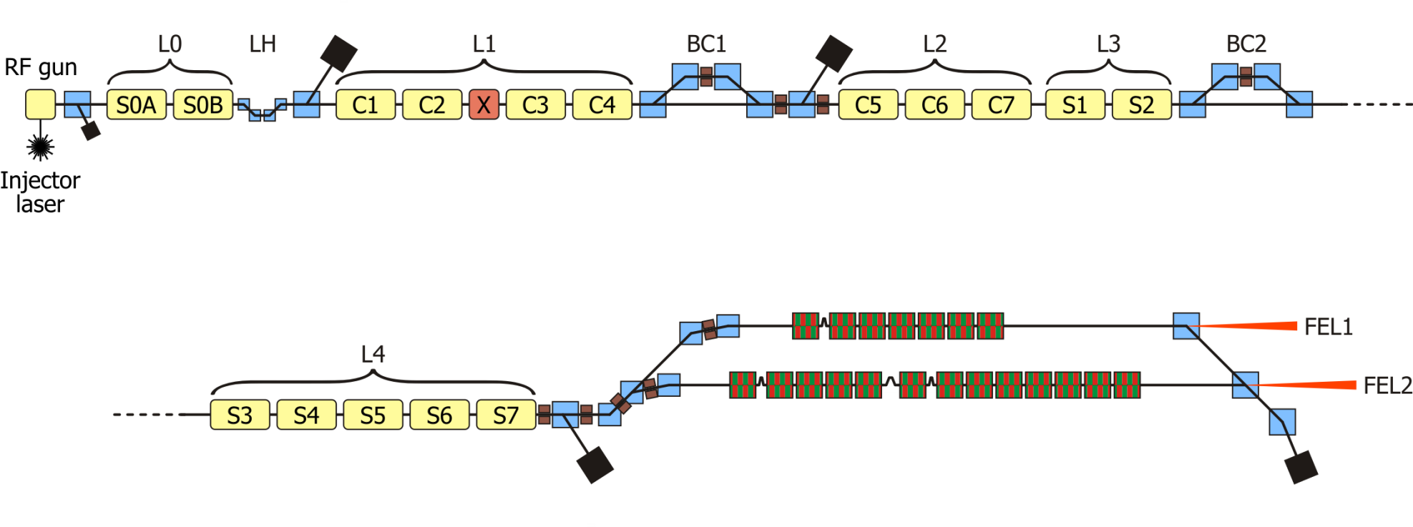
Beam Energy is not everything
FERMI@Elettra
 | Energy | Bunch Charge | Repetition Rate | Beam Power
Typical | 1.2 GeV | 350 pC | 10 Hz | 4.2 W
Design | 1.5 GeV | 1 nC | 50 Hz | 75 W
The scale: 10 kGray → loss of 0.5% of permanent magnet strength
Other example: LHC Quench : 10⁻⁸ level of beam energy

Slide 11
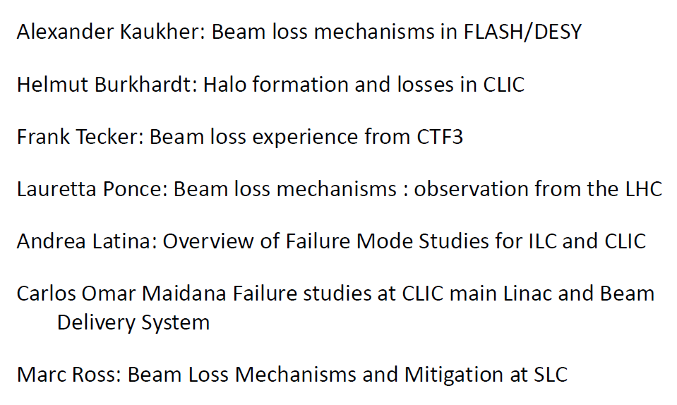
Beam loss

Slide 12
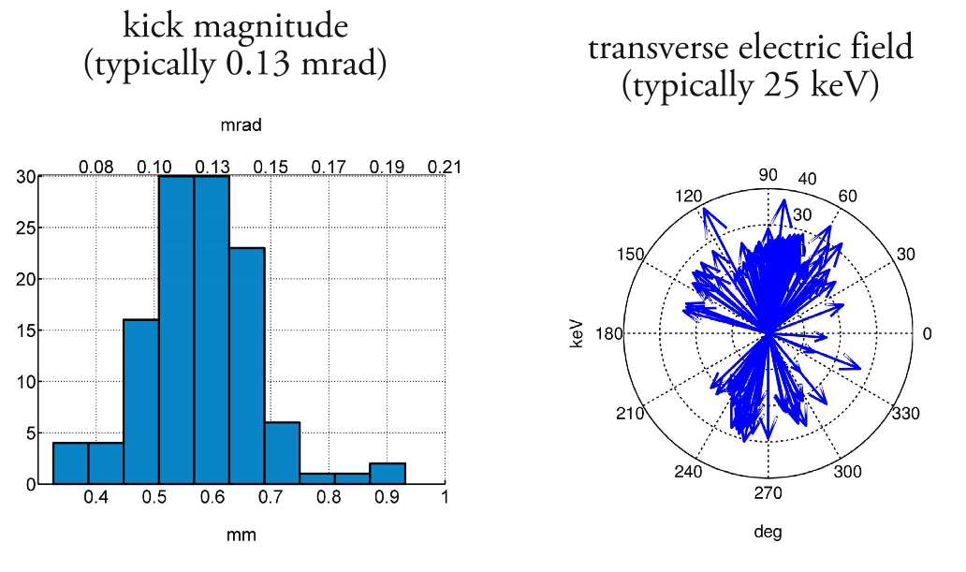
TBTS beam kick measurements
Wilfrid Farabolini
Andrea Palaia
kicks corresponding to transverse momentum
between 10 and 40 keV/c
(measurements at NLCTA < 30 keV/c)
more data with BPMs this year…

Slide 13
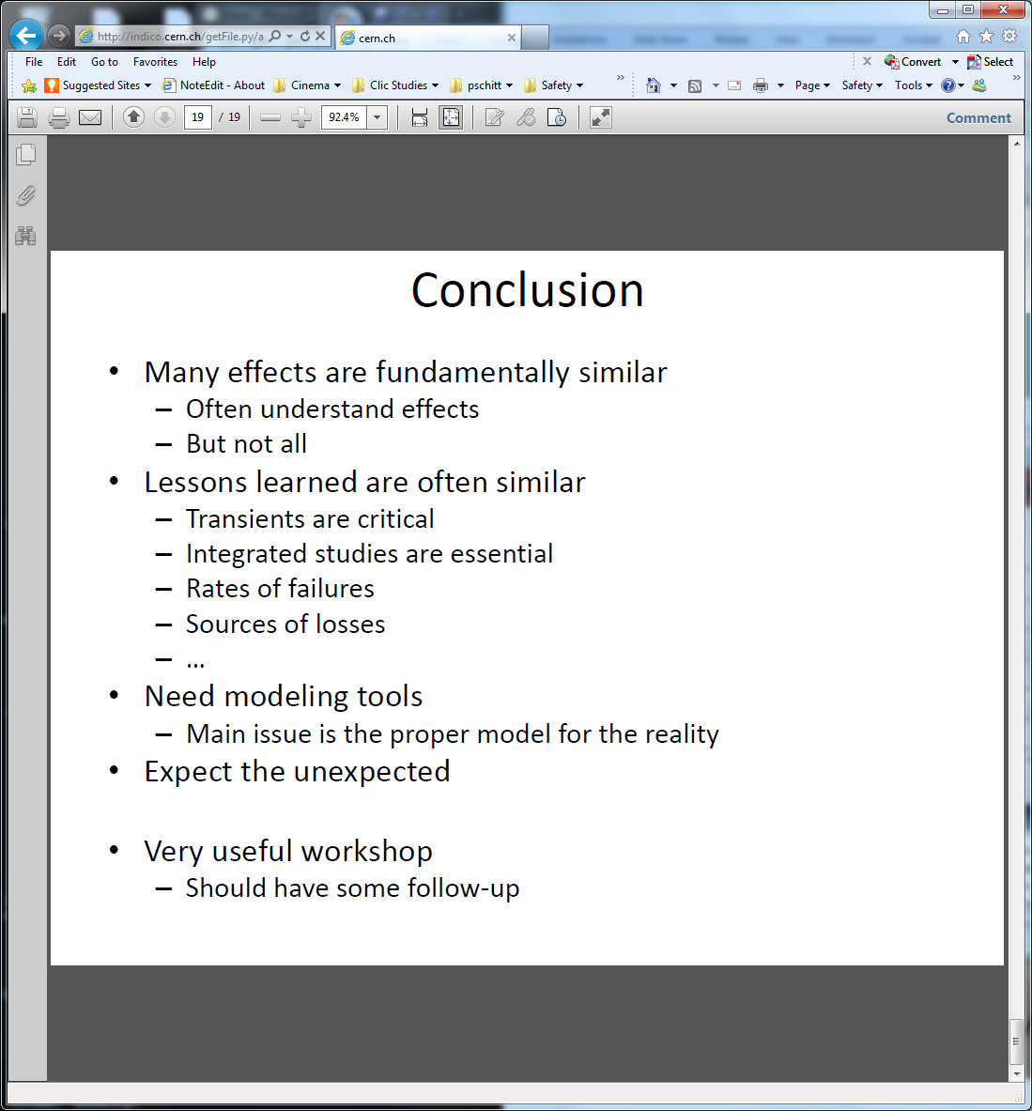
Beam loss conclusions

Slide 14
Failure Detection - Summary
The FIVE presentations:
1) B.Dehning: LHC Beam Loss Detection System
2) S. Mallows: Studies for the CLIC TBM BLM System
3) L. Froehlich: Diagnostics for MP at FERMI@Elettra
4) B. Puccio: Equipment fault Detection Sequence
5) V.Kain: Beam Quality Assessment for the LHC beams
(real time and post-pulse)

Slide 15
Failure mitigation session
Beam Loss Mechanisms and Mitigation at SLC
Marc Ross Slides
The post-LINAC collimation system of CLIC: Machine Protection Aspects
Javier Resta Lopez Slides
Novel advanced materials for next-generation Beam Intercepting Devices
Alessandro Bertarelli Slides
Reliable beam extraction
Jan Uythoven Slides
Safe by design Clic powering
David Nisbet Slides
CLIC Interlock system: preliminary study
Patrice Nouvel Slides

Slide 16
Advanced Materials for Next-generation
Beam Intercepting Devices
Driven by LHC phase II upgrade
New materials Metal Matrix Composites
  Cu-CD, Mo-CD, Ag-CD, Mo-Gr
  Compromise of stability, robustness, rl
  simulation studies
  Sophisticated HiRadMat tests
Results dependent on
  geometry of design.
  Charge density
  below a certain beam size only
  total charge matters
  Wait for tests and understanding of HiRadMat results
  Then study (test) possible applications in Linear Colliders
Mo-Gr in comparison with Mo-CD:
No low melting phase (as Cu in LPS Mo-CD)
Lower Density
Similar Thermal Conductivity
No reinforcement degradation
Lower Costs
Mechanical strength not yet satisfactory

Slide 17

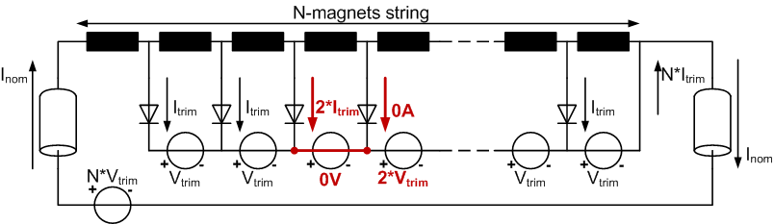
Failure tolerant operation
Trimming cables are implemented with serial diodes (only dissipative trimming).
When a failed trimmer is short-circuited, the diode does not allow the current magnet to fall lower than the following one.
Open circuit case affects all previous magnets.
Few seconds are needed for stabilising the currents in the remaining magnets.
I_{mag4} = I_{mag5} after trimmer 4 failure

Slide 18
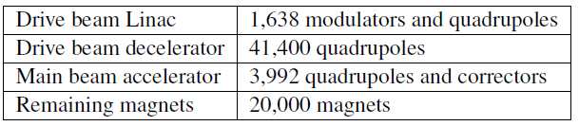
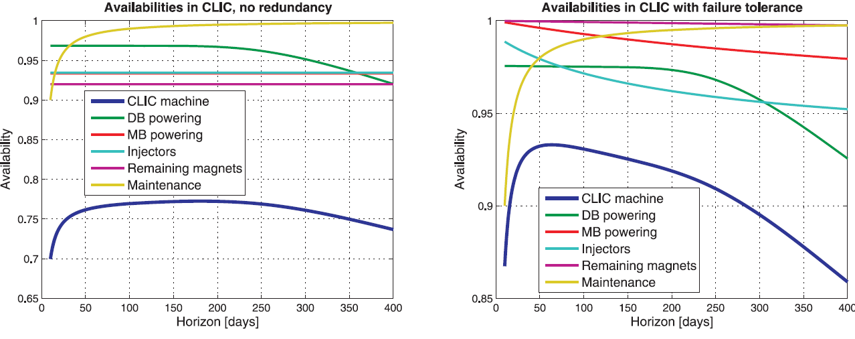
CLIC Powering availability
Comparison of ‘doing nothing’ with ‘appropriate redundant solutions’ (ie hot swap and N+1 where appropriate)
94%
77%

Slide 19
Operational aspects
    RF breakdown recovery , Walter Wuensch Slides
    Clic Intensity rampup, Michael Jonker Slides
    Simulating the Operation and Maintenance of an Accelerator Complex, Marc Ross Slides
    AvailSim is a Monte-Carlo simulation tool that uses Excel and Matlab to show a timeline of operation of a large accelerator complex. The simulation uses and table listing all key accelerator components with mean time to fail (MTBF) and mean time to repair (MTTR) data taken from data recorded at DESY, Fermilab and SLAC from the 1990's. The model includes the full segmentation of the machine so that repairs can be done in one segment while necessary machine development is done upstream. A key parameter in the model is the time to recover operation after a downtime. AvailSim has been a useful tool to aid in the machine design, especially aspects such as equipment location (in /out of tunnel), access and operations segmentation and redundancy.
    Reliability of the CERN Beam Interlock System: Past, Present and Future, Ben Todd Slides
    Risk assessment in Linac-4, management and tools, Andrea Apollonio Slides
    A Systems Engineering Approach to Machine Protection, Kelly Mahoney (TJNAF) Slides
    Jefferson Lab accelerators include the 1MW CEBAF electron machine as well as the high intensity Free Electron Laser. Borrowing risk management practices from the military, aerospace and chemical processing industries, Jefferson Lab manages a graded approach to identify and manage risk presented by beam operations. Constraints are then incorporated in to system level requirements across multiple subsystems. This talk will describe the engineering transition of the Jefferson Lab CEBAF and FEL accelerator machine protection systems to a risk based systems engineering approach. The approach addresses the traditional goals of maximum machine availability, minimal short and long term damage, and configurability. In addition, a systems engineering approach also addresses enabling and supporting processes like project management, controls infrastructure, personnel competency, and long term system effectiveness. We will conclude with a brief look at ongoing work to integrate the systems, software, and cyber security assurance practices.

Slide 20
Machine Protection in Linacs
High Power linacs are planned or under construction
Many – but not all – of the LHC MPS lessons can be directly applied
  (All LHC experience is interesting and useful)
Achievable performance will depend on implementation strategy and details
What are the key questions?
  Safety Culture
  Sub-system boundaries
  Understanding particular failures and rates and comparing to models → ‘benchmarking’
  Remaining risks

Slide 21
“Complex systems”
What is a complex system?
is Linear Collider MPS complex?
  (probably yes)
If yes, can it be made simpler?
See references on reliability performance of complex systems:
  e.g. “Normal Accidents: Living with high risk technology”, Charles Perrow, 1984

Slide 22
Follow up
Summary paper submitted at Linac12 in September
Extended paper for further publication
Next workshop in 2 ~ 3 years
  Extend the scope, more on engineering and operational aspects?
Set up a network for MP experts
Need follow up discussions concerning balance of local/global complexity

Slide 23
CLIC Interlock system: preliminary study
**
X 60
*
*FEC: Front-End Computer
**ACM: Acquisition and Control Module

Slide 24
Risk matrix
Impact
10⁸ | 10⁷ | 10⁶ | ~day 10⁵ | 10⁴ | ~hr 10³ | 10² | 10¹ | ~sec 10⁰ | 10⁻¹
 | ... 5 10⁷ ChF ... 200 days | 5 10⁷ – 10⁶ ChF 200 – 20 days | 10⁶ – 10⁵ ChF 20 – 3 days | 10⁵ ... ChF 3 ... days
10⁰ –
10⁻¹ – 10⁰
10⁻² – 10⁻¹
10⁻³ – 10⁻²
10⁻⁴ – 10⁻³
– 10⁻⁴
~1000% 10⁸ ChF y⁻¹
~100% 10⁷ ChF y⁻¹
~10% 10⁶ ChF y⁻¹
~1% 10⁵ ChF y⁻¹
~0.1% 10⁶ ChF y⁻¹
~0.01% 10³ ChF y⁻¹
10⁸ Chf y⁻¹ 10⁷ Chf y⁻¹ 10⁶ Chf y⁻¹ 10⁵ Chf y⁻¹
10⁷ Chf y⁻¹ 10⁶ Chf y⁻¹ 10⁵ Chf y⁻¹ 10⁴ Chf y⁻¹
10⁶ Chf y⁻¹ 10⁵ Chf y⁻¹ 10⁴ Chf y⁻¹ 10³ Chf y⁻¹
10⁵ Chf y⁻¹ 10⁴ Chf y⁻¹ 10³ Chf y⁻¹ 10² Chf y⁻¹
10⁴ Chf y⁻¹ 10³ Chf y⁻¹ 10² Chf y⁻¹ 10¹ Chf y⁻¹
10³ Chf y⁻¹ 10² Chf y⁻¹ 10¹ Chf y⁻¹ 10⁰ Chf y⁻¹
~1000% | ~100% | ~10% | ~1%
~100% | ~10% | ~1% | ~0.1%
~10% | ~1% | ~0.1% | ~0.01%
~1% | ~0.1% | ~0.01% | ~0.001%
~0.1% | ~0.01% | ~0.001% | ~0.0001%
~0.01% | ~0.001% | ~0.0001% | ~0.00001%
Machine protection issues
Equipment reliability issues
= Operational Availability
Machine interlock reliability issues
(false interlock rate)
Frequency
RISK
Frequency
RISK
False interlock
3 seconds L loss (CLIC)
Budget: 1 % dead time
=> 1 false interlock per 5 min
NB: 10⁵ BLM monitors
If based on single monitors
=> 10⁻¹⁰ per monitor, per cycle ?
Power converter failure
5 hrs L loss for recovery
Budget: 1 % dead time
1 failure in the system per 20 days
NB: 10⁵ Power Converters
MTBF 5 10⁷ hrs ??!!
Notes:
LHC-CI-ES-0004-10-00.pdf https://edms.cern.ch/document/810607/1.0
http://en.wikipedia.org/wiki/Safety_integrity_level
Safety Integrity Level (SIL) is defined as a relative level of risk-reduction provided by a safety function, or to specify a target level of risk reduction. In simple terms, SIL is a measurement of performance required for a Safety Instrumented Function (SIF).
SIL = floar [log(RiskReductionFactor)] e.g. If a safety system needs to provide a risk reduction factor of 3 10³ then it should be SIL 3
Probability of Failure on Demand = Risk Reduction Factor
Probability of failure per hour = 10000 x PFD => demand rate 3.6 per second, this is not enough for CLIC operation
IEC 61508 http://en.wikipedia.org/wiki/IEC_61508
IEC 61511 http://entrac.iaea.org/I-and-C/WS_PORTOROZ_2008_04/Presentations/de_Grosbois/IAEA_Modernization_Workshop_Presentation_2.pdf
The IEEE chart, the explanation, the logic of logarithmic scales
Danger of using these chards
Equal risks, considerations for extreme cases
Low frequency high impact. difficult to estimate
Under estimation of damage (consider knock on effects and collateral damage installation shutdown)
Under estimation of frequency (forgotten failures)
High frequency small impact
Dead time
When to invest
If the investment pays off, i.e. Cost of improving operational availability is smaller than the benefit of improving the operational availability
Where to invest
Example: one false interlock cuts the beam for 5 seconds => one BLM fluctuation per 10 minutes causing am interlock gives

Slide 25
Risk matrix (IEC EN 61508)
Failure rate (SIL) and Risk table used for LHC risk evaluation (adapted from LHC-CI-ES-0004-10-00.pdf)
Event Likelihood [year⁻¹] | Consequence
 | Catastrophic | Major | Severe | Minor
Frequent :
Probable
Occasional
Remote
Improbable
Negligible
 | ... 5 10⁷ ChF ... 200 days | 5 10⁷ – 10⁶ ChF 200 – 20 days | 10⁶ – 10⁵ ChF 20 – 3 days | 10⁵ ... ChF 3 ... days
10⁰ –
10⁻¹ – 10⁰
10⁻² – 10⁻¹
10⁻³ – 10⁻²
10⁻⁴ – 10⁻³
– 10⁻⁴
1 sec ≈1 CHF
10⁸ Chf y⁻¹ 10⁷ Chf y⁻¹ 10⁶ Chf y⁻¹ 10⁵ Chf y⁻¹
10⁷ Chf y⁻¹ 10⁶ Chf y⁻¹ 10⁵ Chf y⁻¹ 10⁴ Chf y⁻¹
10⁶ Chf y⁻¹ 10⁵ Chf y⁻¹ 10⁴ Chf y⁻¹ 10³ Chf y⁻¹
10⁵ Chf y⁻¹ 10⁴ Chf y⁻¹ 10³ Chf y⁻¹ 10² Chf y⁻¹
10⁴ Chf y⁻¹ 10³ Chf y⁻¹ 10² Chf y⁻¹ 10¹ Chf y⁻¹
10³ Chf y⁻¹ 10² Chf y⁻¹ 10¹ Chf y⁻¹ 10⁰ Chf y⁻¹
SIL4 | SIL3 | SIL3 | SIL2
SIL3 | SIL3 | SIL3 | SIL2
SIL3 | SIL3 | SIL2 | SIL1
SIL3 | SIL2 | SIL2 | SIL1
SIL3 | SIL2 | SIL1 | SIL1
SIL2 | SIL1 | SIL1 | SIL1
~1000% | ~100% | ~10% | ~1%
~100% | ~10% | ~1% | ~0.1%
~10% | ~1% | ~0.1% | ~0.01%
~1% | ~0.1% | ~0.01% | ~0.001%
~0.1% | ~0.01% | ~0.001% | ~0.0001%
~0.01% | ~0.001% | ~0.0001% | ~0.00001%
A table made for managers
Easy understandable naming...
underlying logarithmic scale
SIL: Safety Integrity Level, i.e. the risk reduction to be provided by a safety function
Risk Reduction is 10^{SIL}
Notes:
LHC-CI-ES-0004-10-00.pdf https://edms.cern.ch/document/810607/1.0
http://en.wikipedia.org/wiki/Safety_integrity_level
Safety Integrity Level (SIL) is defined as a relative level of risk-reduction provided by a safety function, or to specify a target level of risk reduction. In simple terms, SIL is a measurement of performance required for a Safety Instrumented Function (SIF).
SIL = floar [log(RiskReductionFactor)] e.g. If a safety system needs to provide a risk reduction factor of 3 10³ then it should be SIL 3
Probability of Failure on Demand = Risk Reduction Factor
Probability of failure per hour = 10000 x PFD => demand rate 3.6 per second, this is not enough for CLIC operation
IEC 61508 http://en.wikipedia.org/wiki/IEC_61508
IEC 61511 http://entrac.iaea.org/I-and-C/WS_PORTOROZ_2008_04/Presentations/de_Grosbois/IAEA_Modernization_Workshop_Presentation_2.pdf
The IEEE chart, the explanation, the logic of logarithmic scales
Danger of using these chards
Equal risks, considerations for extreme cases
Low frequency high impact. difficult to estimate
Under estimation of damage (consider knock on effects and collateral damage installation shutdown)
Under estimation of frequency (forgotten failures)
High frequency small impact
Dead time
When to invest
If the investment pays off, i.e. Cost of improving operational availability is smaller than the benefit of improving the operational availability
Where to invest

