Slide 1
Update on Bus Bar Splice Resistance Measurements at 1.9K
(LHC Main Magnet Circuits)
# Most recent general statistics (Oct-2012)
# What are the measurement errors?
# Best fit models for RB and RQ circuits
# Criteria to be redone? To be discussed …
Zinour Charifoulline, TE-MPE-PE

Slide 2
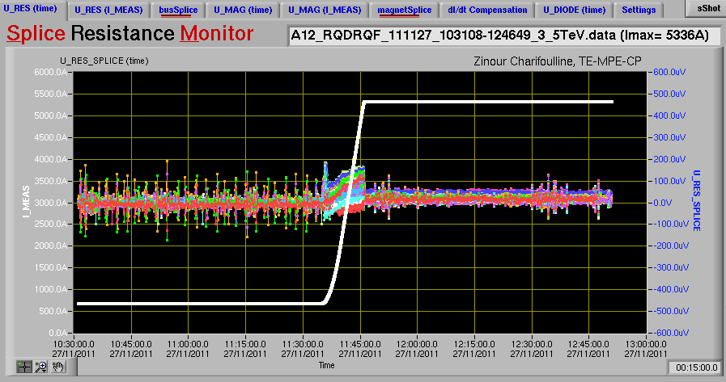
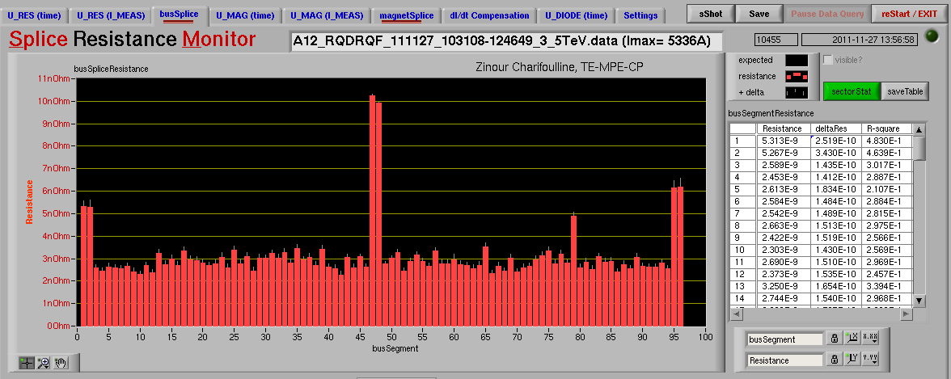
Data Source and Current Statistics
Measurements: 3.5-4TeV Ramps with 1 hour on injection and 1 hour on the top
Current Statistics: about 700 (2010-2012) resistance tables for the bus bars (interconnects)
about 200 tables for the internal splices (magnets)
Injection ~2h20 hours 3.5-4TeV

Slide 3
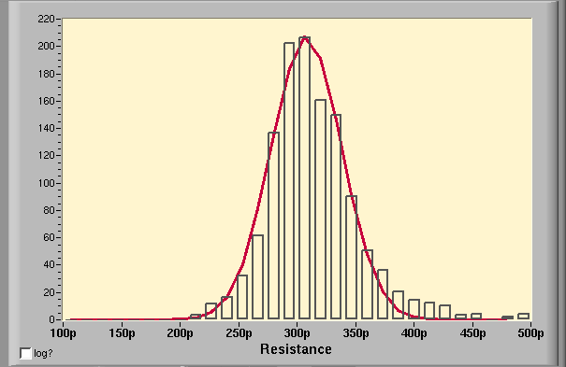
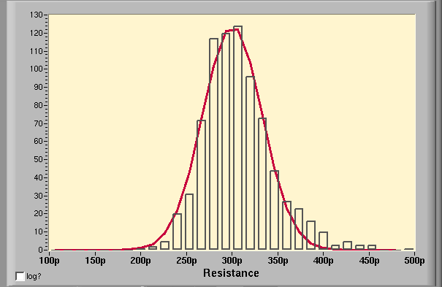
Maximum and Average Splice Resistances
RB Bus Bar Segments
Splice Num | 2 | 3 | 4 | 5 | 6 | All | Joints
Segments | 368 | 816 | 48 | 15 | 1 | 1248 | 3457
RQ Bus Bar Segments
Splice Num | 5 | 6 | 7 | 8 | 15 | 16 | 17 | 18 | 19 | 20 | 21 | 32 | All | Joints
Segments | 8 | 16 | 8 | 728 | 2 | 11 | 2 | 1 | 2 | 12 | 2 | 8 | 800 | 6930
Since each bus-bar segment contains n splices it is not possible to measure the resistance of an individual splice. However, one can estimate the maximum splice resistance in a segment assuming that the excess is localized in one splice only, so R_{spl,max} = R_{segment} – (n-1) * R_{spl,avg}, where R_{spl,avg} is the average splice resistance.
R_{spl,avg}
RB Bus Bars
308±31pΩ
R_{spl,avg}
RQ Bus Bars*
301±34pΩ
* In case of quads the number of splices per segment is corrected due to the specific design of the protection voltage taps .
The correction estimated by comparing the resistances of 6 and 8 splice segments is about 2x0.20 nΩ.

Slide 4
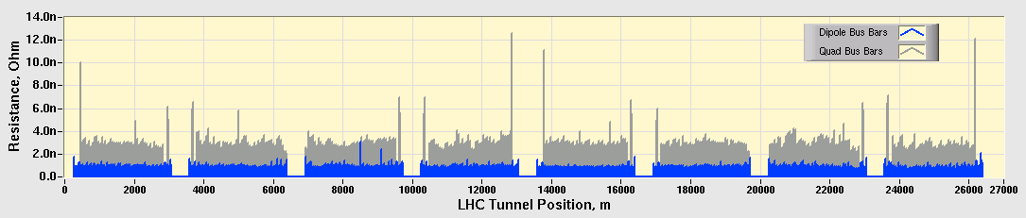
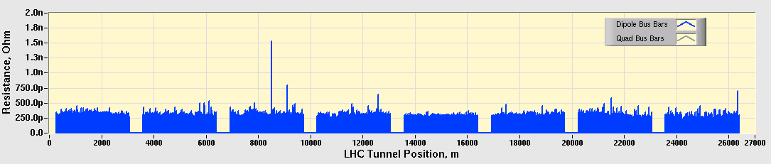
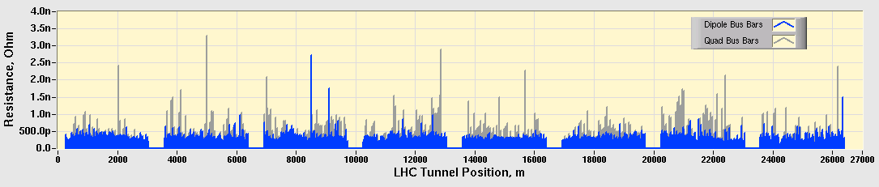
LHC Bus Bar Resistances, 2010-2012 statistics, I
Bus-Bur Segment Resistances, R_{meas}
Average Splice Resistances, R_{avg}=R_{meas}/N
RB : 308±31pΩ
RQ*: 301±34pΩ
Max Splice Resistances, R_{max}=R_{meas}-(N-1)*R_{avg}
RB : 304±83pΩ
RQ*: 308±309pΩ
* In case of quads the number of splices per segment is corrected due to the specific design of the protection voltage taps .
The correction estimated by comparing the resistances of 6 and 8 splice segments is about 2x200pΩ or 1.33x300pΩ.

Slide 5
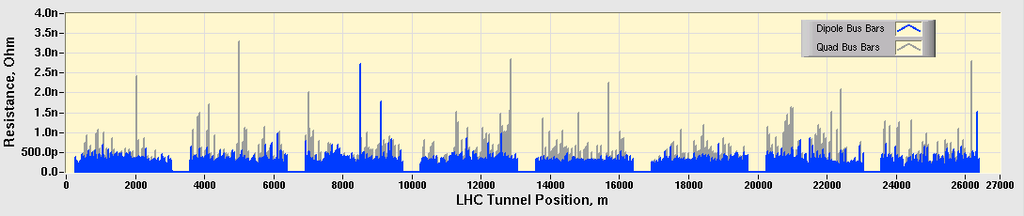
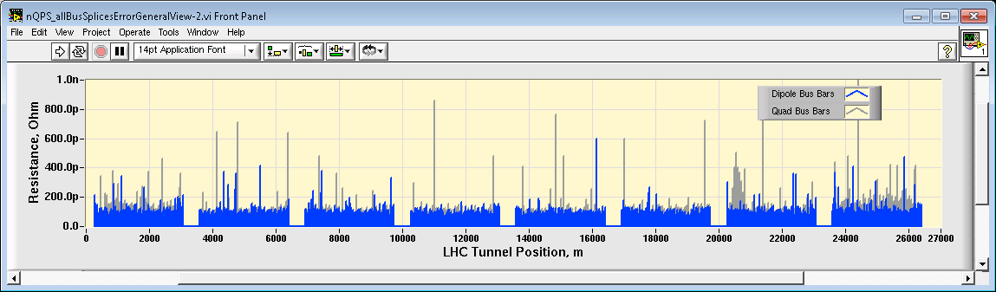
LHC Bus Bar Resistances, 2010-2012 statistics, II
Max Splice Resistances, R_{max}=R_{meas}-(N-1)*R_{avg}
Measurement Error, ~700 Ramps per Point
What are the measurement errors?

Slide 6
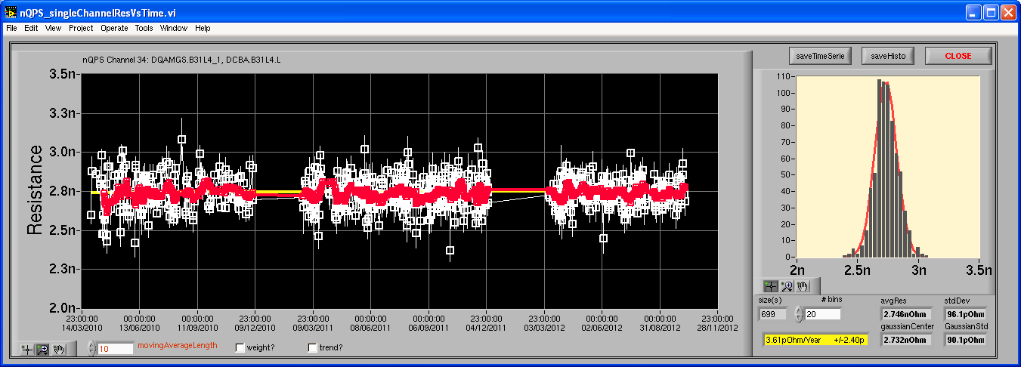
What are the measurement errors?
Max Splice Resistances, R_{max}=R_{meas}-(N-1)*R_{avg}
2010
2011
2012
<R> = ΣR_{i}·(1/σ_{i})²/ Σ(1/σ_{i})²
stdDev = Σ(<R> -R_{i})²·(1/σ_{i})²/ Σ(1/σ_{i})²
Note: Standard Error for <R> = StdDev/sqr(N), N=700 => sqr(N)=26

Slide 7
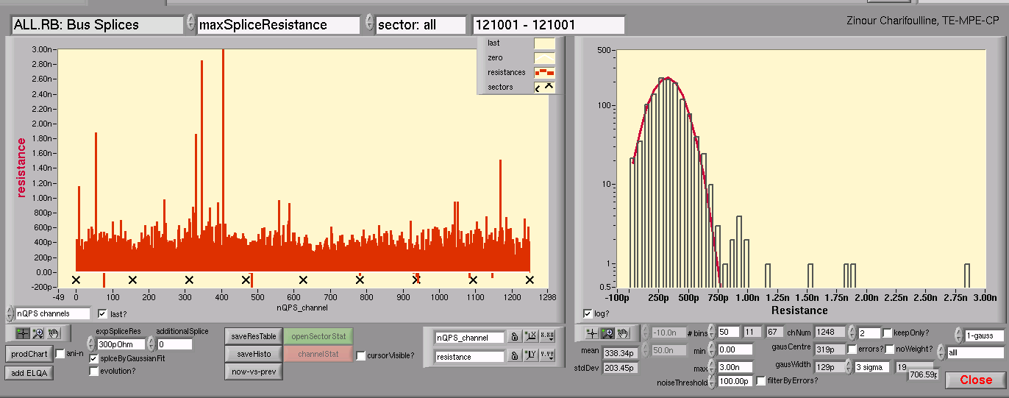
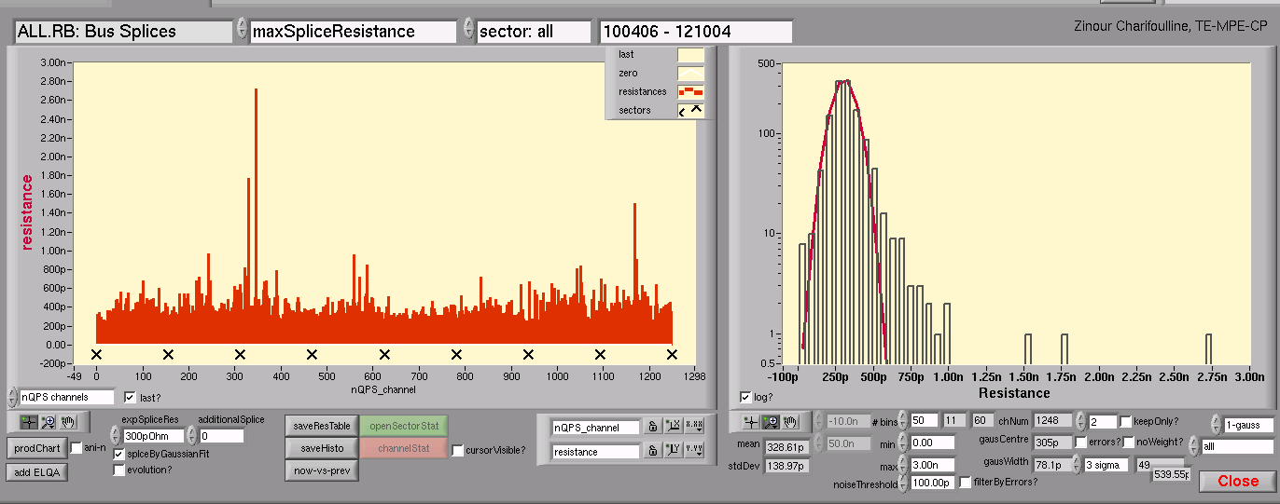
What are the measurement errors?
1 Ramp per Point
~700 Ramps per Point
sqr(700)=26
~700 Ramps per Point
sqr(700)=26

Slide 8
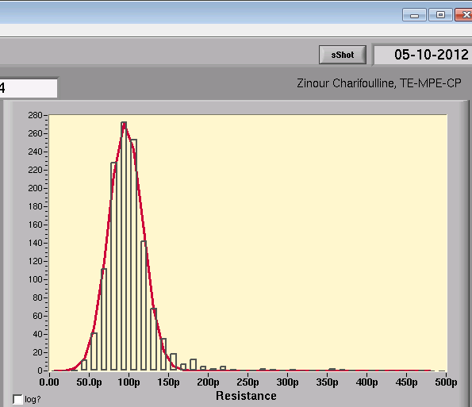
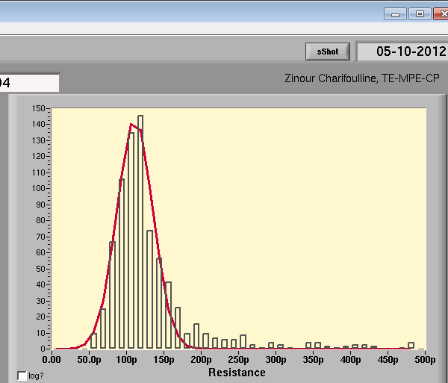
What are the measurement errors?
Measurement Errors, ~700 Ramps per Point
RB: 96±21pΩ
RQ: 111±24pΩ
The average errors for RB and RQ cirquits are almost the same.

Slide 9
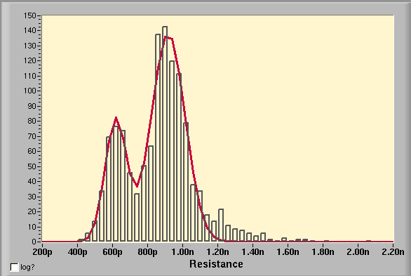
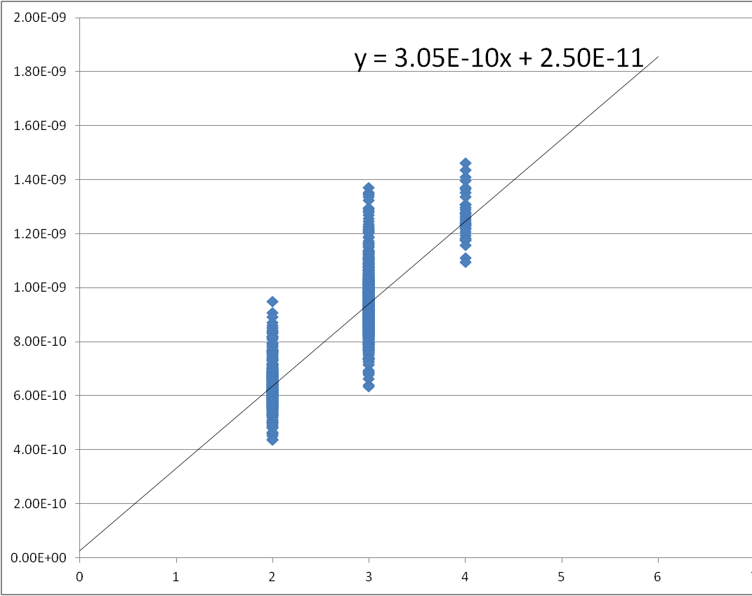
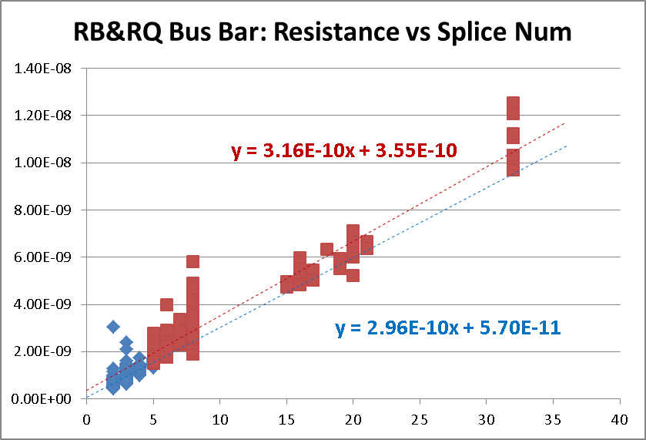
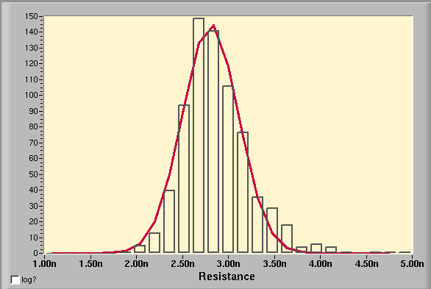
What are the measurement errors? Systematics?
No significant systematic errors are observed
R_{splice,avg} = 300pΩ
RB: R₂/2 = R₃/3 = R₃-R₂ = R_{splice,avg}
RQ: R₈ = 8*R_{splice,avg} + 2*200pΩ
RB: σ₃/σ₂ ≈ sqr(3/2)
RQ: σ₈ ≠ 2*σ₂ => σ_{corr} = 265pΩ
Looks consistent.
R₂=624±70pΩ
R₃=920±90pΩ
R₈=2810±305pΩ
Resistance versus Num of Splices

Slide 10
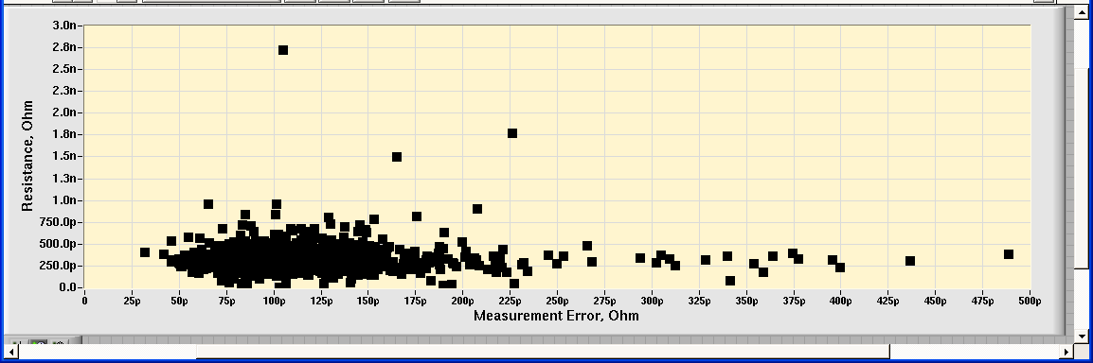
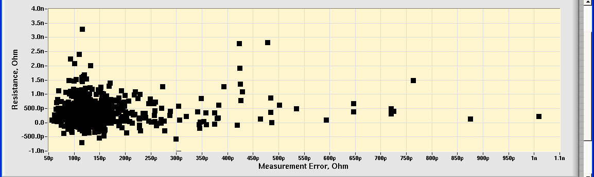
Max Splice Resistance versus Measurement Error
RB
No correlations are observed!
RQ

Slide 11
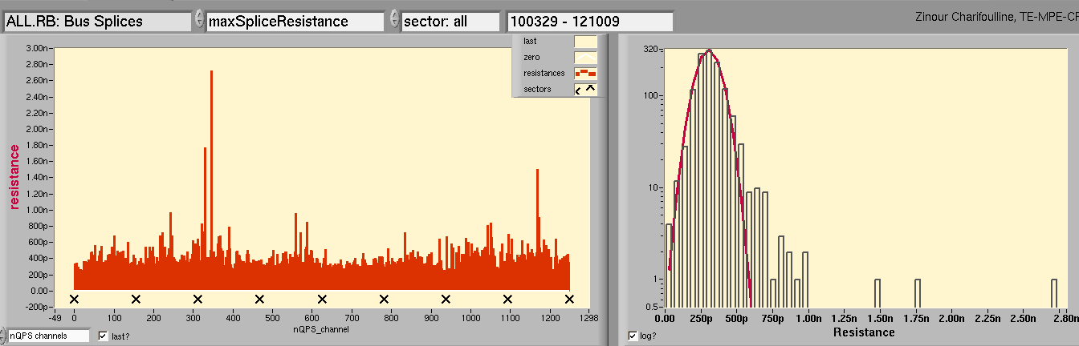
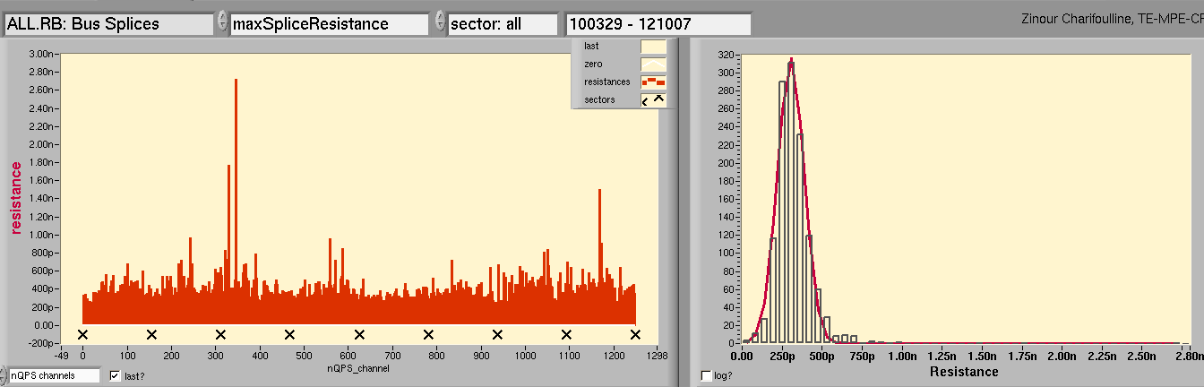
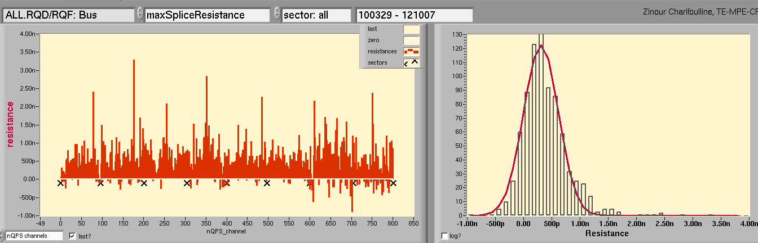
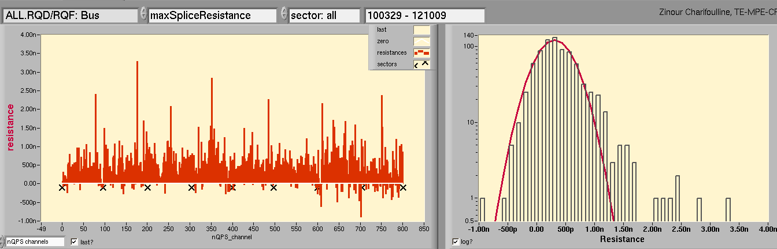
LHC Bus Bar Max Splice Resistances, 2010-2012
RB: 304±83pΩ
RQ: 306±313pΩ
RQ: 2*200±265pΩ ☹

Slide 12
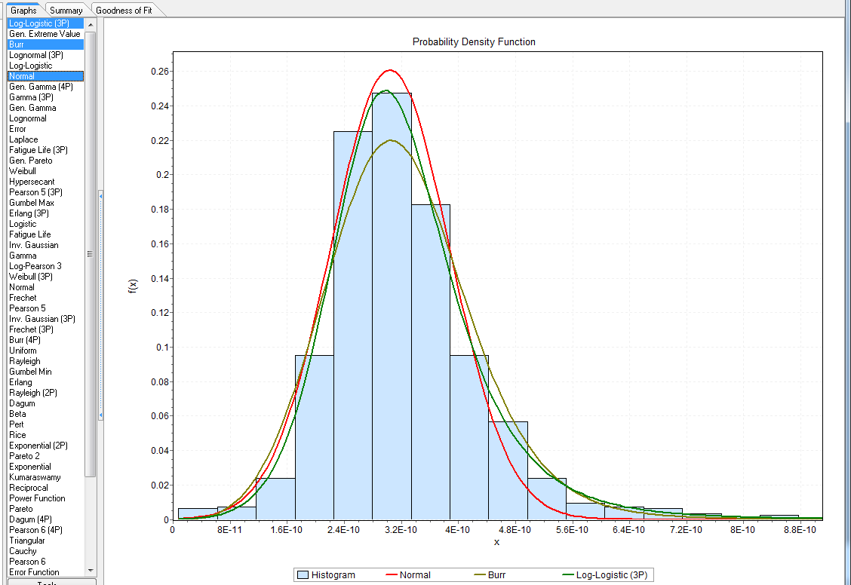
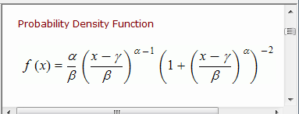
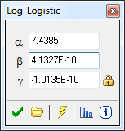
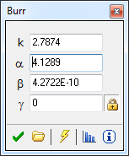
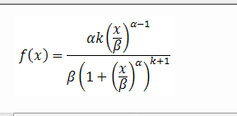
Log-Logistic: 324±108pΩ, 99.7%=801pΩ (EasyFit)
Burr: 321±104pΩ, 99.7%=685pΩ (EasyFit)
Normal: 304±83pΩ, 99.7%=532pΩ (LV, ZCh)
ECDF: 99.7%=970pΩ (LV, ZCh)

Slide 13
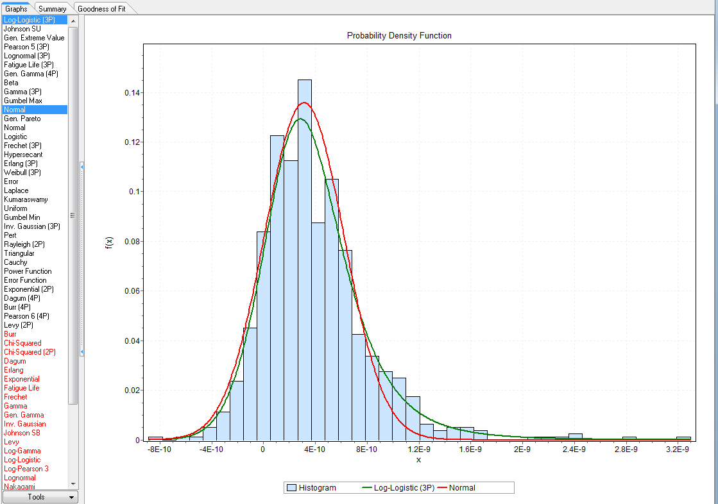
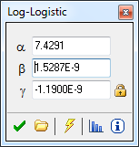
Log-Logistic: 367±387pΩ, 99.7%=2.15nΩ (EasyFit)
Normal: 306±313pΩ, 99.7%=1.17nΩ (LV, ZCh)
ECDF: 99.7%=2.78nΩ (LV, ZCh)

Slide 14
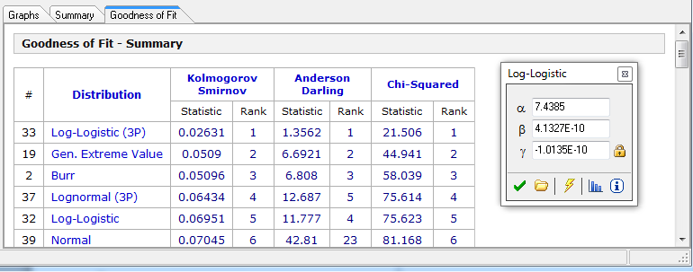
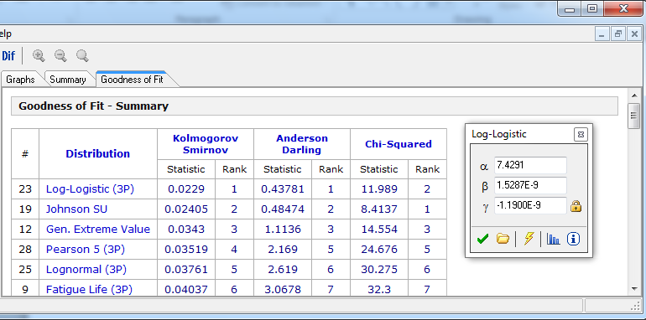
RB
RQ

Slide 15
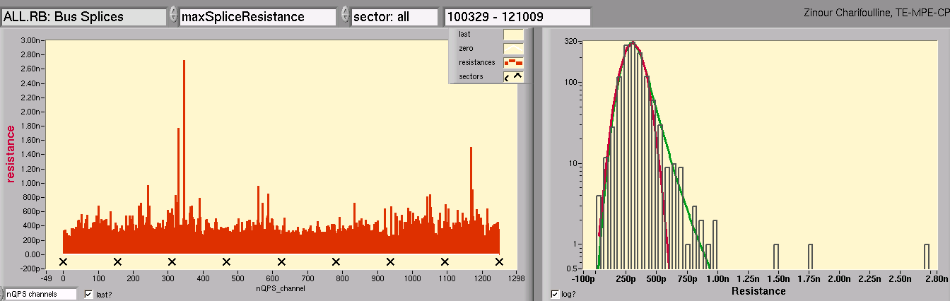
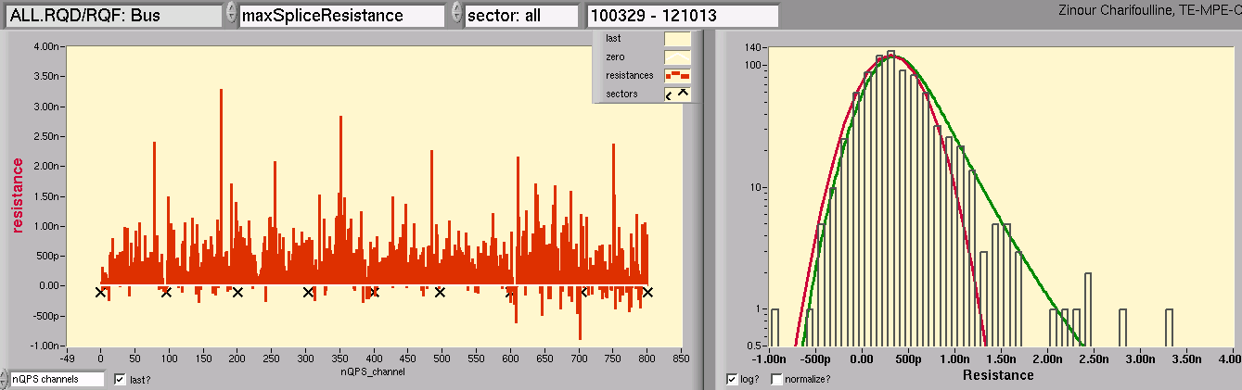
LHC Bus Bar Max Splice Resistances, 2010-2012
Normal: 99.7%=532pΩ (53)
L-L: 99.7%=801pΩ (10)
27 splices
Conclusion:
Measurement error on 700 rumps statistics is about 100±25pΩ for RB and RQ;
Relatively good 3 params fit found for both circuits;
3σ is 0.8nΩ for RB circuit and 2.1nΩ for RQ circuits;
It gives about 27 + 38 = 64 splices to be redone if will be applied as a safe criteria;
Normal: 99.7%=1.17nΩ(30)
L-L: 99.7%=2.15nΩ (7)
38 splices
+ 2*32

Slide 16
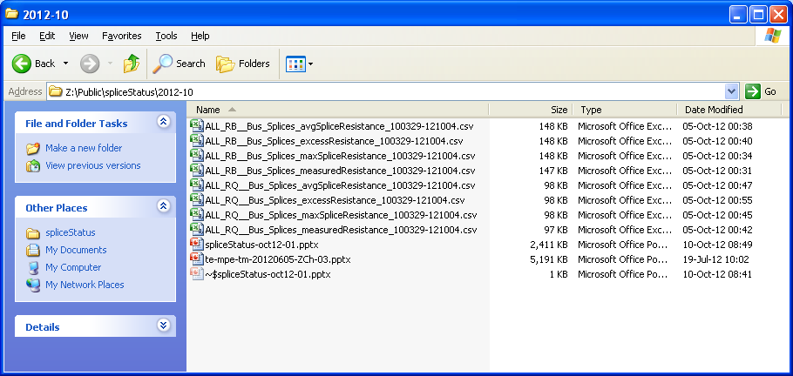
Thanks!

Slide 17
Appendix

Slide 18
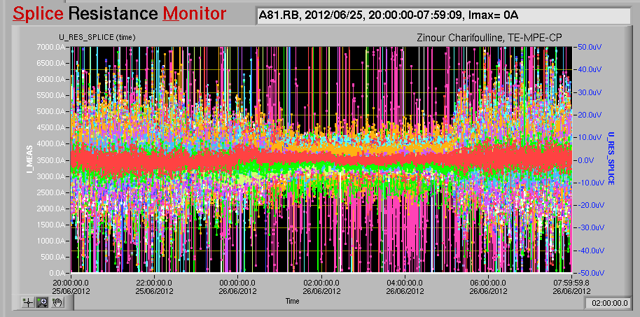
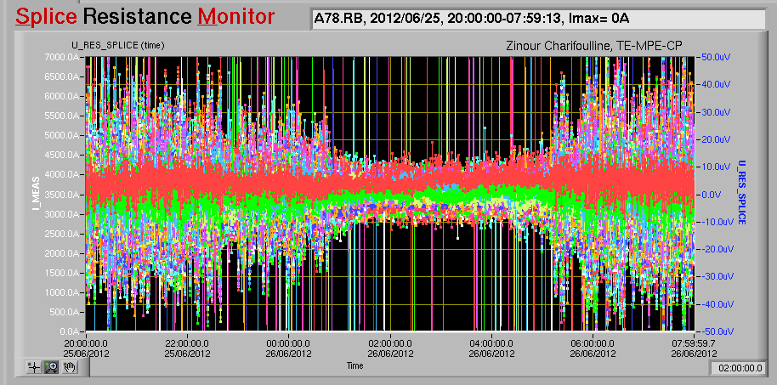
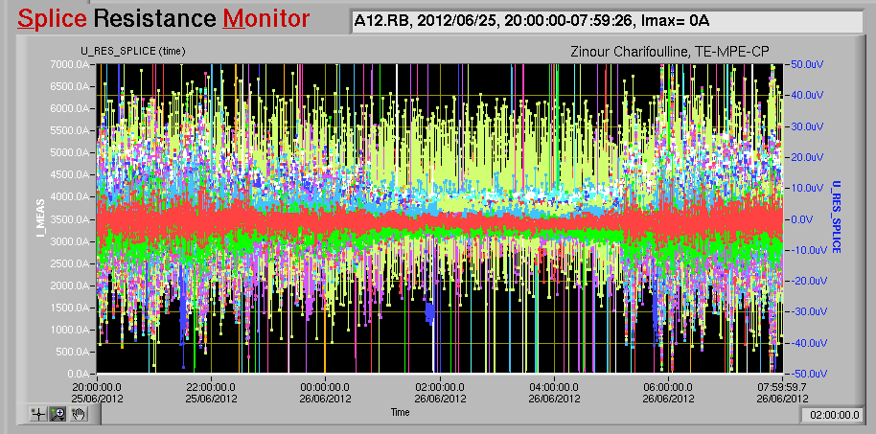
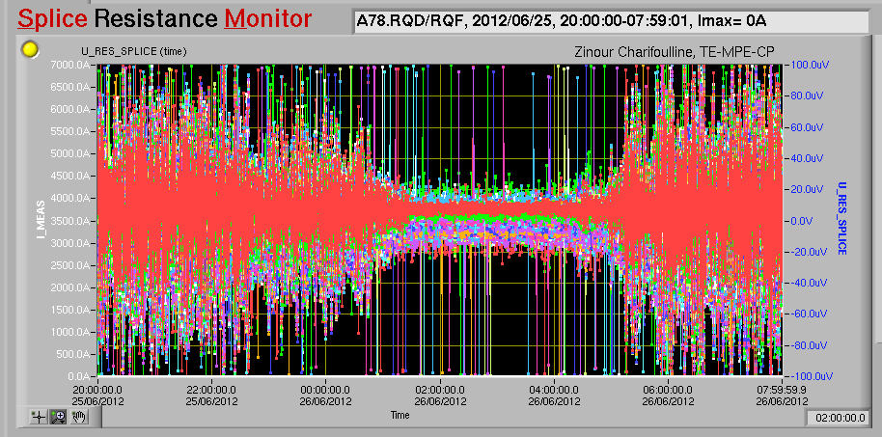
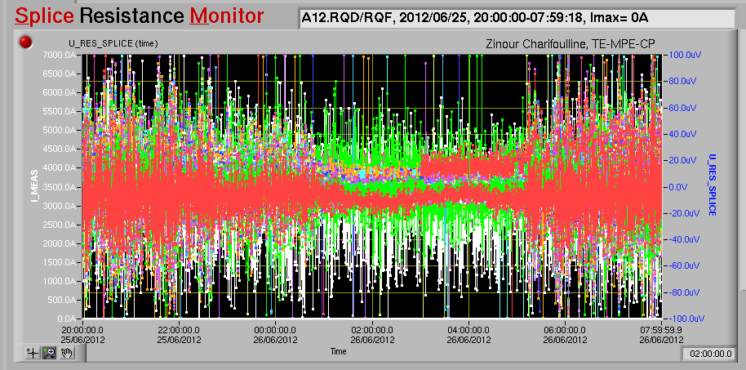
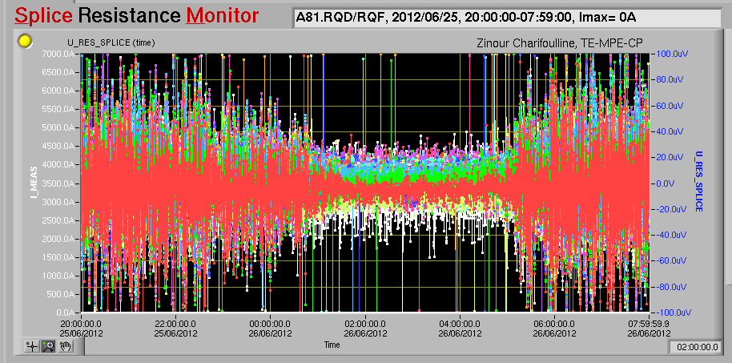
All Sectors | RB | RQ
0h <-> 24h (615) | 308 ± 30pΩ | 301 ± 32pΩ
1h <-> 5h (80) | 308 ± 32pΩ | 300 ± 32pΩ
Sector 12 | RB | RQ
0h <-> 24h (615) | 327 ± 32pΩ | 299 ± 24pΩ
1h <-> 5h (80) | 327 ± 31pΩ | 298 ± 25pΩ
Sector 78 | RB | RQ
0h <-> 24h (615) | 311 ± 40pΩ | 313 ± 46pΩ
1h <-> 5h (80) | 312 ± 43pΩ | 313 ± 46pΩ
Sector 81 | RB | RQ
0h <-> 24h (615) | 285 ± 42pΩ | 284 ± 33pΩ
1h <-> 5h (80) | 283 ± 41pΩ | 284 ± 33pΩ

Slide 19
