Slide 2
Simulation of Transient Effects in Accelerator Magnets
Tools for Magnet Protection and Circuit Modeling
B. Auchmann, L. Bortot, M. Maciejewski, M. Prioli, A.M. Navarro, A. Verweij
with M. Baveco, D. Paudel, E. Ravaioli, who recently left.

Slide 3
STEAM: Summary and Overview
December
Goals, Strategy, Tactics
Common Workflow
c
Co-Simulation
2015
FEM
Solvers
Network
Solvers
January

Slide 4
Goals
Accuracy and performance
Fast reaction times upon incidents
Flexibility for long-term evolution by multiple developers (student projects)
Guaranteed (low) long-term maintenance

Slide 5
Strategy
Combination of a limited number of tools.
Each tool is applied within its specific domain of competitive advantage.
We become specialists in the optimal use and flexible coupling of tools.
We produce recipes and workflows that can be passed on to other teams/labs without software-maintenance and support efforts.

Slide 6
Tactics
Minimalistic software-development to create
code-coupling interfaces and automated workflows.
Clean code (conventions), that is versioned, reviewed, and regularly tested for long-term sustainability.
Maintained and documented model library.
Persistency-policy for input/output of modeling activities.

Slide 7
Work Ongoing
Workflows under development | tools we currently use | Status
COMSOL 1D for longitudinal quench propagation | QP3 | done
PSpice netlists for circuit simulations | PSpice GUI | done
PSpice + COMSOL 2D co-simulation for CLIQ | TALES | on-going
PSpice + COMSOL 3D for quench simulation | ROXIE
Co-simulation
COMSOL
MATLAB/
Simulink
…
PSpice

Slide 8
Overview
Common Workflow
Network Solvers
FEM Solvers
Co-Simulation

Slide 9
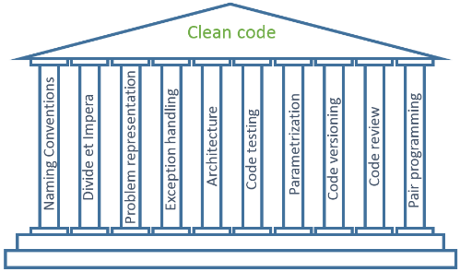


Workflow improvements – our conventions
Code repository
Code review
Wiki documentation
Daily stand-up
meetings @10AM
,,
New section website, one drive cloud, indico: http://cern.ch/te-mpe-pe | June 2015
Clean code development workshop, jointly with MS | 9 July 2015
Object oriented programming workshop, jointly with MS | 13 Aug 2015

Slide 10
Overview
Common Workflow
Network Solvers
FEM Solvers
Co-Simulation

Slide 11

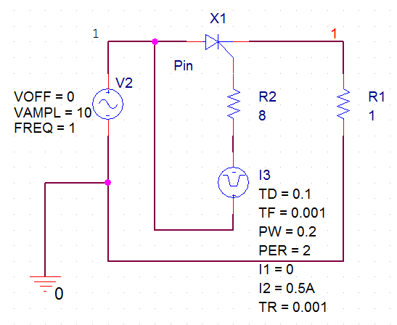




PSpice netlist
Model Description
Workflow Description
Circuit
libraries.lib
FPA
data.csv
A netlist is a textual description of the circuit elements (VI characteristics) and interconnections (topology)
Recently, much effort has been dedicated to the migration of the PSpice RB circuits from the GUI format to the netlist format
  Implementation of circuit libraries
* source
X_X1 N00174 N000402 1 2N6405
R_R2 N03745 N000402 8 TC=0,0
V_V2 N00174 0
+SIN 0 10 1 0 0 0
R_R1 0 1 1 TC=0,0
I_I3 N00174 N03745 DC 0Adc AC 0Aac
+PULSE 0 0.5A 0.1 0.001 0.001 0.2 2
Netlist.cir
Solver
GUI
Netlist
Results.txt
Post
processing.m
Data
processing.m
  OOP
Model
validation
Maurice Baveco, "Lumped element modelling of superconducting circuits with SPICE"

Slide 12
PSpice netlist: motivations
Low maintenance as compared to GUI based tools
  Netlist is a general description of a modelled circuit
Simplified extension to other circuits
  Thanks to the library structure and to protocols that define how to develop it
Easy versioning and code sharing
  Also considering the GitLab repository
The final goal is a quick fault analysis
  Minimum set of measures to identify a fault (support to the ELQA Team)
  Identification of the fault location from the available measurements
Examples
  RQ.A78, Earth failure on 13 Oct 2015, fault position detected in 24h
  RCS.A78B2, intermittent short to ground, first on 16 Jul 2015

Slide 13
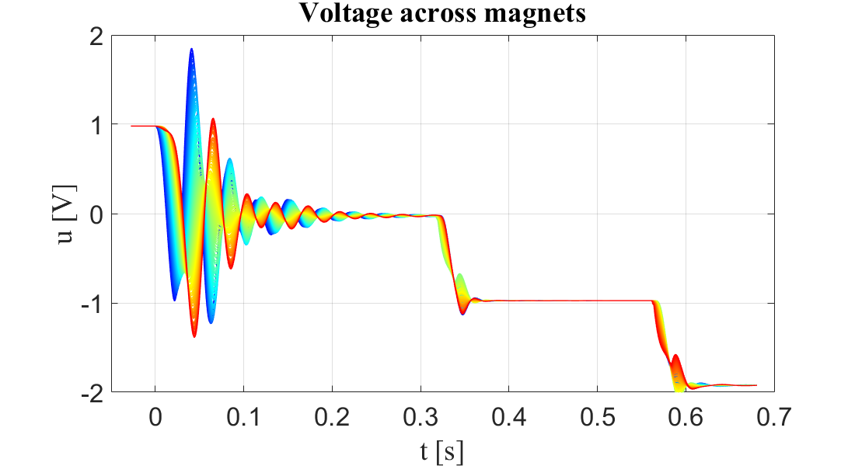
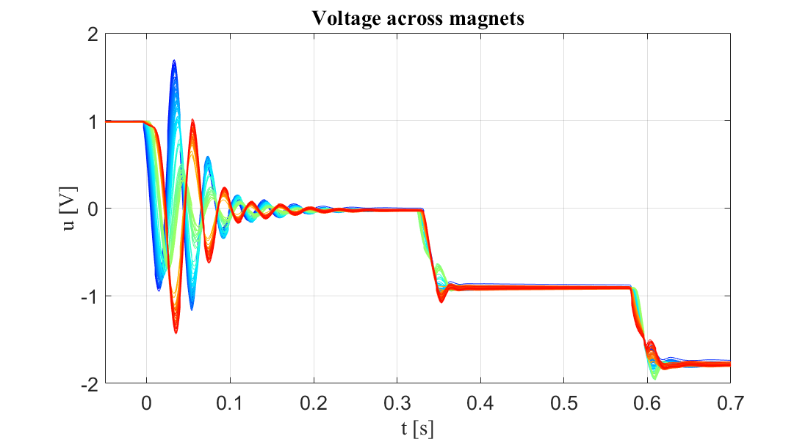
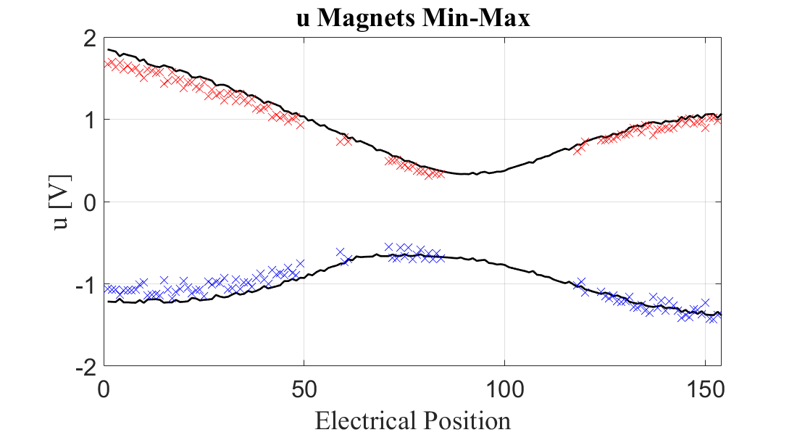
PSpice netlist: model validation at 2kA
For a FPA @ 2kA, 10A/s the model has been validated against
  Previous results: E. Ravaioli et al., Modelling of the Voltage Waves in the LHC Main Dipole Circuits, IEEE Trans. on Applied Superconductivity, 22(3), 2012 (not shown here)
  New FPA data obtained on Oct 2014: the moving average filter of the nQPS is applied to the following traces
Simulation
Measurements
missing
data
— Simulation
X, X Measurements

Slide 14
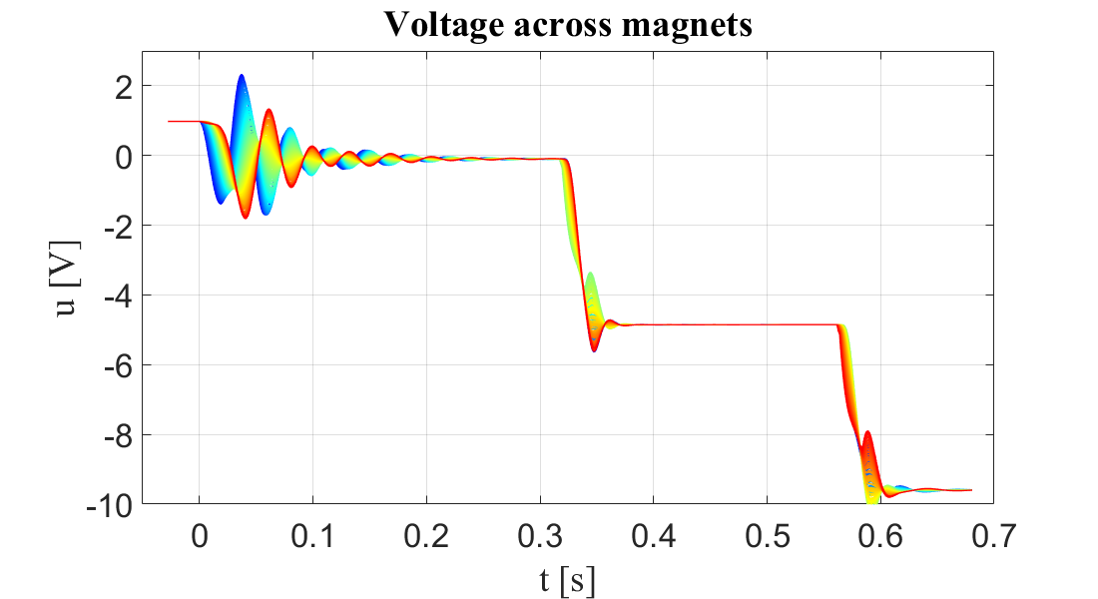
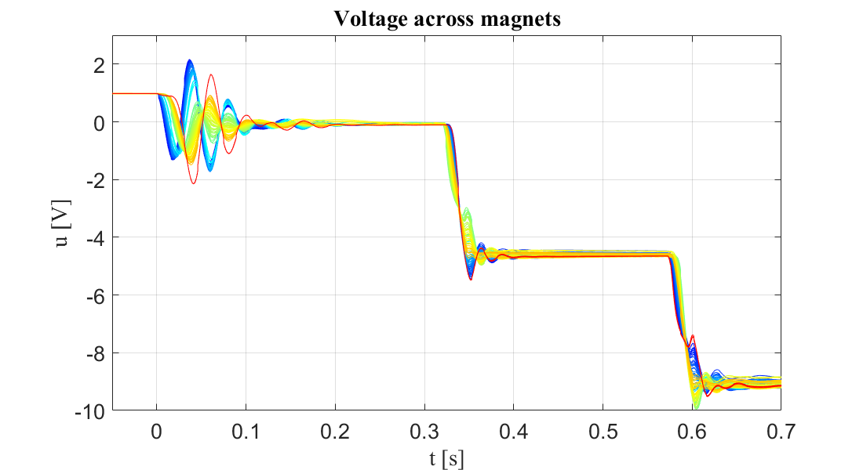
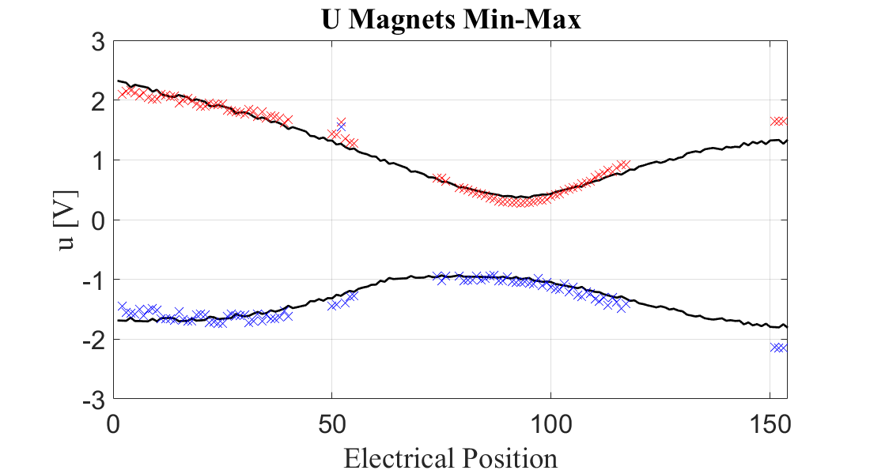
PSpice netlist: model validation at 10 kA
For a FPA @ 10kA, 10A/s the model has been validated against
  New FPA data obtained on Oct 2014: the moving average filter of the nQPS is applied to the following traces
The model provides accurate predictions also at this current level
  The impact of the nonlinear effects on the voltage oscillations is limited
Simulation
Measurements
missing
data
— Simulation
X, X Measurements

Slide 15
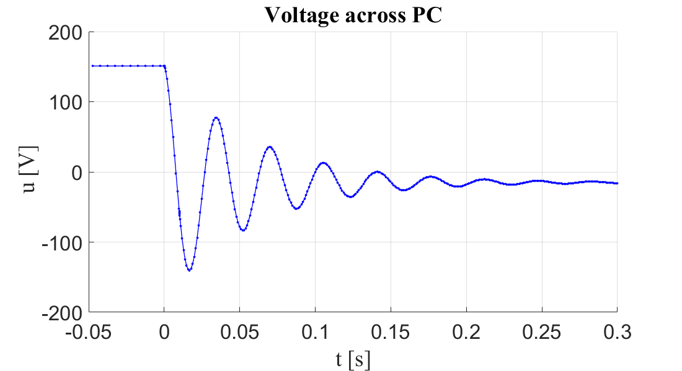
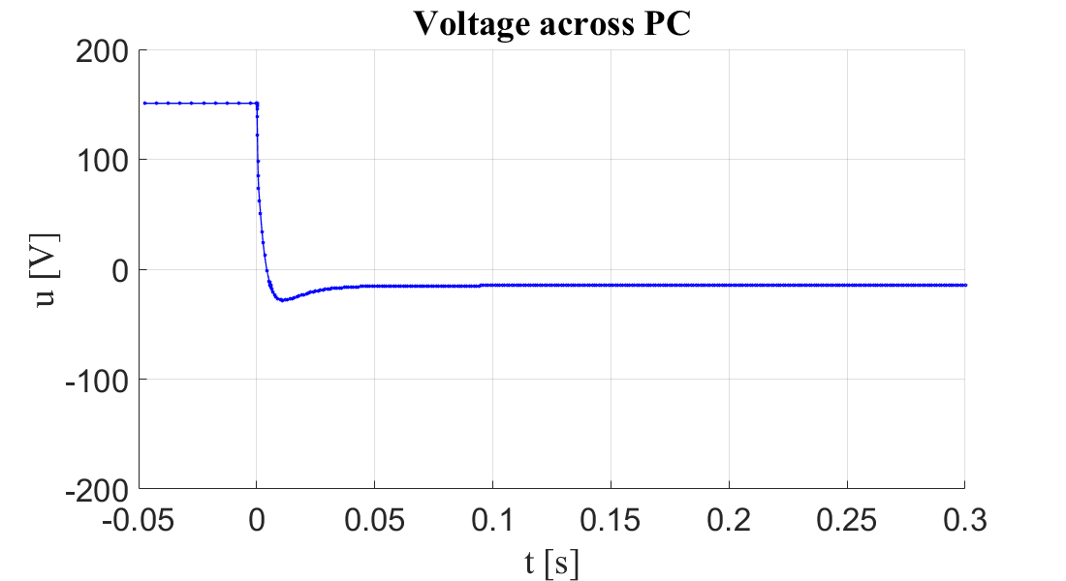
PSpice netlist: changes in the RB circuit
In Oct 2014 dump crowbars were installed on the output filter of the PC
  Eliminate voltage oscillations due to the LC filter
Simulated, w/o dump crowbars
Simulated, with dump crowbars
The model needs to be re-validated starting from new experimental data
X. Genillon, H. Thiesen, "Installation of Dump Crowbars on the LHC Main Dipole Power Converters"

Slide 16
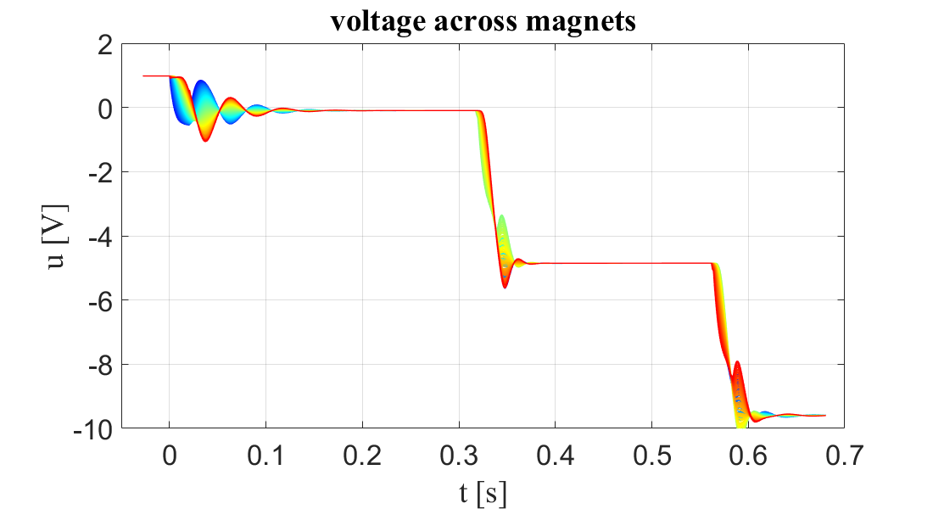
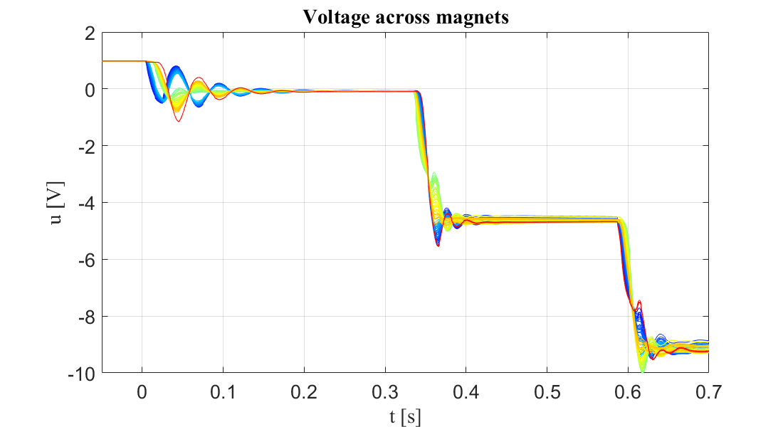
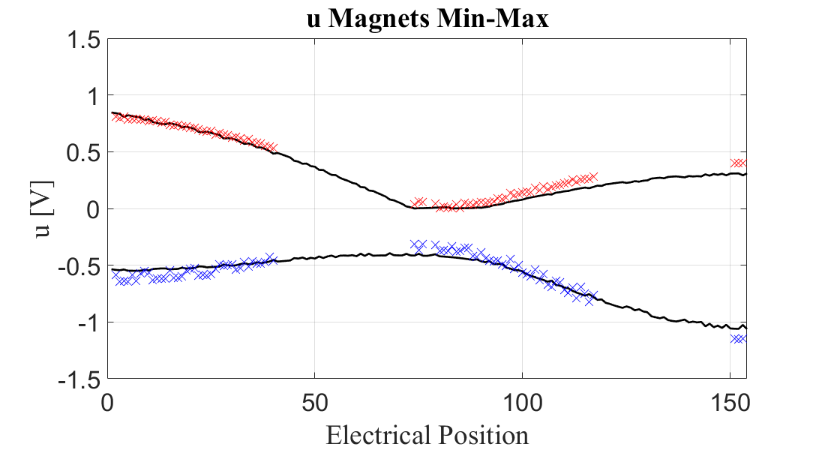
PSpice netlist: model validation at 10 kA, dump crowbars
For a FPA @ 10kA, 10A/s the model has been validated against
  New FPA data obtained on Feb 2015: the moving average filter of the nQPS is applied to the following traces
The model provides accurate estimates also after the installation of the dump crowbars
  Their impact on the voltage oscillations across magnets is evident
Simulation
Measurements
missing
data
— Simulation
X, X Measurements

Slide 17
PSpice netlist: next steps
This project has to be imported in GitLab to improve cooperation and allow an effective versioning
  Two different branches can be created: simulation and experimental data processing
Development of the model for the HL-LHC 11T dipole magnets
  A preliminary model has been already developed but requires further work
The PSpice netlist approach has to be applied to the other circuits of the LHC

Slide 18
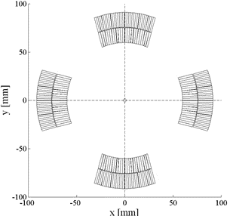
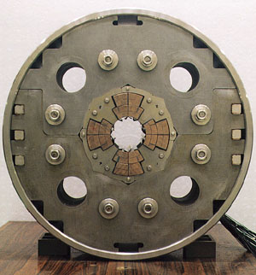
Transient Analysis with Lumped Elements of Superconductors
MATLAB/Simulink framework for quench-protection and fault-cases studies
Model Description
Workflow Description
2D Electro-thermal lumped-element model including
- Inter-Filament and Inter-Strand Coupling Losses
Three-layer architecture
l_{coil}
w_{cable}
h_{cable}
d_{strand}
M. Maciejewski, "Automated Object-Oriented Simulation Framework for Superconducting Magnets Modelling
at CERN", Technical University of Lodz, Lodz, 2014

Slide 19
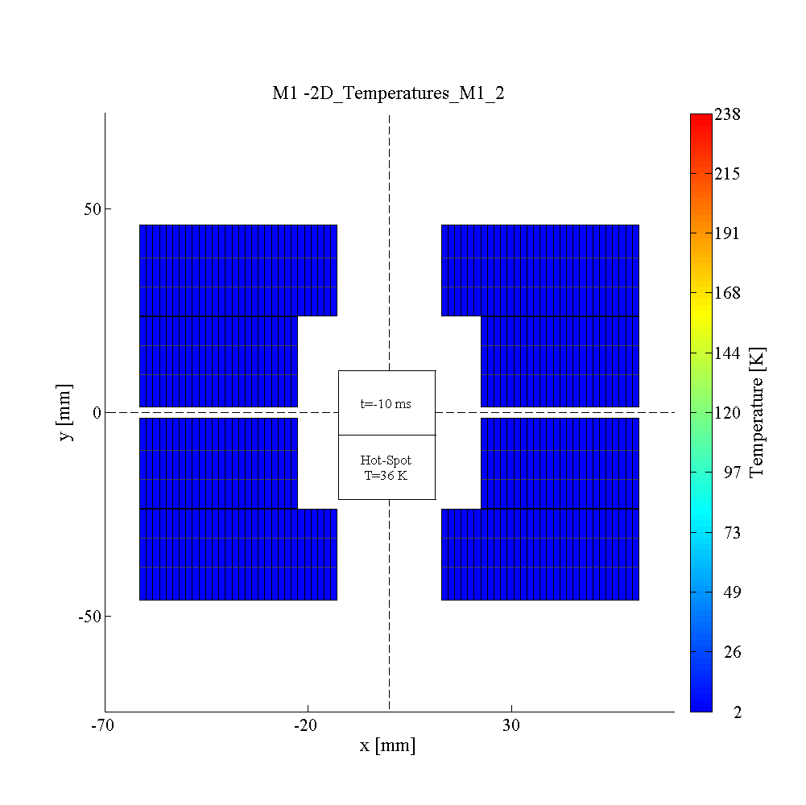
TALES – use cases
Model validation (experiments) | HL-LHC | FCC
HQ02b | D1-D2 (standalone and in a chain) | HD2
MQXC | MQXF
MB | 11 T dipole
MQY | Q4
RCS chain | HT
Users:
Emmanuele
Alejandro
Jonas
Michał
Lorenzo
MB
MB
HD2

Slide 20
Overview
Common Workflow
Network Solvers
FEM Solvers
Co-Simulation

Slide 21

QP3 like 1D strand model
Model Description
Single 1D 1 m long turn model of heat transfer in coil turn with nonlinear helium.
I = 150 A , B = 2.88 T, T = 1.9 K
n = 1000 Linear, Computation time = 110 s (QP3 )
Approximation fun. order
QP3 - Linear
ANSYS - Linear (was used)
Requires discretization in the scale less than 1 mm
In COMSOL Convergence achieved with discretization scale of 1 cm (Cubic order approximation )
D. Paudel, "Quench Simulation of Superconducting Magnets with Commercial Multiphysics Software", Aalto University, Espoo, 2015
Notes:
Physical model

Slide 22
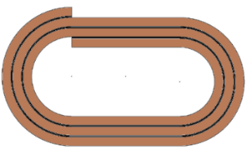
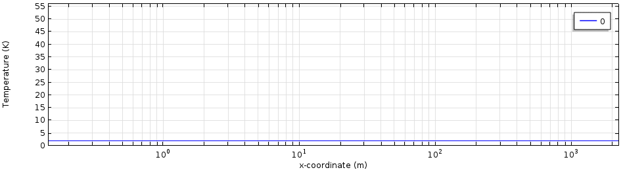
1D FEM Coil Model Development Workflow
Model Description
Workflow Description
Single 1D 2.25 km long line model representing heat propagation in the LHC dipole magnet. I = 4200 A , B = 2.88 T
CAD
ROXIE

Coil Geometry

Turn2turn Mapping

1D FEM Thermal Model

Physics
Coil | Helium

Solver

Slide 23
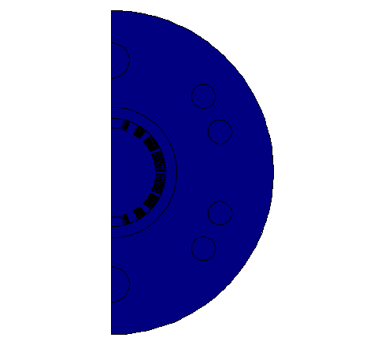
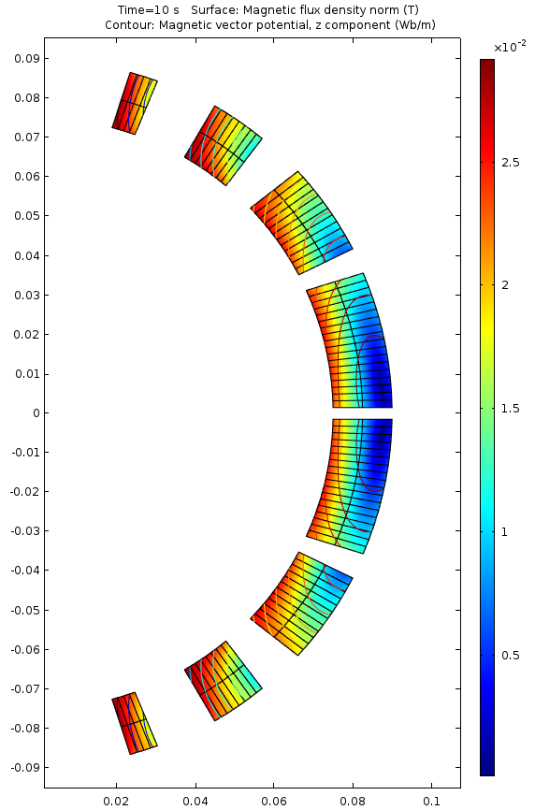
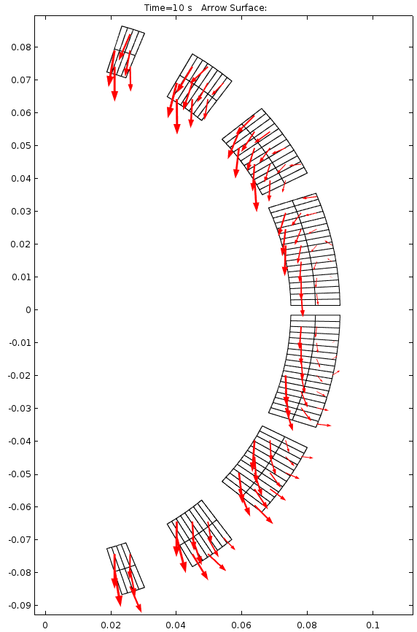
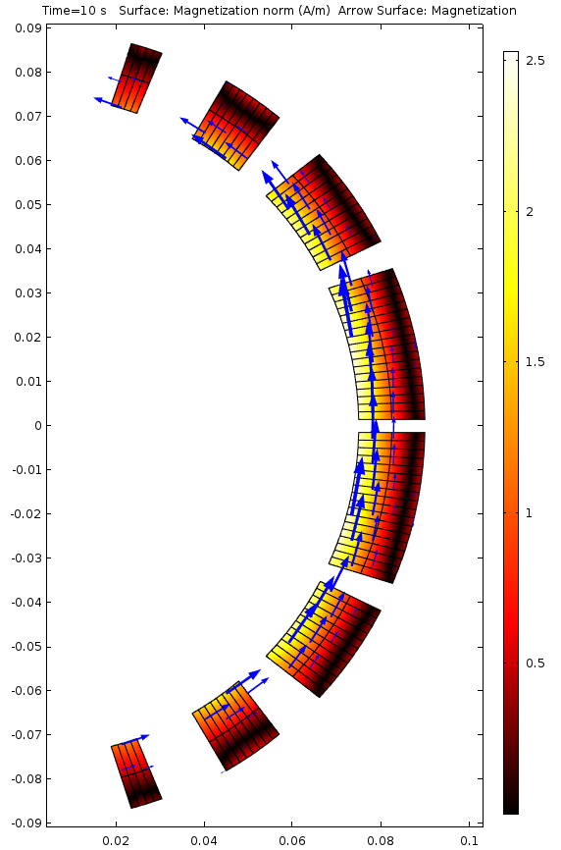
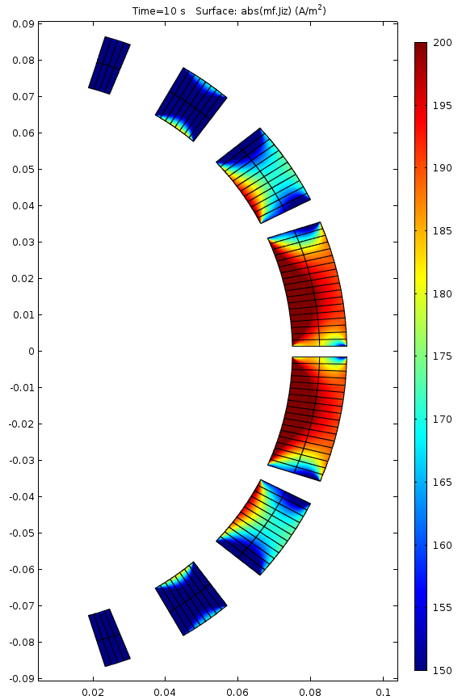
FEM Feasibility study: D1 magnet
Model Description
Equivalent cable magnetization model:
No need to model in detail the cable internal structure;
Eddy-currents magnetization is related directly with magnetic flux change
Laws of Faraday-Lenz and Ampere
are combined with a-priori knowledge about eddy currents path.
Flux density [T]
Flux change [T/s]
Equivalent
magnetization [A/m]
Induced currents [A/m^2]
Transient analysis:
dI/dt = 10 [A/s]
t = 10 [s]

Slide 24


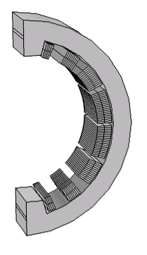



FEM Feasibility study: D1 magnet
Workflow Description
Magnet Features:
Geometry
Materials
Comsol GUI
OOP application
for model creation:
Geometry
Materials
Physics
Mesh
Studies
Comsol server:
Model dynamic repository
Interface
Tasks allocation
.mph
model
*Optional
cluster
Comsol
engine(s)
352 different domains to be defined:
Geometry
Materials
Physics
Post-processing
Therefore, the process has to be automated
Post
processing

Slide 25
3D FEM Coil Model Development Workflow
#2 Tips on how to read geometry from CAD
Coil geometry
Winding direction
Heaters
Central Post
Wedges
Mid-plane insulation
Interlayer insulation
Entire cold-mass
Water Heat Exchange
CAD
ROXIE
Additional elements
Coil Geometry
Automatic detection of thermal contacts
(COMSOL API)
MATLAB/Java
3D FEM Model
Unstructured | Structured
#1 How to adaptively mesh 3D to get 1D performance?
Physics
Heat Exchange| Magnet, Helium
Solver
#3 Performance optimisation
Meeting with Sven Friedel at COMSOL HQ Switzerland in Zurich – 7 Sep 15

Slide 26
Overview
Common Workflow
Network Solvers
FEM Solvers
Co-Simulation

Slide 27
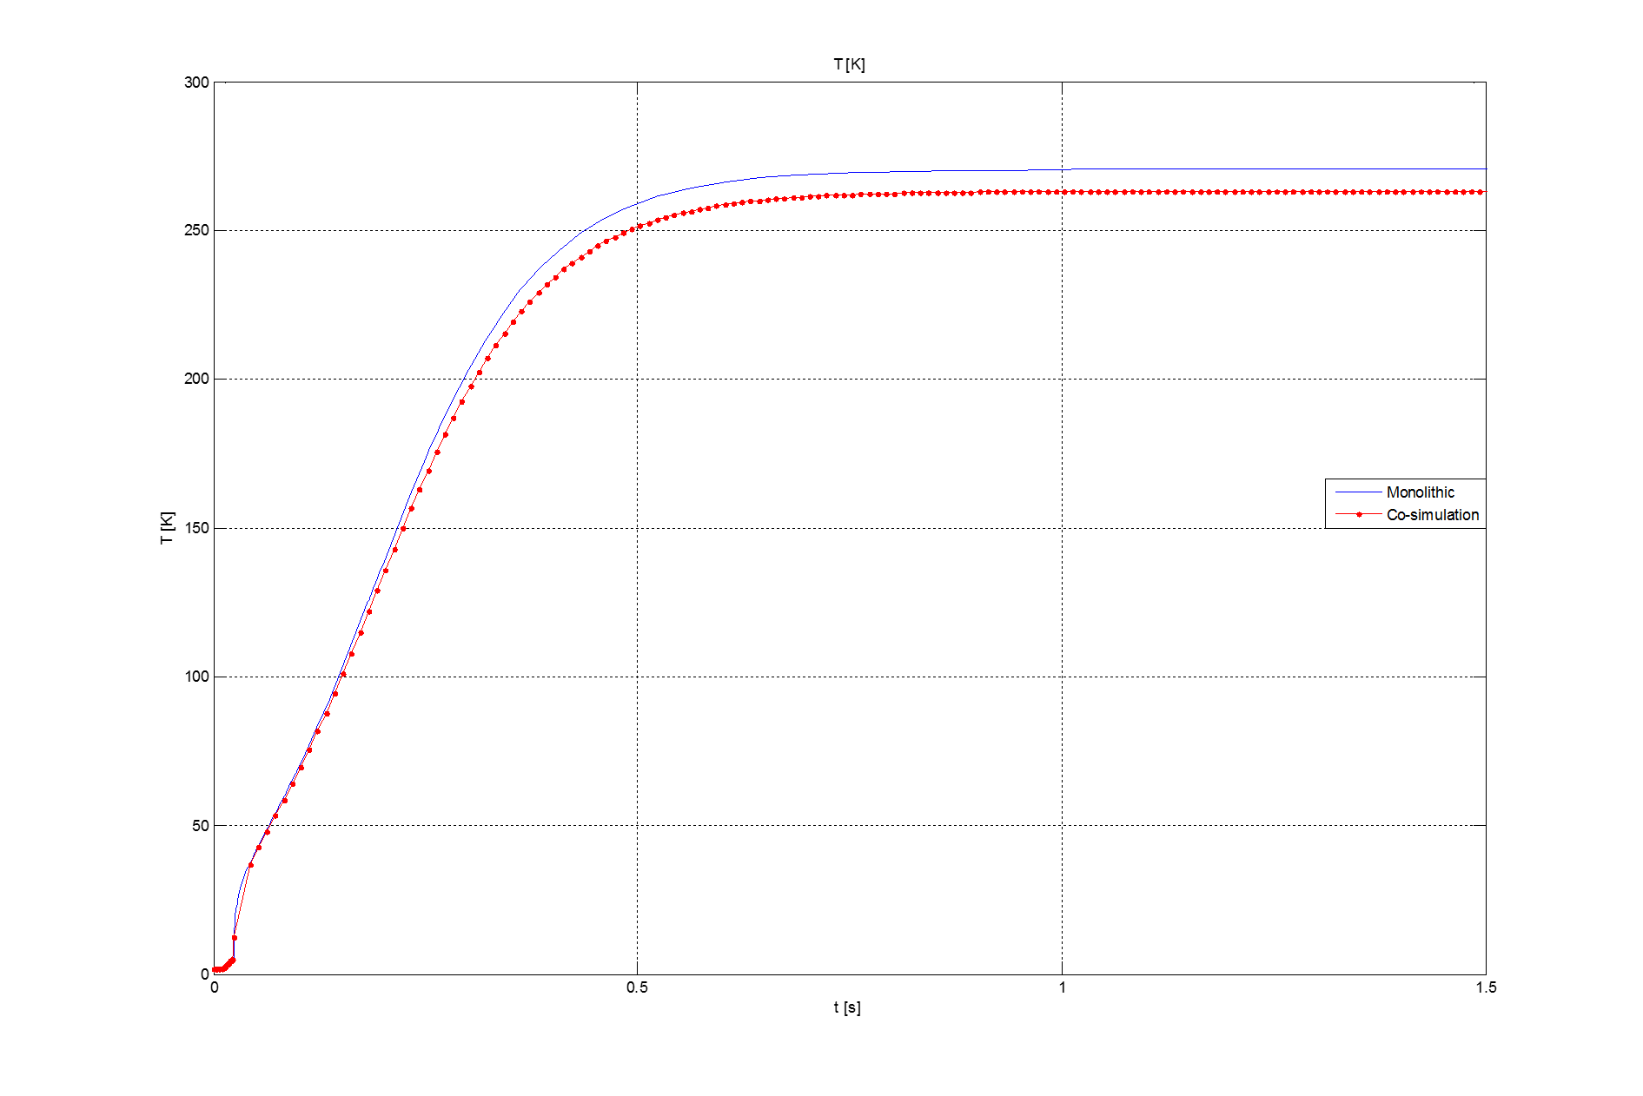
Co-simulation of a single strand with MpCCI
Model Description
R=f(T)
L₁
R₁
Heat load
calculation
i₁
M_{if,x,1,1}
M_{if,y,1,1}
i₁
Q=q*Q_ohmic+(1-q)*Q_ifcl,
q = 1 if quenched, otherwise 0
i_{if,x,1}
L_{if,y,1}
B₁
L_{if,x,1}
i_{if,y,1}
Q_ifcl
R_{if,x,1}
R_{if,y,1}
Q
Thermal part
Electrical part
k_{He,b}
PC
c_{th,b}
T_{He}
R_{EE}=0.06Ω
1 ms time window,
1 ms after quench
1 ms time window,
10 ms after quench
Meeting with Prof. Sebastian Schoeps at TU Darmstadt on 23-27.03.15

Slide 28
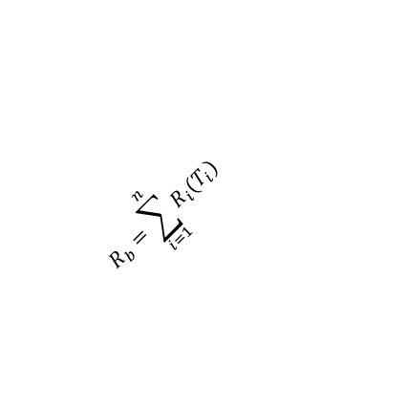
Co-simulation: weak coupling with 1D COMSOL
Workflow Description
Thermal model B:
3)
7)
4) dim 1x1
$$R_{b}=\sum_{i=1}^{n}{R_{i}(T_{i})}$$
2) i_{b}; Q_{ifcl}
dim 1x1
8)
MpCCI serial
simulation coupling
6)
10)
1)
5)
9)
Electrical model A:
Code B: Matlab electrical network should be simulated to obtain current i_{b}, magnetic field B_{b} and AC losses – Q_{ifcl}
i_{b}, magnetic field B_{b}, and Q_{ifcl} are passed to the Code A.
Code A: COMSOL receives appropriate signals from Code B and runs a simulation for certain time span.
The result is a temperature distribution in the 1D turn that allows calculating resistance value at each node.
The sum of resistances R_{b} (turn is a series connection of nodes) is then passed to the Code B that will include it in the electrical network calculations as a lumped resistance.
Repeat 1)

Slide 29
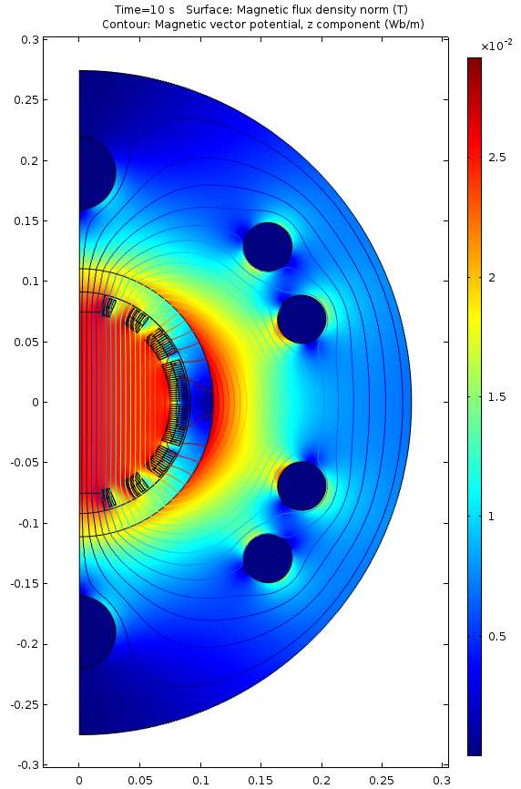
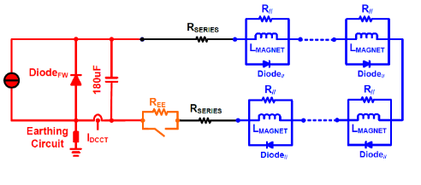
Co-simulation: LEM-FEM codes for RB model
LEM-FEM approach:
PSPICE performs electrical network analysis;
COMSOL takes care about solving the electro-thermal problem.
Benefits:
Full electro-thermal dynamic phenomena;
Full electro dynamic circuit analysis;
Nodal structure suitable for parallelism.
Flux density [T] - D1 magnet

Slide 30
Co-simulation: theoretical description of interdomain coupling
Meeting with Prof. Sebastian Schoeps at TU Darmstadt on 23-27.03.15

Slide 31
Co-simulation: scheme for 3D simulations
Coil geometry
Winding direction
CAD
ROXIE
Computational Fluid Dynamics
Helium Modelling
Electro thermal
Electro thermal
Electromagnetic
Electrical
Domain
decomposition
PSpice
Open Foam
Simulations Coupling (MpCCI, Java)
Collaboration with Fraunhofer Institute and MpCCI trial.

Slide 32
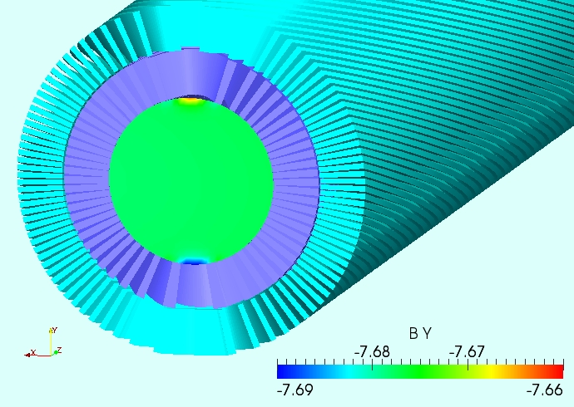
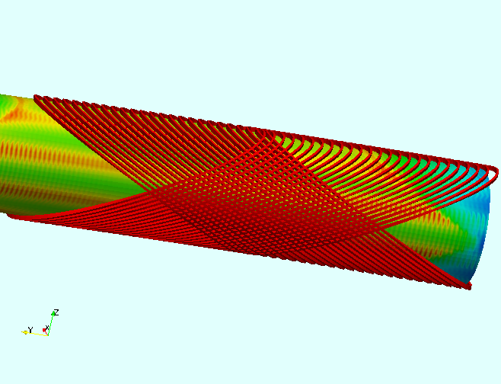
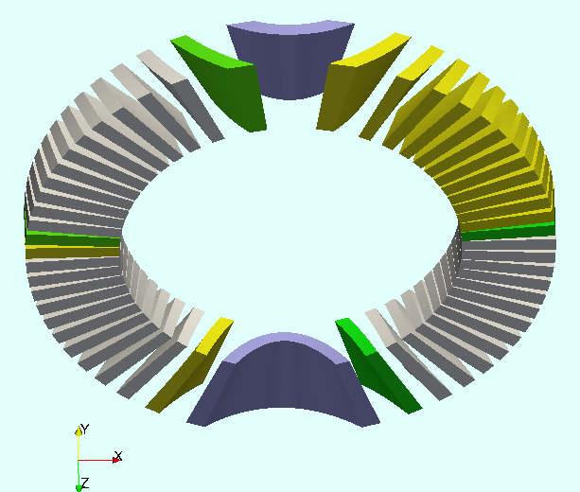
Future FEM Simulations
The Canted-Cosine-Theta Dipole (CCT)
For LBNL High Field Magnet Program
Coil Minimum Symmetry

Slide 33






R&D Topics with External Partners
Topic | Action
Multi-rate domain decomposition and high performance computing (TEMF, TU Darmstadt) | Meeting 13/14.01.2016 at CERN
Port-Hamiltonian analysis of consistent coupling strategy (LAGEP, Uni Lyon) Port-Hamiltonian School in Berlin Port-Hamiltonian Workshop in Berlin | Meeting 20.01.2016 in Valance 4-6.04.2016 7-8.04.2016
1st School on Numerical Modeling for Applied Superconductivity | 20-24.06.2016
Fraunhofer Institute (MpCCI) collaboration on co-simulation interfaces | tbd
COMSOL support | on-going

