Slide 2
Influence of an impact angle and cooling on the temperature of the irradiated target
John Treado
Supervisors: Vivien Raginel, Vera Chetvertkova
Acknowledgements: Depak Paudel, Michal Maciejewski, Scott Rowan

Slide 3
Overview
Introduction & Motivation
Computational Methods
  FLUKA and ANSYS
Results & Discussion
Conclusions & Next Steps

Slide 4
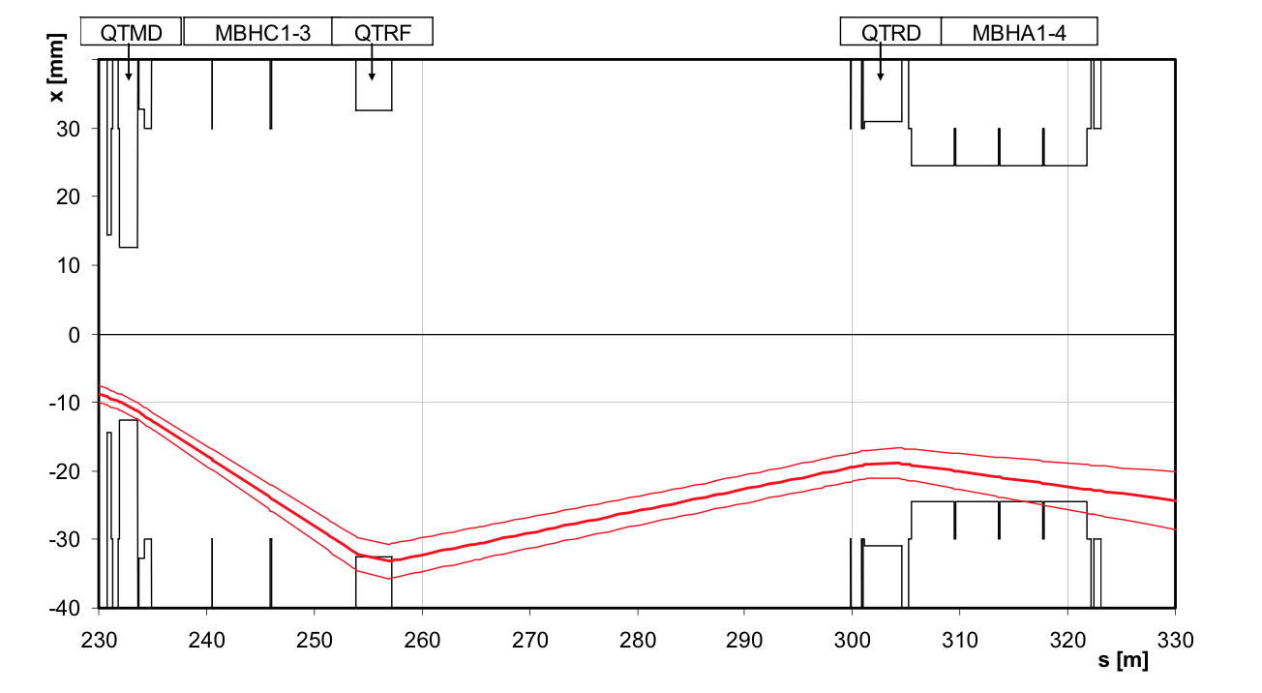
General Introduction
What is the dependence of the temperature in an irradiated target on the impact angle? Is there any?
Example from Engineering:
2004 SPS incident, where 59 μrad impact angle destroyed TT40 magnet
However, no cooling: would it have helped??
We think it might…..

Slide 5
Theoretical Motivation for the Project
Target
Fourier’s Heat Law
Surface Area: always greater than circle for some incident angle φ
Beam
l
s
However, energy deposition is only dependent on volume, which is the same in both cases
Thus, we should expect greater heat transfer and lower temperatures for beams incident at an angle compared to orthogonal incidence.

Slide 6
The main question: For steady-state losses at low impact angles (~ 1 mrad), does cooling affect temperature and the rate of heat transfer within the target?

Slide 7
The Model – FLUKA and artifacts
26 GeV Proton Beam, σ_{x} = σ_{y} = 1 mm, incident on Stainless Steel
We were able to analyze orthogonal and 10mrad incidence for comparison
We should expect energy deposition to be the same for both angles in both cases.
First attempt: Move the beam, keep the target constant

Slide 8
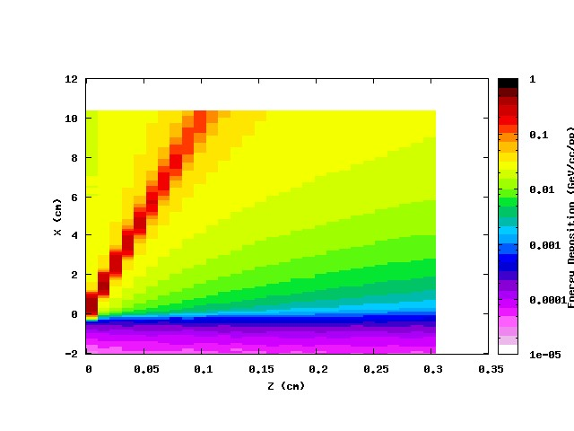
FLUKA Artifact
2D Projection onto Y Axis of 10 mrad incidence

Slide 9
FLUKA Artifact - Solved
To remedy the situation, we tilted the target and kept the beam orthogonal to the bins in both situations
That way, in the case of the angled beam, we still achieved an oblique cylinder without FLUKA overestimates / humps

Slide 10
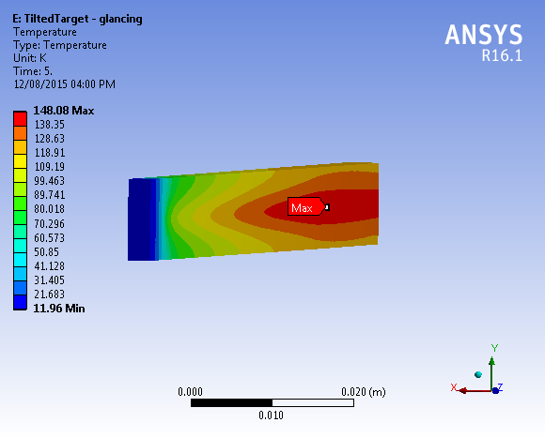
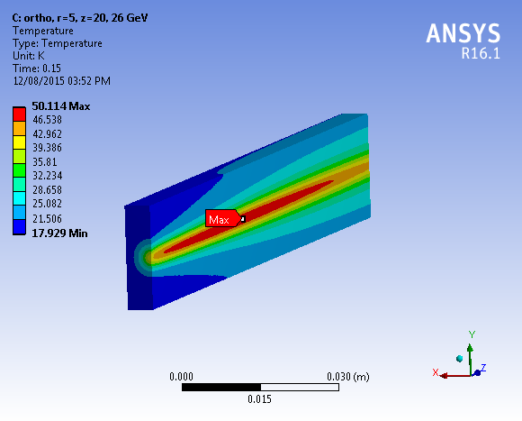
The Model -- ANSYS
Same geometry, now we import Energy Deposition values from FLUKA to calculate power deposition and heat transfer
20 K initial temperature
Cooling performed via convective heat transfer with coefficient h = 250 W m⁻² K^{-1.} From FB-II experimental data
Current calculated from [source]
We ran simulations with 10⁷ and 10⁵ protons/ bunch (anything more creates numerical errors and destroys the target)

Slide 11
Results – 10⁷ protons/bunch
We see a temperature saturation
Cooling has (slightly) greater effect on glancing angle
Slight difference in temperature is likely due to statistical error, especially at longer time scales: FLUKA error at peak is ~ %1

Slide 12
Results – 10⁵ protons/bunch
Temperature saturation w/o cooling
Difference between glancing angle and orthogonal impact is greater when target is cooled
Small changes in temperature because of small beam current
Relative changes:

Slide 13
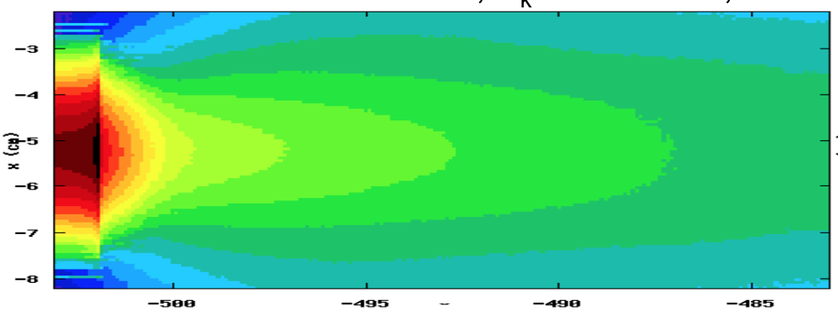
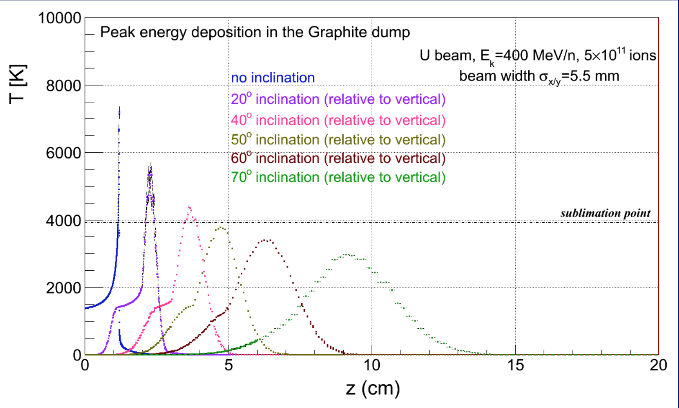
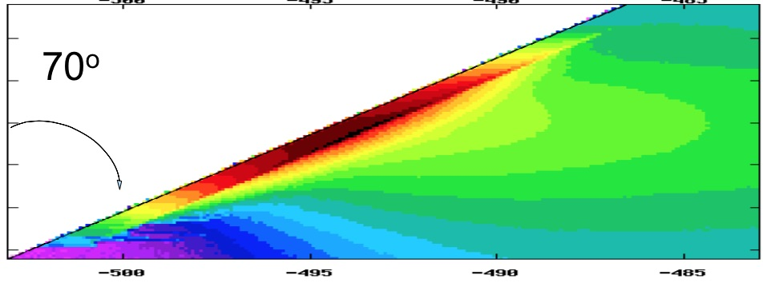
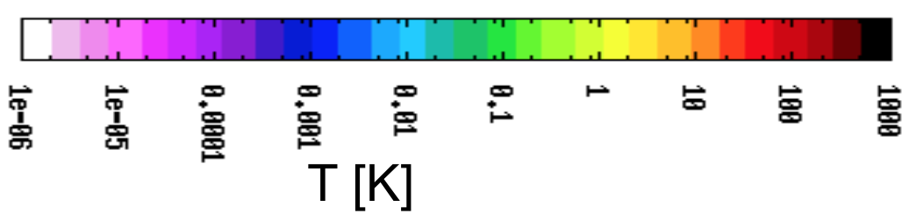
Revisiting the GSI model
Source: S. Damjanovic, GSI, 24/11/13

Slide 14
Conclusions
For angled beam incidence in FLUKA, we’ve shown that keeping the beam orthogonal to the mesh is essential. Tilt the target folks.
Glancing angles do not decrease the peak temperature in a material, but it does increase the rate of heat transfer when exposed to cooling. HOWEVER….
An increase in the rate of heat transfer can only occur for small beam losses ( ~10⁵ protons, maybe a bit more), above a certain point cooling is ineffective across different angles of incidence

Slide 15
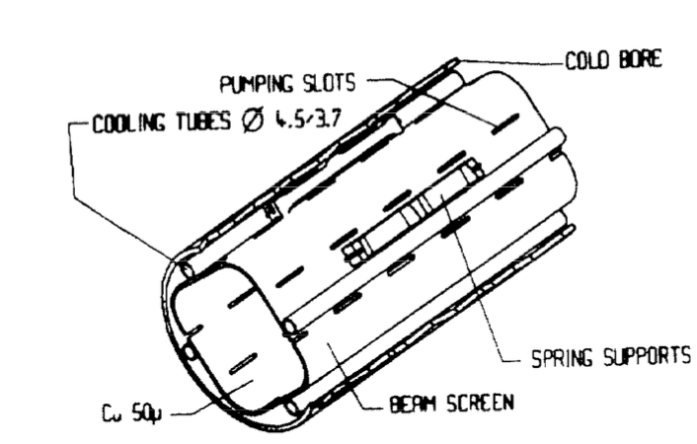
Looking Ahead
Same analysis for 6.5 TeV, although most likely you’ll find that cooling won’t help at such high energies
More complex geometry and cooling point of contact, mimic beam screen
Engineering point of view: can glancing angle impacts be used advantageously? Are they more of a cause for concern?

