Slide 2
Status of the damage test on insulation of sc. cable
V. Raginel, D. Kleiven, D. Wollmann

Slide 3
OUTLINE
Pre-experiment up to 900°C
Reminder of the experimental setup
Dummy High Voltage test
Experimental Plan

Slide 4
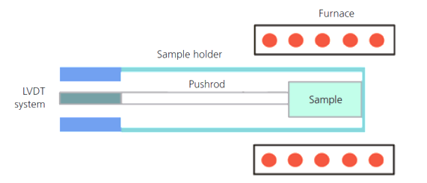
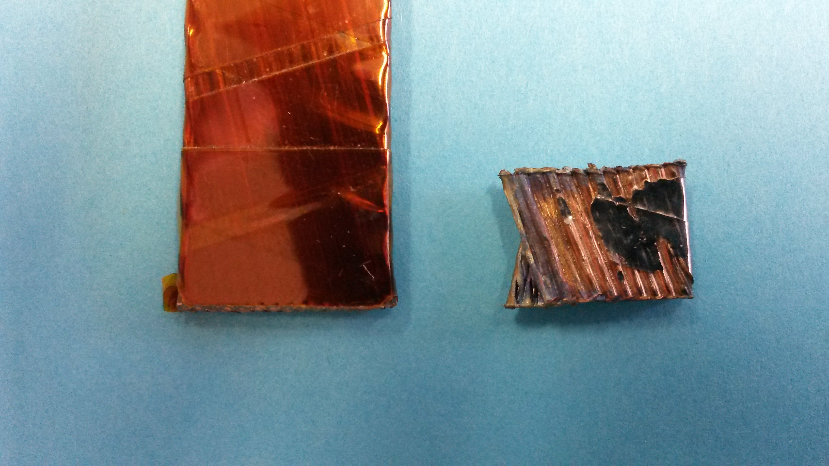
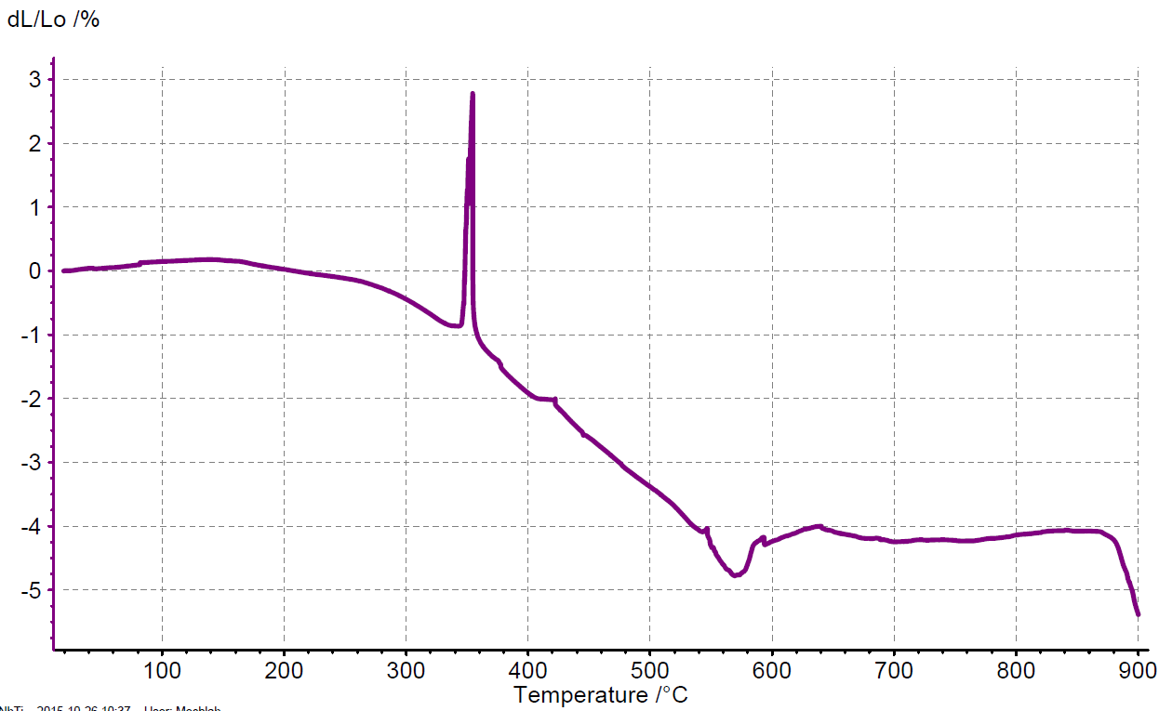
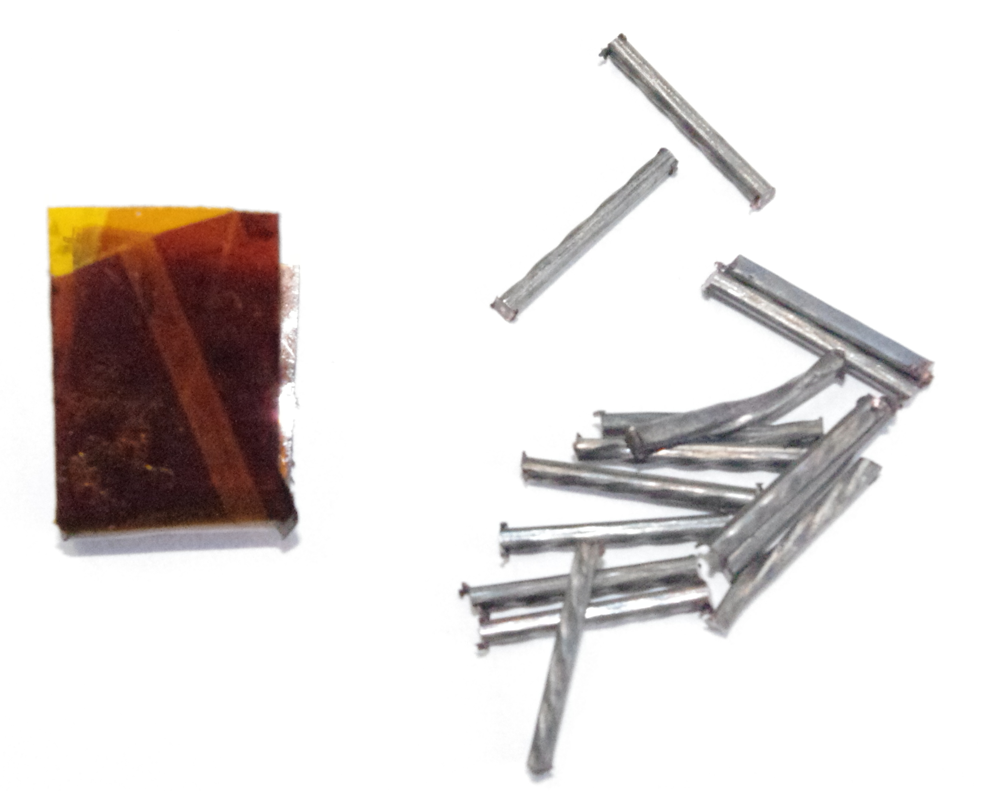
Pre-experiment to measure variation of thickness of an insulated cable from 20°C up to 900 °C in Helium atmosphere.
Courtesy O. Sacristan De Frutos
3 degrees/min
Unknown
up to 900°C
~ 150 µm
Disintegration of insulation
Softening Copper
~ 2h
up to 400°C
1h
2h
3h
4h
5h

Slide 5
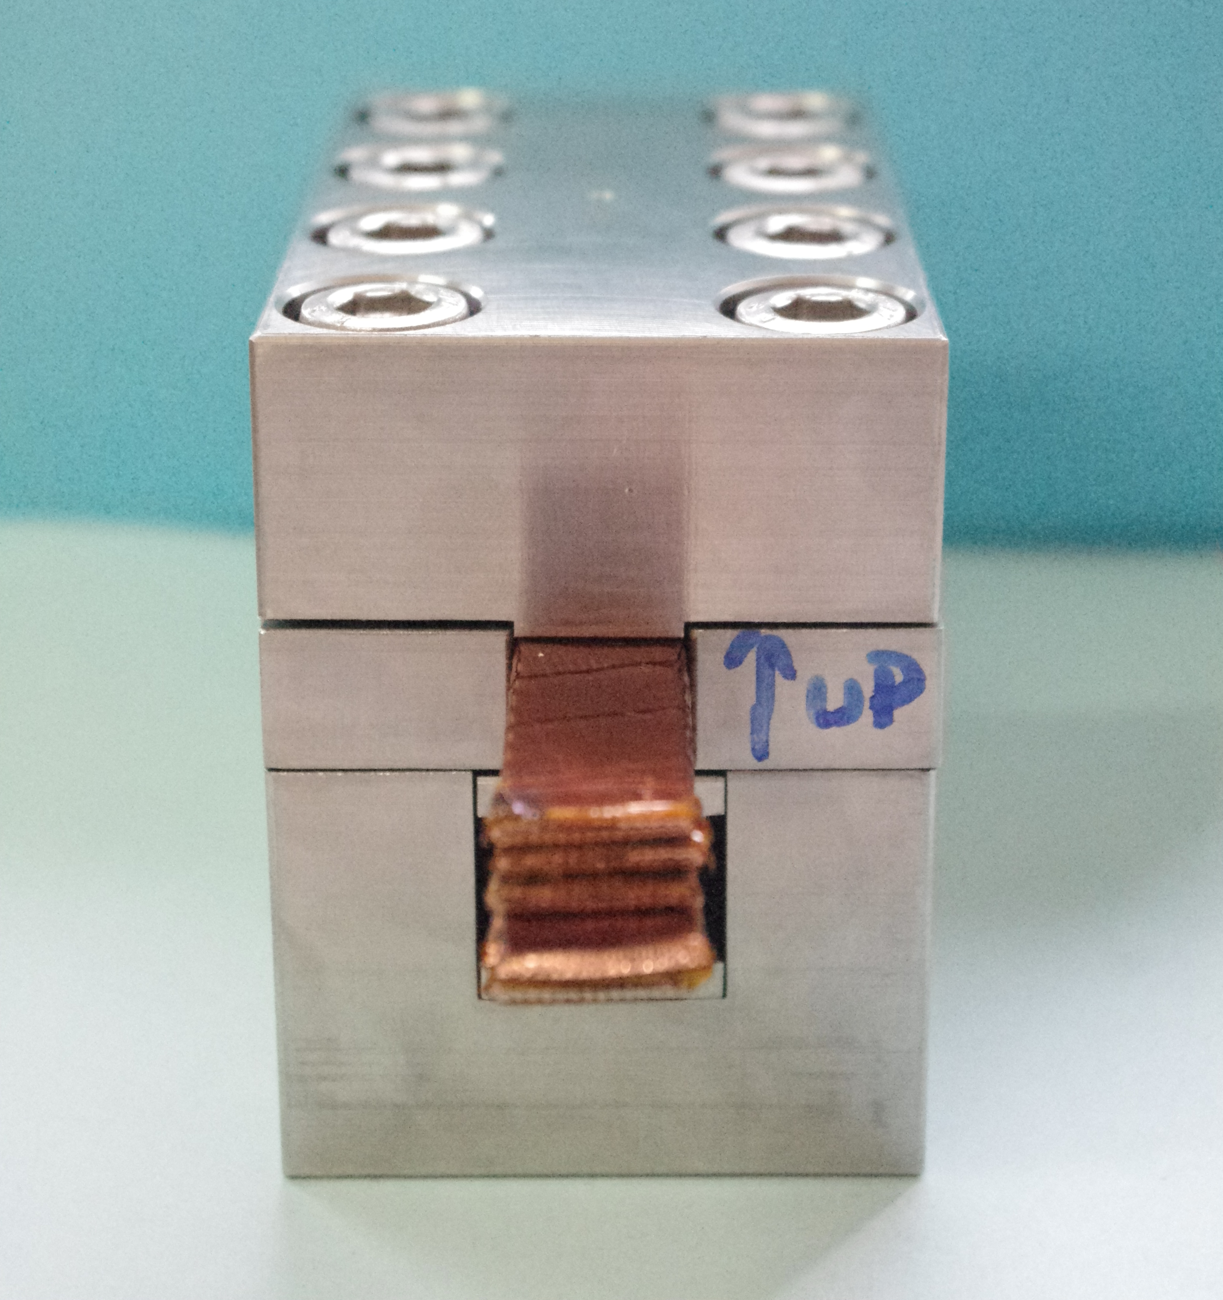
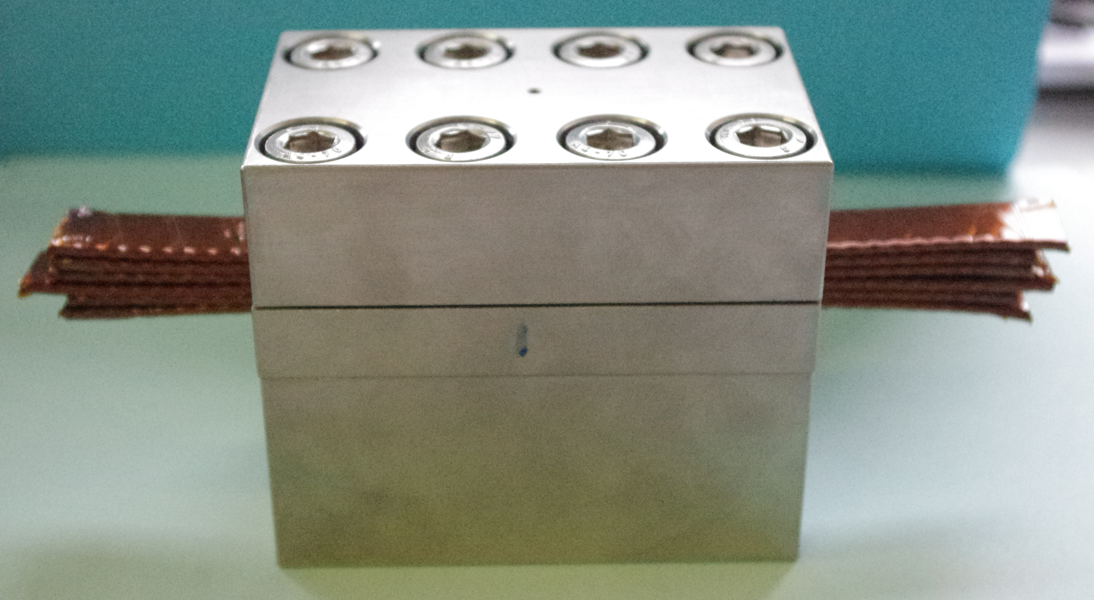
Experimental setup: Stack of 6 cable under stress

Slide 6
Each finger is instrumented with 4 strain gauges (bridge setup to take into account Poisson ratio and to cancel thermal strain)
6 cables per finger to compensate cable length.

Slide 7
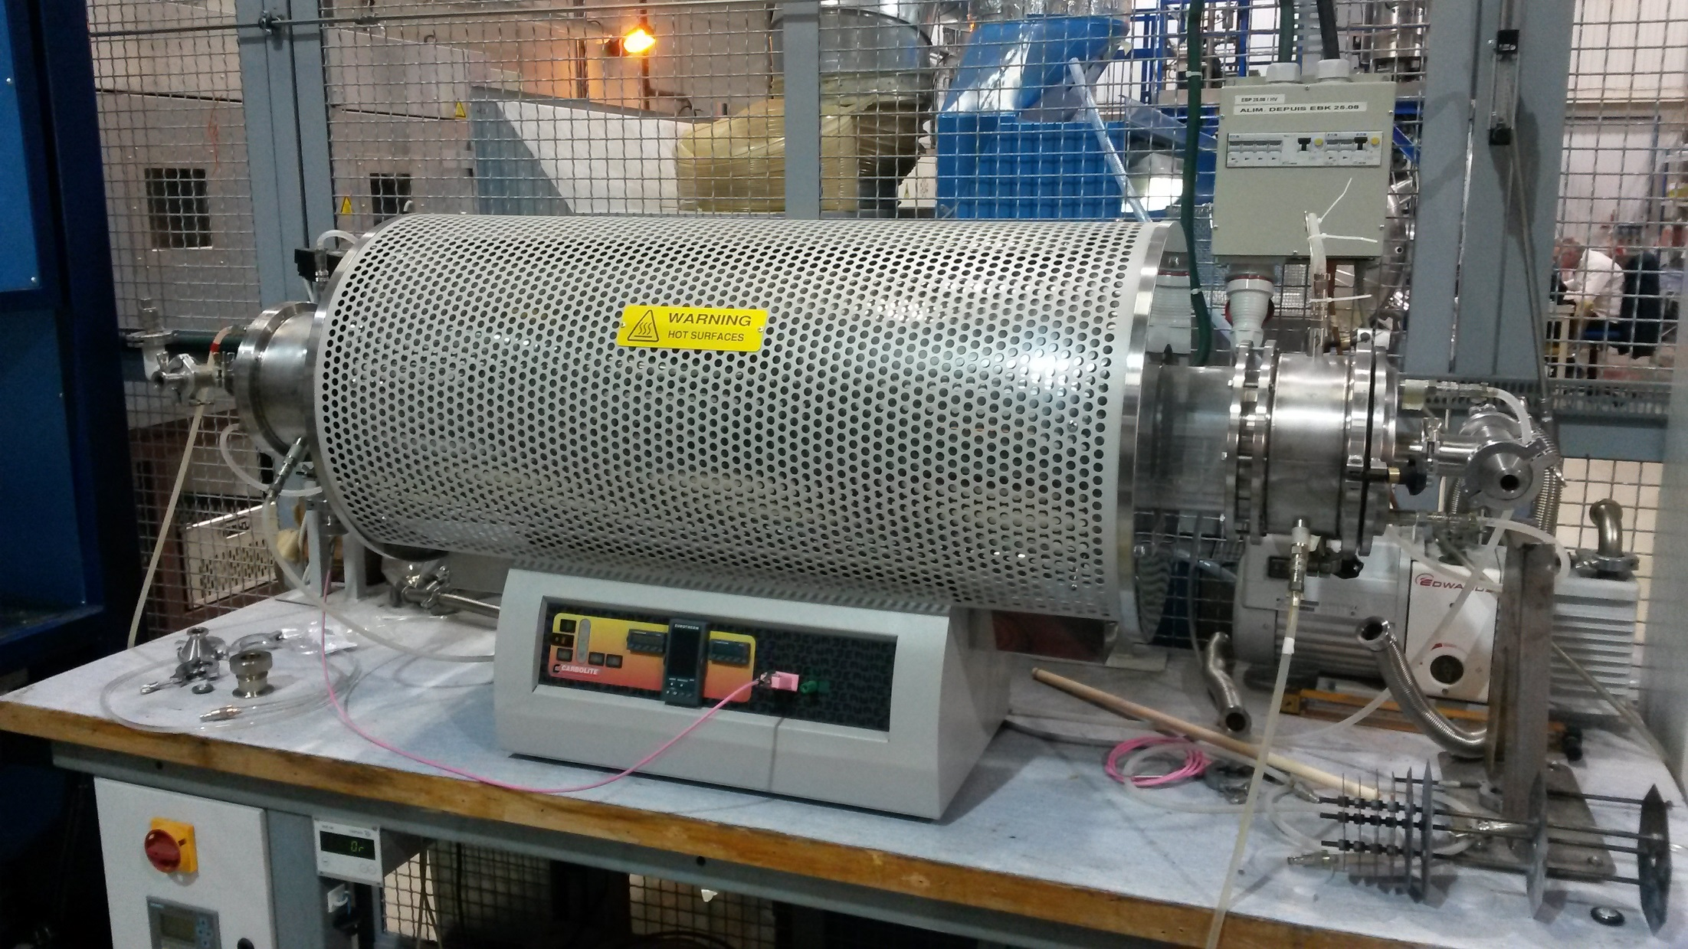
Experimental setup: Heating in argon atmosphere
L = ~ 700 mm, ø = 160 mm
Vacuum or Argon atmosphere
Actual tube in Quartz to be clean after experiment and spare flanges

Slide 8
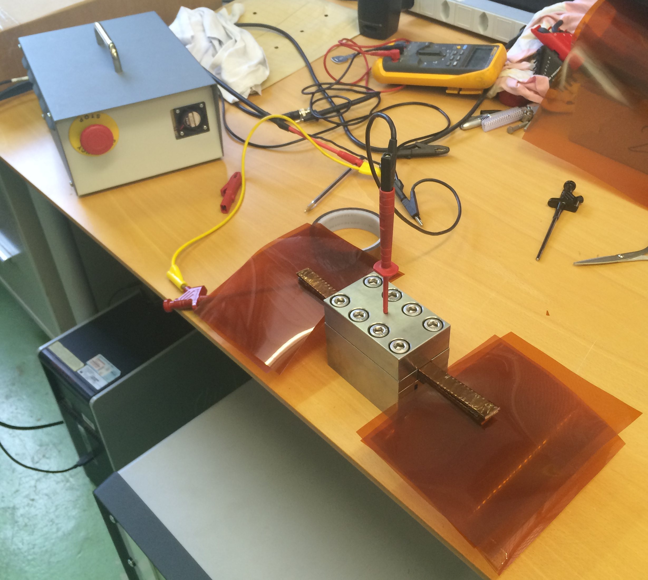
Experimental setup: High Voltage test

Slide 9
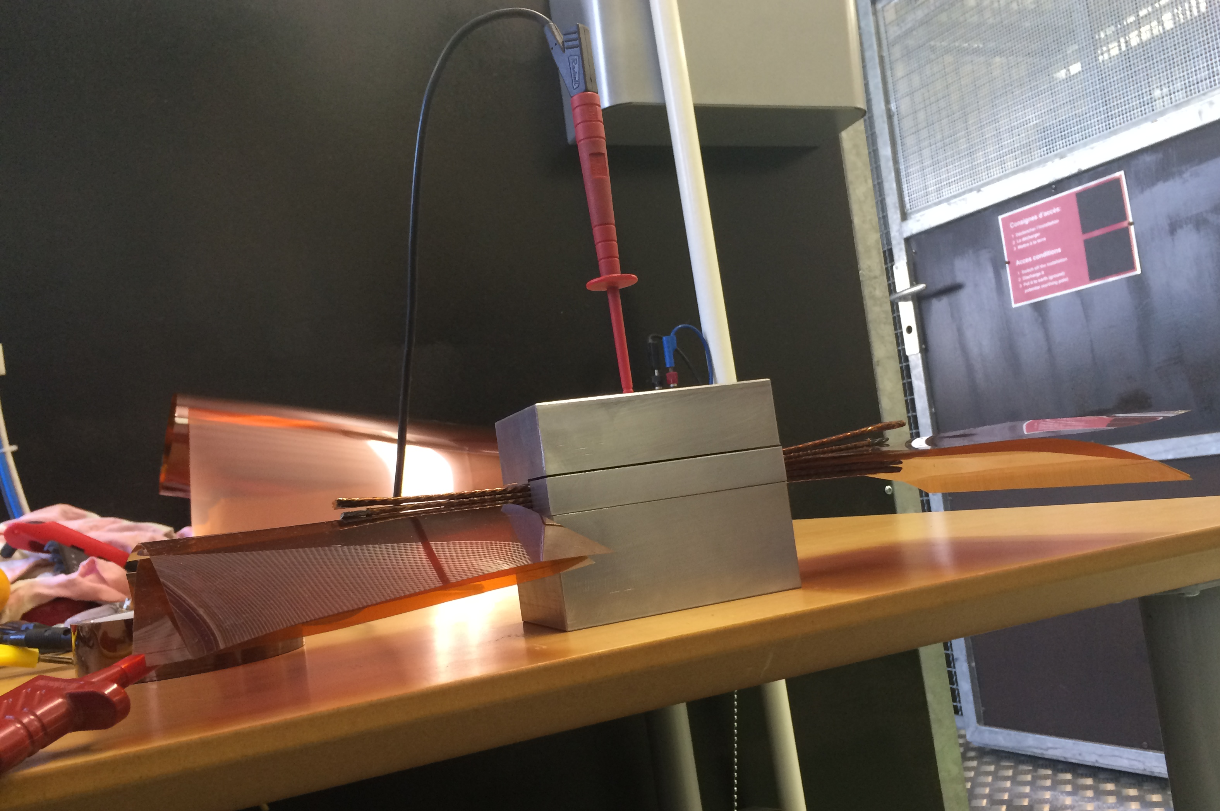
Experimental setup: High Voltage test

Slide 10
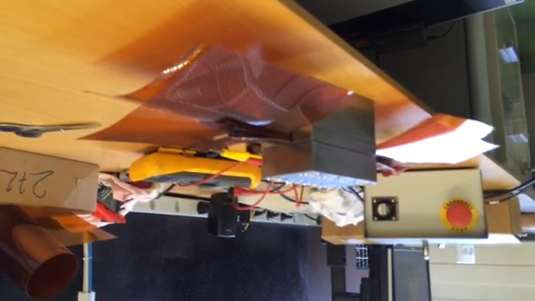
Dummy High Voltage Test: Cable 2 to 3

Slide 11
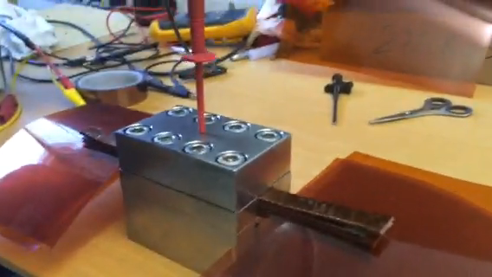
Dummy High Voltage Test: Cable 4 to 5 (first test)

Slide 12
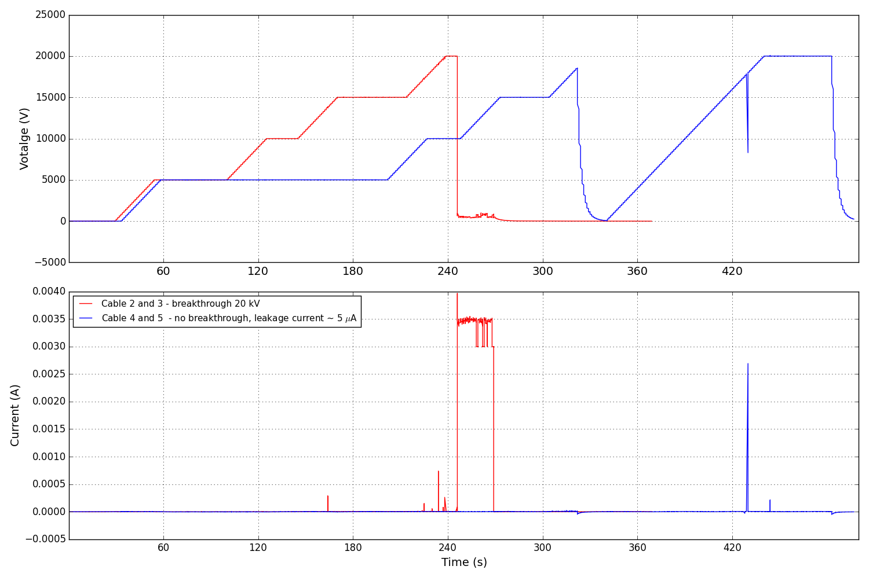
Dummy High Voltage tests : Cable to cable

Slide 13
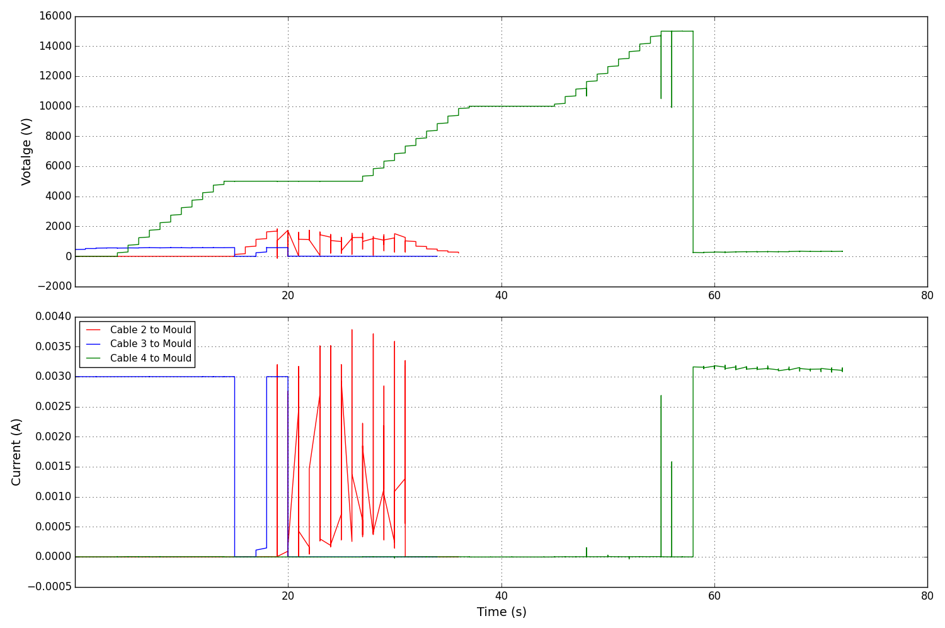
Dummy High Voltage tests : Cable to Mould
- Cable 4 up to 16 kV
- Cable 5 up to 15 kV (not shown here)

Slide 14
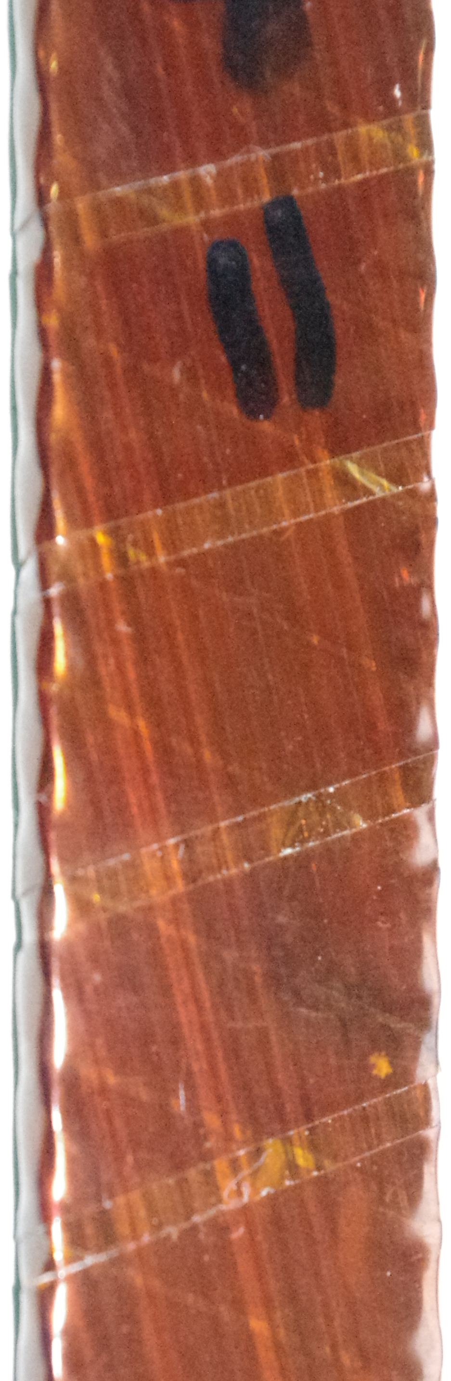
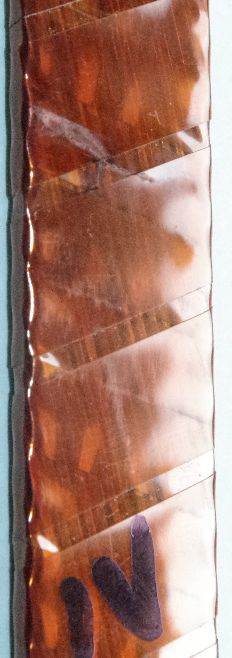
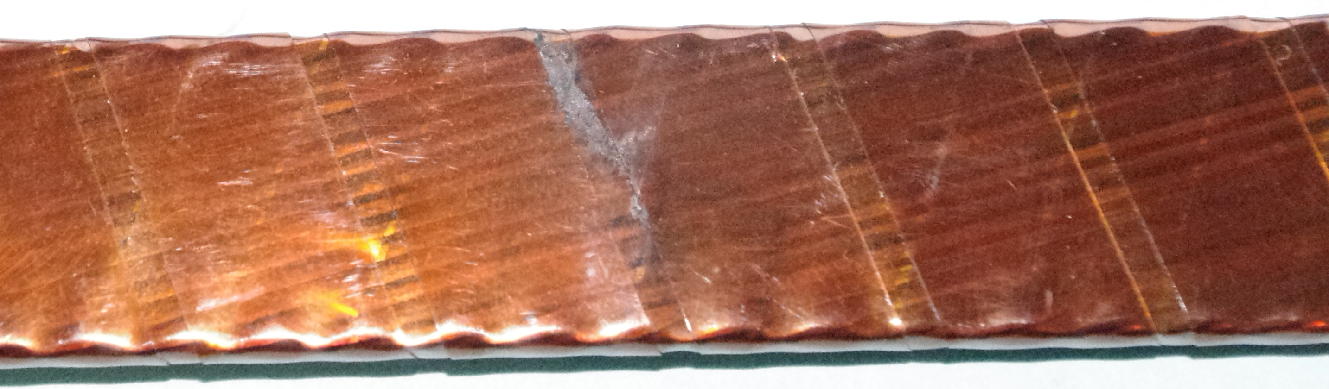
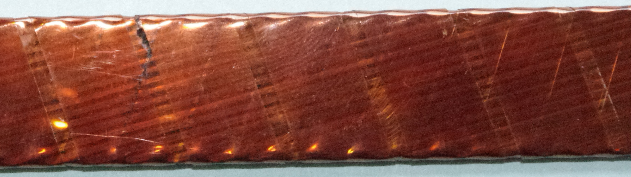
III
V
bottom

Slide 15
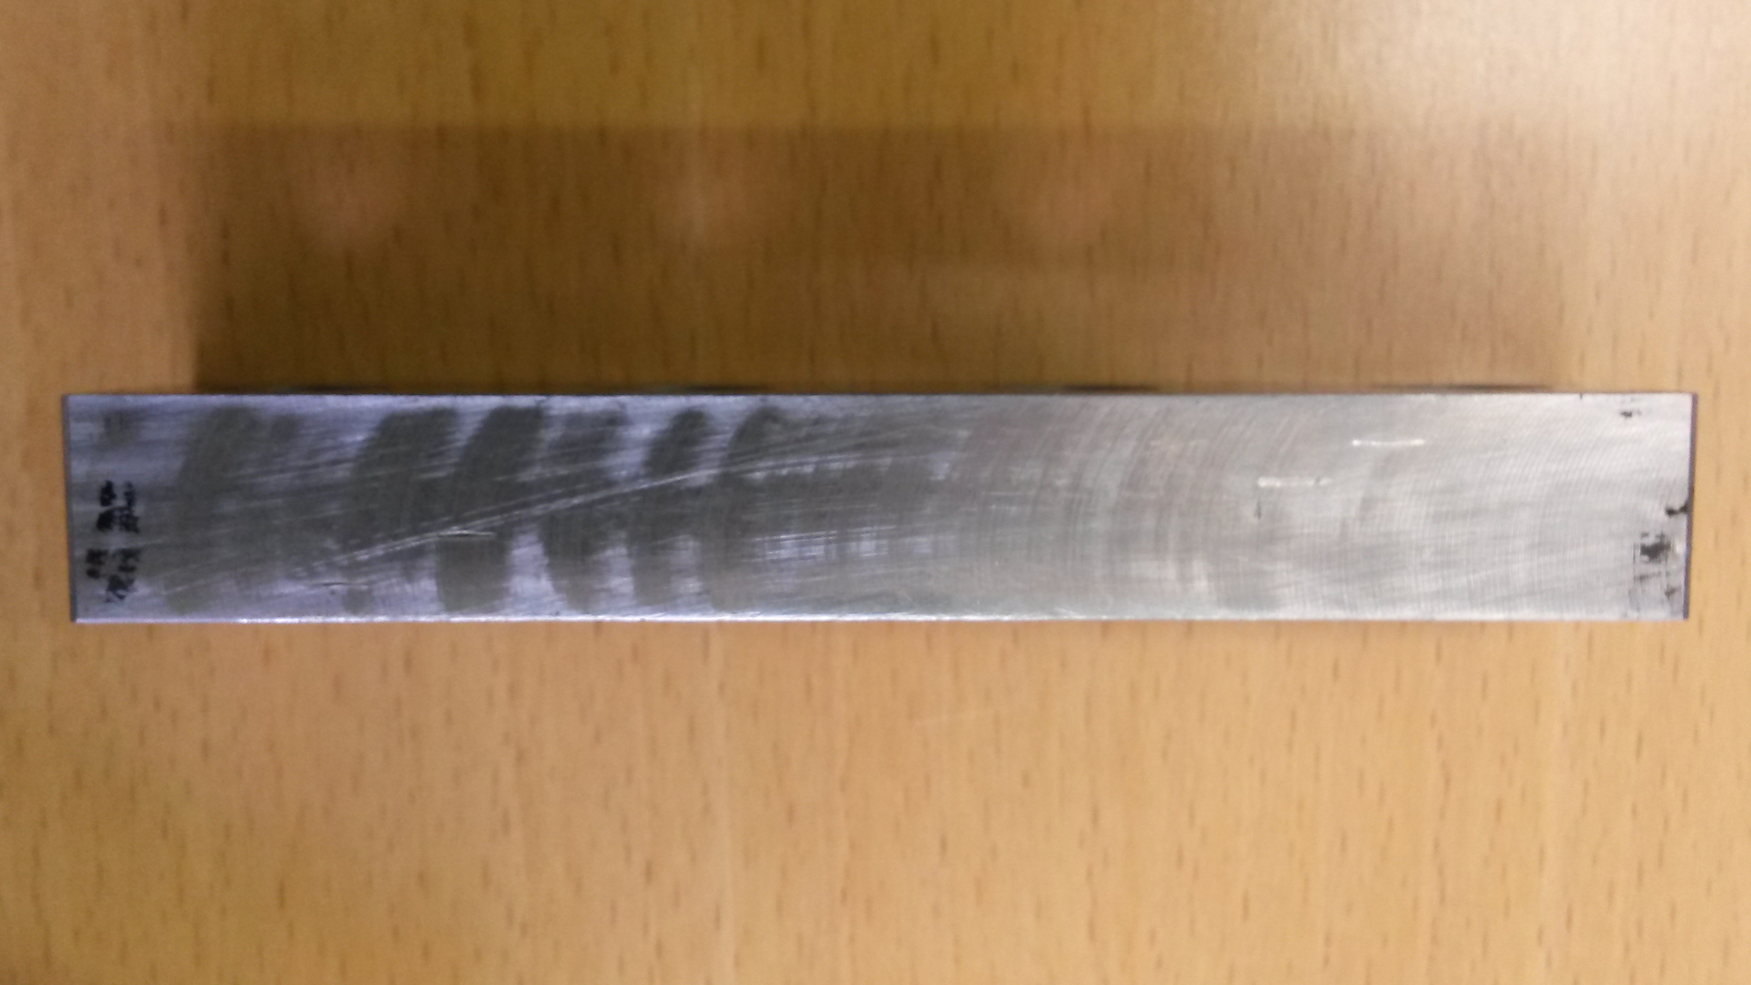
Side of the mould in contact with the cable after HV test

Slide 16
Experimental Plan
Stress measurement on a cable stack at room temperature with mould – week 50
  Adapt cavity height to get 100/120/150 MPa with stainless strip.
Trial Run up to 500 C with one mould (2 thermal sensors - one in nominal position and one in between the cable) – week 50
First Experimental runs with two moulds. 4 tests with different peak temperature – week 51/week 2
  200 C
  300 C
  400 C
  500 C
Second Experimental run with two moulds– refine temperature according to results of first run up to 4 tests - week 2/week 3
Total of up to 9 tests (including trial run – 25 m of insulated cable)

Slide 18
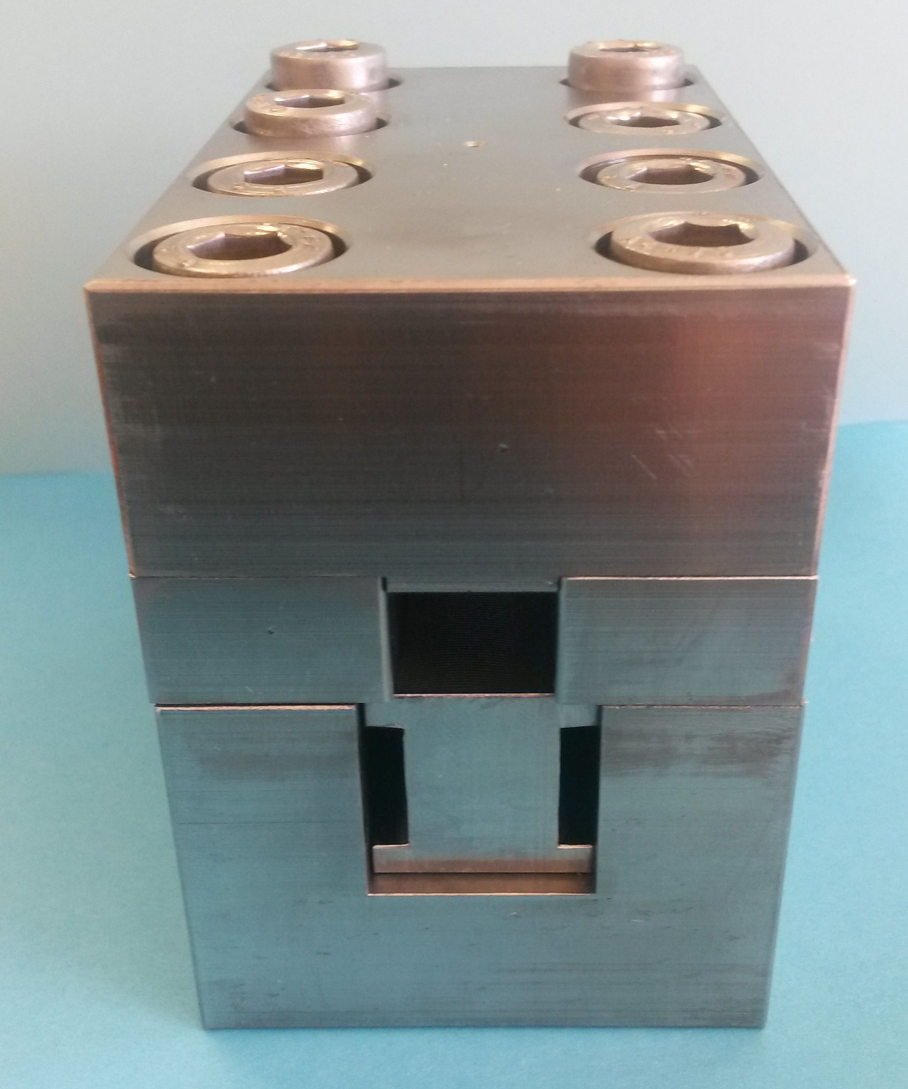
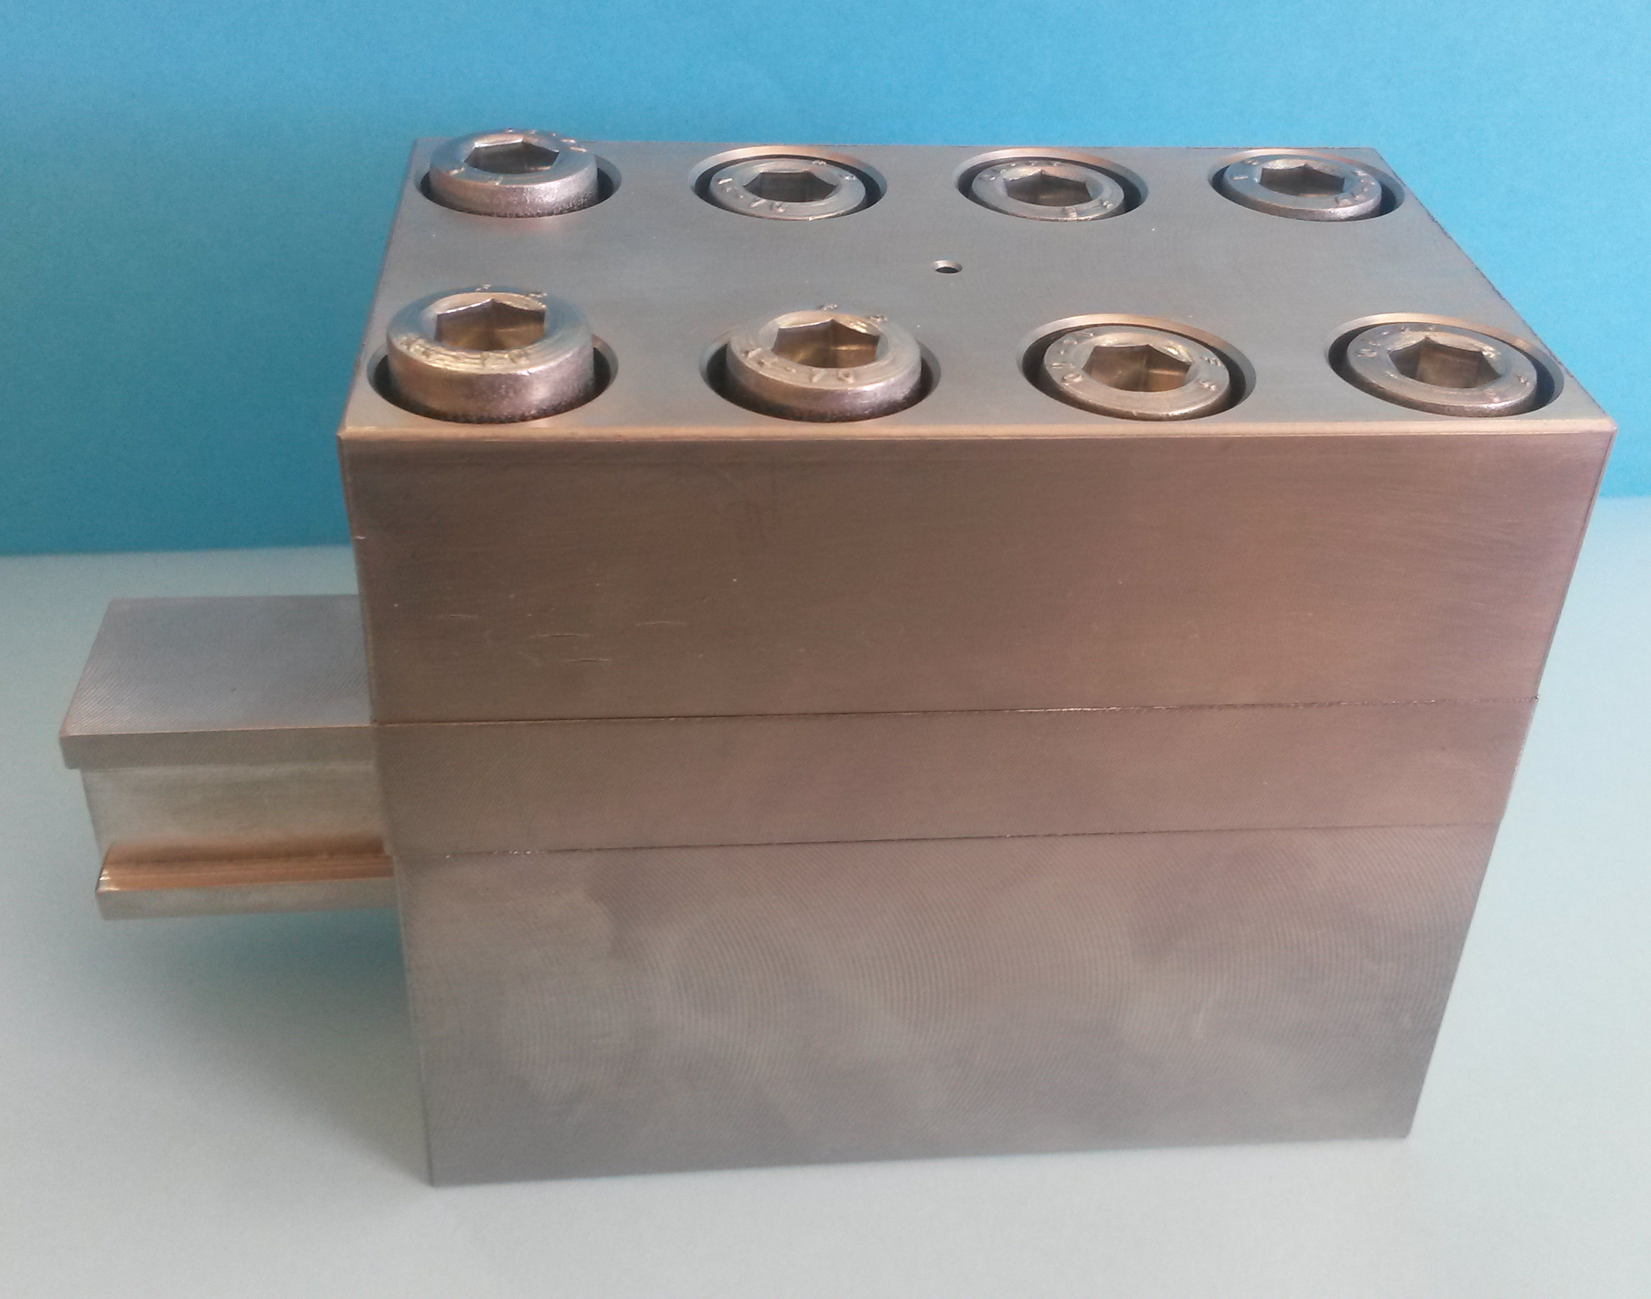

Slide 19
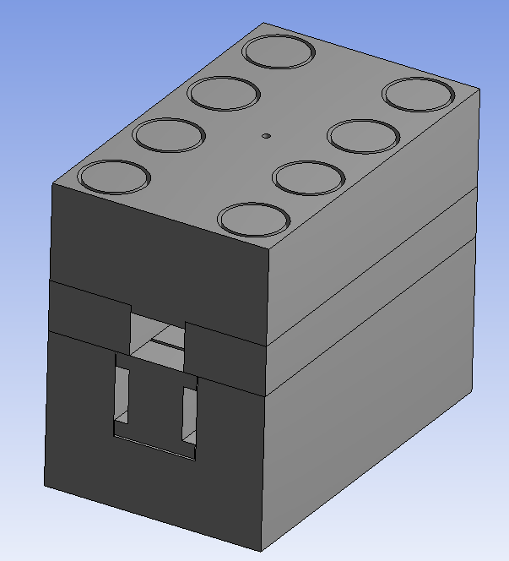
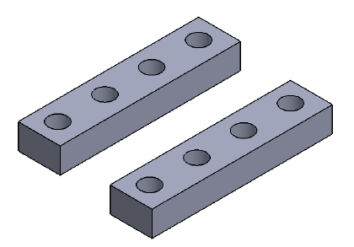
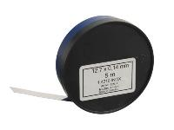
Hole for Thermal Sensor
Mould – Top Part
M10 screw
Mould – Side Parts
105
84
100
62
Mould - Bottom Part
Strain Gauge Bar
Mould dimension 84 x 62 x 100
Material Stainless Steel 304L
Cavity for Six Cable Stack (~ 12 mm)
Fine setting of stress on the cable stack with stainless strip (40 um up to 500 um) insert between the side and top part of the mold

