Slide 2
Fist steps in MPE-PE group
Topics – Tasks - Targets
Lorenzo Bortot
Bernhard Auchmann
TE-MPE-PE
30.04.2015

Slide 3
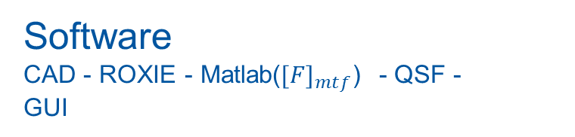
Getting started with QSF - 1
Target: Migrate MQS(T) and MQY magnets in QSF
Correct information
People involved - geometry - materials -
data sources
Internal conventions
workflow - directories - files structure -
feedbacks
Unified, reliable,
time efficient
procedure for migration
of magnets in QSF
Software
CAD - ROXIE - Matlab(${[F]}_{mtf}$) - QSF -
GUI

Slide 4





Getting started with QSF - 2
Target: Migrate MQS(T) and MQY magnets in QSF
Geometry
Materials
Work point
Filed Distribution
analysis
ROXIE
analysis
Field Maps
Cables Num.
Discretization
Thermal
geometry
Transient
Keep the link
$${[M]}_{el}$$
MATLAB
custom
MTF script
LPM error
$${[F]}_{mtf}$$
Magnet
base file
QSF

Slide 5
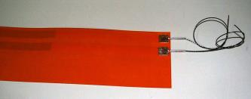
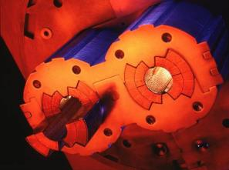
Neural Networks for signal analysis - 1
Quench Heaters
Protection against development of excessive voltage and overheating after a resistive transition of superconducting magnet coils.
Strips are made of stainless steel and copper, embedded in between two polyimide foils.
Powered by capacitor bank
Initial power density and the current decay time determine the effectiveness

Slide 6
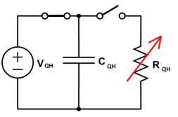
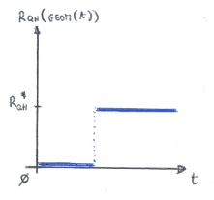

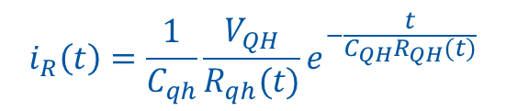
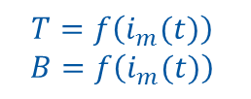
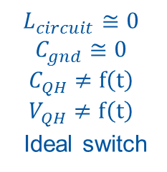

Neural Networks for signal analysis - 2
Target: feasibility of an automatic tool based on NN able to diagnose QH health status from discharge signals
QH
$$v_{R}\left(t\right)=V_{QH} e^{− \frac{t}{C_{QH}R_{QH}(t)}}$$
$$i_{R}\left(t\right)=\frac{1}{C_{qh}}\frac{V_{QH}}{R_{qh}(t)}e^{−\frac{t}{C_{QH}R_{QH}(t)}}$$
$R_{QH}\left(t\right)=f(ρ_{QH}\left(T,B\right);f_{geom}\left(t\right))$
$$L_{circuit}≅0$$
$$C_{gnd}≅0$$
$$C_{QH}≠f\left(t\right)$$
$$V_{QH}≠f\left(t\right)$$
Ideal switch
Evaluating this contribution allows to identify the presence of the second one, anyway…..
$$T=f\left(i_{m}(t)\right)$$
$$B=f\left(i_{m}(t)\right)$$
Example of hypothetical fault in electrical continuity of the heater
Unknown!

Slide 7
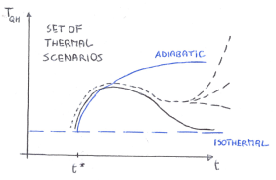

Neural Networks for signal analysis - 3
Target: feasibility of an automatic tool based on NN able to diagnose QH health status from discharge signals
$$T=f\left(i_{m}(t)\right)$$
$$B=f\left(i_{m}(t)\right)$$
Simulation for different magnet operating points, i.e. different currents
Each QH of each magnet has its own set of scenarios
Neural Network
Support Vector Machine
Decisional Tree
(Least squares method)
… ???
QH data with no QH faults
Training Set choice
Signal conditioning
Training on thermal scenarios

Slide 8
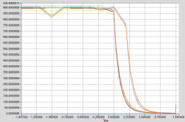
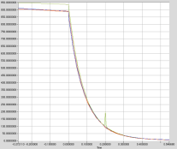
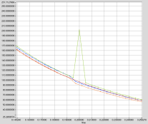
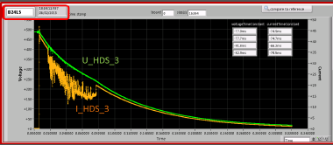



Neural Networks for signal analysis - 4
Signal conditioning
Noise - Sampling
Bit commutation
QH data with no QH faults
Thermal Scenario
$$class ≠0$$
Signal conditioning
NN
QH data with QH faults
No Thermal Scenario
$$class=0$$
$R_{QH}\left(t\right)=f_{geom}\left(t\right)$
Fault!

Slide 9
Neural Networks for signal analysis - 5
Alternative approaches
Feedforward NN with a choice of features based on human experience -> No need of simulations, the NN “sees” the curves as a human being.
Kalman Filter
Savitzky–Golay filter
Expert System (Esper – open source sowtware for Complex Events Processing)
ARIMA – Auto Regressive Integrated Moving Average
…
Quality of data is the most important feature!

Slide 10
Thank you for your attention!
Special thanks to
E. Ravaioli, J. Ghini, M. Maciejewski for their support and precious hints

