Slide 2
Draft: 2015 Availability Summary
Andrea Apollonio, TE-MPE-PE
On behalf of the Availability Working Group (AWG) - L. Ponce, B. Todd
Operation Workshop Evian 15/12/2015
Acknowledgements: AWG-members, C. Roderick & AFT team, R. Schmidt, D. Wollmann, M. Zerlauth, A. Niemi, A. Siemko, T. Griesemer, B. Auchmann, R. Denz, A. Verweij, O. Rey Orozco.

Slide 3
Fault Review in 2015
The Accelerator Fault Tracker (AFT) is operational from the beginning of 2015
Members of the AWG (A. Apollonio, L. Ponce, B. Todd) in charge of the weekly fault review
Aim: identify ALL possible causes of LHC downtime (i.e. not only “faults”)
Ensure consistency of availability data
  Identify of downtime root cause
  Identify consequences of faults (precycles, access, RP)
  Identify fault dependencies (e.g. UFO → quench → quench recovery)

Slide 4
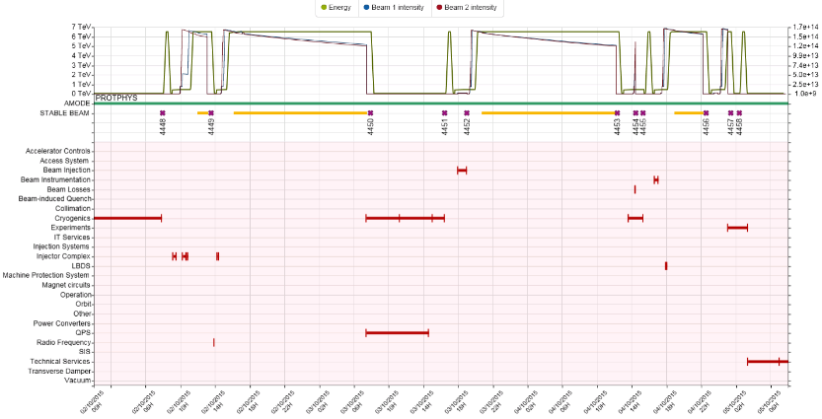
Standardized Availability Summary
“Cardiogram” of LHC operation

Slide 5
Some Statistics…
Reference period: 6-4-2015 to 6-12-2015 (weeks 15 to 49)
1345 faults recorded and analysed (761 in 2012) - manually
90 relevant parent/child relationships identified
~20 modifications in the eLogbook required per week
~ 5 h per week for fault review
Consistent picture of ‘operational modes’ (loss maps, measurements, MDs, etc.)

Slide 6
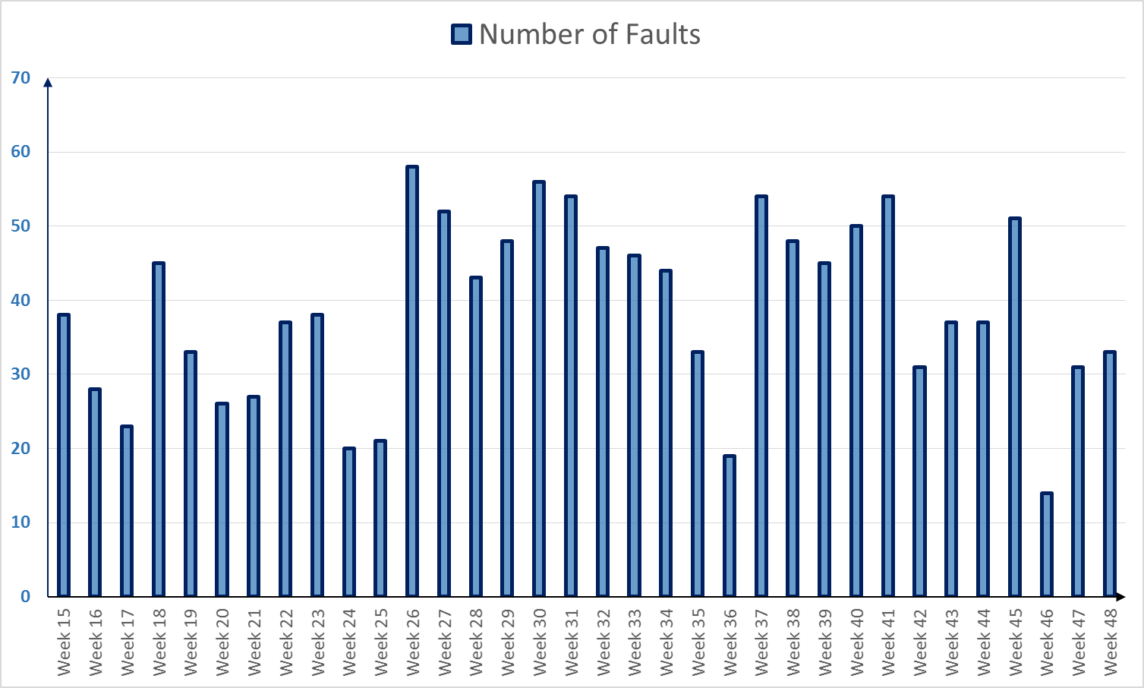
2015 Downtime Overview
Beam Commissioning
Sp. Ph.
TS
Scrub.
RU
50
MD
Scrub.
RU
25
MD
TS
25 ns Run
MD
TS
IS
IR

Slide 7
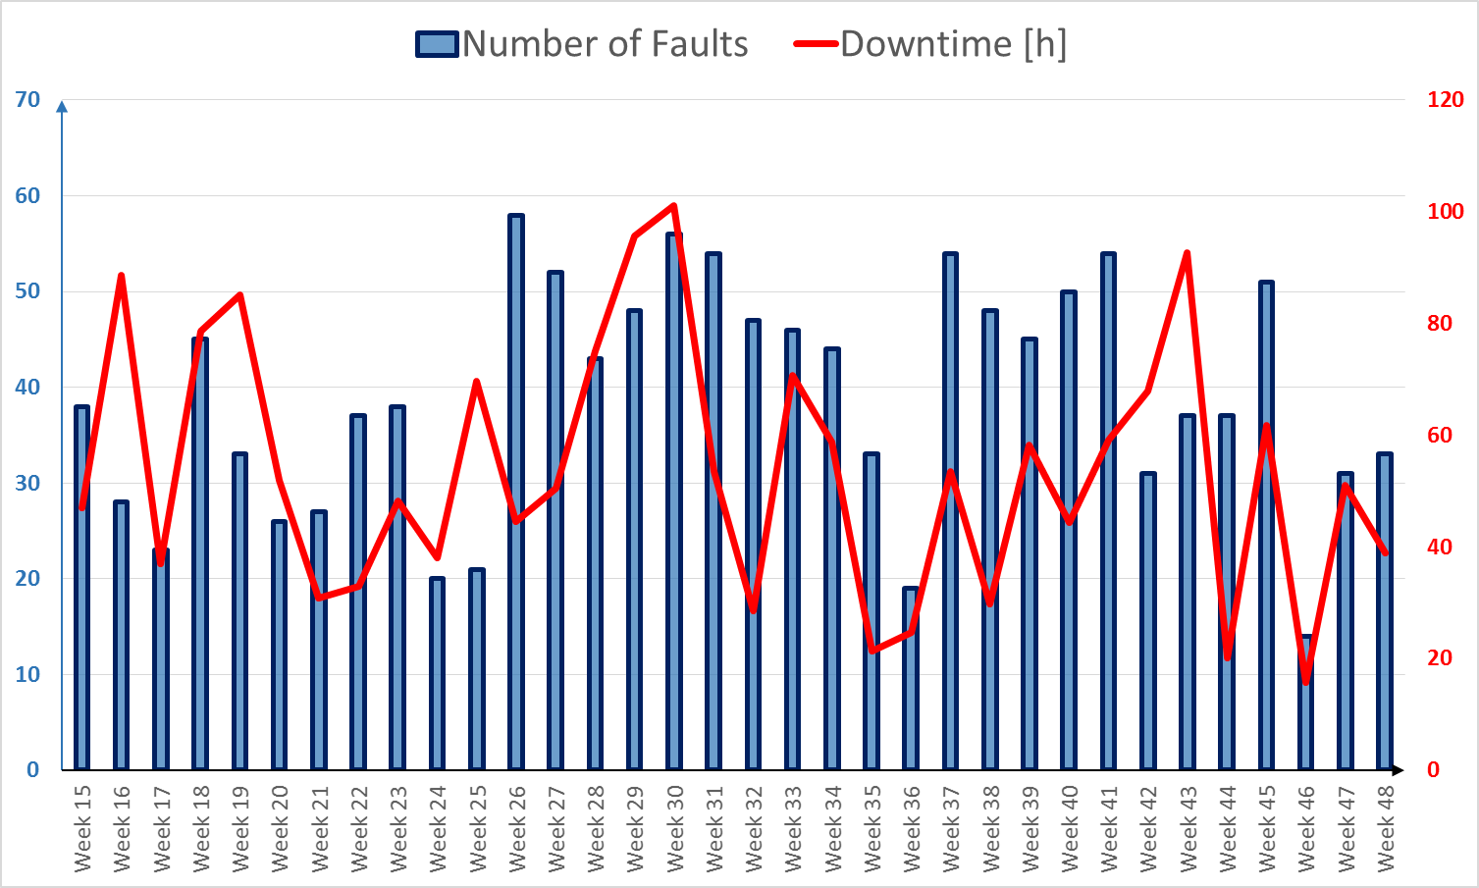
2015 Downtime Overview
Earth fault + cryo valve replacement + LBDS self trigger + ADT
Linac2 HV Cable
QPS SEUs
Cryo CV + SPS magnet replacement
Beam Commissioning
Sp. Ph.
TS
Scrub.
RU
50
MD
Scrub.
RU
25
MD
TS
25 ns Run
MD
TS
IS
IR

Slide 8
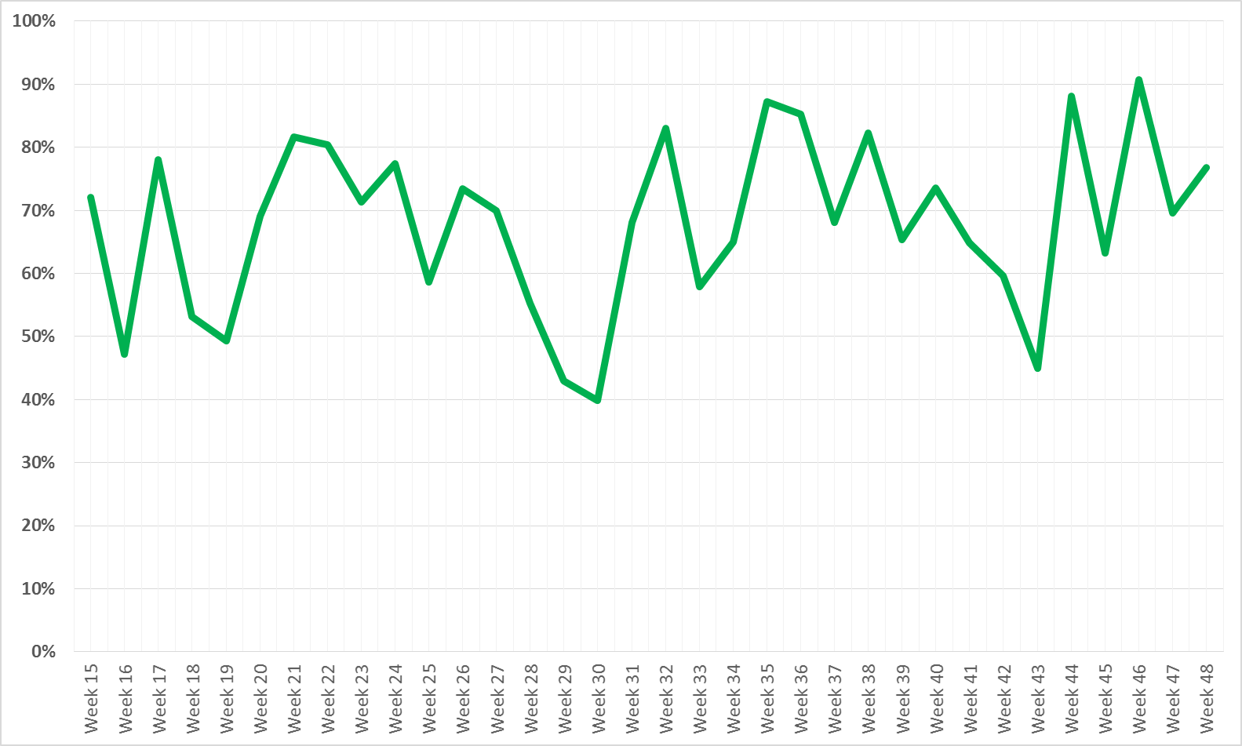
2015 Availability
68 %
Cryo CV + SPS magnet replacement
Linac2 HV Cable
Earth fault + cryo valve replacement + LBDS self trigger + ADT
QPS SEUs
Beam Commissioning
Sp. Ph.
TS
Scrub.
RU
50
MD
Scrub.
RU
25
MD
TS
25 ns Run
MD
TS
IS
IR

Slide 9
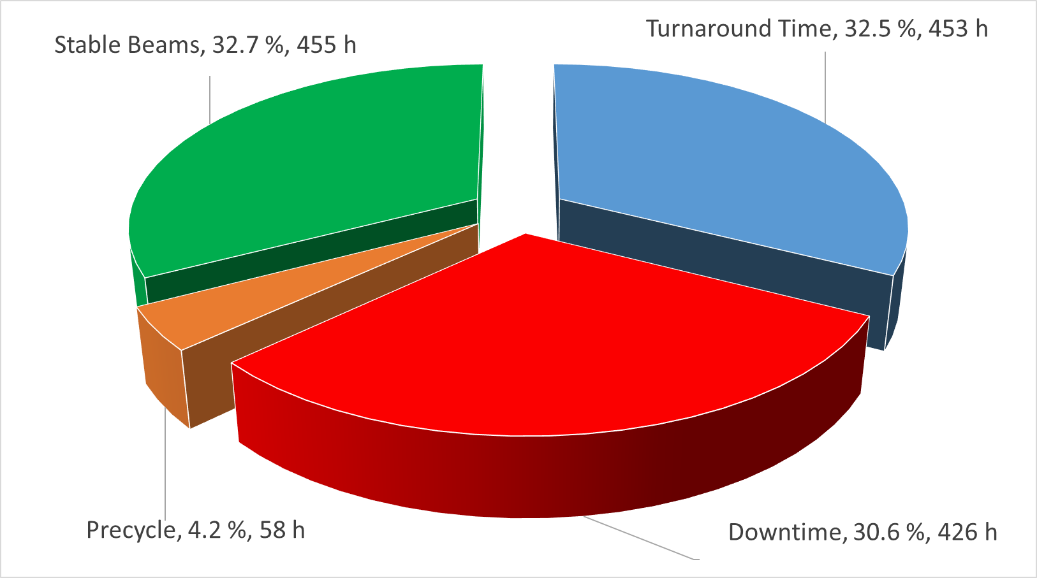
Focus: 25 ns Run (7/9 to 3/11)
70 fills to Stable Beams
22 End Of Fill, 48 dumped due to faults (fraction of premature dumps: 68.6 %)
Average turnaround (per SB) = 6.5 h, Average Fault time (per SB) = 6 h

Slide 10
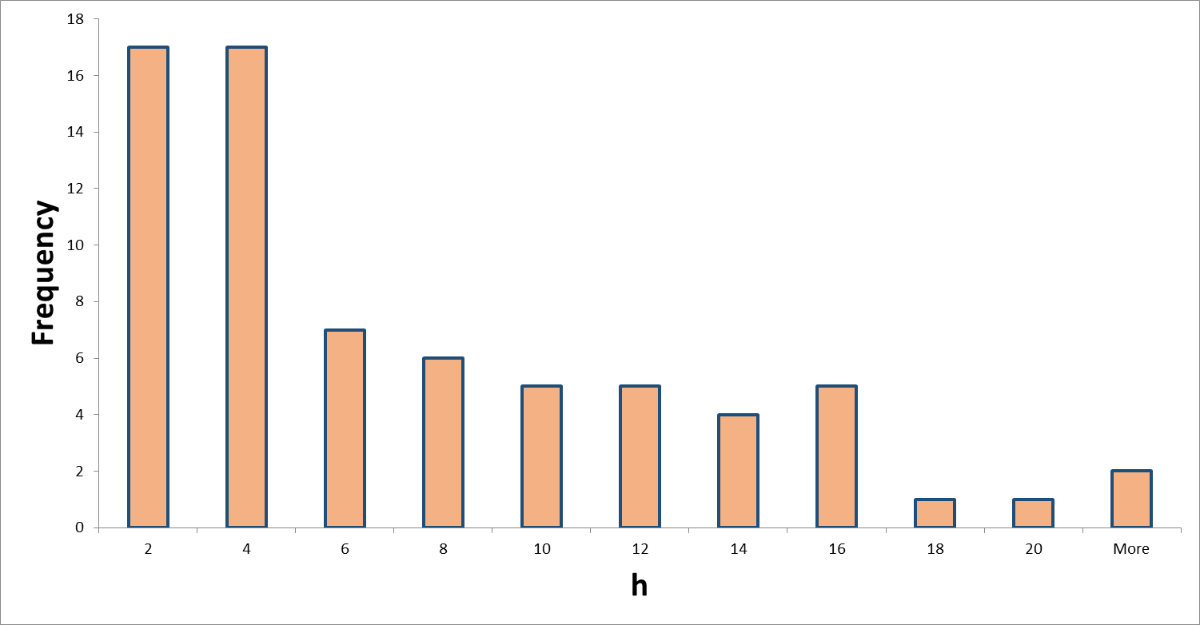
Stable Beams Distribution
Average Stable Beams: 6.3 h
Average EOF = 9.5 h,
Average FAIL = 5 h

Slide 11
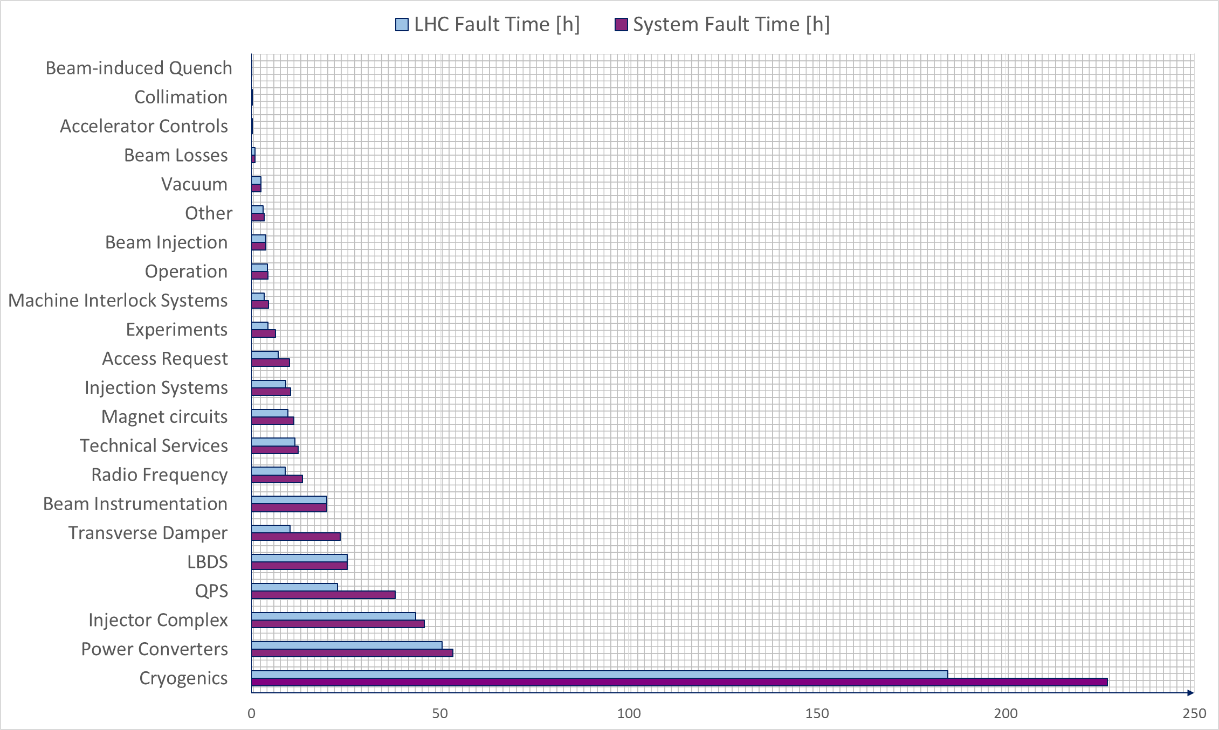
Downtime Distribution

Slide 12
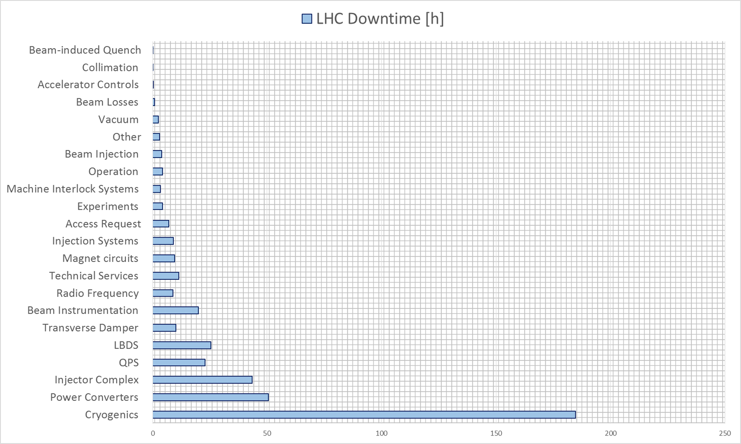
Consider Only LHC Downtime…

Slide 13
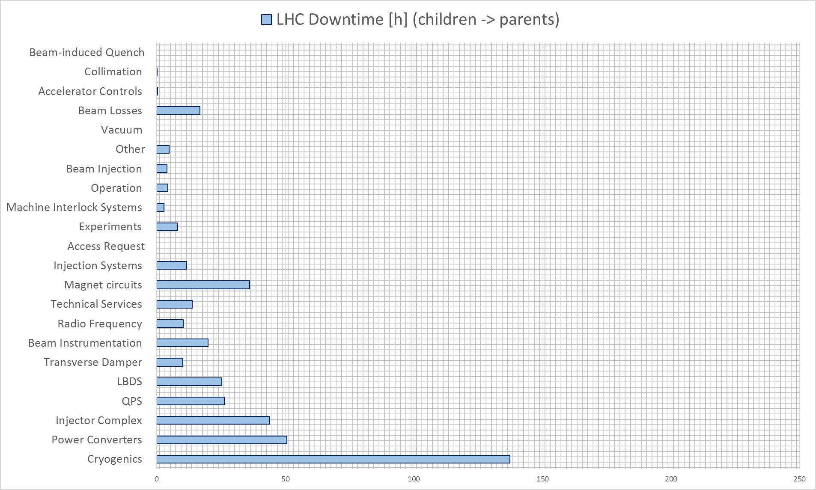
…Accounting for Fault Dependencies

Slide 14
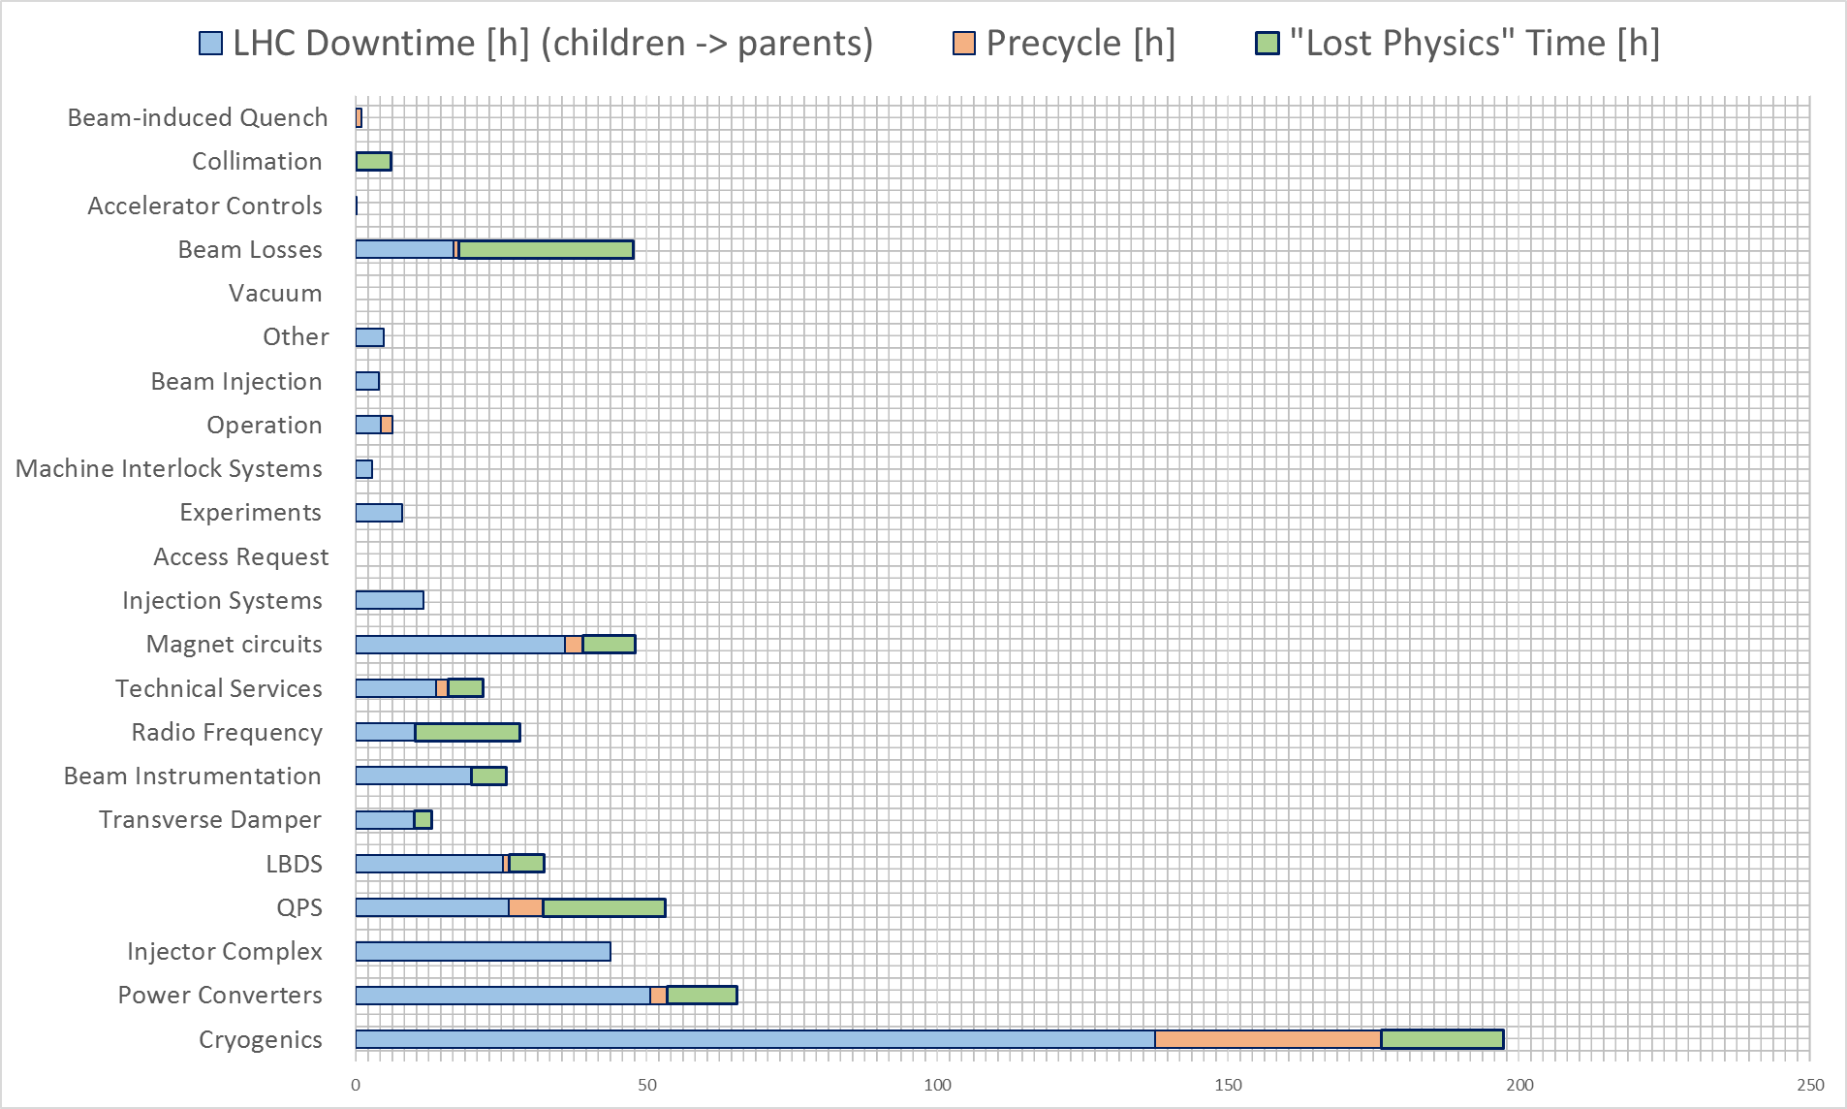
…Impact on LHC Operation

Slide 15
Availability Matrix
Downtime [h]
 | < 1h | 1-4 | 4-8 | 8-12 | > 12
1/week
1/month
1/year
< 1/year
FAILURE MODE 1
Frequency
FAILURE MODE 2
Green: mitigated/not expected to re-appear
Red: not yet mitigated/no need for mitigation

Slide 16
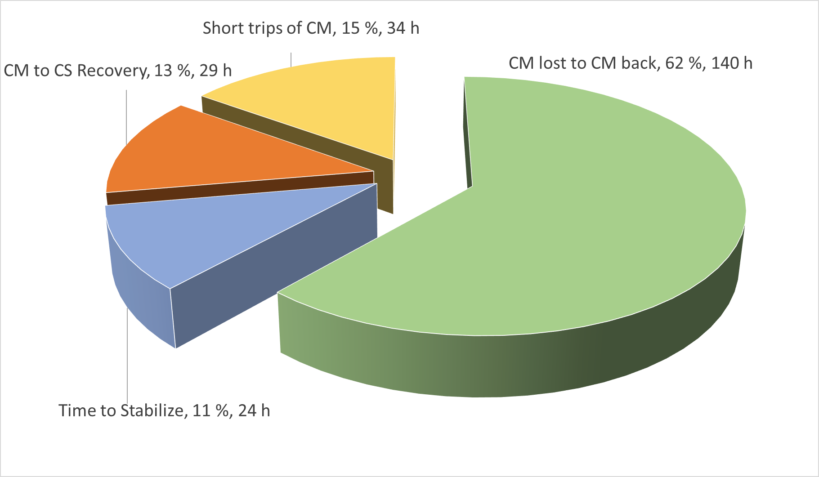
Cryogenic System
Total system downtime: 227 h
Total LHC downtime: 185 h
Total time as ‘child’: 52 h
Total time as ‘parent’: 4.4 h
Number of dumps in stable beams: 7
Number of precycles required: 39
Talk by K. Brodzinski

Slide 17
Power Converters
Total system downtime: 53.5 h
Total LHC downtime: 50.5 h
Total time as ‘child’: 0 h
Total time as ‘parent’: 0 h
Number of dumps in stable beams: 4
Number of precycles required: 3

Slide 18
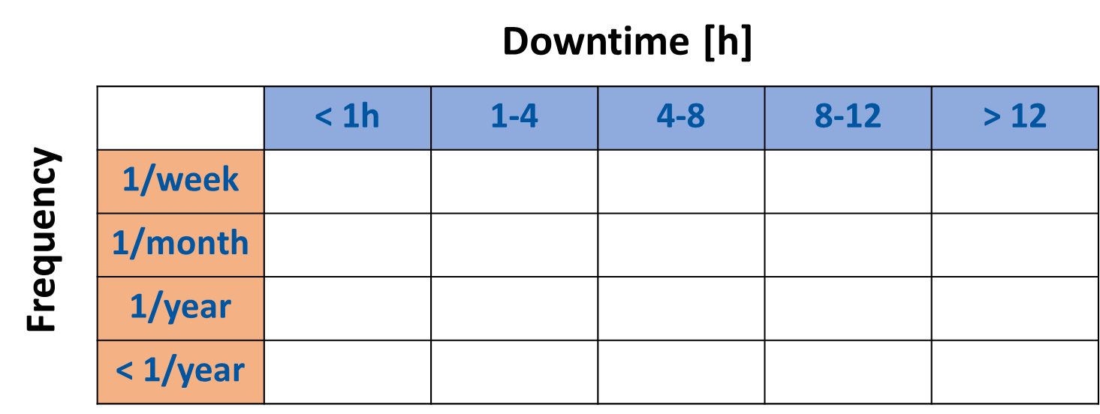
Quench Protection System
Total system downtime: 38 h
Total LHC downtime: 23 h
Total time as ‘child’: 5.5 h
Total time as ‘parent’: 9 h
Number of dumps in stable beams: 7
Number of precycles required: 6
Talk by M. Pojer

Slide 19
Additional Considerations on 25 ns Run
Impact of UFOs (33 UFOs, tbc), talk by B. Auchmann
  Before/after threshold change
  Number of quenches: 3
7 training quenches (tbc)
ULO
  Number of quenches: 3
SEUs (tbc), talk by S. Danzeca
  7 confirmed SEUs

Slide 20
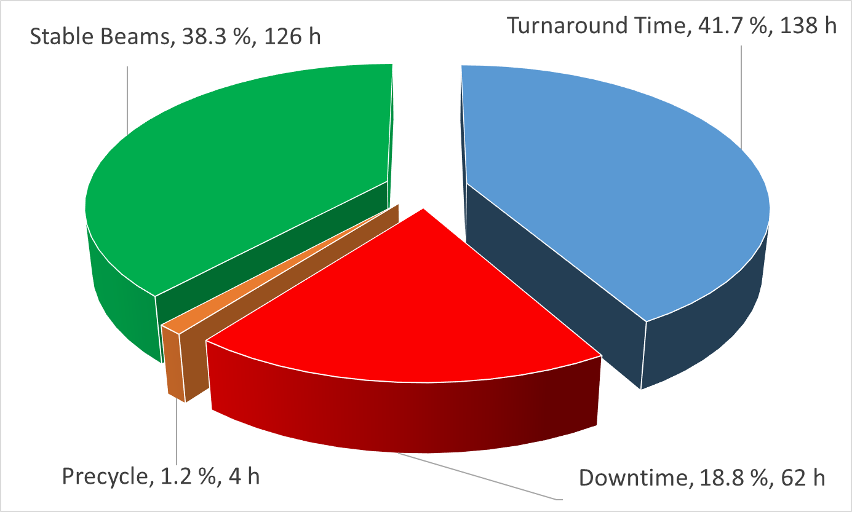
Ion Run (23/11 to 6/12)
23 fills to Stable Beams
20 End Of Fill, 3 dumped due to faults (fraction of premature dumps: 13 %)
Average turnaround (per SB) = 6 h, Average Fault time (per SB) = 2.7 h

Slide 21
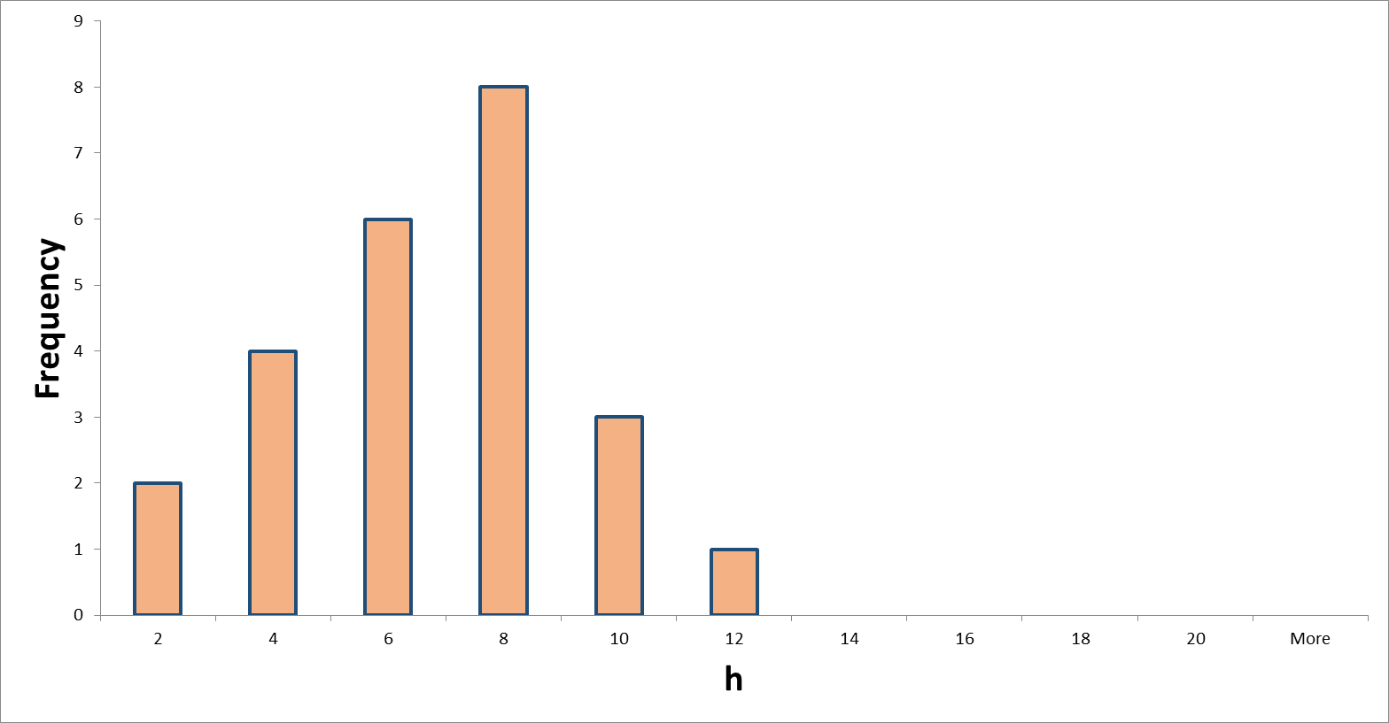
Stable Beams Distribution - Ions
Average Stable Beams: 5.7 h
Average EOF = 6.2 h,
Average FAIL = 2.5 h

Slide 22
Conclusions
Remarkable availability during 25 ns run (close to 2012)
Even more – remarkable availability during ion run
Cryogenic system is – by far – the biggest contributor to LHC unavailability (~ 25 % as ‘child’ due to quench recovery)
Successful deployment of AFT and improvement of fault review process (even better in 2016!)
Going forward…availability: hot topic!
Reliability trainings being organized at CERN

Slide 23
Thanks a lot for your attention!

Slide 24
2015 → 1304 faults
2012 → 761 faults

Slide 25
Availability Matrix - QPS
Downtime [h]
 | < 1h | 1-4 | 4-8 | 8-12 | > 12
1/week
1/month
1/year
< 1/year
nQPS HW
Frequency
FAILURE MODE 2
Green: mitigated/not expected to re-appear
Red: not yet mitigated/no need for mitigation

